Slide 1
Update muX meeting 26/07
Marie Deseyn

Slide 2
Geant4 simulations

Slide 3
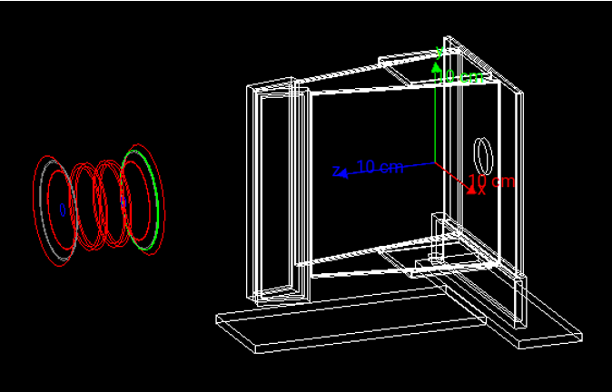
Electron-gamma coincidences

Slide 4
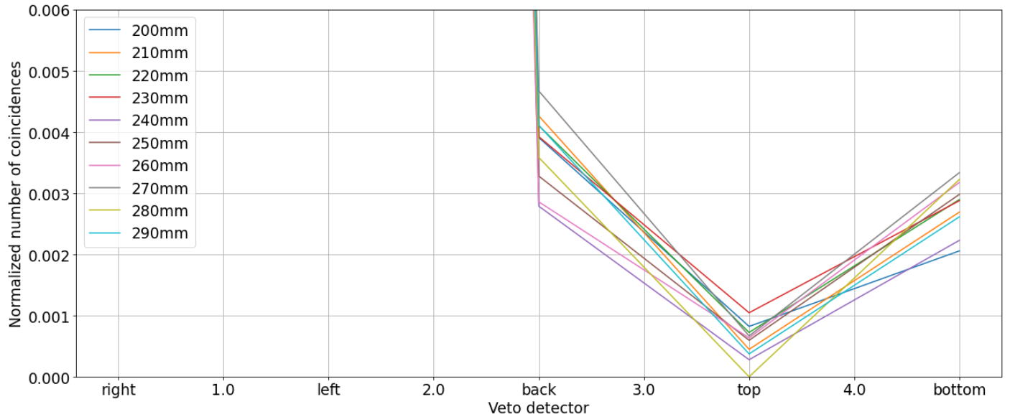
Electron-gamma coincidences

Slide 5
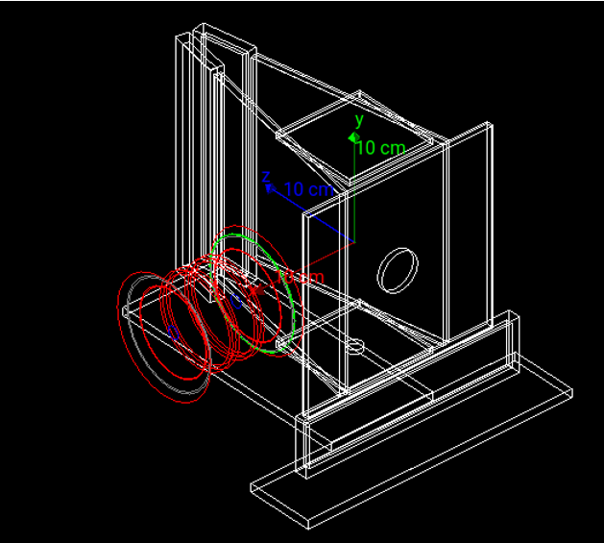
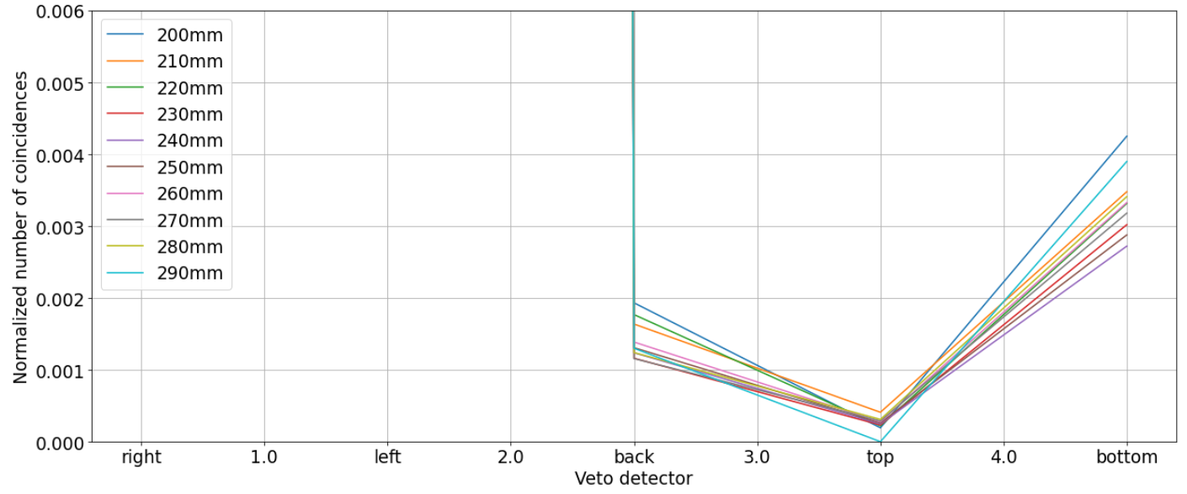
Electron-gamma coincidences

Slide 6
Electron-gamma coincidences
More electron-gamma coincidences in bottom vs. top → most likely because more brehmstrahlung is generated for bottom electrons due to the aluminum support structure
Last year, the scintillator with the hole was the bottom one → Should we switch this such that the scintillator with the hole is now on top? (because there will be less Brehmstrahlung generated from electrons going up)

Slide 7
Geant4
What are the ranges of the detector arms
What is minimal angle between 2 arms
DAQ

Slide 8
Au-Pb data analysis

Slide 9
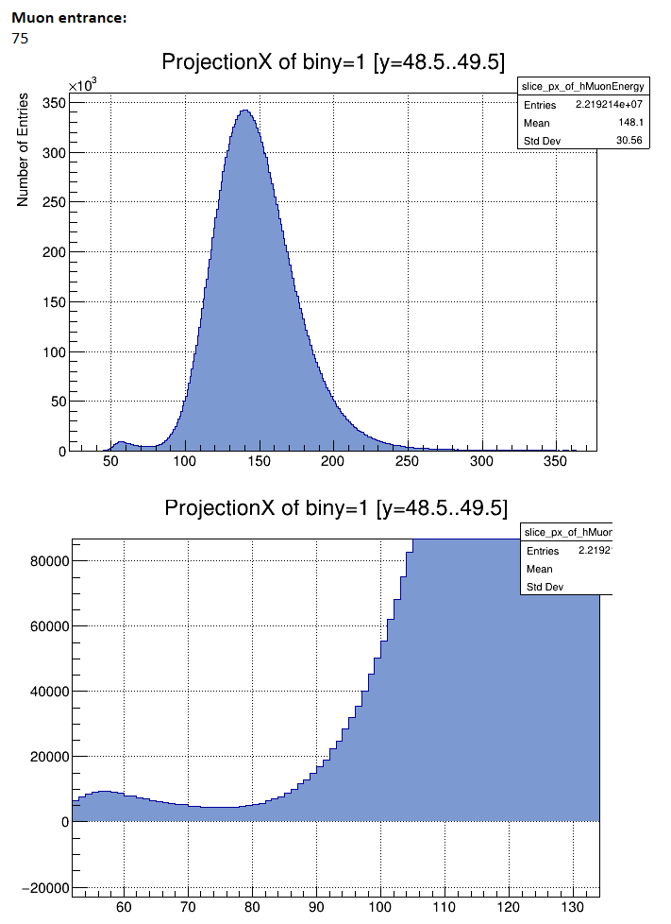
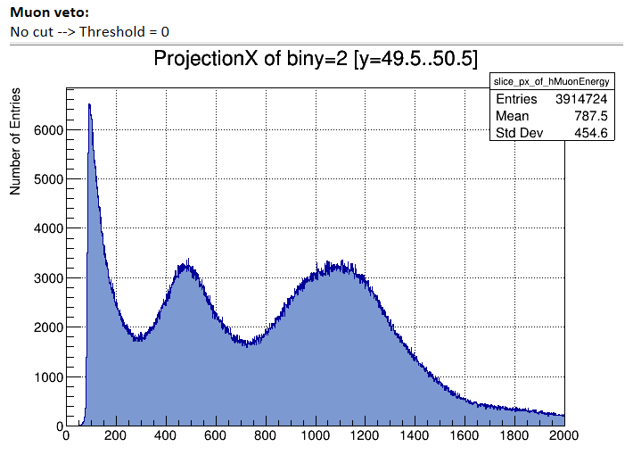
Scintillator threshold

Slide 10
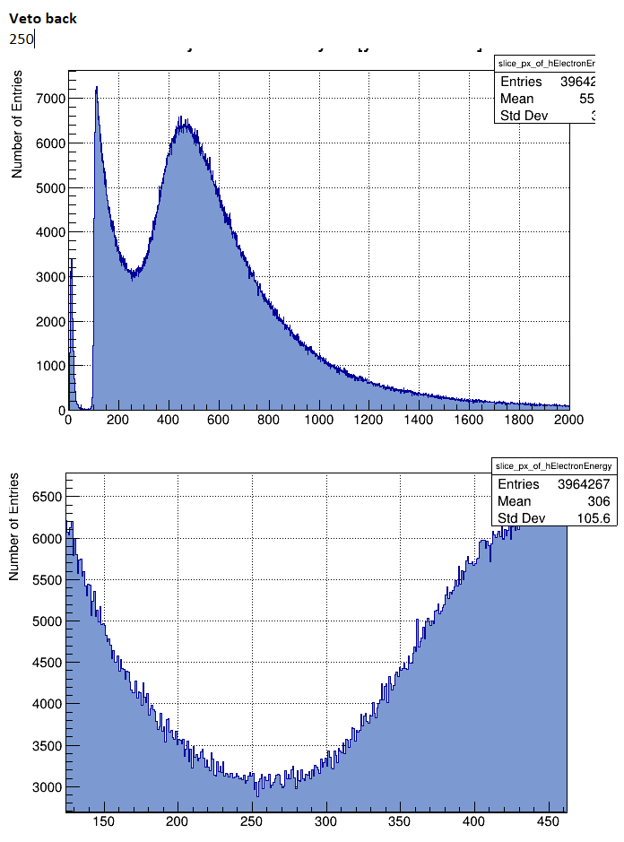
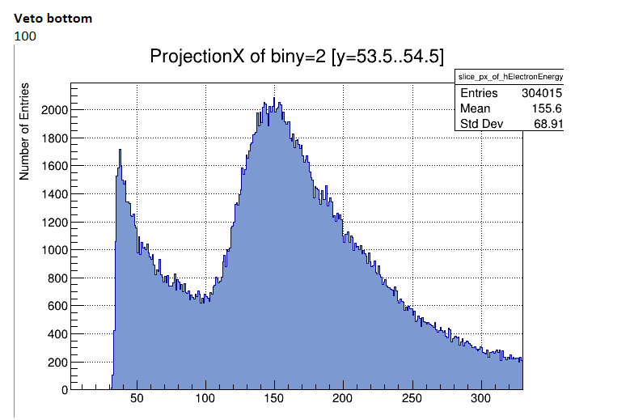
Scintillator threshold

Slide 11
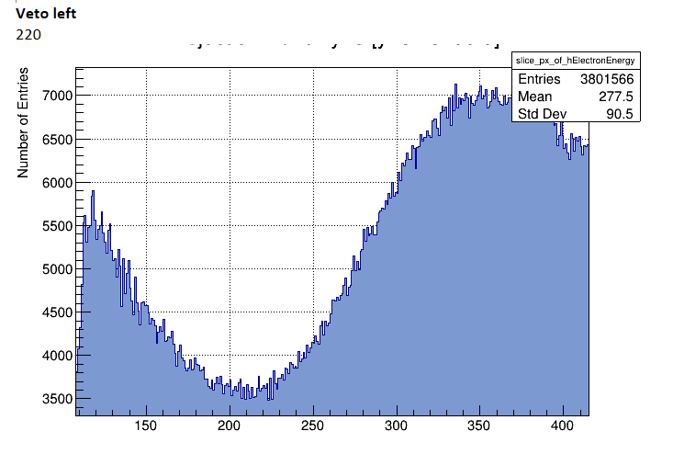
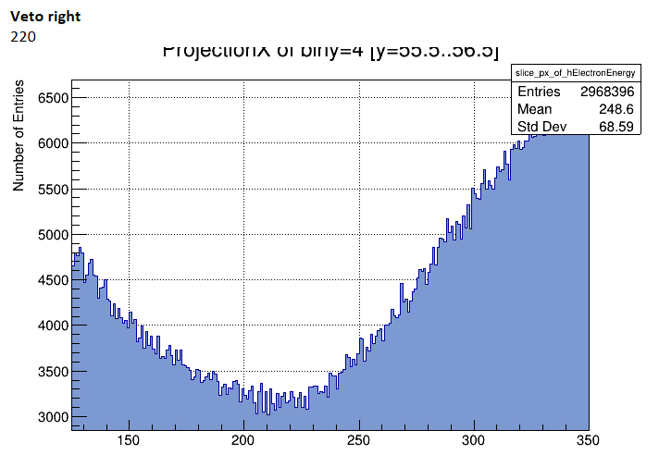
Scintillator threshold

Slide 12
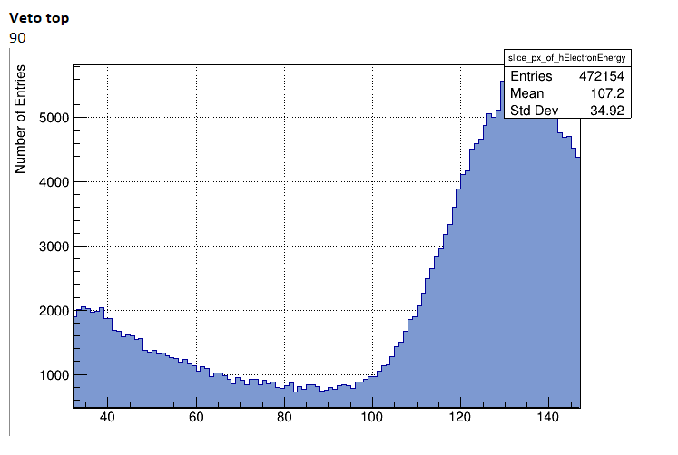
Scintillator threshold

