Slide 1
Update muX meeting 09/08
Michael Heines

Slide 2
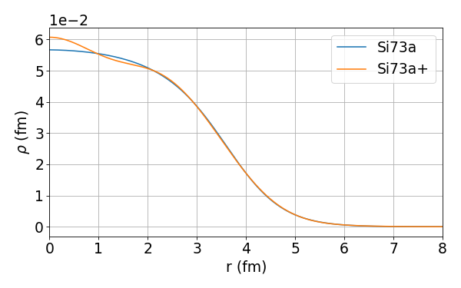
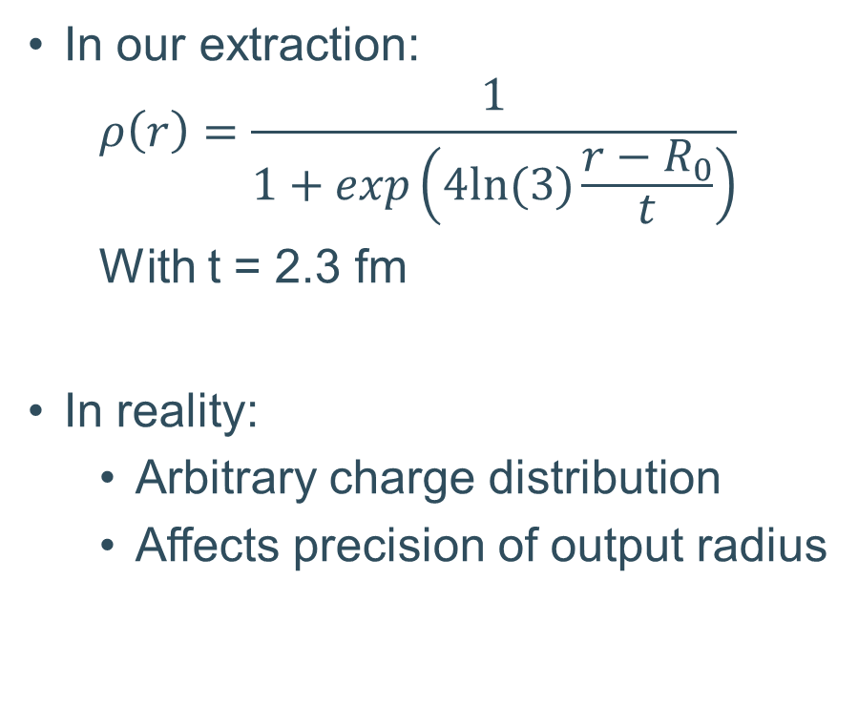
Effects of nuclear shape
In our extraction:
  $$ρ\left(r\right)=\frac{1}{1+exp\left(4ln⁡(3)\frac{r−R_{0}}{t}\right)}$$
  With t = 2.3 fm
In reality:
  Arbitrary charge distribution
  Affects precision of output radius

Slide 3
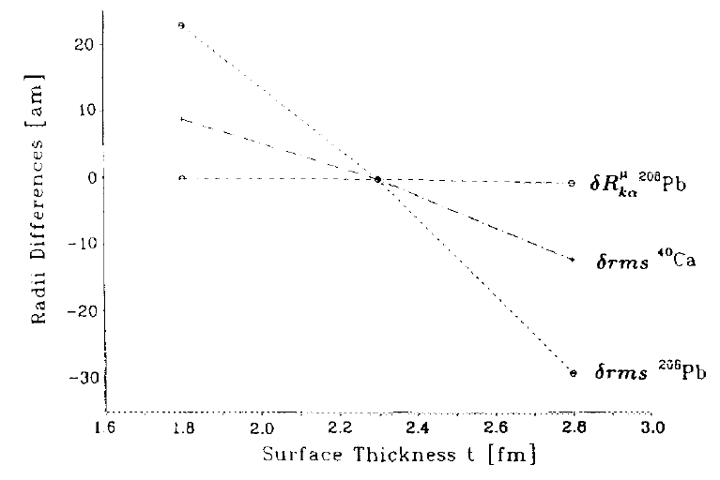
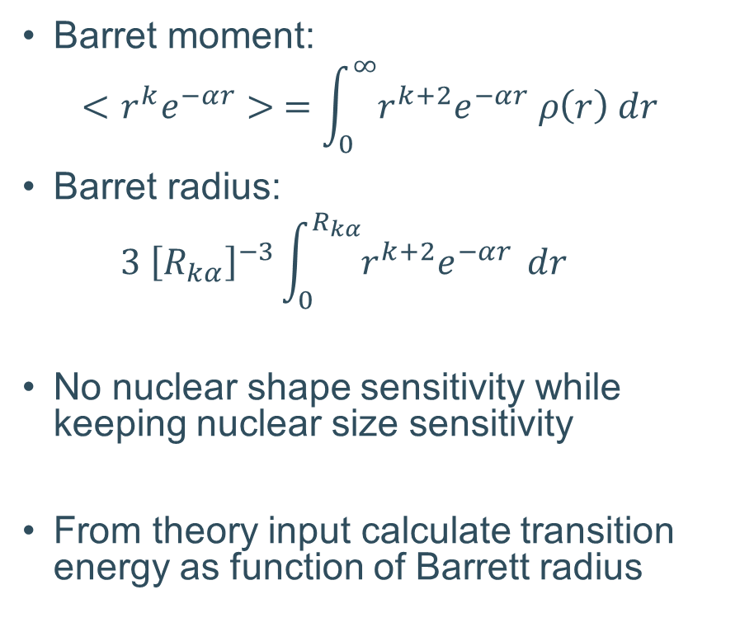
Extracting Barrett radii
Barret moment:
$$<r^{k}e^{−αr}> =\int_{0}^{∞}{r^{k+2}e^{−αr} ρ\left(r\right) dr }$$
Barret radius:
  $$3 {\left[R_{kα}\right]}^{−3}\int_{0}^{R_{kα}}{r^{k+2}e^{−αr}} dr$$
No nuclear shape sensitivity while keeping nuclear size sensitivity
From theory input calculate transition energy as function of Barrett radius
[1] Fricke, G., et al. "Nuclear ground state charge radii from electromagnetic interactions." Atomic Data and Nuclear Data Tables 60.2 (1995): 177-285.

Slide 4
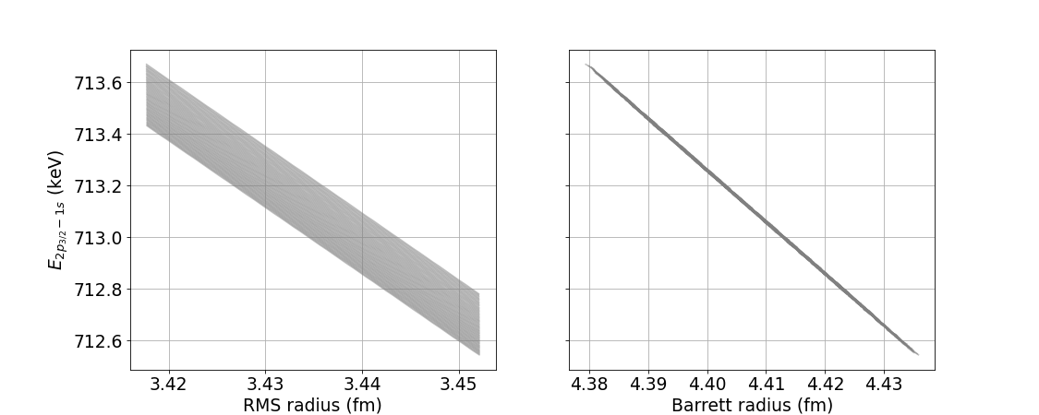
RMS versus Barrett radius

Slide 5
