Slide 1
Update muX meeting 23/08
Michael Heines

Slide 2
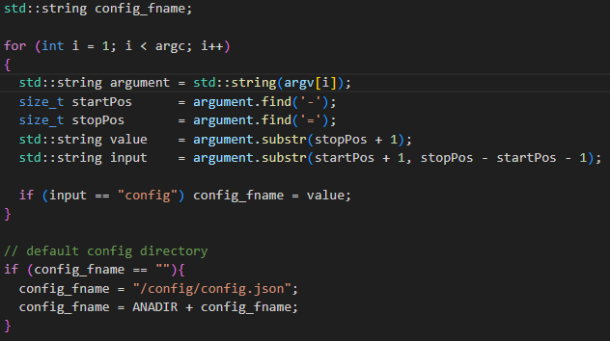
Analyzer update – input config file
Option to give path to config file
If nothing changed → Works the same as before
Solves the “two user” issue
Pushed to master branch

Slide 3
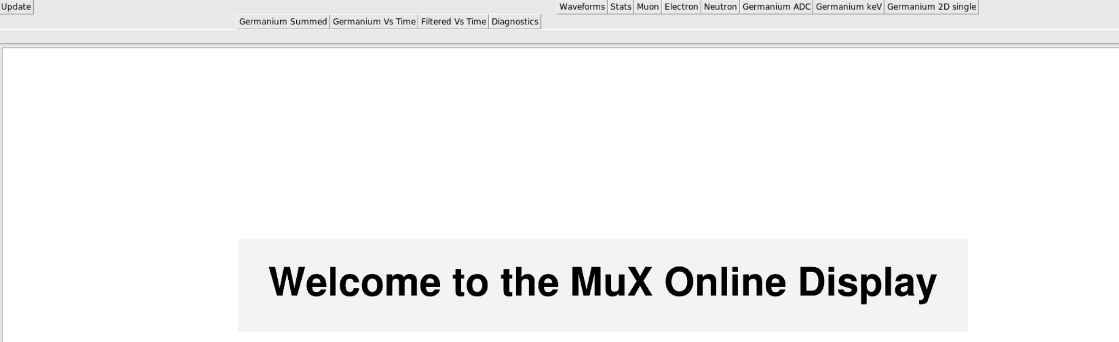
Online display
Still seems to work quite alright → Maybe minor adjustments to what is shown?

