Slide 2
Test and diagnostics: priorities for the high field magnets program
Ezio Todesco
On behalf of HFM collaboration
31 March 2025 – SMTF workshop

Slide 3
Contents
HFM program in a nutshell
Priorities for tests

Slide 4
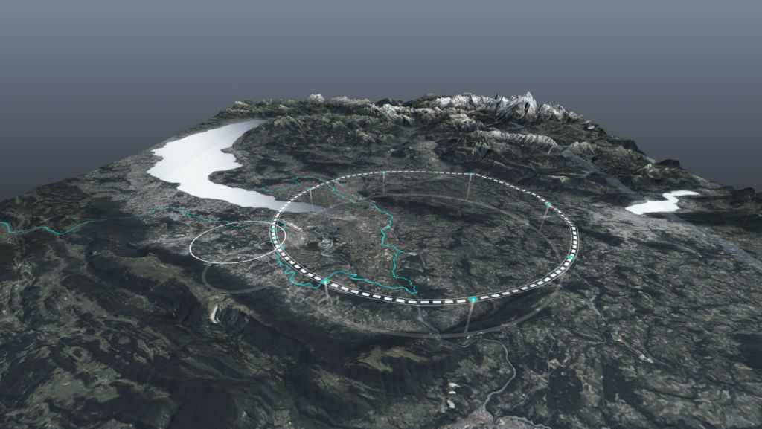
HFM program in a nutshell
HFM is a directed R&D program to develop magnets for FCC-hh
    First baseline: 16 T magnets, 100 km tunnel, 100 TeV [M. Benedikt, et al., FCC-hh CDR, EPJST 228 (2019)]
Nb₃Sn baseline for FCC-hh: a proton-proton collider for 85 TeV c.o.m energy in a 91 km tunnel, based on 14 T operational field magnets
An 85-120 TeV option based on HTS is also proposed, with 14-20 T field
FCC-hh parameters | CDR 2019 | 2024-Nb₃Sn | 2024-HTS
Dipole field (T) | 16.0 | 14.0 | 14-20
Operational temperature (K) | 1.9 | 1.9 | 4.2-20
Tunnel length (km) | 100 | 90.7 | 90.7
Arc length (km) | 82.0 | 76.9 | 76.9
Arc filling factor (adim) | 0.80 | 0.83 | 0.83
Energy c.o.m (TeV) | 100 | 85 | 85-120
Loadline margin | 86% | 80% | TBD

Slide 5
HFM program in a nutshell
Reduction of field from 16 T to 14 T was motivated by the following arguments
  14 T can be reached with 0.80 loadline fraction with the available conductor
    Previous baseline required 0.86 loadline fraction, and a conductor giving 25% more jc
  EuroCirCol studies proved that dipoles with 16 T barely fit a stress limit below 200 MPa: with 14 T we are below 150 MPa, more comfortable for a long production
This field reduction is similar to what happened in the history of LHC design, that started with 10 T and 8 TeV, and ended in 8.3 T and 7 TeV
Do not think that 14.1 T is enough ! Magnets should prove to be able to reach 15-15.5 T in short models

Slide 6
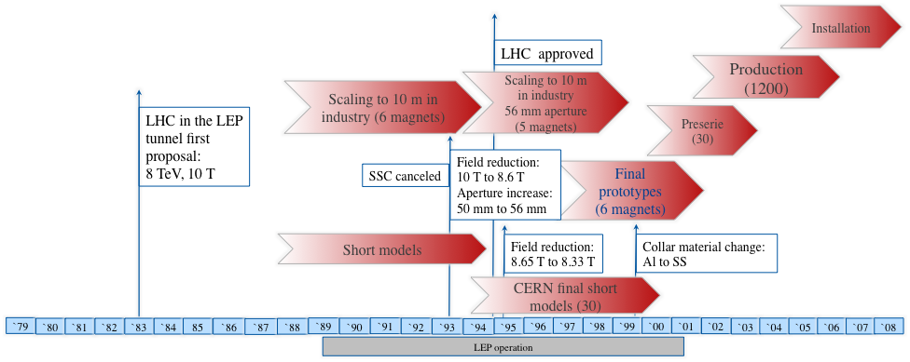

HFM program in a nutshell
During the LHC design, main dipole length also increased from initial 9.5 m to 14 m
  Today baseline for FCC-hh is 14 m, as in the LHC, but we consider an option with 20 m dipole length → 1200 less magnets to produce and test

Slide 7
HFM program in a nutshell
We are building demonstrators and short models with different designs
  Demonstrators: magnets that prove part of the technology, but that do not satify all the requirements
    ISAAC for common coil
    RMM, R2D2, FD for block
    subSMCC for common coil stress managed
Cosθ, block, common coil, stress managed common coil
  BOND and F2D2 for block
  Daisy for common coil
  FalconD for cosq
  SMACC for SMCC

Slide 8
HFM program in a nutshell
Aperture for the short models is 50 mm
Aperture for the demonstrators can be smaller (or zero)
RMM tested in 2022-4
subSMCC tested in 2024
ISAAC, R2D2, expected for end of this year
In 2026 we shall have BOND, FalconD, SMACC

Slide 9
HFM program in a nutshell
Select the design by the end of LS3 (we should start having some indications from tests in 2026-2027)
Have a full short model program to verify reproducibility and margins in 2029-2031
Scaling in length in two steps
First selection
of design
5-m-long prototypes
(>5 each type)
Industrialization (pre-series magnets)
Short model program on two selected designs
(>5 each type)
15 m long prototypes (>5)
Production and test
Ongoing
12 T and 14 T short models
(7 designs, 1 or 2 of each type)
Selection of final design
to start long magnets
Installation and commissioning
Tender
for the series
`25
`26
`27
`28
`29
`30
`31
`32
`33
`34
`35
`36
`37
`38
`39
`40
`41
`42
`43
`44
`45
`46
`47
`48
`49
`50
`51
`52
`53
`54
RunIII
HL-LHC RunIV
HL-LHC RunV

Slide 10
Contents
HFM program in a nutshell
Priorities for tests

Slide 11
Priorities for tests - 1
Ability of testing at temperatures between 4.5 K and 7 K
One of the options for FCC-hh is to have dipoles working at 4.5 K
In the present design, 0.80 loadline fraction implies a 4.5-5 K temperature margin
Working at 4.5 K would mean having a theoretical 2-2.5 K temperature margin
  Note that in the LHC dipoles, theoretical temperature margin is 1.3 K – so 2-2.5 K could be enough
HL-LHC magnets, with similar parameters, were tested systematically at 4.5 K and reached nominal current at 4.5 K (0.90 loadline fraction)
  But we have no measure of the temperature margin at 4.5 K: is it the full theoretical 2-2.5 K margin ? Or is it less ?
Measurements of magnet performance in the 4.5 – 7 K range would be extremely important to assess this option

Slide 12
Priorities for tests - 2
Ability of systematically measure the hysteresis losses (both at 1.9 K and at 4.5 K)
  These losses are the dominant component for the magnet
  Today with Nb₃Sn we are a factor two larger with respect to the requirements
For the HTS case, these losses can be larger, due to the large filament size in one direction
  Moreover the modeling is very complex, due to the asymmetry of the tape
Hysteresis losses measurements are a must to
  Assess that the present filament size is compatible with the budget for hysteresis losses in Nb₃Sn
  Assess the potential of an HTS cable based on tapes

Slide 13
Priorities for tests - 3
Ability of perform endurance tests in automated mode
  Both Nb₃Sn and HTS can go through performance degradation
It is very important to assess the following aspects, as done for HL-LHC:
  Performance stability over cycling (order of 1000)
  Performance stability over thermal cycles (order of 5)
  Performance stability over long flattops (order of 24 h)
  Performance stability over high current quenches (order of 100)
All these test are very time consuming and the possibility of doing them automatically (24/24 h) is a must

Slide 14
Priorities for tests - 4
Ability of measure the transfer function and field quality reproducibility
  Emphasis should be put especially on the TF, with devices allowing sensitivities of 10 ppm – requirements are having reprodicibility better than 100 pm
  … and also on multipoles, especially the low orders
Tools to have early indication of resisitive transition and performance limitations
  VI measurements, developed in the HL-LHC era, proved to be extremely effective
Mechanical measurements that can be connected to observables of the mechanical model
  Seeing the coil unloadling has been a fundamental tool to assess the correct preload and behavious of mechanical structure

Slide 15
Conclusions
The HFM program is building several demonstrators and short models, and many will be tested in the coming years
  Aperture baseline is 50 mm: we shall have adequate tools fitting this constraint
Some priorities
  Ability to measure performance in the 4.5 – 7 K range
  Ability to measure hysteresis losses
  Ability to perform endurance test in automated mode, 24/24h
  Ability of measuring transfer function and low order multipole reproducibility
  Ability of having mechanical measurements that can be related to models, and that can assess the preload level (for classical design)

Slide 17
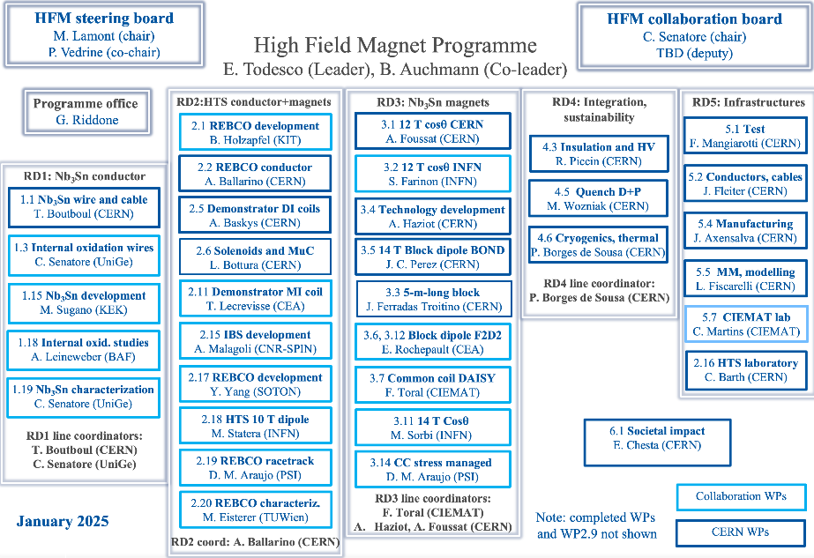
Structure

