Slide 1

JORDI, a test stand for high-current conductors and coil windings
Nikolay Bykovskiy
SMTF Workshop
02/04/2025

Slide 2
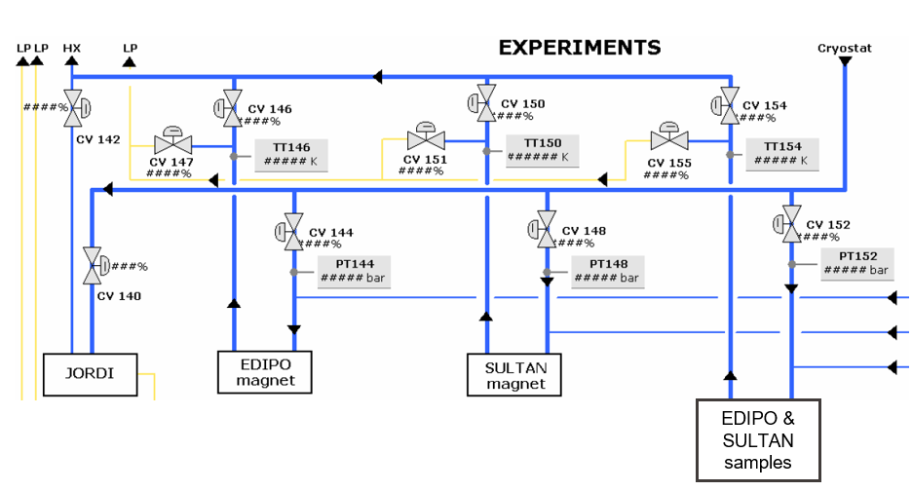
Who is JORDI?
The KA-III cryoplant at EPFL SPC can supply supercritical helium at 10 bar, 4.5 K, 10 g/s
It has 4 ports to serve different ‘experiments’:

Slide 3
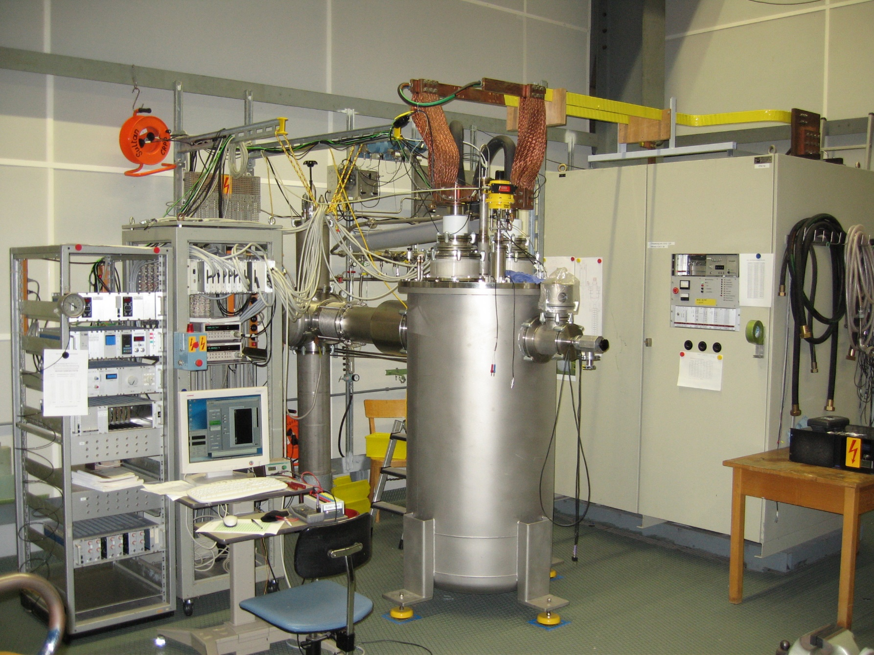
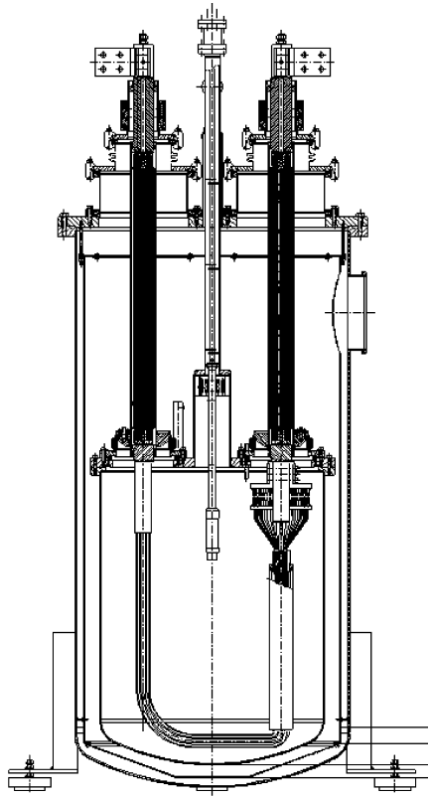
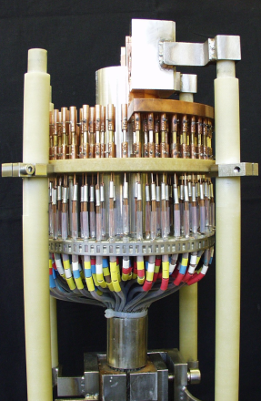

JORDI for JOint Resistance DIstribution
https://doi.org/10.1109/TASC.2004.830653
Original study on the inter-strand resistance in cable-in-conduit conductors:
10 kA power supply, pair of actively cooled copper current leads
Helium bath cooling with automated refill
Thermal shield cooled separately by 80 K outlet of the cryoplant

Slide 4
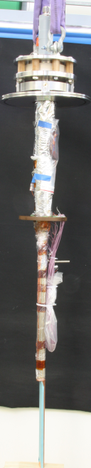
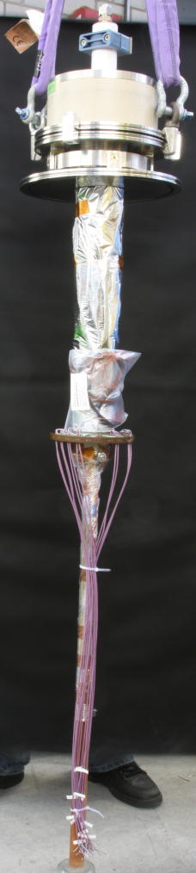
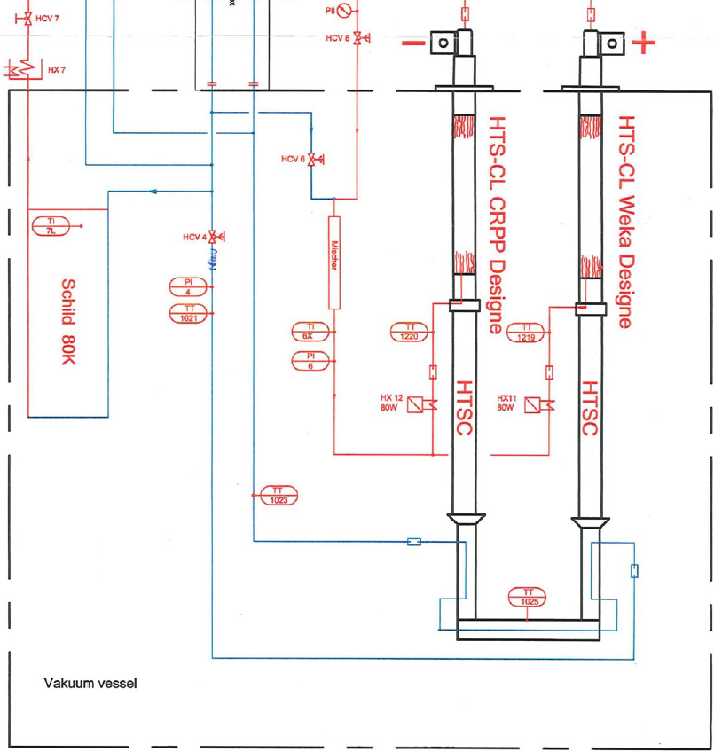
HTS currents leads
WEKA
CRPP
Connections to cryoplant and recovery line
New sample holder providing closed-loop helium circulation
Thermal shield cooled in parallel by 4 K circuit (80 K circuit no longer available)
Current leads and sample cooled by low pressure helium (i.e. placed after JT valves)
https://doi.org/10.1109/TASC.2013.2281121

Slide 5
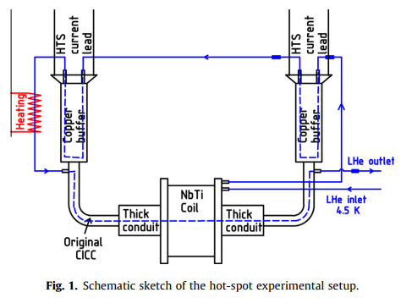
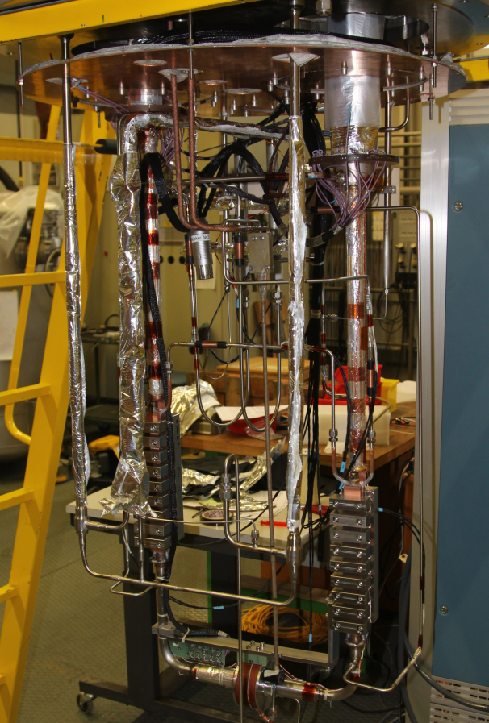
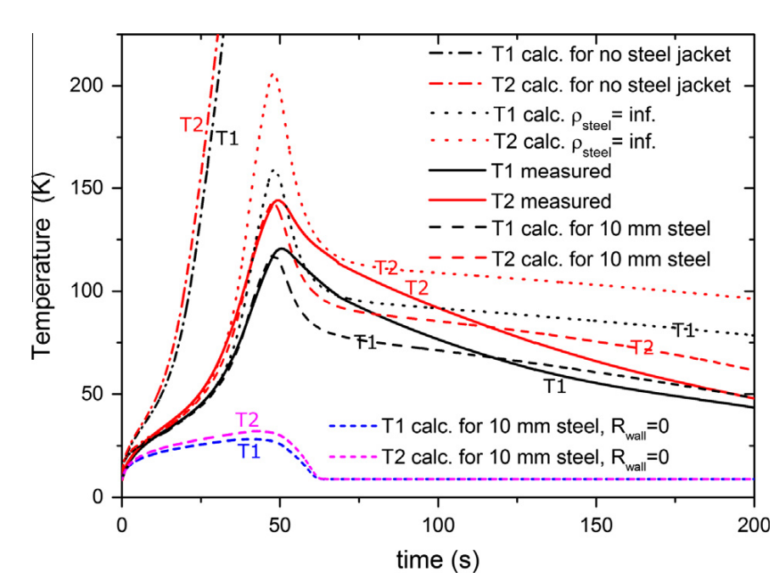
Quench study
https://doi.org/10.1016/j.cryogenics.2015.07.003

Slide 6
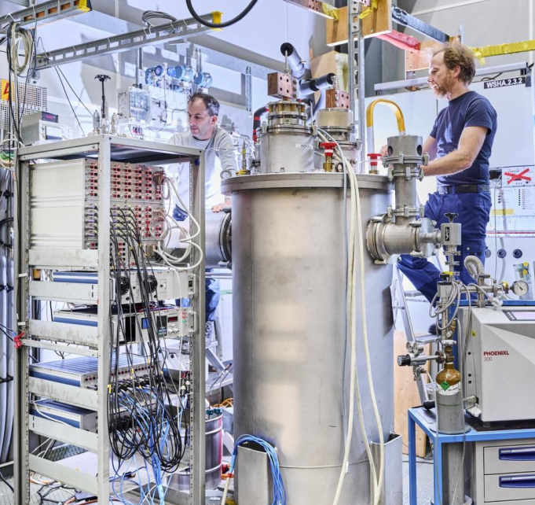
Current status
JORDI offers large test volume for variety of high-current samples by:
Single cooling circuit
(~6 K helium inlet at 10 bar)
10 kA / 2 V power supply
Two sample holders – helium bath and closed-loop circulation
Next samples:
Superconducting switches for quench protection (Nb-Ti, MgB₂)
Transformer and flux-pump (Nb₃Sn)
Sub-size coils for VNS (ReBCO)
…
Each one calling for certain upgrades…

Slide 7
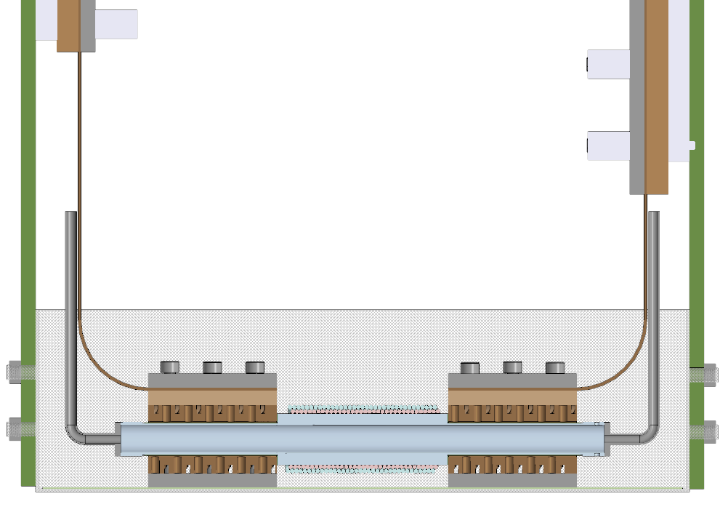
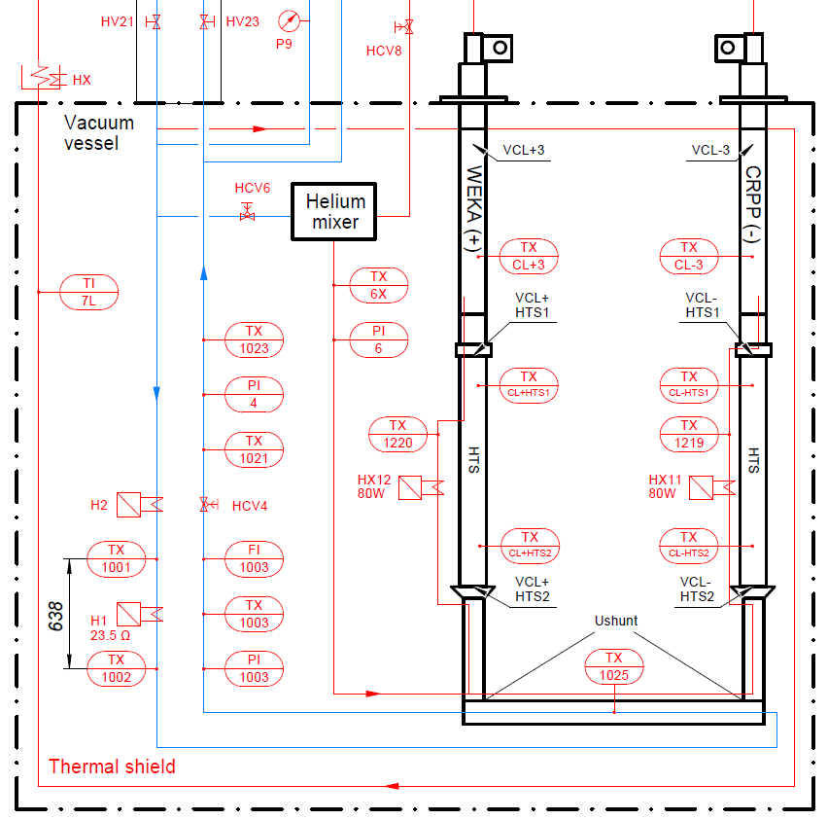
Superconducting switches
Connections to cryoplant and recovery line
Thermally activated switch by non-inductive 12-wire
Nb-Ti winding
Helium flow
Need for mass flow measurements and keeping helium at high pressure, thus:
Orifice flow meter installed
JT valve placed near the exit
+ active cooling of HTS section of the leads

Slide 8
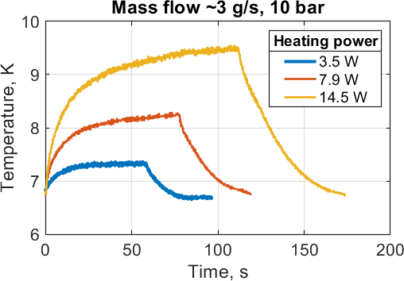
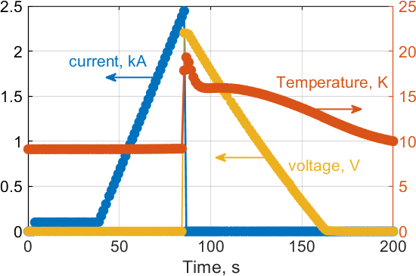
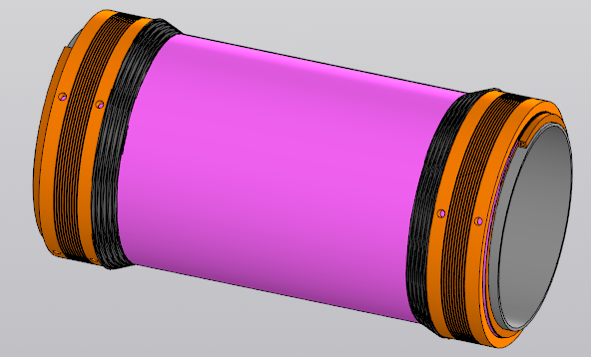
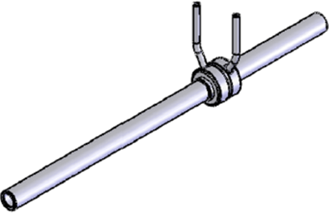
Superconducting switches
Rough agreement (within ~10%) between calibration used in SULTAN (function of dp, P and T) and calorimetric assessment of mass flow (ratio between heating power and enthalpy change)
However, T_{min} ~5.7 K only by reducing pressure to 5 bar
So far, only ~2.5 kA operation achieved. Operation in LHe bath should increase I_{op} by a factor 2-3.
Current discharge of the 10 kA PS is relatively slow, but it was nearly instantaneous due to fast switching of the sample to the normal state.
MgB₂ switch aimed at 10 kA nominal operation and ~0.3 Ohm at 40 K off-state to be tested.

Slide 9
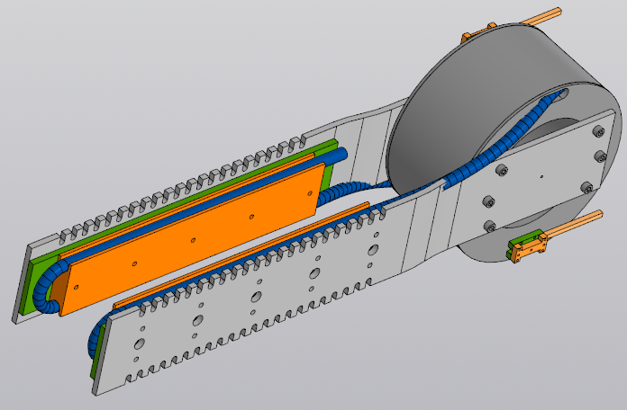
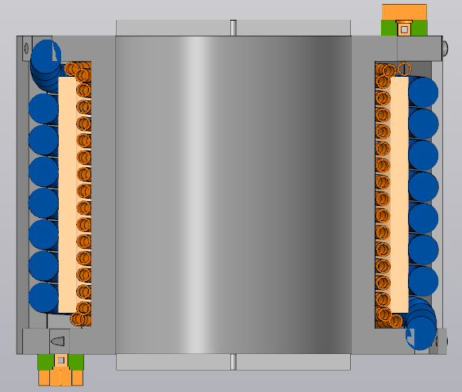
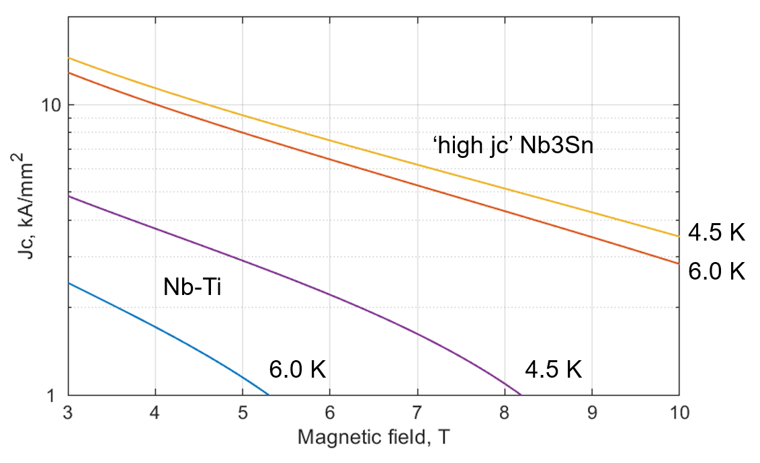
Transformer and flux-pump
SC transformer using Nb₃Sn wires:
Possible operation at elevated temperatures due to high jc, which is only ~10% lower at 6 K than at 4.5 K for Nb₃Sn at 5 T (compared to ~60% for Nb-Ti)
Design and construction of the demonstrator rated at ~100 kA is on-going…
To be equipped with a set of switches to enable rectifier operation (e.g. fluxpump)
→ Need for AC current source and quench protection of the primary coil

Slide 10
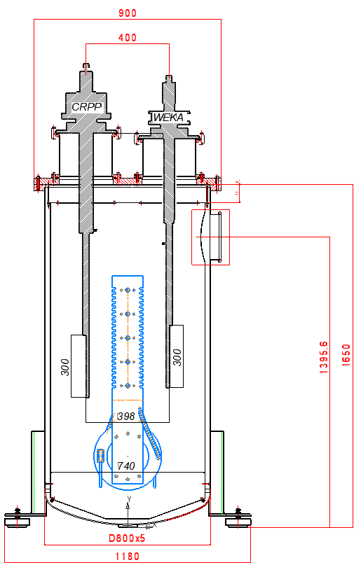
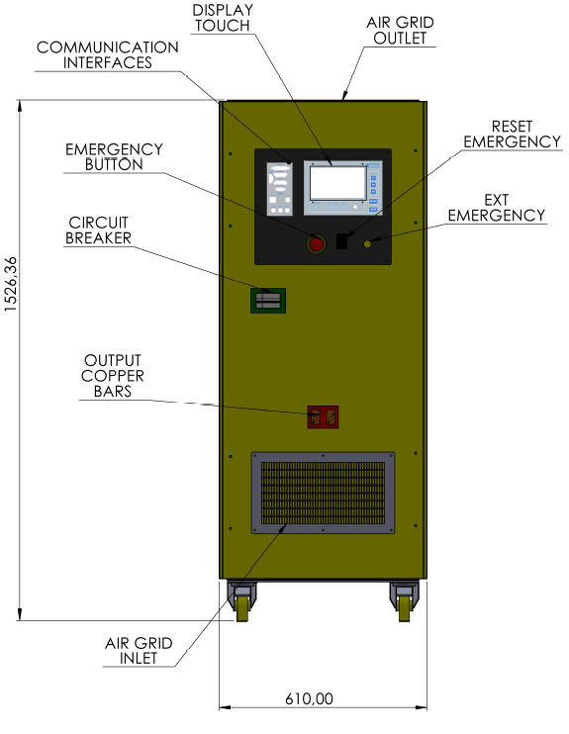
Transformer and flux-pump
Control system to be implemented for:
1 kA circuit breaker and dump resistor
AC power supply (±500 A / ±20 V):

Slide 11
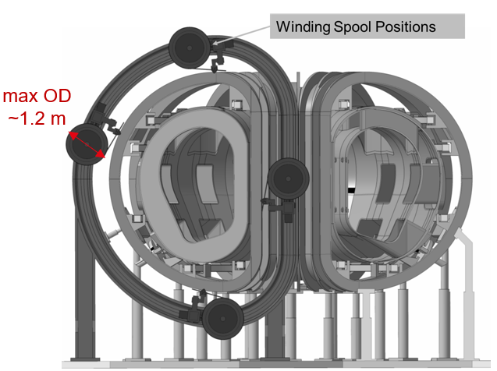
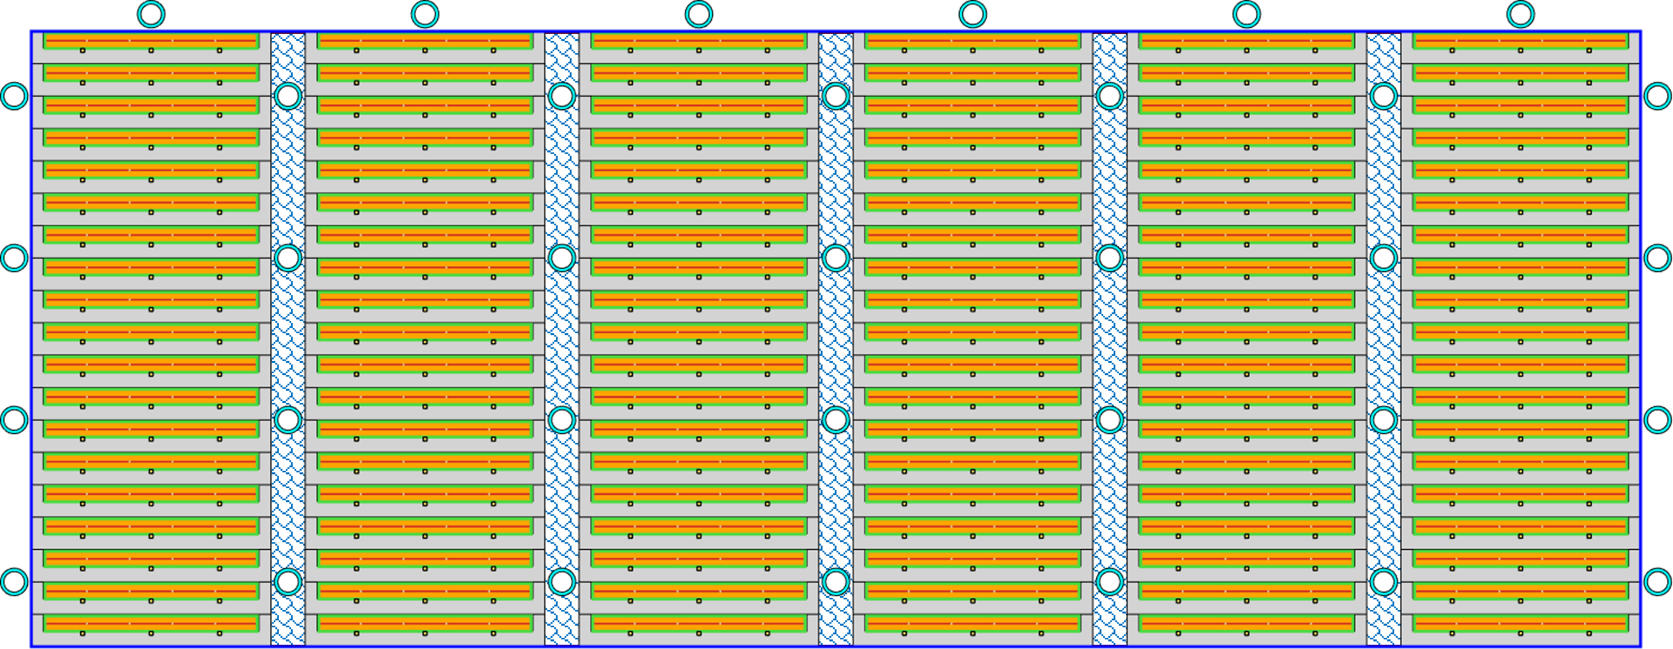
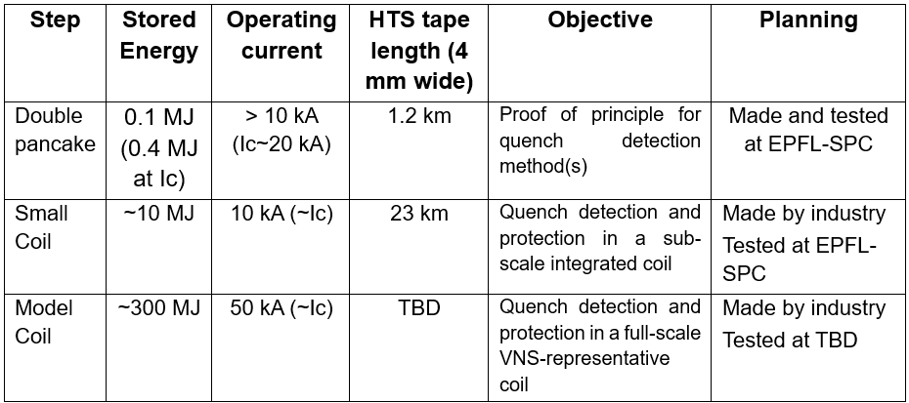
Sub-size coils for VNS tokamak
TF winding pack (in-situ winding)
Indirectly cooled HTS conductor
Co-wound steel strip with embedded quench detection
Feasibility study on using HTS for the ‘in-situ’ wound TF coils of VNS planned to be carried out in JORDI

Slide 12
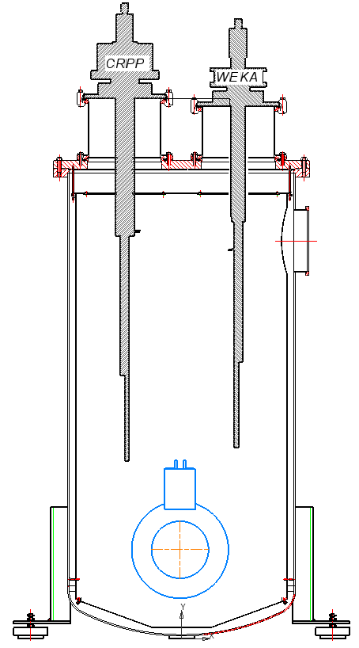
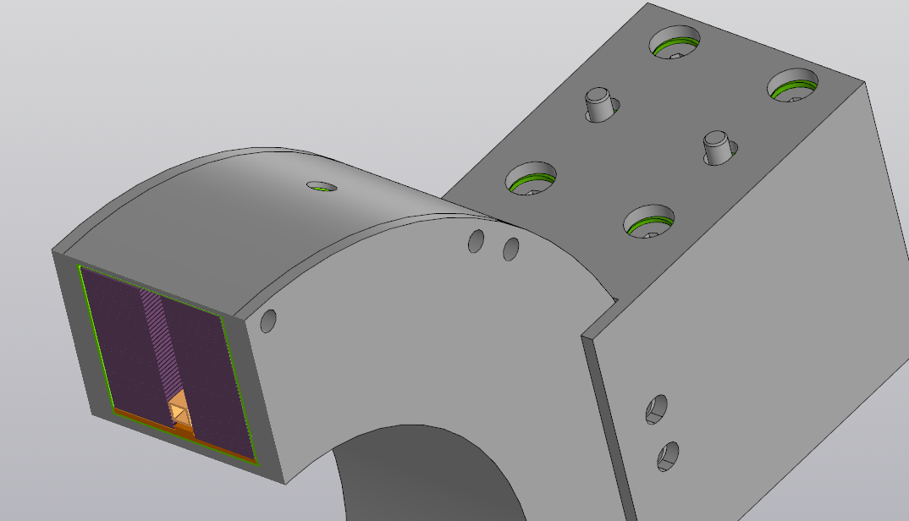

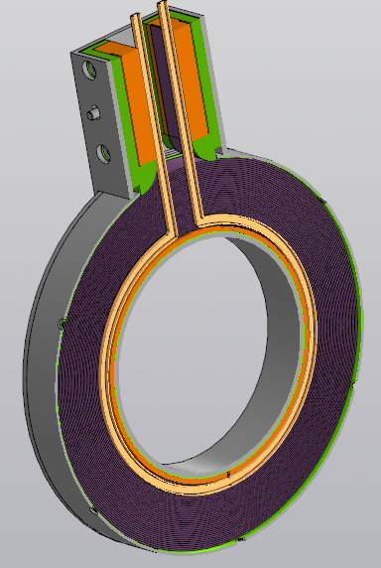
Sub-size coils for VNS: step 1
Co-wound strip for quench detection and turn insulation
Laminated stacked-tape soldered conductor (LASSO)
Double pancake HTS coil:
~70 m long LASSO cable using varying number of tapes along the length (18 to 14)
Pancake transition by a splice made of copper strip soldered to cable terminals
Cooling pipe placed between the pancakes
Quench detection by a co-wound instrumentation strip containing SQD wires, thermocouple arrays and optical fibers

Slide 13
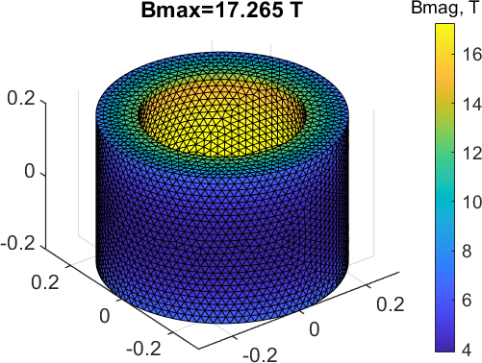
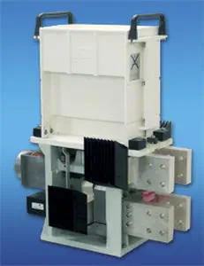
Sub-size coils for VNS: step 2
Sample design parameters:
400 mm bore, 400 mm tall, 100 mm thick winding
Operation ~10 kA, current density ~190 A/mm²
Central field ~15 T, energy ~10 MJ, L ~0.2 H
LASSO conductor ~1.3 km long in 16 single pancakes
Total length of 4 mm tape ~23 km
Quench protection by external energy dump using 10 kA circuit breaker (procured from Secheron) and dump resistor to be implemented in JORDI
Protection by SC switches as an alternative?

Slide 14
Conclusion
The JORDI test stand is being upgraded to meet various demands for high-current testing of superconducting cables, switches, transformers and coils.
Cooling by helium bath (~1 bar) or helium forced flow (~10 bar).
Thank you for your attention and let us know if you are interested to test in JORDI!

