Slide 1
BNL test facility upgrade for hybrid magnet testing
Piyush Joshi, Mithlesh Kumar
5th SMTF and 3rd IDSM 2025, Bad Zurzach, Switzerland
March 31–April 4, 2025

Slide 2
Outline
BNL’s test facility-general
Hybrid magnet and HTS cable test facility
Conductors and coil test in background field
Examples of special tests done in last two years
Upgrade in power supply and quench protection assemblies for direct wind high inductance magnets
Upgrade in cryogenic equipment

Slide 3
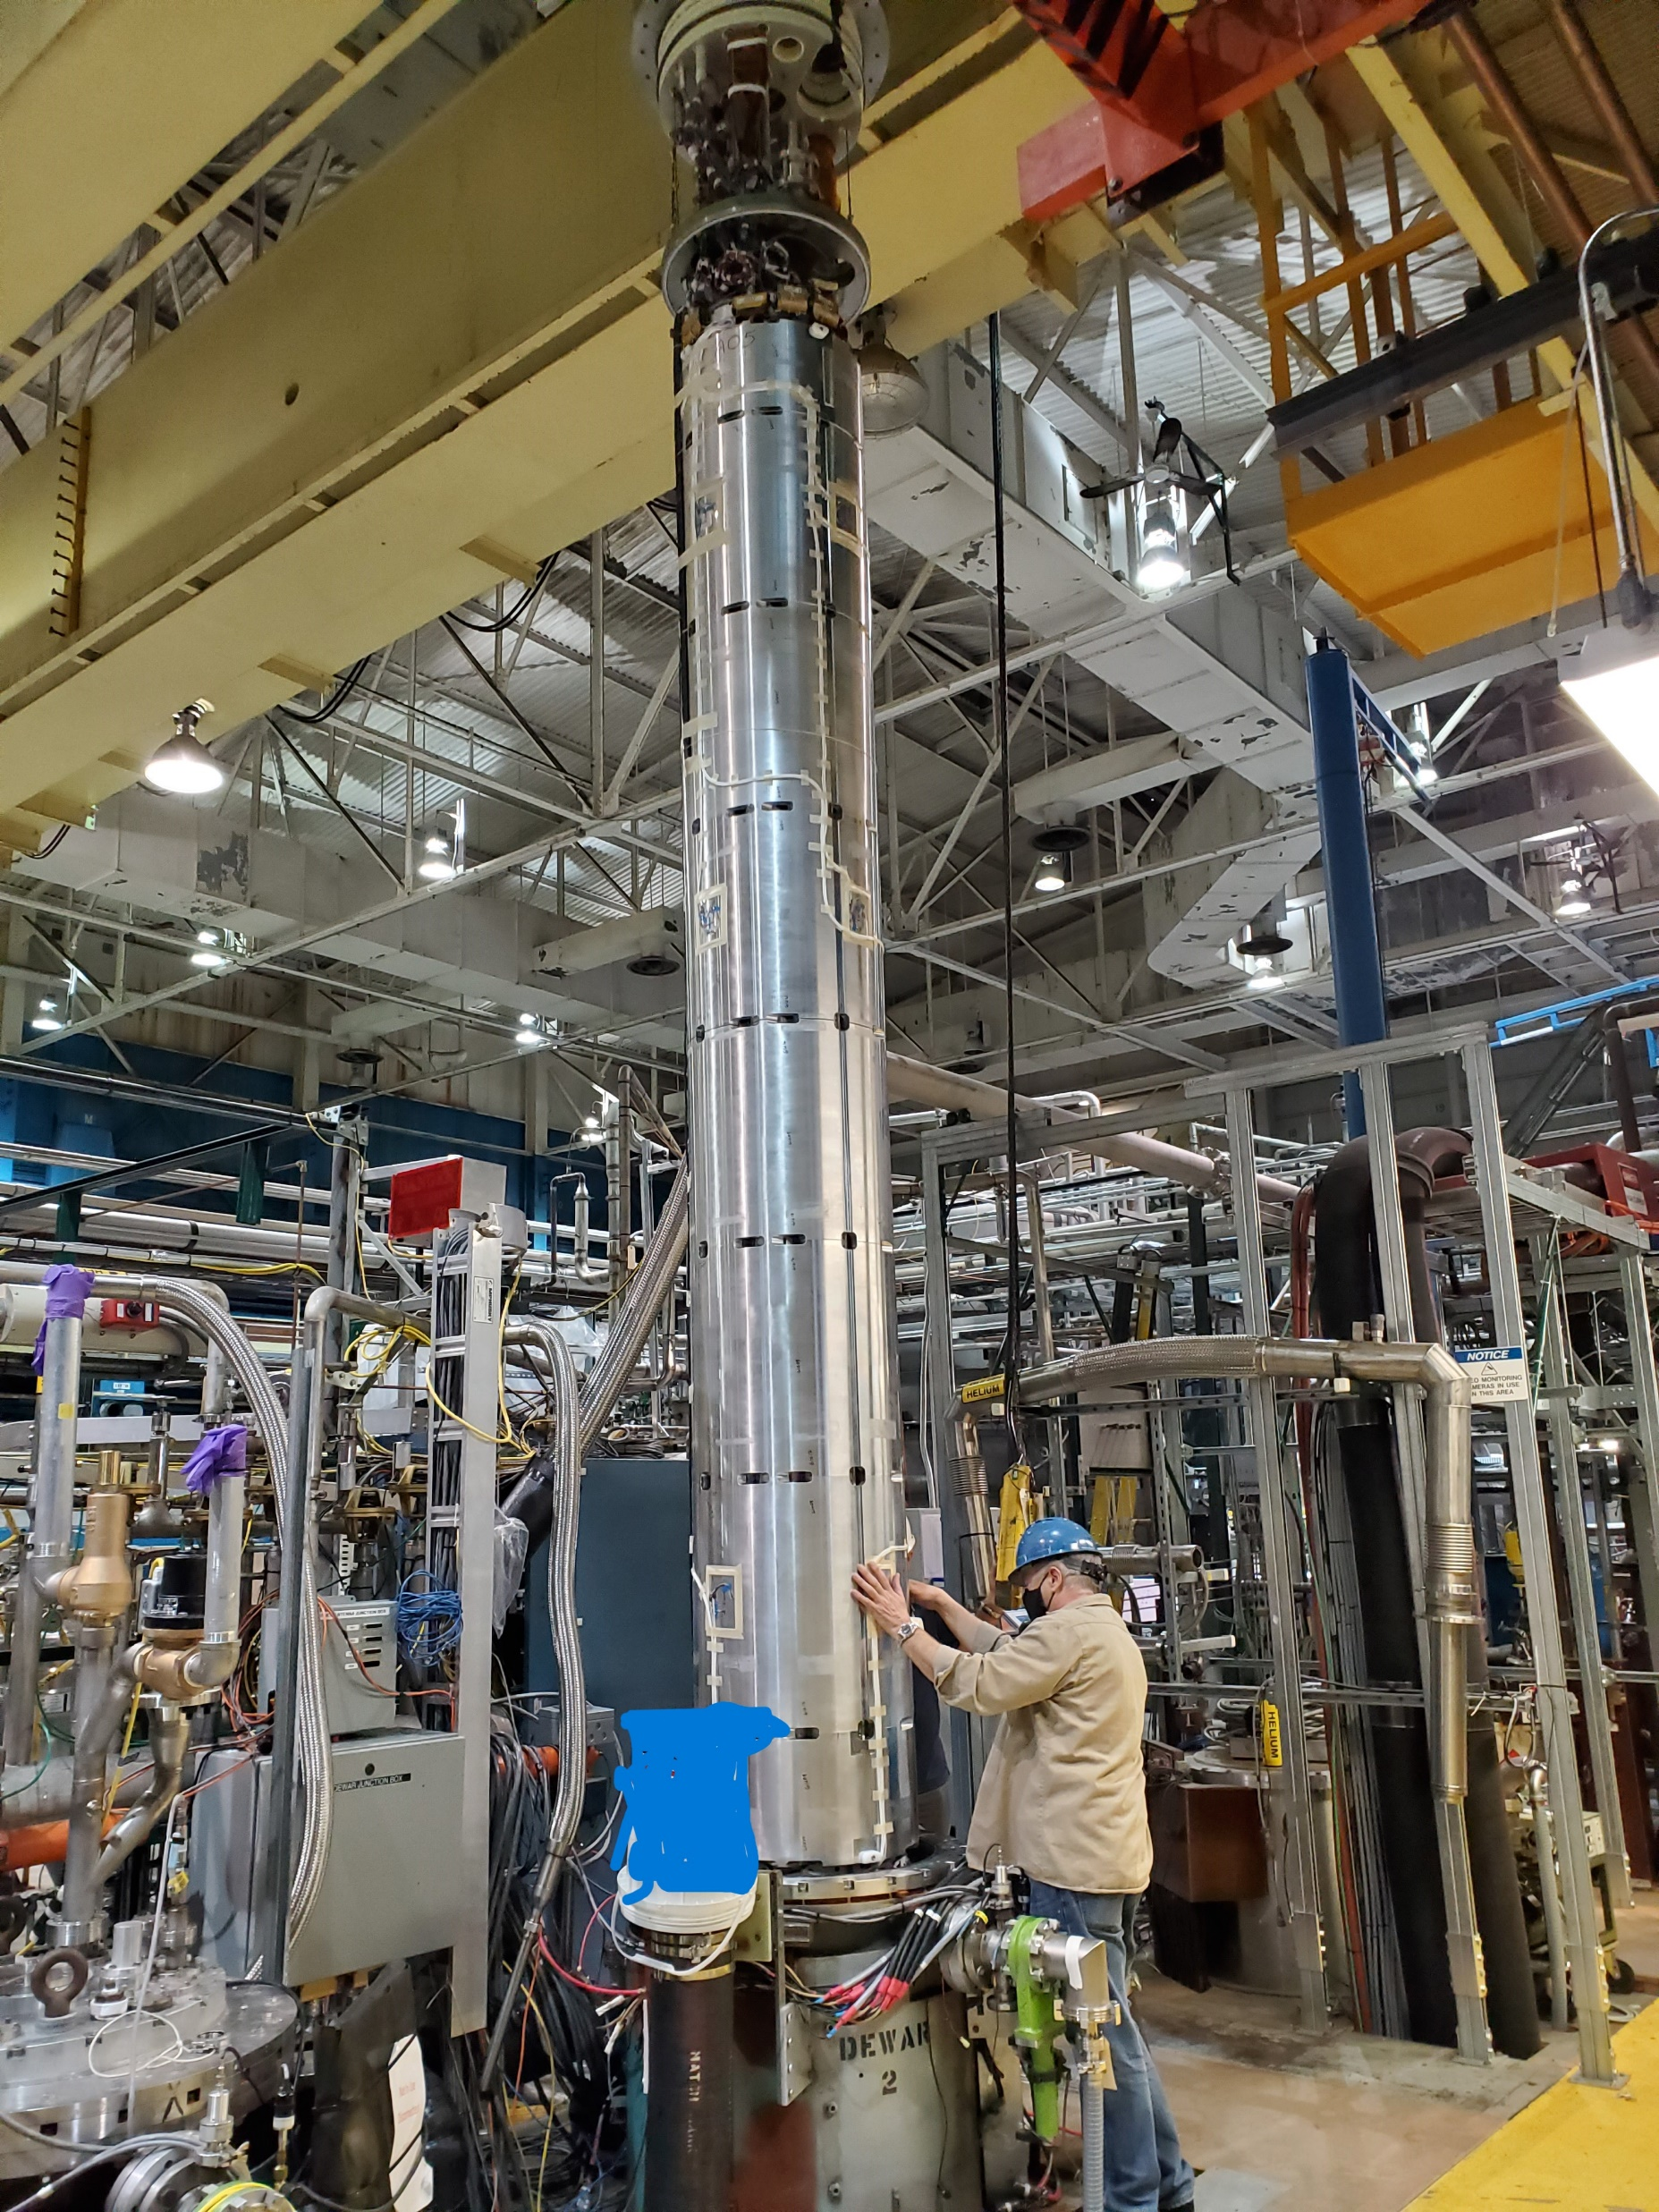
BNL’s unique facility
Magnet Division at BNL has been testing superconducting magnets for many decades.
Three Horizontal test bay: 10kA PS and IGBT energy extraction switch
Five vertical test dewars with 30kA PS and 24kA IGBT energy extraction switch
Assortment of other power supplies ranging from 8.5kA to bipolar 650A
30 ton crane with hook height of 8m
Cryo plant with He liquefaction capacity around 440l/hr
Vacuum pumps for 1.8K operation

Slide 4
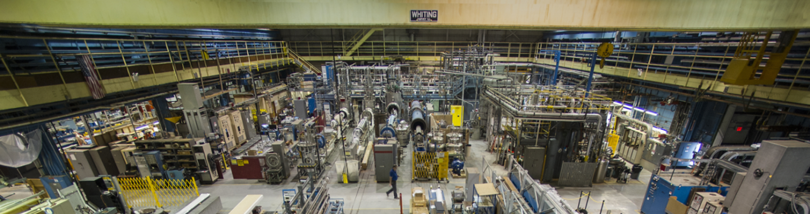
BNL SC Magnet Test Facility

Slide 5
Hybrid Magnet Test : Physics Motivation
Stress managed structures for high field magnets
Training and degradation reduction
Quench protection strategies
HTS/LTS Hybrid towards high field magnets

Slide 6
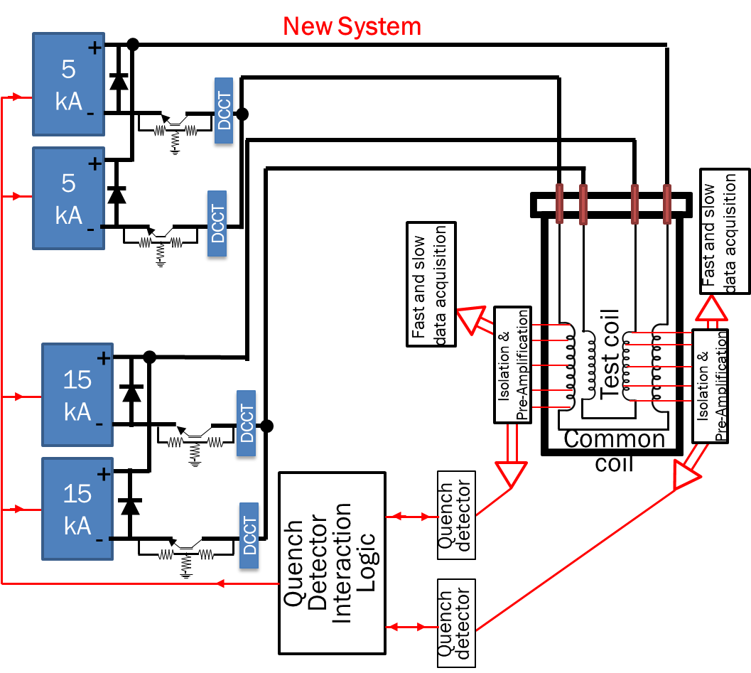
Hybrid Power and Quench Protection Circuits
Key Features:
Manage complex energy interaction of two magnet systems, their independent powering circuits, standalone quench detectors, and data loggers.
Precise quench detection and energy extraction timing sequence to protect both magnets.
FPGA based QD and IGBT switches
120 channels of isolated fast and slow data

Slide 7
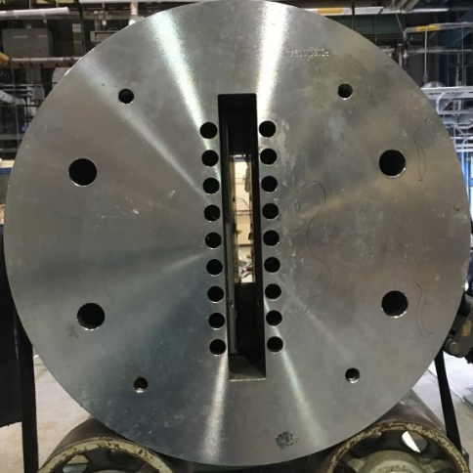
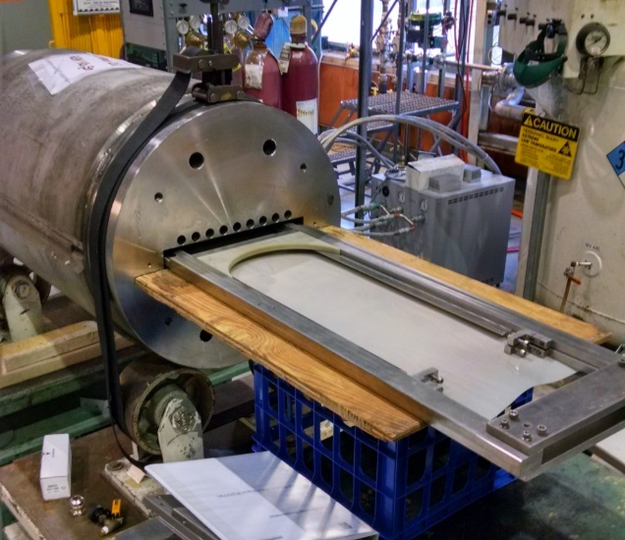
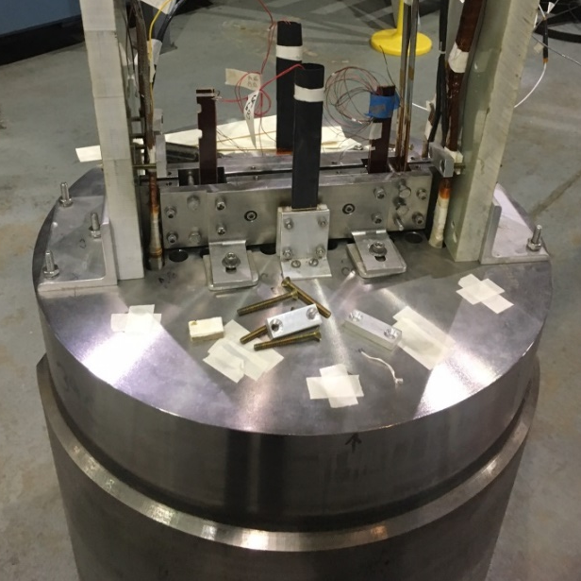
10T common coil test setup for background field
Test space

Slide 8
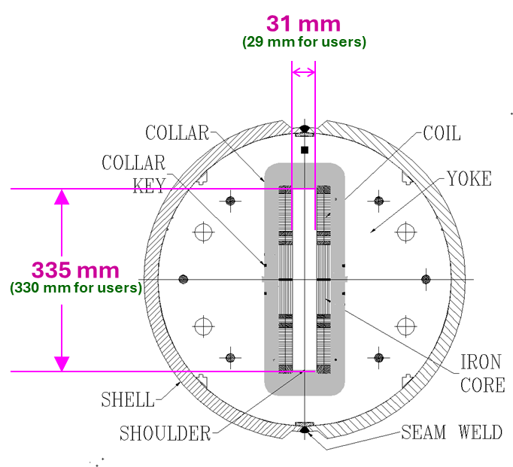
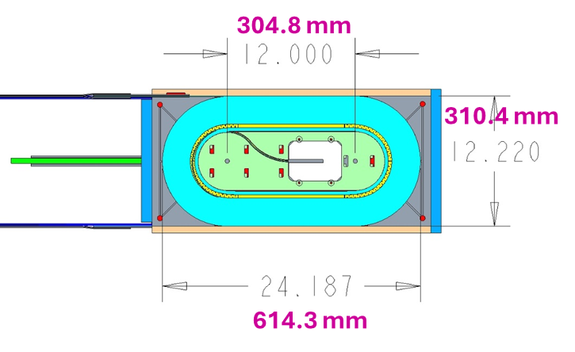
Common coil test facility (II)

Slide 9
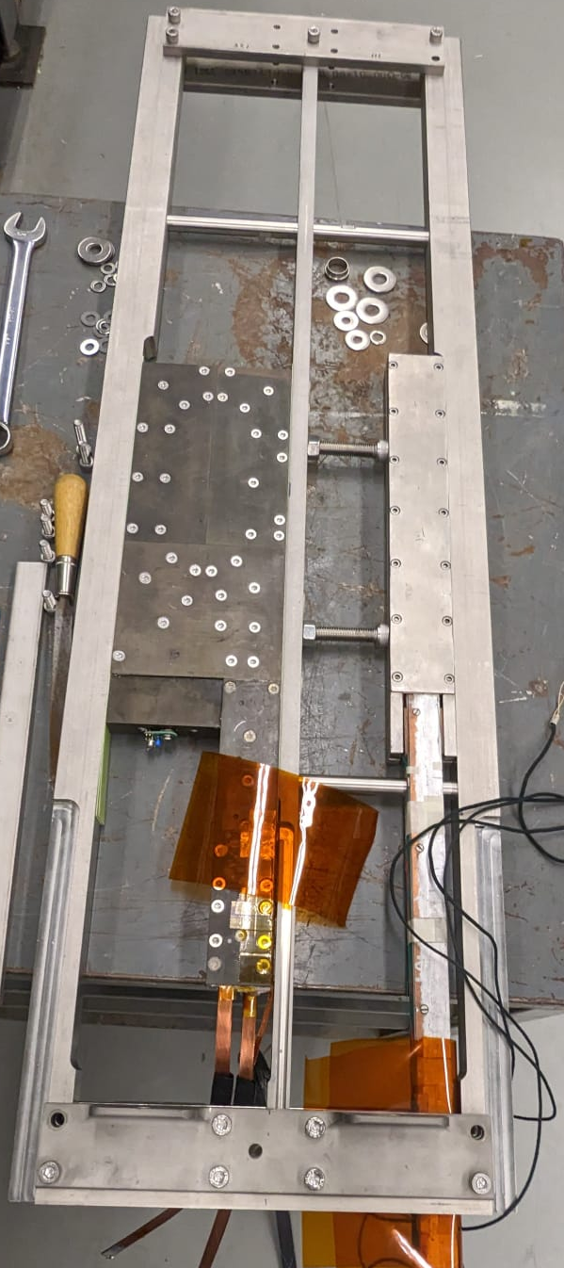
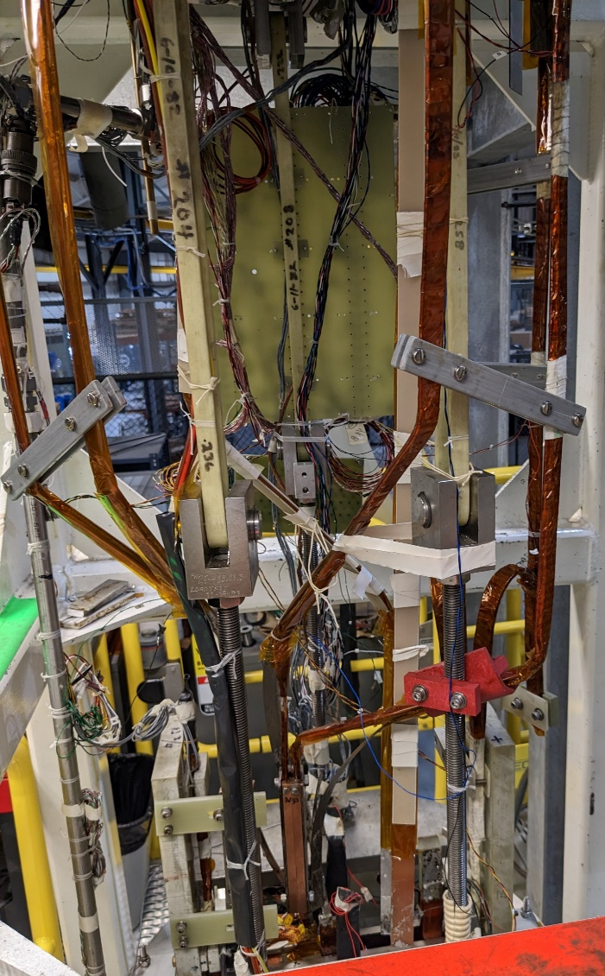
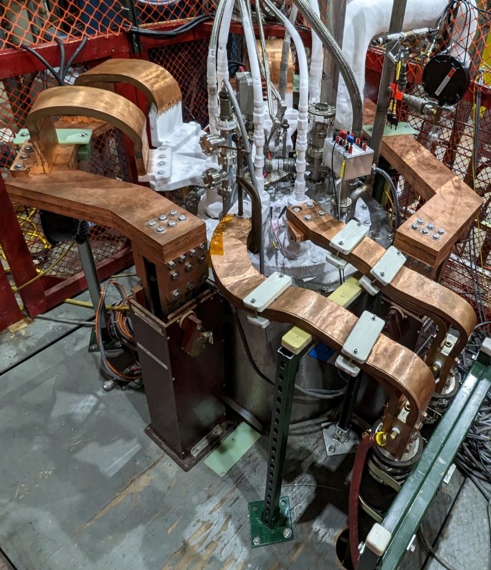
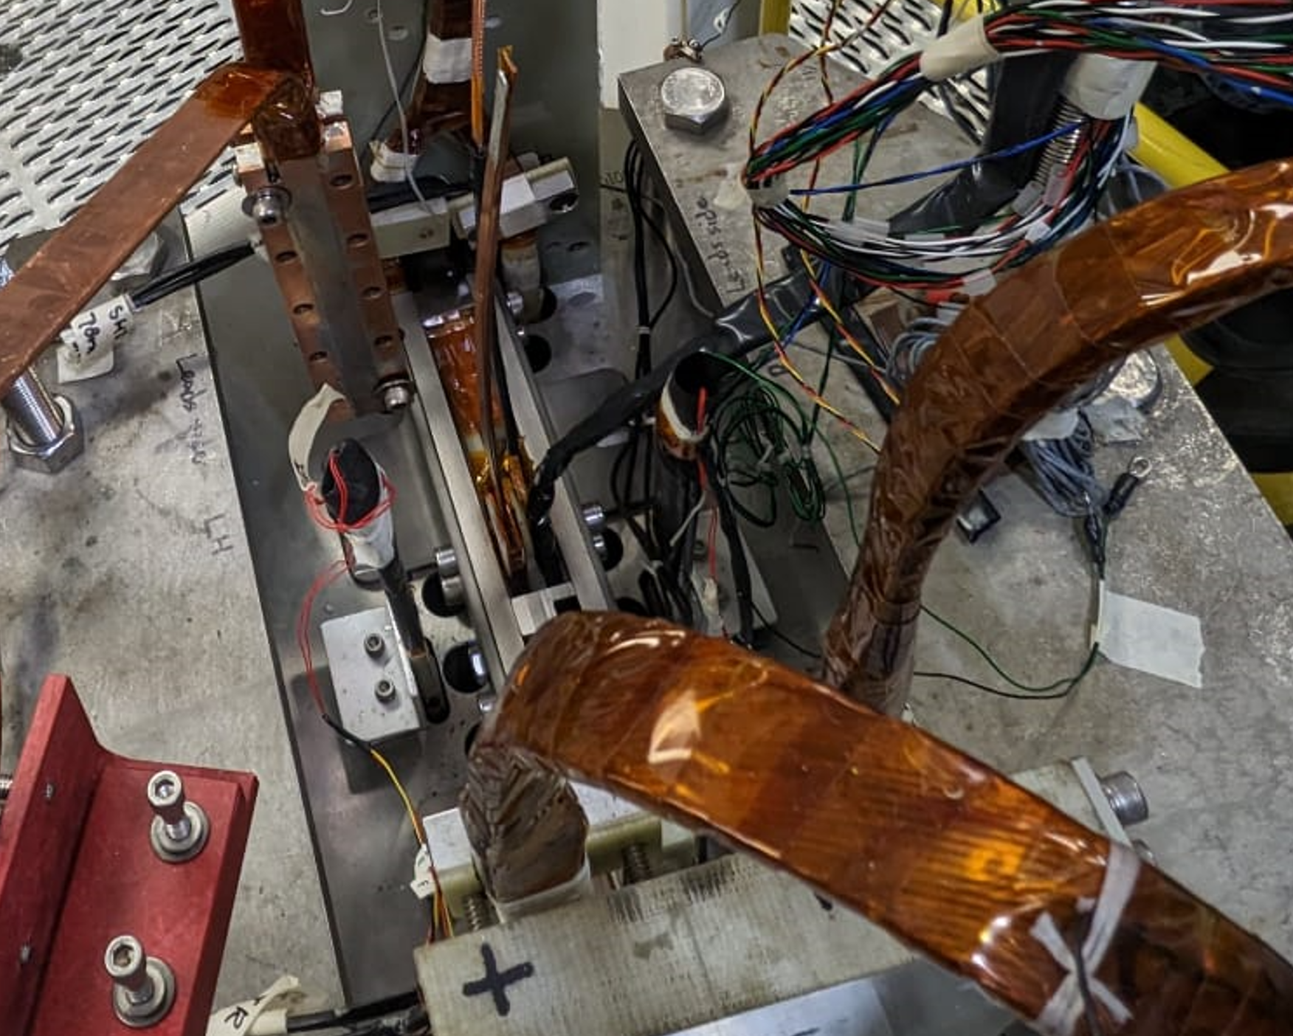
Set up (II)
Connected to superconducting leads
Test Coil
Connected to busbars
Inserted in rectangular space

Slide 10
Some Examples
Testing HTS + LTS hybrid: CORC+Nb3Sn
US-Japan KEK HTS Coils in filed parallel and perpendicular
independent powering circuit
Independent quench extraction

Slide 11
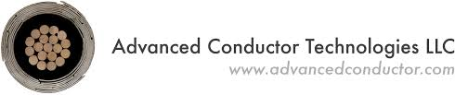
MDP Corc test
~20T class magnet requires HTS: 12-15 T LTS + 5-8 T HTS
Energize HTS+LTS in series, HTS must provide10-20 kA at 20 T⇒ Je of 400 to 600 A/mm² at 20 T ⇒ CORC cables.
2024 cold testing of STTR coil: High field Demo (12-13 T with 9 T from LTS).
    “Demonstration of a high field HTS/LTS hybrid dipole” with two sets of double pancake coils made with 6+8 turns (total 28 turns) of CORC cable.

Slide 12
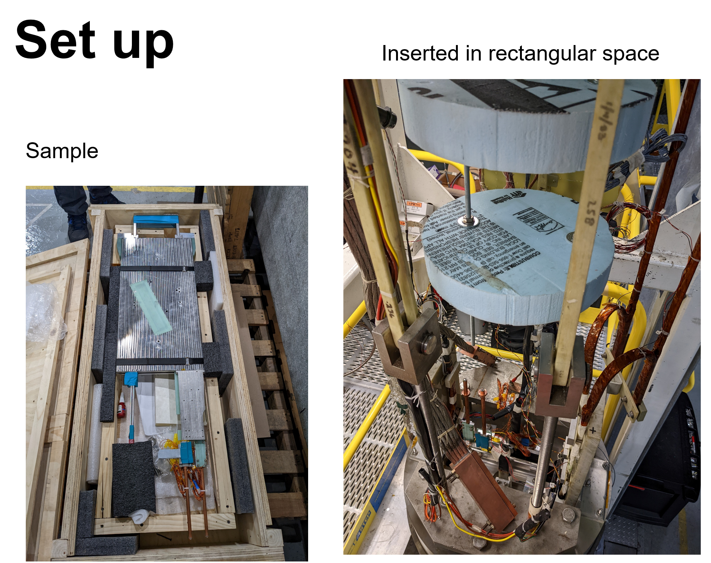
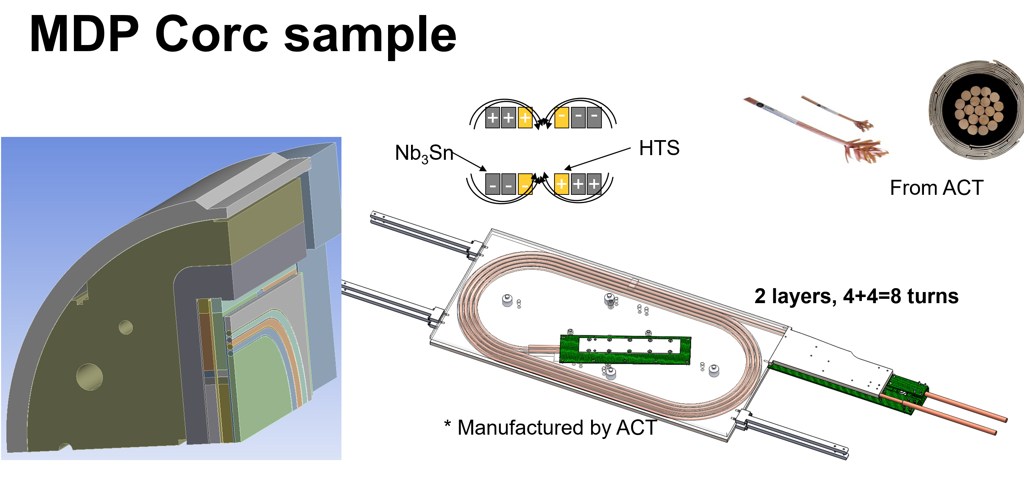
MDP CORC sample and set up

Slide 13
Test Summary and Perspectives
Validated independent powering and energy extraction circuitry of a HTS+LTS hybrid magnet.
Developed Quench detection and protection of a HTS+LTS hybrid magnet.
Corc based insert + Nb3Sn outsert was energized to combined peak field of 8.75 T.
Perspective
2025 cold testing of CORC coil: High field Demo (12-13 T with 9 T from LTS).
    “Demonstration of a high field HTS/LTS hybrid dipole” with two sets of double pancake coils made with 6+8 turns (total 28 turns) of CORC cable.

Slide 14
Some Examples
Testing LTS + LTS hybrid: BIGBOX
independent powering circuit
Independent quench extraction

Slide 15

Motivation
BOX= BOnding eXperiment: paraffin wax impregnated race track coil
Objectives: Design, manufacturing and testing of
  mechanically and magnetic coupled racetrack coil: CCTF+BIGBOX
  stress-managed demonstrator
  Minimize/eliminate training behavior
  Minimize/eliminate stress related degradation
  => European roadmap towards high field, stress-managed common coil.

Slide 16
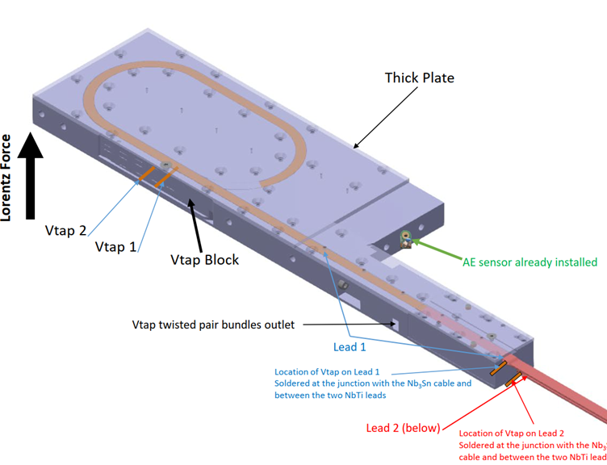
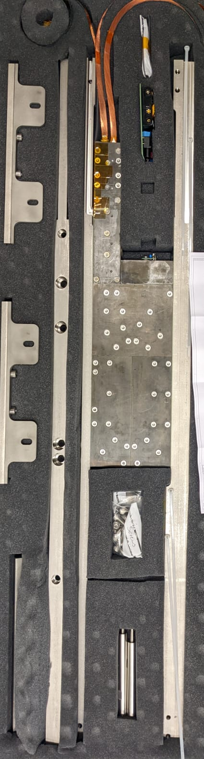
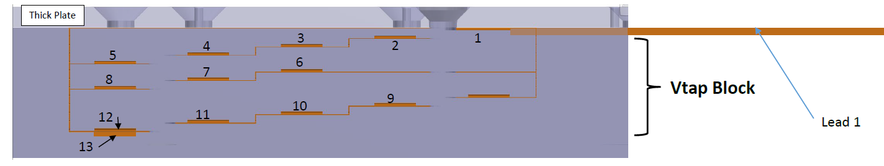
Set up (I)
Current leads
The coil is made of Nb₃Sn conductor but the leads coming out of the magnet are made of NbTi.
Voltage taps: There are 14 pairs (28 wires) of voltage taps coming out of the coil.
Bigbox coil

Slide 17
Main Results
Abbreviations
I_{CC}= current in common coil
B_{CC}= magnetic field in common coil
I_{BB}= Quench current in bigbox coil
B_{BB}= magnetic field in bigbox coil
B_{total}= combined field on superconductor
Experiment # | I_{CC} (kA) | I_{BB} (kA) | B_{CC} (T, estimated) | B_{BB}(T, estimated) | B_{total} (T, estimated) | Cycle #
1 | 7.195 | 12.979 | 6.79 | 3.89 | 10.69 | 1
2 | 8.04 | 12.118 | 7.59 | 3.64 | 11.23 | 2
3 | 9.124 | 10.845 | 8.62 | 3.25 | 11.87 | 3
4 | 8.0393 | 12.06 | 7.59 | 3.62 | 11.21 | 4
5 | 7.0398 | 13.359 | 6.65 | 4.01 | 10.66 | 5
4 EM cycles, ICC= 9 kA, IBB= 2kA to 10.3 kA to 2 kA and so on=> 11.59 T X 10.3 kA = 119.3 kN/m, three loading cycles |  |  |  |  |  | 5+4
6 | 9.0395 | 10.769 | 8.54 | 3.23 | 11.77 | 10
There was a trip during the fourth electromagnetic cycle

Slide 18
Test Summary and Perspectives
Reduced training = Yes
Degradation = within 3 %
Stress managed = Yes
Quench Protection = validated
Perspective
  Try wax with embedded alumina Nano-particles to improve degradation performance.
  => 2025 teating of BIGBOX2.

Slide 19
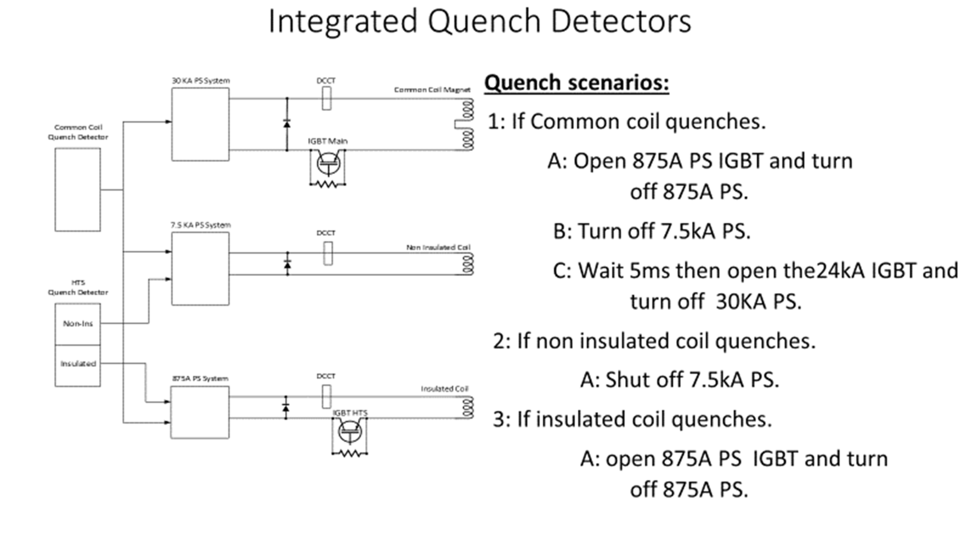
HTS Insulated and Non-Insulated coil test

Slide 20
Cryo Quench Detection and other upgrades
60kA Current Transformer
Cold quench detector for HTS coils and magmets

Slide 21
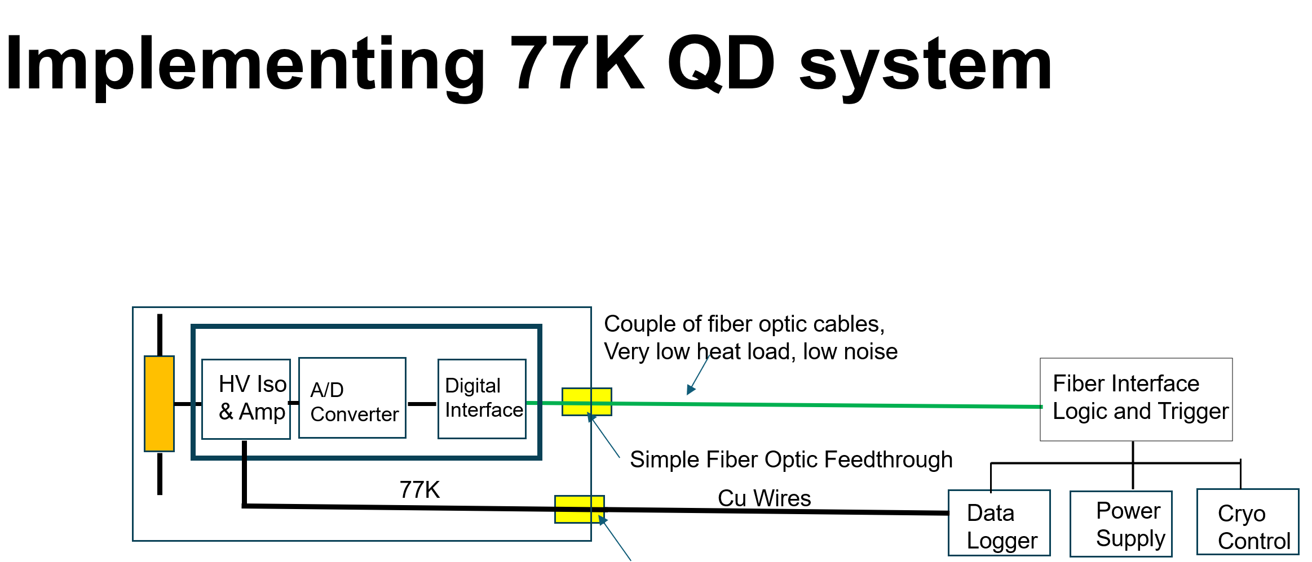
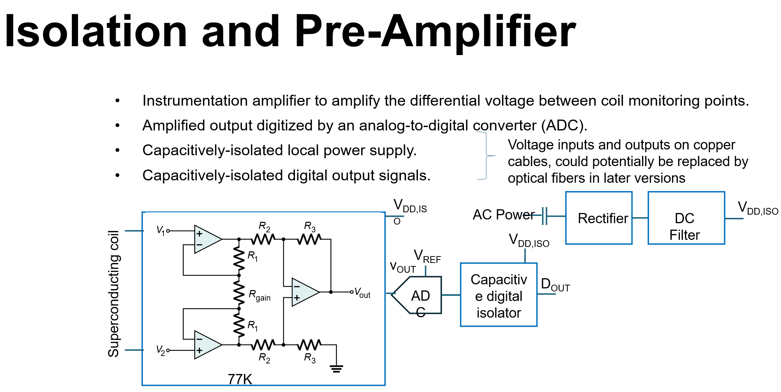

Slide 22
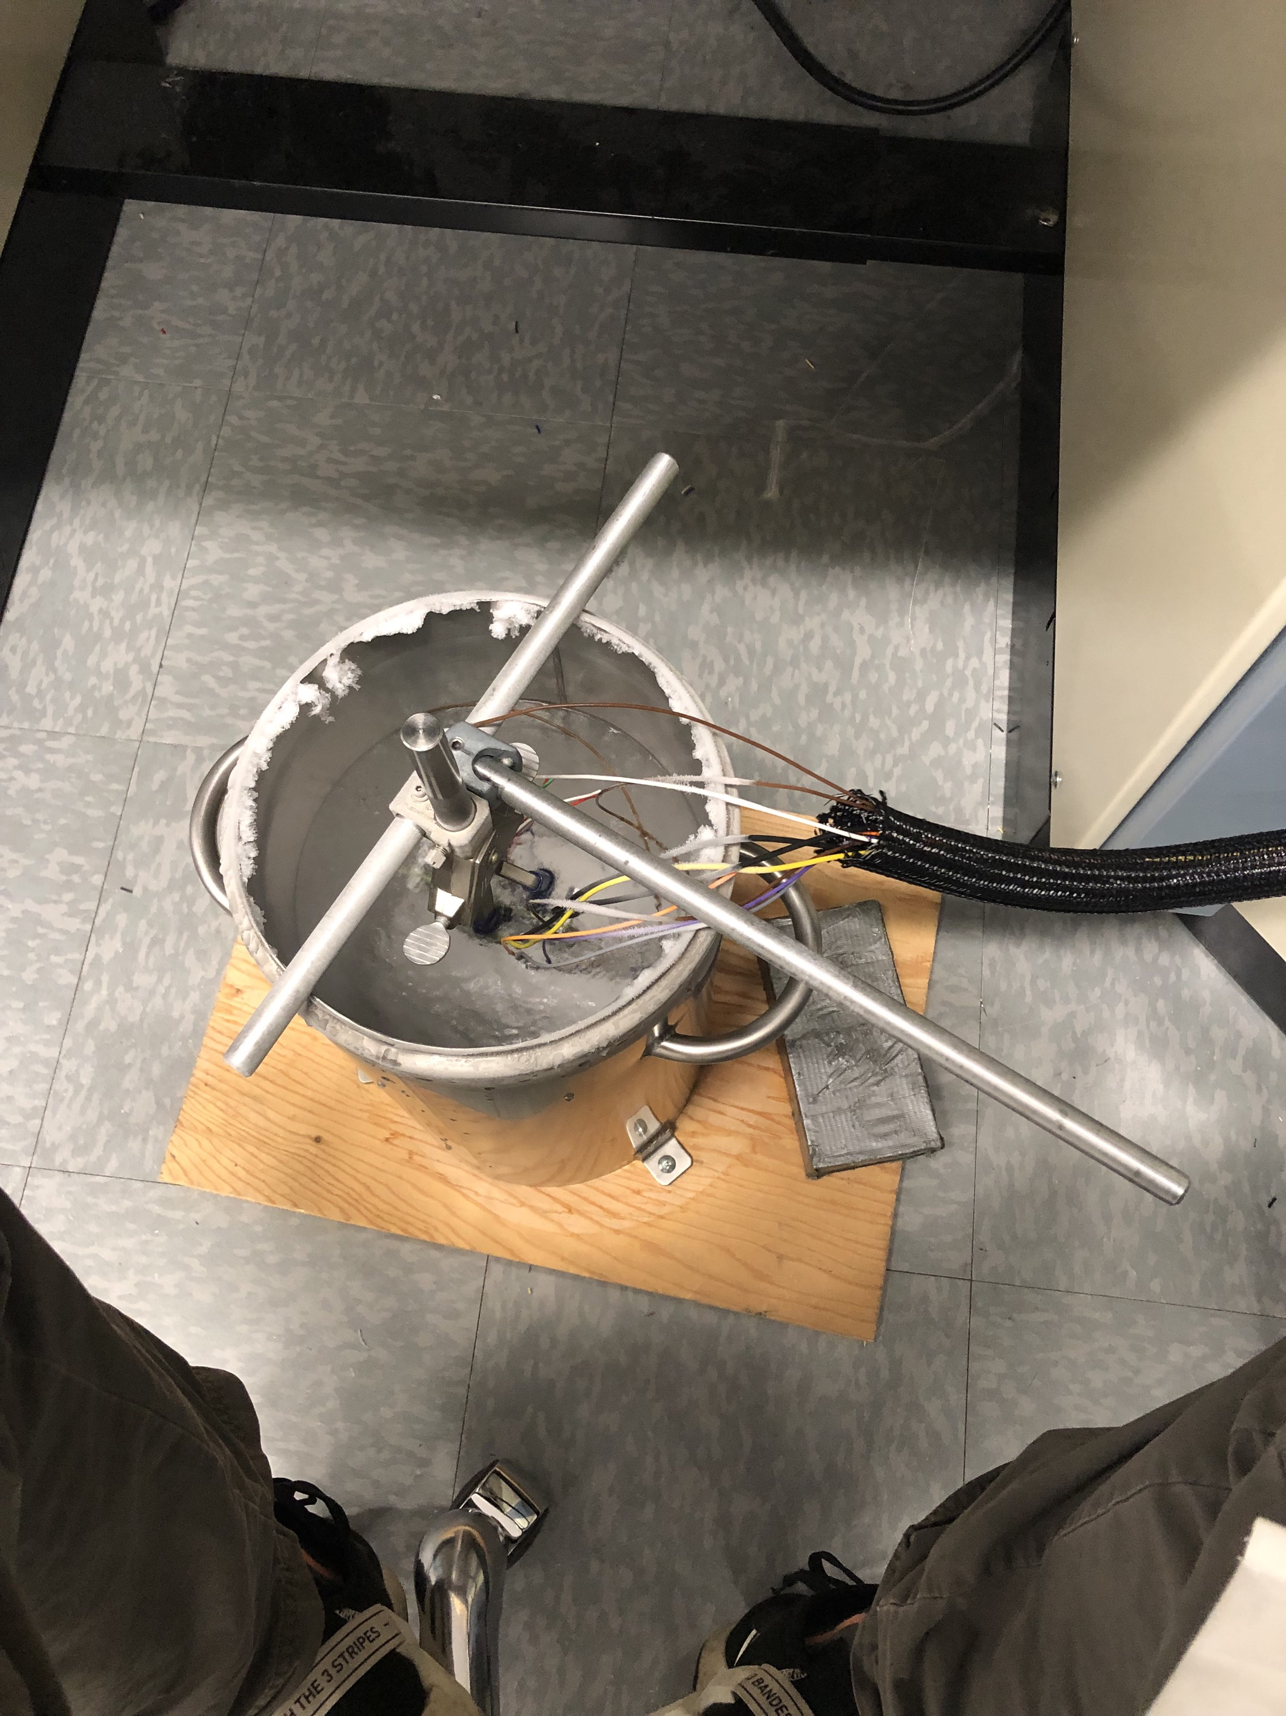
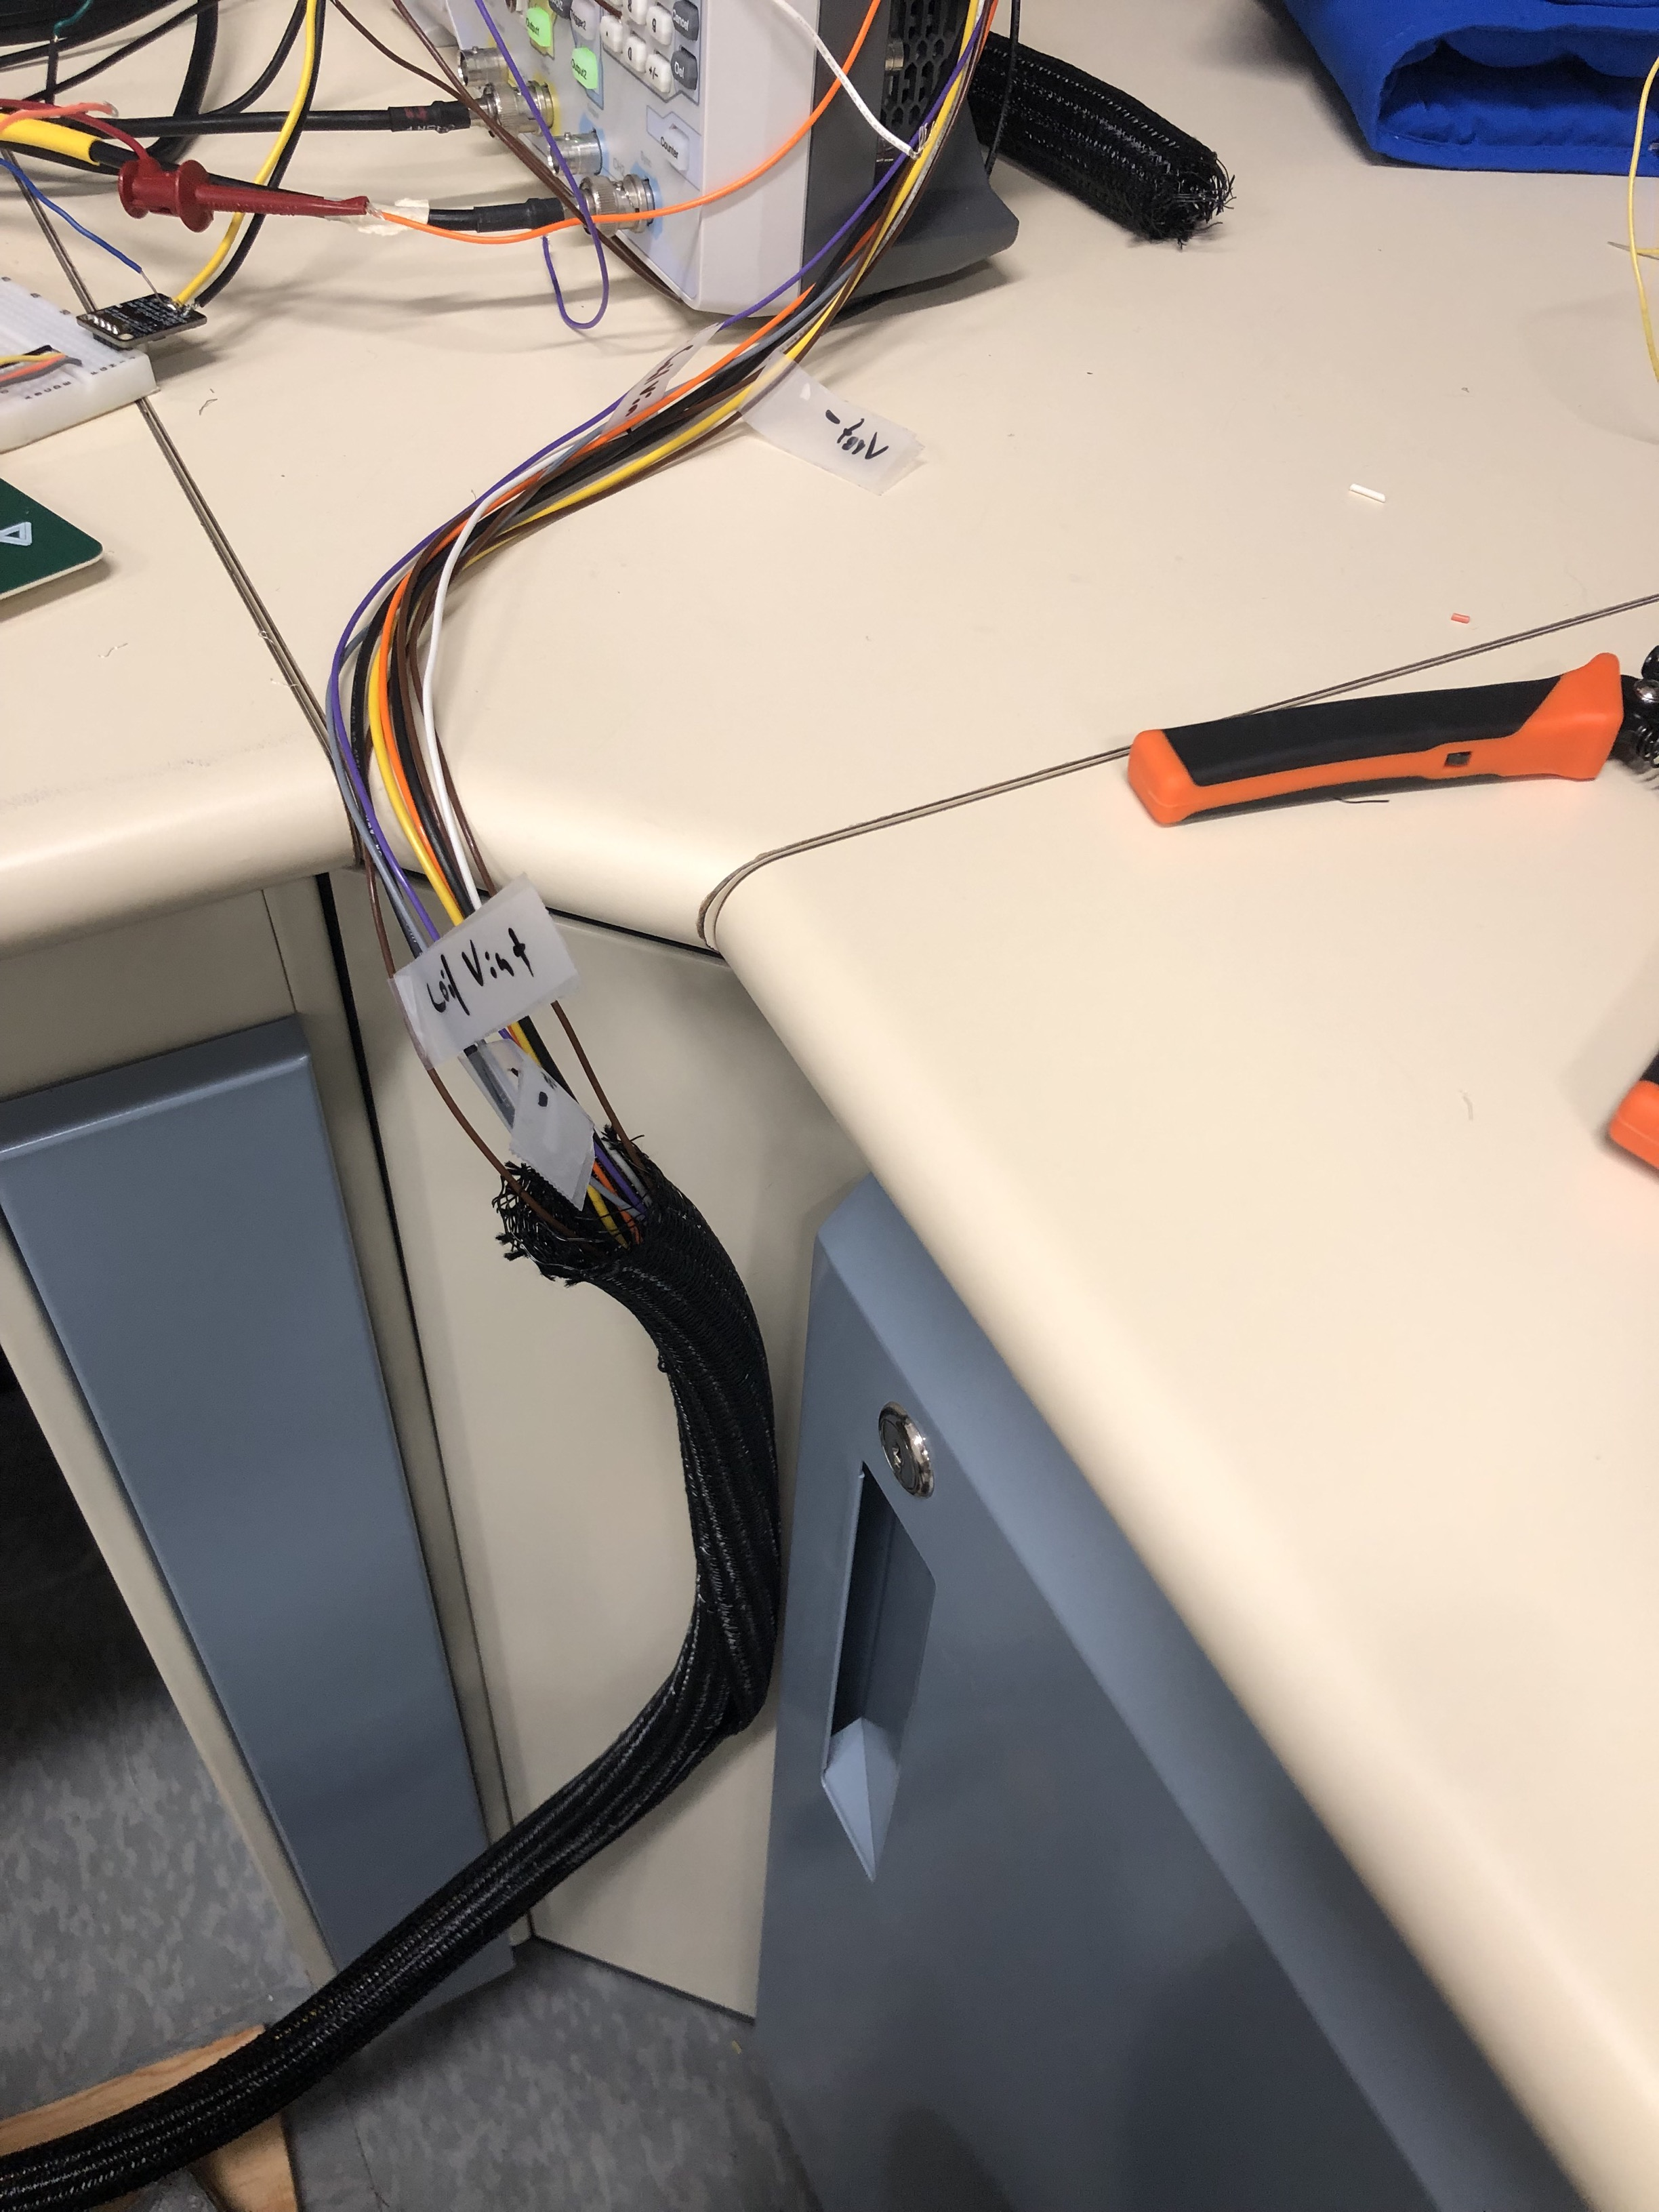
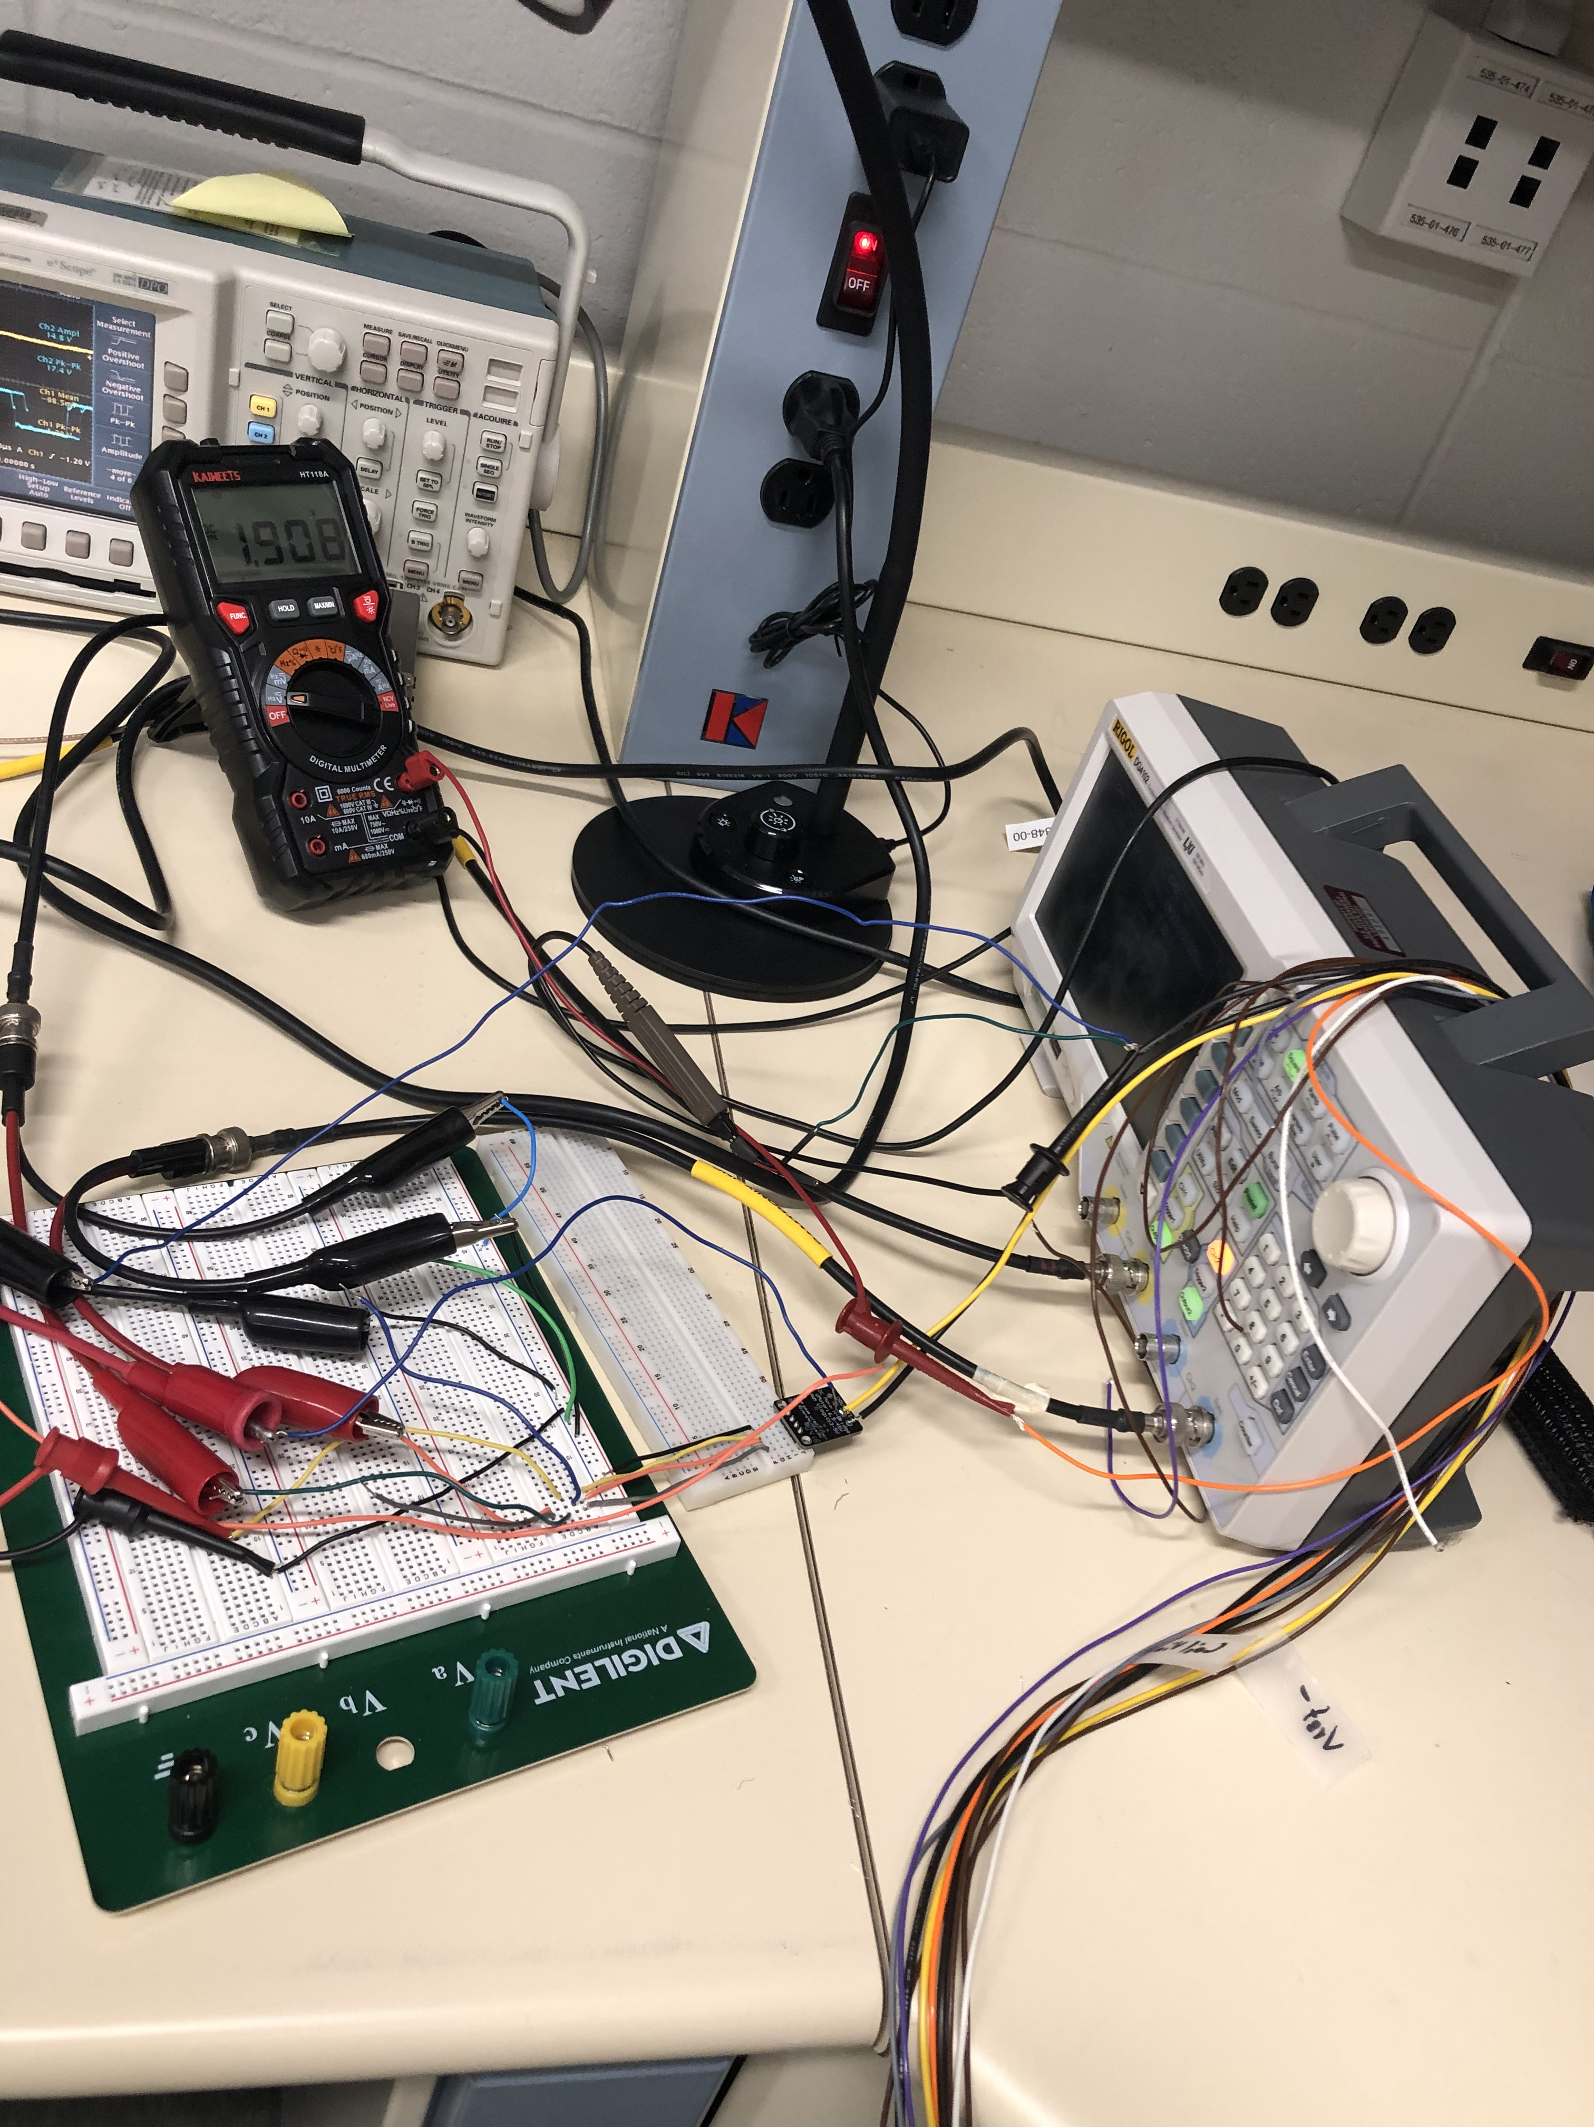
Cryogenic test setup
Power supply measurements were repeated with the board immersed in a liquid nitrogen tank (77K)

Slide 23
Case for prototype transformer
Objectives
  Develop technical knowledge for transformer manufacturing
  Validation of control loops and data acquisition system
  Validate the theoretical model with the experiments for final design of 60kA current transformer for fusion cable testing
Proposal
  1/5th of the actual transformer (w.r.t. number of turns)
  I_{S} max=15kA (flexible), I_{P} max=0-600A, N_{turns,S}=2, N_{turns,P}=580
  The cables and wires remain the same.
  Net outer radial dimension remains the same.

Slide 24
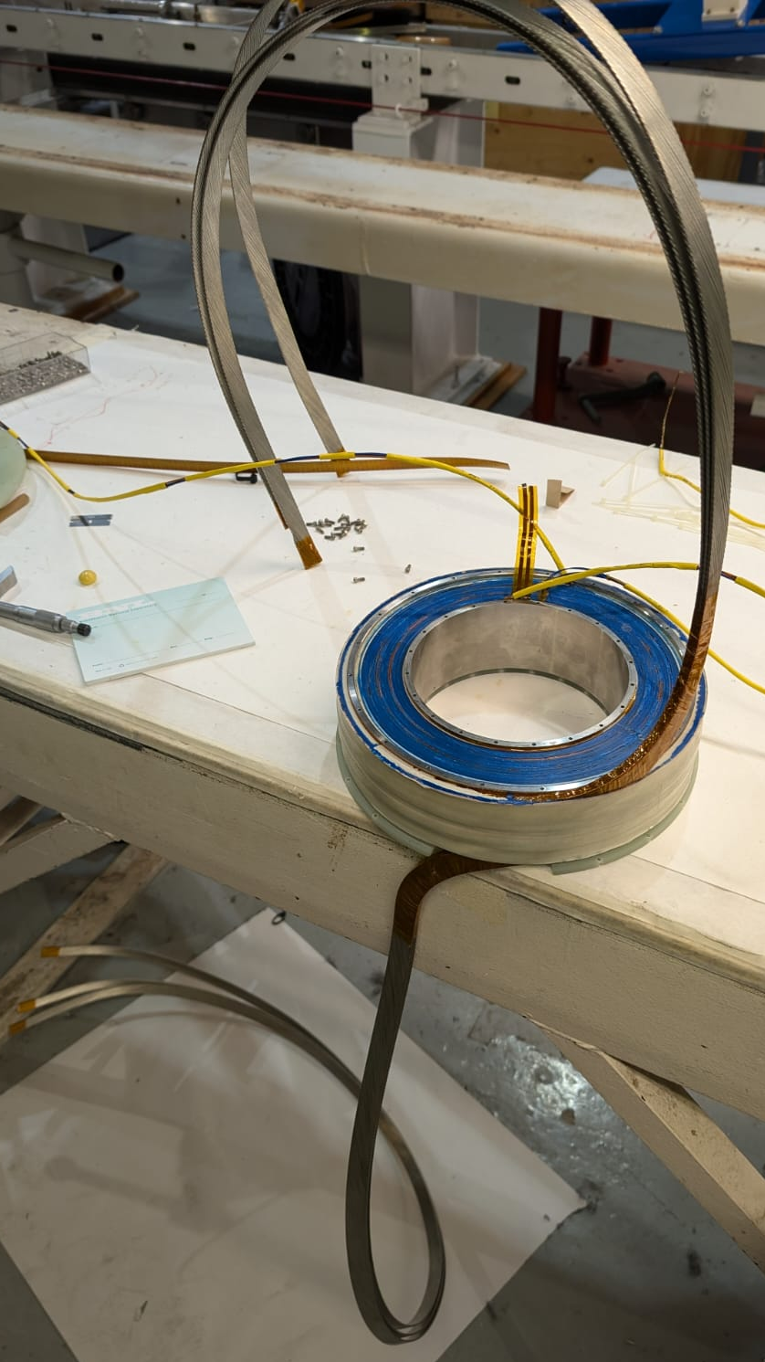
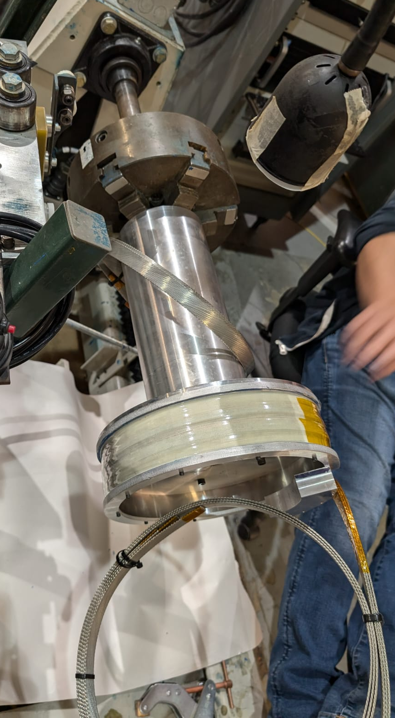
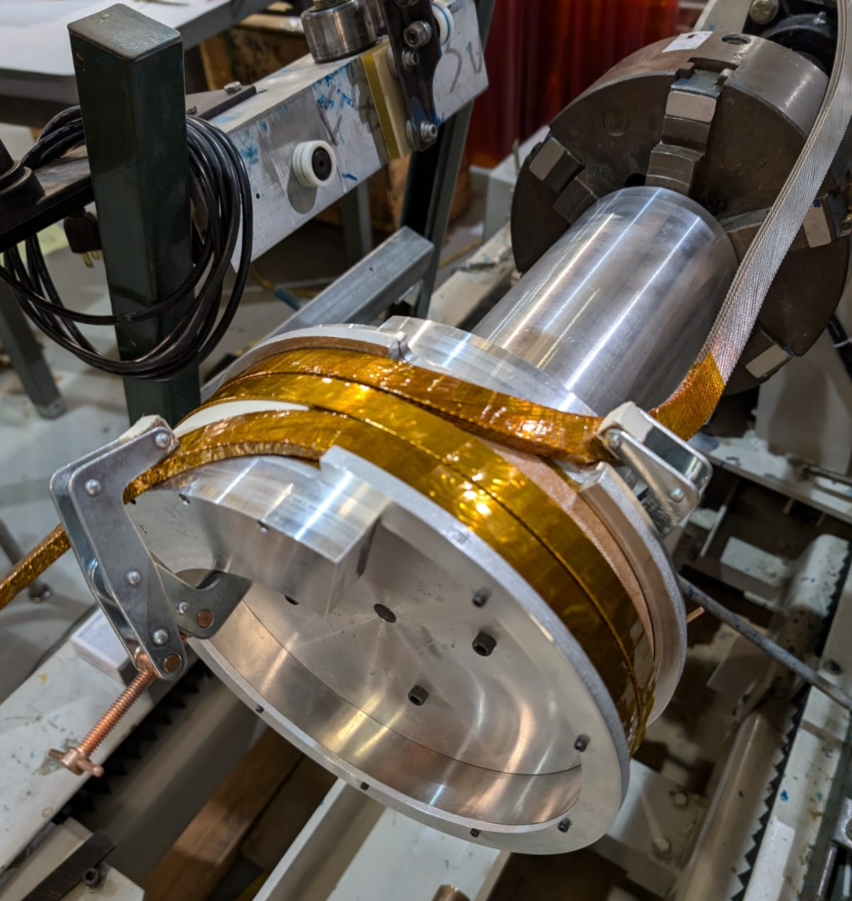
Winding

Slide 25
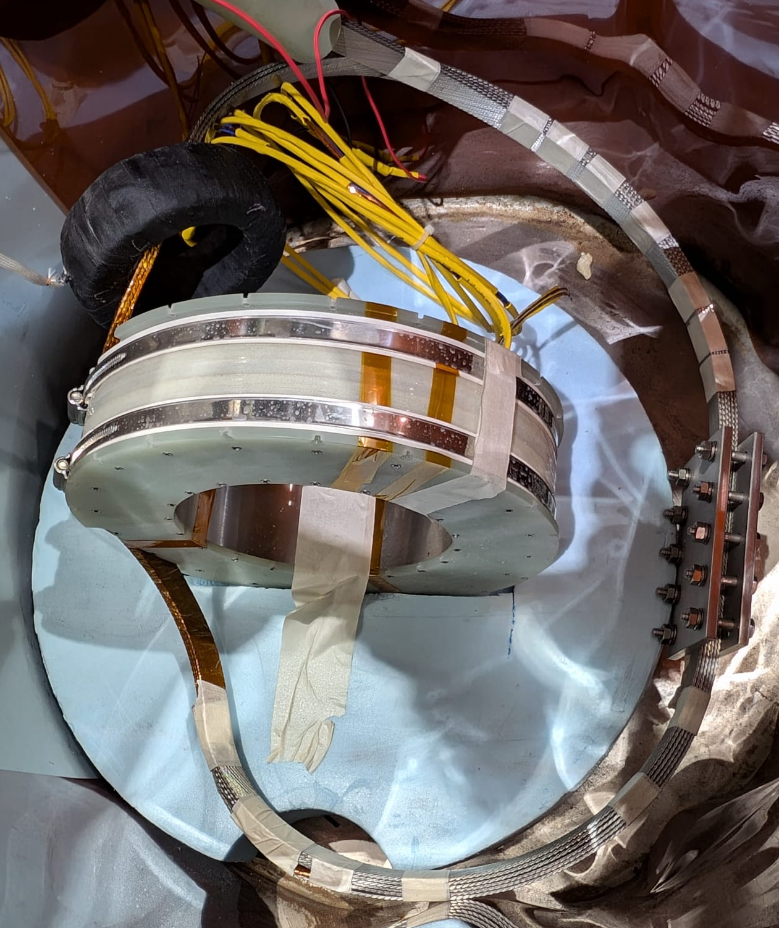
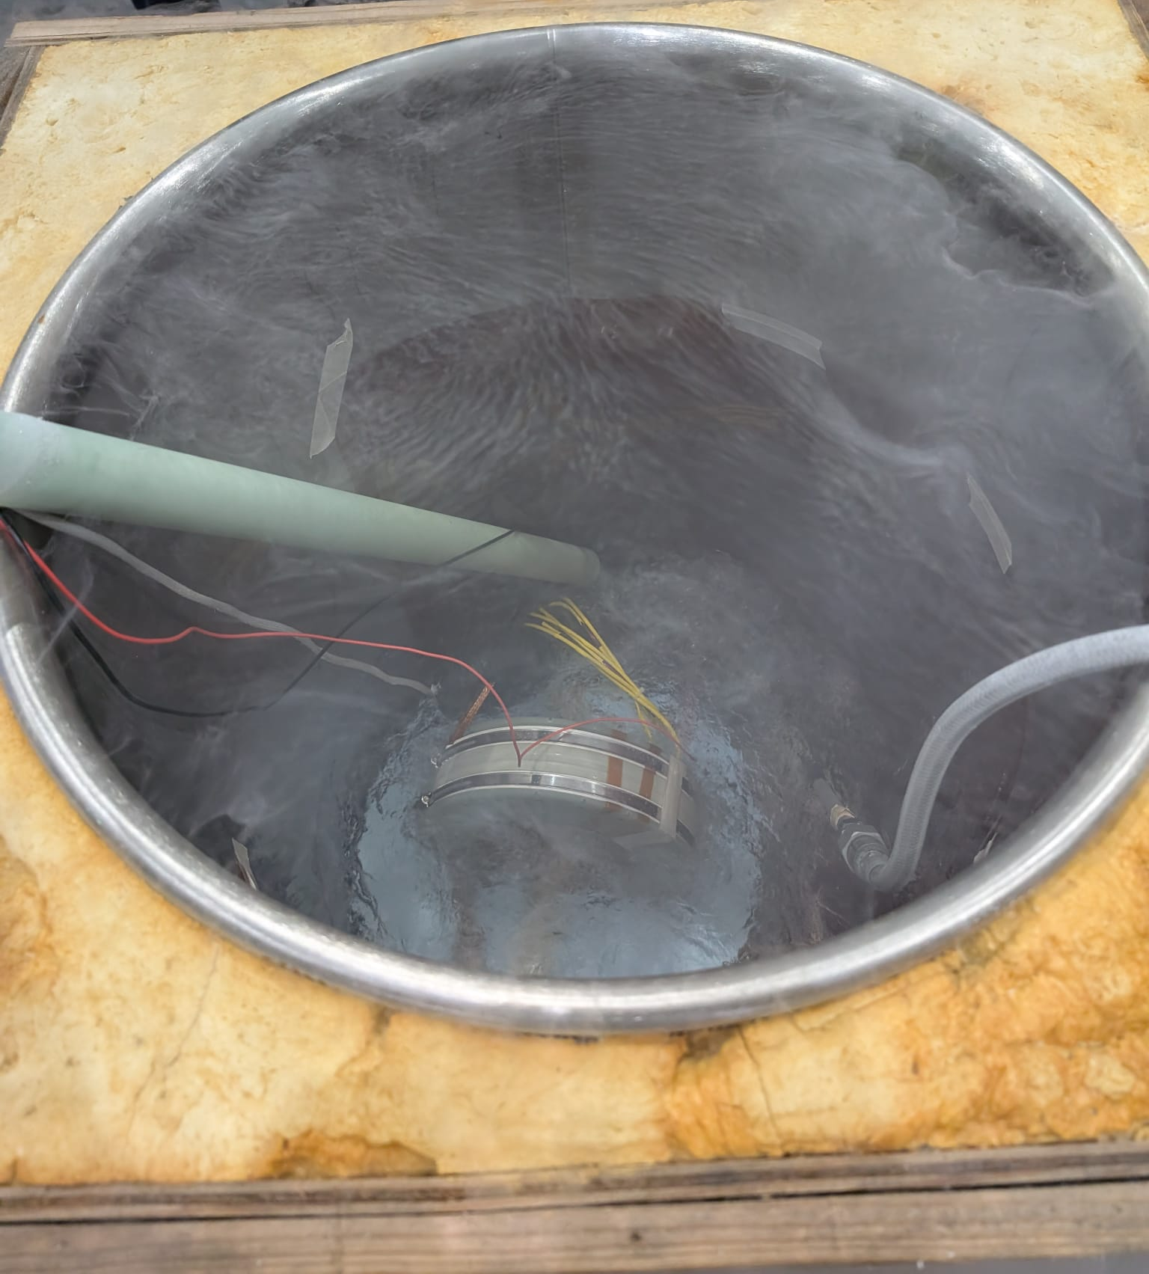
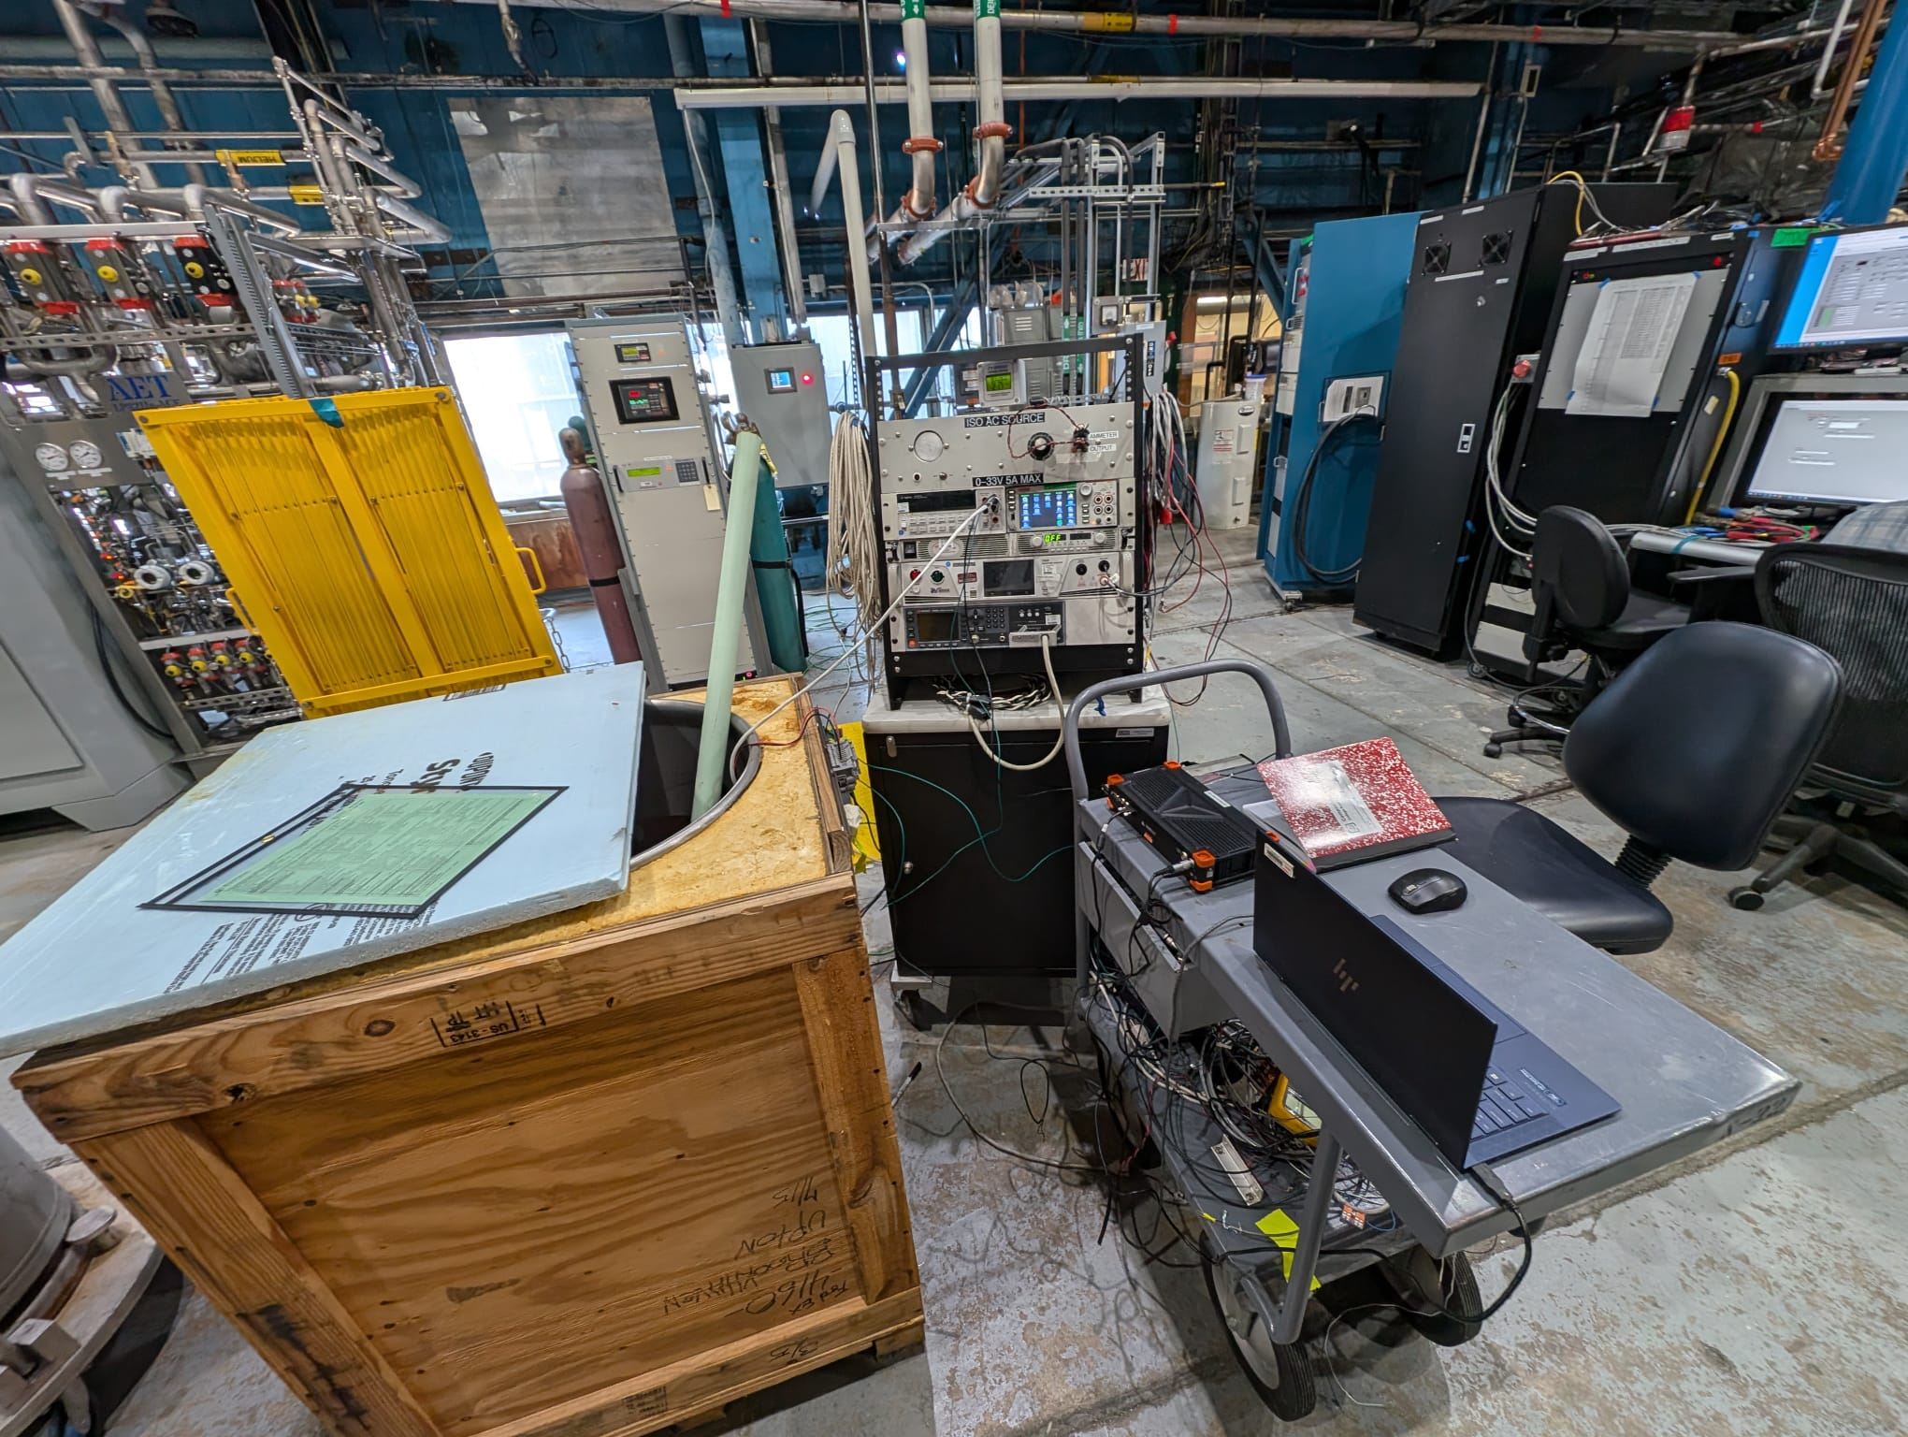
77 K test set up
Rogowski
+
-
Primary coil
Secondary
coil
15A/40V

Slide 26
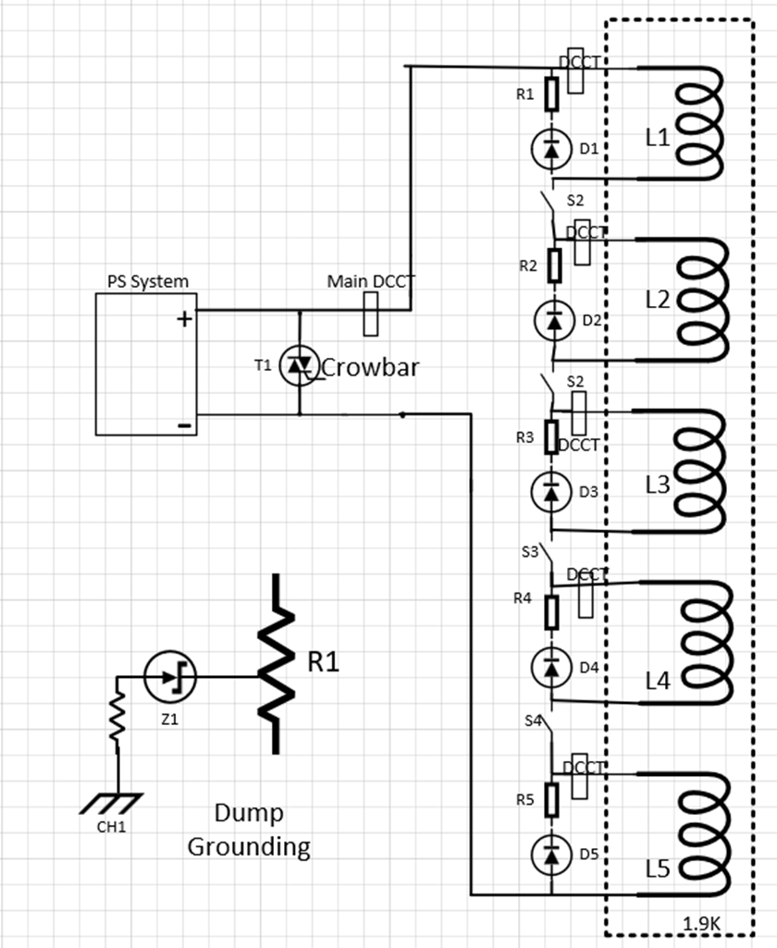
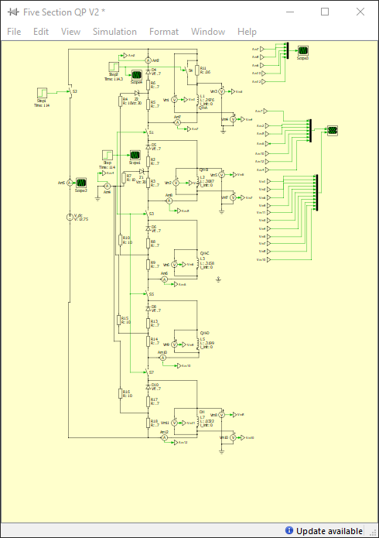
Quench protection of BOPF-5 sections DW magnet
1

Slide 27
Conclusions
Upgraded facility successfully tested Hybrid and HTS magnets
Upgrades for direct wind magnets in progress
Temp control on sample e.g. GA
AC loss calorinetery for Fusion Cable e.g. CFS
Multiple section discharge.
Upgrades to cryo facility Tot capacity up to 420l/hr.
.

