Slide 1
SM18 magnet test infrastructure upgrades
F. Mangiarotti, G. Willering, J. Feuvrier and the TE-MSC-MQA team
2025.03.31

Slide 2
Acknowledgements
The vertical bench upgrades I will discuss are underway thanks to these people:
TE-CRG: O. Pirotte, N. Guillotin, R. Mauny, P. Borges de Sousa, T. Koettig
TE-MSC: C. Petrone, L. Fiscarelli, L. Boudin, N. Bourcey, K. Geiger, P. Schwarz, and the MQA section
SY-EPC: F. Daligault, H. Thiessen
EN-MME: L. Gentini, M. Timmins & design office, J.-M. Malzacker & main workshop
EN-EL: M. Marreiros, A. Jacob
EN-ACE: A. Kosmicki, A. Tursun
SCE-SAM: F. Cesca, M. Lamrani, R. Fernandez
And partially supported by the HFM program

Slide 3
SM18 building layout
IT String test bench
Horizontal magnet test benches
Vertical test benches
Cryogenics
Superconducting RF cavities test benches

Slide 4
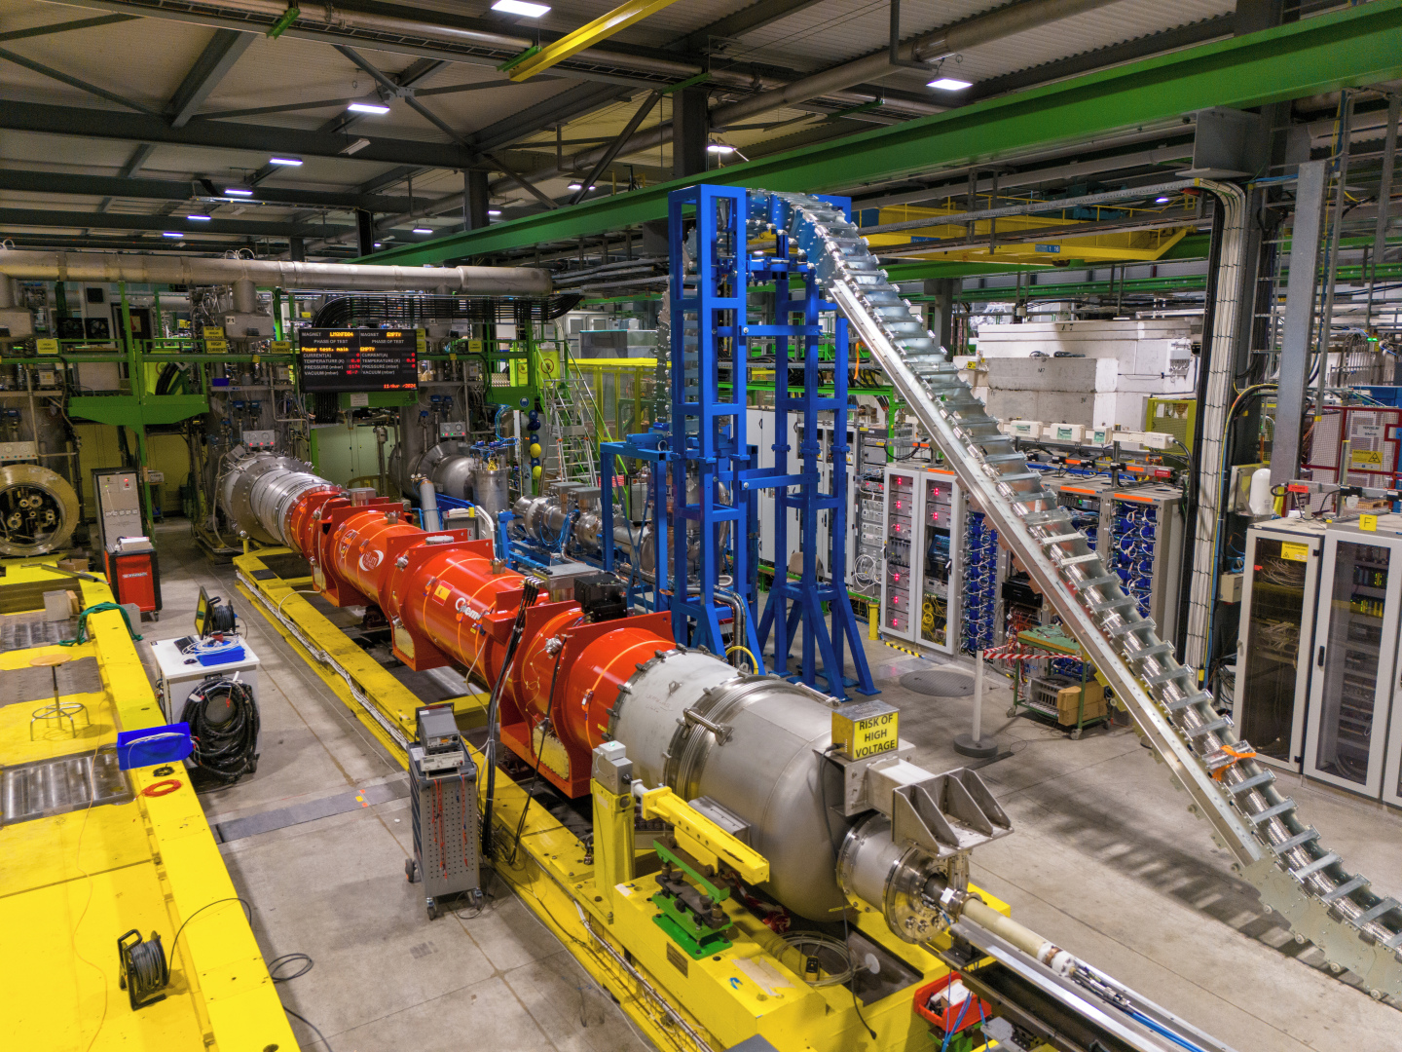
Horizontal test benches: fully upgraded for HL-LHC
Status of the test benches:
5 benches commissioned
3 benches already tested HL-LHC objects
Magnetic measurements shaft garage finalized
Expected workload in the next 3 years:
29 HL-LHC cryomagnets
9 SC link systems
7 LHC dipole cryomagnets

Slide 5
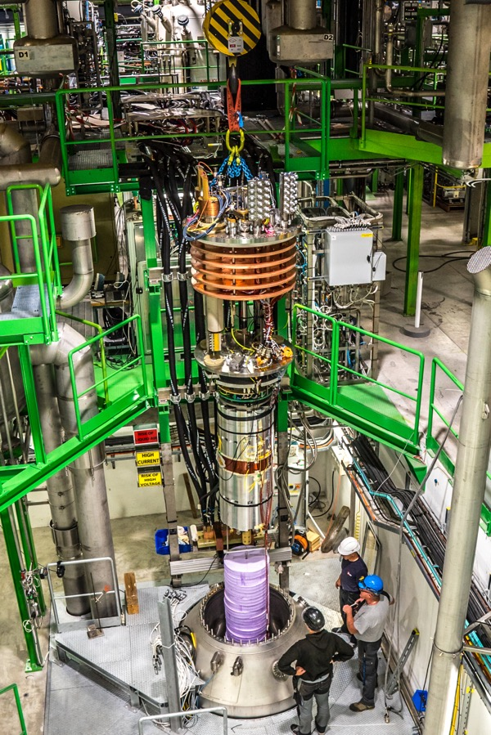
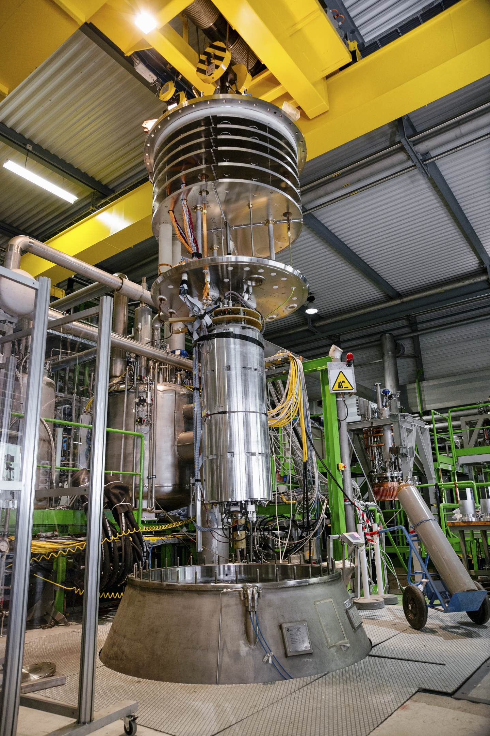
Vertical test benches: testing for HL-LHC and HFM (and others)
Five vertical cryostats:
Cluster D (left picture), mostly used for HL-LHC correctors, expected to be used for HFM “long” magnets
HFM (right picture), mostly used for large demonstrators for HFM and other projects
CTV (variable temperature cryostat): used mainly for HTS magnets and (HL-)LHC diodes
Siegtal: mainly used for small HFM Nb3Sn magnets and LHC correctors
Long: mainly for LHC quadrupoles

Slide 6
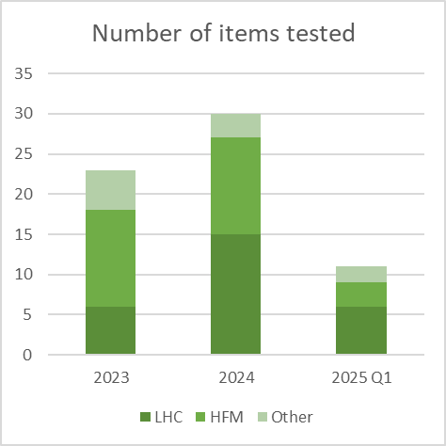
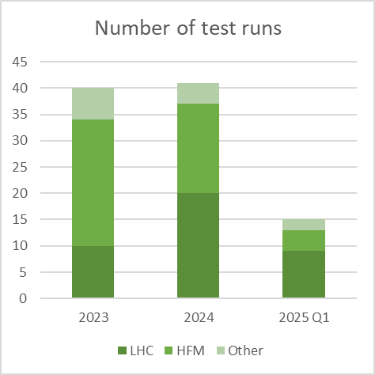
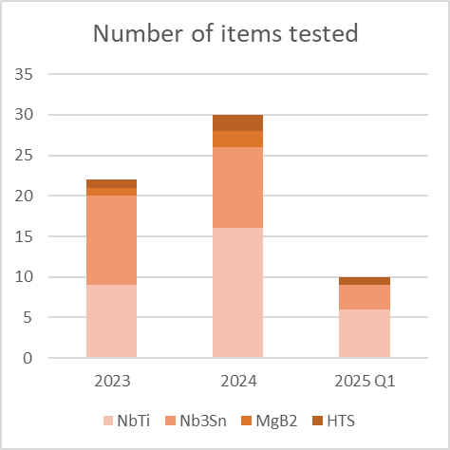
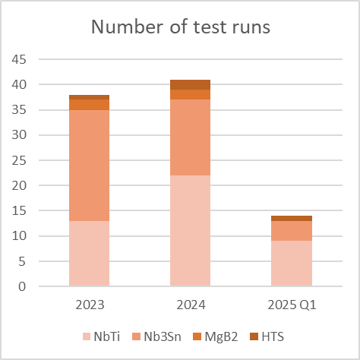
Vertical bench statistics
(HL-)LHC and HFM account for ~85 % of the test station occupancy
We can do ~40 test runs per year, which translates to 20-30 item tests per year
Not specifically accounted for: tests done as part or in parallel of a magnet test
New magnet protection methods: FQPC, ESC, eCLIQ
Technology tests: small splice samples
(see also SMTF4 presentation)

Slide 7
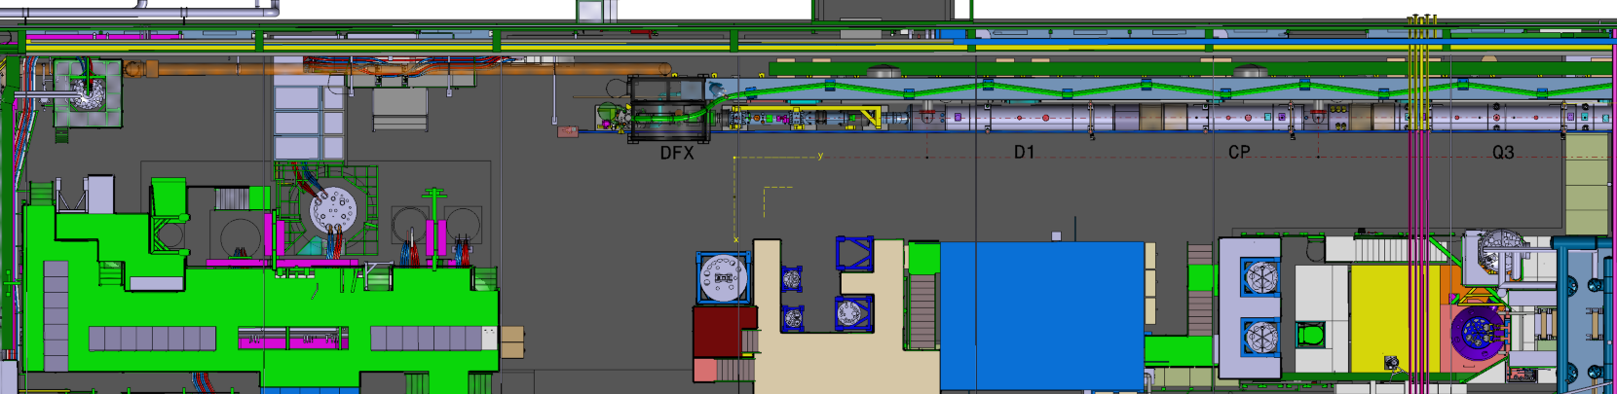
Vertical test benches capabilities and upgrades
 | G-Feedbox | Long | HFM | CTV | Siegtal | Cluster D
Depth [m] | N/A | 0.55 | 2.25 | 1.30 | 1.25 | 0.85
Diameter [m] | N/A | 3.35 | 1.45 | 0.45 | 0.75 | 5.35
Power circuits | 20 kA | 20 kA, 600 A | 20+10 kA, 600 A | 20 kA, 600 A | 20 kA, 600 A | 30 kA, 2+2 kA
Cryogenic conditions | 4.5 K or GHe ~1.5 bar flow | 1.9 or 4.5 K LHe bath | 1.9 or 4.5 K LHe bath | 4.5 K LHe or GHe bath | 1.9 or 4.5 K LHe bath | 1.9 or 4.5 K LHe bath
Upgrades | Reconnection |  | GHe bath, SHe flow | 10 kA connection | 10 kA connection | Anticryostats
SHe: supercritical helium
Flow: these stations have vacuum outside the helium piping

Slide 8

Overnight testing
Already implemented

Slide 9
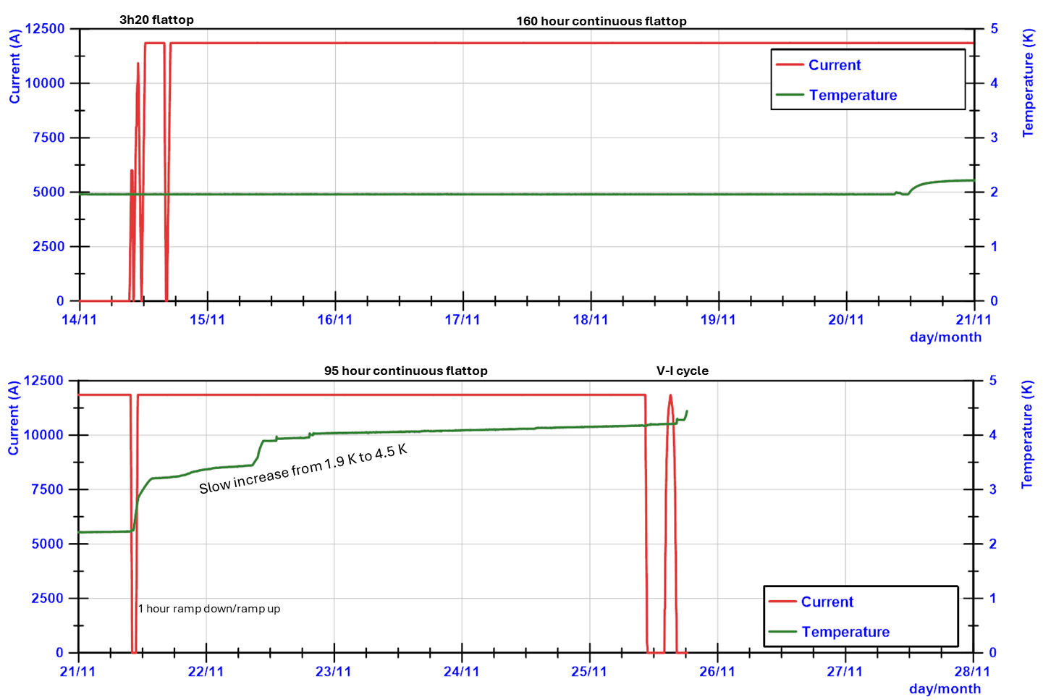
Overnight testing
Procedural update to allow overnight testing:
After magnet is trained
Trying to avoid quenches
Barriers and flashing lights installed locally
Outcome: greatly increased test possibilities
11 days continuous testing a 11 T in vertical benches
Routinely powering 3x20h in horizontal benches

Slide 10
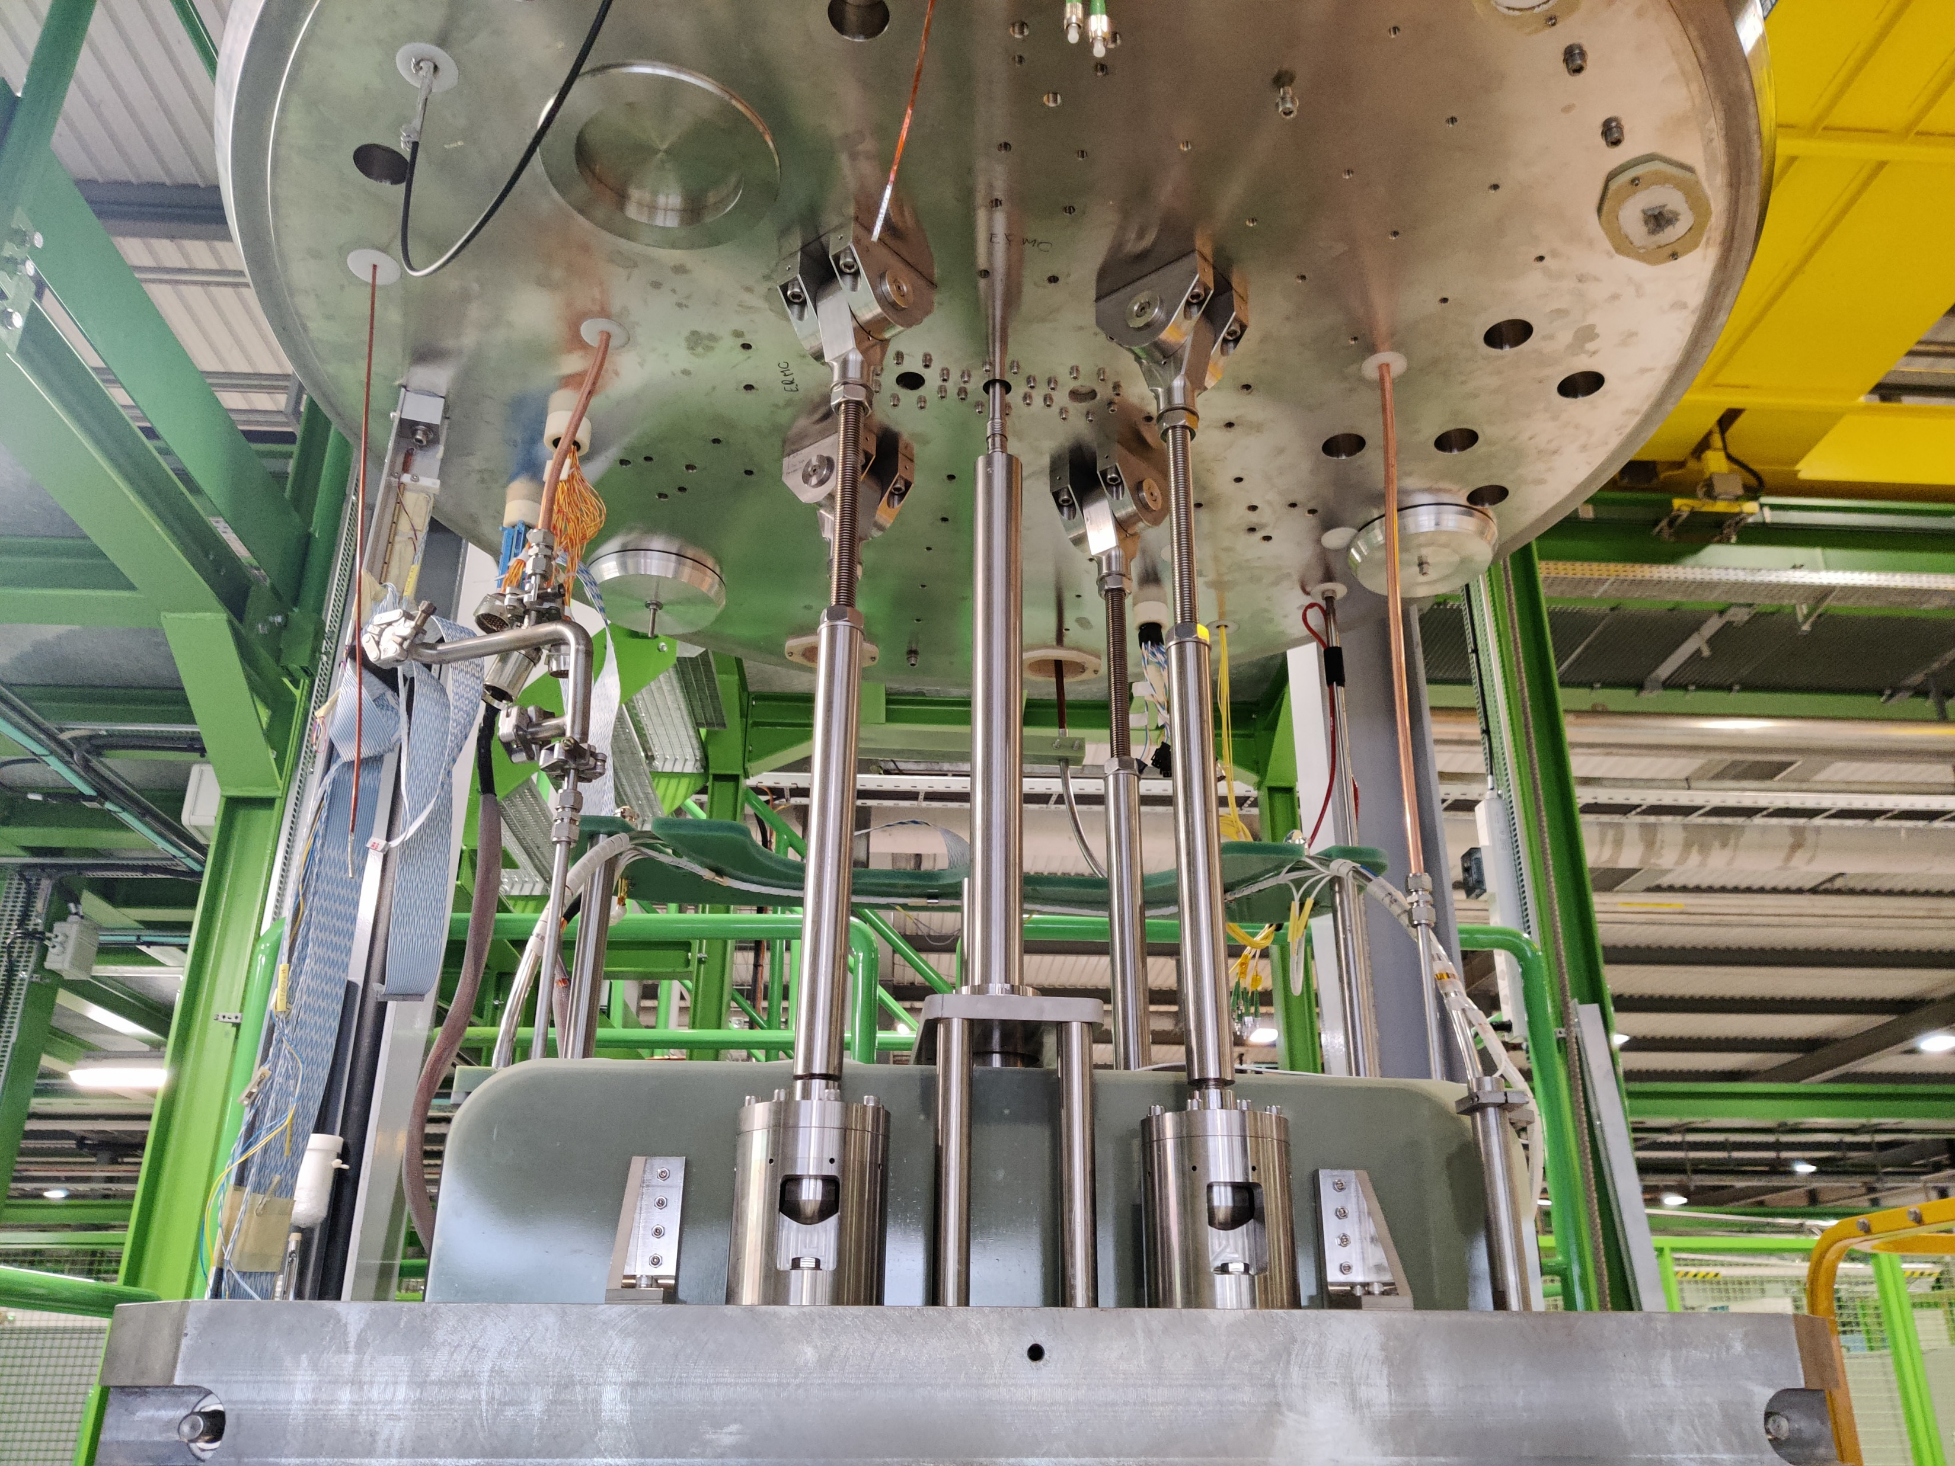
Helium gas bath in HFM cryostat
Already operational

Slide 11
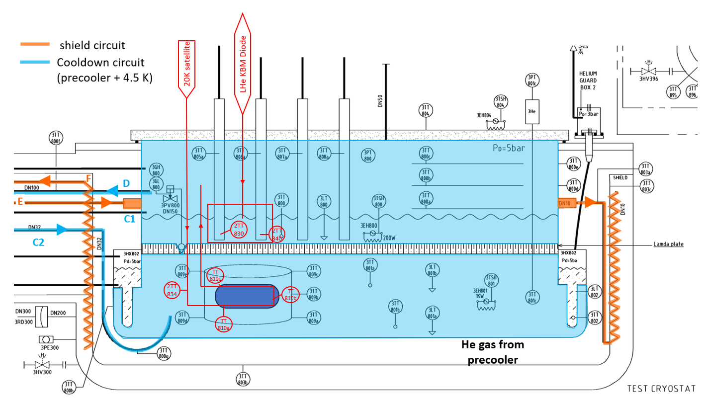
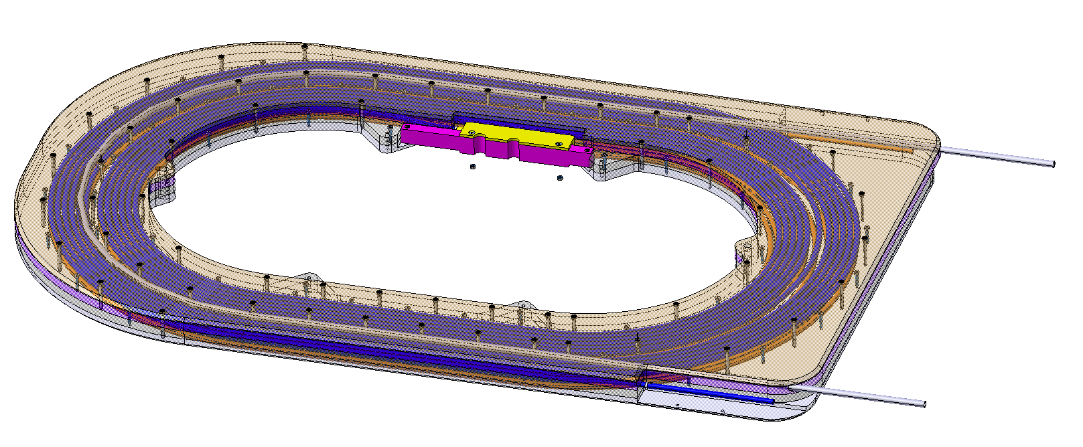
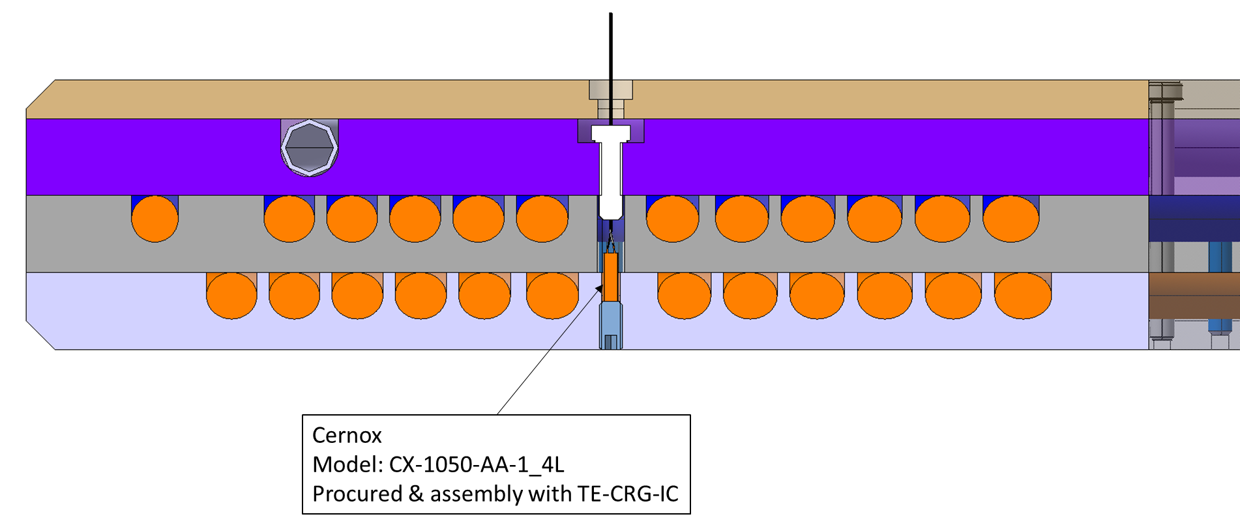
Helium gas bath in HFM
Cool down, warm up: standard process
Operation: empty cryostat and warm up with 20-30 K helium gas flow through the magnet
Cooling pipe
Aluminum cooling layer
MgB2 conductors

Slide 12
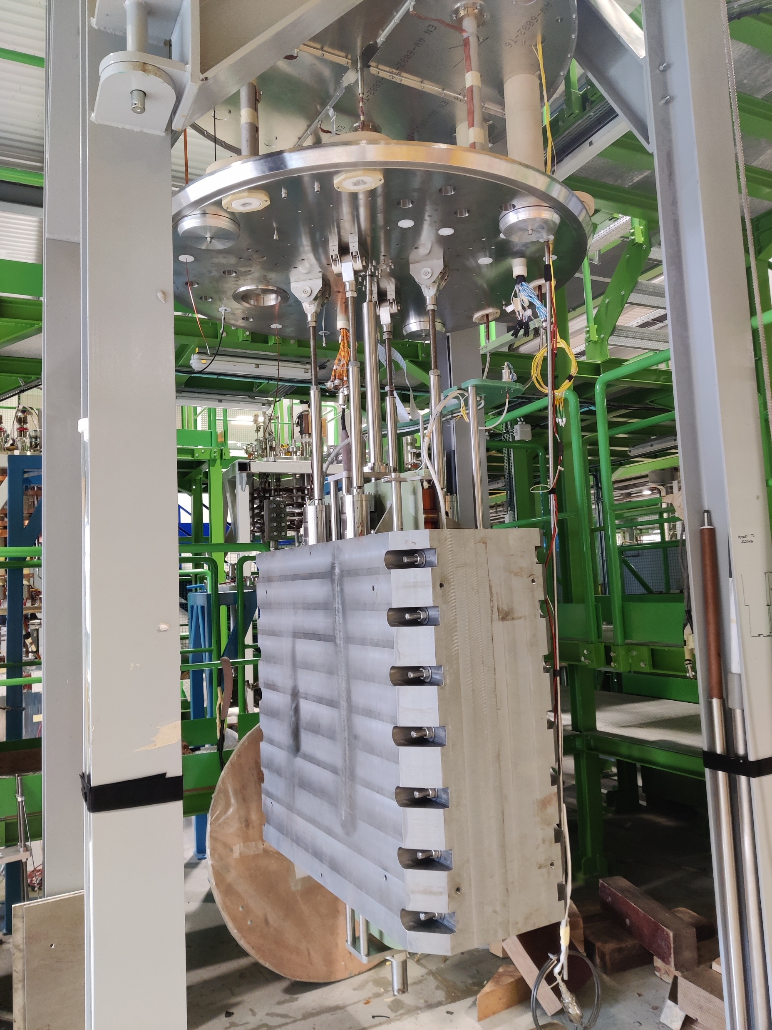
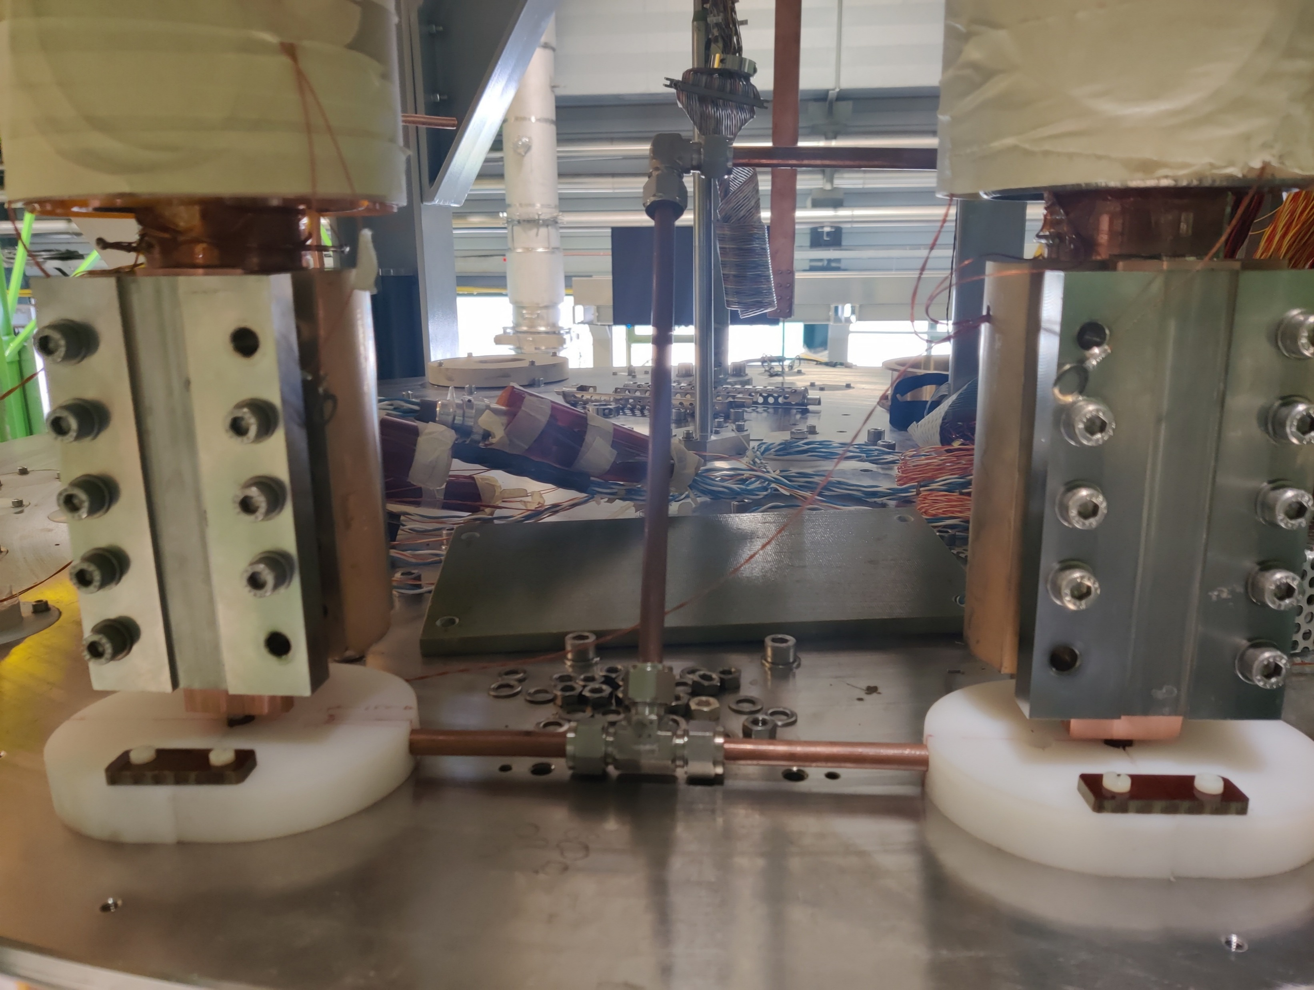
Helium gas bath in HFM
Magnet on insert
Current leads sub-cooled with additional Liquid helium

Slide 13
Helium gas bath in HFM
Gaseous helium circuit highlighted.
Inlet (left) with a T for a temperature sensor for control.
Outlet (right) above the lambda plate.
The “empty” volume below the lambda plate is filled with helium gas, and at the bottom of the cryostat a little bit of liquid helium
→ the gas flow is used to warm up the magnet to 20-30 K

Slide 14
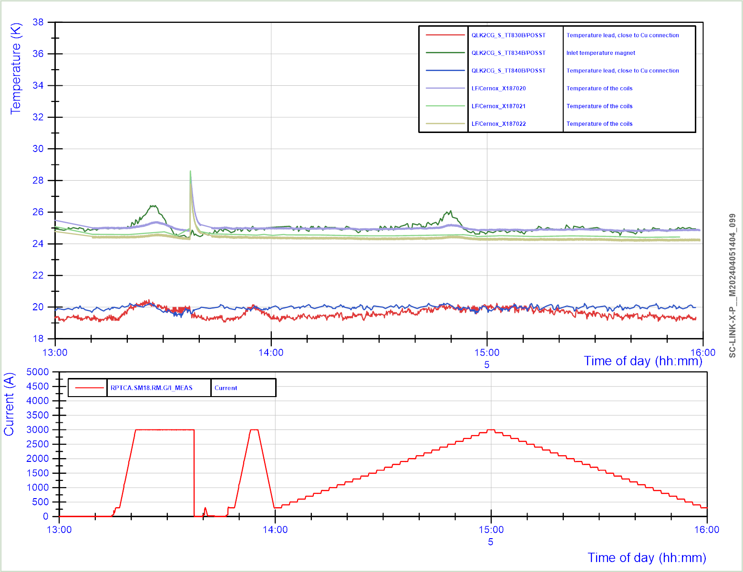
Example
test results
Temperature rise after fast current decay
Powering at ~25 K
5 april 2024
Good efforts by cryo operation for stable 25 K in the coil and control of leads temperature at ~20 K.
Temperature measurement in coil also improved.

Slide 15
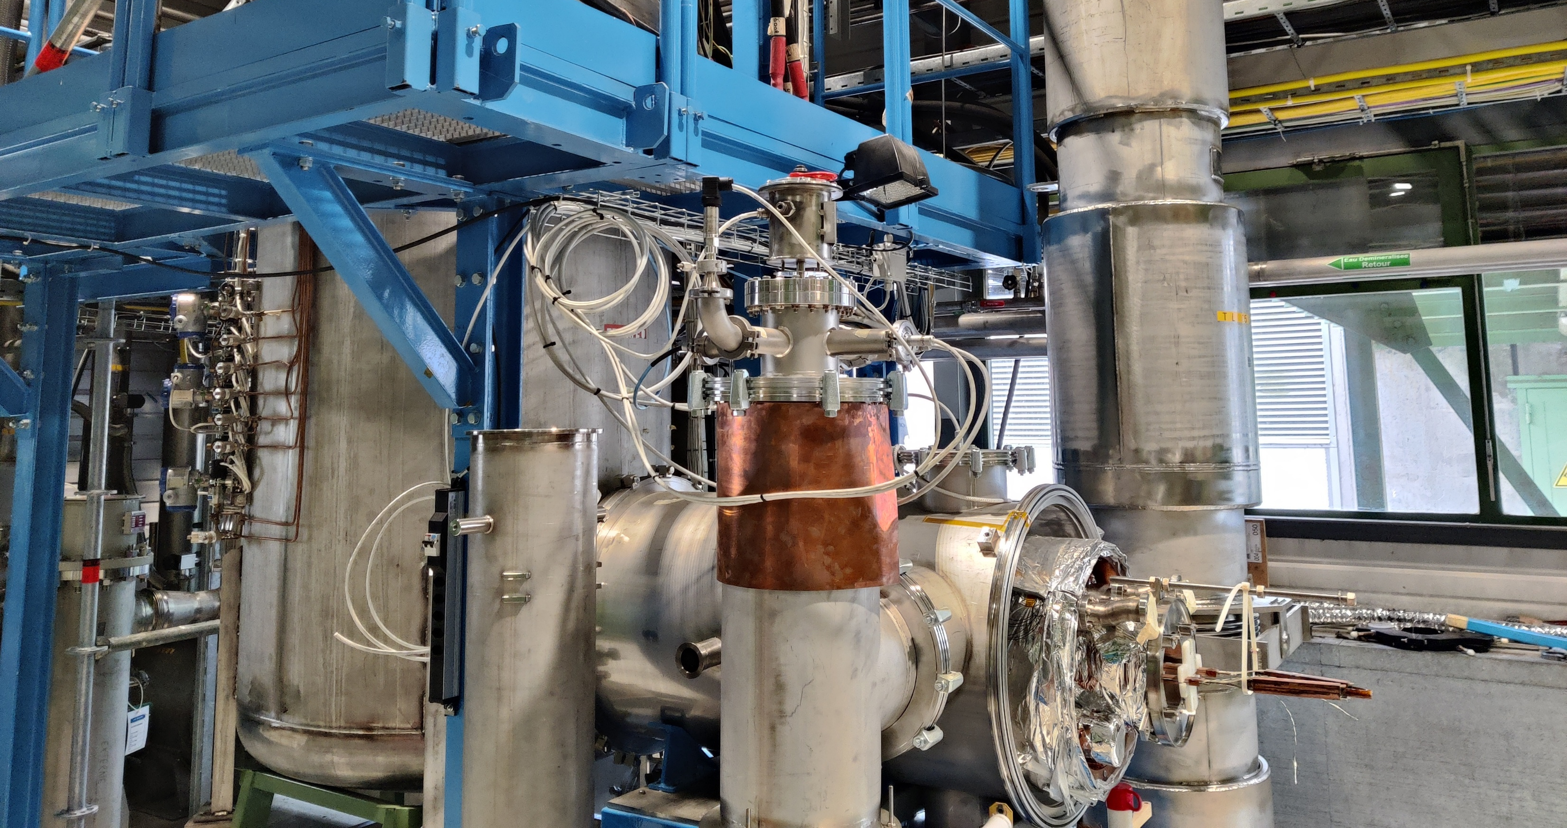
Feedbox for cryostated magnets
Expected for Q3 2025

Slide 16
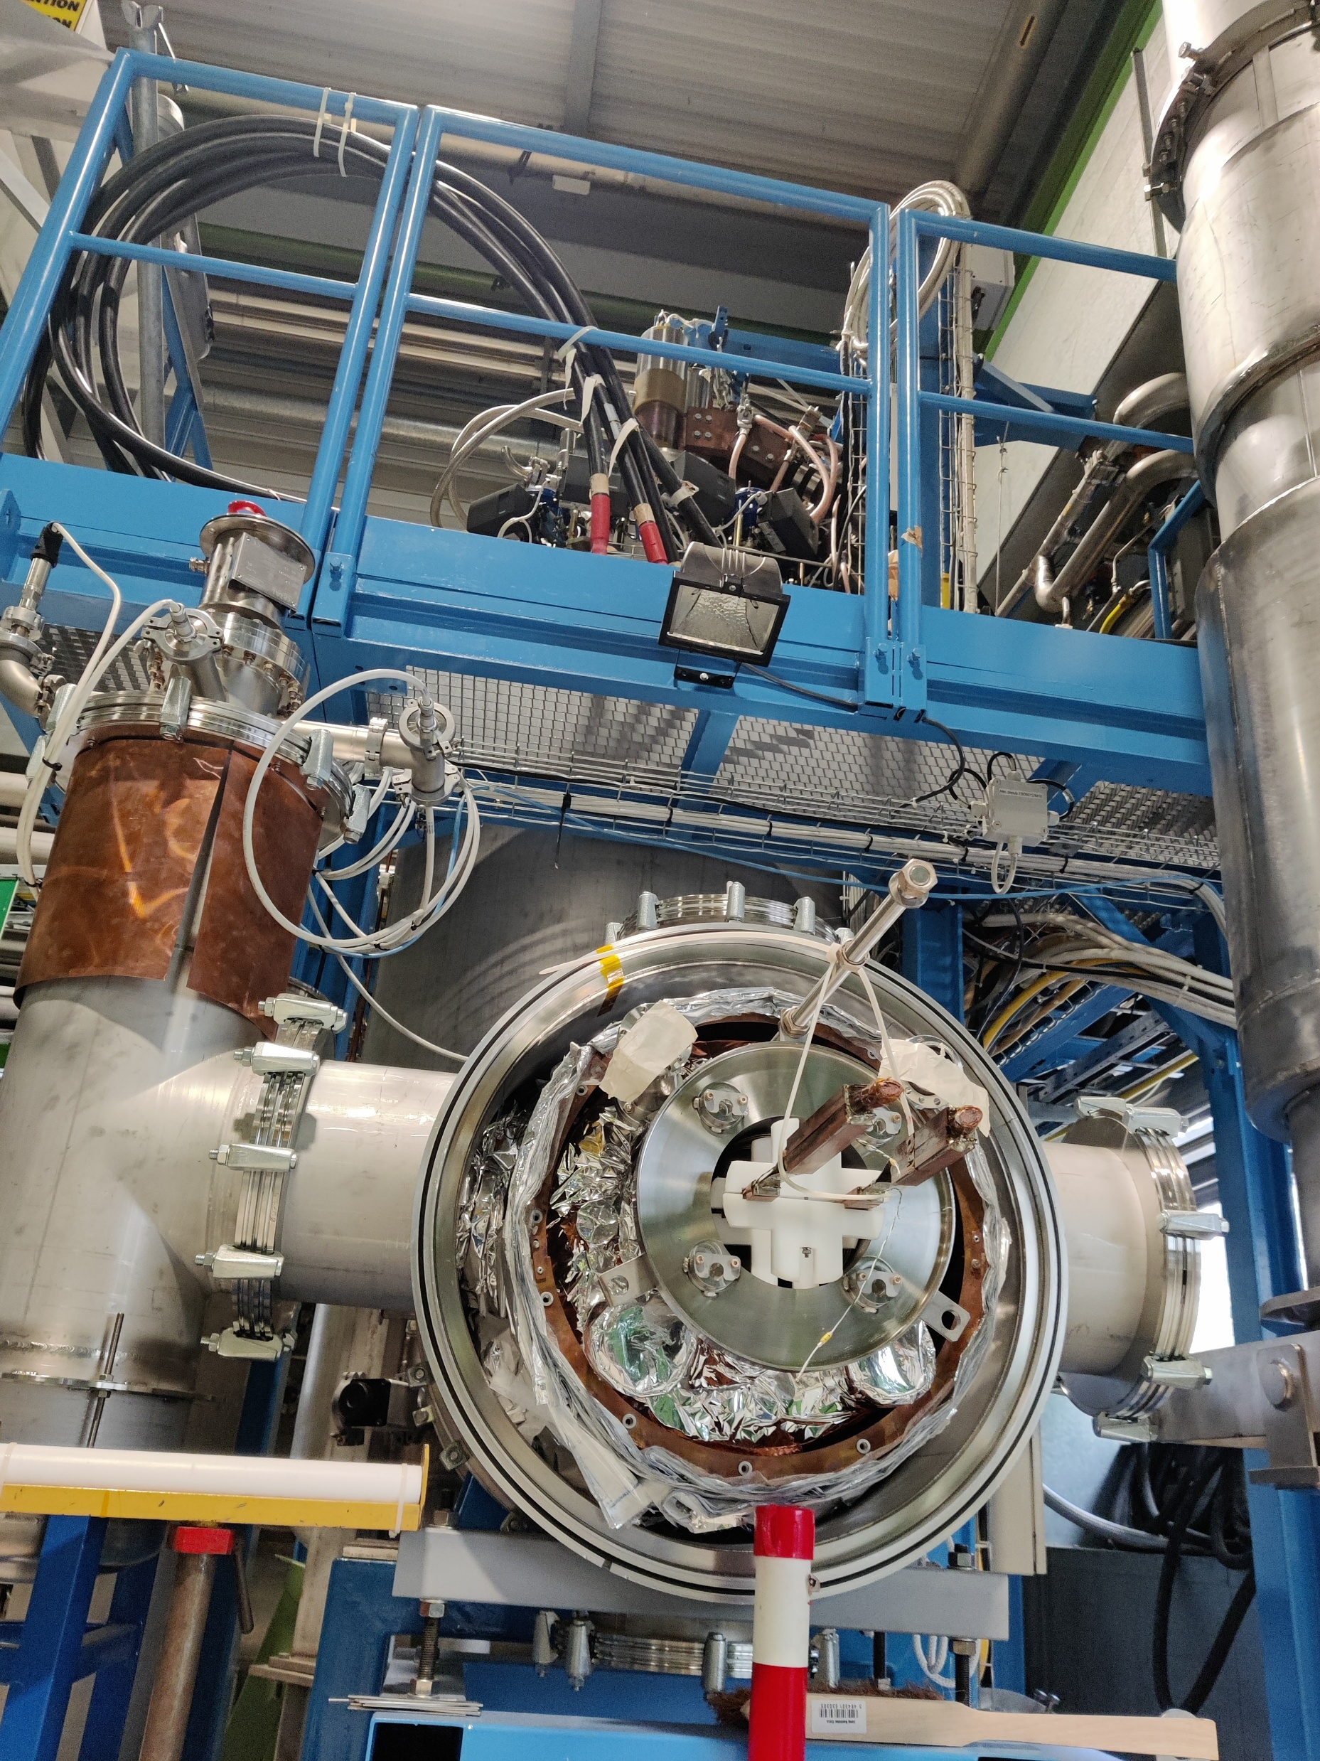
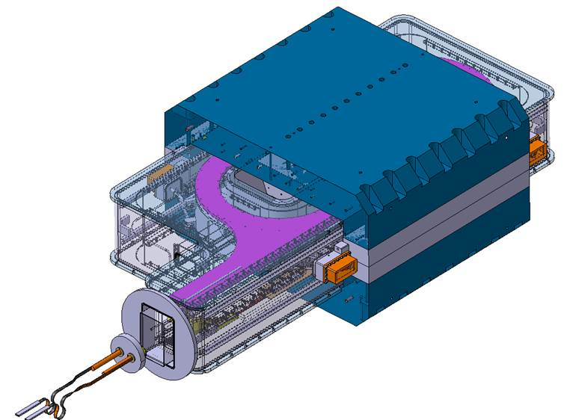
Feedbox for cryostated magnets
Connection to 20 kA circuit
Test station cryogenically disconnected some years ago, to be reconnected this summer for new projects.
Liquid and gas helium outputs, Nb-Ti busbars
Magnet test expected Q4 2025

Slide 17
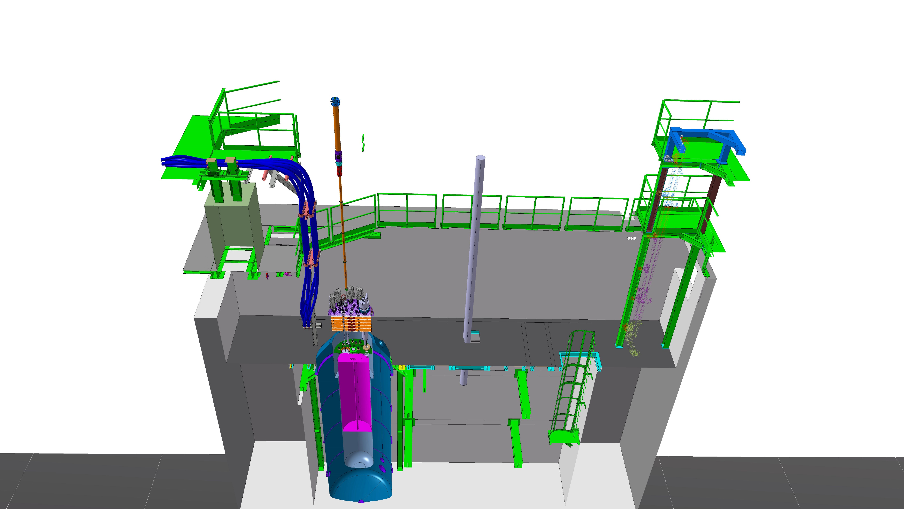
New Cluster D insert & anticryostats
Expected for Q4 2025

Slide 18
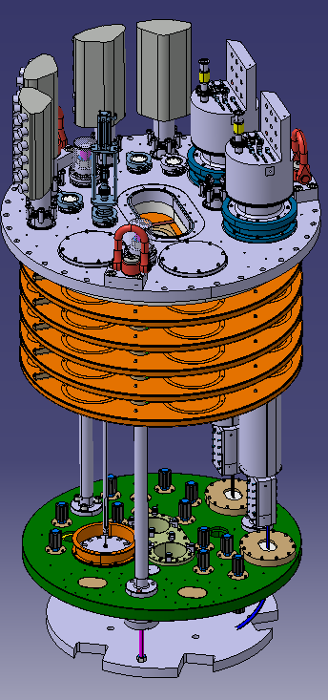
Cluster D new insert & anticryostats
Anticryostats: collaboration with Uppsala University in the frame of the HFM Program
External diameter: 48.3 mm (for 50 mm bore magnets)
Internal diameter: 45.0 mm
Length below lambda plate: 3.46 m
Temperature control: four independent heaters, plus N2 flushing from the top while the anticryostat is empty
New insert developed for the anticryostats
Manufacturing ongoing, first few pieces already arrived
Supports single and double aperture magnets (maximum 230 mm between apertures)
Expected commissioning: Q4 2025

Slide 19
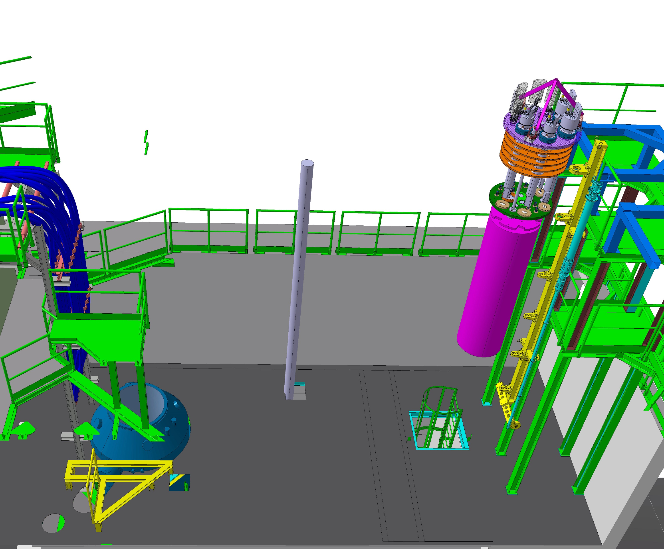
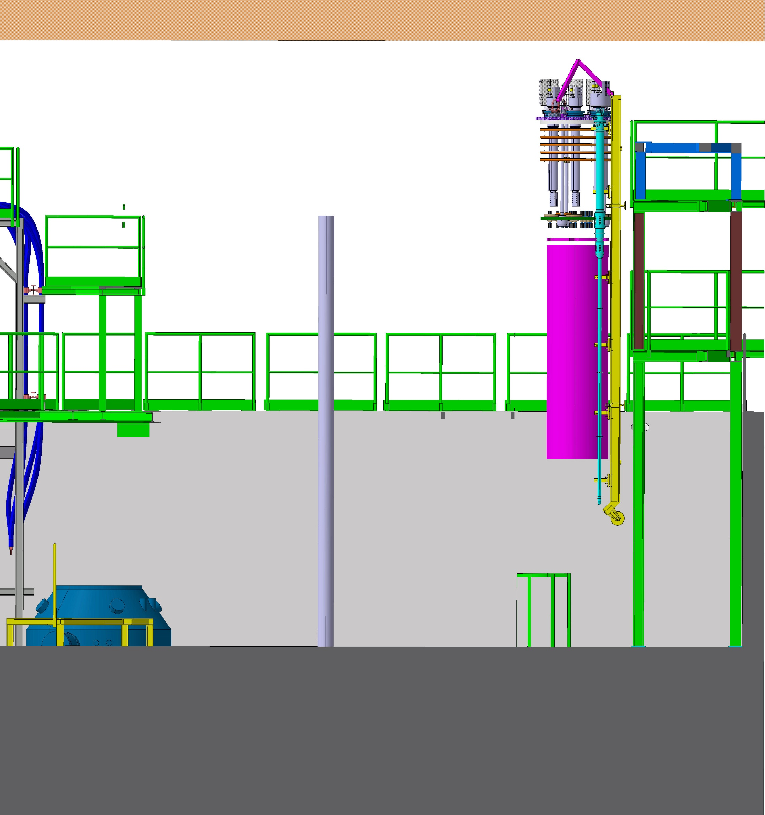
Cluster D anticryostat installation process (1/4)
+ 9100
+ 8500
+3300
+0

Slide 20
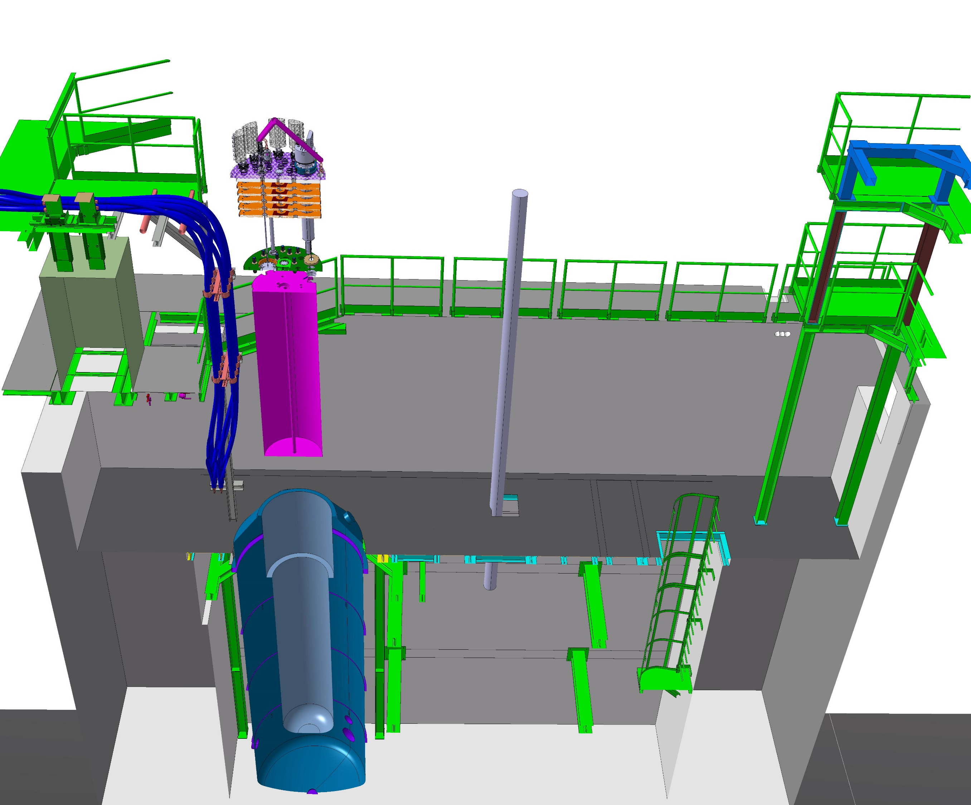
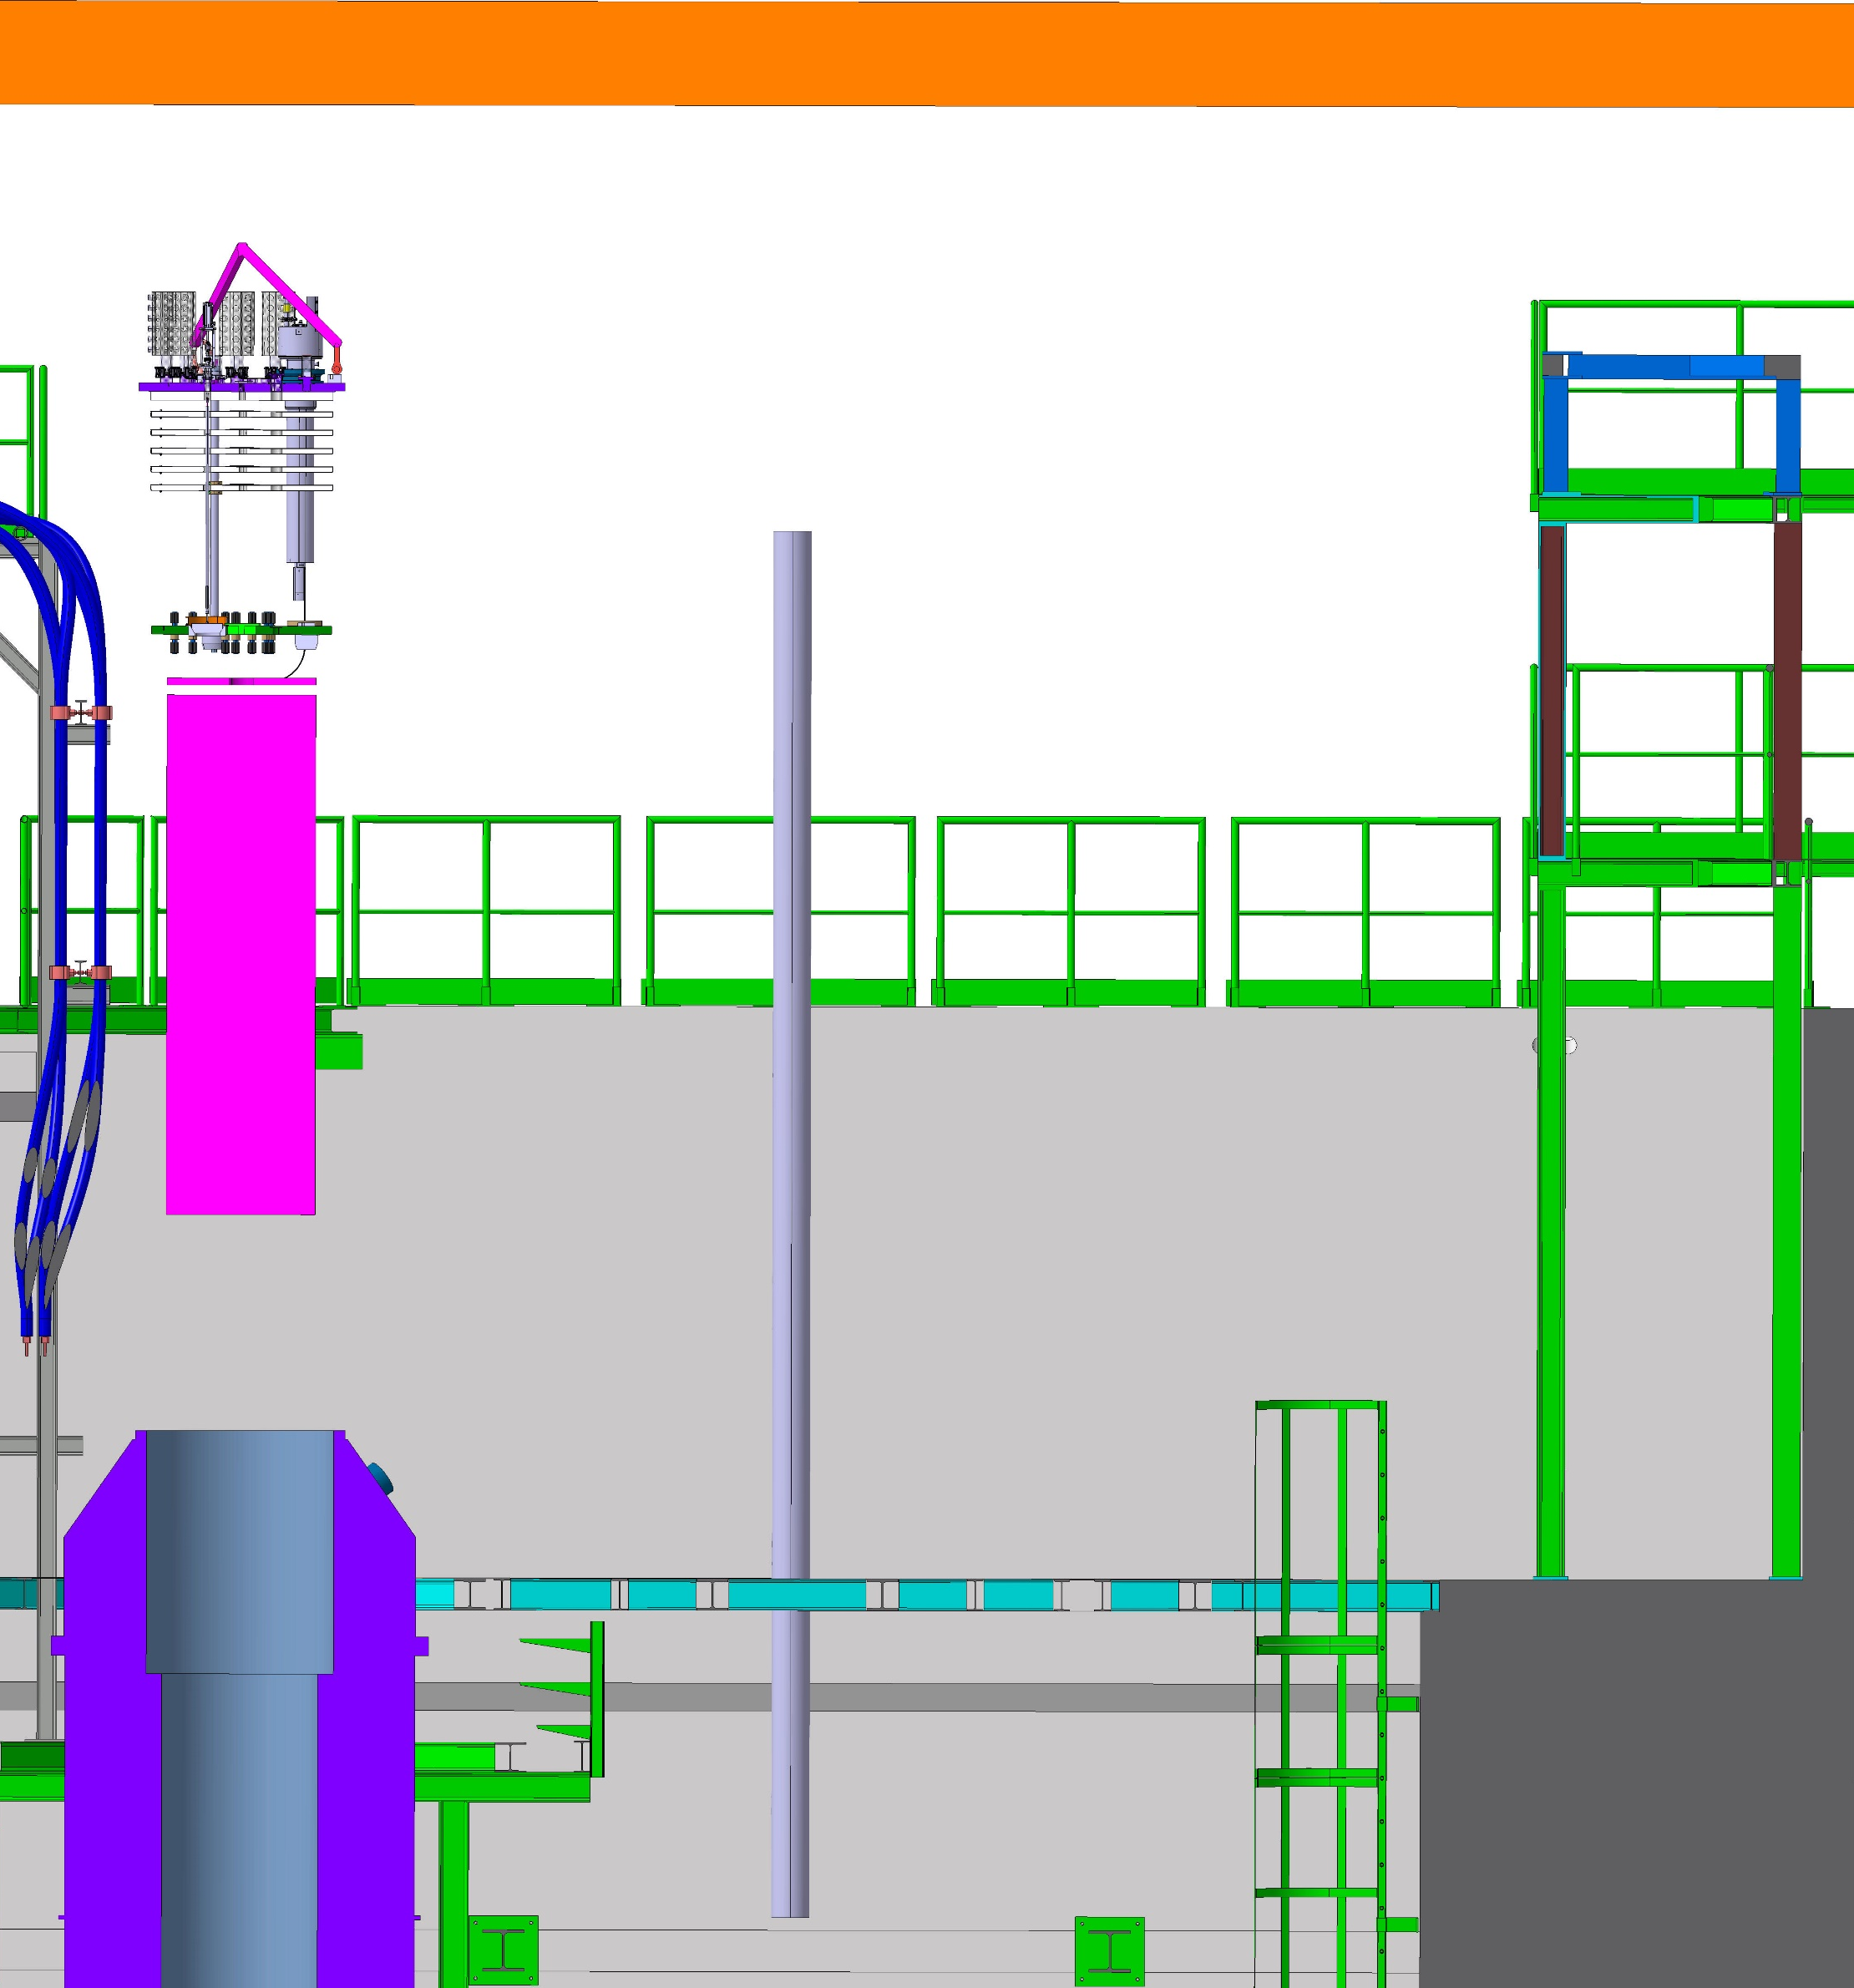
Cluster D anticryostat installation process (2/4)
+ 9100
+ 8500
+3300
+0

Slide 21
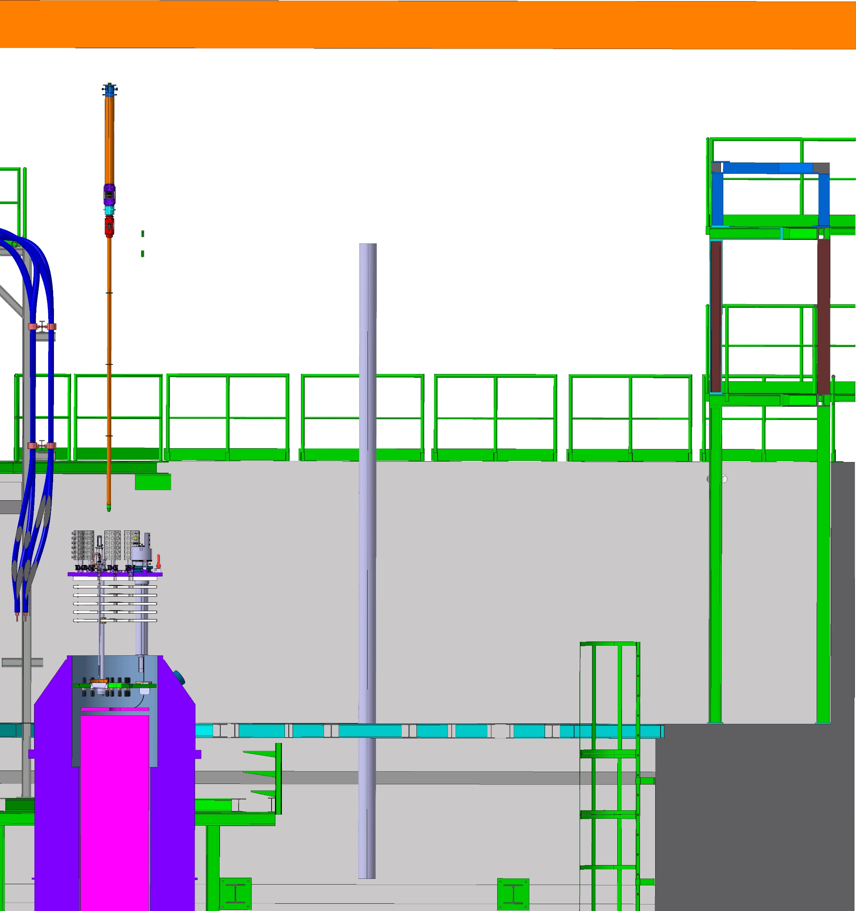
Cluster D anticryostat installation process (3/4)
+ 9100
+ 8500
+3300
+0

Slide 22
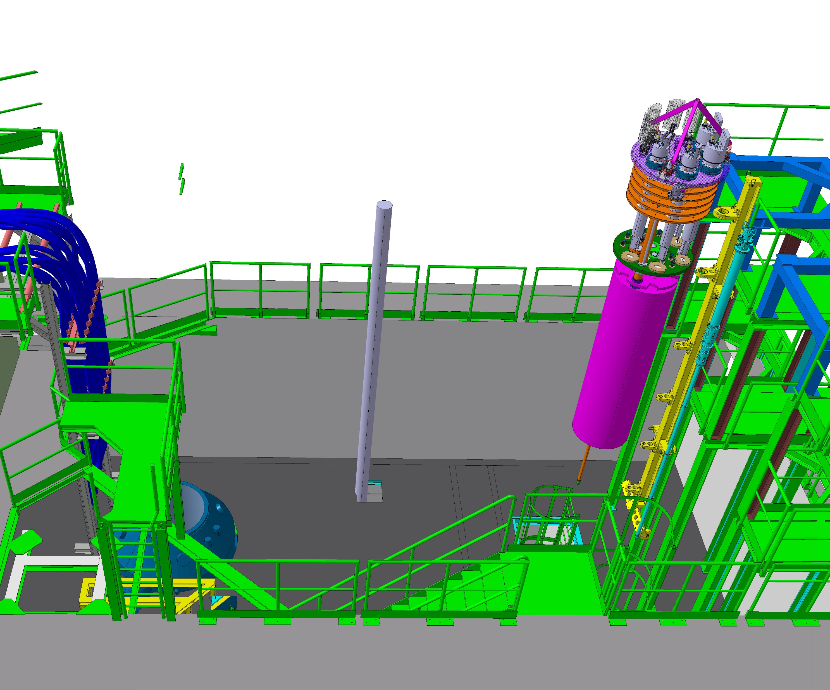
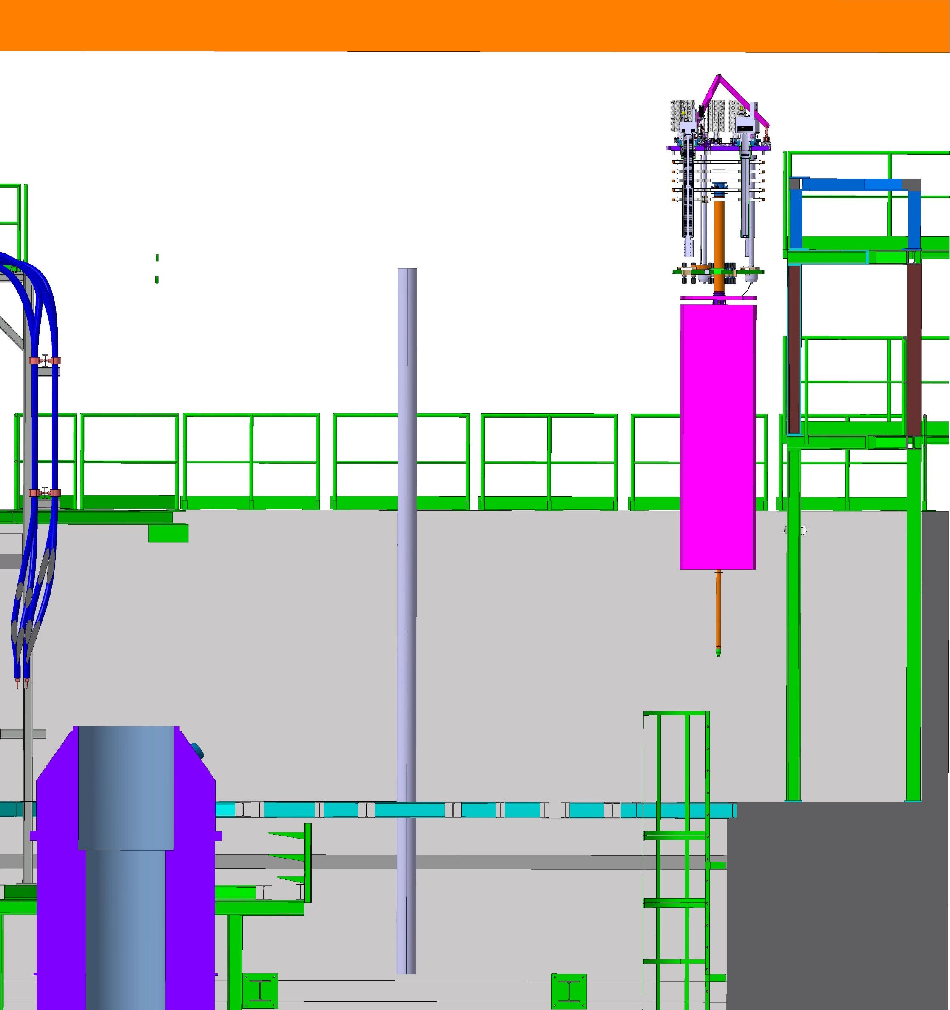
Cluster D anticryostat installation process (4/4)
+ 9100
+ 8500
+3300
+600
+0

Slide 23
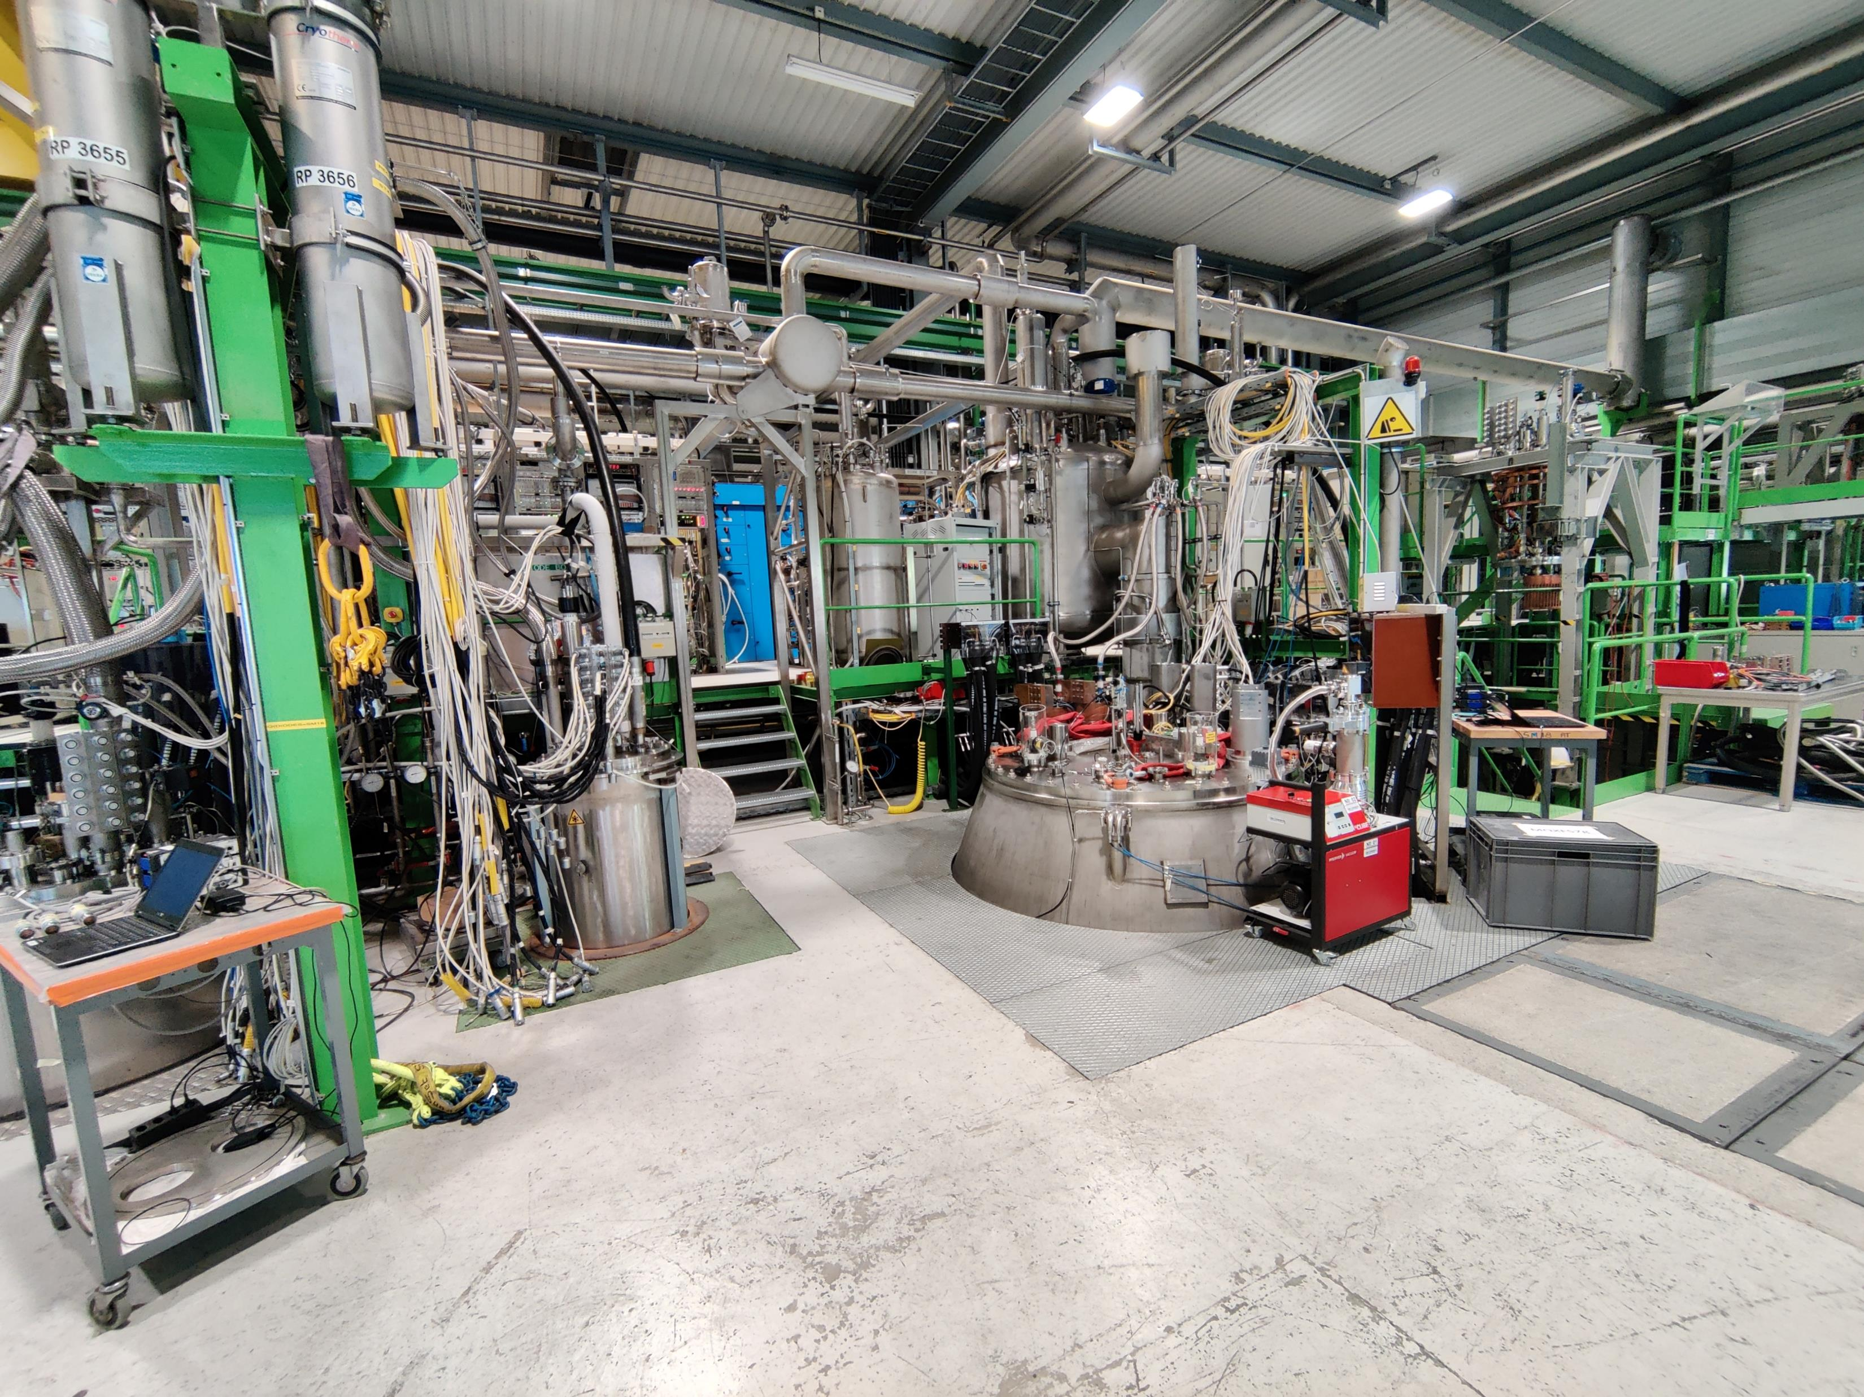
10 kA connection to Siegtal and CTV
Expected for Q1 2026

Slide 24
10 kA connection to Siegtal and CTV
New load switch, cryogenic pipes re-routing, busbar split
HFM
CTV
Siegtal
New load switch (below ground level)

Slide 25
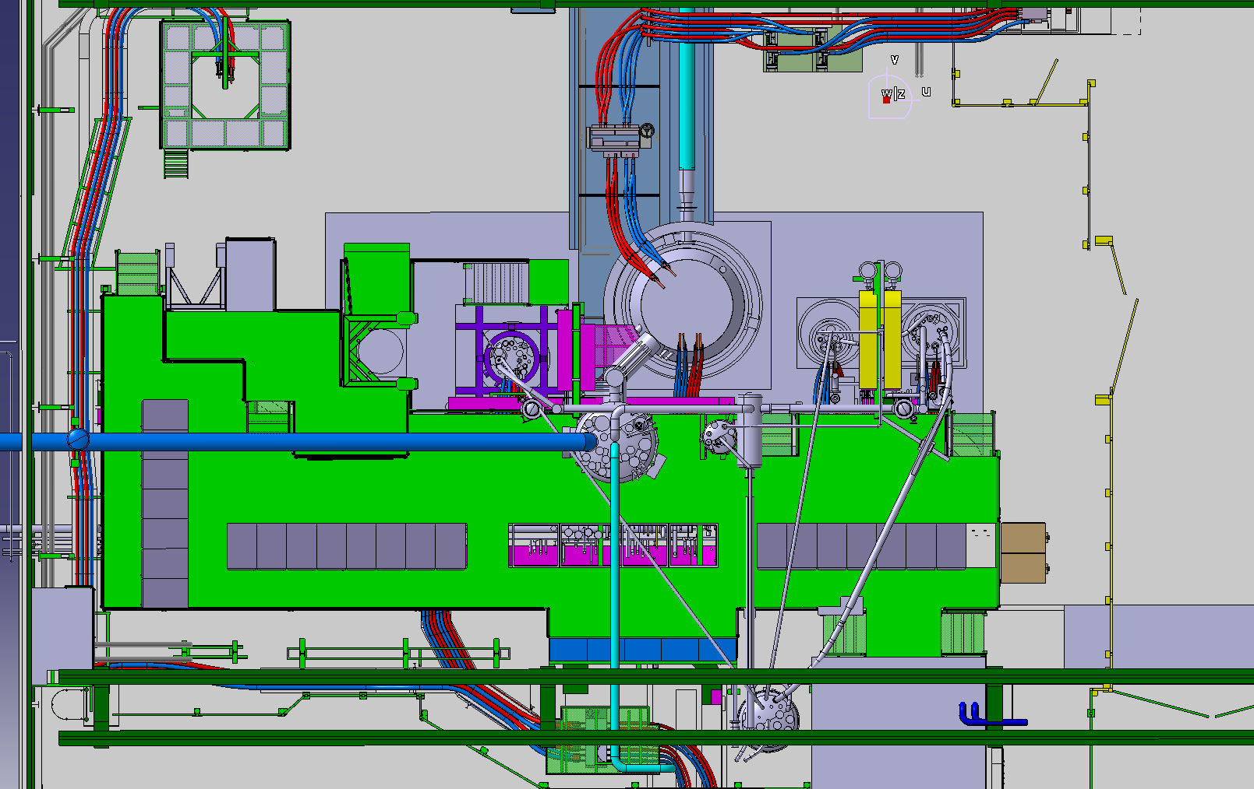
10 kA connection – initial situation
10 kA PC
↓ 20 kA PC

Slide 26
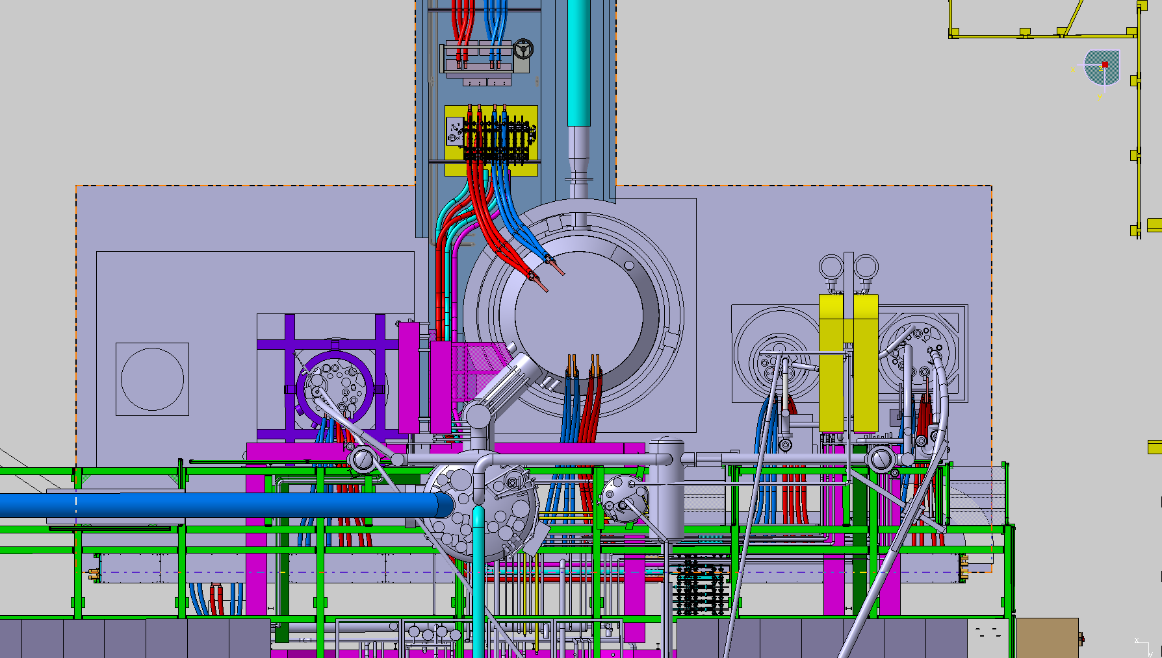
10 kA connection – final goal
10 kA circuit
2 new load switches
20 kA circuit
10 or 20 kA circuit

Slide 27
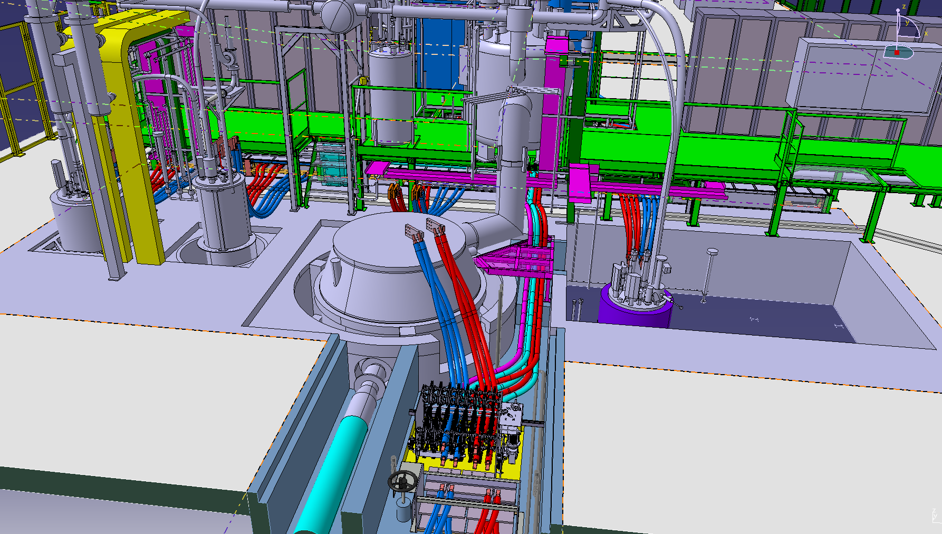
10 kA connection to Siegtal and CTV – status
Work under the green platform:
New load switch received
Cryogenic pipes re-routing this summer
New WCC and busbar cutting by end of 2025 – early 2026
Work in the trench finished, except for the new WCC (pink and cyan)

Slide 28
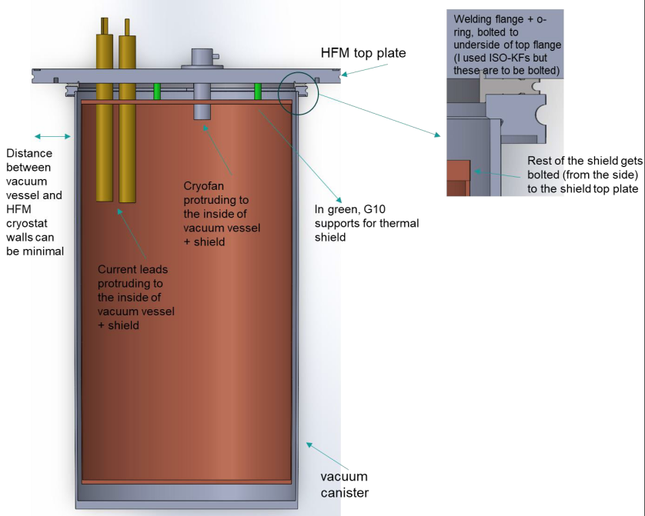
Supercritical helium insert
Expected for Q2 2026

Slide 29
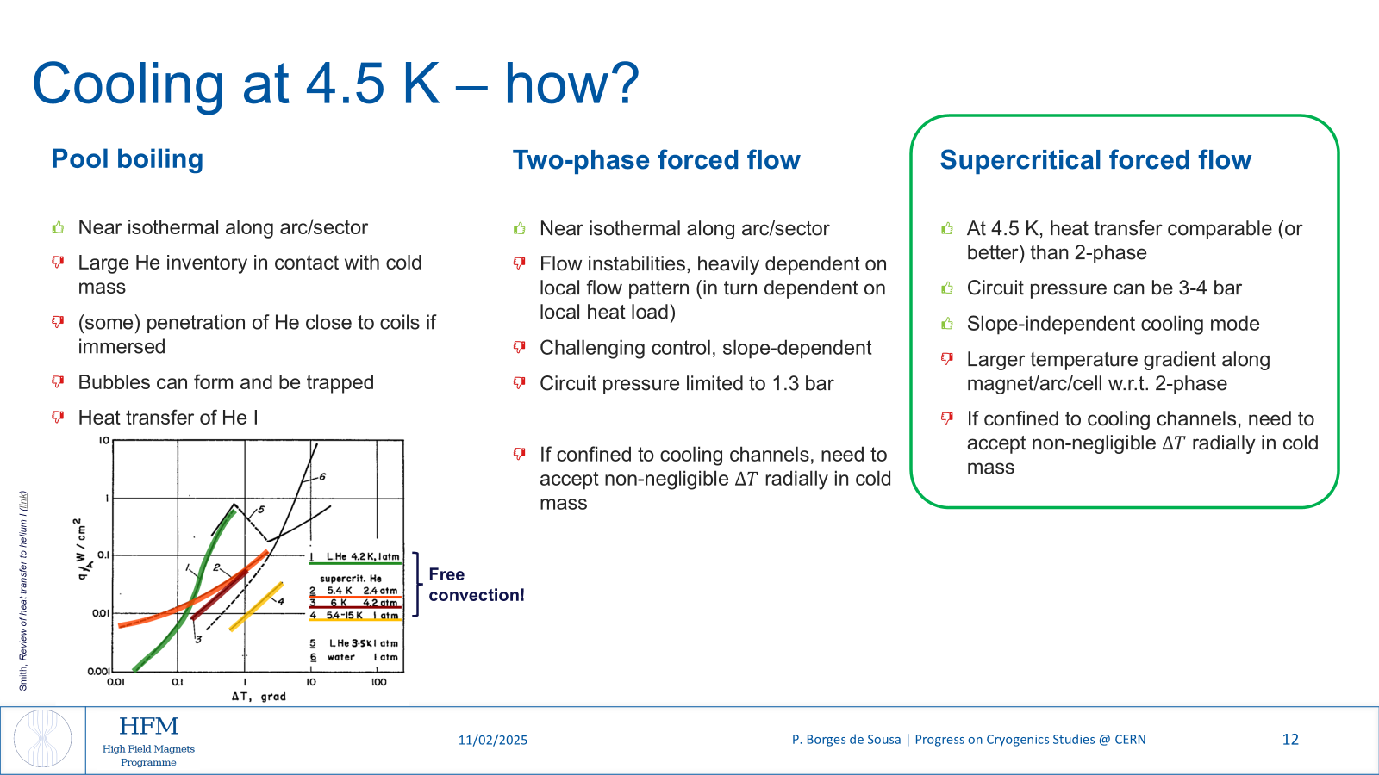
From P. Borges de Sousa
https://indico.cern.ch/event/1471305/

Slide 30
Supercritical helium insert for HFM cryostat

Slide 31
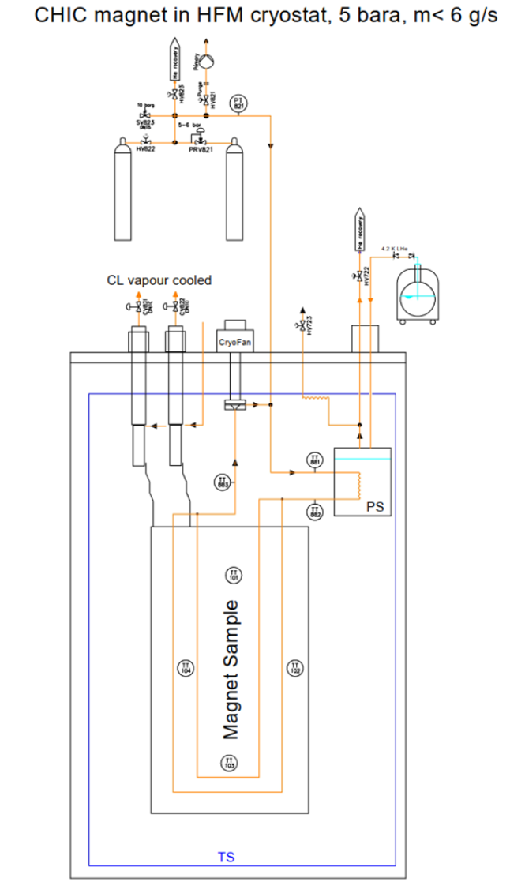
Supercritical helium insert
Main features of the new insert:
Magnet cooled by helium at ~3-5 bar, 4.5-50 K in a closed loop
Pressure provided by a cryofan. Heat exchange with Liquid helium from “standard” SM18 infrastructure
Operation in vacuum (~10⁻⁶ mbar)
Copper and HTS current leads up to 20 kA.
Thermal screen and current leads cooled by an additional helium gas circuit (1.3 bar)
Tentative available test area: 1.4 m diameter, 2.5-3 m depth
Conceptual design ongoing
Expected commissioning: Q2 2026.

Slide 32
Summary: SM18 vertical test benches capabilities
 | G-Feedbox | Long | HFM | CTV | Siegtal | Cluster D
Depth [m] | N/A | 0.55 | 2.25 | 1.30 | 1.25 | 0.85
Diameter [m] | N/A | 3.35 | 1.45 | 0.45 | 0.75 | 5.35
Power circuits | 20 kA | 20 kA, 600 A | 20+10 kA, 600 A | 20 kA, 600 A, 10 kA | 20 kA, 600 A, 10 kA | 30 kA, 2+2 kA
Cryogenic conditions | 4.5 K or GHe ~1.5 bar flow | 1.9 or 4.5 K LHe bath | 1.9 or 4.5 K LHe bath GHe bath (10-50 K) SHe flow (4.5-50 K, 3-5 bar, 6 g/s) | 4.5 K LHe or GHe bath | 1.9 or 4.5 K LHe bath | 1.9 or 4.5 K LHe bath With Anticryostat
In red: upgrades ongoing or recently finished

Slide 33
