Slide 1
Superconducting magnet String test for the
SIS100 accelerator of FAIR
Patricia Aguar Bartolome et al.
GSI Helmholtzzentrum für Schwerionenforschung GmbH
5th SMTF Workshop, 31 March 2025
Bad Zurzach, Switzerland

Slide 2
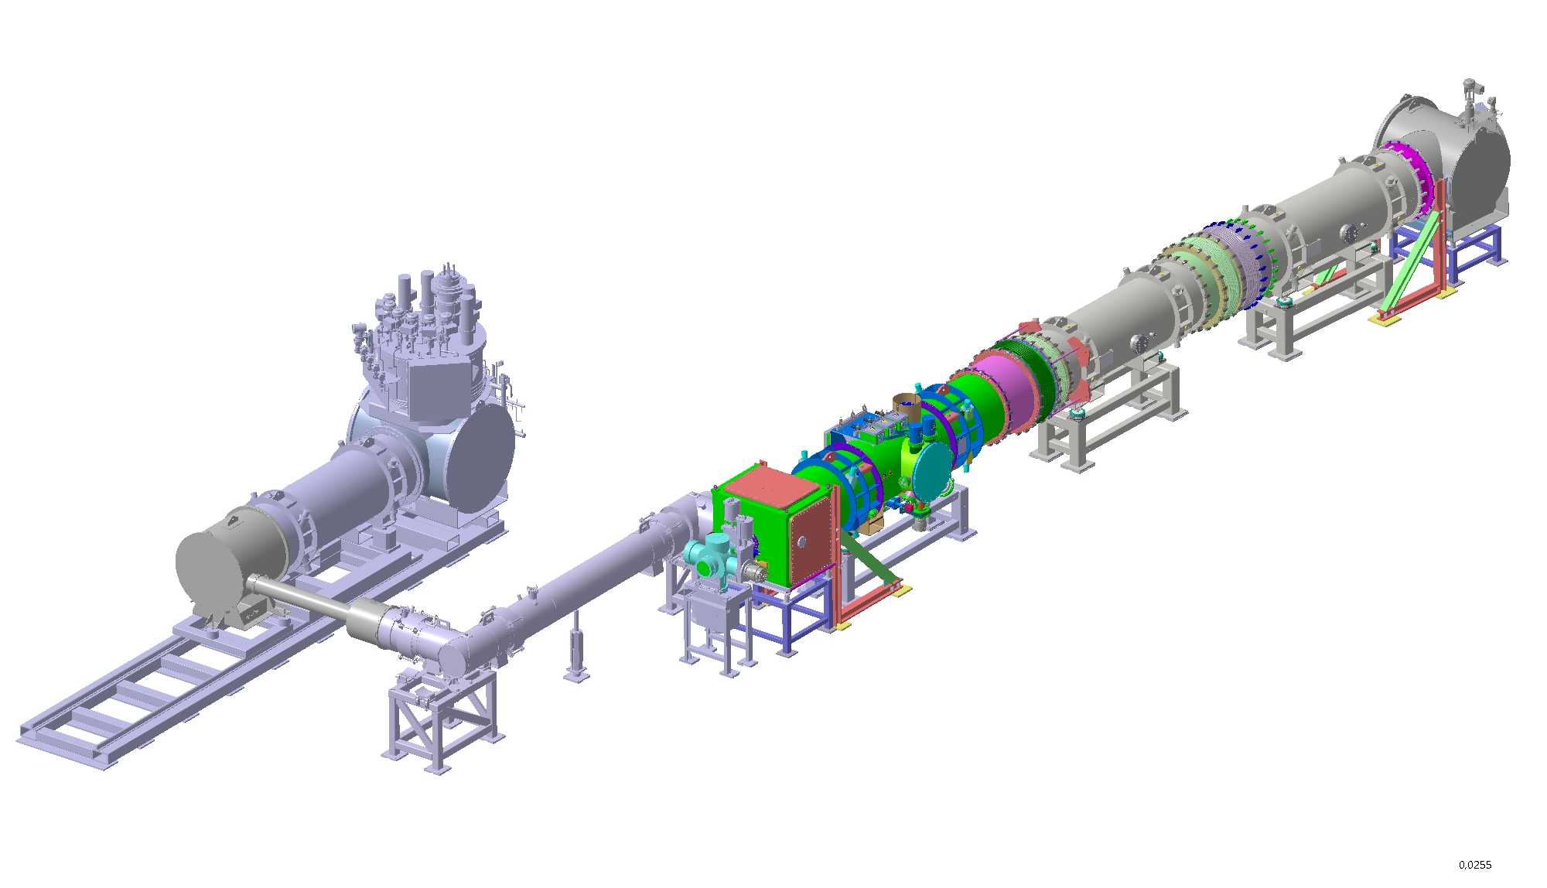
Outline
FAIR / SIS100
Introduction
Installation
Documentation
Performance
Setup
Measurements
Summary

Slide 3
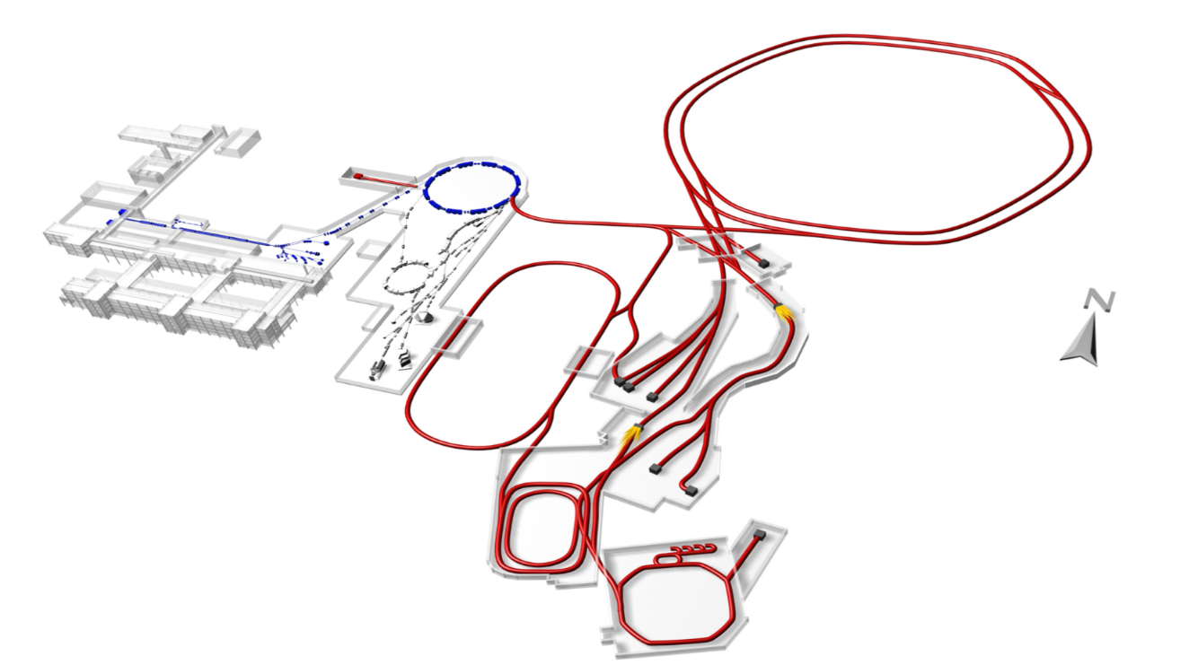
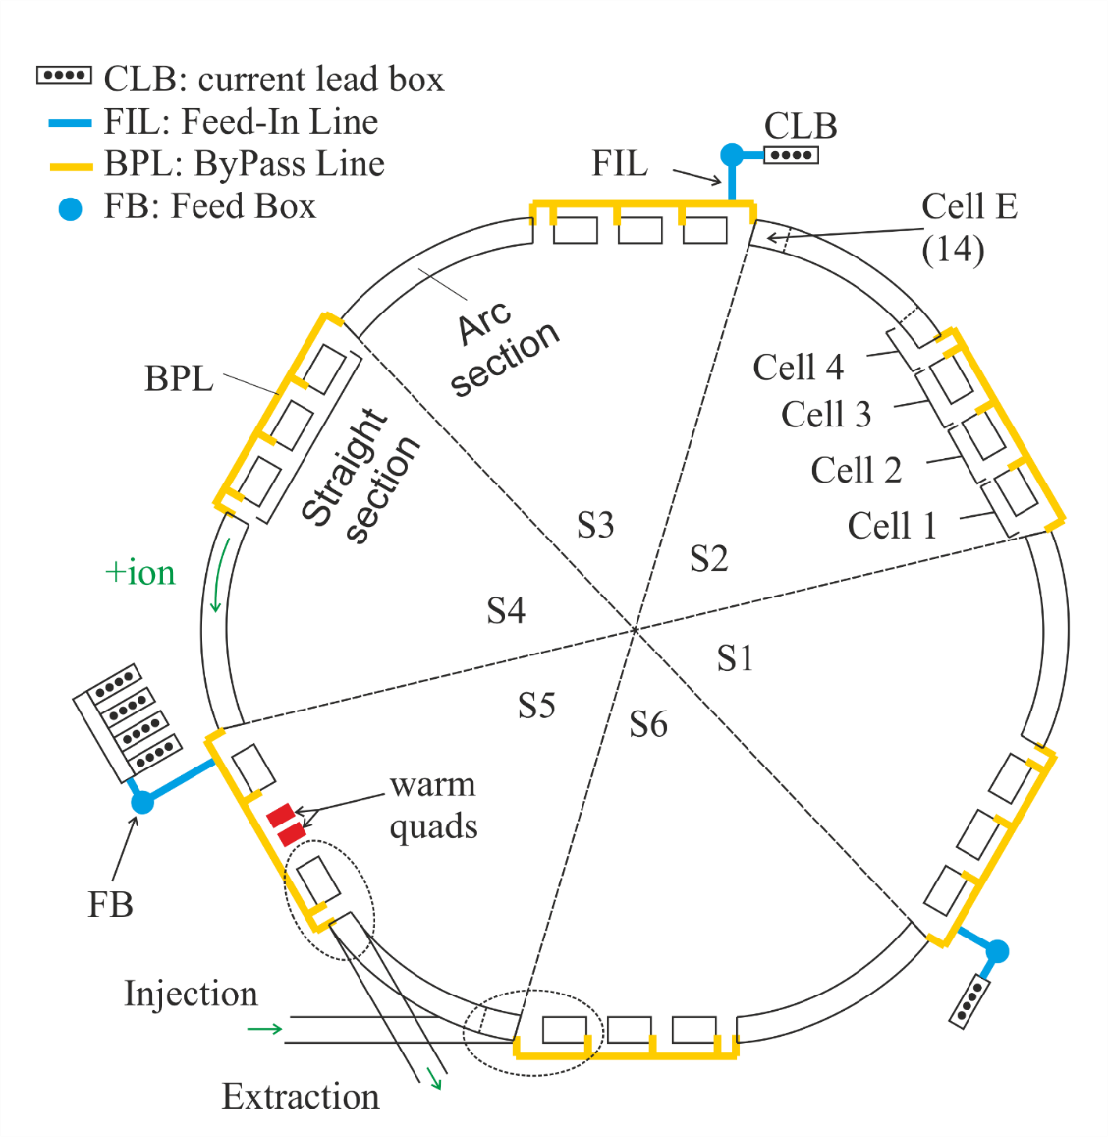
FAIR / SIS100
FAIR facility
Existing GSI facility
The SIS100 heavy ion synchrotron is the main accelerator of the FAIR complex
SIS18
SIS100
p-LINAC
UNILAC
SIS100
beam rigidity 100 [Tm]
circumference 1083.6 m
fast ramped machine 4 Ts⁻¹ → 27.5 kAs⁻¹ (1Hz)
417 sc-magnets assembled in
over 190 cryo-magnetic modules
over 60 local cryo components

Slide 4
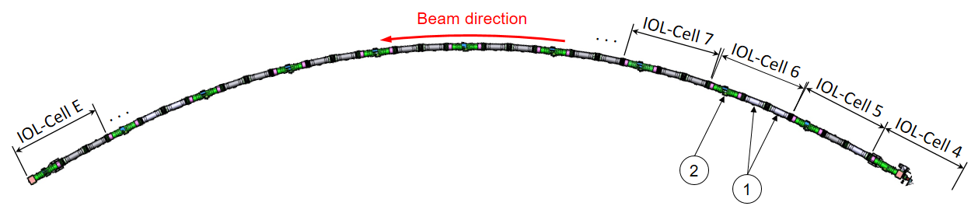
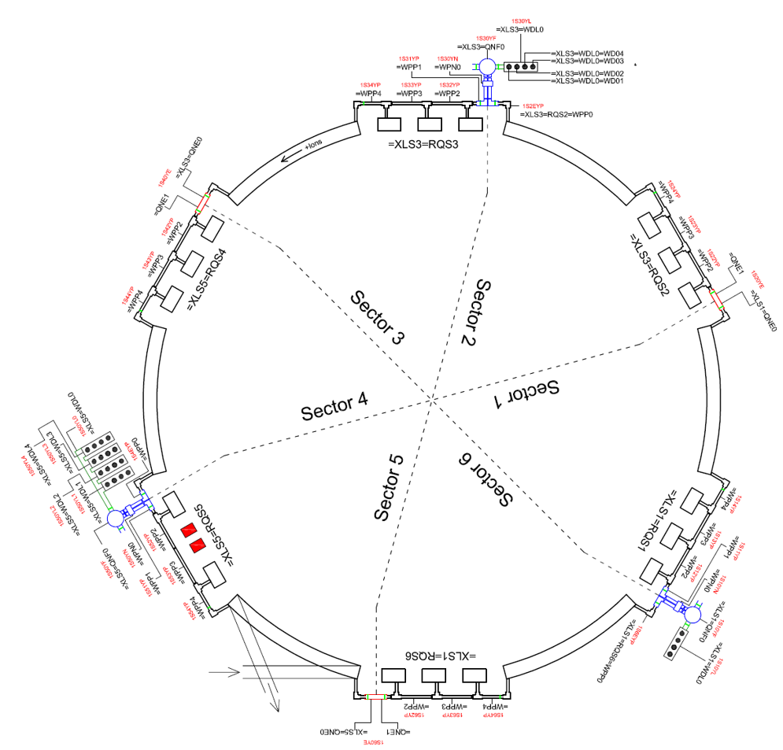
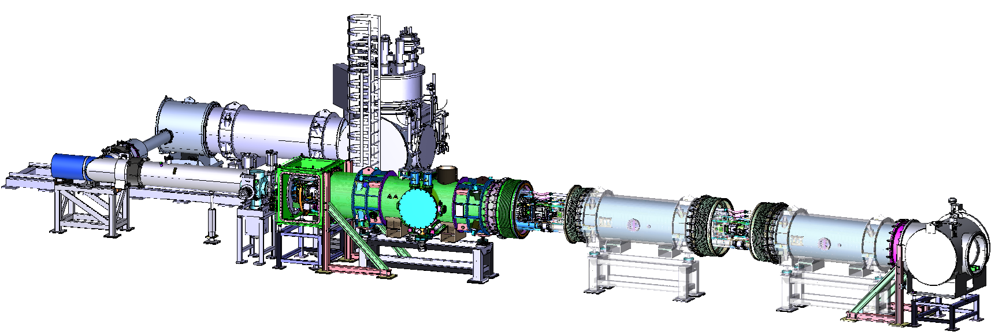
Introduction
Scope
SIS100 String test serves as a crucial preparatory phase for the installation, commissioning and operation of the SIS100 accelerator
SIS100 arc segment
Objectives
establishing installation sequence and procedures
verification of design and interfaces
preparation of work procedures and quality assurance
validation of the cryogenic system
quench and protection study
powering behavior of the system
functionality of the beam and insulation vacuum system
accelerator relevant operation
Feed box
LHe supply
DM with CAP
End Box (EBx)
Bypass line (BPL)
RT
pumping
chamber
End Cap (EC)
with CWT
QDM type 2.5
DM

Slide 5
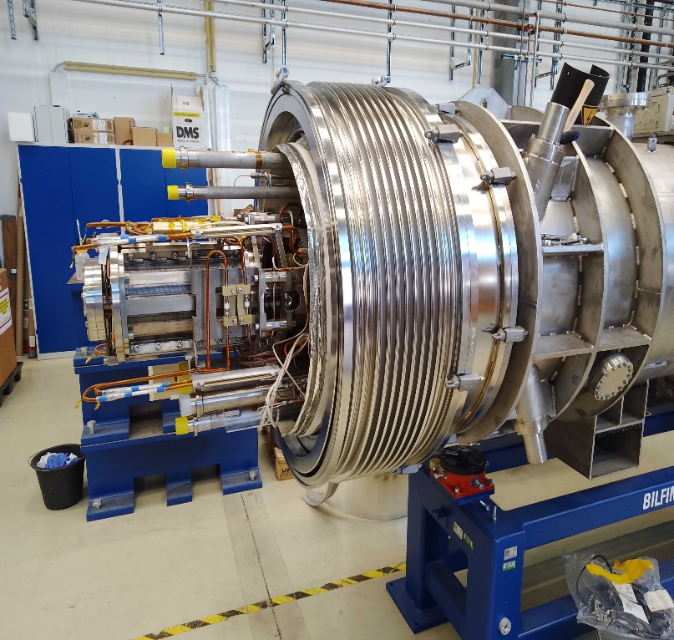
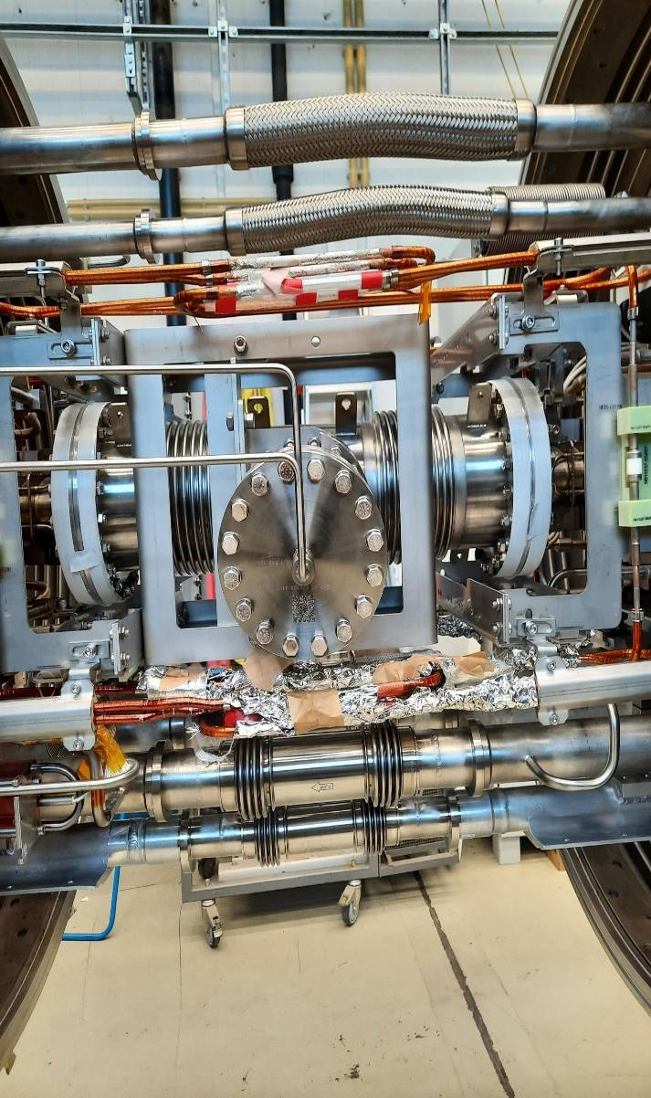
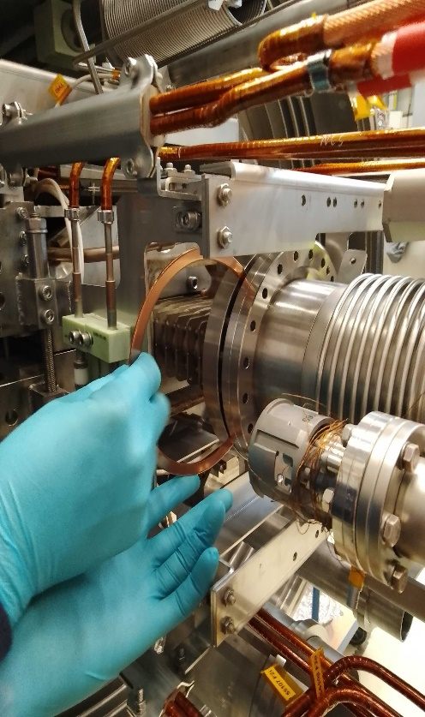
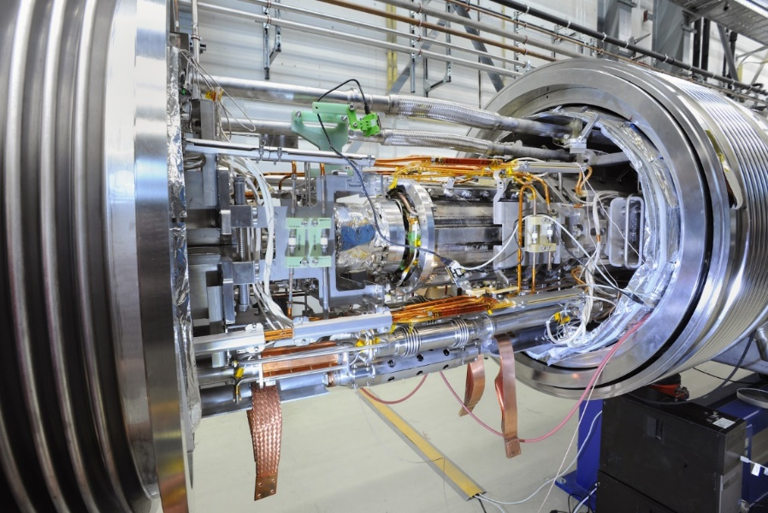
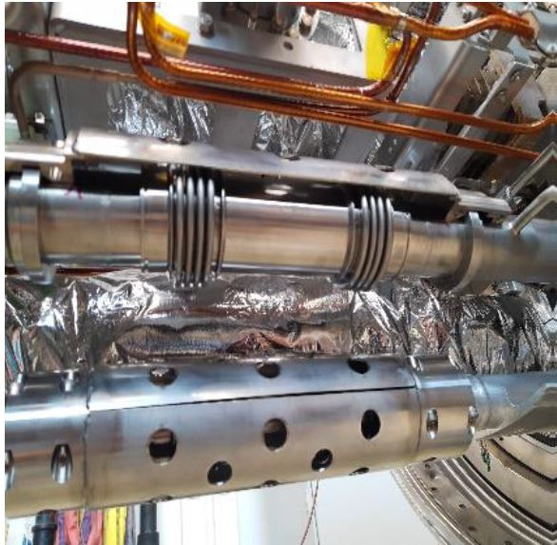
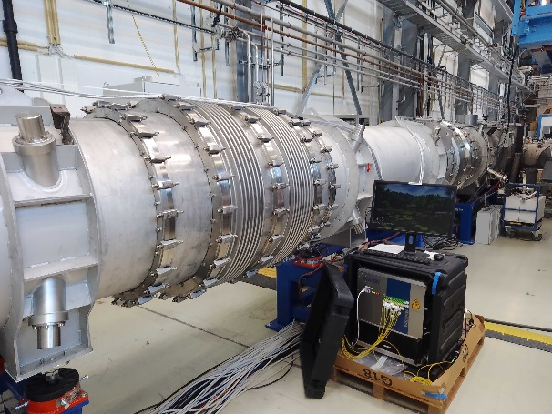
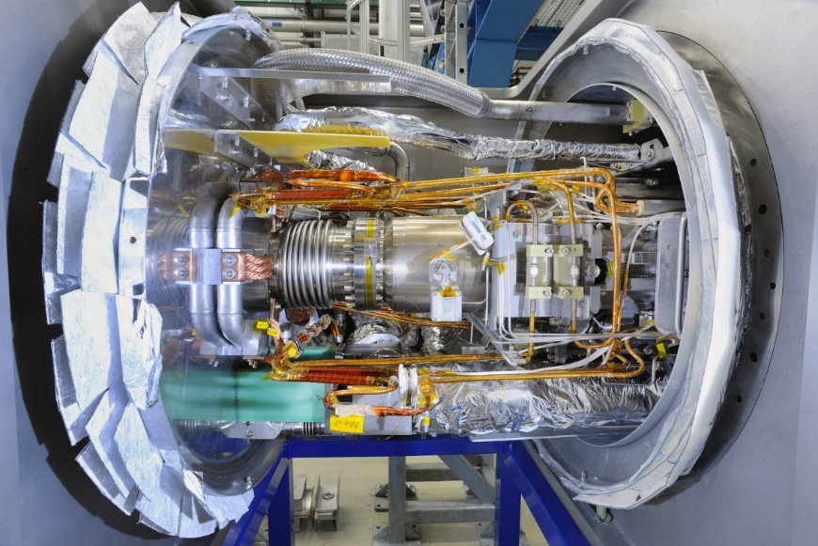
Installation
Assembly of the String test components mainly carried out by IFJ PAN Cracow team except the welding of the hydraulic interconnections (KRIOSYSTEM Wrocław)
Installation of telescopic bellows
UHV interconnections
Hydraulic connections
Electrical connections
Closing of telescopic bellows
Dipole-Dipole connection
Quadrupole-Dipole connection
Stabilizer supports
End cap connection
  Challenges during installation:
    restricted space between components
    large number of interconnections within a limited volume, especially in the end cap
    proximity between critical components (sc-bus bars to welded connections)
    design and production of special tooling
Quality control processes:
  leak test of all the UHV interconnections
  visual inspection of all the hydraulic interconnections
  radiographic test of all the hydraulic interconnections
  leak test of all the hydraulic interconnections
  pressure test up to 16 bar of the He-process line system
  Integral leak test of the entire system

Slide 6
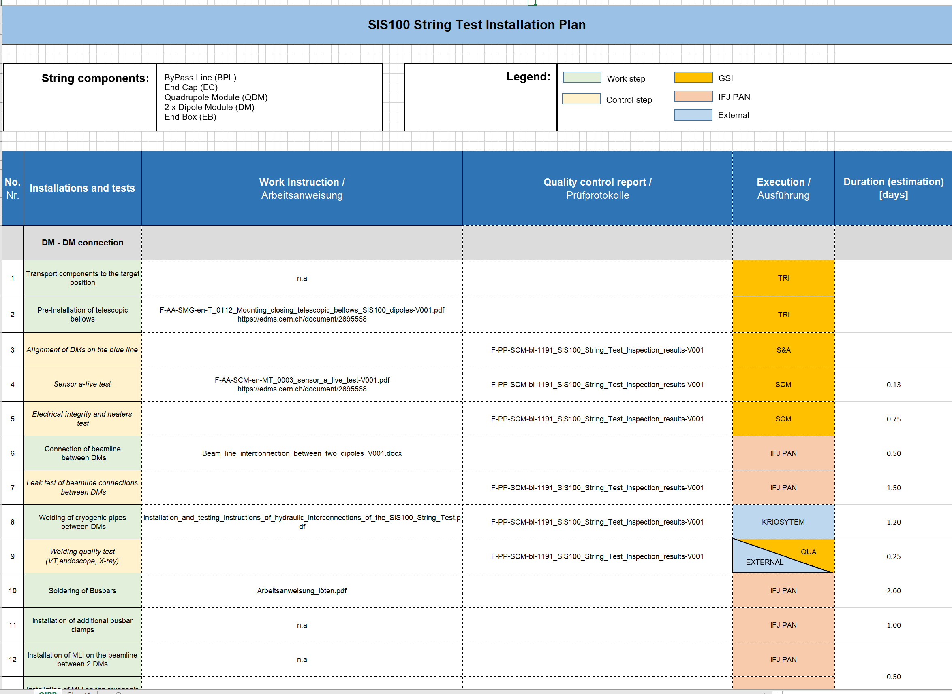
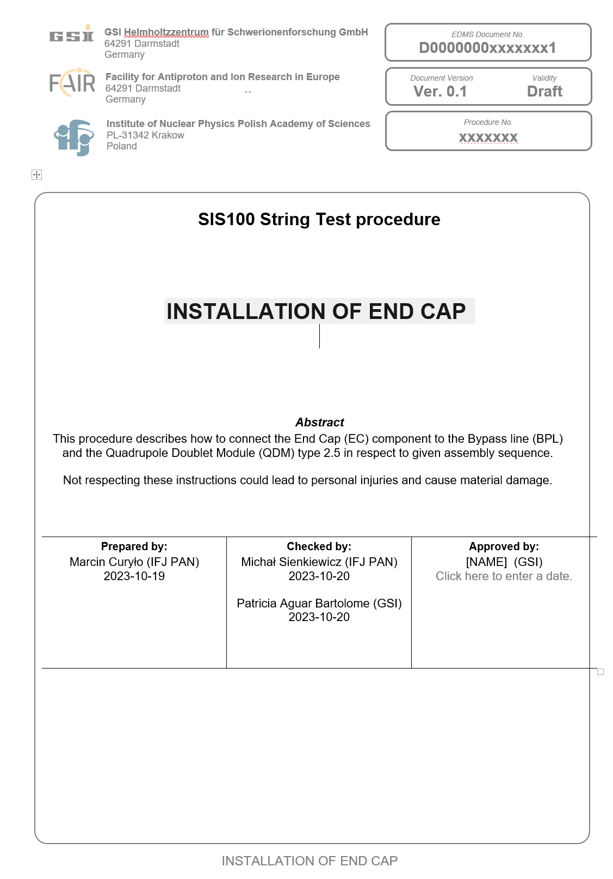
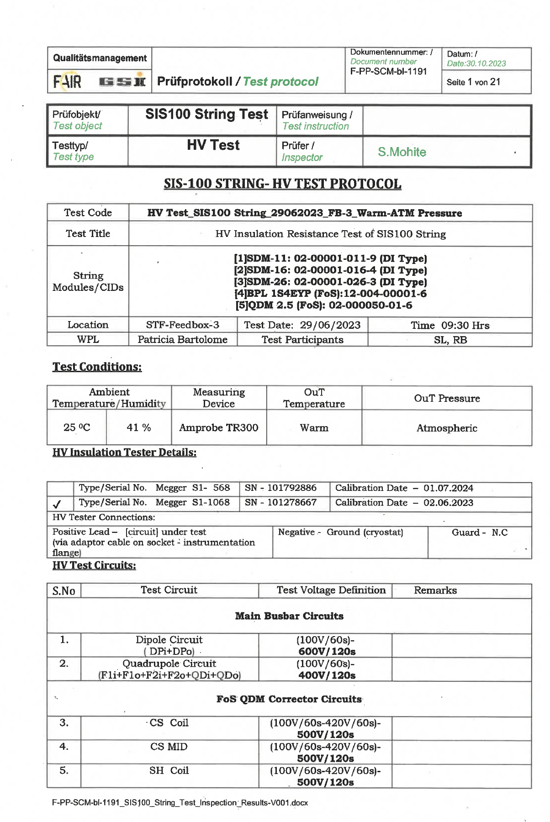
Documentation
Work preparation & test planning
Work plan → contains the relevant assembly and test steps
Work instructions → procedures for the installation and assembly
  13 documents created
Test instructions → procedures for quality control
  5 documents created
Acceptance protocols
  7 documents created
Non conformity reports
Risk assessment for work to be carried out
Lessons learned → compilation of findings and recommendations
String test documentation uploaded to EDMS and currently used in the SIS100 tunnel installation

Slide 7
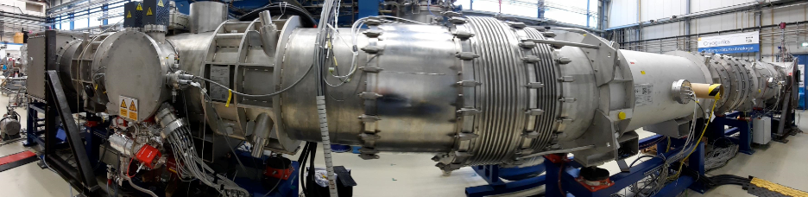
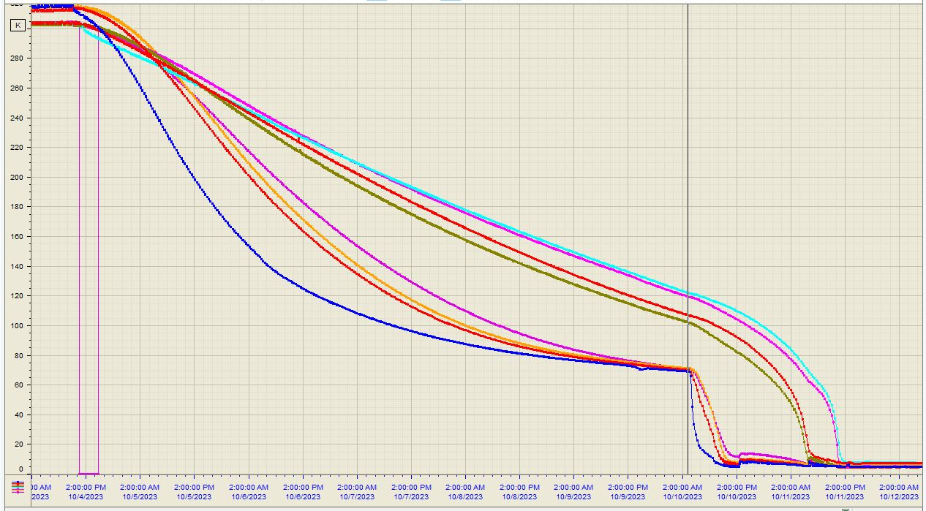
Performance – Cool down
Assembly work completed in October 2023
No problems observed during the cold phase
in the insulation vacuum of the String cryostat
BPL
Cool down
EC
  The cool down process is divided into two phases with different pressure:
  Phase 1: Since the cold masses are smaller in the 2 parallel lines of the quadrupole module, the doublet cools down faster than the dipoles.
  Phase 2: The QDM cools down faster than the dipoles → the mass flow rates start to unbalanced due to the different flow impedance caused by the difference in the temperature.
QDM
Phase 1 | Phase 2
300 K to ~80 K | ~80 K to 4.5 K
QDM
DM1
DM2
DM1
DM2
Balancing of the mass flows of the modules by a combination of capillaries and heaters
p_{InsVac} ~ 6E-6 mbar
EBx

Slide 8
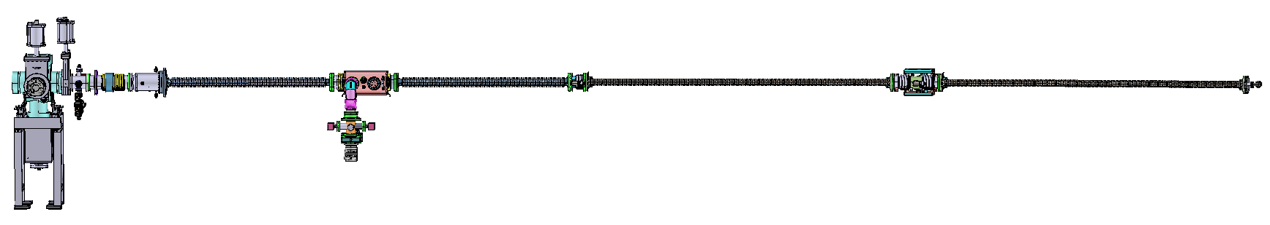
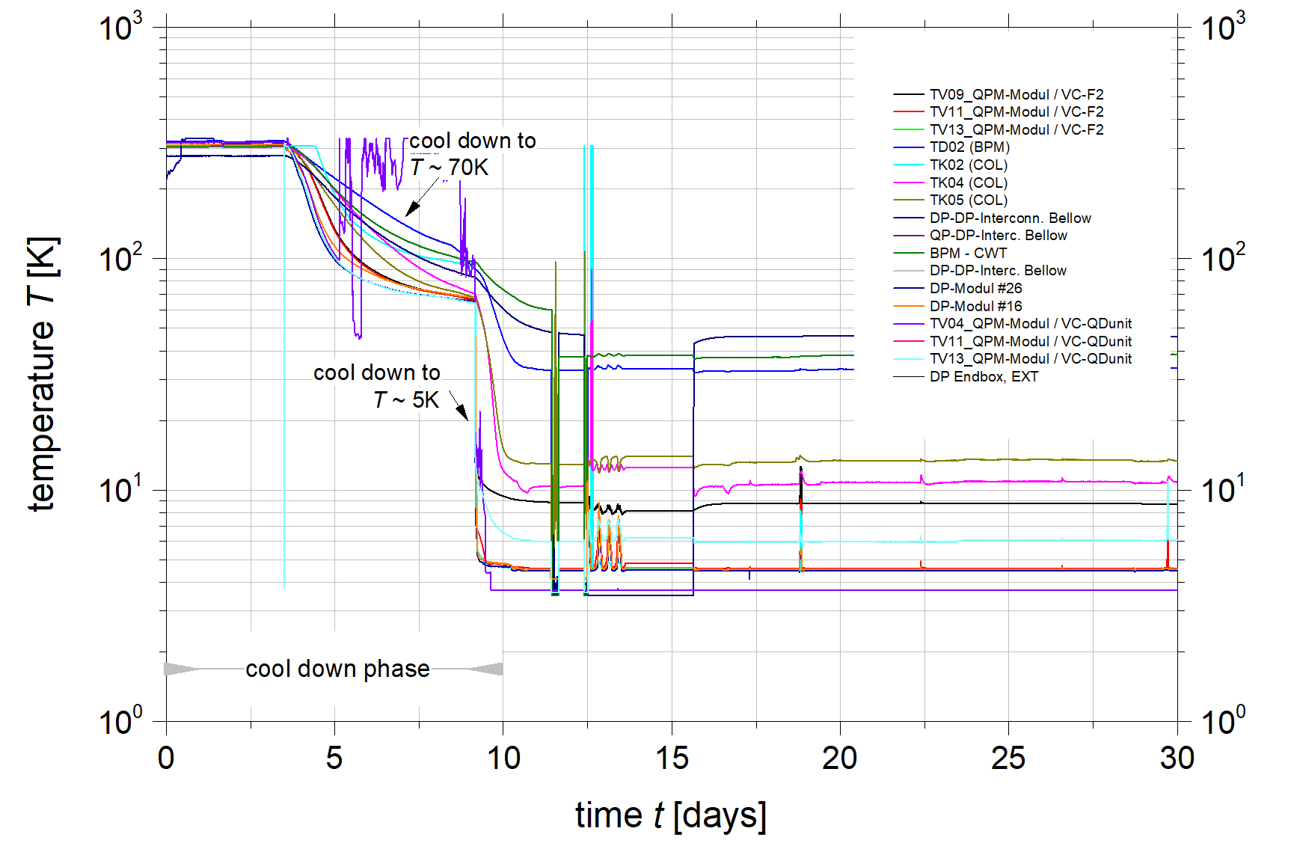
Performance – Beam vacuum / Temperatures
Warm beam vacuum system
Cryogenic beam
vacuum system (~14m)
Temperature
sensor
(T = 293K)
quadrupole
chamber
cryo-
collimator
quadrupole
chamber
dipole
chamber
cryosorption
pump
dipole
chamber
CWT
BPM
R-CWT
+PSC
Magnet chambers reached ultimate temperatures of around 5K
Cryo-collimator temperature around 6K
Temperatures in the interconnection areas significantly higher → not actively cooled
  The filaments of the extractor gauges directly flanged into the cold beam pipe caused a high heat load

Slide 9
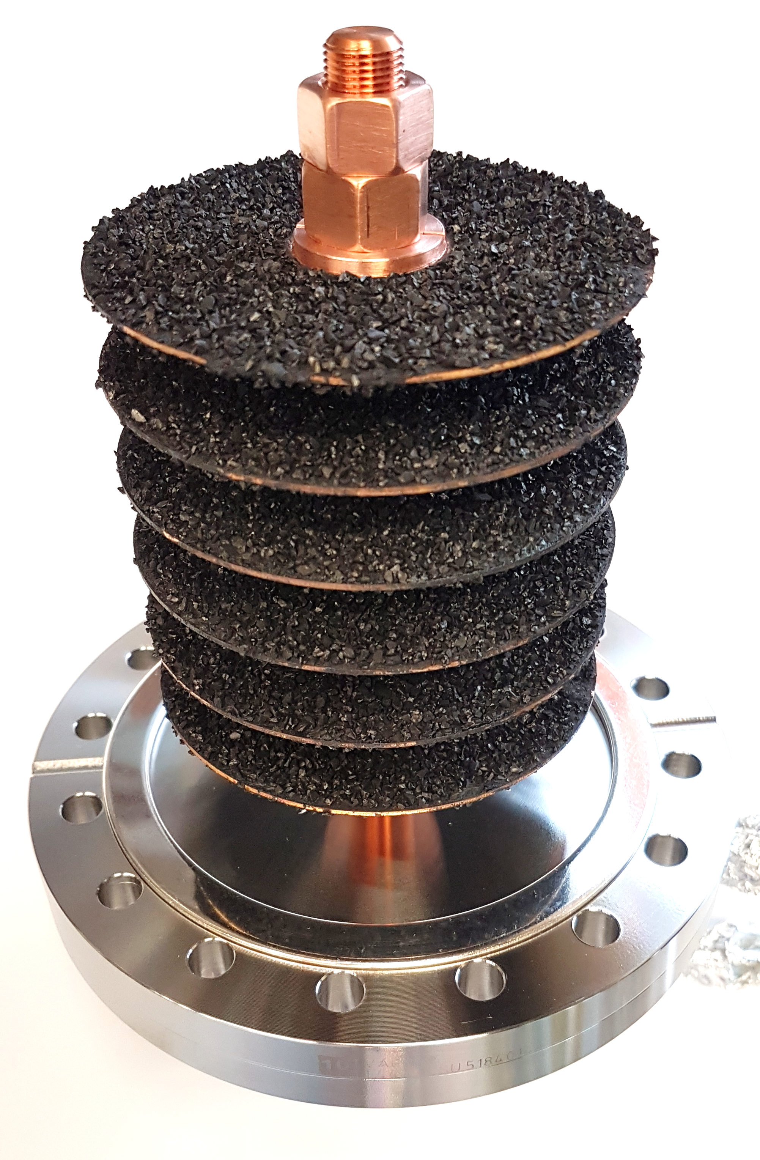
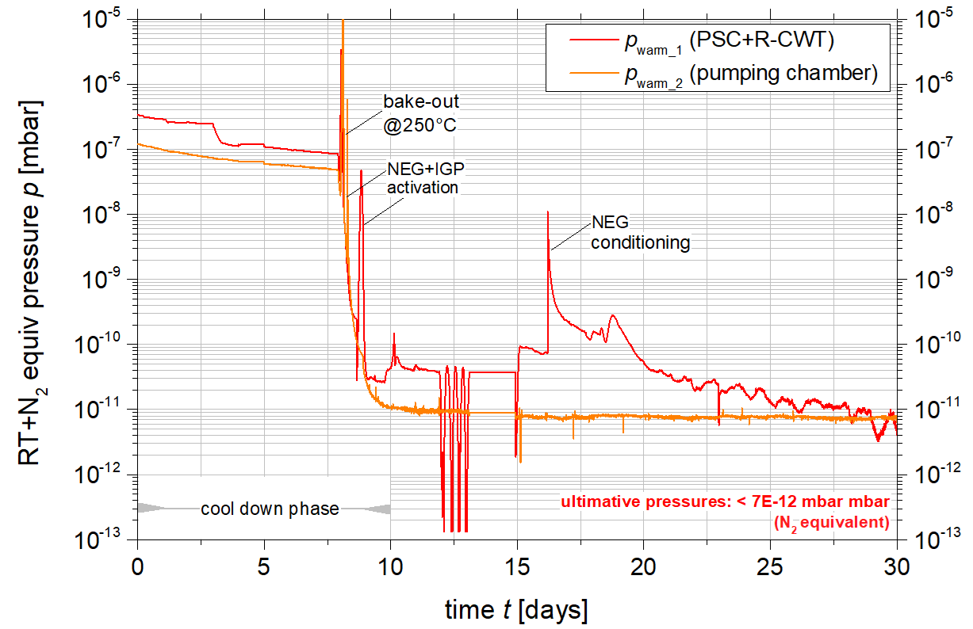
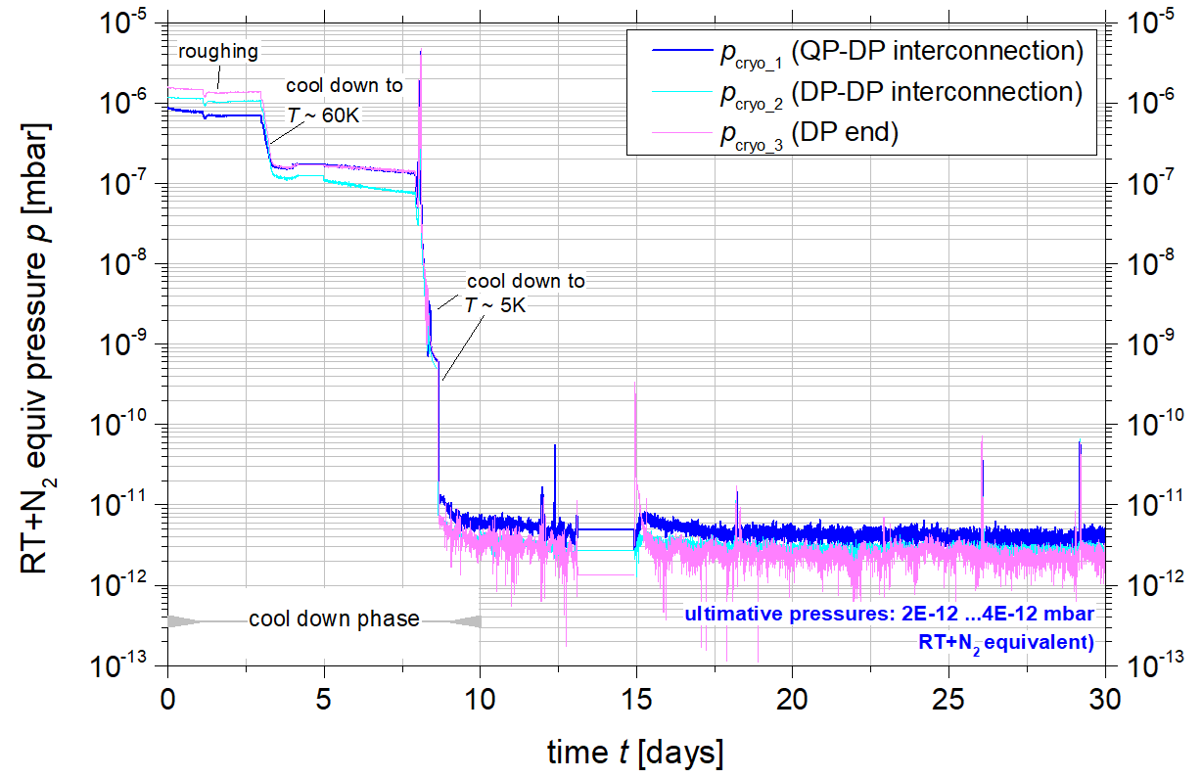
Performance – Beam vacuum / Pressures
Warm beam vacuum system
Pressure measurement along the cryogenic beam line with 3 extractor gauges flanged directly to the cold beam pipe at the interconnection areas
Cryogenic beam
vacuum system (~14m)
T = 293K)
quadrupole
chamber
cryo-
collimator
quadrupole
chamber
dipole
chamber
cryosorption
pump
dipole
chamber
CWT
BPM
T ≈ 5K
p_{warm_2}
R-CWT
+PSC
p_{cryo_1}
p_{cryo_2}
p_{cryo_3}
p_{warm_1}
low UHV pressures in warm beam vacuum system
XHV pressures in cryogenic beam vacuum system
gas type and temperature-corrected real pressure
p_{cryo}≈ 5E-13 mbar or lower

Slide 10

Performance – Beam vacuum
 | Required | Verified @ String
H₂ pressure in cryogenic beam vacuum (< 10K) | < 1E-12 mbar | 5E-13 mbar
H₂ pressure in RT vacuum system | < 3E-11 mbar | < 1E-11 mbar
ultimate temperature of cryogenic beam vacuum system (steady state) | < 5 K | ~ 5 K
Dominant residual gas component | H₂ | H₂
sc magnets and the beam vacuum system reached their planned ultimate temperatures within the expected time period
ultimate pressures and residual gas composition in the two short RT sections were achieved
generated residual gas densities in the cold beam vacuum system corresponded to H₂ vacuum pressures of ~ 5E-13 mbar or even less
density and temperature conditions along the string were constant over the entire duration of the cold phase
no leak-induced density increases were observed
The String test has demonstrated that He mass flows and the magnetic and vacuum cryogenic systems operate as expected
Beam vacuum quality requirements for future beam operation are fulfilled

Slide 11
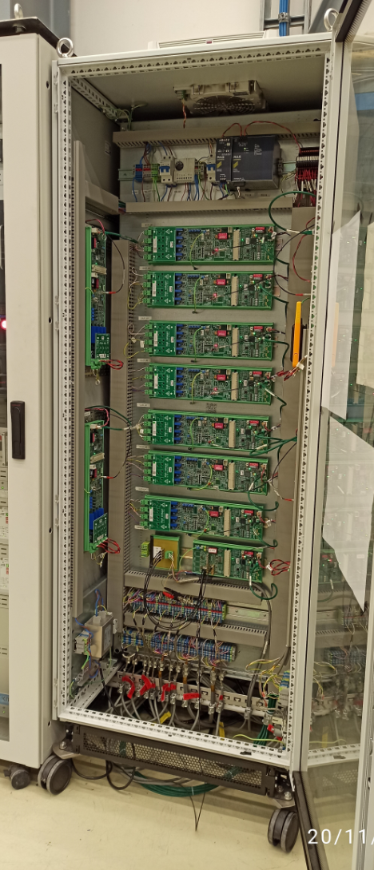
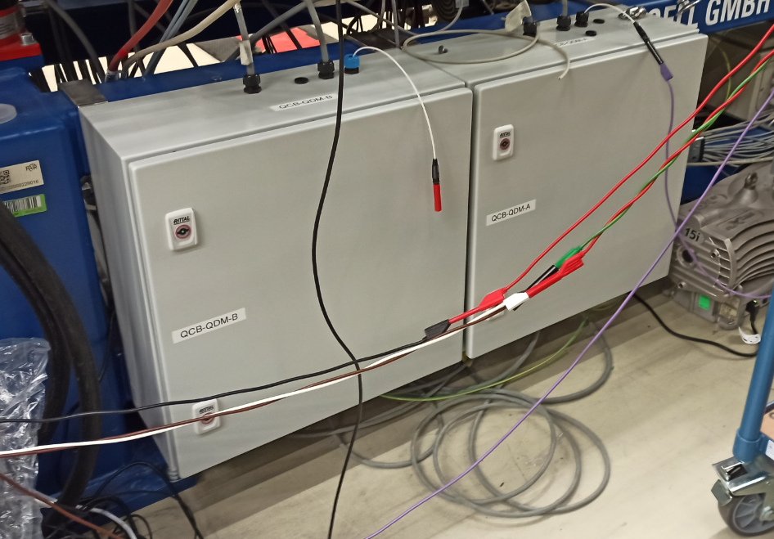
Setup – FAIR quench detection system
FAIR-QDS
Series quench detection electronics installed in the String
Dipole circuit monitored by 2 MCL detectors and 4 bridge detectors
Quadrupole circuit monitored by 2 MCL detectors and 3 bridge detectors
Both main circuits in an overlapping structure similar to SIS100 with quench conditioning boxes
Bridge cabling asymmetry was introduced on purpose Corrector circuits (2 x ST + 1 x CS) monitored by MID detectors
Open topics
Scaling and synchronization of the Dipole and Quadrupole circuits DCCTs (actually not a part of the F-QDS)
Synchronisation of signals acquired by different electronic boards:
  initially ±70 ms, currently ± 6 ms - still not enough
  search for optimal parameters for data frames (work in progress)
  consequence: difficulties with quench data interpretation for Dipole
  and Quadrupole circuits
FAIR quench dection system is reliable and safe to operate

Slide 12
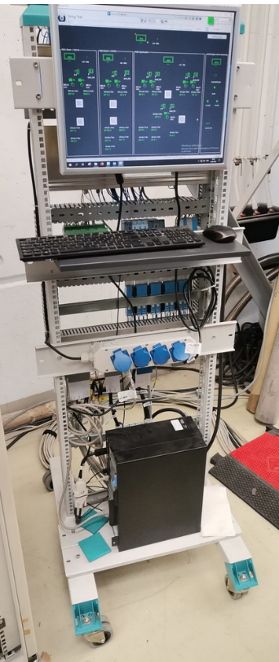
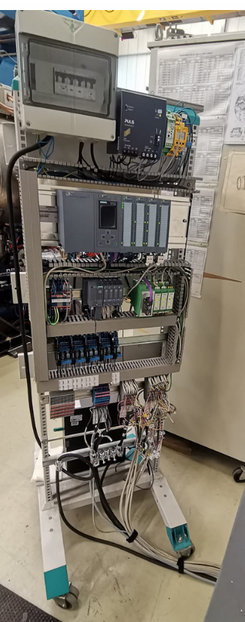
Setup – SIS100 cryo-control system
Key control functions tested to provide information on the control of the SIS100 cryogenics system
Construction (front) of PC and SCADA
Construction (back) of PLC and cabling
Accelerator Control System developed
for FAIR/GSI
  Objectives:
    Test IOs
    find configuration to heat SIS100 magnets
  Sensors and actors tested:
    CERNOX
    TVO
    PT100
    Thermocouple
    Current measurement
    PWM heater
Successful completion of the commissioning of the SIS100 cryo-controls at the String test

Slide 13
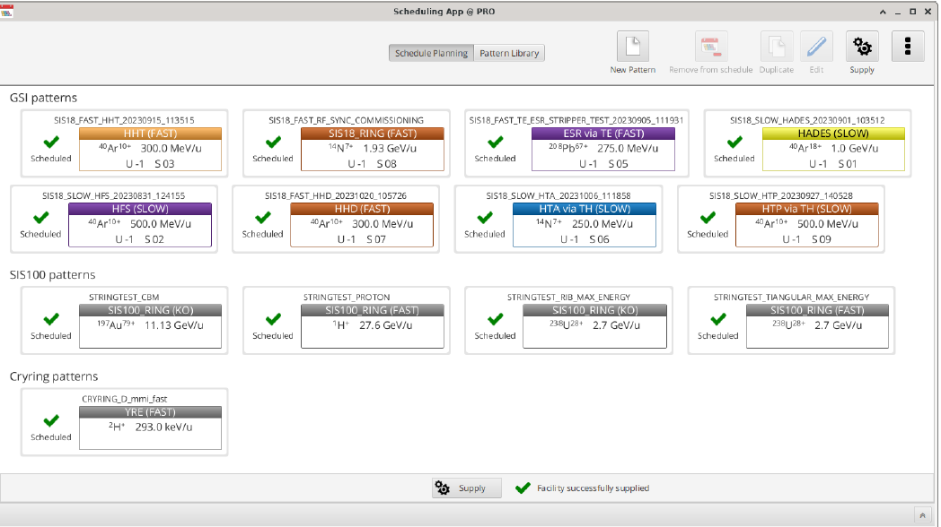
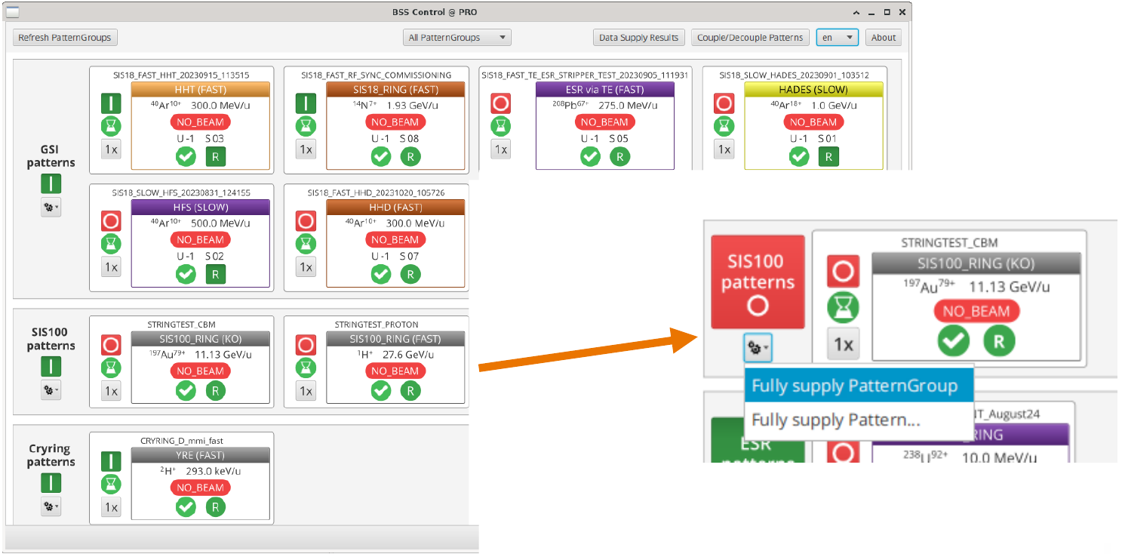
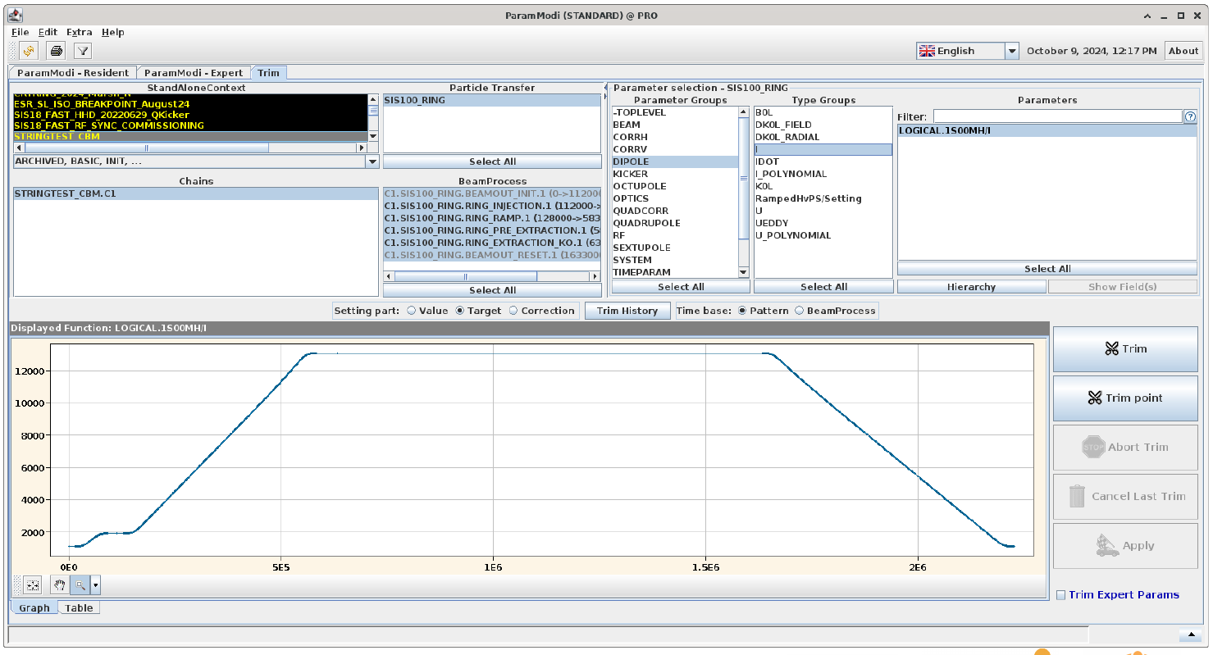
Setup – SIS100 accelerator control system
Applications provided by APP cover all standard operation software used in the central and local control rooms of FAIR
Physics parameters are typically modifyable by the user
Four SIS100 Patterns have been created for the String
the String circuits perform correctly
    no quenches
    no major issues
    powering tests continue...
SIS100 String test serves as a platform for the ACC control system

Slide 14
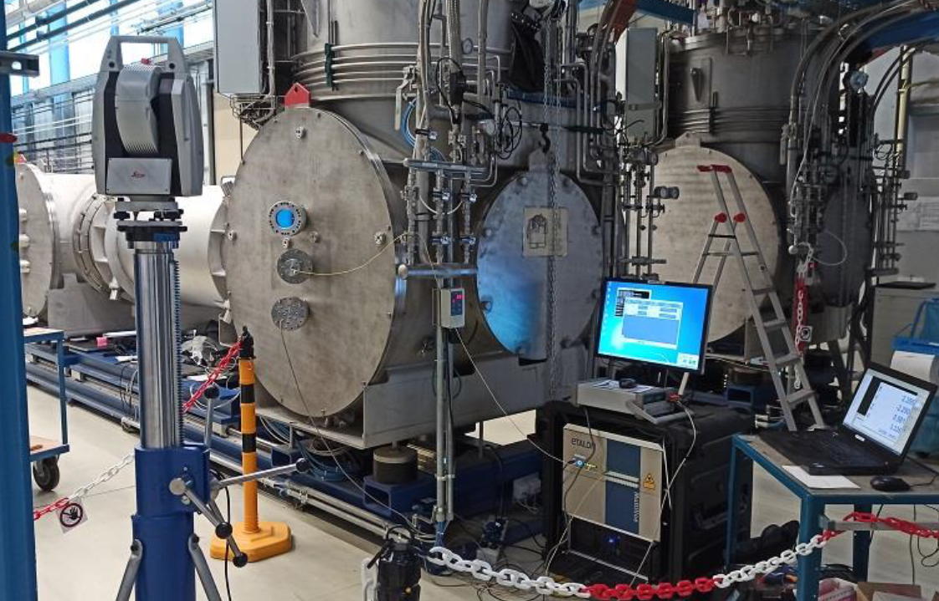
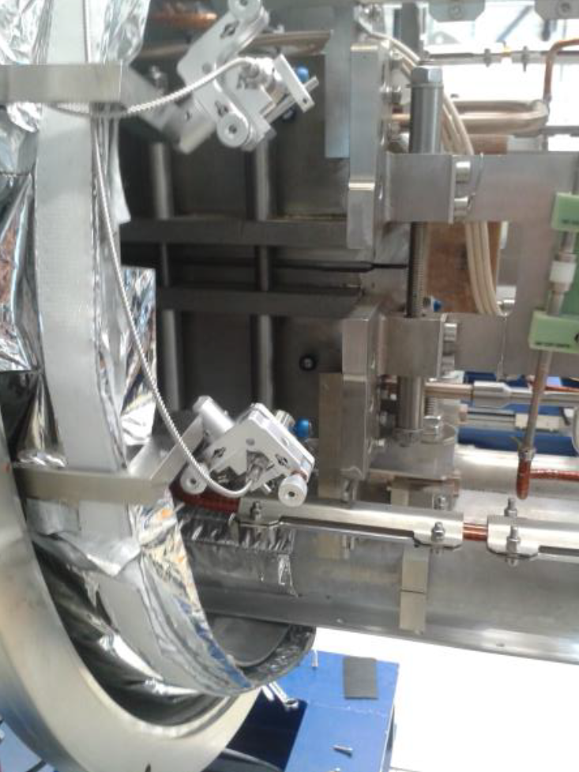
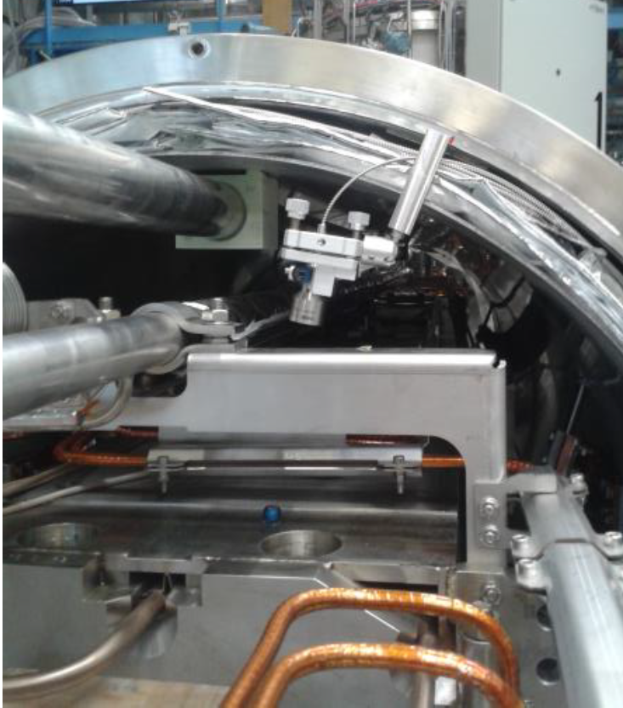
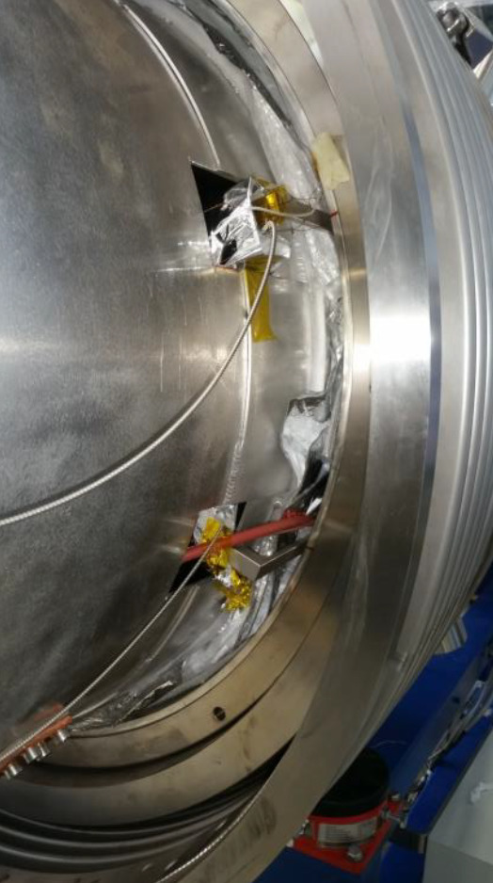
Measurements – Alignment
1
Laser tracker
Change of outer geometry
  relative to each other (cryostat vs. cryostat)
  absolute to external references (cryostats vs. sorrounding area)
2
Photogrammetry
Change of outer geometry
  relative to each other (e.g. cryostat vs. support frame vs. adjustment feet)
3
Absolute Multiline System
Change of inner geometry (cold mass vs. cryostat)

Slide 15
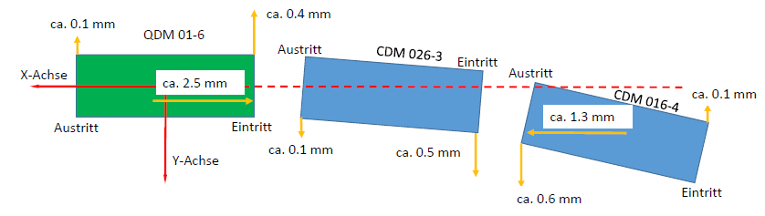
Measurements – Alignment
1
Laser tracker
Measurements @ room temperature - vacuum - 4K
The results refer exclusively to the String cryostats, NOT to the behaviour of the cold mass
String @vacuum – comparison between measurement at room temperature and at 4.5K

Slide 16
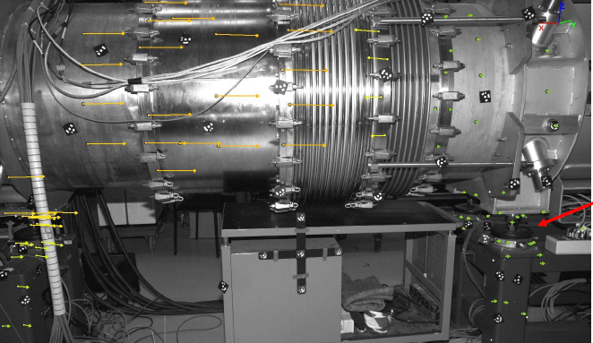
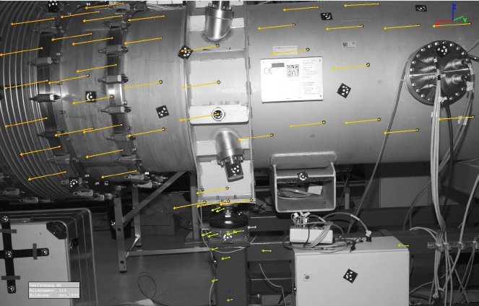
Measurements – Alignment
2
Photogrammetry
Verification of laser tracker results
Visualization of more details
Measurements @ RT – vacuum – 4K → measurement after cold cycle pending
QDM
DM
DM
Deformation after evacuation:
  dipole adjustment feet vs. cryostat → negligible
  cryostat vs. surrounding area ~ 0.15 mm
Deformation after evacuation:
  dipole adjustment feet vs. cryostat ~ 1.2 mm
  cryostat vs. surrounding area ~ 1.5 mm

Slide 17
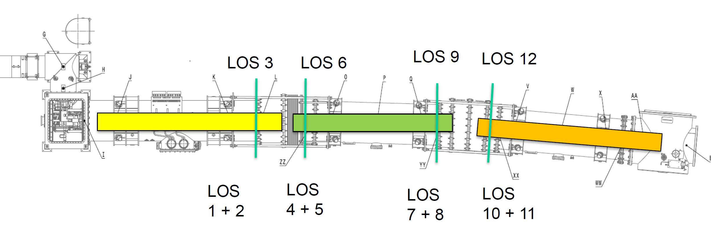
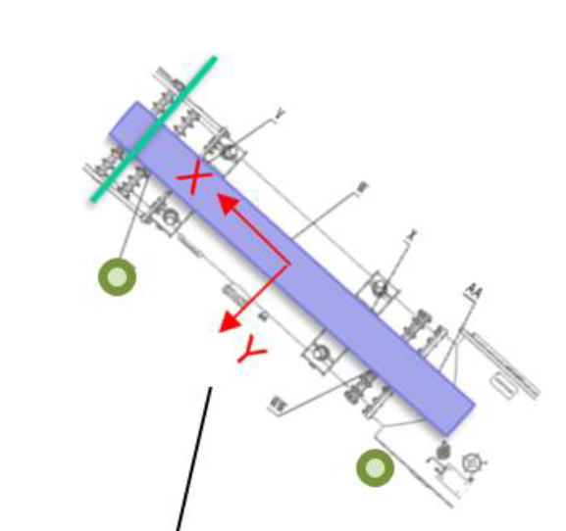
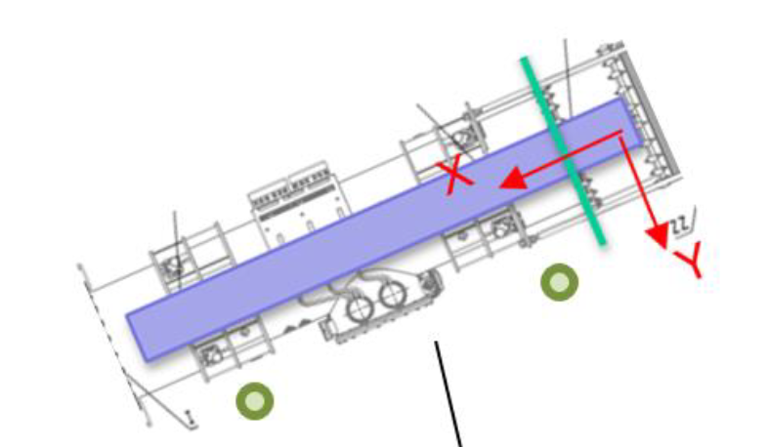
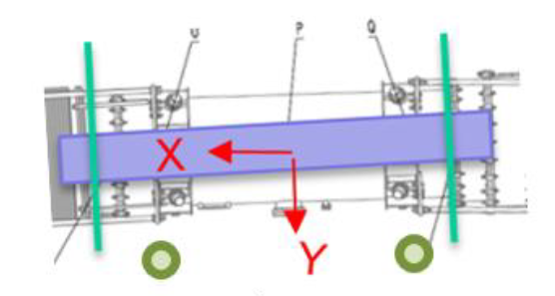
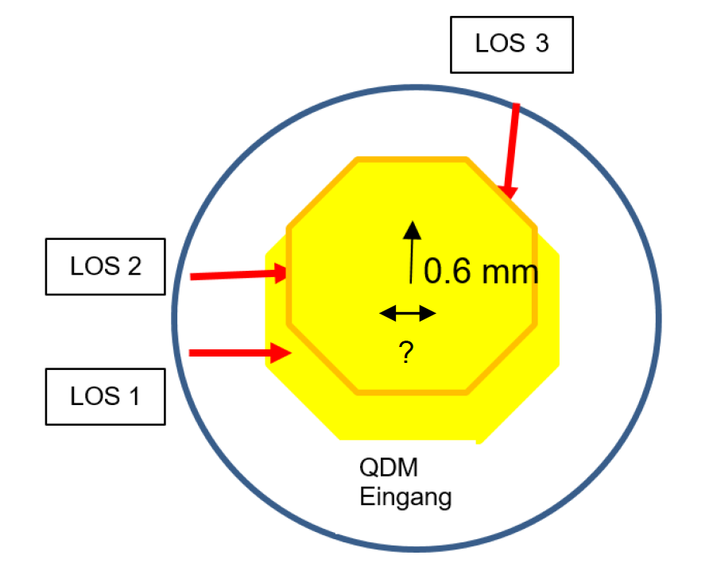
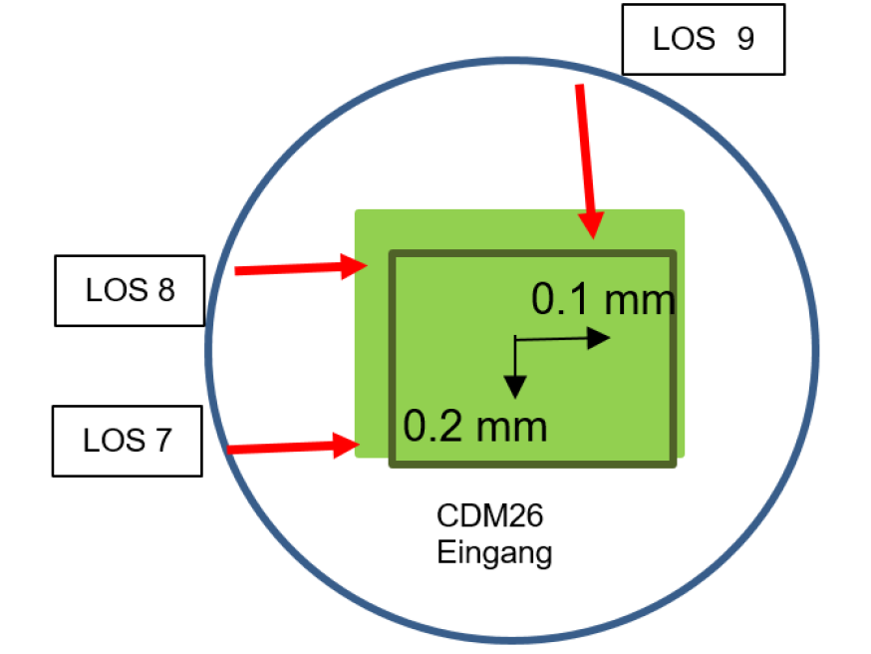
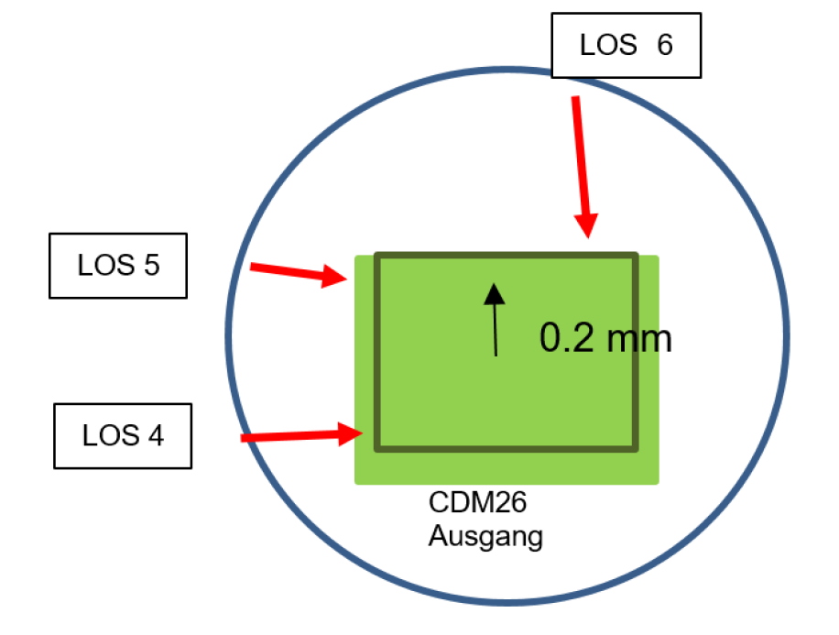
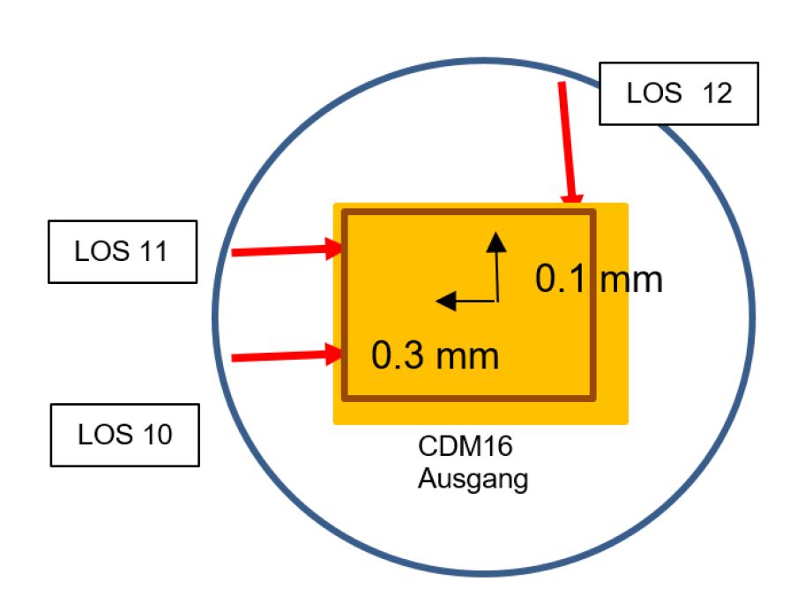
Measurements – Alignment
3
Absolute Multiline System
Monitoring lateral movement of the cold masses vs. cryostats @ RT and 4.5 K
AMS is a 1D interferometric system with 0.5 µm/m accuracy
Line of sight (LOS) created to detect translation and rotation around the beam axis
QDM
DM 26
DM16
X
X
X
Y
Y
Y
magnets cross sections

Slide 18
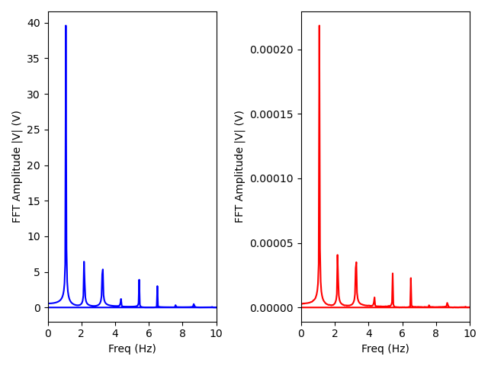
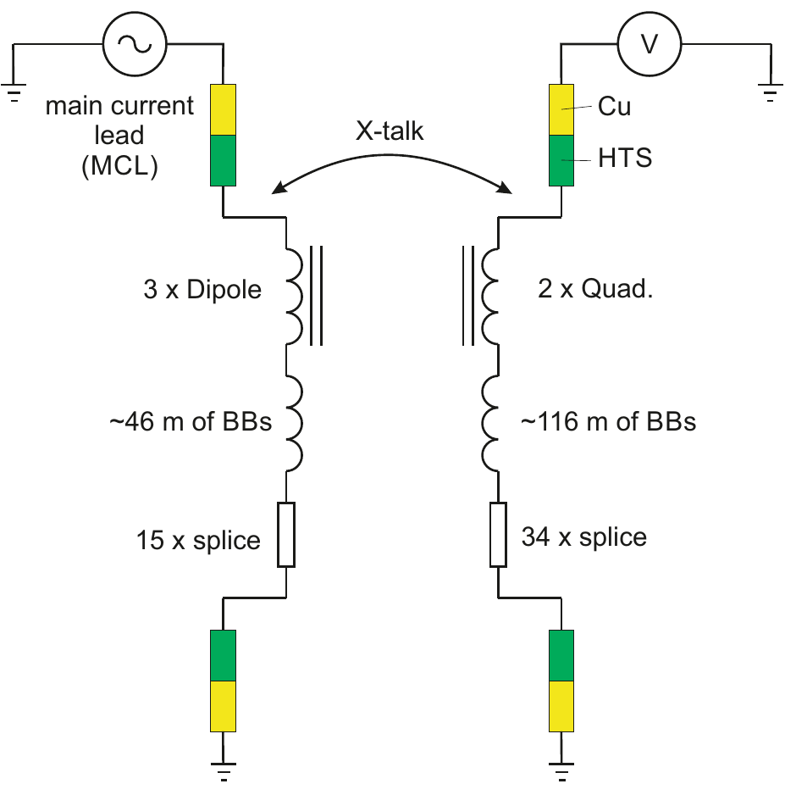
Measurements – Cross talk
Cross-talk between main circuits
Method: powering one of the main circuits and check if there is any induced signal in the other circuit
M
Measured inductance matrix for the String:
MDP-Q = LDP • VQ / VDP
{
}
LQ
Mutual inductance values:
  MDP-Q ≈ 10 nH between DP and Q
  MQ-DP ≈ 3 nH between Q and DP
LDP
 | L_ DP (μH) | L_ Q (μH)
L_ DP (μH) | 1.6E+03 | 9.00E-03
L_ Q (μH) | 3.00E-03 | 8.11E+02
Scaling to the SIS100 (x100) → M ≈ 1.0 μH
LBB = 0.25 μH/m
No significant cross talk between the dipole and quadrupole circuits

Slide 19
Tests – Beam vacuum / “Cryogenic bake-out”
Concept
Principle of a cryogenic bake-out
pumping capacity of cold beam line surfaces limited for H₂ and He → pressure in the cold beam vacuum sections increases with operating time
residual gases (mainly H₂) from the room temperature areas enter the cryogenic areas and increase surface coverage (adsorption isotherm)
cryogenic beam vacuum system of SIS100 designed to warm up independently on the sc magnets to allow for “regeneration” of the cold surfaces
Procedure
cryogenic beam tubes warmed up to approximately thermal shield temperatures → desorption of previously cryo-pumped gases (mainly H₂) from the cold surfaces
desorbing gases are pumped by the NEG-IGP pumps installed at the room temperature side
when the pressures in the cold system are ~1E-10 mbar, re-cooling is initiated to LHe temperatures
low XHV initial conditions in the cryogenic beam vacuum system are restored
Successful experimental test of the functionality of a “cryogenic bake-out” in the SIS100 String

Slide 20
Summary
Objectives
establishing installation sequence and procedures
verification of design and interfaces
preparation of work procedures and quality assurance
validation of the cryogenic system
quench and protection study
powering behavior of the system
functionality of the beam and insulation vacuum system
accelerator relevant operation
SIS100 String test serves as a test site for the installation processes, commissioning and operation of the SIS100 accelerator
String INSTALLATION succesfully completed in October 2023 important MILESTONE for the SIS100 achieved!!
Constant pressure and temperature conditions along the String over the entire duration of the cold phase
No thermomechanical damage to the cold mass even after repeated cold cycles
First energization of the String test electrical circuits with real current ramps of the SIS100 successfully carried out
No significant cross talk between the dipole and quadrupole circuits have been observed
Numerous precision measurements on the movement of cold masses and cryostats with different methods @ vacuum and 4.5K carried out
Experimental proof of the functionality of a „cryogenic bake-out“ at String was successful
Successful transfer of work instructions and QA documents from String test to the SIS100 installation
The team responsible for the installation of the String test is currently carrying out the installation in the SIS100
Sector 3

