Slide 1
Joint 5th Superconducting Magnets Test Facility Workshop
3rd Instrumentation and Diagnostics for Superconducting Magnets Workshop
PSI EPFL
Cryogenic developments for very high field magnets
Reduced gravity: Simon Bagnis, Clément Lorin, Hugo Reymond, Steffen Kramer (LNCMI)
PHP: Tisha Dixit, Gilles Authelet, Charles Mailleret, Florian Gouit, Vadim Stepanov
CFD: Marcin Opalski, Tisha Dixit, Przemysław Błasiak, Sławomir Pietrowicz (WUST)
Bertrand Baudouy
Université Paris-Saclay, CEA, IRFU, Département des Accélérateurs, de la Cryogénie et du Magnétisme bertrand.baudouy@cea.fr

Slide 2
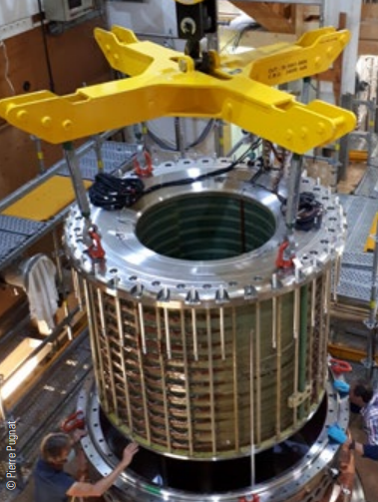
Outline
Very high field magnets cooling
  Cooling issue for very high magnetic field
  Heat transfer disturbance due to magneto-gravitational forces
Helium pool boiling under magneto-gravitational forces
  Experimental study
  Results under modified gravity
Cryogenic cooling of a HTS magnet
  Cryogenic pulsating heat pipe
  Cooling a 10T HTS magnet
Modeling Cryogenic PHP
  1 loop N₂ PHP

Slide 3
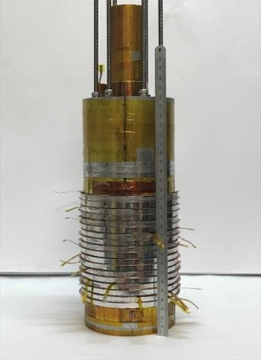
Very high field magnets cooling

Slide 4
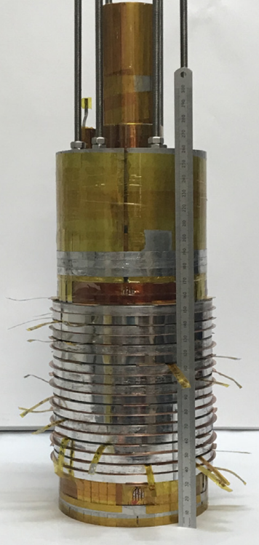
Cooling disturbance at high magnetic field (1/2)
Cooling problems with certain high-field magnets cooled with saturated liquid helium at 4.2 K
  NHMFL: 33,8 T [1]
  Magnet temperature not stabilized at 4.2 K
  CEA/CNRS: 32,5 T [2]
  Magnet temperature not stabilized at 4.2 K
  HMFLCAS: 31,5 T [3]
  Continuous rise in temperature until a “quench” is reached
Phenomenon already observed at MIT in 1986 in liquid helium [4]
Assumption: Heat transfer disturbances due to magneto-gravitational forces
NOUGAT magnet [2]
[1] : W. D. Markiewicz et al. 33.8 Tesla with A YBa2Cu3O7 superconducting test coil, 2010
[2] : Ph. Fazilleau et al. 38 mm diameter cold bore metal-as-insulation HTS insert reached 32.5 T in a background magnetic field generated by resistive magnet. Cryogenics, 2020
[3] : D. Jiang et al. Energizing behaviors of a no-insulation and layer-wound REBCO coil in high magnetic field Cryogenics, 2019
[4] : L. G. Rubin et al, 33.6 T DC magnetic field produced in a hybrid magnet with Ho pole pieces,1986

Slide 5
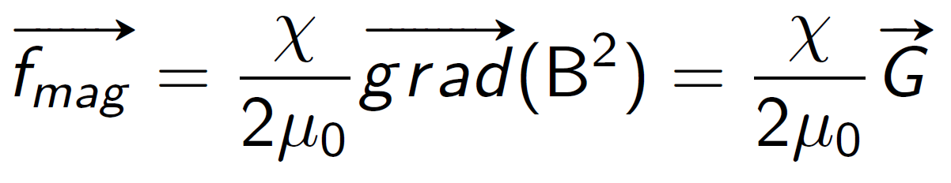
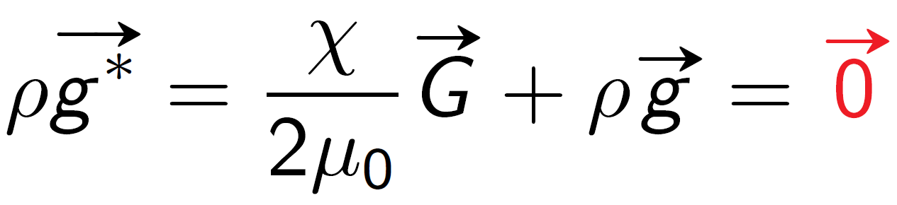
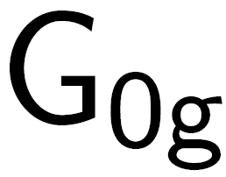
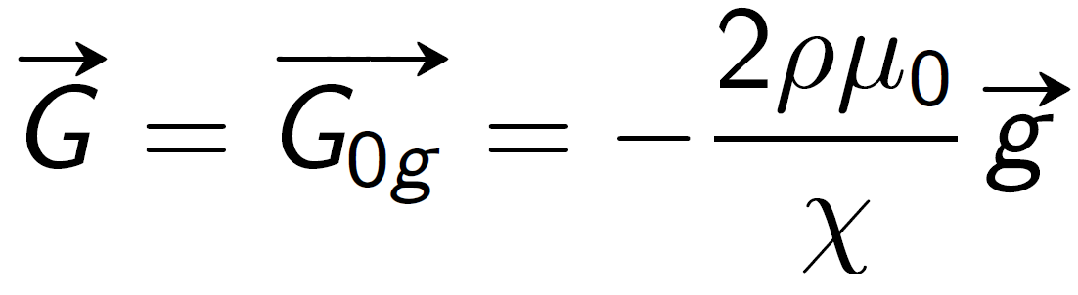
Cooling disturbance at high magnetic field (2/2)
Magnetic forces and other associated physical parameters
Resulting acceleration  resulting gravity
Compensation of gravity if
f_{mag}
g
g
 | T (K) | (T²/m)
H₂ | 20 | -1000
He | 4,2 | -4170
H₂O | 293 | -2721
N₂ | 77 | -4425

Slide 6
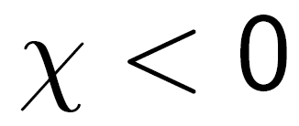
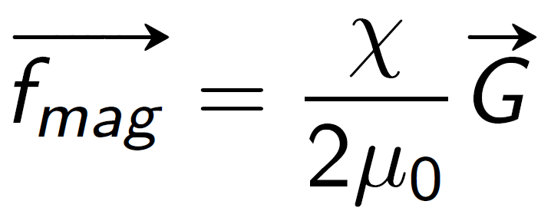
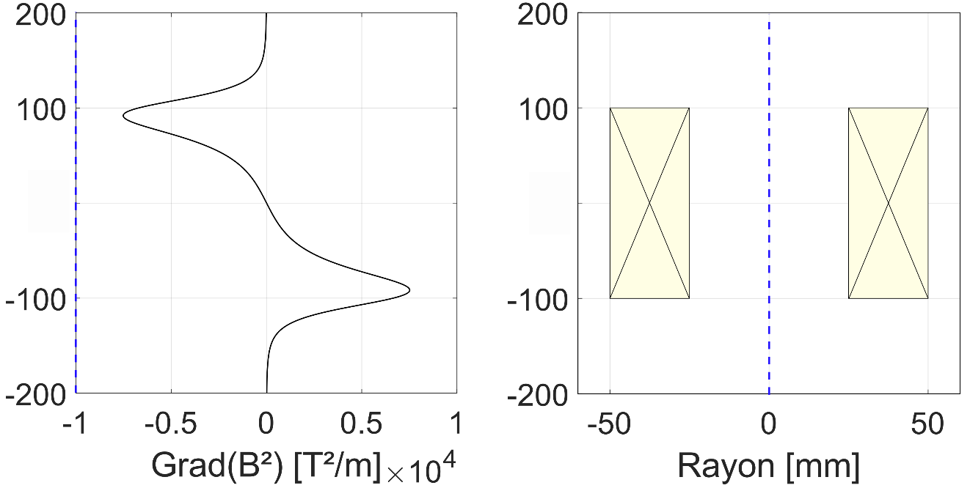

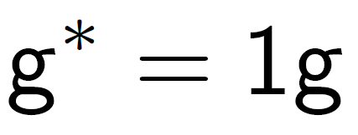
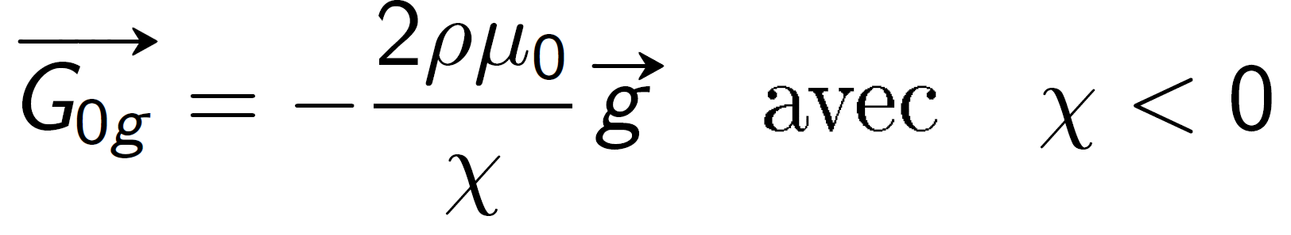

Example for a superconducting solenoid
For a diamagnetic fluid
In the upper part, vertical magnetic forces oppose gravity
At the magnet center, magnetic forces are null
In the lower part, vertical magnetic forces add to gravity
Magnetic gradient on the solenoid axis
Solenoid geometry
Axis [mm]
0
Radius [mm]
Diamagnetic levitation is only possible in the upper part

Slide 7
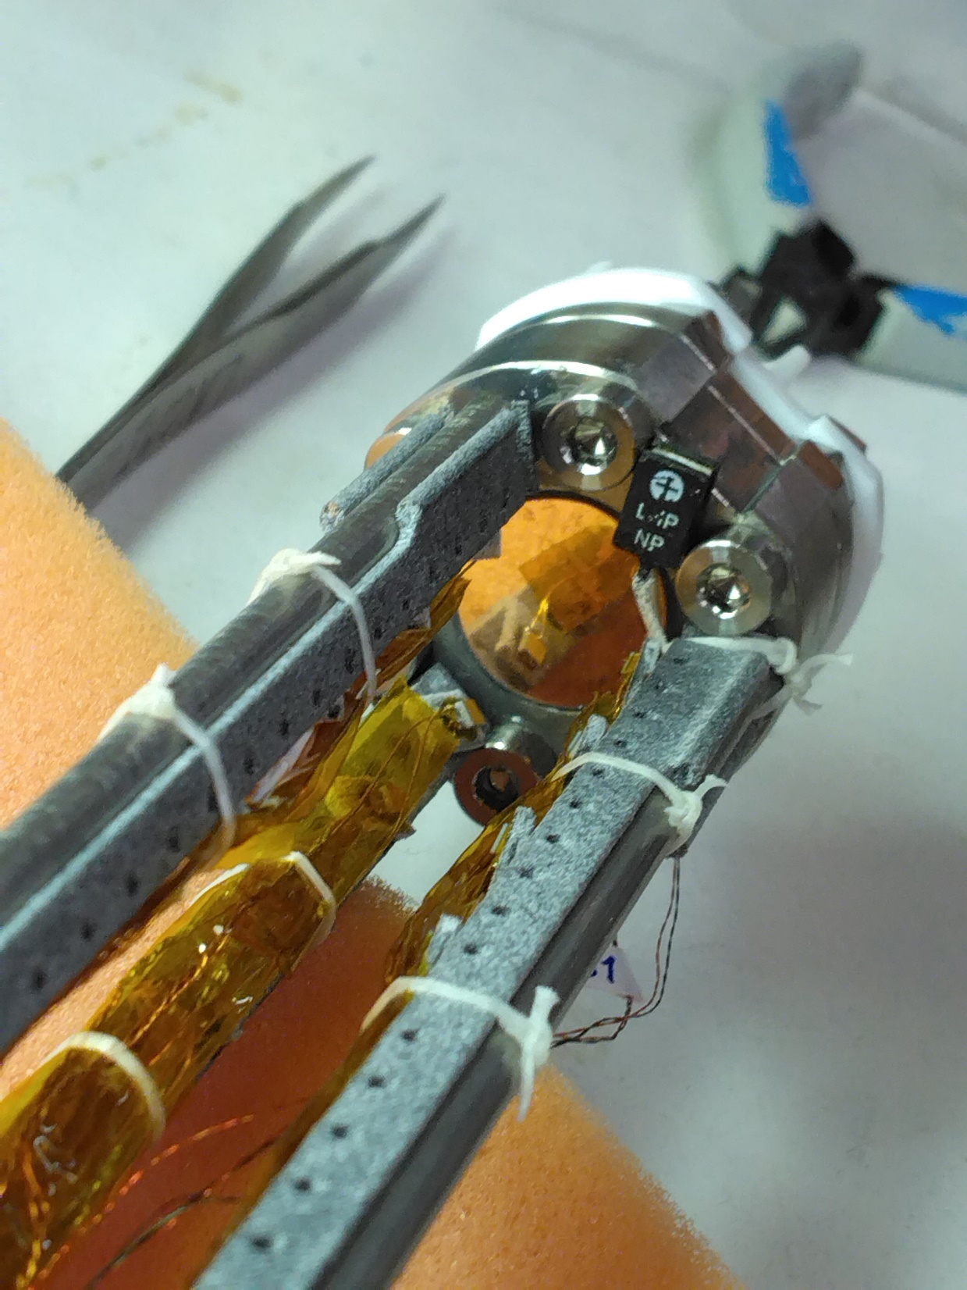
He pool boiling under magneto-gravitational forces

Slide 8
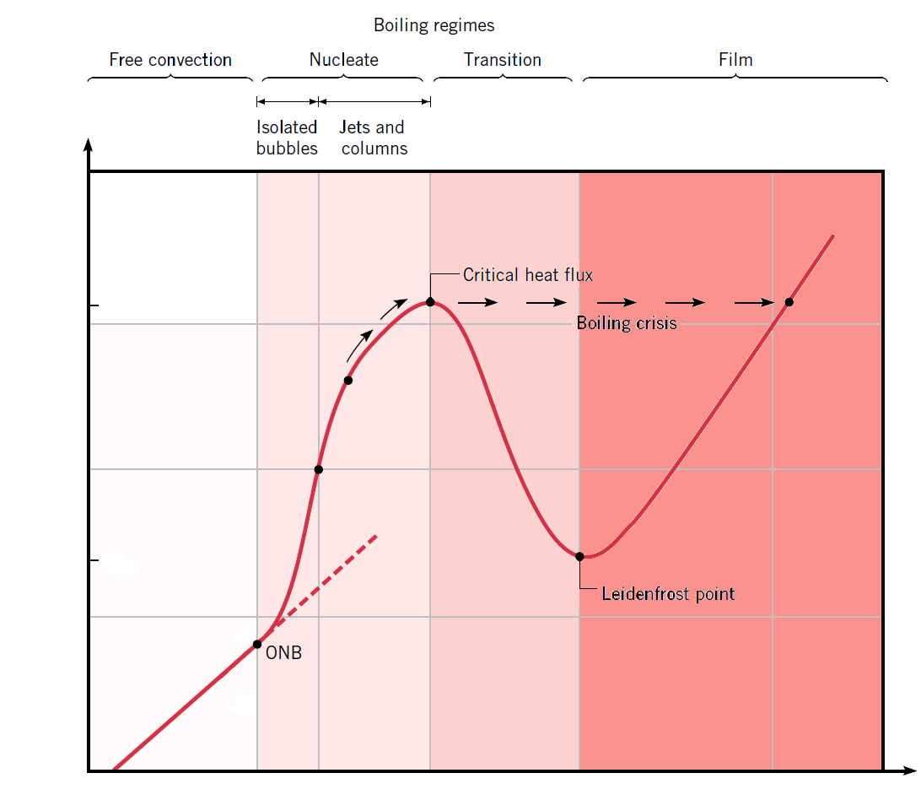
He pool boiling under magneto-gravitational forces
Experimental study of He pool boiling under modified gravity with magneto-gravitational forces
Measurement of the boiling curve (Nukiyama) for different g*
q (W/m²)
q_{max}
q_{min}
ΔT (K)

Slide 9
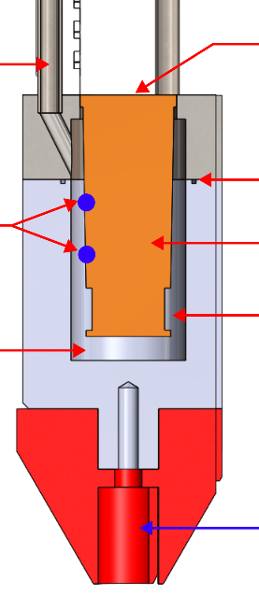
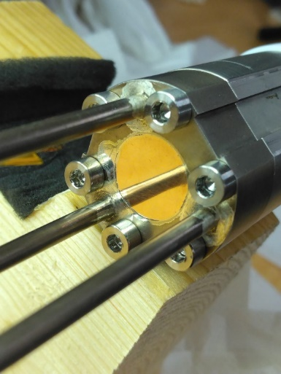
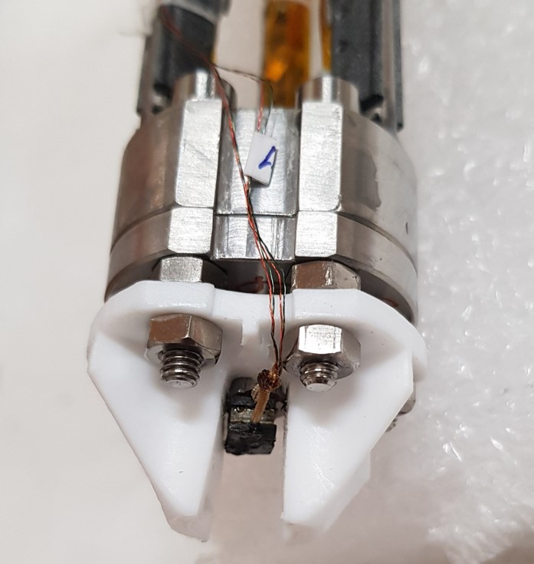
He pool boiling under magneto-gravitational forces
Magnetically transparent experimental cell
  Titanium vacuum can
  Copper heated surface
  Temperature sensors to determine the surface temperature
  Hall probe to evaluate the field and cell positioning
LHe
Heated surface
Vacuum pumping
Temperature sensors
Indium joint
Copper
Vacuum
Heater
Hall probe
S. Bagnis. PhD, https://theses.hal.science/tel-04227350

Slide 10
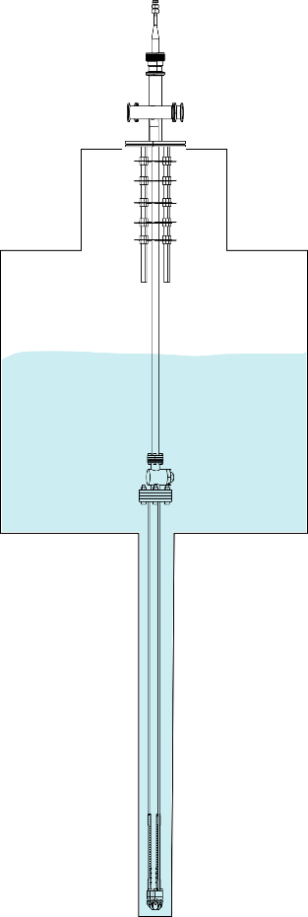
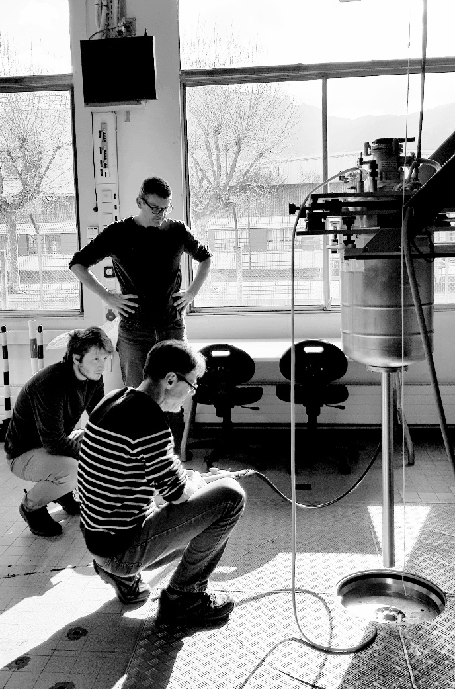
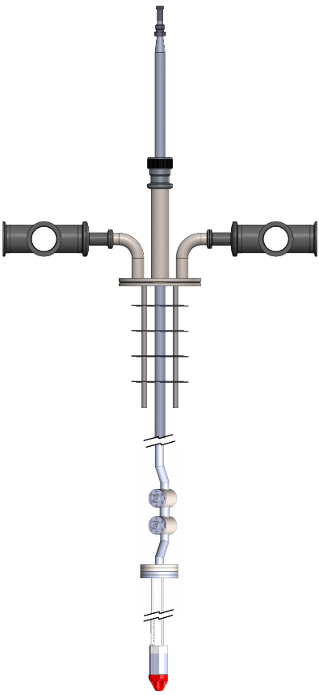
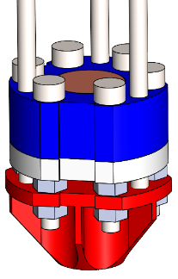
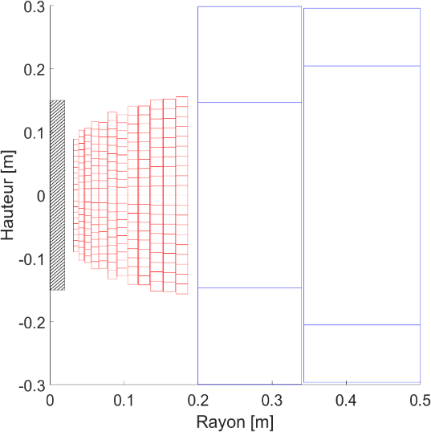
He pool boiling under magneto-gravitational forces
Tests at LNCMI (Grenoble) in a 30 T resistive magnet
  38 mm warm bore
  Axial positioning for different g*
LHe
S. Bagnis. PhD, https://theses.hal.science/tel-04227350

Slide 11
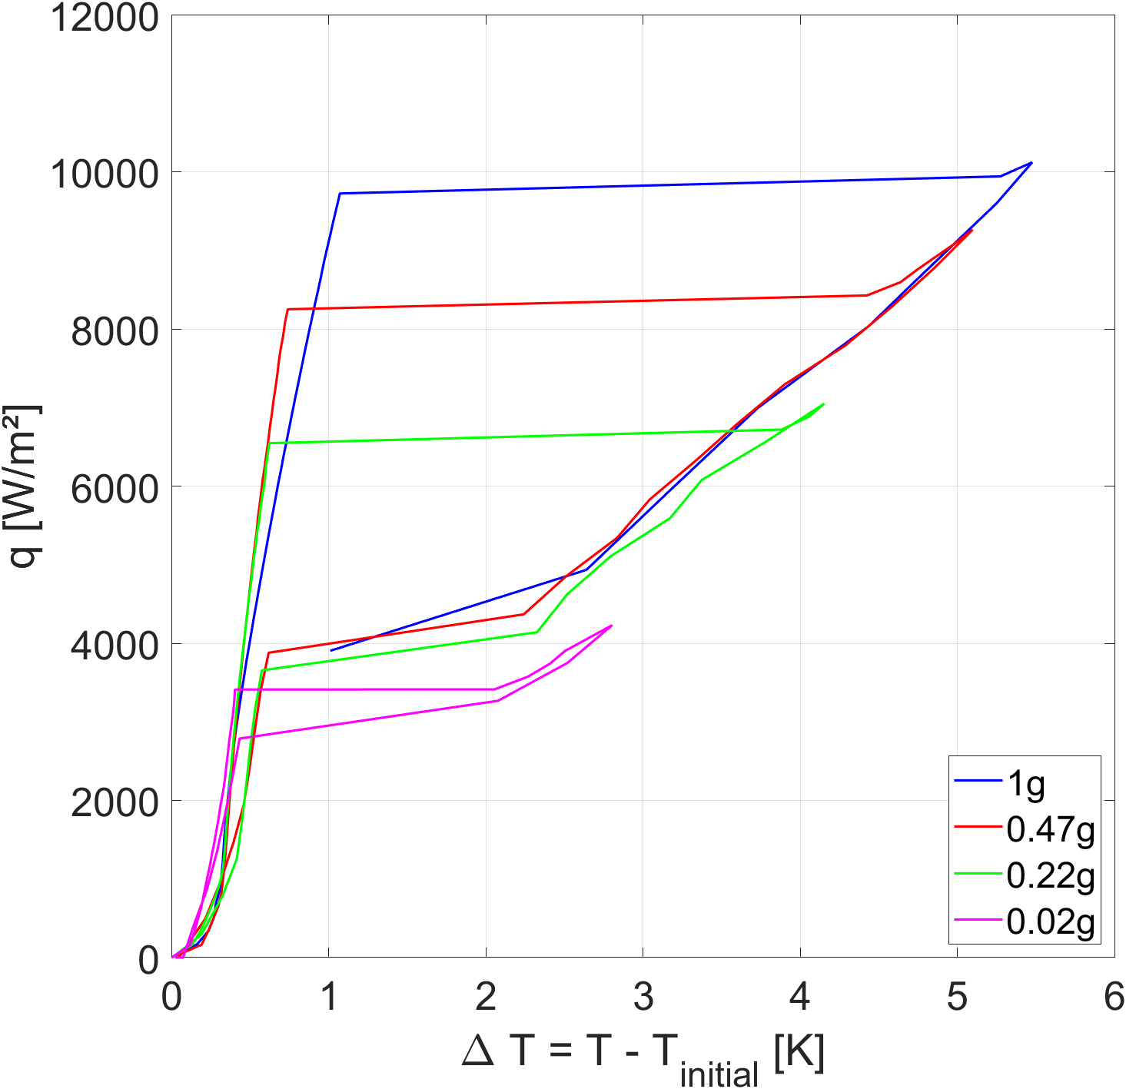
He pool boiling under magneto-gravitational forces
LHe pool boiling curve measurement in a quasi static mode
Entire boiling curve covered
Nucleate boiling regime
  170 W/m² per min
Critical heat flux detection
Film boiling regime (q+)
  500 W/m² per min
Film boiling regime (q-)
  500 W/m² per min
Detection of minimum heat flux (recovery heat flux)
S. Bagnis et al. Helium pool boiling critical heat flux under various magnetically controlled gravity levels, International Journal of Heat and Mass Transfer, Volume 221, 2024, 125107
https://doi.org/10.1016/j.ijheatmasstransfer.2023.125107

Slide 12
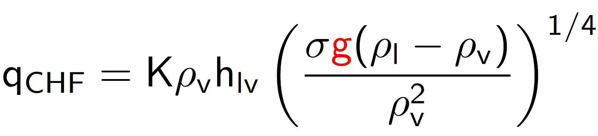
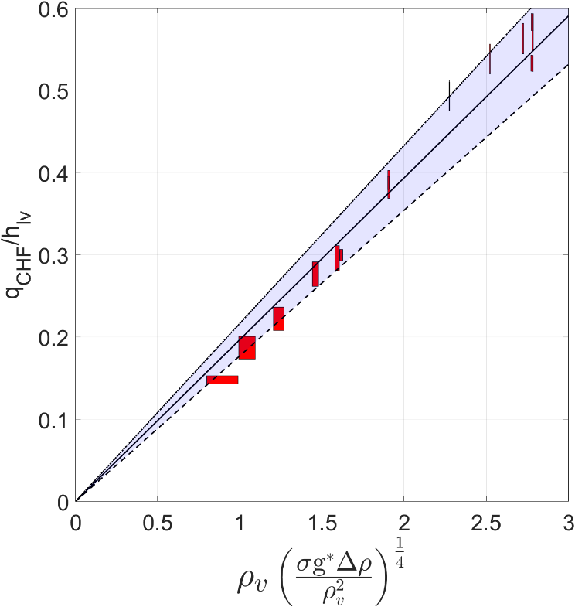
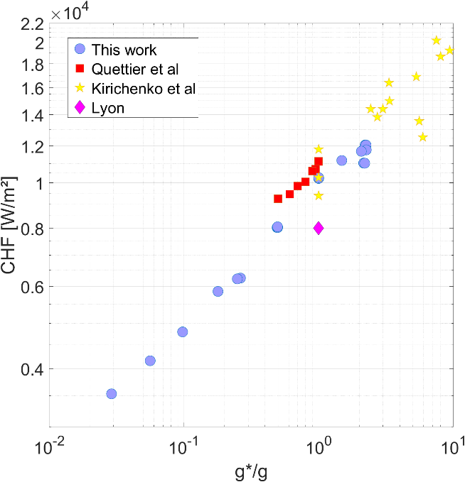
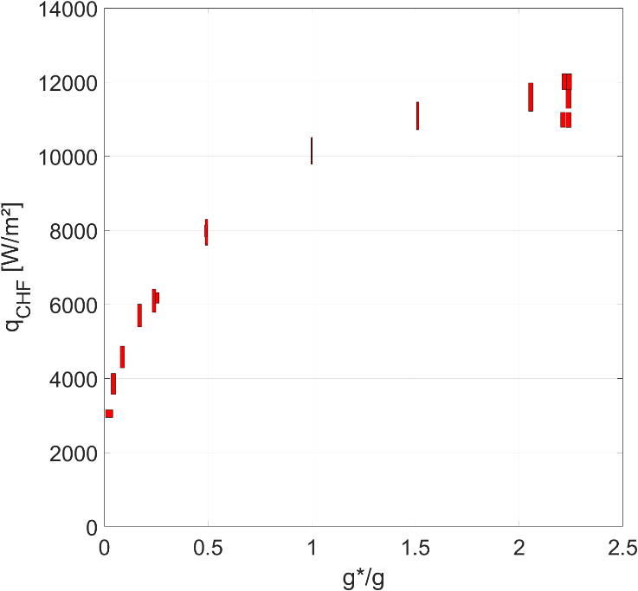
He pool boiling under magneto-gravitational forces
LHe pool boiling critical heat flux
Kutateladze correlation-like
K=0,197
Good accuracy with the correlation from 0.03g to 2,2g
K very close to literature values
S. Bagnis et al. Helium pool boiling critical heat flux under various magnetically controlled gravity levels, International Journal of Heat and Mass Transfer, Volume 221, 2024, 125107
https://doi.org/10.1016/j.ijheatmasstransfer.2023.125107

Slide 13
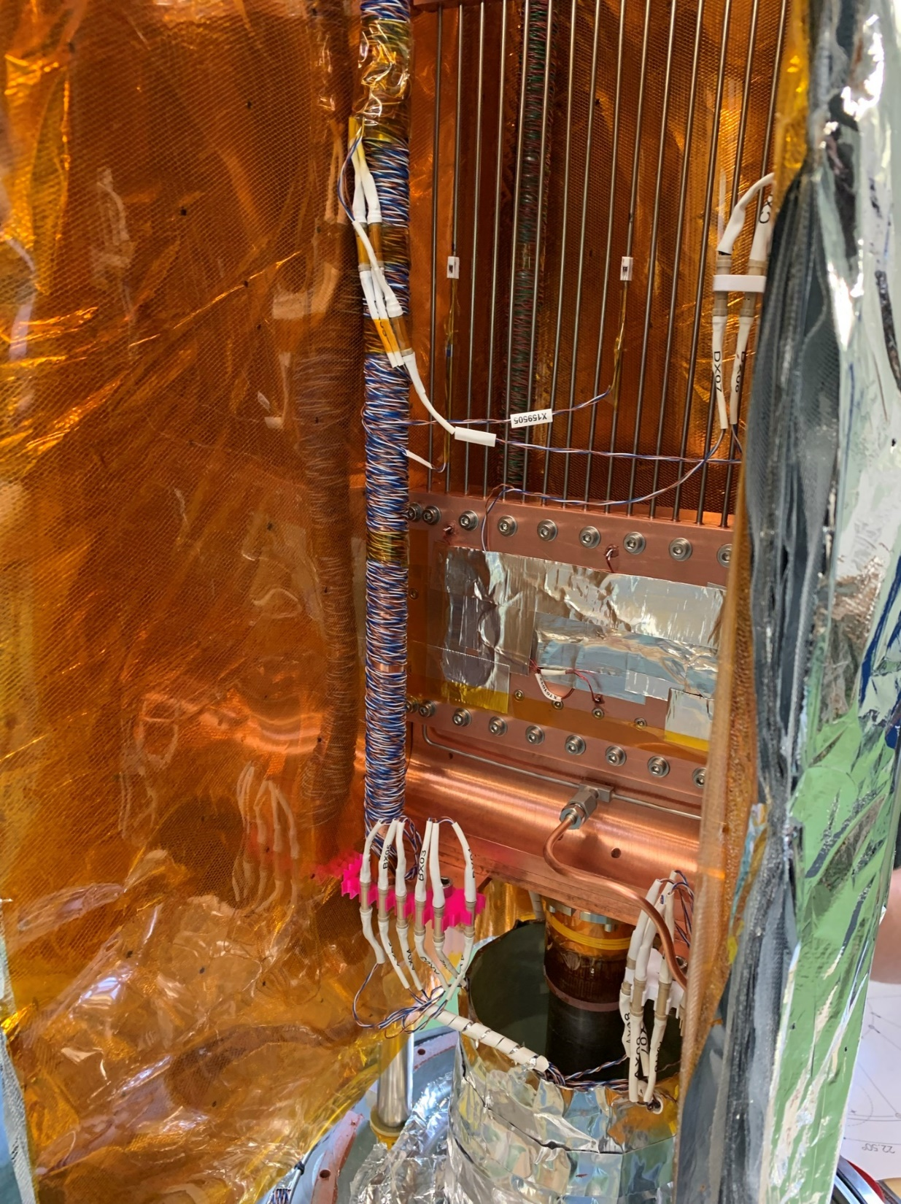
Cryogenic cooling of a 10T HTS magnet

Slide 14
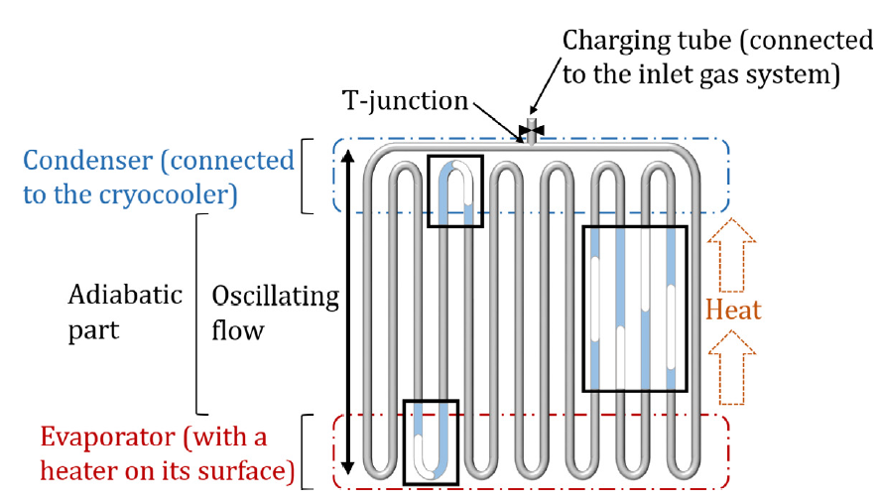
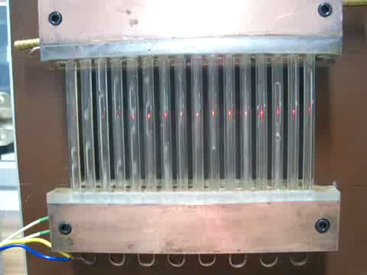
Cryogenic PHP
Two-phase passive heat transfer device
  having oscillating train of liquid slugs and vapor bubbles as thermal transport carriers
  Filled partially with working cryo-fluid operating at its saturation condition
Why using a pulsating heat pipe?
  Almost gravity independent
  Heat transfer/weight ⟶ 100 better than eq. copper link
  Easy to construct, bendable, flexible, light….
  Some drawbacks
    If gravity, most of other heat pipes are more efficient
    Heat transfer very small before reaching saturation
    Cryocoolers do not like magnetic field
Water PHP Credits: Prof. Sameer Khandekar, IIT Kanpur, India

Slide 15
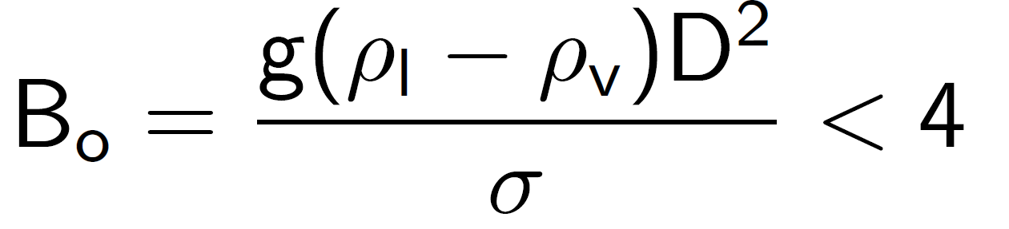
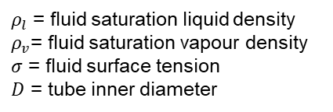
Cryogenic PHP design
Choice of PHP capillary tube diameter based on widely accepted, fluid property dependent Bond number criterion
Choice of other physical characteristics:
  Length of condenser, adiabatic part, evaporator
  Material of condenser/evaporator and capillary tubes
  Number of PHP tubes
$ρ_{l}$ = fluid saturation liquid density
$ρ_{v}$= fluid saturation vapour density
$σ$ = fluid surface tension
$D$ = tube inner diameter
Good starting point but validity of theory deliberated!
Dixit et al. “Oversized diameter helium pulsating heat pipe” ATE 2024
Governing phenomena not completely understood: currently choice based on results of experiments.
1D/2D numerical models being developed

Slide 16
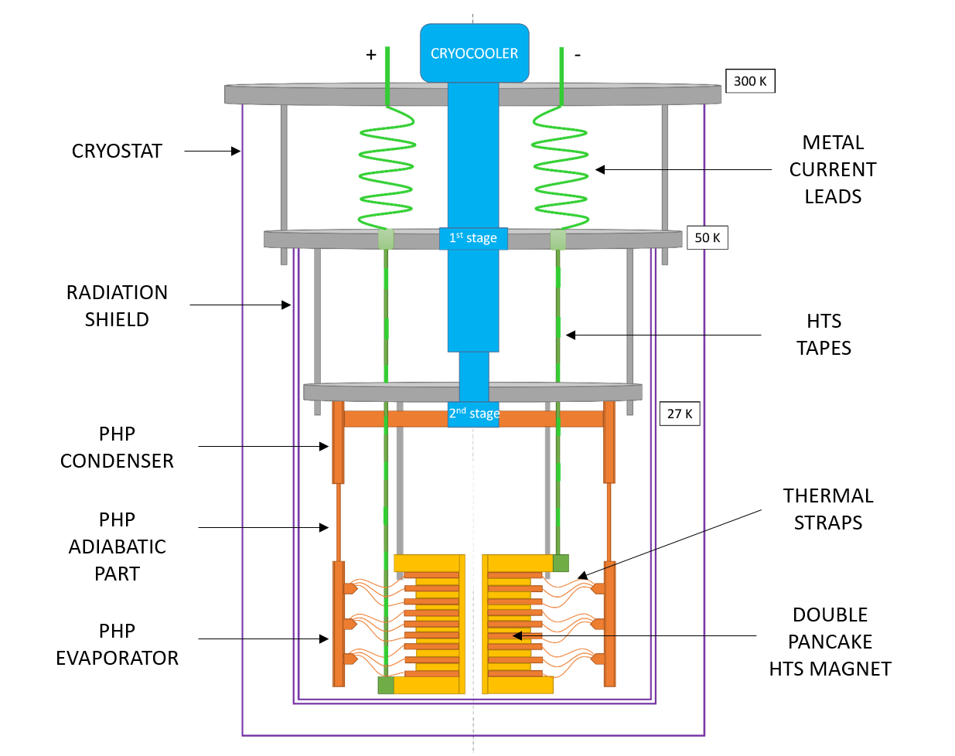
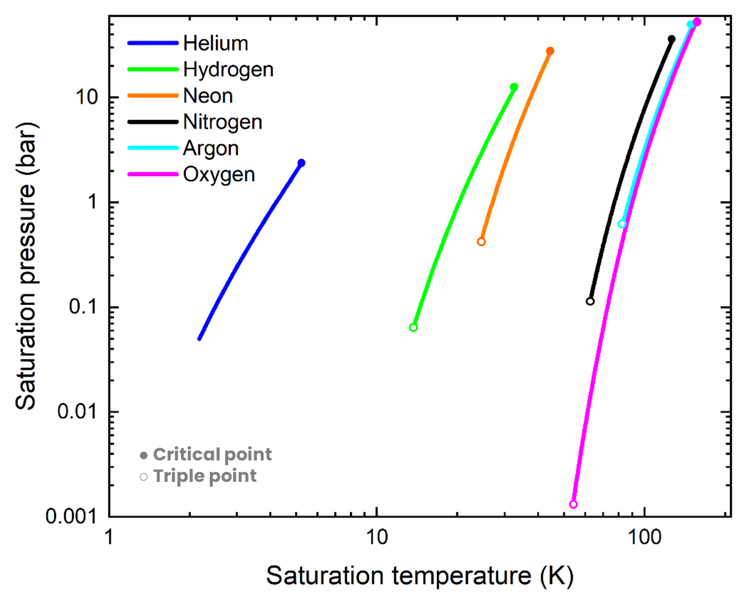
Cooling high field magnet
Demonstrate the generation of 10 T with HTS SC magnet cooled by a single cryocooler and PHPs at neon temperature as thermal links
Saturation curves (P,T)

Slide 17
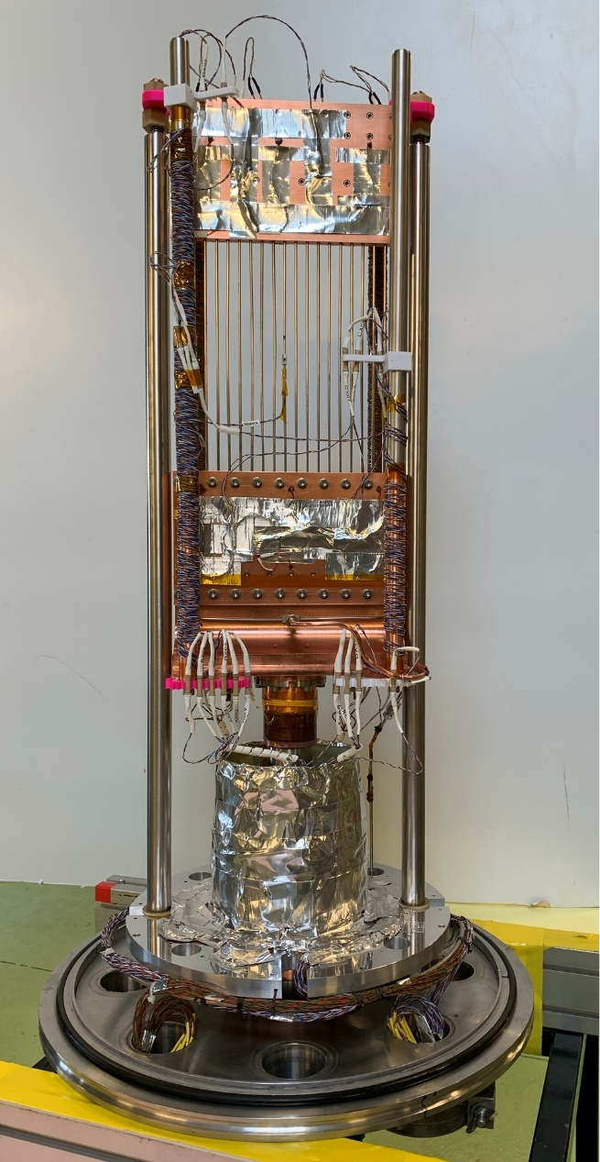
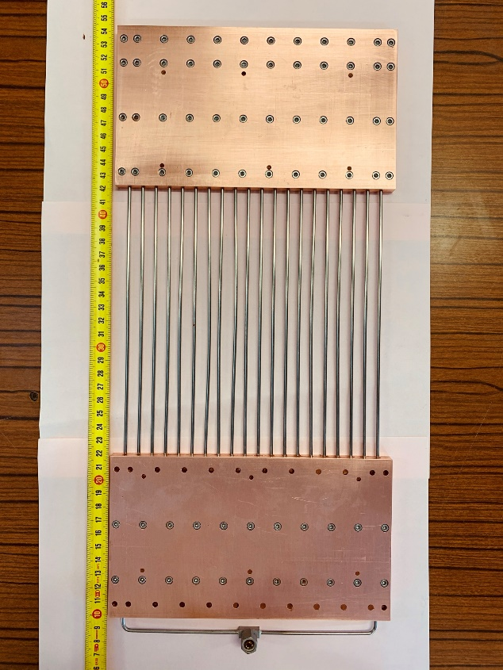
Neon PHP for HTS magnet
Chosen PHP parameters
Material = SS316L
Inner diameter = 1.0 mm
Outer diameter = 2.5 mm
Number of tubes = 20
Length = 440 mm
Bo ≈ 2,5
Evaporator
Adiabatic section
120 mm
Condenser
2nd stage
200 mm
1st stage
120 mm
Cryocooler
T Dixit et al 2022 IOP Conf. Ser.: Mater. Sci. Eng. 1240 012076, https://iopscience.iop.org/article/10.1088/1757-899X/1240/1/012076/meta

Slide 18
Neon PHP for HTS magnet
Evaporator and condenser temperature measurement
Pressure outside of the cryostat (at room temperature) so not really the PHP one
Vertical and horizontal orientations
18 W is reached at @ T_{condenser} = 27.1 K due to cryocooler max capability
FR=V_{liquid}/V_{total}
  Dixit et al., Cryogenics 132 (2023) 103670, https://doi.org/10.1016/j.cryogenics.2023.103670

Slide 19
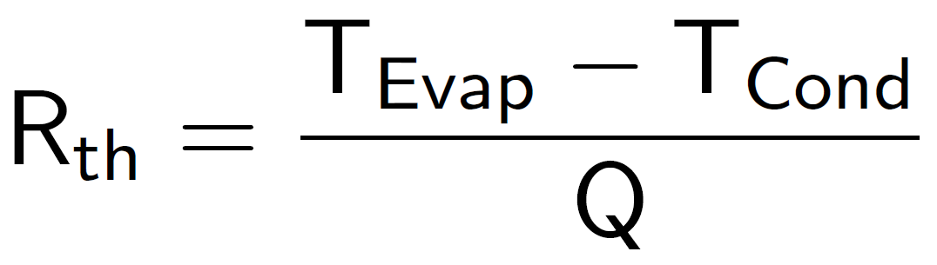
Neon PHP for HTS magnet
At 18 W, Lower thermal resistance for FR=40 %
Orientation effect
  ΔT = 3.9 K for vertical orientation
  ΔT = 5.1 K for horizontal orientation
  Dixit et al., Cryogenics 132 (2023) 103670, https://doi.org/10.1016/j.cryogenics.2023.103670

Slide 20
He PHP
Bo number based on the critical diameter where vapor structure is trapped as a bubble in a capillary tube and starts to move, i.e. for v_{bubble}=0
But “plug flow” exists for non null velocity, i.e. for Bo>4 ⟶ Limit?
Test in helium and 1 mm diameter ⟶ Bo≈12
Dixit et al., Applied Thermal Engineering 251 (2024) 123613 https://doi.org/10.1016/j.applthermaleng.2024.123613

Slide 21
He PHP
Stable working condition in pressurized liquid state in evaporator (T>T_{c})
Stable working condition in supercritical state in evaporator
Visualization is needed to clarify the flow regimes
Stable working conditions for 65 hours
  FR = 40.6% and 0.6 W in vertical orientation
  FR = 64.6% and 0.2 W in horizontal orientation
Dixit et al., Applied Thermal Engineering 251 (2024) 123613 https://doi.org/10.1016/j.applthermaleng.2024.123613

Slide 22
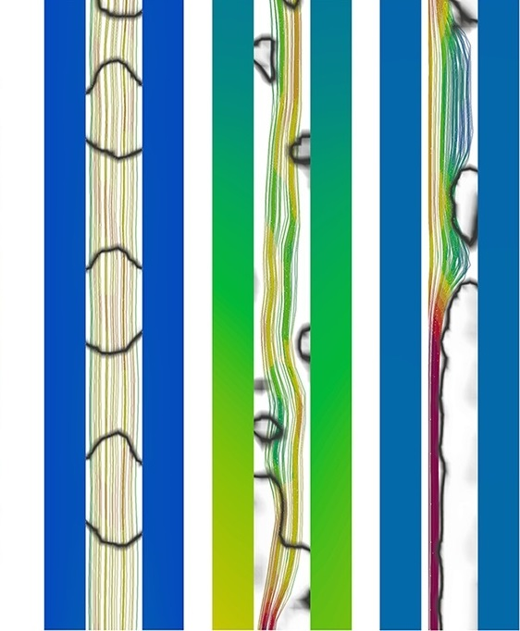
Modeling Cryogenic PHP

Slide 23
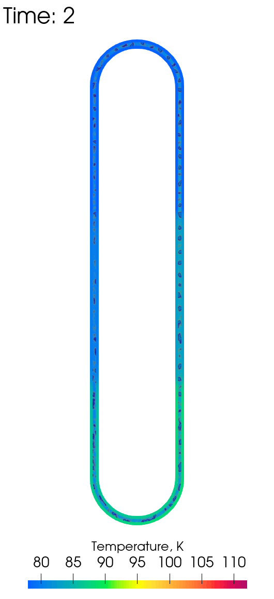
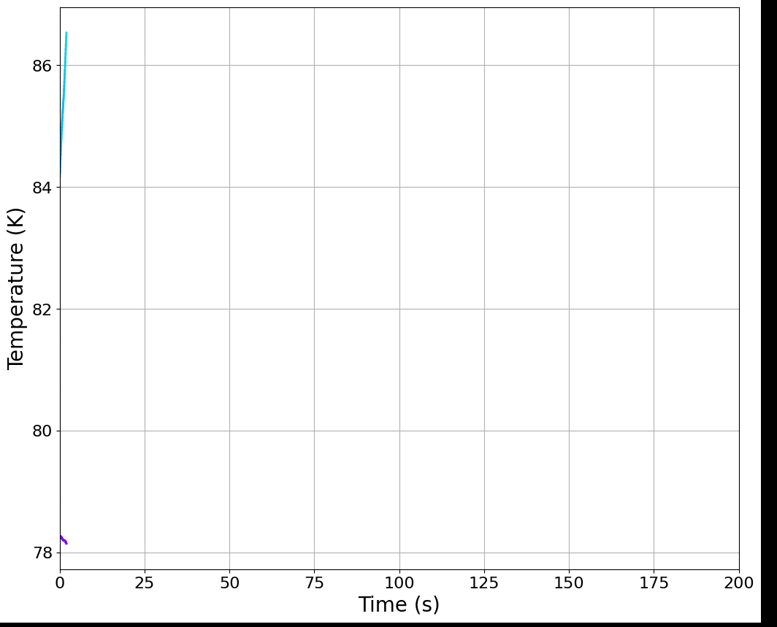
Modeling Cryogenic PHP
Open∇FOAM toolbox providing tools to solve Navier-Stokes equations:
  Fraction conservation equation for multiphase flow
  Mass and momentum conservation equations
  Energy conservation equations with phase change
s
18 W
N₂ PHP
Temperature and fraction contours inside of 1 loop PHP
Marcin Opalski et al. Modeling of cryogenic pulsating heat pipe using CFD techniques, Cryogenics, Volume 147, 2025, 104061,
https://doi.org/10.1016/j.cryogenics.2025.104061

Slide 24
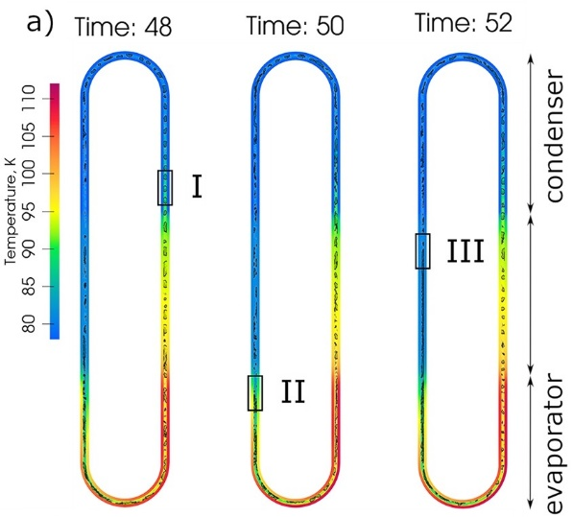
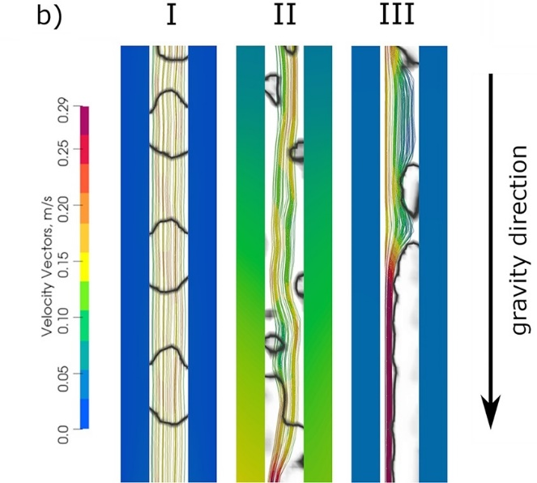
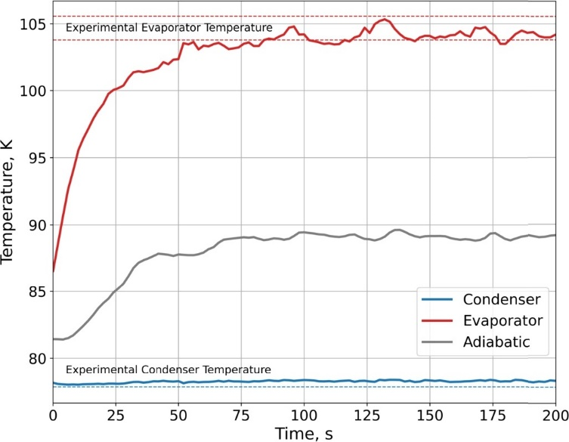
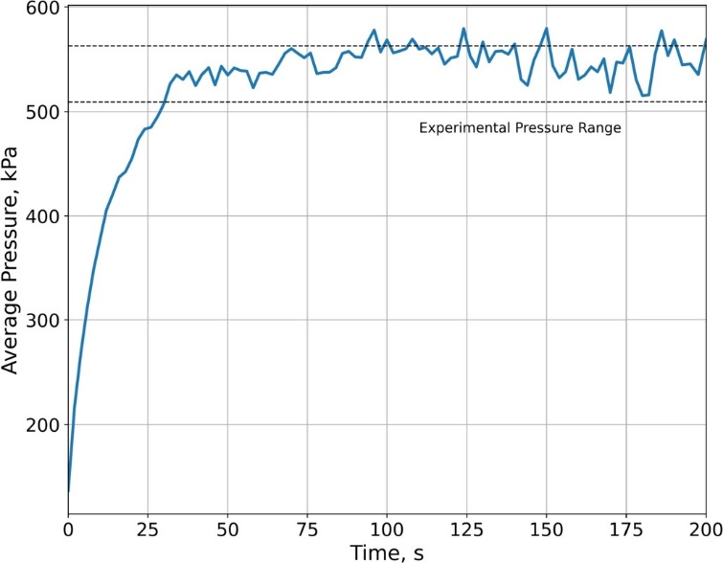
Modeling Cryogenic PHP
s
s
s
Data from K.R. Sagar et al. Novel condenser based cryogenic pulsating heat pipe: investigations on influence of geometrical parameters, Cryogenics, 126 (2022), Article 103543
Marcin Opalski et al. Modeling of cryogenic pulsating heat pipe using CFD techniques, Cryogenics, Volume 147, 2025, 104061,
https://doi.org/10.1016/j.cryogenics.2025.104061

Slide 25
Future work
Reduced gravity
Adding visualization to the LHe boiling test facility under reduced gravity
PHP
Study of the diameter size effect on the thermal performance
Flexible PHP evaporator to match the magnet geometry
Bending effect
Velocity bubble measurement with capacitance method
Modeling PHP
Computations extended to other cryogens
Comparison with a smaller CEA-made PHP

