Slide 1
FRESCA Test Facility
CERN Sc cable test stations
J. Fleiter, F. Girardot, A. Vande Craen and T. Boutboul
Contributions from many CERN colleagues in different departments
5th Superconducting Magnet Test Facility Workshop March 29 – April 4, 2025, Bad Zurzach, Switzerland

Slide 2
Outline
FRESCA1
FRESCA2
Fabrication and installation of FRESCA2
Electrical circuits
Cryogenic distribution
Overview of typical measurements in FRESCA

Slide 3
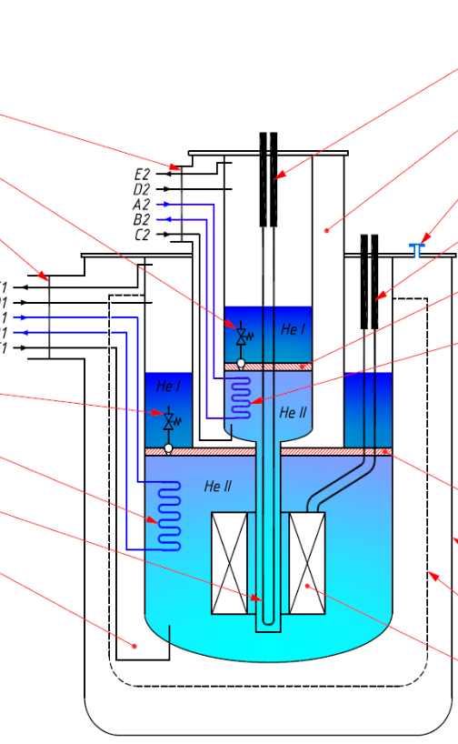
Introduction to FRESCA
FRESCA : Facility for Reception of Superconducting Cables (High Energy collider application)
Electrical characterization of Sc cables in LHe and in transverse field of up to 13 T, located @ CERN in b 163
  FRESCA 1:
    in operation @ CERN since 1998
    T=1.9-4.3 K
    Field of up to 9.6 T
    Used for qualification of LHC and HL LHC cables
  FRESCA 2:
    Installed @ CERN, being commissioned
    T=1.9-4.3 K in LHe, possible higher Temp in GHe
    operating field of up to 13 T
    Will be use for qualification of HFM and R&D cables

Slide 4
Type of measurements
Rutherford cables (Nb-Ti, Nb₃Sn), round cables (Nb-Ti, MgB_{2,}HTS), HTS stacks , Roebel cable…
UI-measurements (B, B-direction, T and dI/dt) ⇒Ic, Iq, n-value
UB-measurements (I, B-direction, T and dB/dt) ⇒flux jump stability
RRR measurement (as function of B if needed)
Measurement of the self field along the cable ⇒transport current distribution among the strands, BICCs
Measurement of splice/joint resistances (accuracy better than 0.05 nΩ)
Measurement of (Minimum) Quench Energy (as function of B, I, T, heater position, heat pulse duration)
Measurement of quench velocity (as function of B, T)
More details in next slides
A.P. Verweij, Workshop on test facilities and measurement equipment needed for the LHC exploitation , 12 April 2006

Slide 5
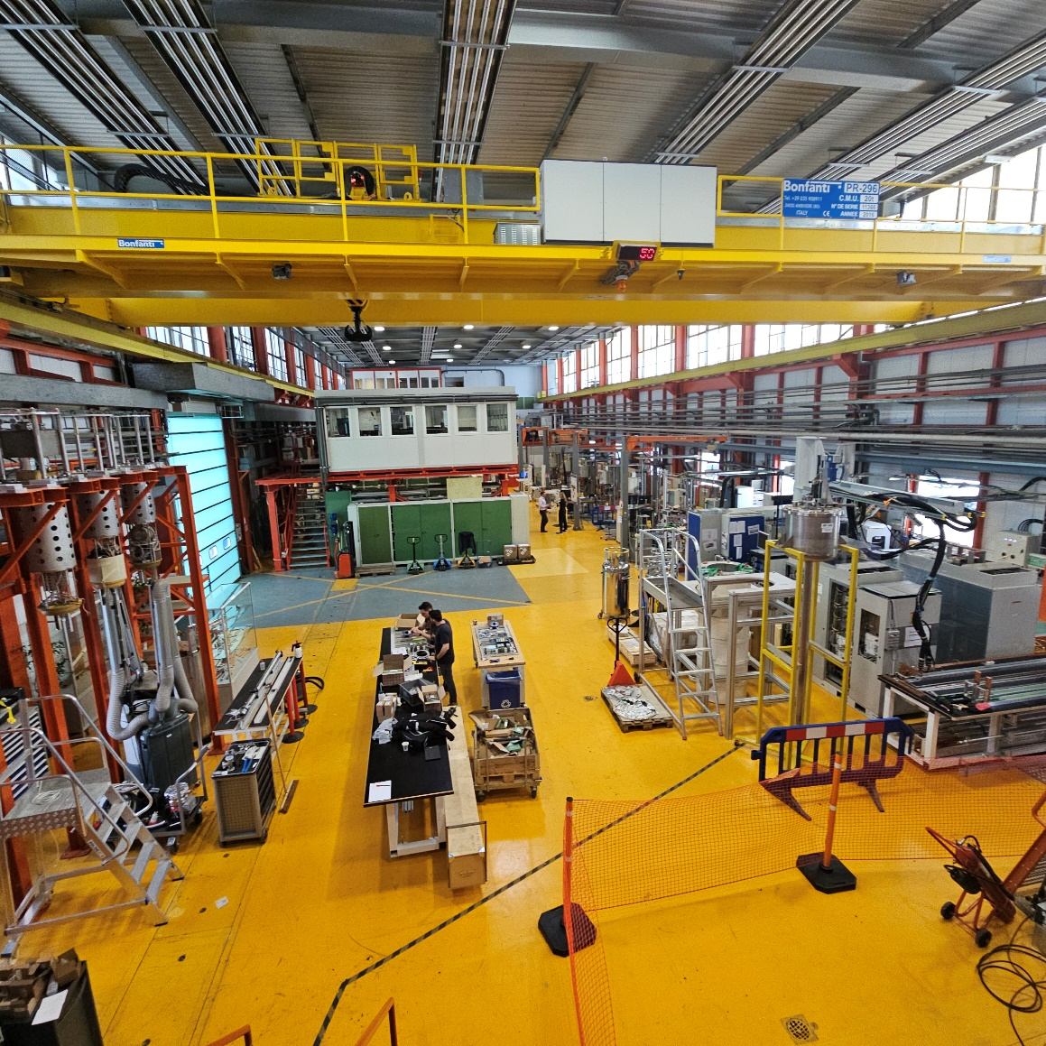
CERN strand and cable Test Facility

Slide 6
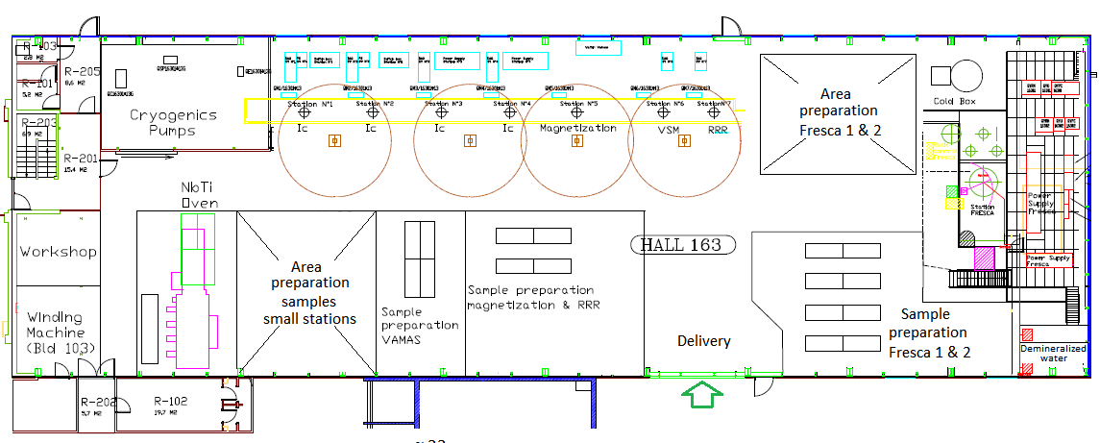
CERN strand and cable Test Facility
  Test stations 1-4: Strand I_{c} (12-15 T, 1.9-4.3 K)
  Test station 5: cable magnetization (1.8 T. 1.9-4.3 K)
  Test station 6: VSM (10 T, Variable Temp.)
  Test station 7: RRR and inter-strand resistance
  FRESCA1: cable I_{c} test station (9.6 T 1.9-4.3 K)
  FRESCA2: cable I_{c} test station (13 T, 1.9-4.3 K)
  Upgrade of Test station 1: Strand I_{c} (20 T, 1.9-4.3 K, then VTI)
  Upgrade of test station 5 : Strand Ic (split pair 10 T, 1.9-4.3 K, then VTI)
  Upgrade
Cold Box
5 g/s
Buffer
6 kLHe
Ic strands 1-4
Magnetization
VSM
RRR
FRESCA1
FRESCA2

Slide 7
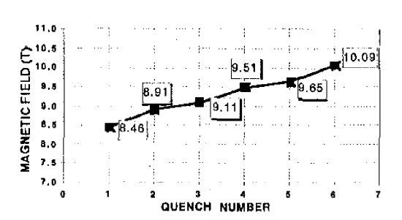
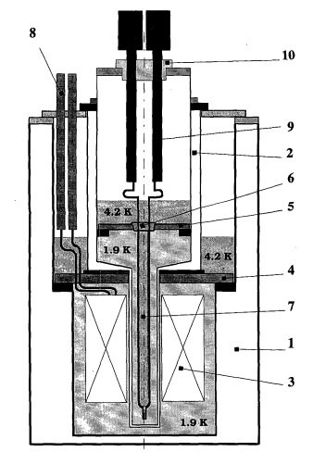
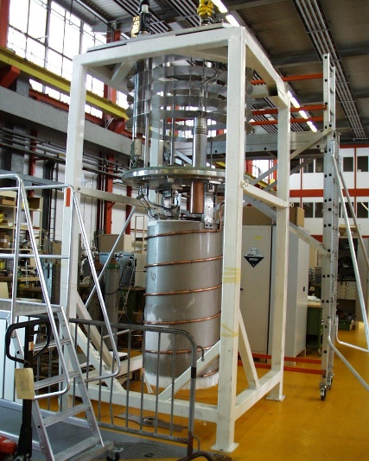
FRESCA1
Built in 1995-1998, operational since then
Magnet:
  88 mm dipole up to 10.1T (at 1.9 K, ~12 kA),
  Operating field of 9.6 T
  Magnet housed in an independently cooled cryostat.
  Current leads of 18 kA
  Power supply of 16 kA 6V 1Q
  Dump resistor of 40 mOhm
Sample
  Housed in a second cryostat (called Inner Cryostat ID ~70 mm)
  Test volume (homo. field) 600 mm x 70 mm ∅
  Free aperture in Sample holder for Nb-Ti and Nb₃Sn cables 35x35 mm²
  Sample current with external 32 kA PC or internal Sc transformer (~50 kA).
A.P. Verweij, 1.9 K Test Facility for the Reception of the Superconducting Cables for the LHC, IEEE Trans. Appl. Supercond. , VOL. 9, NO. 2, JUNE 1999
D. Leroy, Design and Manufacture of a Large-Bore 10 T Superconducting Dipole for the CERN Cable Test Facility, IEEE Trans. Appl. Supercond. 10, 1 (2000) pp.178-82

Slide 8
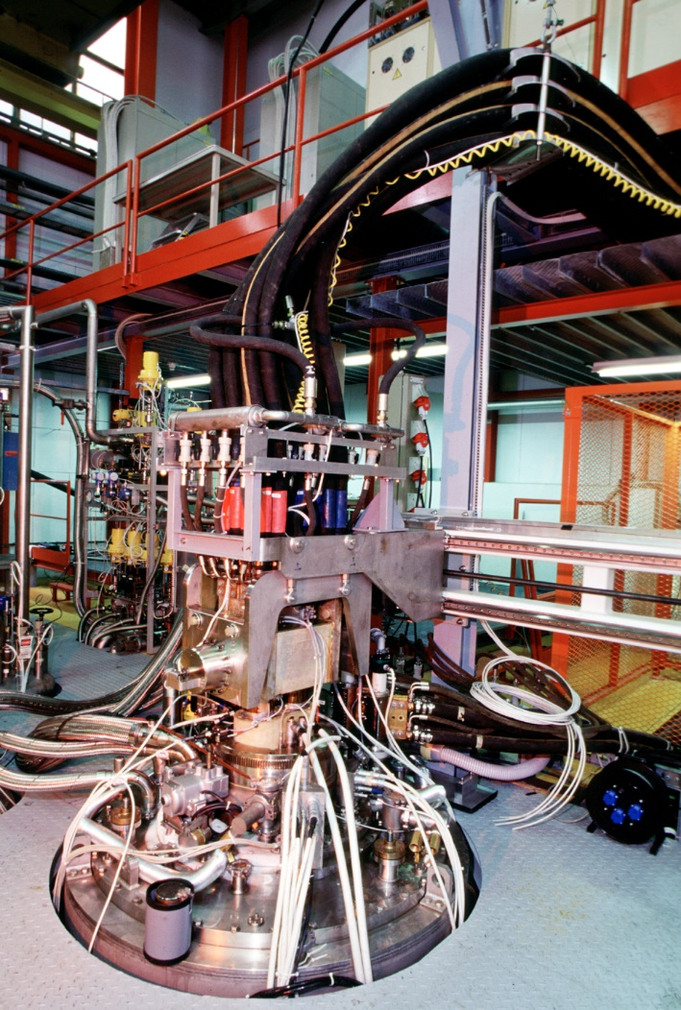
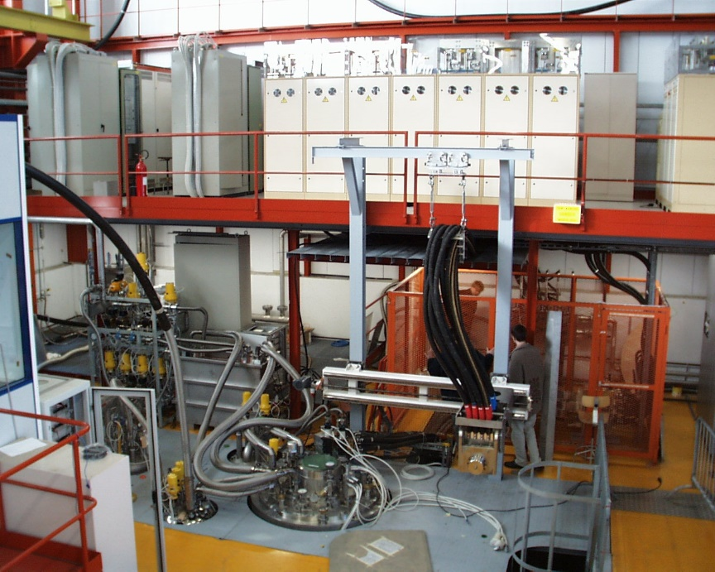
FRESCA1 Test Facility in 1999

Slide 9
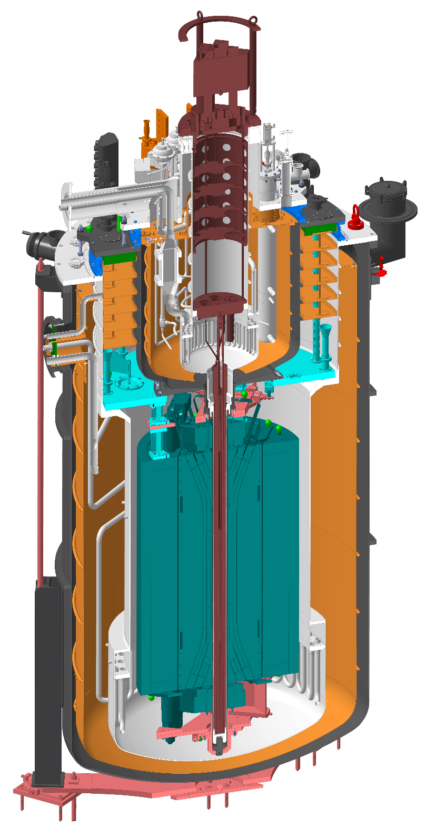
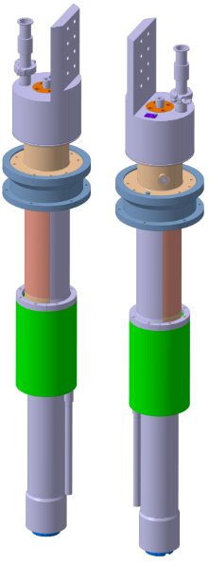
FRESCA2
Being commissioned in 2025
Magnet:
  100 mm aperture dipole up to 14.6 T (at 1.9 K, ~12 kA)
  Operating field of 13 T, 10.6 kA
  Magnet housed in an independently cooled cryostat.
  13 kA HTS Current leads of LHC
  Power supply of 16 kA 6V
  Dump resistor of 80 mOhm
Sample
  Housed in a second cryostat (called Inner Cryostat ID of ~82 mm)
  Test volume (homo. field) 650 mm x 82 mm ∅
  Sample current with external 32 kA PC or internal s.c. transformer (>50 kA).

Slide 10
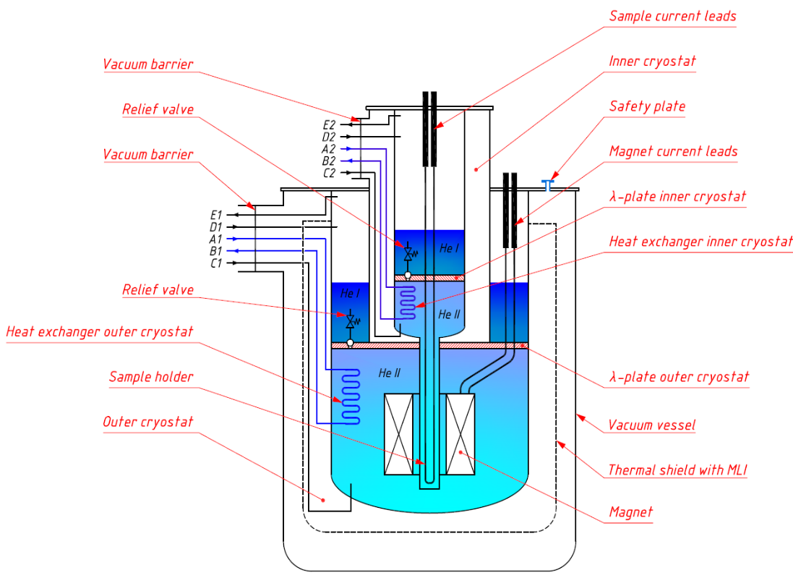
FRESCA2 Inner / Outer Cryostats

Slide 11
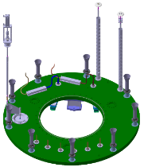
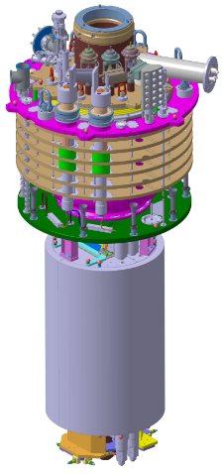
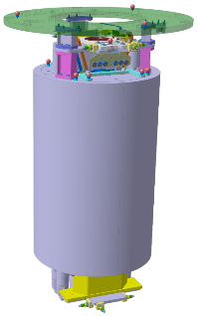

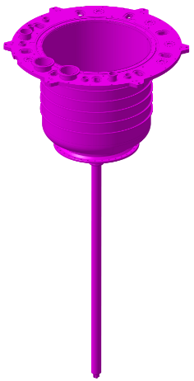
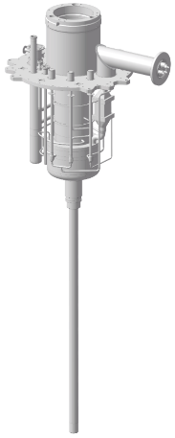
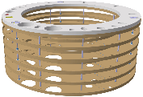
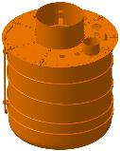

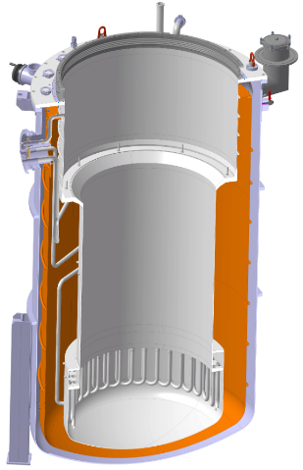
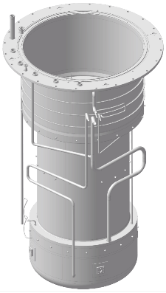
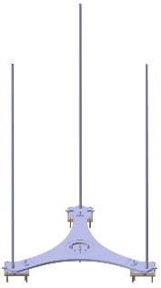
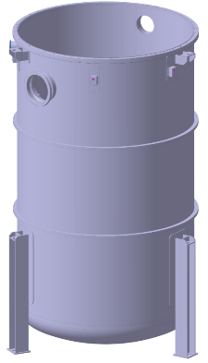
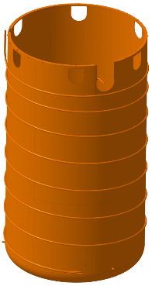
FRESCA2 Assembly
Inner
vacuum vessel
Inner
He vessel
Radiation screen assembly
FRESCA2 cryostat
Inner cryostat assembly
Lambda plate
Magnet current leads
Magnet assembly
Inner
thermal screen
Outer cryostat assembly
Outer
vacuum vessel
Outer
thermal screen
Alignment system
Outer
He vessel
Slide from B. Riffaud, on behalf of CERN EN-MME Design Team

Slide 12
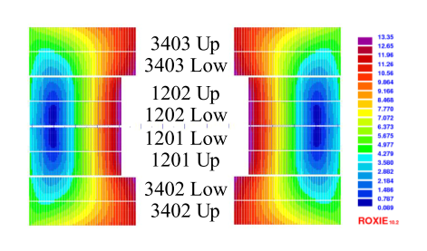
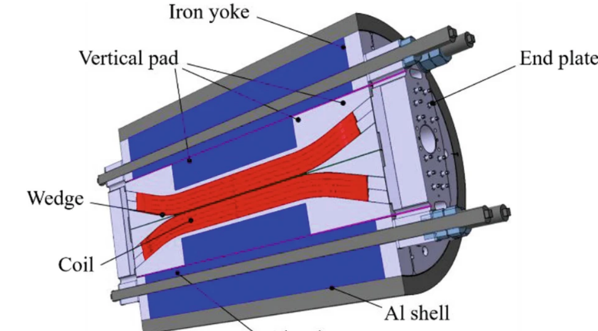
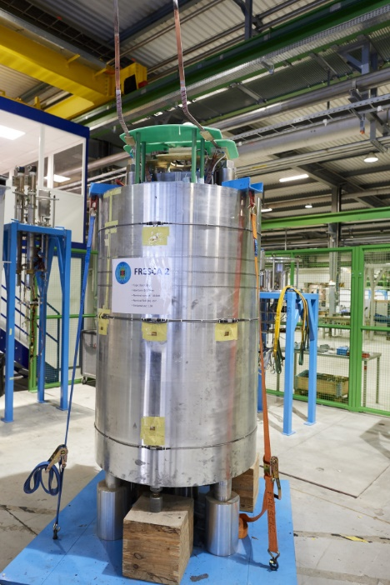
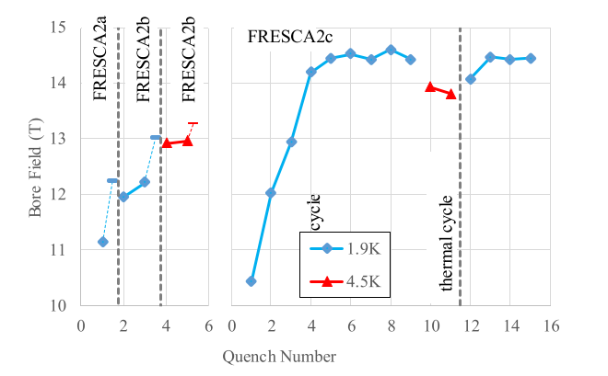
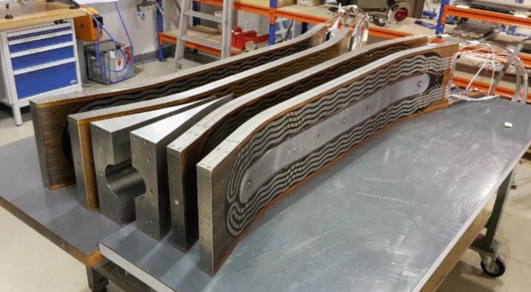
FRESCA2 Magnet Test @SM18
Bloc coil with flared ends
100 mm Ø free aperture
Magnet tested in SM18
  14.6T @1.9 K
  13.9T @ 4.3 K
G. Willering et al., "Tests of the FRESCA2 100 mm Bore Nb3Sn Block-Coil Magnet to a Record Field of 14.6 T," IEEE Trans. Appl. Supercond. , vol. 29, no. 5, pp. 1-6, Aug. 2019
CEA–CERN Block-Type Dipole Magnet for Cable Testing: FRESCA2. In: Schoerling, D., Zlobin, A. (eds) Nb3Sn Accelerator Magnets. Particle Acceleration and Detection. Springer, Cham.

Slide 13
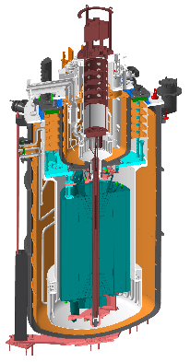
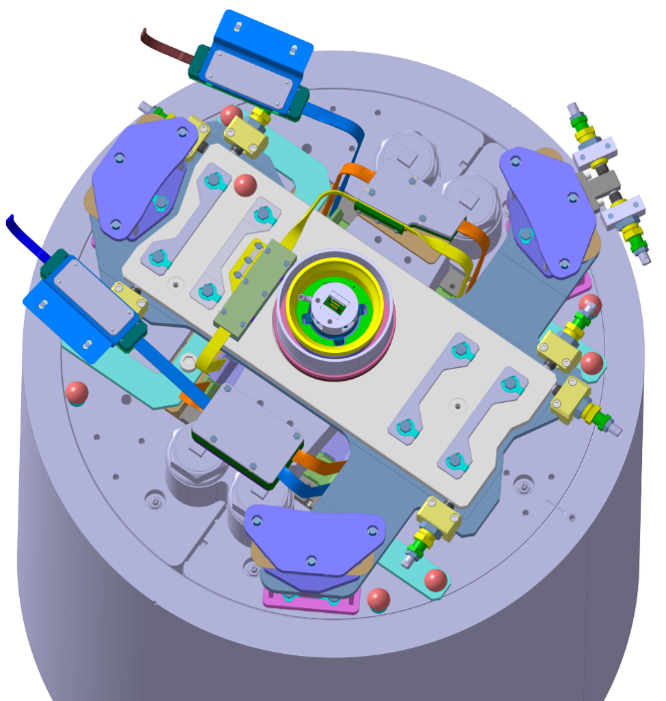
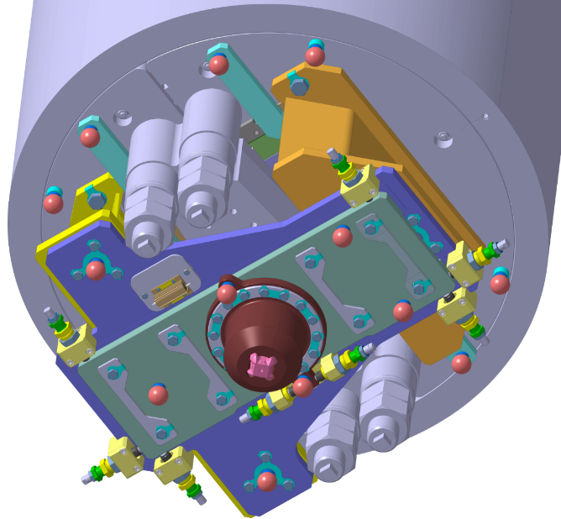
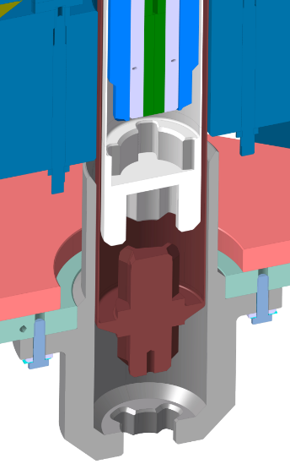
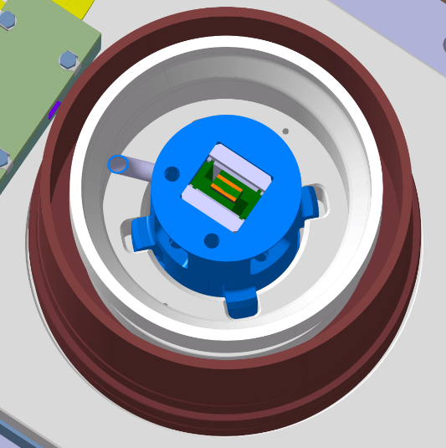
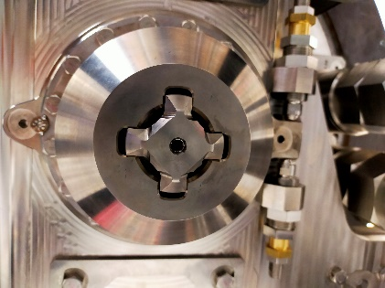
Transfer of torque magnet/sample
Magnetic torque between sample under test and magnet needs to be transferred via the holder and inner cryostat
Top and bottom of holder locked in rotation
Top part
Rigid fixation to the lambda plate
Bottom part
Inner vacuum vessel
Centering (rotation free) with the micrometric xy table
Sample holder
Inner helium vessel cane
Rigid fixation to the magnet
Sample holder
Torx angular positioning with the inner helium vessel
Torx angular positioning
Micrometric angular indexer
Inner helium vessel
13

Slide 14
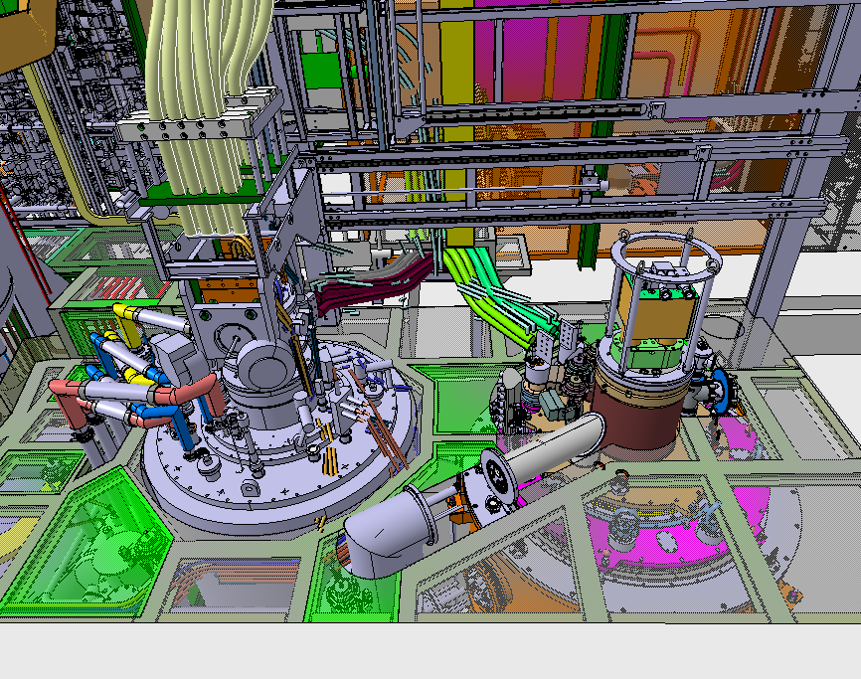
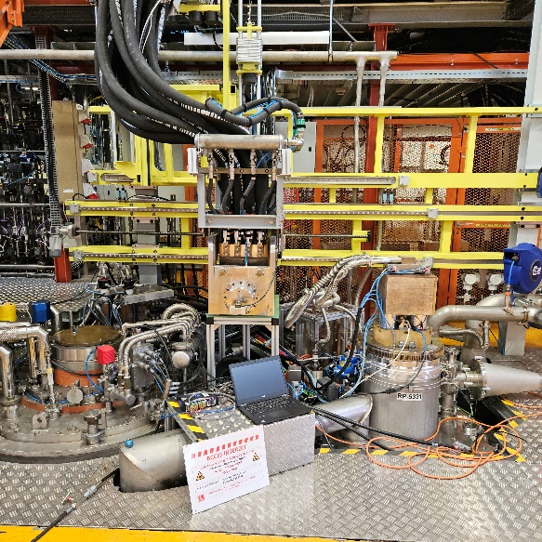
Integration of FRESCA2
Installed in the existing pit, no civil engineering work
Half of the top plate shall be free of protruding components
Cryostat position:
  Top flange of inner cryostats (F1 and F2) shall be at the same heights
  The centre of FRESCA 2 cryostat at same distance from wall as FRESCA 1

Slide 15
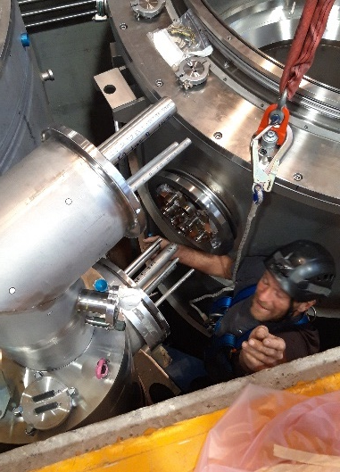
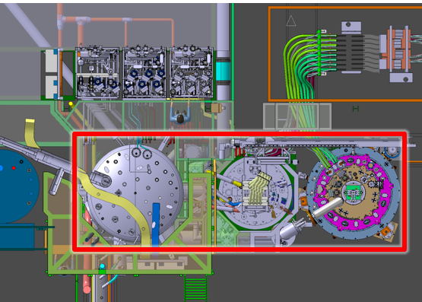
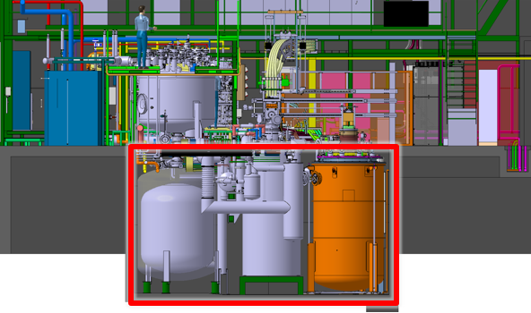
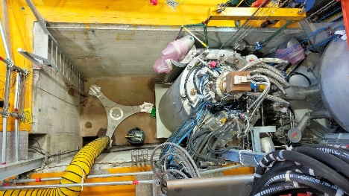
FRESCA2 pit constraints
Small clearance cryostat /pit’s wall
Limited accessibility during installation
  No access to cryostat legs once cryostat is inside the pit
  Tight alignment of components required
  Welding of cryogenic connection were quite challenging

Slide 16
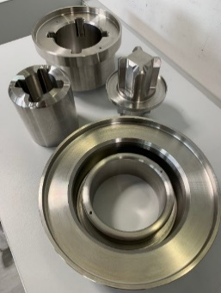
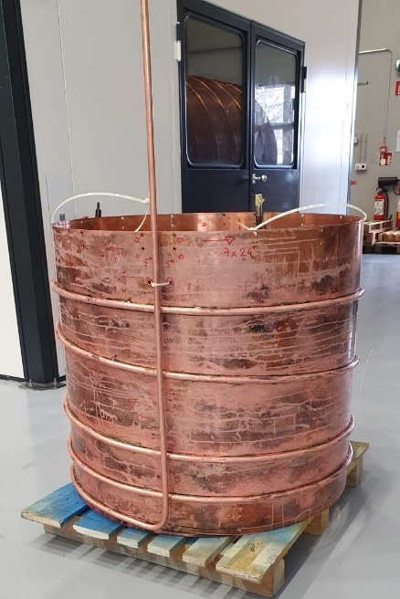
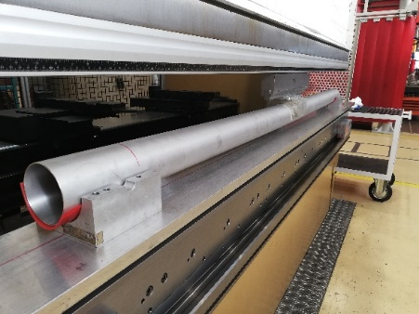
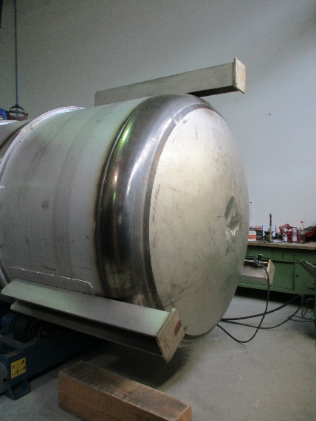
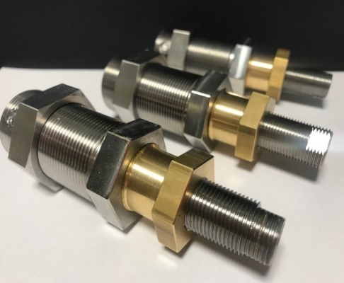
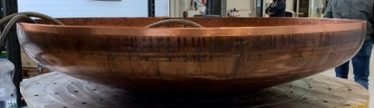
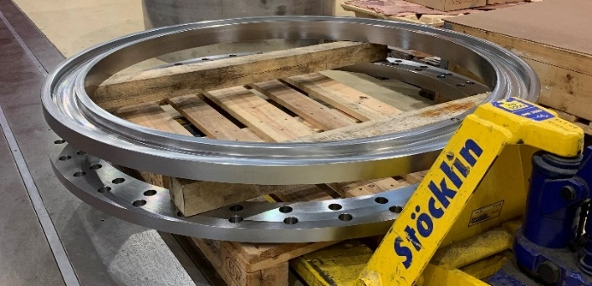
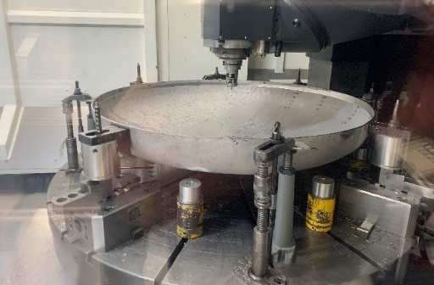
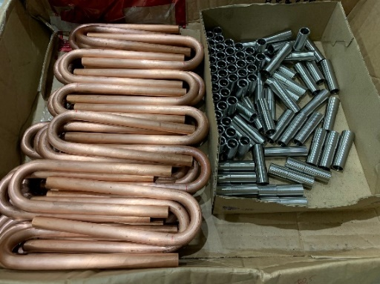
FRESCA 2 Cryostat fabrication
Performed @ CERN
Construction of FRESCA2 Cryostat by CERN main workshop, E. Rigutto (EN) on behalf of the project (EN)

Slide 17
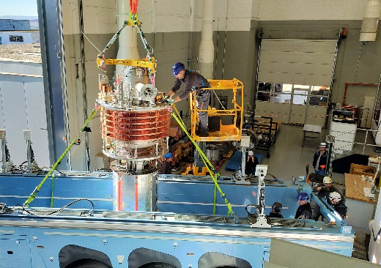



Assembly of FRESCA 2
Assembly of FRESCA2 Cryostat by CERN main workshop (EN) in collaboration with Sc team

Slide 18




Installation of FRESCA 2 in b163

Slide 19

FRESCA2 Test Facility in 2024

Slide 20



FRESCA Field profile
Dipole magnets
  FRESCA1 warm bore of 70 mm , 9.6 T
  FRESCA2 warm bore of 82 mm, 13 T
  3% homogeneity over ~600/650 mm
Cable sample splices placed out of field

Slide 21




FRESCA Sample Insert
FRESCA1 and FRESCA2 shares the same inserts:
  2x 32 kA vapor cooled leads
  1x Sc transformer 50 kA
Sample insert could be rotated by 90º when sample is at 4.3 K or 1.9 K
  Applied field Perp or // to cable face
  Change of field direction by polarity invertor
Hydraulic jack lifting the insert to unlock the antirotating system
Leak tightness maintained during rotation

Slide 22





Sample Holder of FRESCA1
  Standard Rutherford cable holder:
    Welded stainless steel tube structure
    OD 69 mm
    Inner cavity 35x35 mm
    Pre-stress via M16 screw
  High pressure holder
    Based on bladder and Keys
    Al shell
  Cable mounted on plate (low Lorentz force)
    Cable wrapped with Kapton
    Cable assembly inserted in G10 structure
P. Ebermann et al Irreversible degradation of Nb3Sn Rutherford cables due to transverse compressive stress at room temperature 2018 Supercond. Sci. Technol. 31 065009
B. Bordini, Critical Current Measurements of High-Jc Nb3Sn Rutherford Cables under Transverse CompressionIEEE Trans. Appl. Supercond. vol. 24, no. 3, 2014

Slide 23


Electrical Distribution
Power converters
  Three 16 kA -6 V power converters each equipped with DCCT and FGC2
    16 kA for the magnet
    32 kA for the sample
  Sample could also be operated from a 50 kA Sc Transformer (PC 200 A, 4Q )
FRESCA magnet polarity inverter
  allow to change the direction of the field applied to the cable samples.
  Interlocks switches to ensure it is in one position or in the other.
FRESCA magnet selection switch
  allow to energize from a single 16 kA PC either FRESCA1 or FRESCA2 magnet
  Interlocks switches to ensure that the switch is in one position or in the other.
FRESCA sample quick disconnect
  Use to connect quickly the 32 kA PC to the sample inserted either in FRESCA1 or in FRESCA2
  Interlocks switches provided to ensure that the switch is in one position or in the other.

Slide 24



Station 32 kA Quick connect
Allow with one PC 32 kA to operate either:
  Samples FRESCA1
  On short circuit
  Samples in FRESCA2
Water cooled cables attached to a slidable clamp (pneumatic clamping)
Time of swapping ~3 mins
Quick connect 2020=>
Quick connect 1999-2019

Slide 25


Magnet Protection
Redundant Quench Detection System (developed at CERN)
Fast Mechanical switch, opening in less than 40 ms
Dump resistor 40 mOhm (F1) and 80 mOhm (F2)
No quench heaters

Slide 26


Data acquisition system
DAQ shared between FRESCA1 and FRESCA2
DAQ consists of commercial/CERN developed test equipment coupled to a PXI workstation.
  High accuracy low Voltage (nV) measurements (~10 Hz / channel )
    8 x Keithley 2182A, inputs channels selected via matrix
  High frequency Voltage measurements
  (100 kHz)
    Gen3i transient recorder
    uQDS CERN developed for quench detection (see J. Steckert presentation, Thursday)

Slide 27



Cryogenic operation of FRESCA2
Operation performed by an automate that controls:
  Purging Cool-down (300 K to 4.3 K and 4 K 1.9 K)
  Nominal operation at 4.3 K or 1.9 K
  Recovery of nominal operation after quench
  Warm up (1.9 K to 4.3 K)
  Drain and warm up (4.3 K to 300 K)
ΔT<50 K for Magnet during cool down and warm up
Maximum cool down/warm up time
Cryo. OK signals to QPS
        LHe level at its nominal
        Temp of magnet and sample leads
        Magnet bath temp. and pressure

Slide 28




Cryogenic distribution system
One LHe cold box ~5g/s
One buffer 6 kLHe
Few valve boxes, many GHe racks
9 test stations (2 cables, 7 strands)
Recovery GHe system

Slide 29
Overview of typical measurements
Cable I_{c} measurements LTS/HTS
Cable Splice resistance
Normal zone propagation velocity
MQE and current distribution

Slide 30








Cable I_{c} measurements NbTi /Nb₃Sn
Qualification of LHC cables cable I_{c} measured in FRESCA (1.9 K/ 4.3 K) and at BNL (4.3K)
Qualification of HL-LHC cables and FCM cables
I_{c} degradation of Nb₃Sn cables
Transverse stress applied to cables:
  At room temperature
  In situ with a specific holder
Critical Current Measurements of the Main LHC Superconducting Cables IEEE Trans. Appl. Supercond. VOL. 17, NO. 5, 2007
P. Ebermann et al Irreversible degradation of Nb3Sn Rutherford cables due to transverse compressive stress at room temperature, Supercond. Sci. Technol. 31 065009, 2018
L. Bottura, “Strand and cable R&D for fast cycled magnets at CERN,” IEEE Trans. Appl. Supercond., vol. 21, no. 3, pp. 2354–2358, Jun. 2011
J.E. Jean-Eudes Duvauchelle, Critical Current Measurements Under Transverse Pressure of a Nb3Sn Rutherford Cable Based on 1 mm RRP Wires,Appl. Supercond., vol. 28, 2018
J. Fleiter Quench Propagation in Nb3Sn Rutherford Cables for the Hi-Lumi Quadrupole Magnets", IEEE Trans. Appl. Supercond, vol.25, no.3, pp.1-4, 2015.

Slide 31









Cable I_{c} measurements MgB₂ / HTS
MgB₂ cables of Sc Link 4 K
  Up to 22 kA in s.f.
REBCO ROEBEL 4K
15 kA sf, 12 kA 8 T
CORC cable 4K
Twisted Pair REBCO 4K
K. Konstantopoulou, Electro-Magnetic Performance of MgB2 Cables for the High Current Transmission Lines at CERN, Appl. Supercond. ., VOL. 29, NO. 5, 2019
J. Fleiter Electrical characterization of REBCO Roebel cables. Supercond. Sci. Technol. 26 065014 2013
T. Mulder Performance Test of an 8 kA @ 10-T 4.2-K ReBCO-CORC Cable,, IEEE Trans. Appl. Supercond. VOL. 26, NO. 4, JUNE 2016
A. Ballarino First tests of twisted-pair HTS 1 kA range cables for use in superconducting links Physics Procedia Vol. 36, 2012

Slide 32






Cable Splice resistance
LHC Nb-Ti cables
MgB₂ cables Sc Link
The Electrical Resistance of Rutherford-Type Superconducting Cable Splices IEEE Trans. Appl. Supercond. , VOL. 25, NO. 3, 2015
S. Giannelli Investigation of Splice Resistances of High-Current MgB2 Cables Operated in Liquid and Helium Gas IEEE Trans. Appl. Supercond. , VOL. 27, NO. 4, AUGUST 2017

Slide 33





Normal zone propagation velocity
NZPV measured by time of flight
Quench triggered by Heater
Transverse delay quench
J. Fleiter Quench Propagation in Nb3Sn Rutherford Cables for the Hi-Lumi Quadrupole Magnets", IEEE Trans. Appl. Supercond, vol.25, no.3, pp.1-4, 2015.

Slide 34





MQE and current distribution
MQE on Nb-Ti Nb₃Sn cables
Current distribution
A. Verweij. , Experimental results of current distribution in Rutherford-type LHC cables Cryogenics 40 (2000) 663-70
W. M. de Rapper et al., Thermal Stability at 1.9 K and 4.3 K of Nb3Sn Cables for Quadrupole Magnets for the LHC Upgrade IEEE Trans. Appl. Supercond. , vol. 23, no. 3, 2013
G. Willering et al., Stability of Nb-Ti Rutherford Cables Exhibiting Different Contact Resistances IEEE Trans. Appl. Supercond. , vol. 18, no. 2, 2008

Slide 35
Next steps
Electrical commissioning of FRESCA2 May-June 2025
First test of Sc cable Q3 2025
Develop a VTI operated with GHe

Slide 36
Conclusions
FRESCA:
  A versatile cable test station
  Mandatory tool to qualify Sc cable for accelerators applications
  In operation since 25 years
  Installation of FRESCA2 completed
  Cryogenic Commissioning Completed
  Electrical commissioning to be completed by mid 2025

Slide 37
Thank you for your attention

