Slide 1
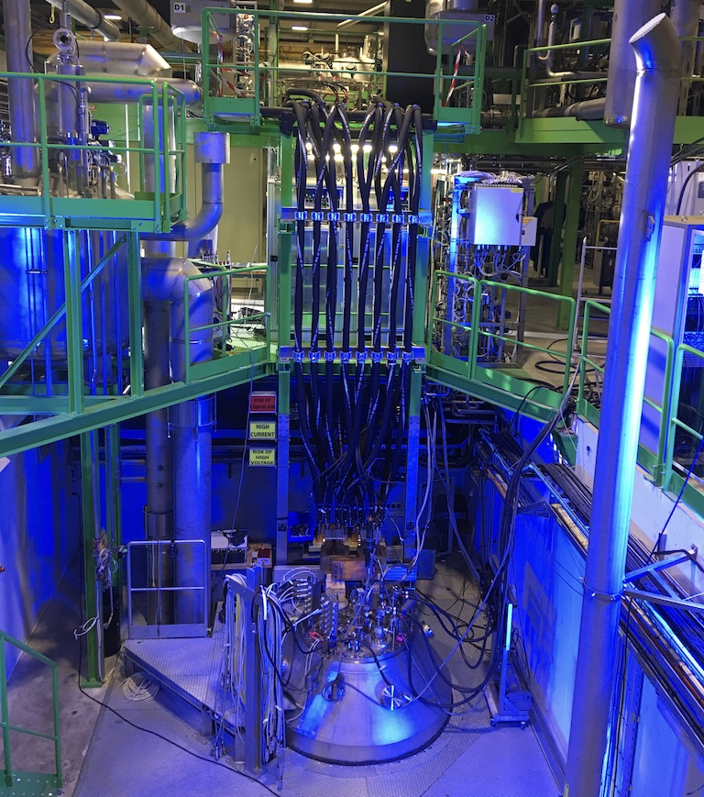
SMTF
Workshops
Marta Bajko
CERN

Slide 2
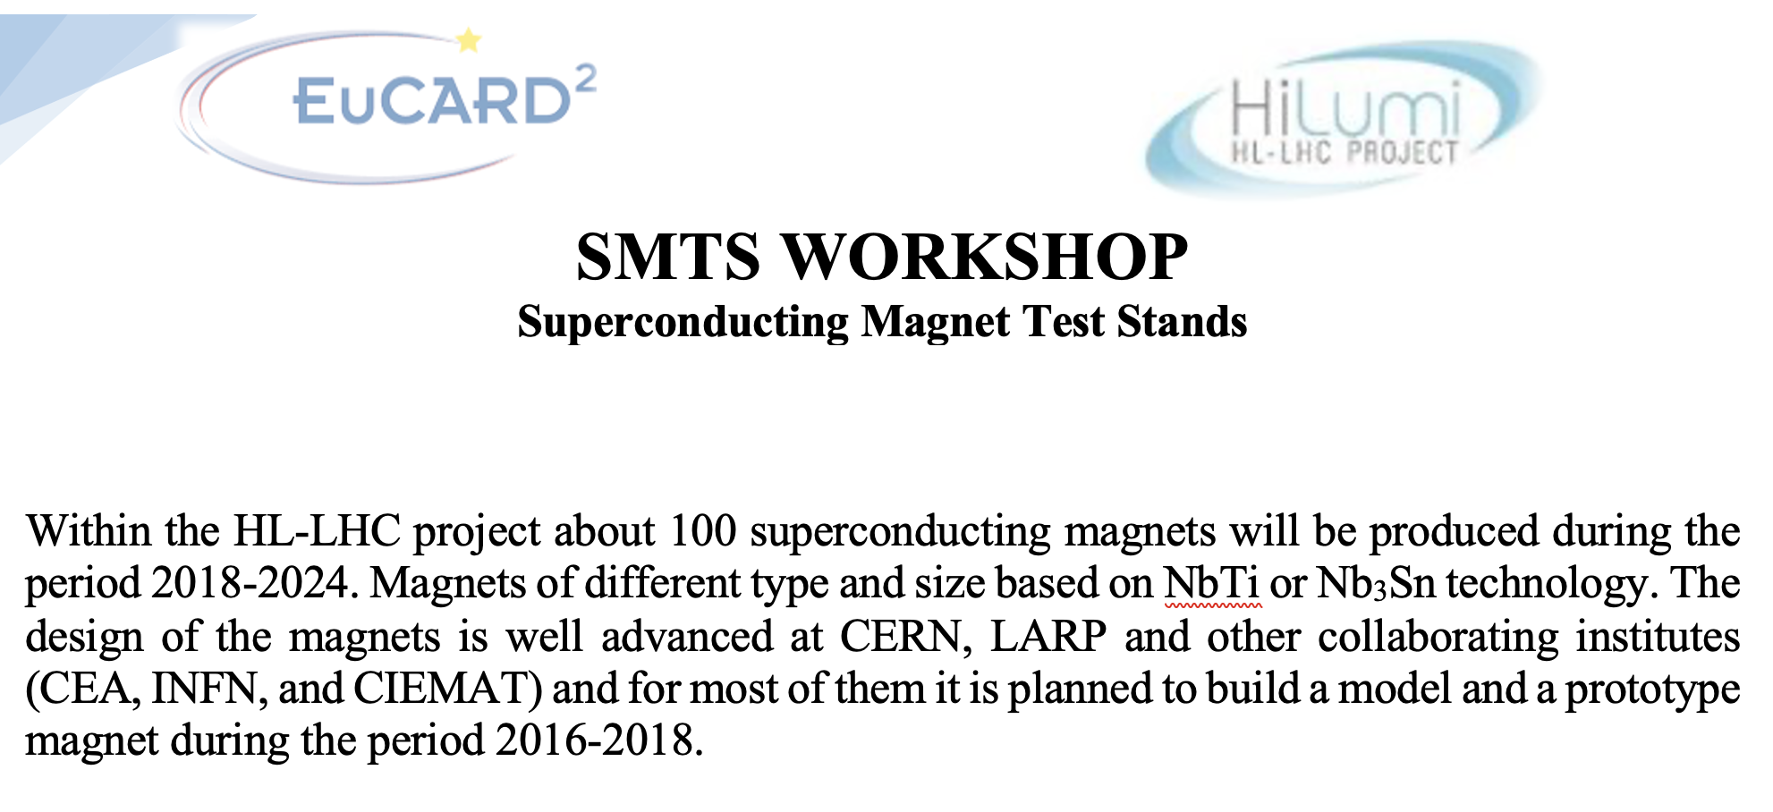
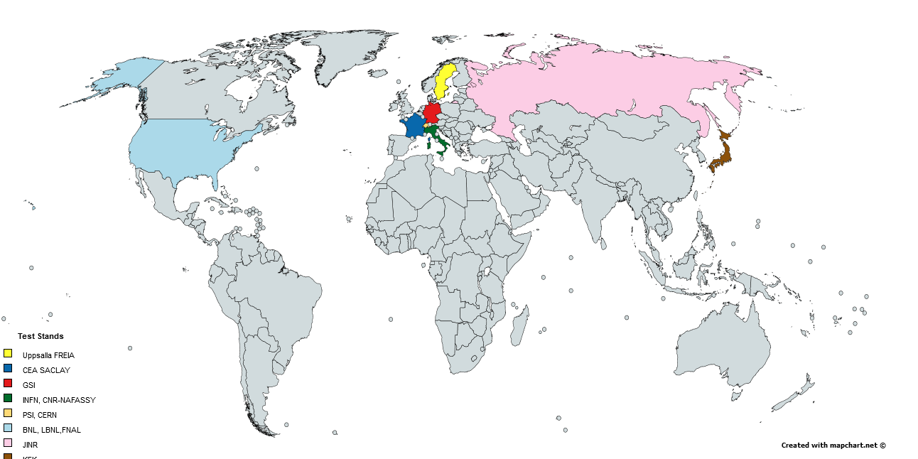
Superconducting Magnet Test Facility Workshop
The organisation of the workshop raised from the needs of collaboration of test stand that are related to the HL-LHC,
but we already wanted to include those not necessarily working for the HL-LHC. In total 12 institutes were invited.
EUCRAD² Trans National Access related to the Sc magnet testing CERN
became a partner of this workshop.

Slide 3
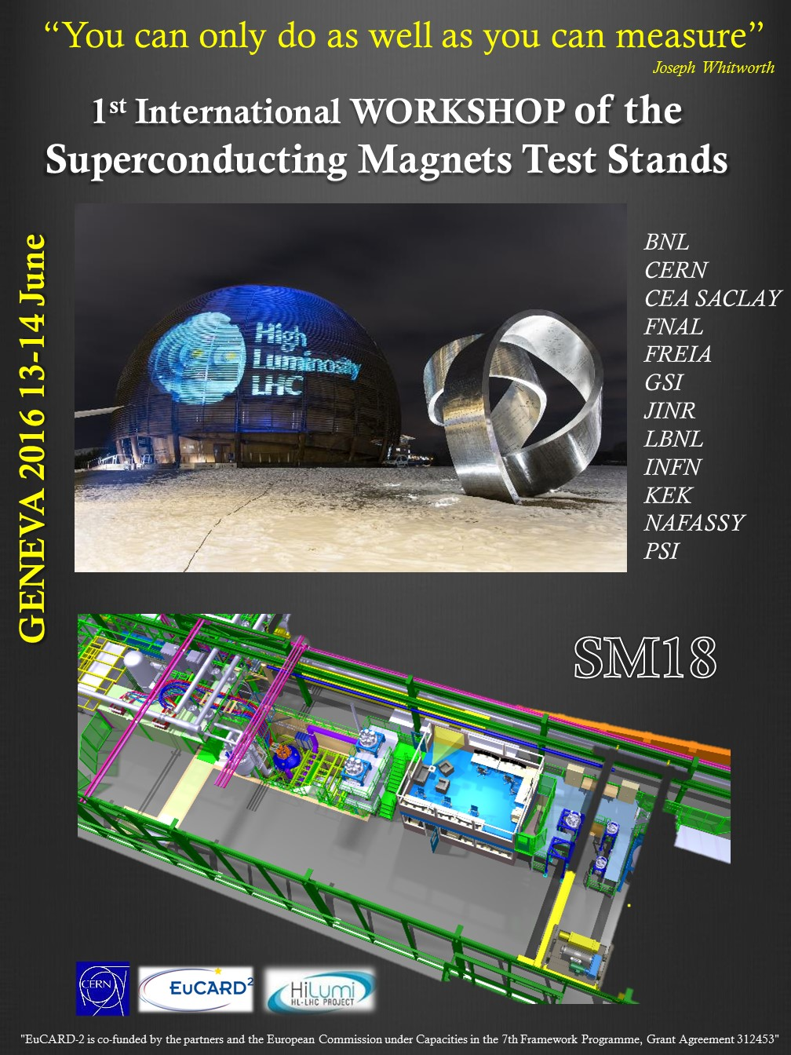
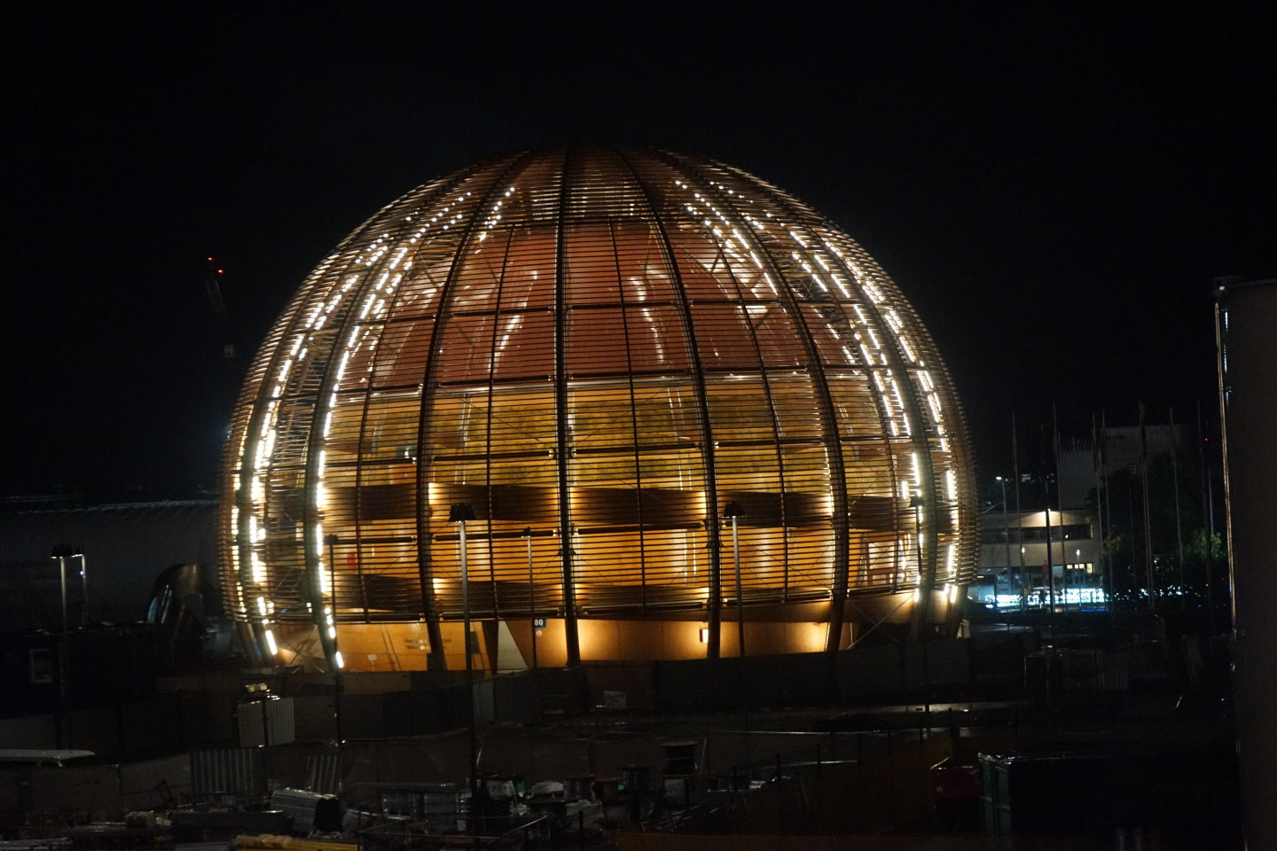
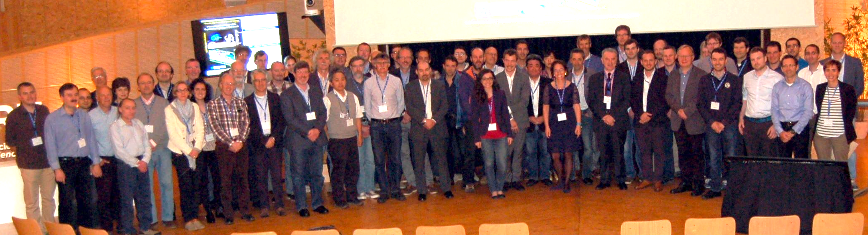
1st edition
@ CERN
13-14 June 2016
2 full days
Industrial exhibition
SM18 test stand visit
63 participants
Geneva (CH)
M. Bajko CERN
Marta Bajko chair of the workshop and of the local Organising Committee
March 2025
EUCRAD² Trans National Access related to the Sc magnet testing CERN partner of this workshop.

Slide 4
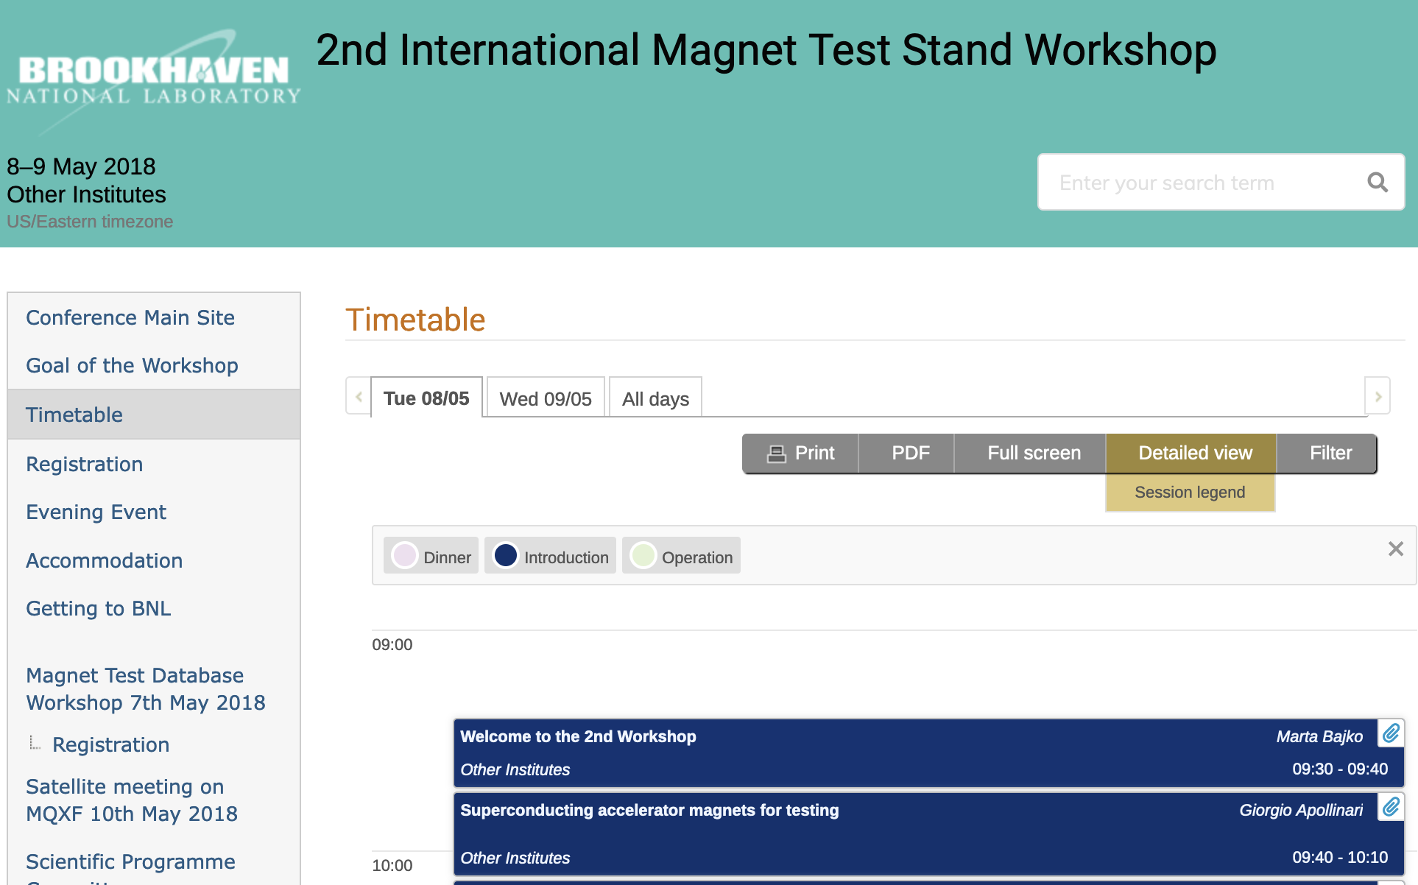
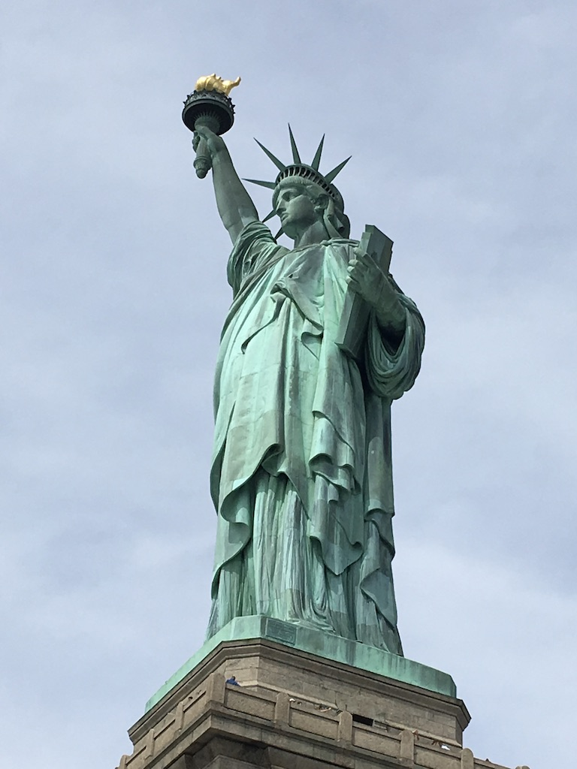
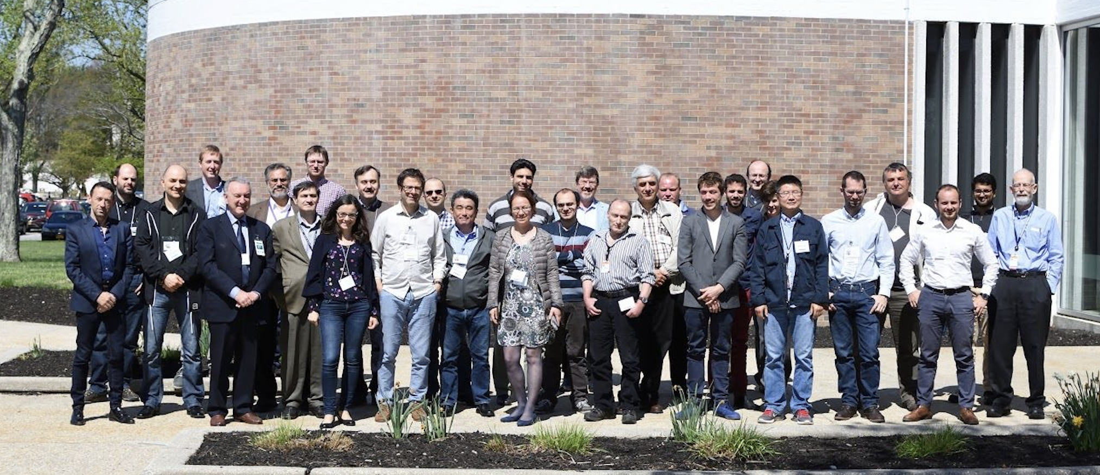
2nd edition
@ BNL
8-9 May 2028
2 full days
Industrial exhibition
BNL vertical test stand visit
63 participants
Long Island (USA)-Brookhaven
Joseph Muratore as local Organising committee chair

Slide 5
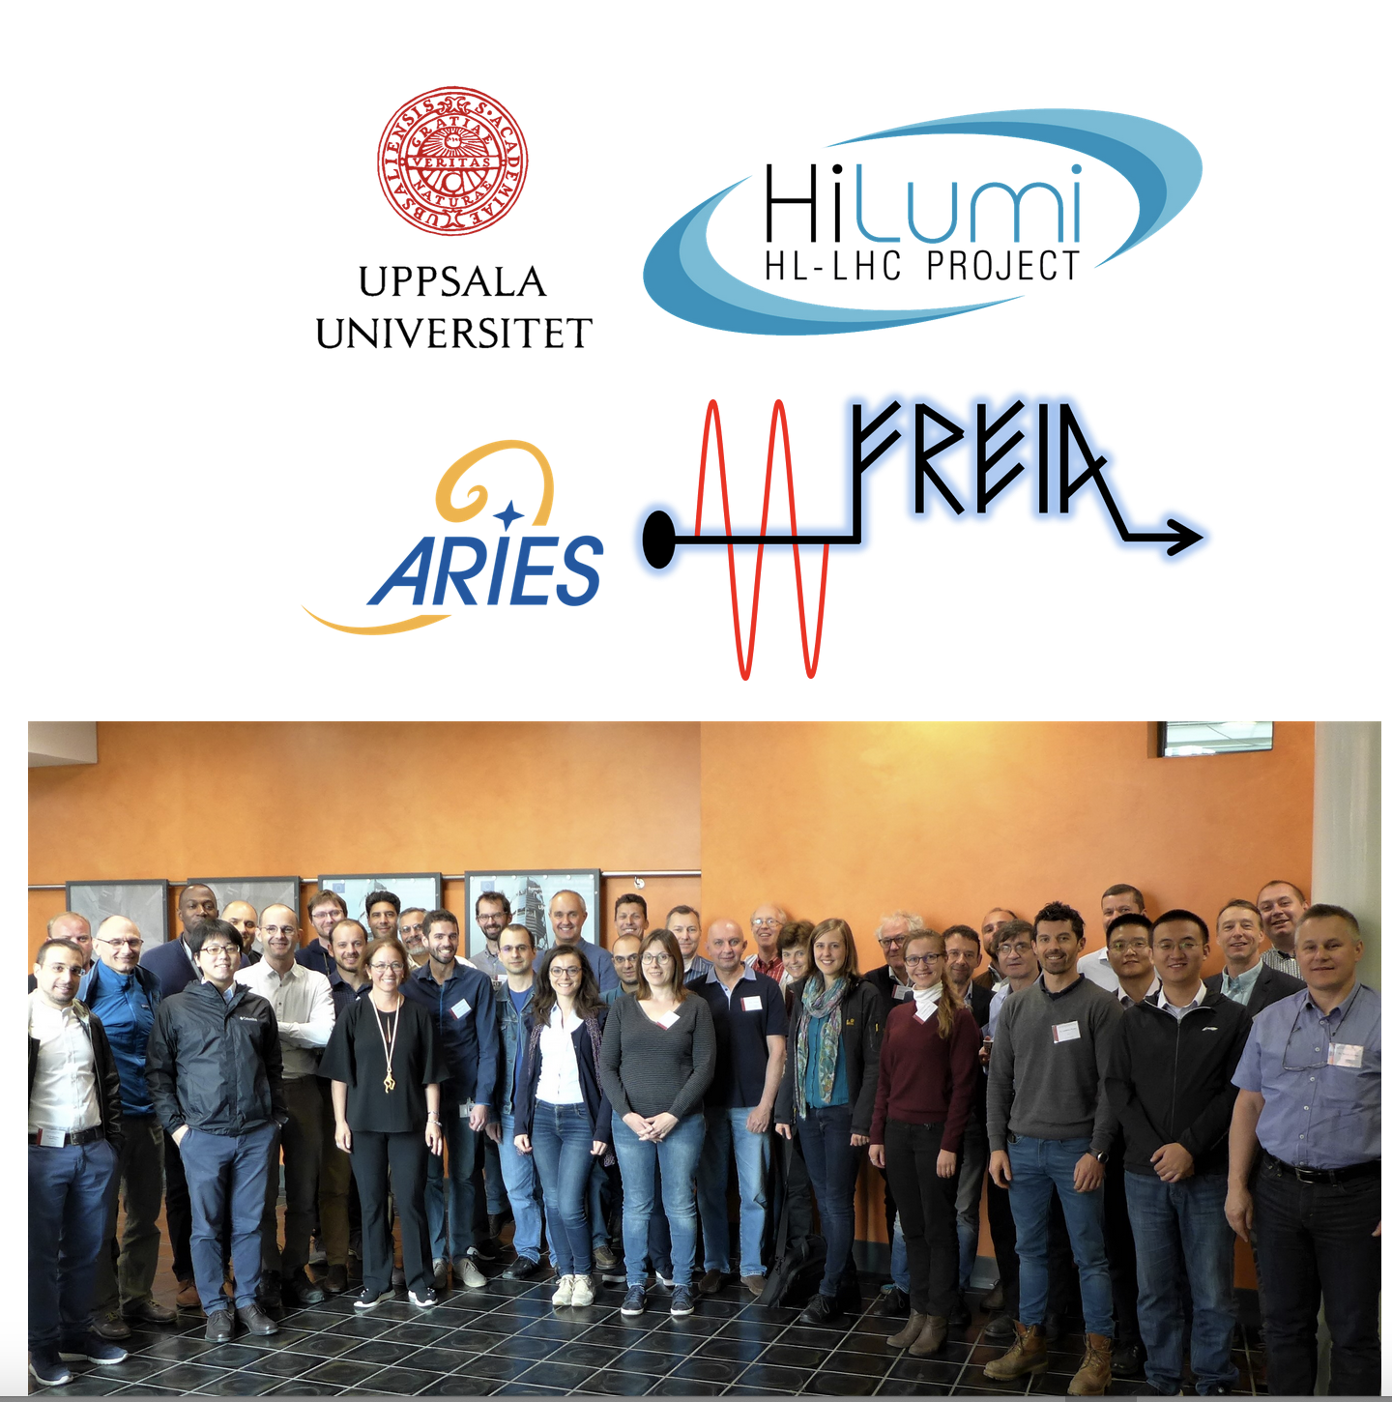
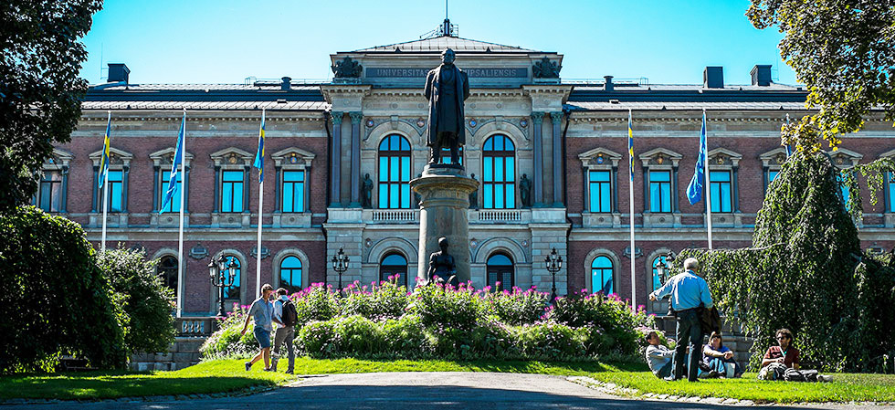

3rd edition
@ FREIA
11-12 June 2019
2 full days
Industrial exhibition
GERSEMI test stand visit
45 participants
Uppsala (S) @ the oldest Scandinavian University
Kevin Peptone and Roger Ruber as local Organising committee chair
ARIES Trans National Access related to the Sc magnet testing CERN is partner of this workshop.

Slide 6
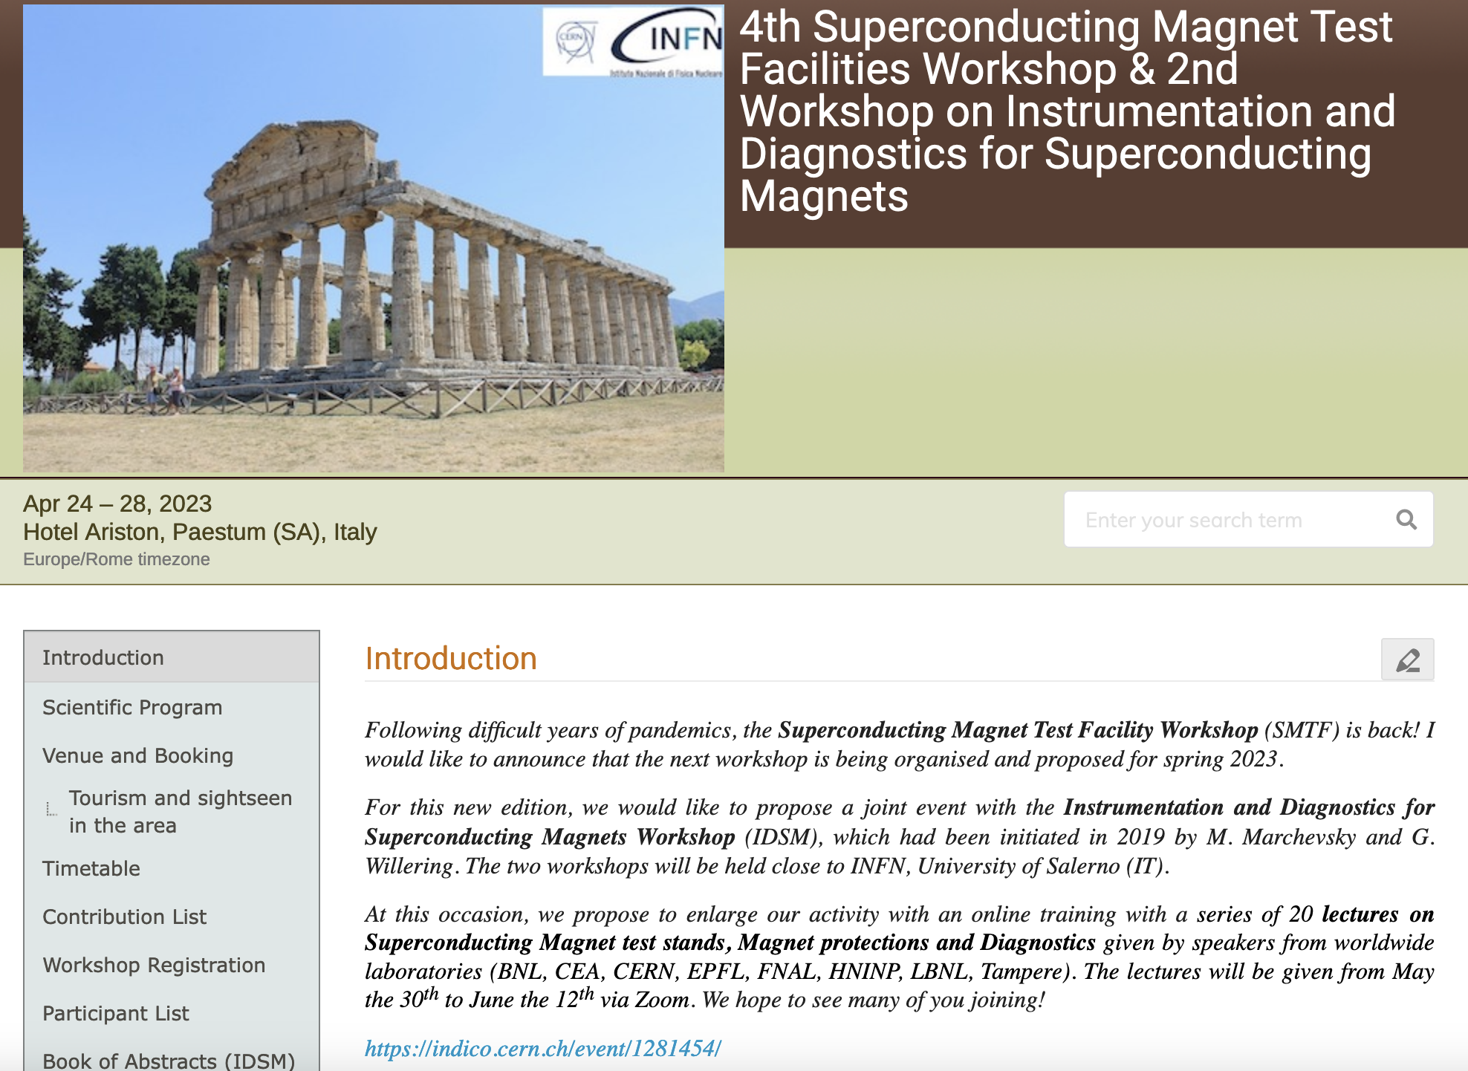

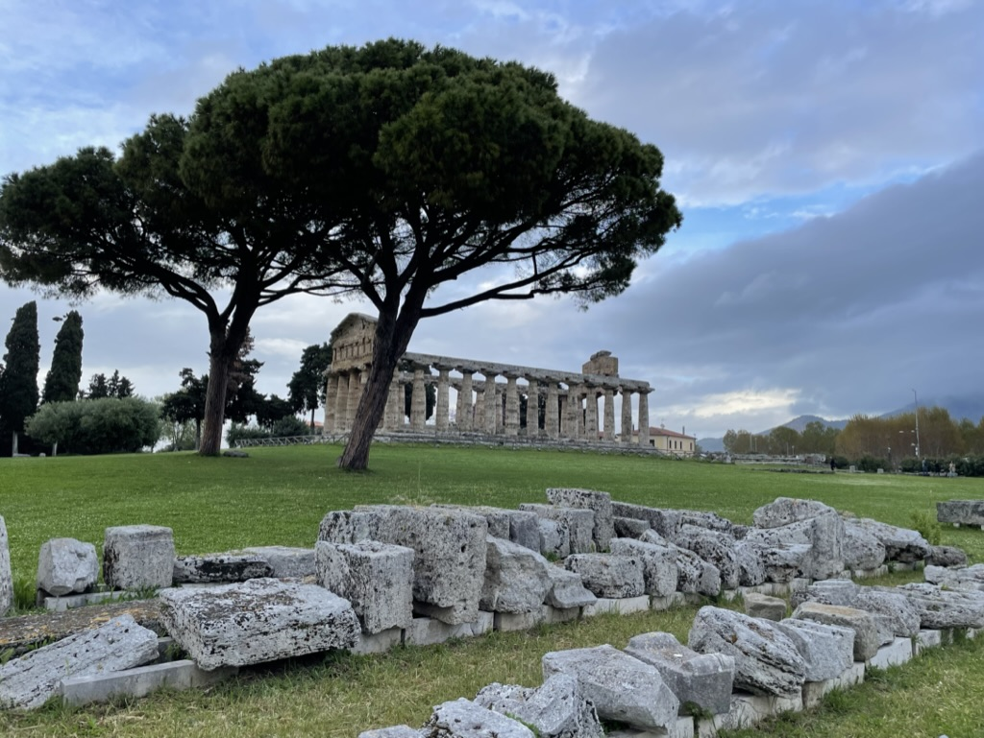
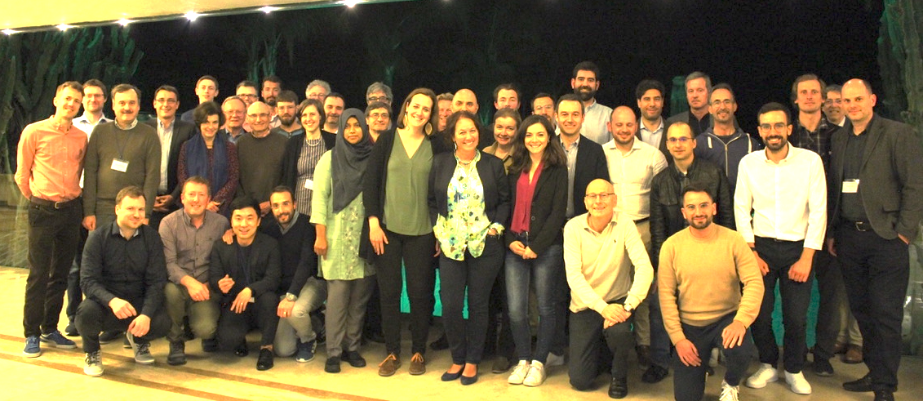
4th edition
@ INFN Salerno
24-28 June 2023
2 full days
2.5 day of IDSM
20 lectures off line
THOR test stand visit
59 participants over the two workshops
Paestum (IT) a major ancient Greek city with the best conservation of the ruins in EU
Umberto Gambardella, Domenico D Agostino
as local Organising committee chair
HFM program is partner of this workshop.

Slide 7
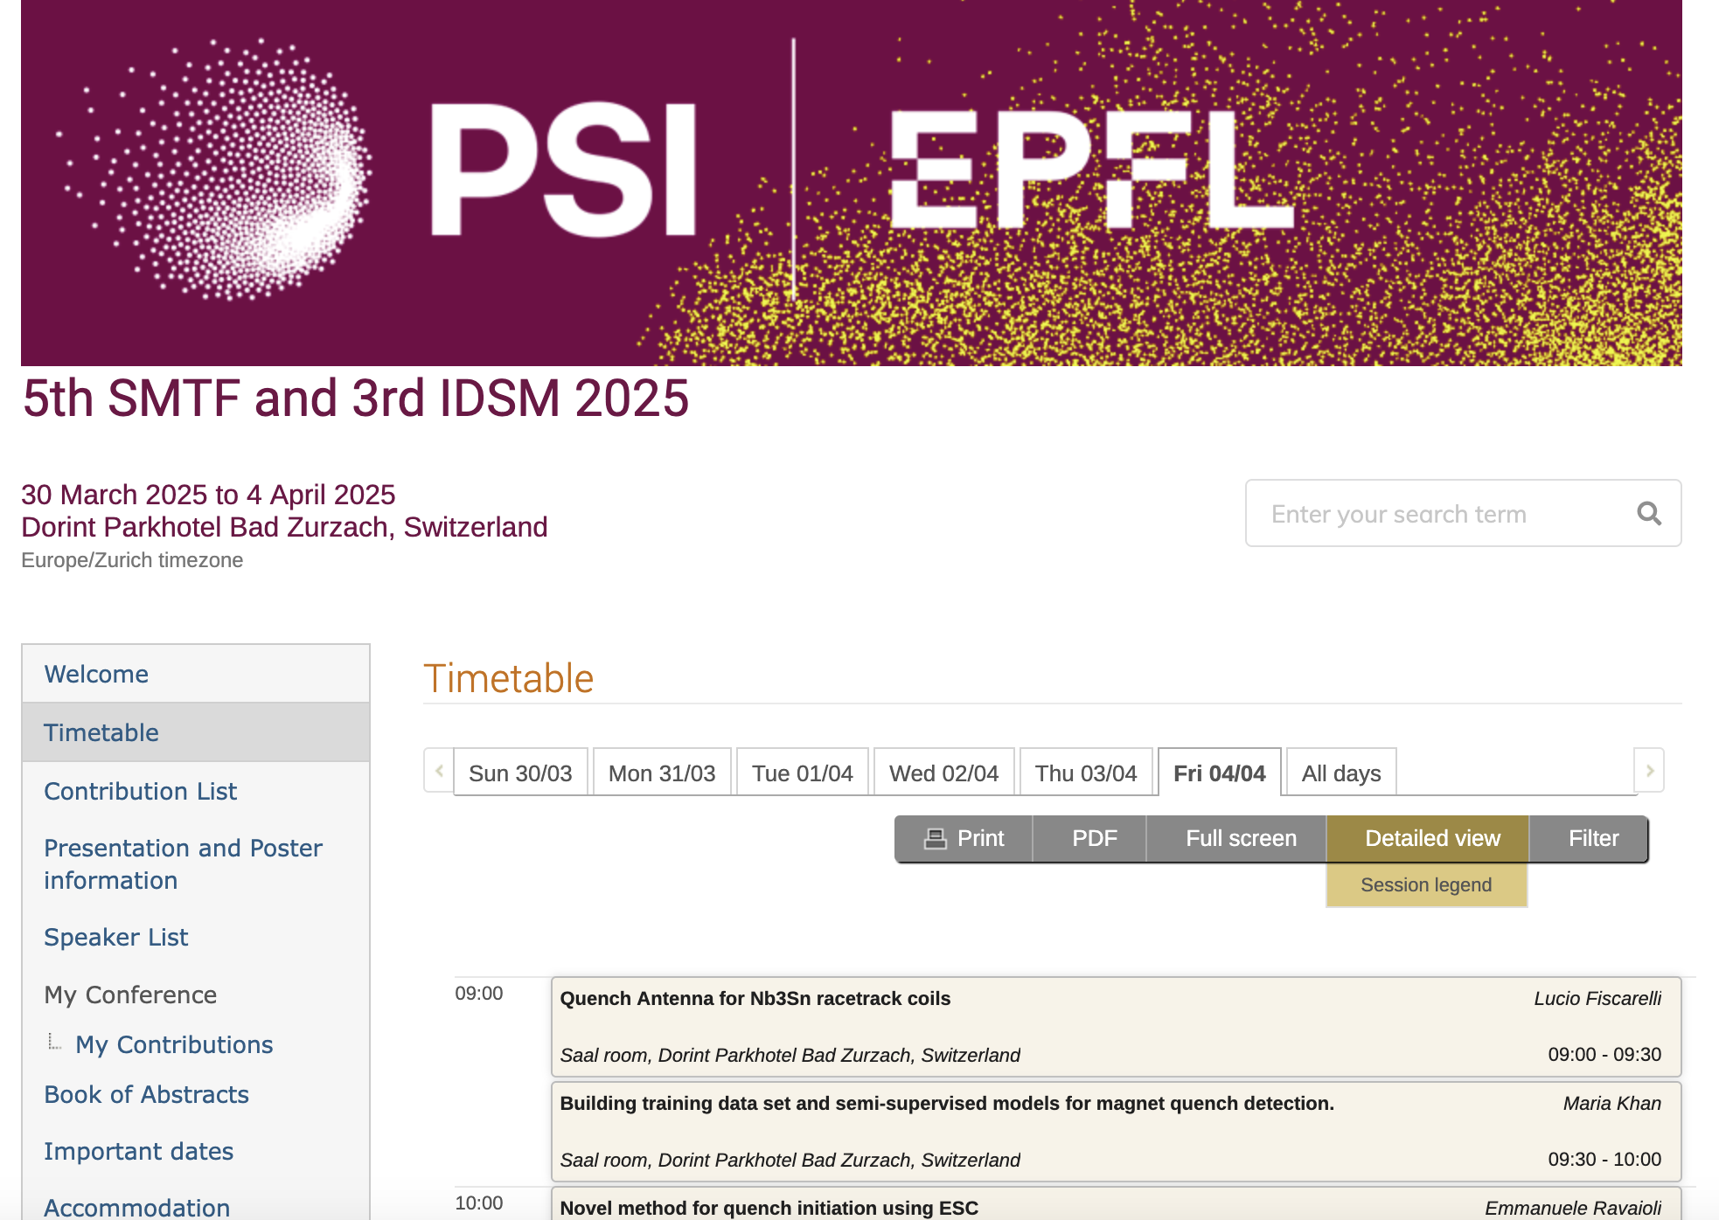
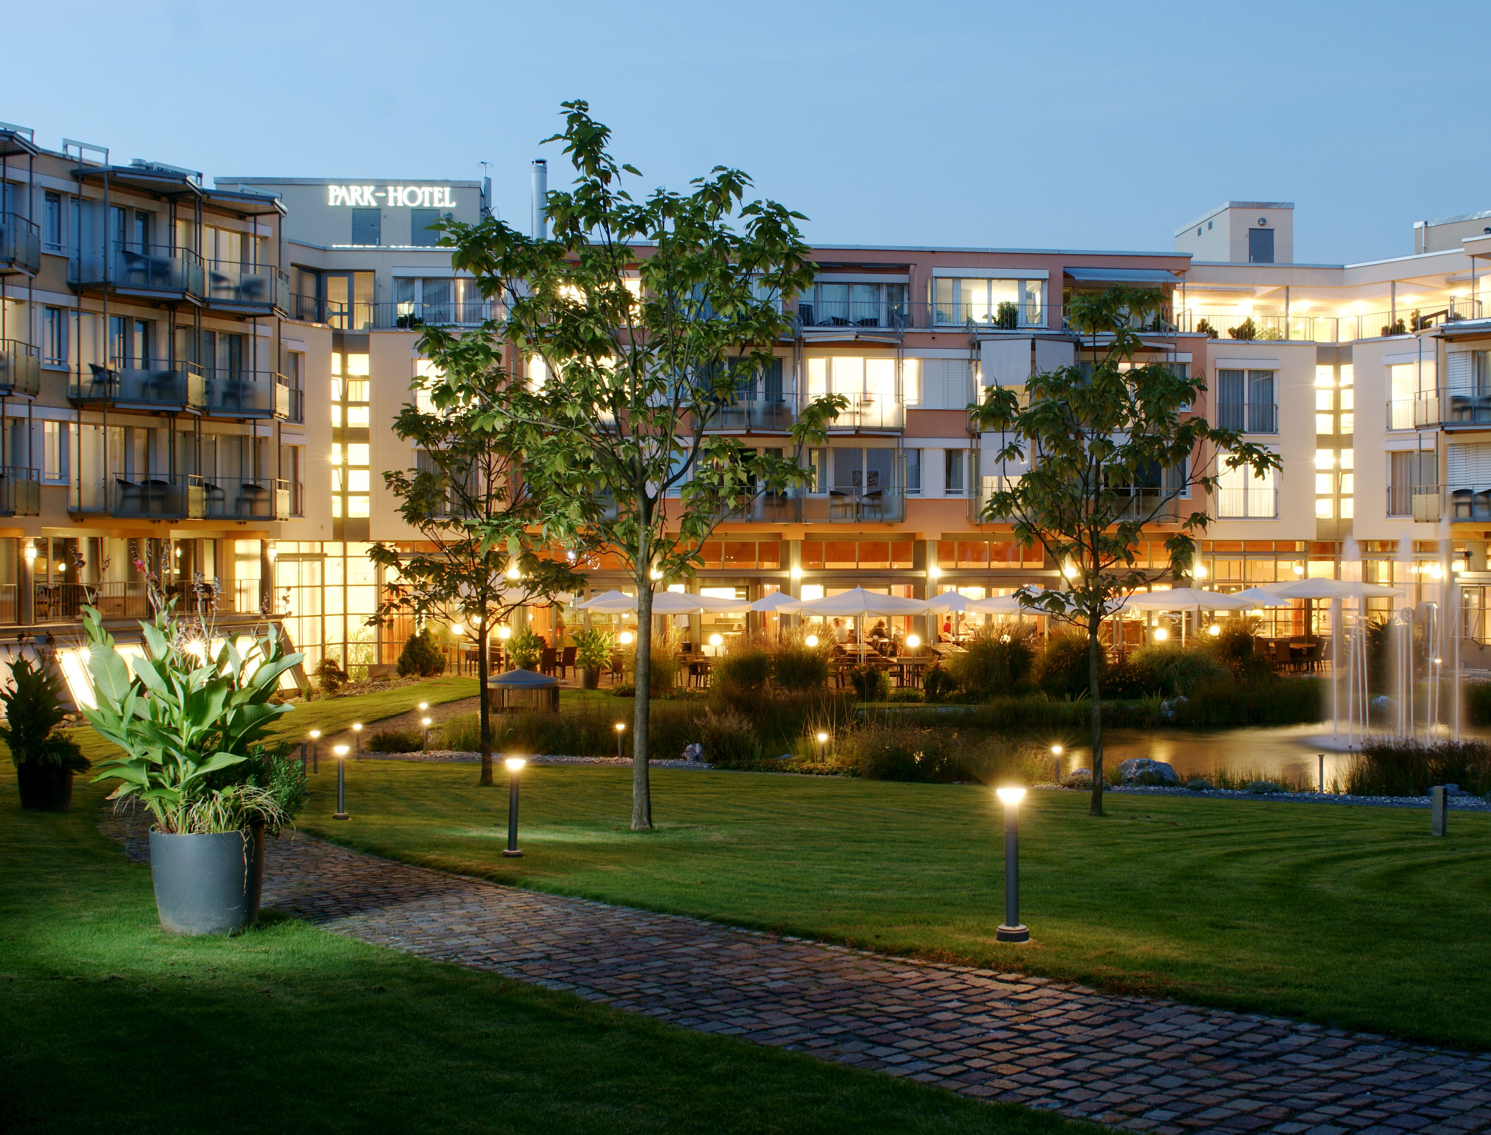
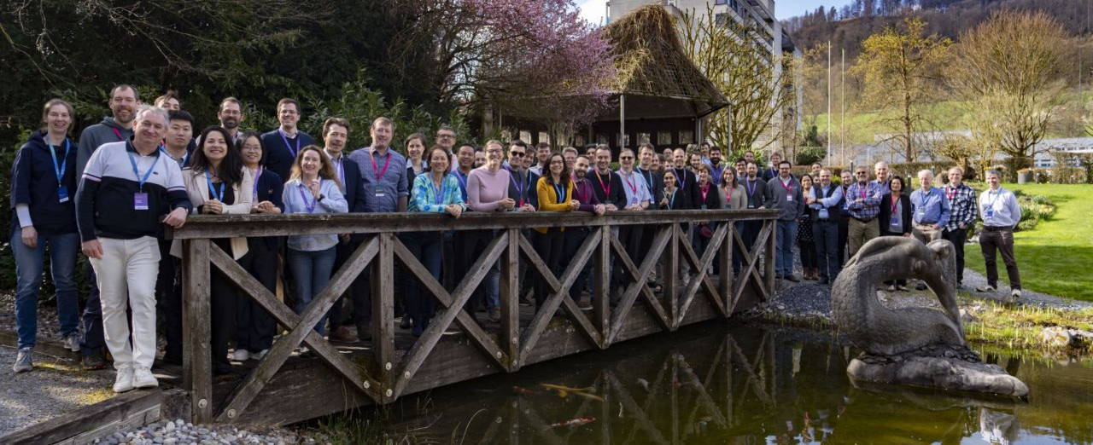
^{5th} edition
@ PSI Switzerland
31st June-4th. April 2025
2 full days SMTF
2 day of IDSM
Aprox 20 lectures offline
PSI Installation visit
61 participants over the two workshops
The townscape of Bad Zurzach dates back to the Middle Ages, when it was known as “Tenedo”.
M. Bajko CERN
We invited the Fusion community
We have a “Women in Science and Technology” session
LOC chair: Carolin Zoller
LOC Members: Michal Duda PSI, Quentin Gorit VDL ETG&PSI, Stéphane Sanfilippo PSI, Stefan Keller PSI, Kamil Sedlak EPFL, Nadja Zingg EPFL
SOC chair : Marta Bajko SMTF, Gerard Willering, Maxim Marchevskii IDSM,
SOC members: Hugo Bajas Training, Roser Vallcorba, Stoyan Stoynev
CERN is partner of this workshop.

Slide 8
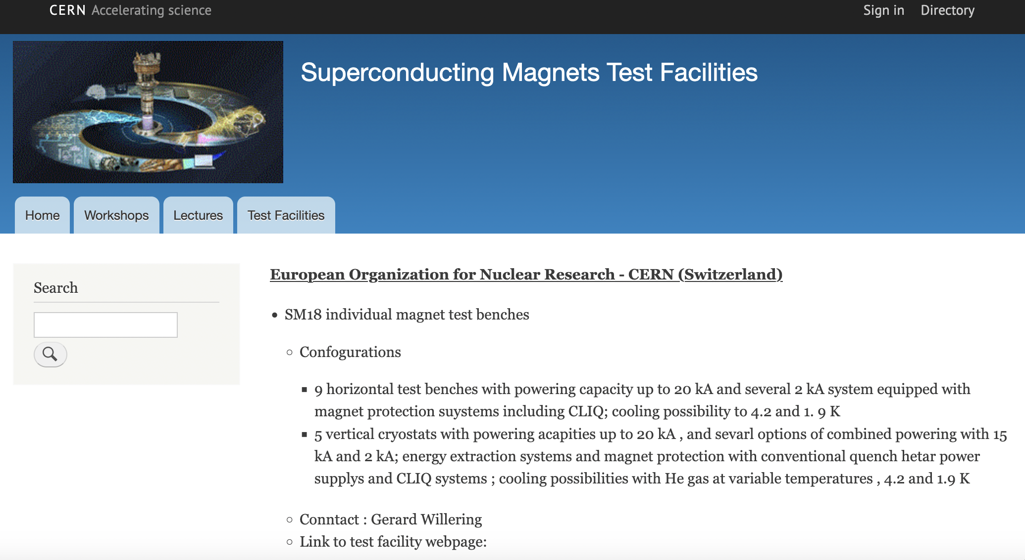
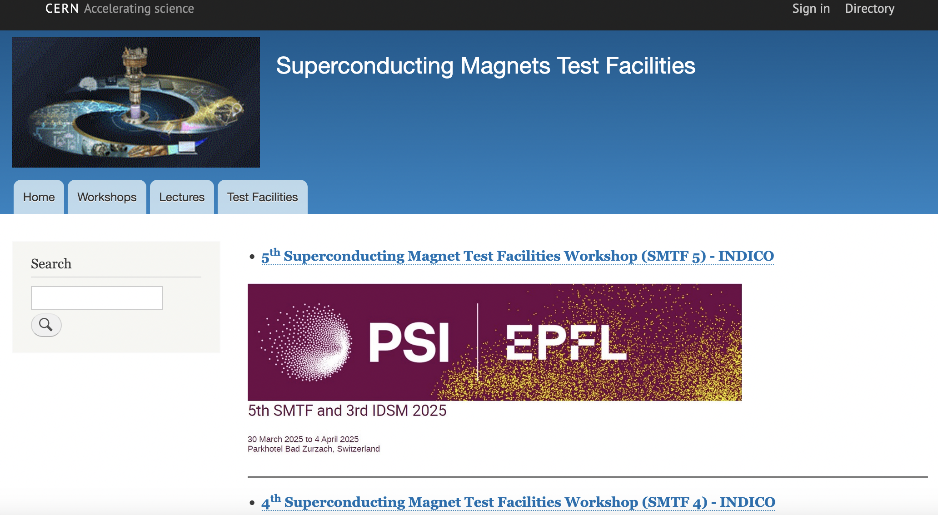
https://smtf-info.web.cern.ch/

Slide 9
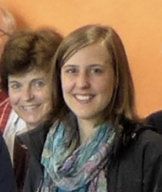
Thanks Roser
Thanks Carolin

