Slide 1
Challenges in Instrumentation and Diagnostics in the Hybrid Magnet Program
Soren Prestemon
US Magnet Development Program
Lawrence Berkeley National Laboratory
On behalf of the US MDP Collaboration

Slide 2




Outline
The US Magnet Development Program – hybrid magnet elements
  The Nb₃Sn magnet outsert program
  HTS insert program
Review of challenges and driving questions
Instrumentation and diagnostic needs
The role of modeling and analysis
Summary perspectives

Slide 3
Our program has been reviewed and revised to align with P5 recommendations
Central focus: develop and test high field magnets for HEP
Improve integration for hybrid magnets
Investigate HEP-motivated solenoid designs
Support magnets with critical materials, expertise & dev. of new enabling technologies
Strengthen linkage between technologies and magnets
Forward looking – what is enabled by our advances, and what is achievable for colliders
Align with, and support, collider design efforts
Further build collaborations, leverage synergies with fusion and with the NHMFL

Slide 4
Central themes of MDP magnet R&D to-date
Use fast turn-around platforms (subscale magnets, mirror magnets, etc)
Develop and apply advanced diagnostics, modeling
Explore “Quench Current-boosting”, high-Cp concepts, etc.
Understanding the disturbance spectrum and its control
  Study training, operating margin, and means to mitigate/reduce
Develop stress-management concepts to enable high-field accelerator magnets with strain-sensitive materials (Nb3Sn, HTS)
Develop and demonstrate REBCO and Bi2212 magnet technologies
Explore the viability of hybrid HTS/LTS magnets for efficient high-field accelerator magnets
Work with industry to advance superconductors tailored to HEP needs
Focus on developing conductor / cable / coil / magnet processes, identifying key issues
Leverage elements above to design optimized high-field configurations
Longstanding nexus between Labs, Universities, and industry in the US
  Example: Annual Low Temperature Superconductor Workshop >40+ years!

Slide 5
Driving questions
Can stress management be used to produce high field magnets with large apertures that can approach the conductor limits without degradation?
What are the most effective impregnation materials regarding training, degradation, radiation hardness, etc?
Can training be significantly reduced / eliminated and degradation avoided by using stress management together with wax or Telene-based impregnation for large aperture (> ~ 120mm) high field magnets (>~10T)?
Are HTS conductors compatible with the hybrid HTS/LTS approach and what needs to be done to improve the compatibility?
How do we minimize critical current degradation in HTS materials during coil and magnet fabrication, under Lorentz forces, and due to thermo-cycling?
Stronger support materials are needed for fields > ~16 T magnets. How does this affect fabrication of components (machinability, scale up, 3D printing, etc.)?

Slide 6
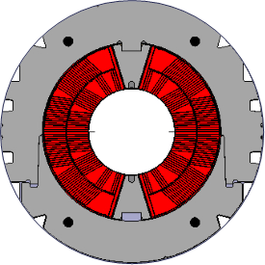

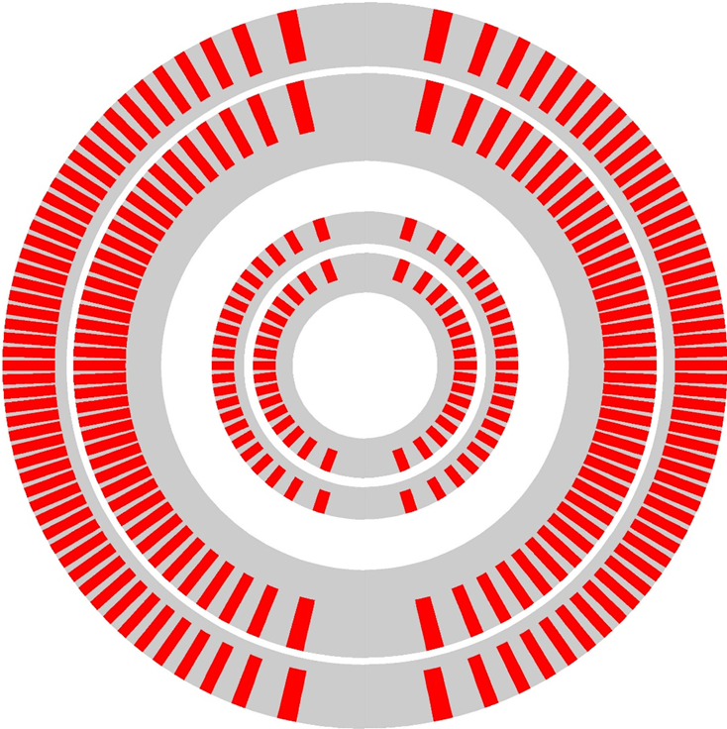
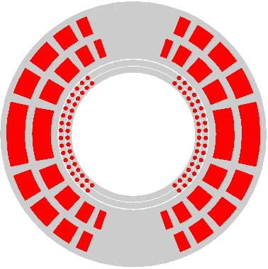
Nb₃Sn magnets R&D focus
2) Stress management designs
In a traditional dipole designs, e.m. forces accumulate on mid-plane and radially
  In the 15-20 T range, stress of the order of 150-200 MPa
Nb₃Sn is brittle and strain sensitive
  → Performance degradation with about ≥ 150 MPa
MDP has being focusing on the development of stress managed structures
  The coil includes structural elements
    Radially: mandrels
    Azimuthally: ribs
  Interception of e.m. forces
    → Risk reduction of conductor degradation

Slide 7
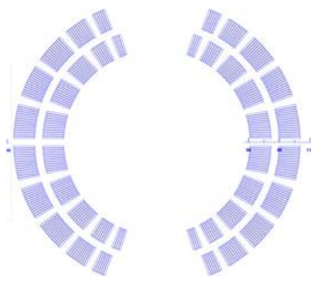
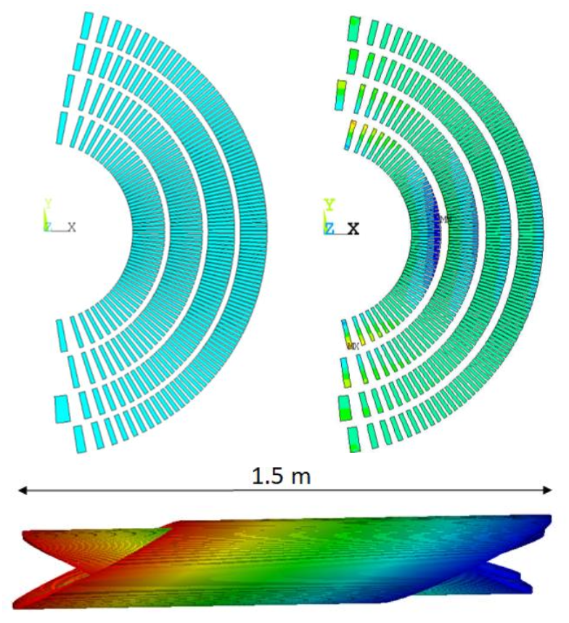
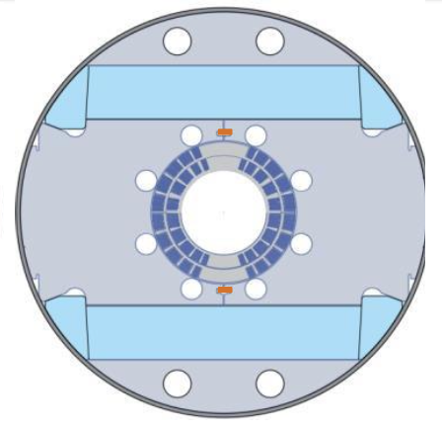
A priority now is to build the Nb₃Sn outserts
Canted Cosine theta:
  4 layers
    Bore field of ~12 T / 13 T for standalone operation
    Bore diameter: 120 mm
Stress-managed Cosine Theta:
  2 layers
    Bore field of ~12 T
    Bore diameter: 120mm
SMCT
CCT
30+ % current margin at target fields of 12 T, 4.2 K and 13 T, 1.9 K
These are two variants on stress-management
CCT is a “limiting case” of maximal SM
SMCT is a more efficient design

Slide 8
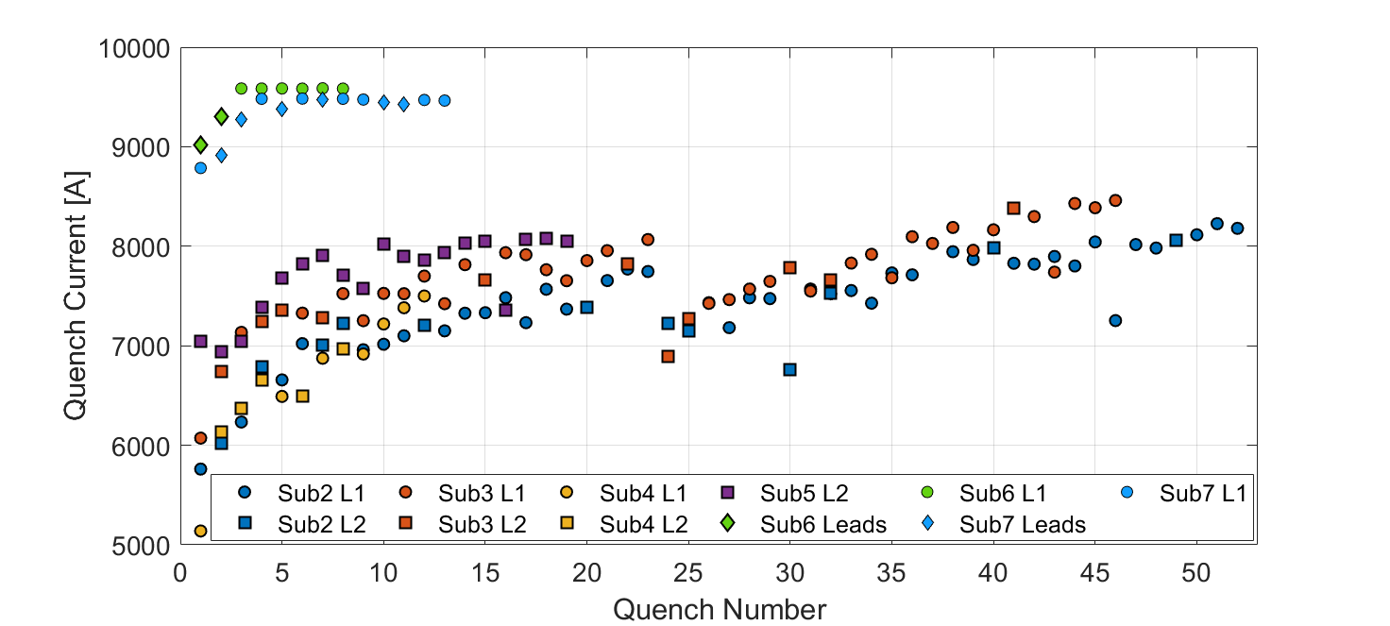
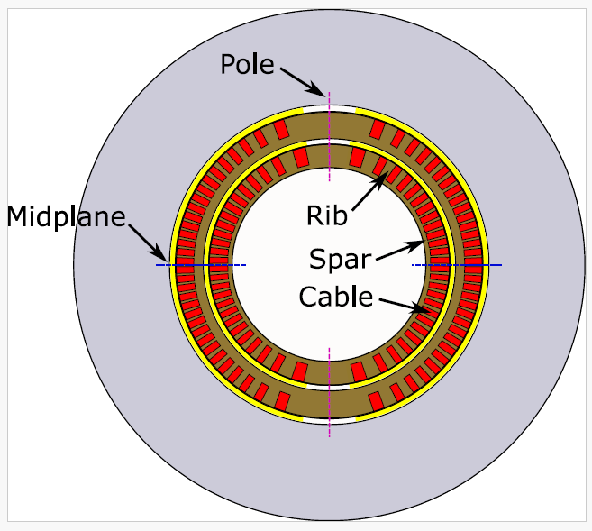
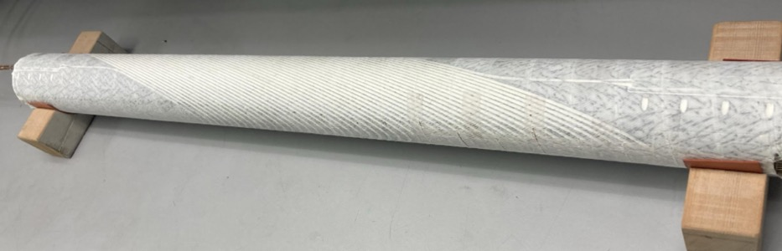
Subscale magnets are used to evaluate impregnation materials – the return of Paraffin Wax!
Diego Arbelaez
    Daly et al 2022 ,SUST 35 055014
    D. Arbelaez, IEEE TAS, Vol. 32, No. 6, Sep. 2022, 4003207.
    D Arbelaez et al., SUST, 37 065015, 2024
    E. Barzi et al 2024 SUST. 37 045008
Subscale CCT’s built with Paraffin wax (sub-6), then filled-wax (sub-7)
Subscale with Telene is being fabricated
Very promising – is it a lasting breakthrough?

Slide 9
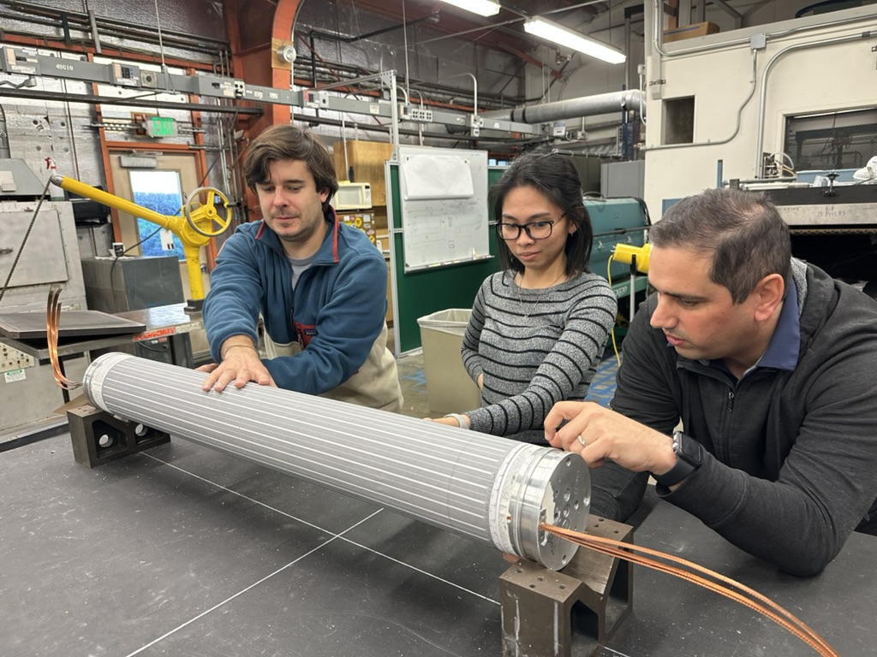
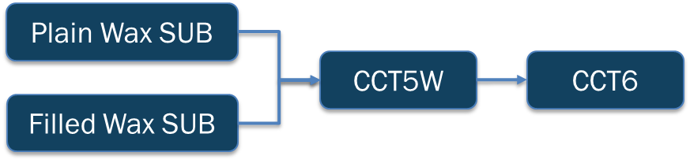
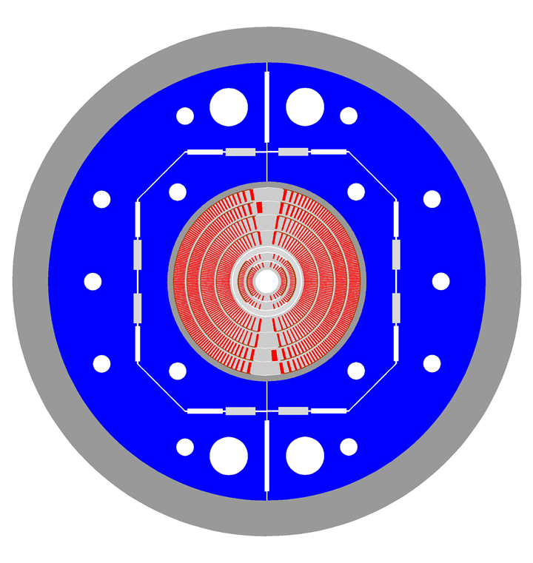
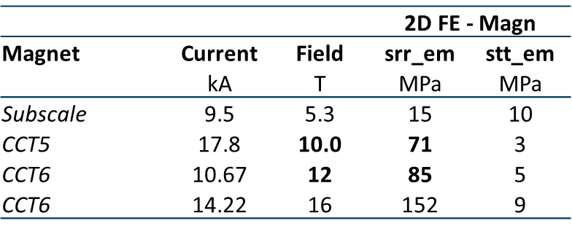
Need to demonstrate technology at relevant stress levels
✔️
CCT5w coils completed
✔️
Under fabrication at LBNL; test planned at FNAL in late April
“Flagship” ~14T large bore dipole construction beginning; highly relevant to muon collider storage ring and FCC-hh
Stress on Turn from Lorentz Force
Instrumentation:
Quench antennas
Strain measurements
Voltage taps
….
Practice winding of CCT6

Slide 10
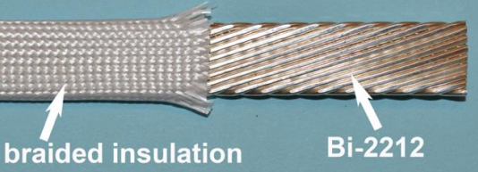
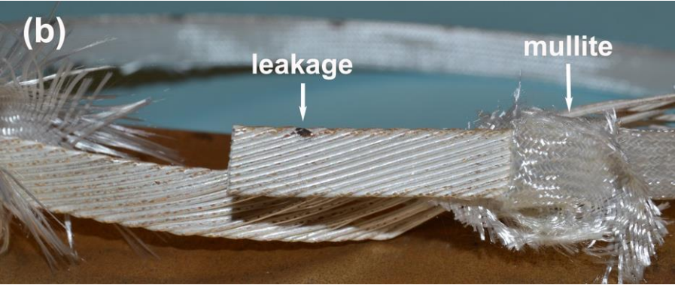
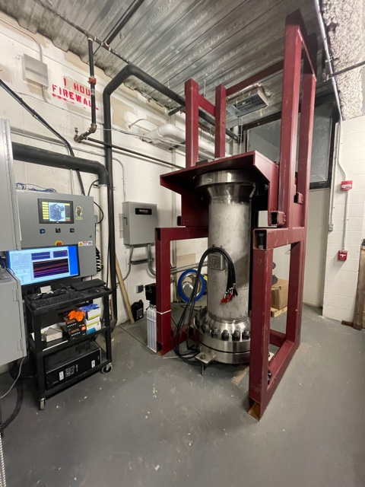
Bi2212 magnets
Technical challenges
Possibility of fabricating Rutherford cable is a major advantage towards accelerator magnets
However, challenging fabrication process
  50 bar in O₂ at 885-900 °C
R&D to minimize “leakage” observed after heat treatment
  The Bi-2212 liquid leaks through the encasing metal (Ag alloy) at high temperatures → degradation of performance
Major improvements (but not total removal yet) obtained with
  Combination of a TiO₂ coating with a mullite sleeve as insulation
  Over pressure heat treatment
    Achieved in “short” (~½ m) furnaces
    Development of a longer (1 m +) furnace on going at NHMF

Slide 11
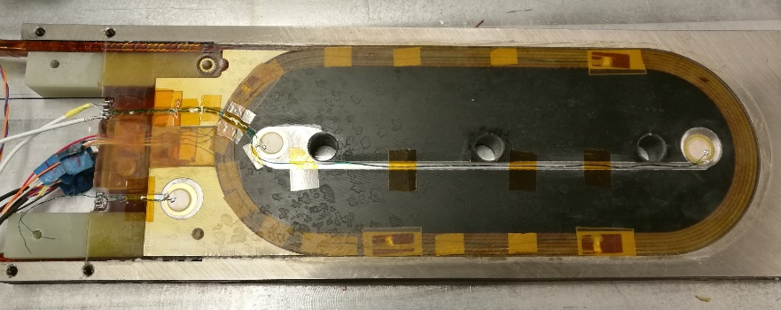
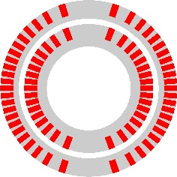
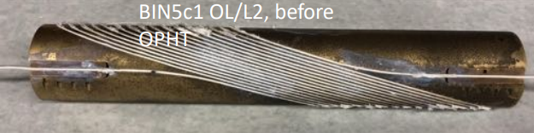
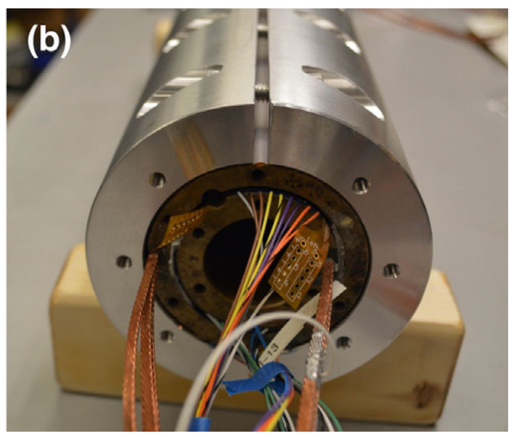
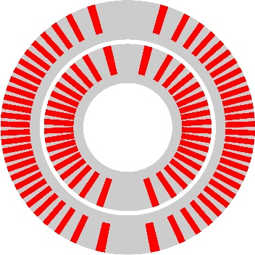
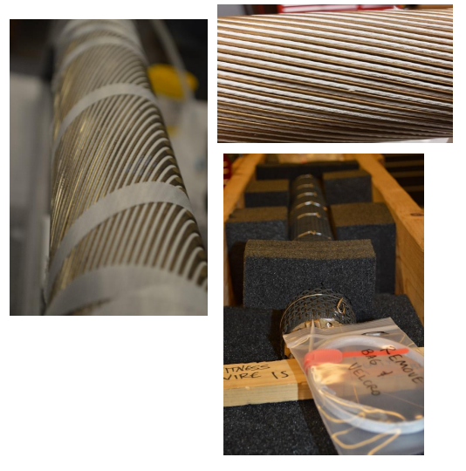
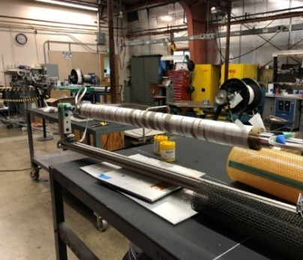
B12212 magnets
Development of racetrack and CCT magnets
LBNL has being focusing on racetracks and canted Canted-Cosθ
RC7n8 (2019)
  4.7 T reached in with racetrack coils configurations
  Highest field so far in “no bore” design
Bin5 (2021)
  1.6 T in 31 mm aperture
  Successfully tested in stand alone
  Ready to be tested in CCT5
Next steps
  BiCCT1 and 2
  Progressively larger cable
  Target: 5 T to 7 T in 40 mm aperture
  Coil fabrication in progress

Slide 12
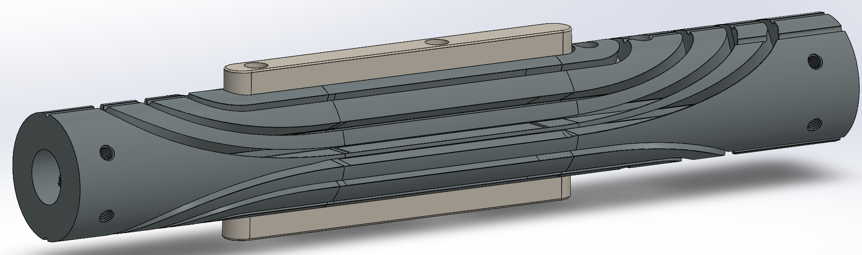
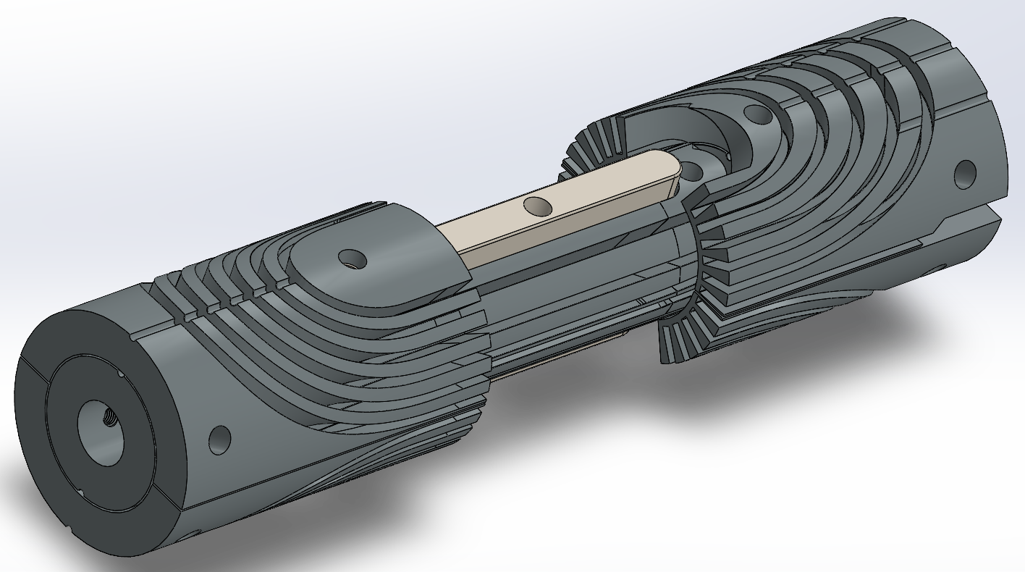
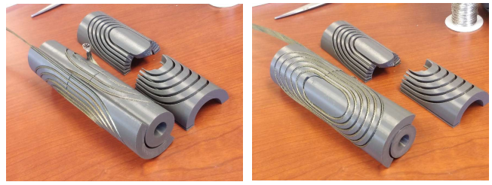
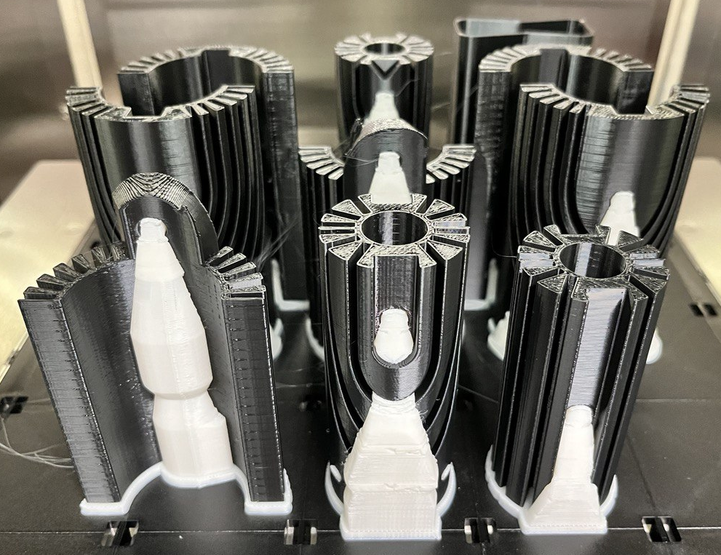
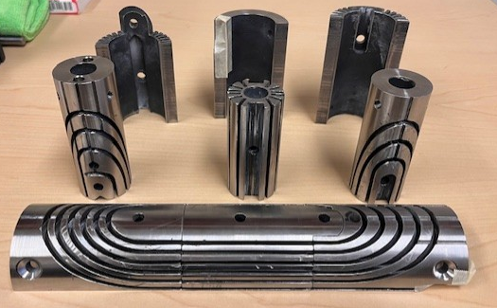
B12212 magnets
Development of SMCT magnets
An SMCT-type coil is in the process to be fabricated by FNAL
  Goal: 1-2 T in 15 mm aperture
  Winding test performed with plastic parts
  Fabrication of Inconel 3D printed mandrel completed

Slide 13
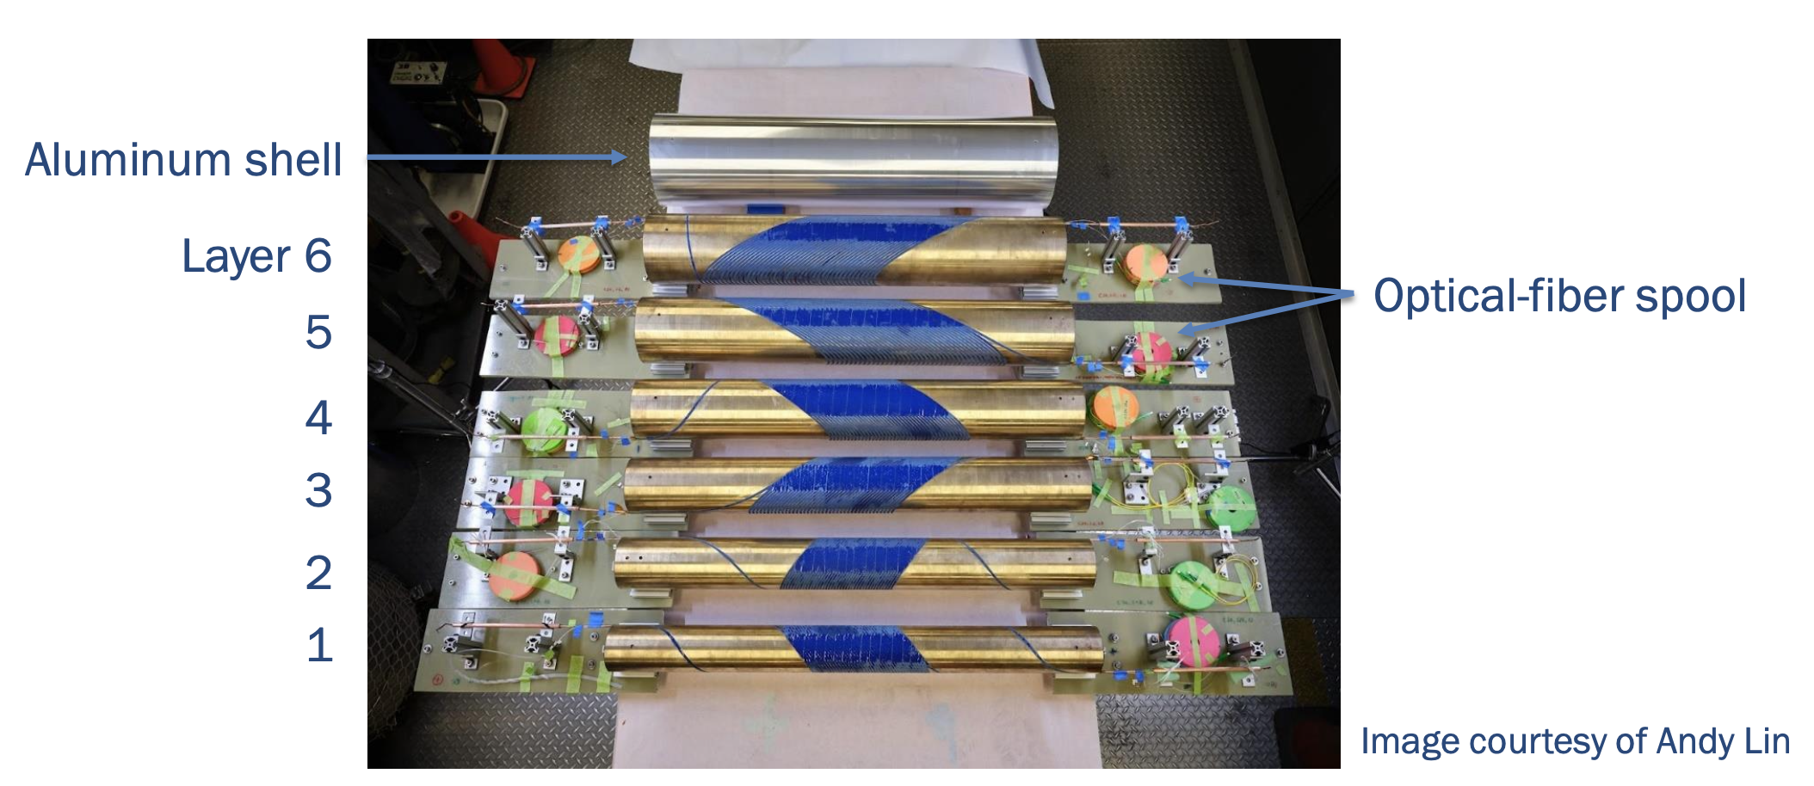
C3 is a 6-layer CCT magnet using CORC conductor
Xiaorong Wang
145 m of CORC® wires in six pieces, maximum piece length 35 m
Specified the minimum tape Ic for HM tapes
Instrumentation:
Fiberoptics for strain measurements
Voltage taps
….

Slide 14
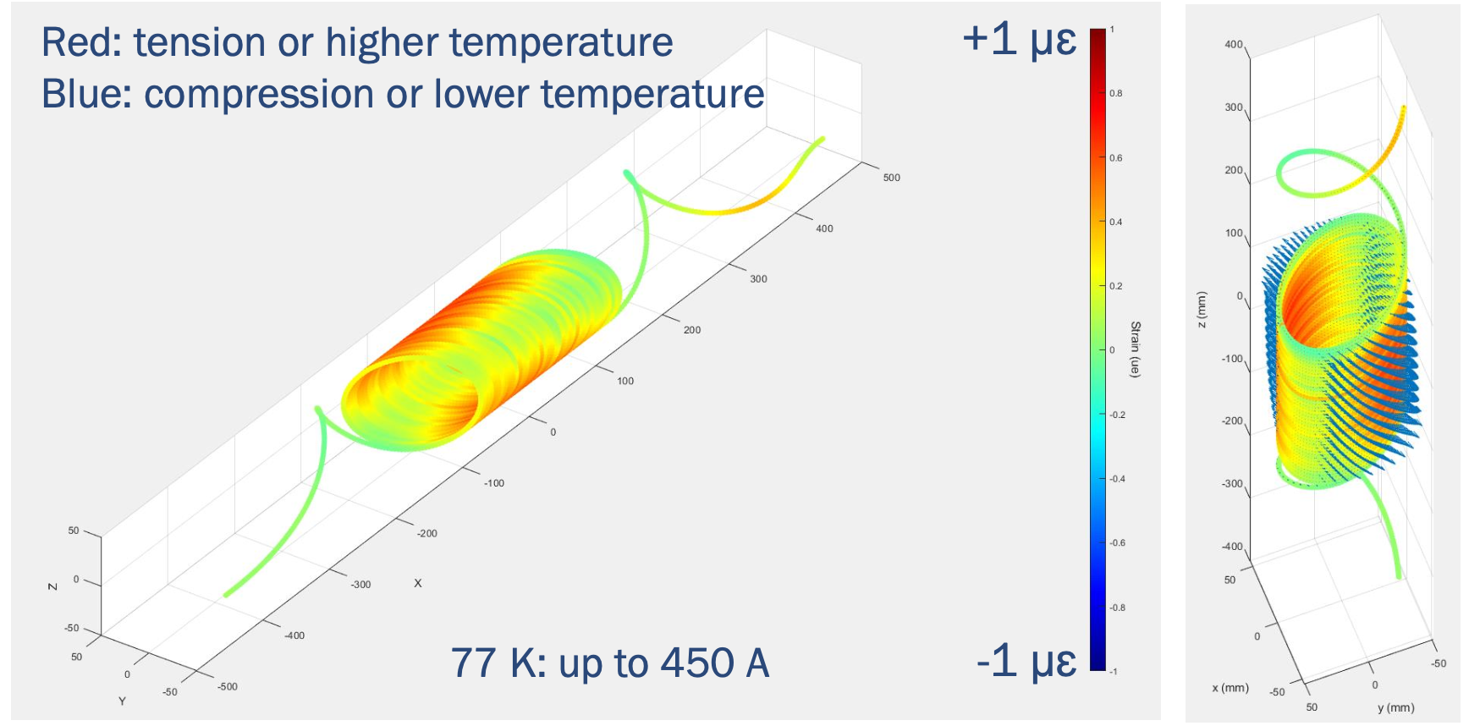
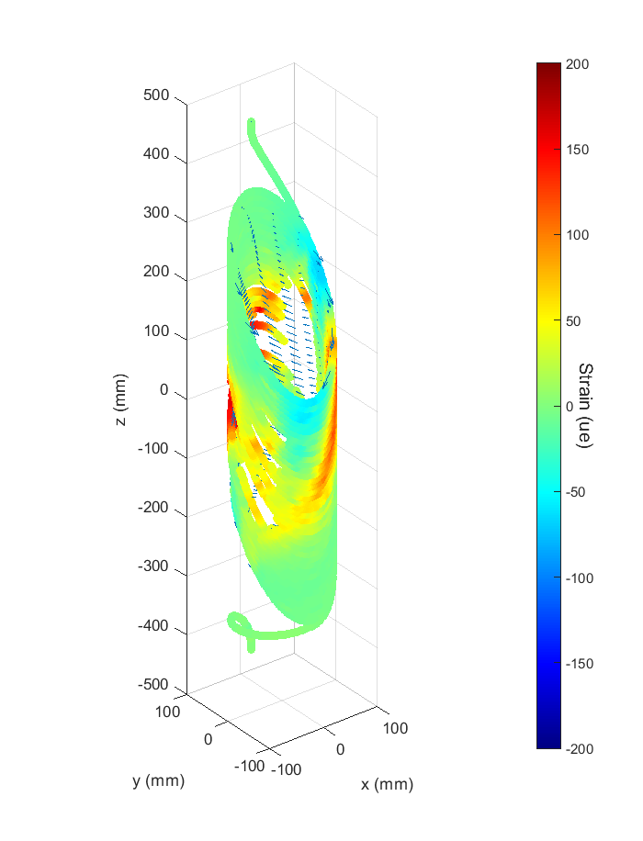
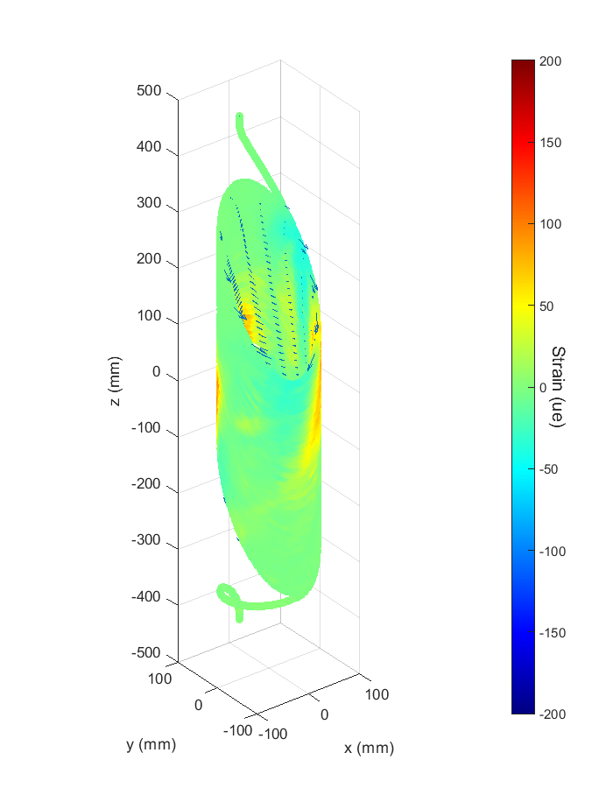
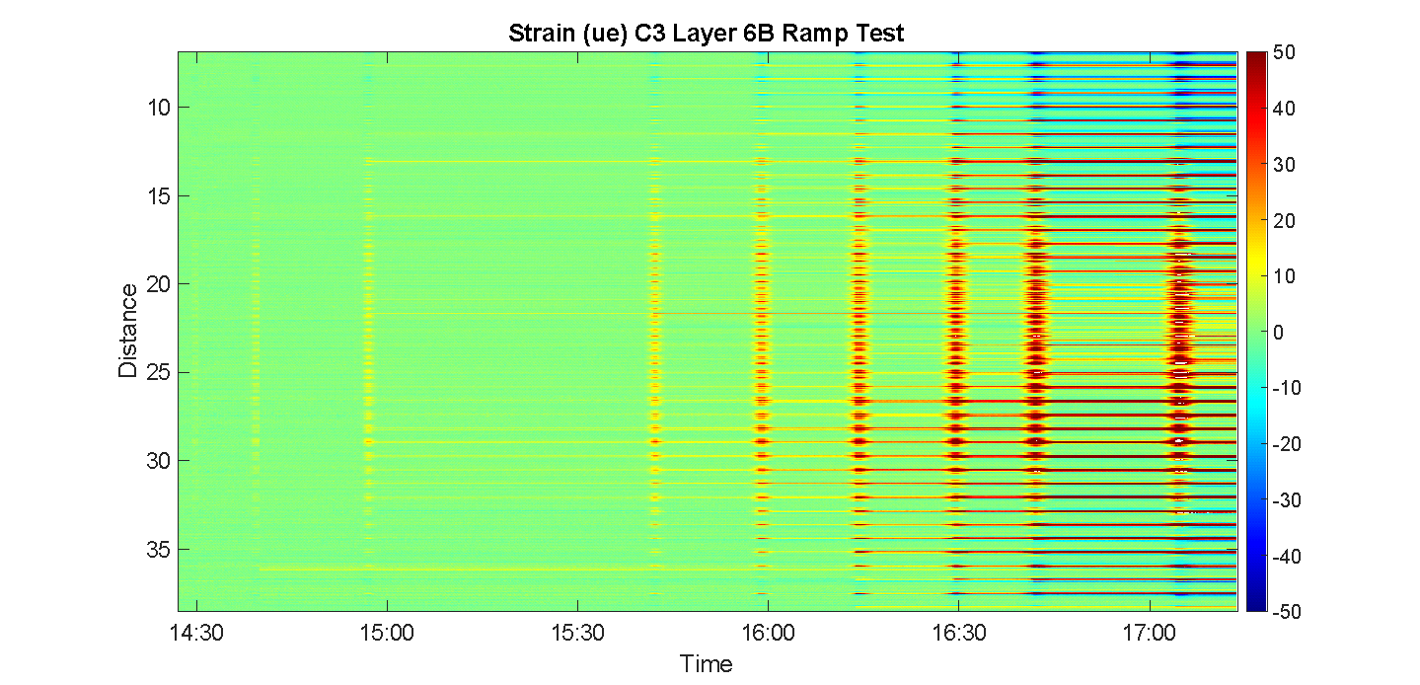
C3 achieved 5.2T => major goal of the 2020 MDP roadmap
First test successfully completed – decision to limit to 10 micro-volt/layer
Second test campaign in coming months
  Will include magnetic measurements
  Push to higher field (higher voltage)
Teaser of data to come – example layer 6 (will be presented at MT29 by Linqing Luo)
Strain measured via distributed optical fiber – fibers in each layer, all worked well throughout test (Linqing Luo et al 2025 SUST 38 035029)

Slide 15
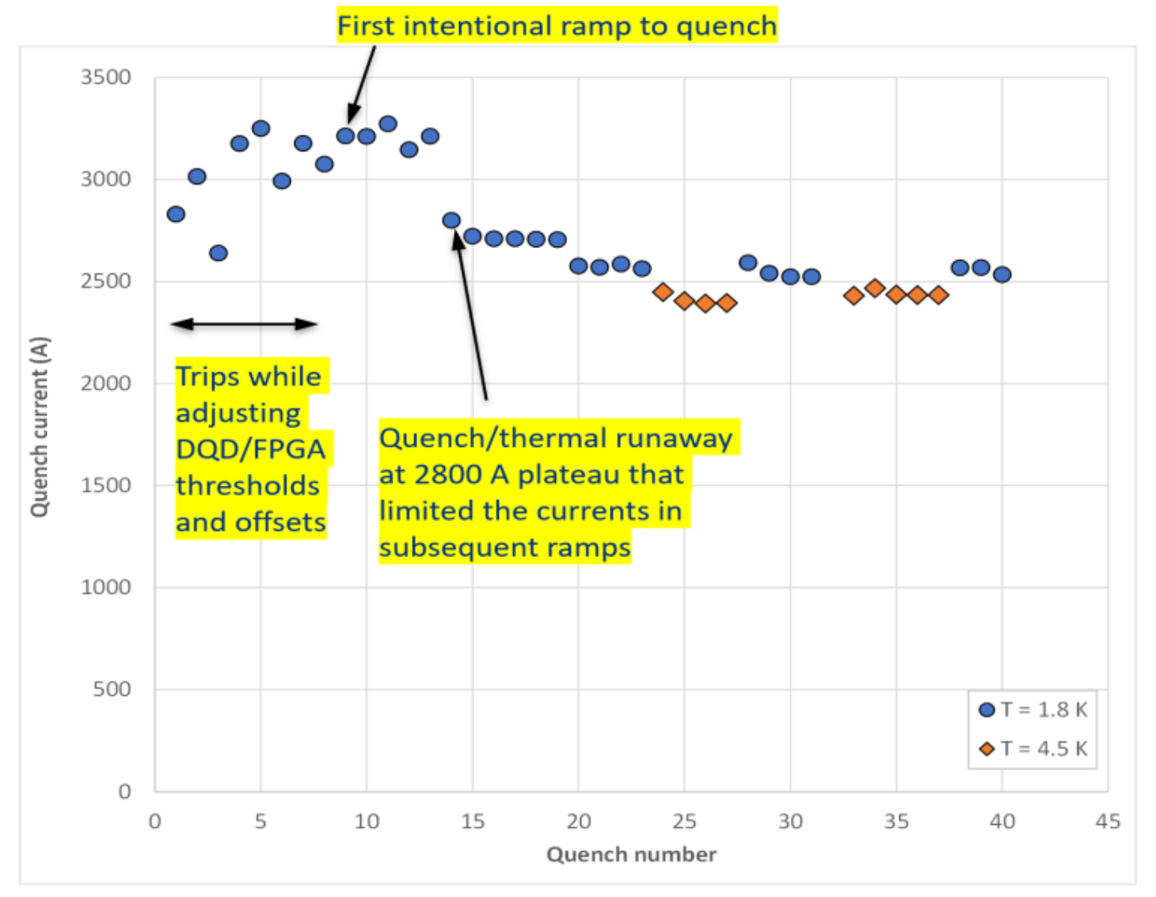
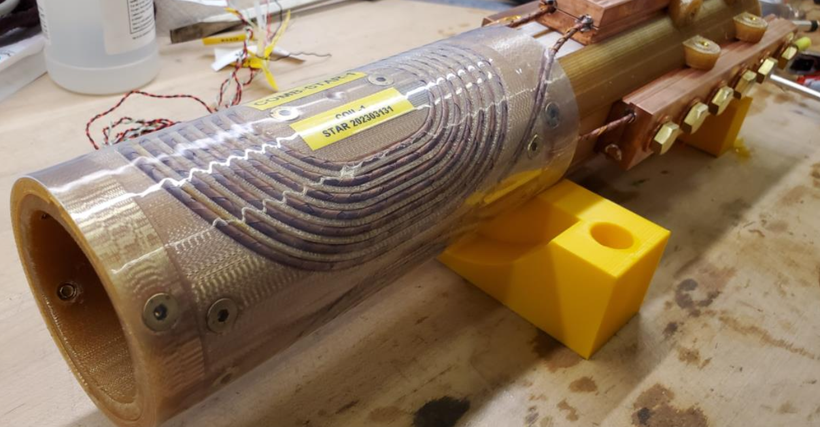
COMB concept yielding results
Vadim Kashikhin
COMB-STAR-1 magnet (2023-24) Achieved 1.5 T bore field @ 3.3 kA in LHe
  Degradation in one coil explored vi micro-CT scan

Slide 16
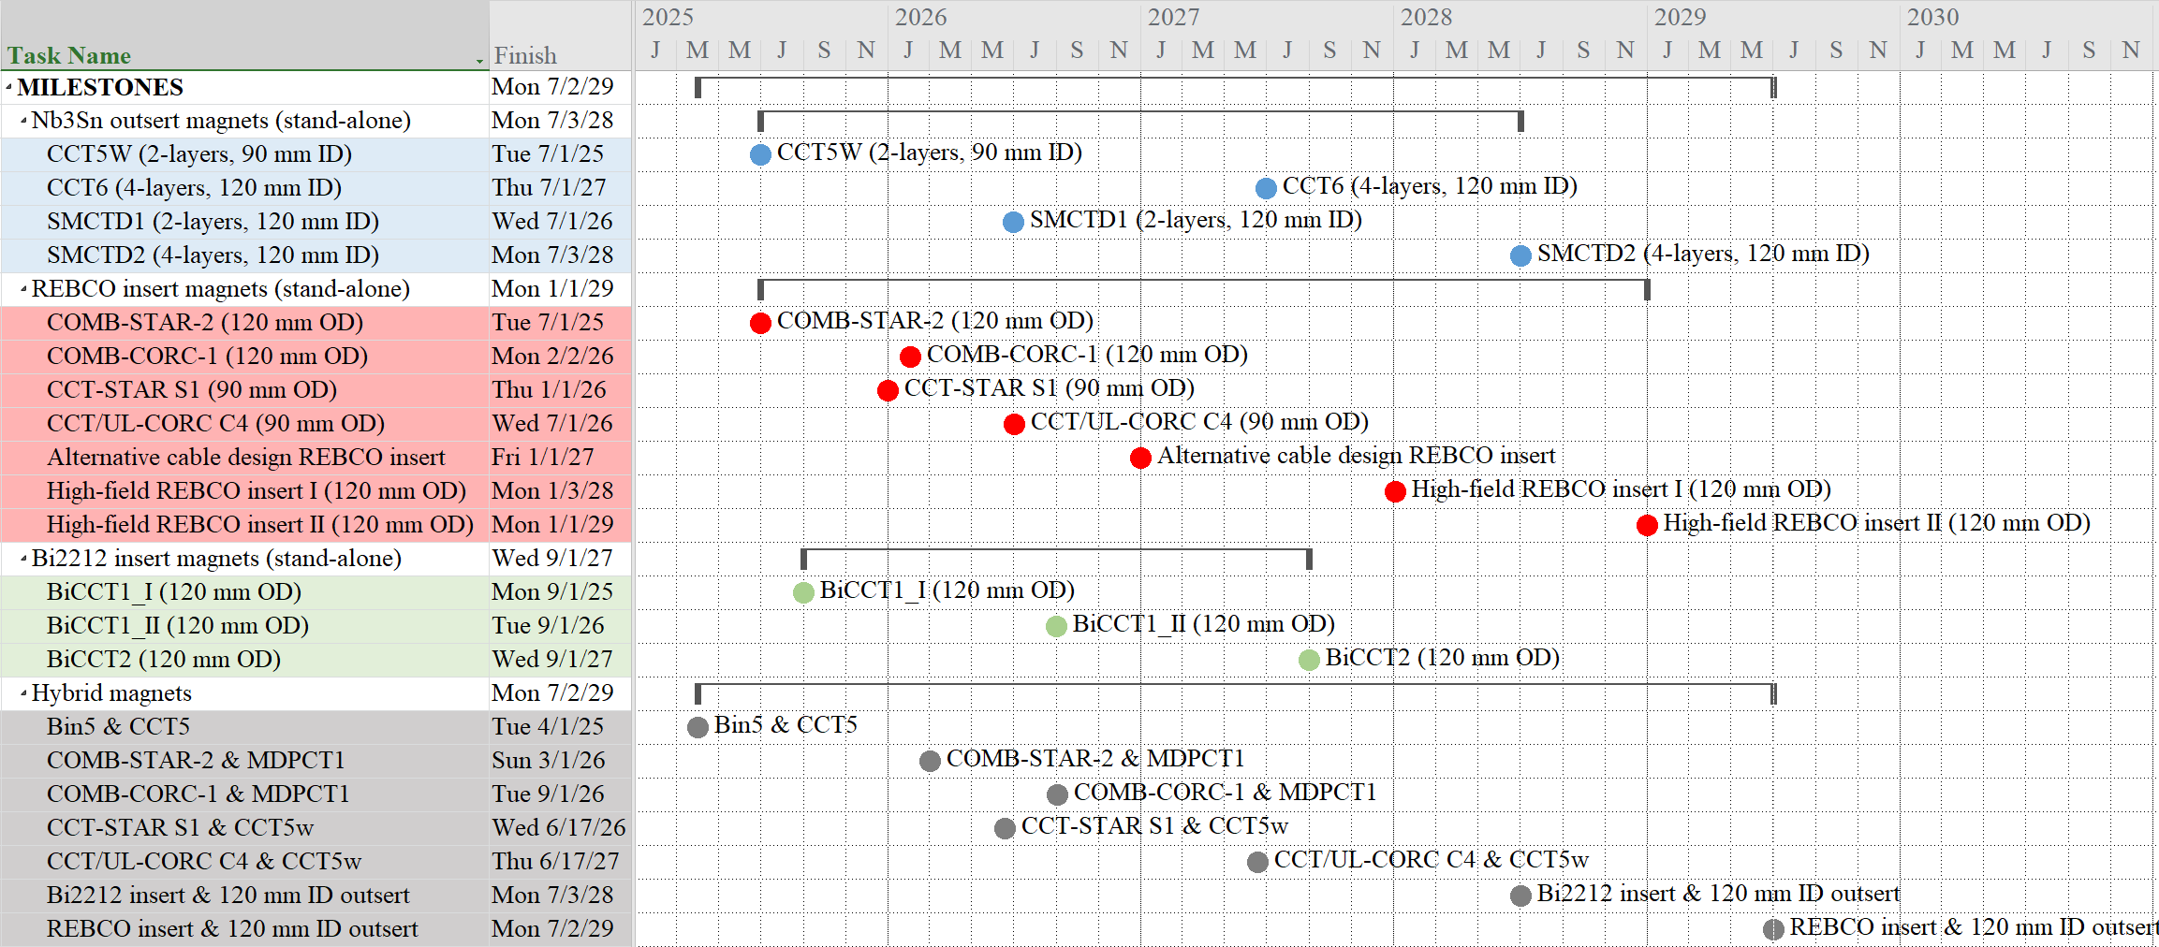
Major push now is to integrate HTS and LTS in hybrid magnets
Paolo Ferracin
Tentative – dates still being revised

Slide 17
Review of challenges and driving questions
HTS magnet development
Questions related to conductors
Questions related to cables
Questions related to coils & magnets
How hybrid magnet tests can guide development of HTS accelerator magnets
Issues that are specific to hybrid operation

Slide 18
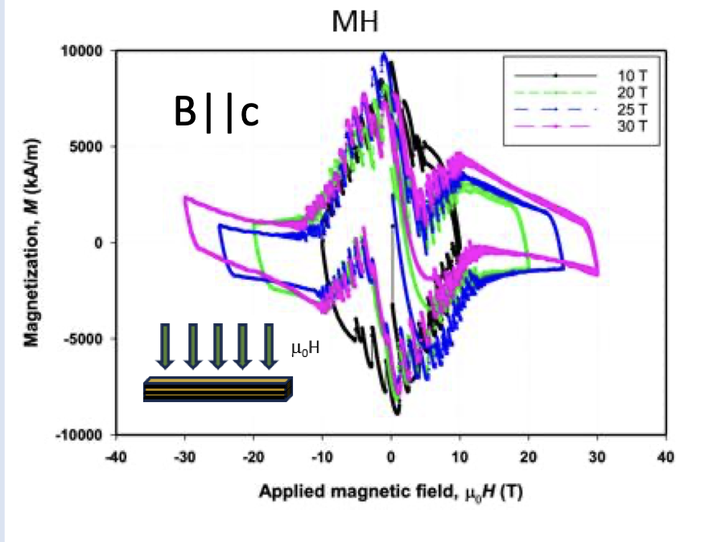
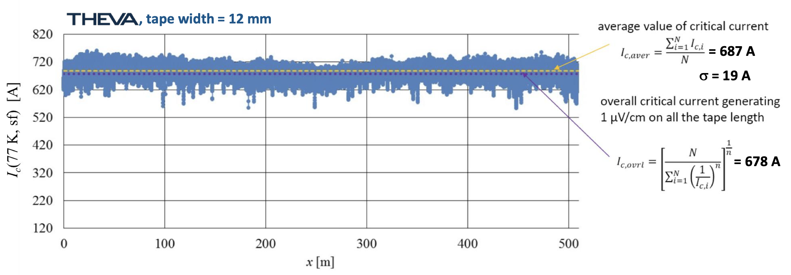
Review of challenges and driving questions - related to conductors
Characterization of properties - and variation of properties along length
What are the mechanisms of conductor degradation?
  Thermal, mechanical; coupling to electromagnetic behavior
Are flux jumps an issue in HTS? Under what conditions? (impact protection via threshold)
J. Jaroszynski, CCA
C. Senatore, CCA
See C. F. Gömöry, et al., SuST 36 (2023) 054001
DOI: 10.1088/1361-6668/acb73f
https://arxiv.org/pdf/2502.02706

Slide 19
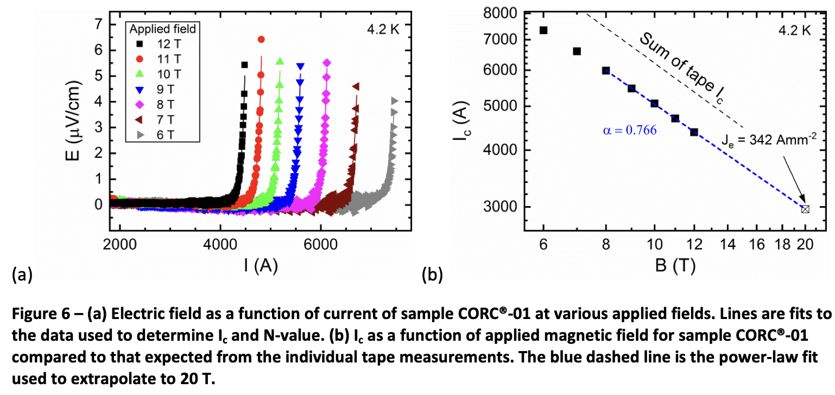
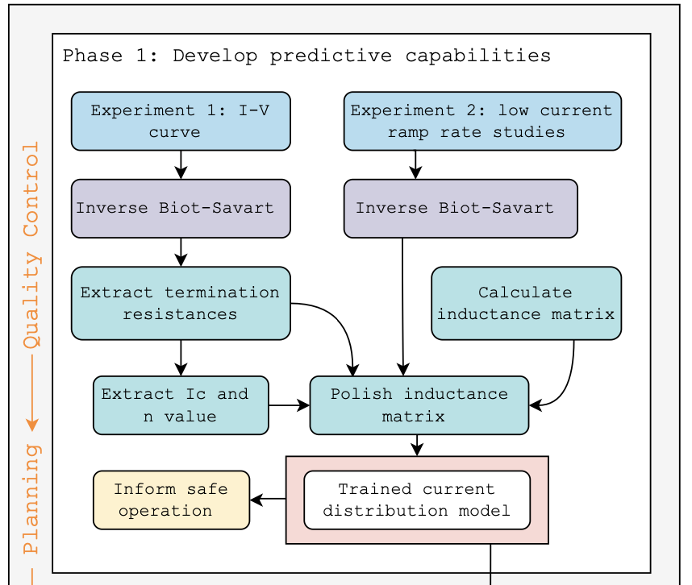
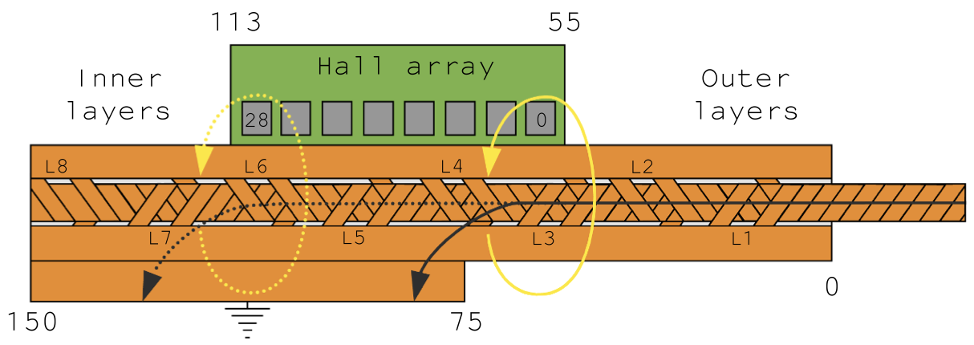
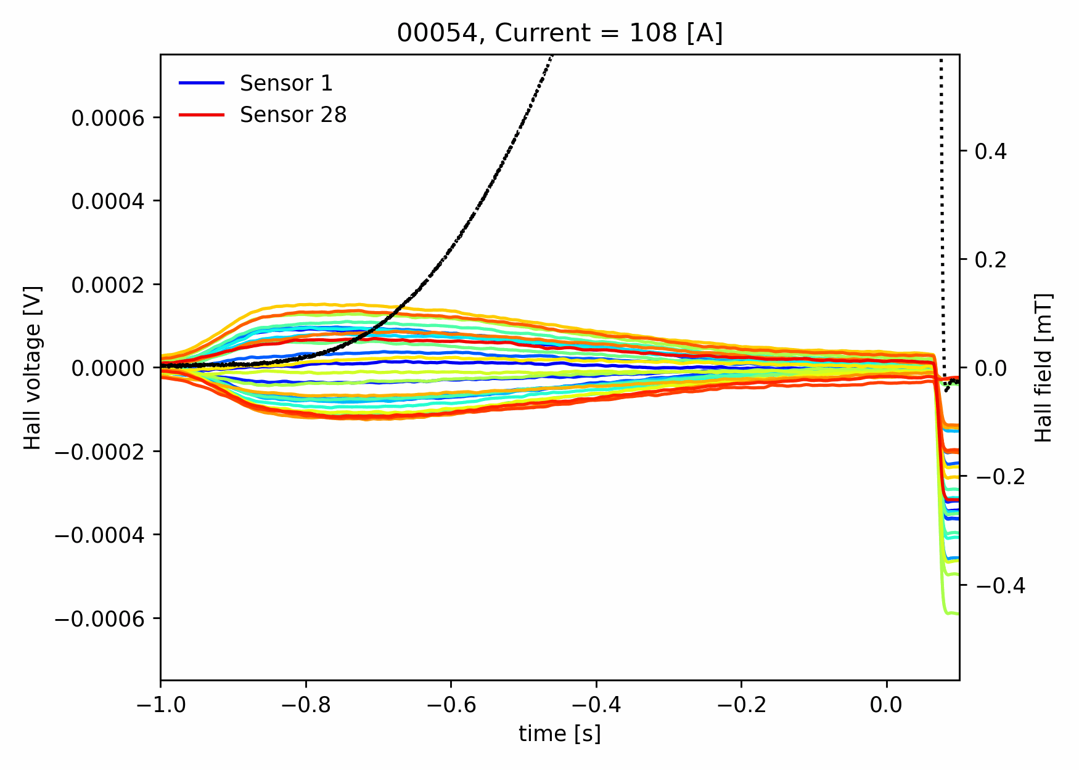
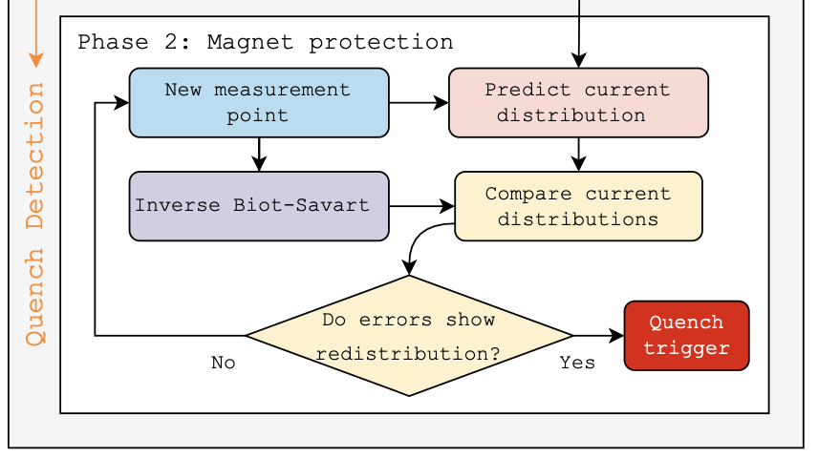
Review of challenges and driving questions - related to cables
Characterization of cable properties
  Can we deduce cable properties from constituent tape/wire properties?
  Can we agree on a ”standard” for cable Ic measurement?
  Determination of contact resistance, its variation
How does termination design impact current distribution?
What are best practices for joint design & fabrication?
What are mechanisms of cable damage?
Can we define acceptable design criteria for cables?
Can we use cable n-value, i.e. V(I) as a means of monitoring operational margin?
J D Weiss et al 2020 Supercond. Sci. Technol. 33 044001
Teyber et al., Sci Rep 12, 22503 (2022)
Reed Teyber et al 2020 SUST. 33 095009

Slide 20
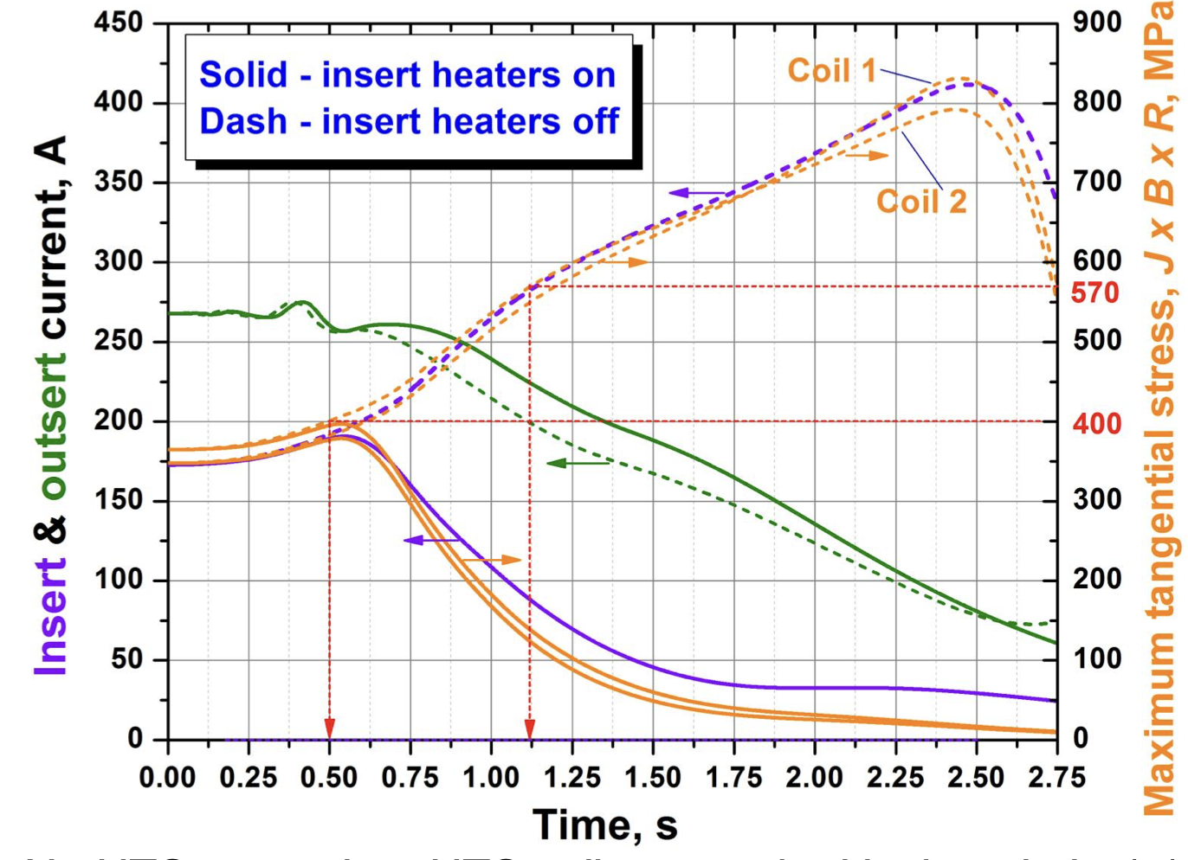
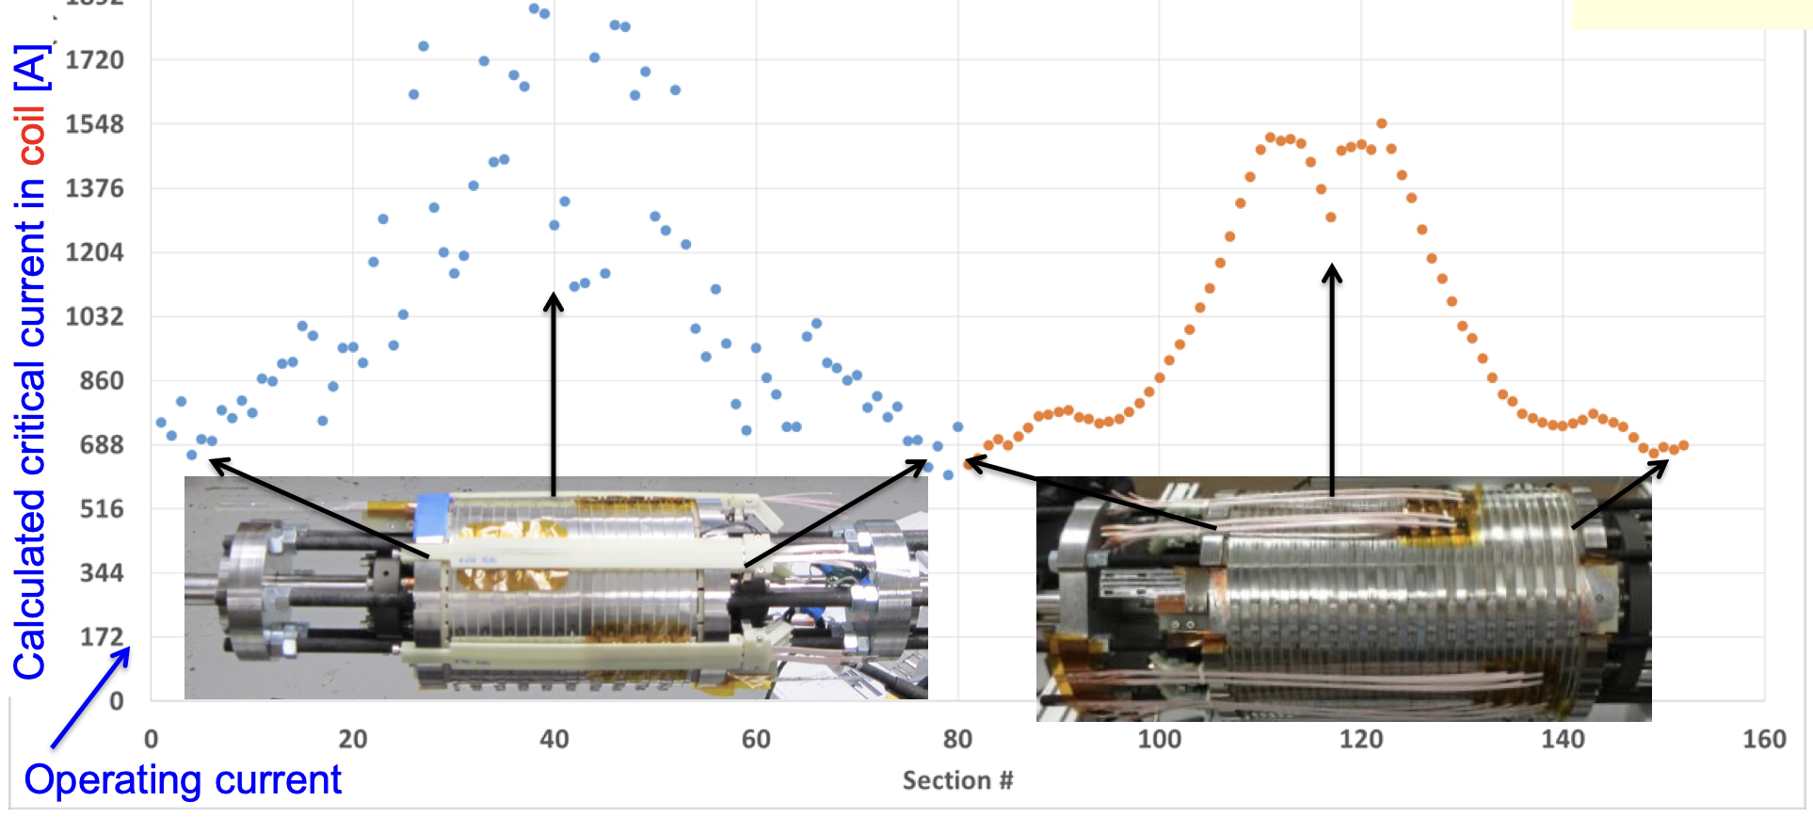
Review of challenges and driving questions - coils & magnets
What are the tradeoffs in terms of magnet inductance and protection strategy?
  Traditionally want cables to reduce inductance, help with L/R decay
    Note the solenoid community does not typically use cables!
Can we predict magnetization and hysteresis in HTS magnets?
“The NHMFL 32 T superconducting magnet”, H. Weijers, EUCAS 2017

Slide 21
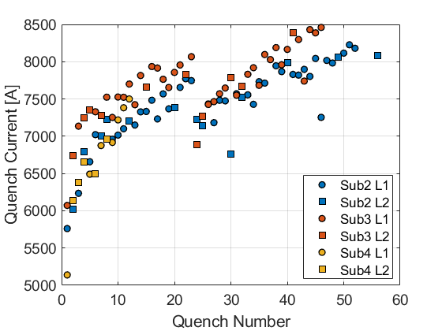
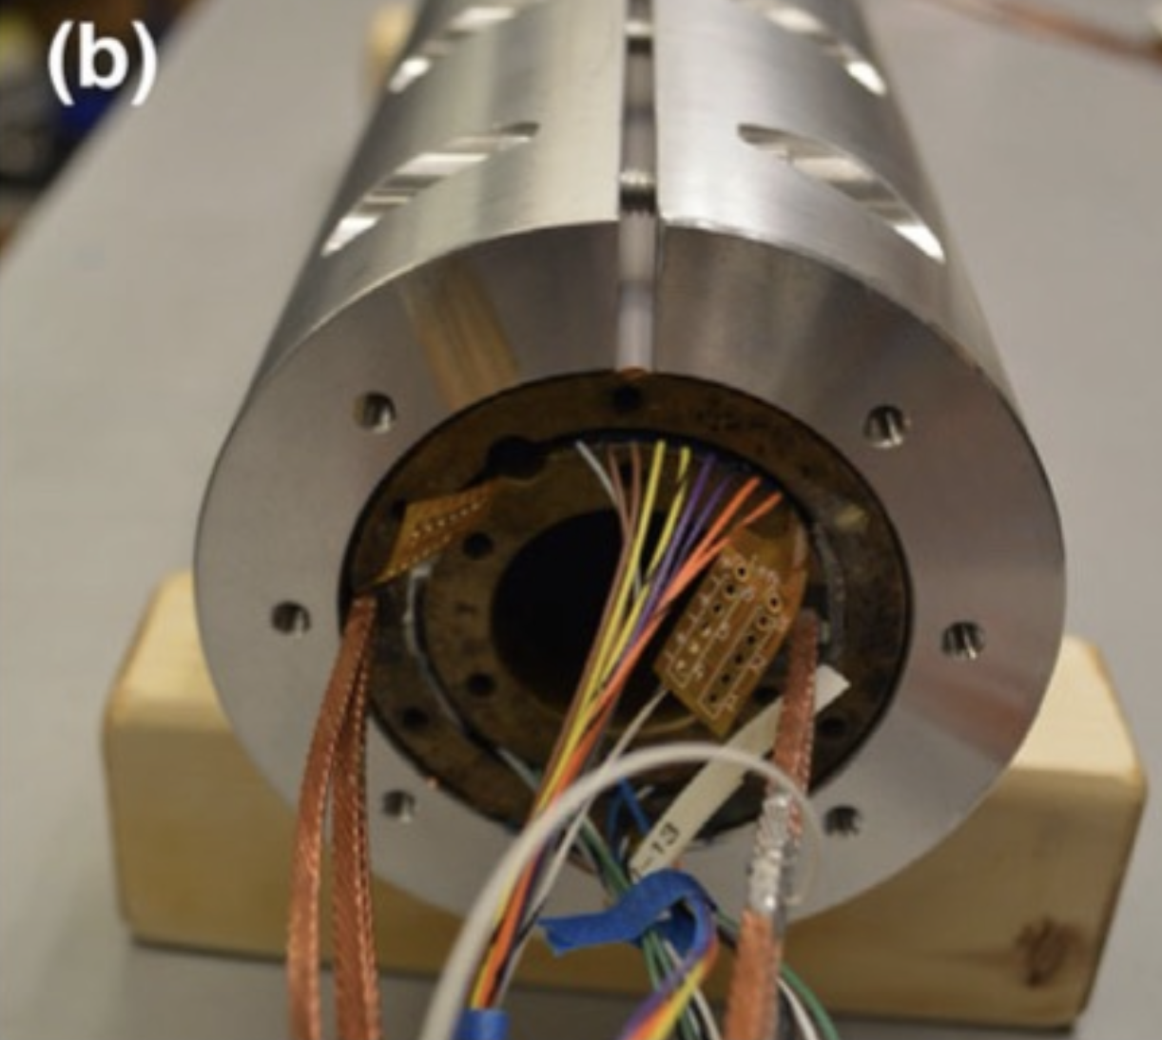
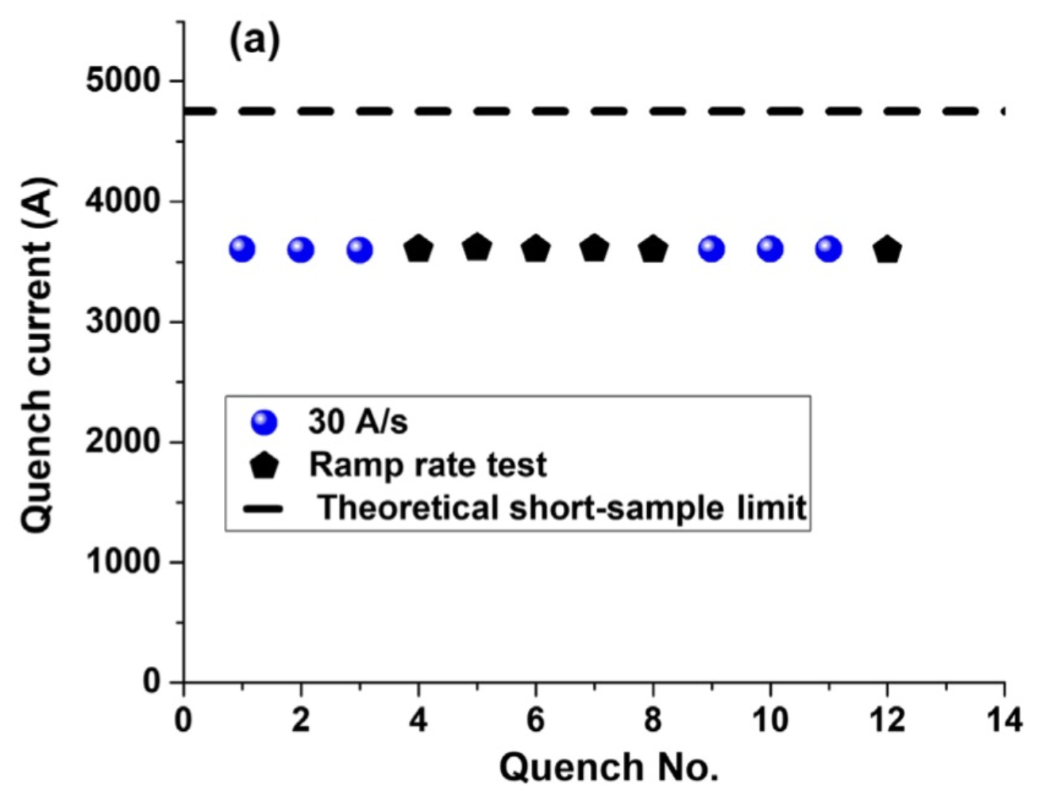
New paradigms: quench-free HTS magnet designs?
Traditional superconducting magnet design ensures magnet can survive quenches
  Motivation:
    spontaneous quenches => lack of reliable precursor, not controllable
    Training => potential for improved performance after quenching
Can we contemplate a new paradigm for HTS?
Higher MQE => not (?) susceptible to spontaneous quenches => no “random” behavior
So far no indication that HTS magnets exhibit training => no performance enhancement
Design to eliminate run-away quenching !?
“Typical” Nb₃Sn CCT magnet training
T. Shen et al., PHYS. REV. ACCEL. BEAMS 25, 122401 (2022)
“Rapid” training to ~75% short-sample, then rate changes
“Fair” memory after thermal cycle
Sub 2/3 thermal cycle
“Thermal runaway criterion as a basis for the protection of high-temperature superconductor magnets”
M Marchevsky and S Prestemon 2024 SUST. 37 035012

Slide 22
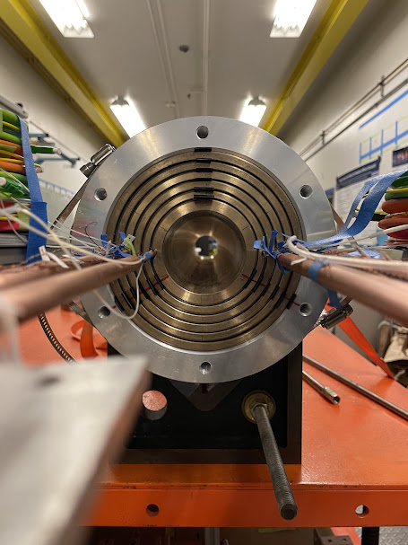
Review of challenges and driving questions
How can hybrid magnet tests guide development of HTS accelerator magnets?
  “low field” all-HTS accelerator magnets allow “rapid, low-cost” development of processes
    How to handle conductors
    Tooling and assembly process development
    Understand V(I) transition and magnet testing protocols
  The big issues appear at higher field
    More stored energy means real magnet protection strategies are needed
      Extraction via dump resistor may no longer be sufficient
    Higher forces mean stresses and potential for conductor degradation
Putting HTS dipoles in a background field is likely the fastest, most effective means of probing these issues
Notes:
li

Slide 23
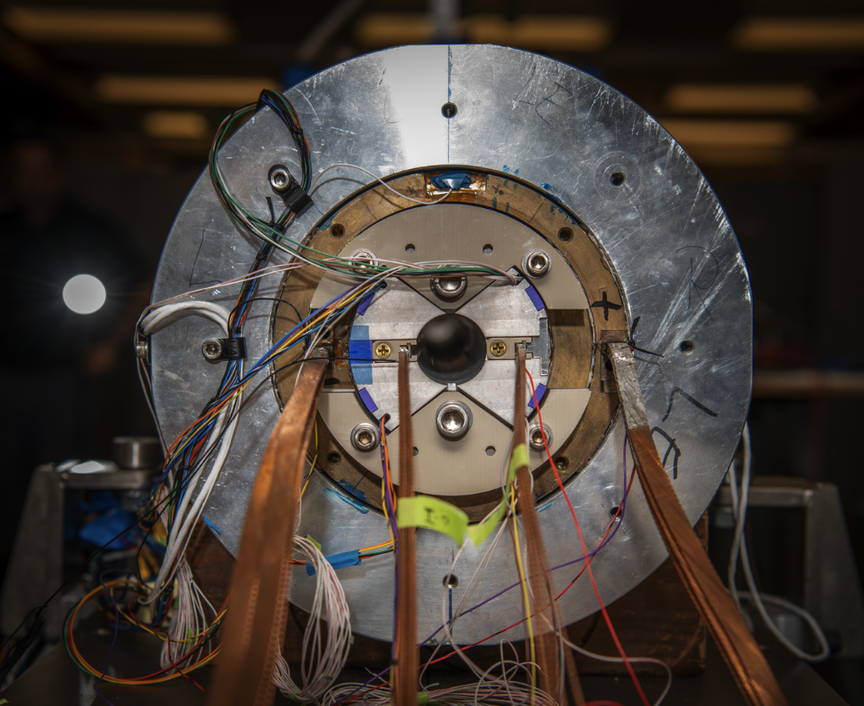


Towards high field LTS/HTS hybrid magnets
Work ongoing in MDP to combine CCT5 with Bin5 in hybrid configuration
  Lesson learned: not simple insertion, but rather an integrated design
Test expected by May 2025: first hybrid magnet at 10 T field level
  Again, still relatively “low field”, but first milestone towards higher field
    With CCT6/SMCT and future Bi2212 and REBCO inserts: explore the 15-20 T field level

Slide 24
Review of challenges and driving questions
Issues that are specific to hybrid operation
  The potential for spontaneous quenching of outsert must be considered
    Concept of “non-quenching” HTS protection cannot be fully explored/exploited
  Independent power supplies has implications
    Need to synchronize/coordinate protection actions, e.g. energy extraction
    Separate inductances and strong mutual inductance complicates LR circuit, response
    Forces/temperatures/stresses may vary depending on details of how protection actions are taken, e.g. order of actions, delays, etc.
Test infrastructure investments to enable hybrid magnet testing are significant!

Slide 25
Instrumentation and diagnostics needs
Diagnostics that provide understanding; corelated with models => physics
Instrumentation that guide operation
  Protection, e.g. voltage, temperature, current redistribution, etc
  System integrity, e.g. strain, and history of temp., current distribution, etc.
Controls software that leverages instrumentation to perform actions
  FPGAs, cryo-electronics, etc.

Slide 26
How modeling connects with - and enhances - instrumentation
Giorgio Vallone
Models + diagnostics data = understanding of physics
  Important to match model to measurement
  Models depend on reliable measured data

Slide 27








New modelling techniques and material studies
Training studies with
  Debonding strength measurements
  Finite element models
Computing/measuring strain
  Measurements with fibers compared to FEM
Cable Strain
Measure and compute failure criteria in Nb₃Sn
  How do we pre-load magnets to minimize conductor degradation?

Slide 28









Modeling on multiple fronts (examples)
  Berkeley Lab Finite Element Framework for High Temperature Superconductors
BELFEM:
Goal: predict quench propagation along three-dimensional thin shells
Strong collaboration with Polytechnique Montréal
Use state of the art numerical models and solver libraries (h-phi & STRUMPACK)
Bi2212 – Strain Effects On I_{c}
https://belfem.lbl.gov

Slide 29

Possible visions of how HTS will be utilized in large-scale applications
Systems must be reliable and fault-tolerant
Developments should enable automation (fabrication, qualification, operation)
Paradigms should be capable of adapting to advances in conductor manufacturing
Traditional paths:
Passive protection (e.g. cold diodes + subdivision)
Active with heaters, dump
…
New paradigms:
Pre-emptive depowering, non-quenching
Active power redistribution via cold power-electronics
…

Slide 30
Thank you!

Slide 31

Test facility needs for MDP Roadmap
Large-bore Nb3Sn dipoles will utilize large diameter “Utility Structure”
  Need test cryostats with ~1m diameter
  Large stored energy => requisite dump resistors
  Accommodate CLIQ, heaters, other protection methodologies
Hybrid magnets will require independent power and energy extraction systems
  Preferably use IGBTs for fast switching
  Ample current for each (preferably >16kA)
  Energy extractions should accommodate different dump resistor values
  Want both 4.5K and 1.9K capability within MDP
For development magnets (e.g. subscale)
  Need high current
  Need to accommodate very low inductance (low stored energy)
  Need fast energy extraction (high J_{cu})
In addition, need magnetic measurements, hysteresis, losses, etc.
Planned: 860mm OD compatible with LBNL cryostat and future FNAL HFMTF

Slide 32


Magnet R&D testing must accommodate new instrumentation
Continued diagnostics & instrumentation developments challenge test facilities
  Many issues unique to magnet R&D:
    New diagnostics require adapting wiring / ports
    New protections schemes require integration and commissioning
    Magnet test plans are challenged to leverage diagnostics feedback
  Example: power cryo-electronics offer new opportunities, but may pose difficulties:
    Integration into existing systems
    Validation, fault scenario evaluations, safety reviews, etc
E. Ravaioli, CERN MSC Seminar

Slide 33

Facilities within MDP, and upgrade paths
George Velev
BNL:
  Already demonstrated hybrid magnet testing capabilities (1.9K)
    10T common coil + independent powering of insert coils
    Independent IGBT switching and energy extraction
    Recently upgraded to >10kA + 20kA (?) for insert and outsert powering
LBNL:
  Hybrid capability recently developed (4.2K)
    First test using insert cable in a ~8.5T “outsert” dipole completed
    Independent IGBT switching and energy extraction
    Insert currently limited to ~7.2kA; further upgrade planned
FNAL:
  Hybrid capability being developed as part of joint HEP-FES Cable Test Facility project
  Will have independent IGBT switching and energy extraction
  Current >20kA for both insert and outsert
  Large bore cryostat (~1.2m) with 1.9K capability

Slide 34

The US MDP currently pursues research addressing a– critical – subset of the magnet needs for a future FCC hadron collider
Current MDP is highly relevant
xx T

Slide 35
A muon collider will require critical advances in magnet technology – ripe for synergies with other applications
Radiation is a major consideration:
  Study tradeoff in aperture/bore+shielding vs magnet radiation hardness
  Further advance understanding of radiation hardness of superconductors and magnet materials
Rapid acceleration is critical:
  Study fixed-field booster options where applicable
  Further investigate high dB/dt magnet concepts
  Evaluate acceleration (particularly low-energy) schemes in an integrated approach
Large thermal loads suggest higher-temperature operation
  Explore all-HTS option
  Explore facility and operational cost models
Leverage strong synergies with fusion and High-Field magnets (e.g. condensed matter):
  Fastest development path for very challenging target and cooling magnets
New P5-aligned MDP roadmap focuses on these areas

Slide 36



Managing mechanical stresses is key to higher fields – exploring stress-managed structures
“Traditional” Cos-theta
- Midplane stress due to azimuthal force accumulation
“Stress-managed” Cos-theta
- Groups of turns, azimuthal forces intercepted by support
MDP stress-managed hybrid magnets are under development
Critical for strain sensitive Nb₃Sn & HTS conductors
Characterized by significant interfaces
Nb₃Sn outsert
These “stress-managed” structures may enable combined function high-field accelerator magnets, which are subject to complex force distributions
HTS insert
Serves as good candidate for muon collider ring dipole

Slide 37







Strong synergies with Fusion REBCO research are leveraged
No sign of degradation seen in high field & low-cycle fatigue testing - IC>80% sum of tapes
Demonstrate feasibility of direct dry wound (non-VPI) coil design
DOE Offices of HEP & FES jointly funding a large-bore cable test facility
Will provide 15T dipole field over 750mm good-field, 1.9-50K on-sample
Cryostat will enable testing of high-field hybrid magnets
Being located at FNAL
A two layer Cable Model Coil to test for cyclic degradation

Slide 38






Bi2212 shows strong promise – being readied for hybrids
CCT6-Bi-CCT1
ID 40mm
OD 95mm
SSL 5T
17-strand
0.8mm diameter
3 coils at FSU, ready for reaction
CCT6-Bi-CCT2
ID 40mm
OD 115mm
SSL 6.8T
23-strand
1.0mm diameter
Renegade furnace

