Slide 1
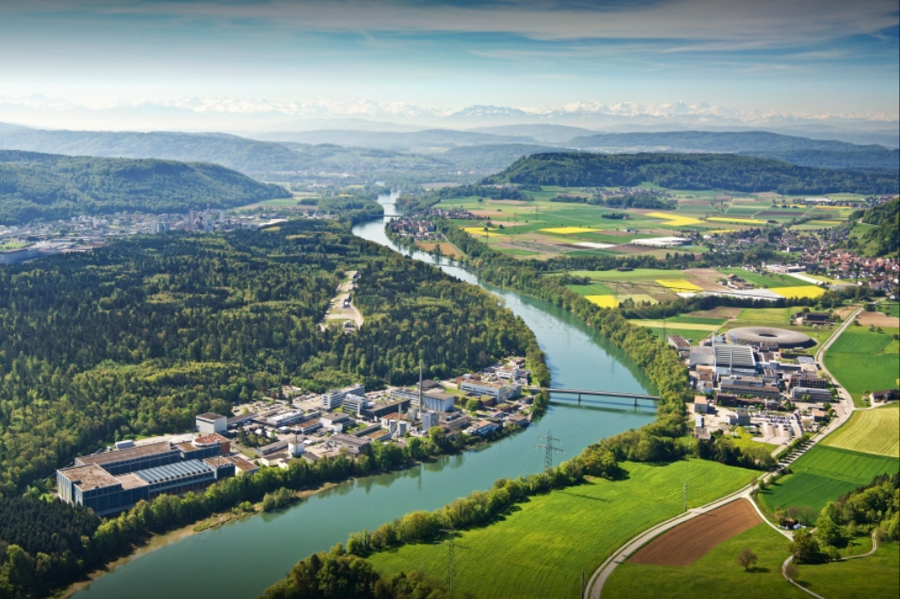
HTS quench detection using optical fibers, SQD wires and thermocouple arrays
Nikolay Bykovskiy
IDSM Workshop
03/04/2025

Slide 2
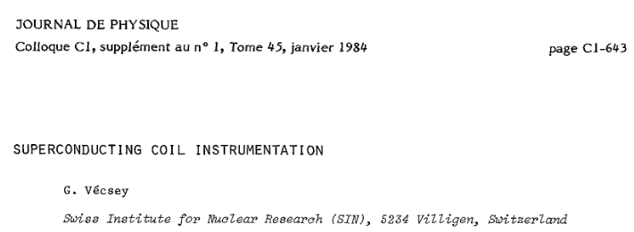
https://doi.org/10.1051/jphyscol:19841130

Slide 3
Introduction
QD methods studied at EPFL-SPC in the context of fusion magnets:
Superconducting quench detection (SQD) wires
Thermocouple chain (TC)
Optical fibers
→ Aiming at temperature-based response immune to:
electromagnetic noise (challenging for SQD and TC)
mechanical strain (challenging for optical fibers)

Slide 4
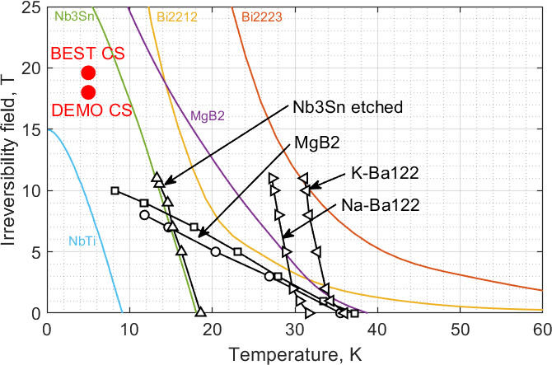
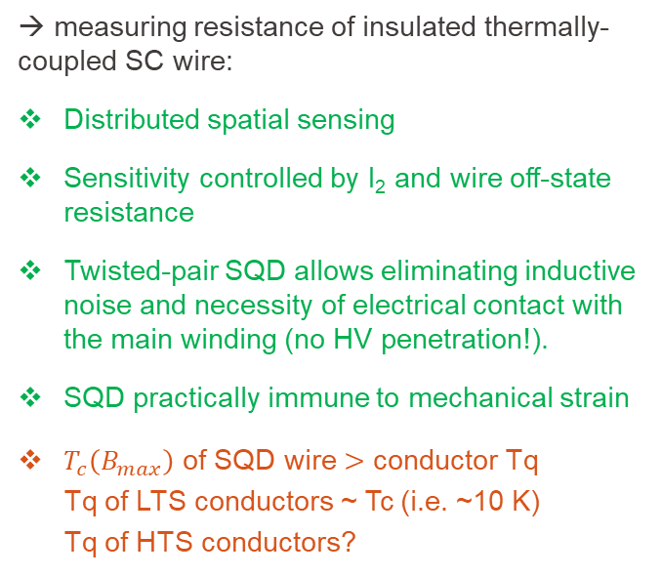
SQD
SQD twisted pair
V
I₂
→ measuring resistance of insulated thermally-coupled SC wire:
Distributed spatial sensing
Sensitivity controlled by I₂ and wire off-state resistance
Twisted-pair SQD allows eliminating inductive noise and necessity of electrical contact with the main winding (no HV penetration!).
SQD practically immune to mechanical strain
$T_{c}\left(B_{max}\right)$ of SQD wire $>$ conductor Tq
Tq of LTS conductors ~ Tc (i.e. ~10 K)
Tq of HTS conductors?
Thermal coupling
Coil winding

Slide 5
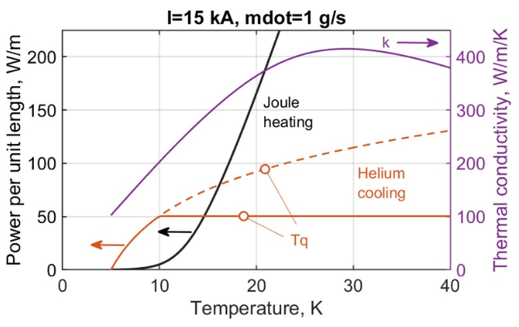
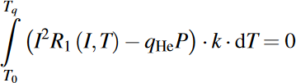
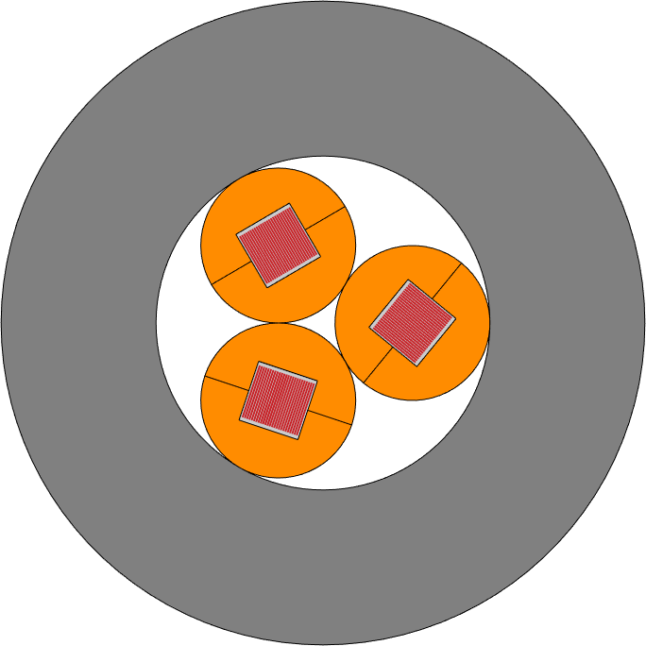
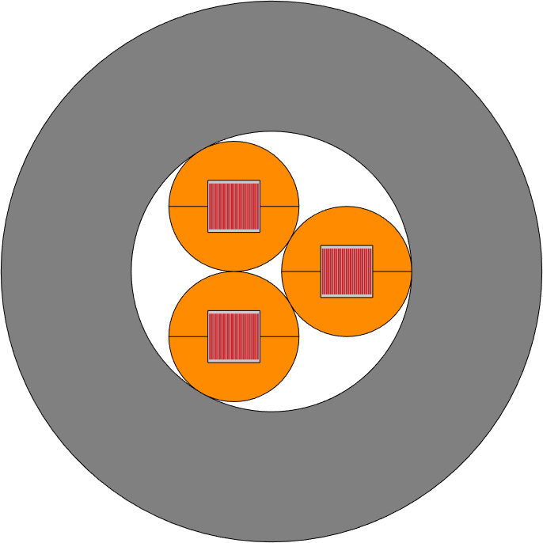
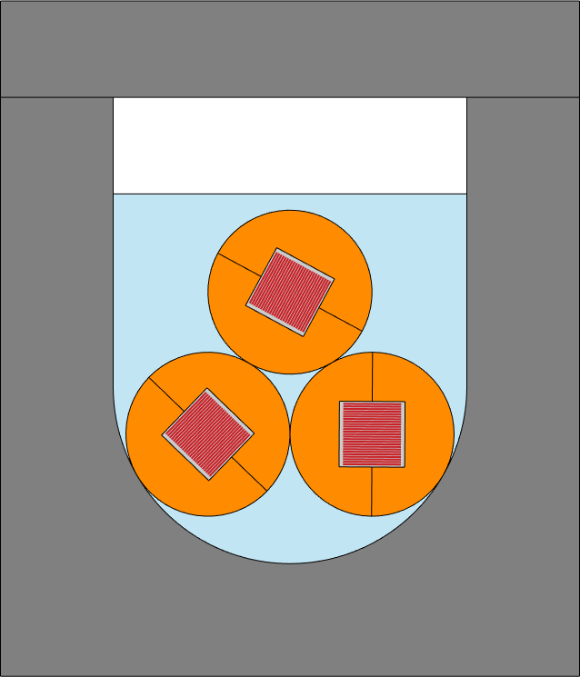
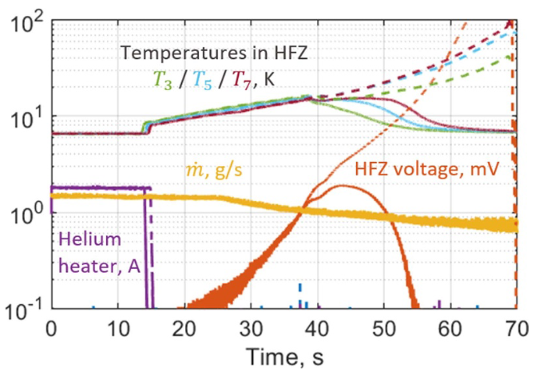
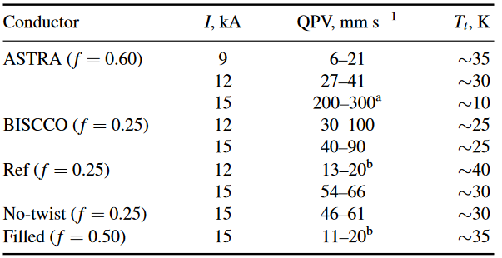
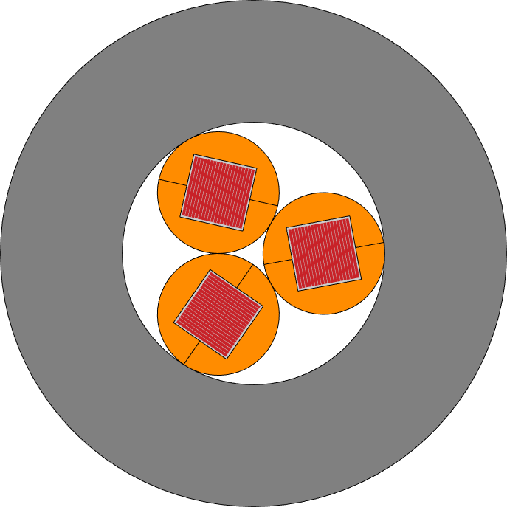
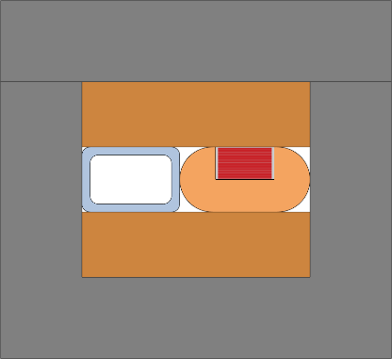
SQD: quench temperature of HTS conductors?
SULTAN
QE samples
T_{q} determines balance between cooling and Joule heating

Slide 6
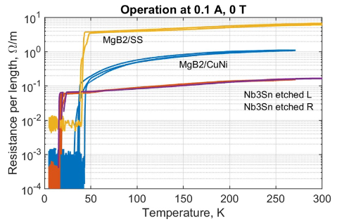
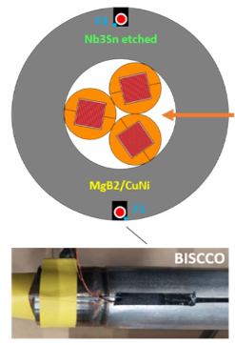
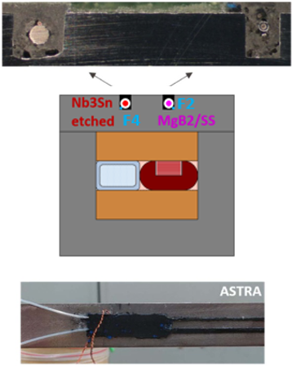
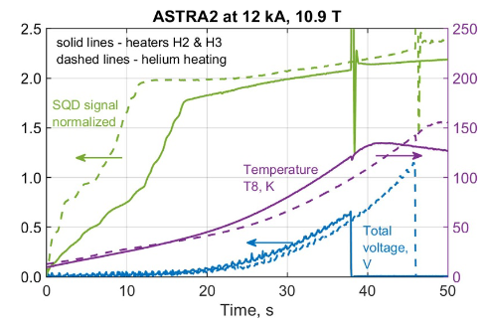
SQD: testing on sub-size fusion conductors

Slide 7



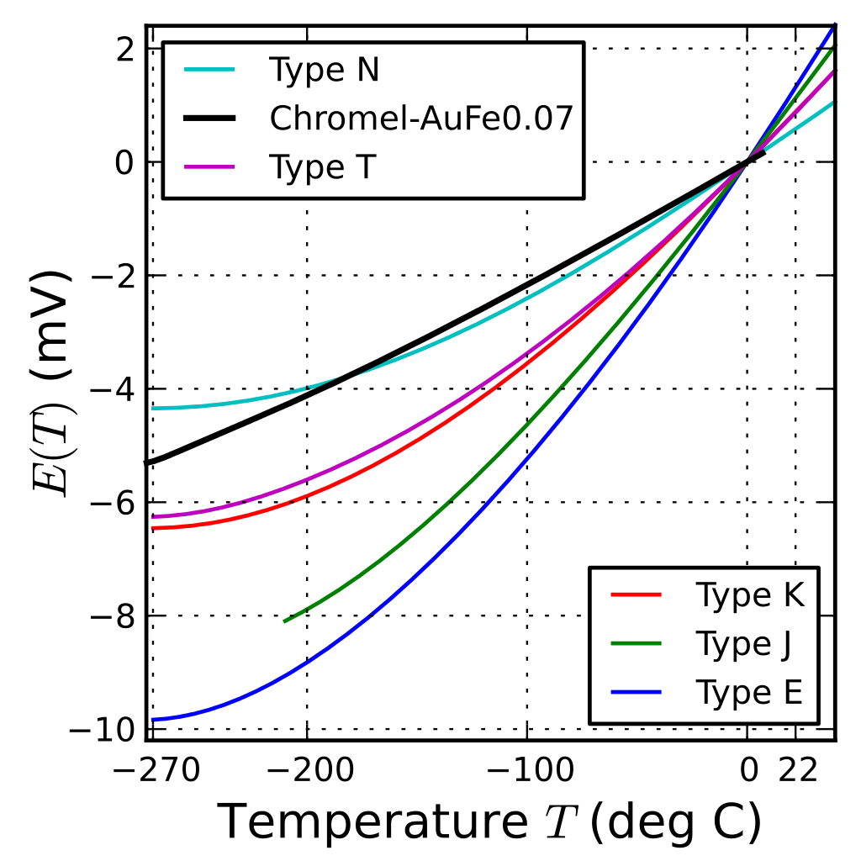
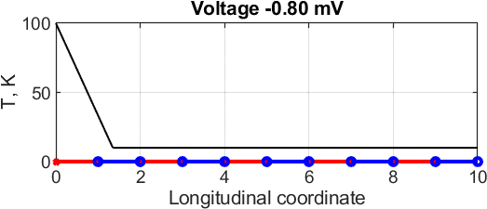
Thermocouple chain
Conventional thermocouple: response on ΔT only at the ends
Array of thermocouple wires connected in series: response on ΔT along the length
V
ref point
sense point
→ measuring voltage over series connected thermocouple wires:
Continuous response on T gradient among joints
Immune to EM noise by using shielding sleeve
Varying sensitivity due to discrete sensing

Slide 8
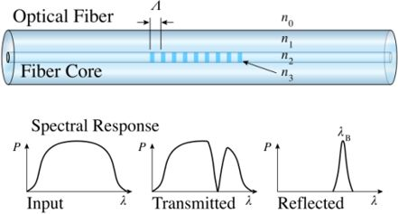
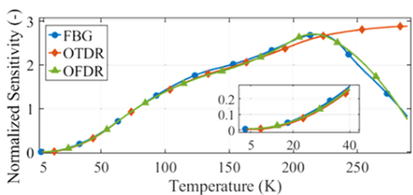
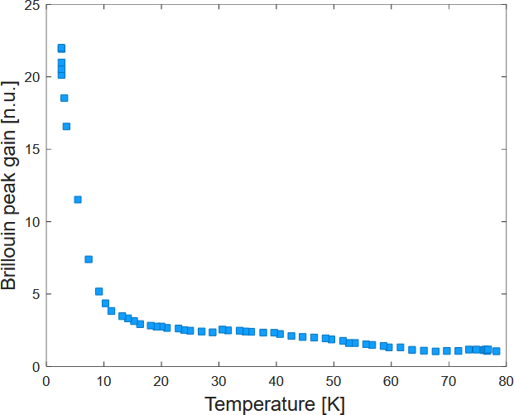
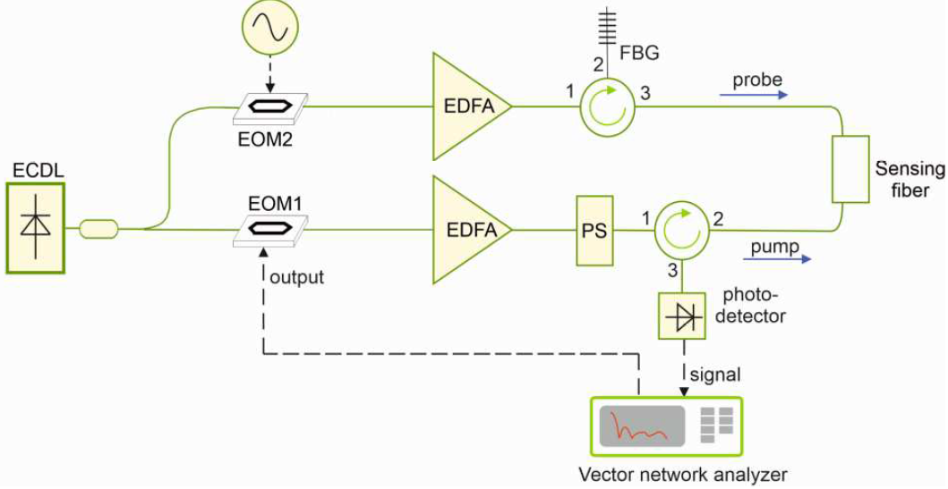
Optical fibers
SPC samples in 2025 will include bare fibers for Distributed Fiber Optic Sensing (DFOS) using:
Rayleigh OFDR by ENEA:
Spatial resolution ~5 mm, Rate ~100 Hz, Range ~0.1 km
FBG studied by Hugo Bajas at SPC till mid-2024
Sensitivity decreasing at low temperature
https://doi.org/10.1109/
TASC.2025.3532931
→ measuring spectral shift of light reflected by each FBG:
Continuous temperature monitoring at each FBG location
Decoupled mechanically by Teflon tubing
Brittle; high spatial resolution over long length is cumbersome
Brillouin OFDA by University of Campania:
Spatial resolution ~10 mm, Rate ~10 Hz, Range ~0.3 km
Closed-loop sensing
Sensitivity increasing at low temperature (!)
https://doi.org/10.1109/
SAS60918.2024.10636574

Slide 9
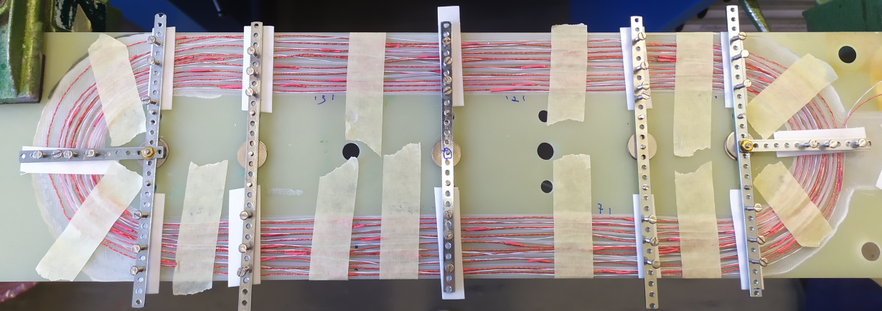
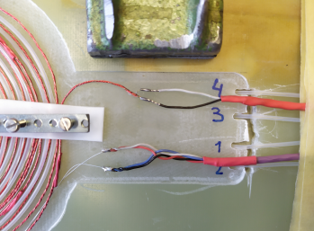
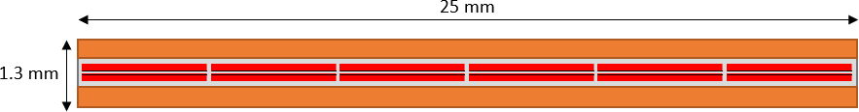
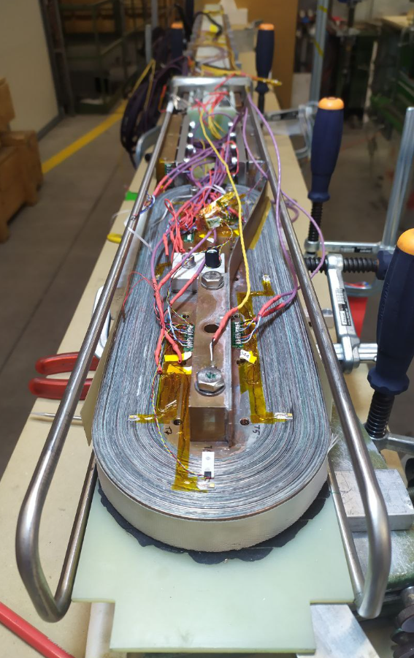
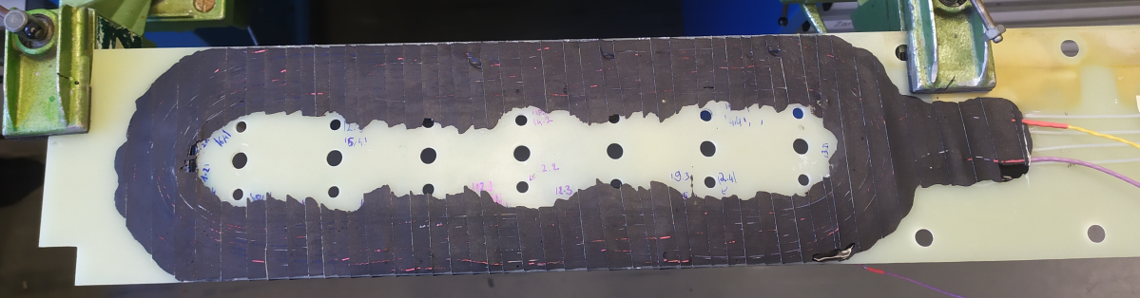
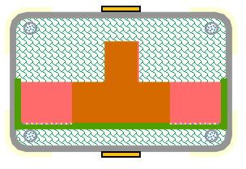
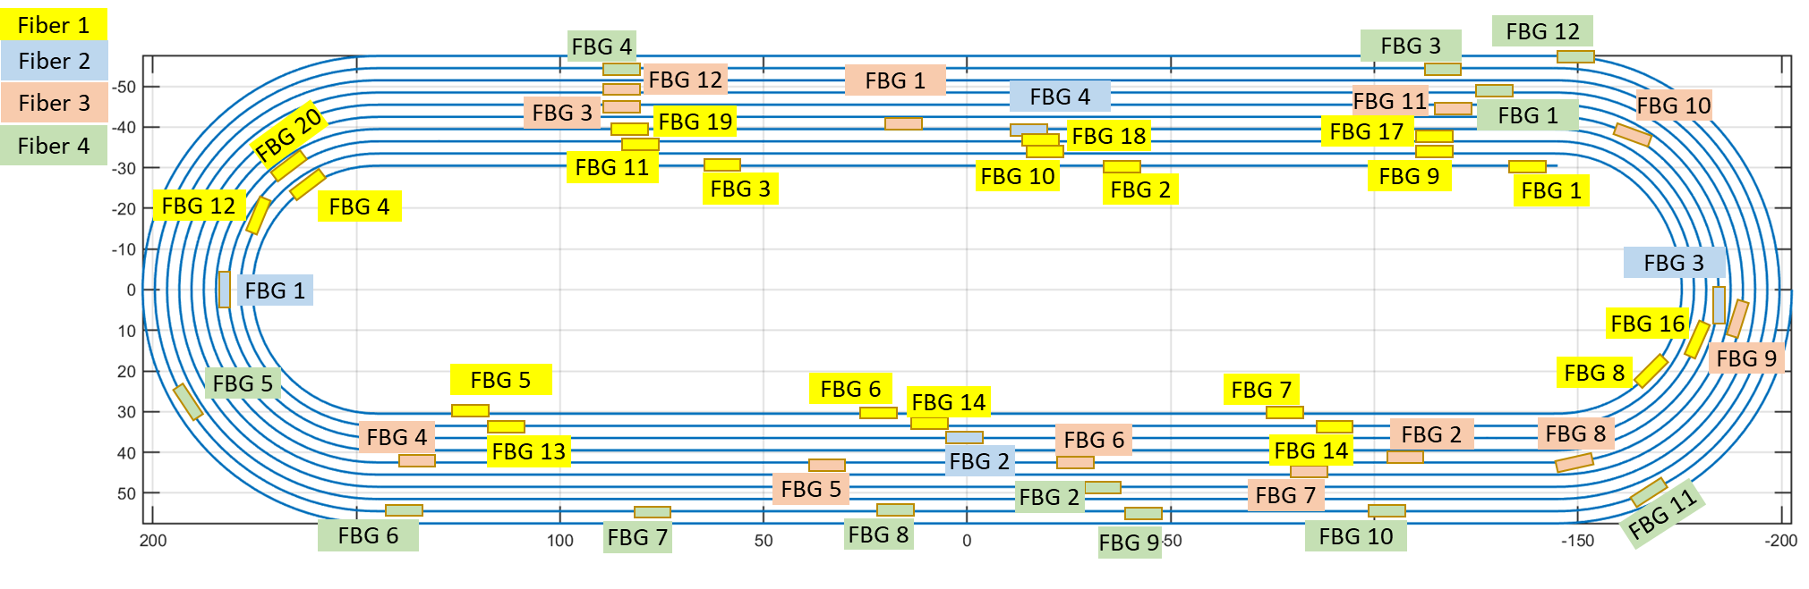
Test sample – LASSO coil
Laminated stacked-tape soldered conductor (LASSO)
(3)
(2)
~13% DMSO
(common cryoprotective agent)
(1)
142 mm
Twisted-pair Nb₃Sn 0.2 mm, acrylate insulation
Type K 0.2 mm, ~60 joints, wrapped copper shield
48 FBGs in 0.6 mm Teflon tubing in 4 paths:
92 mm
Inlet cooling
(supercritical helium)
Steel casing
(2 welded U-shapes, 4 mm thick)
20-turn flat racetrack
Fiberglass turn insulation
Impregnated and indirectly cooled

Slide 10
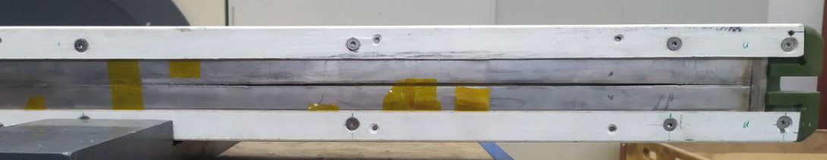
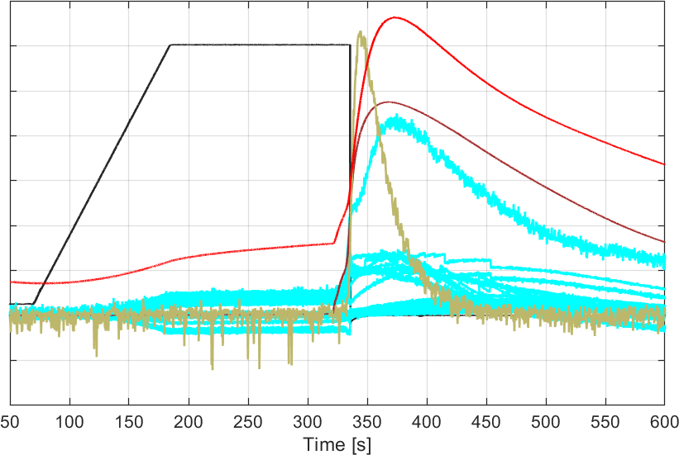
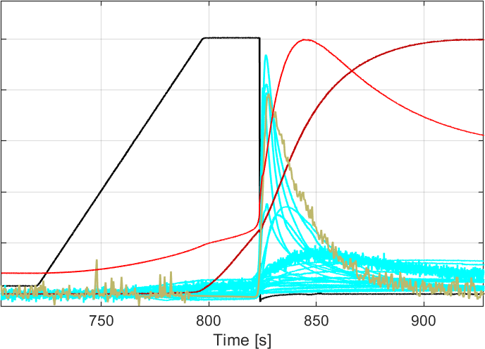
Detection response
Limited quench testing due to steel casing cracked by EM load ~1200 kN/m (at 8.3 kA, 7.2 T) during DC testing…
Quench by embedded heater
Quench by overcurrent
6 kA
~70 K
8 kA
~85 K
SQD
SQD
~15 K
TC
FBG
TC
~20 K
FBG
New sample needed to address numerous test issues: fracture of steel structure, arcing to ground, SULTAN false-positive quench triggers, damage of the coil terminal and optical feedthroughs…

Slide 11
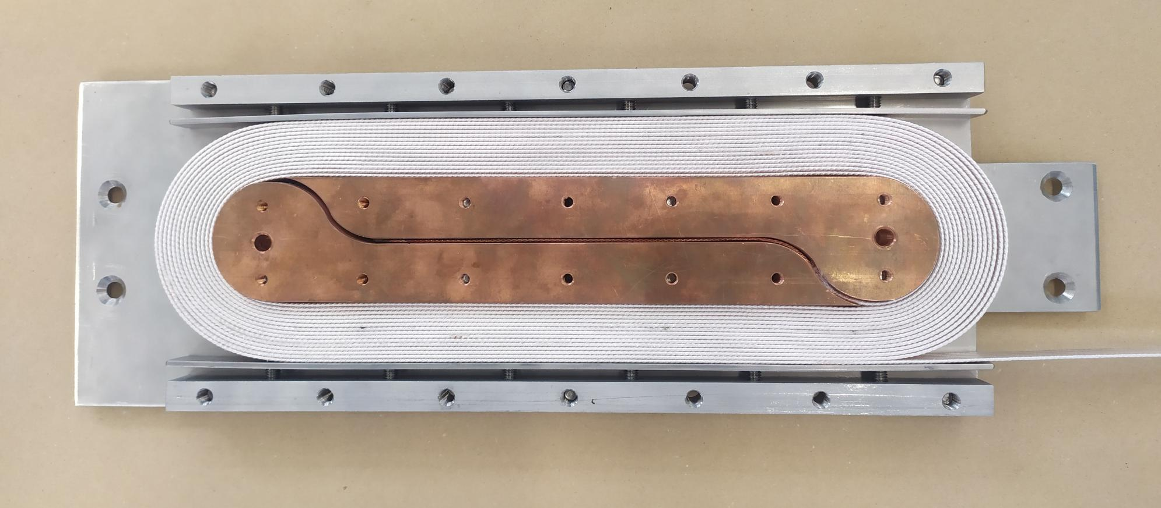
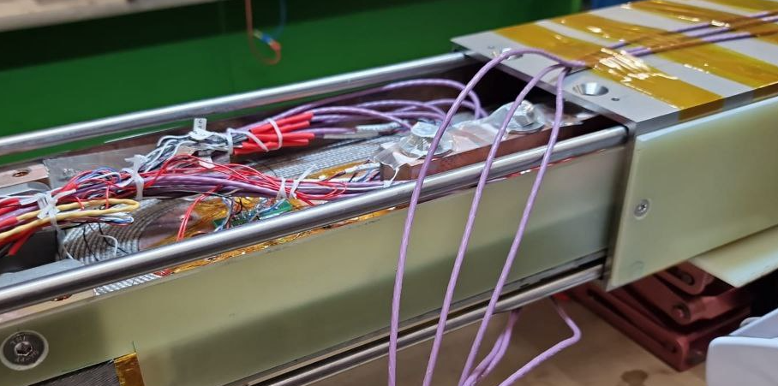
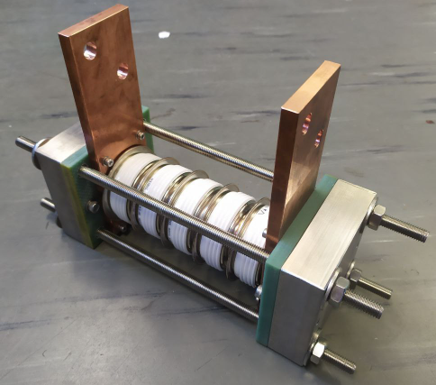
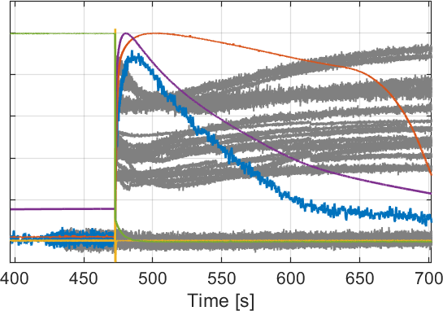
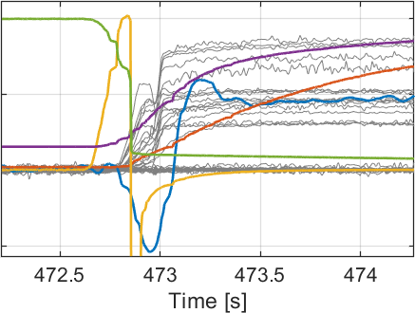
Nb₃Sn coil: recycle of the instrumentation plate
Flat racetrack coil using MQXF conductor (thanks D. Araujo for the coil winding!)
Laser-welded steel structure
Protection by high-current diodes (~10 V discharge)
4 V
~50 K
SQD
FBG
10 kA
QD response delayed by a fraction of second
Current cannot be maintained by PS
due to coil becoming resistive too fast…
~8 K
TC

Slide 12
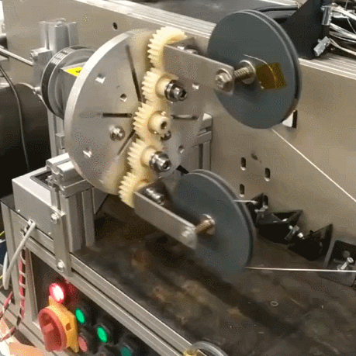
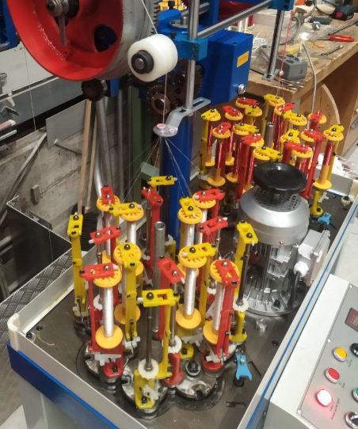
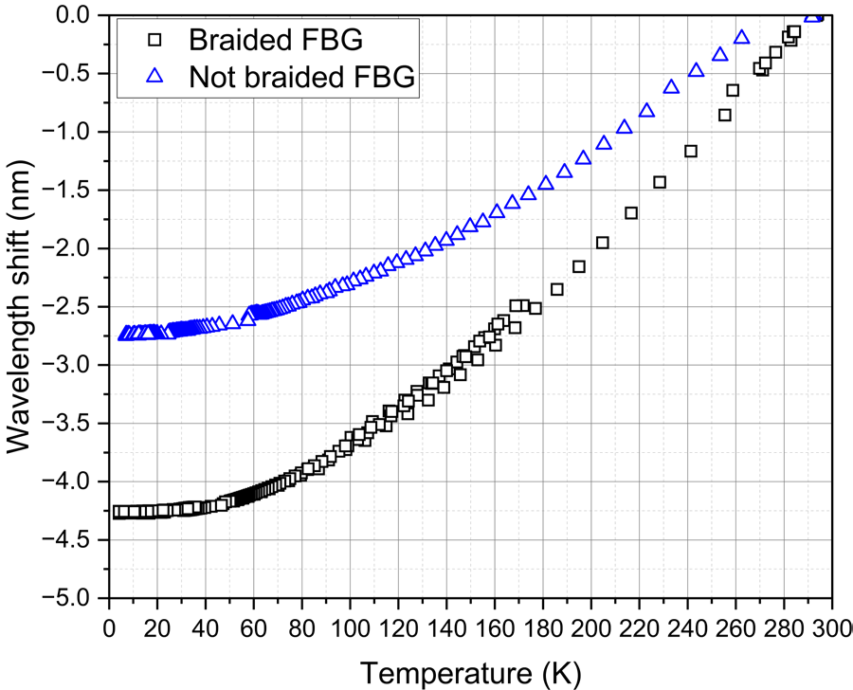
New tooling for QD sensors
Small braiding machine for insulation (SQD and TC) and shielding (TC)
Twisted-pair with back-twist pay-off (SQD)
Optical fiber reinforced by copper braid
data by H. Bajas

Slide 13
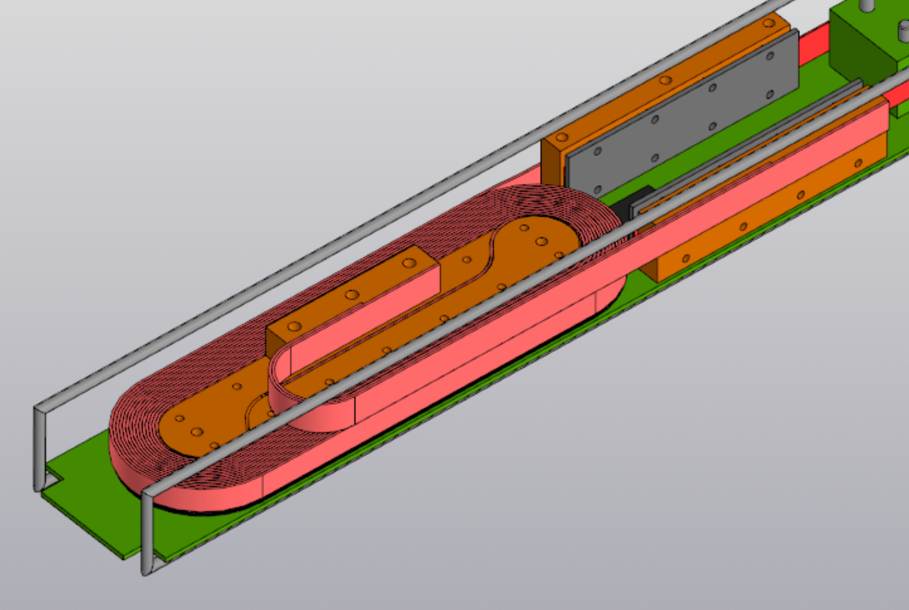
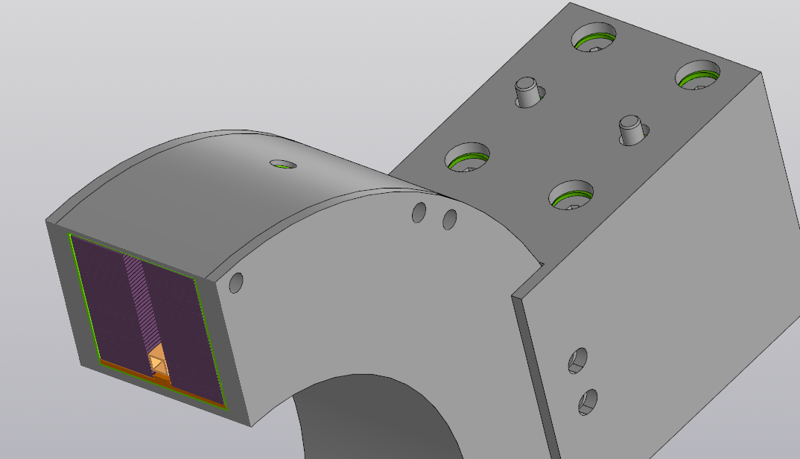
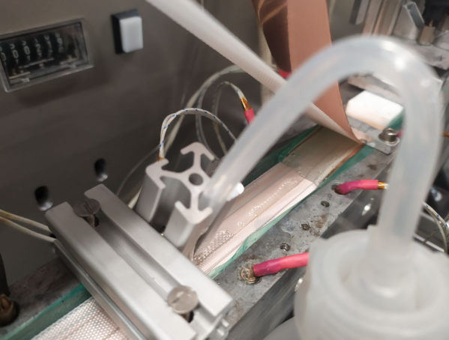


Future plans
LASSO racetrack
LASSO double pancake
→ SQD, TC and optical fibers will be embedded in the two new samples as a co-wound strip:
Reel-to-reel epoxy filling
Co-wound strip for quench detection and turn insulation:
Co-wound strip can also provide mechanical reinforcement:

Slide 14
Conclusion
SQD wires, thermocouple chain and optical fibers offer promising ways for the temperature-based quench detection uncoupled from EM noise and mechanical strain.
Practical way of their integration is being developed, next attempt is focused on a co-wound strip.
The remaining issues are:
SQD: industrial availability of specific layouts
TC: long-length manufacturing, varying sensitivity
Optical fibers: optimal sensing method? increasing complexity for large magnets?
THANK YOU FOR YOU ATTENTION!

