Slide 1
Advanced DAQ and Quench Detection using FPGA based UQDS systems
Jens Steckert, Reiner Denz, Tomasz Podzorny, Jelena Spasic
David Bailey, Daniel Blasco Serrano, Magnus Christensen, Adam Hollos, Josef Kopal, Surbhi Mundra, Guzman Martin, Andrzej Skoczen, Dragos Gabriel Vancea, Vito Vizziello & MPE-EP Colleagues
Thanks to SM18 & Test bench crews for their support !

Slide 2
Introduction
TE-MPE-EP designed, built and operates the LHC quench detection system
comprising 13000 interlocking quench detectors and a total of 20k active circuit boards
located all over LHC’s 27km tunnel
MQXFA
MCBRDHA
MCBXFA
MQSXF
MCBXFB
MBRD
Motivation
HiLumi comprises of many different new and complex magnets:
➔ Big variety but small numbers per item (compared to LHC)
SC Link
MQXFB
MBXF
MCBRDVA
Basic concept
Design one generic system with enough resources to perform quench detection and monitoring of all HiLumi circuit elements
Base new design on programmable Logic (FPGA) in combination with a number of galvanically isolated front-end channels
Design is a quench detection AND measurement system

Slide 3
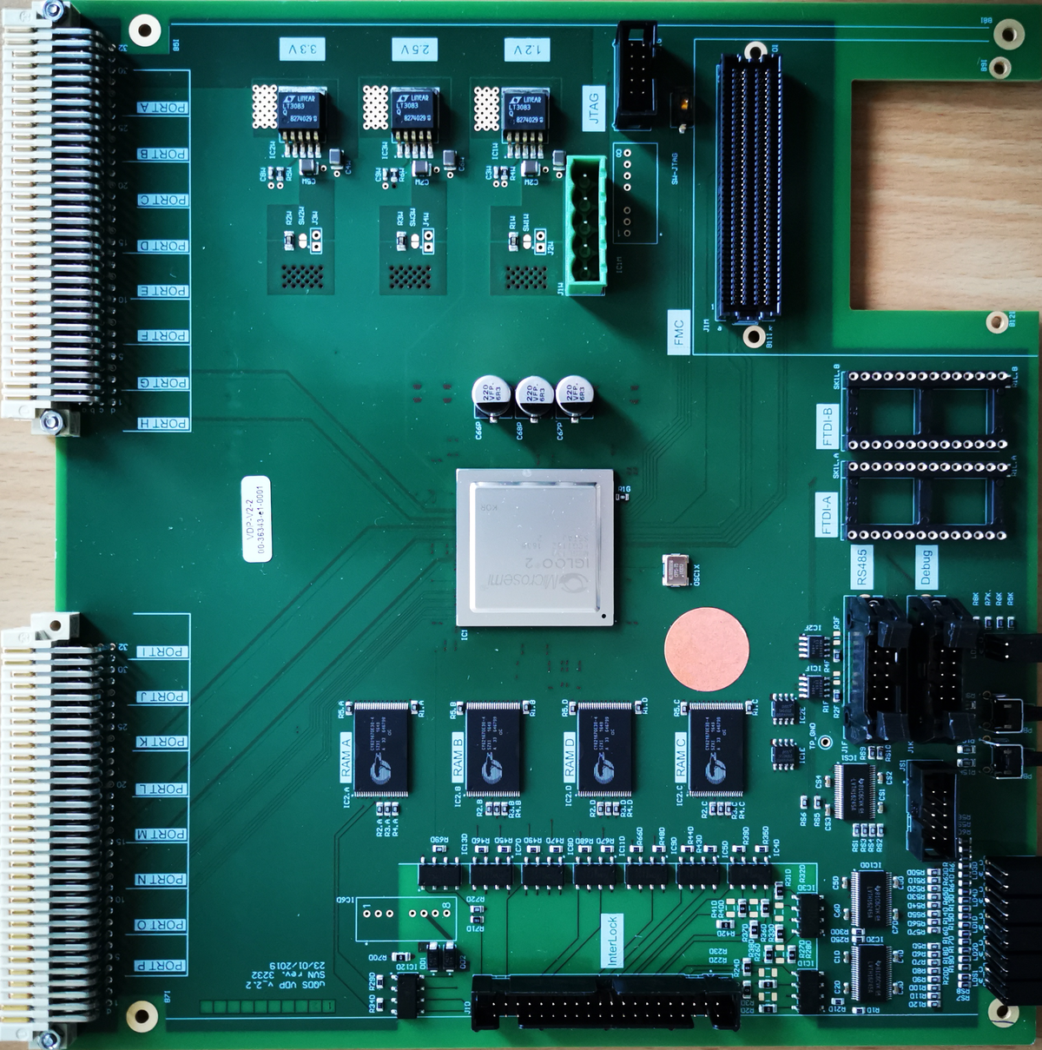
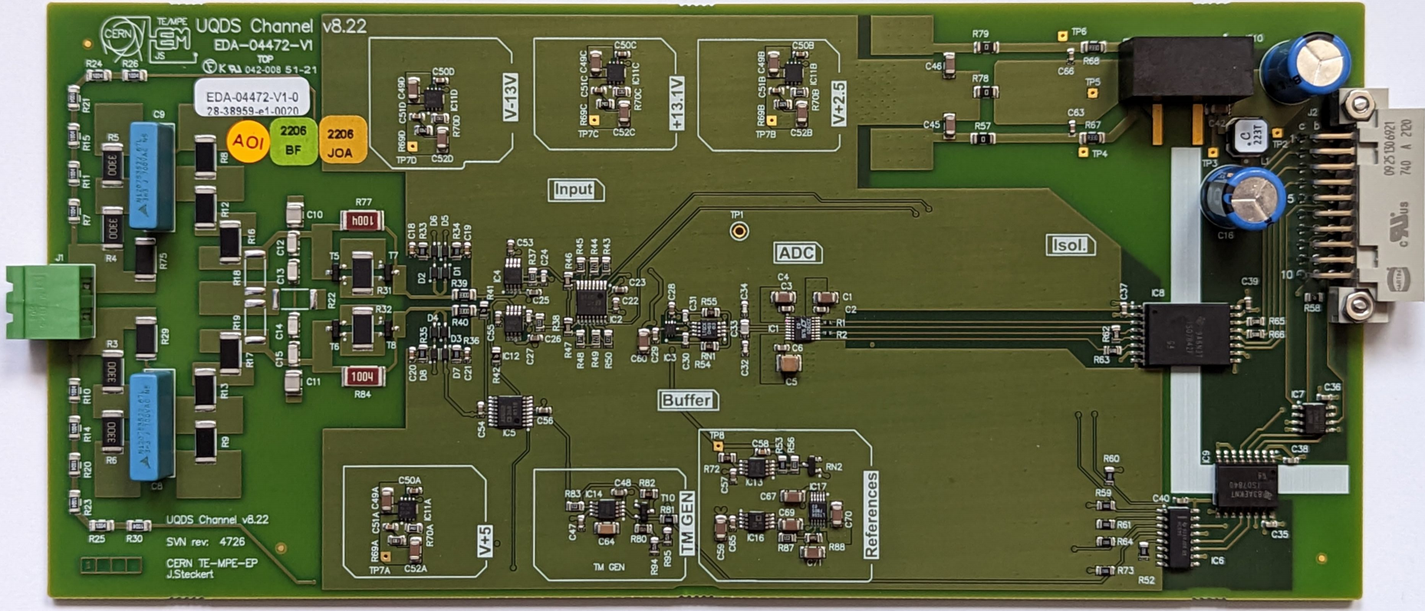
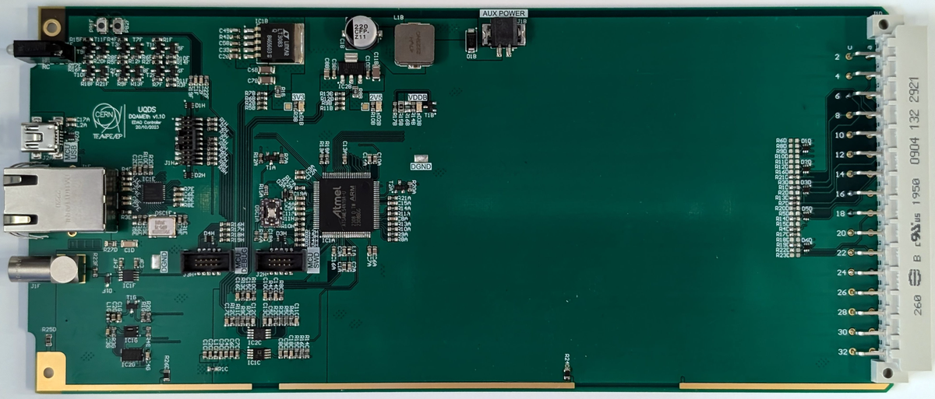
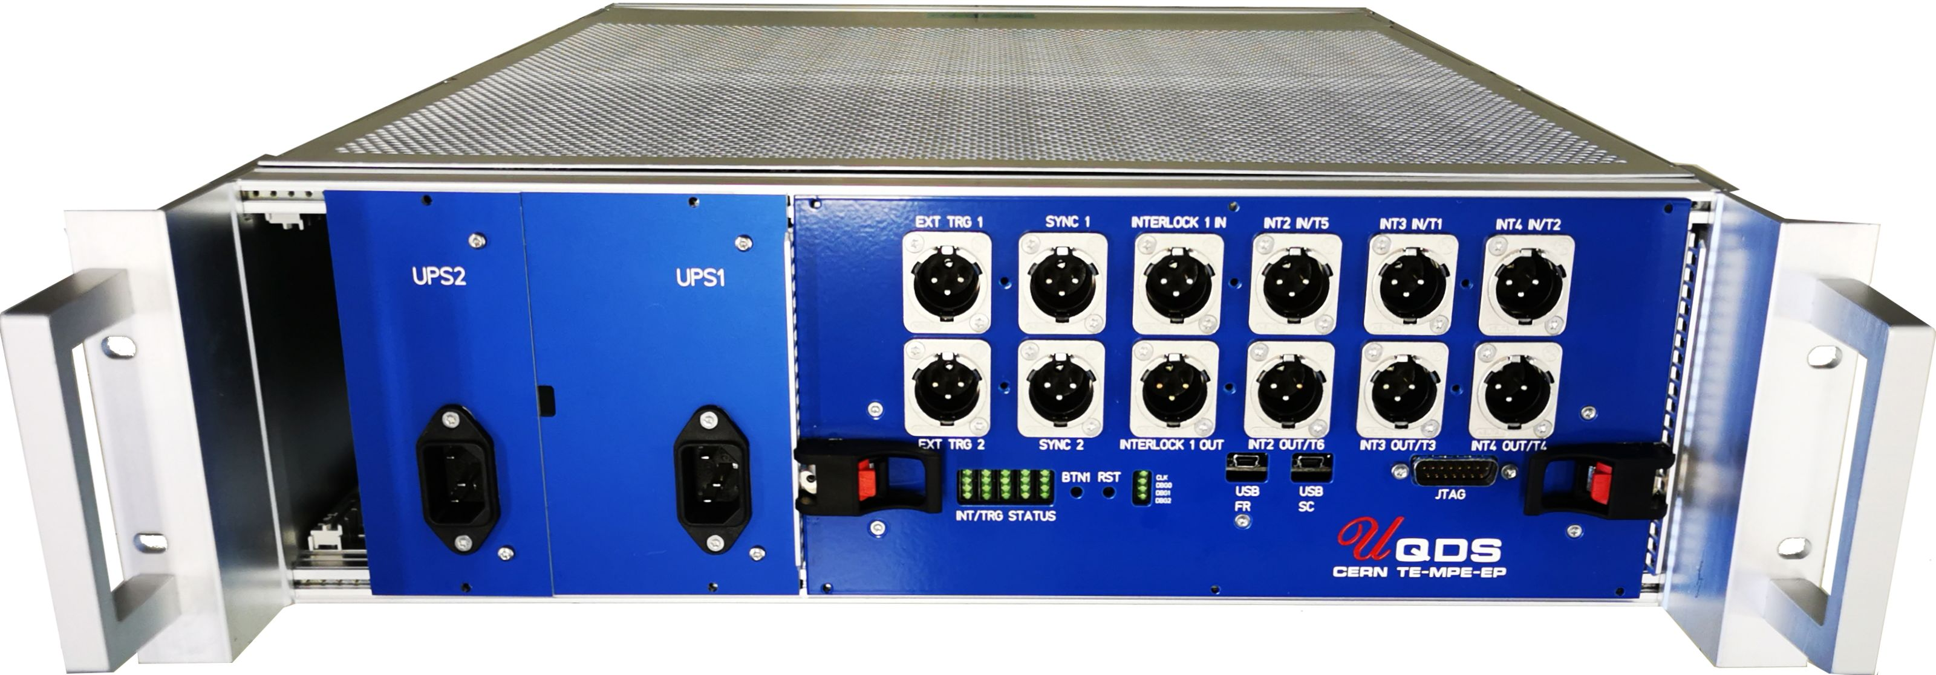
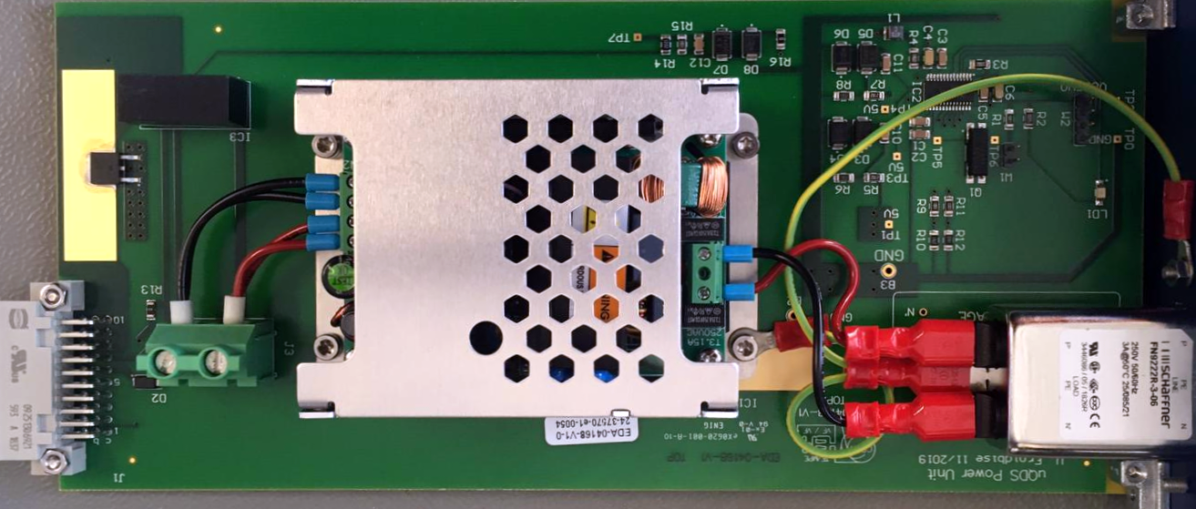
System overview (UQDSv2)
Insulated font-end channel
Digital platform
Processing Element
(FPGA)
Interlocks
&
Active
triggers
Insulated font-end channel
.
.
.
Voltage taps
Insulated font-end channel
Passive mid-plane
Up to 16 channels
galvanic insulation
Communication interface
Power Supply (monitored) 230V AC
Power Supply (monitored) 230V AC

Slide 4
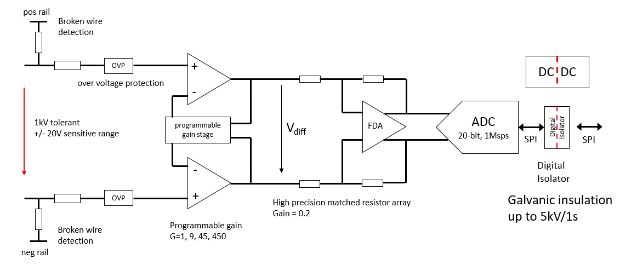
Measurement channel
Galvanically isolated measurement channel ~2.5kV/1h, 5kV/1s
Fully differential architecture with very good common mode rejection
High performance 20-bit, 1Msps ADC
Robust input protection (1kV/1s differential)
Excellent signal quality
Parameter | Value
Resolution (20-bit ADC) | 105 nV/LSB .. 48 uV/LSB
ADC speed | Up to 909 kS/s
Analogue bandwidth | 120 kHz @ G=1 (customizable)
Active input voltage range | +/-50 mV (G=450) .. +/-22.5 V (G=1) (1.2kV with divider)
Max differential input voltage | 1 kV/10 s
Galvanic insulation | 2.5 kV/1h, 5kV/1s

Slide 5
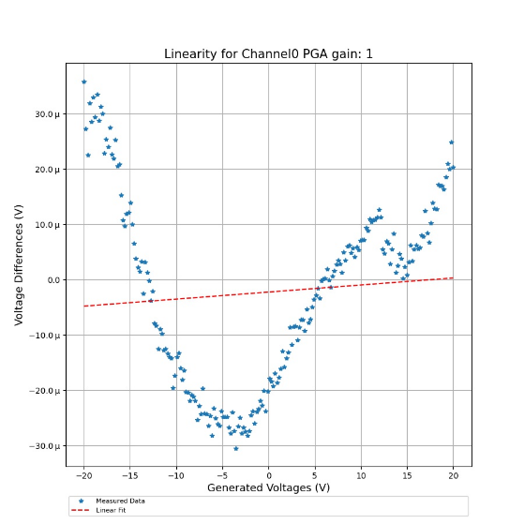
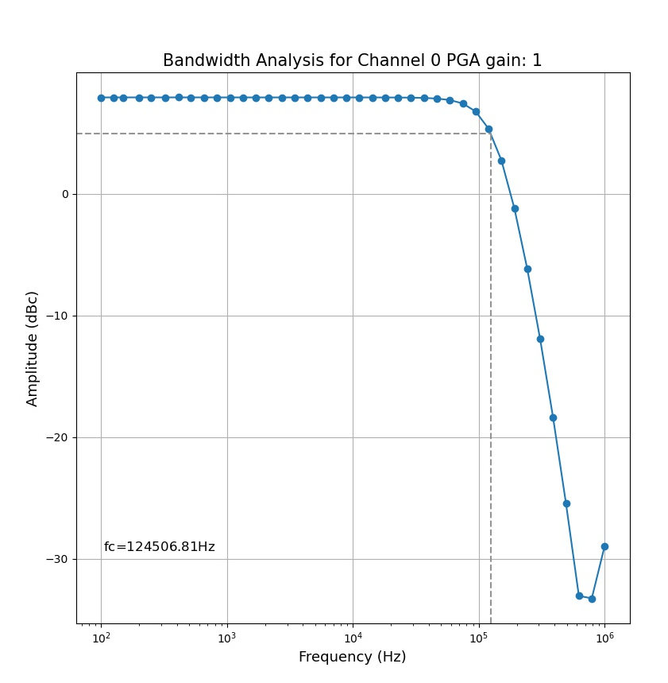
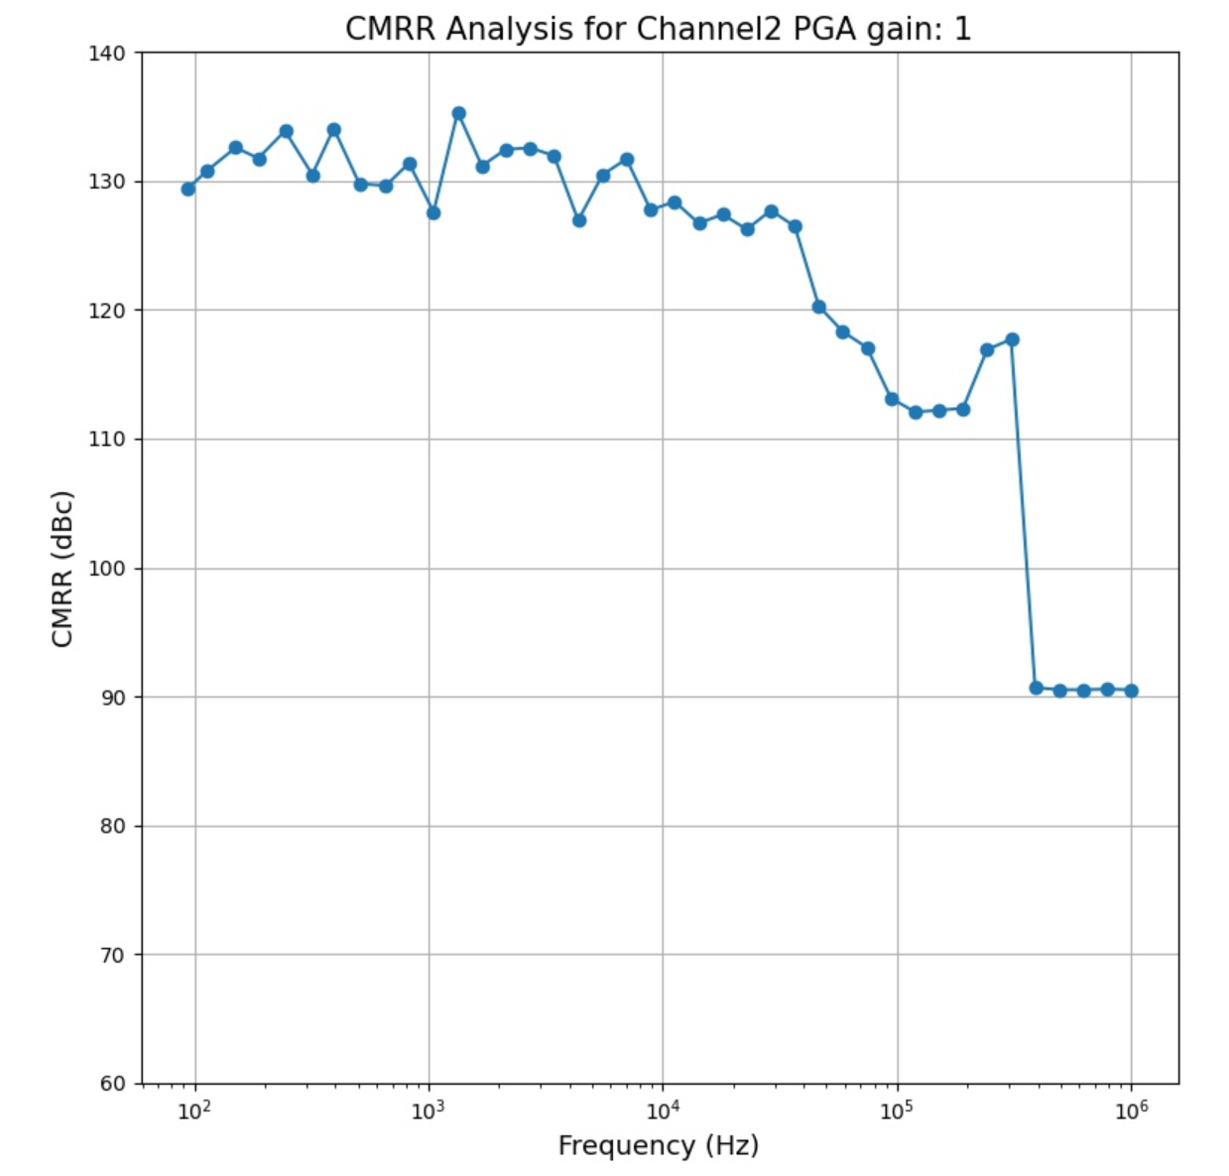
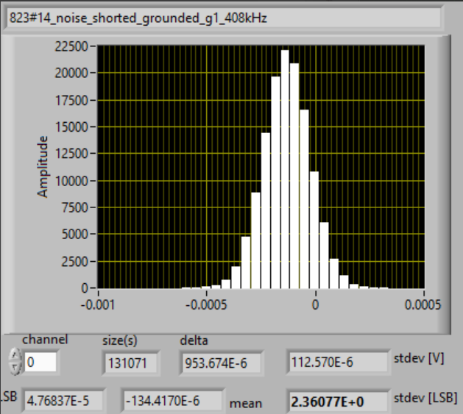
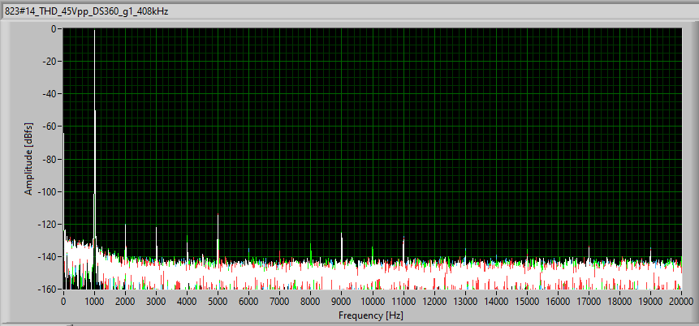
Analog channel measurements
Total Harmonic Distortion
(THD)
Noise
Common mode rejection ratio (CMRR)
Bandwidth
Linearity
Total Harmonic distortion
<-110dBfs @ 1kHz
Common mode
rejection vs frequency
> 100dB
Linearity (calibrated):
< 5ppm
(uncalibrated ~0.1%)
Noise: 2.3 .. 2.6 ppm
standard deviation

Slide 6
System Properties
Excellent analogue performance both in AC and DC measurements
Real time digital signal processing on FPGA (filters, gain/offset correction)
Quench detection algorithms or other user code in FPGA
Various hard interlock options and standards (modular design)
Post-Mortem event recording with large buffers
Absolute time synchronization on microsecond level using Ethernet PTP
Fast logging up to 10kHz via EDAQ (Currently R&D to increase to 100..200kHz)

Slide 7
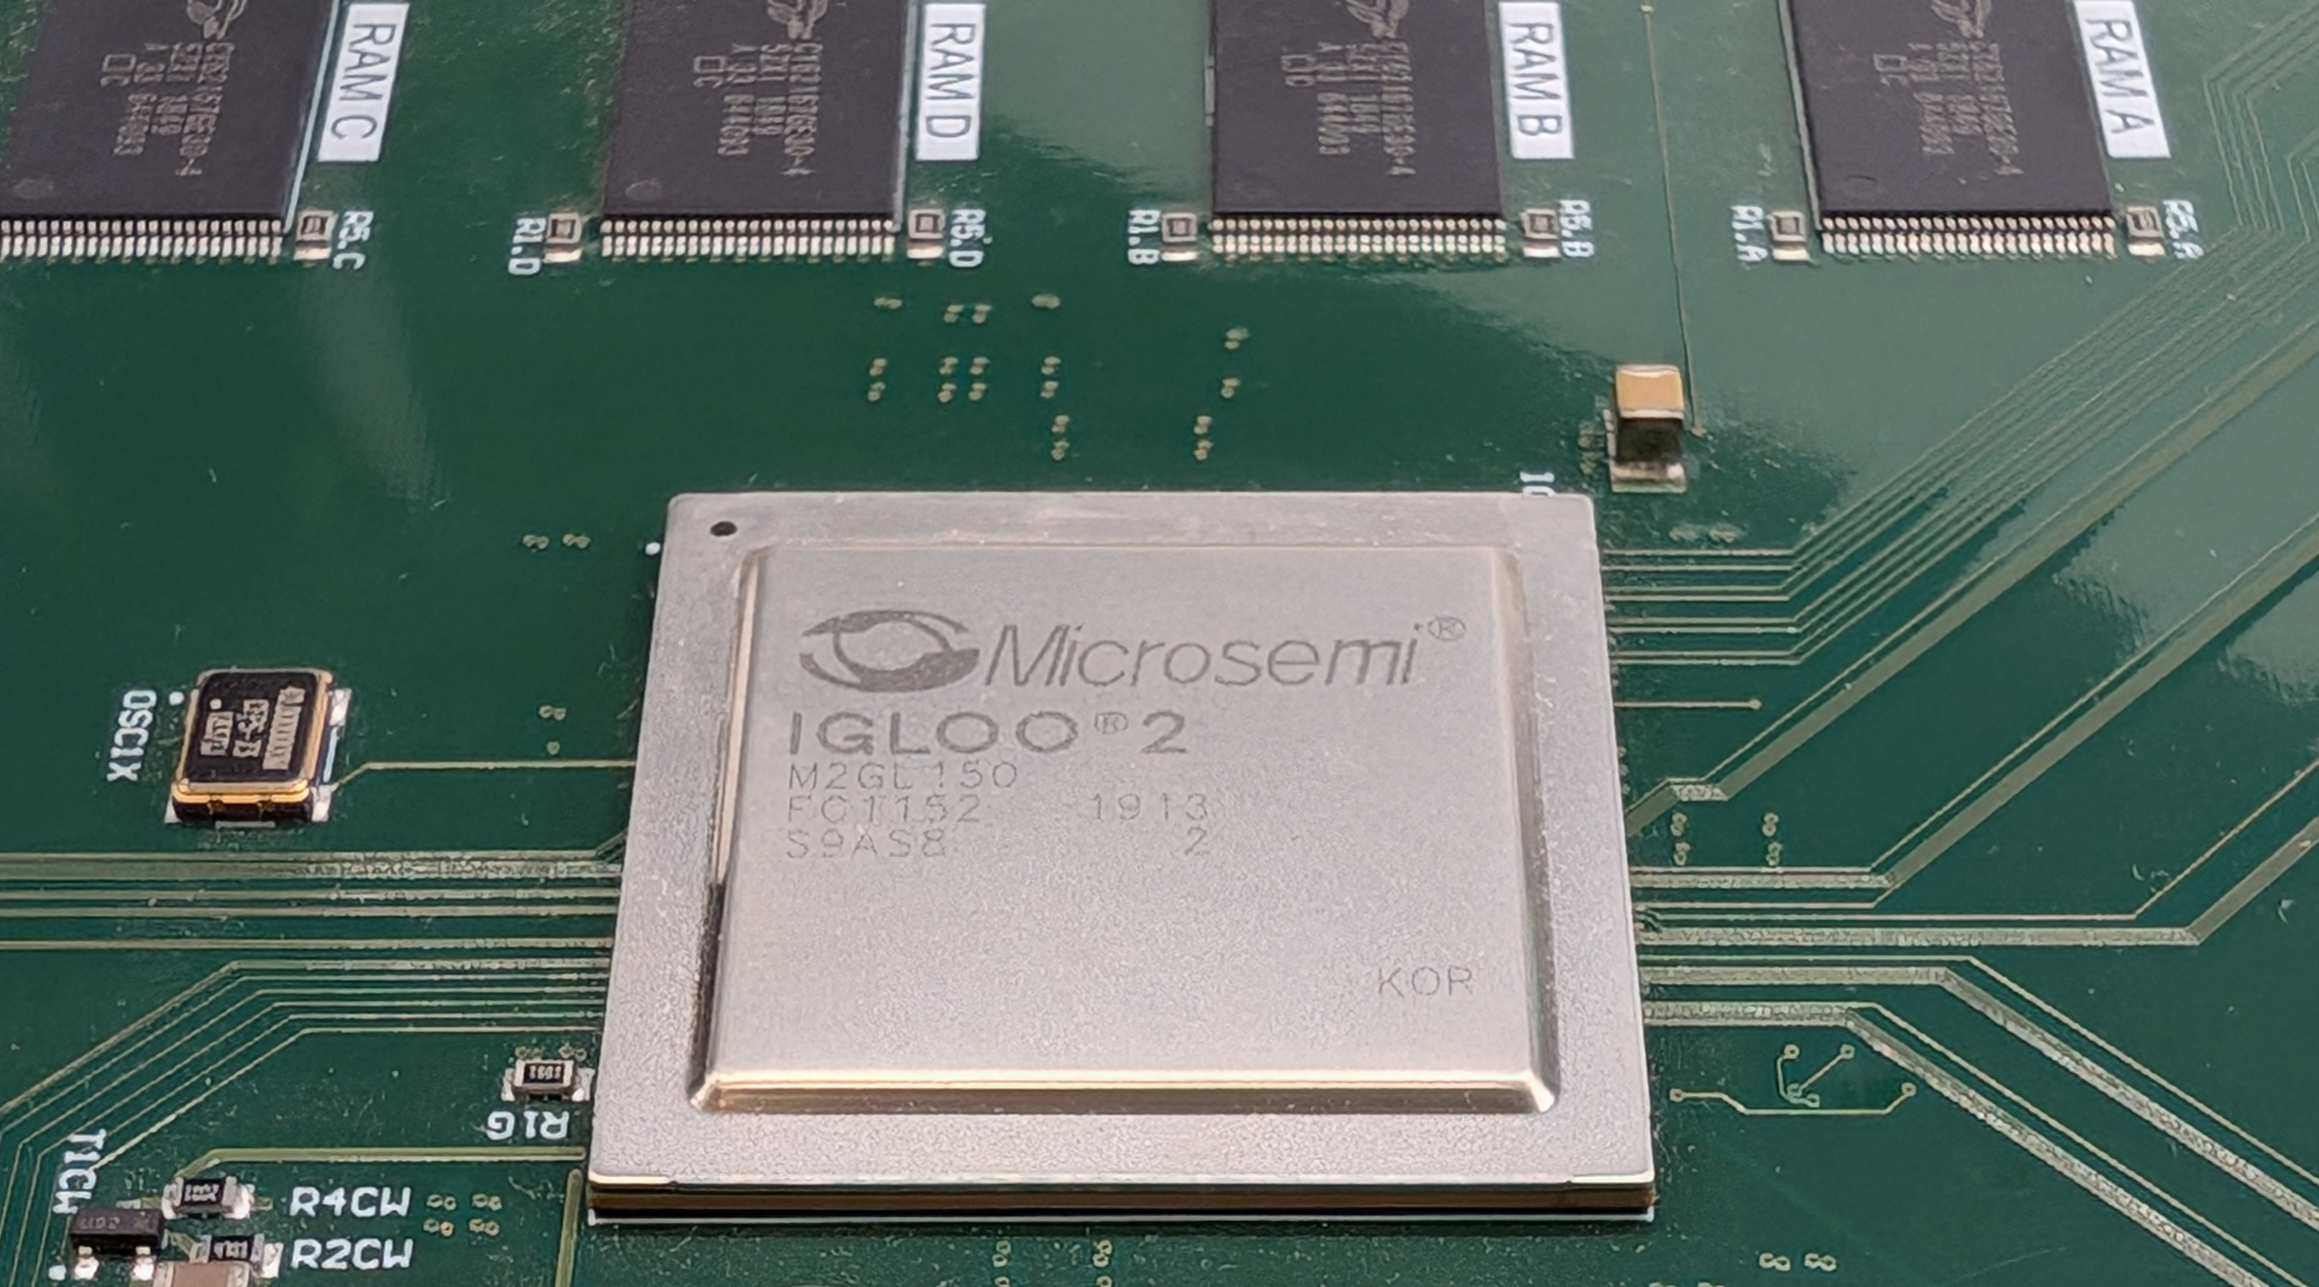
Gateware structure – Multi-platform Multi-purpose
Superconducting Link
protection
Common UQDS services
(interfaces, communication & control)
Hardware abstraction Layer
Hardware specific interfaces
Static for each hardware
Interfaces to payload code “config block”
Payload code
“config block”
Inner triplet protection
Swiss Knife

Slide 8

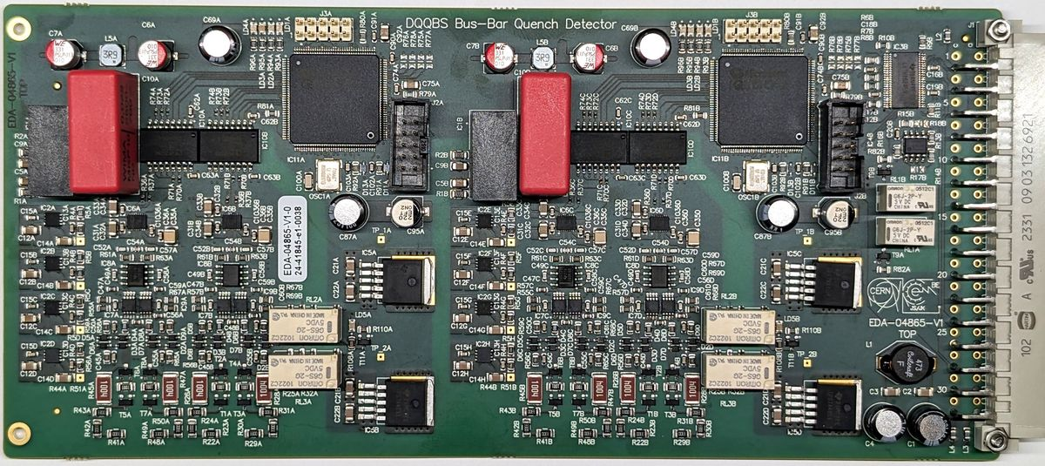
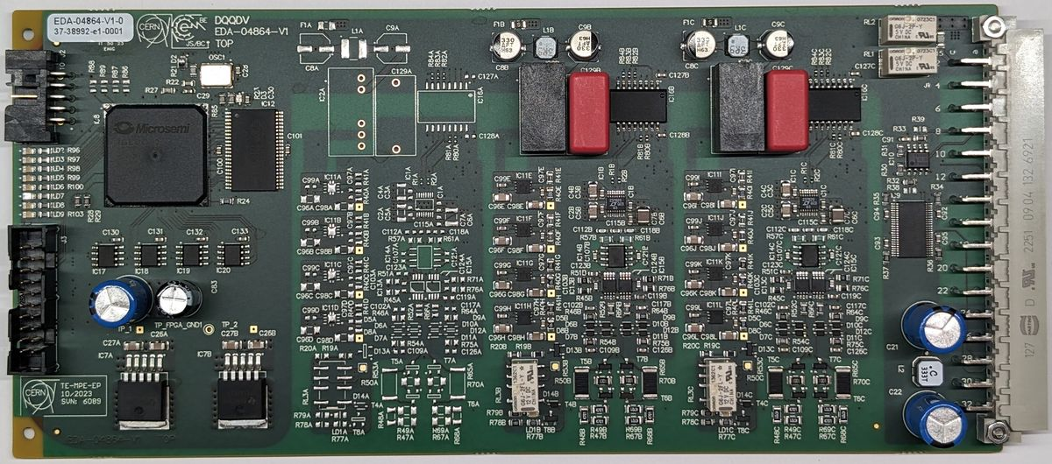
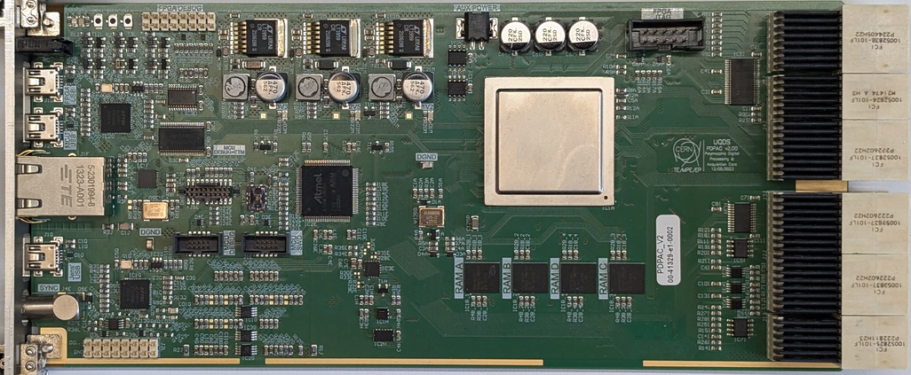
Multi-purpose Gateware on multiple Hardware
Spreadsheet
(config block specific)
Common Codebase
Configuration files & HAL
➔ Toolchain allows selection of target hardware
and config block
Toolchain
Gateware compiled from common code base
Common Repository
Application specific parts defined in HDL and Spreadsheet
Automatic VHDL code generation for register map and interfaces
Toolchain heavily scripted (Python & tcl)
Hardware-in-the loop verification techniques
Common Logic & communication interface
Config blocks
Hardware abstraction Layer
Hardware abstraction Layer
Hardware abstraction Layer
HAL

Slide 9
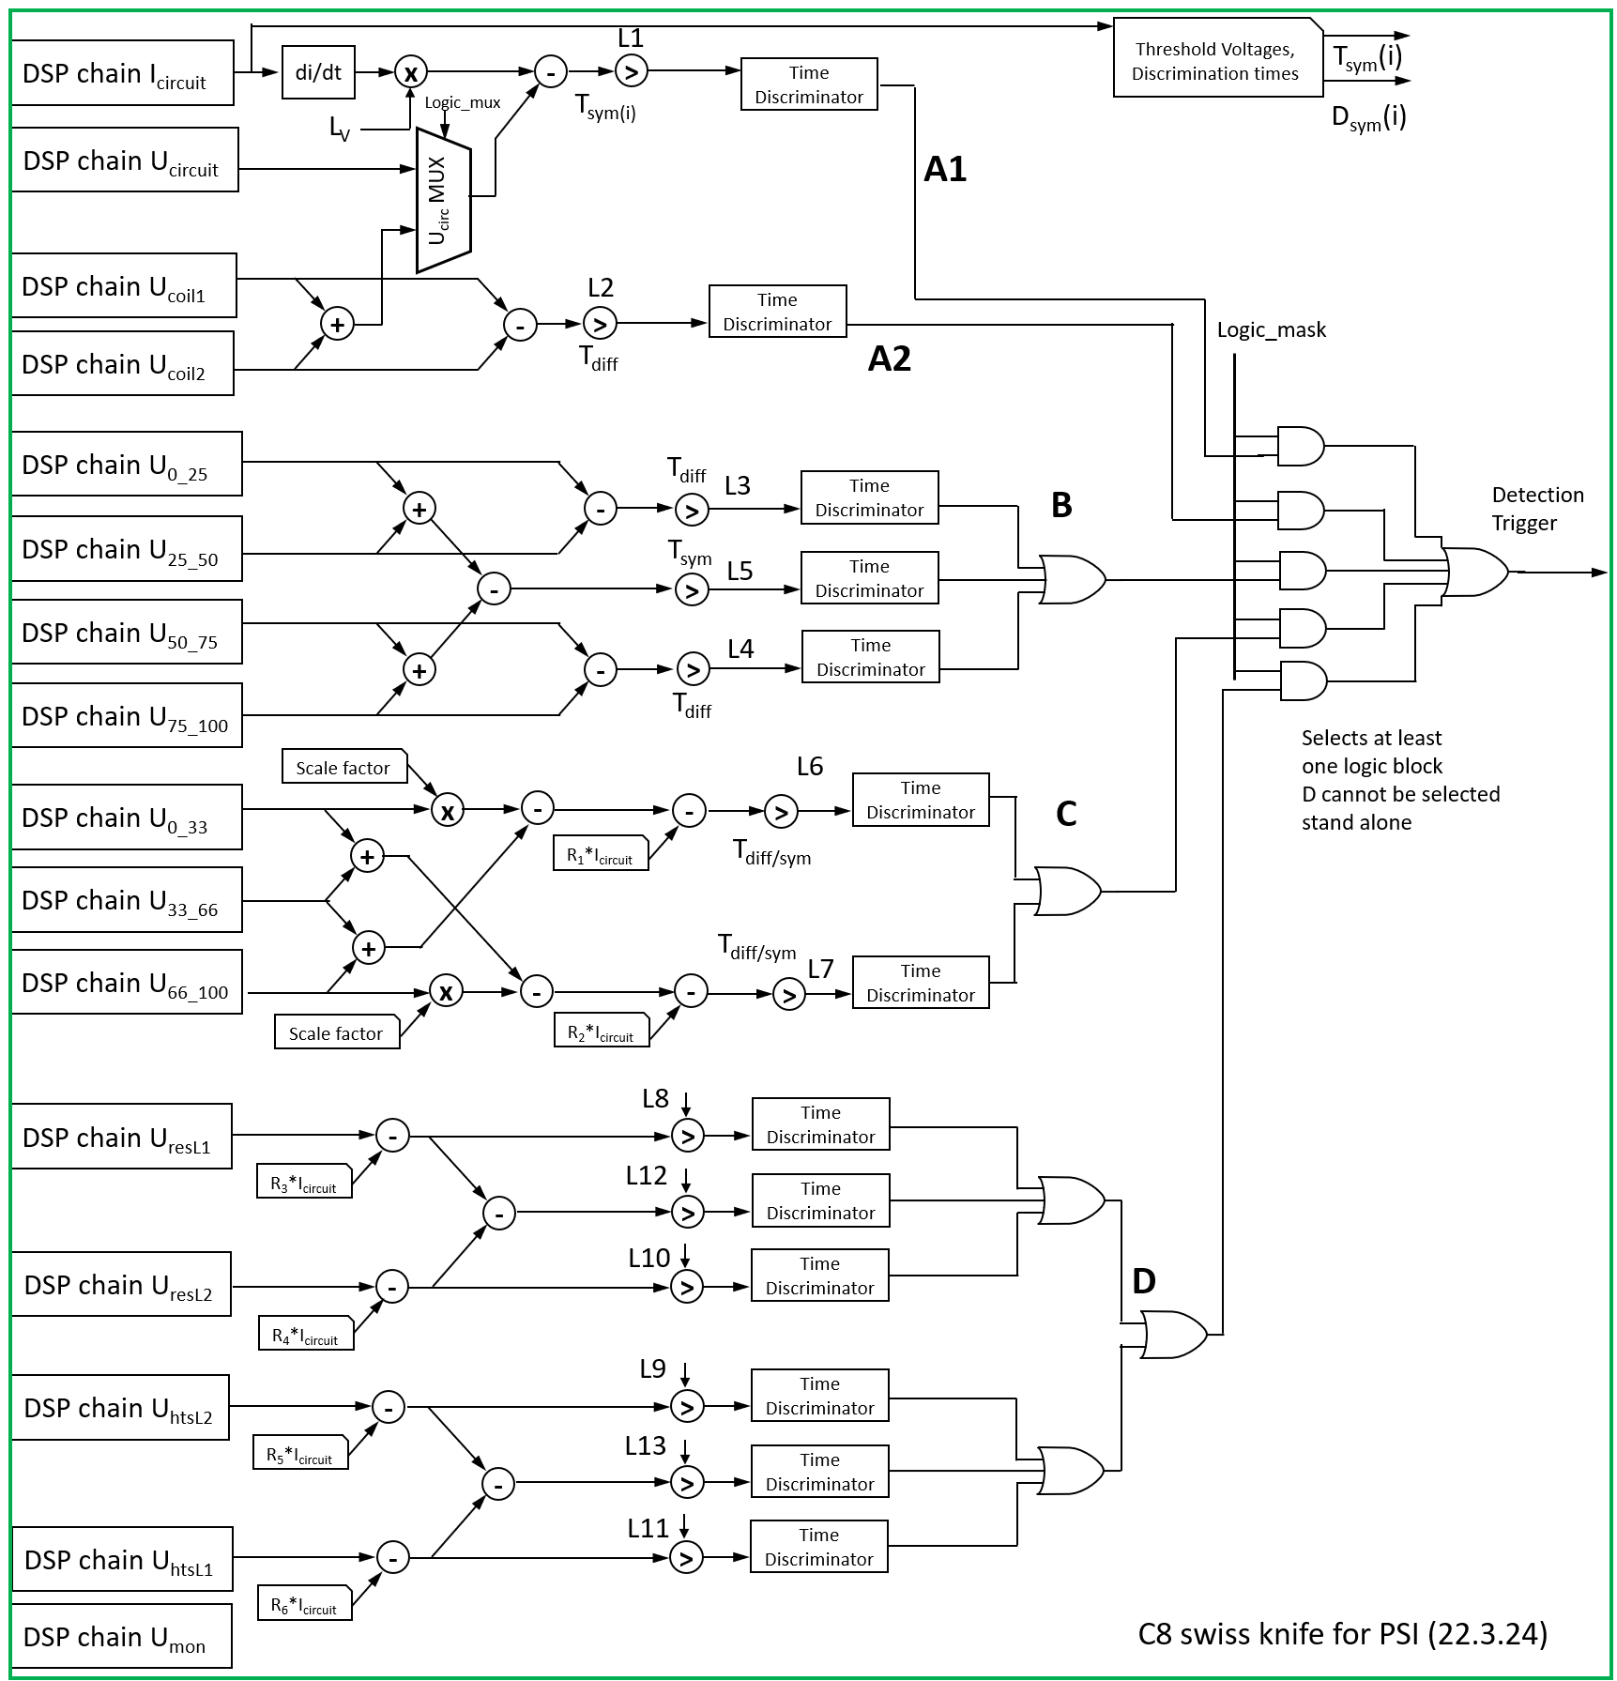
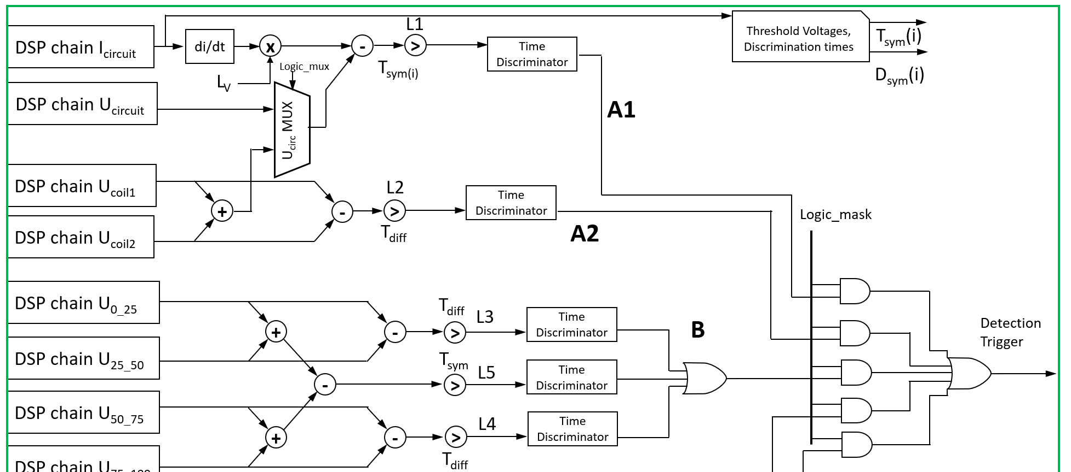
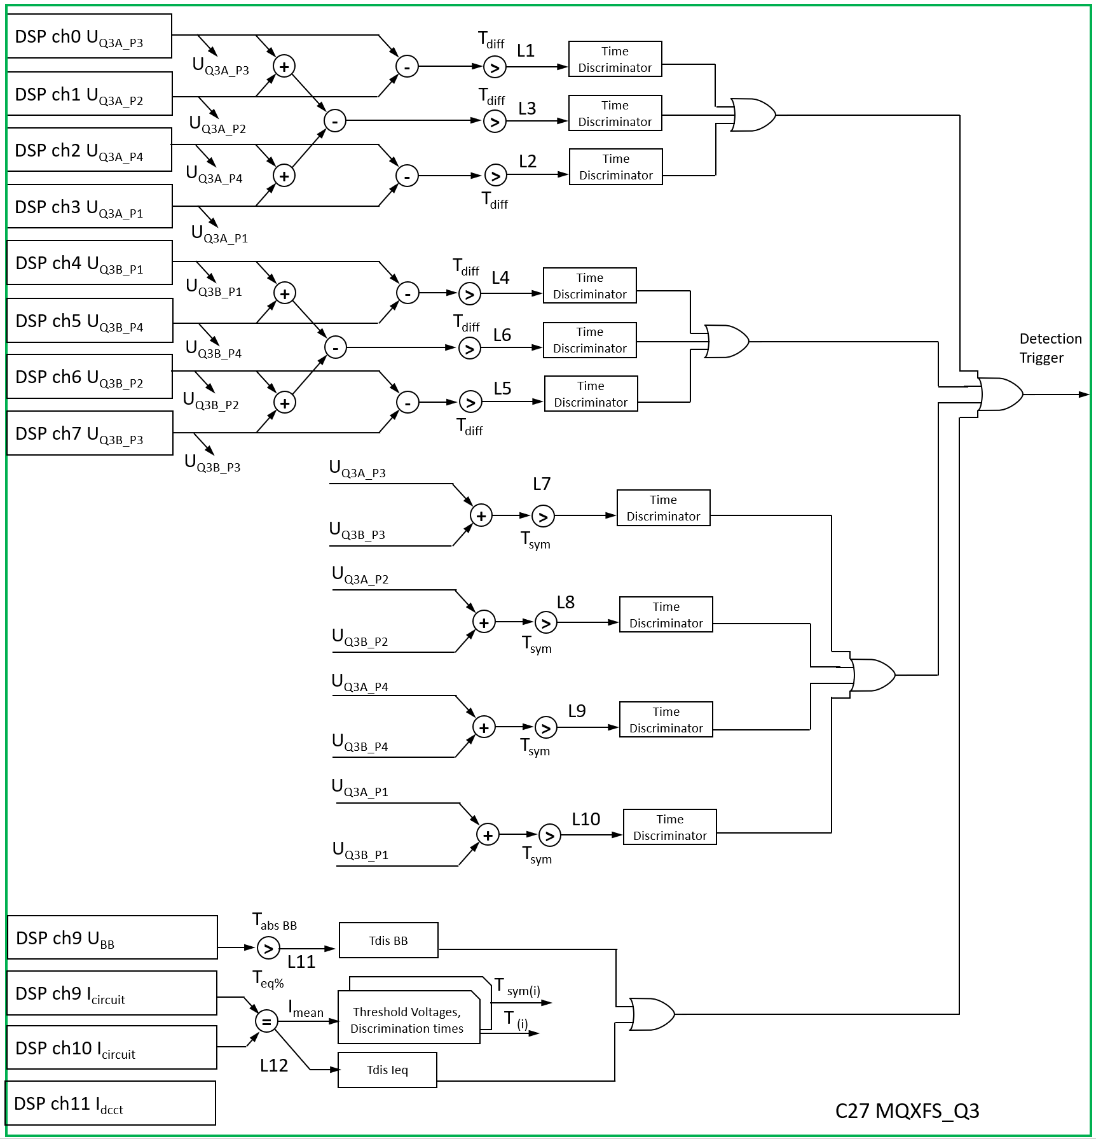
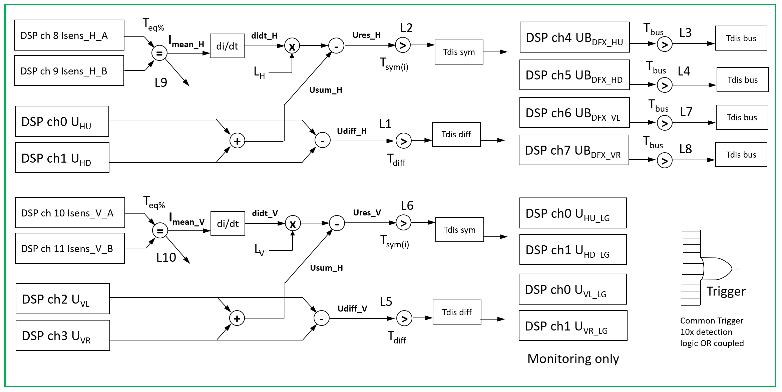
Gateware structure – “config block” examples
IT corrector Prot.
Q3 protection
Swiss Knife

Slide 10

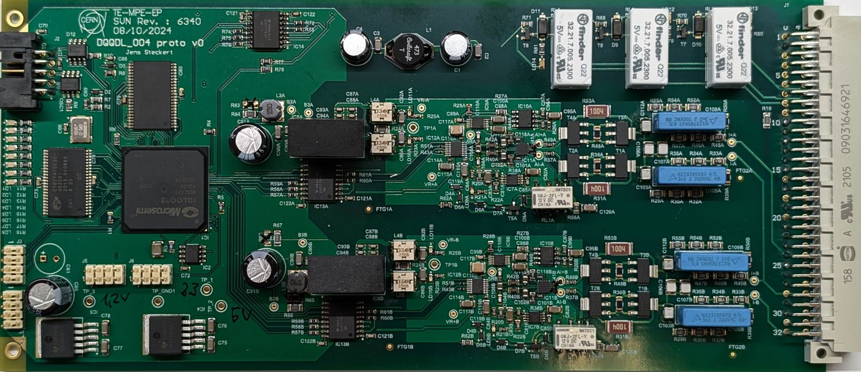

UQDS – more than the “blue boxes”
It’s a hardware and Gateware framework providing building blocks for:
  Programmable logic & Flexible Gateware framework
  High performance isolated analogue input channels
  Interlocks & digital I/O
  Communication solution with us precision (with EDAQ)
Allows for rapid development of new electronics
due to existing “Lego bricks”
And more
Standard
API
Fast
Logging
Testing
framework
UQDS
FPGA
Block
UQDSv3 channel (adapted)
ADC
channels
Power
supplies
Interlocks
Example:
DQQDL_004 for LHC
main dipoles
< 2 Months to prototype
UQDSv3 channel (adapted)
FPGA
Gateware

Slide 11


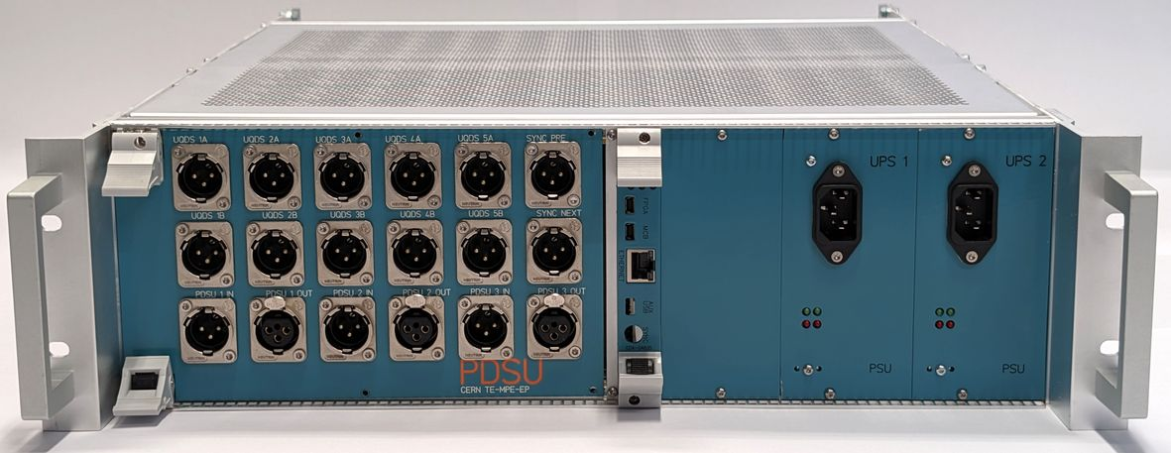
UQDS ecosystem
Image Description Configuration Status
~120 systems
produced and in use
(usage: see next slides)
UQDSv2
16 isolated channels
33 configurations
… and counting
Versatile quench
detector board for
LHC CONS
3 config blocks
planned
60 boards produced
production of
630 boards pending
Bus-bar and
current lead monitor
DQQBSv2
122 installed in LHC
Production of 500 more started
2 config blocks
Protection
Devices
Supervision
Unit for HiLumi
1
3 configurations planned
10 systems produced
for IT STRING
100 analog channels

Slide 12
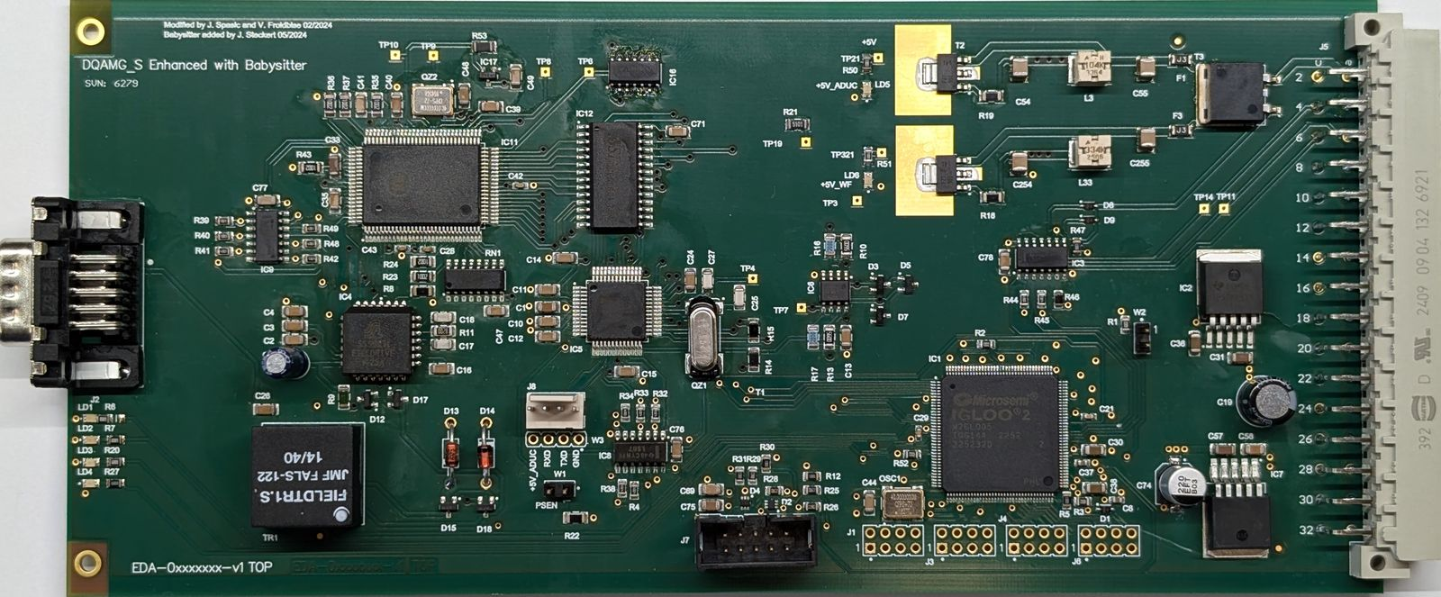
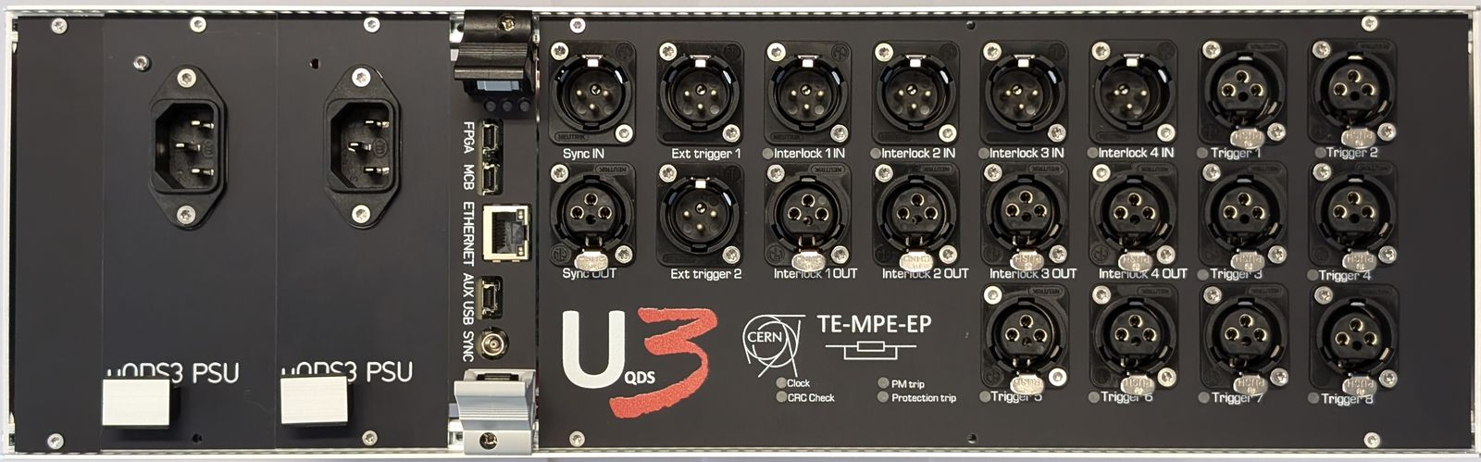
UQDS ecosystem
Image Description Configuration Status
Rad tol upgrade for QDS crate controller for ion run. FPGA with UQDS firmware, rapid development thanks to ready building blocks
34 pieces installed in LHC around
experiments
UQDSv3
Up to 32 isolated channels,
Faster acquisition speed
Optimized mechanics
Evolutionary upgrade of UQDSv2
Baseline for the HiLumi
First prototype in testing
Production of pre-series started
At least 7 for
LHC HiLumi
DQQDL_004
Upgrade of LHC dipole
quench detectors
Large production of 2600 pieces
Variable threshold & radiation tolerant
Prototypes in testing
1 test ,1 production
➔ Evolutionary upgrades and extensions of the ecosystem

Slide 13
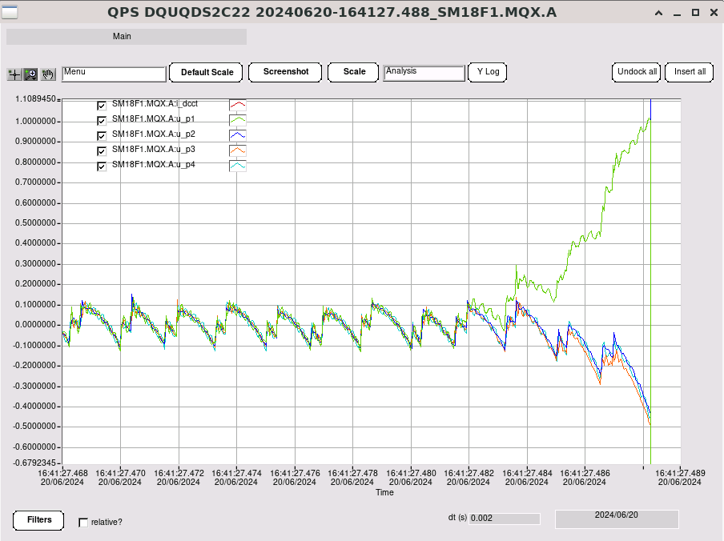
EDAQ – timing and communication for UQDS
Ethernet based solution with ~ 1000x the throughput compared to field bus used in LHC
(~10Mbit per client)
Timing precision > 1000x better than previous solution using ethernet precision timing protocol ➔ absolute precision better than 1 us
Connects to services such as logging and post mortem
R&D for high bandwidth communication using
gigabit ethernet started !
Q2 quench in cluster F1

Slide 14
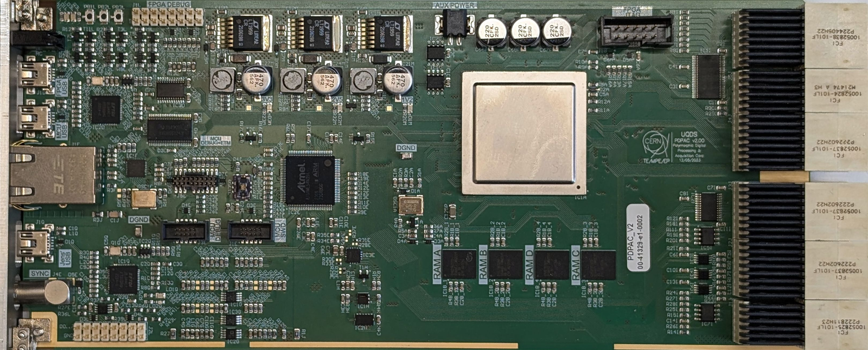
EDAQ & UQDS combined
EDAQ
UQDS
PDPAC card is implementing core UQDS and EDAQ functionality on one PCB
Polyvalent use case, same hardware used for:
  UQDSv3 controller: General UQDS firmware and EDAQ for communication
  PDSU controller: Special firmware for protection devices supervision, trigger matrix/controller EDAQ com.
  CLIQ controller: Crate controller & EDAQ for communication
PDPACv2 adds faster uC to FPGA link and gigabit ethernet capable microcontroller

Slide 15
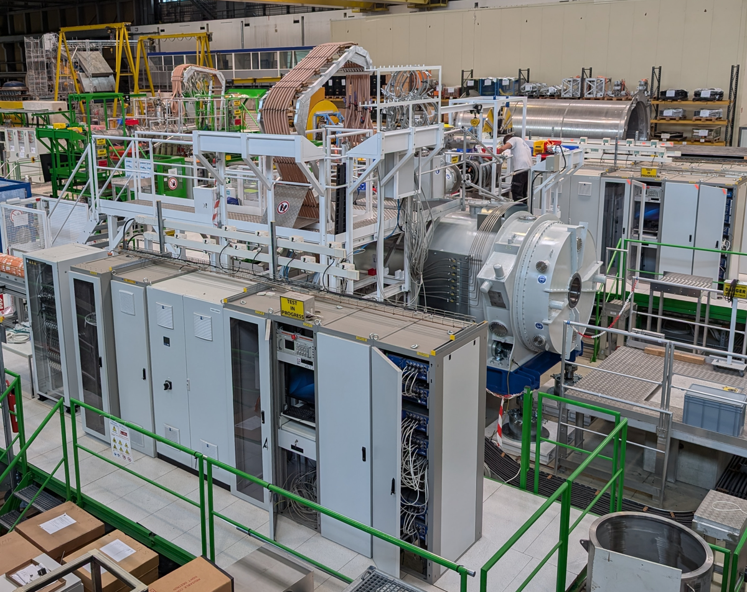
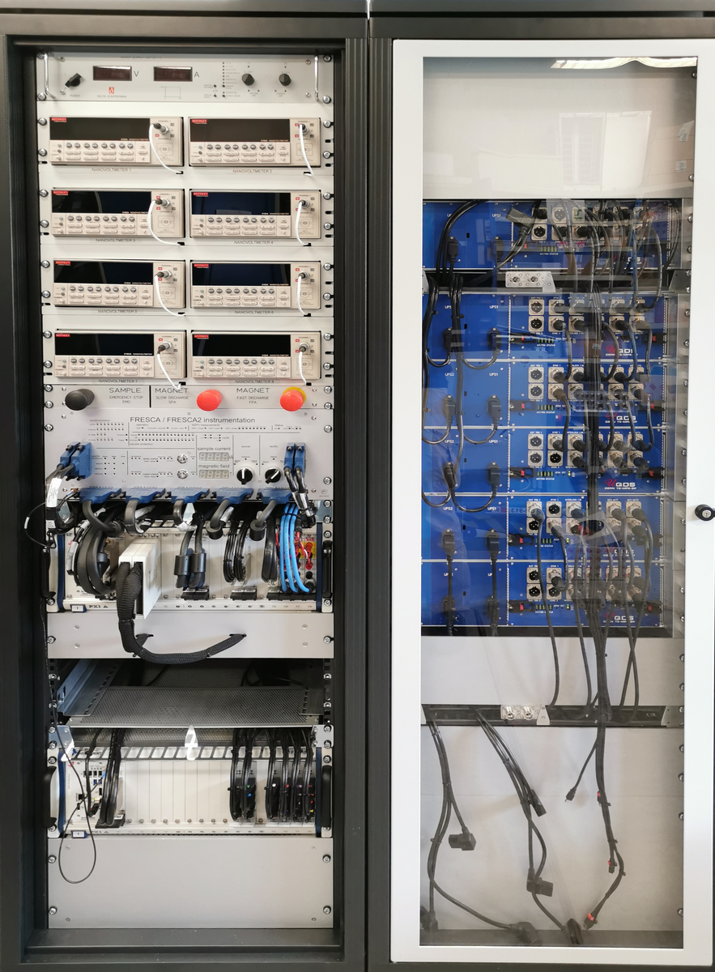
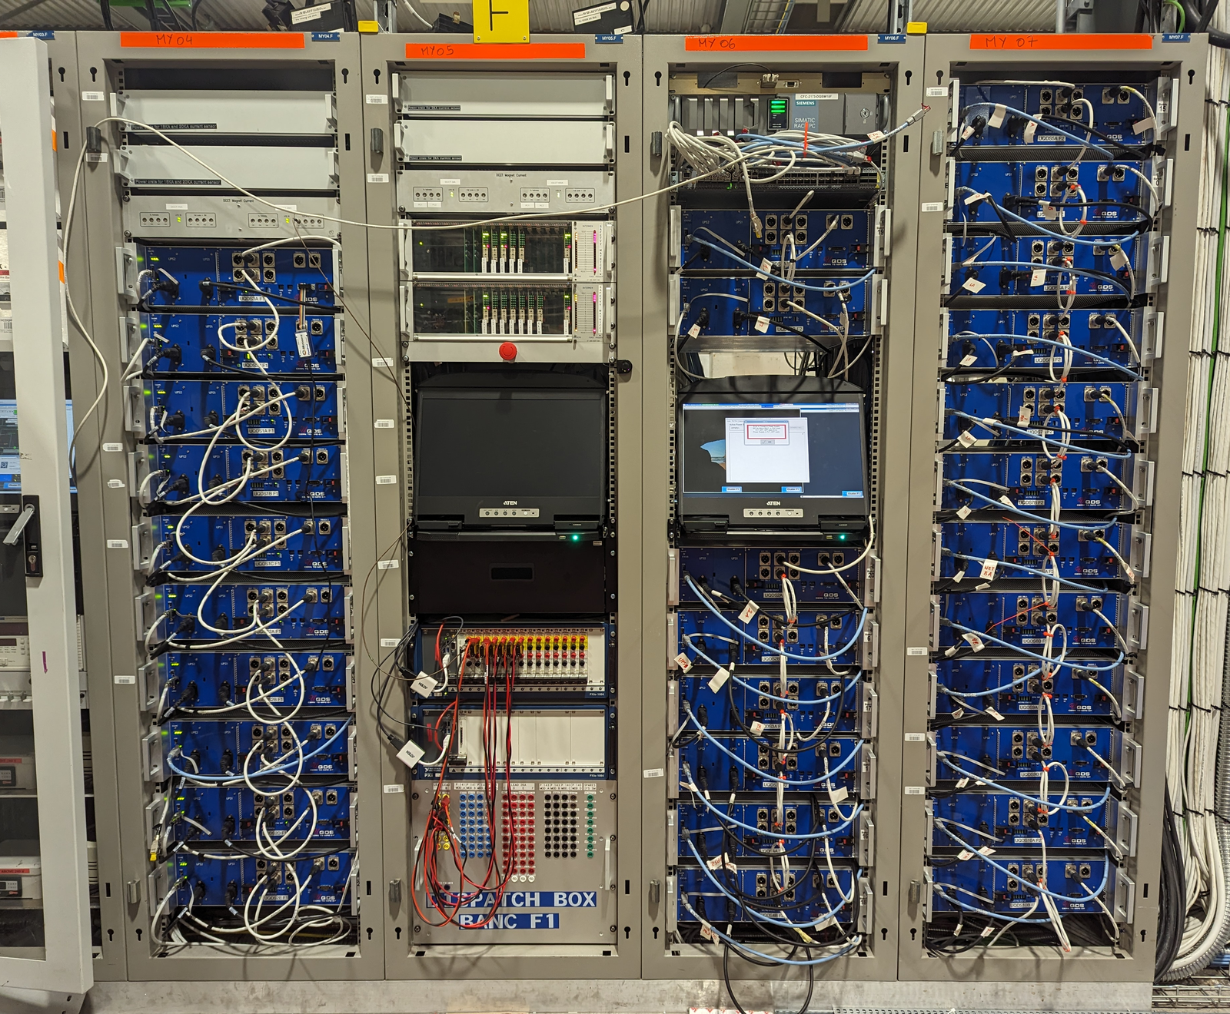
Applications at CERN
FAIR magnet test stand in
B180
18 x UQDSv2
C3
C3
FRESCA facility B163
8 x UQDSv2
C7
C19
C20
C28
SM18 cluster F1 & F2
(HiLumi Q2 & SC Link testing)
30 x UQDSv2
C22
C23
C24
C6
➔ Full exploitation of flexible Gateware to follow the rich test program in SM18
SM18 clusters A, B, C, D, G
10 x UQDSv2
SM18 HiLumi STRING
35 x UQDSv2
C30
…
C33
C24
122 x DQQBSv2 around IPs
40 x DQAMGS babysitter
LHC tunnel

Slide 16


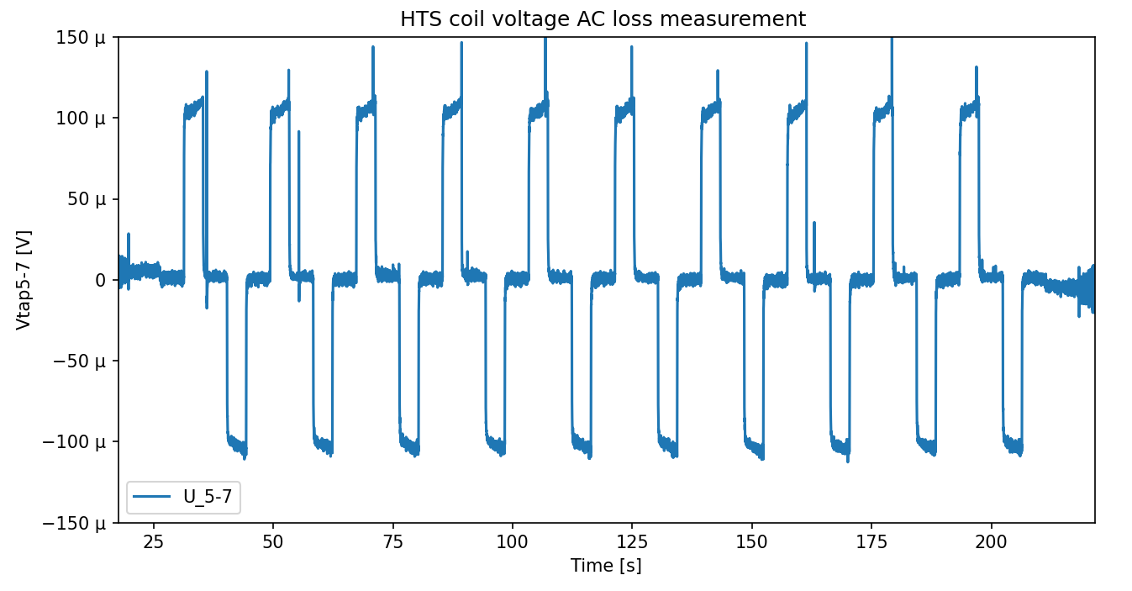


Applications outside CERN
FREIA test facility
Uppsala Sweden
2x UQDSv2
For test of HiLumi magnets
C3
PSI Villingen
Switzerland
2x UQDSv2 for SC Magnet Lab
7x UQDSv2 quench detection of
SLS2.0 2x super bend magnet
C8
C16
300 uV
IFJ PAN
Krakow Poland
2 x UQDSv2
Collaboration agreement in preparation for 2x UQDS & Training
INFN LASA
(Milano)
Data: M. Duda PSI
50Hz moving average filter

Slide 17
Outlook
Software support other than the rigid CERN controls stack is could be improved
Work has started on a Python based library for communication and configuration
  Handles communication protocol via: UART, SPI, I2C or EDAQ
  Abstracts settings and allows user friendly configuration of the system (no register settings in hex anymore)
Plans for a more user-friendly GUI (based on the library)
Currently R&D for much faster communication speeds which would allow continuous logging with 100..200kHz via Ethernet
R&D for novel QD methods: DAC channel to inject signals into magnet
Next big challenge after STRING will be HiLumi with about 175 UQDS3 systems

Slide 18
Summary
Established platform with full system integration in CERN controls services
Inhouse solution with full control about all elements
→ We can cope with obsolescence etc…
Quite unique feature set
  High performance measurement channels with galvanic insulation of ~5kV peak
  FPGA for real time processing of data & hardware interlocks
  Radiation tolerant versions available
Flexible adaptable design which can serve many purposes !
Focus now on completion of units for IT STRING
UQDS3 development ongoing

