Slide 1
Use of uQDS
Various real life scenarios
Michal Duda
3rd Instrumentation and Diagnostics for Superconducting Magnets Workshop (IDSM 3), 3.04.2025

Slide 2
Content
Motivation
uQDS
Swiss knife
Real life scenarios
Highlights

Slide 3
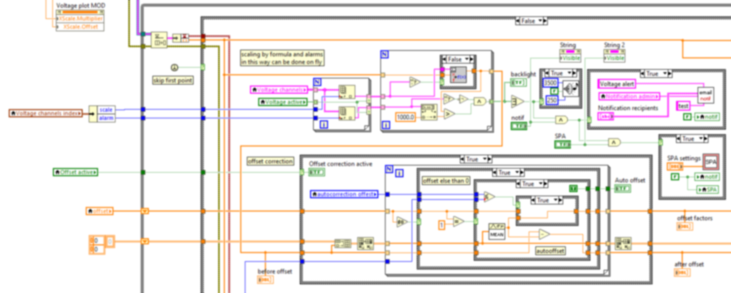
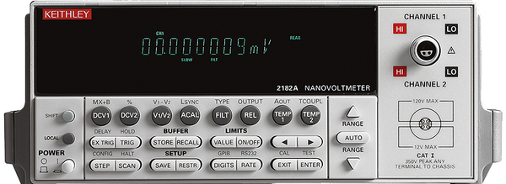
Motivation
What do we need at a teststand?
Flexibility – from sample to magnet
Easy setup – programmable by config file
Safety – interlock
What to choose for a teststand?
Different commercial hardware exist..
..but no dedicated one
Small selection built-in-house hardware
Different operating software

Slide 4

universal Quench Detection System
Highlights*:
16 high resolution galvanically isolated channels/crate
Modularity
Protection fully configurable by csv/xls files
Fast real-time data logger
Digital signal processing
System interlock functionality
Works as standalone system (no PC required)
uQDS
* besides quench detection functionality and from user perspective, not salesman – see Jen’s talk ;)

Slide 5
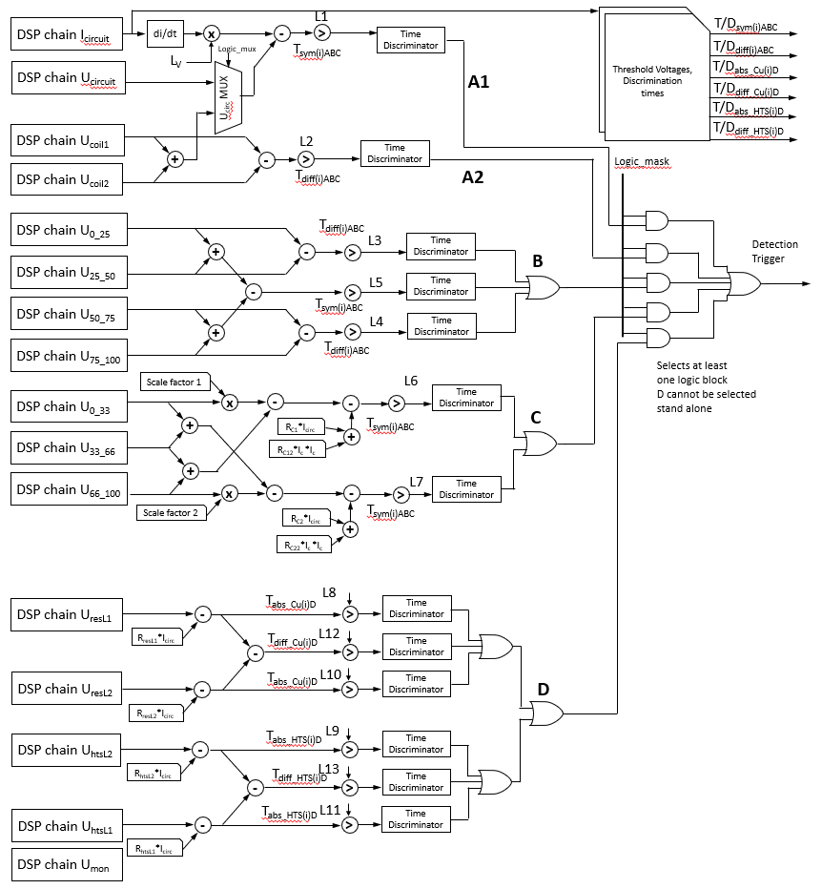
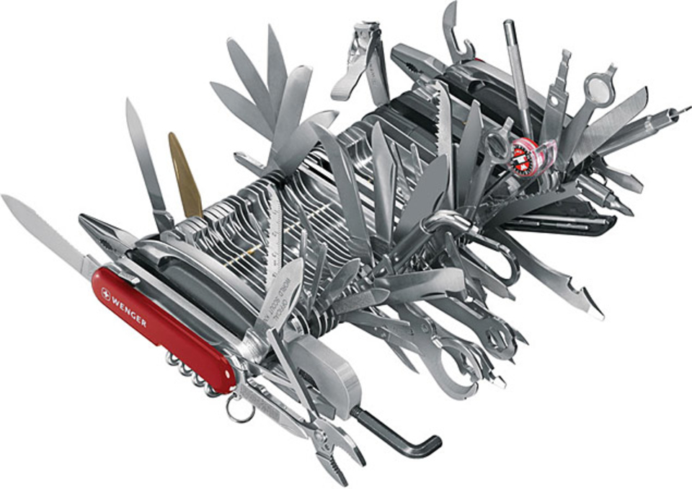
C8: Swiss knife
4 main protection algorithms for different coils
v taps configuration, used as single or combined
Dedicated algorithm for Cu and HTS leads
Current dependent thresholds and validation times for all logics
Additional settings for inductive signals or residual resistance removal

Slide 6
Logics A1 and A2
Single coil* with only 2 v taps
not really safe scenario except...
L1: Ures_A1 = Ucoil – L*di/dt
Two coils or single coil with symmetric v taps
a bit better but still something missing...
L1: Ures_A1 = (Ucoil1 + Ucoil2) – L*di/dt
L2: Ures1_A2 = Ucoil1 – Ucoil2
* or sample

Slide 7
Logics B and C
Four coils or luxury 4 symmetric v taps
vary rare scenario but may happen if you were good..
L3: Ures_B1 = U_0_25 – U_25_50
L4: Ures_B2 = U_50_75 – U_75_100
L5: Ures_B3 = (U_0_25 + U_25_50) – (U_50_75 + U_75_100)
Three coils or asymmetric v taps
..if you were nasty
L6: Ures_C1 = U_0_33 * S – (U_33_66 + U_66_100) – (I * R1 + I² * R2)
L7: Ures_C2 = U_66_100 * S – (U_0_33 + U_33_66) – (I * R3 + I² * R4)

Slide 8
Logic D
Standard leads protection but can be used freely
L8+L10: direct protection of Cu section
L9+L11: direct protection of HTS section
L12+L13: differential Cu and HTS sections
All ABCD* logics cover most of the teststand scenarios giving the necessary flexibility and safety
* more might come, but so far system works for 2+ years

Slide 9

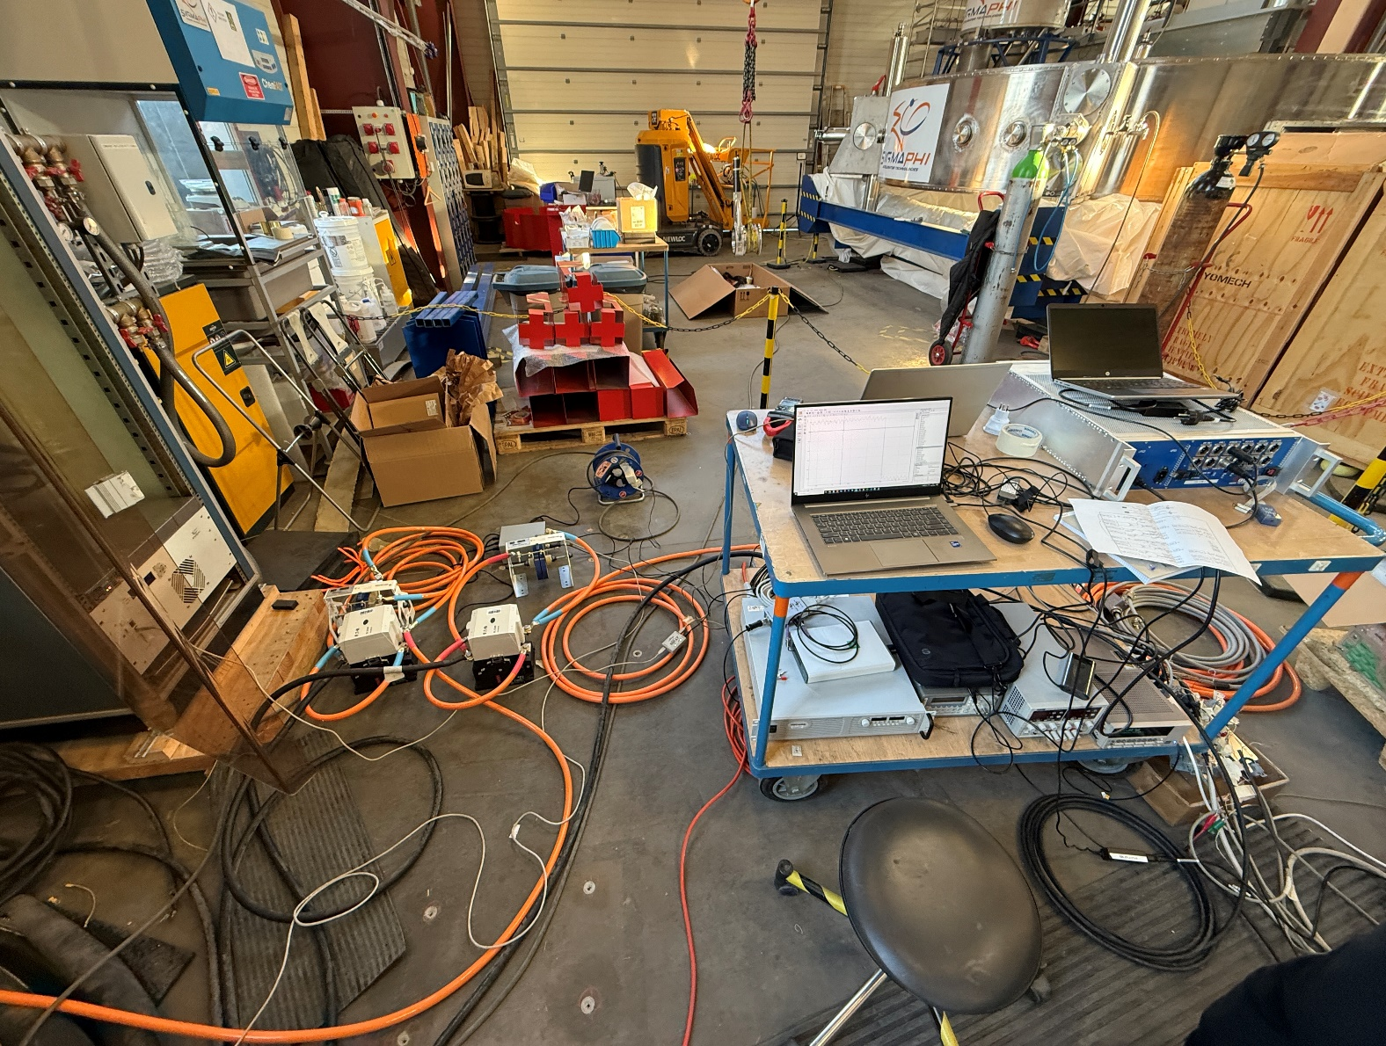
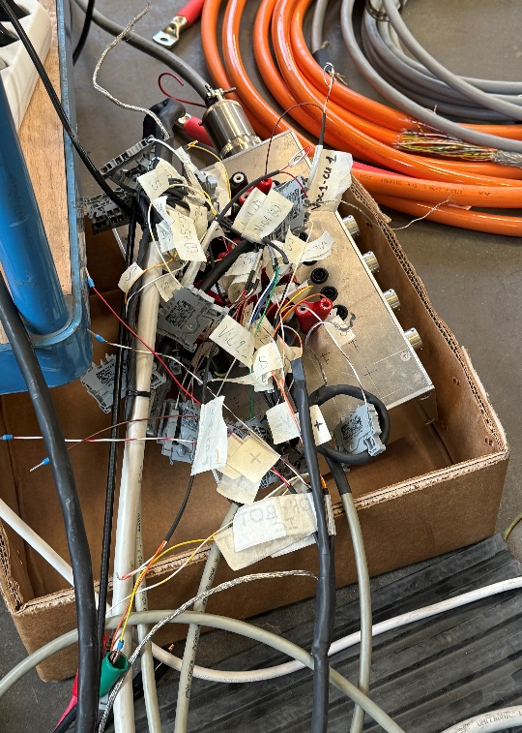
Check if all signals are connected..

Slide 10
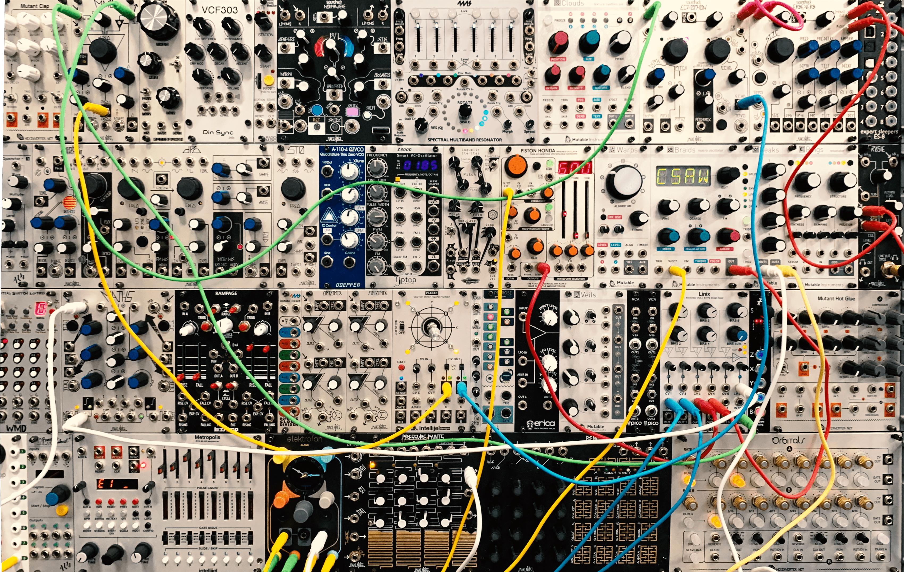
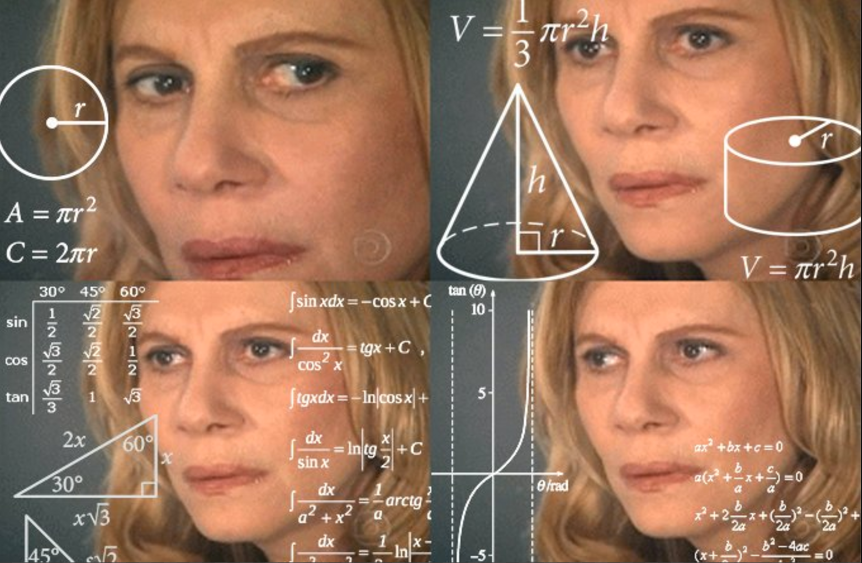
..set up protection parameters.. Wait!

Slide 11

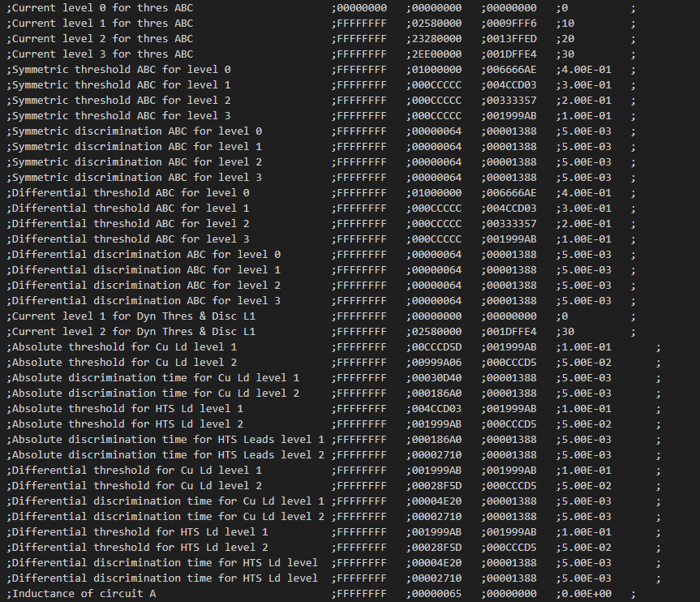
uQDS config file

Slide 12
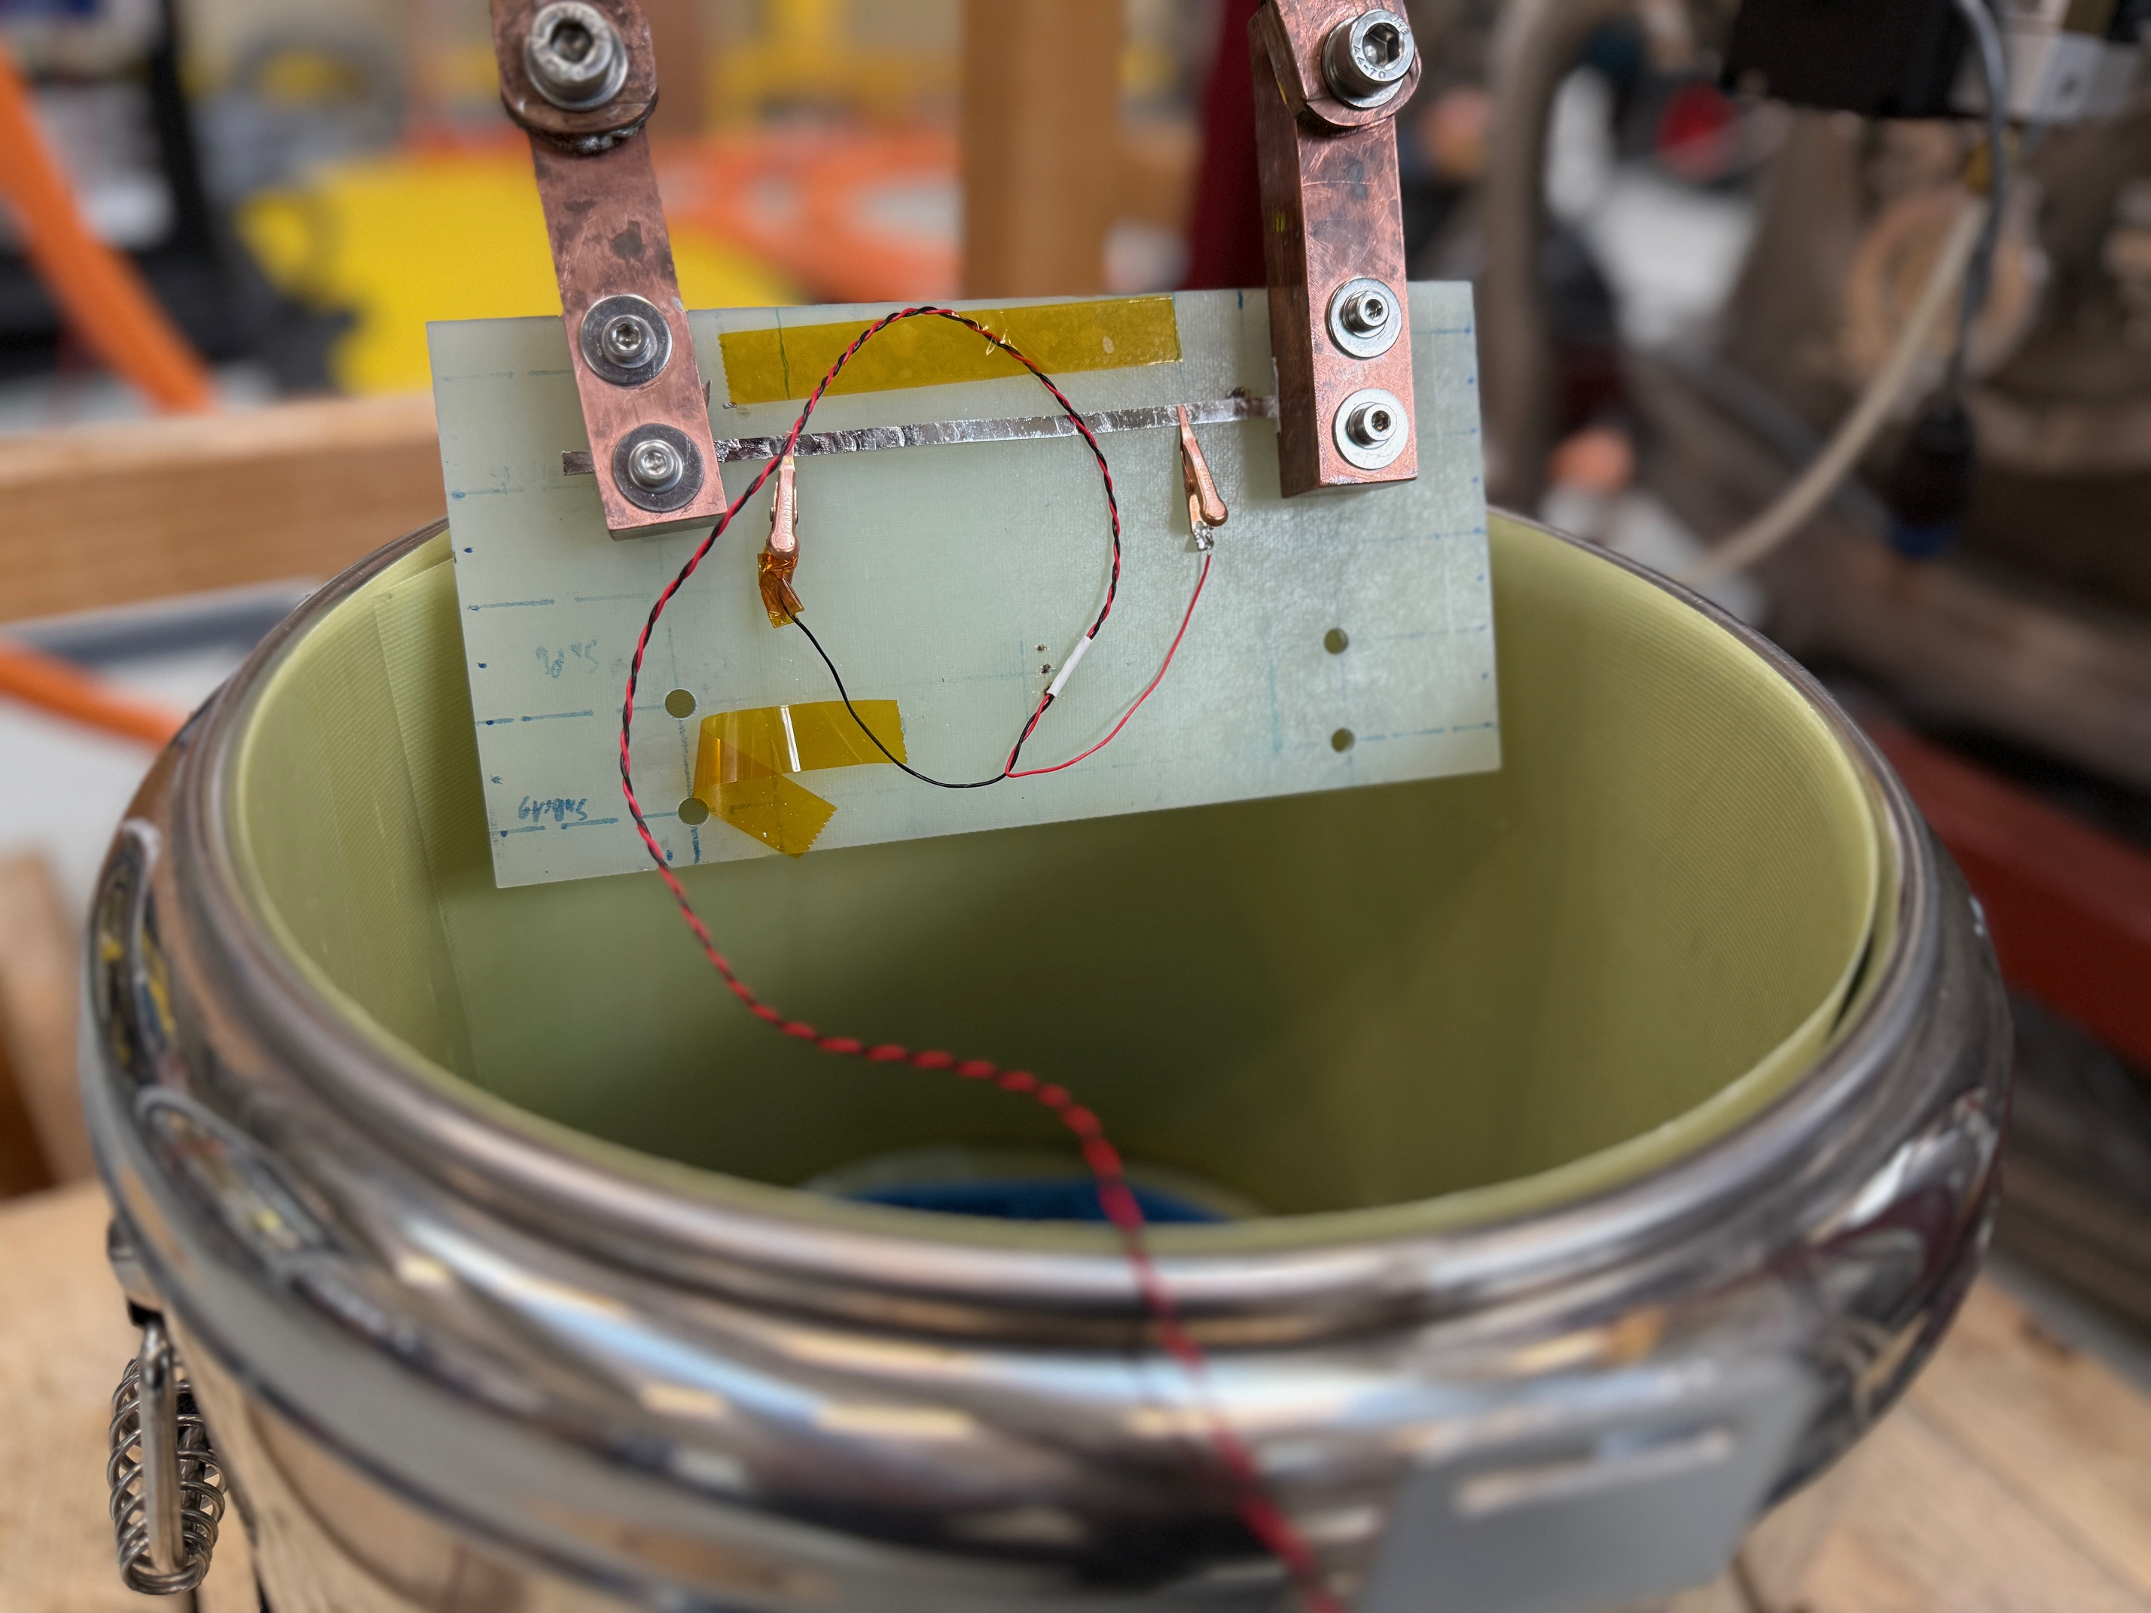
Case #1 HTS tape characterization
HTS tape degradation after different steps of coil production
HTS cable degradation after heat treatment

Slide 13
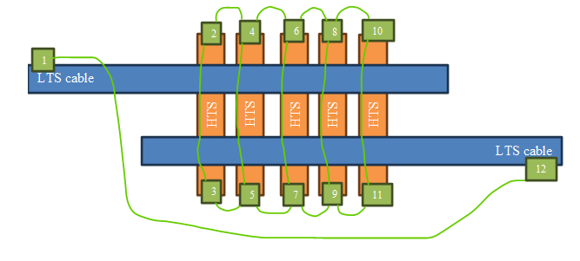
Case #2 LTS/HTS splice
LTS/HTS splice test, current sharing effects and single tape quenching

Slide 14
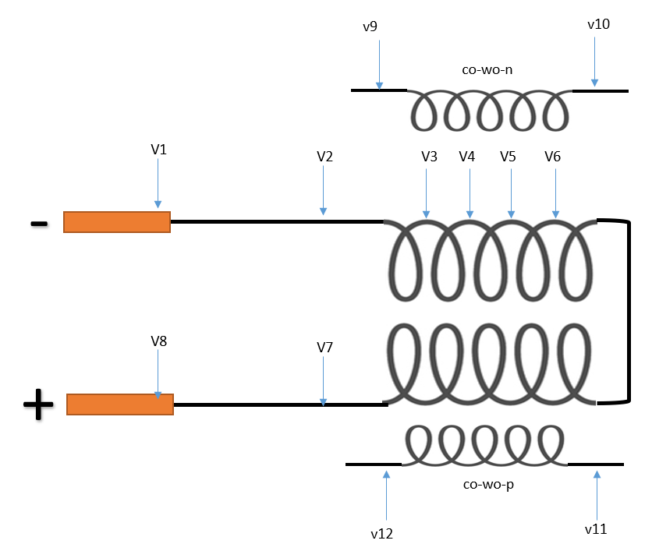
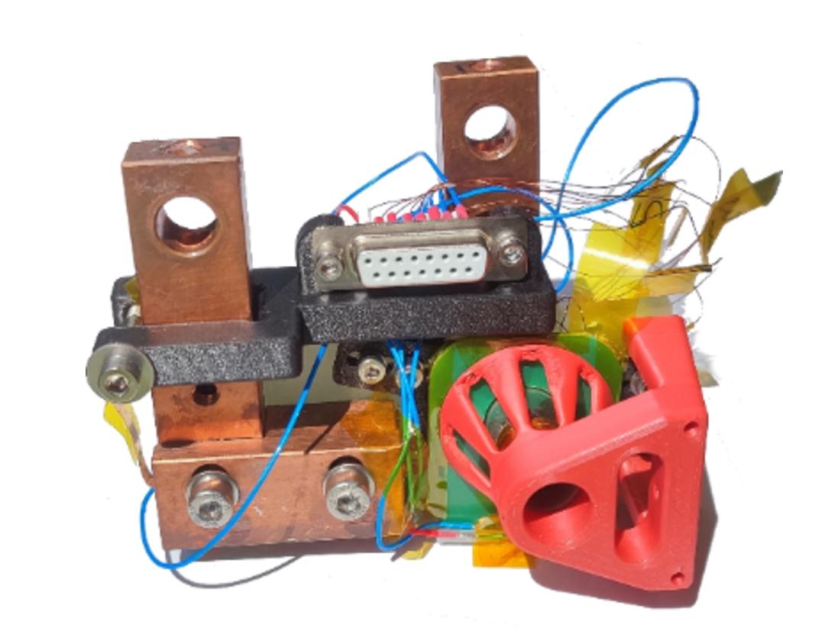
Case #3.1 HTS insulated double pancake
AC losses in HTS cable study
PCB pick-up coils used as protection to compensate signals

Slide 15
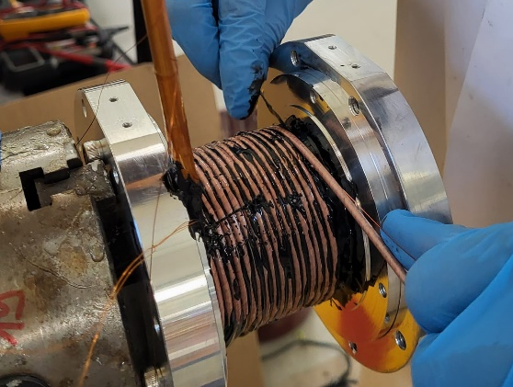
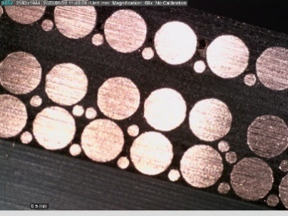
Case #3.2 insulated CORC coil
Ramp rate and AC losses study
Co-wind wire used as main protection

Slide 16
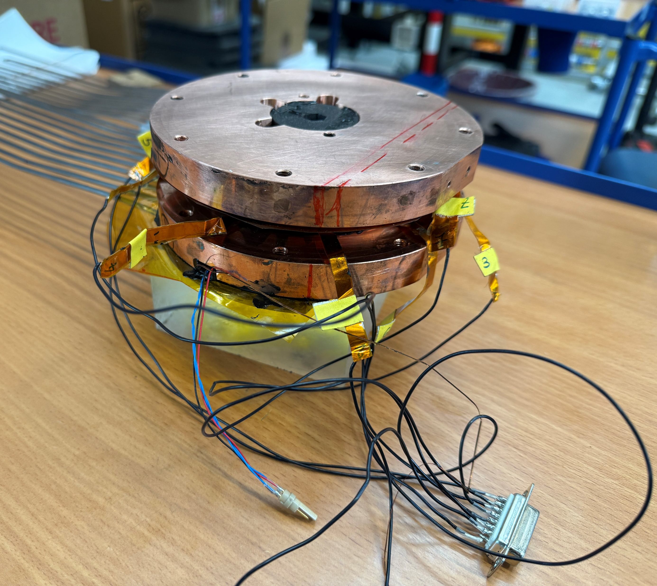
Case #3.3 HTS insulated coil cooled by PHP
Ramp rate and AC losses study
Coil cooled by PHP
Unbalanced coil algorithm used for protection
V threshold

Slide 17
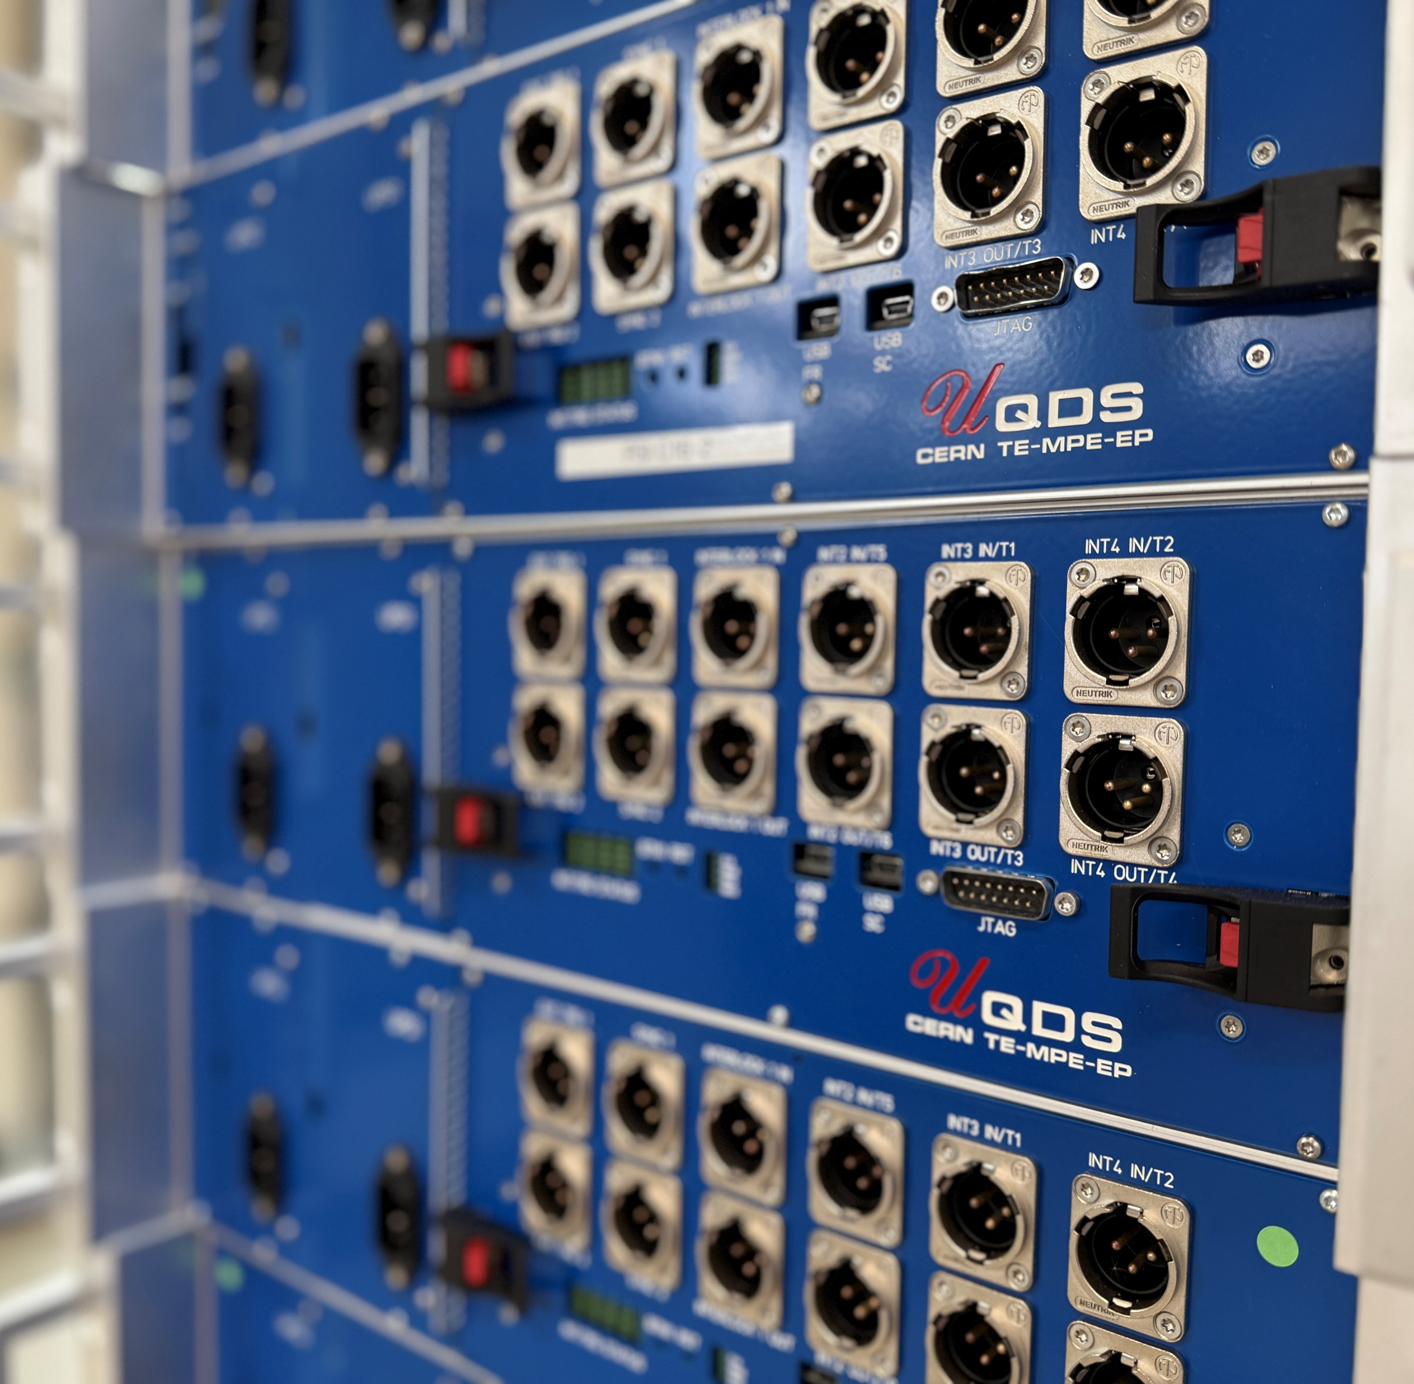

Highlights
Realy universal – you can test whatever you want
Flexibility – different quench protection algorithms
Precision – down to 1uV and 200kHz sampling
Modular – 16 channels/crate
Easy to setup – config files
Successful technology transfer between
Coffee Enthusiast Resource Network (CERN) and Pleasure Science Institute (PSI)
Thank you for your attention!

