Slide 1
Update on the Fiberoptic Sensing at Fermilab
S. Krave, M. Baldini
Instrumentation and Diagnostics for Superconducting Magnets

Slide 2
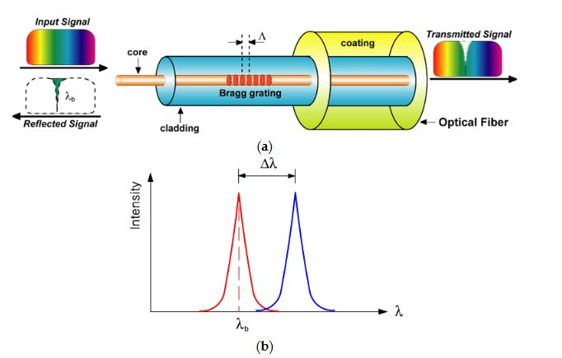
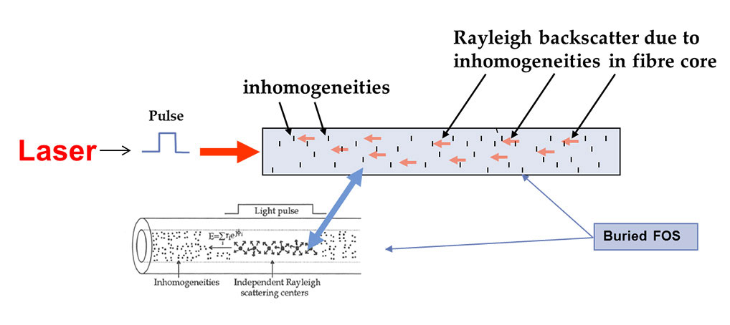
Fiber optics sensor overview
Rayleigh sensor: distributed sensor
FBG sensor: discrete sensor
We primarily use a Luna ODiSI 6108 for distributed sensing
  8 channels up to 384,000 measurements per second
  To 250 Hz
  And 0.65mm gage pitch

Slide 3
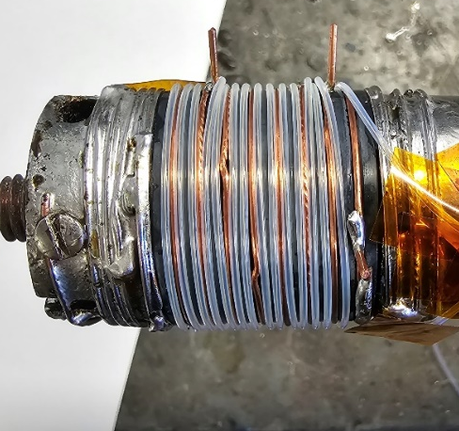
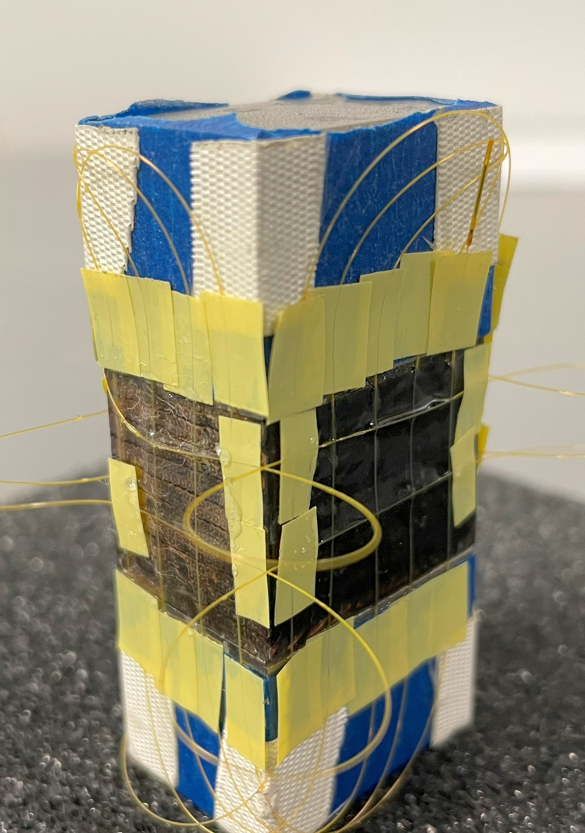
Outline
Quench propagation studies and small scale measurements using distributed fiber sensing
  Barrel Samples: Nb₃Sn and REBCO
  Test with a star cable
  Ten Stack measurement
  Coil Mechanics
Strain measurements on magnets and distributed rosettes
  CCT subscale magnet
  SMCT magnet
  AUP cryo-assembly during welding
  Mirror magnet

Slide 4

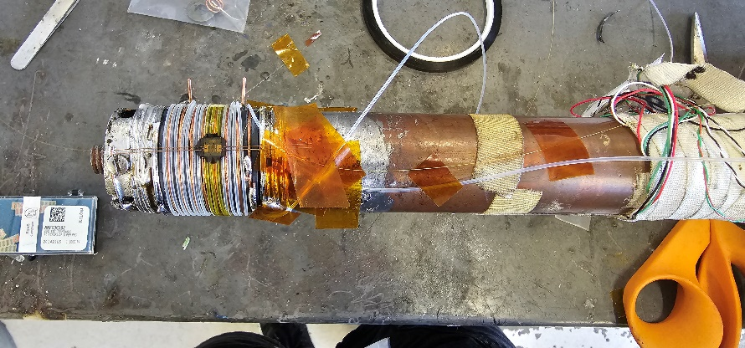
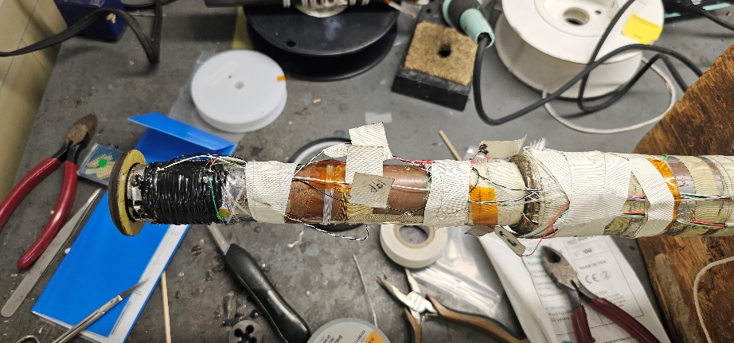
Quench propagation study on Nb3Sn strand
Year 2023
Nb₃Sn witness sample from QXFA coil
Strain gauge was used as a spot heater to quench the wire
5 m temperature and strain fiber to study quench propagation.
Test in liquid He at 4.5 K
Test 1: At 15T, 14T, 12T, 10T ramped up the current until quench
Magnetic Field | Critical Current
15T | 376A
14T | 466A
12T | 693A
10T | 985A

Slide 5
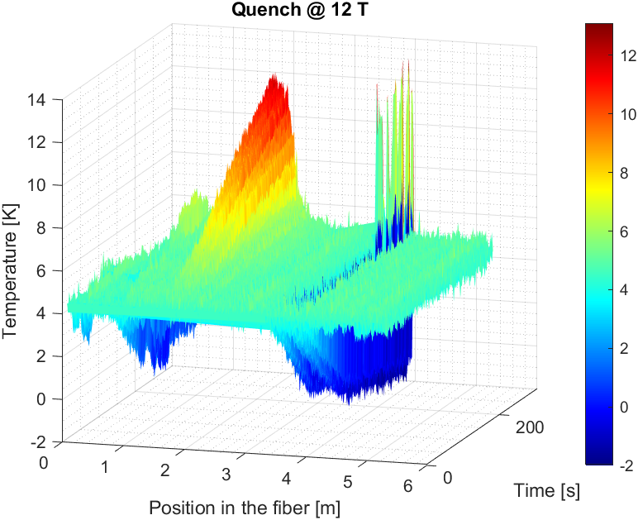
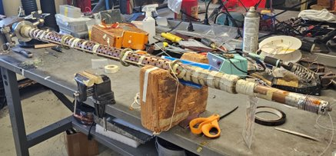
12T Nb3Sn DATA analysis
Heating due to contact with the probe
Ramp before and after the quench (just first wrapping)
Issue: negative T variation during ramping suggests that
Strain and temperature are not fully decoupled

Slide 6
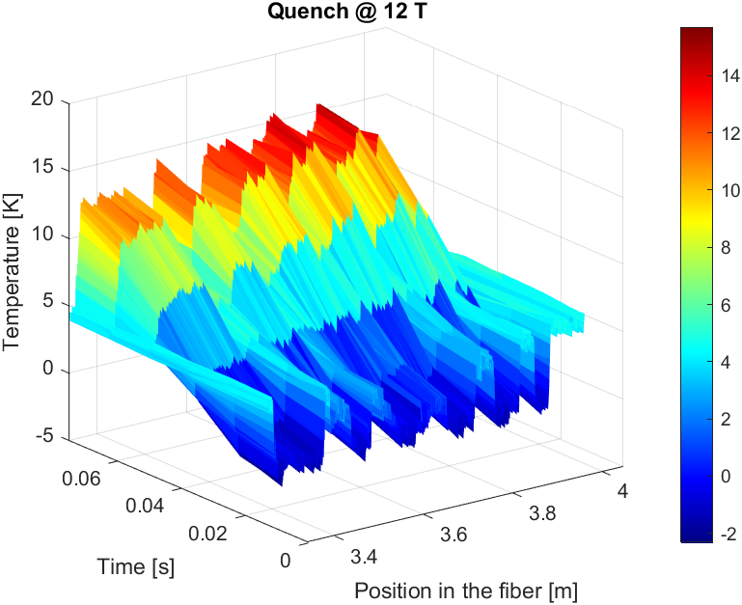
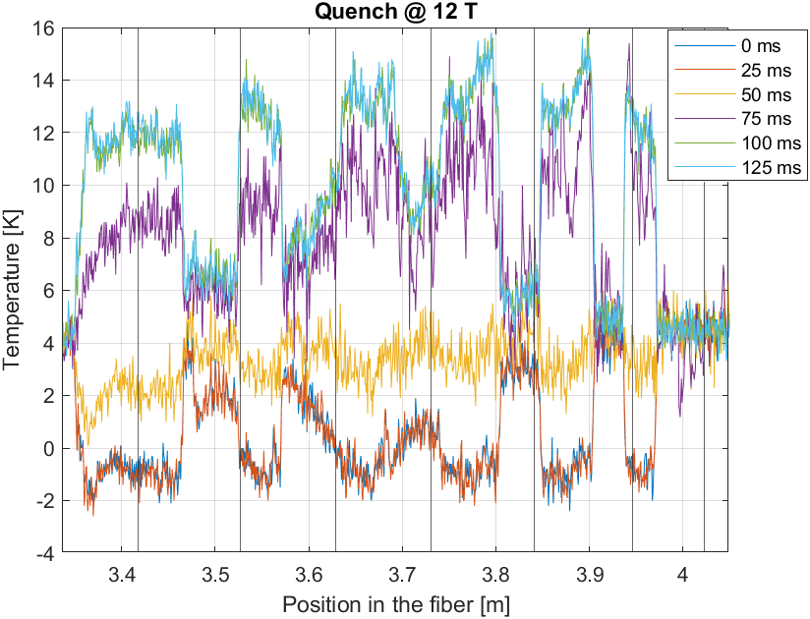
T variation during quench

Slide 7
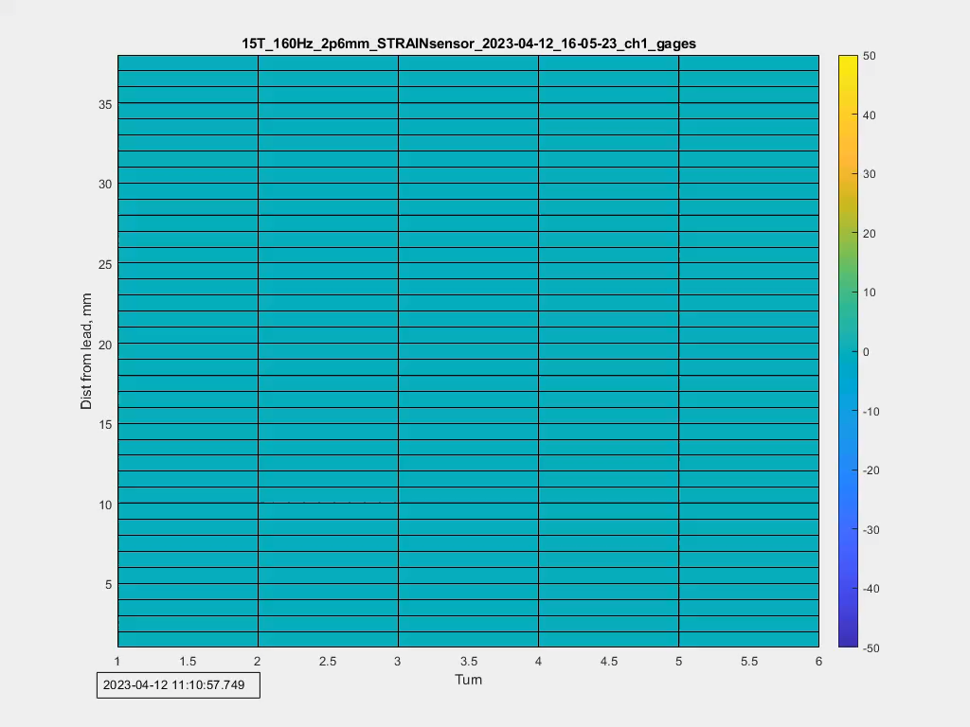
Nb₃Sn Quench Propagation
Strain Sensor Readout during quench at 15T
Mapped around barrel.
Turn 6 is at top of sample
  Hard to see, but quench propagated from top to bottom over ~3 frames at 160 Hz
  Perhaps originated at yellow spot

Slide 8
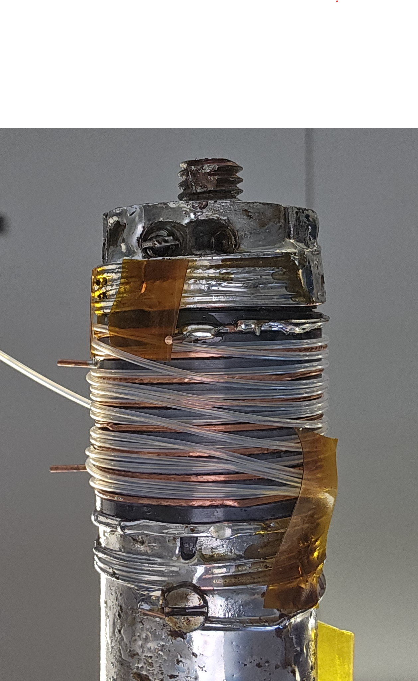
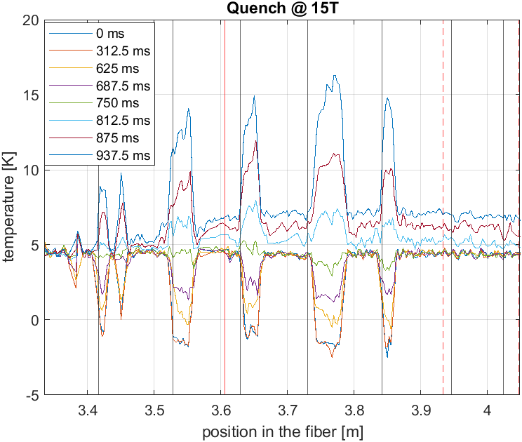
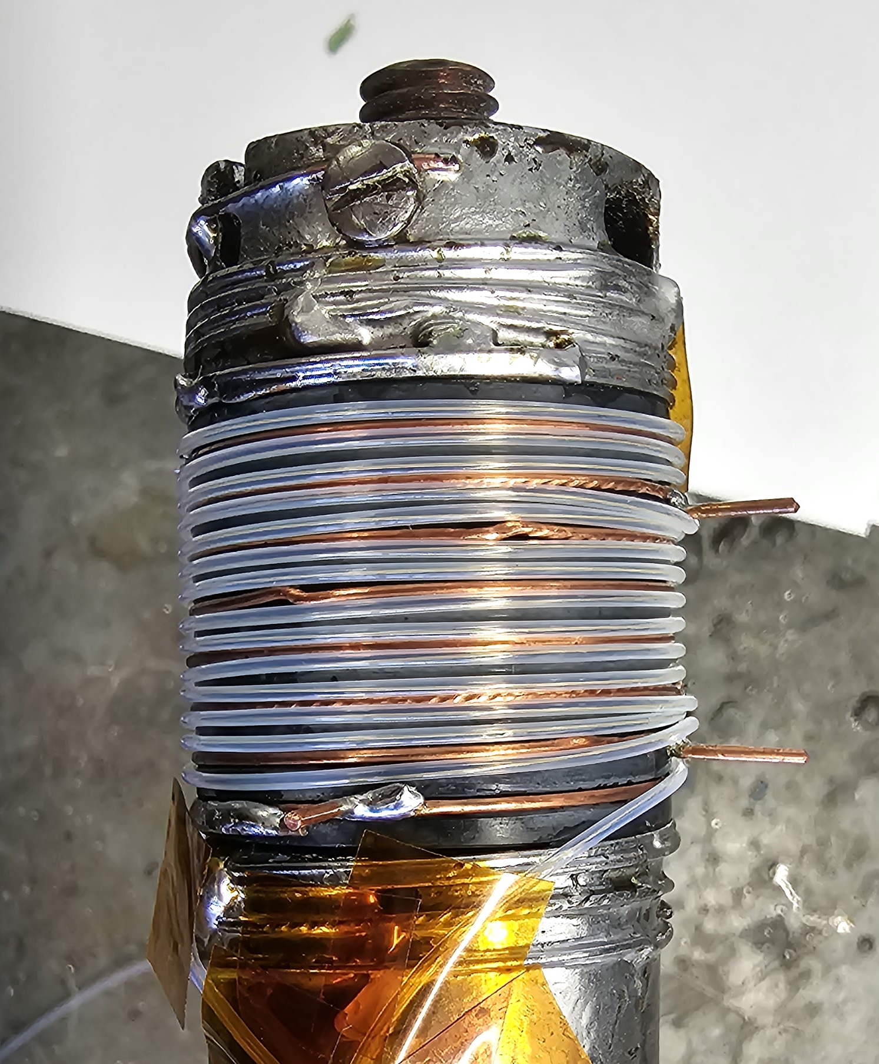
Quench at 15T with spot heater
Spot Heater
One side of the barrel was more sensitive to temperature variation, maybe this is due to the different arrangement of the sensors. Issue: we need better thermal contact?

Slide 9
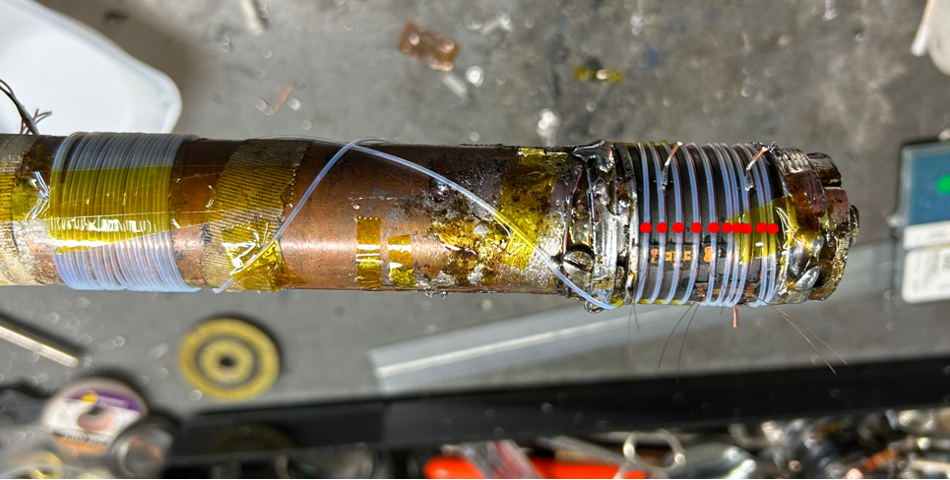
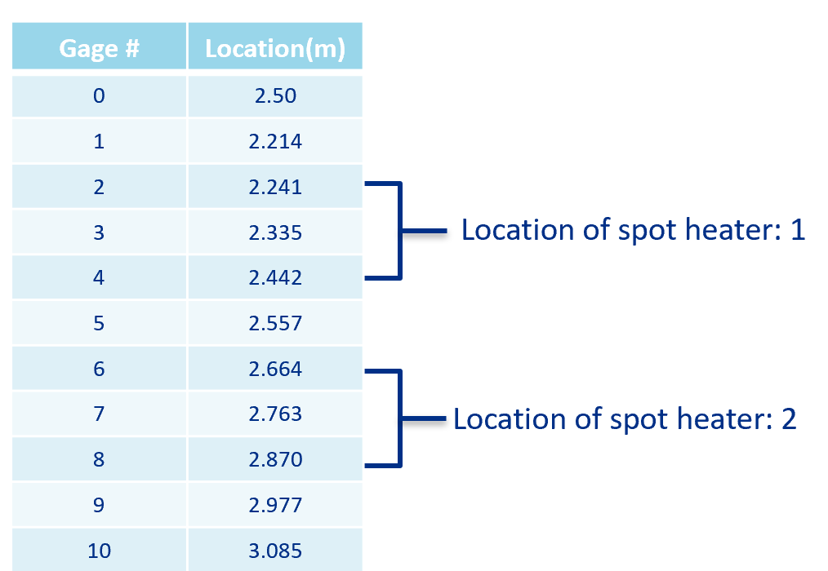
Nb₃Sn sample: test 2
Two spot heaters 1 and 2 were attached, each with the same resistance:
  R = 350Ω
Each turn of the fiber was identified: 50 cm wrapped around the Nb3Sn strand.
Covered with Stycast 2850 FT
  During painting with Stycast, the fibers shifted somewhat
Magnetic Field: 15T, 12T
Minimum quench power tests done at different magnetic field and current levels

Slide 10
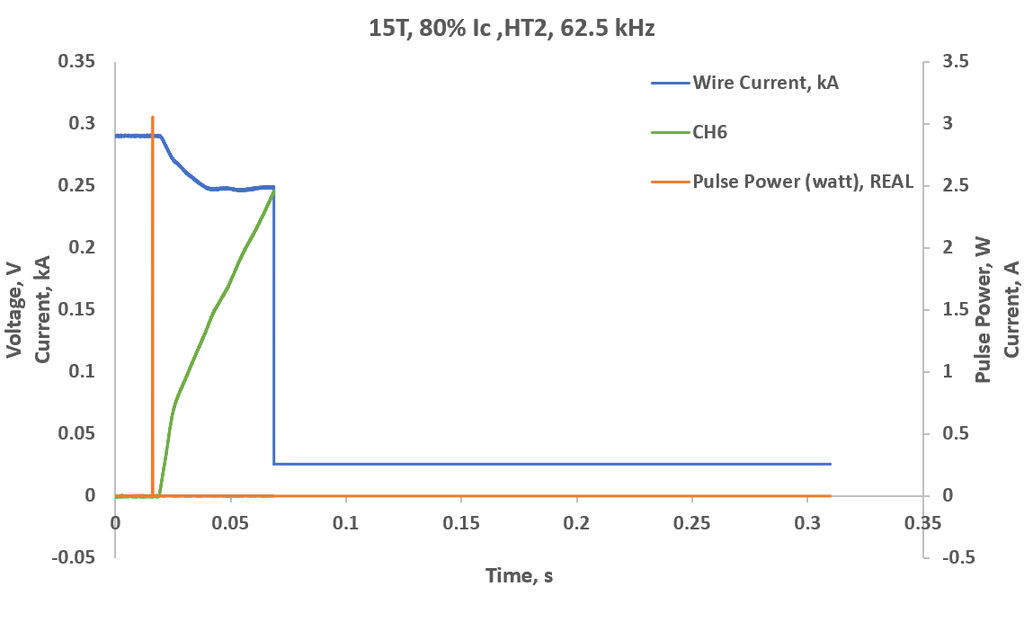
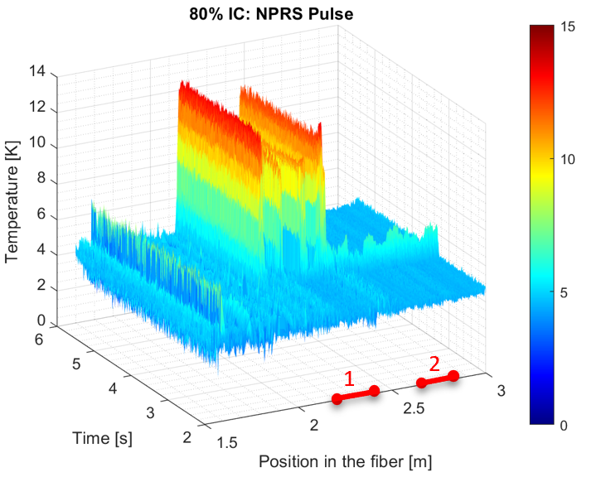
Nb3Sn test: 15T, 80% Ic
Spot Heater | Pulse (µs) | Current (A) | Power (W) | Quench Y/N | ΔT? (K)
1 | 200 | 0.06 | 1.26 | N | -
1 | 200 | 0.07 | 1.72 | N | -
1 | 200 | 0.08 | 2.24 | N | -
1 | 200 | 0.09 | 2.85 | N | -
1 | 200 | 0.12 | 5.04 | N | -
1 | 200 | 0.15 | 7.875 | N | -
1 | 200 | 0.20 | 14 | Y | ~
2 | 200 | 0.06 | 1.26 | N | -
2 | 200 | 0.07 | 1.715 | N | -
2 | 200 | 0.08 | 2.24 | N | -
2 | 200 | 0.09 | 2.84 | N | -
2 | 200 | 0.095 | 3.16 | Y | 8.85
Current ~ 290A
Spot heater pulse length remained constant
Temperature variation is better seen on the one half of the barrel.

Slide 11
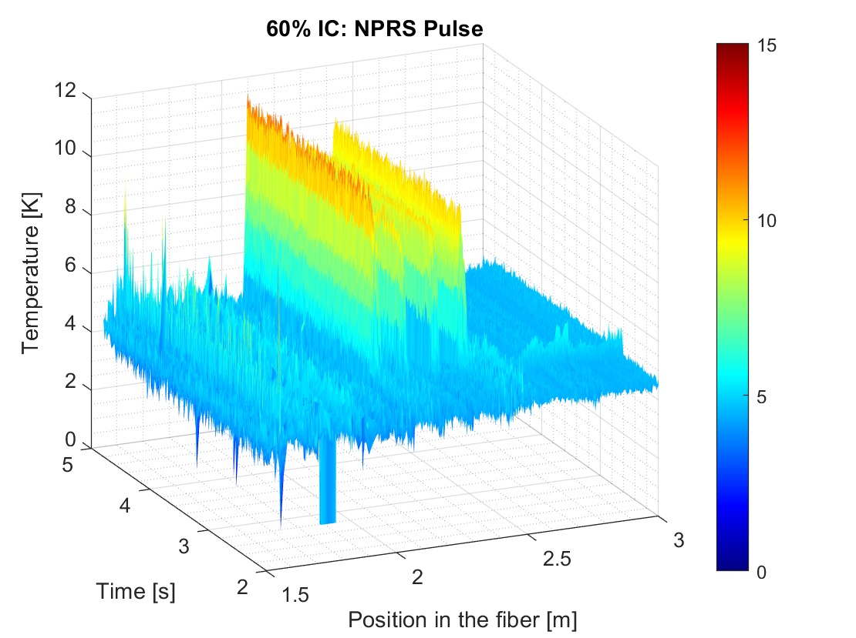
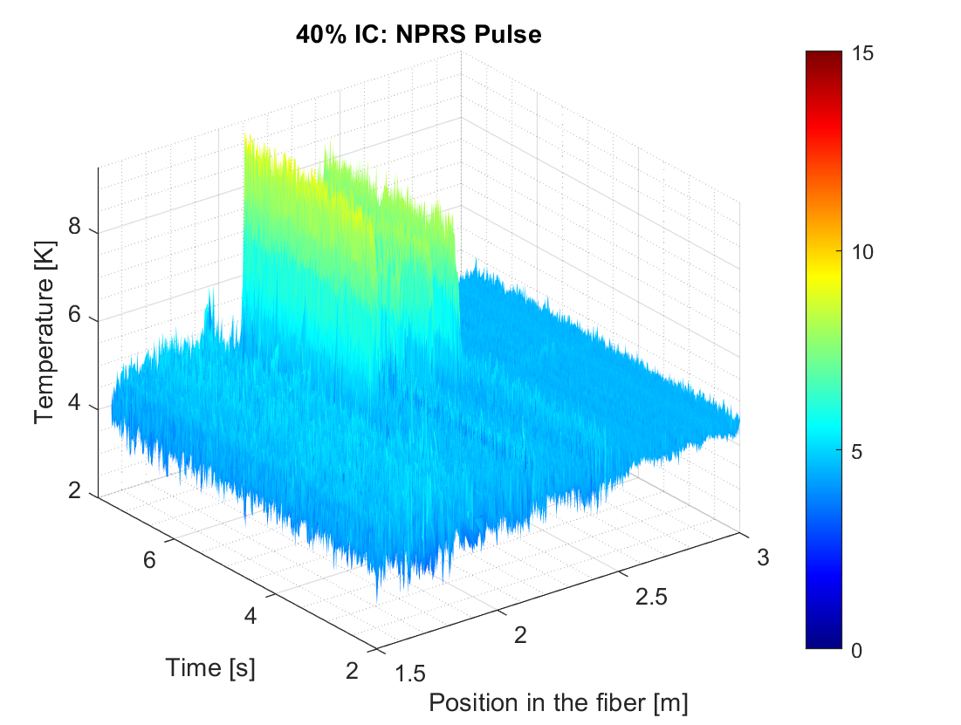
Nb3Sn test 2: 15T, 60% and 40% Ic
60% IC ~ 216A
40% IC ~ 144A
Spot Heater | Pulse (µs) | Current (A) | Power (W) | Quench (Y/N) | ΔT? (K)
2 | 200 | 0.12 | 5.04 | N | -
2 | 200 | 0.13 | 5.92 | N | -
2 | 200 | 0.14 | 6.86 | N | -
2 | 200 | 0.15 | 7.875 | Y | 6.5
Spot Heater | Pulse (µs) | Current (A) | Power (W) | Quench (Y/N) | ΔT? (K)
2 | 200 | 0.20 | 14 | N | -
2 | 200 | 0.21 | 15.44 | Y | 4.6
2 | 200 | 0.22 | 16.94 | Y | 4.45

Slide 12
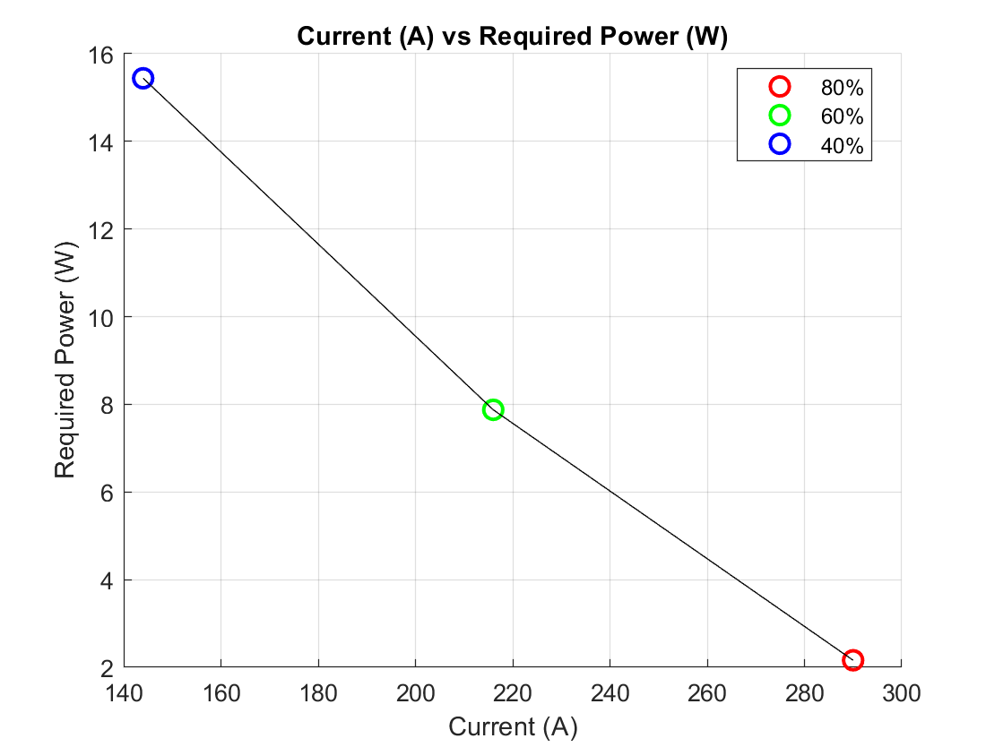
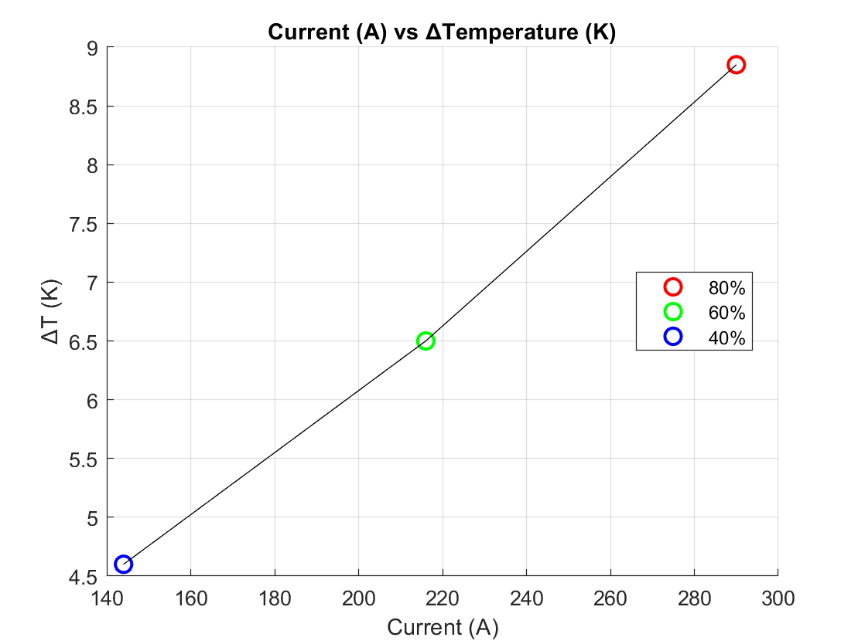
Minimum quench power
Current vs Power
  Roughly 0.4 mJ to 3 mJ (200µS pulses)
Current vs DT
  Higher current will produce a greater change in temperature from quench
  Can detect small temperature changes

Slide 13
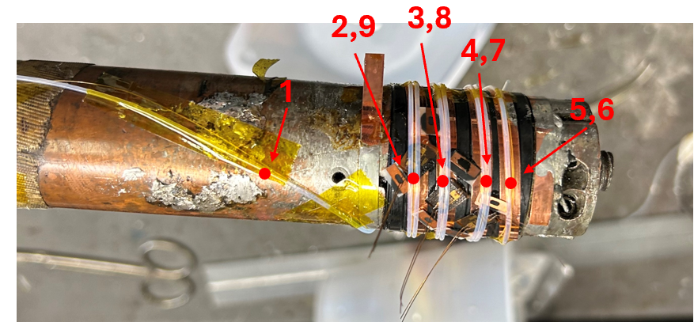
REBCO test
Test Run | Current (A) | Magnetic Field (T) | Gage Pitch (mm) | Sample Rate (Hz) | Spot Heater (Y or N) | Spot Heater Pulse (ms)
1 | 650 (IC) | 12 | 2.6 | 160 | N | -
2 | 160 | 12 | 2.6 | 160 | Y | 30
3 | 100 | 12 | 2.6 | 160 | Y | 30, 40
4 | 100 | 12 | 2.6 | 160 | Y | 30, 40
5 | 100 | 12 | 2.6 | 160 | Y | 40
6 | 100 | 12 | 2.6 | 160 | Y | 40
7 | 120 | 12 | 2.6 | 160 | Y | 40
Gage # | Location(m)
1 | 4.461
2 | 4.603
3 | 4.699
4 | 4.811
5 | 4.916
6 | 5.020
7 | 5.125
8 | 5.229
9 | 5.334
SH: 1
SH: 2
SH: 1
SH: 2
The red dots indicate the spot on the fiber where the gage positions were recorded
Spot Heater 1
Spot Heater 2

Slide 14
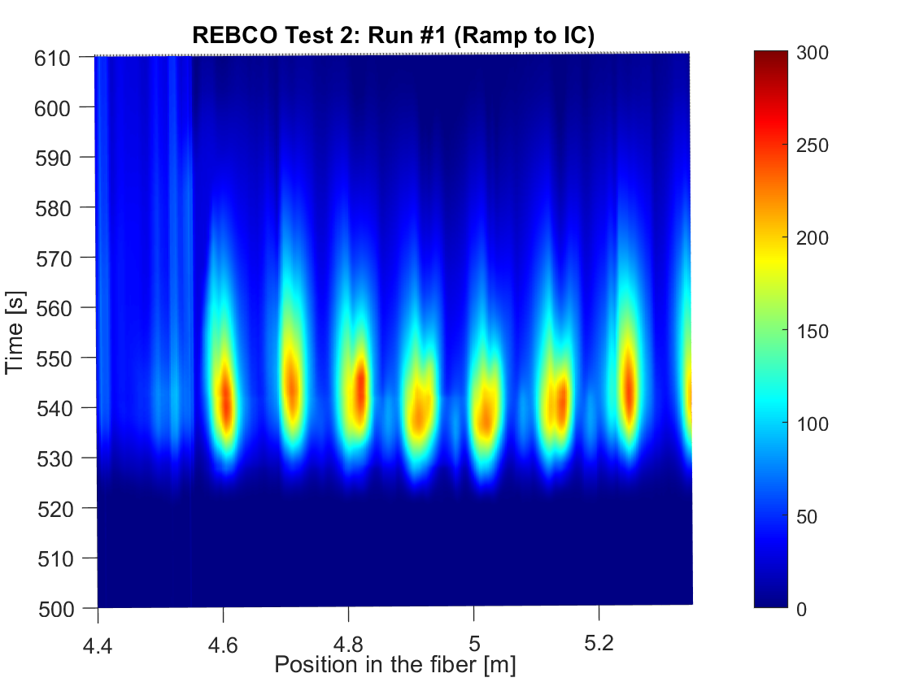
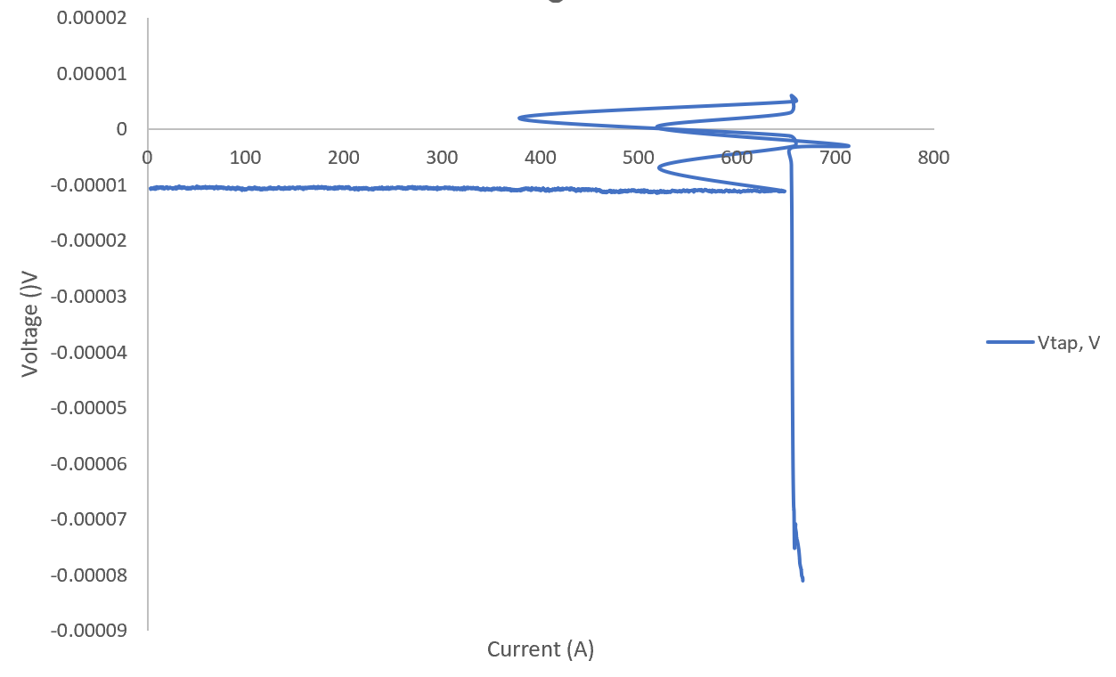
REBCO Test: critical current measurements
Ramp to IC = 650A
No clear voltage rise in the data
The quench start propagated at the end of the barrel
Sample was degraded after reaching Ic

Slide 15
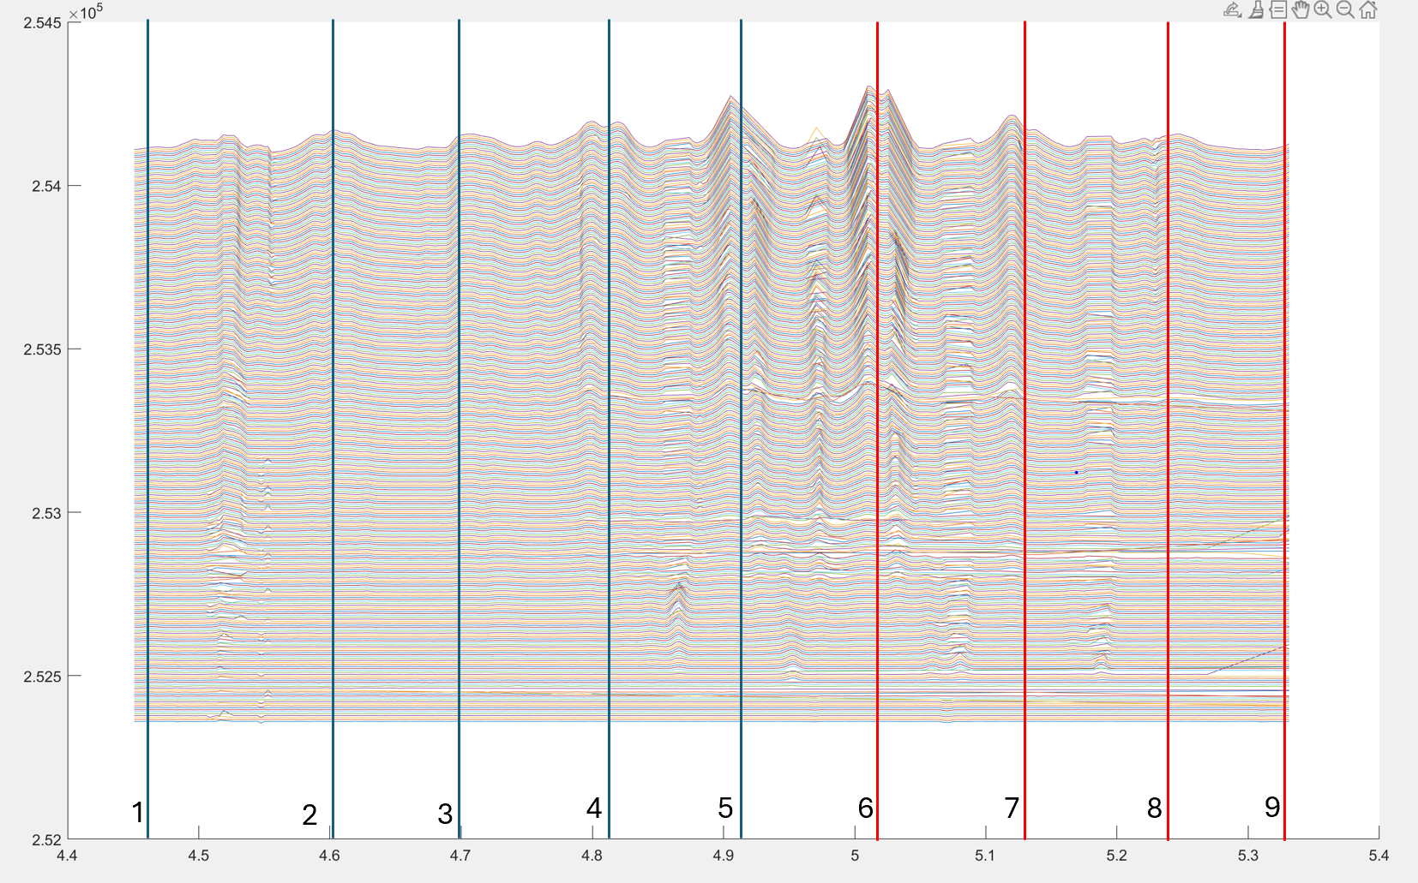
REBCO Test: critical current measurements
  3 seconds of data during quench at IC
  Data collected every 12 ms
  Heat propagation began at the end of the barrel
  T variation is large~ 242 K
Fiber length (m)

Slide 16
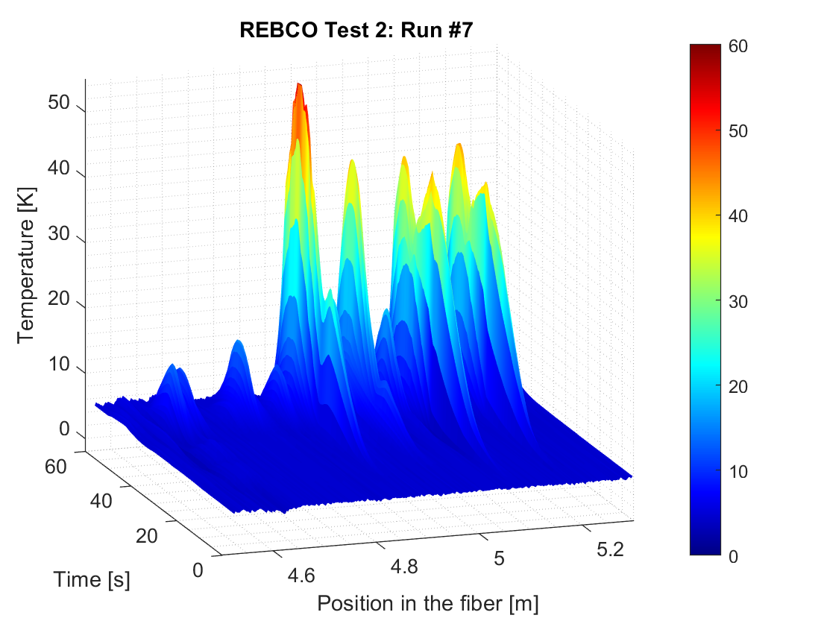
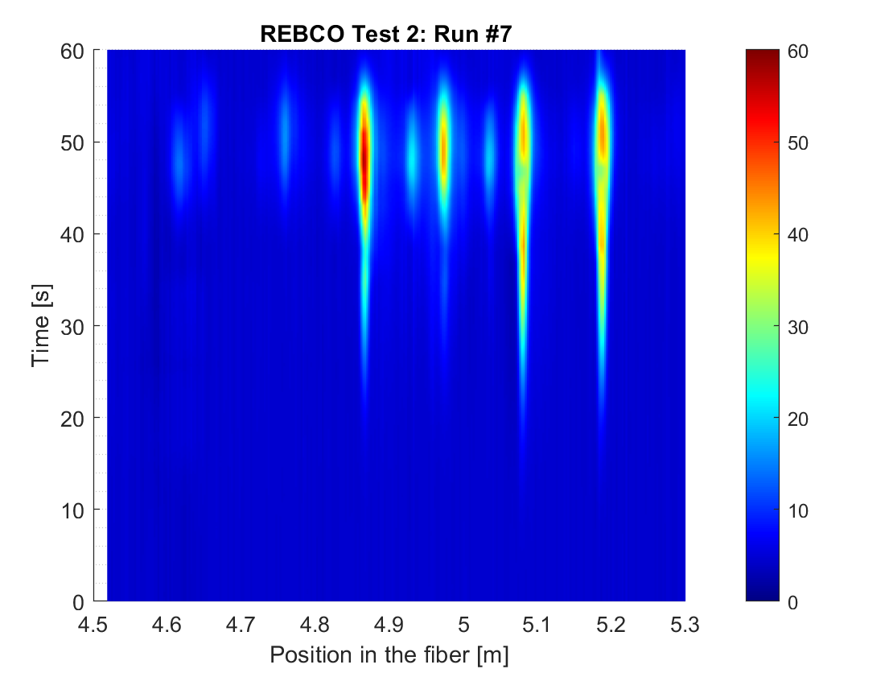
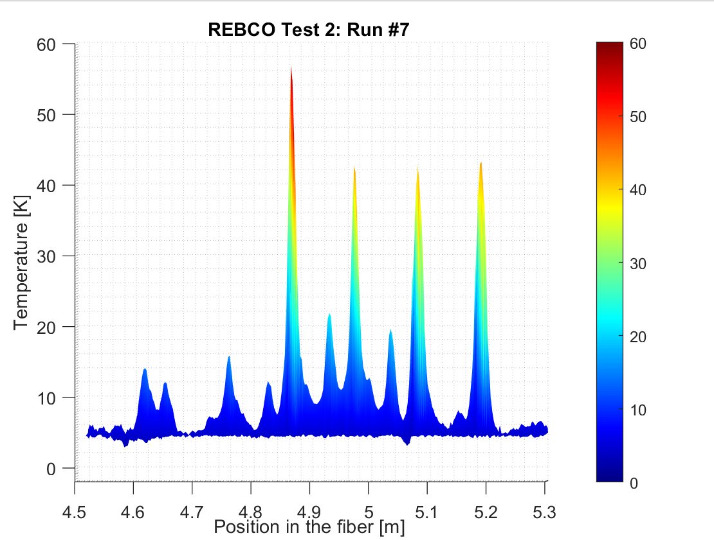
REBCO TEST with spot heater
Ramp to 80% of IC (I = 580 A) found in first test
Quenched at ~ 160 A: sample was degraded after the first quench
Similar to run #1, quench propagated from the end of the barrel

Slide 17
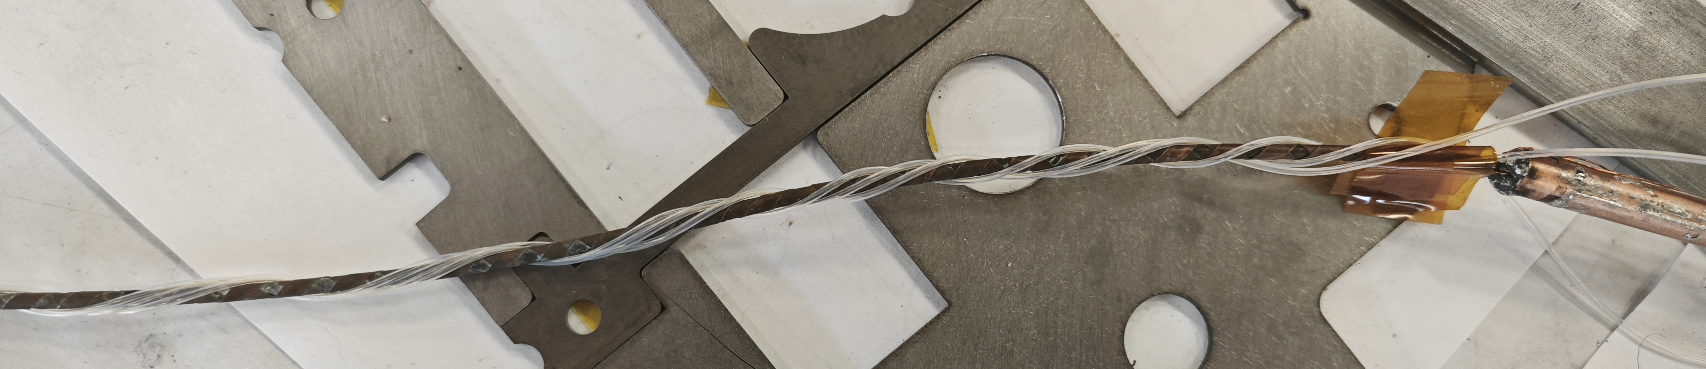
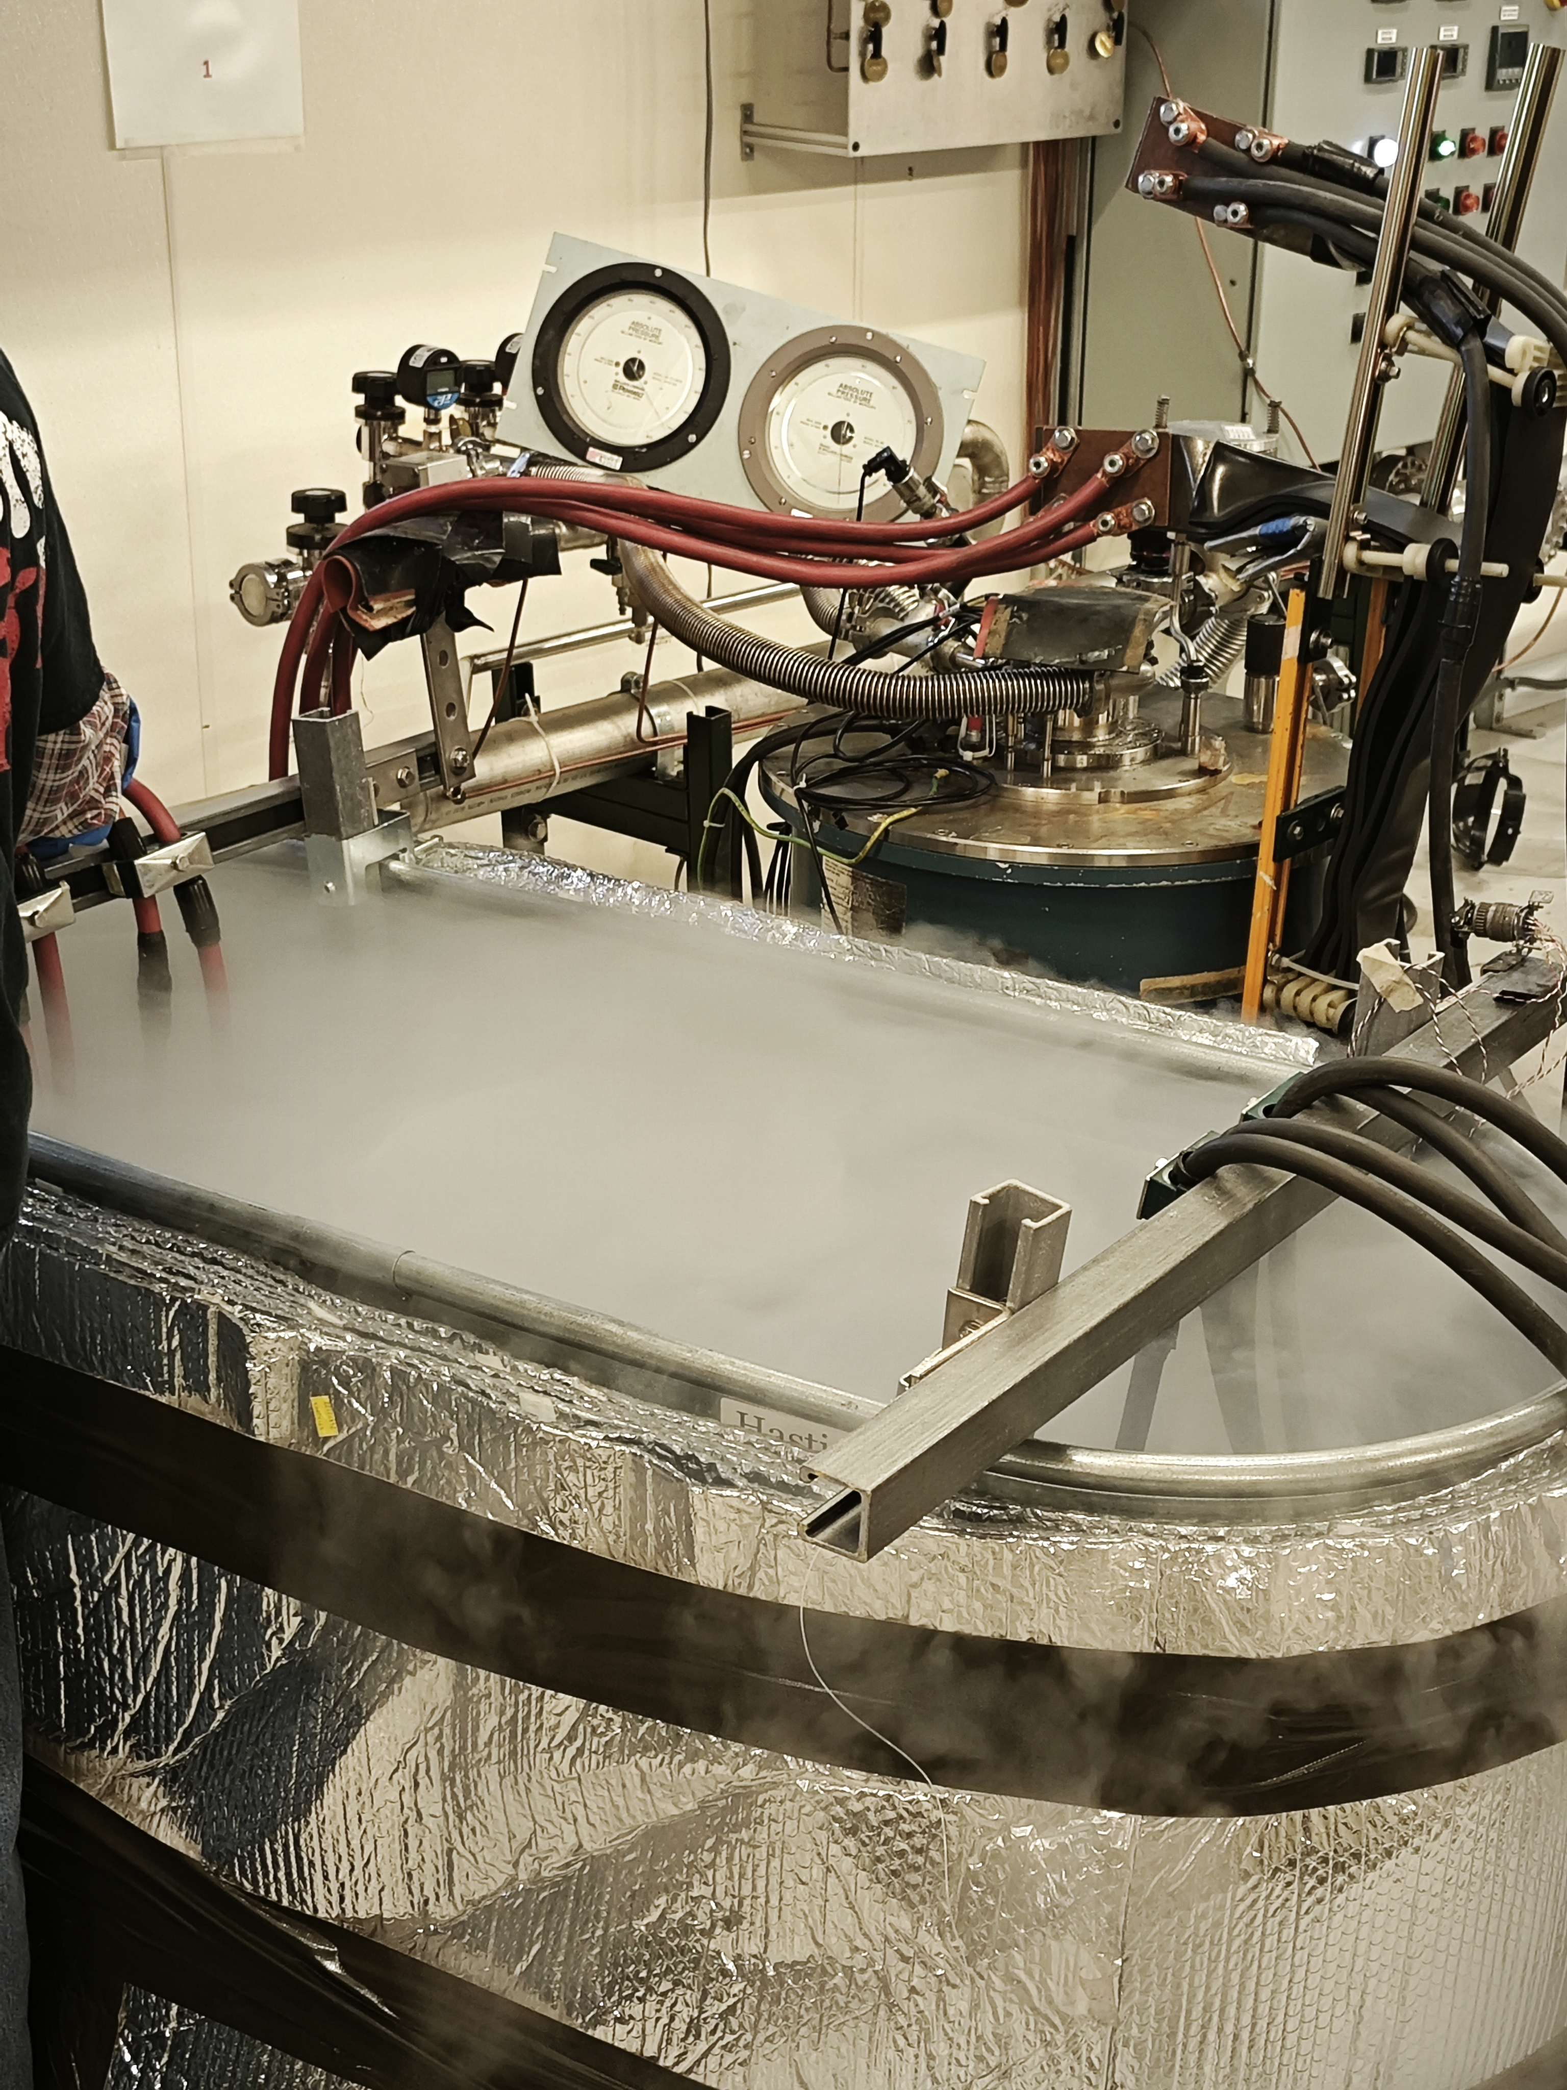
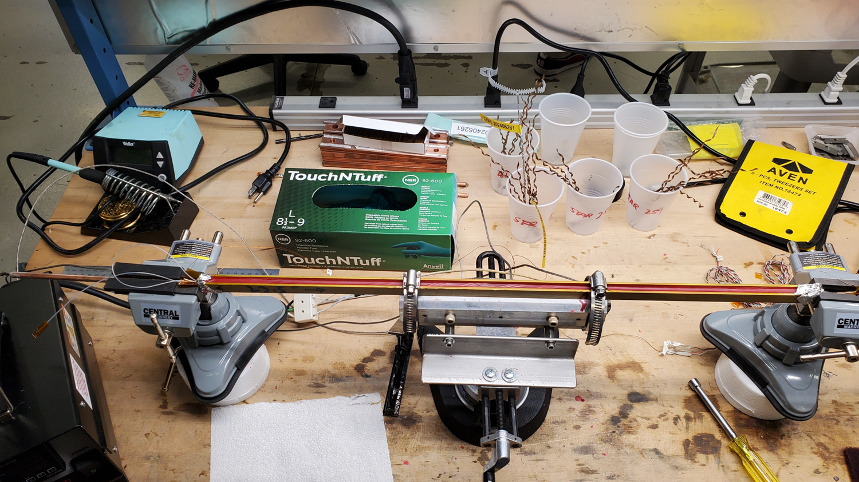
Experiment with STAR wire in liquid N
Fiber in direct contact in Liquid N
Fiber wrapped with Kapton
Fiber impregnated in wax
No temperature variation observed in the fiber
Wax case: Max current 700 A,
Voltage threshold 50 mV
11 tapes:
Notes:
with 10A /s up to 500 A and 5 A/s above 500A

Slide 18
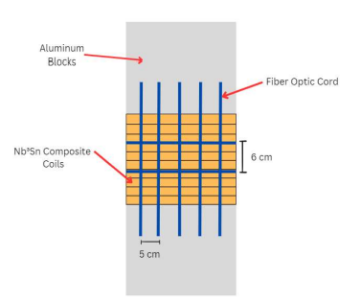
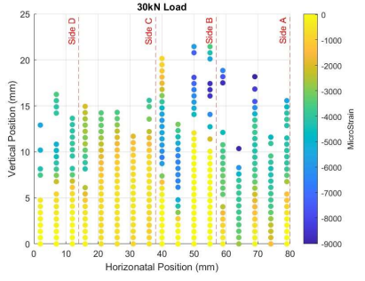
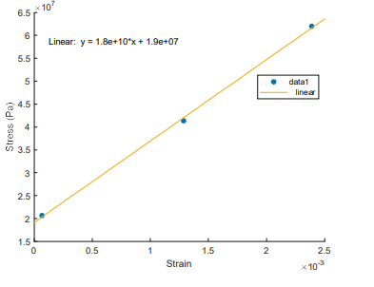
Fiber on Small Sample
Test Objective:
  Measurement of composite stacks usually relies on strain gages to determine stack modulus and Poissons ratio.
  Strain gages are sensitive to placement
    Does the gage cover 3 cables and 2 layers of insulation or 3 layers of insulation?
    Is the loading even?
Composite measurement using Luna Fiber on QXF Stack
~18 GPa to 30 kN

Slide 19
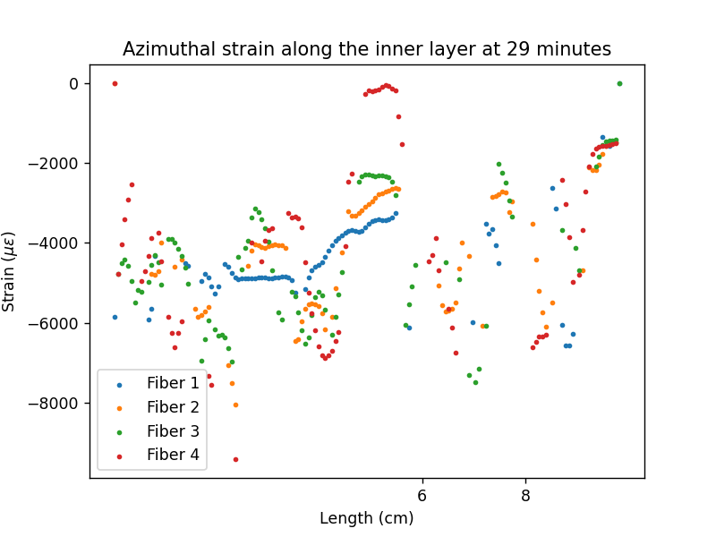
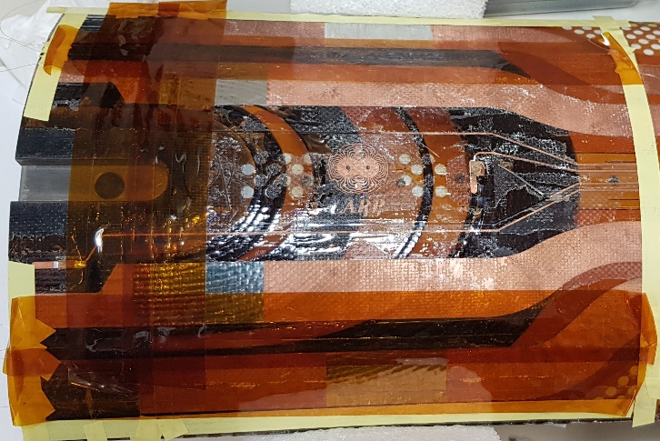
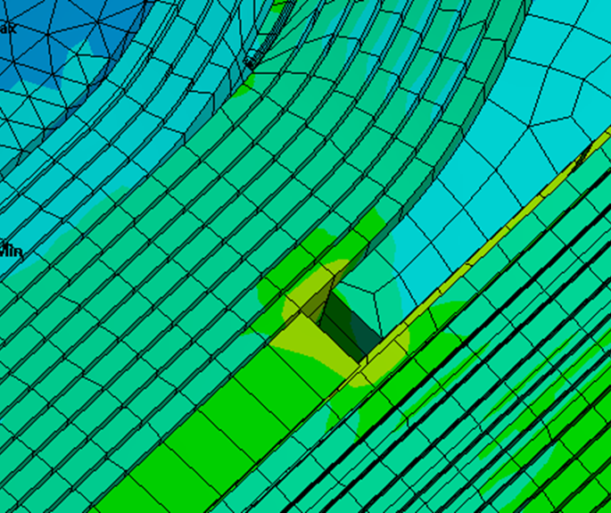
Fiber on QXF Coil Section
Test objective: Measure strain gradients near the wedge pole transition and effects of cooldown
Data shown
  Data in region of interest lost
    High strain gradient
  Fiber over magnet parts shows smooth strain behavior
  Fiber on coil is all over the place, lost several points

Slide 20
Conclusion I
Three tests were performed using fiber optics:
Two tests in liquid He with fibers installed on REBCO tape and Nb3Sn strands.
Test on wax impregnated REBCO STAR wire in liquid N
REBCO tape results
  Quench at IC was clearly observed
  Tape was degraded from IC run
  Tests with a spot heater were inconclusive because samples were degraded
Nb3Sn sample
  Minimum quench power and change in temperature could be estimated with the fiber data
On short smples, a dedicated fixture for testing with integrated fibers should be considered
STAR wire in liquid N
  No Temperature variations observed. Power is probably too low
Technical details
  Integration between datasets could use some work

Slide 21
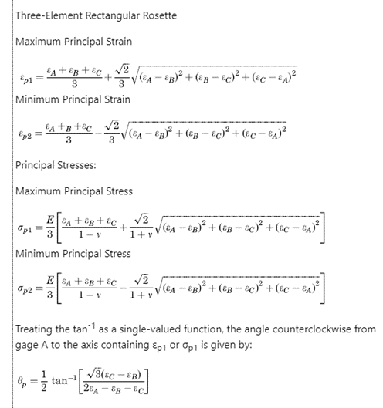
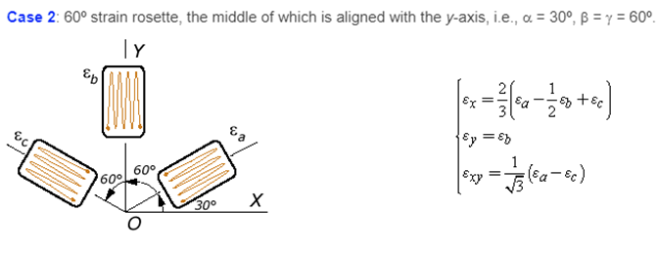
Fiber Grids
Distributed fibers are very interesting on their own, but consider that along the length of the fiber, most measurements are nearly redundant as the sensors are typically arranged in a linear fashion
To extract the most information from the fiber, considering the large amount of data that may be obtained, additional dimensions are added.
Arranging fibers in 3 directions, it becomes possible to solve the 2d strain state of a surface (rosette)
After obtaining strain measurements in 3 directions, each direction is interpolated onto a rectangular grid
  Interpolation only valid within area bounded by points with all directions measured
  Principal strain calculated on grid
  X strain is the 0° orientation fiber
  Y strain is calculated as 𝟐 𝟑 (𝟔𝟎° + 120° - 0.5 * 0°) After loading the dataset, most operations are linear and calculate very quickly. (sub ms per sample)

Slide 22
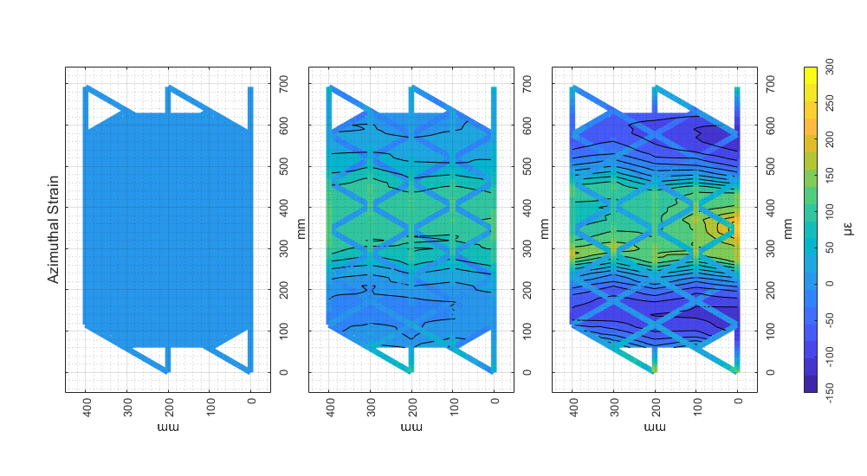
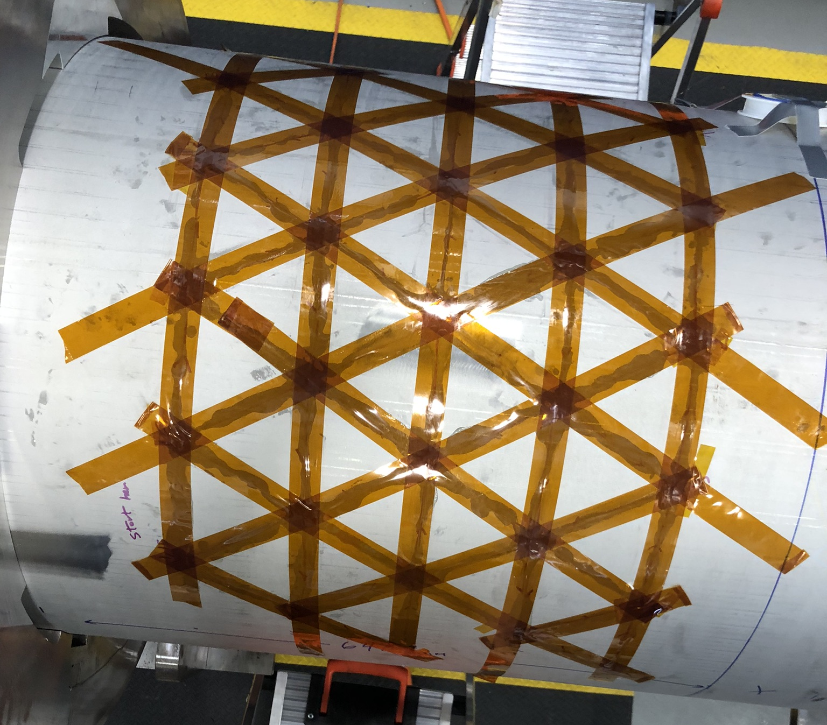
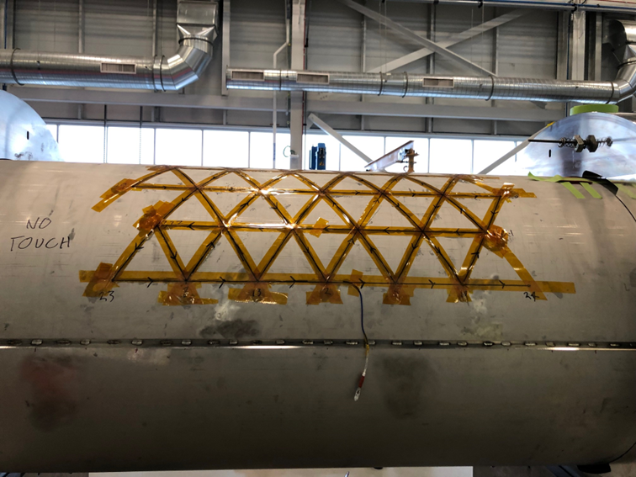
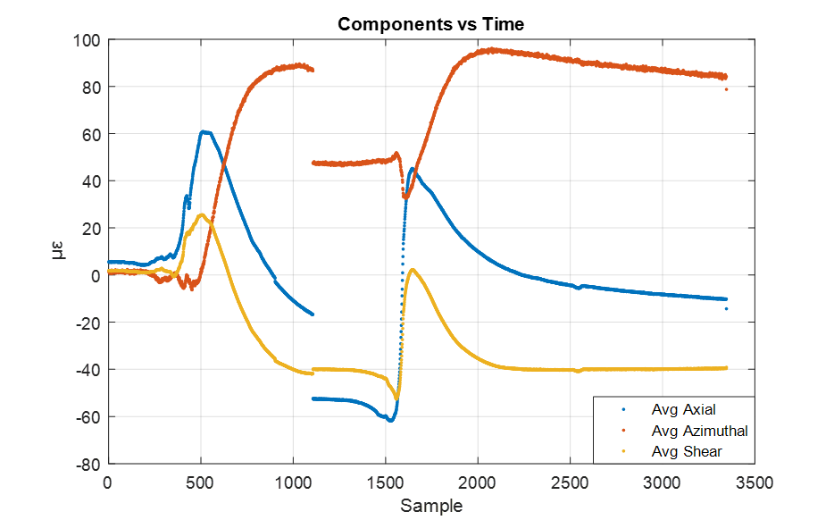
Strain map during welding of Hi-Lumi coldmass
CM01
CM02
Some average shear strain, but overall azimuthal strain is low ~30 µε
This is consistent with addition of shim between the SS shell and the magnets

Slide 23
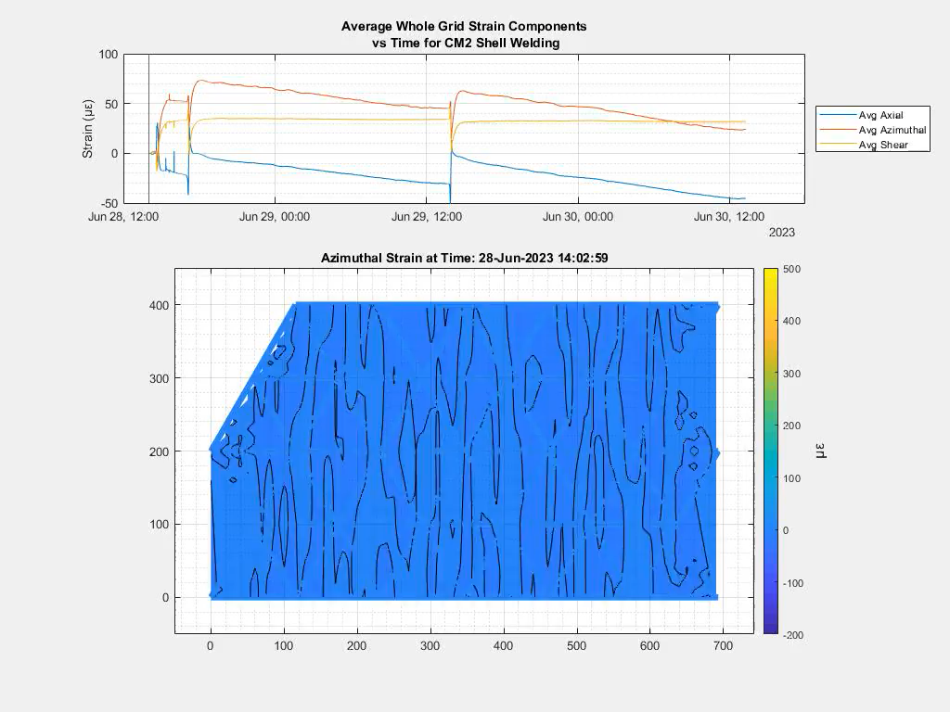

Slide 24
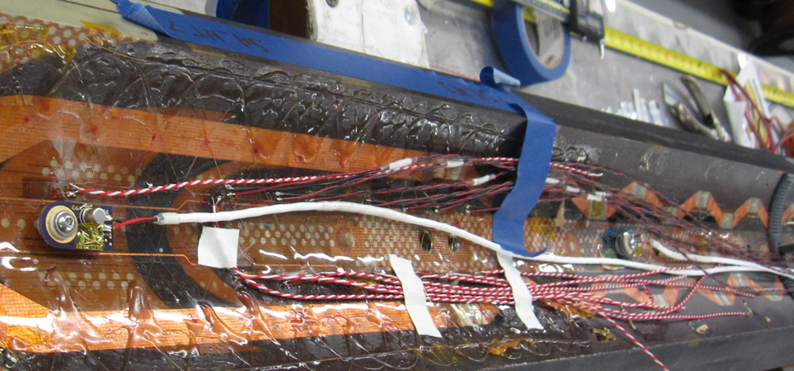
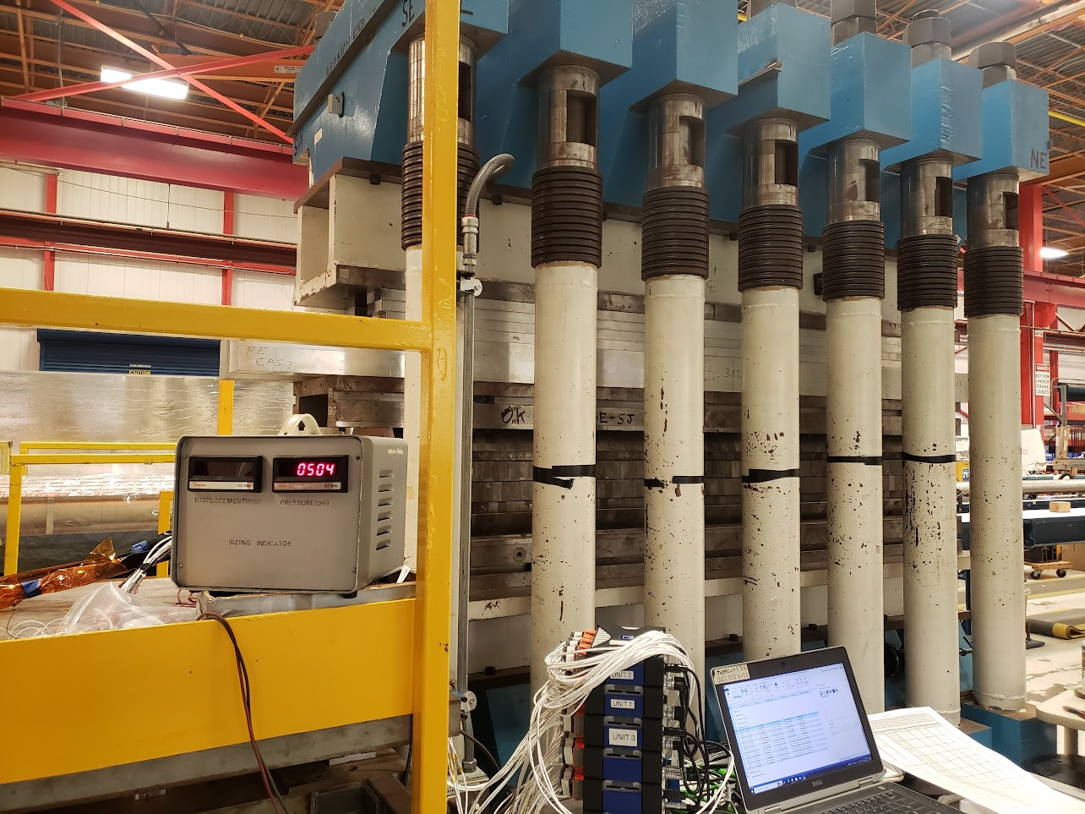
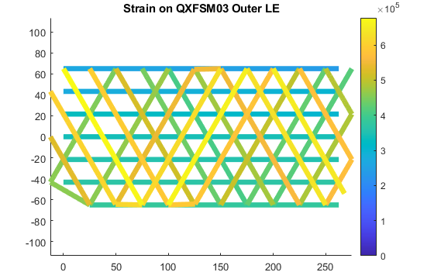
QXFSM03
Fibers have been installed on ID and OD of coil
Test goals:
  Validate fibers mounted directly to coil during magnet powering
  View pole/wedge strain discontinuity behavior during operation
  Observe magnet mechanics
We lost the outer fibers during initial loading. Issue:
One break on the edge coming out of the coil
  Added strain relief
One termination was crushed
  Keep both ends of fiber accessible
One internal fiber damage during assembly
One internal fiber damage during loading

Slide 25
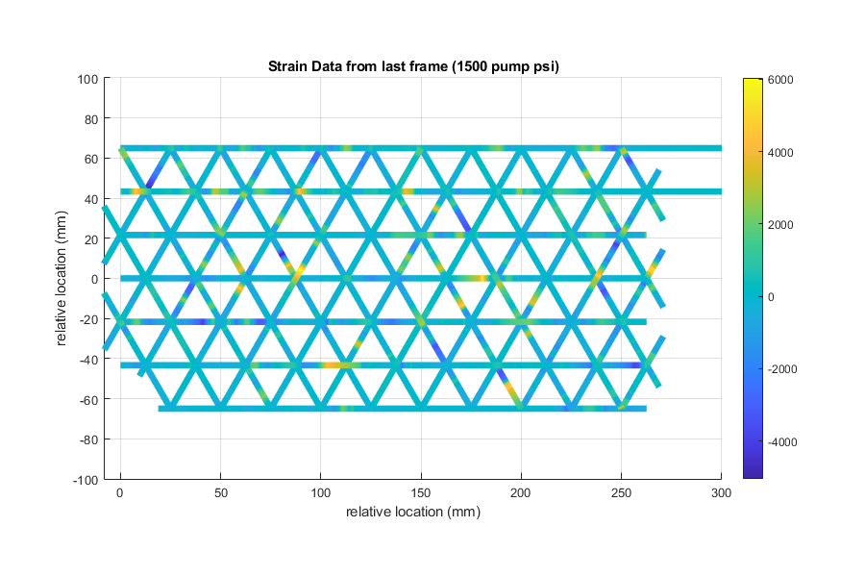
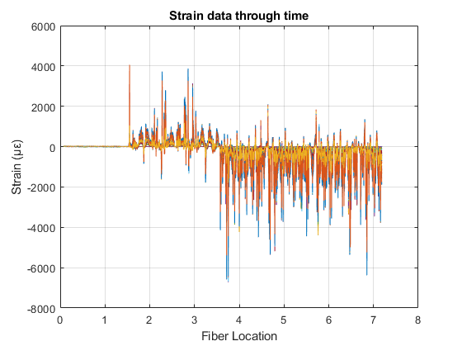
Some data from the prestress
Strain Data from RE Outer Fiber at 1500psi (before it broke)
Strain Data from LE Inner Fiber at During prestressing
Additional analysis from grid coming soon (a few solid days of reconfiguring code)

Slide 26


Fiber optics on SMCTM1 magnet
7 m Rayleigh fiber on the magnet skin
Validate updated fiber feedthrough and connectors at 1.9 K
Validate fiber splices at 1.9 K
Measure shell strain during testing: failed
Tape is used to guarantee a uniform small distribution of glue
Tape disconnected from the shell at cold
Fiber followed the tape

Slide 27

Strain fiber on CCT magnet
Fiber survived and we collected data during test (Analysis is ongoing).
  Signal at cold is still intermittent. We suspect that the issue is at the connector level. One possible solution is to splice everything.

Slide 28
Summary
Tests in liquid N and liquid He show that temperature variations can be measured
  Spatial information on where the quench is and how it propagates
However, there is still a long way to go to make those sensors a robust tool for quench detection:
    Are those sensitive/fast enough to detect a quench at the beginning and start protection?
    Good thermal contact
    Sample rate
Distributed strain and temperature Fibers are a useful tool for magnet assembly and diagnostics, especially in a distributed rosette configuration
  Strain sensors are very easy to break especially in the presence of edges/angles/ feedthrough opening (ex. Exit a coil)
  Fiber need to be protected.
  Signal at cold is still intermittent.
While easy to understand visualizations are possible, they potentially come with substantial labor overhead

Slide 29
Acknowledgments
Nisa Kuvvet, Undergraduate student, Dartmouth
Simone Busatto, Graduate student, LASA
Emily Spreitzer, Undergraduate student, Northern Illinois University
Kristofer Thomas, Undergraduate student, University of Southern California
Chris English, Undergraduate Student, Northern Illinois University
Alex Jacopin, Undergraduate Student, Northern Illinois University
James Karambis, All things technical, FNAL

Slide 31

Spot Heater induced Quench
Magnetic Field​ | Current​
15T​ | 300A​
14T​ | 372A​
12T​ | 555A ​
10T​ | 788A
Test at 4 different magnetic fields (15T, 14T, 12T, 10T) at 4.5 K.
Current set at 80% of the critical current.
Increase of pulse power given to the spot heater
In the first test 13.08 mJ were required to quench the wire, most likely beccause of bad thermal contact between the spot heater and the wire.
Very high temperatures were reached during this test.

Slide 32






2D plot of the T profile

Slide 33
Milestones
Calibration of FBG fibers in a small cryostat (2021)
Installation of fibers on an MDP magnet and strain measurement during a quench.
Modification of magnet test facility top plate to accommodate fiber line (2021)
Design a proof of principle experiment for quench detection:
Small coil fabrication and tests (March 2023)
Energy spectrum analysis (Dec 2023)
Coil azimuthal strain mapping:
Experiment on coil ten stacks sample made with different epoxy (March 2023)
Install distributed fiber on a mirror magnet for coil strain map (Dec 2022

