Slide 1
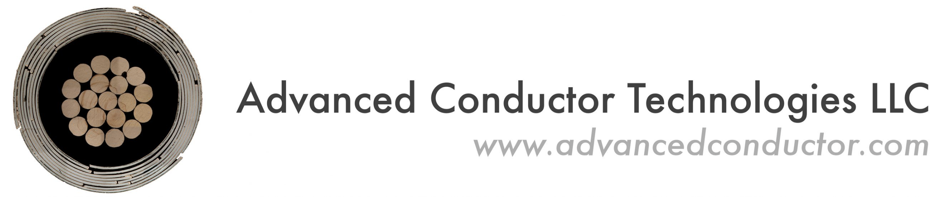
TITO: Individual Tape Powering Experiments in CORC® High Temperature Superconducting Cables
Reed Teyber, Chet Spencer - LBNL
Jeremy Weiss (PI) and Danko van der Laan - Advanced Conductor Technologies

Slide 2
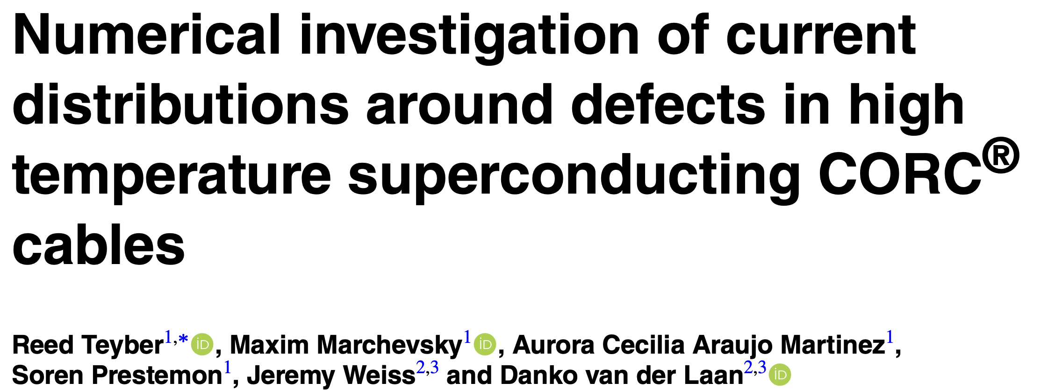
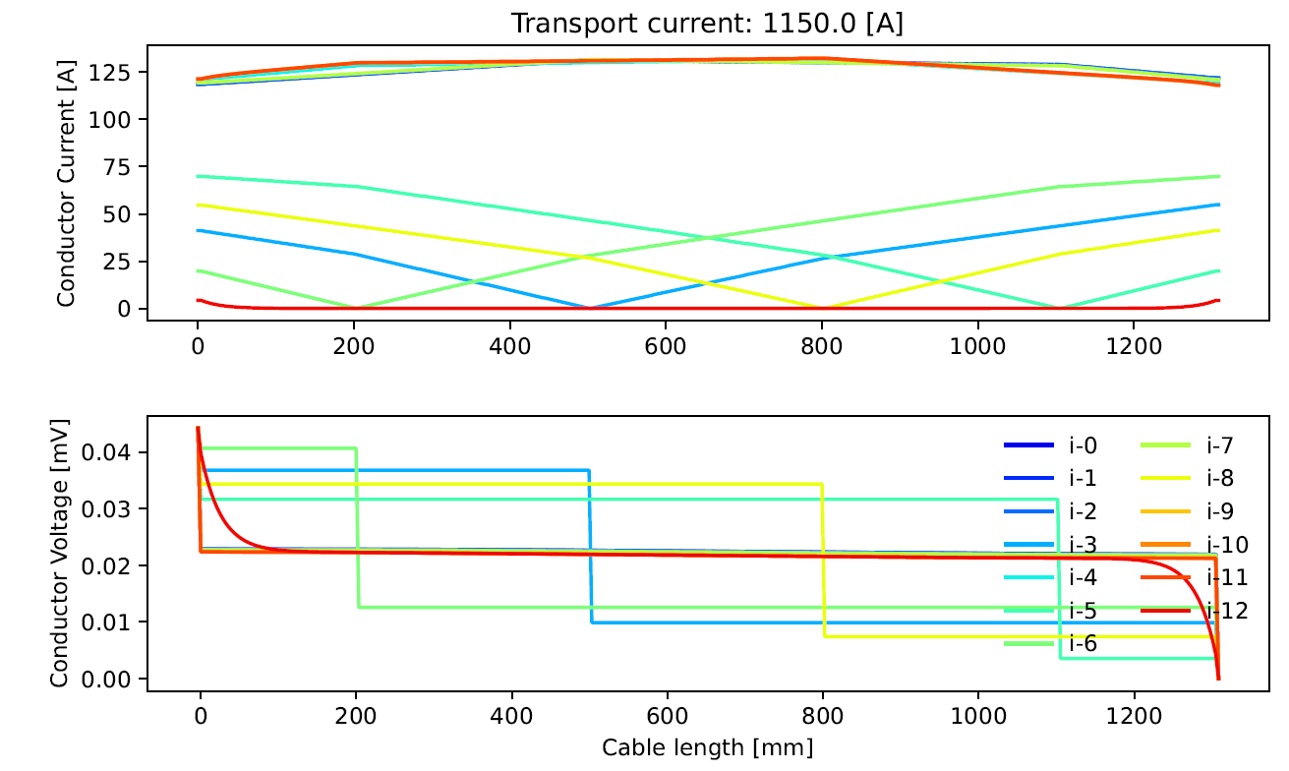
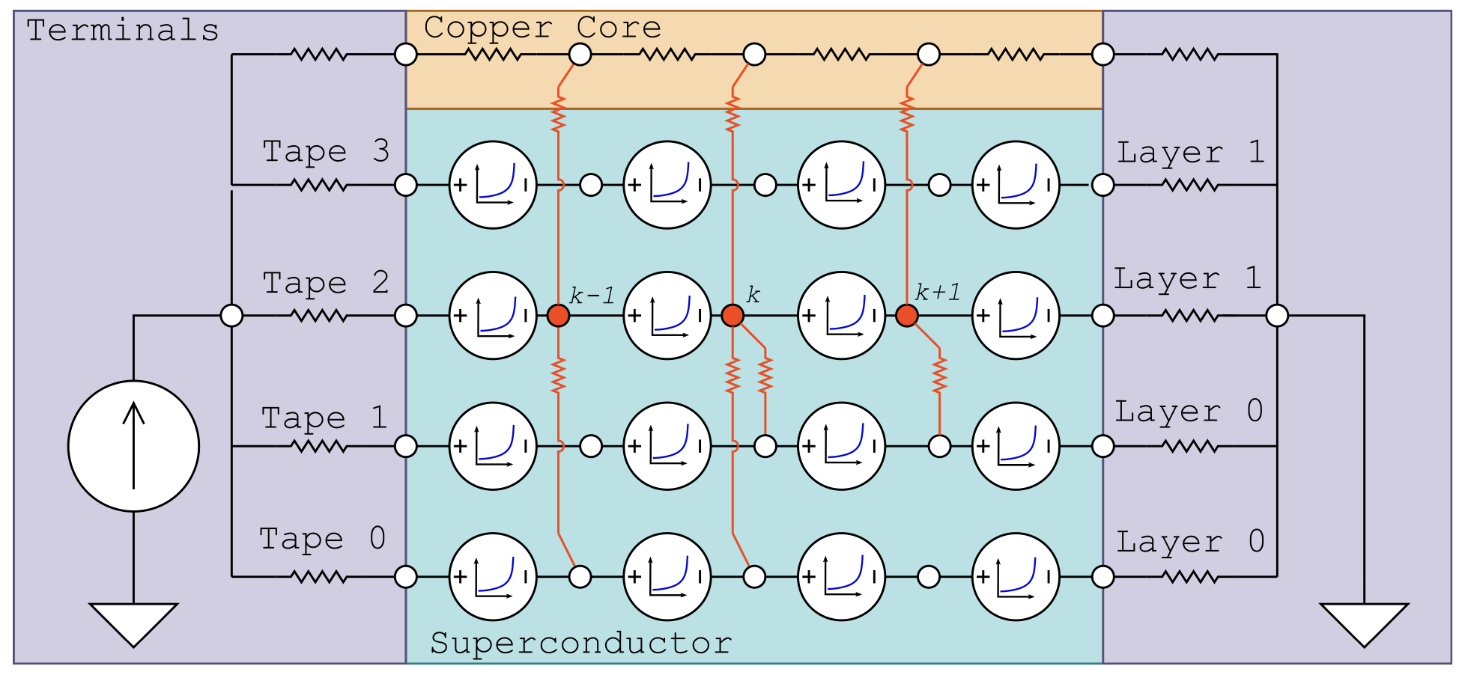
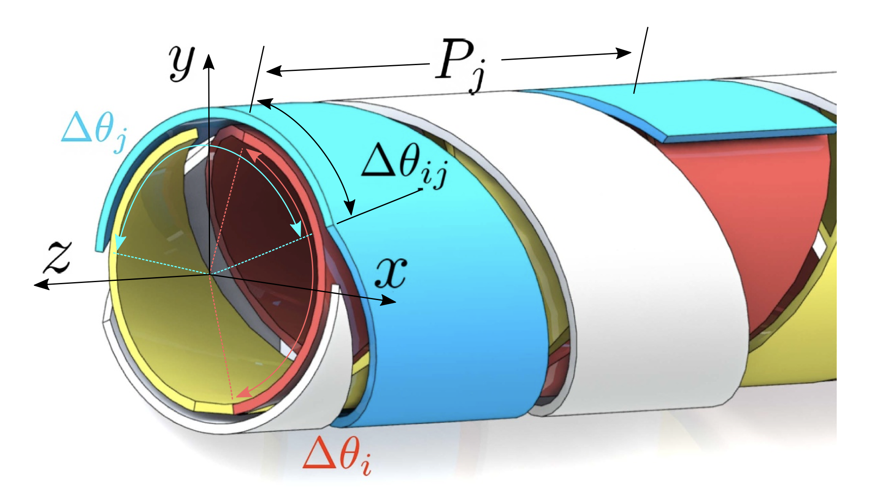
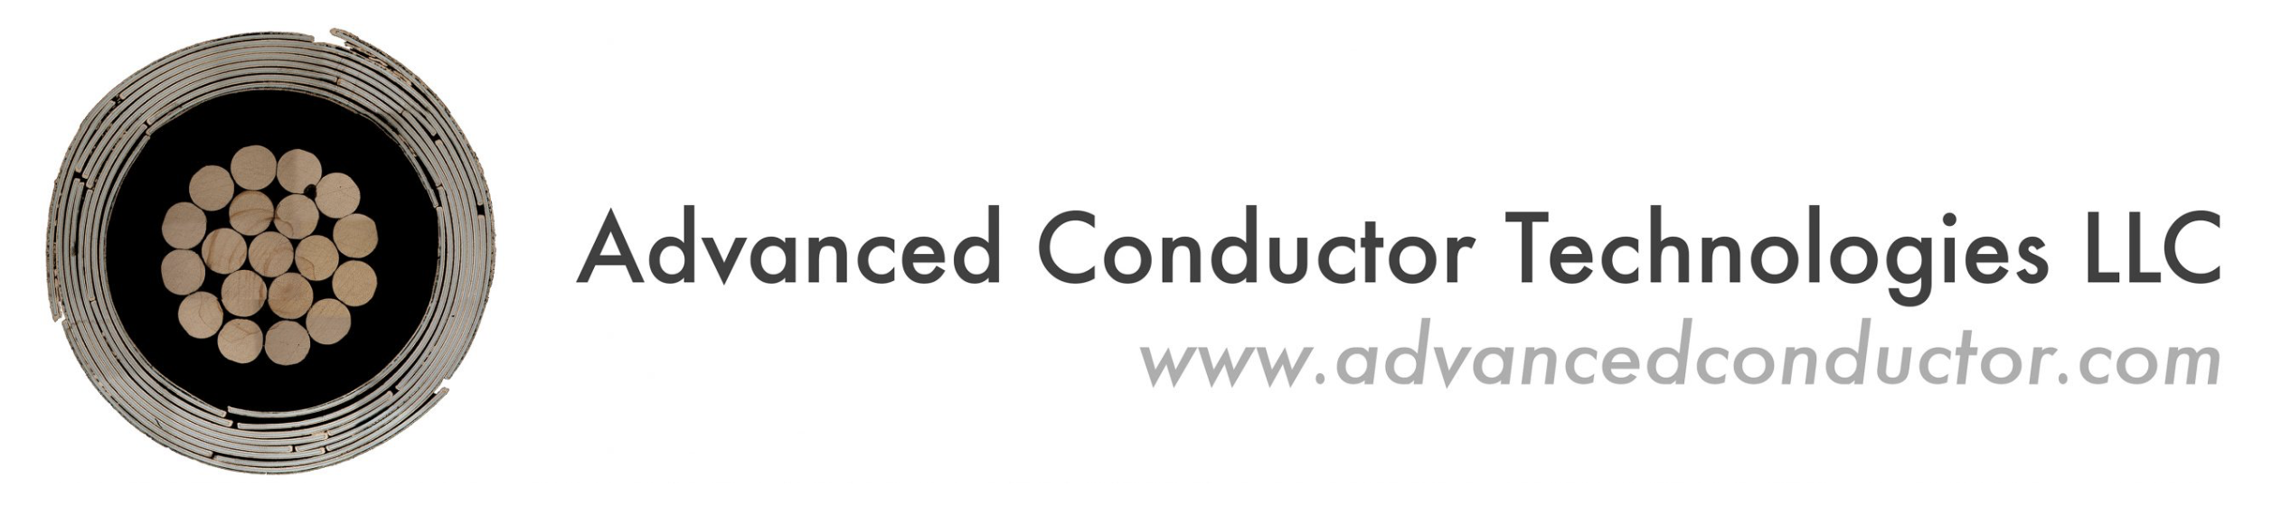
Objectives
We are investigating reduced-cost CORC ® cables using tapes with dropouts
To do this, need to understand and manipulate inter-tape contact resistance
We present our Tape-In-Tape-Out (TITO) model-guided methodology to characterize inter-tape contact resistances in CORC ® cables
~Constant voltage between dropouts

Slide 3
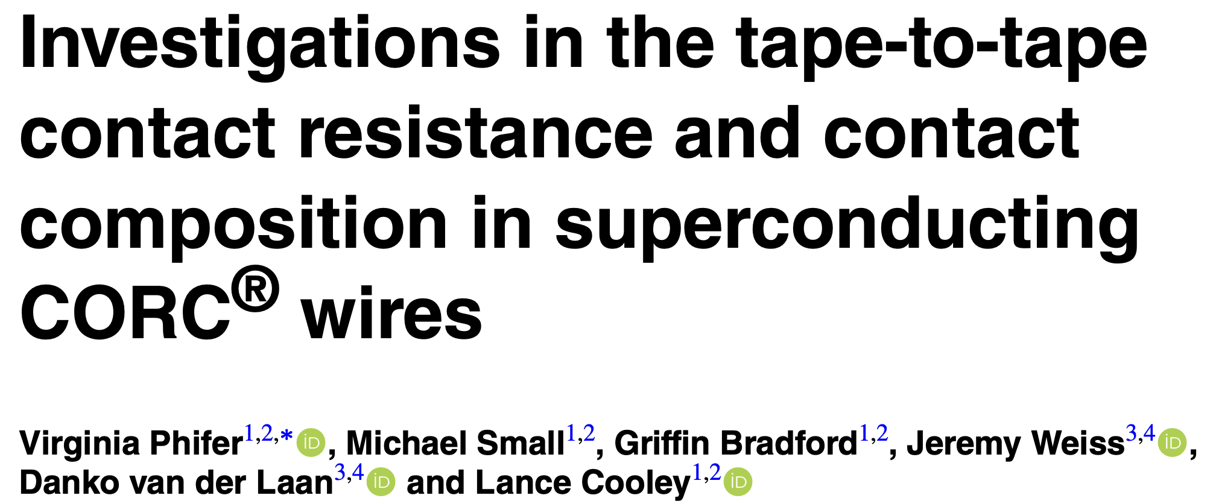
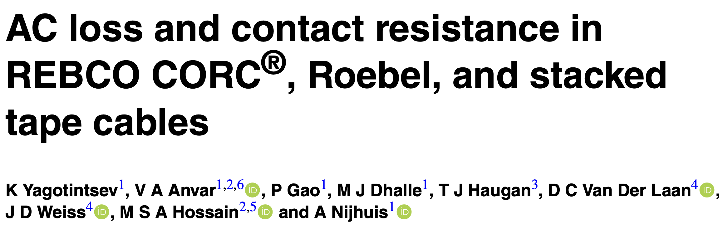
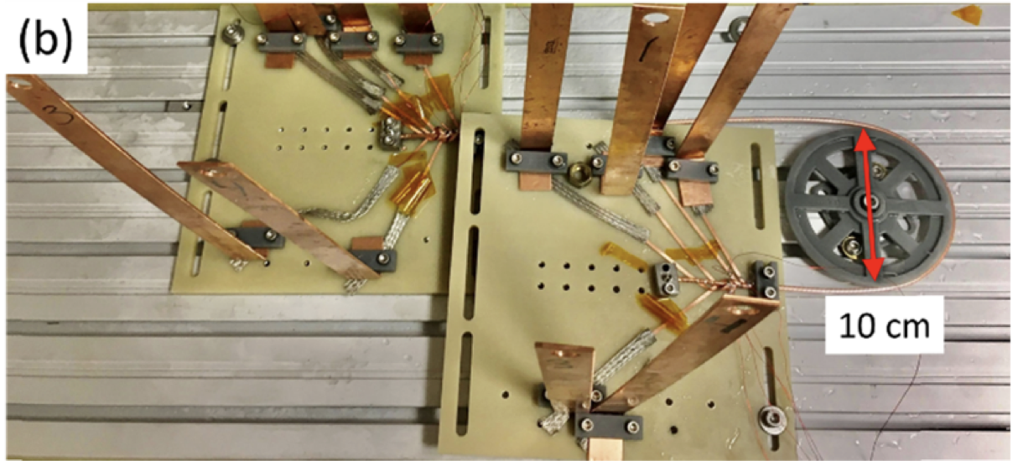
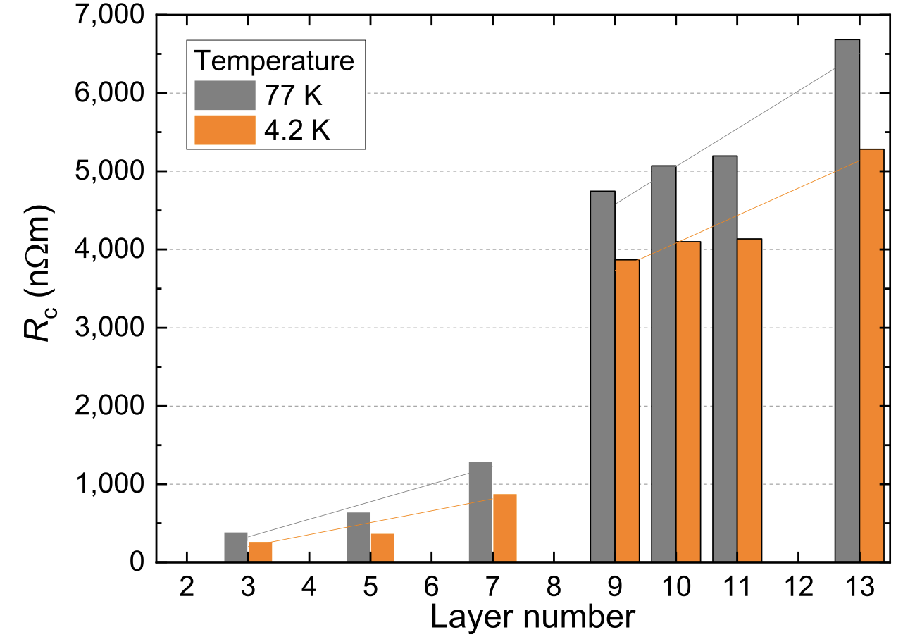
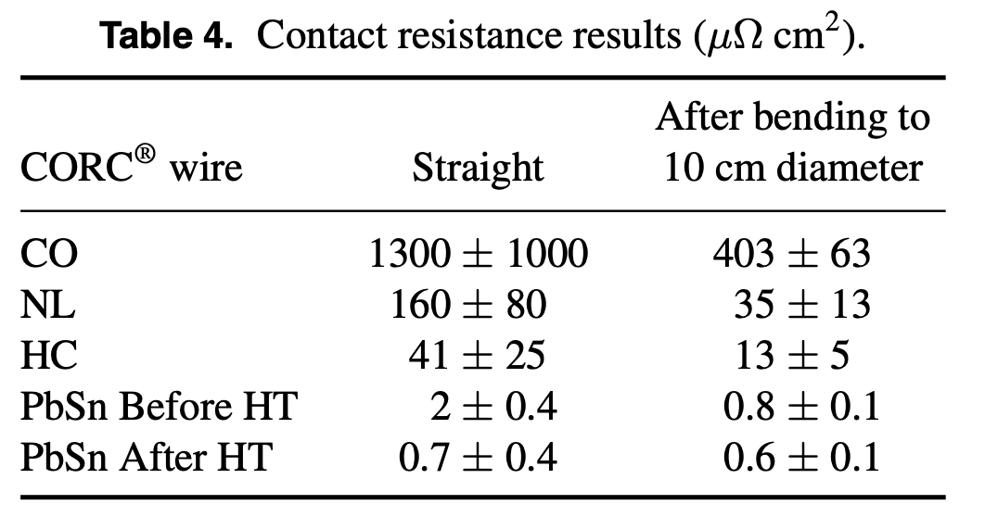

CORC ® Contact Resistance – Prior Work
FSU/NHMFL
Twente
160 [$μΩ−cm^{2}$] = 16e-9 $[Ω−m^{2}$]

Slide 4
Goals of our work & Outline
Our work aims to build on these excellent manuscripts via
  Automation of TITO tape powering, switching and measurement process
  Measurement of all tape voltages during TITO experiments
  Development of a TITO simulation tool to resolve current percolation
  Optimization-based fit of TITO model to experiments to extract distribution of inter-tape resistances in cable

Slide 5
Goals of our work & Outline
Our work aims to build on these excellent manuscripts via
  Automation of TITO tape powering, switching and measurement process
  Measurement of all tape voltages during TITO experiments
  Development of a TITO simulation tool to resolve current percolation
  Optimization-based fit of TITO model to experiments to extract distribution of inter-tape resistances in cable

Slide 6
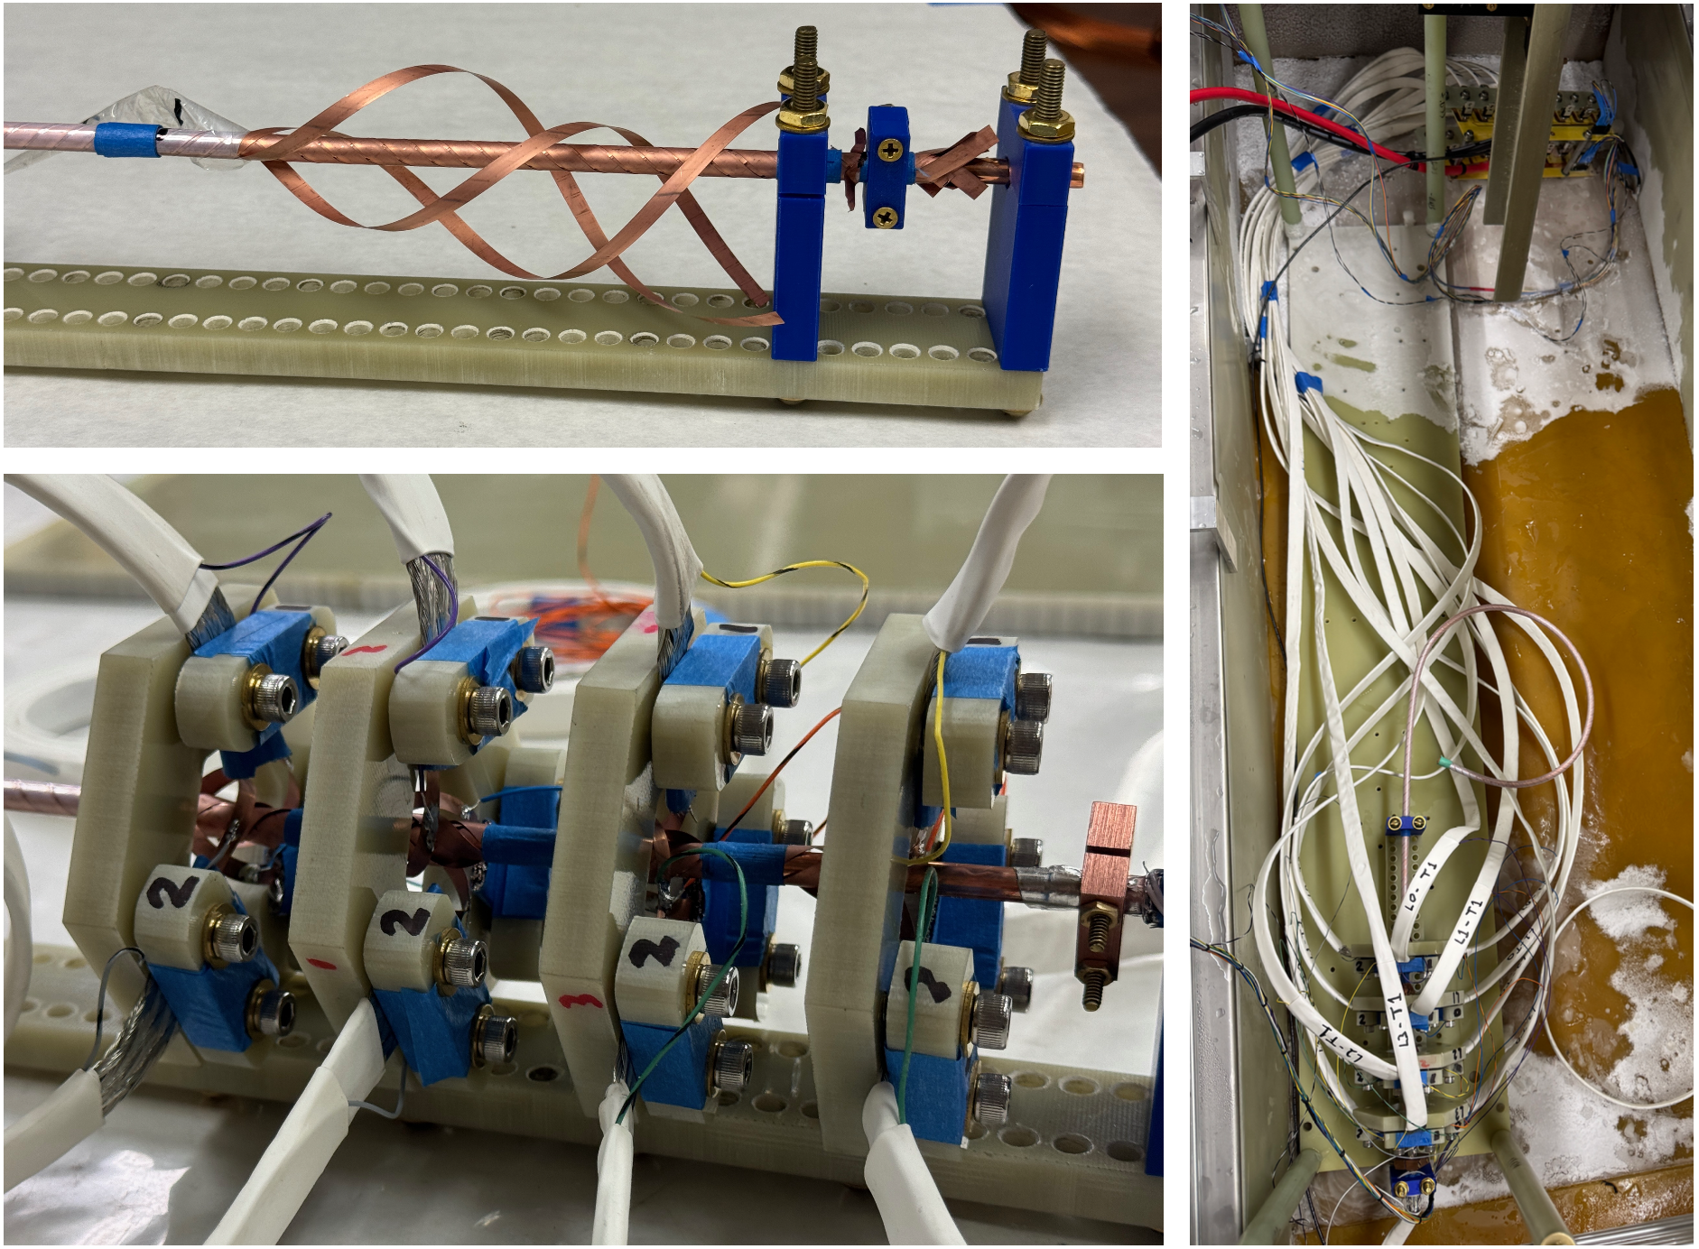
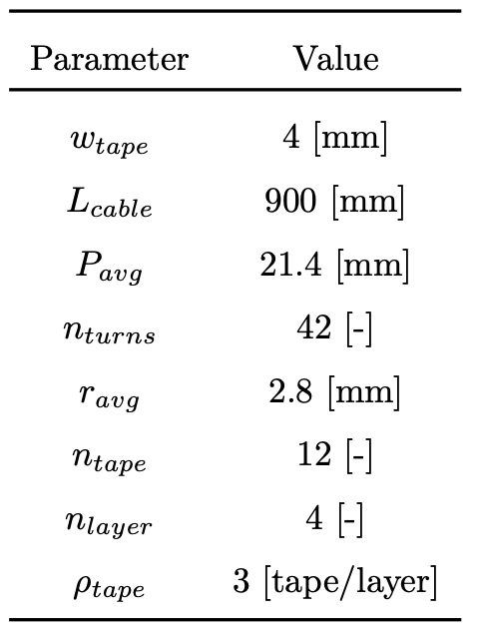
TITO Terminations

Slide 7
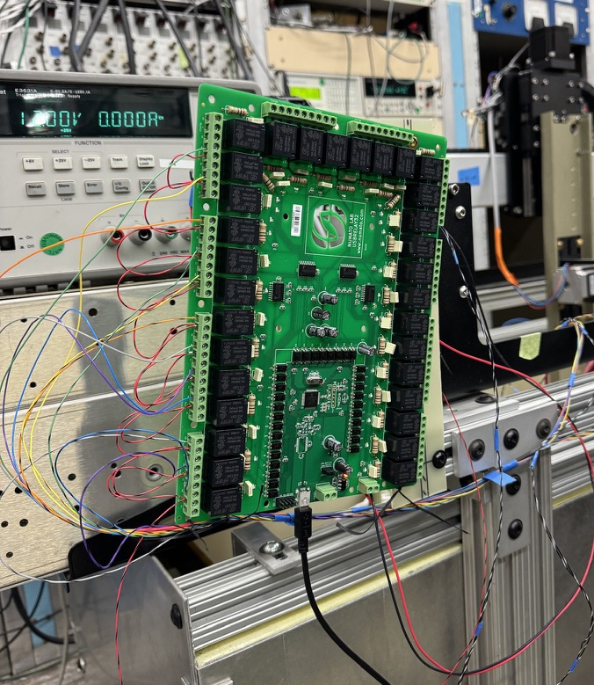
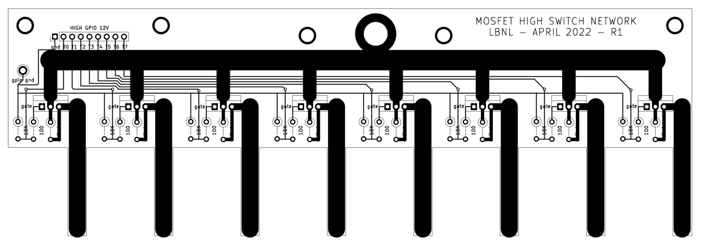
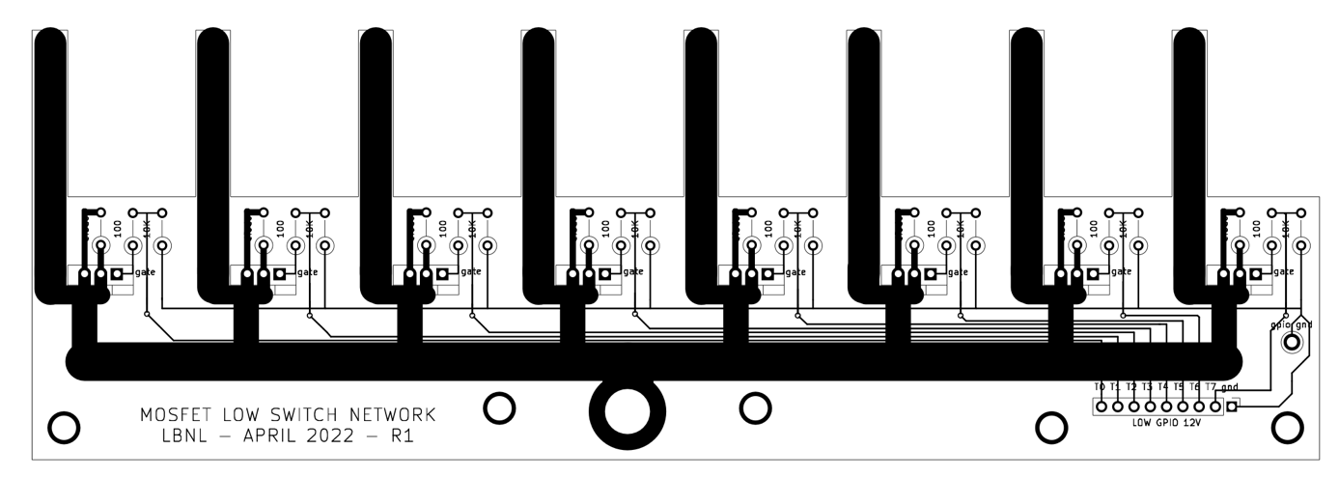
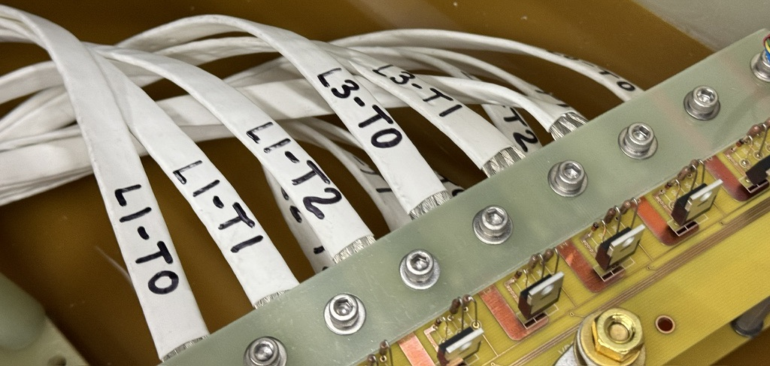

Cryo Switch Network
Infineon IRLB3813 MOSFETS – 1 $mΩ @ 77 K$

Slide 8
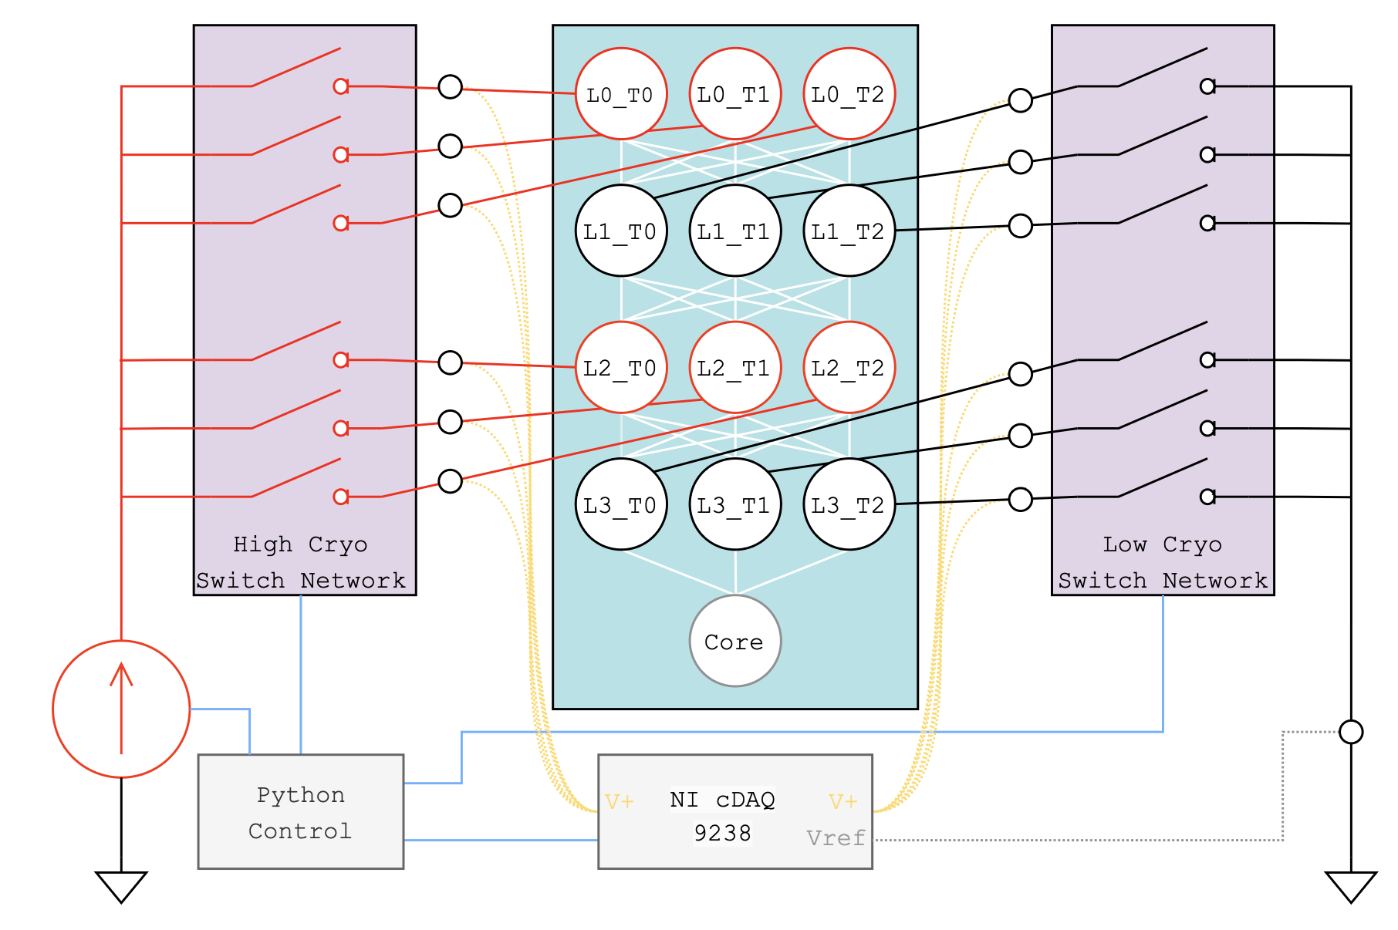
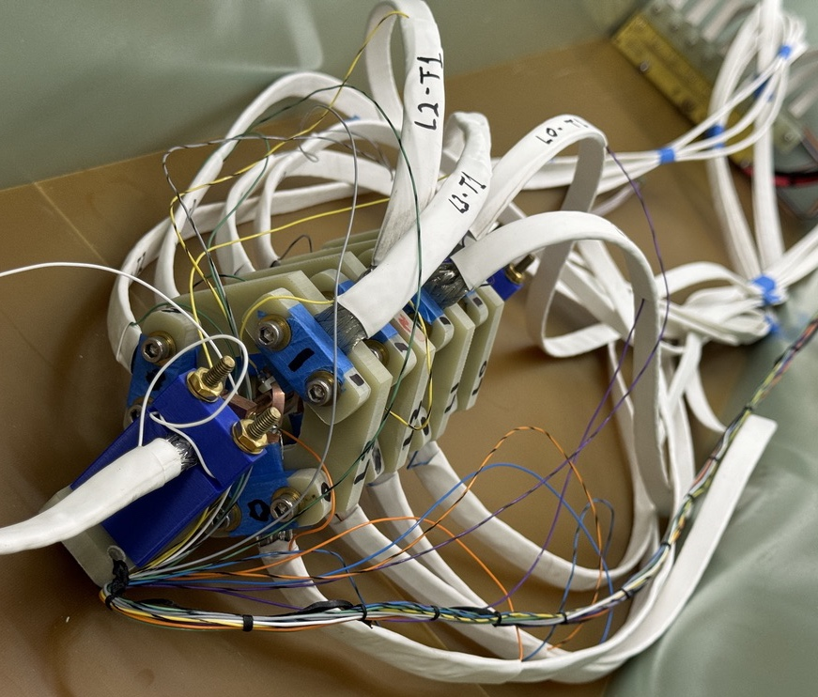
Experimental Methods

Slide 9
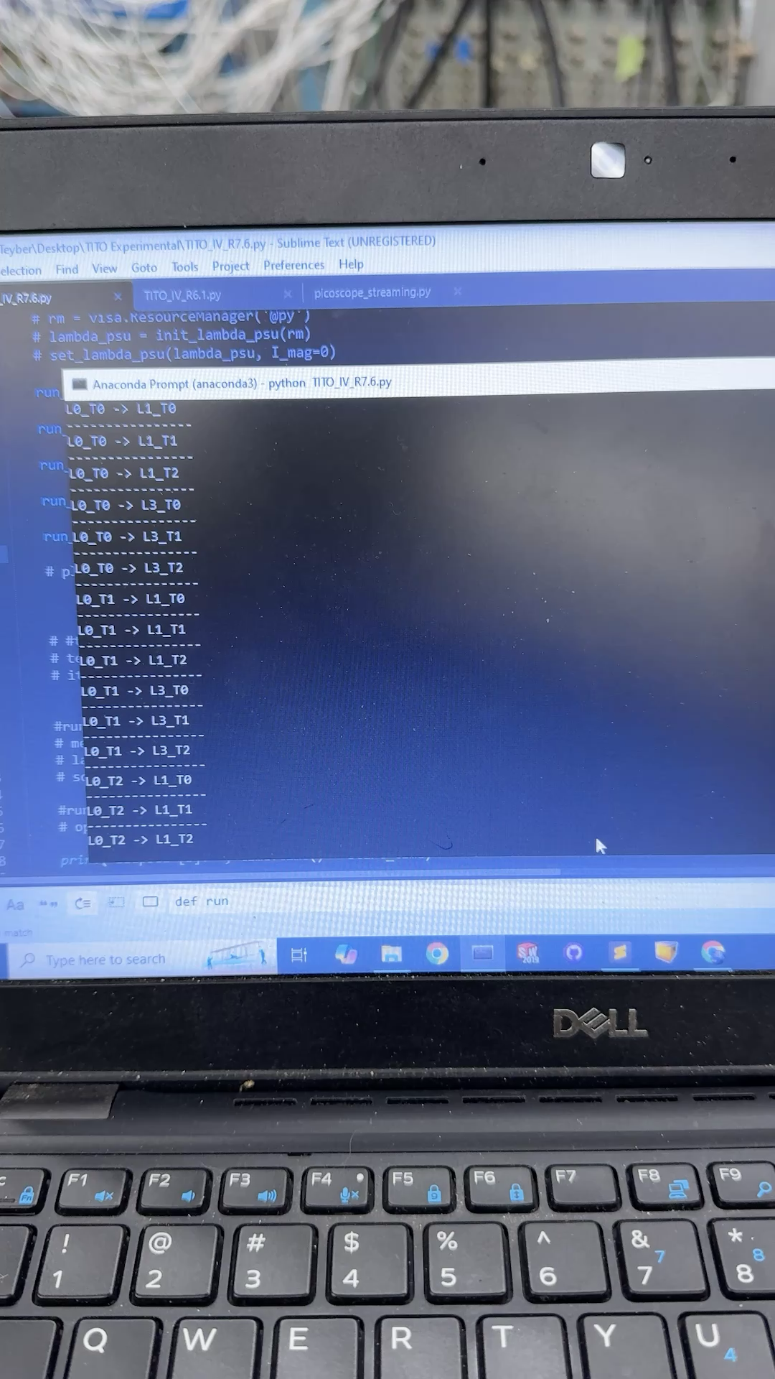
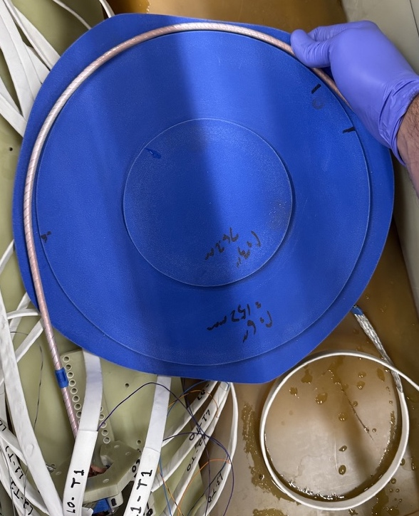
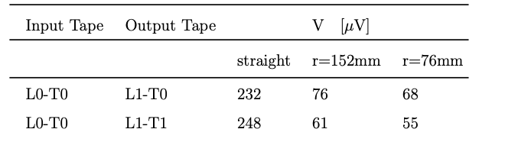
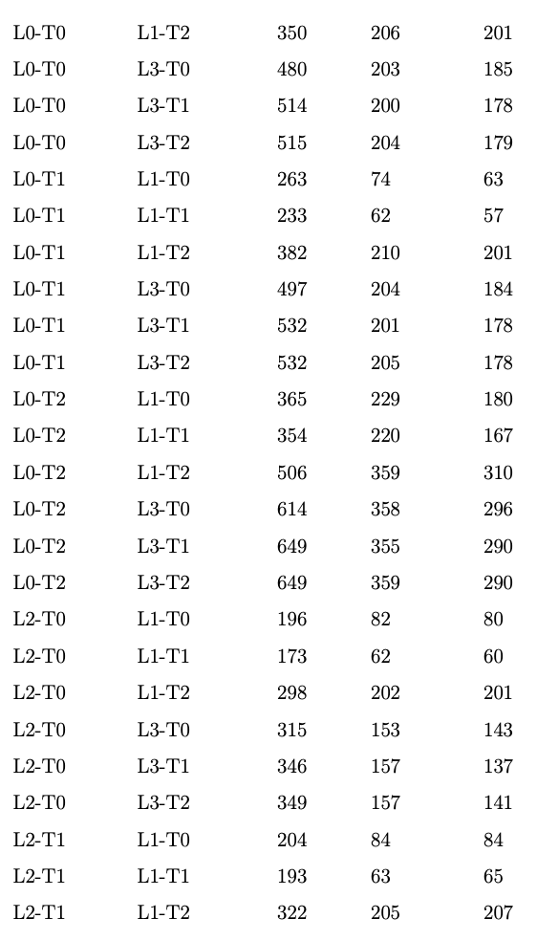
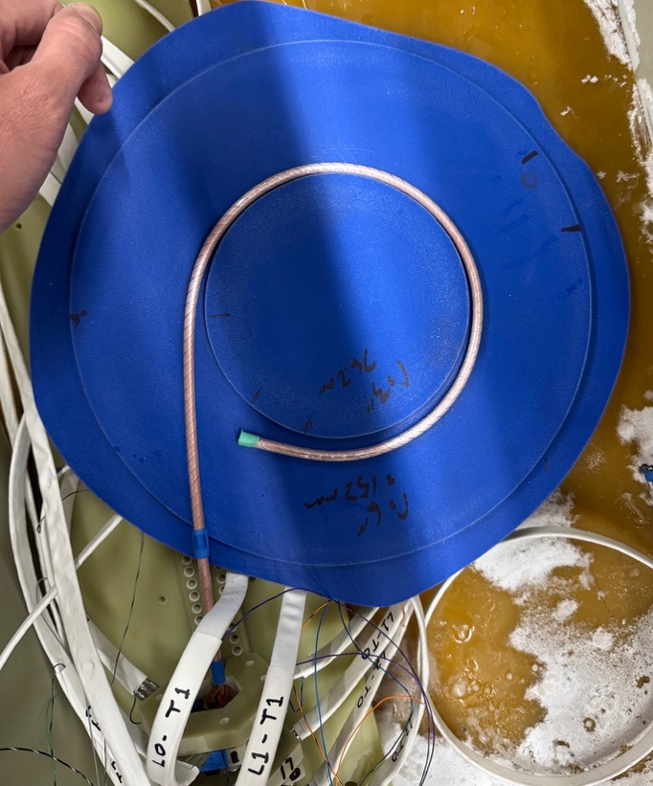
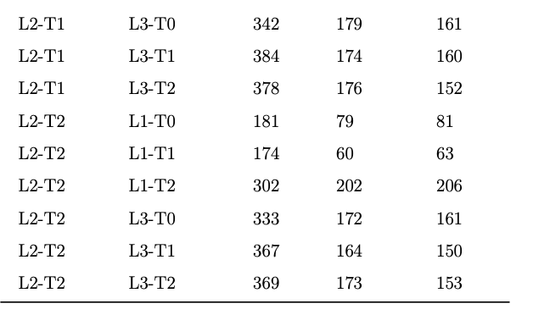
TITO Experiments and Voltage Results
All TITO experiments
Straight
152mm (6”) radius
76mm (3”) radius

Slide 10
Goals of our work & Outline
Our work aims to build on these excellent manuscripts via
  Automation of TITO tape powering, switching and measurement process
  Measurement of all tape voltages during TITO experiments
  Development of a TITO simulation tool to resolve current percolation
  Optimization-based fit of TITO model to experiments to extract distribution of inter-tape resistances in cable

Slide 11
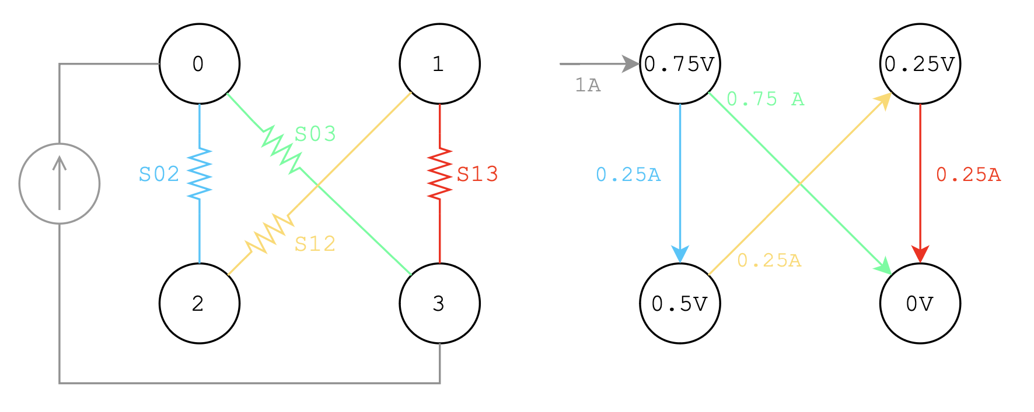
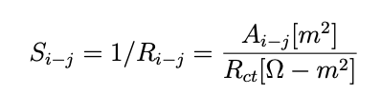
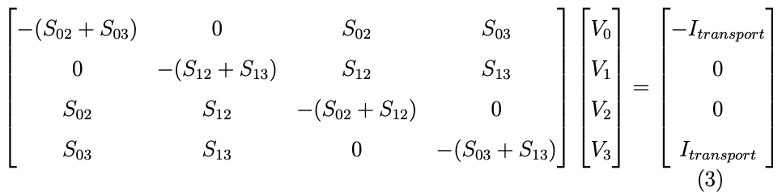
TITO Simulator - Percolation Model
4 tape cable illustrates TITO percolation effect

Slide 12
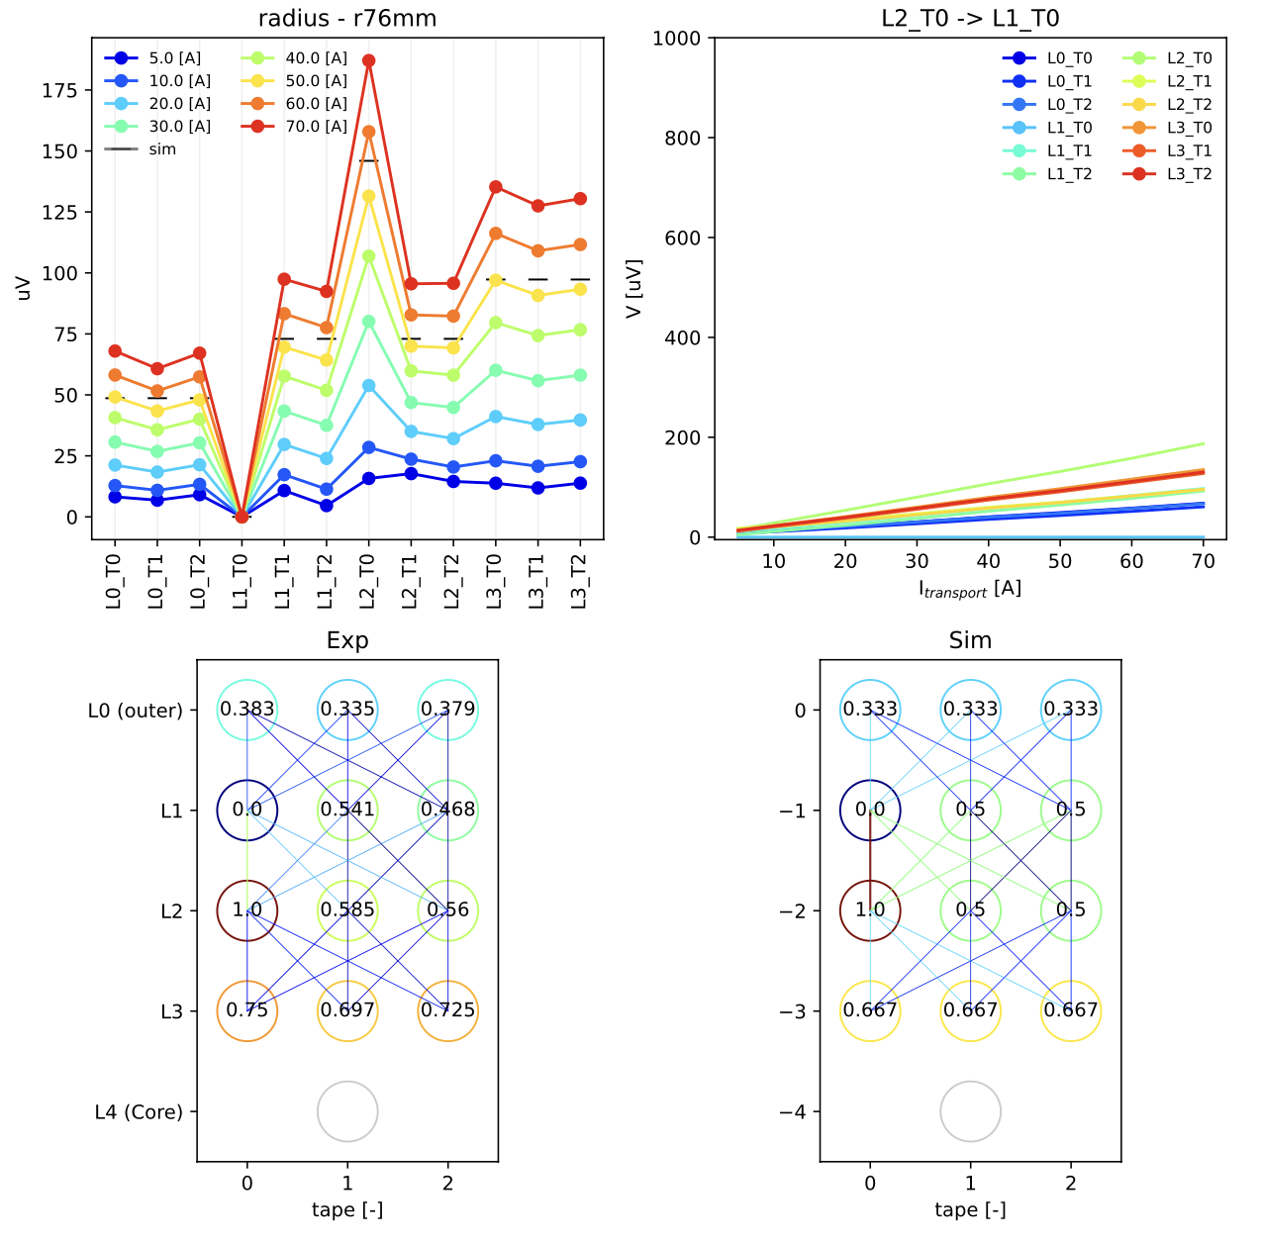
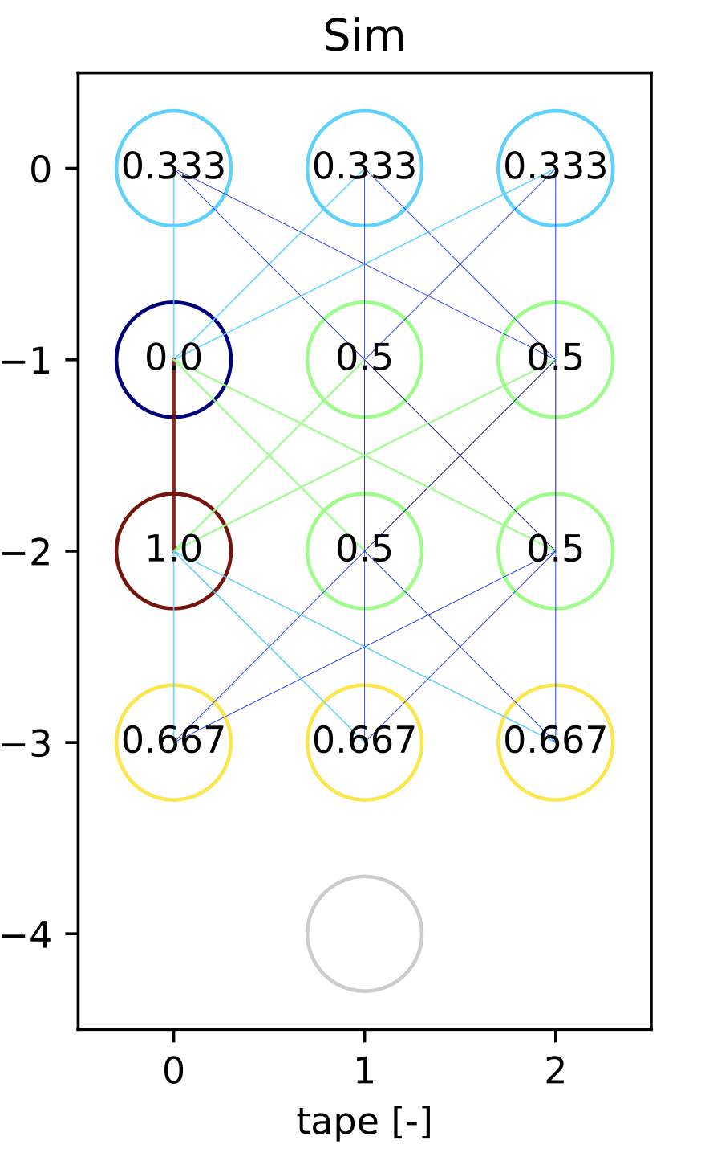
Results – Uniform Resistivity

Slide 13
Goals of our work & Outline
Our work aims to build on these excellent manuscripts via
  Automation of TITO tape powering, switching and measurement process
  Measurement of all tape voltages during TITO experiments
  Development of a TITO simulation tool to resolve current percolation
  Optimization-based fit of TITO model to experiments to extract distribution of inter-tape resistances in cable

Slide 14
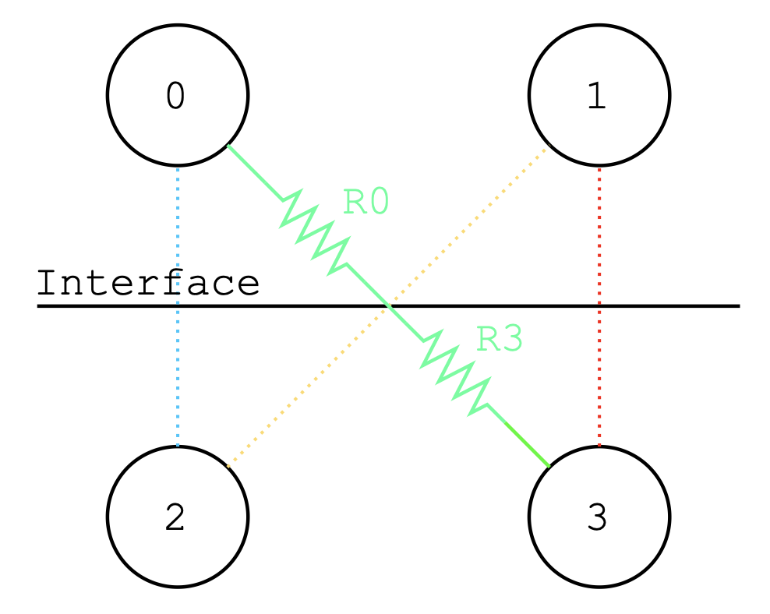

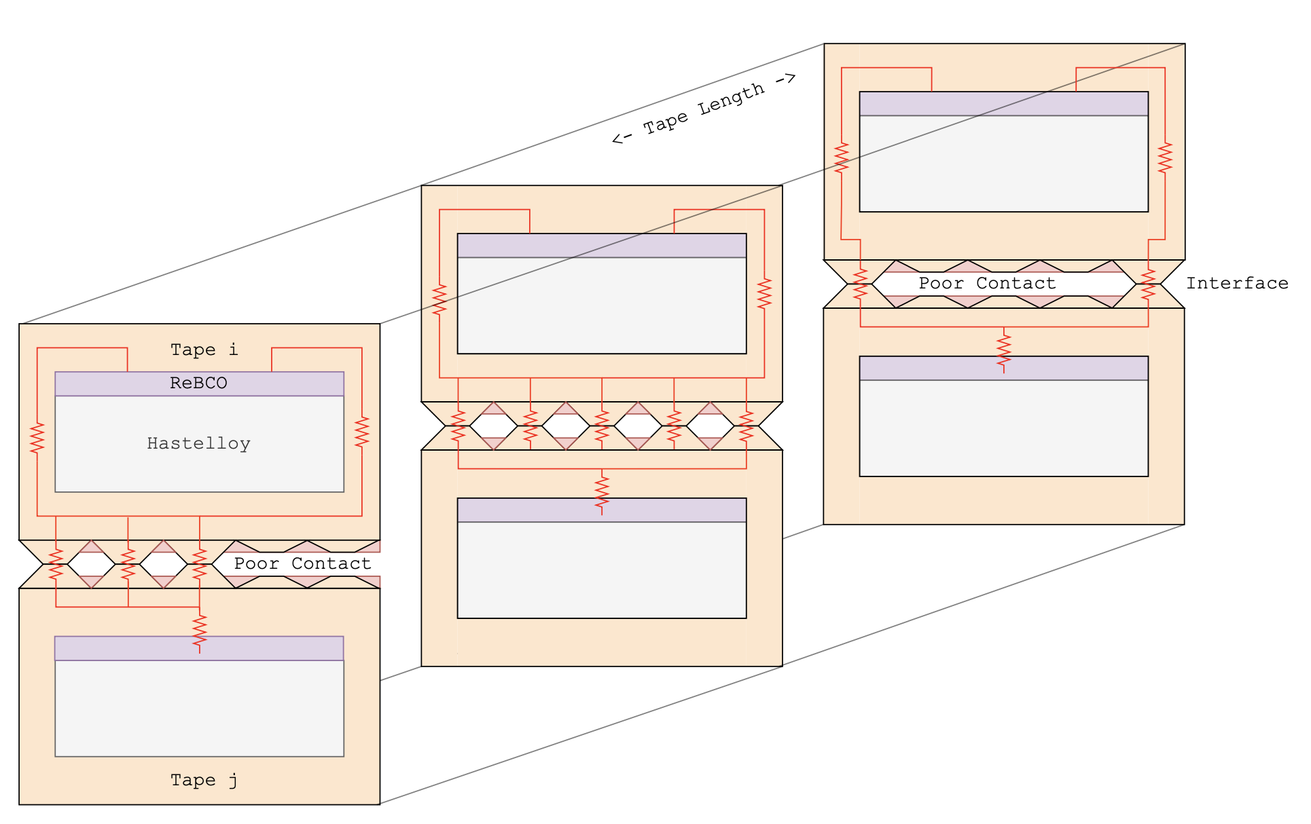
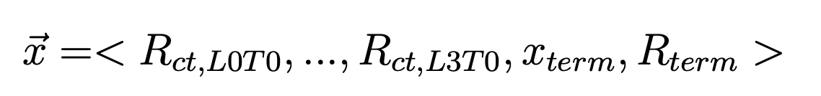
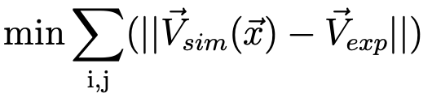
Optimization Formulation
Sum over all TITO exps
30 A only
Defect in termination
12 contact resistance params
56 parallel CPU differential evolution optimization

Slide 15
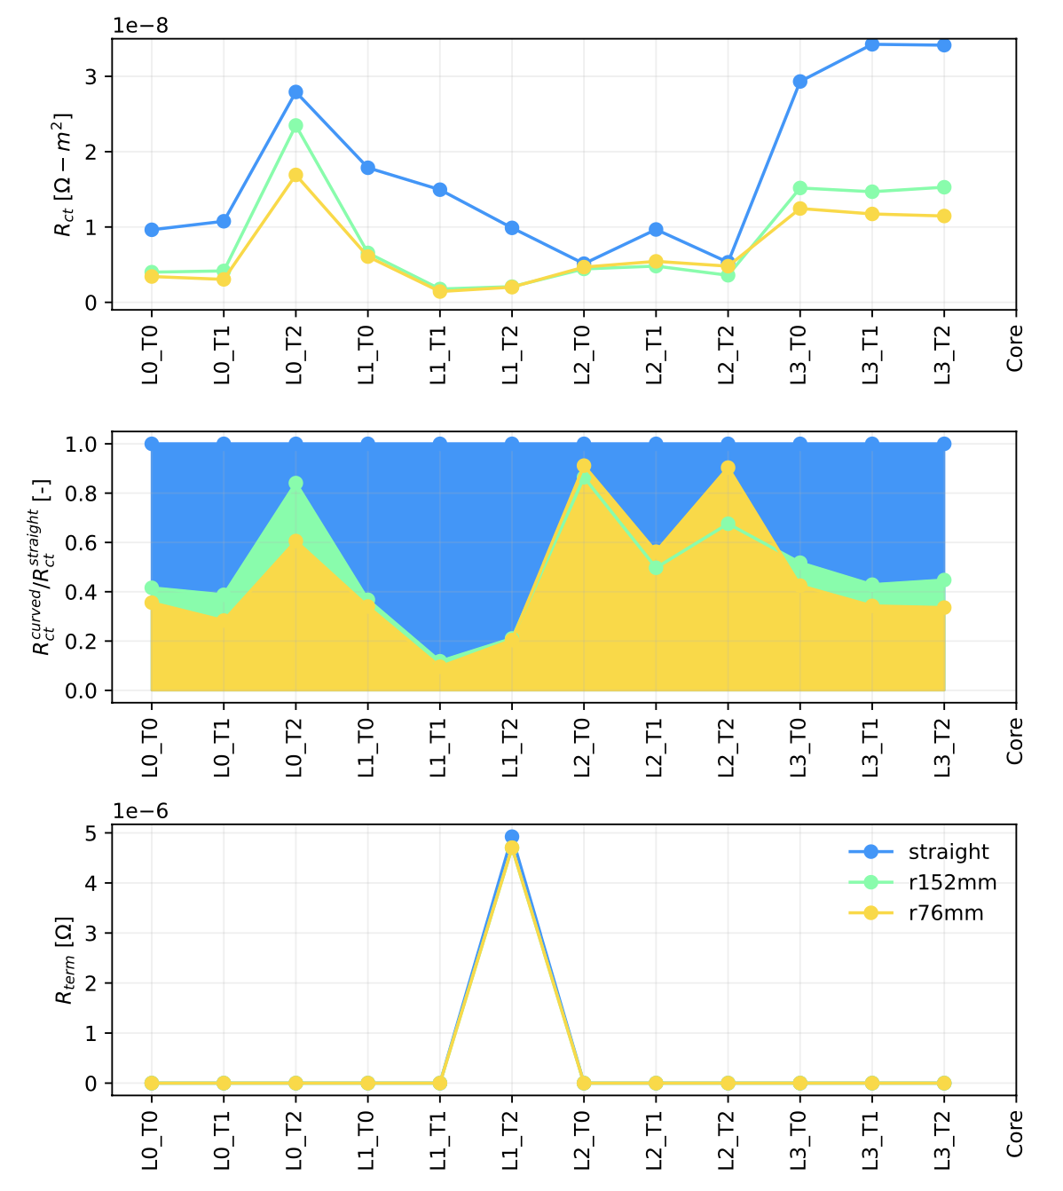
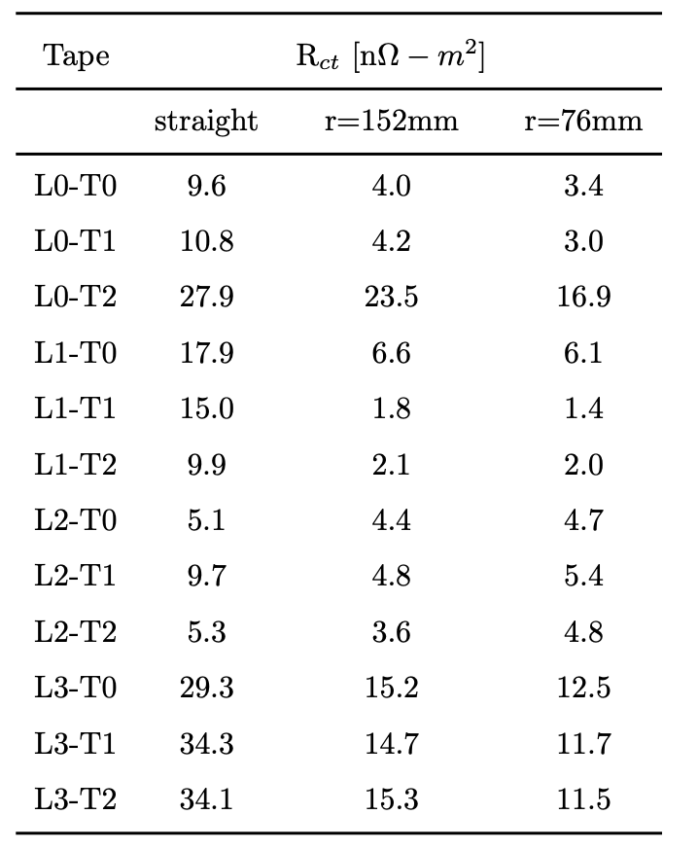
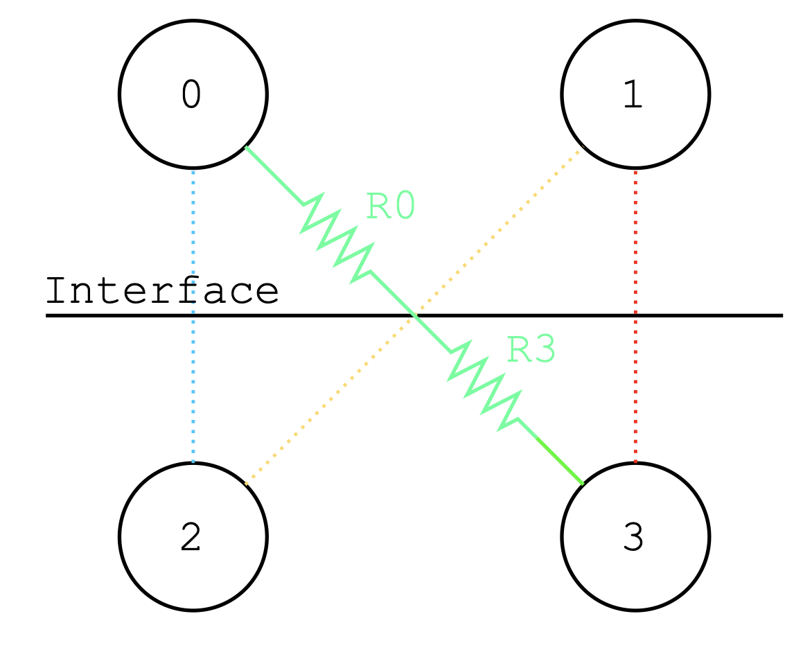
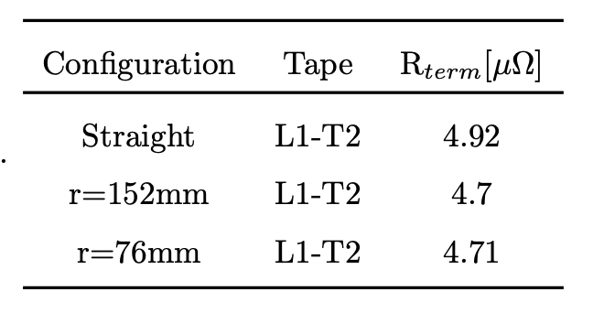
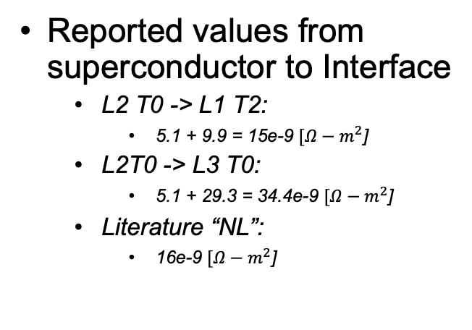
Optimized Parameters
Reported values from superconductor to Interface
  L2 T0 -> L1 T2:
    5.1 + 9.9 = 15e-9 $[Ω−m^{2}$]
  L2T0 -> L3 T0:
    5.1 + 29.3 = 34.4e-9 $[Ω−m^{2}$]
  Literature “NL”:
    16e-9 $[Ω−m^{2}$]

Slide 16
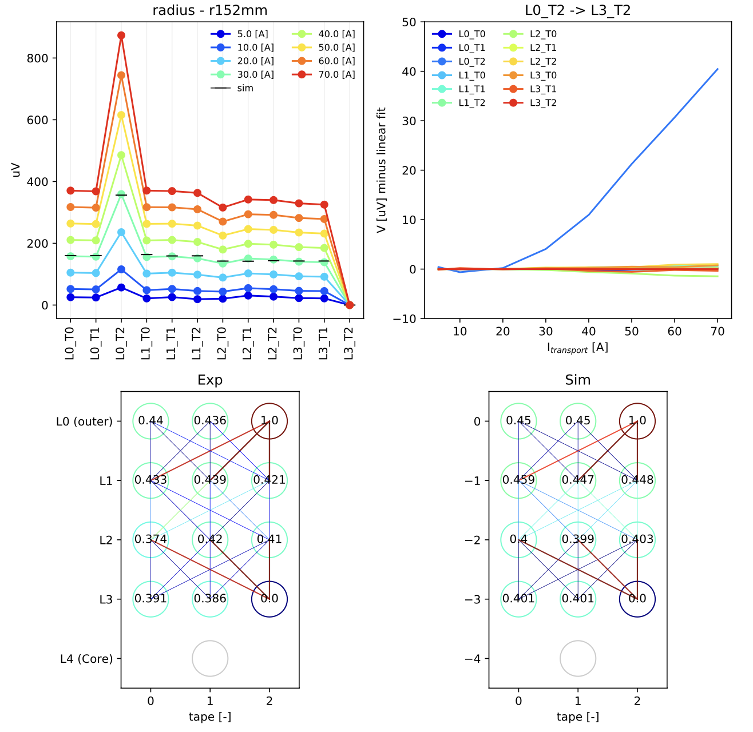
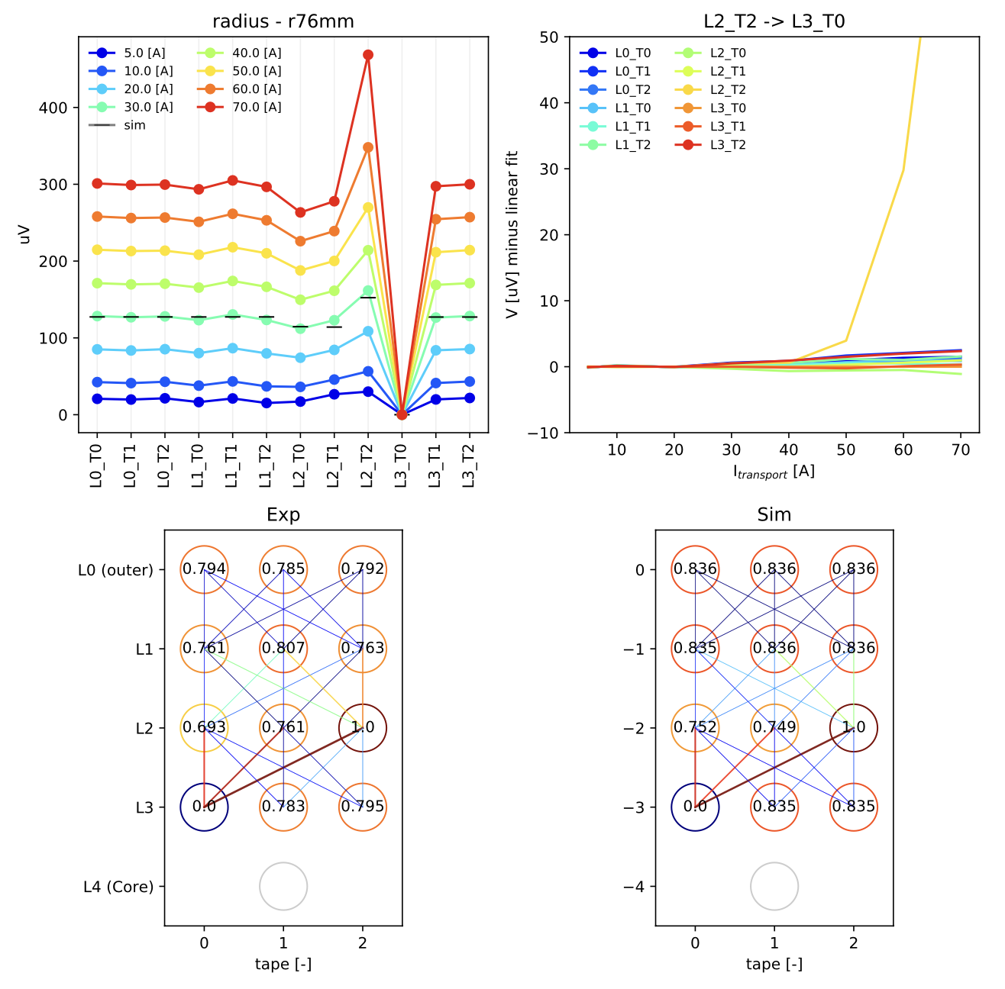
Results – Optimized Resistivity

Slide 17
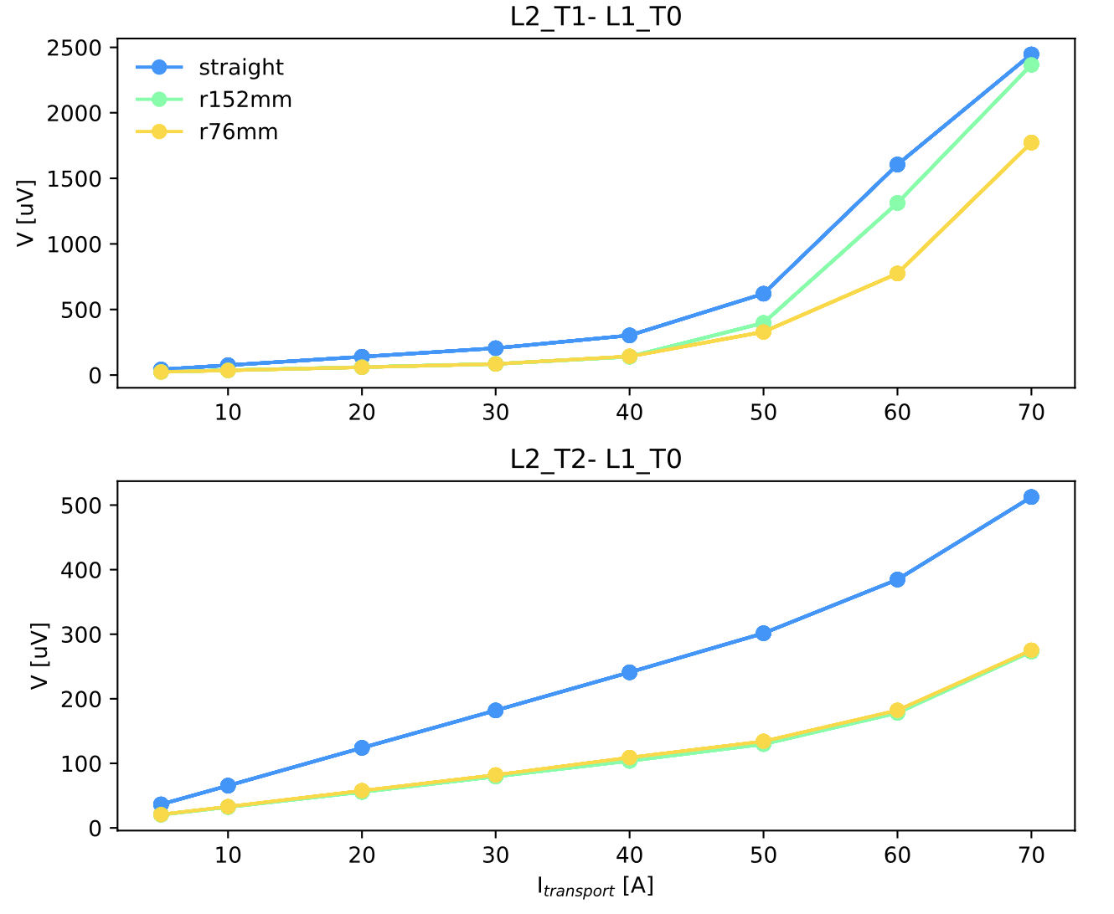
Visualizing Impact of Contact Resistance

Slide 18
Summary
Model guided dis-aggregation of local inter-tape contact resistance from bulk cable behavior
Accounting of percolation effect suggests higher resistances than previously reported
Results show layer-dependent inter-tape contact resistances
Results show layer-dependent sensitivities to bending
”Peaks” in Rct fit possibly result of internal tape defect
  Would benefit from more statistics

Slide 19

Future work
Faster optimization process towards near-real time (e.g. sub-minute) monitoring
Simplified / more efficient fabrication of TITO terminations to facilitate testing more samples, higher tape count cables
Higher current TITO terminations, move towards probing tape performance limits
Development of TITO percolation model with internal tape defects, working toward simplified cable modeling tool

Slide 20

Summary
Thanks to support of DOE Fusion Energy Sciences (FES), SBIR phase 1 proposal with ACT
Thanks to support of DOE High Energy Physics (HEP), US Magnet Development Program

