Slide 1
First test of the ESC quench protection system
(Energy Shift with Coupling)
+10 new ideas for quench protection
Emmanuele Ravaioli (CERN)
J. Bauche, M. Dumas, J. Feuvrier, I. Garcia-Aguirrebeitia Sanchez, M.M. Gawedzki, J-L. Guyon, F. Mangiarotti, M. Masci, J.C. Perez, P.A. Thonet, A. Verweij, P. Wachal, G. Willering, M. Wozniak (CERN),
This work was (partially) supported by HFM program.
3rd Instrumentation and Diagnostics for Superconducting Magnets Workshop (IDSM 3)
2025.04.04

Slide 2
High-field magnet designs are often limited by
Critical
current density
Stress
in the conductor
Quench protection performance
Quench protection performance
New ESC method tested for the first time
+10 new ideas for quench protection

Slide 3
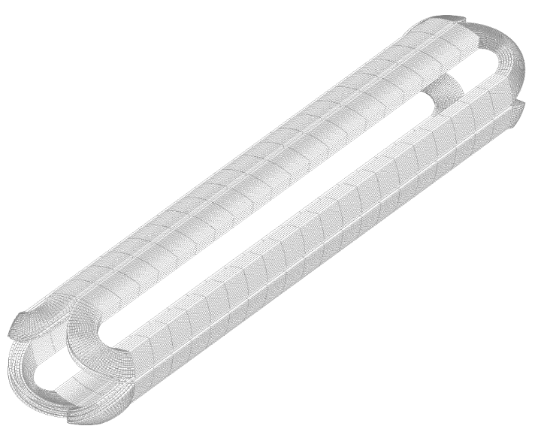
Quench protection in a high magnetic-field magnet
High temperature
High voltages
High stresses
DETECT QUENCH
ACTIVELY
EXTRACT ENERGY
Energy extraction
ACTIVELY
SPREAD ENERGY
Heaters, CLIQ

Slide 4
Energy Extraction
Extracts part of the magnet energy
Quench Heaters
Make it easy to add redundancy
CLIQ
Achieves very fast quench initiation
Energy Extraction
It requires high voltage across the magnet coil
Quench Heaters
They require thin insulation between protection elements and magnet coil
CLIQ
It requires direct electrical connection to the magnet circuit

Slide 5
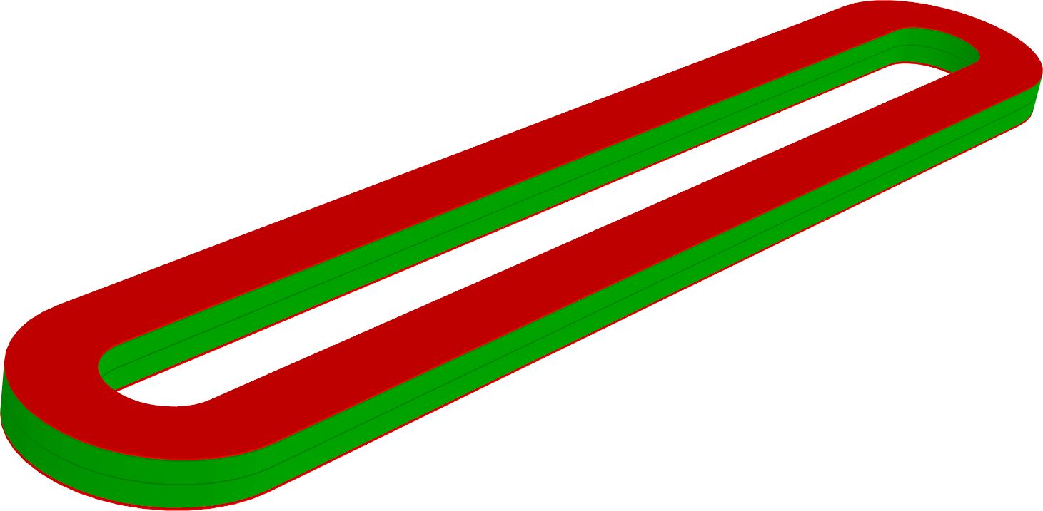
ESC
Energy Shift with Coupling
E. Ravaioli, A. Verweij, and M. Wozniak,
“Energy shift with coupling (ESC): a new quench protection method”, SuST, 2025
https://dx.doi.org/10.1088/1361-6668/ada833

Slide 6

ESC auxiliary coils
ESC auxiliary coil 1
magnet coils
Resistive (copper)
Electrically insulated
ESC auxiliary coil 2
Strongly magnetically coupled

Slide 7
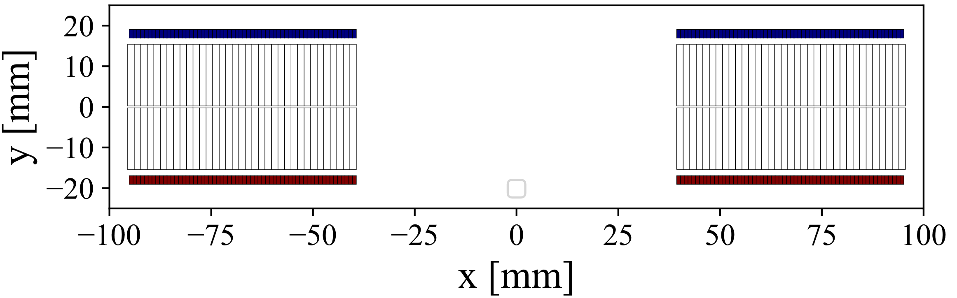
Short Model Coil (SMC) cross-section including two ESC auxiliary coils
ESC coil 1
Magnet coils
ESC coil 2
Magnetic field of 12.5 T at 1.9 K
ESC coils made of 0.8x2 mm Cu single wire
Cable made of 40 Nb₃Sn 0.7 mm strands
Thick insulation between ESC and magnet coils
Design of the Short Model Coil (SMC) magnet by J.C. Perez and team (CERN).
Design of the ESC coils for SMC: E. Ravaioli, J. Bauche, M. Dumas, I. Garcia-Aguirrebeitia Sanchez, M. Masci, J.C. Perez, P. Wachal, M. Wozniak (CERN).

Slide 8
ESC
working principle

Slide 9
ESC working principle
1
Immediate reduction of the magnet current
reduces ohmic loss
and magneto-resistance
2
Very high dB/dt
(~1E2-1E3 T/s)
transfers most/all turns
to the normal state due to transient losses
3
Energy transfer
from magnet coils
to auxiliary coils
induced by ESC unit and coil resistance increase

Slide 10
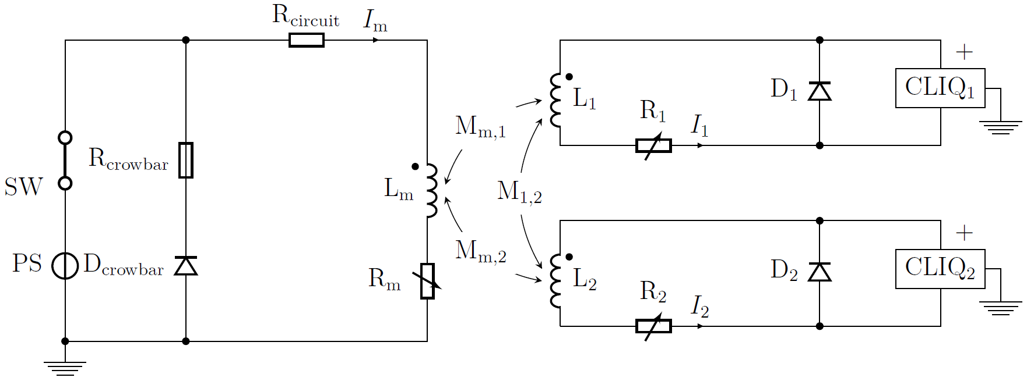
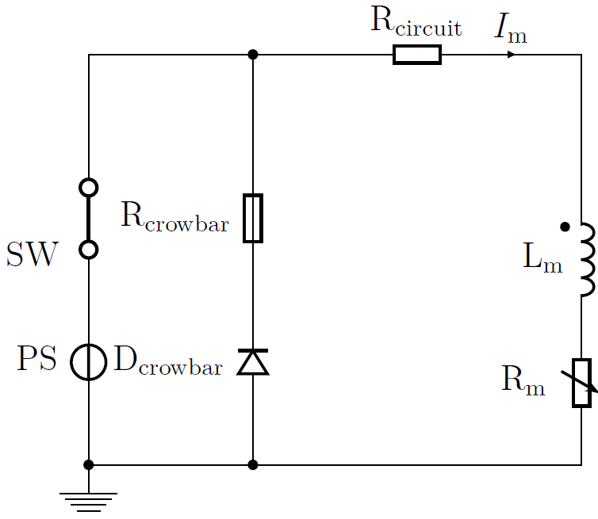
Energy Shift with Coupling (ESC) simplified schematic
ESC auxiliary coil 1
magnet coils
dI₁/dt↑
ESC auxiliary coil 2
ESC₁
dI_{m}/dt↓
ESC₂
dI₂/dt↑

Slide 11
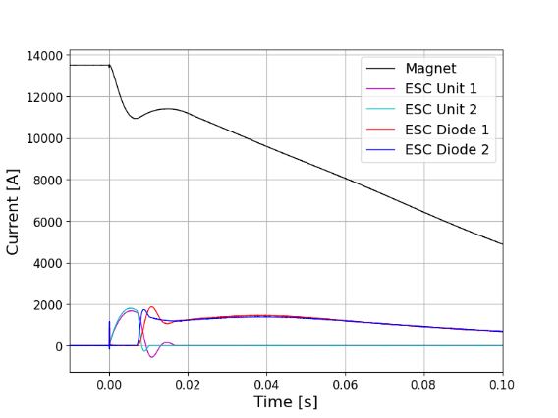
Typical ESC transient – Phase 0 – Powering
ESC auxiliary coil 1
magnet coils
ESC auxiliary coil 2
Phase 0

Slide 12
Typical ESC transient – Phase 1 – Unit discharge
ESC auxiliary coil 1
magnet coils
ESC auxiliary coil 2
Phase 1

Slide 13
Typical ESC transient – Phase 2 – Diode conduction
ESC auxiliary coil 1
magnet coils
ESC auxiliary coil 2
Phase 2

Slide 14
Typical ESC transient – Phase 3 – Magnet discharge
ESC auxiliary coil 1
magnet coils
ESC auxiliary coil 2
Phase 3

Slide 15
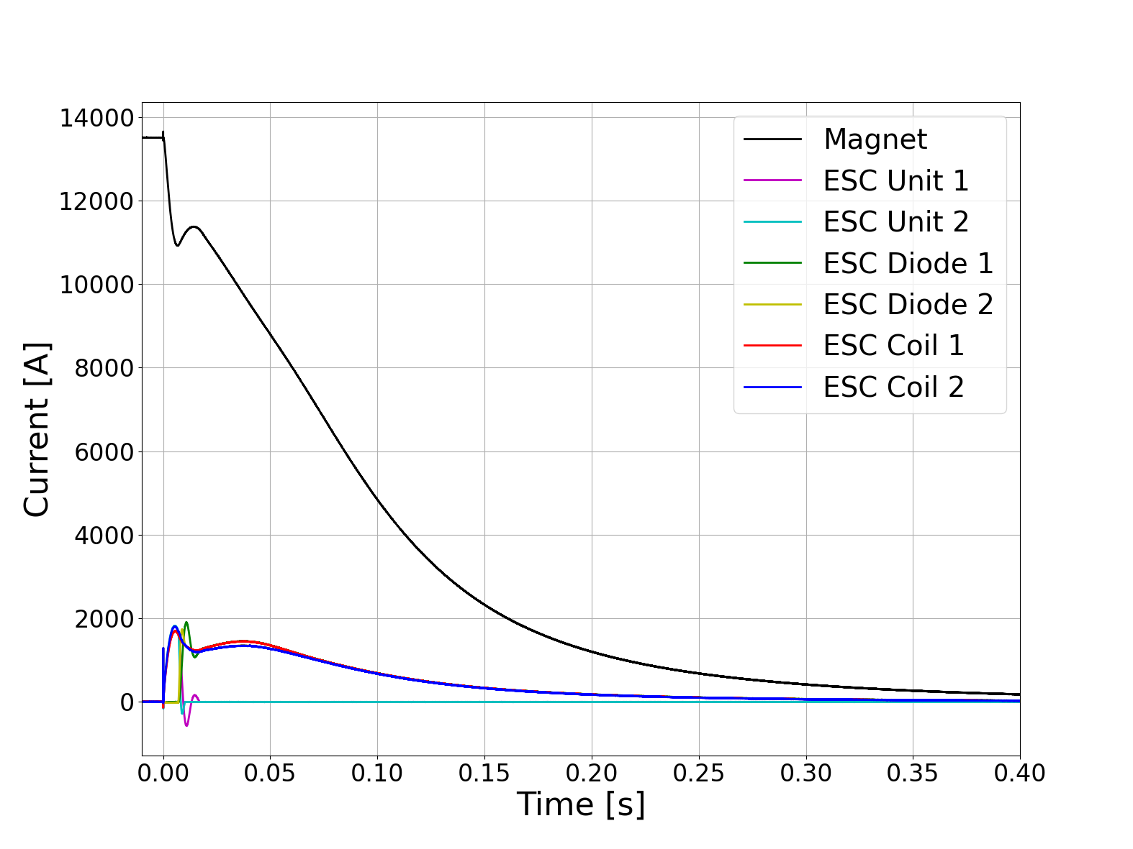
Typical ESC transient – Measured currents
Peak dI/dt ≈ 0.5 MA/s
Peak dB/dt >1000 T/s
100% magnet coil
quenched in <3 ms
Extracted >15%
of the magnet’s stored energy
Voltage across the magnet <30 V

Slide 16
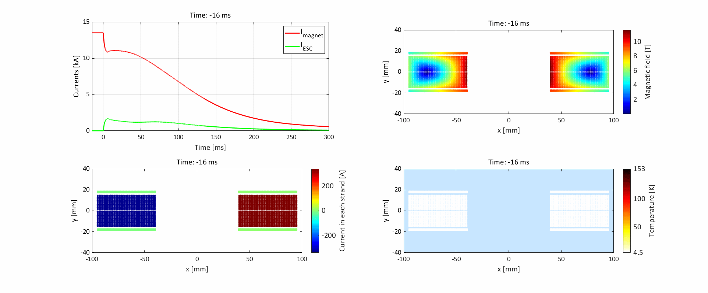


Simulation of a typical ESC transient
Simulations performed with STEAM-LEDET electro-magnetic and thermal magnet model
LEDET

Slide 17
ESC technology development

Slide 18
ESC technology development
Conceptual
design
Conductor
selection
Magnetic design
Integration study
Performance analysis
Mechanical design
ESC coil manufacture
ESC coil assembly
Test

Slide 19
ESC technology development
Conceptual
design
Conductor
selection
Magnetic design
Integration study
Performance analysis
Mechanical design
ESC coil manufacture
ESC coil assembly
Test
Thanks to M. Dumas

Slide 20
ESC technology development
Conceptual
design
Conductor
selection
Magnetic design
Integration study
Performance analysis
Mechanical design
ESC coil manufacture
ESC coil assembly
Test

Slide 21
ESC technology development
Conceptual
design
Conductor
selection
Magnetic design
Integration study
Performance analysis
Mechanical design
ESC coil manufacture
ESC coil assembly
Test
Thanks to M. Masci, P. Wachal

Slide 22
ESC technology development
Conceptual
design
Conductor
selection
Magnetic design
Integration study
Performance analysis
Mechanical design
ESC coil manufacture
ESC coil assembly
Test
Thanks to J. Bauche, M. Dumas,
I. Garcia-Aguirrebeitia Sanchez, M. Masci, J.C. Perez, P. Wachal, M. Wozniak

Slide 23
ESC technology development
Conceptual
design
Conductor
selection
Magnetic design
Integration study
Performance analysis
Mechanical design
ESC coil manufacture
ESC coil assembly
Test
Thanks to J. Bauche, M. Dumas,
I. Garcia-Aguirrebeitia Sanchez,
M.M. Gawedzki, P.A. Thonet

Slide 24
ESC technology development
Conceptual
design
Conductor
selection
Magnetic design
Integration study
Performance analysis
Mechanical design
ESC coil manufacture
ESC coil assembly
Test
Thanks to J.C. Perez and team

Slide 25
ESC technology development
Conceptual
design
Conductor
selection
Magnetic design
Integration study
Performance analysis
Mechanical design
ESC coil manufacture
ESC coil assembly
Test
Thanks to J. Feuvrier, J-L. Guyon,
F. Mangiarotti, G. Willering

Slide 26
ESC technology development
Conceptual
design
Conductor
selection
Magnetic design
Integration study
Performance analysis
Mechanical design
ESC coil manufacture
ESC coil assembly
Test
Thanks to M. Wozniak

Slide 27
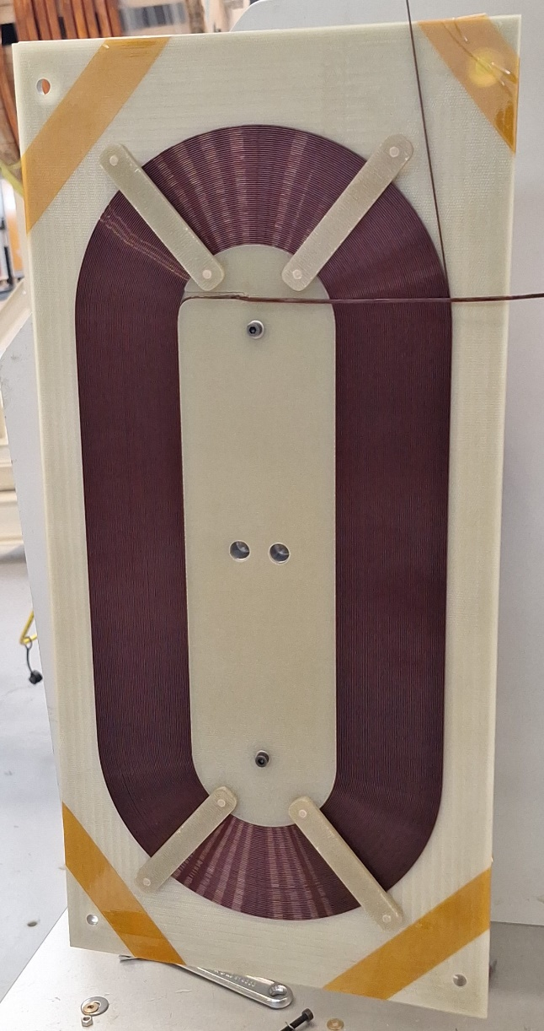
A BIG THANK YOU TO ALL THE COLLEAGUES INVOLVED!
ESC technology tested on the CERN Short Model Coil (SMC)
SMC magnet design and fabrication: J.C. Perez and team (CERN).
ESC coil design: J. Bauche, M. Dumas, I. Garcia-Aguirrebeitia Sanchez, M. Masci, J.C. Perez, E. Ravaioli, P. Wachal, M. Wozniak (CERN).
ESC coil fabrication: J. Bauche, M. Dumas, I. Garcia-Aguirrebeitia Sanchez (CERN).
ESC coil impregnation: M. Gavedzki, P.A. Thonet (CERN).
ESC coil integration in the SMC 107b magnet: J.C. Perez and team (CERN).
SMC 107b magnet test: J. Feuvrier, J-L. Guyon, F. Mangiarotti, E. Ravaioli, G. Willering (CERN).
Last minute current sensor loan: B. Panev, V. Vizziello (CERN).
SMC 107b frequency transfer measurements: M. Bednarek, E. Ravaioli (CERN).
SMC 107b ESC simulations: E. Ravaioli, M. Wozniak (CERN).

Slide 28
Highlights from ESC first experimental demonstration

Slide 29
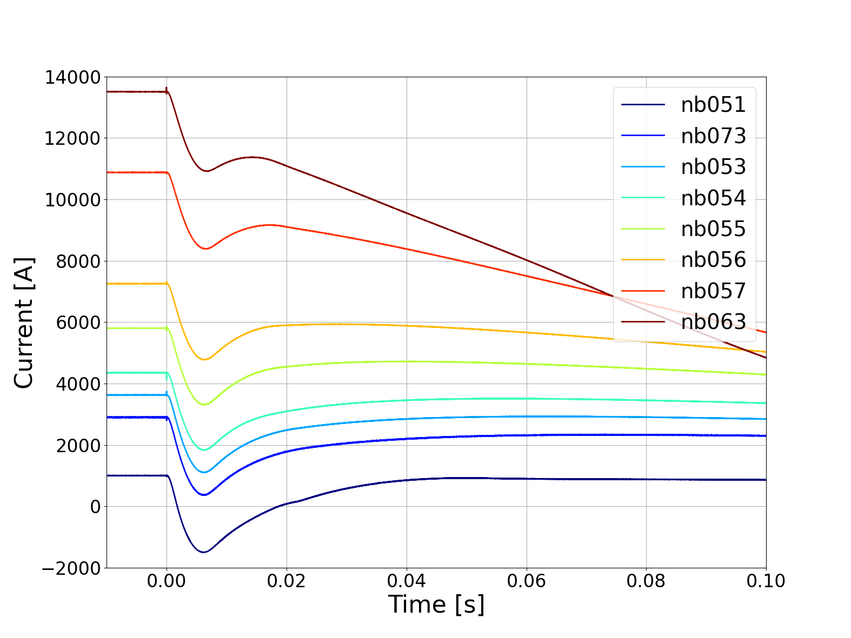
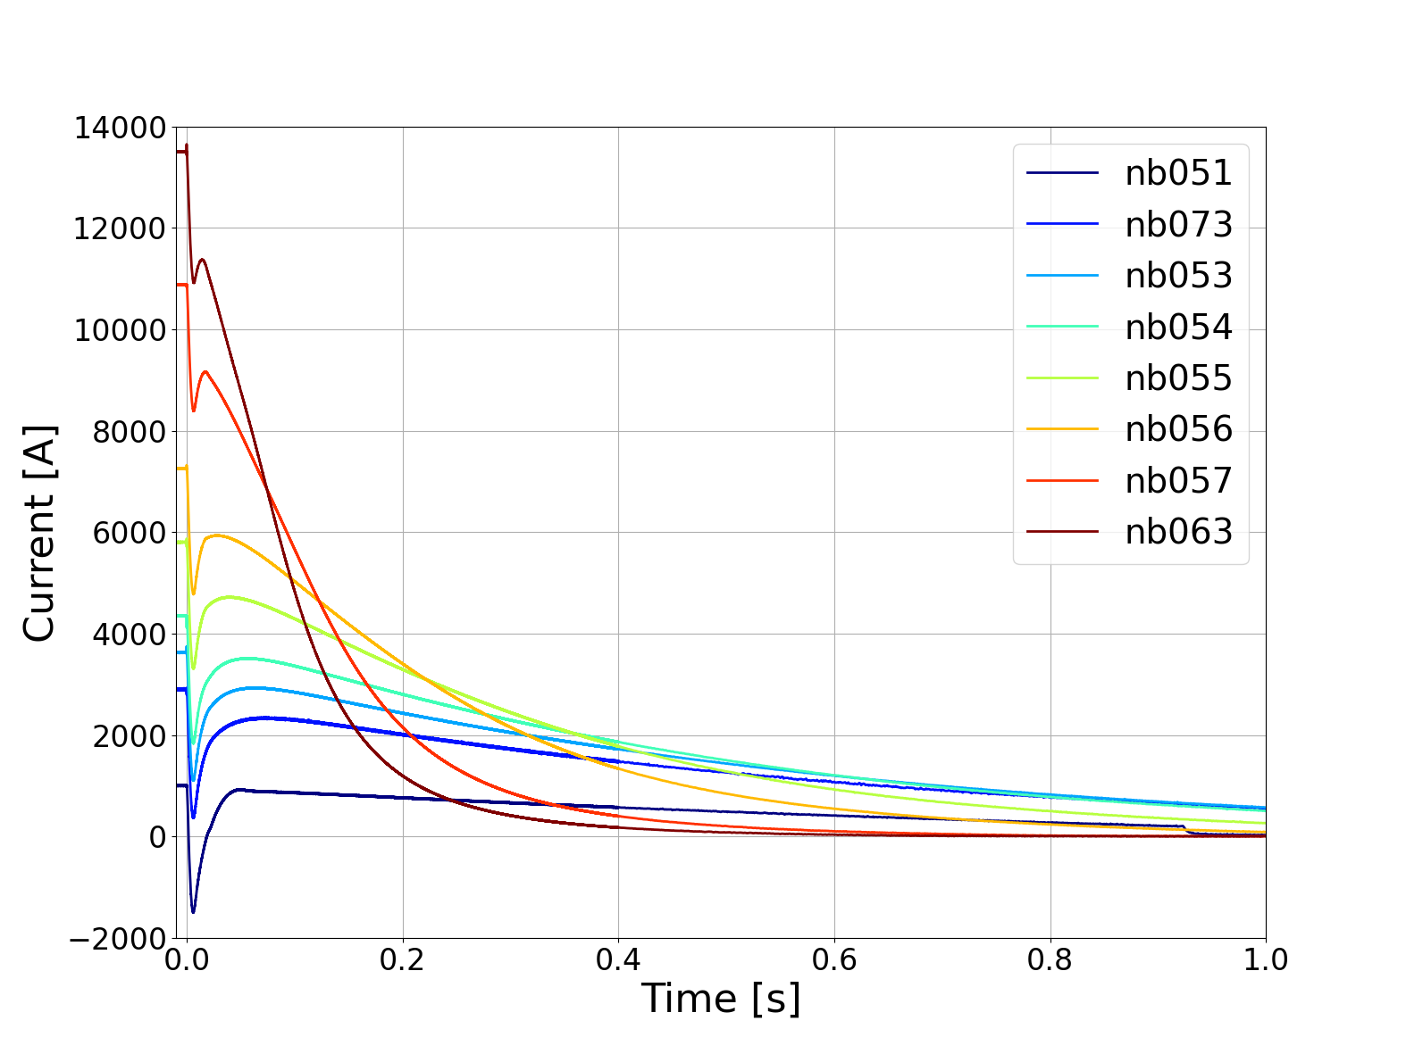
Quench protection at all relevant current levels
Quench was certainly induced when the magnet current is in the range 3625-15000 A.
Analysis is still ongoing for the currents ≤2900 A.

Slide 30
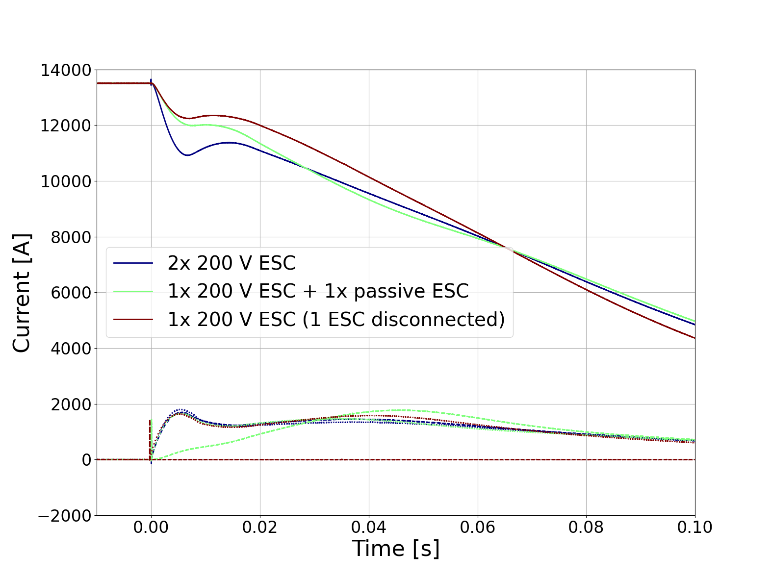
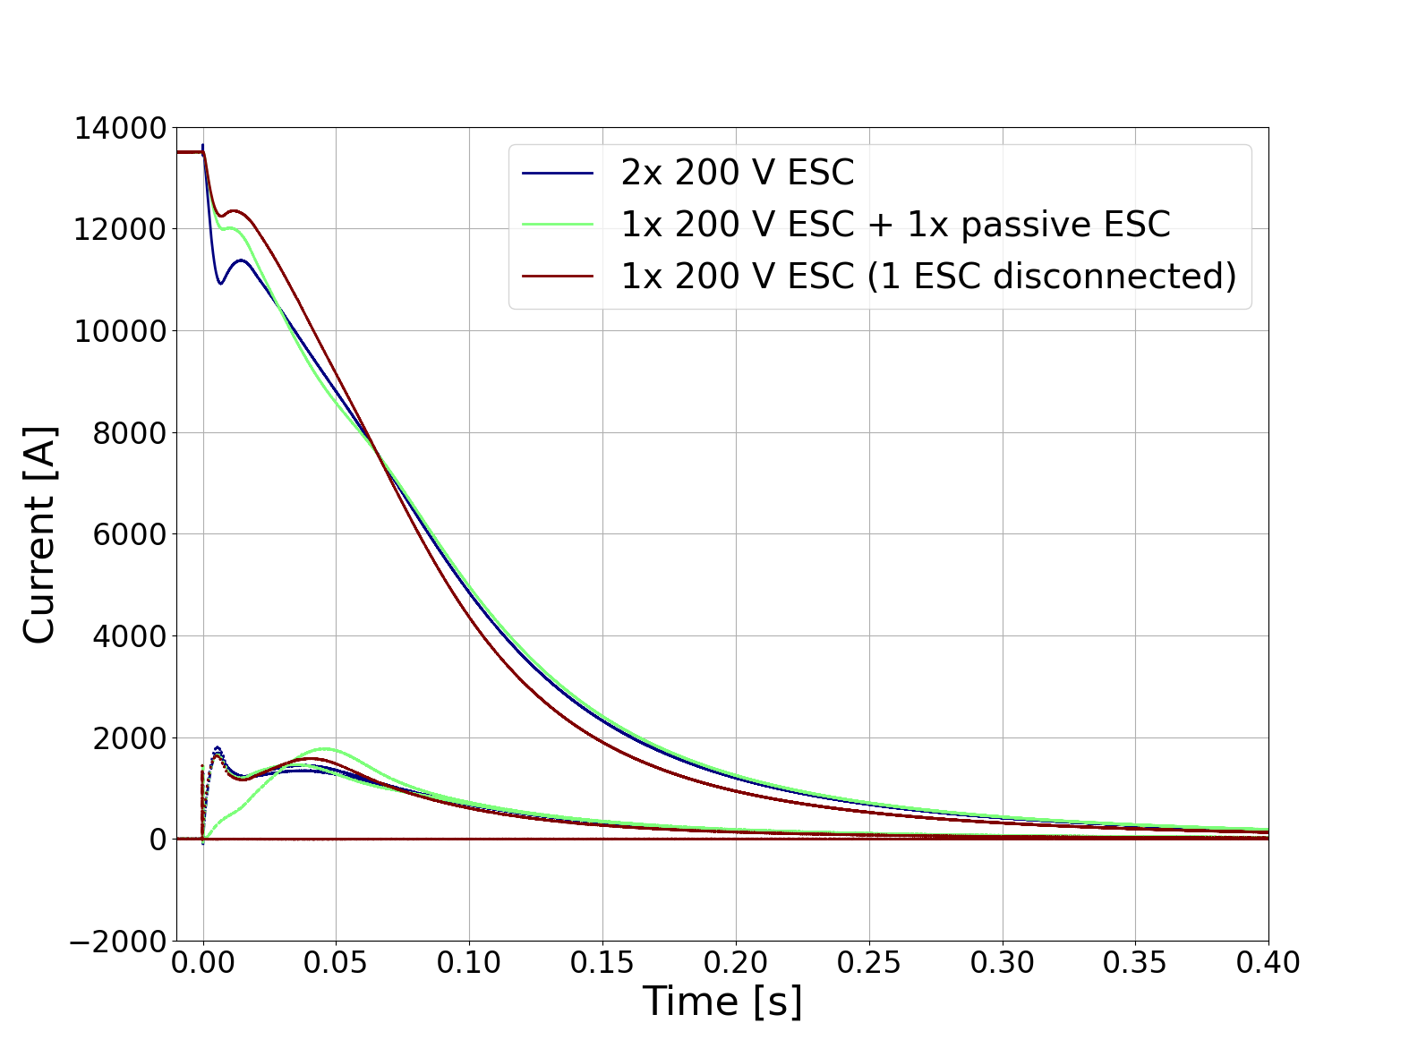
Redundancy
Redundancy
When only 1 out of 2 units is used, the discharge is almost as fast
Failure cases successfully reproduced.
Redundancy demonstrated: performance was acceptable also when 1 out of 2 units was disconnected.

Slide 31
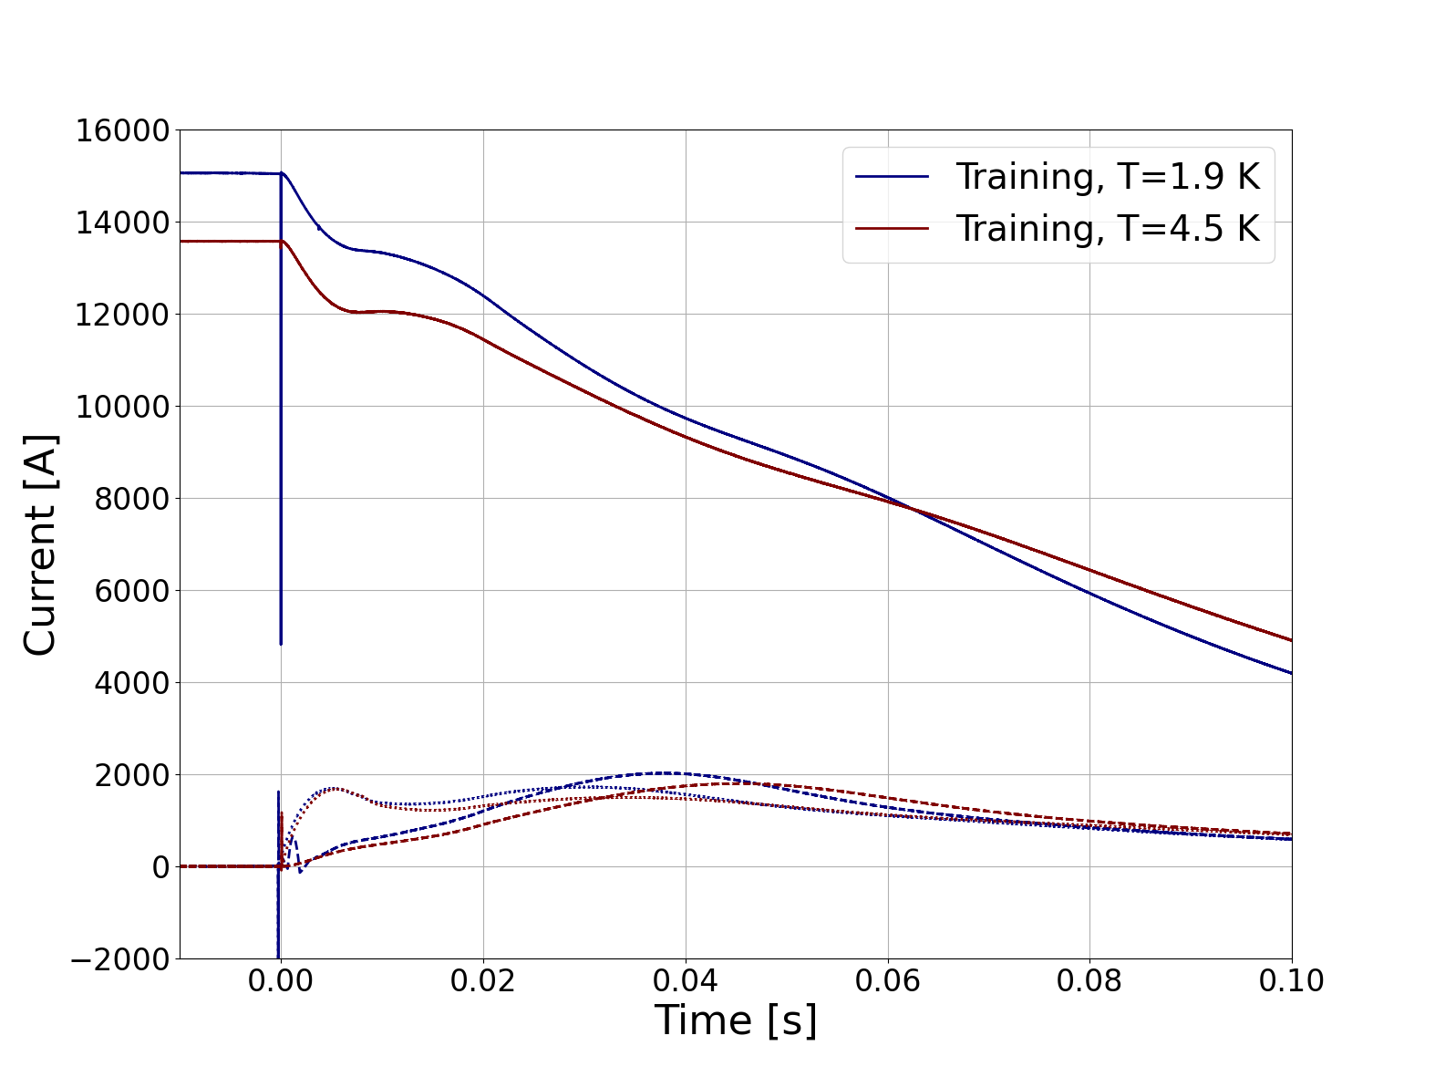
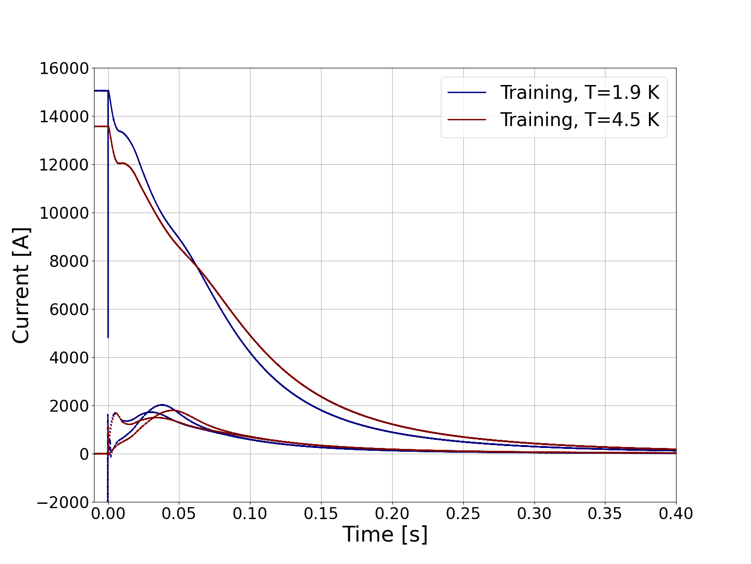
Training quenches protected only by ESC [1 ESC active, 1 ESC passive]
The training quenches at T=1.9 K and T=4.5 K reached 12.1 and 11.1 MIIt, respectively.
The conservative limit of 12 MIIt written in the test plan corresponds to 200 K adiabatic hot-spot temperature.

Slide 32
Extract part of the magnet energy
= Energy Extraction
Make it easy to add redundancy
= Quench Heaters
Achieve very fast quench initiation
= CLIQ
Without high voltage across magnet coil
≠ Energy Extraction
Without requiring thin insulation layers
≠ Quench Heaters
Without electrical contact to the coil
≠ CLIQ

Slide 33
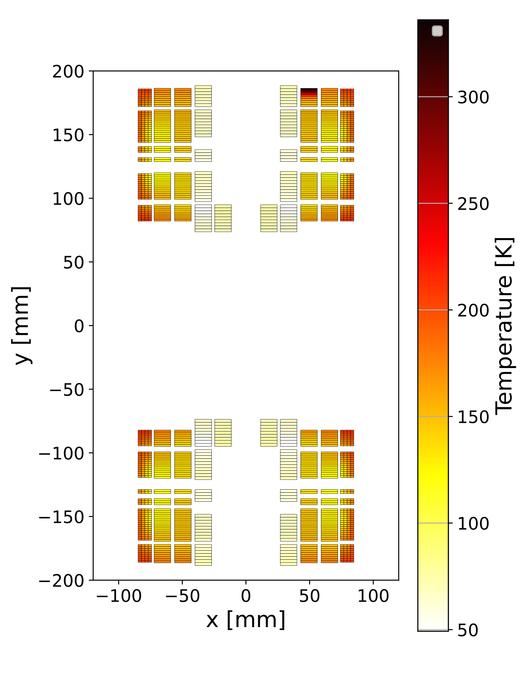
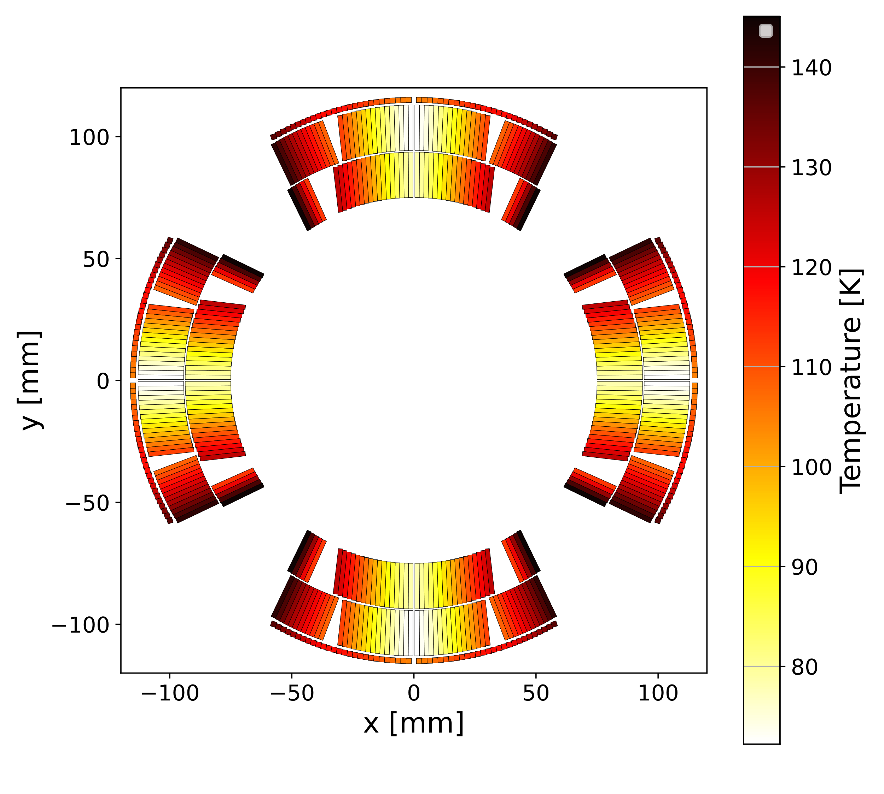
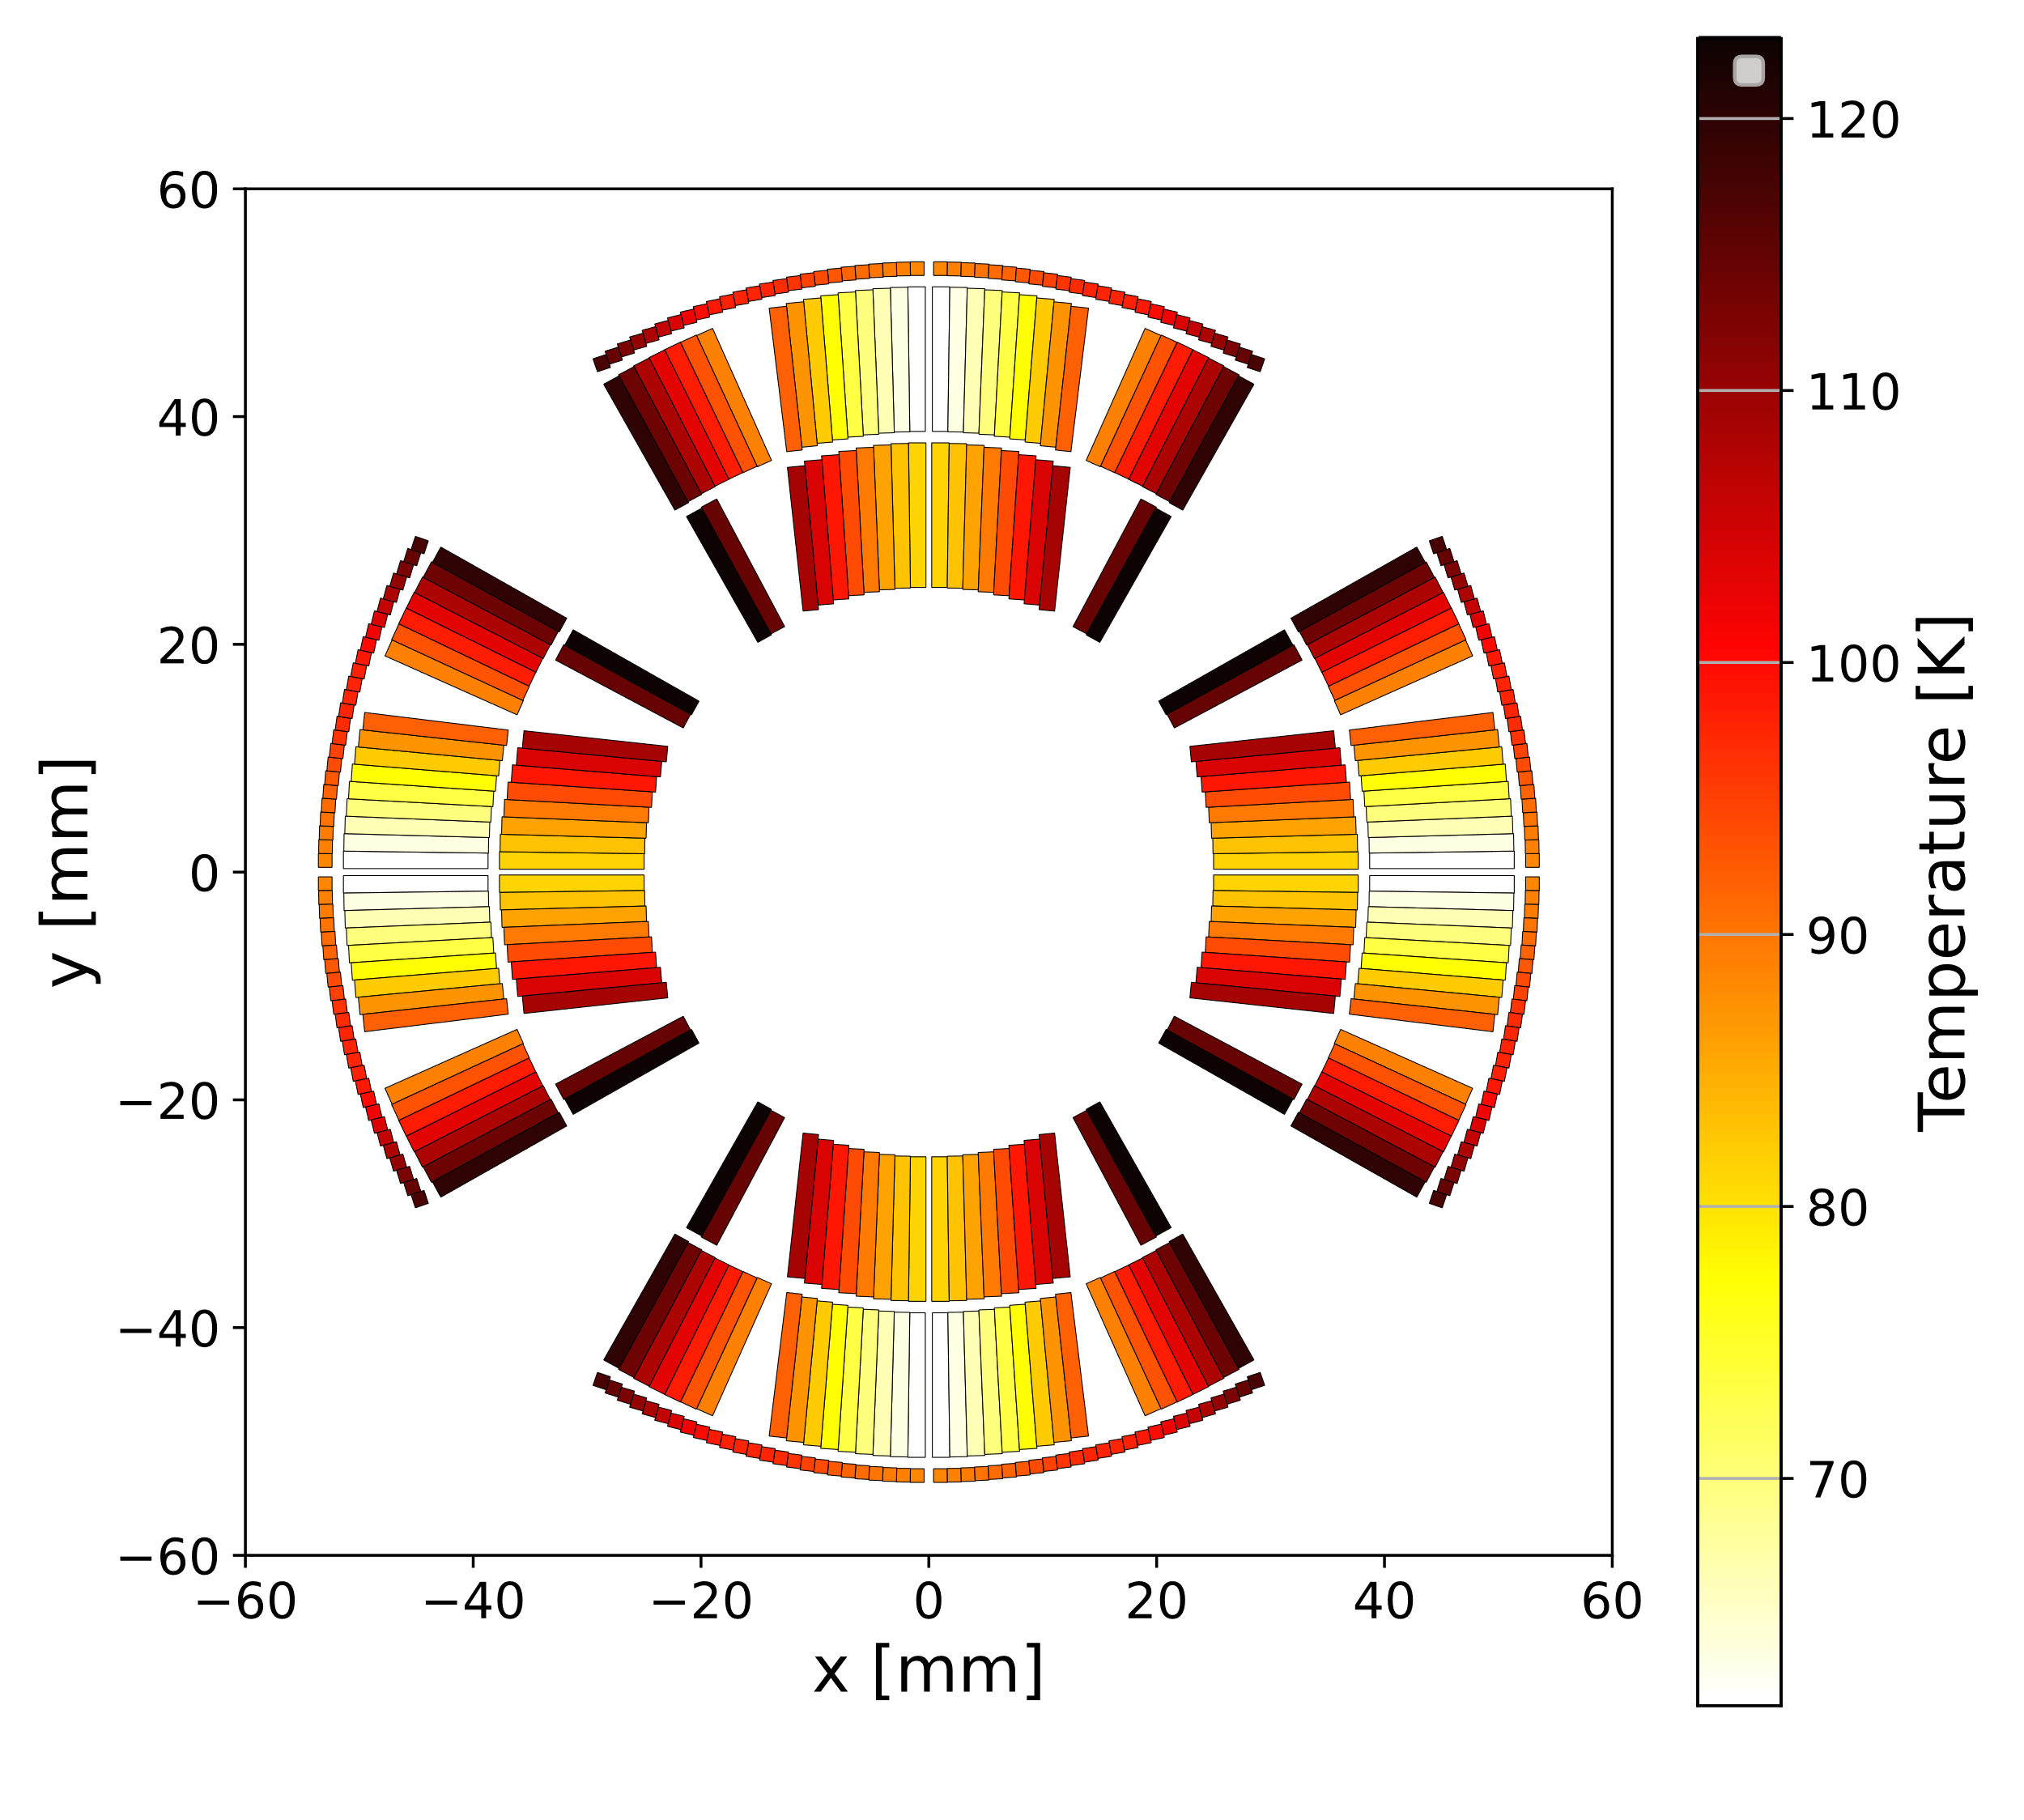
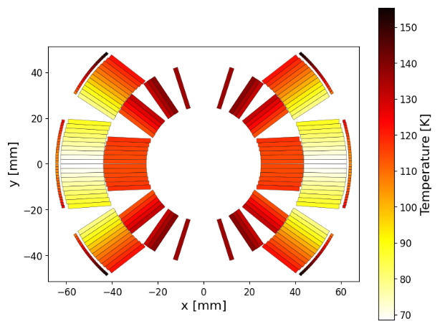
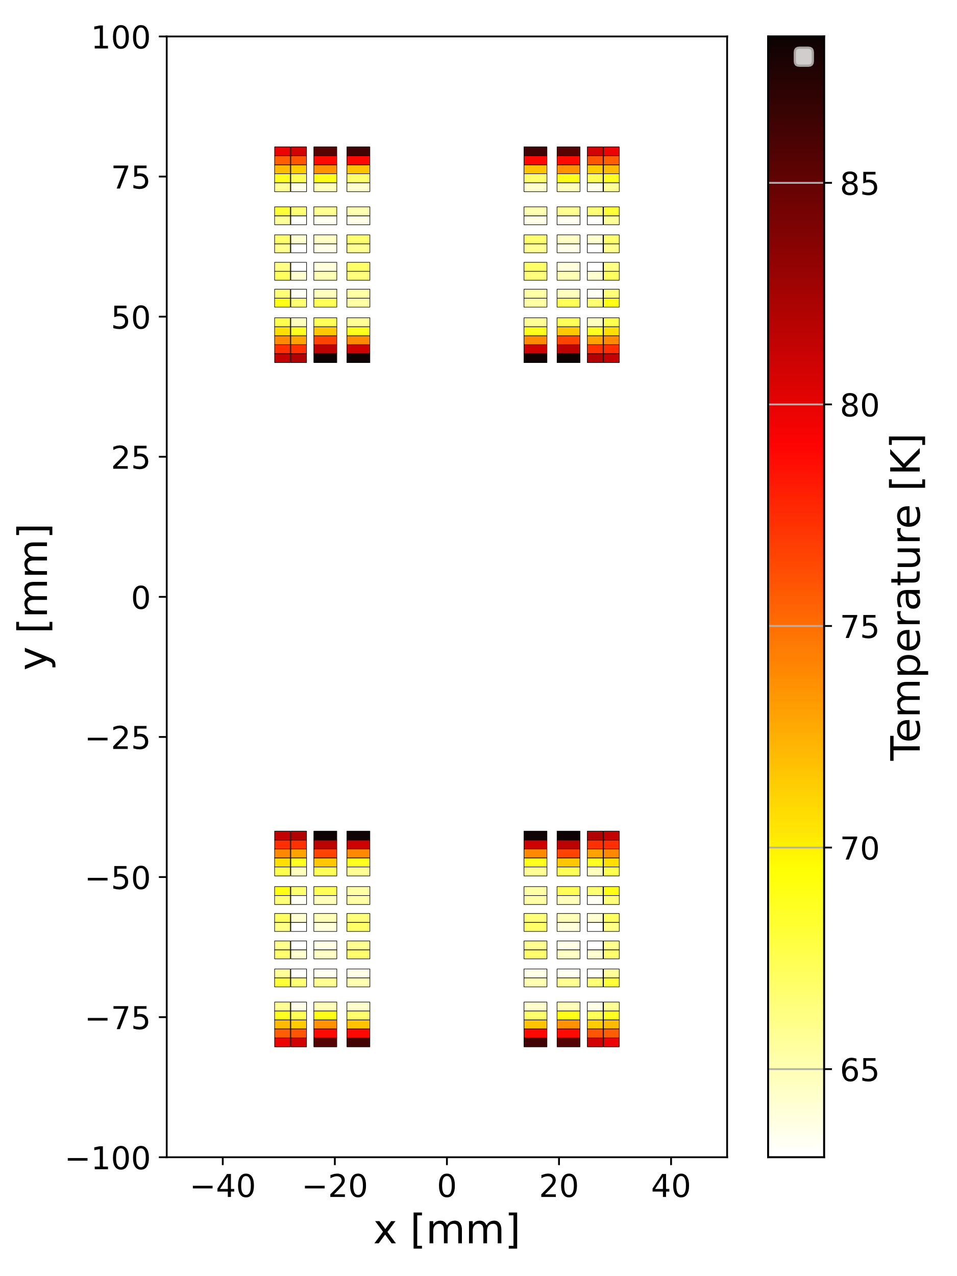
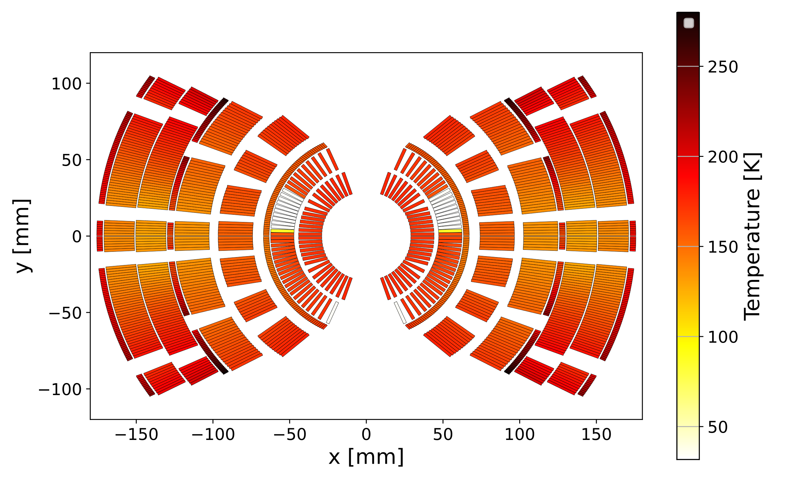
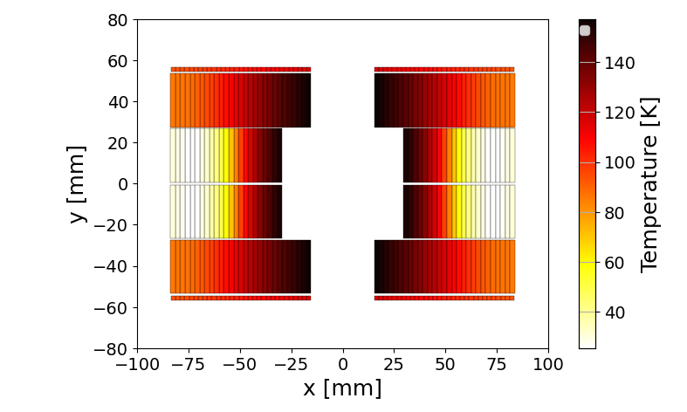
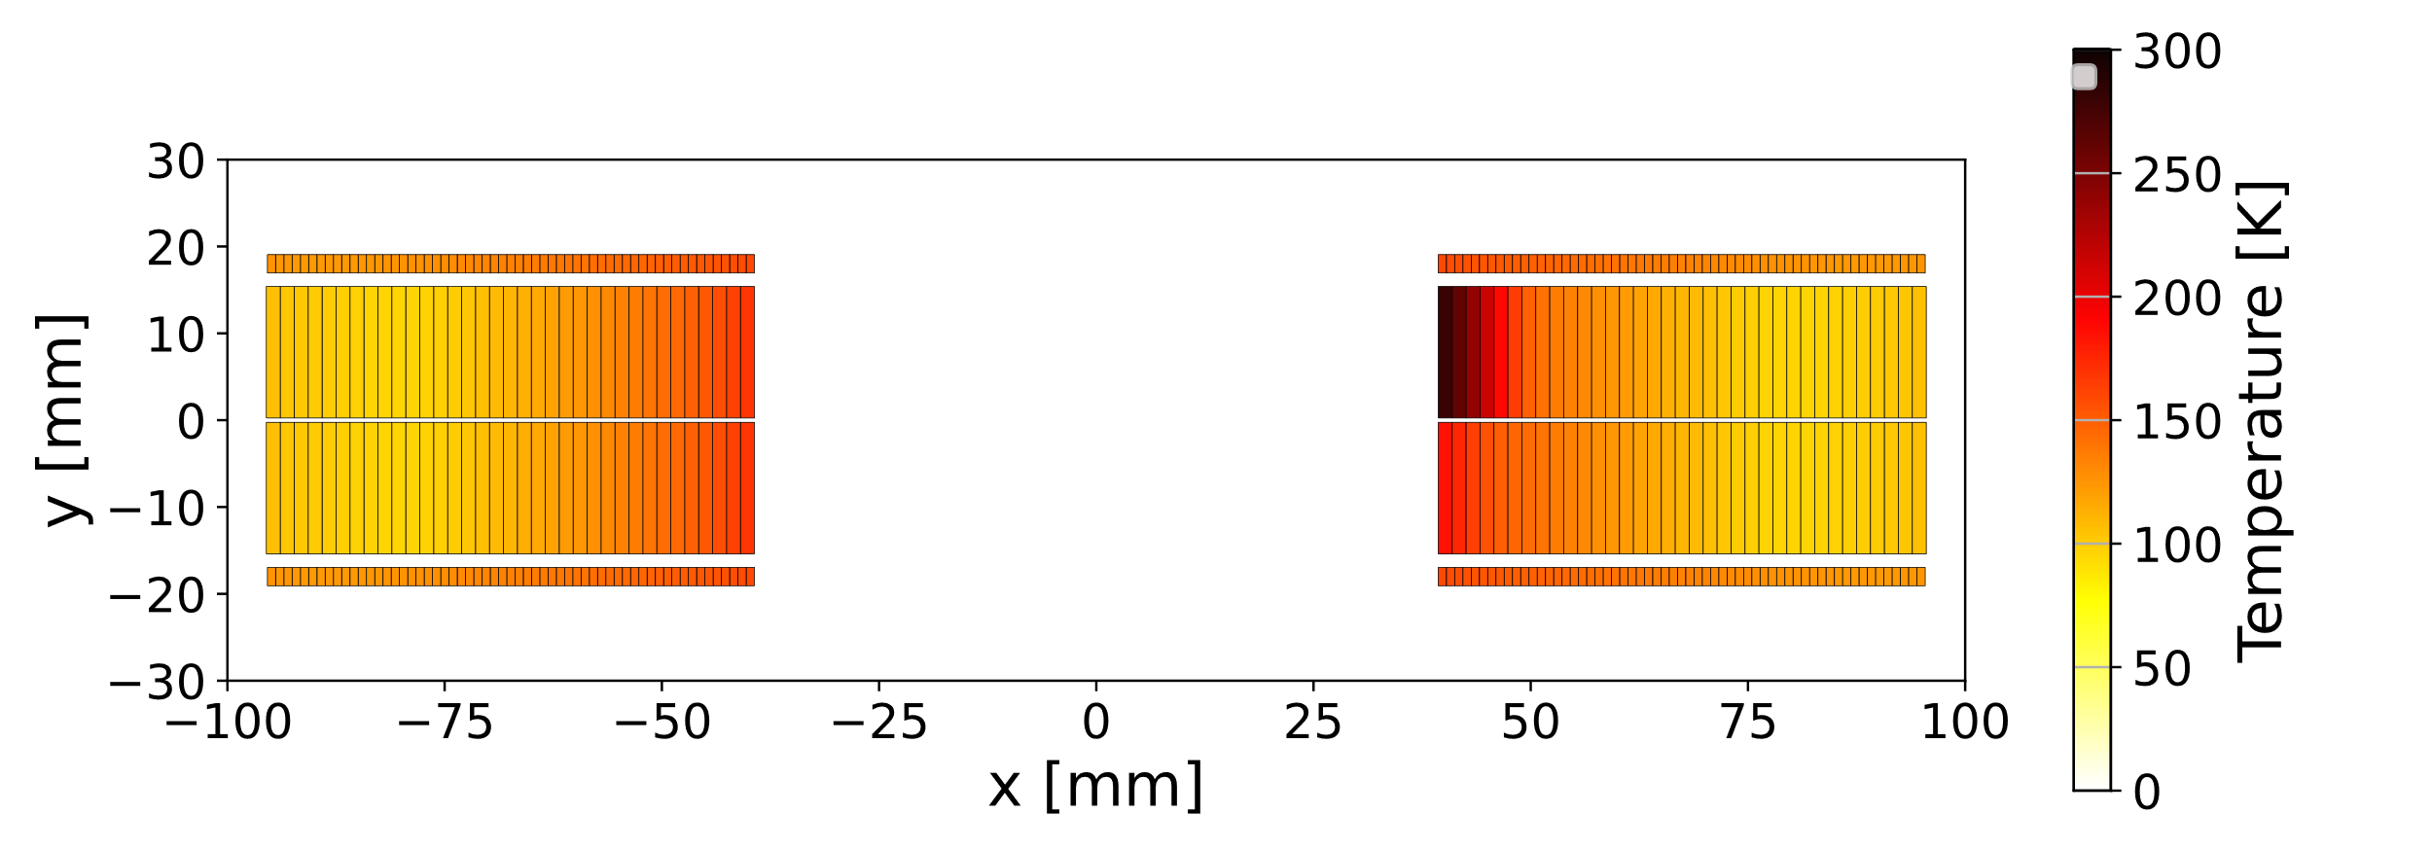
ESC studies for future magnets (not in scale)
1
3
5
7
6
4
8
2
1 - SMACC2 (D. Araujo, PSI), 2 - SMC (J.C. Perez, CERN), 3 - FCC MQ (M. Karppinen, CERN),
4 - BOND (A. Haziot, J.C. Perez, CERN), 5 - HFM 12 T (L. Fiscarelli, CERN), 6 - SMCC (D. Araujo, PSI),
7 - MQXF (P. Ferracin, S. Izquierdo Bermudez, et al., CERN, US HL-LHC AUP),
8 - US MDP 20 T cos-theta (M. D’Addazio (LBNL), V. Marinozzi (FNAL), E. Ravaioli (CERN), G. Vallone (LBNL))

Slide 34
Do we stop?
10 New
Quench Protection Methods
for High-Field Magnets

Slide 35
Six strategies successfully discovered/re-discovered over the years
Active magnet discharge by applying a voltage across the magnet EE, …
Passive energy extraction with magnetic coupling Coupled Secondary, …
Active heating via heat diffusion QH, …
Active heating via transient losses CLIQ, …
Active discharge with magnetic coupling ESC, …
Co-wound or bi-filar technology

Slide 36
Novel and Underexplored Quench Protection Methods for High-Field Magnets
Method | 1 | 2 | 3 | 4 | 5 | 6 | Reference
Energy Extraction (EE) | X |  |  |  |  |  | …
Energy Extraction with coupled secondary | X | X |  |  |  |  | Green, 1977, …
Quench protection heaters (QH) |  |  | X |  |  |  | …
EE + passive QH (magnet current partially driven through QH coils) | X |  | X |  |  |  | LHC Design Report (MU magnet)
Capacitive discahrge through central current lead |  |  |  | X |  |  | Green, 1977
Coupling-Loss Induced Quench system (CLIQ) |  |  |  |  |  |  | Ravaioli, “CLIQ”, PhD thesis, 2015
Inductive quench (inductive heating stations) |  |  |  | X |  |  | Bromberg et al., 2016
CLIQ with external coil |  |  |  |  |  |  | Ravaioli, “CLIQ”, CH 6, PhD thesis, 2015
External CLIQ (E-CLIQ) |  |  |  |  |  |  | Mulder et al., IEEE TAS, 2022
Secondary CLIQ (S-CLIQ) |  | X |  | X |  |  | Mentink and Ravaioli, SUST, 2020
Energy Shift with Coupling (ESC) |  | X |  | X | X |  | Ravaioli, Verweij, and Wozniak, SUST 2025
EE + coupled co-wound conductor (passive coil closed on itself) | X |  | X |  |  | X | Mentink el al., IEEE TAS 2016 Tong el al., IEEE TAS 2023
Capacitive discharge with magnet coils made with bi-filar conductor |  |  |  | X |  | X | Wakuda, Ichiki, and Park, IEEE TAS 2012
 |  |  |  |  |  |  | Krave, Marinozzi, IEEE TAS 2023
Dual-Capacitor Switching | X |  |  |  | X |  | Choi et al, IEEE TAS 2019
Active De-Excitation System Using Magnetically Coupled Secondary Coil and Charged Capacitor |  |  |  |  | X |  | Choi et al, IEEE TAS 2023
1 = Active magnet discharge by applying a voltage across the magnet. 2 = Passive energy extraction with magnetic coupling. 3 = Active heating via heat diffusion. 4 = Active heating via transient loss. 5 = Active discharge with magnetic coupling. 6 = Co-wound or bi-filar technology.
Notes: This is NOT an exhaustive list of all existing/possible quench protection systems. NEW’s mark 10 methods which I believe I’m showing here for the first time. Please let me know if I’m missing important information or references!
Method | 1 | 2 | 3 | 4 | 5 | 6 | Reference
Energy Extraction (EE) | X |  |  |  |  |  | …
Energy-extraction that becomes N times faster by putting some sections in parallel during the discharge | X |  |  |  |  |  | NEW
Energy Extraction with coupled secondary | X | X |  |  |  |  | Green, 1977, …
Quench protection heaters (QH) |  |  | X |  |  |  | …
EE + passive QH (magnet current partially driven through QH coils) | X |  | X |  |  |  | LHC Design Report (MU magnet)
Capacitive discahrge through central current lead |  |  |  | X |  |  | Green, 1977
Coupling-Loss Induced Quench system (CLIQ) |  |  |  |  |  |  | Ravaioli, “CLIQ”, PhD thesis, 2015
EE + passive CLIQ with R | X |  |  | X |  |  | NEW
EE + passive CLIQ with RC | X |  |  | X |  |  | NEW
Inductive quench (inductive heating stations) |  |  |  | X |  |  | Bromberg et al., 2016
CLIQ with external coil |  |  |  |  |  |  | Ravaioli, “CLIQ”, CH 6, PhD thesis, 2015
External CLIQ (E-CLIQ) |  |  |  |  |  |  | Mulder et al., IEEE TAS, 2022
E-CLIQ aimed specifically at changing B direction |  |  |  | X |  |  | NEW
Secondary CLIQ (S-CLIQ) |  | X |  | X |  |  | Mentink and Ravaioli, SUST, 2020
Energy Shift with Coupling (ESC) |  | X |  | X | X |  | Ravaioli, Verweij, and Wozniak, SUST 2025
EE + passive ESC (magnet current partially driven through ESC coils) | X |  |  | X |  |  | NEW
EE using ESC coils as extraction resistor (magnet current fully driven through ESC coils) | X | X |  | X | X |  | NEW
EE + coupled co-wound conductor (passive coil closed on itself) | X |  | X |  |  | X | Mentink el al., IEEE TAS 2016 Tong el al., IEEE TAS 2023
Capacitive discharge with magnet coils made with bi-filar conductor |  |  |  | X |  | X | Wakuda, Ichiki, and Park, IEEE TAS 2012
 |  |  |  |  |  |  | Krave, Marinozzi, IEEE TAS 2023
EE using ESC co-wound coils as extraction resistor (magnet current fully driven through ESC CW coils) | X | X |  | X | X | X | NEW
ESC with co-wound conductor |  | X |  | X | X | X | NEW
ESC with bi-filar conductor |  | X |  | X | X | X | NEW
Dual-Capacitor Switching | X |  |  |  | X |  | Choi et al, IEEE TAS 2019
Active De-Excitation System Using Magnetically Coupled Secondary Coil and Charged Capacitor |  |  |  |  | X |  | Choi et al, IEEE TAS 2023
Resonant transformer energy extraction |  | X |  | X | X |  | NEW
1 = Active magnet discharge by applying a voltage across the magnet. 2 = Passive energy extraction with magnetic coupling. 3 = Active heating via heat diffusion. 4 = Active heating via transient loss. 5 = Active discharge with magnetic coupling. 6 = Co-wound or bi-filar technology.
Notes: This is NOT an exhaustive list of all existing/possible quench protection systems. NEW’s mark 10 methods which I believe I’m showing here for the first time. Please let me know if I’m missing important information or references!

Slide 37
1. Energy-extraction N times faster by putting sections in parallel
Powering
N=2
Extraction made N times faster for the same peak voltage
1 power supply
2*N current leads
N energy-extraction resistors + Diodes
N-1 energy-extraction switches
1/N time constant → 1/N quench load
Conductor might be made smaller (wire rather than cable?)
Extraction

Slide 38
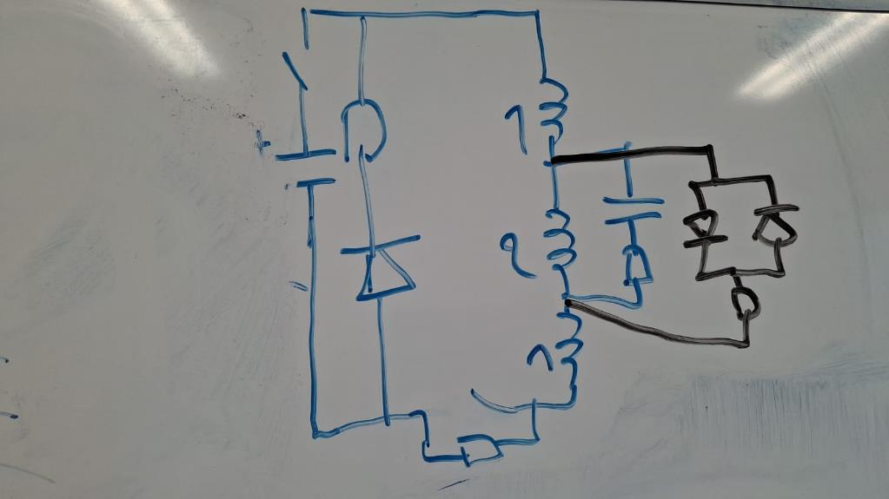
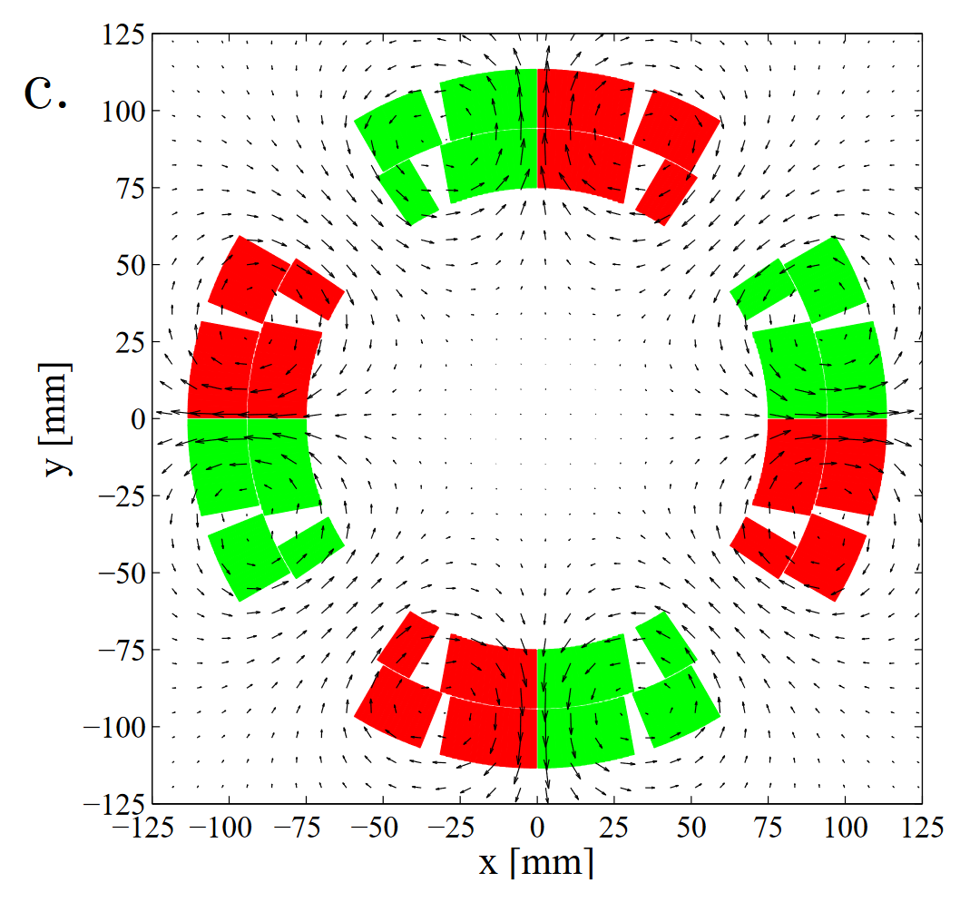
2. EE + “passive CLIQ” (resistors installed across selected coil sections)
dI/dt↓
dI₁/dt↓
dI₂/dt↑
dI₁/dt↓
CLIQ + EE performance with no need to install active CLIQ units (still extra leads are needed, unless at cold)
Conventional EE

Slide 39
3. EE + “passive CLIQ” (resistors+capacitors across coil sections)
dI₁/dt↓
dI₂/dt↑
CLIQ + EE performance with no need to install active CLIQ units (still extra leads are needed, unless at cold)
J. van Nugteren proposed this RC variant when we chatted about the previous idea
dI₁/dt↓

Slide 40
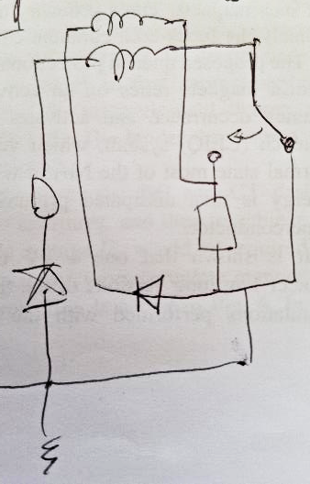
4. EE + passive ESC (magnet current partially driven through ESC coil)
Conventional EE
EE + Passive ESC

Slide 41
5. EE using ESC coil (magnet current fully driven through ESC coil)
Conventional EE
EE + Passive ESC
EE using ESC coil
with correct polarity ;-)

Slide 42
6. EE using ESC CW coil (magnet current fully driven through ESC coil)
CO-WOUND
Suddenly (<1 ms) the magnet current is halved and ohmic loss is divided by 4
Fast current redistribution likely quenches as quickly as CLIQ/ESC
Co-wound conductor heats up quickly…
EE using ESC coil
with correct polarity ;-)

Slide 43
7. ESC with co-wound coils
CO-WOUND
dI₁/dt↑
ESC₁
dI_{m}/dt↓
ESC₂
dI₂/dt↑
Some magnet and/or cable geometries are particularly well suited (6-in-1, SCSC, STAR©, wires in channel, etc)
Multipurpose coils for detection, protection, and…

Slide 44
8. ESC with bi-filar coils
dI₁/dt↑
ESC₁
dI_{m}/dt↓
ESC₂
dI₂/dt↑
Effectively this electrical circuit would look very similar to Secondary CLIQ

Slide 45
9. ESC/E-CLIQ aimed specifically at changing B direction
The critical current density of HTS tapes strongly depends on the magnetic field angle
One could design E-CLIQ or ESC coils to locally change the field direction for a short time to induce a quench not (only) due to transient loss, but also due to the much reduced current density margin
[This wouldn’t work in semi-isotropic conductors like CORC©, STAR©, SCSC, etc]

Slide 46
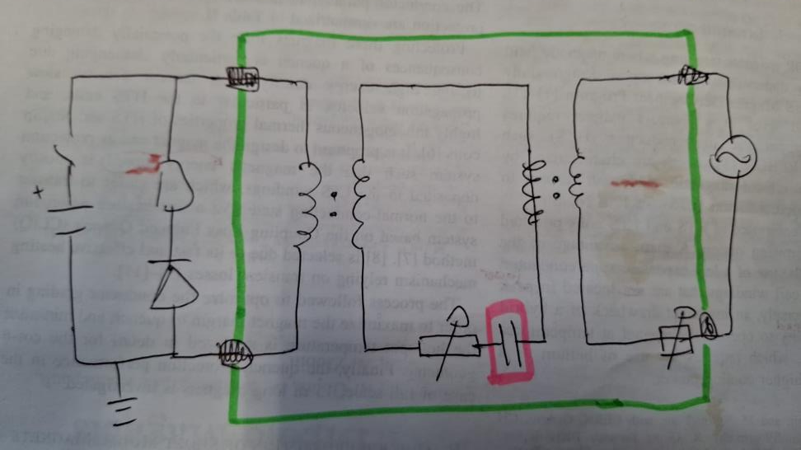
10. Resonant transformer energy extraction
Discharge a magnet with the same technology that charges a phone wirelessly
Central coil could have large conductor, few turns, huge current while right-side coil could have thin conductor, many turns
Is the capacitor needed/useful?

Slide 47
Magnet quench protection
ESC (Energy Shift with Coupling)
10 new ideas for quench protection
What next?
ESC first demonstration

Slide 48
Annex

Slide 49
A few words on SMC 107b training performance
5 training quenches at T=4.5 K. Last quench at 13695 A
V-I curve at T=4.5 K. Quench at 13640 A
9 training quenches at T=1.9 K . Last quench at 15136 A
2 training quenches at T=4.5 K. Last quench at 13625 A
V-I curve at T=4.5 K. Quench at 14290 A
>110 ESC discharges
1 training quench at T=1.9 K at 15045 A (protected by ESC)
1 training quench at T=4.5 K at 13563 A (protected by ESC)
1 training quench at T=4.5 K at 13567 A (protected by EE)
V-I curve at T=4.5 K. Quench at 14203 A

Slide 50
SMC 107b test campaign in a nutshell
Test type
Training at 4.5 K and 1.9 K using EE
V-I curve
ESC checkout
EE + ESC with 2 units
A. ESC with 2 units and 2 separate coils
B. ESC with 1 unit and 2 coils in series
C. ESC with 1 unit + 1 passive ESC coil
D. ESC with 1 unit (1 ESC coil disconnected)
EE with 2 passive ESC coils
ESC minimum energy to quench
Training at 4.5 K and 1.9 K using ESC
Training at 4.5 K using EE
V-I curve
Transfer Function Measurements
A
B
C
D

Slide 51
SMC 107b test campaign in a nutshell -2
A
I [A] | A, T=1.9 K | B, T=1.9 K | C, T=1.9 K | A, T=4.5 K | A, 1/2 voltage, T=4.5 K | B, T=4.5 K | C, T=4.5 K | D, T=4.5 K
15000 |  |  | 50 | - | - | - | - | -
13500 | 50 | 50 |  | 50 | 50 | 50 | 50 | 50
10875 | 50 |  |  | 50 | 50 |  | 50 | 50
7250 | 50 | 50 |  | 20-50 | 50 | 50 | 50 | 50
5800 |  |  |  | 20-50 | 50 |  | 50 | 50
4350 | 50 | 50 |  | 10-50 | 50 | 50
3625 | 50 | 50 |  | 10-50 | 50 | 50 | 50 | 50
2900 | 50 |  |  | 50
1450 |  |  |  | 50 | 50
1000 | 50 | 50 |  | 50 | 50 | 50 | 50 | 50
0 | 50 | 50 |  | 50 | 50 | 50 | 50 | 50
The numbers indicate the ESC (CLIQ) unit capacitance values in [mF]. Green: Quench induced. Red: Quench not induced. Yellow: Analysis is ongoing.
B
C
D

Slide 52
Conclusion: Very successful first ESC test campaign
Demonstrated that the ESC method works as expected
Demonstrated quench protection at all relevant current levels
Demonstrated quench protection during a training (detection → trigger → protection)
Demonstrated the redundancy of the method when only one unit is triggered
Demonstrated no magnet performance degradation after using ESC
Demonstrated reproducibility

Slide 53
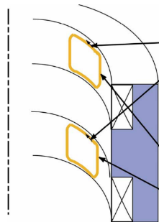
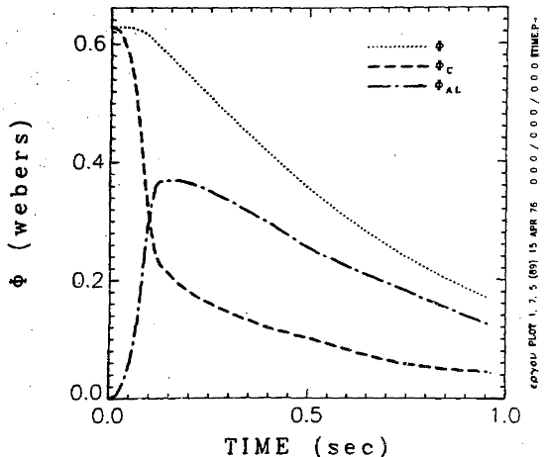
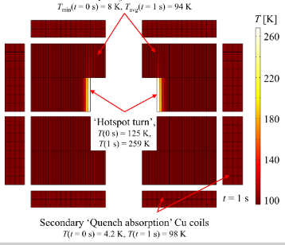

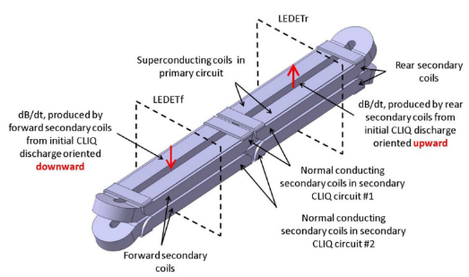
The 5 concepts that inspired the development of ESC
1. Inducing a quench with inductive heating using insulated coils
2. Extract energy with a coupled secondary
3. Design auxiliary coupled coils to extract energy
4. Inducing a quench with transient losses using the magnet coils
5. Double-purpose auxiliary coils
More information and references in the Annex

Slide 54
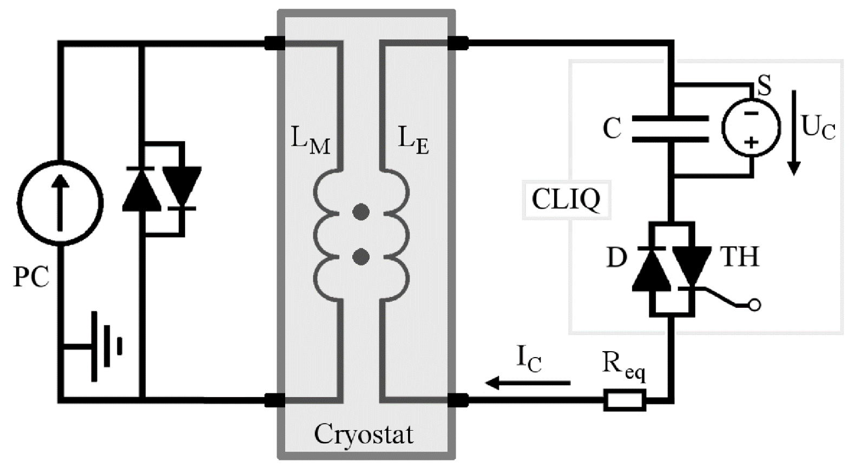
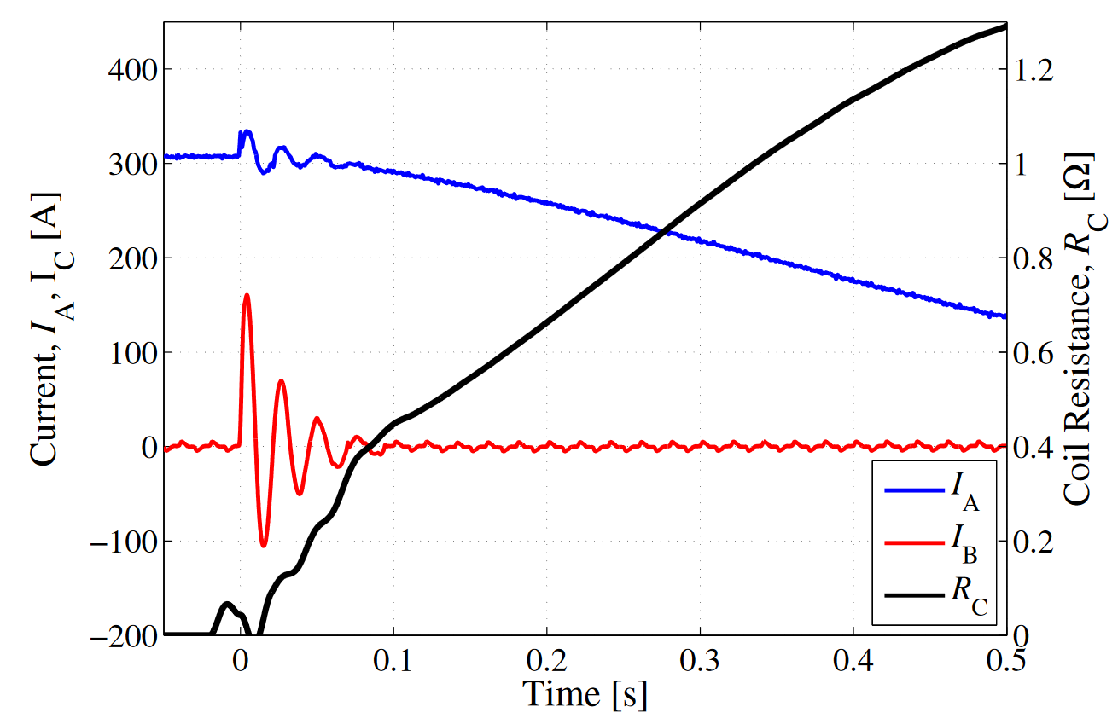
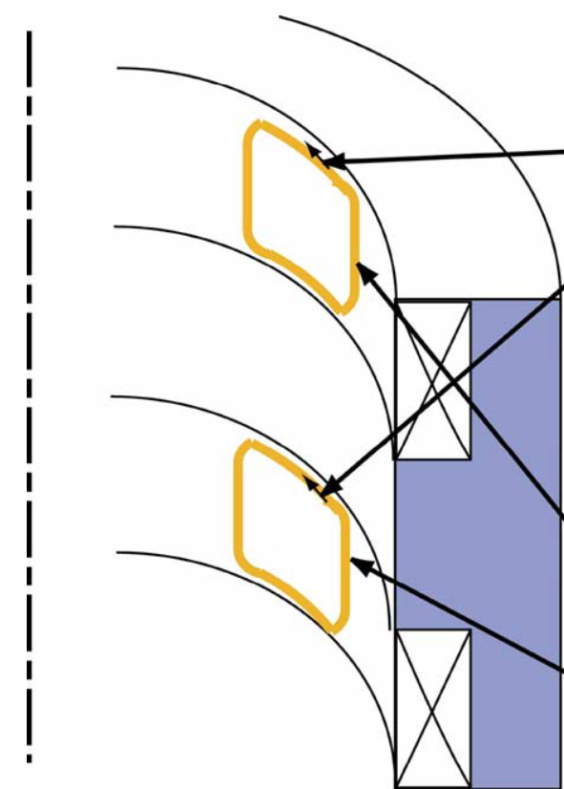
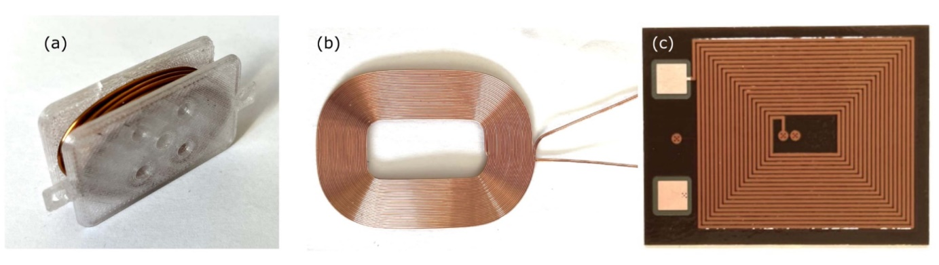
1. Inducing a quench with inductive heating using insulated coils
[1] L. Bromberg, J.V. Minervini, L. Myatt, T. Antaya, J.H. Schultz, Inductive quench for magnet protection, WO 2008030911 A2, US 7701677 B2, EP 2064564 A2, priority date: 7 September 2006
[2] L. Bromberg, J.V. Minervini, J.H. Schultz, T. Antaya and L. Myatt, Use of inductive heating for superconducting magnet protection, PSFC/JA-11-26, 2011
[3] L. Bromberg, J.V. Minervini, J.H. Schultz, L. Myatt, and T. Antaya, Internal Quench of Superconducting Magnets by the Use of AC Fields, IEEE Transactions on Applied Superconductivity, 2012
[4] R. Agustsson, J. Hartzell, and S. Storms, Inductively coupled pulsed energy extraction system for 2G wire-based magnets, Proceedings of PAC2013, Pasadena, CA USA, 2013
[5] E. Ravaioli, V.I. Datskov, A.V. Dudarev, G. Kirby, K.A. Sperin, H.H.J. ten Kate, and A.P. Verweij, First Experience with the New Coupling-Loss Induced Quench System, Cryogenics, 2014
[6] E. Ravaioli, “CLIQ”, Chapter 6, PhD thesis, 2015
[7] T. Mulder et al., “External Coil Coupled Loss Induced Quench (E-CLIQ) System for the Protection of LTS Magnets”, IEEE Trans. Appl. SC. 2022

Slide 55
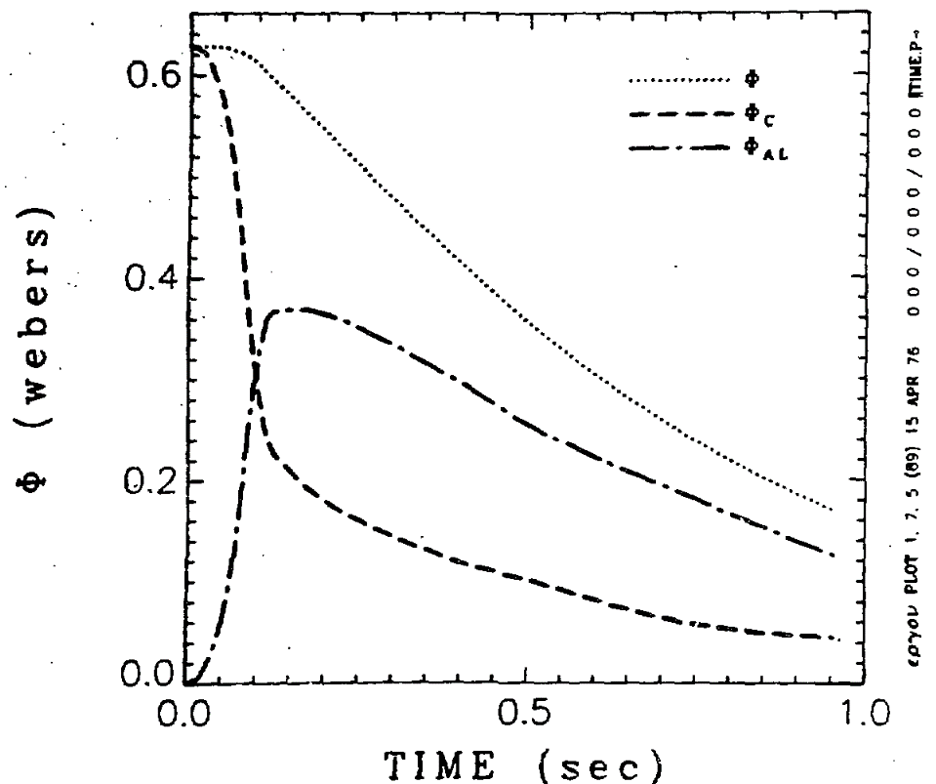
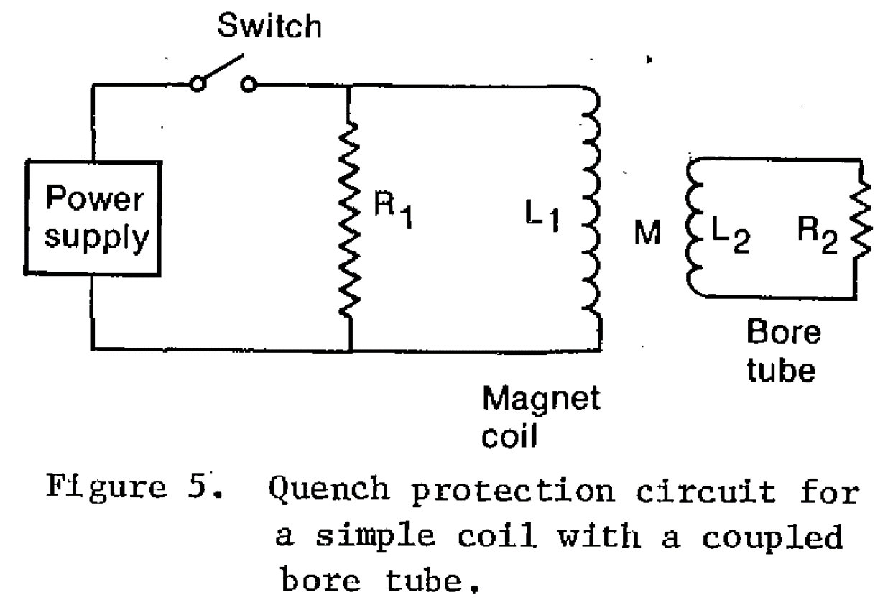
2. Extract energy with a coupled secondary
[8] M.A. Green, Large superconducting detector magnets with ultra thin coils for use in high energy accelerators and storage rings, 1977
[9] M.A. Green, Development of large high current density superconducting solenoid magnets for use in high energy physics experiments, [Thesis], 1977
[10] J.A. Taylor et al., Quench protection for a 2-MJ magnet, IEEE Transactions on Magnetics, 1979

Slide 56
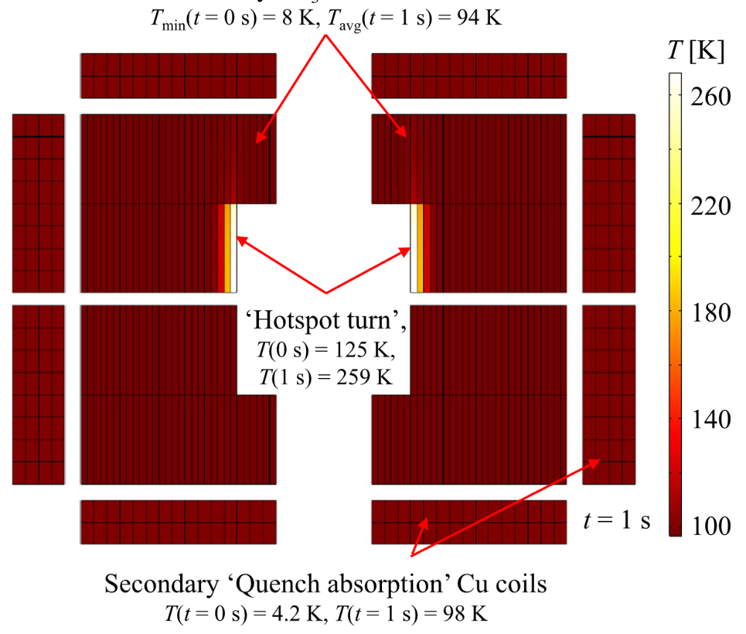
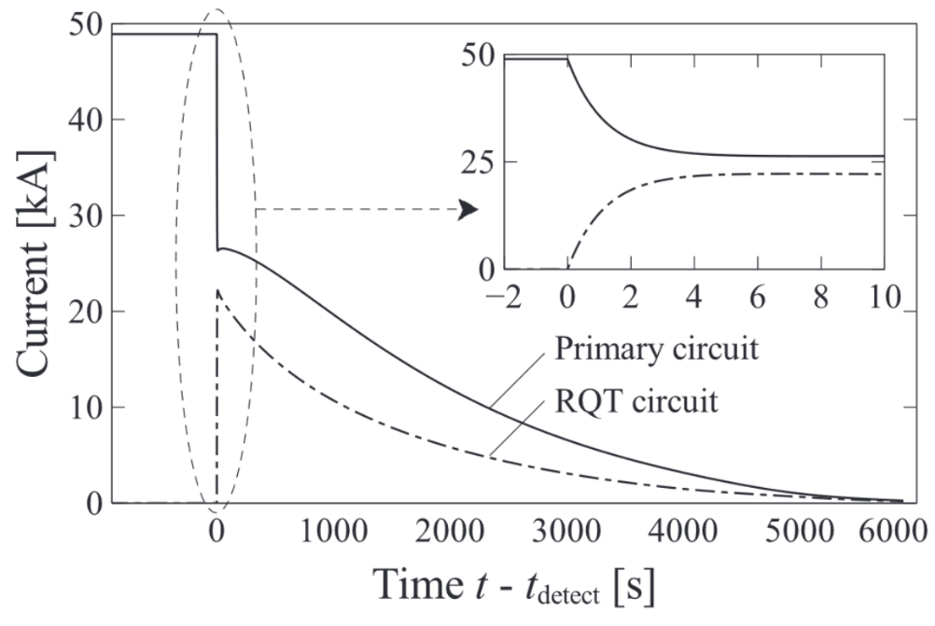
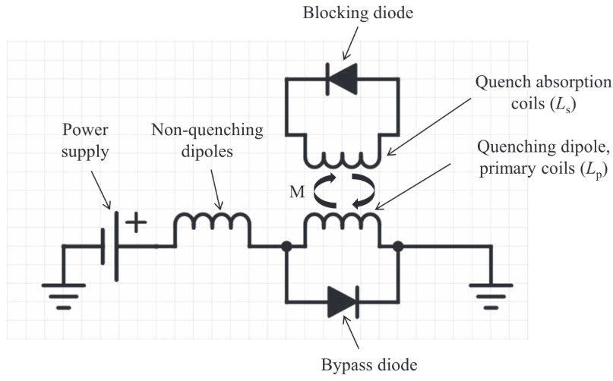
3. Design auxiliary coupled coils to extract energy
[11] M. Mentink et al., “Quench protection of very large, 50-GJ-class and high-temperature-superconductor-based detector Magnets”, IEEE Trans. Appl. Supercond., 2016
[12] M. Mentink and T. Salmi, “Quench absorption coils: a quench protection concept for high-field superconducting accelerator magnets”, SuST, 2017

Slide 57
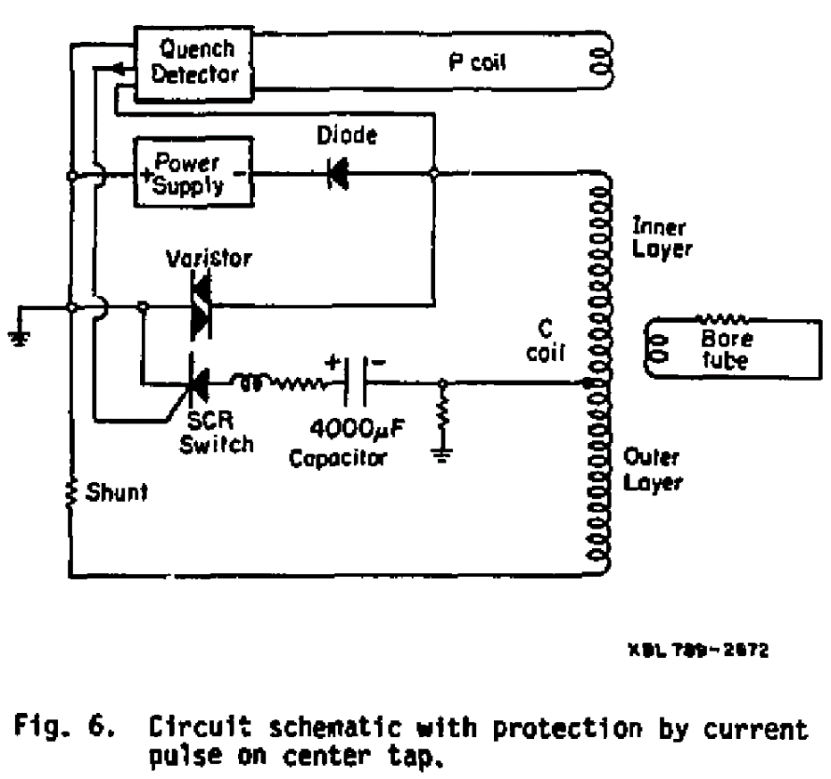
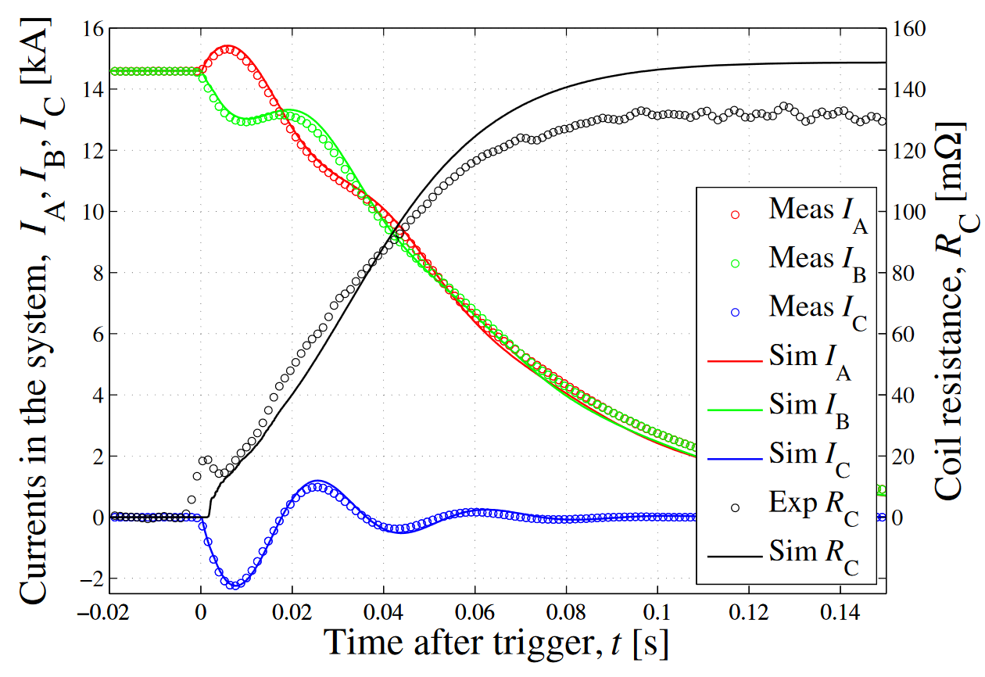
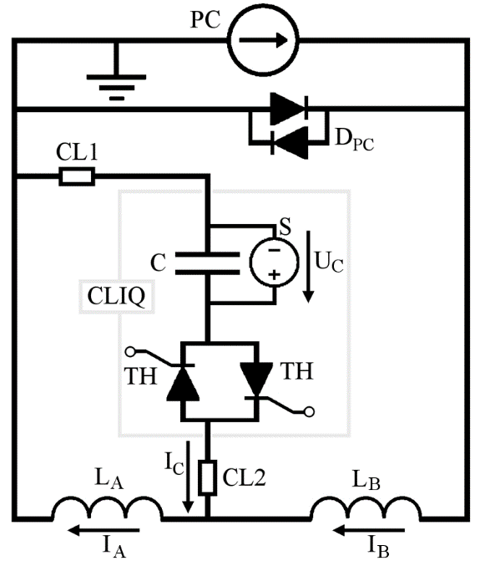
4. Inducing a quench with transient losses using the magnet coils
[10] J.A. Taylor et al., Quench protection for a 2-MJ magnet, IEEE Transactions on Magnetics, 1979
[13] R. M. Schöttler and H. W. Lorenzen , “Temperature and Pressure Rise in Supercritical Helium during the Quench of Indirectly Cooled SC Coils”, Cryogenic Eng. Conference Publication, 1996
[6] E. Ravaioli, “CLIQ”, PhD thesis, 2015
[14] E. Ravaioli et al., “New, Coupling Loss Induced, Quench Protection System for Superconducting Accelerator Magnets”, IEEE Trans. on Appl. SC, 2014
[15] V. Datskov, G. Kirby, E. Ravaioli, Patent EP13174323.9, 2013

Slide 58

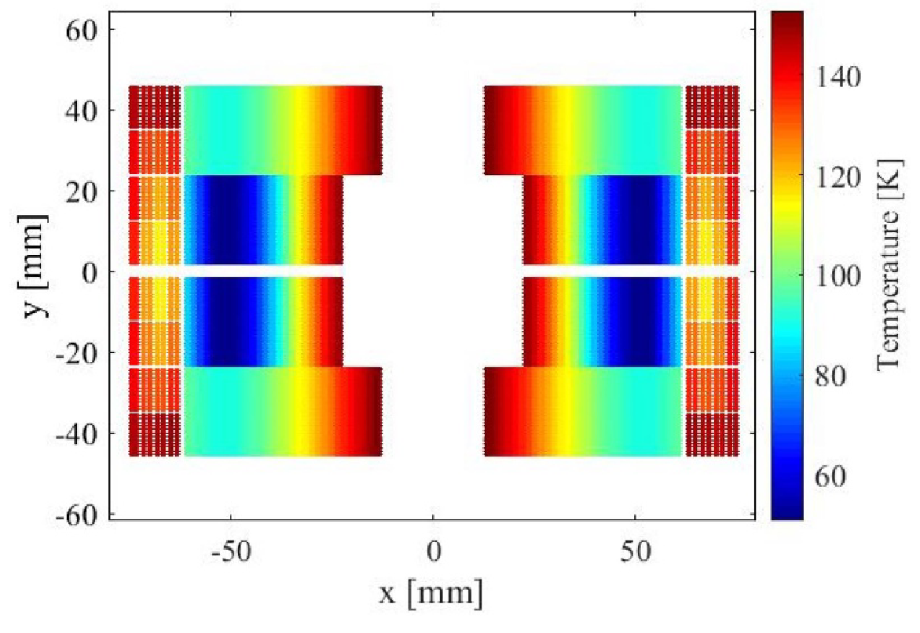
5. Double-purpose auxiliary coils
[16] M. Mentink and E. Ravaioli, “Secondary CLIQ, a robust, redundant, and cost-effective means of protecting high-field accelerator magnets,” Supercond. Sci. Technol., vol. 33, no. 8, 2020
[17] E. Ravaioli, T. Mulder, A. Verweij and M. Wozniak, "Optimizing Secondary CLIQ for Protecting High-Field Accelerator Magnets," IEEE Transactions on Applied Superconductivity, 2023

Slide 59
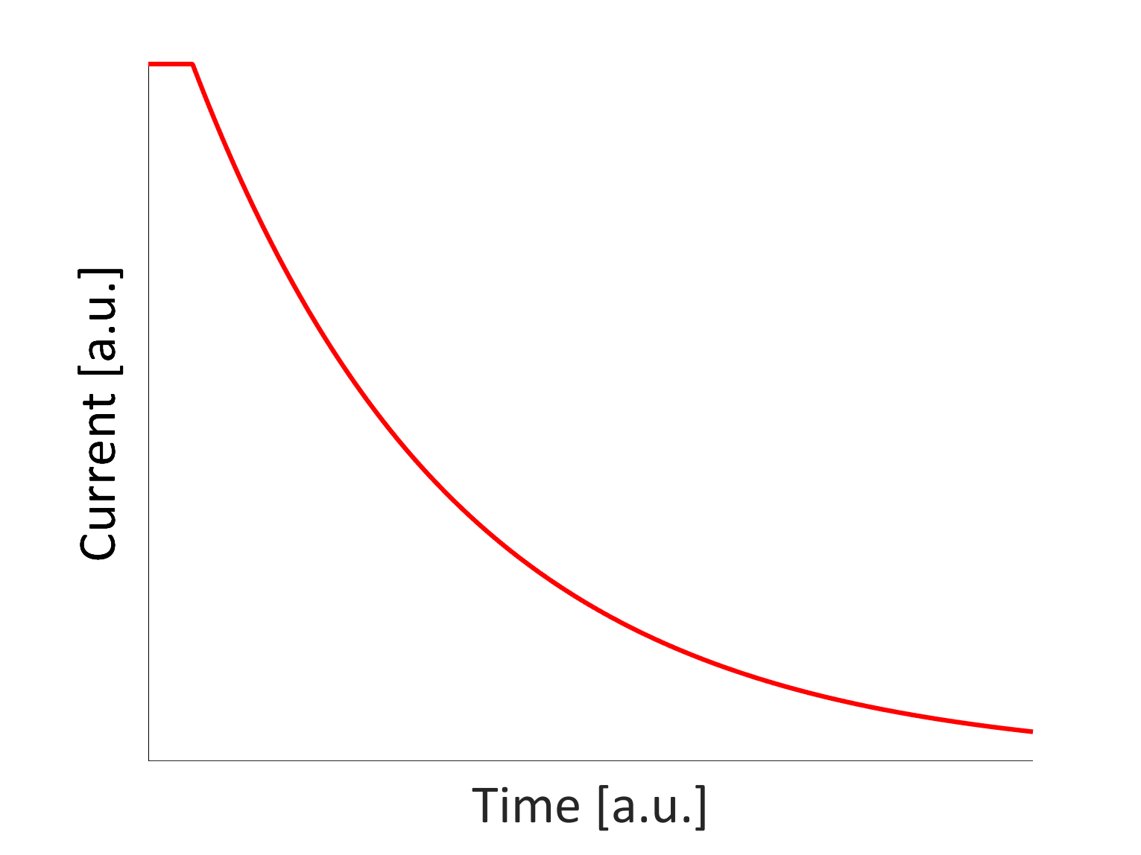
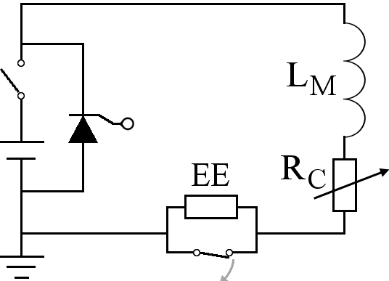
Energy extraction system (EE)
Advantages
Straightforward design and implementation
Extracts energy from the cryostat
Disadvantages
Can be large and expensive for high current magnets
Impractically high voltage needed for high current density magnets
Can’t be applied to a chain of high-field magnets
Note: EE of LHC main dipole circuits doesn’t protect magnets

Slide 60
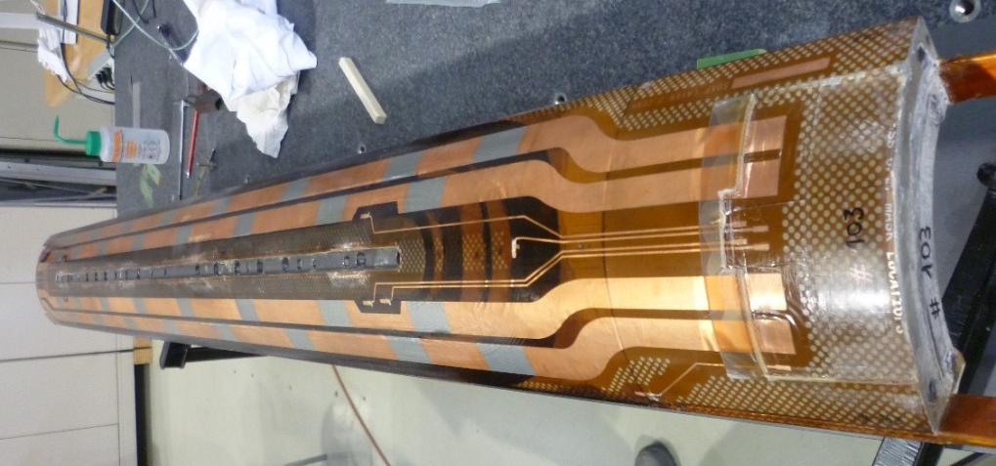
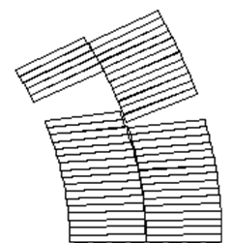
Quench Heaters (QH)
Strip heating
Heat transfer
to coil
Temperature increase
Coil SC→resistive
Magnet energy discharged
Courtesy of D. Cheng
Reduced hot-spot temperature
Advantages
Scales well with the magnet length
Doesn’t impose a voltage on the magnet coils
Well known and established technology
Disadvantages
Thin insulation between QH and conductor is risky
Challenging to cover all turns and layers
Challenging to cover all length (heating stations)

Slide 61

Coupling-Loss Induced Quench (CLIQ)
Current change
Field change
Transient losses
Temperature increase
Coil SC→resistive
Magnet energy discharged
Reduced hot-spot temperature
Advantages
Fast and effective heat deposition
Heat deposited simultaneously in most of the coil volume
Electrically robust system
Disadvantages
Direct electrical connection to the magnet circuit
Challenging to make it redundant
Additional asymmetric forces on the magnet coils

Slide 62

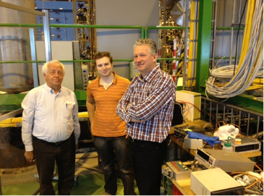



CLIQ (Coupling-Loss Induced Quench) technology
Current change
Magnetic field change
Coupling losses (Heat)
Temperature rise
Magnet current discharged
Coil SC→resistive
[ref] V. Datskov, G. Kirby, E. Ravaioli, Patent EP13174323.9, 2013
[ref] E. Ravaioli, “CLIQ”, PhD thesis, 2015
Reduced hot-spot temperature

Slide 63
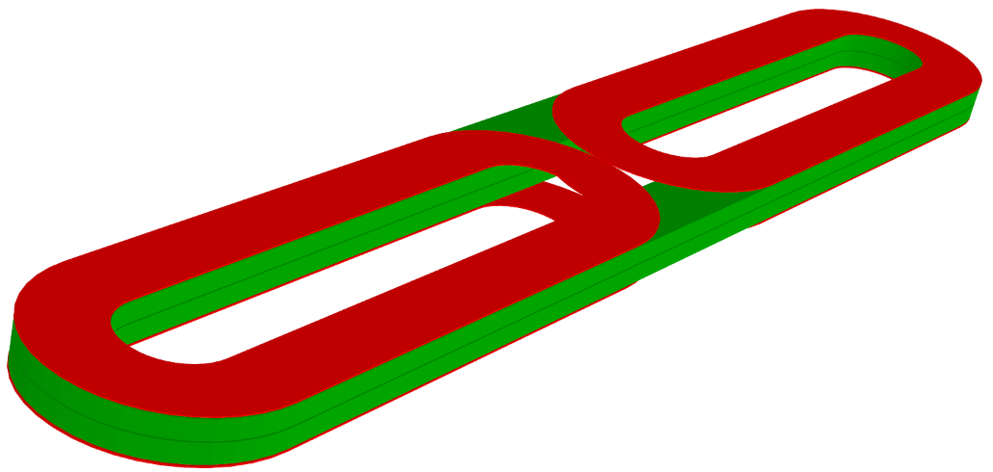


S-CLIQ (Secondary CLIQ)
auxiliary coil 1
magnet coils
auxiliary coil 2
[ref] M. Mentink and E. Ravaioli, “Secondary CLIQ, a robust, redundant, and cost-effective means of protecting high-field accelerator magnets”, SuST 2020, https://cds.cern.ch/record/2724798?ln=en.

Slide 64

CLIQ using an external coil

Slide 65


Inter-filament coupling loss
.
B
“Fast” loss:
Characteristic time constant in the order of ms or tens of ms
Deposited power density roughly proportional to (dB/dt)²
SC
Cu

Slide 66

SMC magnet and ESC coil parameters
SMC magnet parameters
Nominal current, I_{nominal} | 14500 A
Peak field on the conductor at I_{nominal} | 12.5 T
Operating temperature | 1.9 K
Differential inductance per unit length at I_{nominal} | 3.8 mH/m
Magnetic length | 0.38 m
Superconductor | Nb₃Sn
Number of strands | 40
Strand diameter | 0.7 mm
Cu/no-Cu ratio | 1.19
ESC coil parameters
Conductor material | Copper
Insulation material | Enamel
Wire cross-section | 2x0.8 mm²
Insulation thickness | 60-65 μm
Number of turns | 2x 60
Total cross-section | 2x 189 mm²
ESC coils cross-section / magnet coils cross-section | 2x 7%
Distance between magnet and ESC conductors | 1.775 mm

Slide 67
ESC unit and coil design
Fast reduction
of the magnet current
Unit capacitance
ESC unit design
Unit charging voltage
High dB/dt in most of
the magnet coil turns
Magnetic coupling between
ESC and magnet coils
ESC coil design
Extract energy
from the magnet
Magnetic field generated by the ESC coils in the magnet turns
Total ESC coil cross-section
Limit temperature and stress in the ESC coils
ESC conductor cross-section

Slide 68


Further analysis is ongoing to fully understand the transients
Aluminium Shell
(eddy currents during transients)
ESC coil 1
(Cu)
Magnet coil
(Nb₃Sn)
Iron Yoke and Pads
(nonlinear, shorter than the magnet coil)
ESC coil 2
(Cu)
3D transient analysis performed by M. Wozniak (CERN) using STEAM-FiQuS

Slide 69


ESC coil fabrication
Design of the ESC coils for SMC: E. Ravaioli, J. Bauche, M. Dumas, I. Garcia-Aguirrebeitia Sanchez, M. Masci, J.C. Perez, P. Wachal, M. Wozniak (CERN).
Fabrication of the ESC coils for SMC: J. Bauche, M. Dumas, I. Garcia-Aguirrebeitia Sanchez (CERN).

Slide 70
ESC technology development
Magnet | Conceptual design | Conductor selection | Magnetic design | Mechanical design | Integration study | ESC coil manufacture | ESC coil assembly | Test | Performance analysis
SMC | done | done | done | done | done | done | done | done | ongoing
PSI subscale | done | done | done | done | done | ongoing
MQXFS | done | done | done | ongoing | ongoing
HFM 12 T | done
HFM 12 T mirror | done
BOND | done | ongoing | ongoing
FCC MQ | done | done | done | ongoing | ongoing
PSI 13 T SMACC | done | ongoing | ongoing | ongoing | ongoing
PSI 14 T SMACC | done | ongoing | ongoing | ongoing | ongoing
MDP 20 T dipole | done | ongoing | ongoing
Many thanks to the designers who already considered using ESC.
It’s relatively easy (and very interesting!) to study new cases, so you’re very welcome to ask for a custom analysis.

Slide 71
The future of ESC technology
Fast design/simulation tools to study different applications
Demonstrate ESC on insulated high temperature superconductor magnets
Focus on applications that remove technology bottlenecks and enable
Keep an open mind (and eyes) for other protection techniques

Slide 72
Enabling a new design space for superconducting magnets?
Conventional high-field magnet designs are often limited by
Critical current density
Stress in the conductor
Quench protection
Targets for Optimized ESC
90% magnet conductor quenched in 5 ms
90% magnet’s stored energy extracted
Less stabilizer needed
Lower Cu/Ag fraction
Smaller conductor
More compact magnet
Future R&D efforts
Lower Cu/Ag fraction
Use the extra space for strand reinforcement
Use the extra space for stress-management elements
It’s likely that past rules of thumb for designing quench protection will need to evolve. For ex:
Current density J
J²/f_{stabilizer}
“Time margin”
Challenges
Integrate ESC coils
Mechanical analysis including transients
Identify most effective ESC coil concepts
Cu/Ag can’t be reduced at will (due to stability, mechanical strength)
Current density can’t be increased at will (stress in the conductor)

Slide 73
References
Energy extraction with coupled secondary
M.A. Green, Large superconducting detector magnets with ultra thin coils for use in high energy accelerators and storage rings, 1977.
M.A. Green, Development of large high current density superconducting solenoid magnets for use in high energy physics experiments, [Thesis], 1977.
J.A. Taylor et al., Quench protection for a 2-MJ magnet, IEEE Transactions on Magnetics, 1979.
Coils to extract/absorb energy
M. Mentink et al., “Quench protection of very large, 50-GJ-class and high-temperature-superconductor-based detector Magnets”, IEEE Trans. Appl. Supercond., 2016.
M. Mentink and T. Salmi, “Quench absorption coils: a quench protection concept for high-field superconducting accelerator magnets”, SuST, 2017.
Quench protection based on inductive heating
L. Bromberg, J.V. Minervini, L. Myatt, T. Antaya, and J.H. Schultz, “Inductive quench for magnet protection”, September 2006.
L. Bromberg, J.V. Minervini, J.H. Schultz, T. Antaya, and L. Myatt, “Use of inductive heating for superconducting magnet protection”, PSFC/JA-11-26, 2011.
L. Bromberg, J.V. Minervini, J.H. Schultz, L. Myatt, and T. Antaya, “Internal quench of superconducting magnets by the use of AC fields”, IEEE Trans. on Appl. SC, 2012.
R. Agustsson, J. Hartzell, and S. Storms. Inductively coupled pulsed energy extraction system for 2G wire-based magnets. Proceedings of PAC2013, 2013.
Other quench protection methods
Y. tong et al., “Quench Behavior of a Superconducting Dipole Magnet Protected by a Scheme With the Adjustable Quench-Back”, IEEE Trans. on Appl. SC, 2023.
T. Choi et al., “A New Quench Protection System Using Dual-Capacitor Switching for Fast Energy Extraction From HTS Magnets” , IEEE Trans. on Appl. SC, 2019.
T. Choi et al., “Active De-Excitation System Using Magnetically Coupled Secondary Coil and Charged Capacitor for Fault Protection of Superconducting Coils, IEEE Trans. on Appl. SC, 2023.
Bi-filar conductor quench protection
T. Wakuda, Y. Ichiki and M. Park, "A novel quench protection technique for HTS coils", IEEE Trans. on Appl. SC, 2012.
S. Krave and V. Marinozzi, “Bi-Filar Coil Winding for Fast Quench Protection”, IEEE Trans. on Appl. SC, 2023.
CLIQ
E. Ravaioli, “CLIQ”, PhD thesis, 2015.
E. Ravaioli et al., “New, Coupling Loss Induced, Quench Protection System for Superconducting Accelerator Magnets”, IEEE Trans. on Appl. SC, 2014.
V. Datskov, G. Kirby, E. Ravaioli, Patent EP13174323.9, 2013.
E. Ravaioli et al., "First experience with the new Coupling Loss Induced Quench system", Cryogenics 2014.
E. Ravaioli et al., “Towards an Optimized Coupling-Loss Induced Quench Protection System (CLIQ) for Quadrupole Magnets”, Physics Procedia, 2015.
CLIQ with external coil
E. Ravaioli, “CLIQ”, PhD thesis, Chapter 6, 2015.
E. Ravaioli et al., "First experience with the new Coupling Loss Induced Quench system", Cryogenics 2014.
E-CLIQ
T. Mulder et al., “External Coil Coupled Loss Induced Quench (E-CLIQ) System for the Protection of LTS Magnets”, IEEE Trans. Appl. SC. 2022.
S-CLIQ
M. Mentink and E. Ravaioli, “Secondary CLIQ, a robust, redundant, and cost-effective means of protecting high-field accelerator magnets”, SuST, 2020.
E. Ravaioli, T. Mulder, A. Verweij and M. Wozniak, "Optimizing Secondary CLIQ for Protecting High-Field Accelerator Magnets," IEEE Transactions on Applied Superconductivity, 2023.
ESC
E. Ravaioli, A. Verweij, and M. Wozniak, “Energy shift with coupling (ESC): a new quench protection method”, SuST, 2025.
STEAM-LEDET simulations
E. Ravaioli et al., “Lumped-Element Dynamic Electro-Thermal Model of a Superconducting Magnet”, Cryogenics, 2016.
E. Ravaioli et al., "Modeling of Inter-Filament Coupling Currents and Their Effect on Magnet Quench Protection", IEEE Trans. on Appl. SC, 2017.

