Slide 1
Transient Current Measurements for SMCT1b
S. Krave
IDSM 3
4 April 2025

Slide 2
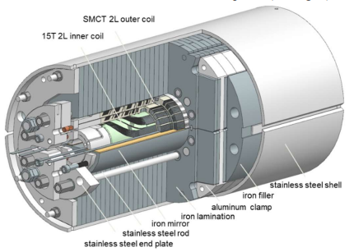
SMCT1b
The SMCT Magnet is a 4 layer cosine theta design with an aperture of 60mm.
This presentation focuses on the mirror configuration test with both coils powered in series (1b)
  A. V. Zlobin, I. Novitski, M. Baldini and E. Barzi, Quench Performance of a Large-Aperture Nb3Sn Cos-Theta Coil With Stress Management in Dipole Mirror Configurations
The outer coil (stress managed coil) has already been tested without powering the inner coil (SMCT1a)

Slide 3
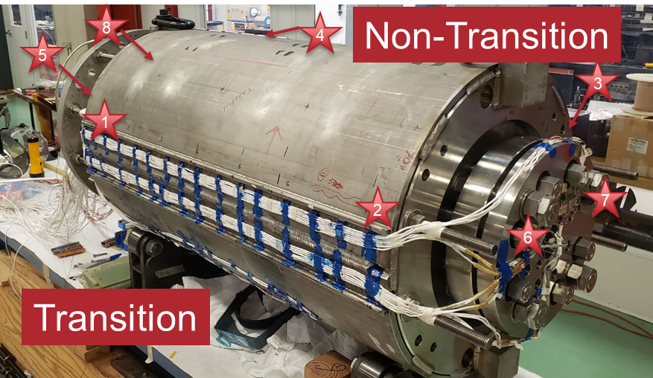
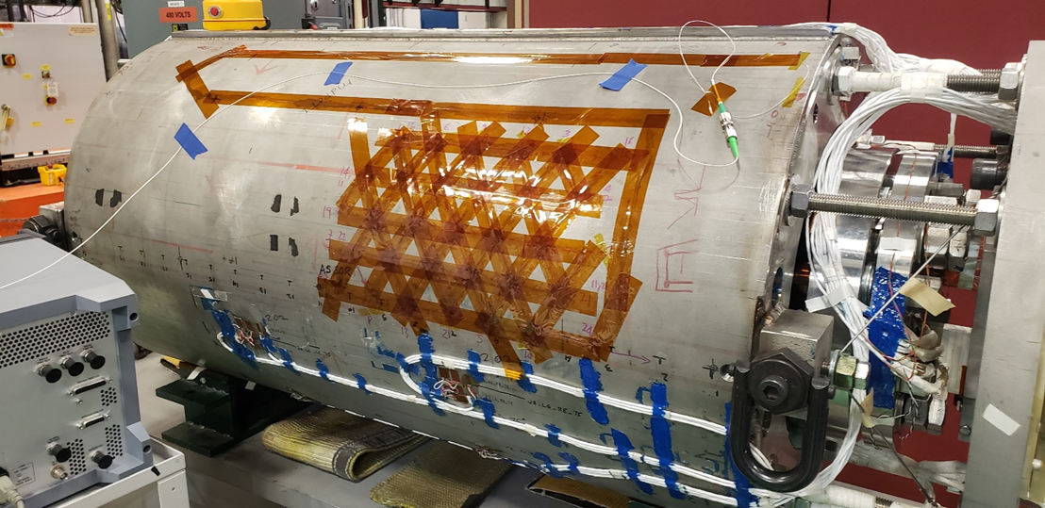
Magnet instrumentation
SMCT01b was tested at FNAL in VMTF and utilized the built in quench protection and diagnostics
  Several voltage taps at 7200 Hz +/-1 second of quench
  Strain gauges (slow scan, every several seconds)
Additionally:
  8 acoustic sensors
  External fiber grid
Acoustic Sensors

Slide 4
Magnet Behavior
Initial magnet ramps (6 or so) tripped on very large voltage spike events, tripped in FPGA detector.
  These spikes assumed to not be quenches and were not logged normally.
An analog filter on the suspect channels (half-coil) was added to suppress initial trips
  This allowed the magnet to continue to operate to such that we could observe magnet behavior
Spikes continued to occur, but at higher levels, apparently training.

Slide 5
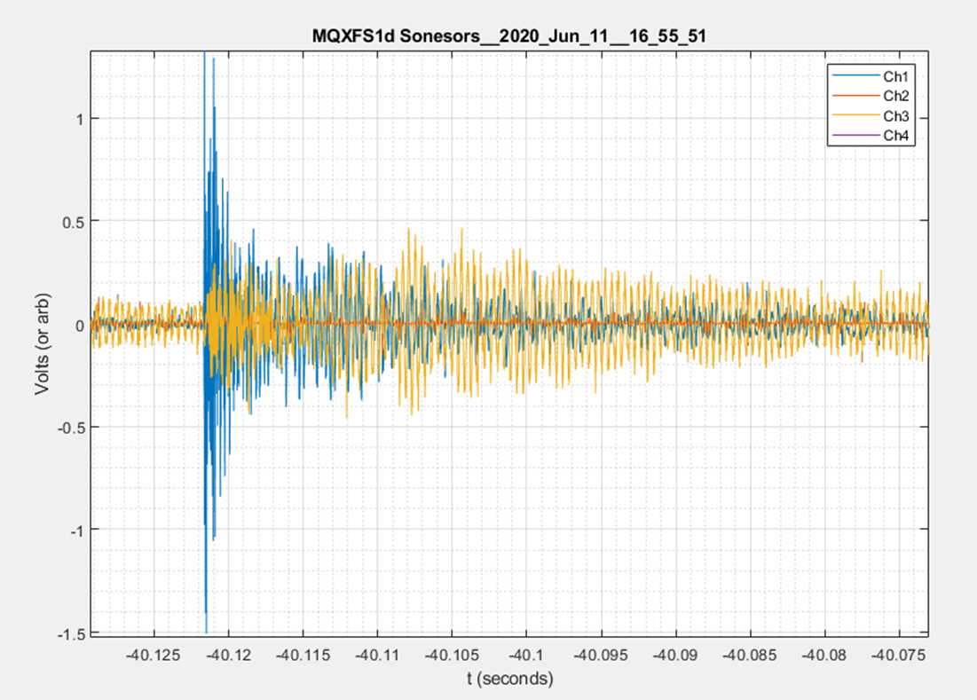
Example “Fake” acoustic data
Due to several compounding issues the acoustic sensors on this magnet initially appeared OK, but were mostly non-functional
  Initial USB issues
    Fixed, new cord
  Sensors had no power
    Installed current limiting resistors on each channel
  Sensors produced incorrect data
    Data was likely emi issue from sensor mis-wiring
  They still pick something up.

Slide 6
Adding Channels
Since additional channels were available, some additional instrumentation was added
Half-coil Bucked from AQD
Current (1V = 3kA)
Quench Trigger
A mix of plots for now from the picoscope app, used to capture and convert the data, and MATLAB, used for additional analysis and plotting.
This presentation focuses on ramp 55 when including current data, however voltage spikes and the correspondence in the acoustic channels holds for all ramps.
Spikes are most prevalent at high current and low to moderate ramp rates (below ~10ish kA).
I presume this is a mechanical hysteresis behavior with frictional forces preventing motion at lower current.

Slide 7
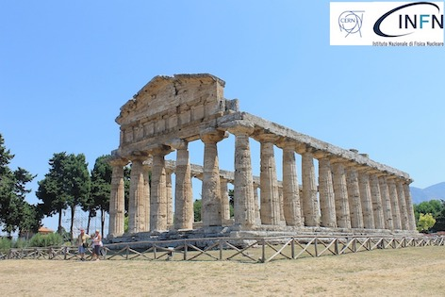
Following in work done at CERN by Gerard Willering-Transients and quantification of Coil Displacement in Accelerator Magnets , it may be possible to determine coil motion from voltage spikes/current dips
Likely need good resolution on the current channel, likely in the mA range.
Our current measurement is shown to the right
  ~+/- 20A
  Low measurement resolution (10A)
  ~3 orders of magnitude higher than we would like
Example current signal from VMTF

Slide 8
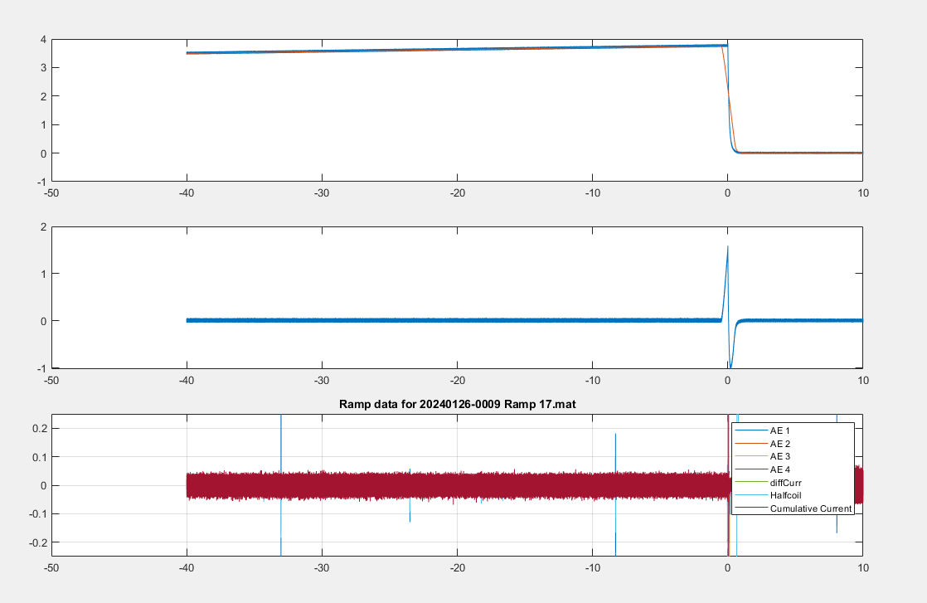
Early Correction/smoothing of current channel (fullscale)
DC Coupled Current channel smoothed and subtracted on 0-10V transducer output at 3 kA/volt
Not enough resolution to determine anything at this point

Slide 9
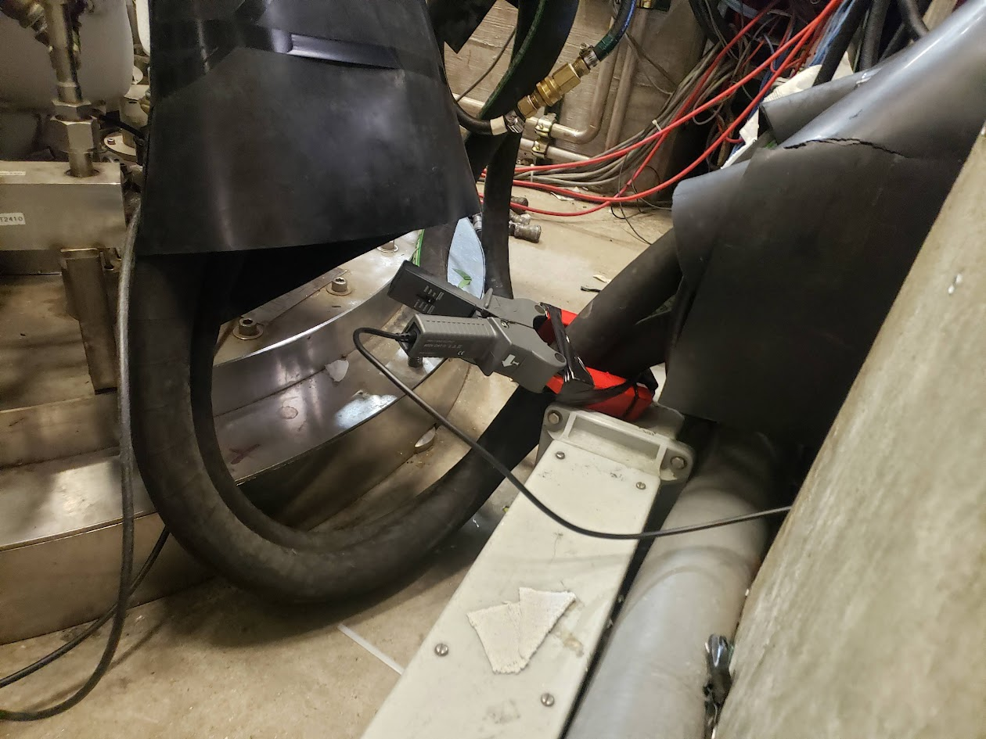
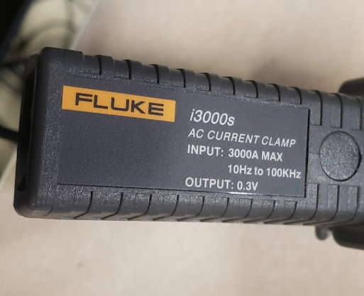
Transient Current Measurement for Last Quenches
After some unsuccessful processing of the power supply signal, we added a traditional current clamp (Rogowski coil). The Rogowski coil rejects DC and only shows AC component of signal.
Clamp Installed on + lead
Positive direction oriented towards magnet
Fluke I3000s, 10 Hz to 100 kHz
  Set to 10 mV/Amp
  Connected to picoscope
  A bit broken, but still functional. Held together with electrical tape.

Slide 10
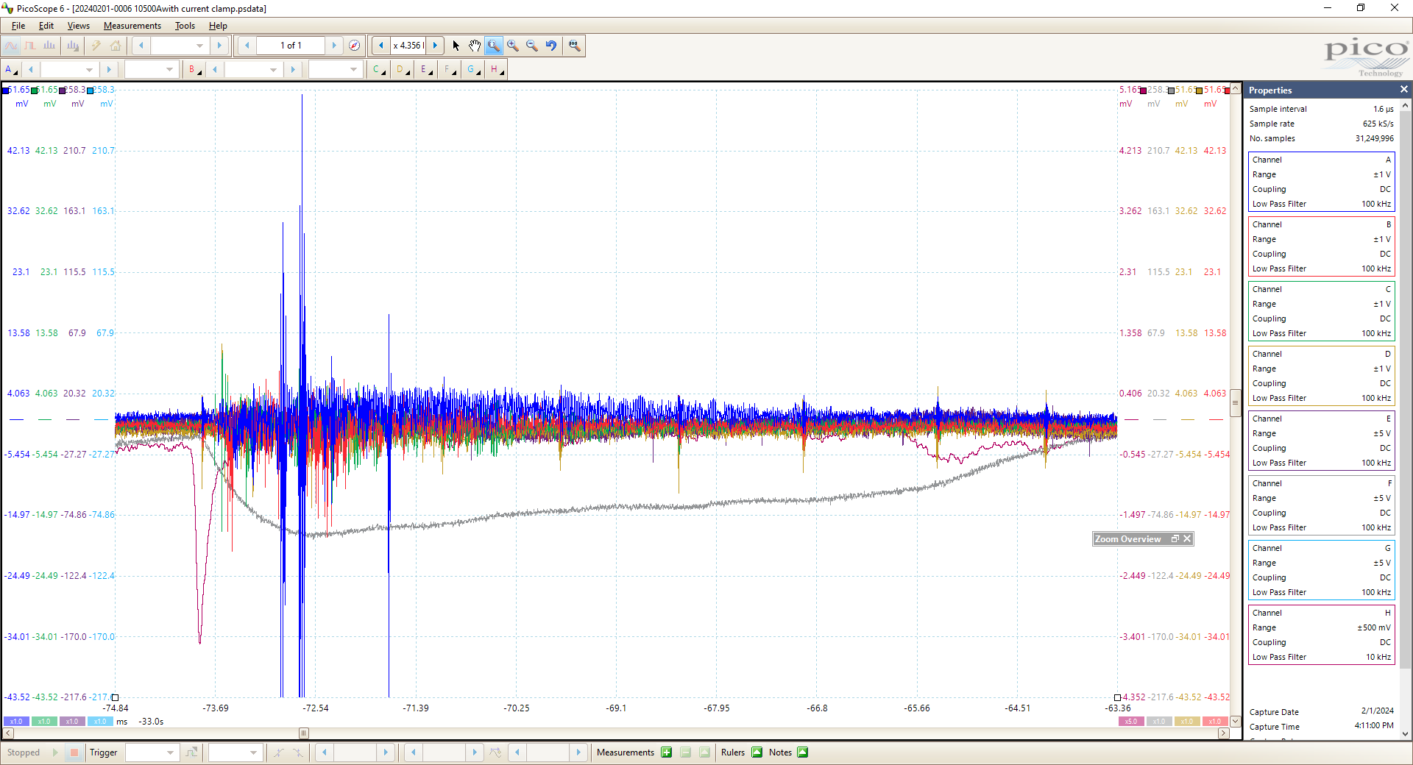
“Acoustic” response
Half Coil Bucked ~100 mV
Current Drop
-340 mA

Slide 11
Example Data from Non-quench Spike
One of the first current spikes recorded on slight current change between 10 and 10.5 kA. The magnet did not quench

Slide 12

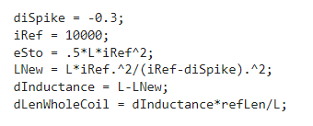
Determining displacement via conservation of energy
Estimate a change in length based on inductance per unit length
Stress managed structure and laminations are very rigid
Inductance/StraightSectionLength
  4.06 mH/0.5m = 0.0081 mH/M
  Note, for individual coils,
Assume energy is conserved and calculate the current change as a function of inductance
Example shown for 300 mA dip in current
  If this was an energy loss it would be 12.18 Joules
  The corresponding length change is 50 µm
Estimate the length change based on the different inductance from Inner/outer coil extracted from balancing. As a ratio of the total inductance or length change (maybe re-evaluate later)
  L_{outer} = 2.8 * L_{inner}
  Dl_{inner}/dL = 3.8* dl_{total}/dL
  So that 300 mA spike above is now associated with a ~200 µm change of the inner coil

Slide 13
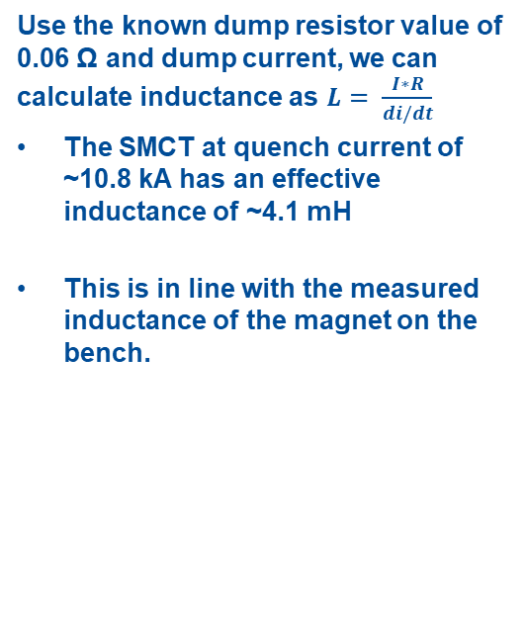
Calculating Inductance
Use the known dump resistor value of 0.06 Ω and dump current, we can calculate inductance as $L= \frac{I∗R}{di/dt}$
The SMCT at quench current of ~10.8 kA has an effective inductance of ~4.1 mH
This is in line with the measured inductance of the magnet on the bench.

Slide 14
Ramp 55: Data collected with normal ramp and AC Current measurement
Developed a dynamic filter to better identify spikes without washing out data shape
Using a min prominence of 0.075 A, 18 spikes were detected in the last 90 seconds of ramp
Average displacement for whole coil of 12.5 µm per detectable event
Total displacement of 223 µm
If the inner coil only is responsible for this shift, it is moving 855 µm in the last 90 seconds of the ramp

Slide 15
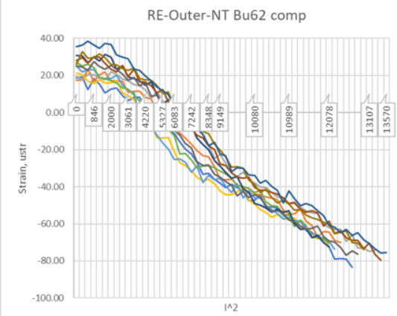
Cross checking with strain gages
Since magnet structure is instrumented with strain gages, it may be possible to check for motion on gages.
Best gages here are bullets which measure load. They do not measure structure strain.
Note that dl/l per event is expected to be ~12µm/2m (6 µε)
On first glance, the strain gages are too noisy to see any generic bahavior that matches
Future work: apply some filtering
Additional work:
  Look into timing of strain discontinuities with spike events.

Slide 16
This spike behavior is reversible
As a function of friction, this behavior exhibits hysteresis and is reversible.
It exists during ramp down as well; however, the spikes occur in the opposite direction as the magnet inductance is decreasing.
This spike is positive 20 mA

Slide 17
If we look at the halfcoil imbalance on each event, we see that it resolves in ~1/120 s. This corresponds to 0.5 NPLC, likely a result of the power supply correcting the current in response to the spike.
We can calculate the volt-seconds of this event as the integral over the time window, assuming that the filtering applied reasonably removes offsets to the data and that the regular signal is centered on 0.
The small voltage bump ends with a value of <1 mV*Second (except for the quench)

Slide 18
Converting halfcoil to similar units (by multiplying by I_{OP)}
Multiply by operating current at the time of each spike event, roughly 10 kA
Coil delta Q equivalent in Joules is nearly equivalent to halfcoil imbalance
  This delta Q was calculated above from the energy change at the operating current as a function of inductance.
  Does this make sense?
  I would have assumed that the voltage present is proportional to the imbalance of the half-coil bucked signal

Slide 19
Event 18 (Raw data) The Quench
Following I present a couple events worth of data, 1st the quench because that is what we care about, but then an additional event that is typical of all other observed events
Note that non-spike voltage growth begins ~5ms after spike
AE: Yes
Current Spike: Yes
Coil Imbalance: Yes
Most activity in purple/yellow

Slide 20
Event 18 with filtered curves
Dump begins
Note that because of symmetric filter, Halfcoil data is blown out.
With filtering, sharp current spike is visible 10 ms before quench
Dump Forced commutation start

Slide 21
Note small bump in spike current channel as power supply appear to return to normal operation
Indicates that halfcoil spike is likely result of power supply correcting the current drop
This bump is almost always ~15 ms after the initial change (1 power line cycle)
  Why? One would assume that spike events are random
  Does the ripple in the magnet psu cause the motion???
This second spike is prevalent in many halfcoil signals.

Slide 22
Timing
The onset of the current spike precedes the halfcoil signal by approximately 200µs
This change in current is ~ 90 mA (1 part in 125,000)

Slide 23
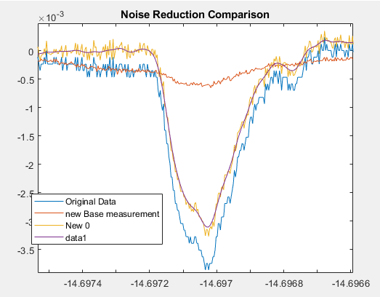
Noise reduction in signals
Signals contain a large amount of 60 Hz and 720 Hz noise (12 cycles per cycle)
Applied an effective comb (ish) filter subtracting median of 12 cycles at 720 Hz from smoothed data.
This shifts data where nothing is very different back to centered on 0
% oldDat is input data, Fs is sample frequency;
nplc = 12; %Use median value for 10 nplc to compute average
FsRef = 720; % Choose 60 Hz as reference, use 720 as it picks up a couple harmonics from the data.
lFilt = round(nplc*Fs/FsRef);
newRef = zeros(size(oldDat));
for n = 1:lFilt
redDat = oldDat(n:lFilt:end);
raDat = smoothdata(redDat,'movmedian', nplc);
newRef(n:lFilt:end)= raDat;
end
newDat = oldDat - newRef; %Subtract new reference waveform
toc

Slide 24
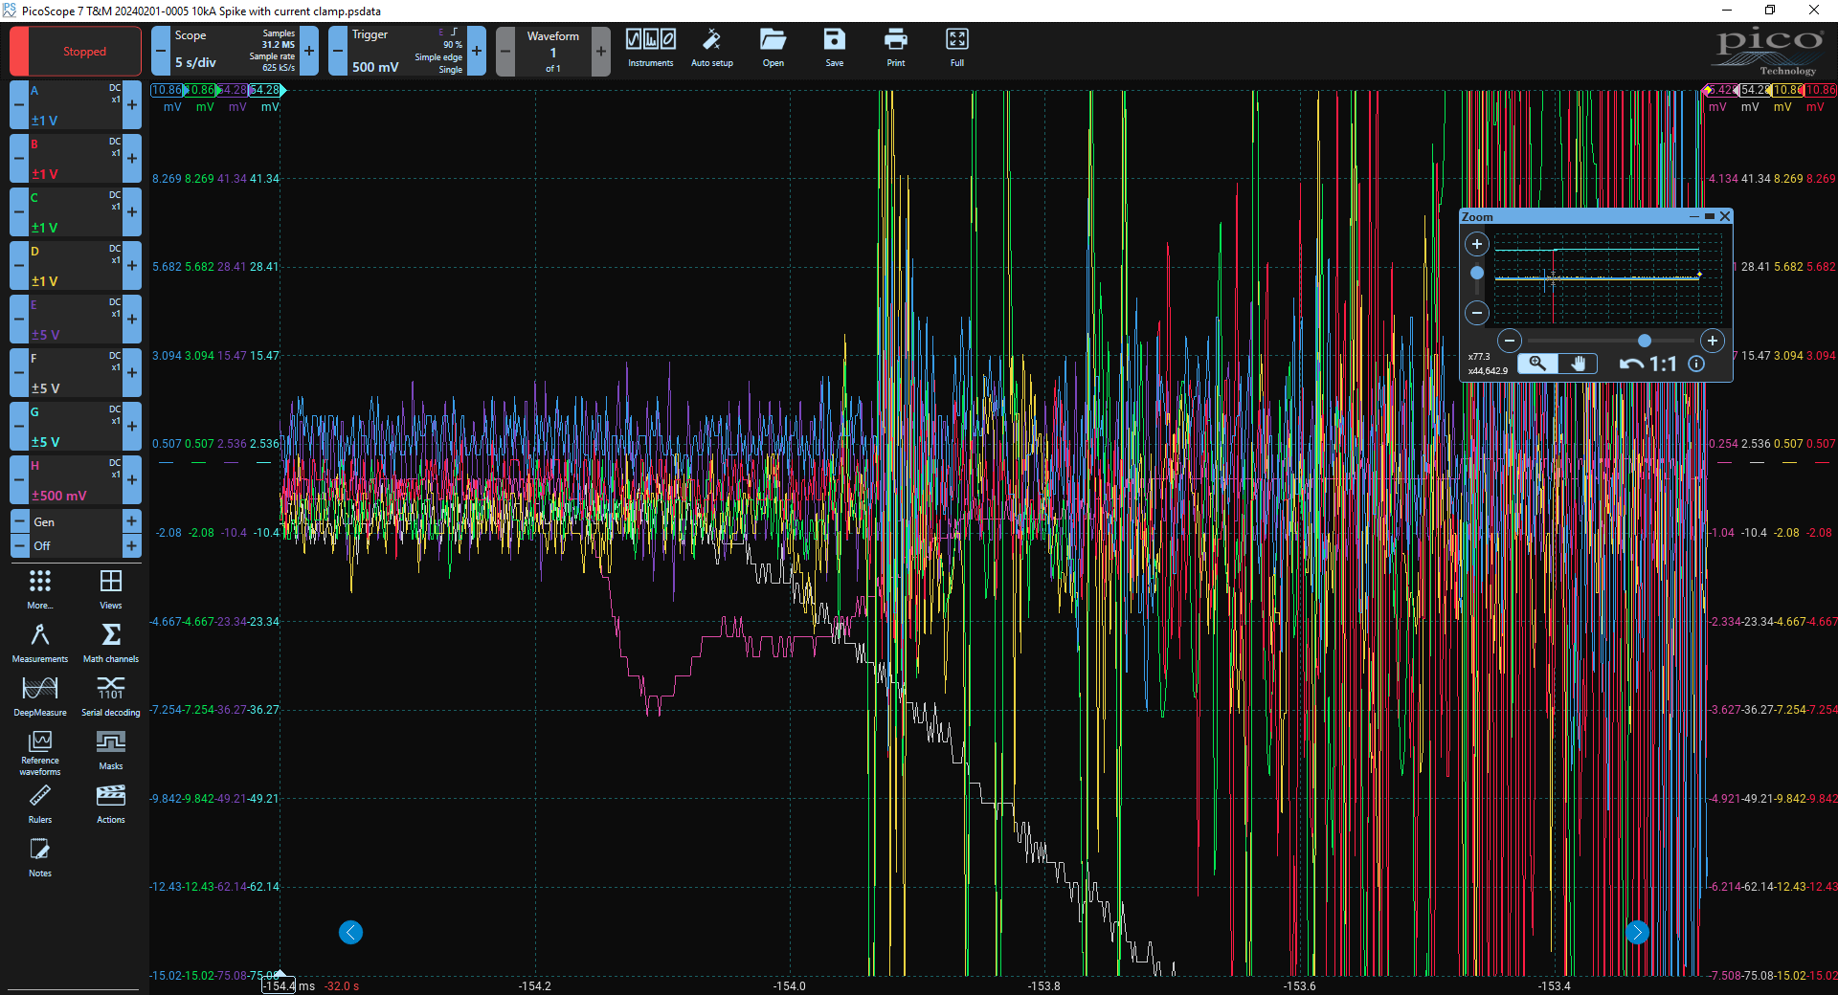
Conclusions
Initial Measurements of SMCT1b showed large spike behavior.
Spikes followed training but were often not training events (mechanical hysteresis)
Acoustic Sensors picked up spike events, but not in an acoustic fashion
Detailed AC current measurements hint at substantial relative coil motion. This behavior is reversible an in line with expectations
The magnet just arrived back from the test stand for dis-assembly Monday. We will look for signs of motion.
This measurement is very easy and provides insight of quench events (in motion case) several ms before resistive growth

