Slide 1
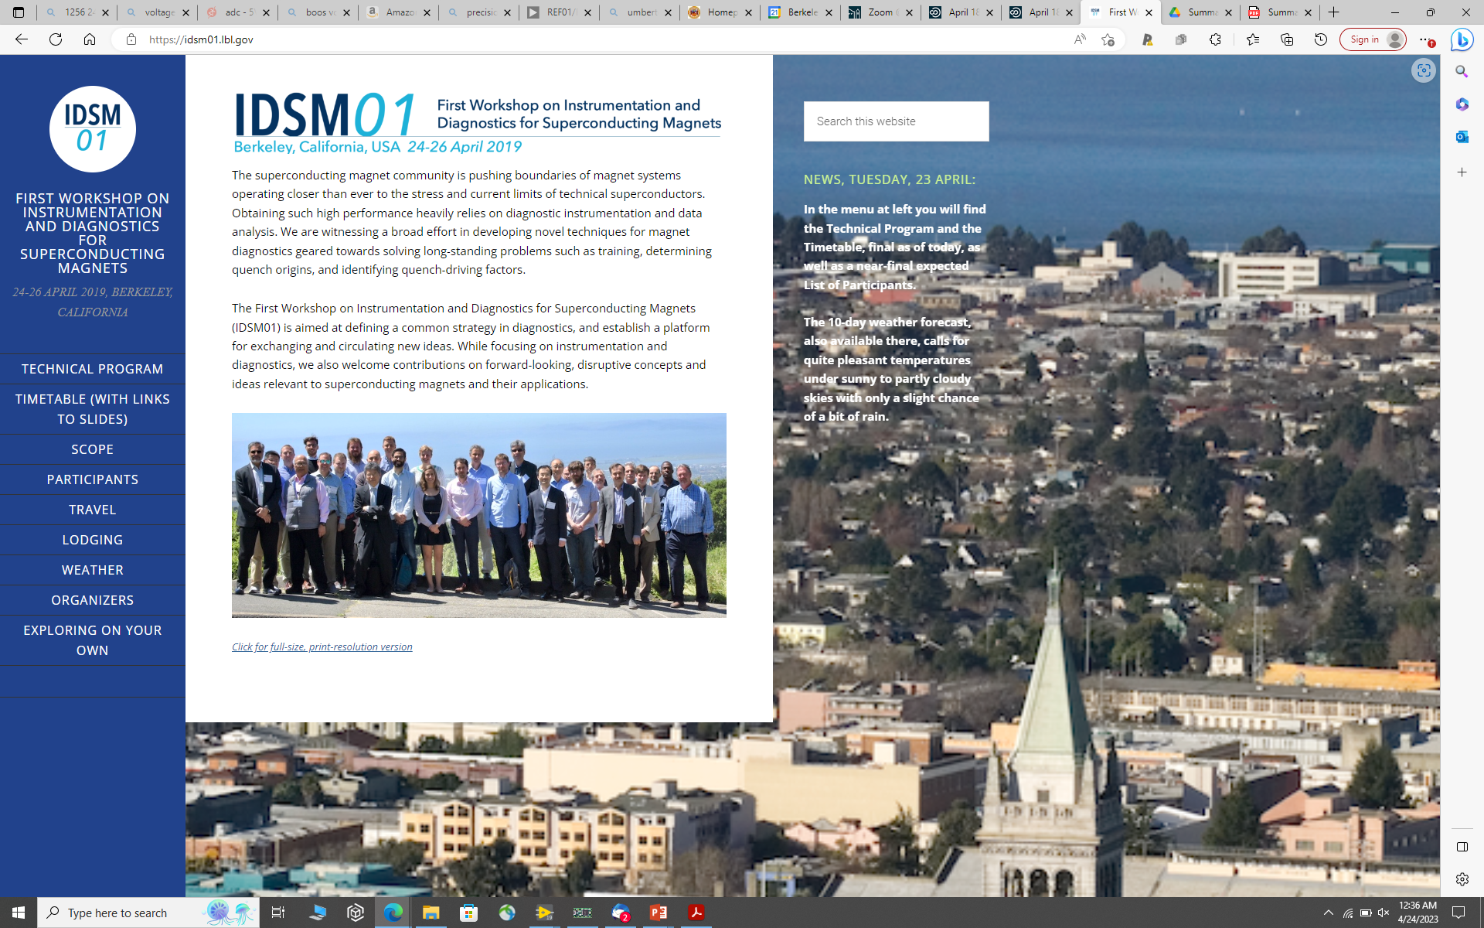
33 Participants
36 Presentations in 2.5 days
https://idsm01.lbl.gov/timetablewithlinks/

Slide 2
IDSM’01 Workshop Summary: directions going forward
Paradigm change for quench diagnostics: from investigating quench causes and locations after the event towards guarding magnet system to stay within its operational and safety margins in real-time.
Multi-technique diagnostics: combining voltage, acoustic and magnetic methods to get a full picture. Advanced, multi-functional probes for magnet disturbance spectra
Need for well-designed and calibrated experiments to study training and build a database of diagnostic signals for typical transient events in magnets.
Make more magnet data available for developers of Deep Learning models; adopt ML and DL as standard analysis tools for our field
Quench detection for HTS under extreme ac background/noise conditions
Way to detect the presence and accumulation of micro-cracks in HTS tapes in high-field solenoids
Ways to visualize and monitor current sharing in HTS cables, NI coils
Cryogenics DAQs and digital processing integrated with the magnet
FPGAs for various diagnostics and magnet safety functions

Slide 3
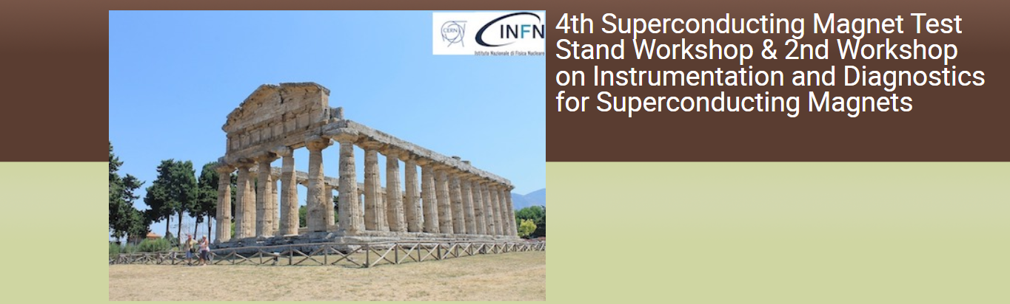
Key topics of IDSM’02
Understanding of magnet training (or lack thereof). Disturbance spectra of LTS high-field magnets
Quench detection and protection for HTS / hybrid magnet for HEP and Fusion
Novel diagnostic instrumentation approaches and techniques
Novel (cryo) electronics, data analysis, modeling
26-28 April, 2023, Paestum, Italy
A follow-up from IDSM’01 organized at Berkeley in 2019
Joint with the Test Stands Workshop
Co-sponsored by CERN and INFN
- 50 participants
- 27 presentations in 2 days
https://agenda.infn.it/event/32061/

Slide 4
IDSM’02 discussions summary
Connecting mechanical transients with training
Development of correlation matrices for classification of damage in different impregnation materials
Digital twin models and use of AI for predicting magnet behavior
Monitoring inductance variation for quantifying coil block displacements
Current flow in a quenching cable and advanced quench antennas
Fiberoptic detection of heat (down to 20 K and below)
Use of fiber meshes for 2D mapping of strain
Alternative non-voltage QD: acoustic, RF, SC wire, thermocouples, MEMS sensor, Hall sensors
Use of strain gauges to monitor fast mechanical transients
Cryogenic data acquisition and digital processing
All speakers acknowledged the importance and challenge for future technology in quench detection, understanding performance limitations and identifying degradation mechanisms.

Slide 5
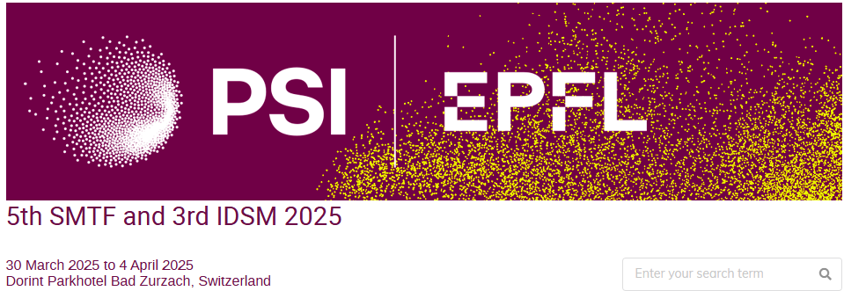
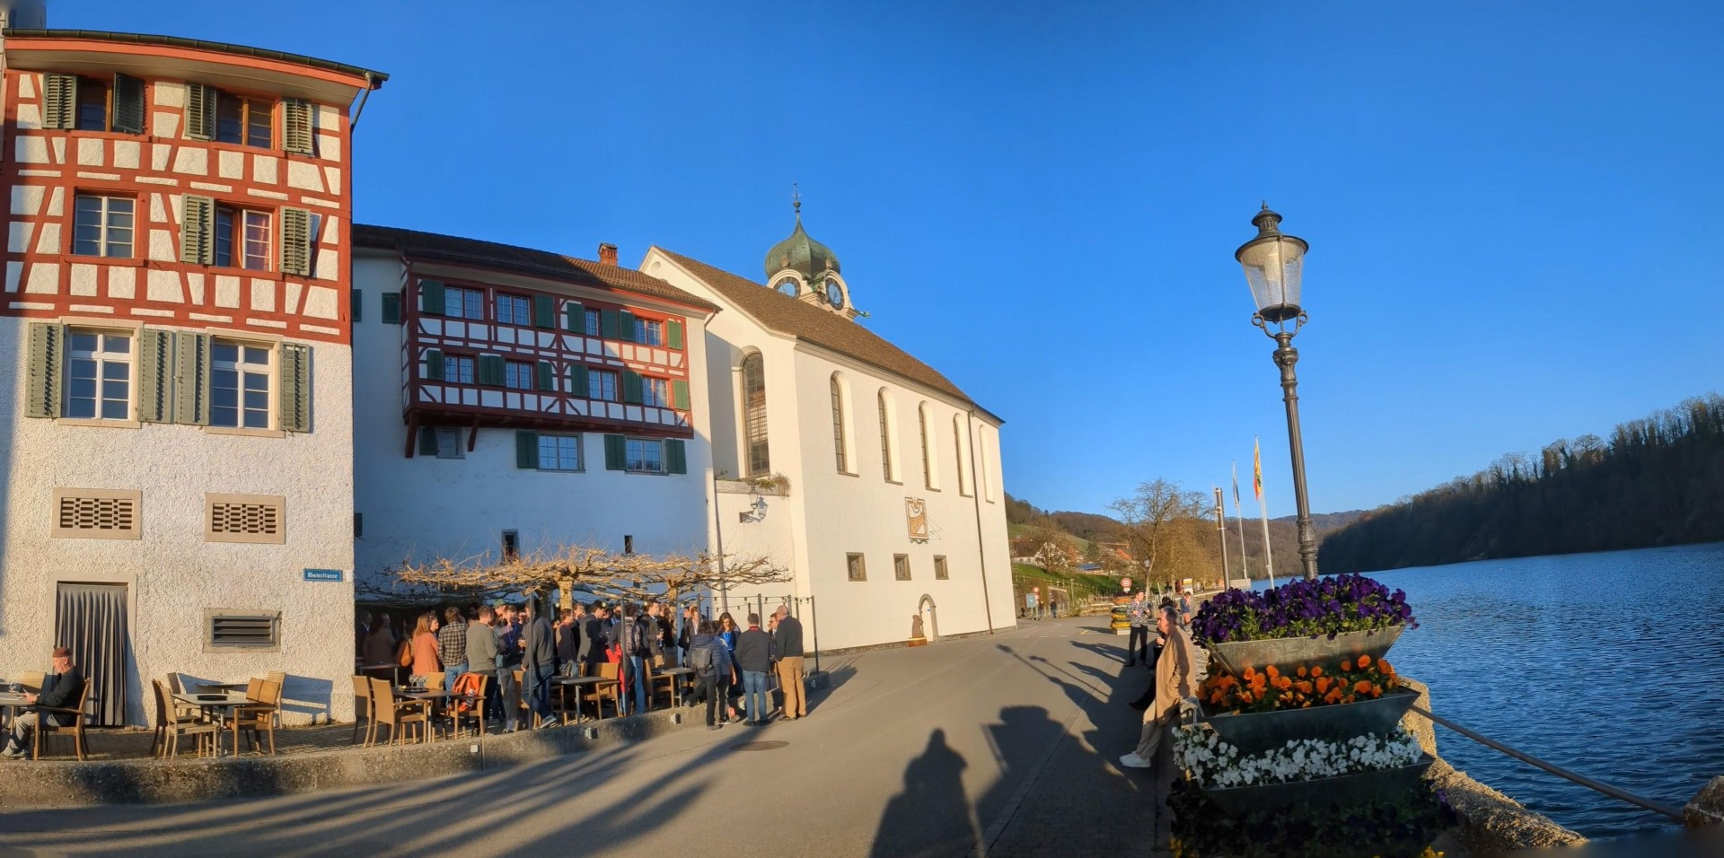
Joint with the SMTF
Co-sponsored by CERN and PSI/EPFL
.. Participants
18 presentations in 1.5 days
New chapter

Slide 6
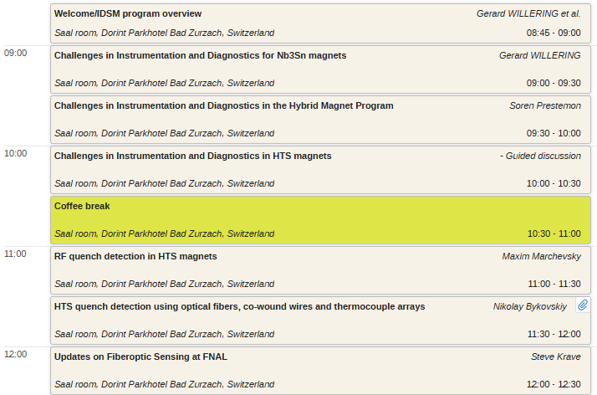
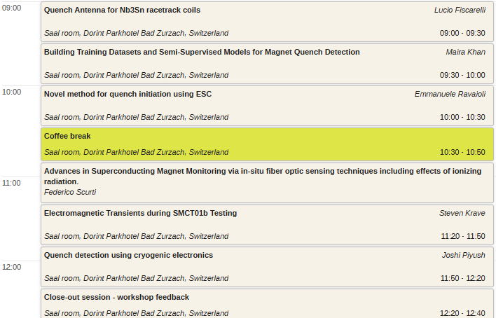
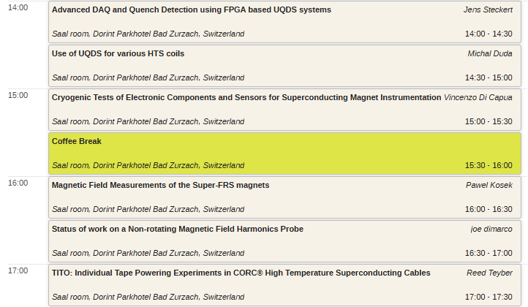
Program this year:
6 blocks of 3 talks.
Speakers are requested to leave time for discussion. Discussion is very welcome.

