Slide 2
Status update from the
FREIA Laboratory
Rocío Santiago Kern
On behalf of the FREIA team

Slide 3
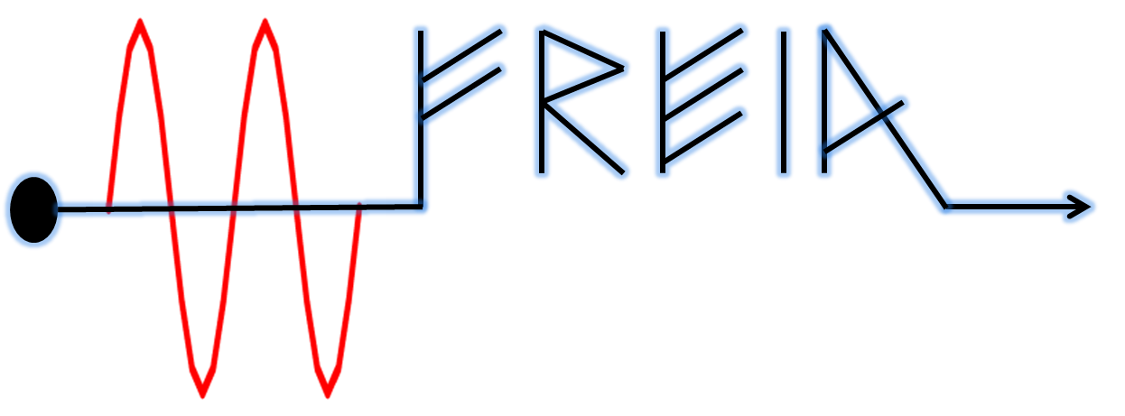
Outline
The FREIA laboratory
Our magnet test-stand
Magnet tests at FREIA
Current developments
Magnet R&D

Slide 4
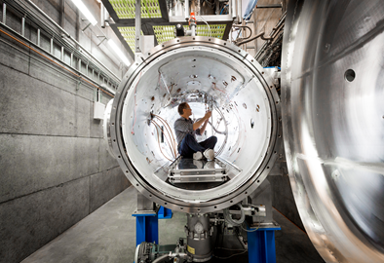
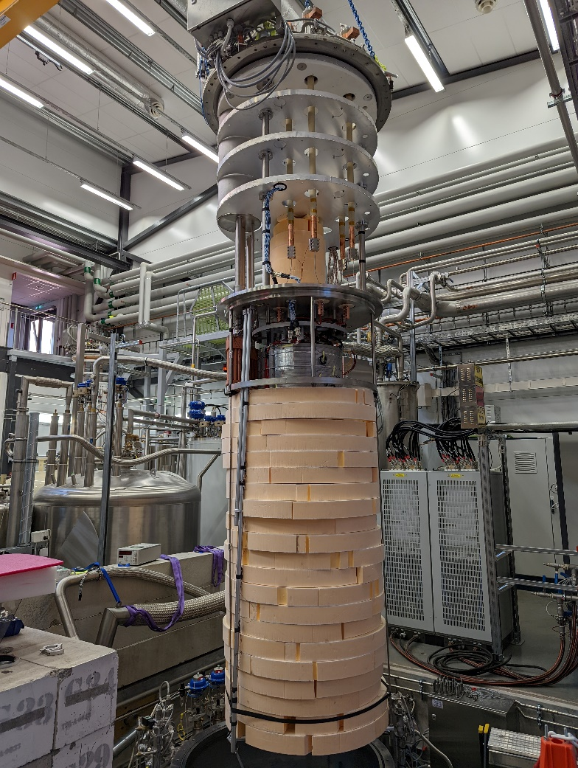
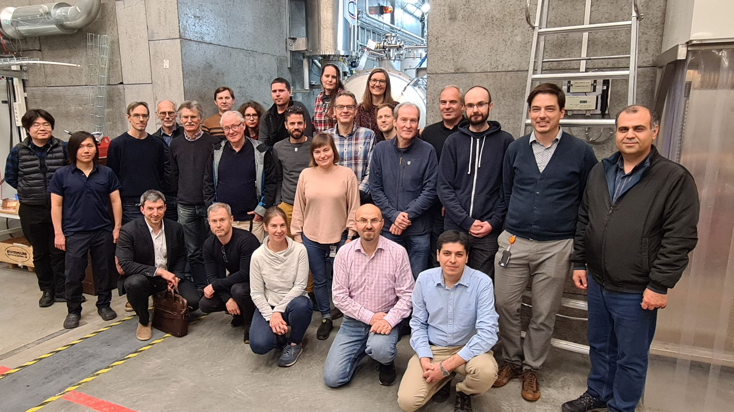






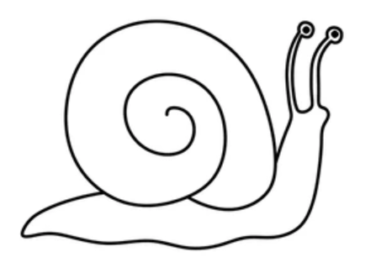
FREIA Facility for Research Instrumentation and Accelerator Development
Funded by KAW, UU and Swedish government, inaugurated in 2013
About 25 Researchers, engineers and students

Slide 5
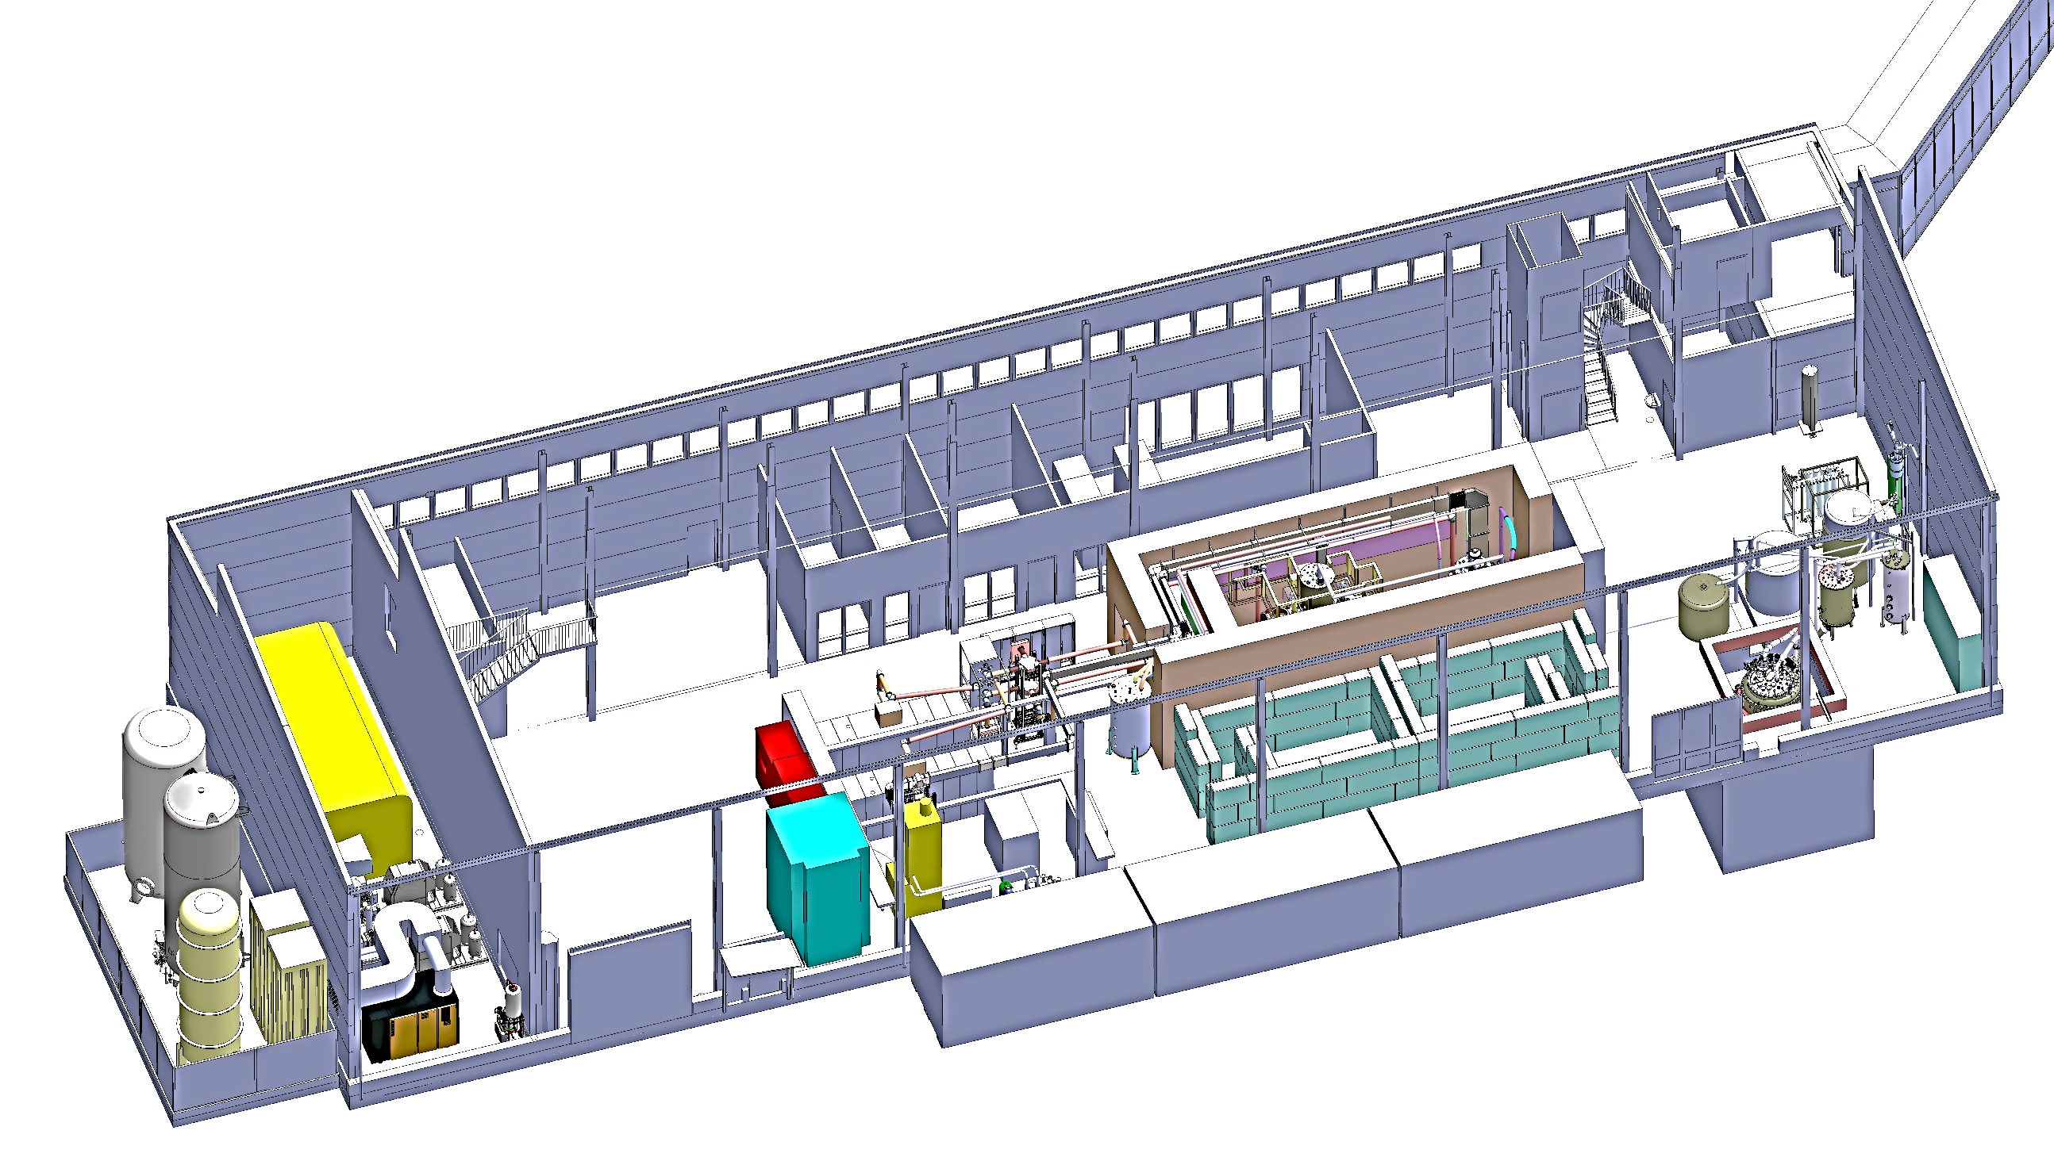
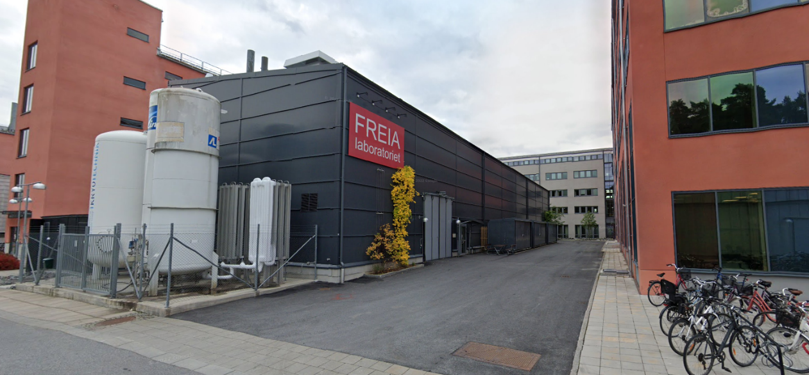
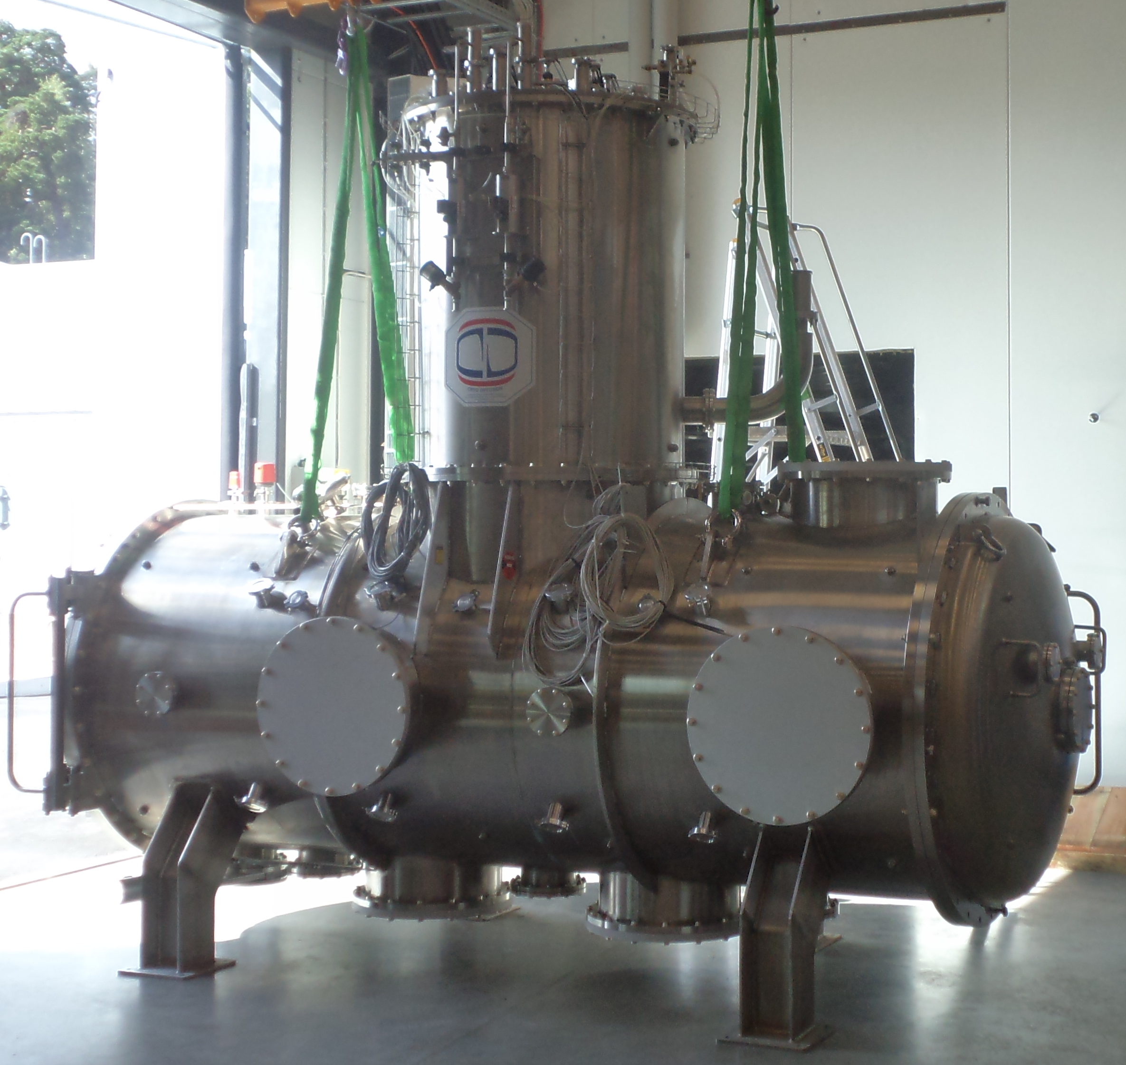
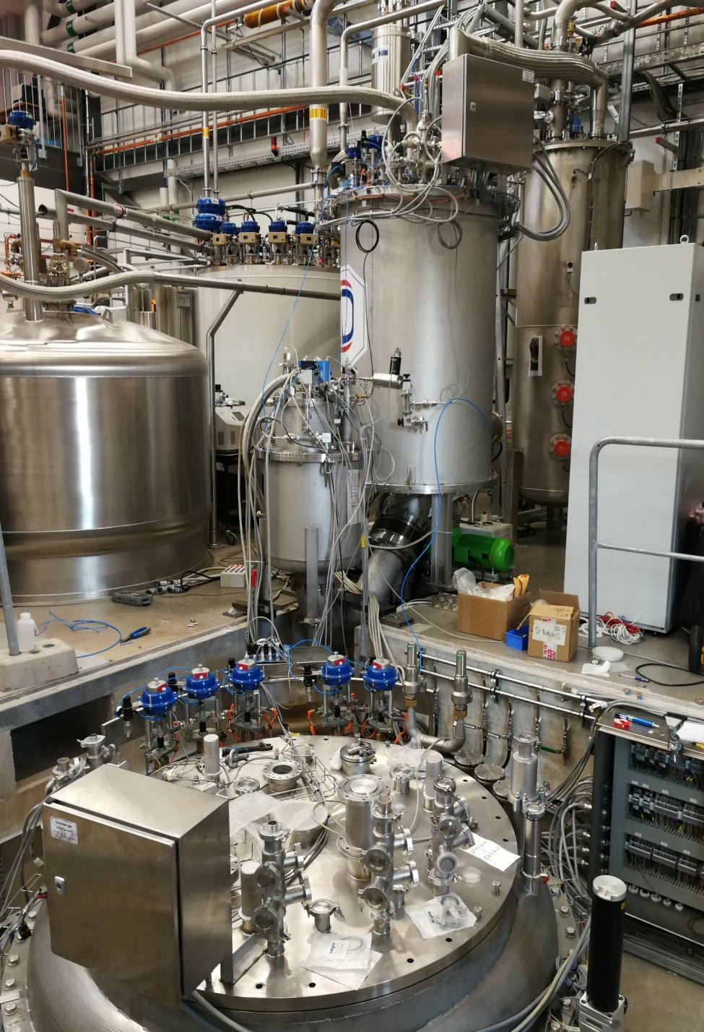
FREIA Infrastructure
The FREIA hall
1000 m² large, 10 m high
Has a 6.3-ton movable crane and other mechanical equipment
Small workshops for mechanics and electronics and 50 m² control room
Office space for ~20 people
Control Room
The overall control system is based on EPICS
Self-excited loop, 352 MHz, 1 kW CW
LLRF controls and RF power measurement
Standard Measurement Equipment
Cryo system:
2000 L dewar (+ 1000 L extra dewar)
140 L/h liquefier
19.2 m³ high pressure storage at 200 bar
132 kW recovery compressors
100 m³/h circulating compressor (Kaeser)
100 m³ gas bag
Gersemi - Vertical Cryostat
System for testing superconducting devices such as accelerating cavities and magnets
Dimensions: 1.1 m diameter, 2.8 m height
Range of operation: 1.8 to 4.5 K, 16 to 1250 mbar
Pressure stability at 16 mbar: +/- 0.1 mbar
Cooling power at 1.8 K: 90 W
Maximum allowed weight up to 5 ton
2 x 2 kA power converters
1 kW RF power in a self-excited loop
Uppsala
HNOSS- Horizontal Cryostat
System for testing superconducting cavities.
Inner measures 3.2 m length and 1.19 m diameter
Range of operation: 1.8 to 4.5 K, 16 to 1250 mbar
Internal warm magnetic shielding: mu-metal, 1 mm
Pressure stability at 16 mbar: +/- 0.1 mbar
Cooling power at 1.8 K: 90 W
Stockholm
Kévin Pepitone

Slide 6
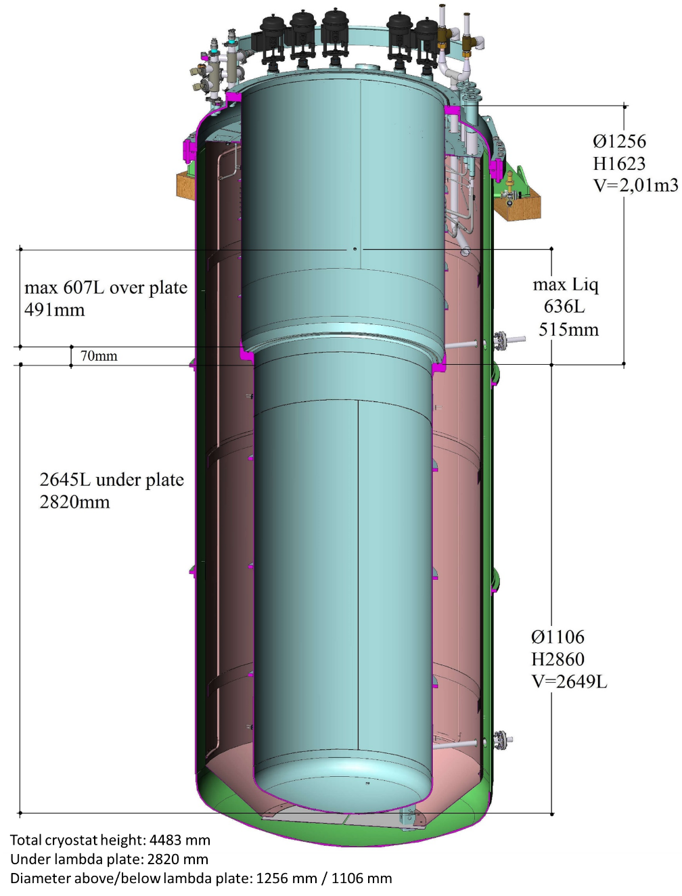
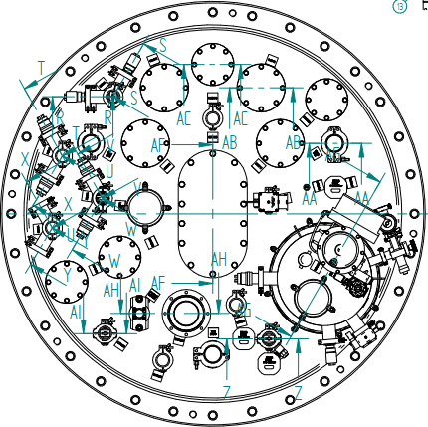
Gersemi
Two inserts
  For cavity testing (without lambda plate)
  For magnet testing (with lambda plate)
Magnet insert
  Superconducting magnets at temperatures between 4.2 K and 1.9 K, at atmospheric pressure
  Up to 350 kJ
3.2 m
2.65 m
Top view
Cryogenics instrumentation
4 current leads
Magnet measurement (under development)
Up to 36 voltage taps
1.1 m

Slide 7
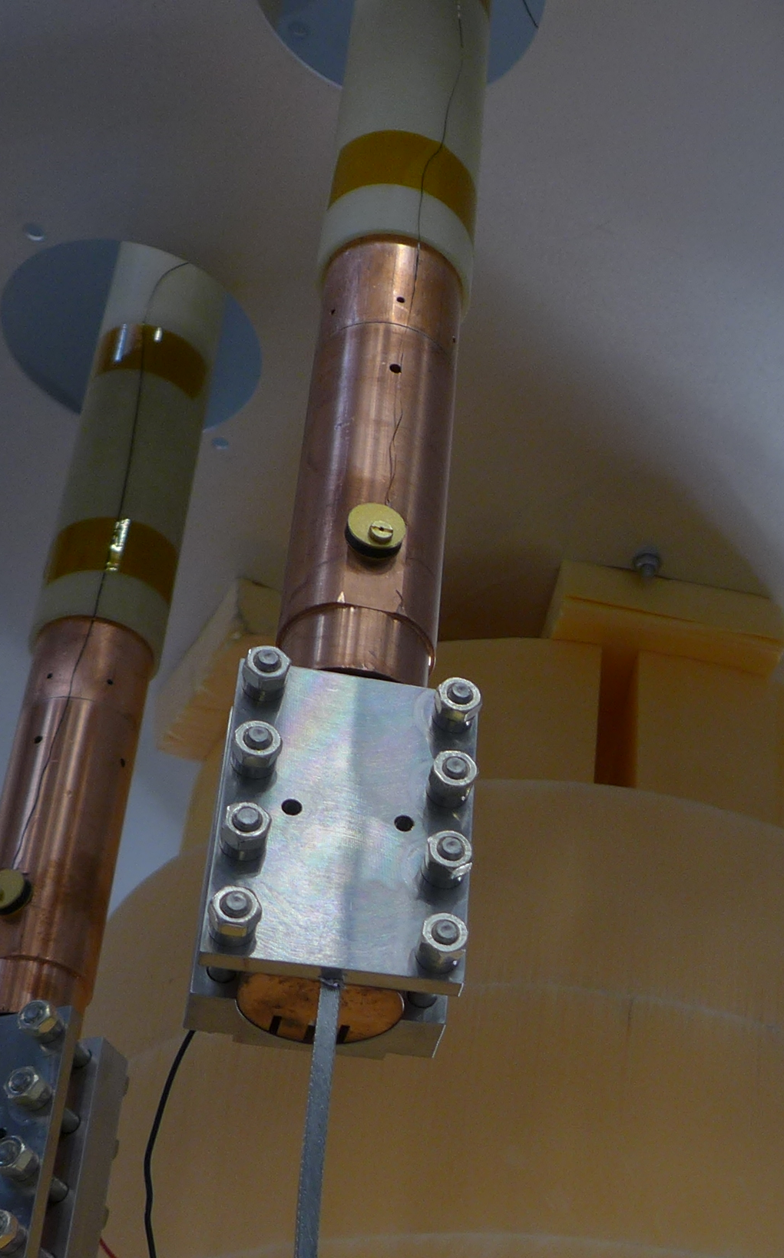
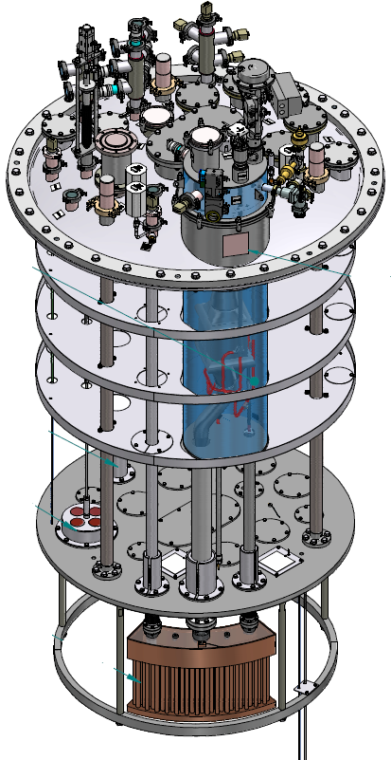
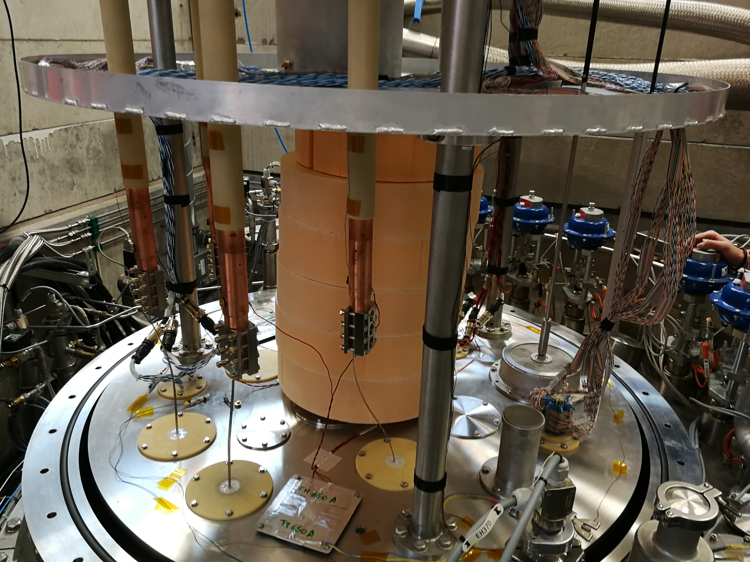
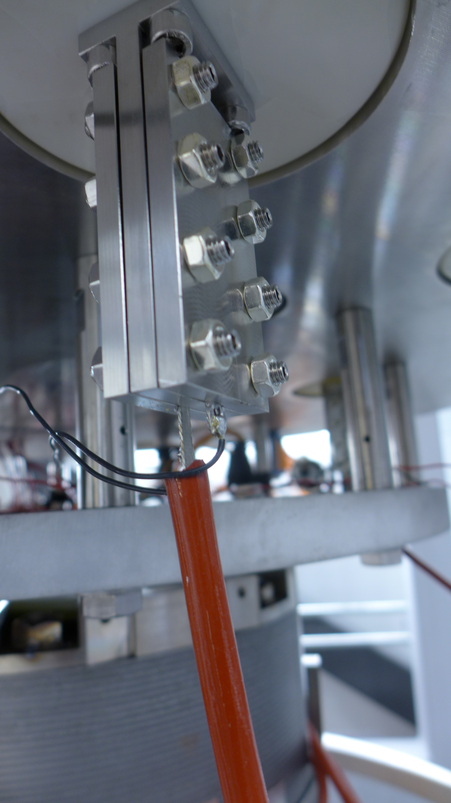
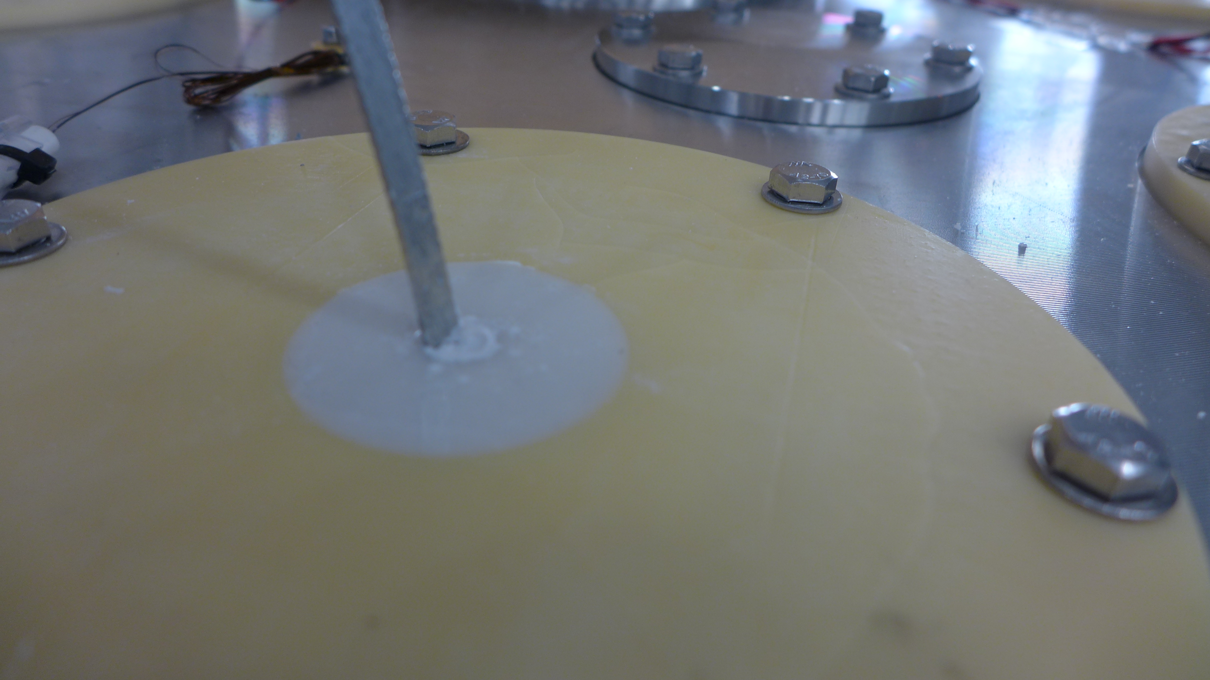
Gersemi – The magnet insert

Slide 8
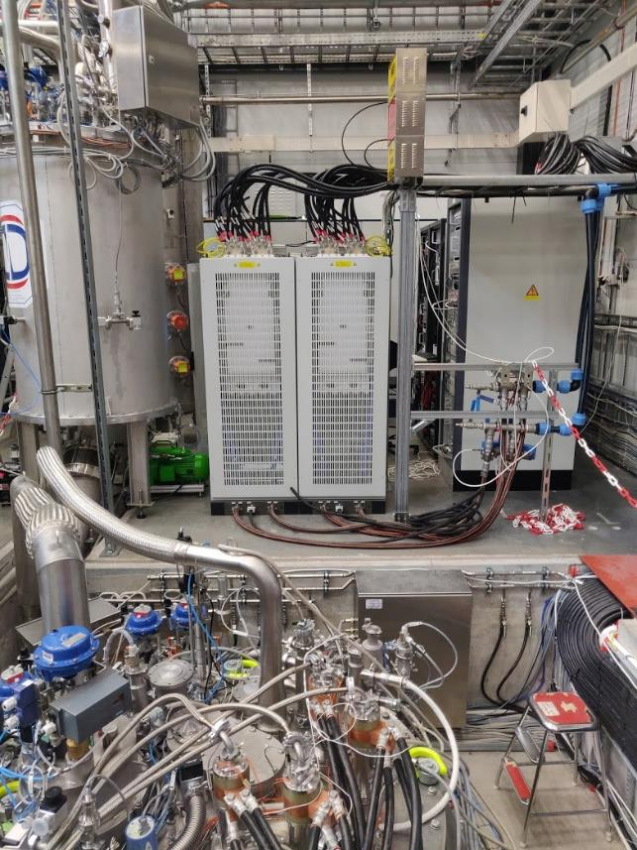
The magnet test-stand
Power converters 2x2 kA
Data acquisition and PLC
48 high frequency channels
72 low frequency channels
1 uQDS, universal quench detection system for symmetric quenches
Polarity switch
Magnet insert, fully equipped
Software for the DAQ system provided by CERN
Two energy extraction units
https://arxiv.org/abs/2108.10648

Slide 9
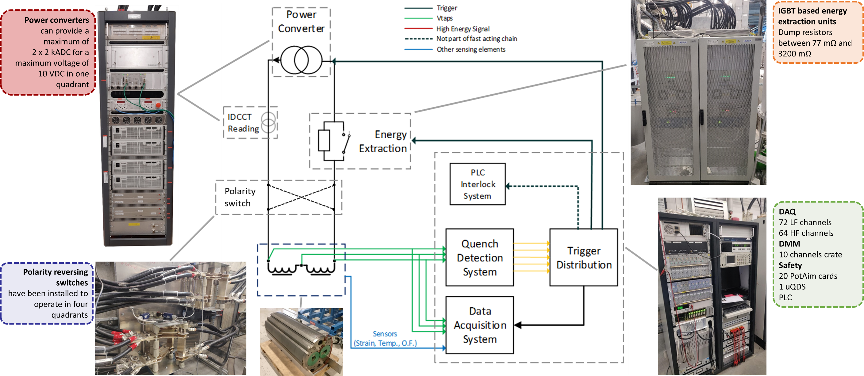
The magnet test-stand

Slide 10
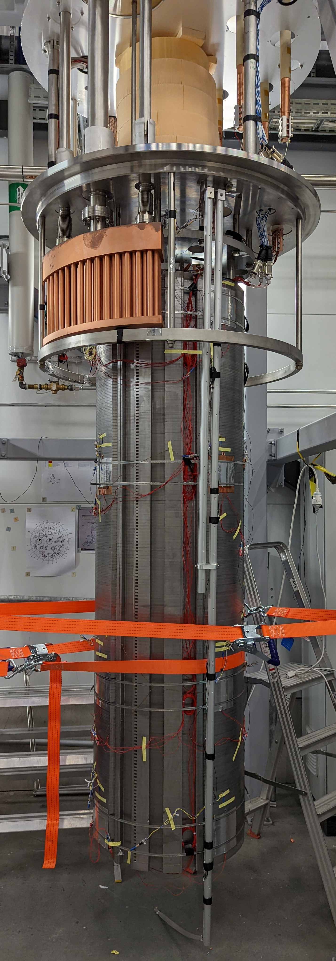
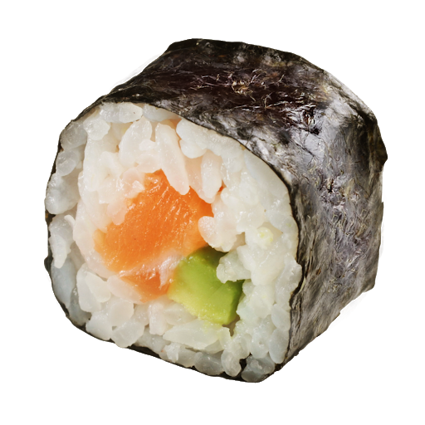
Magnet testing at FREIA
MCBC (2021)
  Goal: commission cryostat and the overall magnet test stand
  Powered to 80% of nominal current at 4.5 K and 1.9 K
  Not allowed to quench the magnet because of risk of damages
MCBRD (2022)
  Cooled to 1.9 K but not powered
  Electrical short on insert – fixed cable
  Arcs in Burndy connectors on top of the insert – fixed with resin
SuShi (2023)
  Septum magnet
  Test funded through EuroLabs
  Powered to nominal current at 4.5 K
  No quenches!
N.B: Functionality of quench protection system has been tested through manual triggering.
MCBRD
D Barna et al 2024 Supercond. Sci. Technol. 37 045006, DOI:10.1088/1361-6668/ad2981
  CERN has always been readily available for help

Slide 11

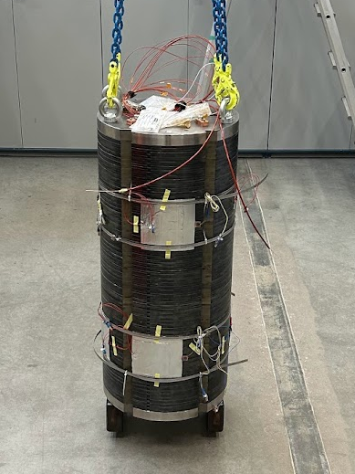
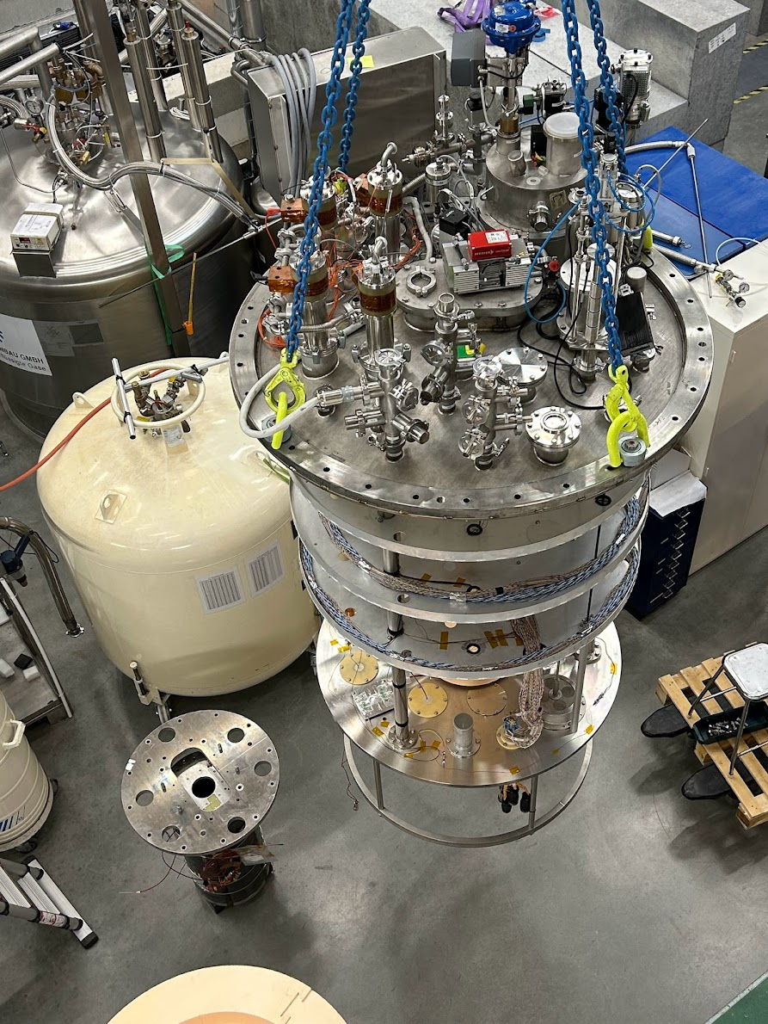
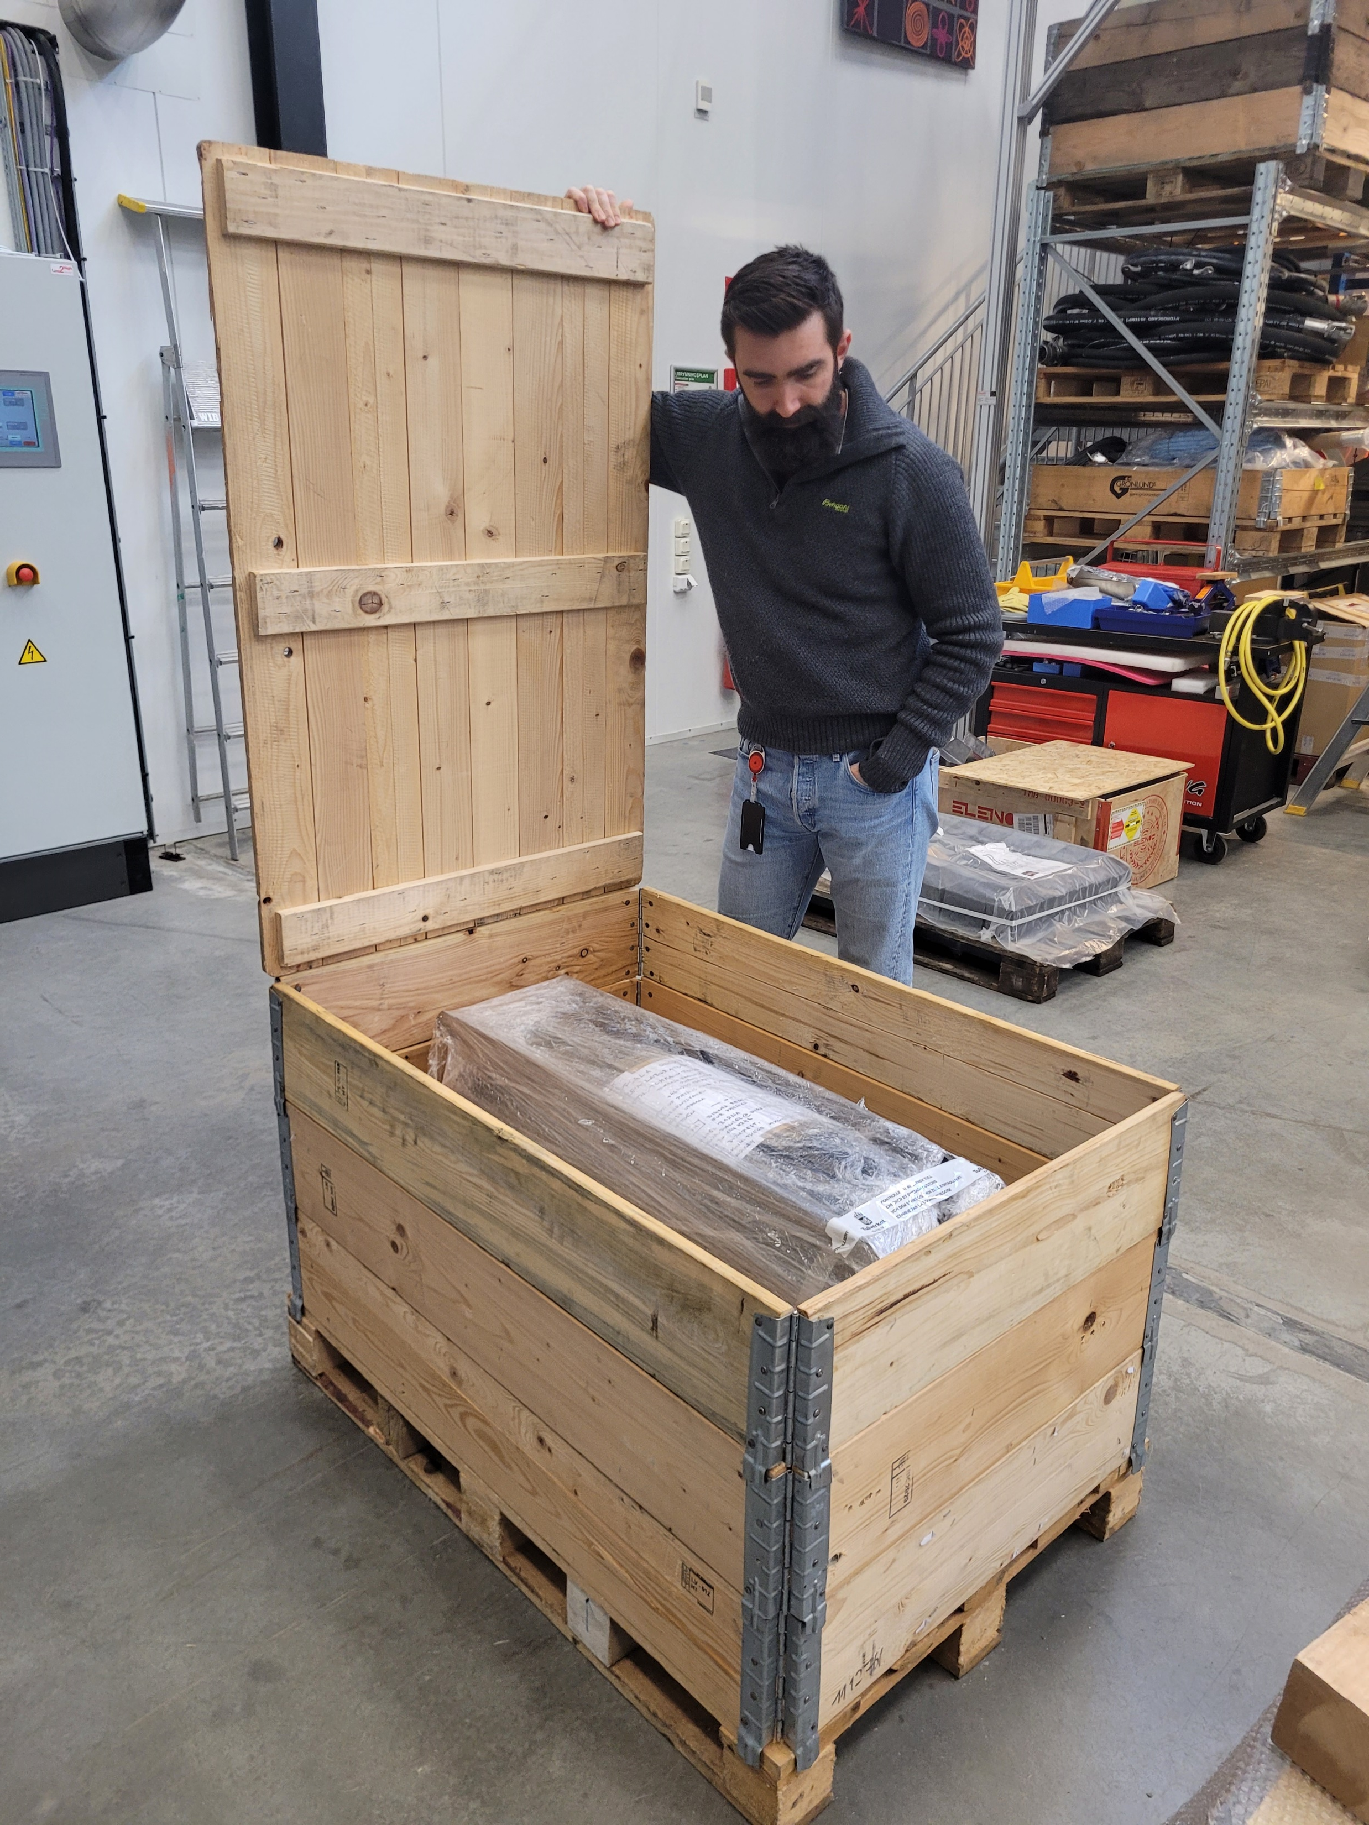
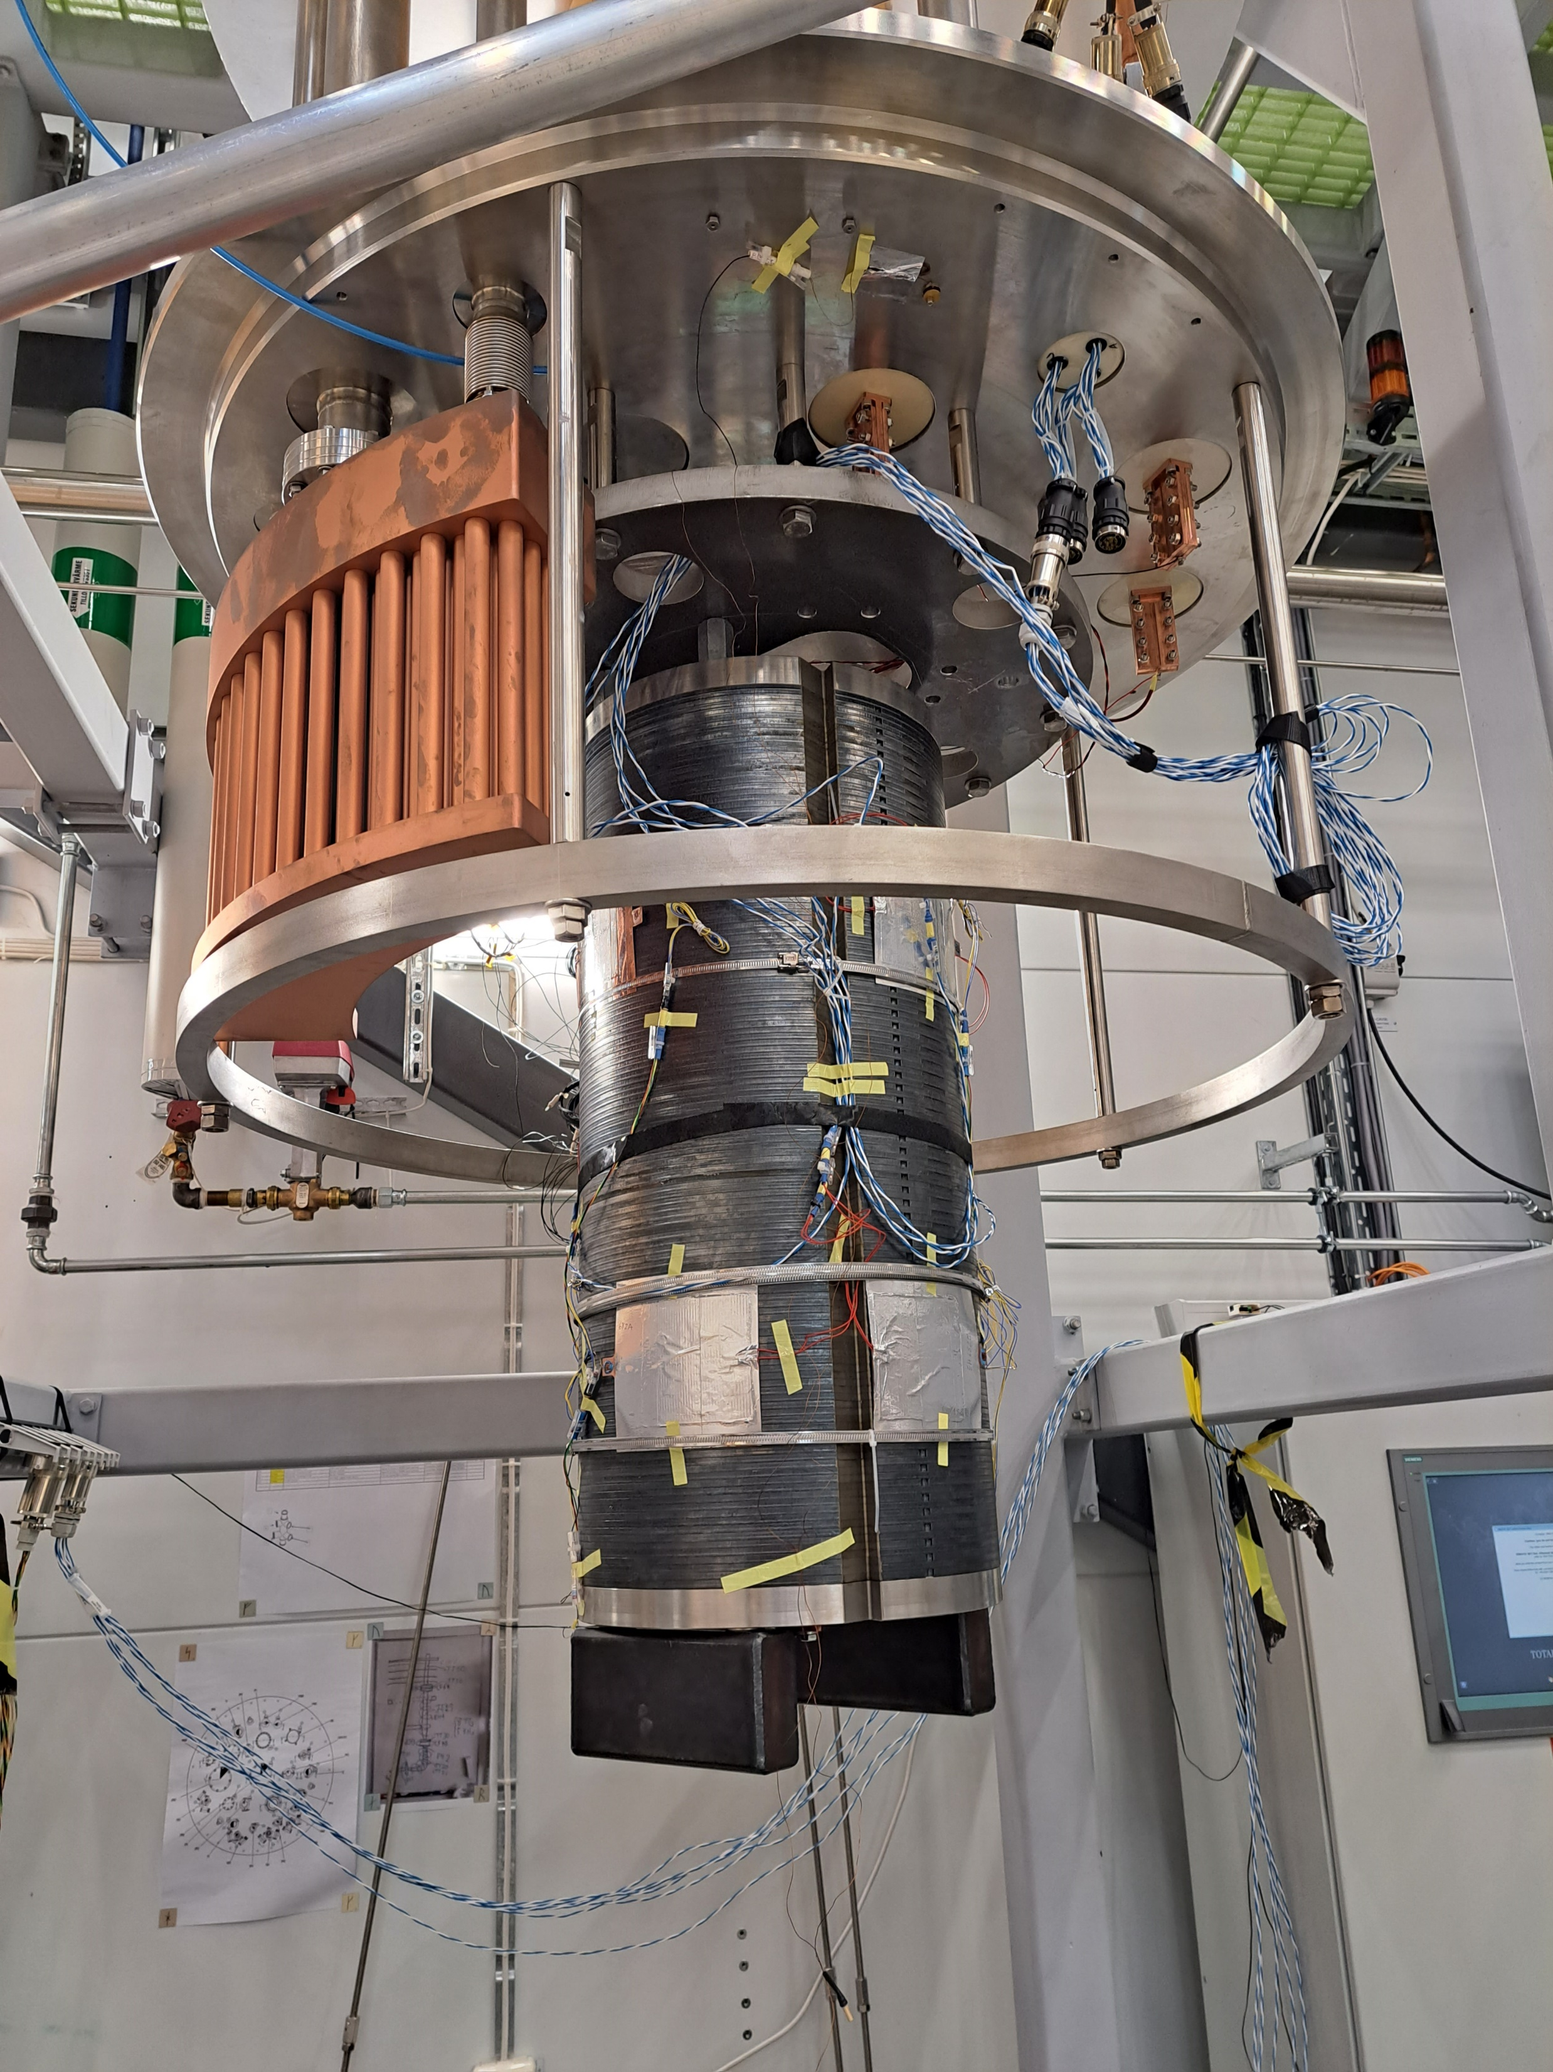
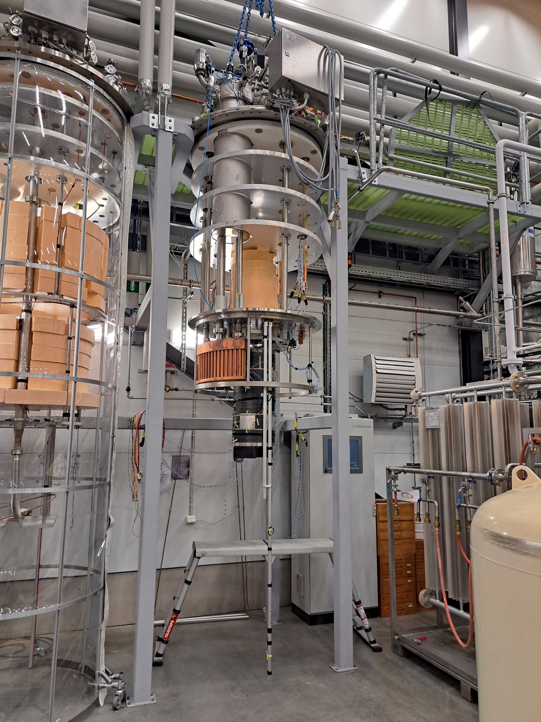
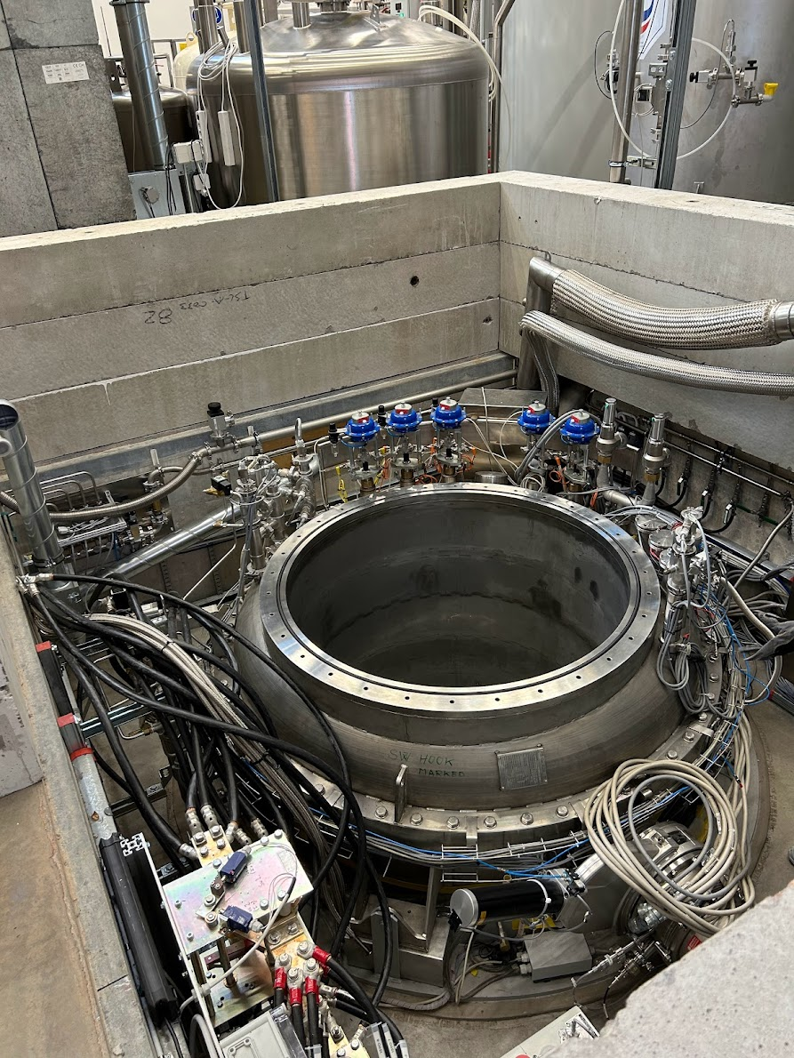
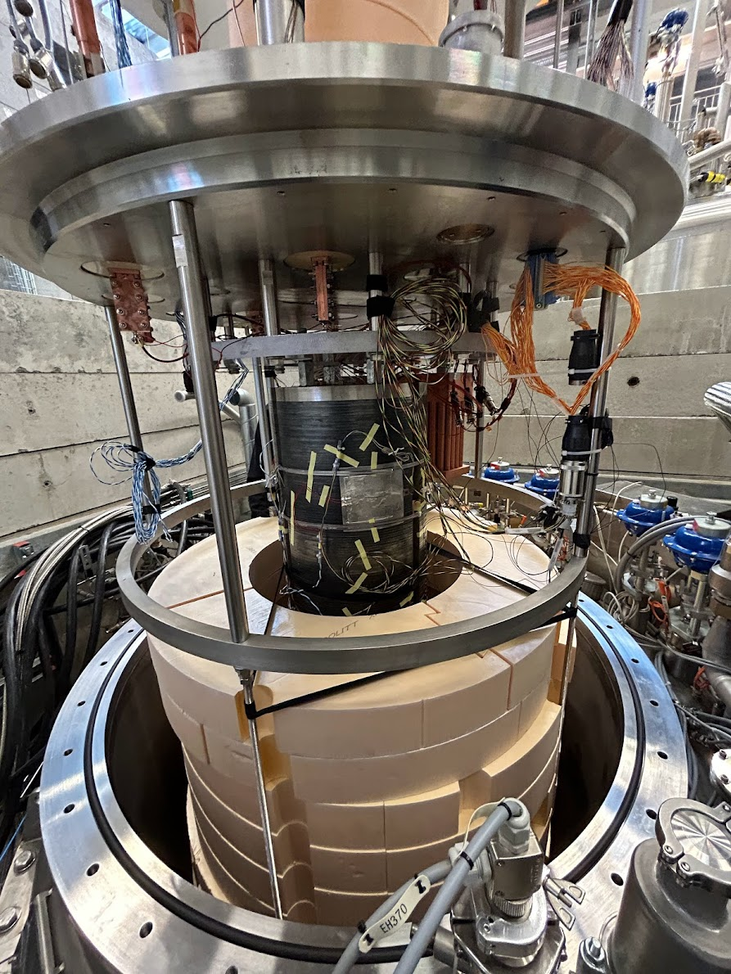
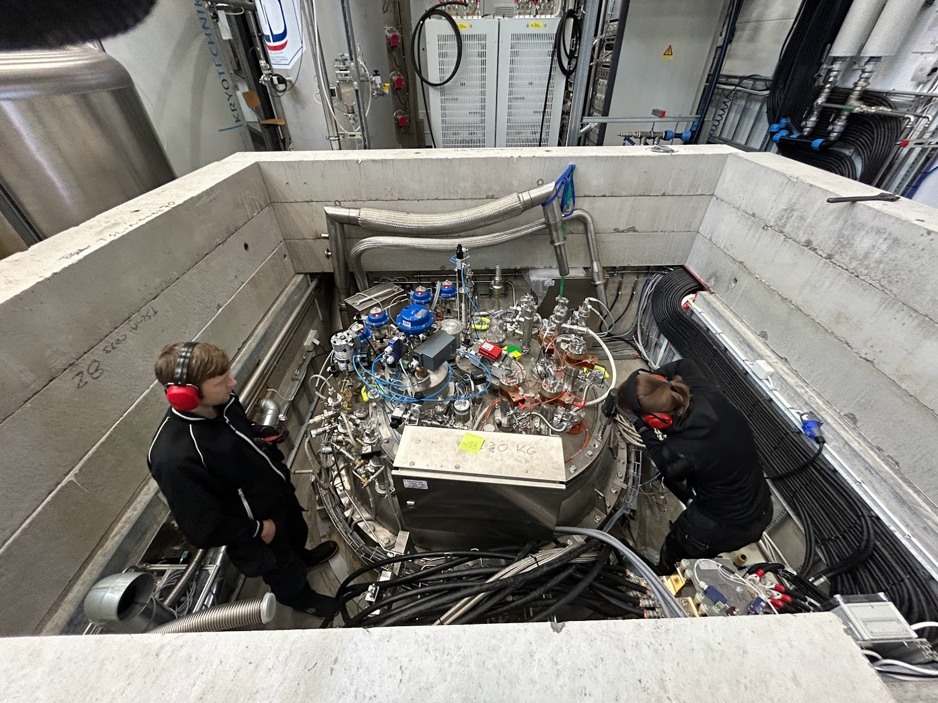
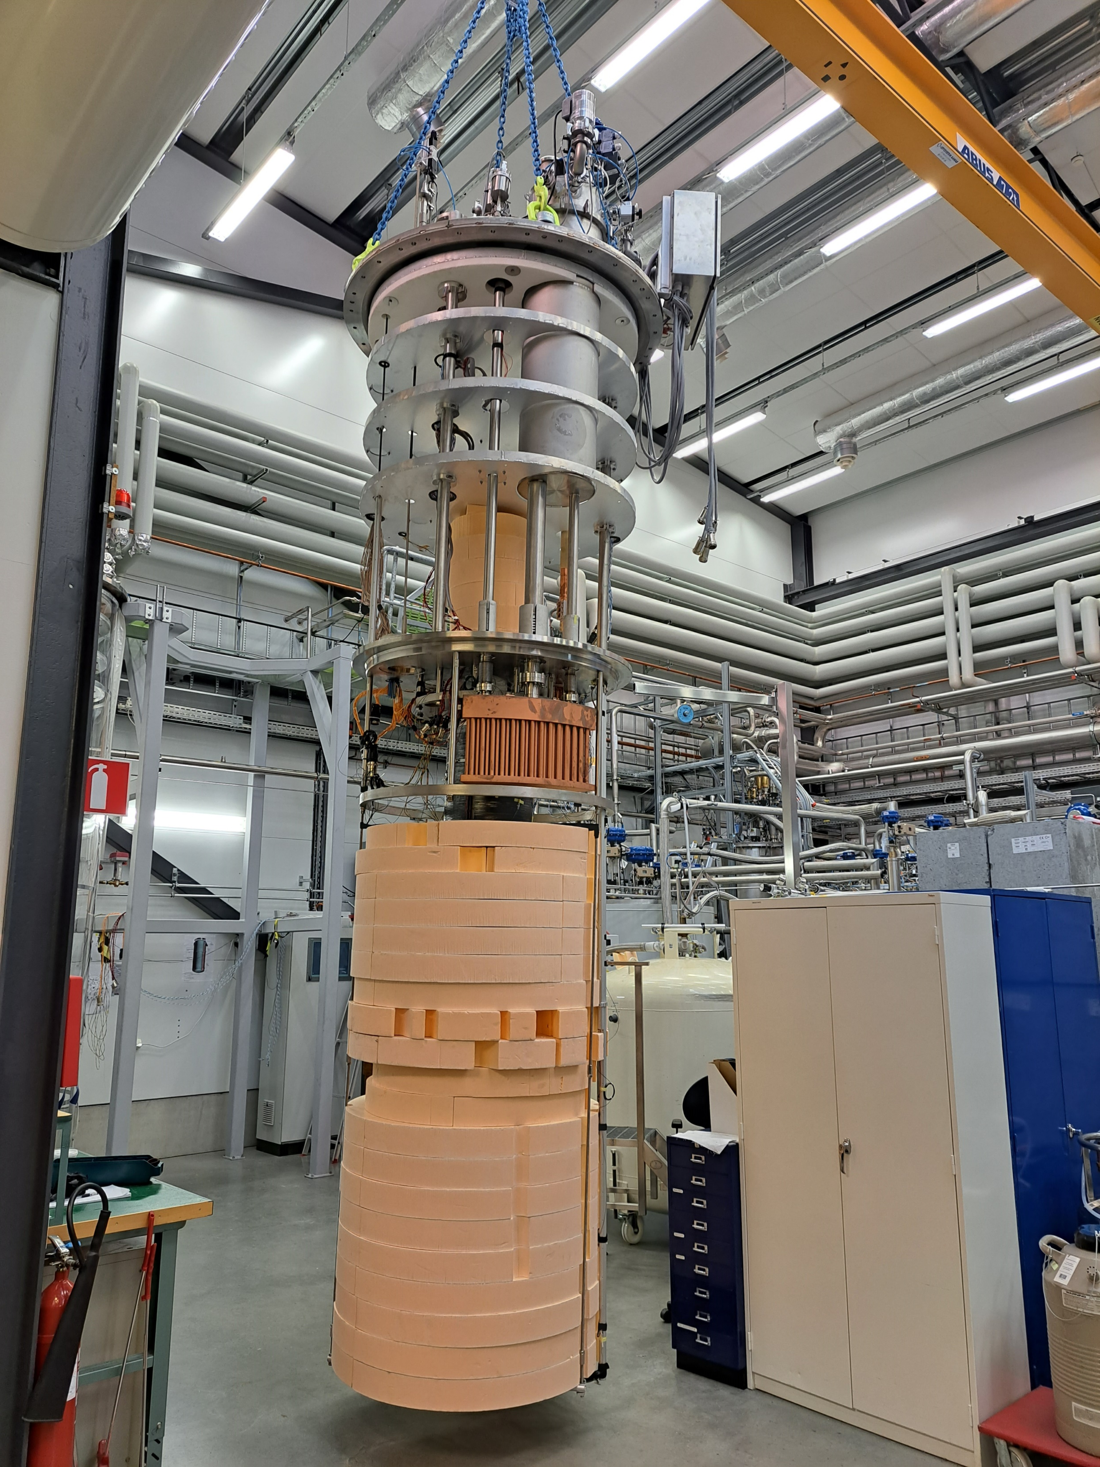

SuShi: Superconducting Shield
Credit: D. Barna & K. Brunner (HUN-REN) and T. Bagni, et al.

Slide 12
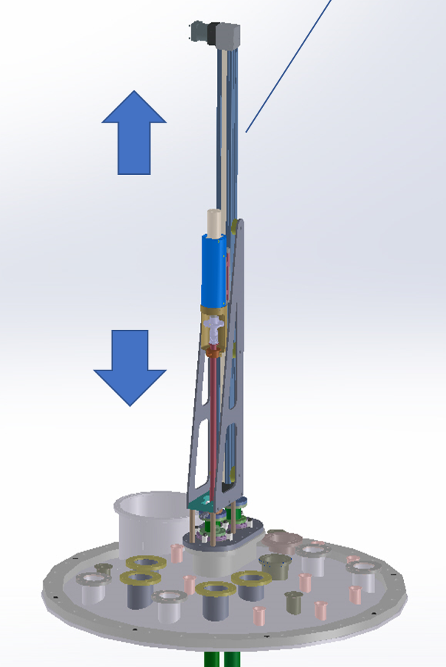
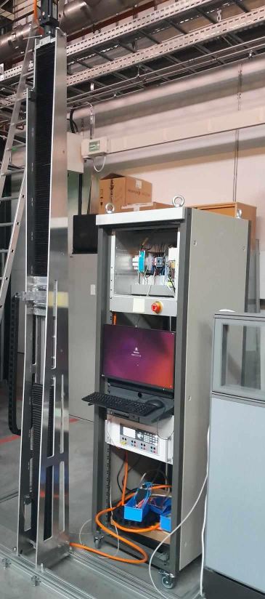
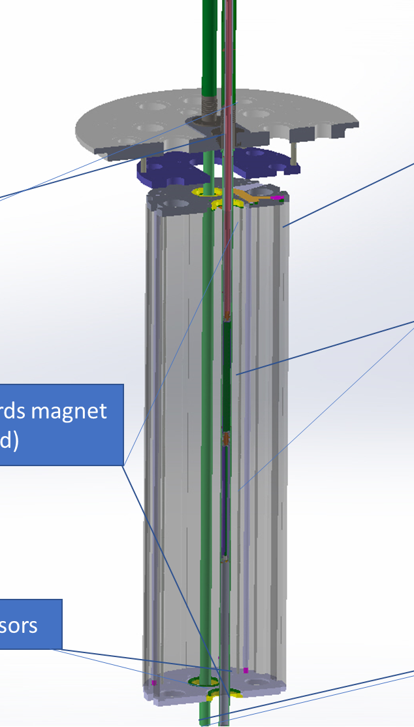
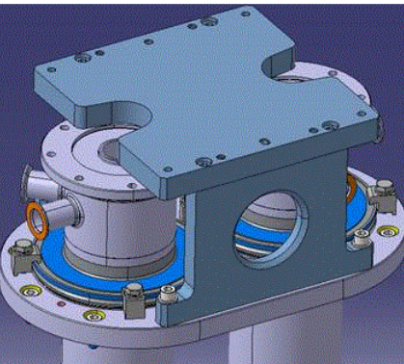
Magnetic measurement with anticryostat
Project done in collaboration with CERN (KM5676/TE/HL-LHC)
  To be finalized end 2025
Test bench comprising
  anticryostat: modification of the existing cryostat to have a volume at room temperature and pressure
  magnetic measurement system: motorized system with rotating coil able to measure the magnetic field at different locations
Main characteristics:
  Magnet’s max aperture: 50 mm
  Length for rotating coils: 500 mm
  Max magnet length: 2.2 m (max displacement 2.3 m from lambda plate)

Slide 13

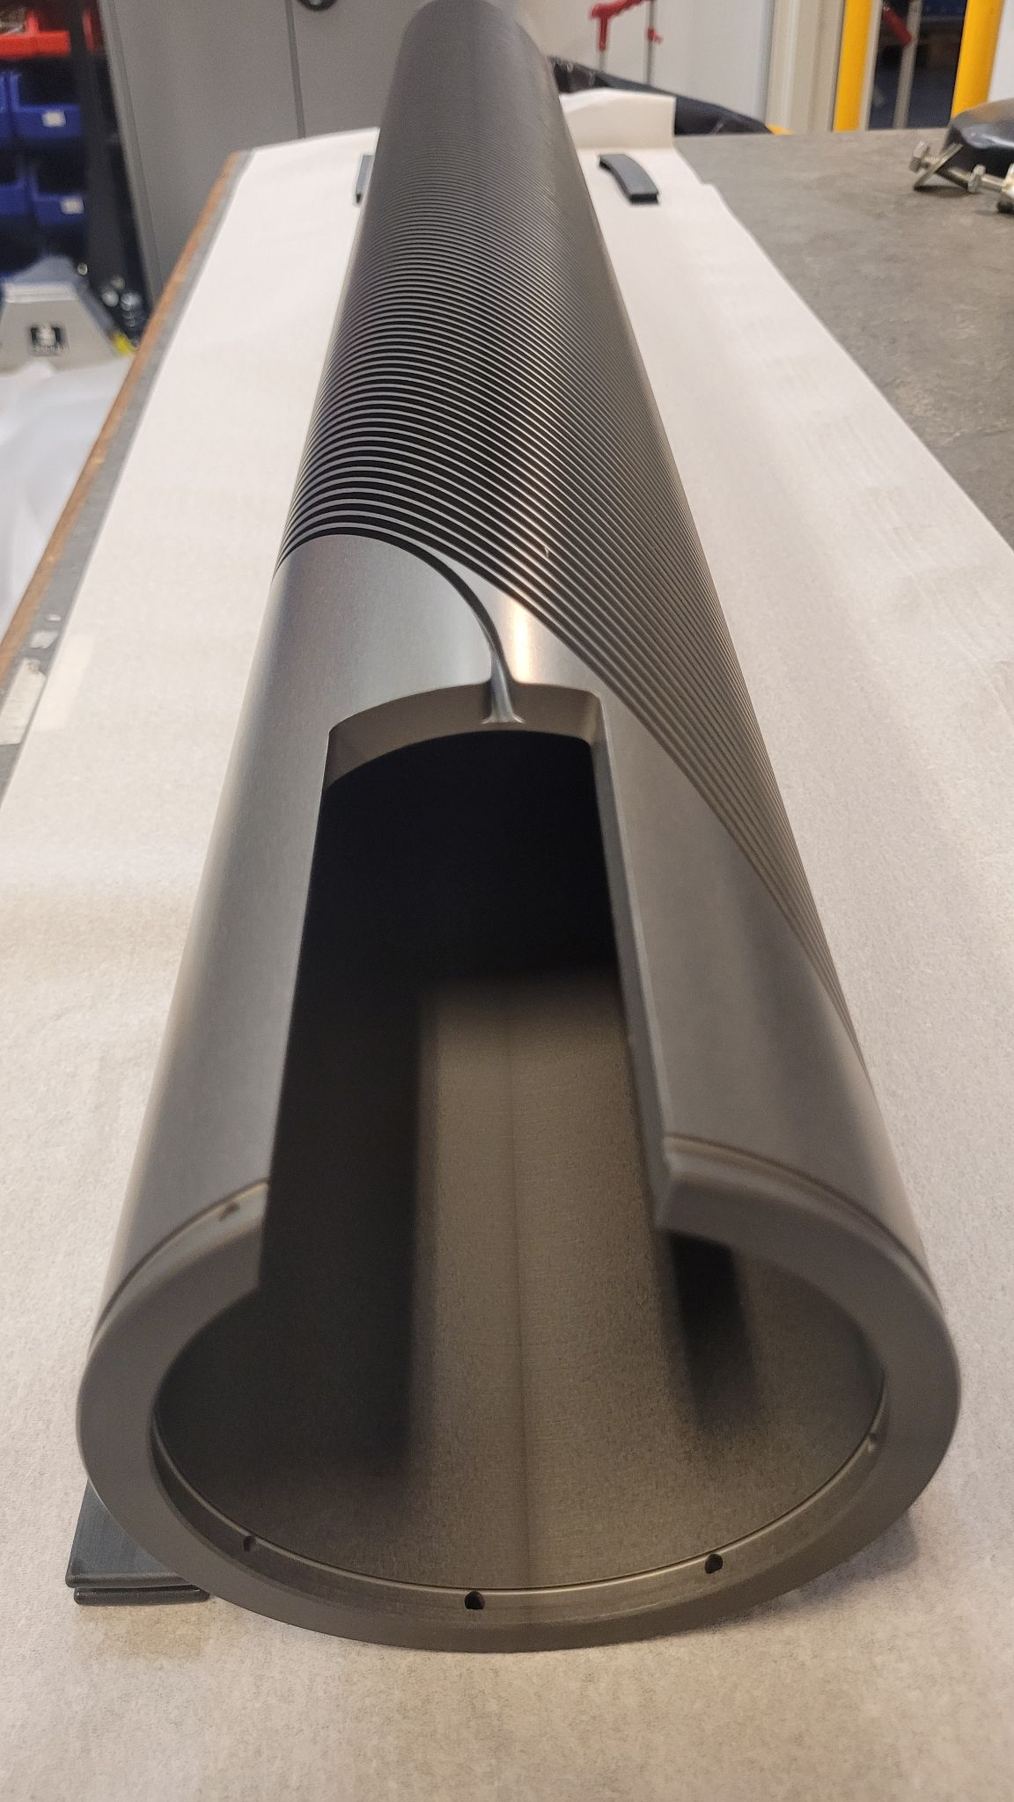
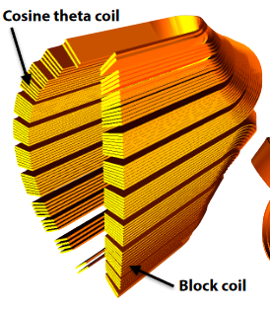


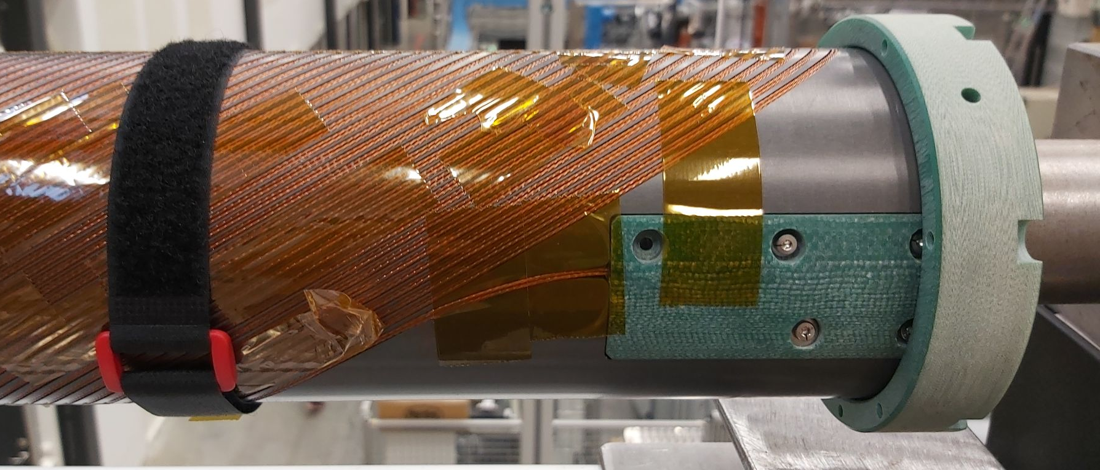
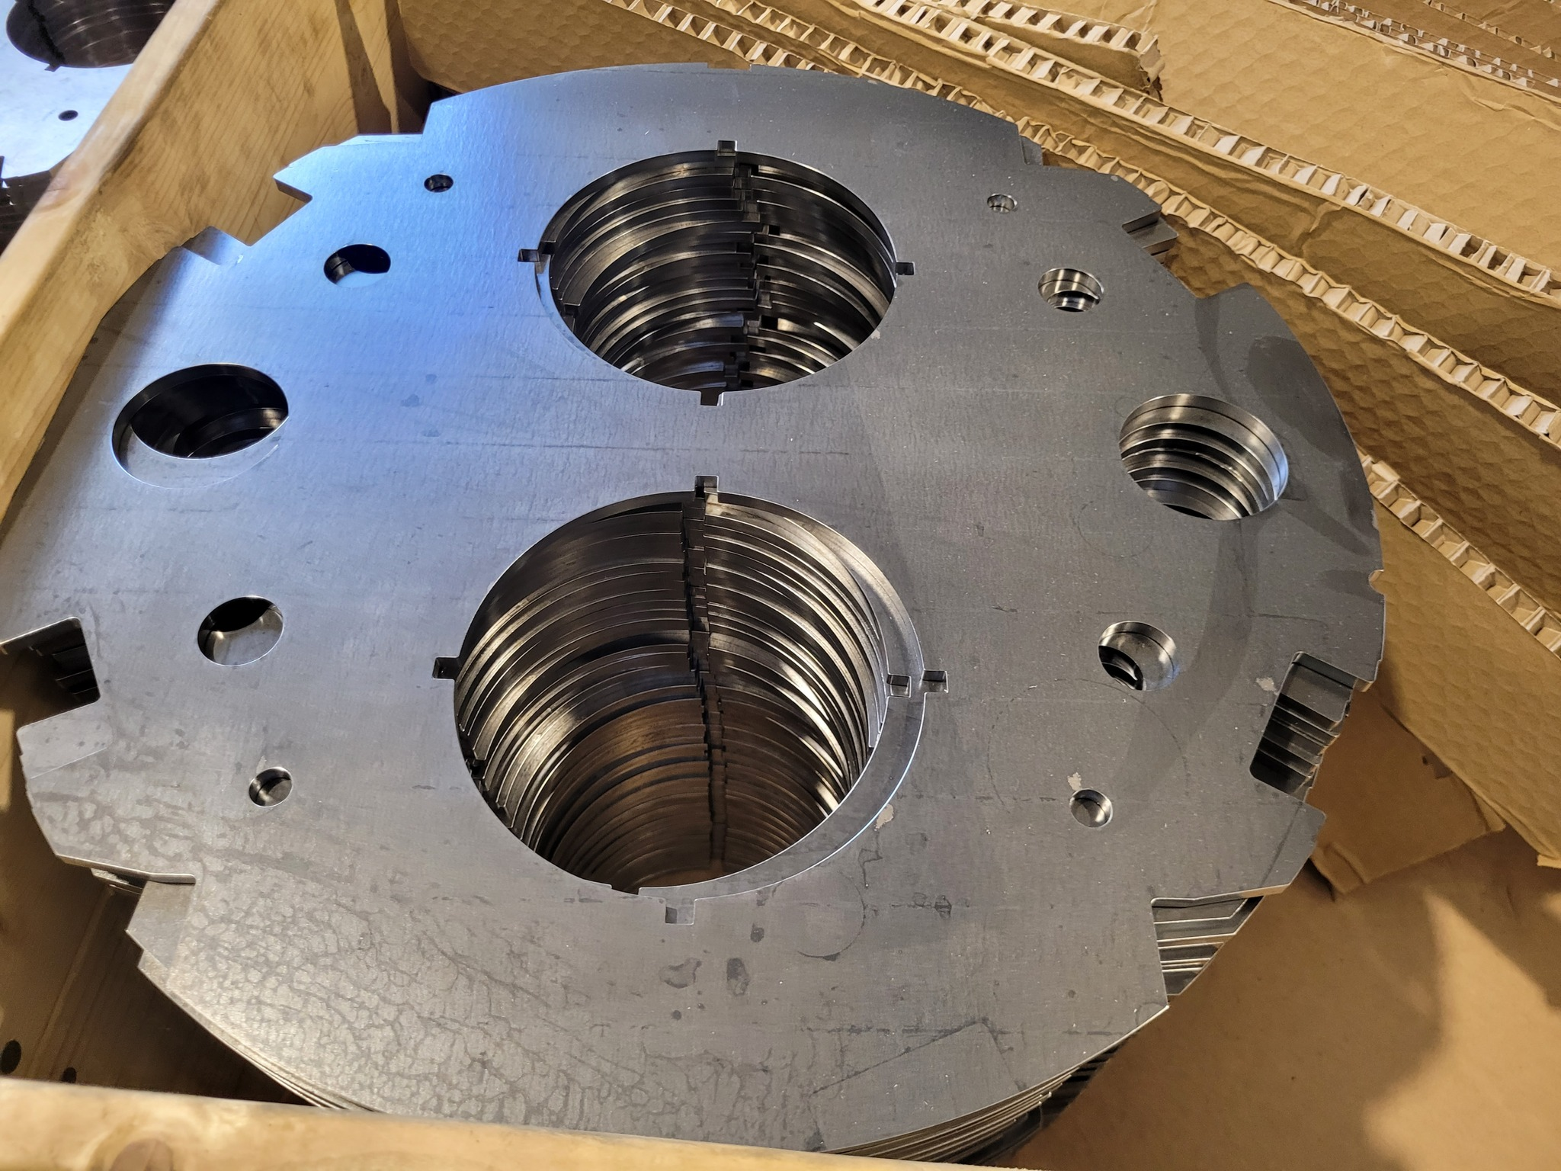
Magnet R&D
The first Swedish superconducting accelerator magnet, industrial innovation partnership
  A CCT dipole corrector prototype (3 T)
  NbTi rope cable
  Goal: Serve as replacement of LHC correctors MCBC/MCBY
  Status: Ready for impregnation (wax or Resin, to be decided)
The Truncated Cosine Theta, with GSI/FAIR and Examec (3 T if SC version)
  Working on a normal conducting ”mock-up” of a GSI/FAIR patented invention
  Copper cable
  Looking into a superconducting prototype
Kei Sugita,
doi:10.18429/JACoW-IPAC2018-WEPML036

Slide 14
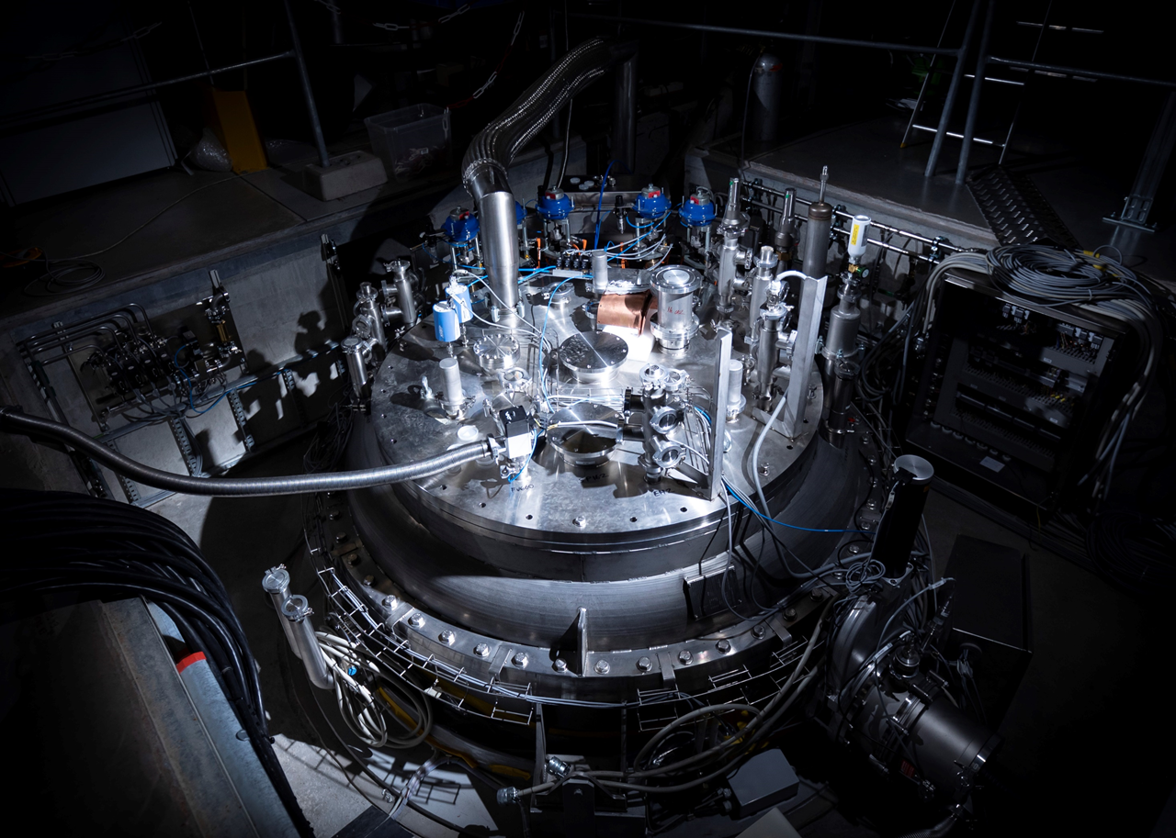
Thank you
We are hiring…

Slide 15
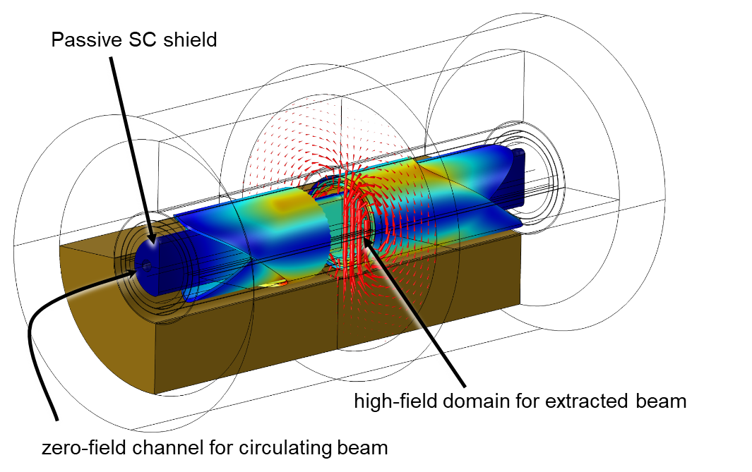
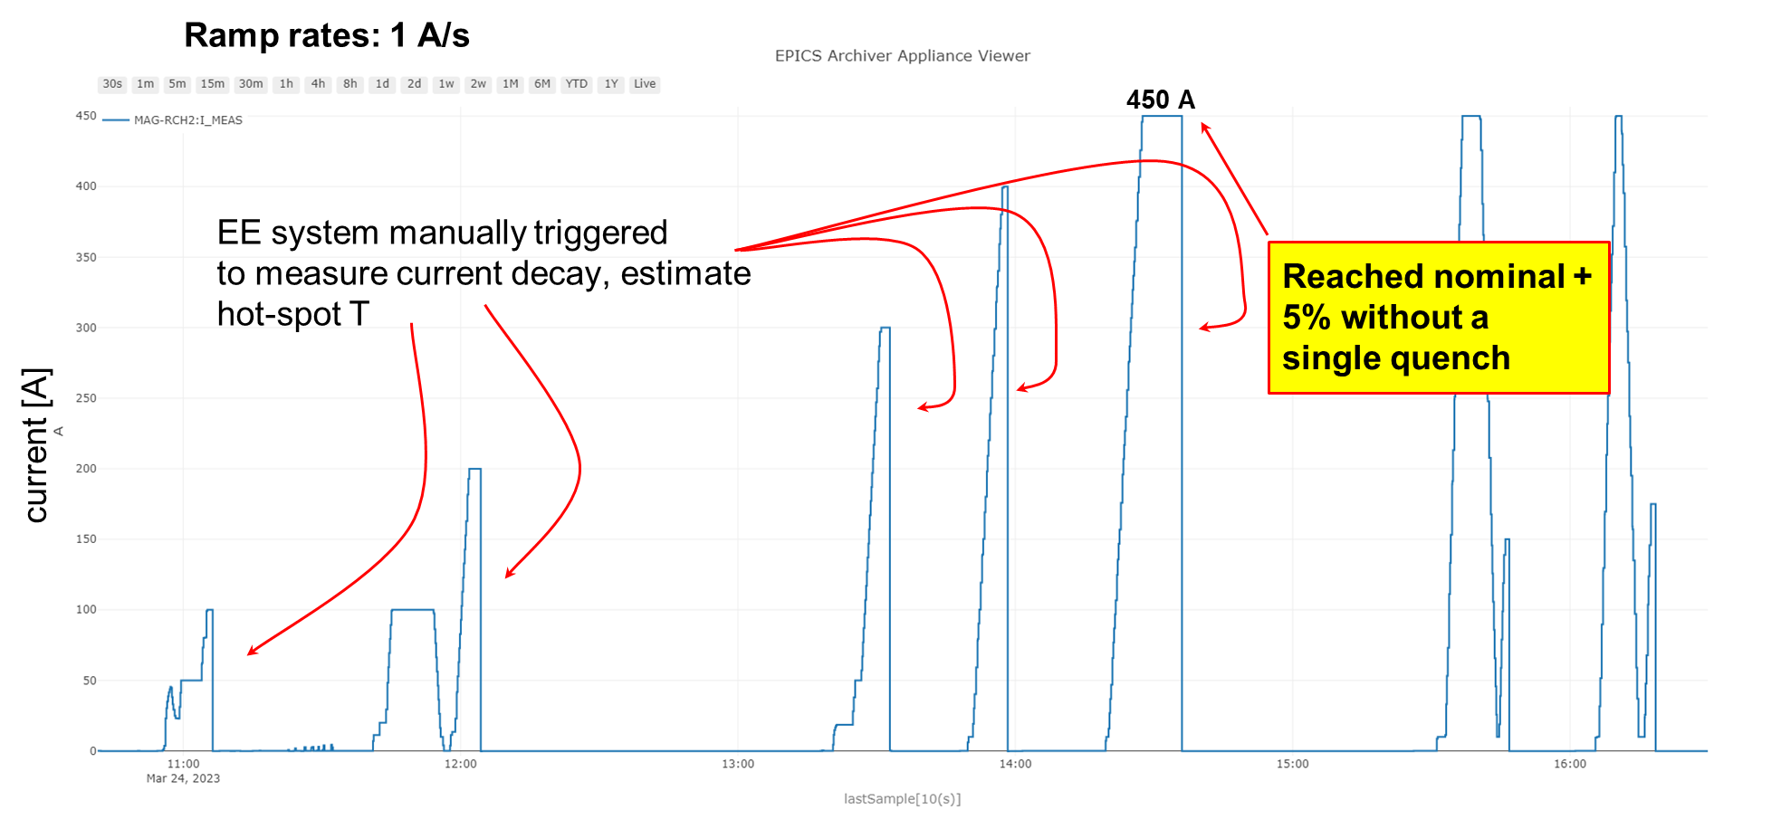
SuShi
Septum prototype for FCC extraction to dump.
Wax-impregnated CCT magnet
Passive superconducting shield
D Barna et al 2024 Supercond. Sci. Technol. 37 045006, DOI:10.1088/1361-6668/ad2981

