Slide 1
Lectures on Superconducting Magnet Test Stands, Magnet Protections and Diagnostics
M. Bajko & H. Bajas

Slide 2
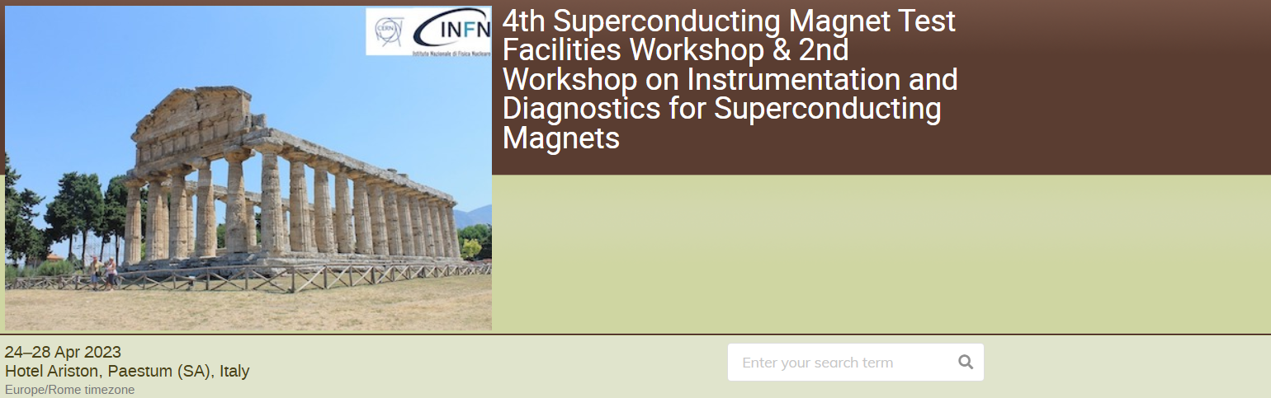
Initiated after the 4th SMTF workshop

Slide 3
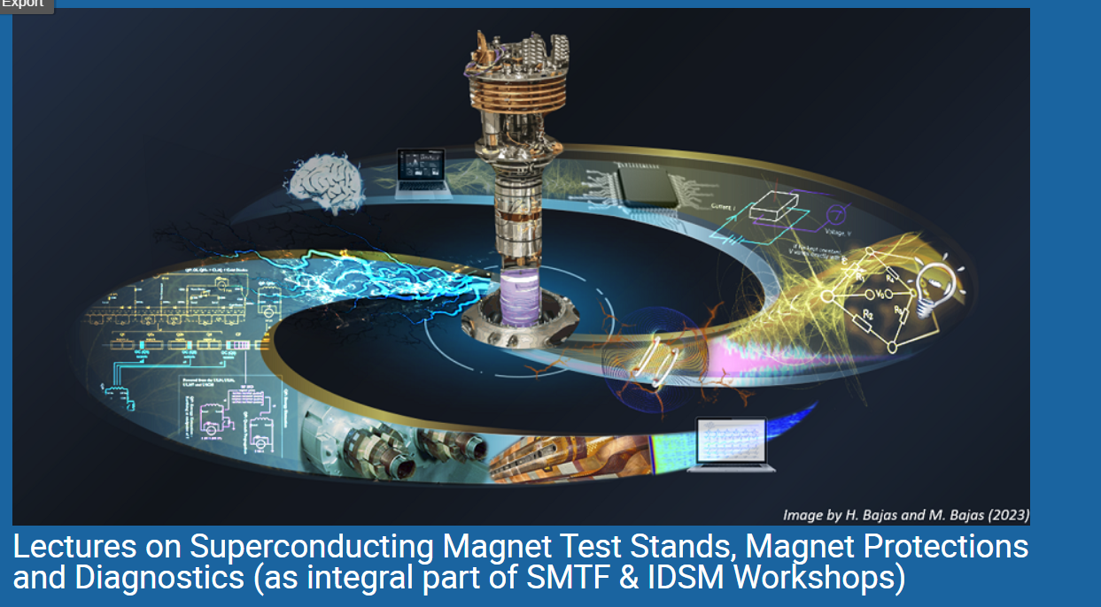
ZOOM
30 May -12 June .2023
CET 16h30-18h30
20 lectures
Organisers
M. Bajko CERN/ H. Bajas EPFL
Support @ CERN
N. Heredia Garcia CERN
I. Garcia Obrero CERN
https://indico.cern.ch/event/1281454/
Upcoming online training on Superconducting Magnet test stands, Magnet protections and Diagnostics | High Luminosity LHC Project

Slide 4
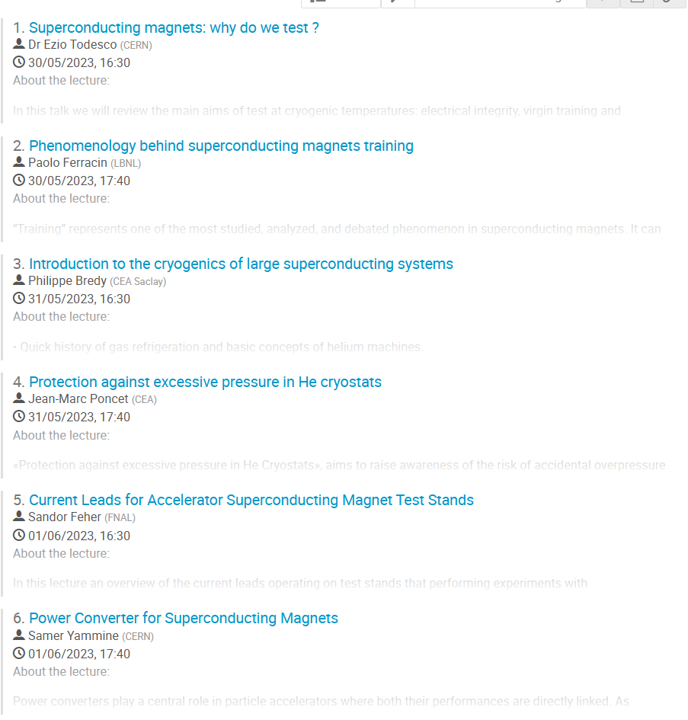
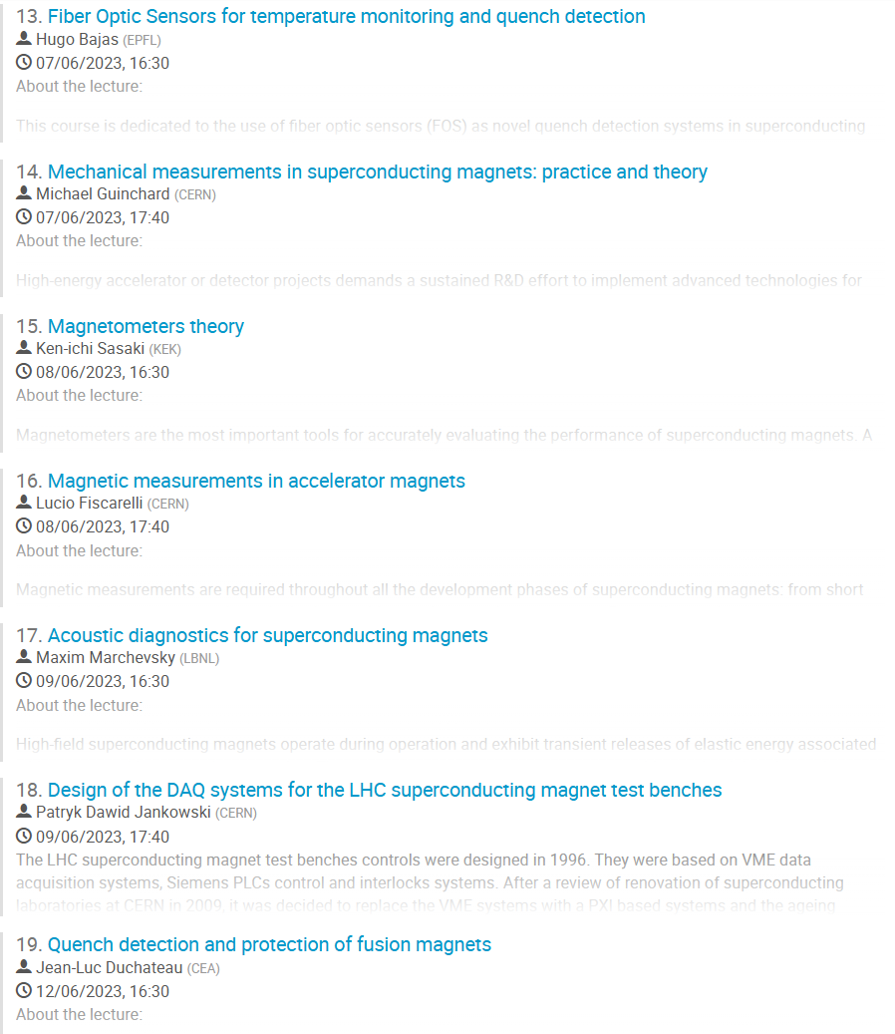
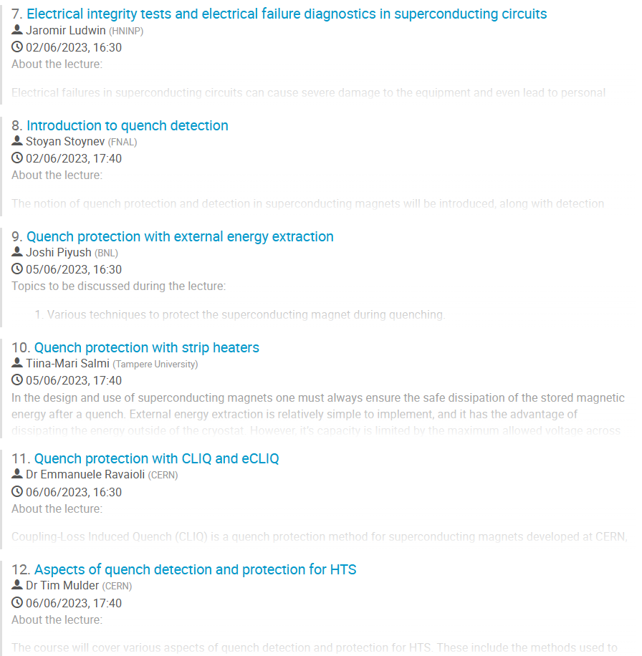
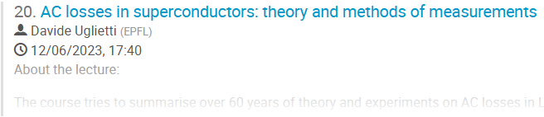
20 lectures over two week dealing with all aspect of magnet testing

Slide 5
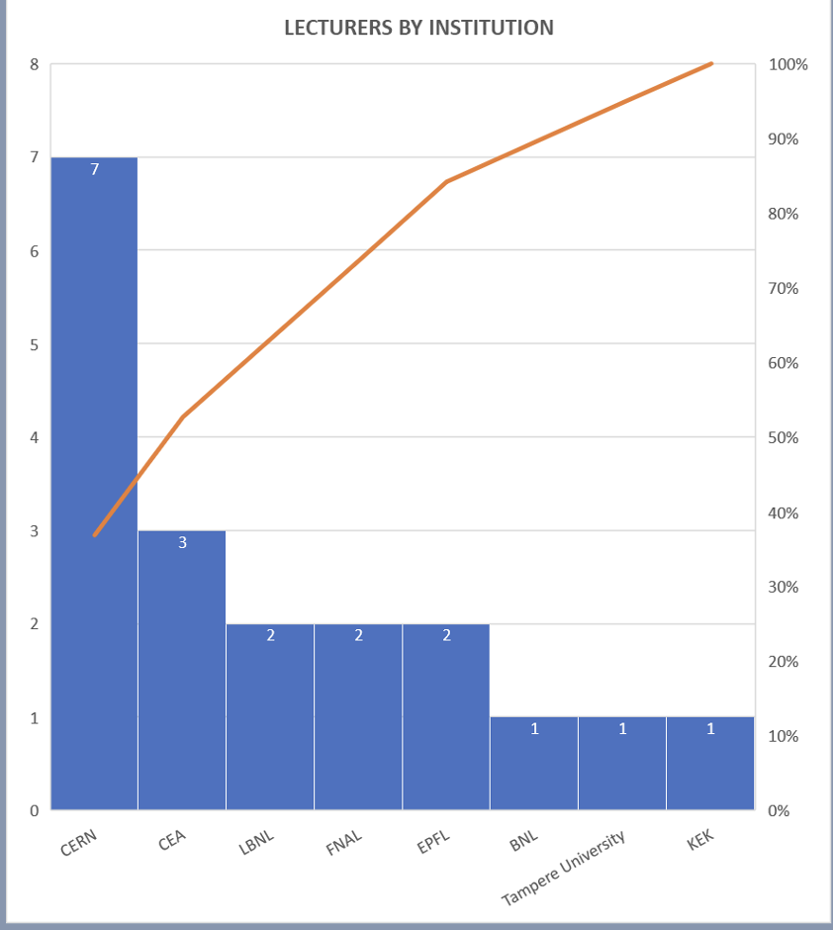
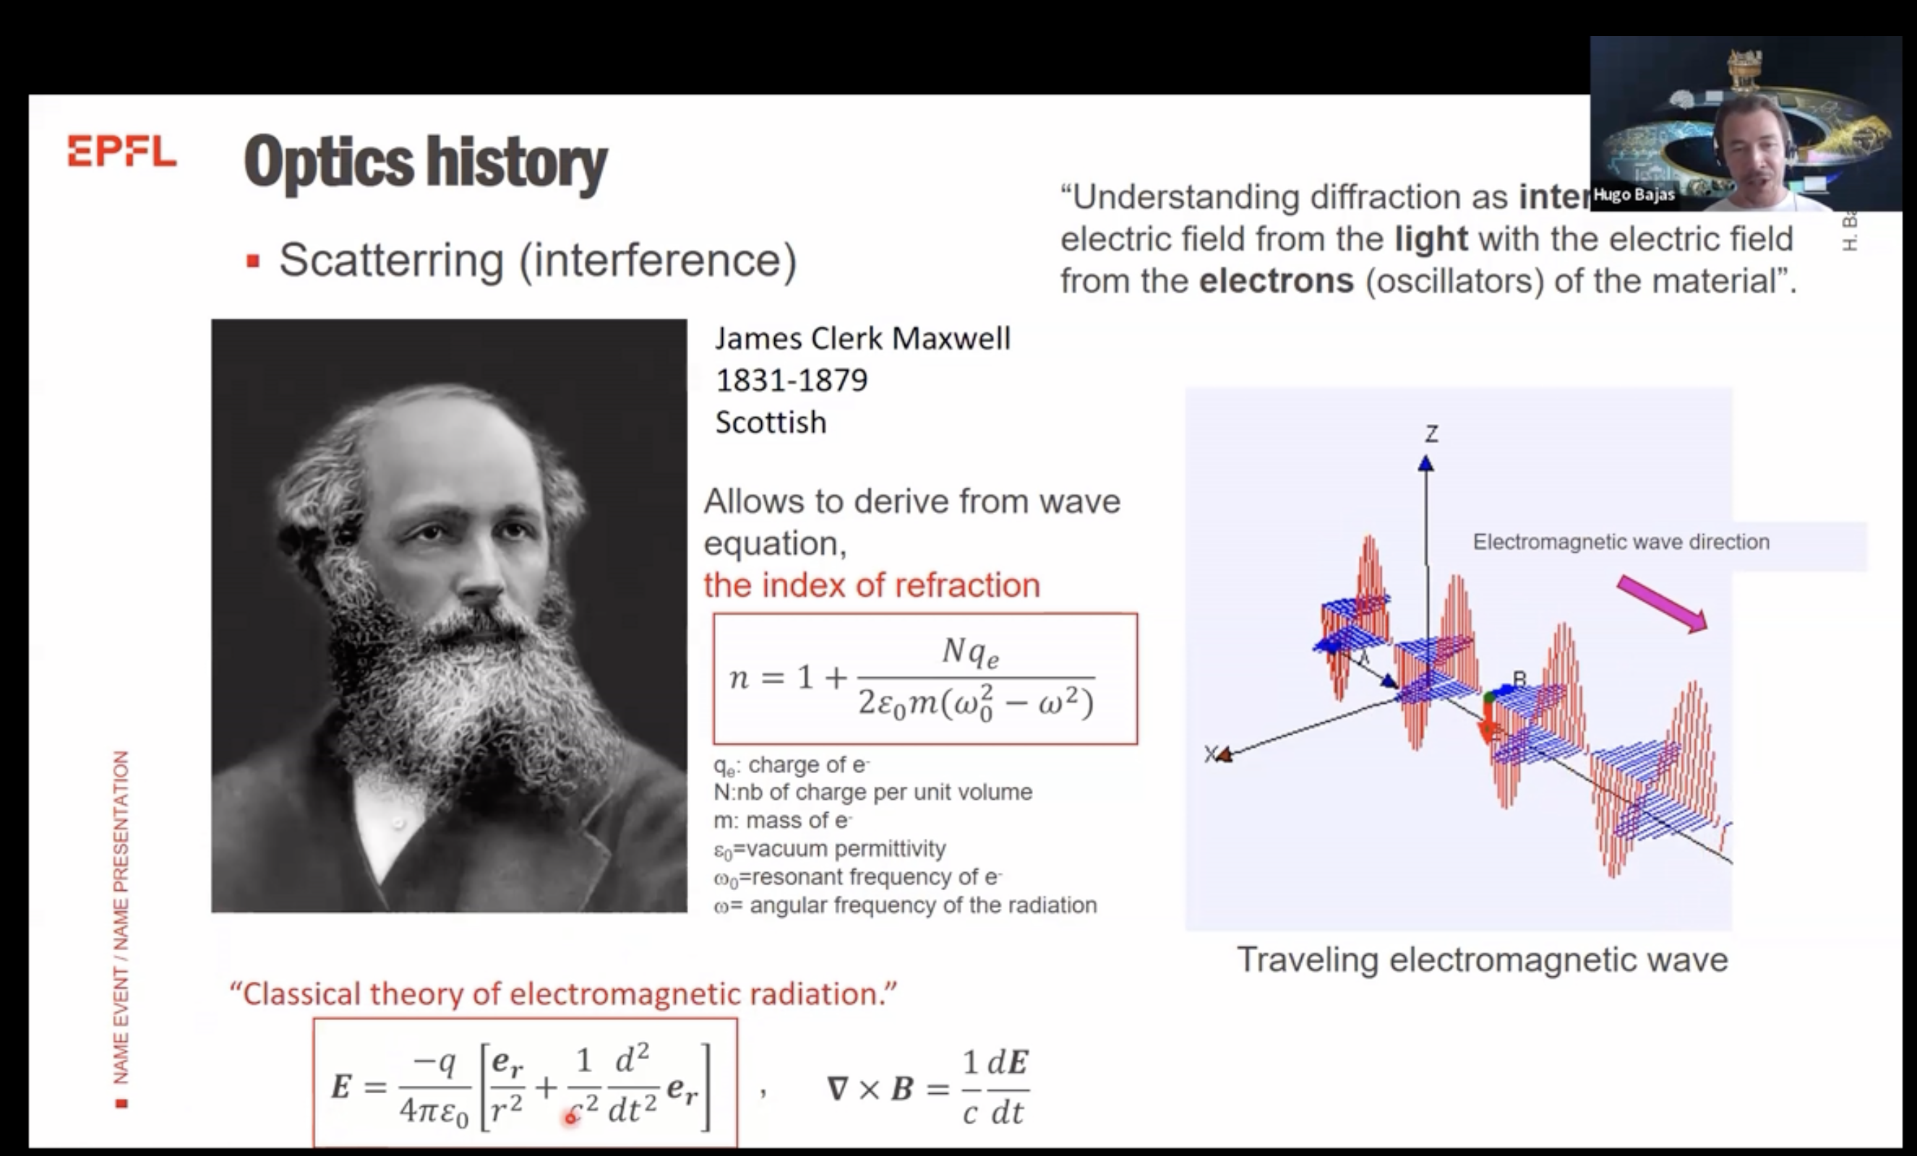
STATISTICS OF THE LECTURERS-RECORDS
First Name | Last Name | Affiliation | Institute Origin
Ezio | Todesco | CERN | Int. Organization
Paolo | Ferracin | LBNL | USA
Philippe | Bredy | CEA | France
Jean-Marc | Poncet | CEA | France
Sandor | Feher | FNAL | USA
Samer | Yammine | CERN | Int. Organization
Stoyan | Stoynev | FNAL | USA
Joshi | Piyush | BNL | USA
Tiina | Salmi | Tampere University | Finland
Emmanuele | Ravaioli | CERN | Int. Organization
Tim | Mulder | CERN | Int. Organization
Hugo | Bajas | EPFL | Switzerland
Michael | Guinchard | CERN | Int. Organization
Ken-ichi | Sasaki | KEK | Japan
Lucio | Fiscarelli | CERN | Int. Organization
Maxim | Marchevsky | LBNL | USA
Patryk Dawid | Jankowski | CERN | Int. Organization
Jean-Luc | Duchateau | CEA | France
Davide | Uglietti | EPFL | Switzerland
Ex. Lecture given by Dr. H. Bajas EPFL on
Fiber Optic Sensors for temperature monitoring and quench detection

Slide 6
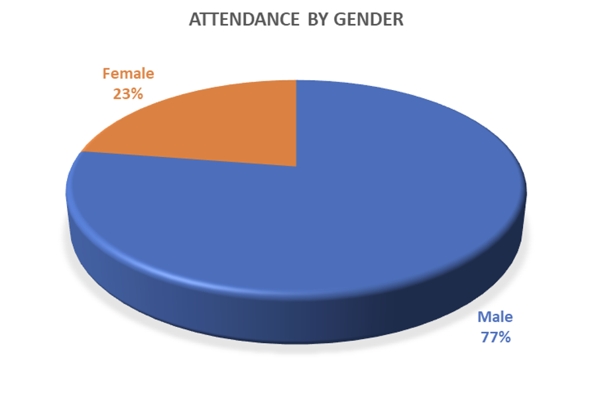
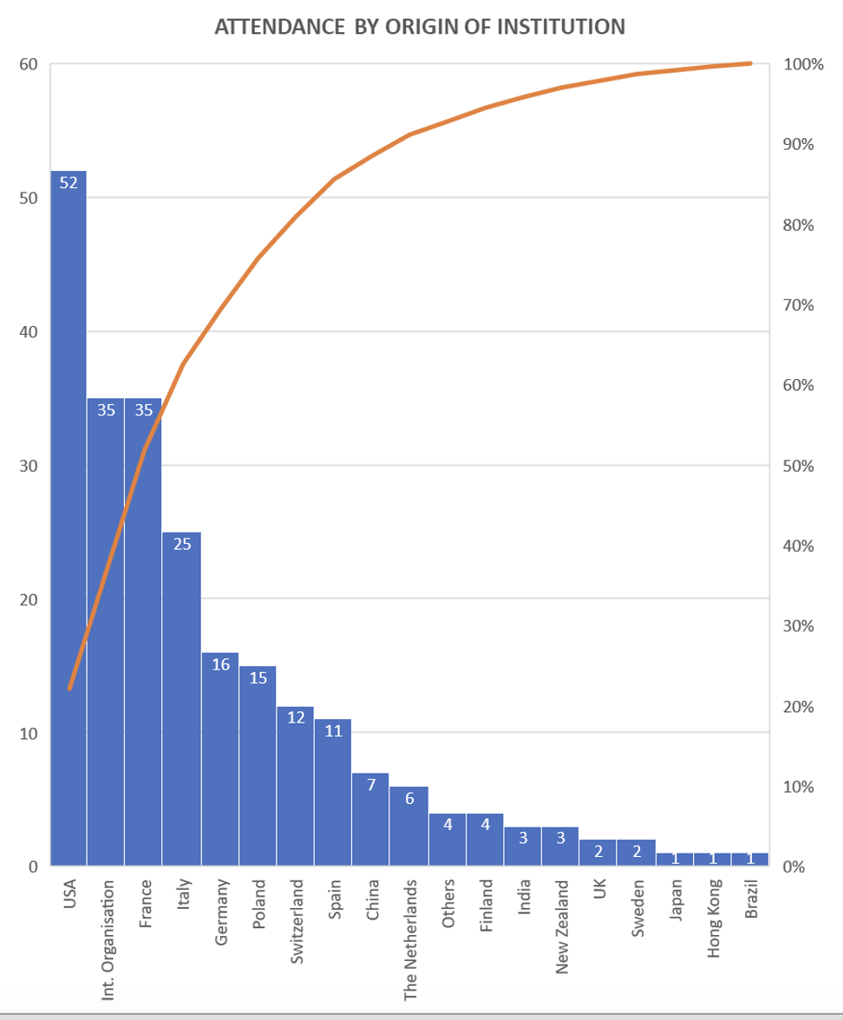
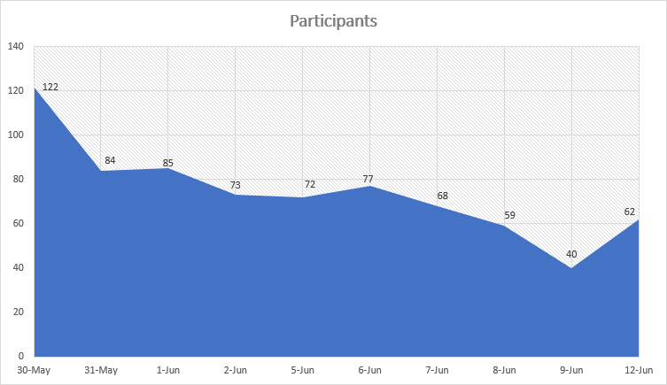
STATISTICS OF THE STUDENTS
240 Registered Students
Request for academic credits
is in discussion today with CERN Training Centre

Slide 7

After the 5th SMTF workshop, we will organize a new round of lectures
Save the date: 2025, from 2nd to 13th of June

