Slide 1
Quench detection using cryogenic electronics
Piyush N Joshi
Soumyajit Mandal
5th SMTF and 3rd IDSM 2025, Bad Zurzach, Switzerland
March 31–April 4, 2025

Slide 2
Outline
Motivation. Why we need cryogenic quench detector (QD)?
Cryogenic QD versus normal QD
Implementation at 77K
Facility and Setup
Progress and Status
Summary

Slide 3
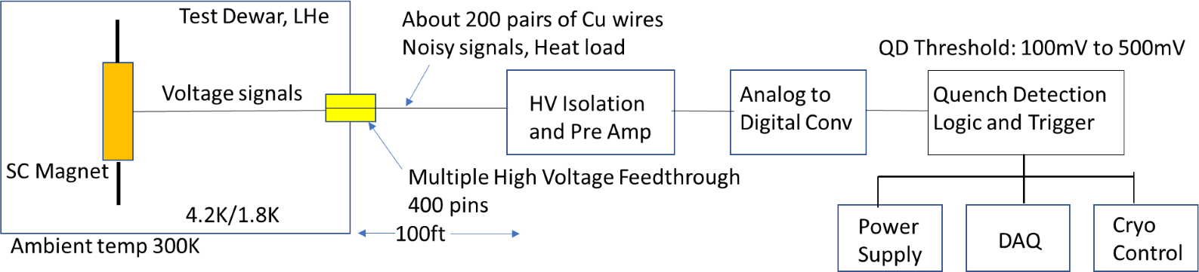
Motivation
Problem
Quench training is integral part of any new magnet development and testing program. It involves repetitive quenching of a magnet till it reaches its designed stable operating current. Conventional quench detection techniques are reaching limits of their application. Major issues related to reliable quench detection in HTS magnets are:
Requirement of lower quench detection threshold for HTS magnets (order of 100uV to 500uV)
Very high heat load on cryogenic system due to increased number of sensors and voltage tap wires
Costly interfaces and feedthroughs.
Solution :
Introducing quench detection electronics inside the test dewar close to SC magnet takes care of most of the above issues.
Introducing Fiber Optic communication takes care of high voltage isolation and improves signal to noise ratio
Conventional
Quench Detector
ATRO Accelerator Science & Technology Department

Slide 4
Phase 1: implementation at 77K
Phase 1: Test components in an 77K cryostat close to an accelerator magnet (utilizing ADCs and digital interface developed by BNL’s IO for DUNE).
Couple of fiber optic cables,
Very low heat load, low noise
HV Iso
& Amp
A/D
Converter
Digital
Interface
Fiber Interface
Logic and Trigger
Simple Fiber Optic Feedthrough
77K
Cu Wires
Data
Logger
Power
Supply
Cryo
Control
ATRO Accelerator Science & Technology Department

Slide 5
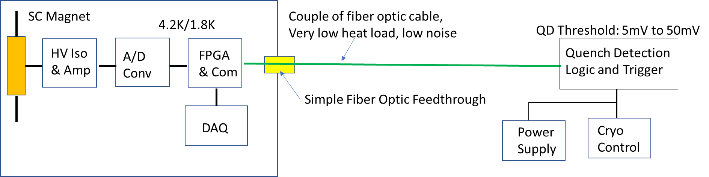
Phase 2: Implementation at 4.2K
Phase 2: Based upon the results of Phase 1, explore CMOS quench detection electronics capable of operating at 4.2K
ATRO Accelerator Science & Technology Department

Slide 6
Main design specifications
 | Value | Unit
Regulated power supply voltage | +/- 1.65 | V
Max isolation voltage | 4 | kV
Amplifier voltage gain | 20 | dB
Bandwidth | 100 | kHz
Maximum ADC sampling rate | 3 | MSPS
Isolator data rate | 0~25 | Mbps
ADC power consumption | 11.4 | mW

Slide 7
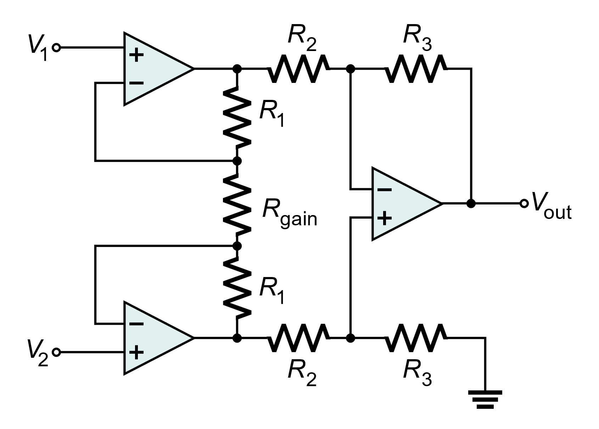
Pre Amp and isolated power circuit for 77K operation
Instrumentation amplifier to amplify the differential voltage between coil monitoring points.
Amplified output digitized by an analog-to-digital converter (ADC).
Capacitively-isolated local power supply.
Low-dropout linear regulator for the power supply.
Capacitively-isolated digital output signals.
Voltage inputs and outputs on copper cables, could potentially be replaced by optical fibers in later versions
Parameter | Nominal value
V_{DD} | 3.3 V
V_{CC} | 12 V
V_{DD,ISO}, V_{SS,ISO} | +1.5 V, -1.5 V
V_{REF} | 2.5 V
V_{DD,ISO}
V_{DD,ISO}
V_{DD}
V_{REF}
v_{OUT}
Capacitive digital isolators
Superconducting coil
D_{OUT}
(SPI)
ADC
Reference generator
V_{REF}
V_{SS,ISO}
C₁
V_{DD,ISO}
+
V_{CC}
H-bridge
V_{AC}
Rectifier
Voltage regulators
V_{SS,ISO}
Single channel
CLK
-
C₁
V_{REF}

Slide 8
Initial choice of components
Component type | Part number | Function
Op-amp | AD8605 | 3x to realize the instrumentation amplifier
Op-amp | ADA4666-2 | 2x to realize the positive and negative voltage regulators
ADC (12-bit, up to 3 MS/s) | AD7274 | 1x for digitizing the outputs of the instrumentation amplifier
Capacitive isolator | ISO7220 | 2x to enable bidirectional communications
Zener voltage reference | UMZ5_1N | Nominal output = 5.1V
Schottky diode | BAT54 | Used by the capacitively isolated power supply
H-bridge | DRV8871 | Used to generate the isolated AC power waveform
Pass transistor | FDN337N | Used by positive and negative voltage regulators
Both op-amps and the ADC were verified to work at 77K in earlier projects
Capacitive isolator and H-bridge have not been tested at 77K earlier

Slide 9
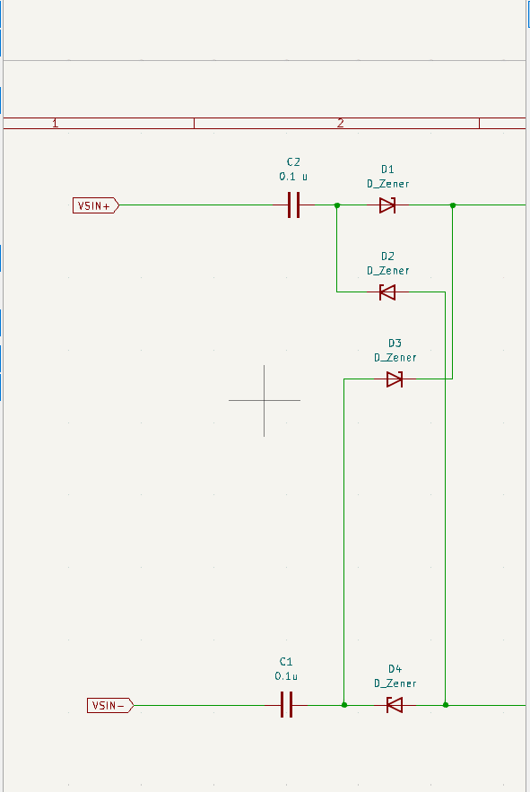
Isolated power supply
Step 1: External AC power supply passes through HV ceramic capacitors and a bridge rectifier, which creates unregulated voltages (Vin+ and Vin-) for the internal circuitry.

Slide 10
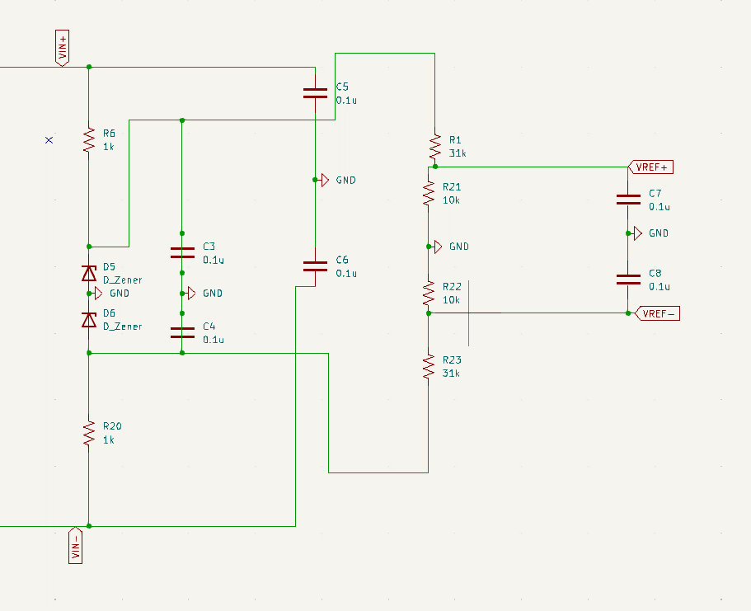
Isolated power supply (2)
Step 2: Rectified power supply is used for the internal circuit. Here C5 and C6 provide filtering of the AC ripple.

Slide 11
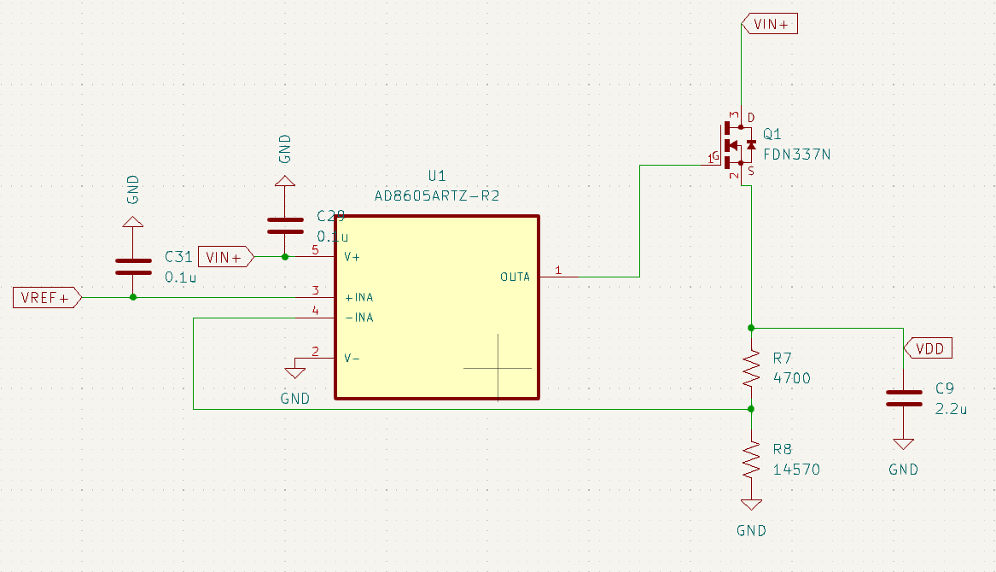
Positive voltage regulator
Step 4: The op-amp (U1) compares a scaled copy of the output voltage (VDD) to the positive reference input (Vref+). The result drives the gate of an NMOS (Q1) that acts as controlled resistor, i.e., a pass transistor.

Slide 12
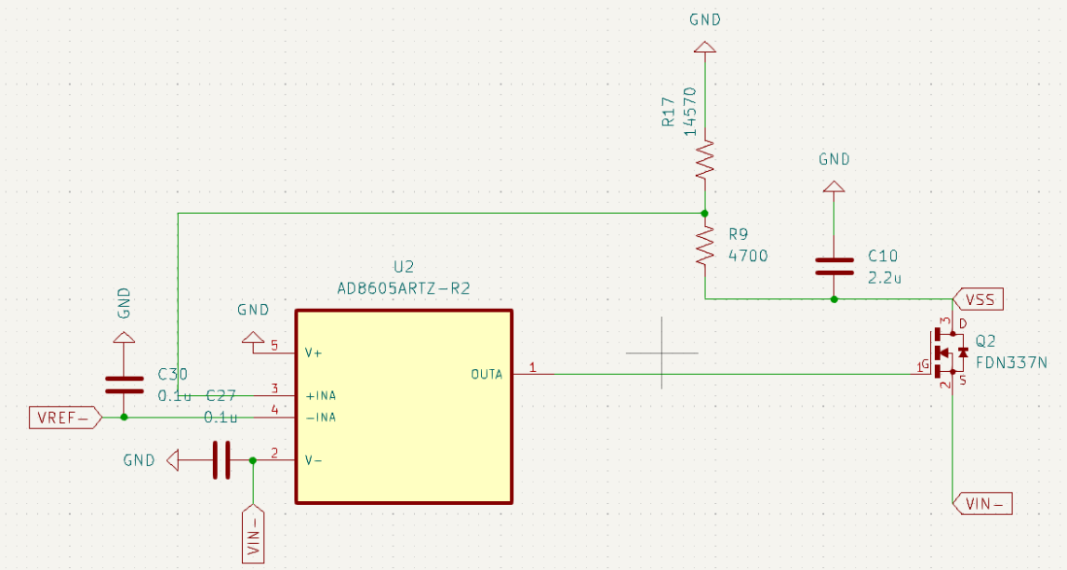
Negative voltage regulator
Step 5: Similar to positive voltage regulator, but with Vref+ replaced by Vref-. Generates the regulated negative supply (VSS).

Slide 13
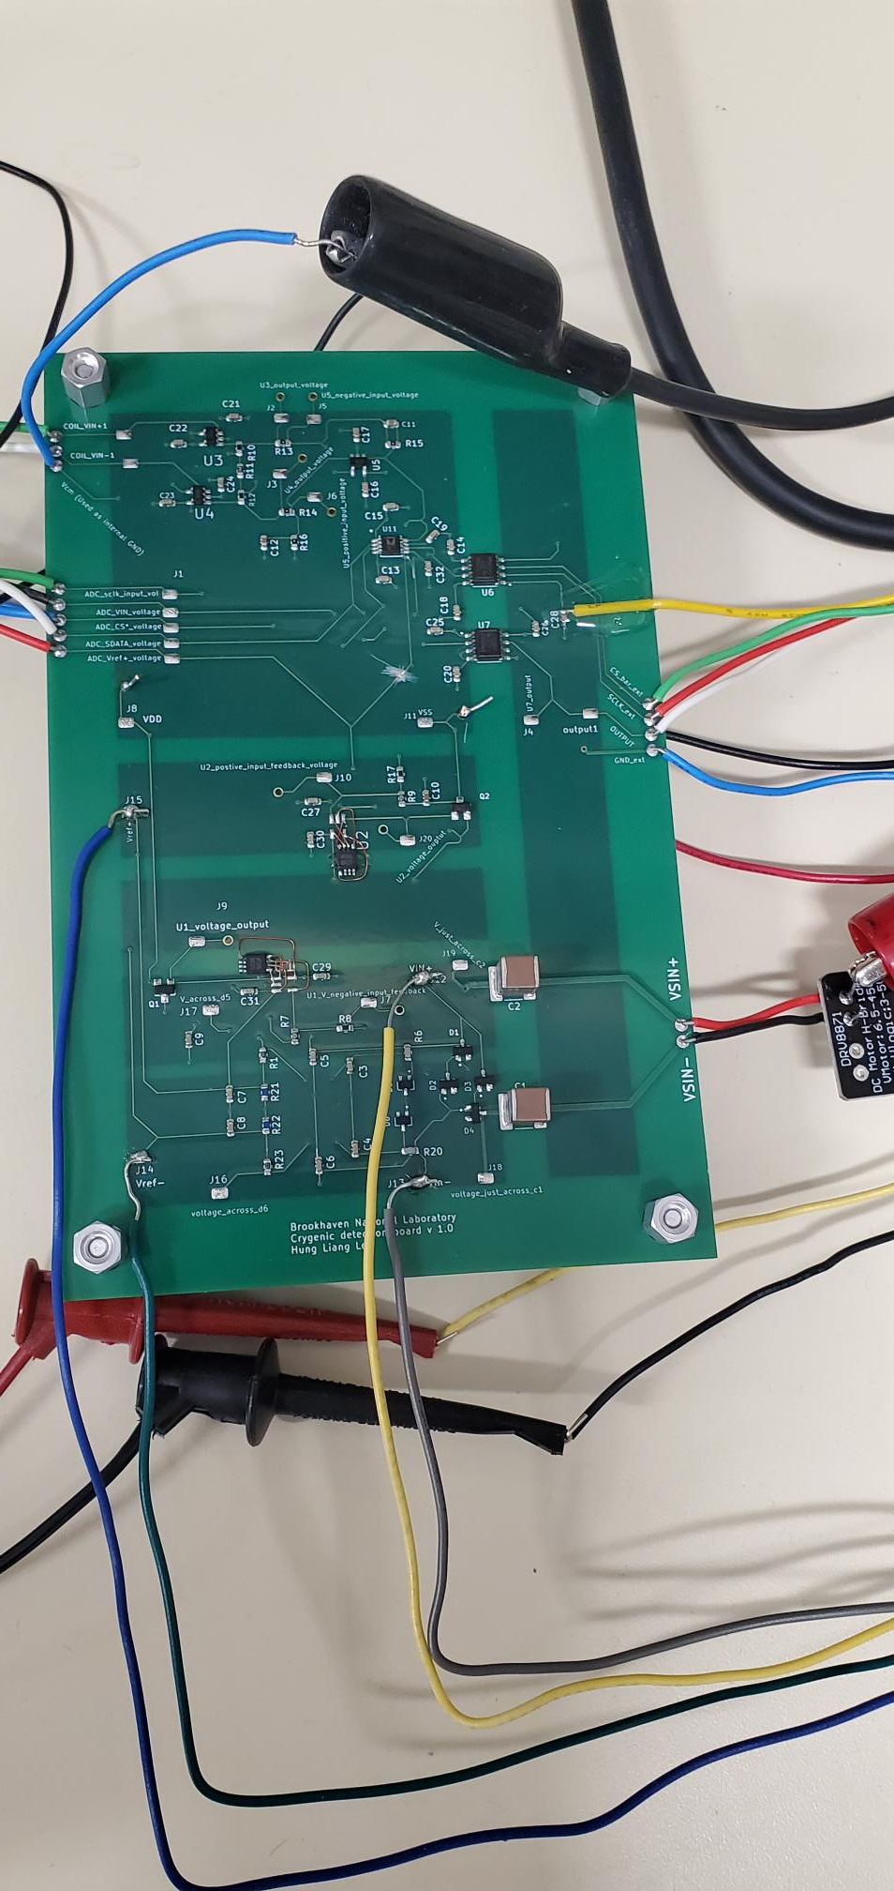
Fabrication of PCB for operation at 77K
Differential Amplifiers and ADC
Isolation Barrier
High Voltage Isolation capacitors
HV isolated regulate power supply
Instrumentation amplifier to amplify the differential voltage between coil monitoring points.
Amplified output digitized by an analog-to-digital converter (ADC).
Capacitively-isolated local power supply.
Capacitively-isolated digital output signals.

Slide 14
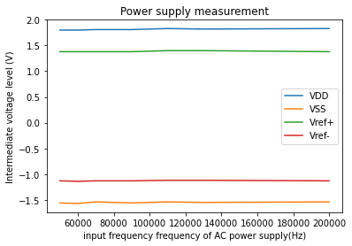
Power supply measurement
Design works as expected

Slide 15
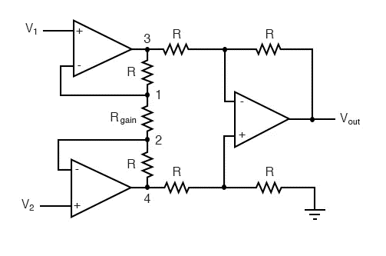

Instrumentation amplifier concept
Inputs are buffered by the two input op-amps, resulting in high input impedance
Differential voltage gain: $v_{out}=\frac{R_{2}}{R_{1}}(1+\frac{2R_{3}}{R_{4}})(v_{2}−v_{1})$
1
2
3
4
3
1
2

Slide 16
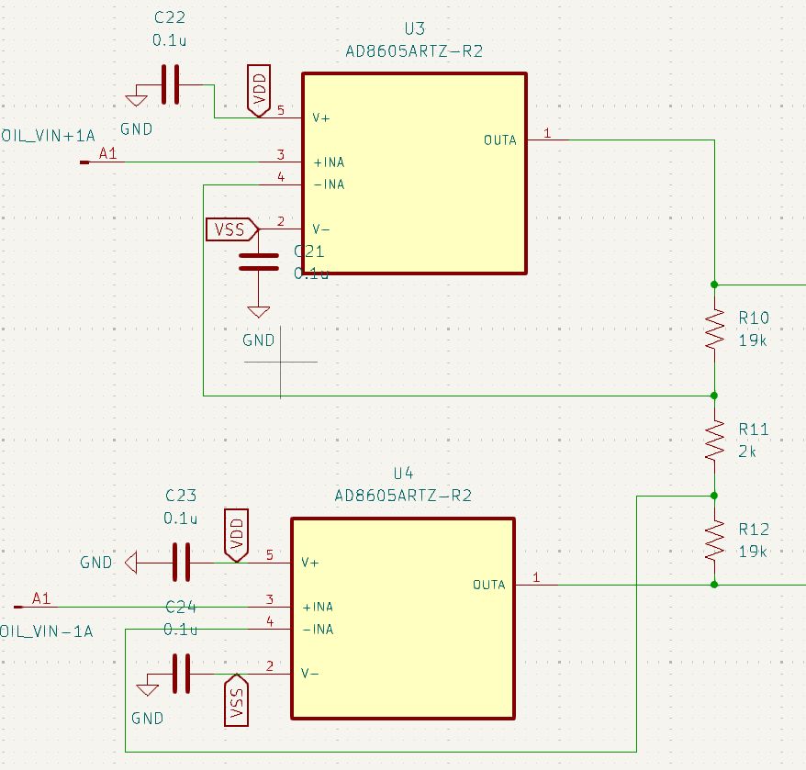
Input circuit
The voltage difference between the coil inputs (COIL_VIN+ and COIL_VIN-) is amplified by the instrumentation amplifier

Slide 17
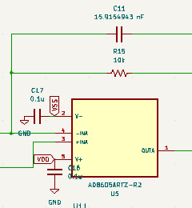
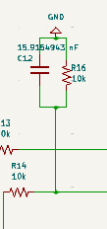
Low-pass filter
Limits the bandwidth of the instrumentation amplifier to remove high-frequency noise and prevent aliasing, i.e., acts as anti-aliasing filter.

Slide 18
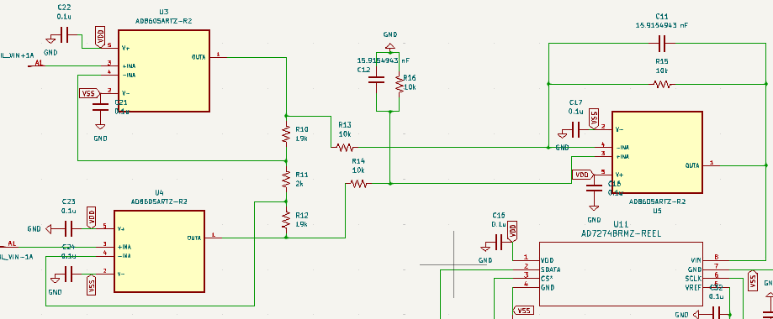
Complete instrumentation amplifier

Slide 19
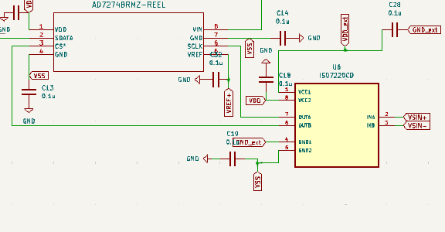
ADC and digital isolator
All digital I/O signals generated by the ADC (AD7274) are passed through a capacitive digital isolator (ISO7220).

Slide 20
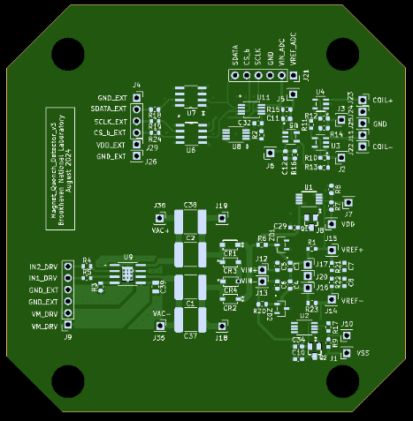
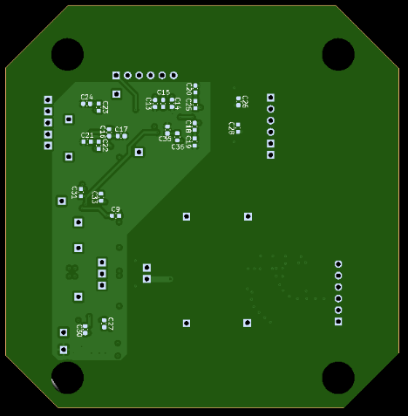
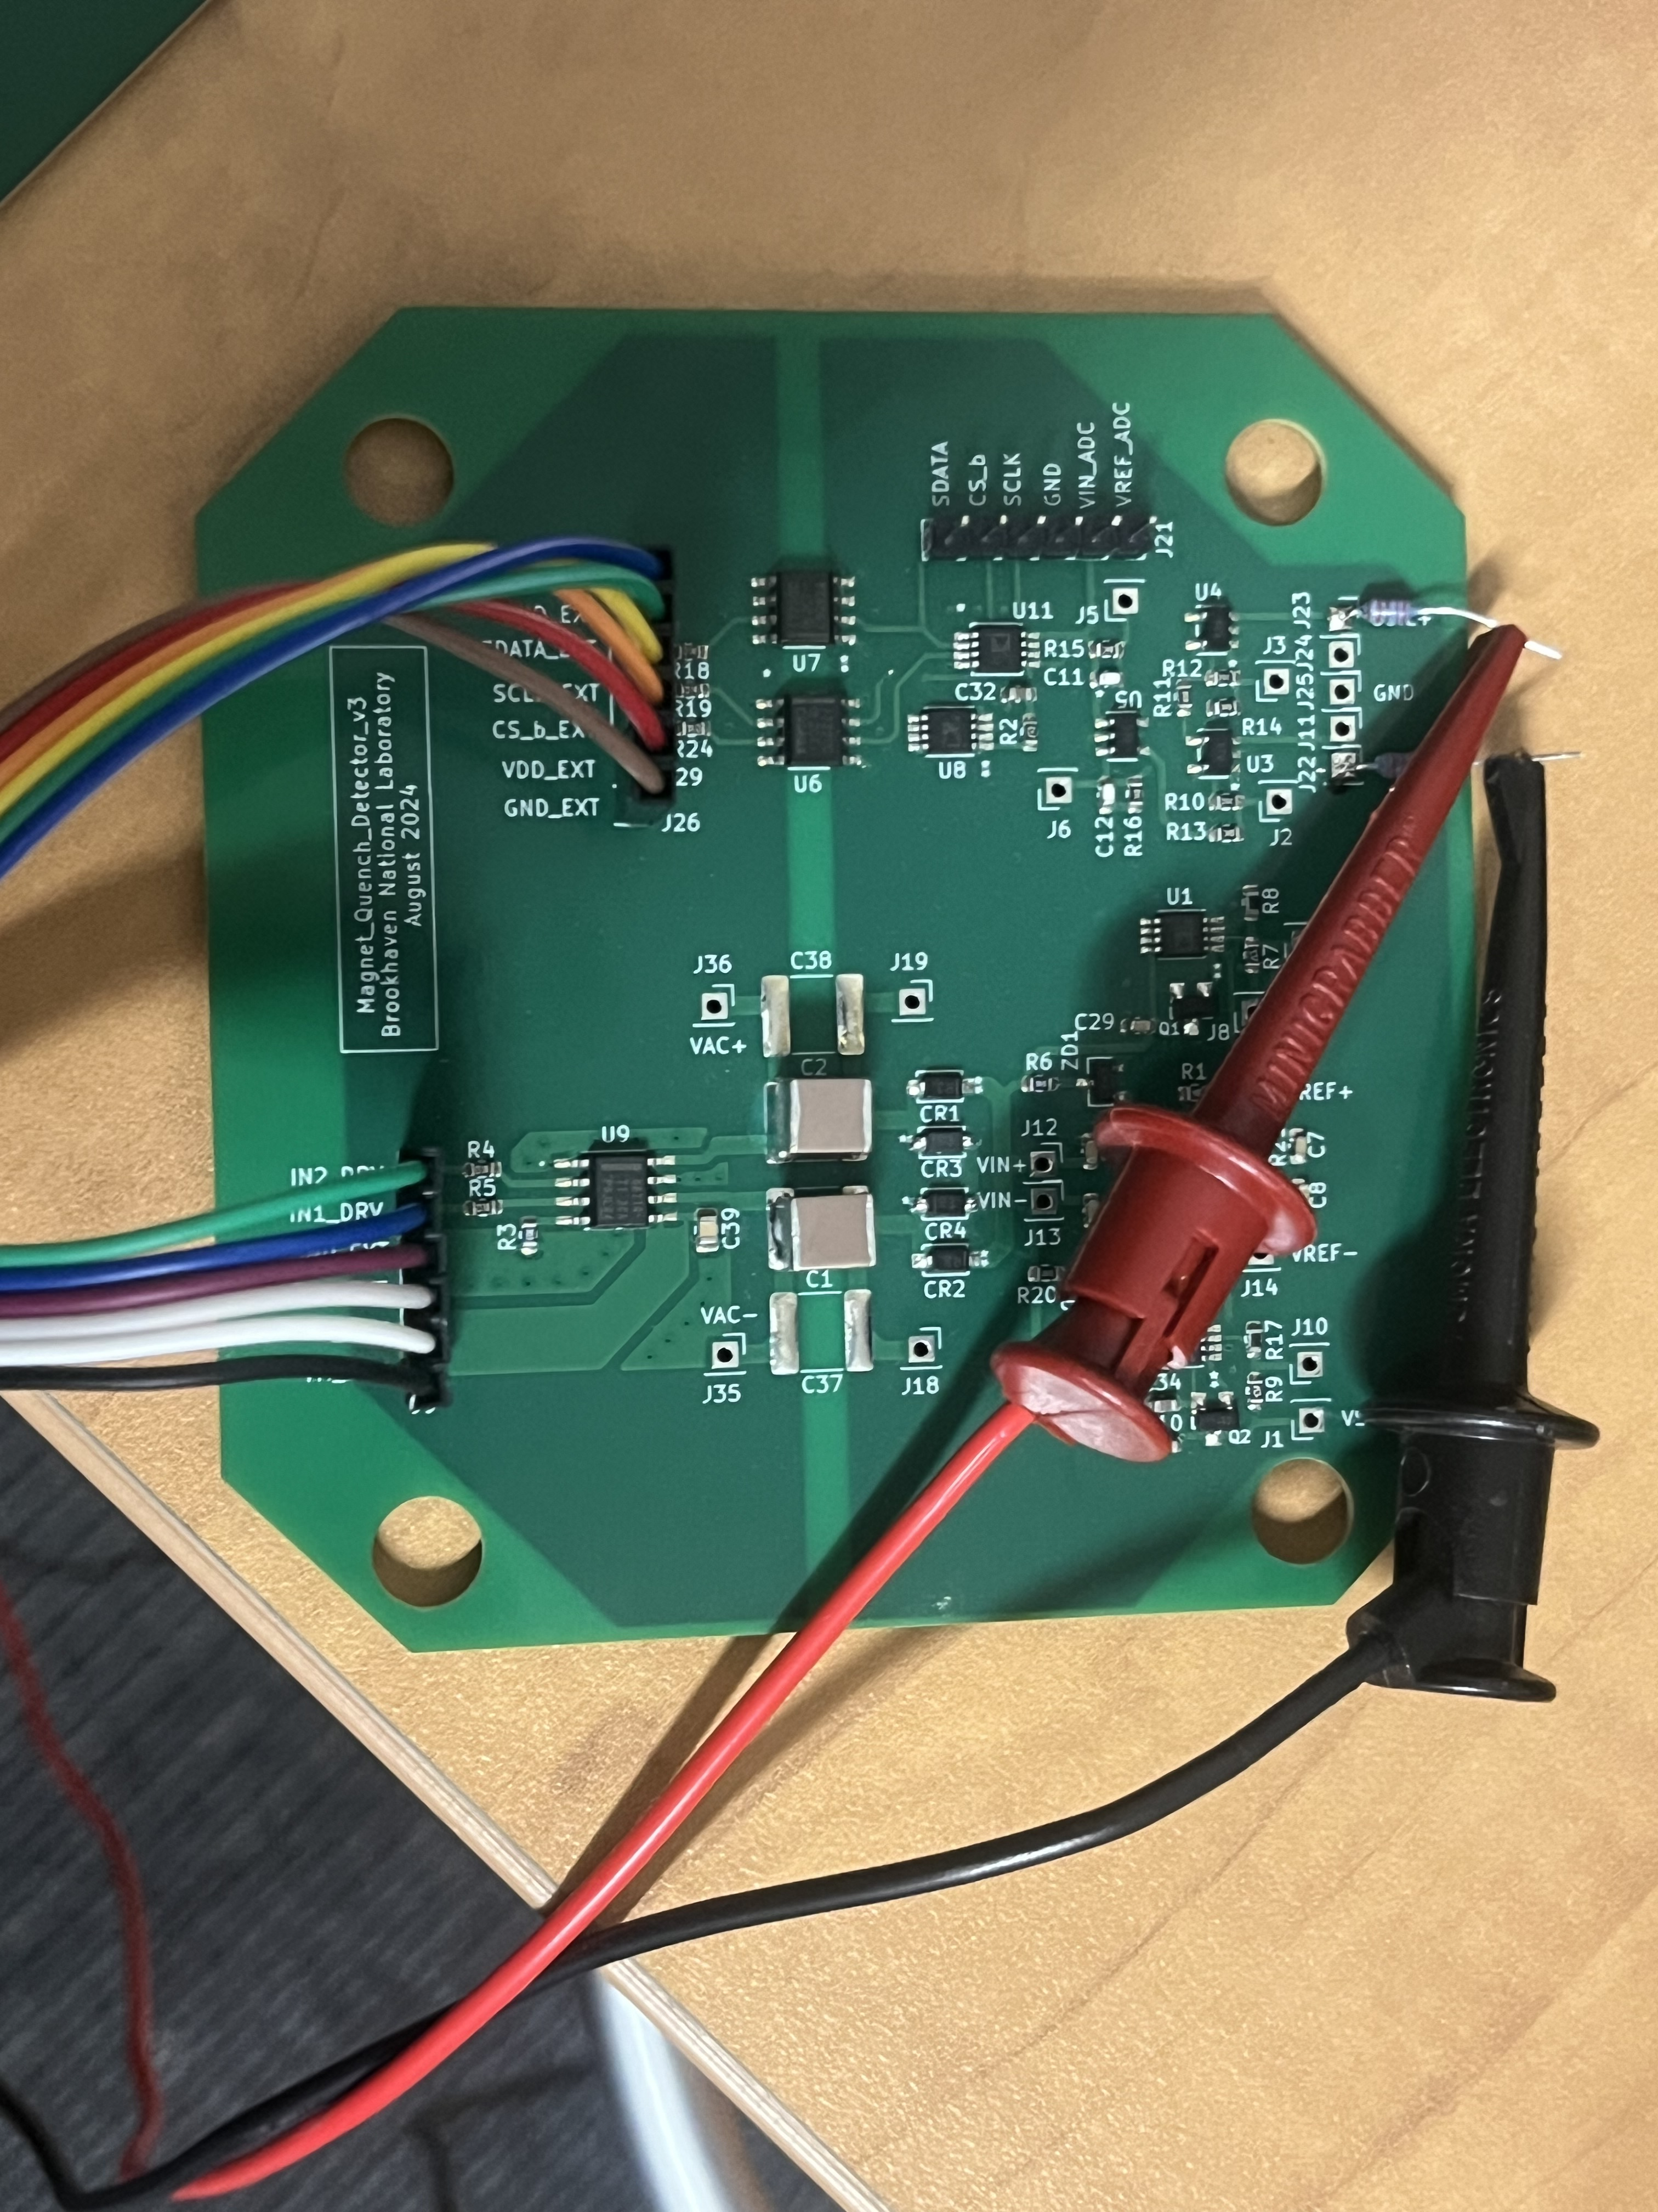
Version 2: Revised board design
Fixes design bugs, moves H-bridge into the board
Layout improvements to reduce board size (3.5” x 3.5” per channel)
Power and data lines
Floating input voltage
Top side (single channel)
Bottom side (single channel)
Test setup (at room temperature)

Slide 21
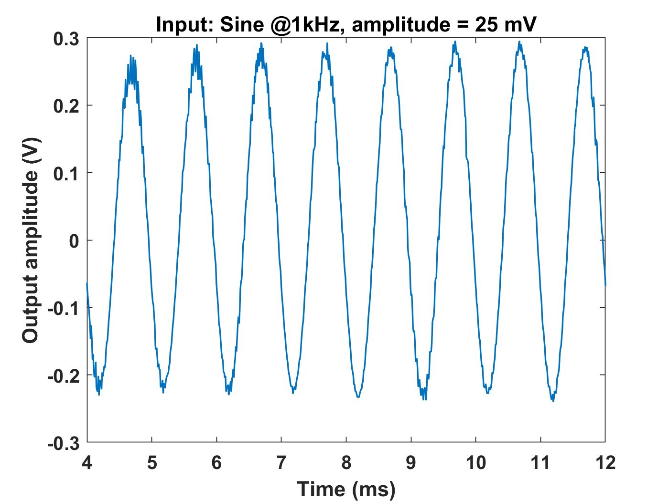
Test results
All components (power supply, amplifiers, and ADC) work perfectly at room temperature
  Floating input voltages were applied using a battery-operated signal generator
  H-bridge control signals and ADC interface (SPI) were handled by a microcontroller (Teensy 4.1)
  A simple data acquisition (DAQ) interface was written using the Arduino IDE
  Used to test the isolated ADC up to 100 kS/s
Cryogenic tests showed that the commercial H-bridge and digital isolators fail at 77K
  Need to be replaced by a custom design
Digitized sine wave from the isolated ADC (acquired at room temperature)

Slide 22
H bridge using discrete components
Custom H-bridge and digital isolator circuits were designed
  Custom circuits use only basic components (resistors, discrete FETs, and CMOS logic gates) to ensure normal operation at 77K
  Sizes of coupling capacitors was minimized to increase the isolation impedance, thus improving common-mode immunity during quench events
All digital signals (H-bridge drive, ADC interface) in the FPGA interface were converted to low-voltage differential signaling (LVDS) format

Slide 23
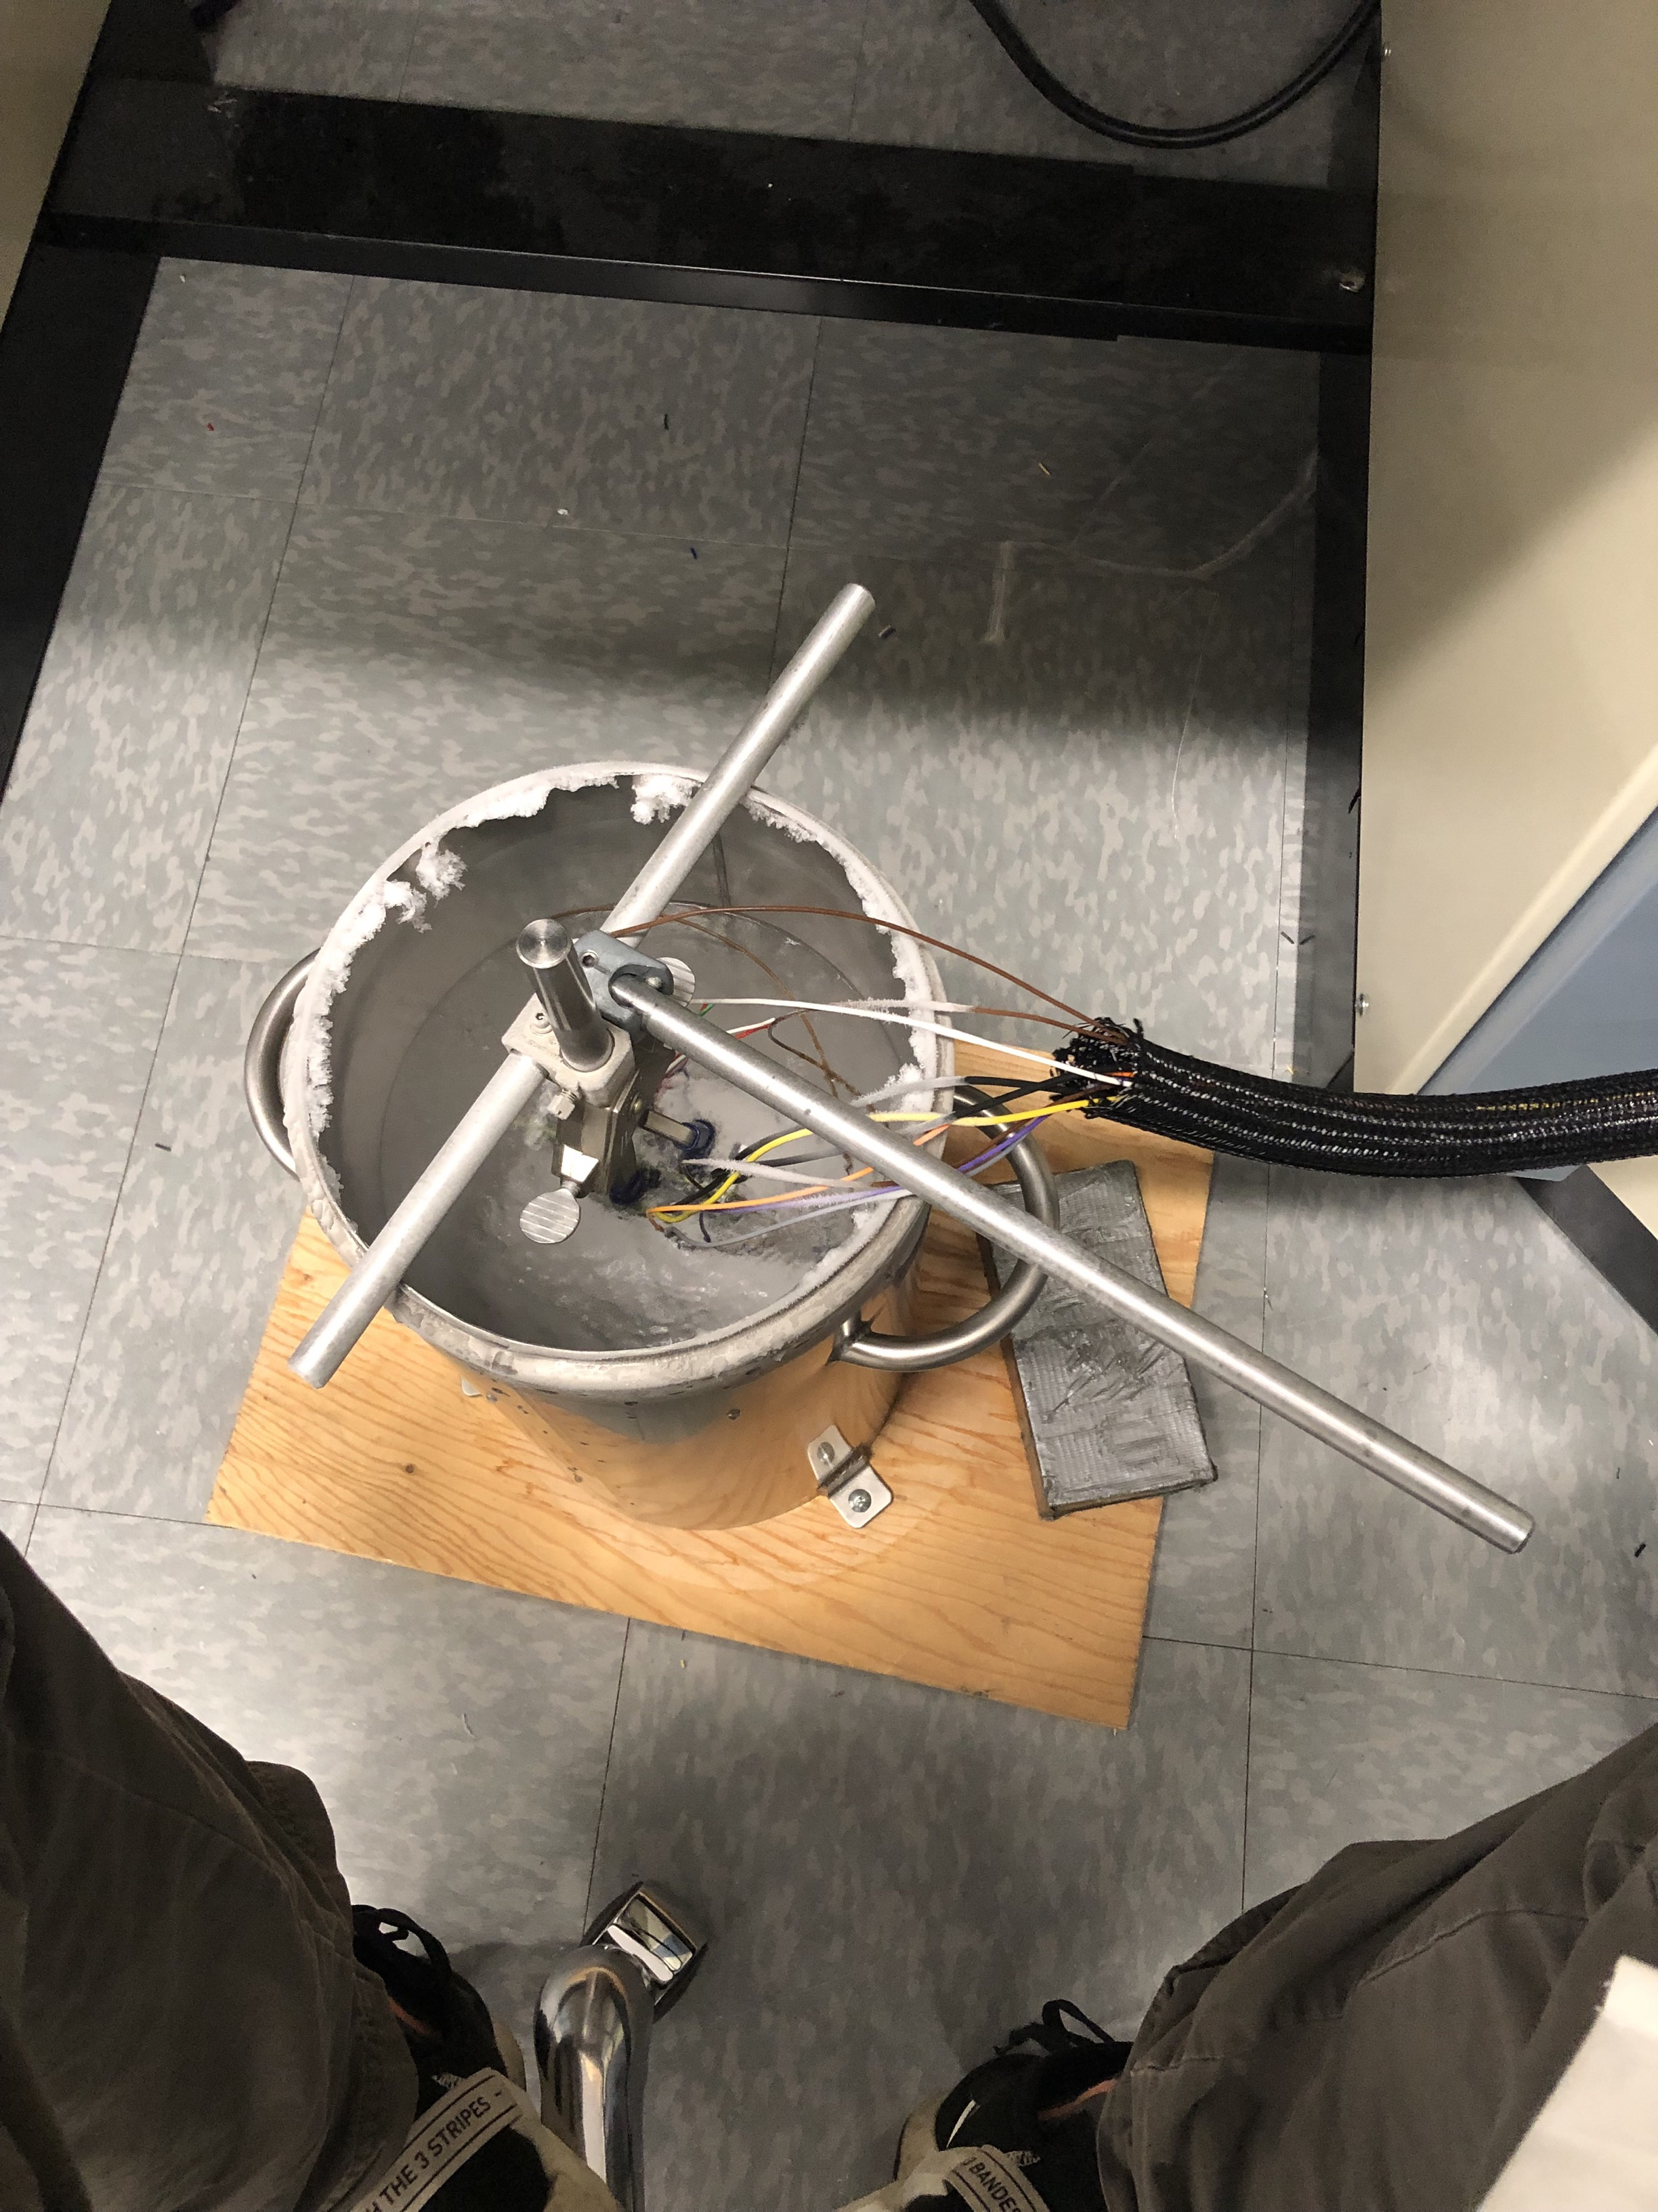
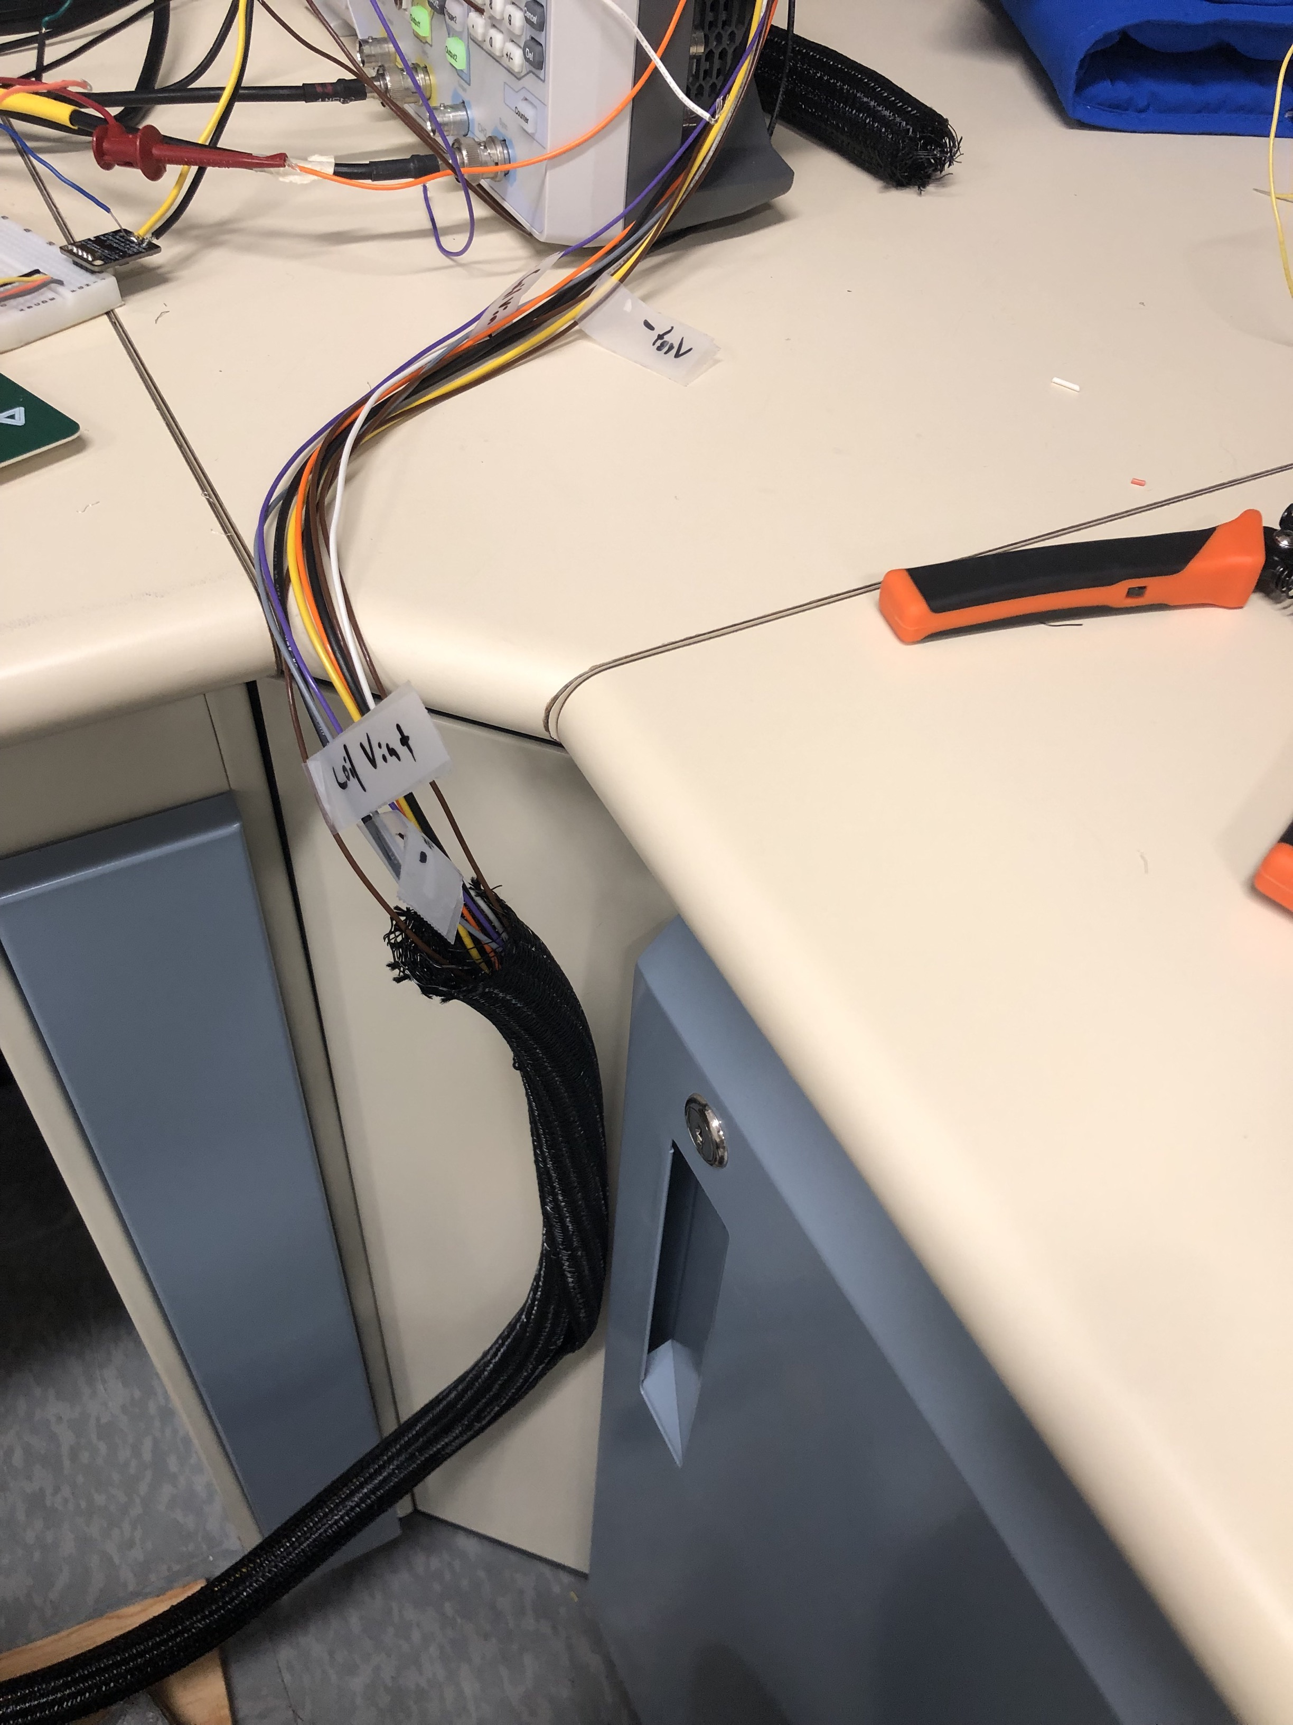
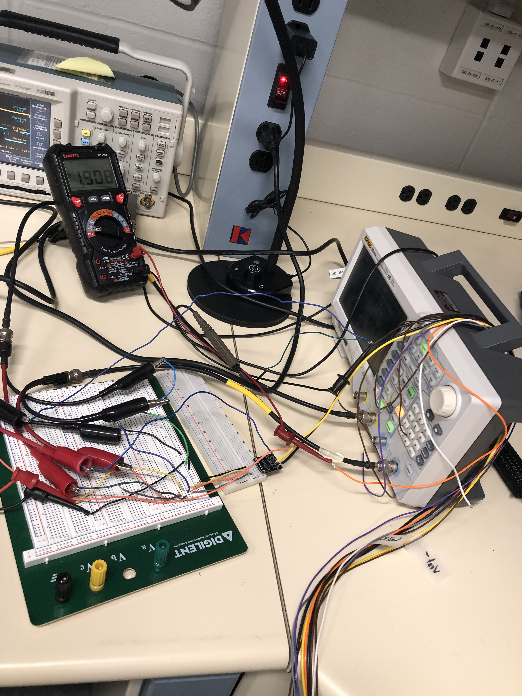
Cryogenic test setup
Power supply measurements were repeated with the board immersed in a liquid nitrogen tank (77K)

Slide 24
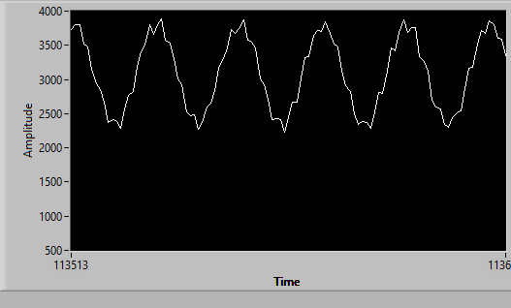

ADC readout by FPGA at room temperature
Channel 1: Sine wave input, 16 mVpp,1kHz
Channel 2: Sine wave input, 16 mVpp

Slide 25
Next steps
Phase 1 goals
  Complete cryogenic testing of basic functionality
  Demonstrate quench detection on a test coil
Phase 2 goals
  Integrate the cold electronics on a custom ASIC
  Using an ASIC has multiple advantages: functionality, reliability, size, power consumption, …
  The BNL ASIC group has many years of experience in cold electronics
    Recent example: 16-channel analog front-end (LArASIC) in 180 nm CMOS technology for charge readout of DUNE far detectors in liquid argon (85 K)
  Proposed approach (Next Year): integrate all cryogenic circuits on a partially-depleted silicon-on-insulator (PDSOI) fabrication process (X-Fab XT011) already being used by the ASIC group
    PDSOI technology allows the substrate to be split by deep trench isolation (DTI), thus providing the desired Galvanic isolation
    Many of the required building-block circuits (amplifiers, voltage references, ADC, …) already exist

Slide 26
Summary
Quench detection at very low half coil voltage difference threshold (microvolt level) requires QD to be located very close to magnet inside the cryostat
Initial attempt will be to assemble 77k quench detector using off-the–self components and components validated by BNL’s Instrumentation department for LAr detector.
Test the Cryogenic QD for very low threshold on HTS coil
Assemble 4.5K QD circuit using custom ASIC (2026)

Slide 27
Thanks
Questions ?

Slide 28
Back up slides

Slide 29
Isolated power supply (3)
Step 3: The unregulated power supply is regulated to +/- 5 V using Zener diodes (D5 and D6). The regulated voltages are further divided by a factor of ~4 to create reference voltages for the voltage regulators and ADC.

Slide 30
Simulation model
The proposed isolated power supply design was simulated using LTSpice.
Rectifier
Potential divider
Voltage regulators

Slide 31
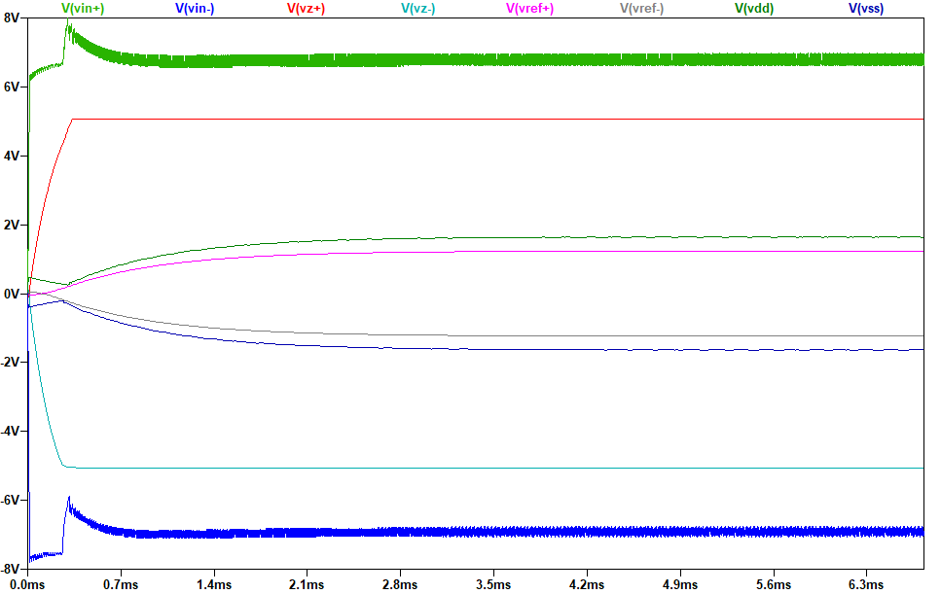
Simulation results
AC source: 15 V (amplitude) at 100 kHz
Load: 390 Ω (models ~7 mA drawn by the amplifier and ADC)

Slide 32
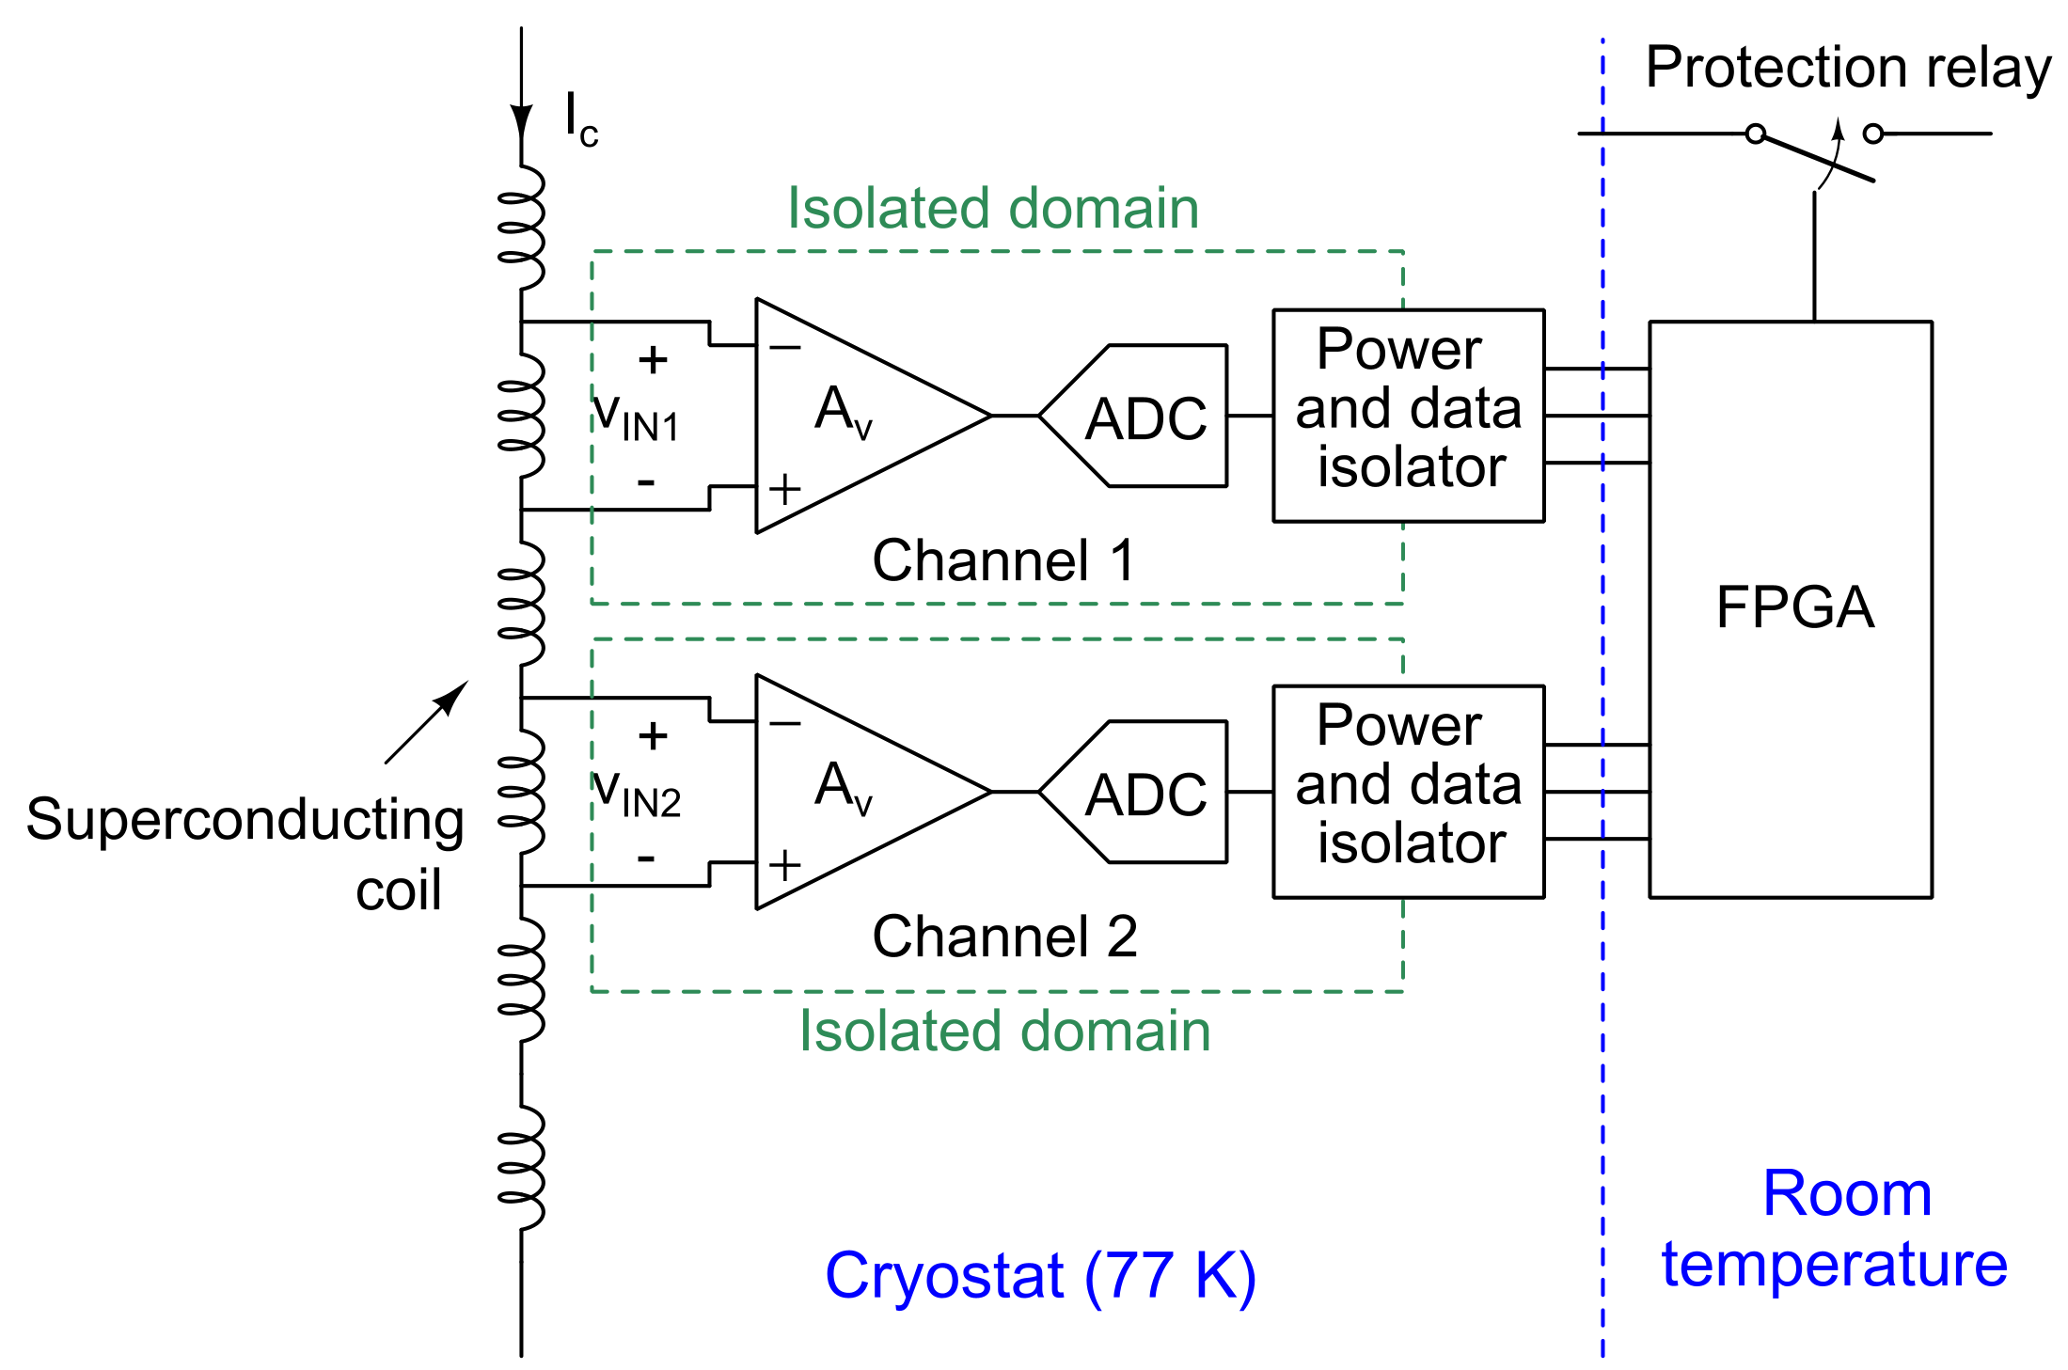
System architecture (Phase 1)
Dual channels for compensation of inductive drop
Isolated power and data domains need > 1 kV of Galvanic isolation to ensure uninterrupted operation during quench events
v_{CTRL}
Computed by FPGA

Slide 33
Isolation and Pre-Amplifier
Instrumentation amplifier to amplify the differential voltage between coil monitoring points.
Amplified output digitized by an analog-to-digital converter (ADC).
Capacitively-isolated local power supply.
Capacitively-isolated digital output signals.
Voltage inputs and outputs on copper cables, could potentially be replaced by optical fibers in later versions
V_{DD,ISO}
V_{DD,ISO}
AC Power
Rectifier
DC Filter
V_{DD,ISO}
V_{REF}
v_{OUT}
Capacitive digital isolator
D_{OUT}
Superconducting coil
ADC
77K

