Slide 1
Status of the EDIPO2 Test Facility
X. Sarasola,
P. Bruzzone,
N. Bykovskiy,
J. Greenwood,
M. Jenni,
C. Müller,
T. Nes,
K. Sedlak
April 2nd, 2025

Slide 2
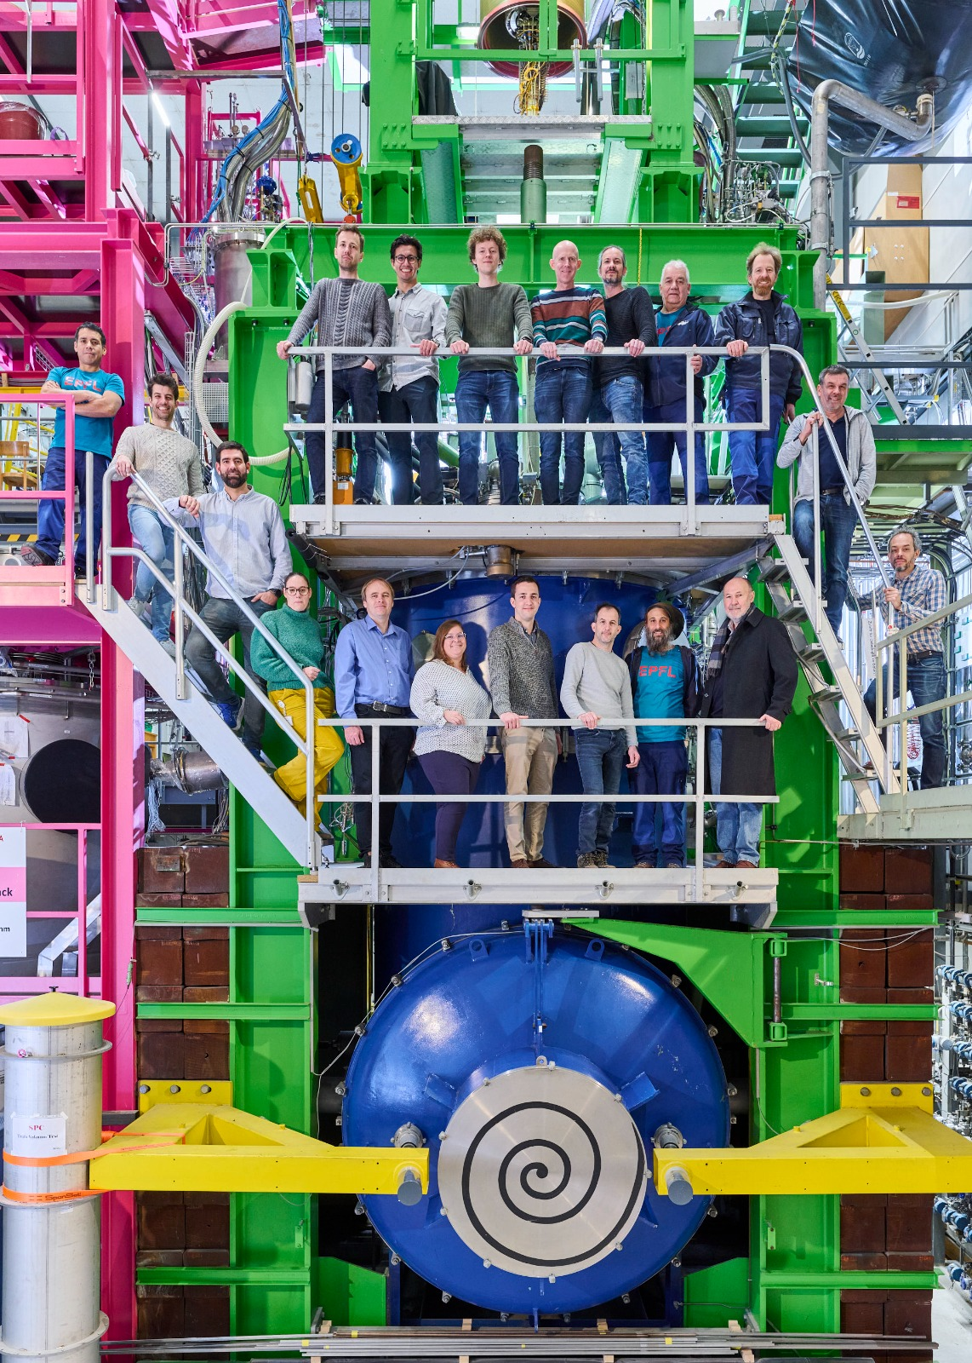
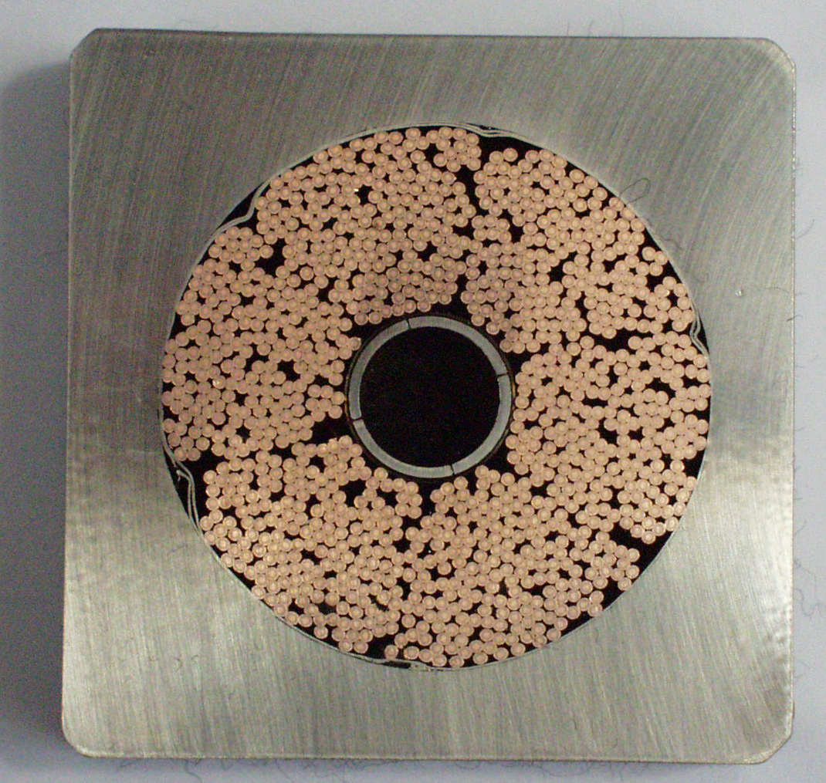
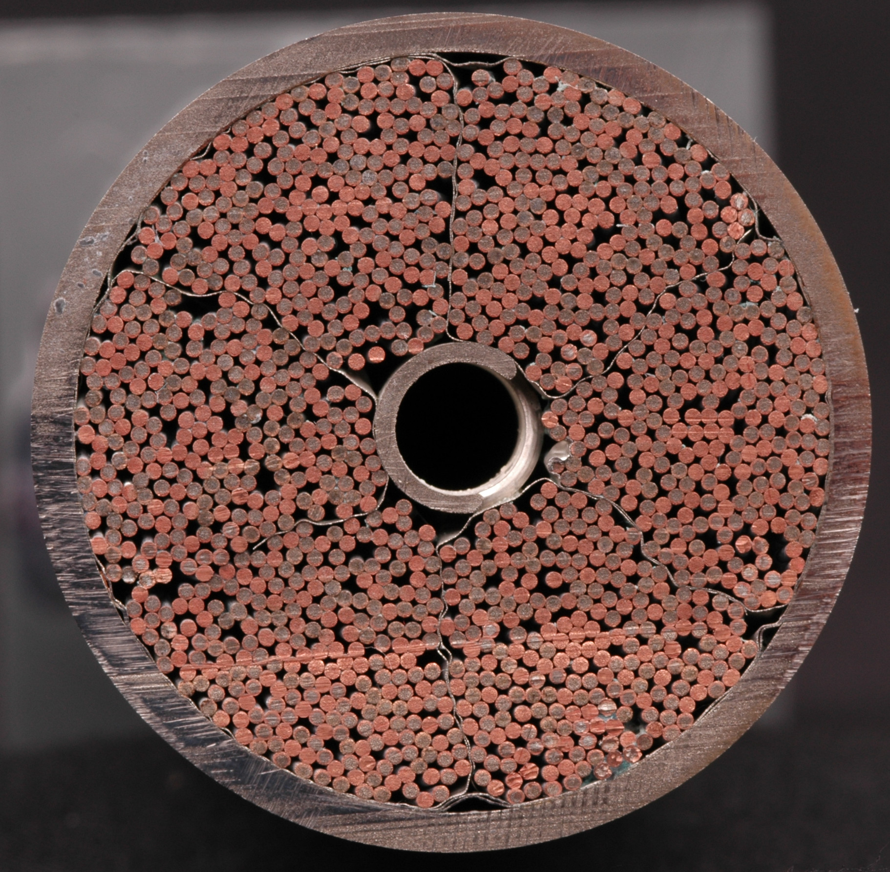
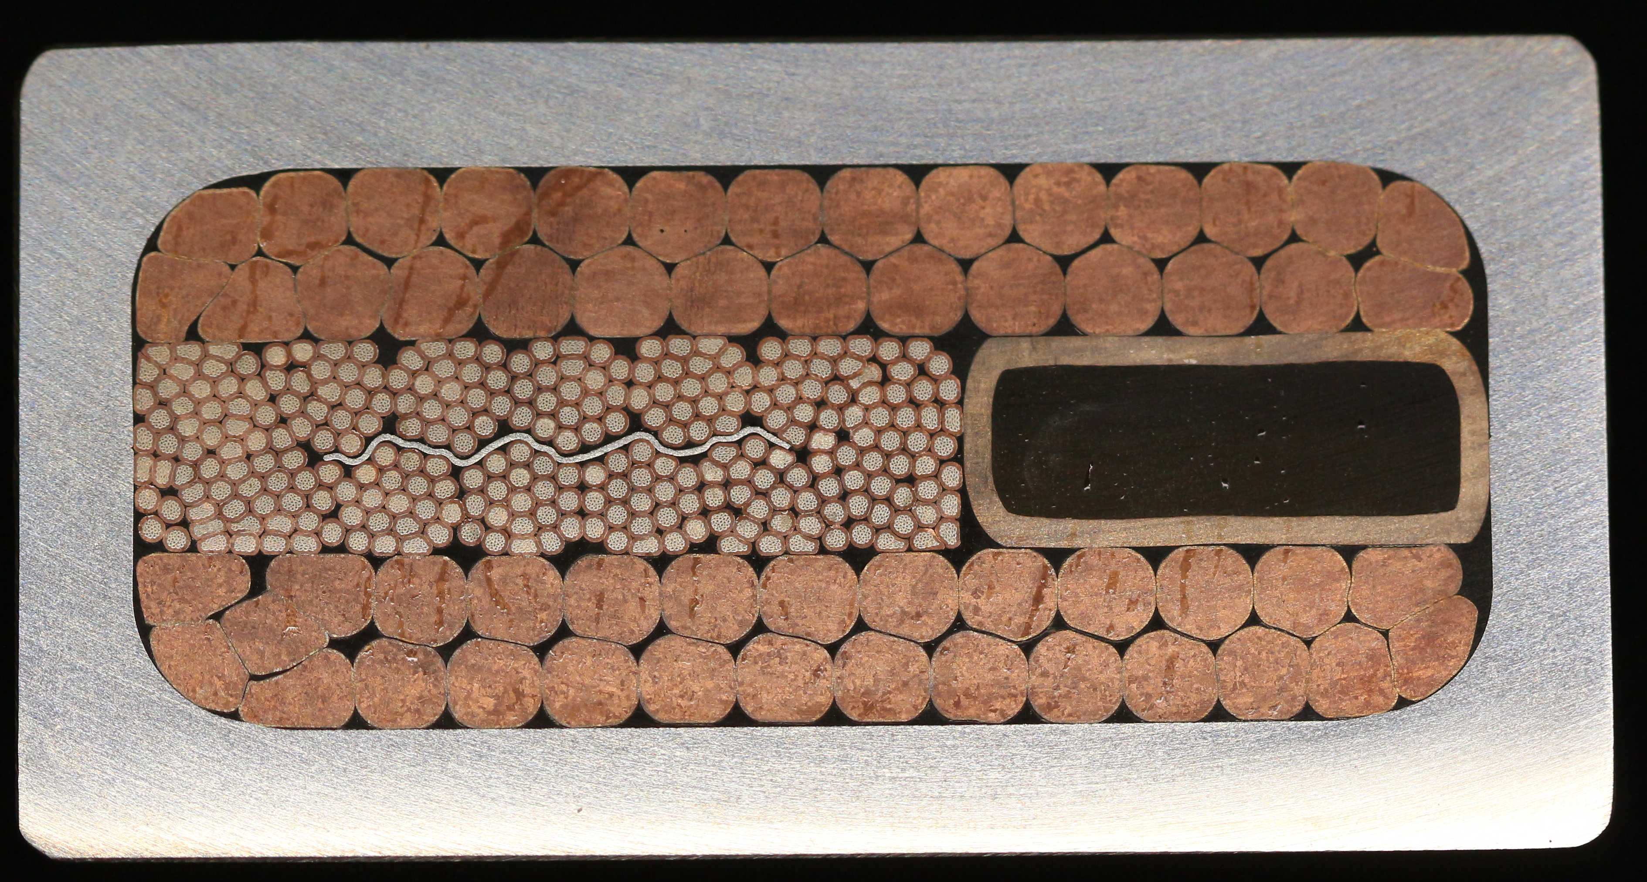
Where do we come from?
SULTAN test facility:
  B_{max} = 10.9 T in test well
  Homogeneity (2%) along ~400 mm
SULTAN has been pivotal in qualifying forced-flow conductors in the last three decades
  ITER
  DTT
  EU-DEMO
  JT60-SA
  SPARC
  BEST
  CFETR
  …
ITER CS
ITER TF
DEMO TF
Nov 2024
JT60-SA CS and EF

Slide 3
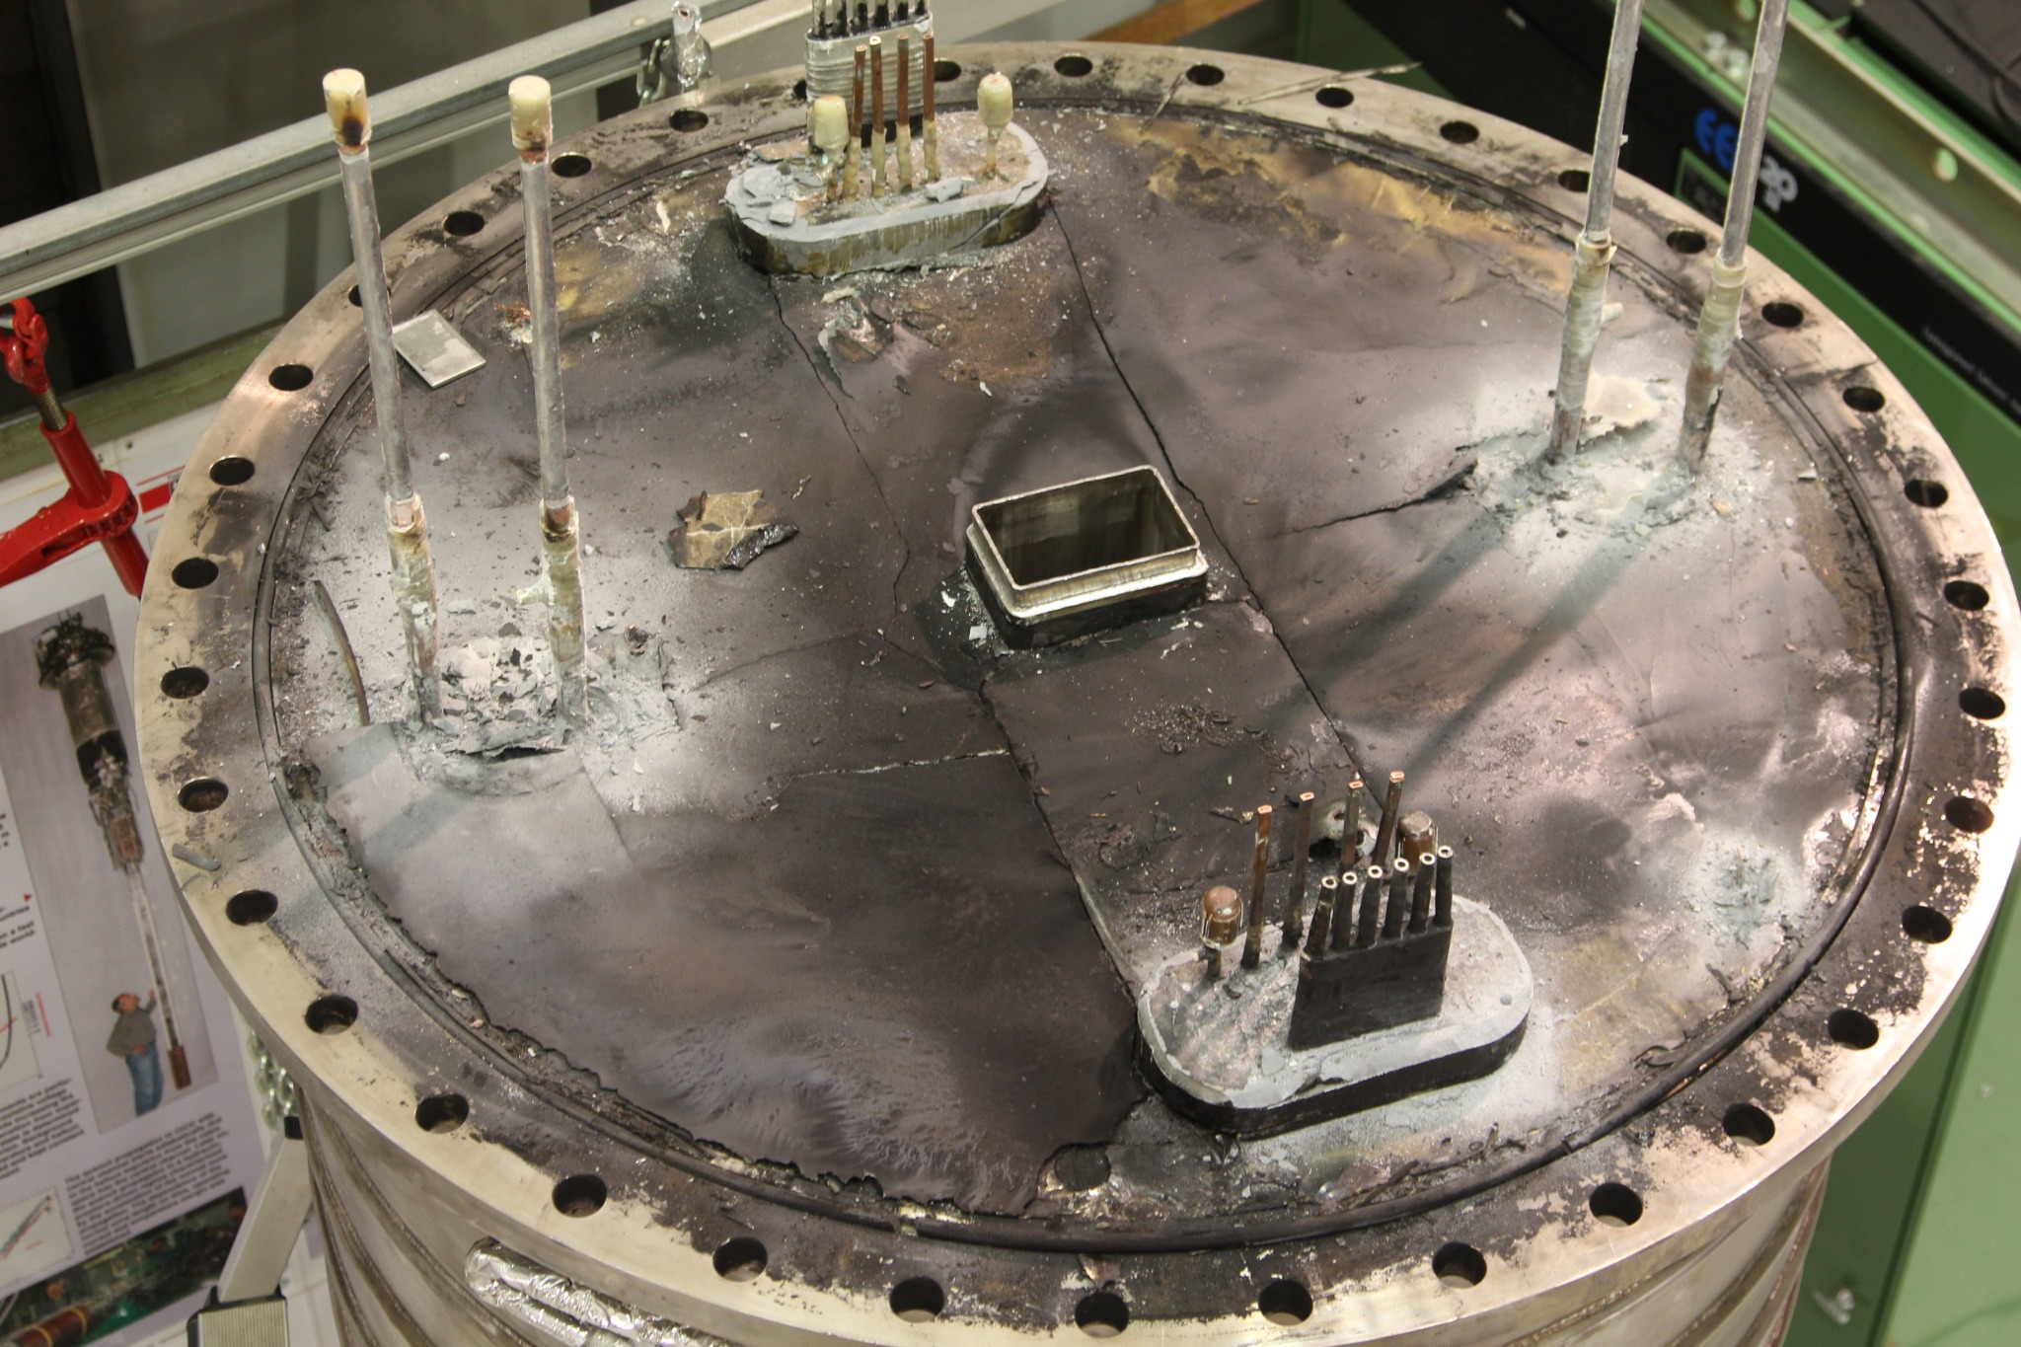
Where do we come from?
The EDIPO test facility was built to complement and upgrade SULTAN
In May 2016, the magnet of EDIPO was damaged by the malicious manipulation of the quench detection software
Unfortunately, the magnet cannot be repaired
The rest of the test facility remains available
JT60-SA CS and EF

Slide 4
Where do we go?
Rising demand towards:
  High current conductors (beyond 100 kA)
  Conductors for high field magnets (partly driven by the development of HTS)
EDIPO 2 will enhance the background B field and the aperture size while keeping attractive features from SULTAN and EDIPO
Since January 2025, a SNF Infrastructures grant funds the construction of EDIPO 2 (as part of the Swiss Fusion Hub)
 | SULTAN (SPC) | EDIPO (SPC) | FRESCA2 (CERN) | EDIPO 2 | Units
B_{center aperture} | 10.9 | 12.35 | 13 (14.6) | 15 | T
Aperture size | 94×144 | 90×141 | Ø100 | 144×144 | mm
Homogeneous field length (1%) | 320 | 680 | 650 | 900 | mm
Sample current | ≤100 | ≤100 | ≤ 32 (50) | >100 | kA
Sample operating temperature | 4.5 to 50 | 4.5 to 50 | 1.9 & 4.2 | 4.5 to 50 | K

Slide 5
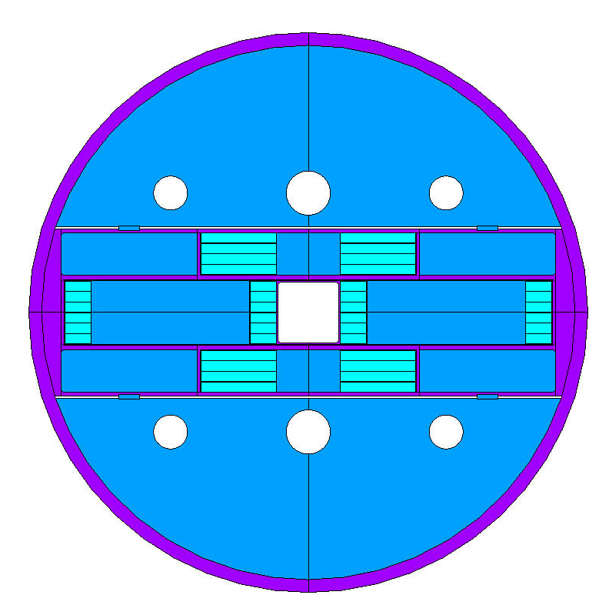
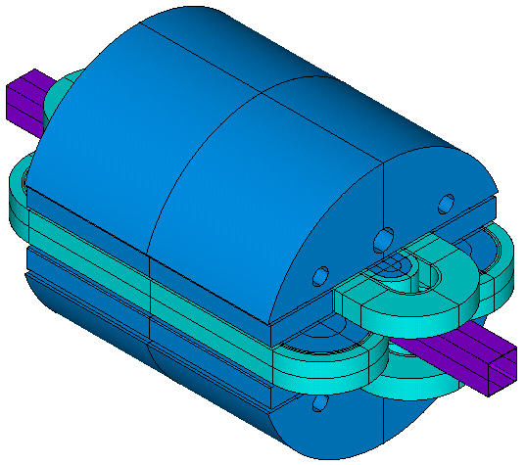
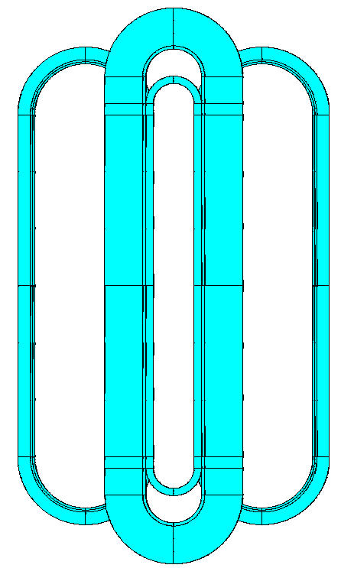
Conceptual design of the EDIPO 2 magnet
Dipole based on two pairs of planar racetrack coils:
  Bath cooled (4.2 K), high j_{eng} winding pack (as opposed to SULTAN and EDIPO1)
  Operating current ≤ 18 kA (limited by existing power supply)
    It requires a large cross-section of superconductor
  There is no 3D transition in the coil ends:
    No hardway bending → Presumably no performance limitation in the ends region
    Simplifies manufacturing
    Simplifies management of mechanical stress

Slide 6
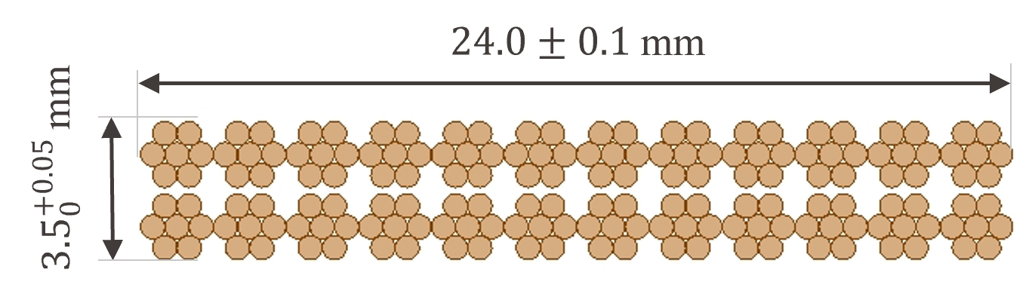
EDIPO2 strand and cable design
Nb₃Sn high-j_{c} strand:
  j_{c,nc} ≥ 2600 A/mm² at 12 T and 4.2 K, 0.7 mm diam, Cu:nCu = 1.0
  ~110 kg delivered in Dec 2023 for prototype cabling
  1.6 tons of strand required for the production of the magnet:
    Adjudication of this call will be published in the coming days
Cable based on a flat two-stage design: 24×(6+1), 0.7 mm
  Cabling R&D activities in 2024 (copper dummy):
    Two industrial partners + CERN have been qualified to produce this cable
  Production of 150 m of Nb₃Sn prototype cable + 500 m of insulated copper dummy:
    Contract signed in 2024
    Production expected by summer 2025

Slide 7
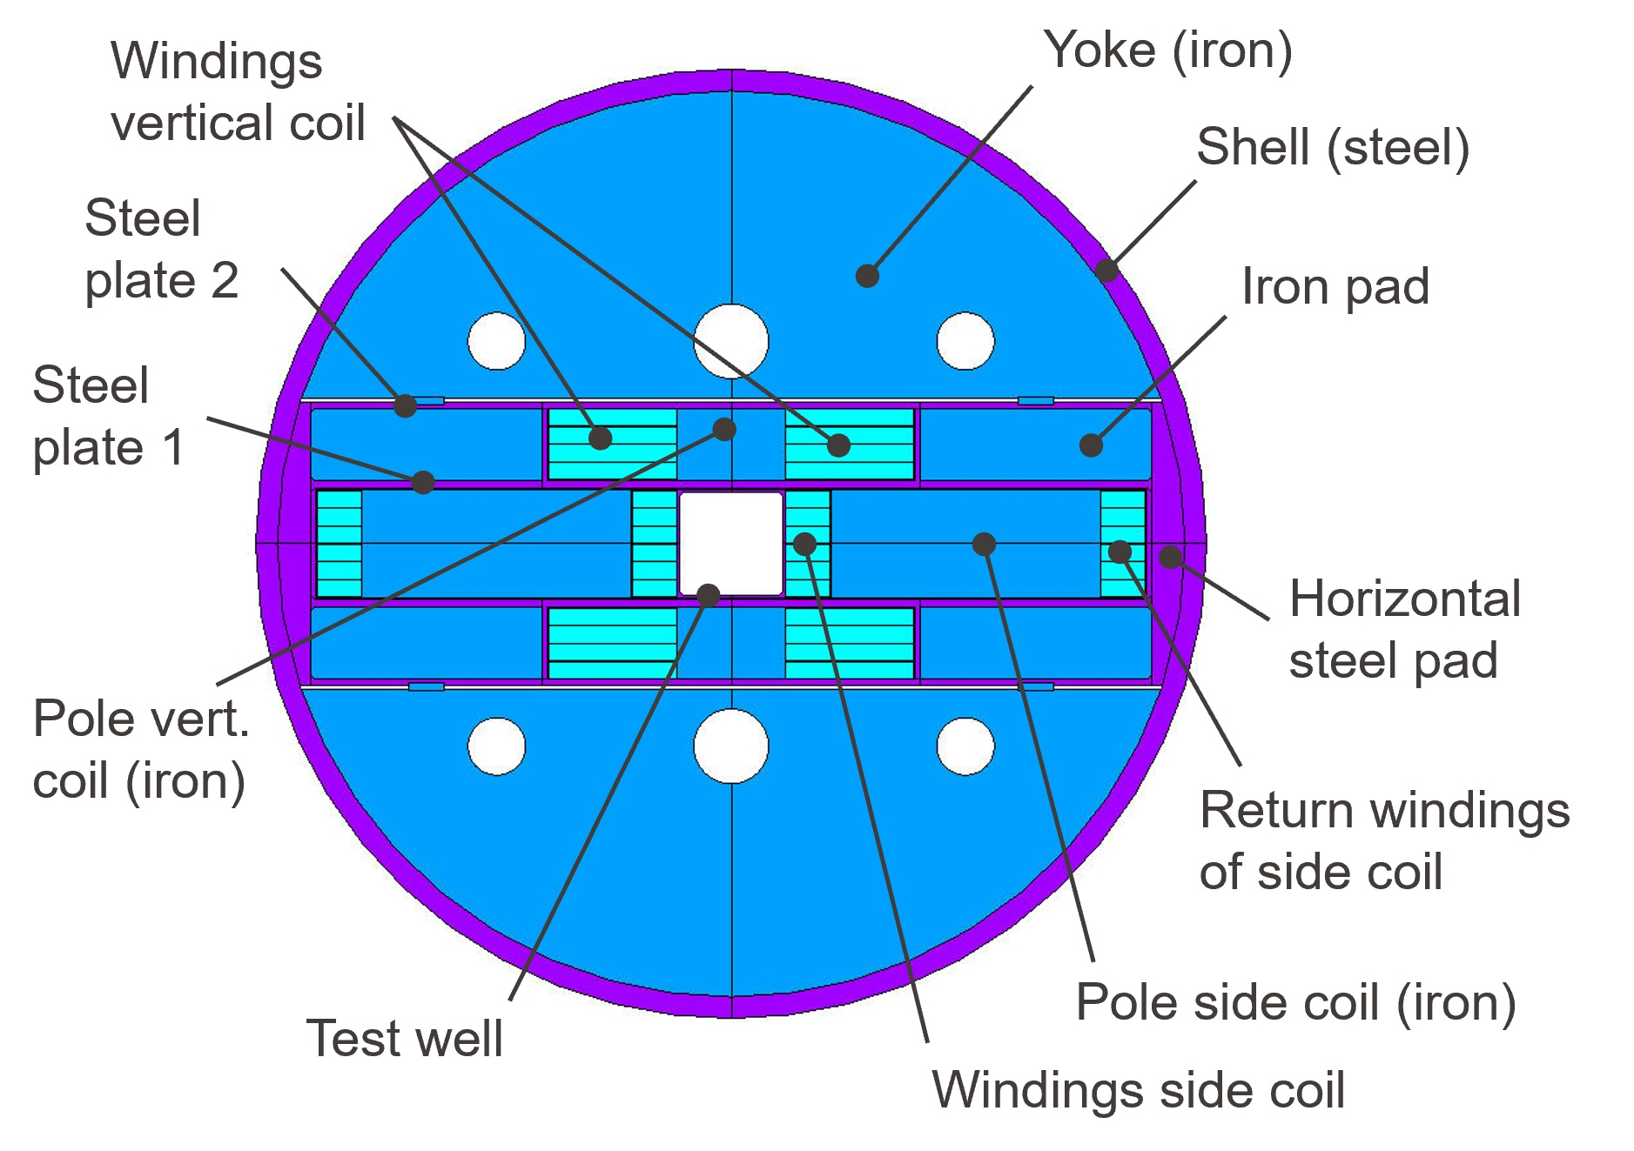
Conceptual design of the EDIPO 2 magnet
Field generated by two sets of flat racetrack coils:
  Vertical coils: one pair of coils each made of 4 pancakes: 46 turns/pancake
  Side coils: one pair of coils each made of 6 pancakes: 16 turns/pancake

Slide 8
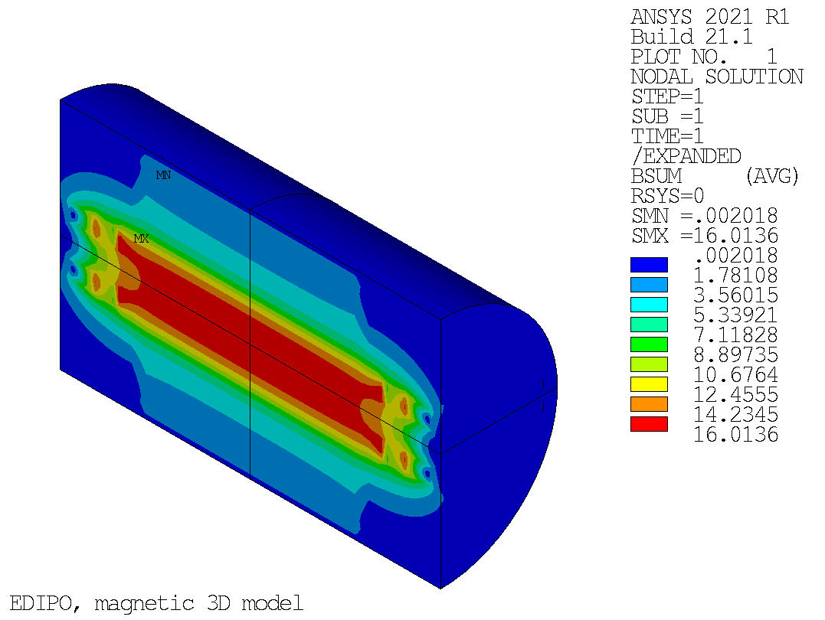
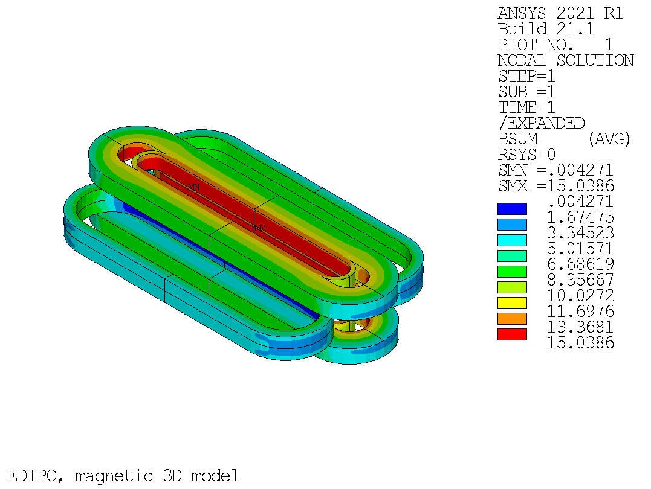
Magnetostatic 3D analysis
I_{op} = 0.85×I_{ss}
 | I_{op} = 0.85×I_{ss} | I_{op} = I_{max}
Cable layout | 24×(6+1), 0.7 mm diam
Number of turns | Side coils: 2×6×16 Vertical coils: 2×4×46
Total number of turns, n_{total} | 560
Total area of insulated conductor | 52886 |  | mm²
Operating current, I_{op} | 17.40 (85%×I_{ss}) | 18.00 (88.1%×I_{ss}) | kA
B field in the center of the aperture, B₀ | 15.00 | 15.46 | T
Peak B field in the coils, B_{peak} | 15.04 | 15.51 | T
Total ampere-turns, I_{total} | 9.74 | 10.08 | MAt
Total magnet stored energy, E_{total} | 20.7 | 22.1 | MJ
Magnet self-inductance, L | 136.6 |  | mH
Engineering current density, j_{eng} | 184.3 | 190.6 | A/mm²
Copper current density, j_{Cu} | 522.2 | 540.1 | A/mm²
B field in the magnet
B field in the winding pack
https://doi.org/10.1109/TASC.2025.3526109

Slide 9
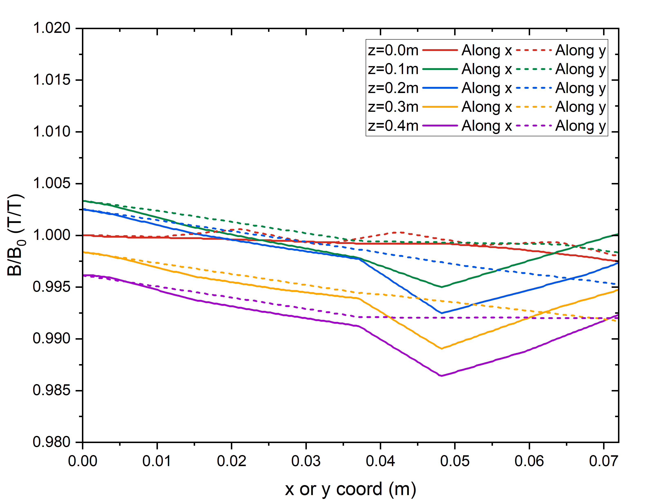
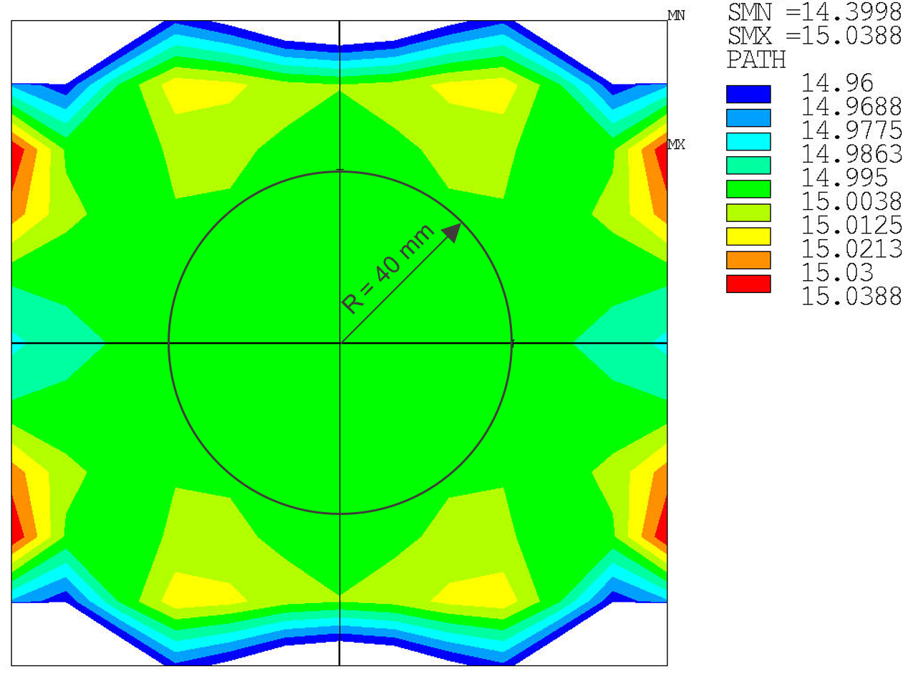
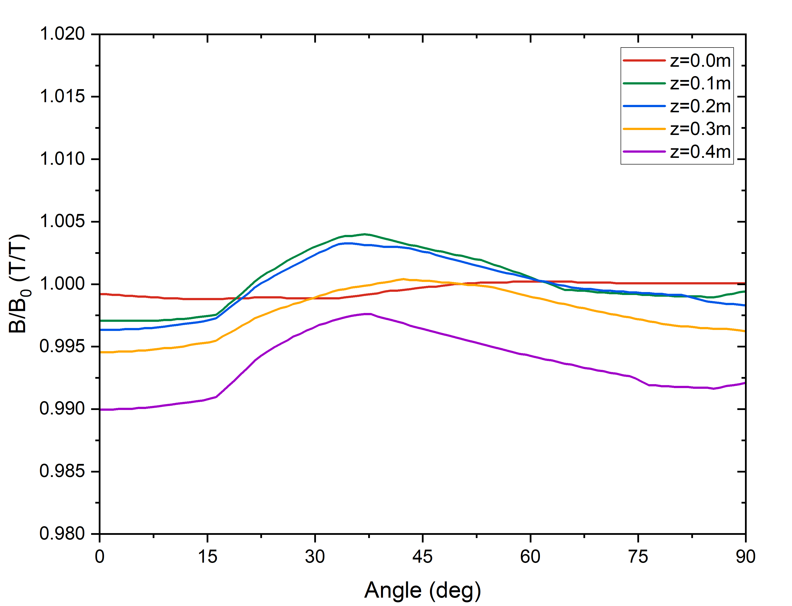
Magnetostatic 3D analysis: field quality
Field quality is not a crucial design target
Uniformity along x and y axis: ±1%
Uniformity around a circumference of
R_{ref} = 40 mm: ±1%
Homogeneity along the z axis:
  1% drop of the field at z = ±0.450 m
  2% drop of the field at z = ±0.526 m
Uniformity along x and y axis
Uniformity around R_{ref} = 40 mm

Slide 10
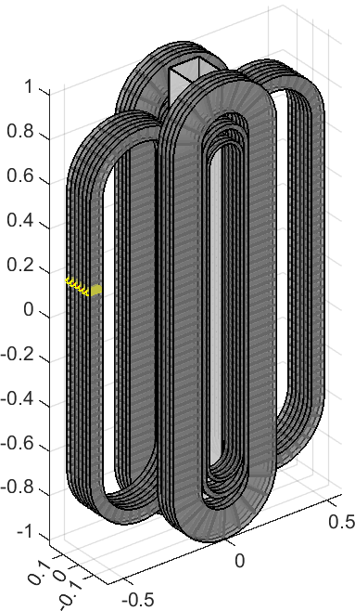
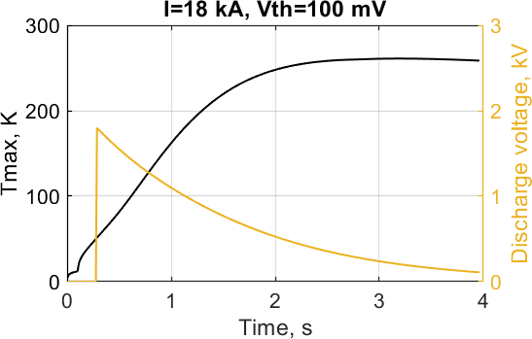
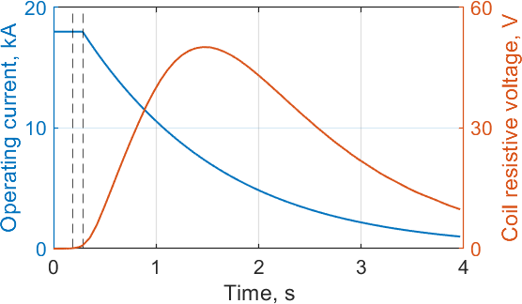
3D quench analysis
$C\frac{∂T}{∂t}=q_{joule}+\frac{∂}{∂x}\left(k\frac{∂T}{∂x}\right)+q_{transverse}−q_{cooling}+q_{external}$ [W/m³]
→ 56’000 nodes to evaluate heat propagation in 3-D (560 turns x 100 nodes per turn)
Protection scheme based exclusively on energy extraction:
  Assumed delay time: 100 ms
Terminal-to-terminal voltage, kV
18 kA
50 V
260 K
1.8 kV
t_detect
t_detect+t_d
V_{max} = ±0.9 kV (assuming symmetric grounding)
T_{max} = 260 K for the operation at 18 kA and V_{th} = 0.1 V detection threshold
Higher values of V_{th} highly undesirable, increasing T_{max} above 300 K at 0.5 V
~98% of stored energy released in the dump resistor

Slide 11
Mechanical 3D analysis
Coils assembled in a steel casing
Lorentz forces reacted by the casing and a 30-mm-thick steel shell
ateral and axial pre-load on the vertical coils
The test well is stress-free during operation

Slide 12
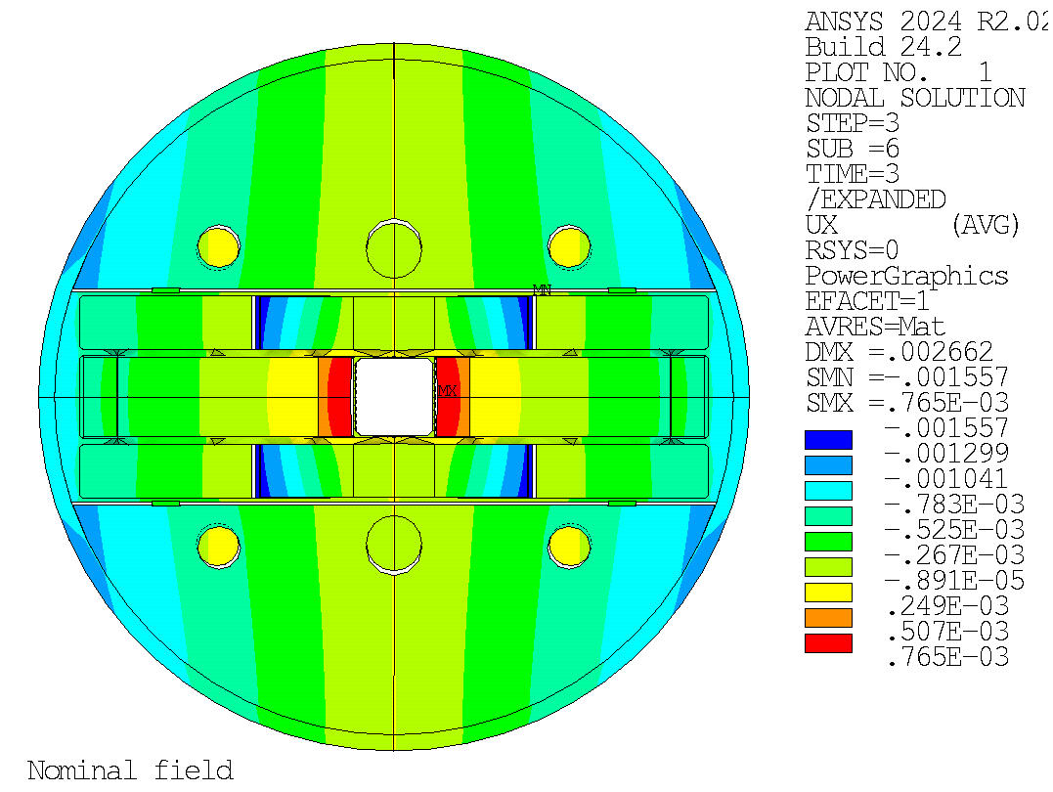
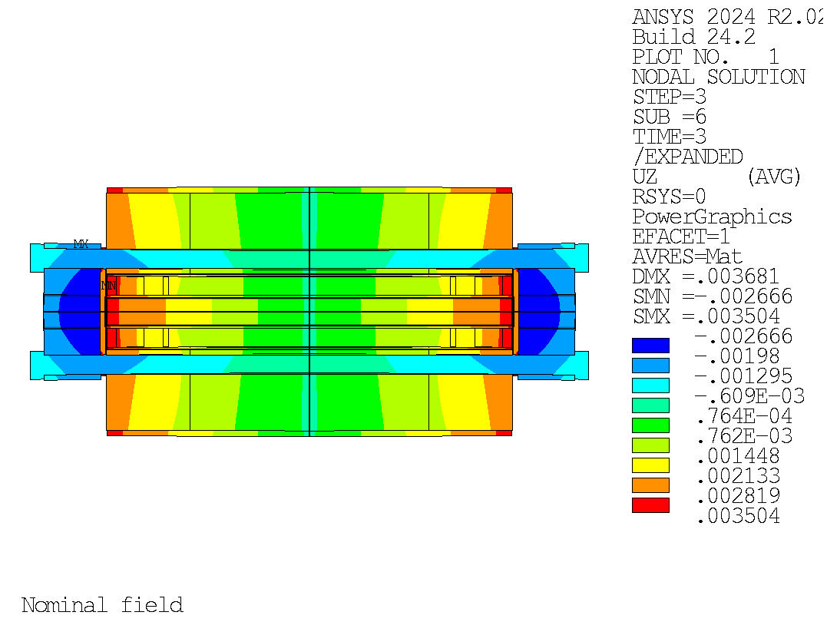
Mechanical 3D analysis
Coils assembled in a steel casing
Lorentz forces reacted by the casing and a 30-mm-thick steel shell
Lateral and axial pre-load on the vertical coils
The test well is stress-free during operation
Deformation during operation

Slide 13
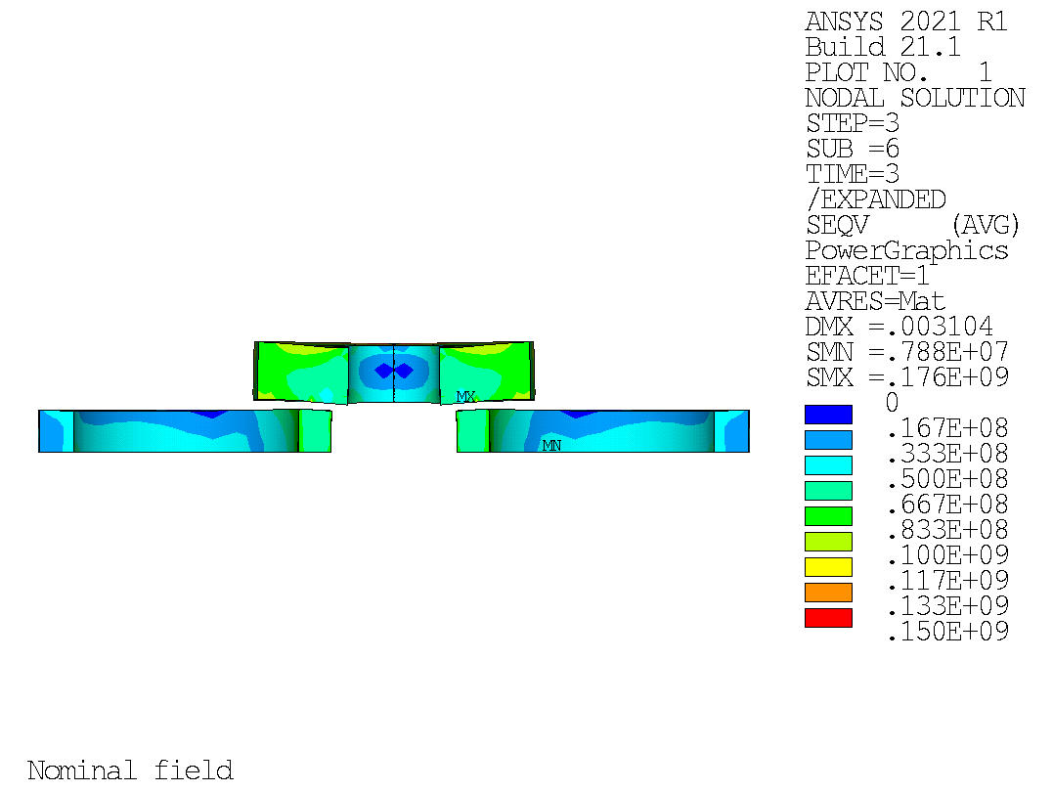
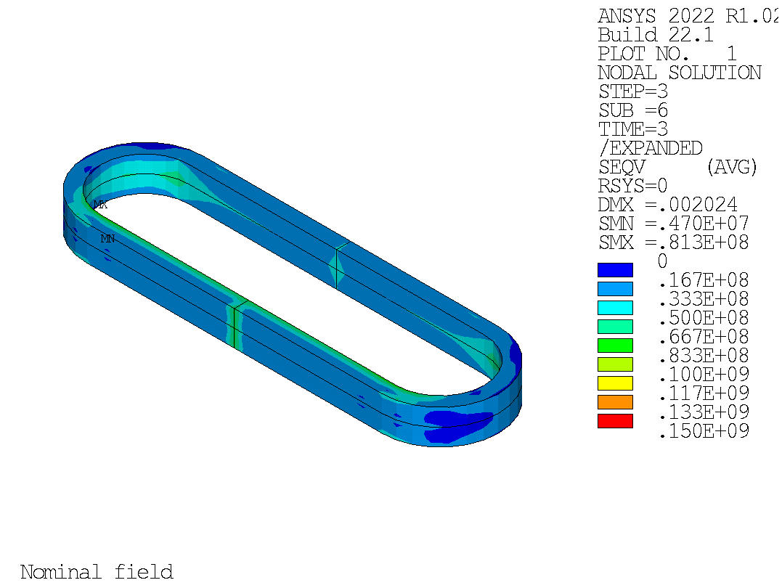
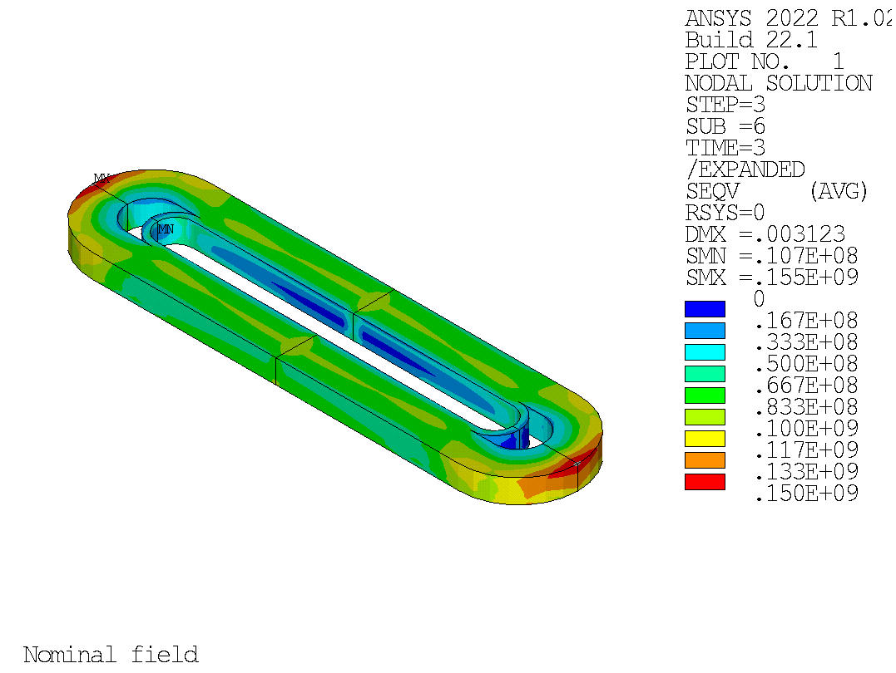
Mechanical 3D analysis
Stress in the coils at B = 15 T
Stress is moderate after cool-down
Remains below allowable limits during operation:
  Side coils:
    σ_{eq} ≤ 82 MPa
    ε_{L} ranging from -0.06 and +0.06%.
  Vertical coils:
    σ_{eq} ≤ 155 MPa (at low field regions, B ≤ 6 T)
    ε_{L} ranging from -0.2 and +0.29%
Side coils at B = 15 T
Vertical coils at B = 15 T
https://doi.org/10.1109/TASC.2025.3526109

Slide 14
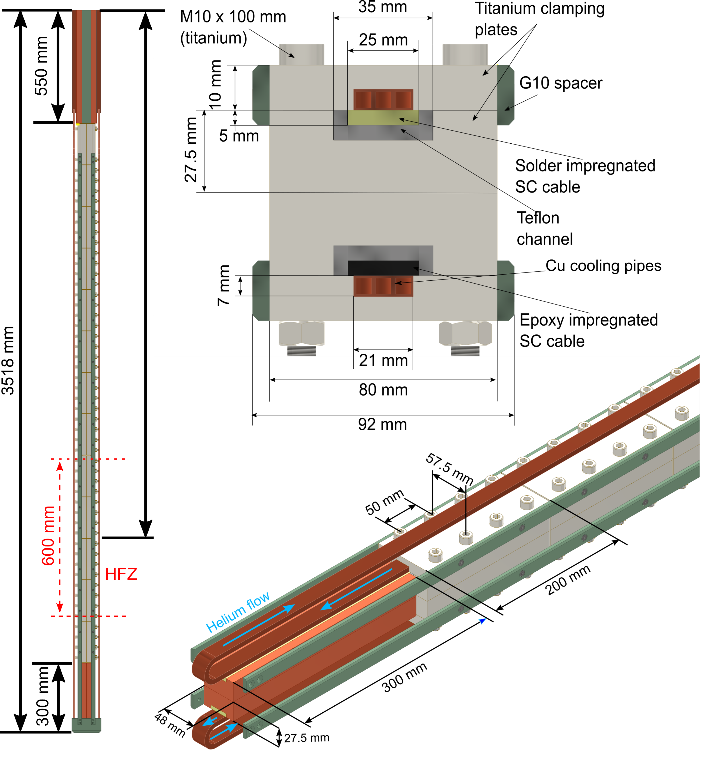
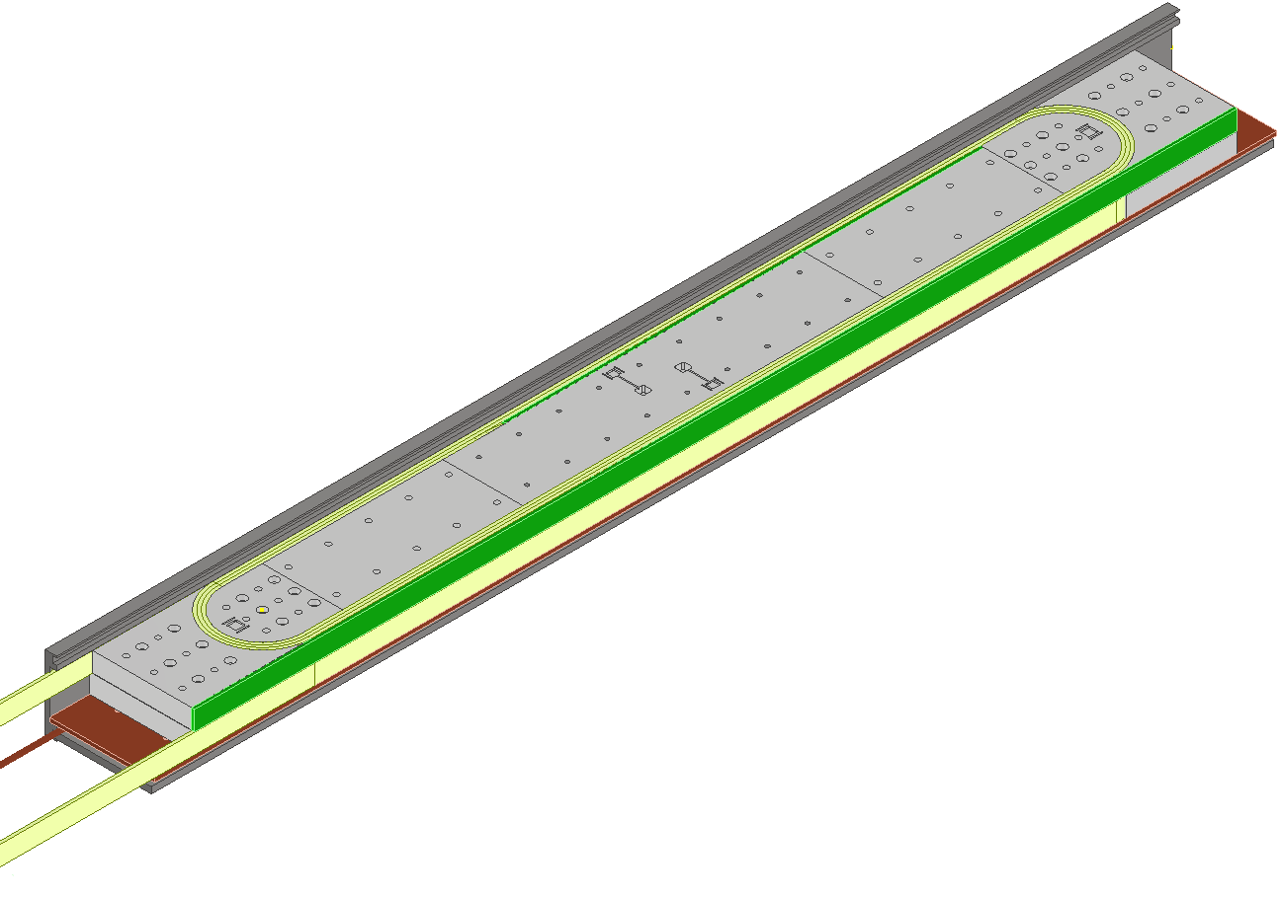
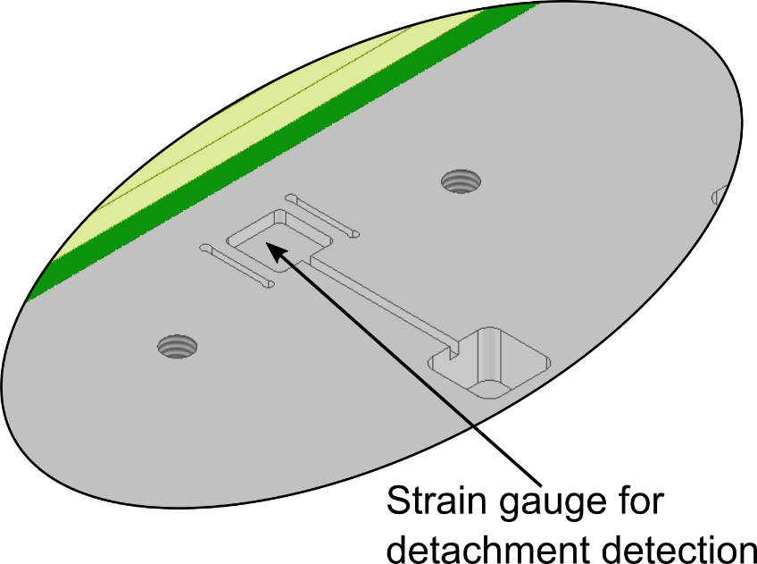
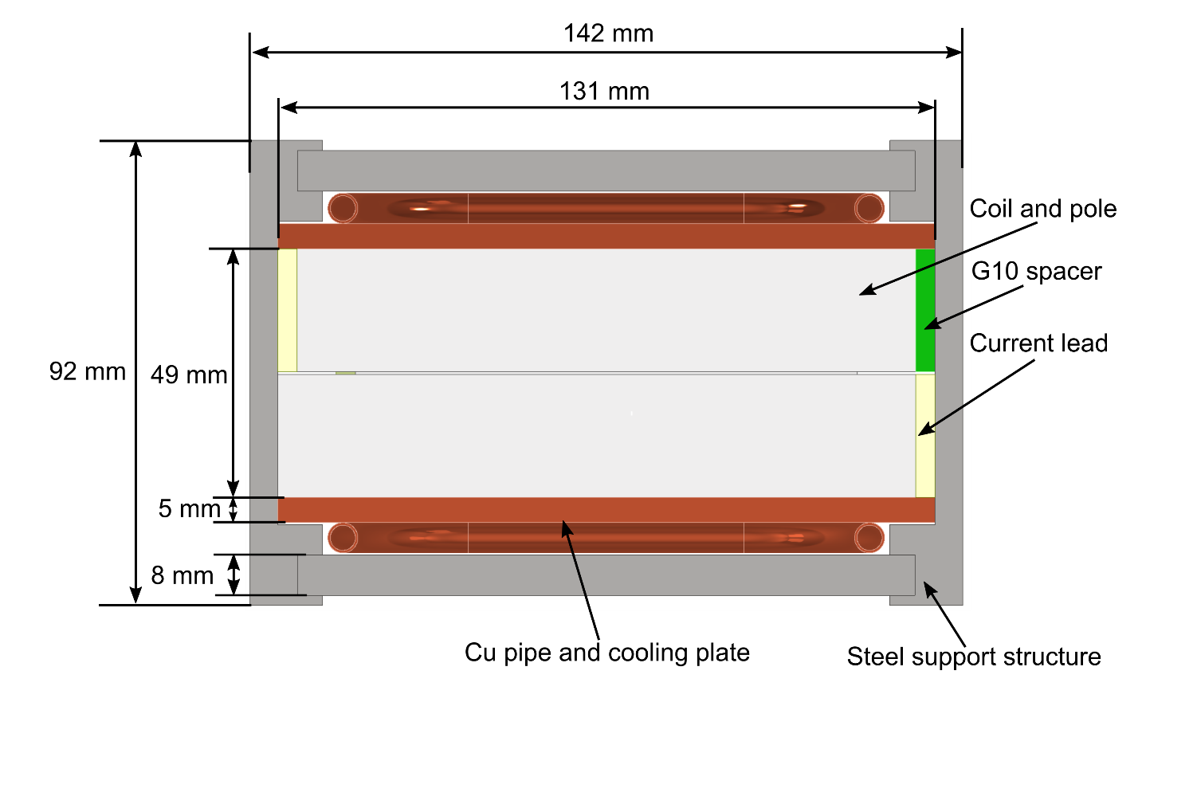
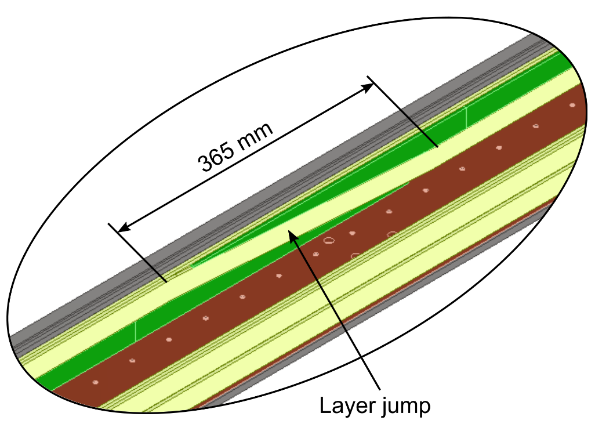
Magnet R&D activities
Magnet R&D activities to de-risk technologies associated with the EDIPO2 coil design:
  Contract will be signed with a qualified industry in the coming weeks
Cable and subscale coil tests planned in SULTAN in 2025-2026:
  Nb₃Sn cable and joints
  Subscale coils
  (pancake transitions and detachable poles)

Slide 15
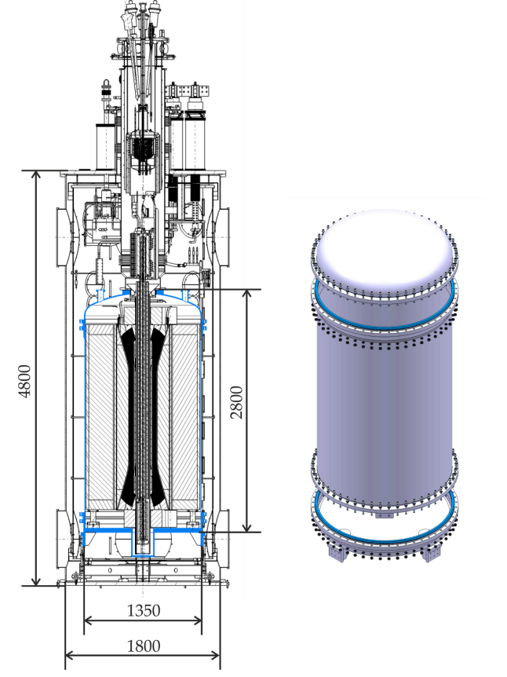
Cooling / Cryogenics
EDIPO 1 was based on a CICC design (cooled by a forced-flow of supercritical He)
The EDIPO 2 magnet will be bath-cooled at 4.2 K
  Volume: ~50 l
New helium vessel. Three main parts:
  Bottom base (interface with the existing facility)
  Cylindrical body
  Lid (not final design)
Main parameters:
  Operating pressure: 1 bar
  Accident pressure: 3 bar
  Leak rate < 10⁻⁸ mbar·l/ s
https://doi.org/10.1016/j.cryogenics.2023.103648

Slide 16
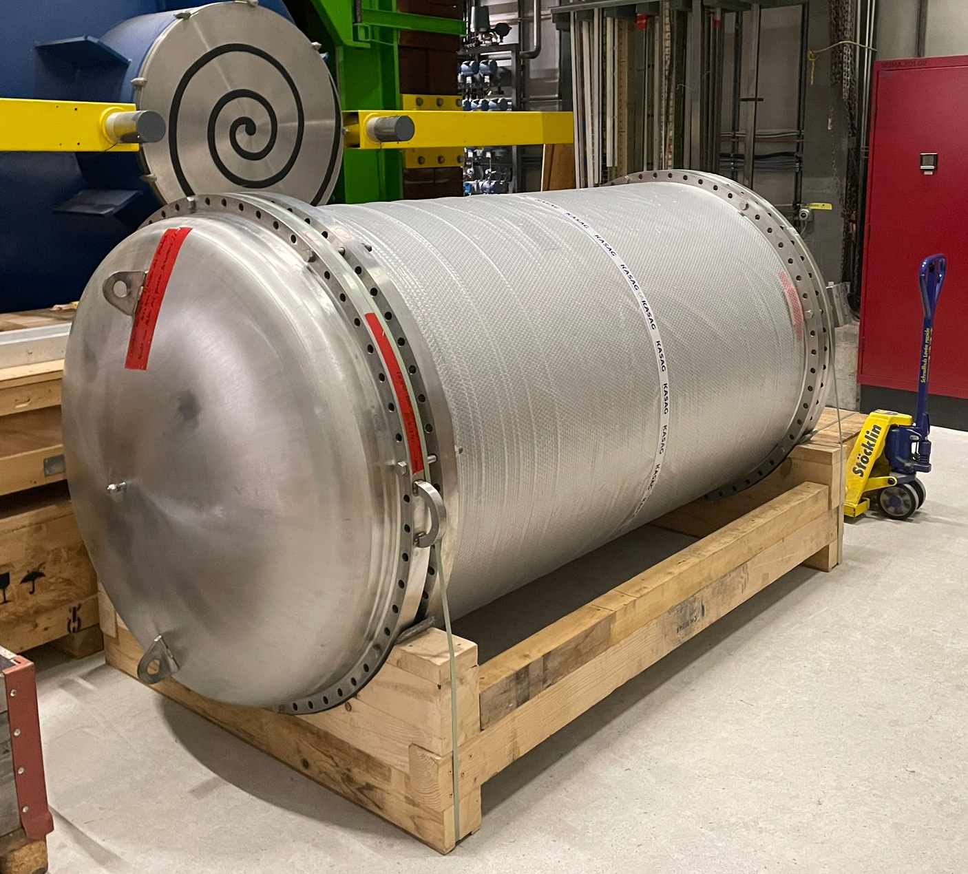
Cooling / Cryogenics
EDIPO 1 was based on a CICC design (cooled by a forced-flow of supercritical He)
The EDIPO 2 magnet will be bath-cooled at 4.2 K
  Volume: ~50 l
New helium vessel. Three main parts:
  Bottom base (interface with the existing facility)
  Cylindrical body
  Lid (not final design)
Main parameters:
  Operating pressure: 1 bar
  Accident pressure: 3 bar
  Leak rate < 10⁻⁸ mbar·l/ s
In case of quench or loss of vacuum, the evaporated He volume captured in a balloon
https://doi.org/10.1016/j.cryogenics.2023.103648

Slide 17
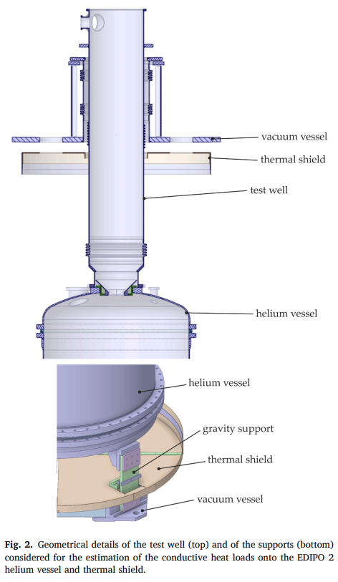
Cooling / Cryogenics
Estimated thermal heat load
  Conduction: 2.4 W
  Radiation: 1.1 W
Joule heating from joints
  Assumed
    R=3 nΩ
    I=18 kA
    n=10
  P = 9.7 W
Total heat load at max current: ~13 W
https://doi.org/10.1016/j.cryogenics.2023.103648

Slide 18
Modified cryogenic circuit (preliminary)

Slide 19
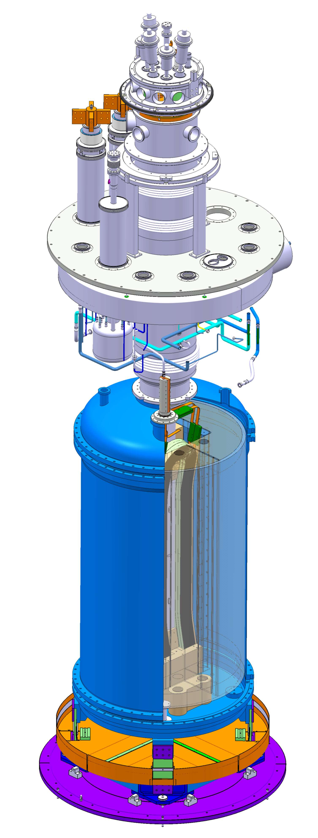
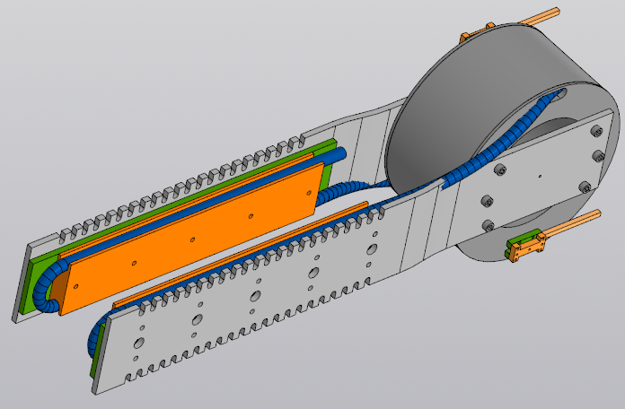
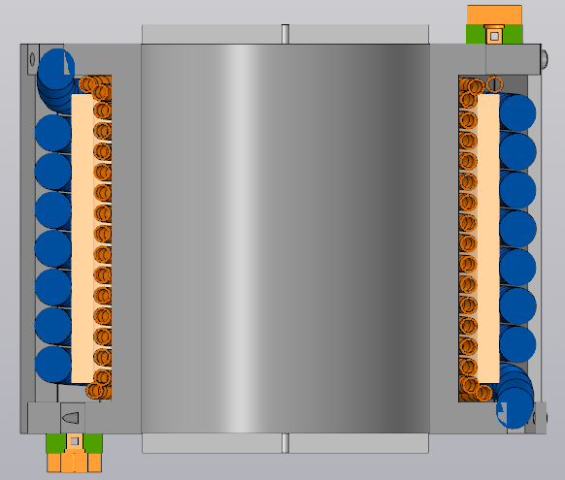
Sample environment
EDIPO 2 keeps attractive features from SULTAN and EDIPO:
  Separate cryogenic environment for magnet and sample (quick sample change)
  Sample cooling by supercritical He at 10 bar
  Sample operating range:
    Current up to 120 kA (new superconducting trafo)
    Variable temperature between 4.5 to 50 K
    Mass flow up to 10 g/s at 4.5 K

Slide 20
Conclusions and Outlook
EDIPO 2 will generate a background field of 15 T in a large aperture (144×144 mm²)
Use of a Nb₃Sn two-stage cable design for high operating current
Dipole purely based on the use of planar racetrack coils:
  No hardway bending
  Simplification of the coil manufacturing
Cooling/cryogenics shall be modified (bath cooled at 4.2 K)
Outlook for 2025:
  Production of 150 m of Nb₃Sn prototype cable (contract signed)
  New contracts with the industry:
    Procurement of 1.6 tons of Nb₃Sn strand required for the magnet
    Technological coil R&D activities (including production of a prototype coil and test in SULTAN)
    Magnet manufacturing design

Slide 21
We are hiring
EDIPO2 Postdoc
https://www.psi.ch/en/hr/job-opportunities/68766-postdoctoral-fellow-mechanical-engineer-superconducting-magnets-epfl
Join our team!

Slide 22
Thanks for your attention!

