Slide 2

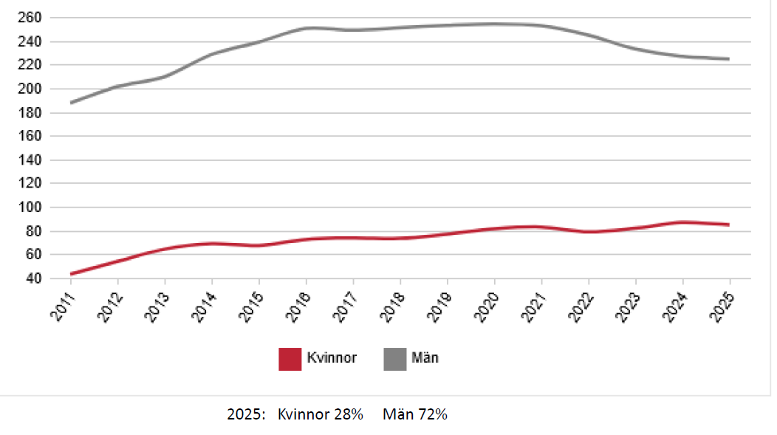
Uppsala University: Department of Physics and Astronomy
Title | Average age | Women [%]
Administrative staff | 51 | 74.2
Technical Staff | 50 | 6.5
PhD Students | 28 | 35.5
PostDocs | 33 | 25.6
Other research and teaching staff | 44 | 15.2
University Lecturers | 54 | 66.7
Senior Lecturers (associate professors) | 46 | 30.2
Professors | 59 | 12.3

