Slide 1
Women in science
Patricia Aguar Bartolome
GSI Helmholtzzentrum für Schwerionenforschung GmbH
5th SMTF Workshop, 2nd April
Bad Zurzach, Switzerland

Slide 2
Women at GSI and FAIR
The Board of Equal Opportunities
Who are they?
The current Board of Equal Opportunities consists of three women and has been in office since June 1, 2019
What they do?
They are actively involved in all recruitment processes
    Access to application documents
    Participation in interviews
    Involvement in committees and appeals procedures
    Involvement in the final decision
They are integrated in all major projects and processes by regular participation in the monthly meeting between the management board and working council.
They are contact persons for all colleagues (all genders):
    They conciliate in case of conflicts
    They act in case of transgressions
    They act in case of bullying at work
    They act in case of sexual harassment

Slide 3
Women at GSI and FAIR
They advocate for
  General measures and guidelines by the management to increase the number of women in leading positions
  Monitoring the observation and and advancement of the equalization plan at GSI corresponding to § 11 BGleiG with the management board
General goals
  Equalization of women and men
  Reconciliation of work and family life
  Advancement of women at GSI and FAIR
Events
„Women Guide Women“
The women of GSI/FAIR give interested colleagues an insight into their work through a guided tour of their department.
„It’s a Women’s World“
In this series of talks GSI/FAIR women share their experience or that of their mothers when they immigrated to Germany.
Lecture series -„Famous women of the past and present “
GSI women give talks on their favorite woman for interested female colleagues.
Women Workshop
The Women workshop (Frauen-ArbeitsKreis - Frauen-AK) at GSI/FAIR meets one to two times a year and serves as a platform for exchange between the equal opportunities board and female colleagues. The board reports on their work and gets feedback and suggestions on burning issues. The workshop is open to all female GSI/FAIR colleagues.

Slide 4
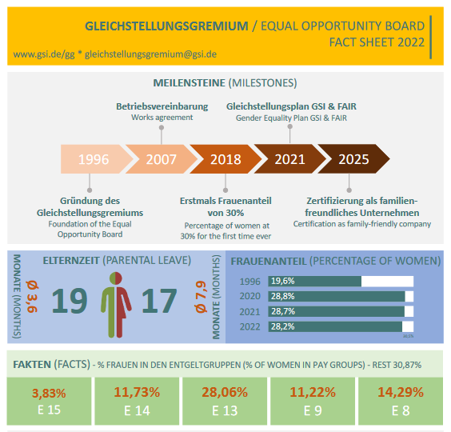
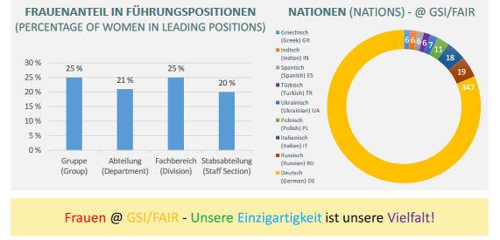
Women at GSI and FAIR

