Slide 1
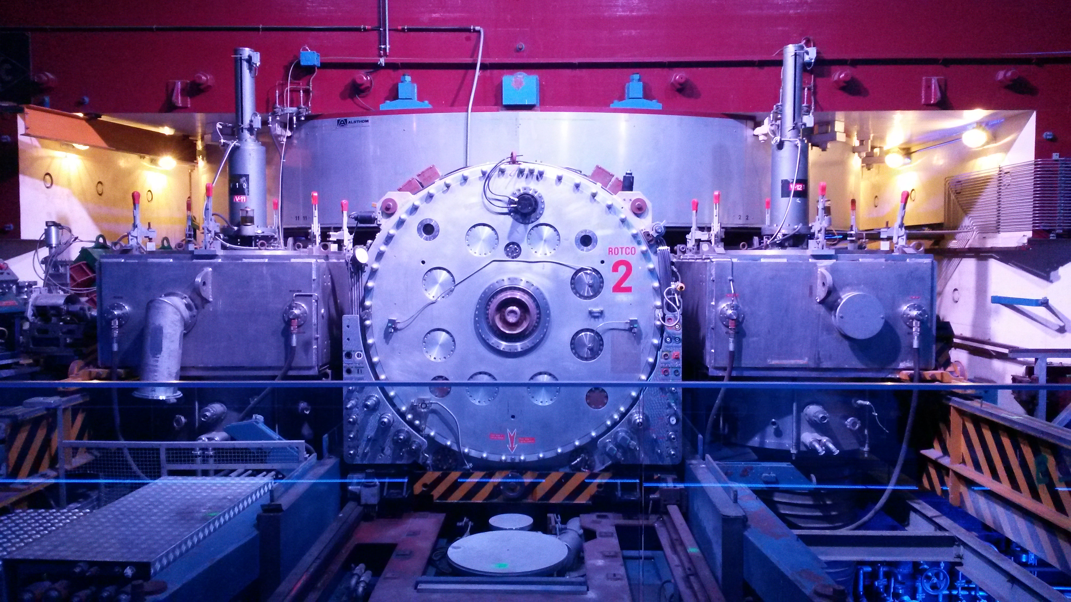
Accelerating Diversity at CERN (European Organization for Nuclear Research)
Louise Carvalho
Diversity & Inclusion Programme Leader
5th SMTF & 3rd IDSM
2025.04.02
Synchrocyclotron: CERN’s first particle accelerator, built 1957

Slide 2
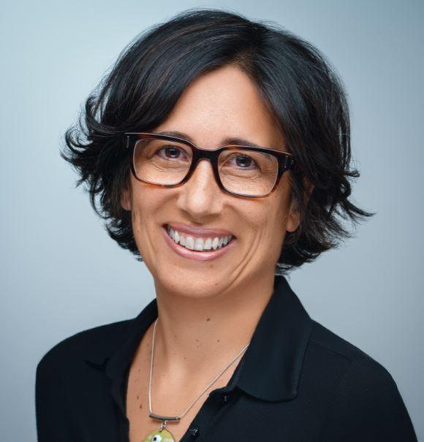
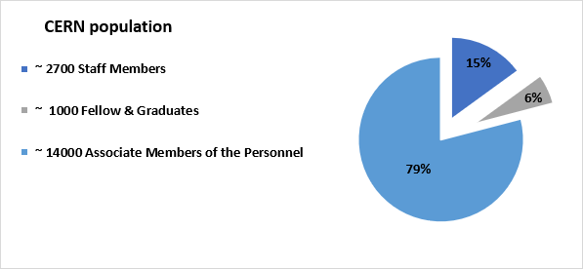

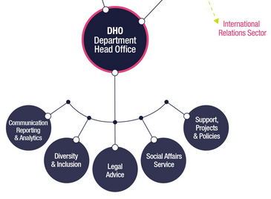

Diversity & Inclusion Programme since 2012
Louise Carvalho
D&I Programme Leader
(+ Legal Adviser, HR)
Under Recruitment
D&I Officer
CERN Code of Conduct

Slide 3



“We commit to
placing the principles of
equality, diversity & inclusion
at the heart of all the
physics community’s
activities.”
- ESPP 2020 update
OUR VISION
scientific excellence through diversity and inclusion
OUR GOAL
to increase the nationality and gender diversity
of Staff & Fellows (MPE) population by 2025
The STRATEGY
GENDER target
NATIONALITY indicator
(aspirational)
Leadership-led
Leverage existing progress: gender balance increased in Senior Management
25% as an average across MPE population (not per Department)
Diversity & inclusion in recruitment (and talent pipelines), promotion, training, communications
Sustainable actions toward long-term gender parity
(not a cap, not a quota)
GOAL
With a particular focus on women in STEM:
GOAL
With a particular focus on under-represented MS and a more balanced return by 2025:
from 21%
in 2020
address nationality clusters
> 25%
25% in 2025
and increase our conscious efforts toward nationality diversity in recruitment & retention

Slide 4
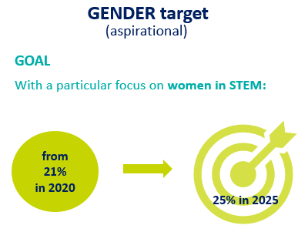
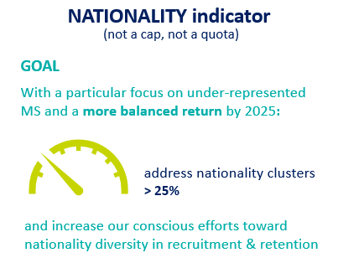
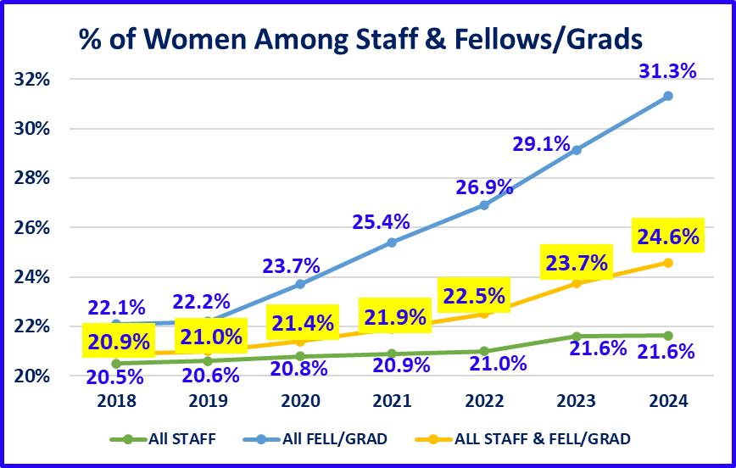
OUR VISION
scientific excellence through diversity and inclusion
OUR GOAL
to increase the nationality and gender diversity of Staff & Fellows (MPE) population by 2025
25 by ‘25 Periodic Update: Gender
2020
Strategy Paper submitted to Director-General
2021
Enlarged Directorate endorses Strategy
Department Heads appoint 33 Focal Points
Focal Points create & consult Focus Groups
HR implements Nat / Gen Population Dashboards
2022
1st D&I Review Exercise
Action Menu + Fitness Plans approved
Dept Heads appoint 18 D&I Officers (DIOs)
DIOs establish a Community of Practice
2023
Transforming Bias Workshop
Theatre Forum on sexism
HR implements Nat / Gen Recruitment Dashboard
1st Departmental Fitness Plan checkpoint
→ 0.4% from our 25% target!
4

Slide 5
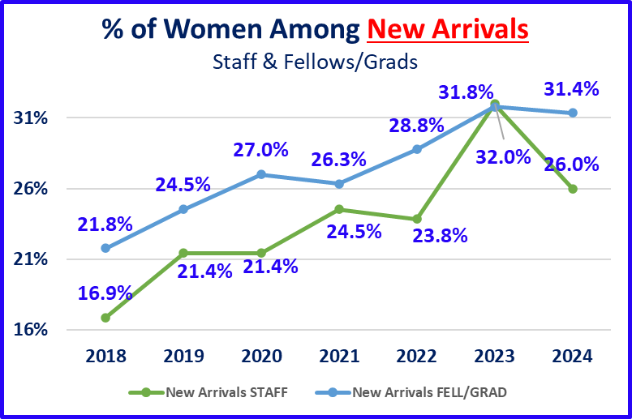
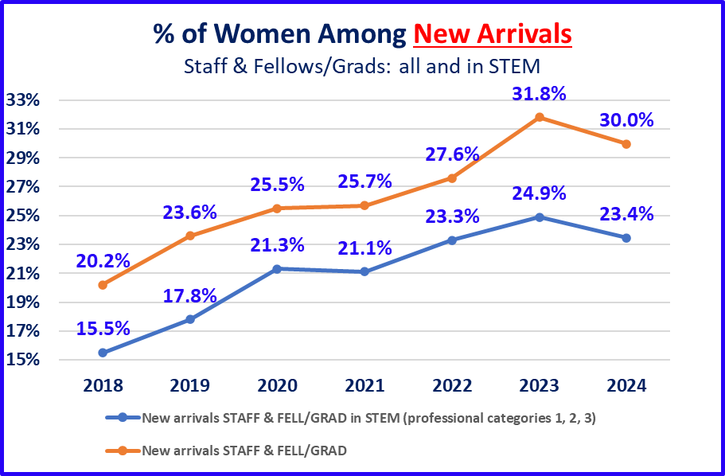
OUR VISION
scientific excellence through diversity and inclusion
OUR GOAL
to increase the nationality and gender diversity of Staff & Fellows (MPE) population by 2025
Gender: New Arrivals
5

Slide 6
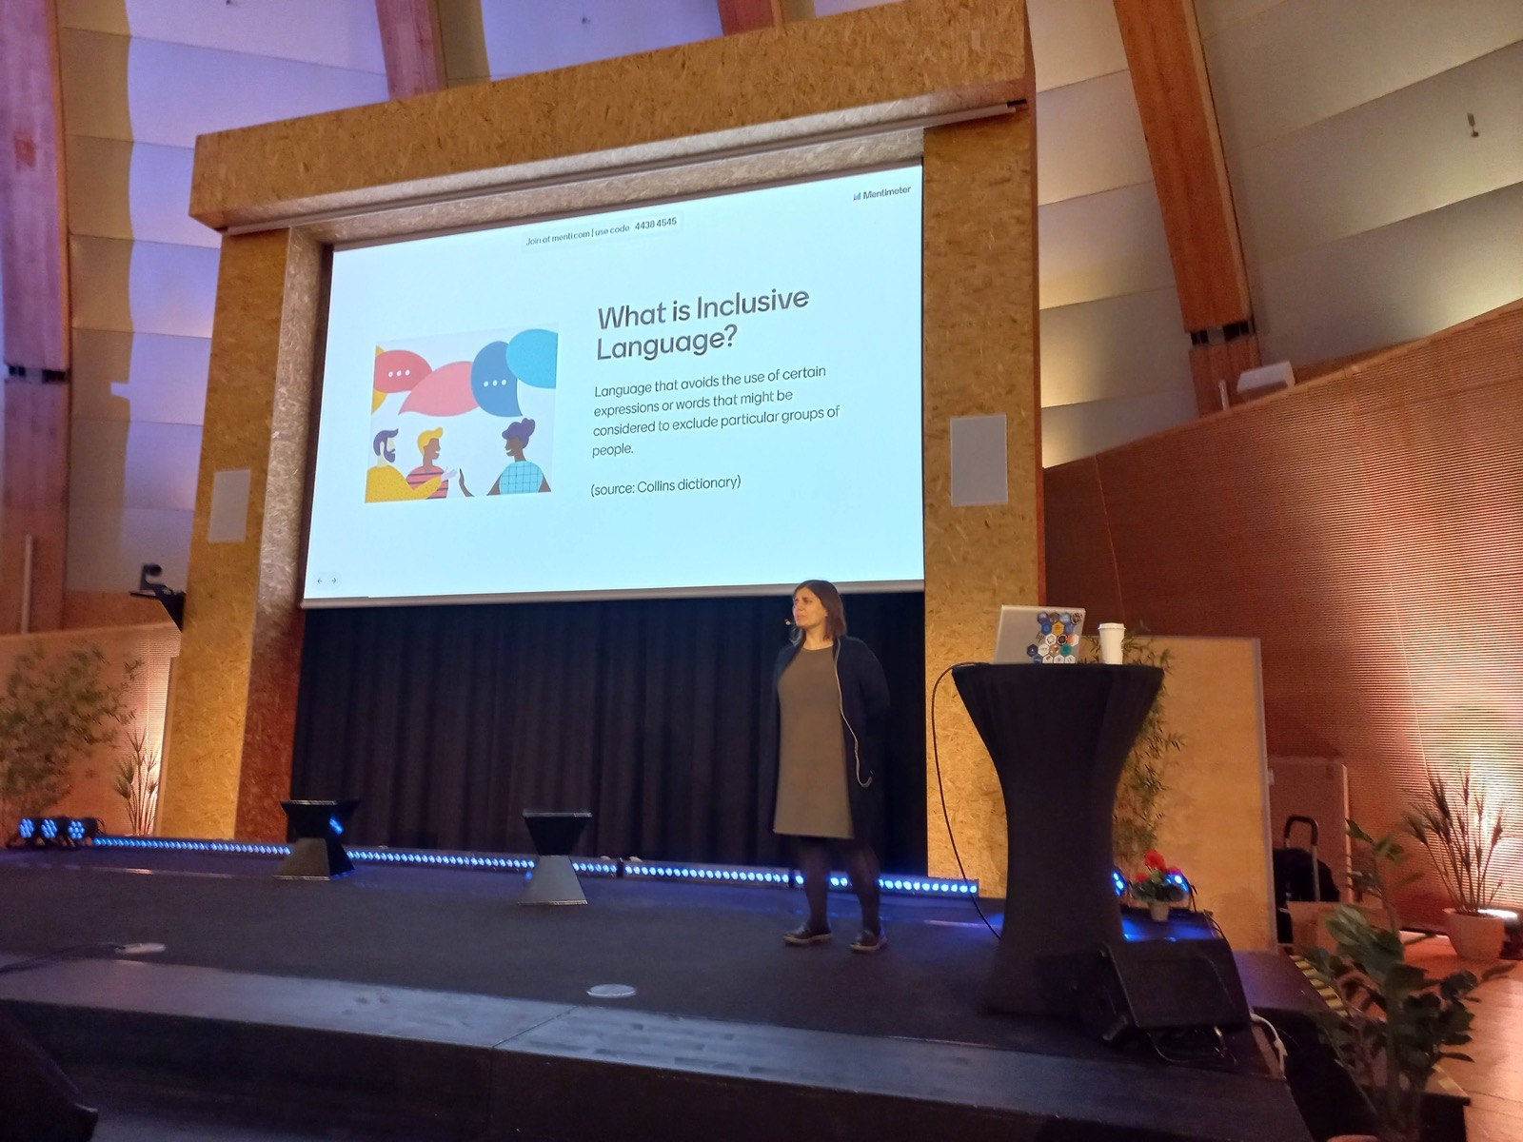
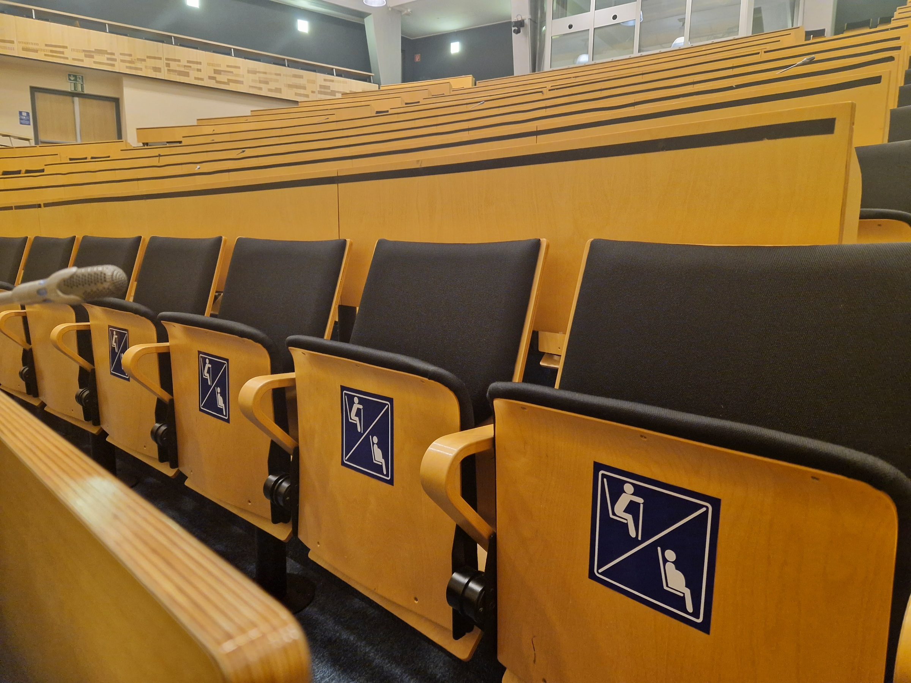
Inclusion: language & learning & infrastructure
Inclusive language workshop
Unconscious bias workshop
Theatre Forum: sexism at work
NEW: Priority Seats in all rooms > 50 capacity

Slide 7
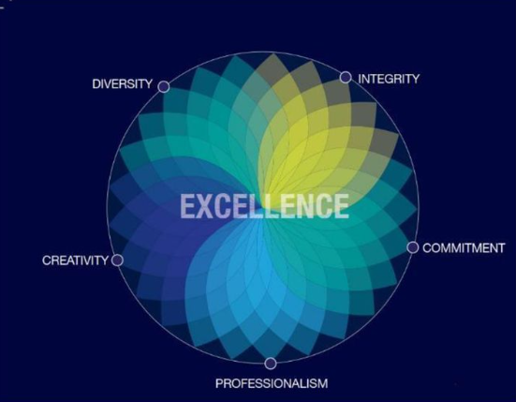
(re)defining Excellence . . .
“ Consider not only a diverse candidate’s individual potential…but the potential for excellence of a diverse team. ”
“I just wanted to thank you so, so deeply for giving a voice to so many "hidden" issues and for bringing these topics to our workplace. I am bi-sexual, have migraine attacks often, and I am recently diagnosed ADHD, suspected ASD, at 29 years of age. It felt incredibly meaningful to see some of my internal struggles be verbalised and explained to my colleagues.
I especially appreciate how much effort you put into representing so many different dimensions of diversity so humanely, and for starting conversations about them. This is incredibly important for all of us to do.”
- Participant in Invisible Dimensions Poll

