Slide 1
WOMEN IN SCIENCE AND TECHGNOLOGY
Marta Bajko CERN , April 2025

Slide 2
“Role models are [..] important to show the younger generations of women that they have the same opportunities as their male colleagues”.
by Fabiola Gianotti

Slide 3
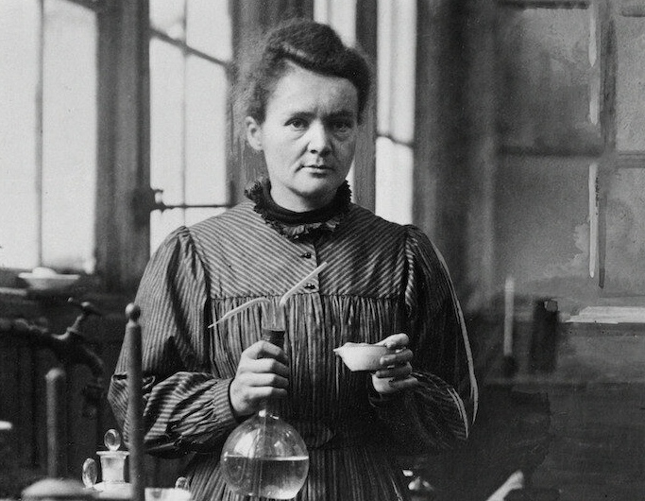
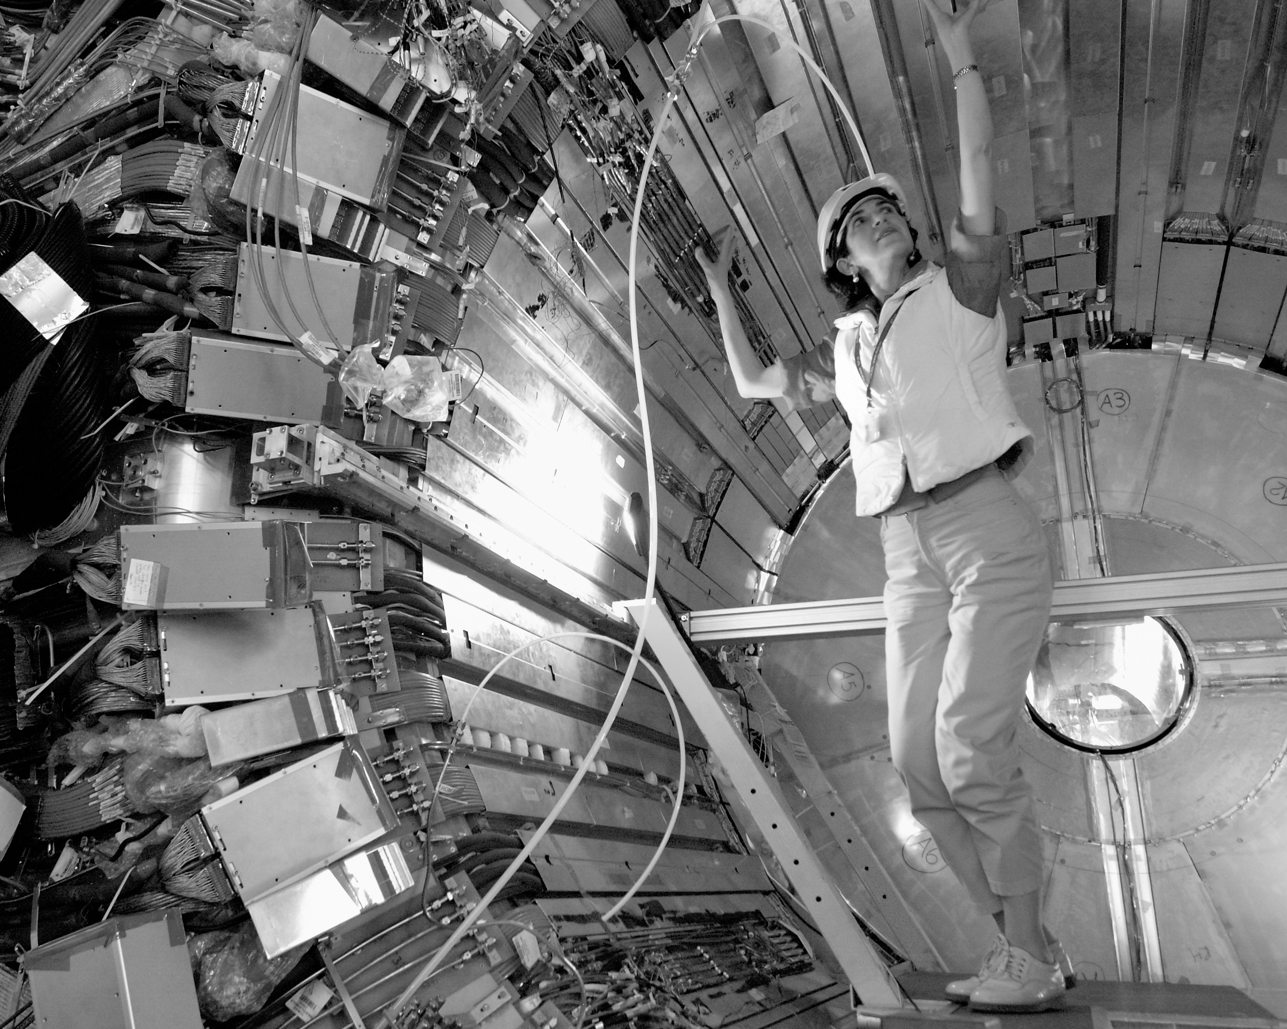
From Marie Skłodowska-Curie's Pioneering Spirit to Fabiola Gianotti's Groundbreaking Leadership: Women who Inspire the Next Generations
Fabiola Gianotti was elected CERN’s Director General in 2016 and renewed for a second mandate in 2021.
https://lelephant-larevue.fr/thematiques/sciences/physique/marie-curie-pionniere-dune-revolution-scientifique/
With a Nobel Price and a nomination for a 2nd ,
Marie Skłodowska-Curie was not elected to the male dominated French Academy of Science in 1911

Slide 4
“Role models are [..] important to show the younger generations of women that they have the same opportunities as their male colleagues”.
by Fabiola Gianotti

Slide 5
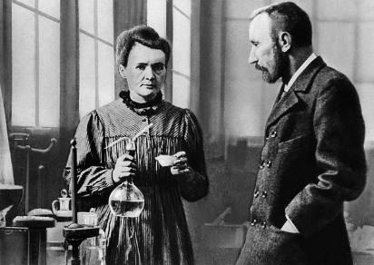
Pierre Curie was not only a brilliant physicist but also an equal research partner to Marie Skłodowska Curie. He recognized her talent, insisted that she be acknowledged for their joint work, and even declined a Nobel Prize nomination unless she was included. His support helped Marie Skłodowska Curie break barriers as the first woman to win a Nobel Prize (and the only person to win in two scientific fields!).
https://www.britishpoles.uk/116-years-ago-maria-sklodowska-curie-and-her-husband-pierre-curie-received-the-nobel-prize/
https://www.britishpoles.uk/116-years-ago-maria-sklodowska-curie-and-her-husband-pierre-curie-received-the-nobel-prize/

Slide 6
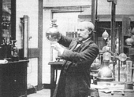
Faces in CRYOGENICS in about 1890
About 1892, the idea occurred to James Dewar of using vacuum-jacketed vessels for the storage of liquid gases – the Dewar flask (otherwise known as a Thermos or vacuum flask) – the invention for which he became most famous.
Wikipedia

Slide 7
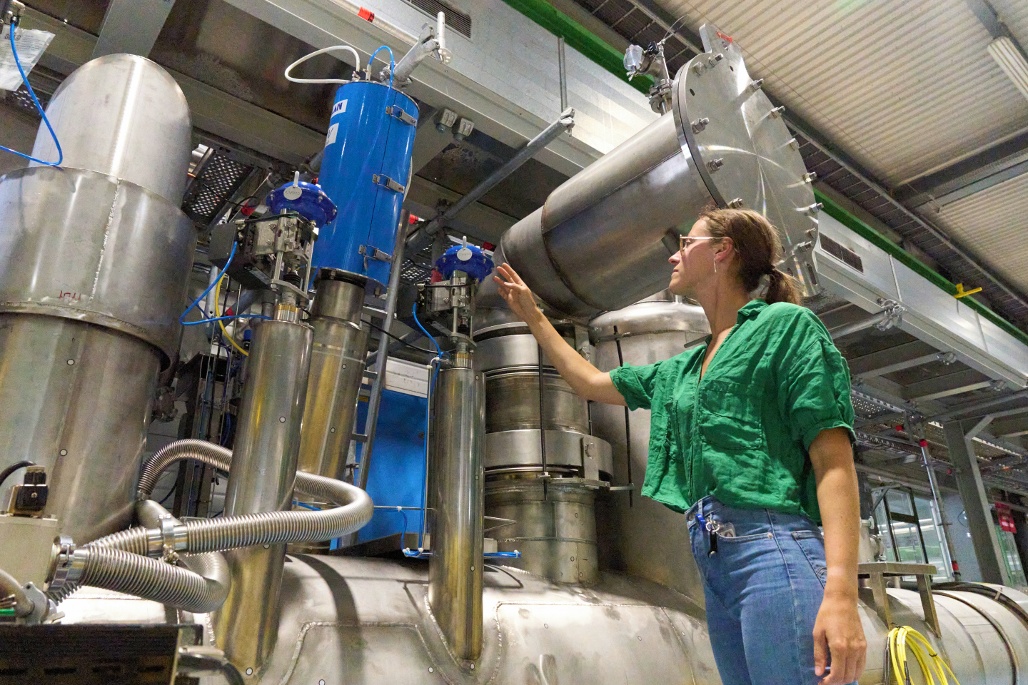
Faces in CRYOGENICS in 2024
The cryogenic system of the HL-LHC IT String was successfully cooled (without magnets) for the first time to nominal operating temperatures, with stable Helium II conditions (1.9 K).
CERN CDS

Slide 8
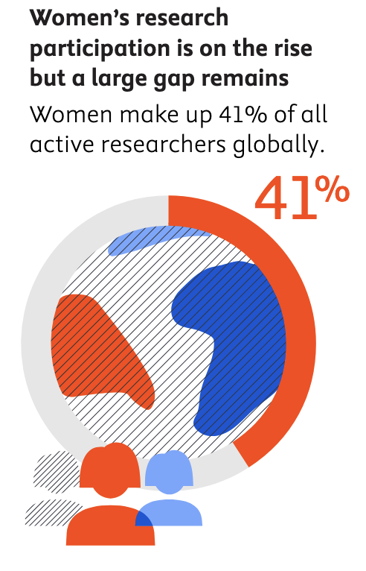
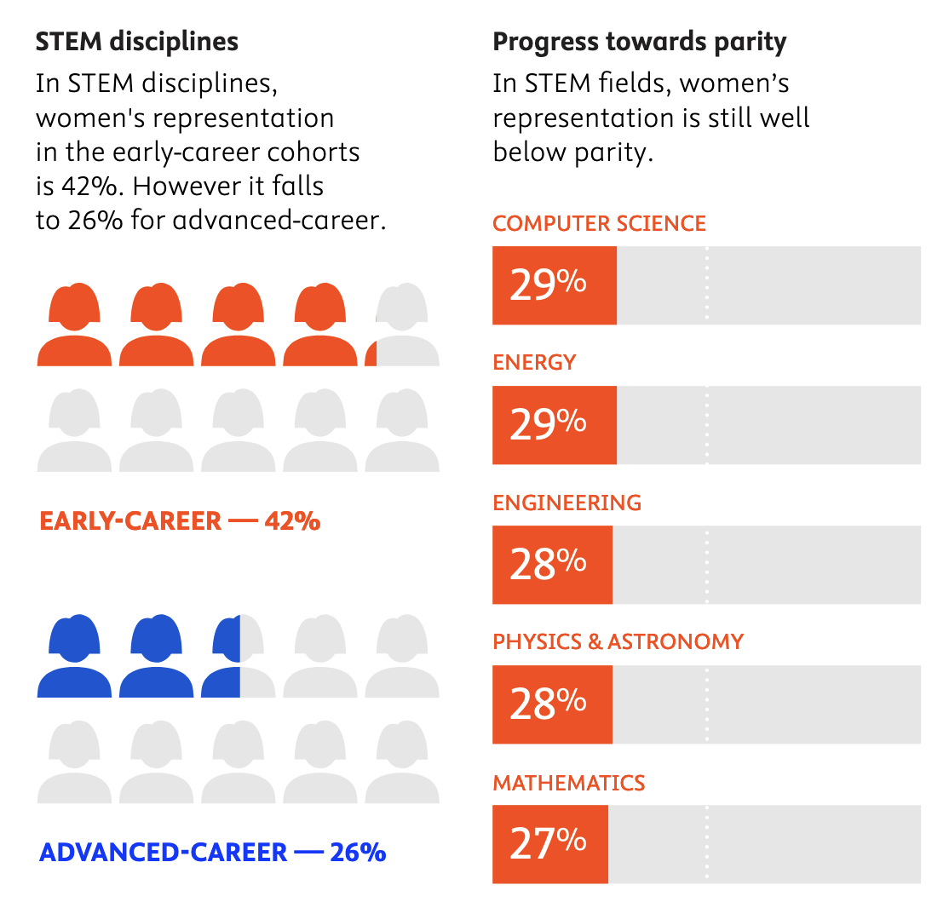
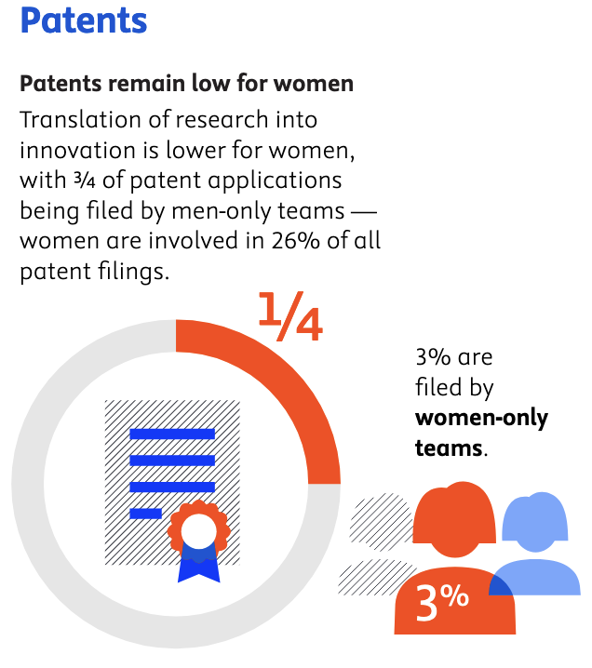


SOME GLOBAL STATISTICS: 2024
Progress Towards
GENDER EQUALITY IN RESERCH & INNOVATION 2024 Review
https://assets.ctfassets.net/o78em1y1w4i4/3W1JKBd7ez41lAJKFWkB4l/29265cb67668b03d273015fc3bb83b54/Progress_Toward_Gender_Equality_in_Research___Innovation___2024_Review__2.pdf

Slide 9
SOME SPECIFIC STATISTICS
Participation of women in SMTF
Low ( 4%) rate of annual staff renewal at CERN explains some of these numbers.
With the 3% of observed increase still 10 years to get to a gender equality!

Slide 10
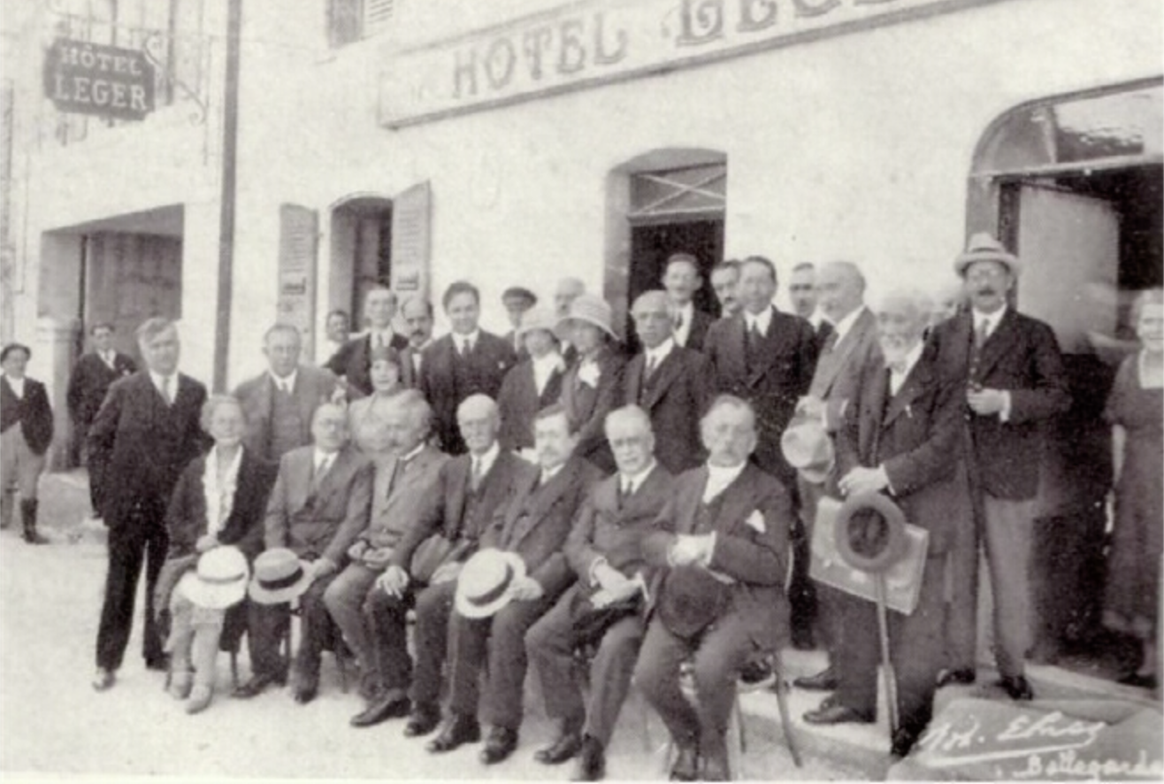
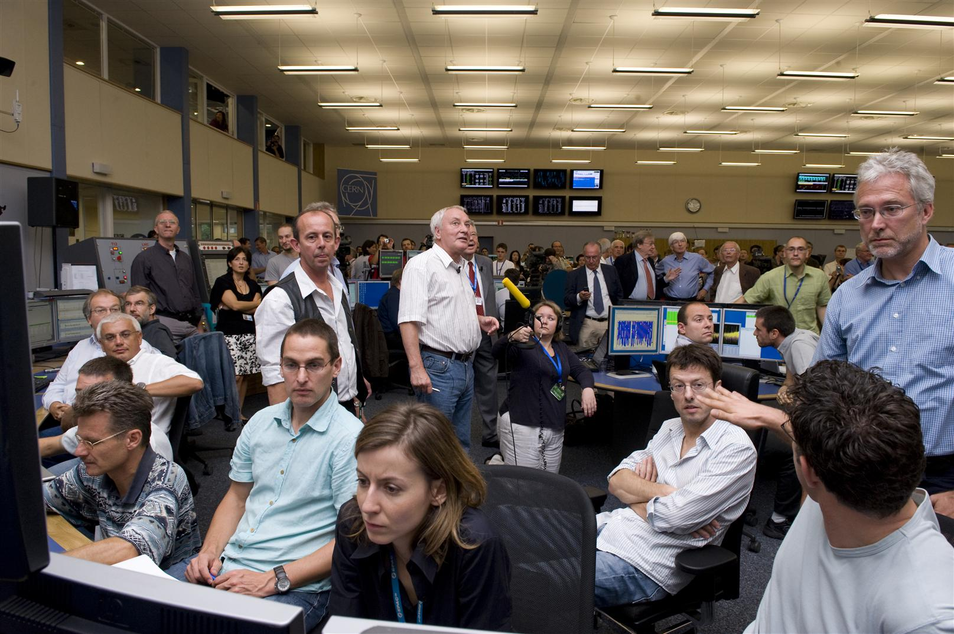
Diversity is a FACT. Inclusion is a CHOICE!
But is not only an ethical choice: divers teams bring different perspectives, leading to more innovative solutions and discoveries
Marie Skłodowska -Curie and Albert Einstein in Thoiry in 1930
LHC First Beam Day from the CERN-2008
Aprox. 16%
Aprox. 13%
As for the place of women in science, while Marie Curie showed the way,
the path to equality and equity is still long and difficult.

Slide 11
“ Consider not only a diverse candidate’s individual potential…but the potential for excellence of a diverse team. ”

Slide 12
PROGRAM
WELCOME ADDRESS
Speaker Marta Bajko CERN
LEADING IN SCIENCE AND TECHNOLOGY
Speaker Peter Michael Derlet PSI
THE FUTURE OF WOMEN IN STEM: some statistique and institution policy
Conveener Marta Bajko CERN
Speakers:
Roser Vallcorba CEA
Franco Mangiarotti CERN
Antonella Chiuchiolo INFN
Christine Hoa ITER
Patricia Bartolome GSI
Rocio Santiago Kern UPPSALA Univbersity
FREE DISCUSSION with the presence of Melina Spycher, head of the PSI/EMPA/EWAG DEI competency centre
CLOSING REMARKS AND ACKNOWLEDGMENTS 5 min
Speaker Marta Bajko CERN

Slide 13
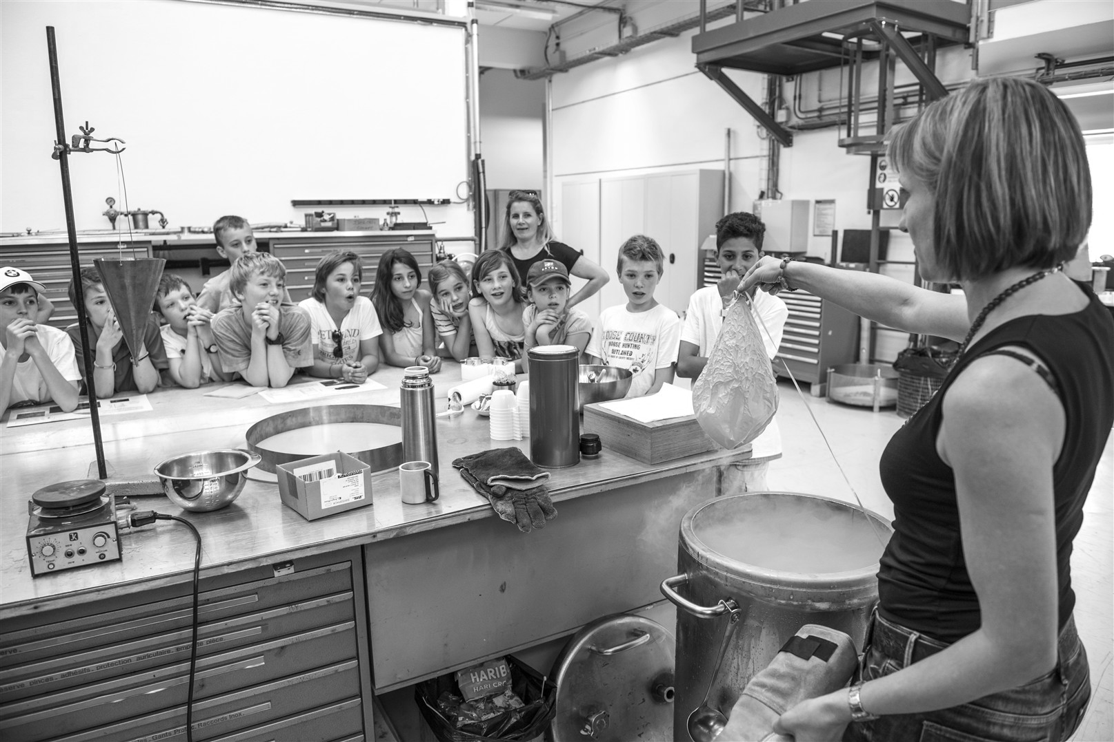
“Science allows young people to grow fast because it is very democratic.
We all work together, we are all on the same level, at CERN you find students and Nobel Prize winners sitting at the same table talking physics.”
by Fabiola Gianotti
“In life, nothing is to be feared, everything is to be understood”
by Marie Skłodowska-Curie
“Never Abandon Your Dream ;
You May Regret It For The Rest Of Your Life”
by Fabiola Gianotti
Laetitia Dufay-Chanat @ the CERN CRYOLAB

