Slide 1
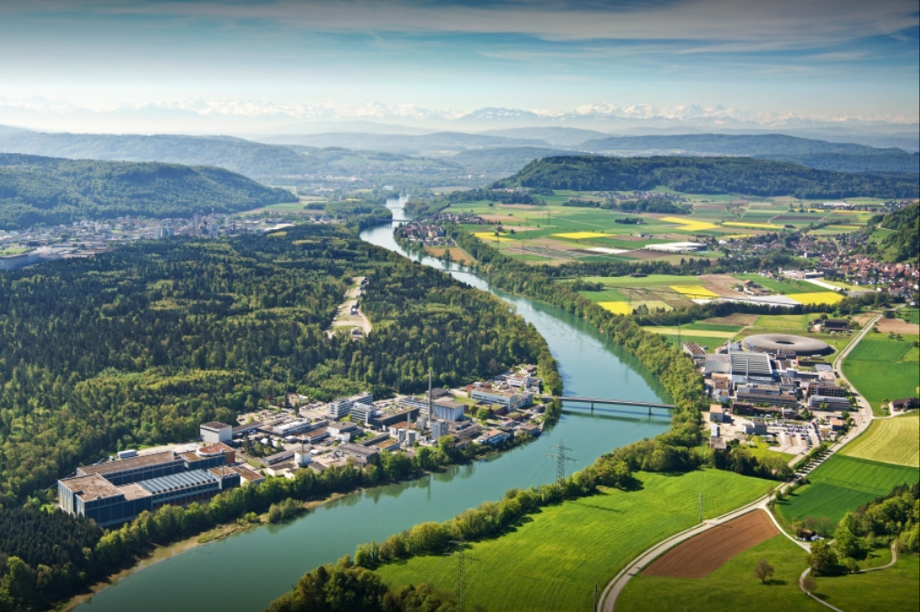
Introduction and Welcome EPFL-SPC
Kamil Sedlak
April 2, 2025

Slide 2
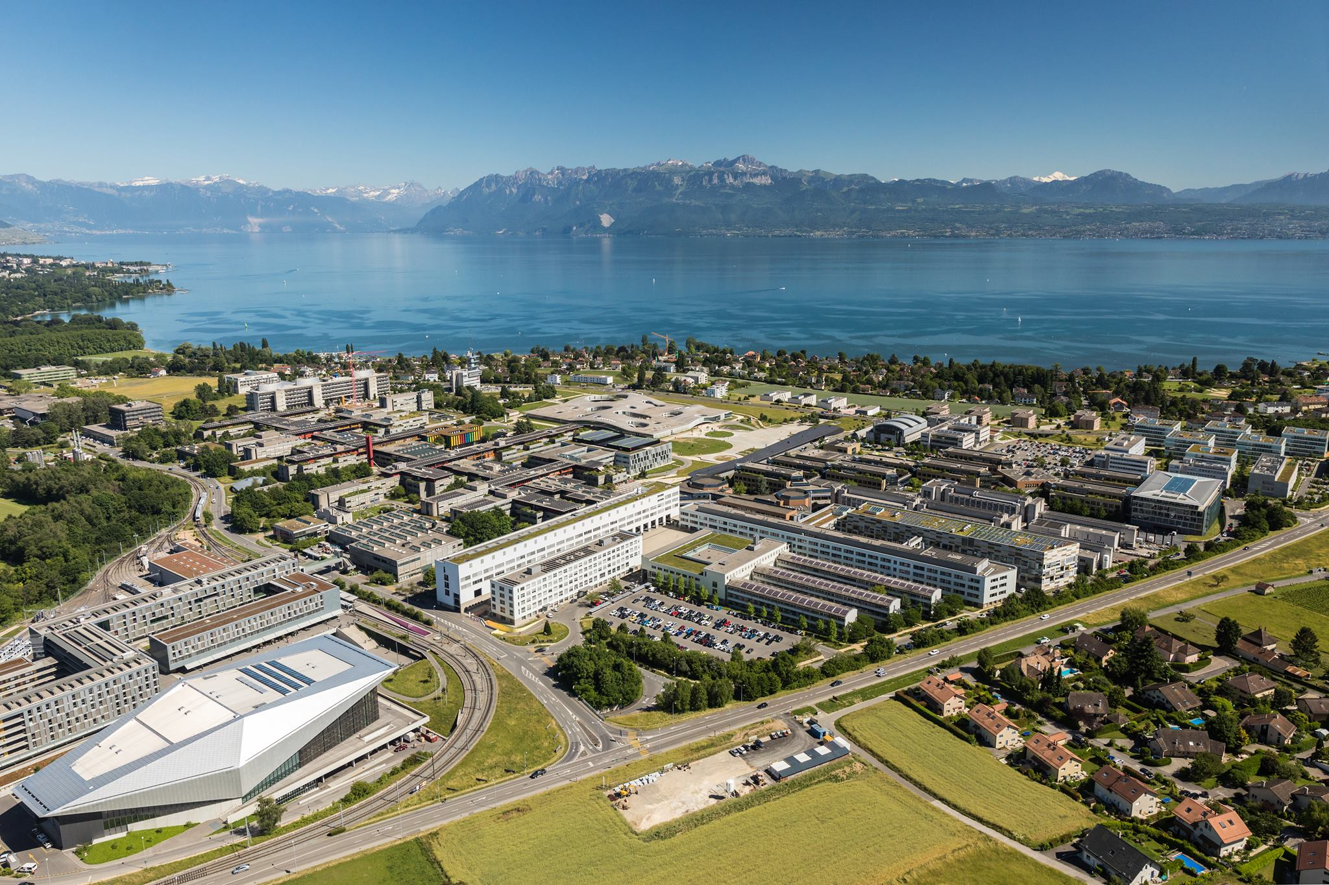
SPC – the Largest Laboratory of EPFL in Lausanne

Slide 3
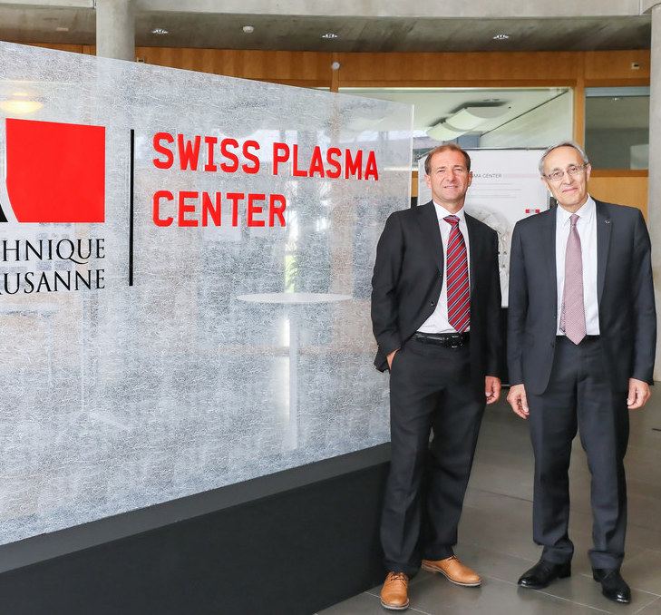


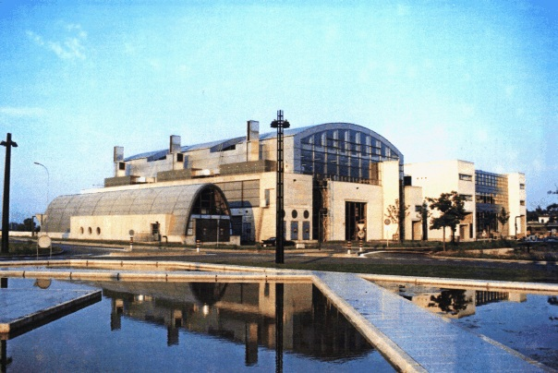
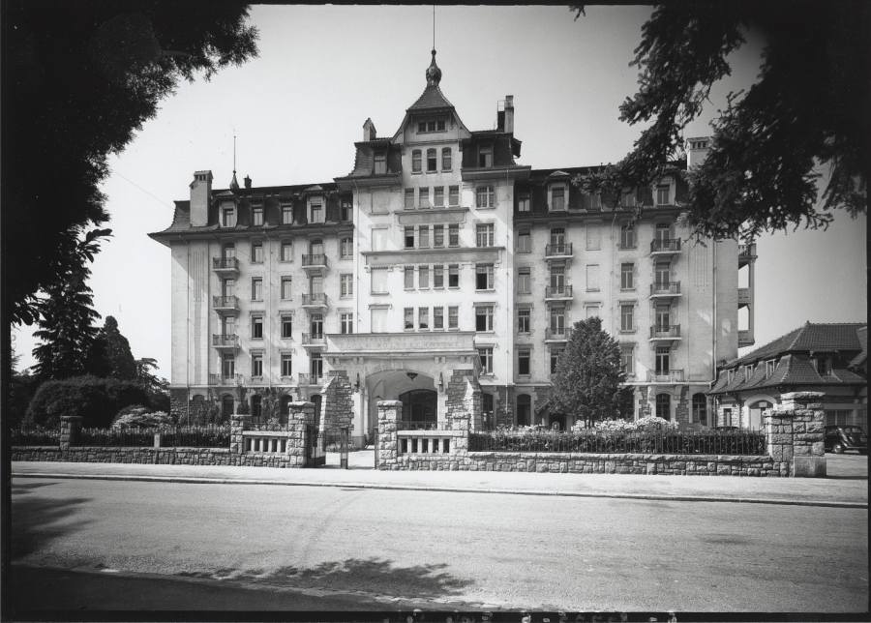
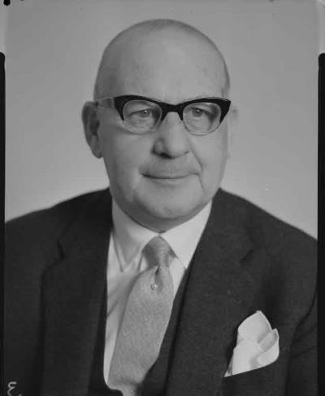
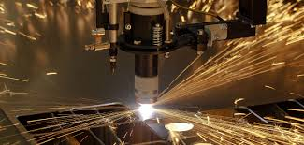
Swiss Plasma Center was known as CRPP
PPL becomes “Centre de recherches en physique des plasmas” (CRPP)
CRPP becomes SPC
Agreement with Euratom
TCV tokamak is built
1968
1978
1992
2015
1961
1973
1989
2002
Plasma Physics Laboratory (PPL) is created by Federal Council
CRPP joins EPFL
Industrial
Plasma
Group
CRPP is Center of the School of Basic Science

Slide 4
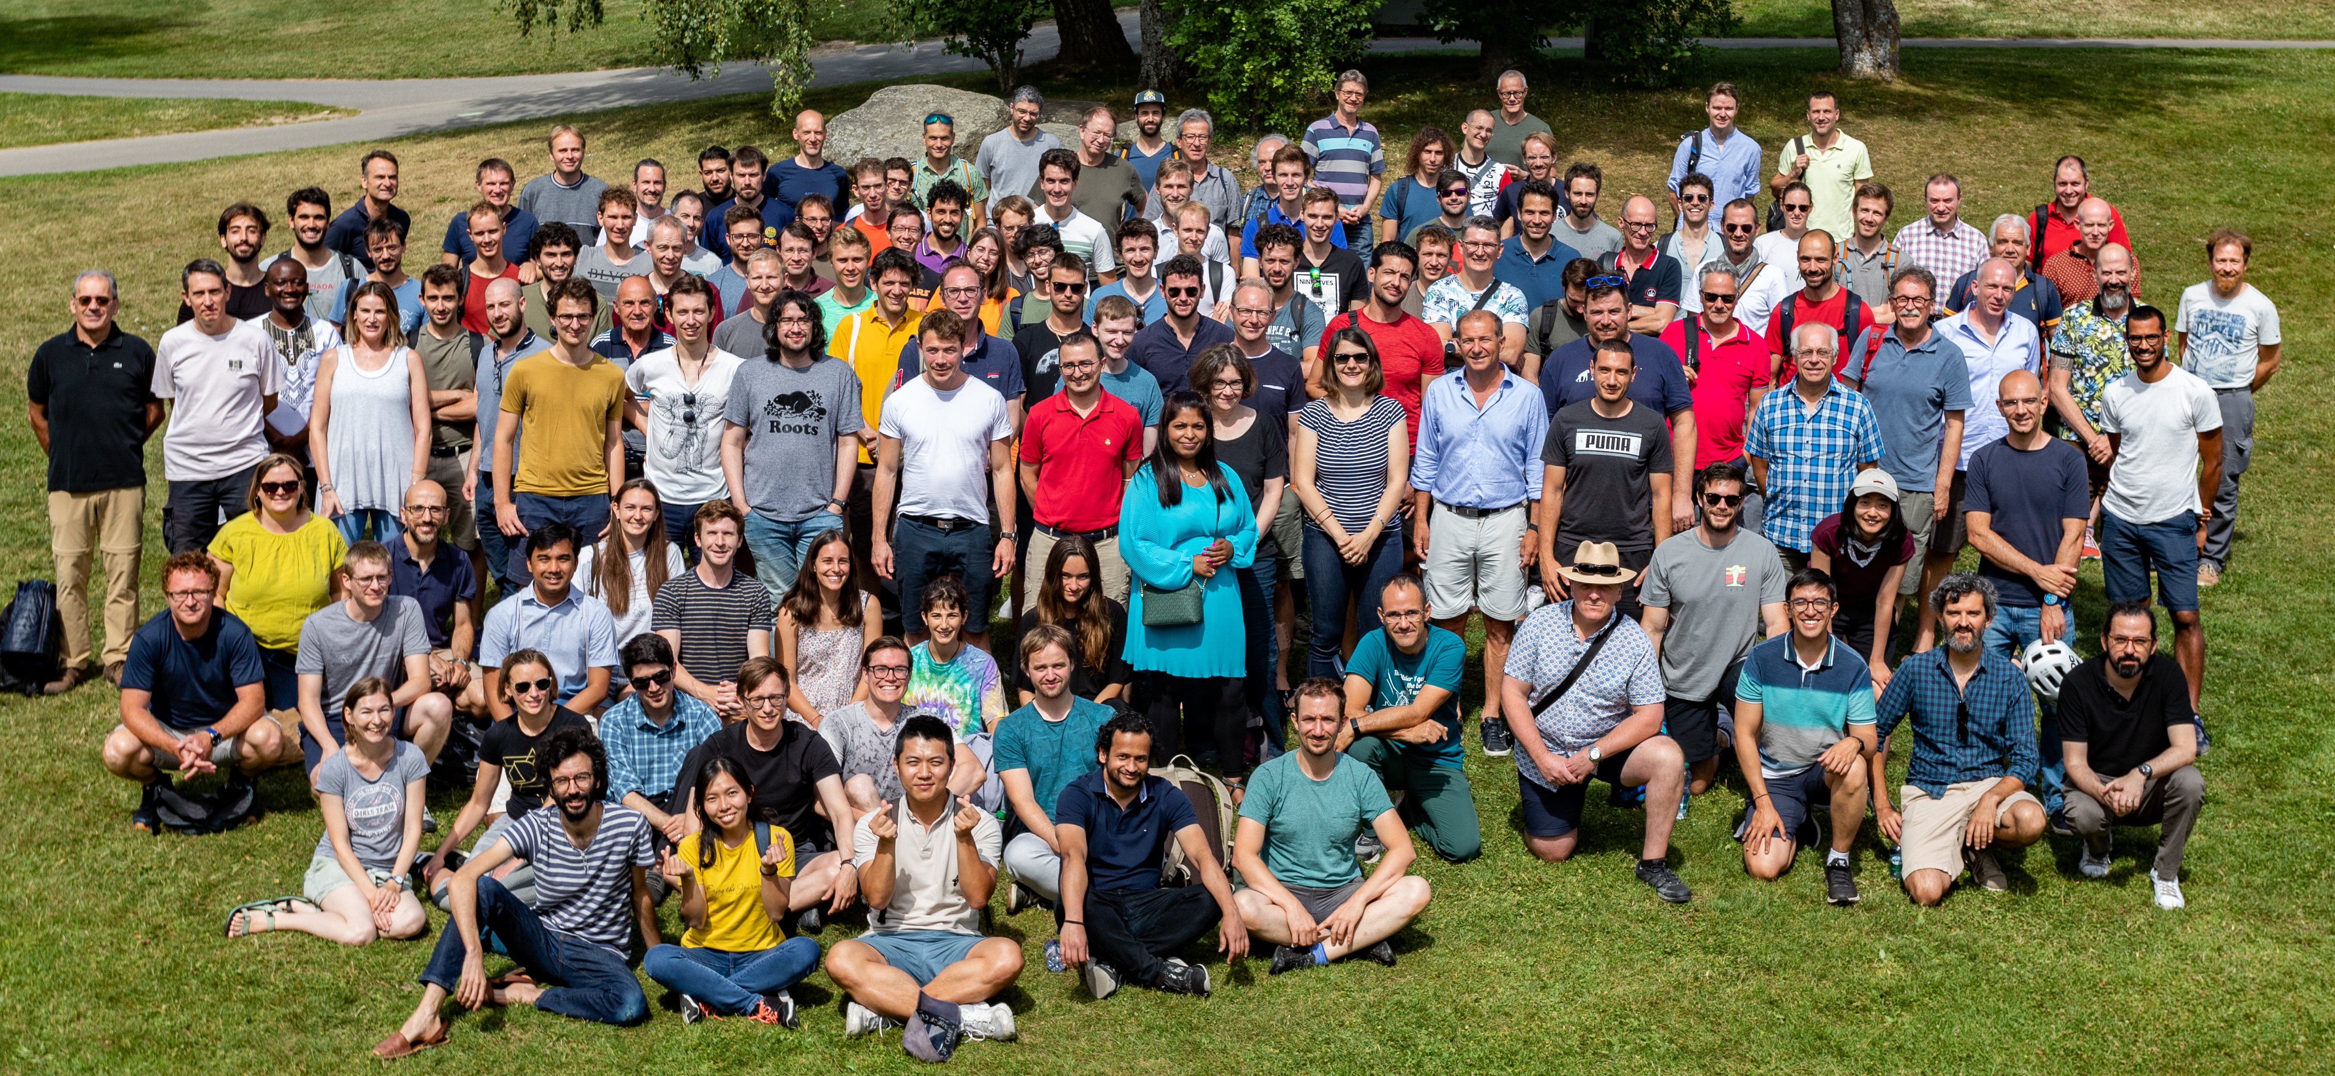
SPC Now Counts 200 Staff Members
Majority of SPC (180 people) works on plasma research in Lausanne.
20 people working on applied superconductivity is based at premises of PSI in Villigen.

Slide 5
Research Lines of SPC
Tokamak Physics - TCV
Plasma Heating
  FALCON: testing of ITER Gyrotron components
  T-Rex: experiment to understand electron cloud formation
Theory
  Studies of core and boundary turbulences in plasma
  Plasma control
  Advanced modelling on powerful computing clusters
Low Temperature Plasma and Application
Applied Superconductivity

Slide 6
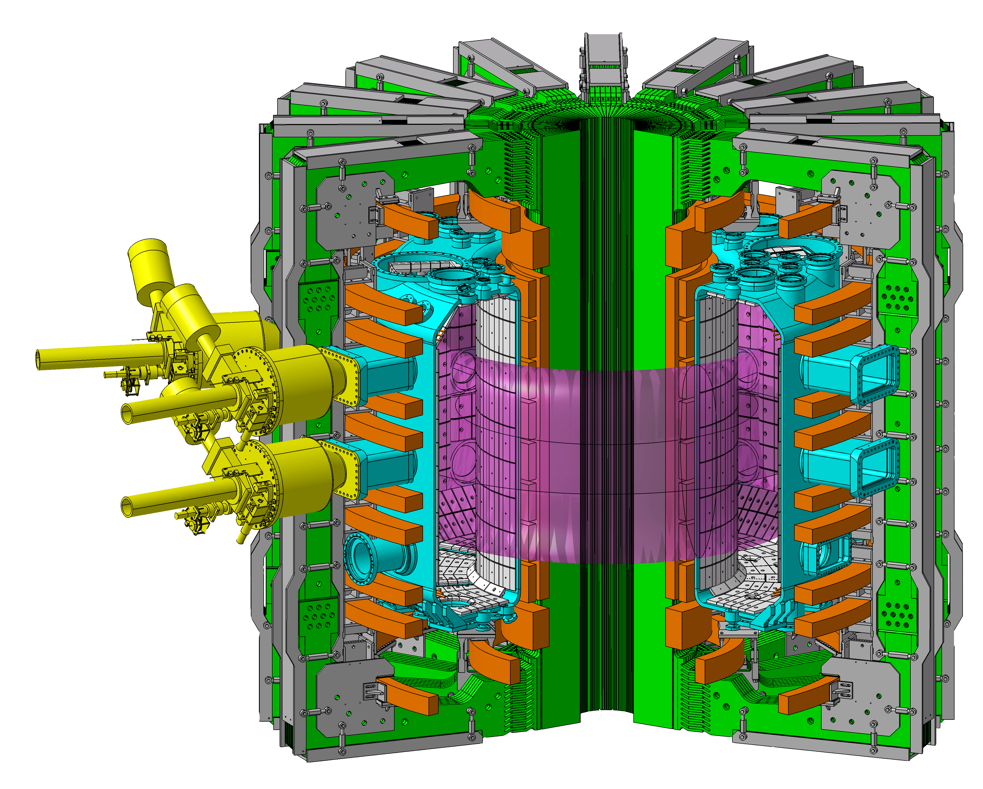
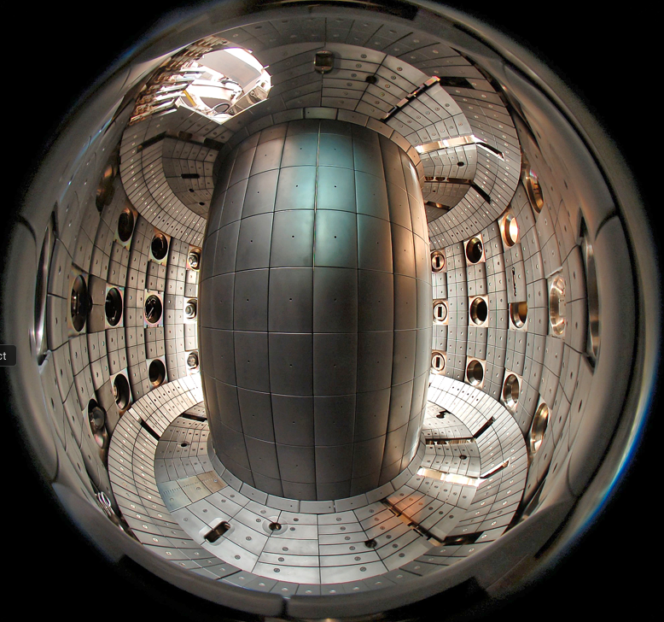
TCV: the Most Flexible Tokamak Worldwide
R_{major} = 0.9 m
R_{minor} = 0.25 m
I_{p} < 1 MA
B_{T} < 1.54 T
2.3 MW NBI heating
3.75 MW ECRH
Independently powered
16 shaping coils
2 OH coils
1 internal vertical control coil
κ < 3, -0.6 < δ < 0.9
Graphite tiles
Internal divertor baffles
a=0.25 m
R=0.88 m
graphite walls
More than 40 international institutions participate in the TCV program

Slide 7
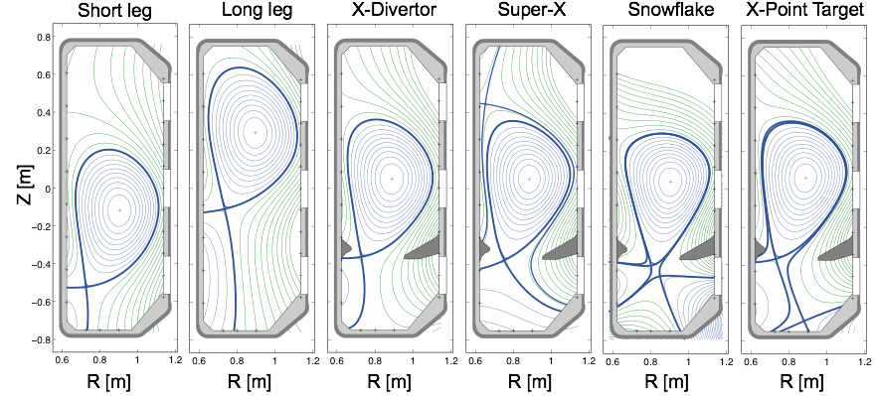
Built-in Flexibility and Versatility of TCV Tokamak
Fasoli et al., Nucl. Fusion 2020

Slide 8
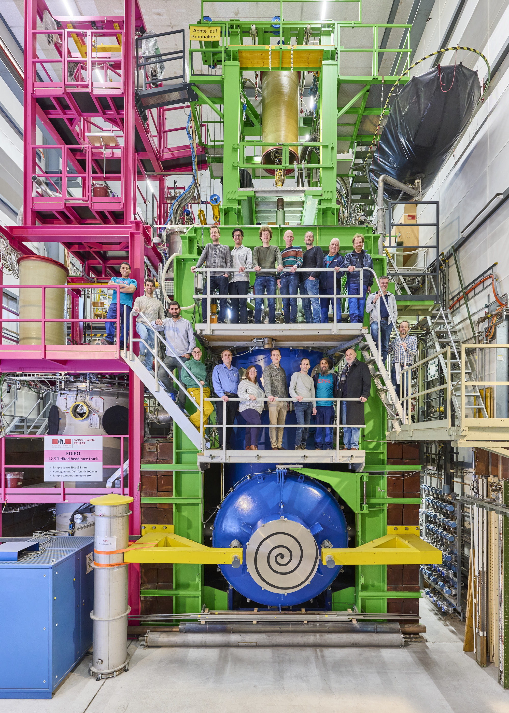
Applied Superconductivity Group
Testing of superconductors for fusion magnets:
  Sample assembly (conductors and joints)
  Sample testing
Maintenance and upgrades of existing test facilities SULTAN, EDIPO and the smaller one JORDI.
R&D on fusion-size superconductors within EUROfusion programs:
  DEMO, VNS, stellarator
  Quench behaviour in HTS, fusion-relevant samples
  Quench detection based on non-voltage methods (optical fibers; co-wound superconducting strands; thermocouples)
Other collaborations, e.g. with Bruker Biospin and CERN

Slide 9
Test Facilities

Slide 10
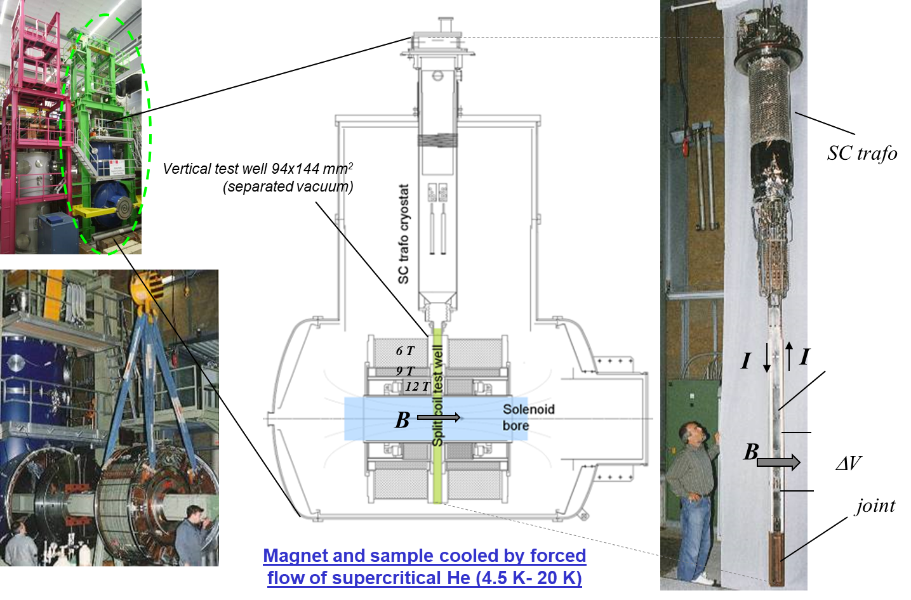
SULTAN Test Facility – DC Field up to 10.9 T

Slide 11
AC Loss Measurements in SULTAN
AC sinusoidal field:
  Frequency 0.2 – 10 Hz
  Max. field amplitude 0.4 T
Pulse mode:
  Pulse duration: 40 ms – 130 ms
  Amplitude: up to 4 T (130 ms) or up to 1.3 T (40 ms)
  Sinusoidal, trapezoidal, triangular
Effective field length: 390 mm
Re-cooling time after a test: a few minutes

Slide 12
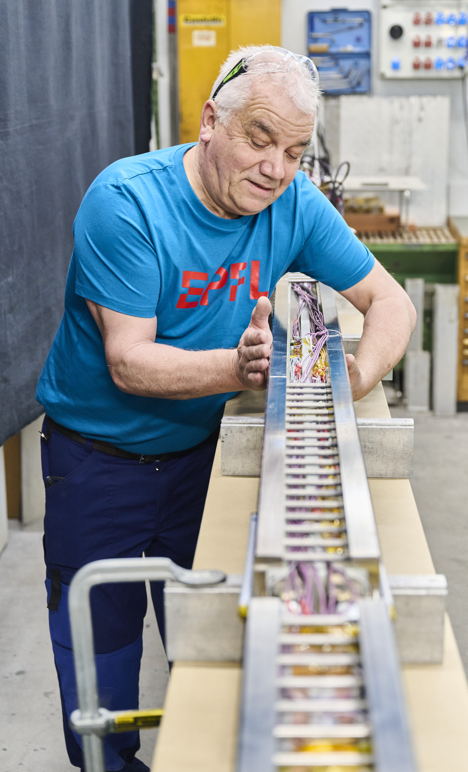
Tests in SULTAN
 | SULTAN | EDIPO II
status | in operation | to be upgraded after accident
Matnetic field | 11 T | 15 T
Sample space | 94x144 mm² | 144x144 mm²
Temperature | 4.5-50 K | 4.5-50 K
Possible use of the SULTAN/EDIPO test facilities:
Test of superconducting cables for fusion magnets (ITER, EU DEMO, CFS, BEST, CFETR, DTT, …) up to 85 kA.
Test of joints (fusion and accelerator cables).
Quench experiments (only up to 15 kA).
Test of sub-size accelerator coils (e.g. Feather HTS magnets for CERN).

Slide 13
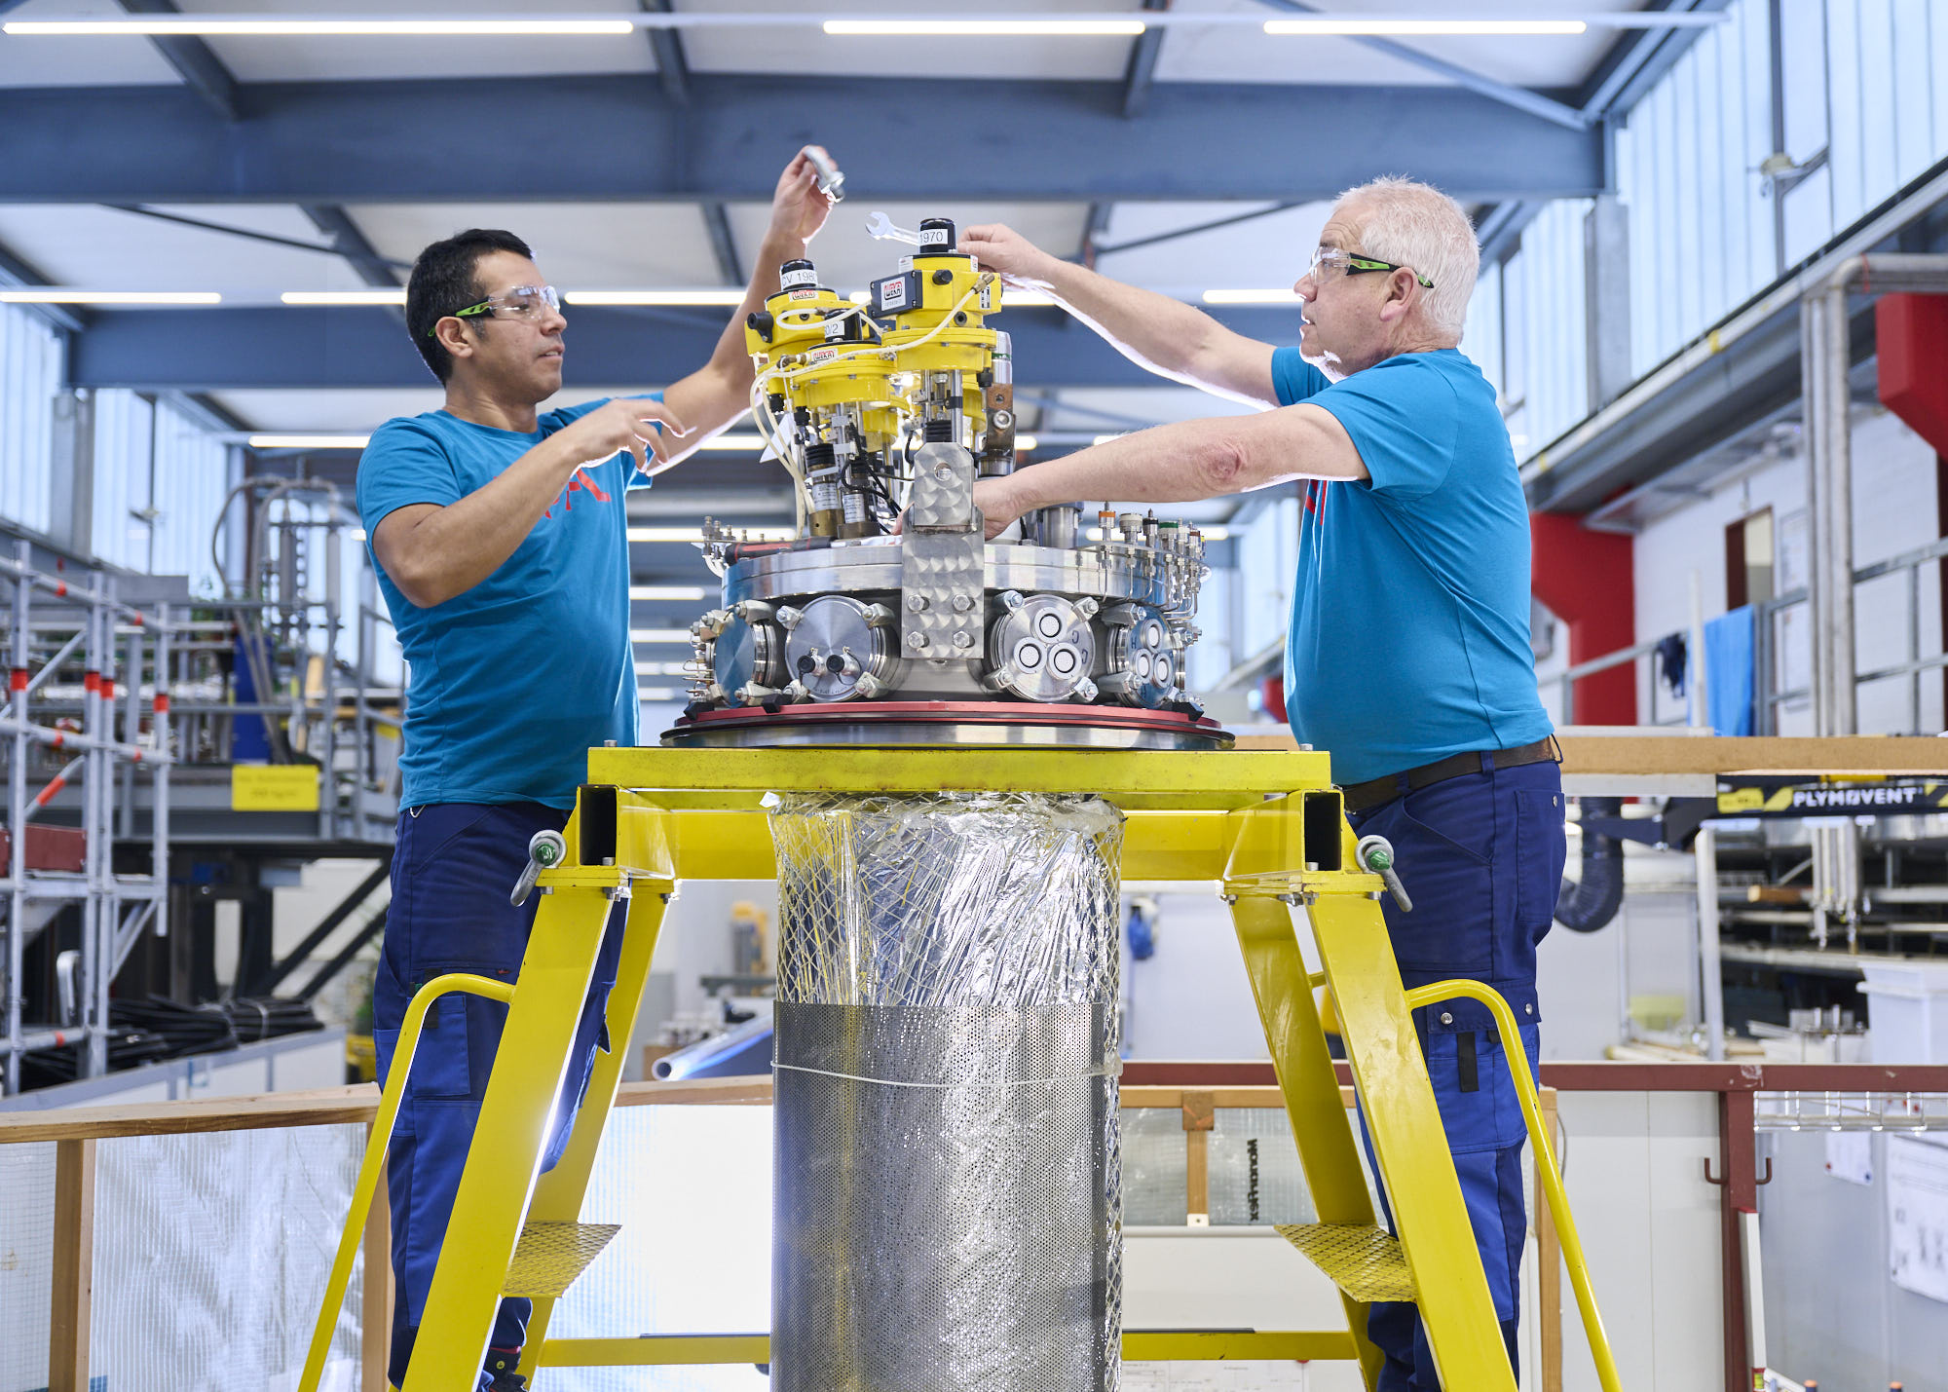
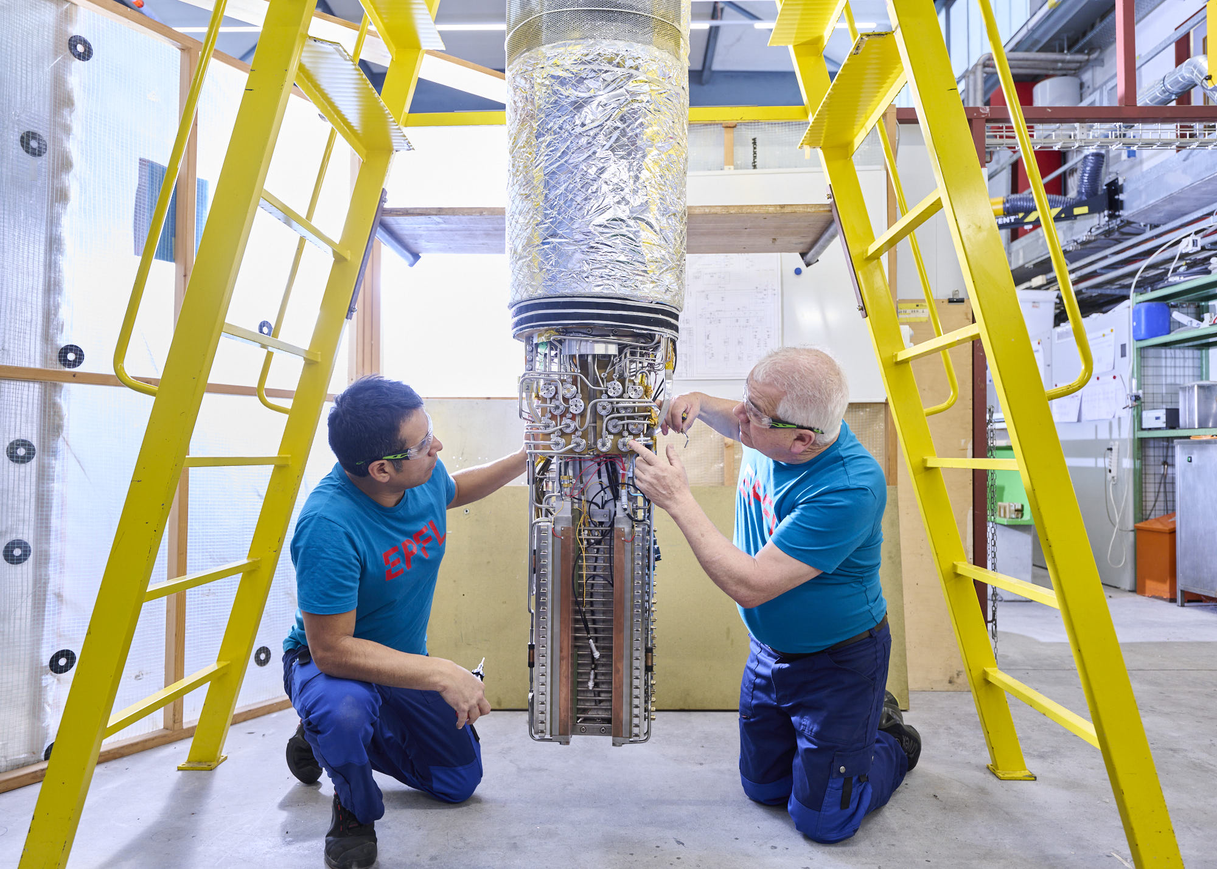
Tests with Superconducting Transformer
Currents up to ~85 kA.
With a small resistance (a few nΩ) in the sample (due to the joints), the test duration can be up to an hour – very precise measurement of I_{C} or T_{CS}.
When the resistance is larger than a few nΩ, the test duration can get severely limited → also the measurement precision is reduced.
In case of quench → “high” resistance in the sample leads to an immediate current switch off.
  Measurements can be done until quench, and the quench evolution cannot be studied.
Typical tests: I_{C}, T_{CS}, effect of electromagnetic and thermal cycles on the sample performance, AC loss, MQE.

Slide 14
Tests of HTS Samples Using the Transformer
Field center
Right – ASTRA
HTS adaptor
Left – NTNT
2555
790
Currents theoretically up to ~85 kA, in practice usually less due to higher overall resistance of the sample.
An HTS Adaptor must be inserted as an interface between the HTS sample and the superconducting transformer (made of NbTi). The adaptor made of HTS tapes can carry current up to 100 kA, but has a low heat conductivity → it allows us to keep the temperature of the terminals attached to the transformer low (<8 K), while the sample temperature can reach up to 50 K.
In addition, a recuperating heat exchanger preheats the cold helium (4.5 K) coming from the cryoplant to a higher temperature (up to 50 K), and at the same time pre-cools the warm helium coming from the sample to lower temperature manageable by the cryoplant.

Slide 15
HTS Adaptor

Slide 16
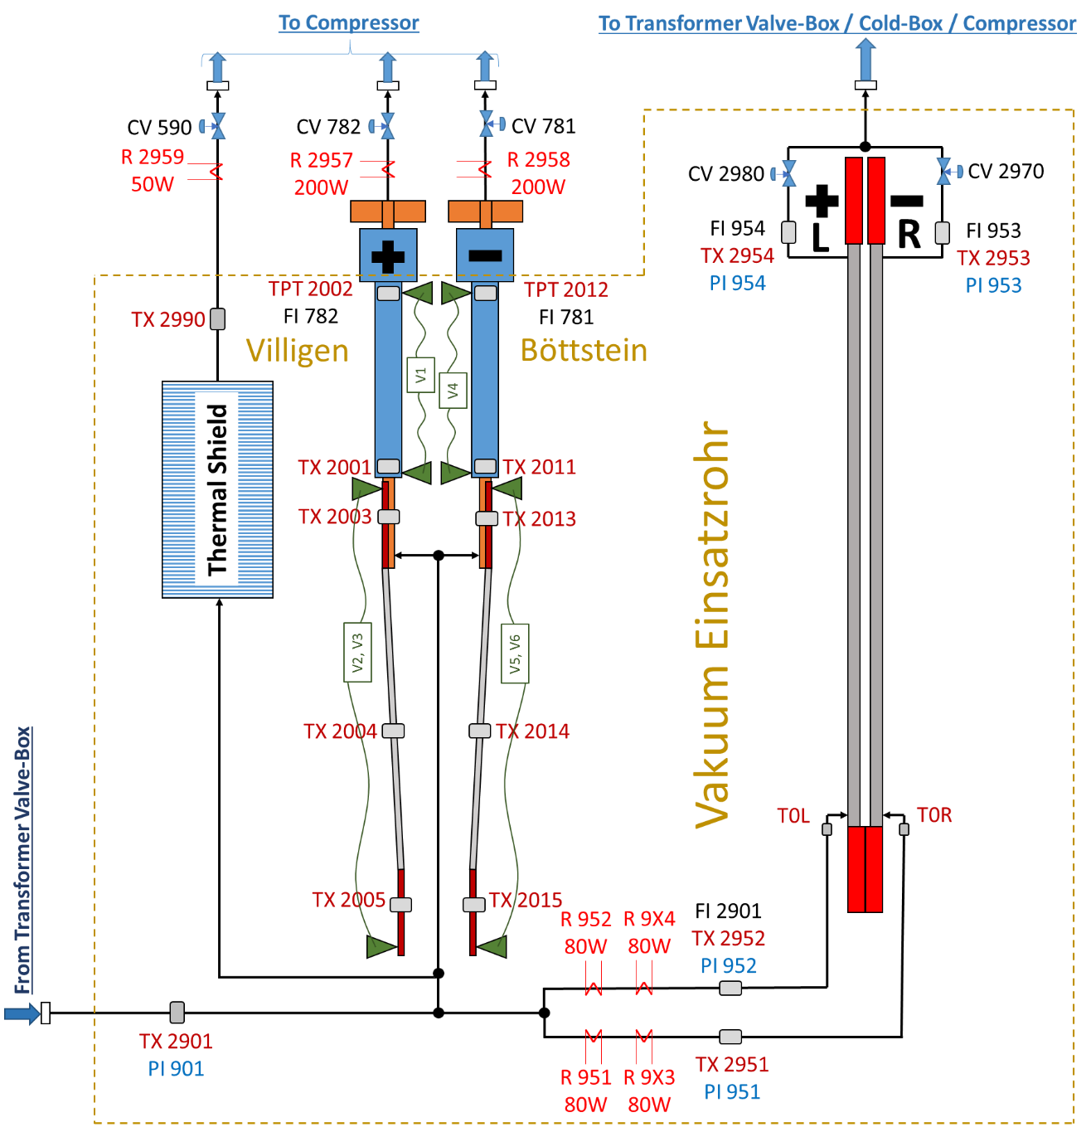
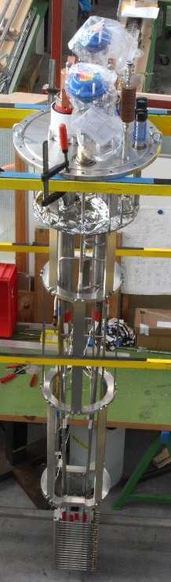
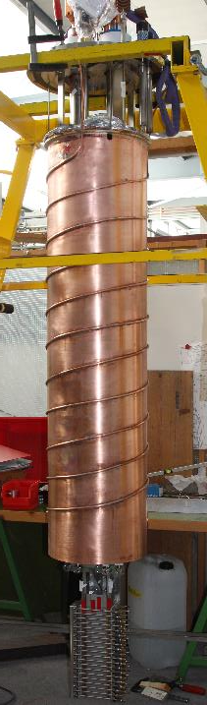
Tests with a Power Supply – Quench Studies
A sample holder replaces the transformer.
The current is provided by a direct power supply. It is limited to 15 kA.
The current can be maintained also in the resistive sample. Maximum voltage over the sample is a few V.
In the Quench experiments, temperature over 200 K could be reached, allowing us to study the quench evolution in HTS samples.
Sample holder with and without the thermal shield
Cryogenic circuit

Slide 17
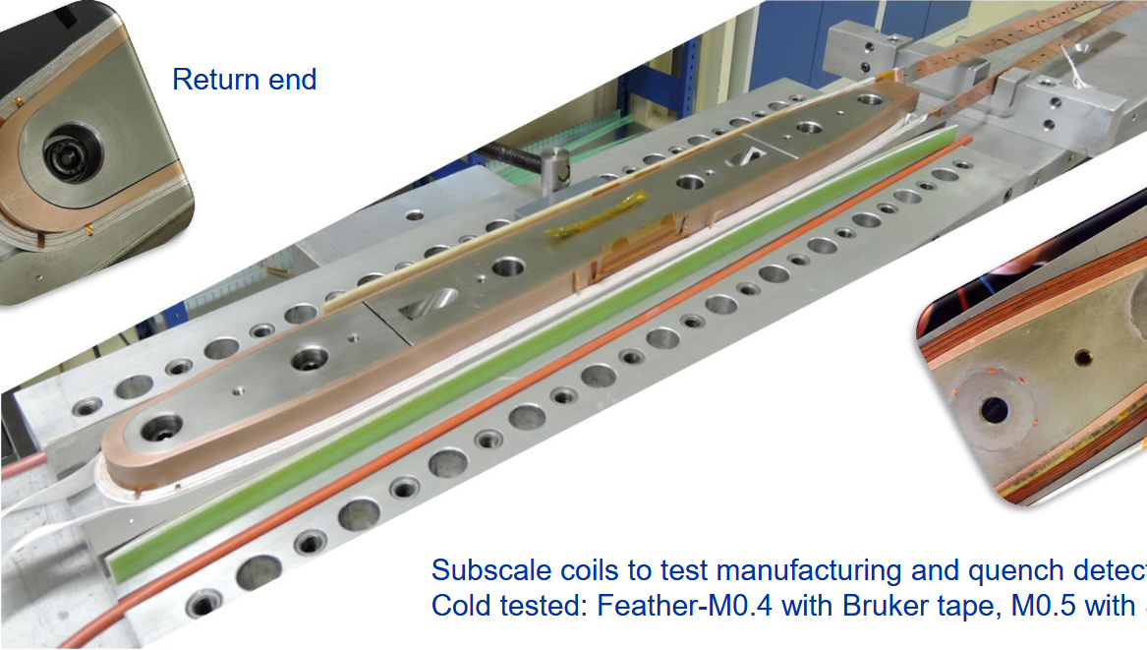
Variable Temperature Cryostat
Most of fusion conductors are forced-flow cooled, surrounded by vacuum in the SULTAN test well.
Occasionally, we test accelerator-type conductors (e.g. Rutherford cables or joints) or sub-scale coils (e.g. Feather M0.4 and M0.5, CERN), which need He coolant surrounding the sample.
➔ We use Variable Temperature Cryostat, with He gas inside.
Feather M0.4, M0.5

Slide 18
R&D for Fusion Magnets

Slide 19
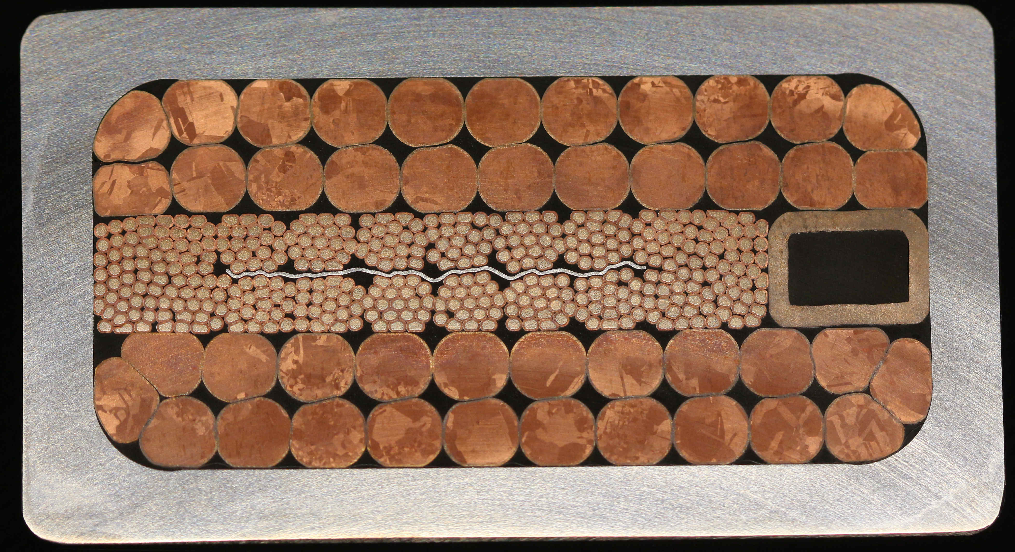
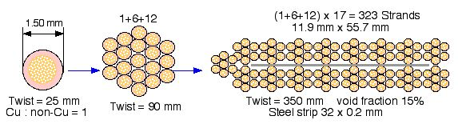
React & Wind Nb₃Sn Conductor for DEMO
Post-ITER LTS conductor development
Cable assembled at room temperature from heat-treated Nb₃Sn cable. Steel jacket laser welded from two symmetric half-profiles.
Measured effective strain:
  ε_{eff} = -0.28%
  (ITER TF: ε_{eff} ≈ -0.7%)
➔ DEMO RW conductor reaches ITER TF cable performance with only 50% of Nb₃Sn.
Additional saving due to grading of Nb₃Sn and steel in the layer-wound winding pack.
Very small AC loss (cable might be used also in the CS coil).
1 mm
In 2025-2026: We work on an industrial demonstration of 100m long conductor manufacture.

Slide 20
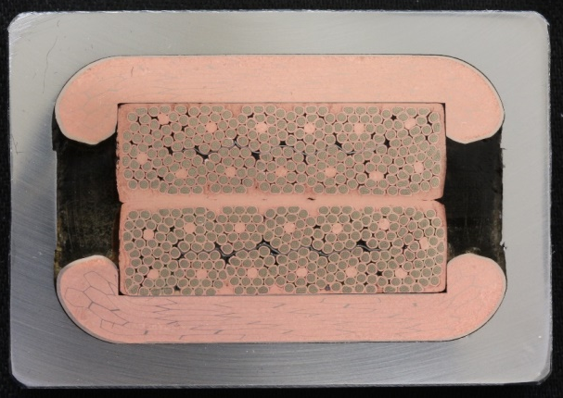
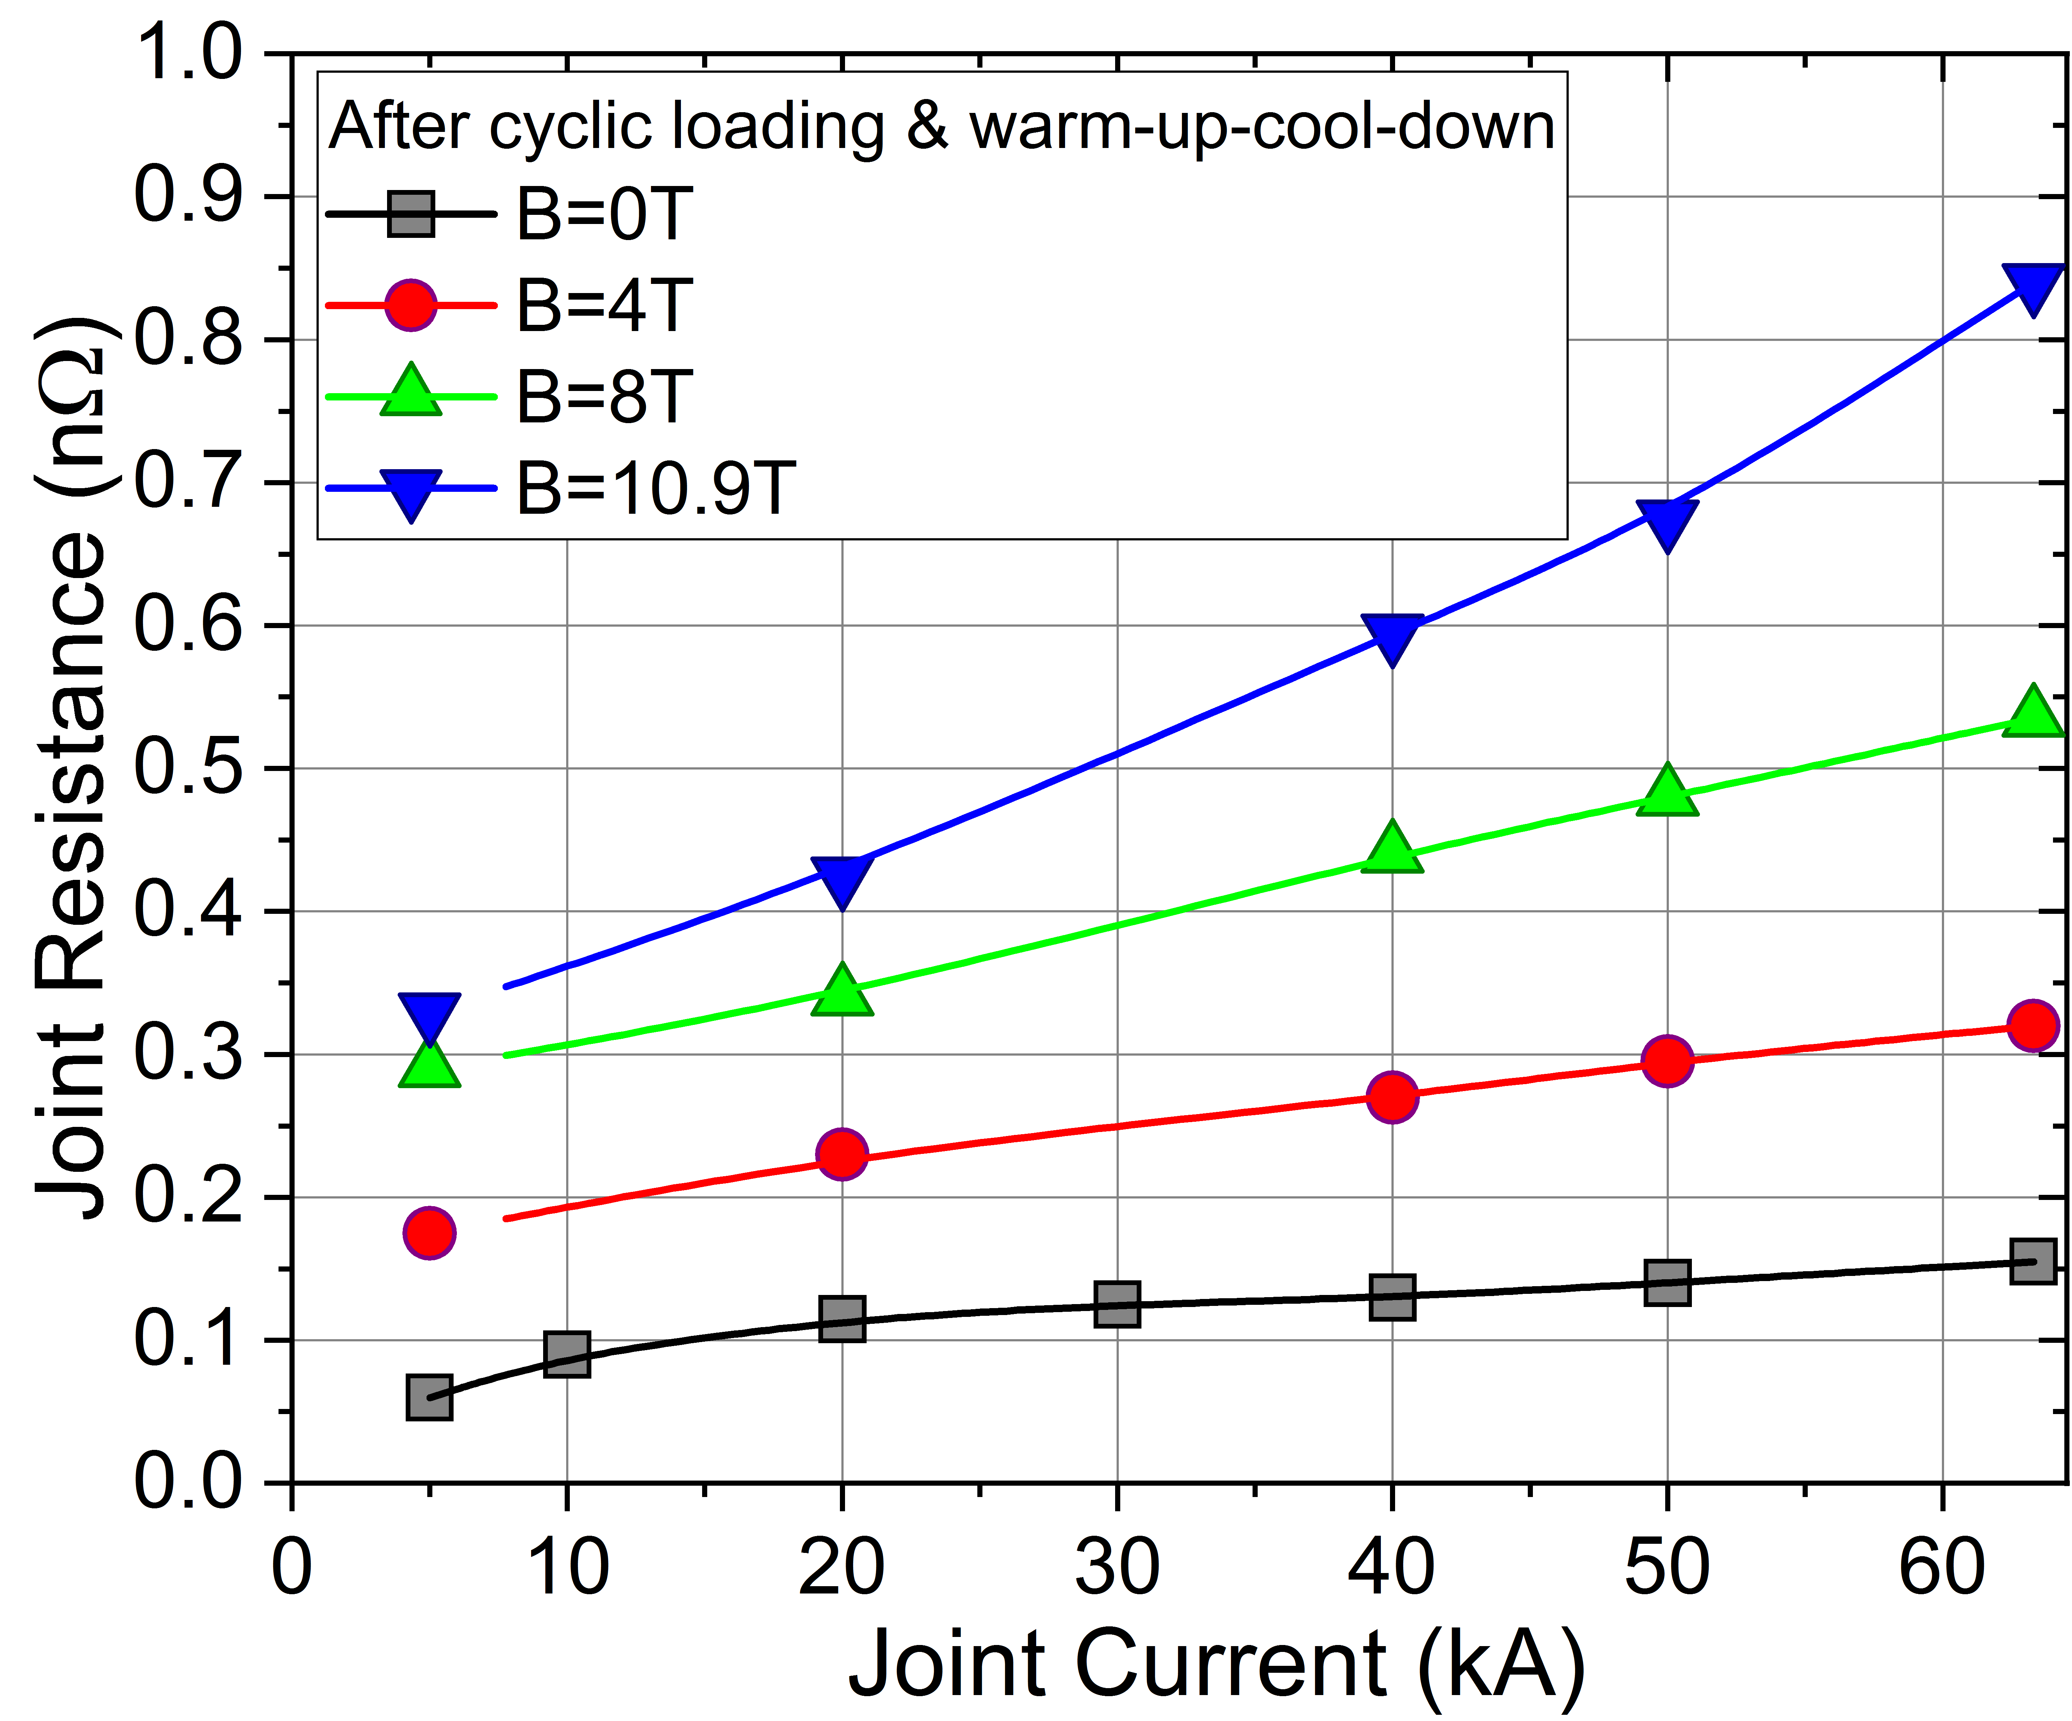
RW Diffusion-Bonded Joint
In operating conditions :
R at 8 T, 63.3 kA = 0.54 nΩ
(Target: 1.0 nΩ)
Diffusion-bonding (DB) of two overlapping RW conductors. The bonding is done after the Nb₃Sn heat treatment.

Slide 21
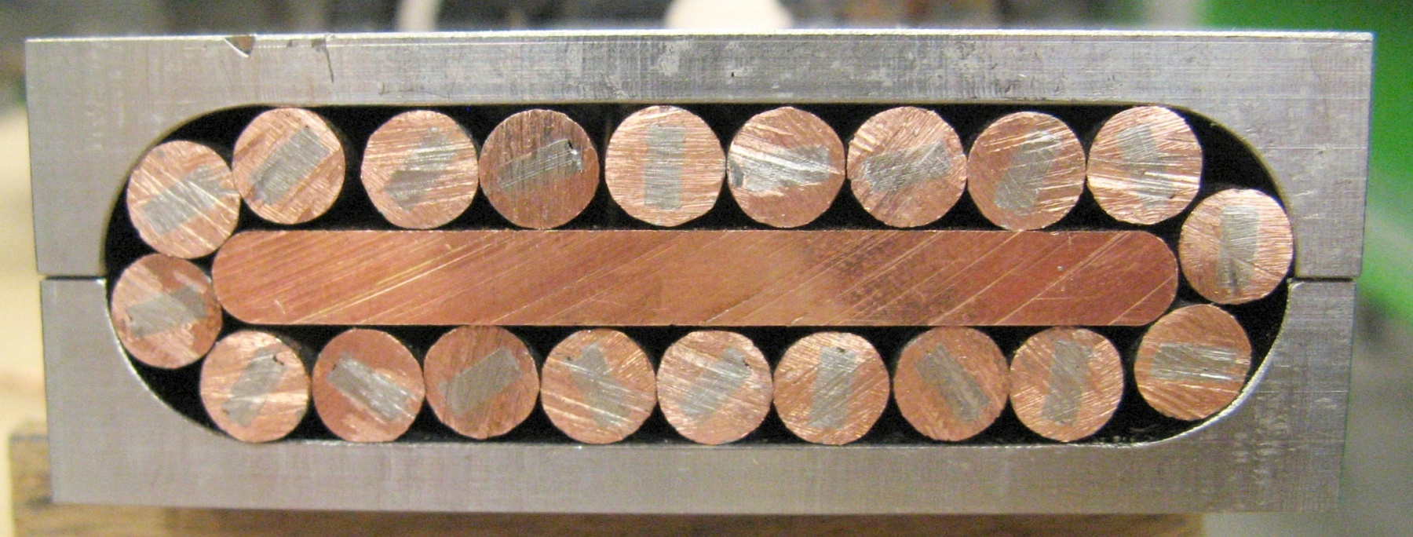
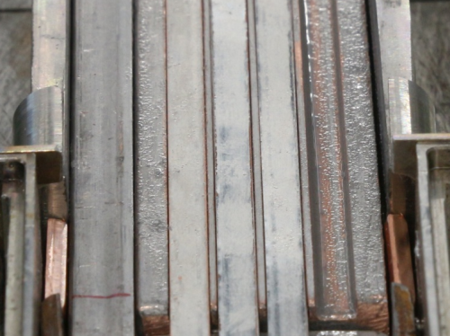
R&D on HTS Conductors
  NTNT – Non-Twisted Non-Transposed conductor, 2024
  SPC: 60 kA, B⊥12.5 T, 7.8 K, 2016
  The SPC conductor is transposed, scalable to 50-100 kA, designed for B⊥ > 12 T, AC tolerant, force flow.
  (Nikolay Bykovskiy)
He
  (Davide Uglietti)
Three stacks in the Cu profiles
Notes:
Other conductor designs, e.g. Röbel based cables and CORC are still far from the threshold of 50kA / 12T

Slide 22
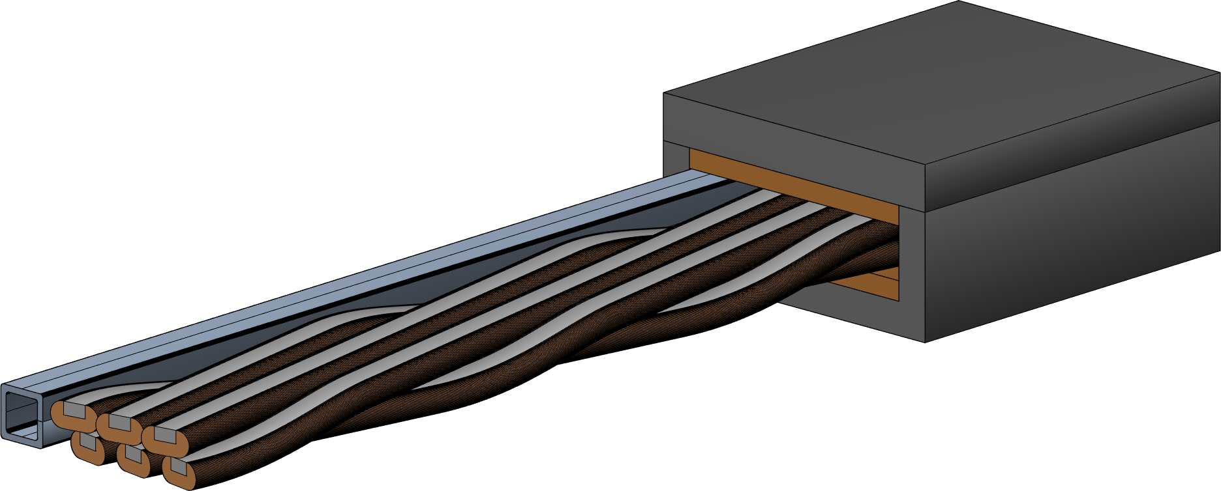
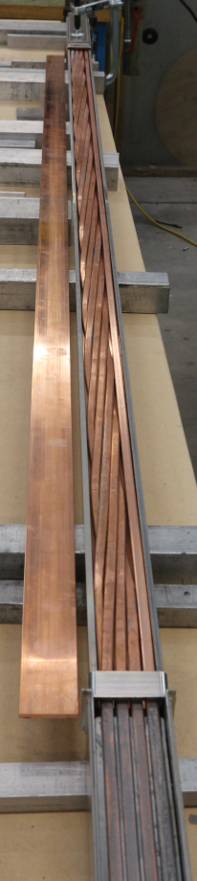
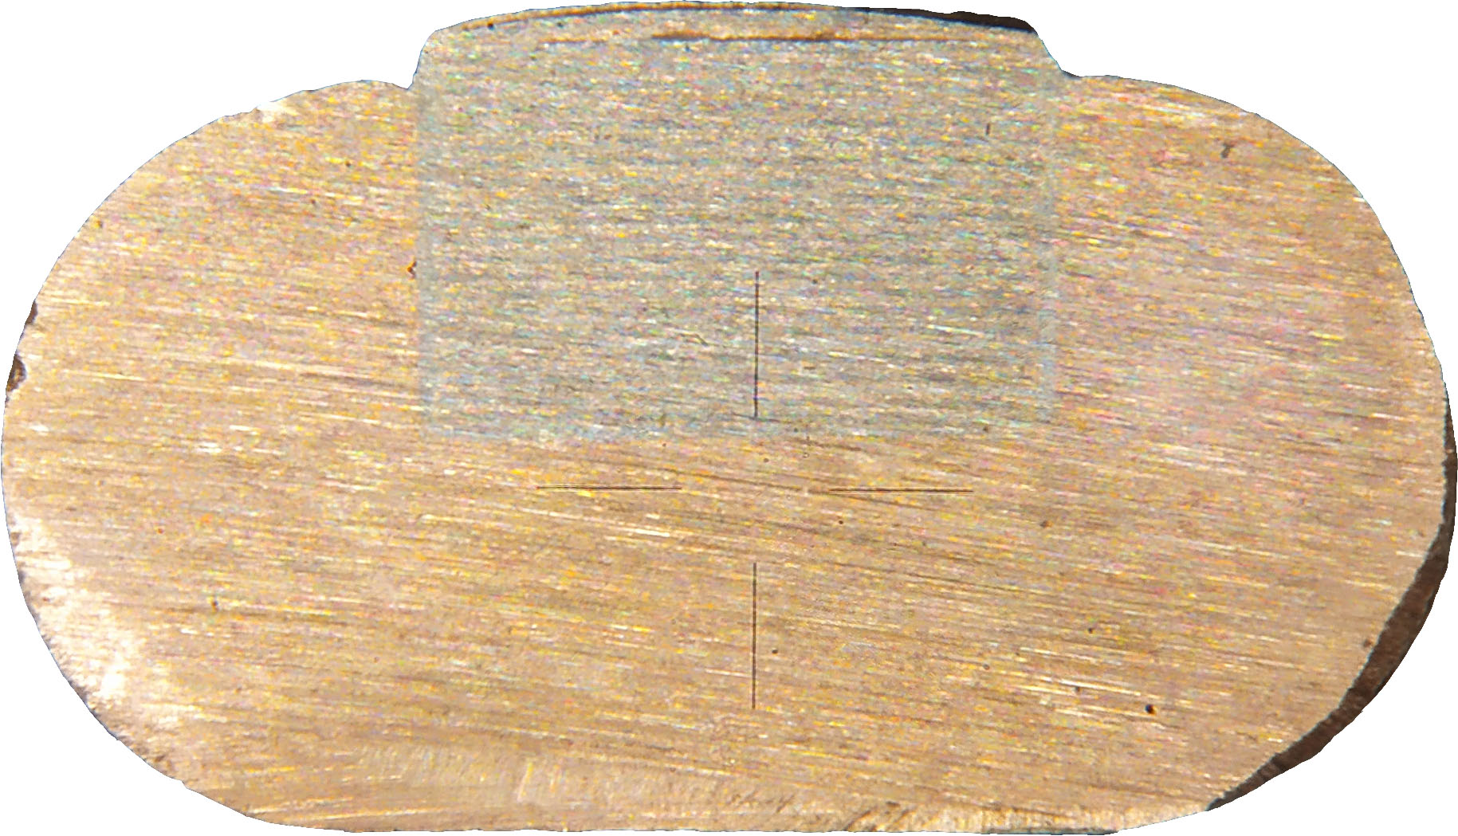
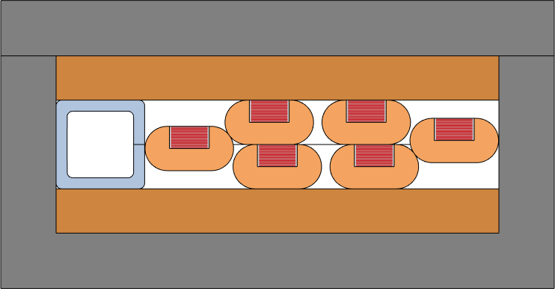
ASTRA prototype construction & testing
3.3 mm tapes
21 tapes in a stack
8 x 4 mm copper profile
50 mm
Designed for 60 kA at 18 T
Impregnation with dimethyl sulfoxide (DMSO) – water solution
26 mm
  Nikolay Bykovskiy, SPC, 2023

Slide 23
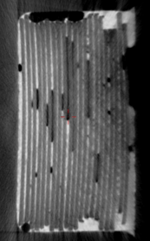
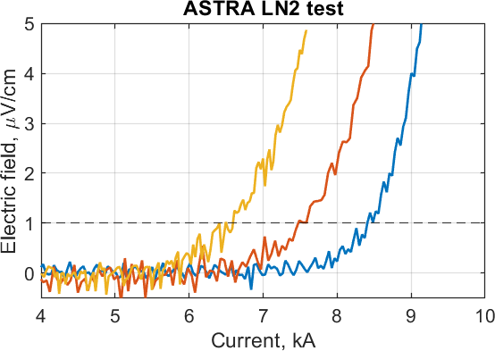
ASTRA full-size conductor 2023
Impregnated by DMSO 12%
Performance degradation of the ASTRA conductor, likely due to voids in the solder in between the tapes.
Overall observation for HTS samples tested in SULTAN from all the world:
Conductors are usually very stable against quench (as expected).
Making the terminations (joints) with low resistance is challenging.
Almost always there is a performance degradation with electromagnetic cycling. So far only Viper cable from CFS showed only negligible degradation. Other conductors degraded significantly.

Slide 24
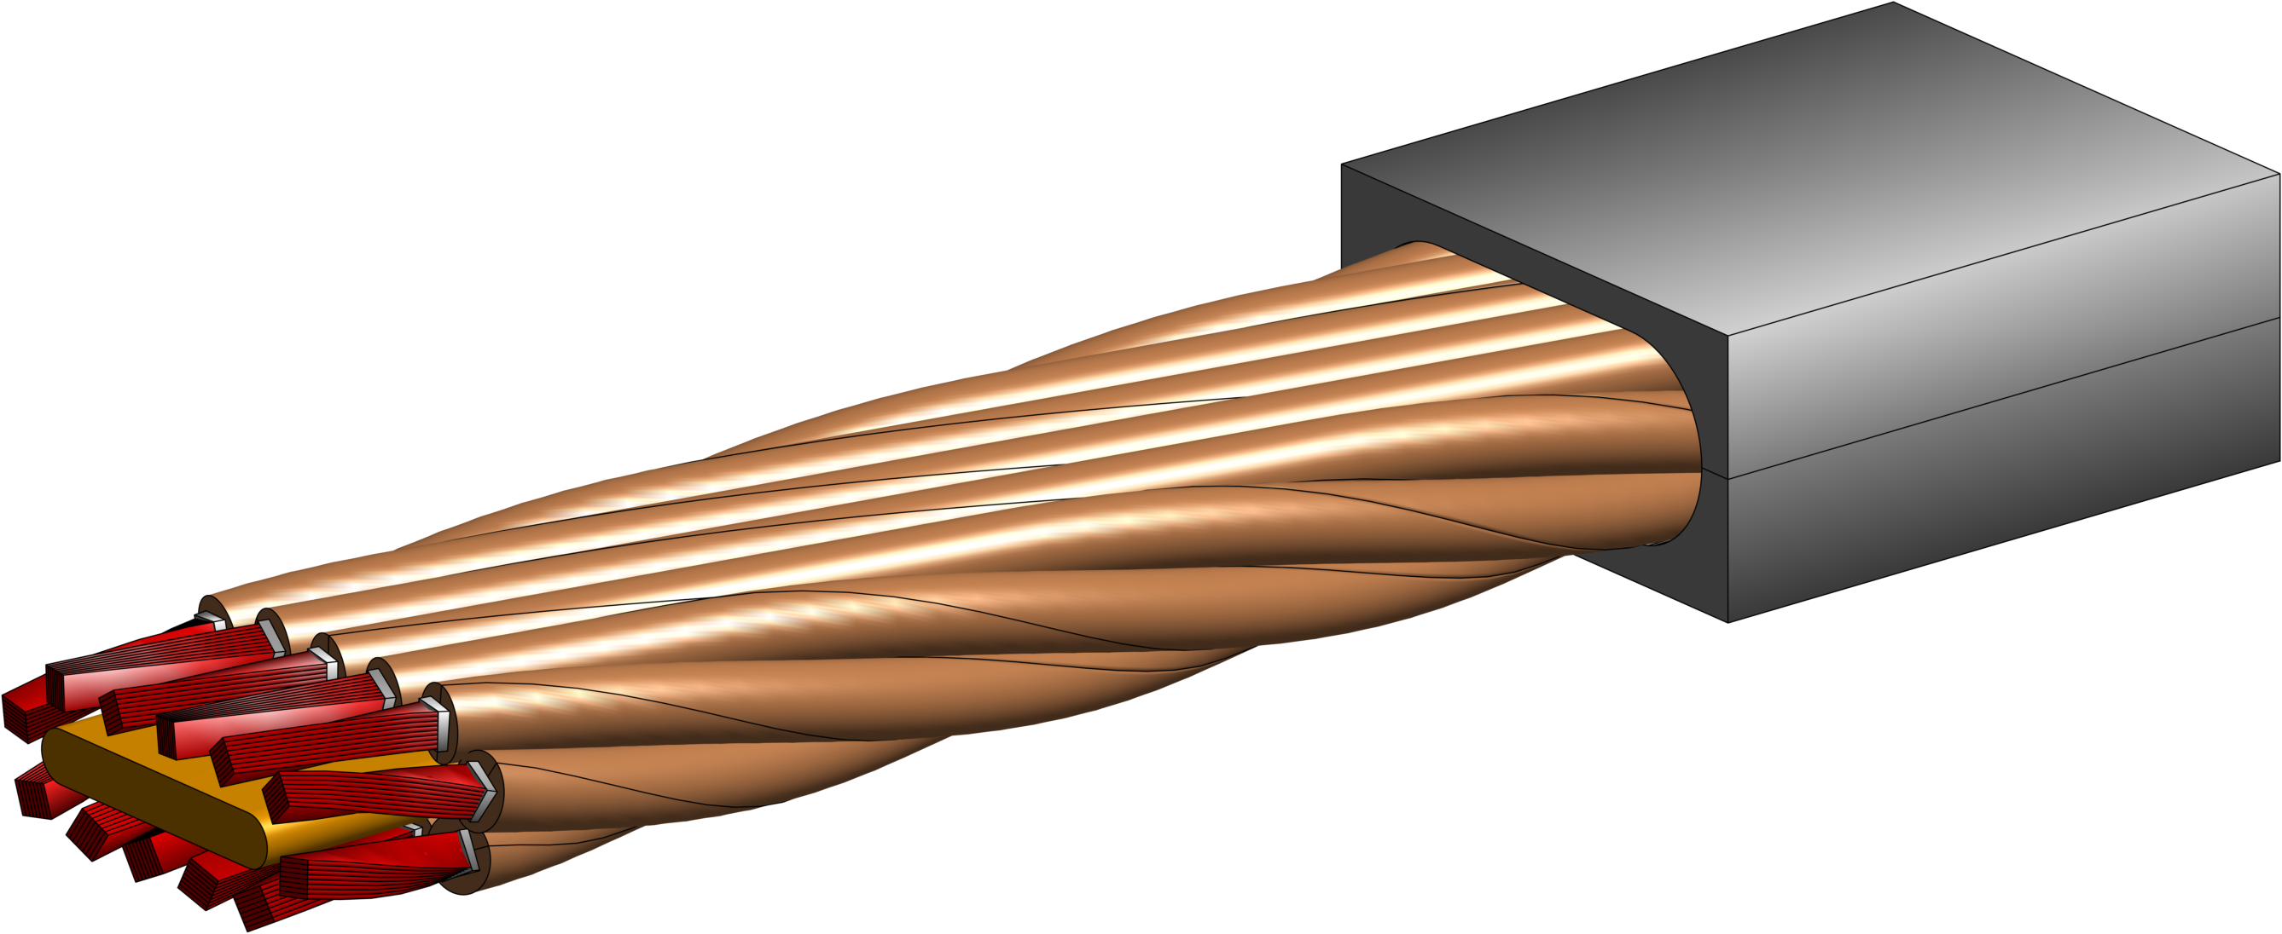
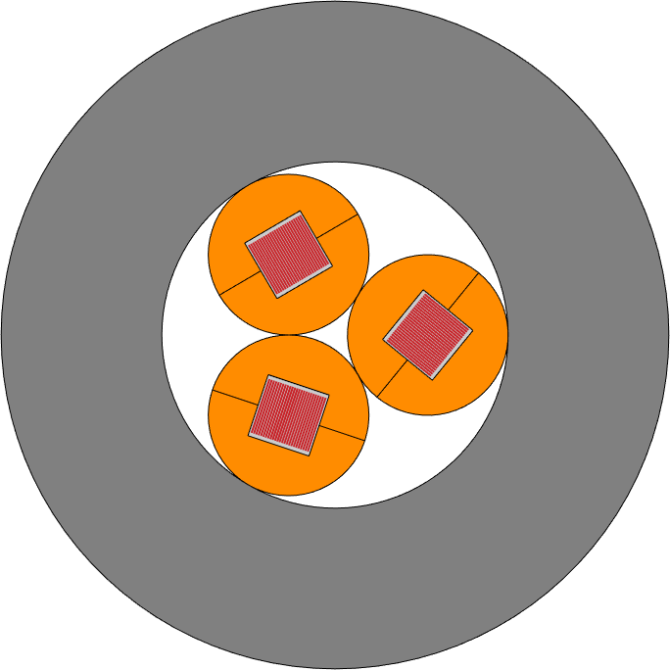
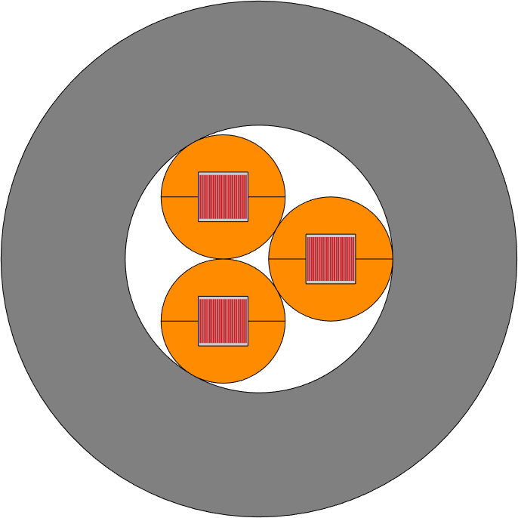
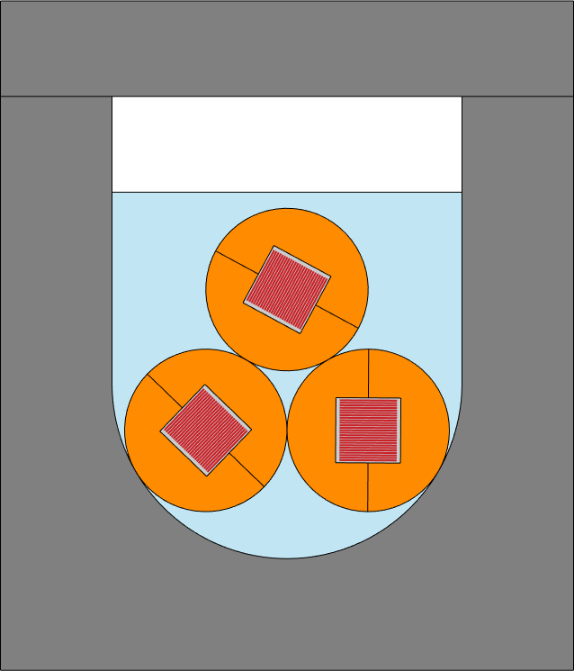
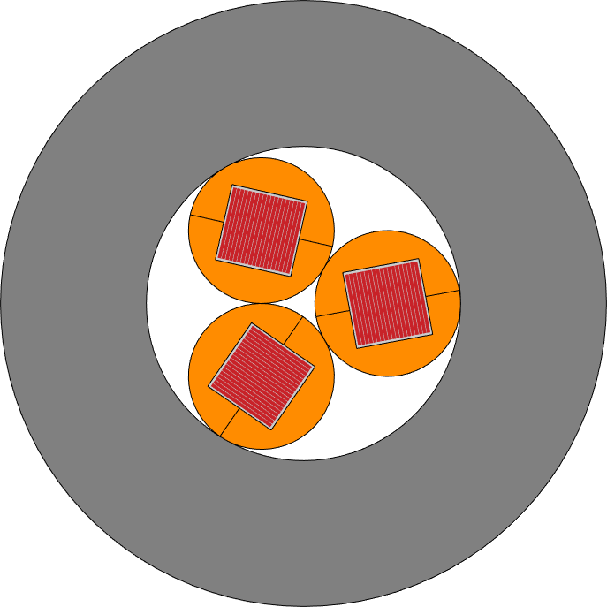
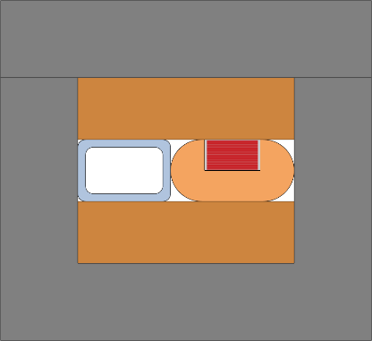
SPC Quench Samples
Round soldered strands in copper-cored Rutherford layout
Aligned stacks transposed in Roebel arrangement (ASTRA)
Full-scale layout:
Ref
No-twist
Filled
BISCCO
ASTRA
ASTRA2
D36 mm
D36 mm
D36 mm
Sub-size samples:
35 mm
22 mm
24 mm
30 mm
Features:
twisted stacks & strands
straight stacks & strands, perp. field
twisted stacks & strands, solder filled
twisted stacks & strands
straight stack & strand,
parr. field, indirect cooling
We reached T_{hot-spot} around 200 K (sometimes leading to the conductor degradation)
Quench Propagation Velocity (QPV) in HTS samples is 10-100 mm/s (it confirms QPV_{HTS}<< QPV_{LTS} ~500-1000 mm/s)
Enhancing the thermal coupling between the cable and steel jacket is found to be important to avoid overheating, even though it decreases the QPV.

Slide 25
Final Comments
SULTAN and EDIPO test facilities are key elements of applied superconductivity group of SPC.
We try to keep them up-to-date with maintenance, small updates and large upgrades.
  EDIPO upgrade to 15 T: 2025-2028
  Cryoplant upgrade to reduce electricity consumption: 5 months, starting towards the end of 2025.
The second largest activity is R&D on conductors & joints for fusion-size magnets, and related technologies (quench detection using optical fibers and SQD, superconducting switches, …)

Slide 26
Guided Tour PSI & SPC

Slide 27

Guided Tour Through PSI & SPC Labs
We will visit 4 stations at PSI:
SULTAN with Jack Greenwood and Mattia Ortino
Test stand WNLA/010 with Michal Duda and Quentin Gorit
Magnetic Measurement (MM) lab with Giuseppe Montenero and Rebecca Riccioli
CHART lab with Douglas Araujo Martins and Jaap Kosse
For the visit, we will split into 4 groups. Every group will visit every station.
Please inform your guides, if you have a heart implant. In this case you are not allowed to enter MM lab.
Notes:
Nicht aktualisiert

Slide 28
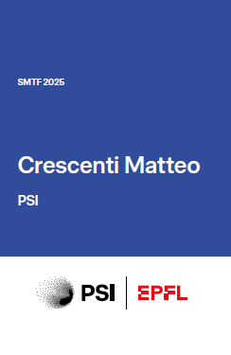
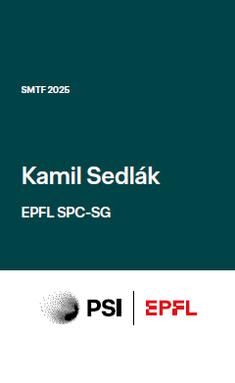
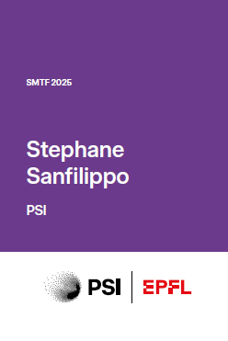
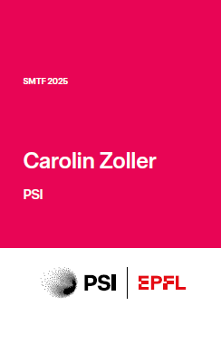
The Guides
Every group has a guide. The colour of your workshop badge will tell you to which group you belong.
Joep Leon
Van den Eijnden
Notes:
Nicht aktualisiert

Slide 29
Time Schedule of the Tours
14:20-14:45 Coffee Break in foyer Auditorium: Pick up your entrance badge and your headset in the foyer and check that it is working.
14:45 Go to your group guide
14:50 Walk to the first station
15:05-15:35 Station 1
15:45-16:15 Station 2
16:20-16:30 Break Water and Toilets
16:35-17:05 Station 3
17:15-17:45 Station 4
17:55 Bus stop PSI West return PSI Badge_Headset_Dosimeter to your guide
18:00 Bus transfer to Gala Dinner in Eglisau

