Slide 1
Cryogenic Tests of Electronic Components and Sensors for Superconducting Magnet Instrumentation
Vincenzo Di Capua, Lucio Fiscarelli, Unai Martinez, M. Buzio
03/04/2025

Slide 2
Table of contents
  Quench localization methods
  Electronics for quench localization
  Needs
  Limitations
  Embedded electronics
  Cryogenic electronics
  Test plan and setup
  First application
  Future perspectives
  Conclusions
Motivation
Proposal

Slide 3
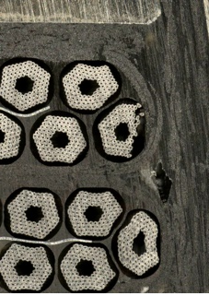
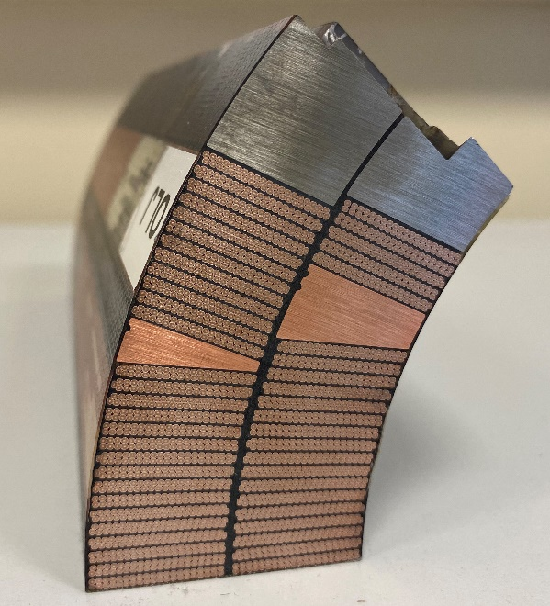
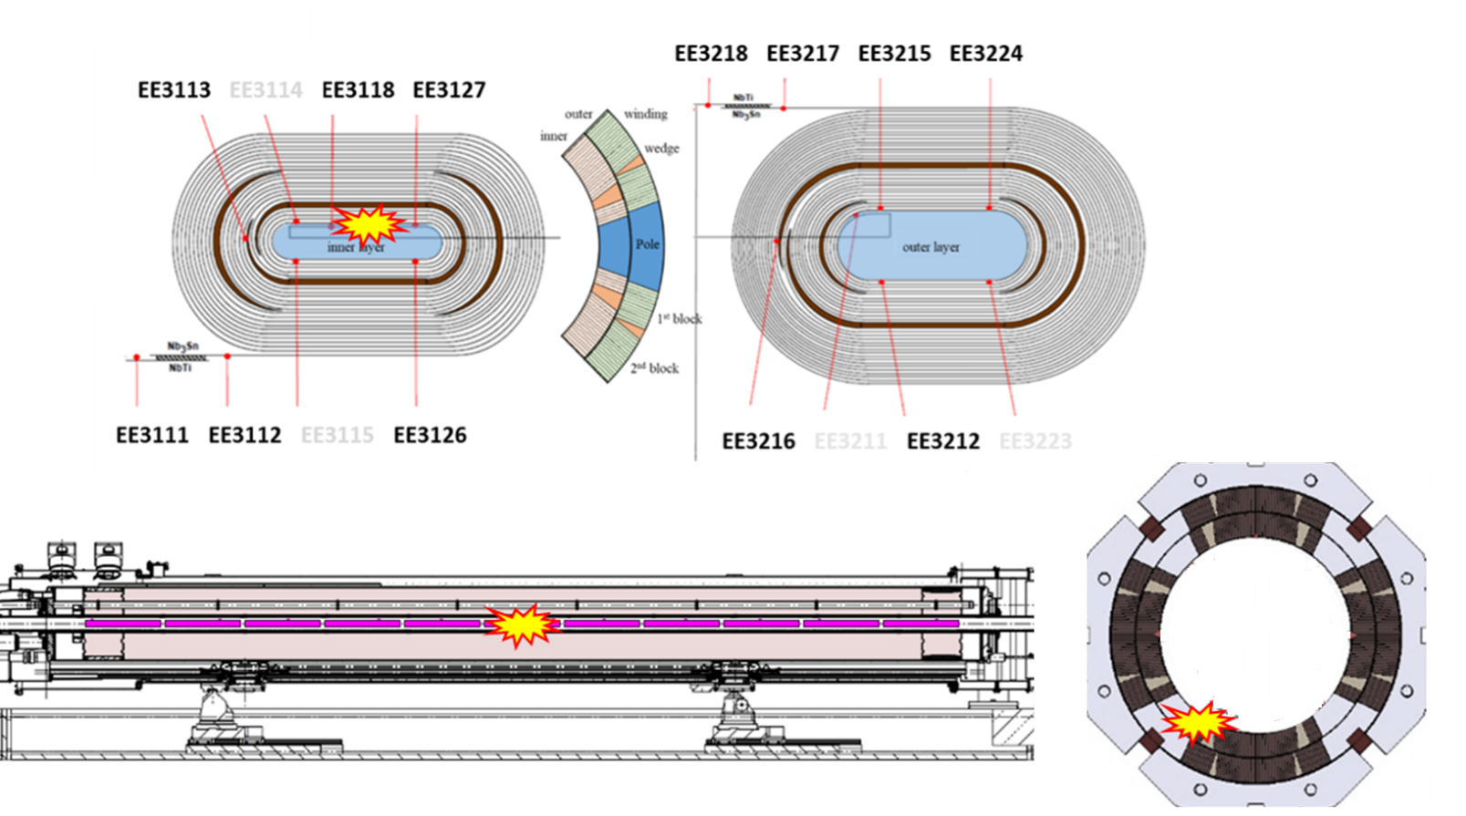
Quench localization
  Identifying the starting location of a quench during superconducting magnets training is critical:
    To identify defects.
    To drive the design and the manufacturing.
    For protection systems.

Slide 4
Quench localization methods
Electrical
    Passive: voltage taps to monitor the resistance.
    Active: AC signals to measure impedance, reflectometry, or stray capacitances measurements.
Magnetic
    Array of induction coils.
    Array of Hall sensors.
Mechanical
    Acoustic emission sensors.
Thermal
    Fiber-optic based sensors.
Voltage taps and induction coils are widely used for LTS magnets.
All others are considered promising for HTS magnets.

Slide 5
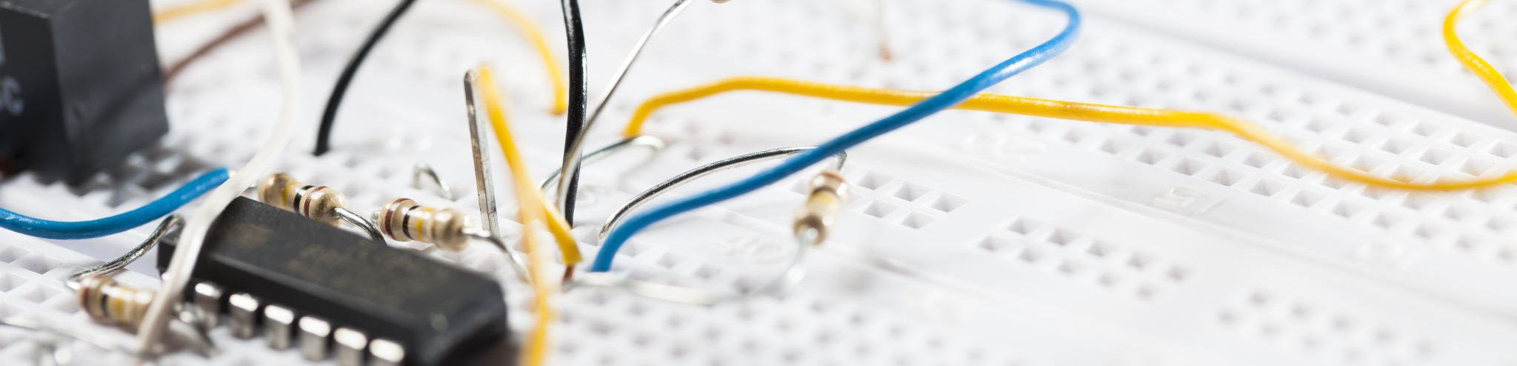
Electronics for quench localization
  Needs
  Acquire a large number (>40) of signals.
  Signal conditioning (mV or uV range).
  High sample rate (>50 kHz).
Limitations
The number of signals.
Signal integrity.
Environmental noise.

Slide 6
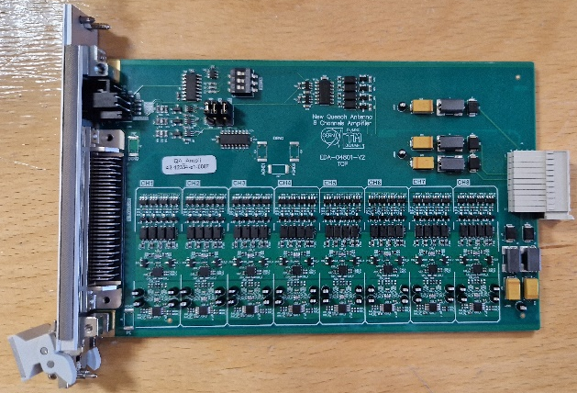
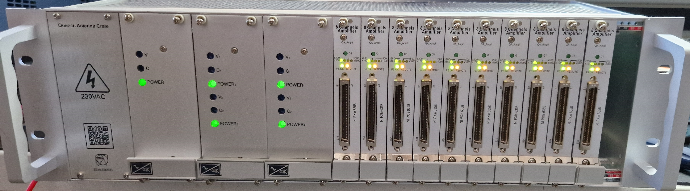
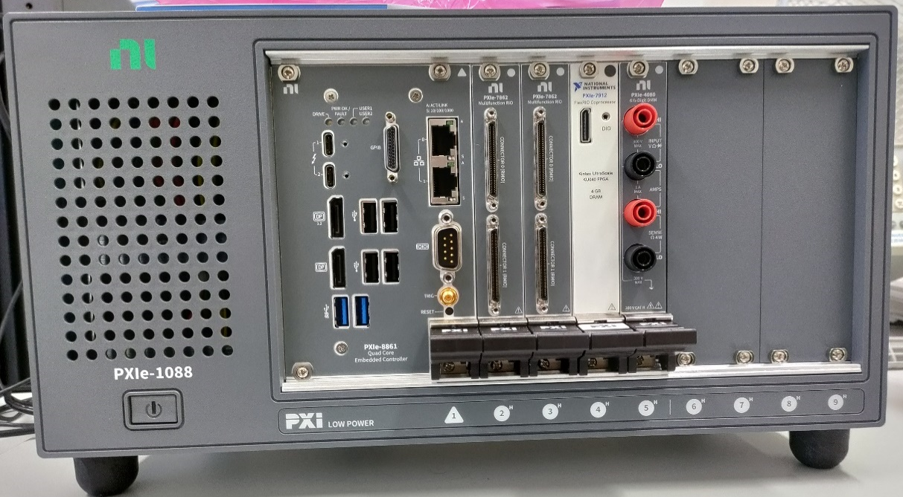
Needs
  Acquire a large number (>40) of signals.
    Internal: V taps, current.
    External: Quench antenna, induction coils, Hall probes.
  Signal conditioning (mV or uV range).
    Multi-stage amplifiers to increase the SNR.
    Isolation.
    Antialiasing filtering.
  High sample rate (>50 kHz).
    To capture the full dynamic of the acquired signals.
    Study the quench propagation.
Custom design of amplifier cards and crates for Quench Antenna.
Commercial acquisition system with real-time processing (FPGA).

Slide 7
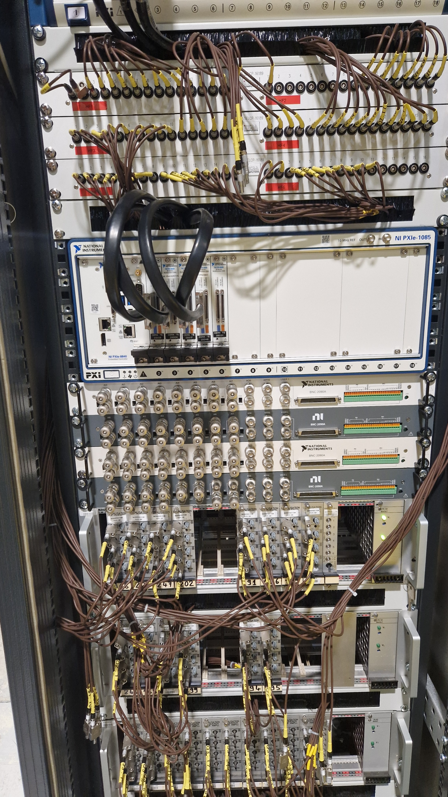
Limitations
The number of signals.
  Number of signals that are possible to be extracted from the cryostat.
  Acquisition channels.
Signal integrity.
  Due to several interconnections.
Environmental noise.
  Captured by sensors and cables.
Measurement hall (300 K)
ADC1
Cryostat (300/4.5/1.9 K)
Amplifier chassis
sensor
ADC2
Quench Antenna conditioning and acquisition rack.

Slide 8
Embedded detection and conditioning electronics
  One approach possible to mitigate most of these limitations would be to embed the whole acquisition chain into the sensors and/or into the cryostat:
    Signal conditioning:
      Shorter distances.
      Fewer interconnections.
    Digitalization:
      Reduced impact of external electromagnetic disturbances.
      We need to extract only a few digital signals.
Measurement hall (300 K)
ADC1
Cryostat (300/4.5/1.9 K)
Amplifiers chassis
sensor
ADC2
Cryostat (300/4.5/1.9 K)
(300 K)
conditioning
sensor
ADC
Digital readout

Slide 9
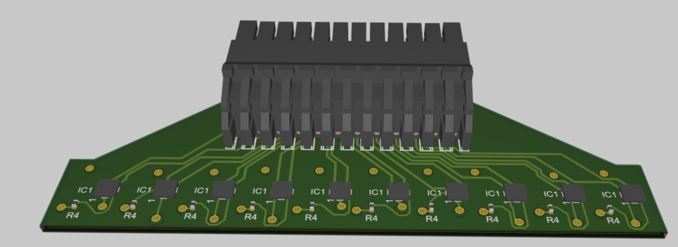
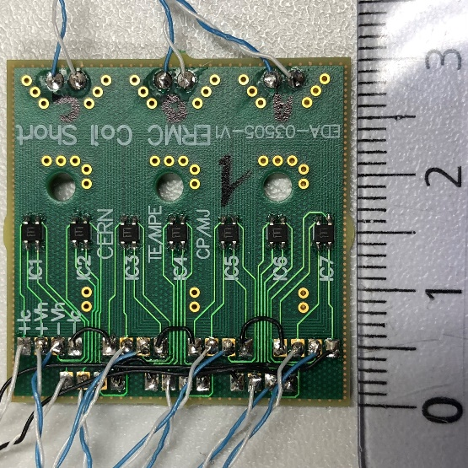
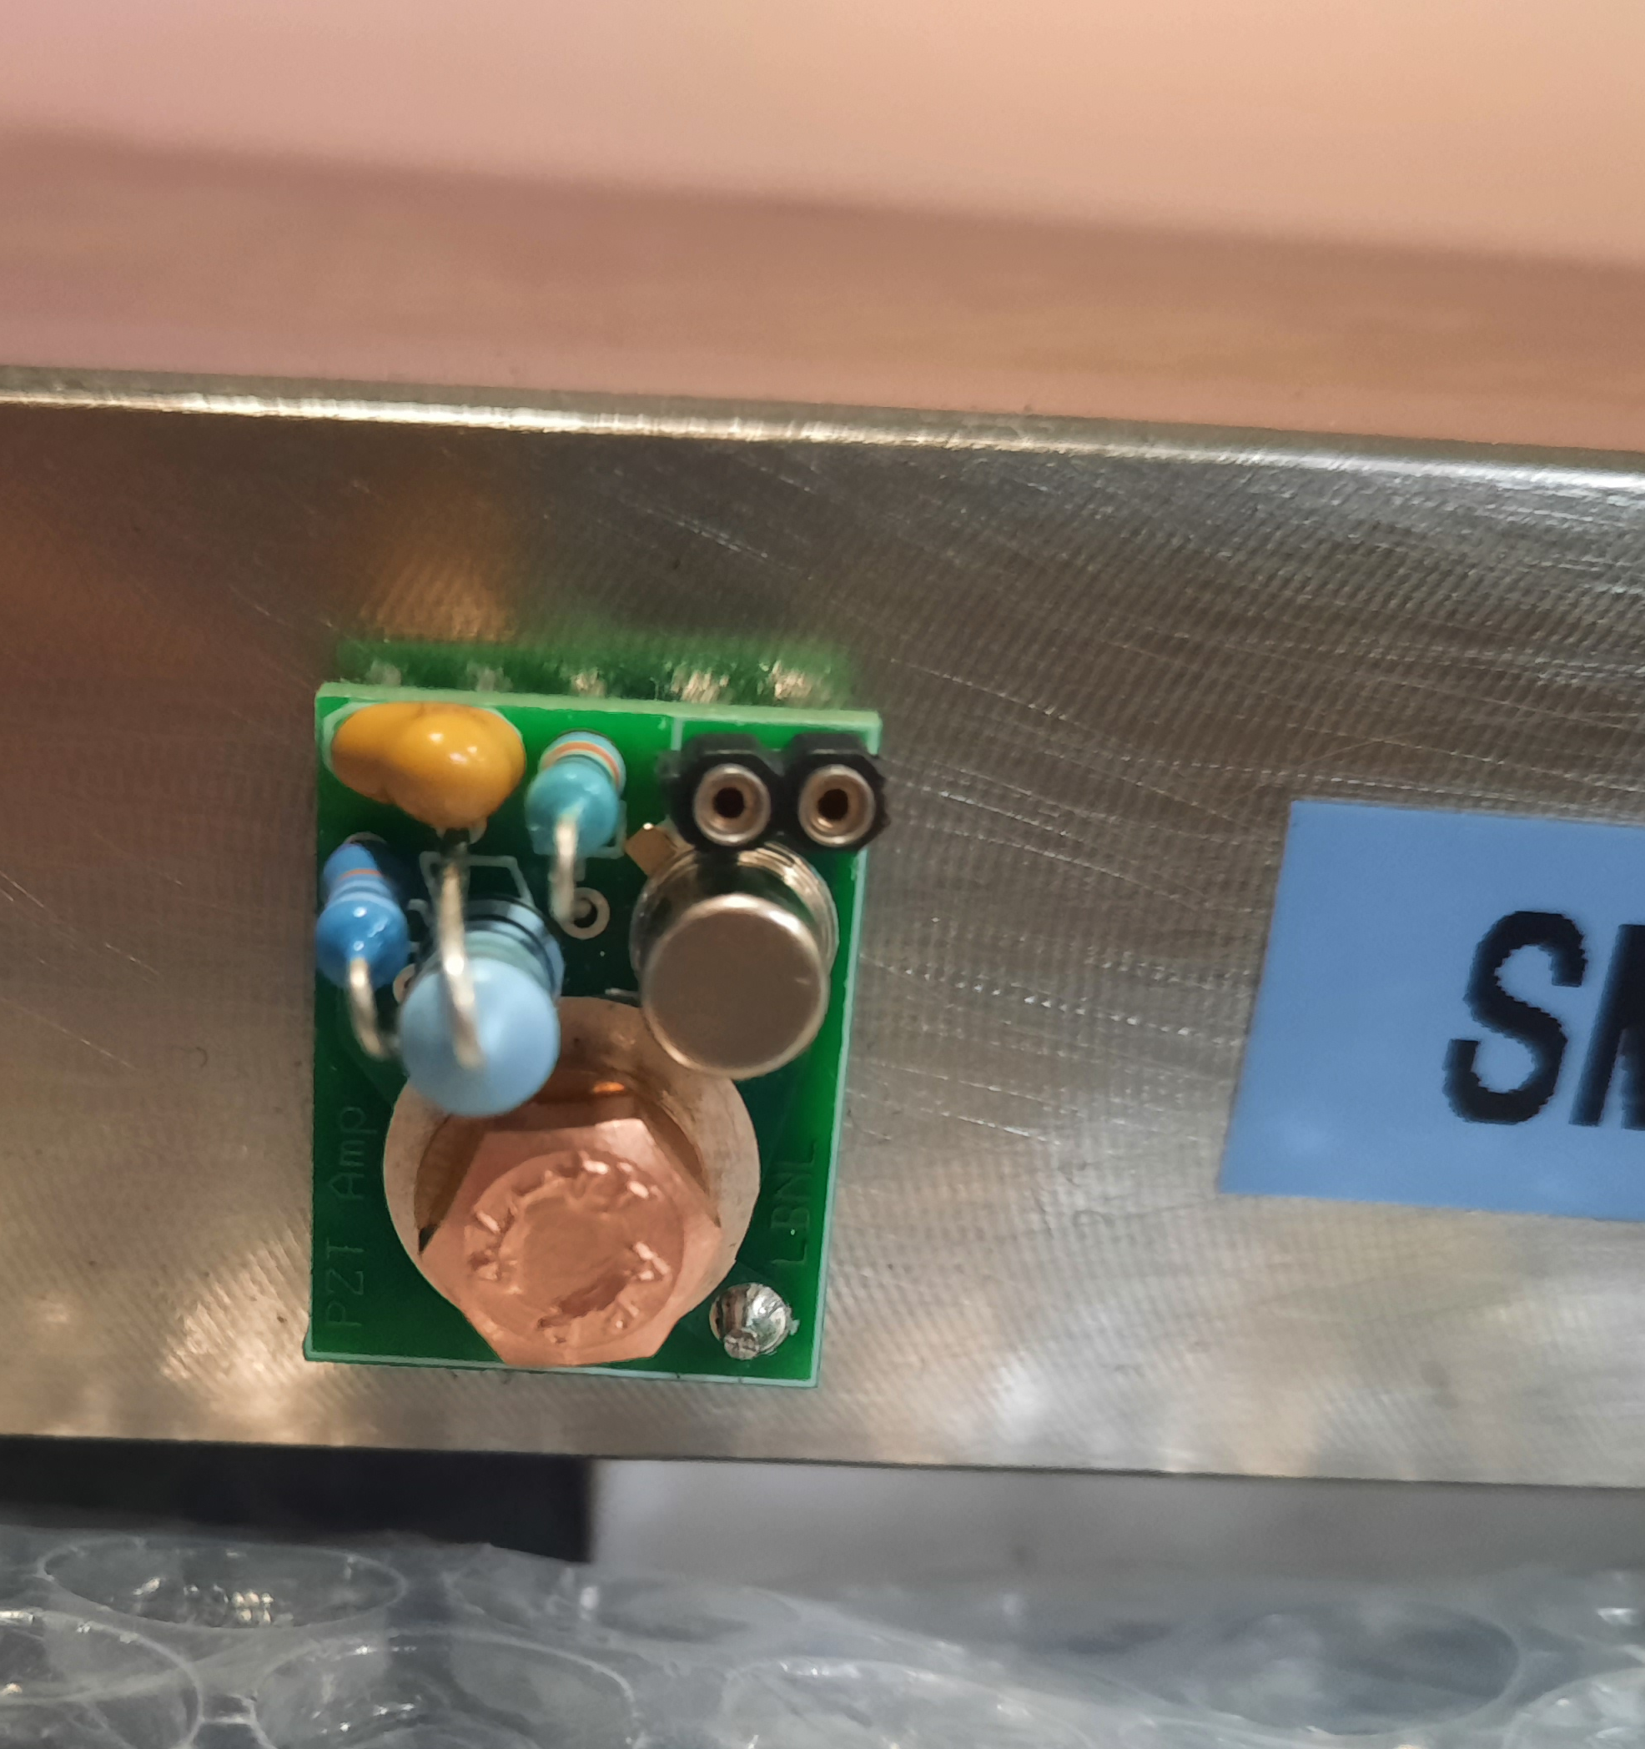
Cryogenic electronics
  A crucial aspect to be investigated is to embed sensors and electronics in the superconducting magnets’ cryostats.
  A vast literature on using commercial microphones, Hall probes, and conditioning electronics at cryogenic temperatures (4.5 and 1.9 Keven if only in dry conditions)[1,2,3,4]
  Each component family and each manufacturer must be evaluated individually.
Hall probe array for cryogenic environments.
Hall probe sensors already in use on racetrack magnets (left) (credits: Carlo Petrone). Piezoelectric cryogenic sensor with embedded amplifier (right).
[1] Marchevsky, M. (2022). Understanding training in superconducting accelerator magnets using acoustic emission diagnostics. arXiv preprint arXiv:2203.08871.
[2] D. Conway Lamb, et All; An FPGA-based instrumentation platform for use at deep cryogenic temperatures. Rev. Sci. Instrum. 1 January 2016; 87 (1): 014701.
[3] Song, M., et All,(2018, March). Evaluation of commercial-off-the-shelf (COTS) electronics for extreme cold environments. In 2018 IEEE Aerospace Conference (pp. 1-12). IEEE.
[4] Valiente-Blanco, et All (2013). Characterization of commercial-off-the-shelf electronic components at cryogenic temperatures. Instruments and Experimental Techniques, 56, 665-671.

Slide 10
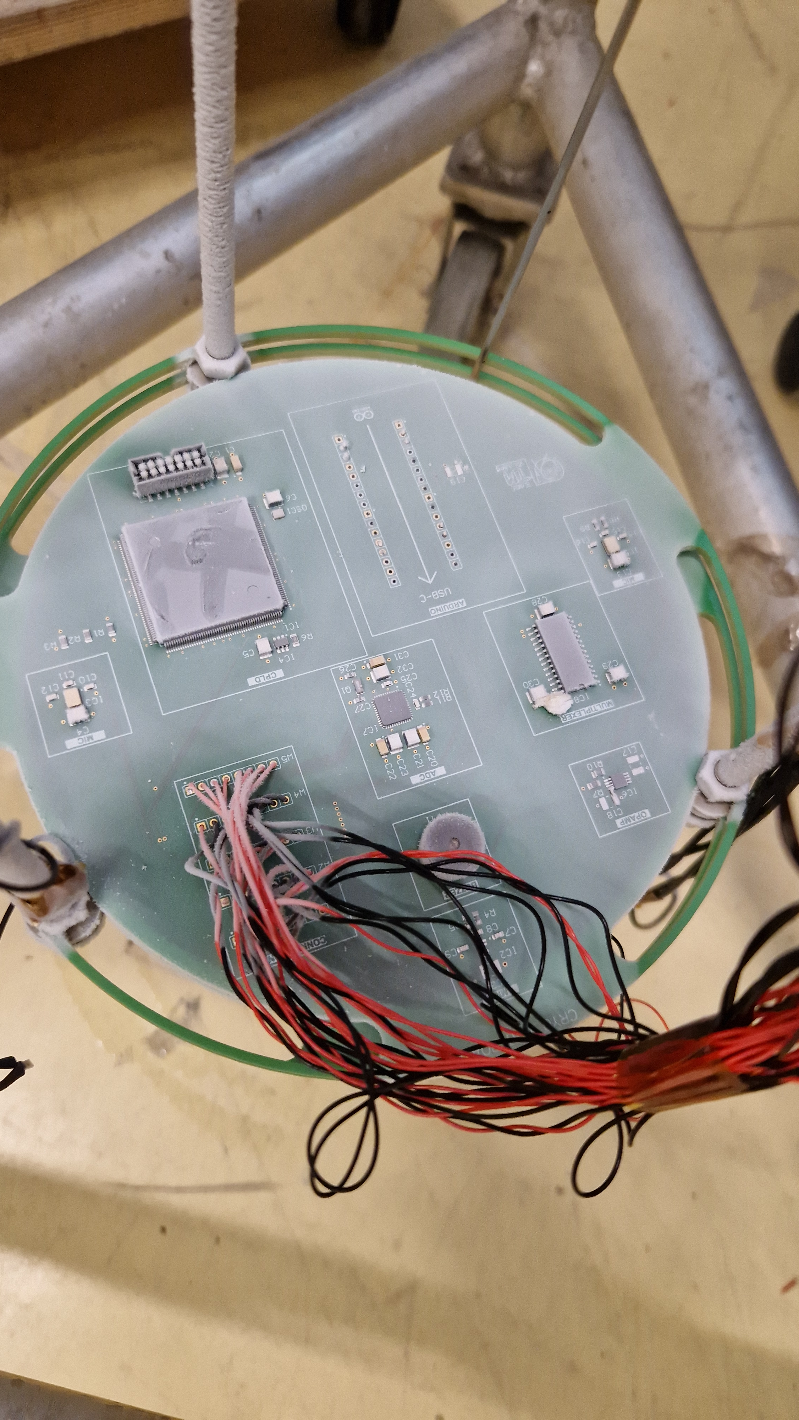
Evaluation board
  Custom PCB has been designed to host all the devices under test and provide a suitable interface for the signal cable and the 40 available feed-throughs.
  Test points have been added to simplify the debugging in case of faults.
  Form factor tailored for the test head.
  Standard industrial processes, FR4 dielectric, and ENIG surface finish.
PCB for 1st campaign of tests of sensor and electronic components at cryogenic temperature.
Cryogenic tests of electronic components and sensors for superconducting magnet instrumentation. M Buzio, V Di Capua, L Fiscarelli, UM Hernandez. Measurement: Sensors, 101436

Slide 11
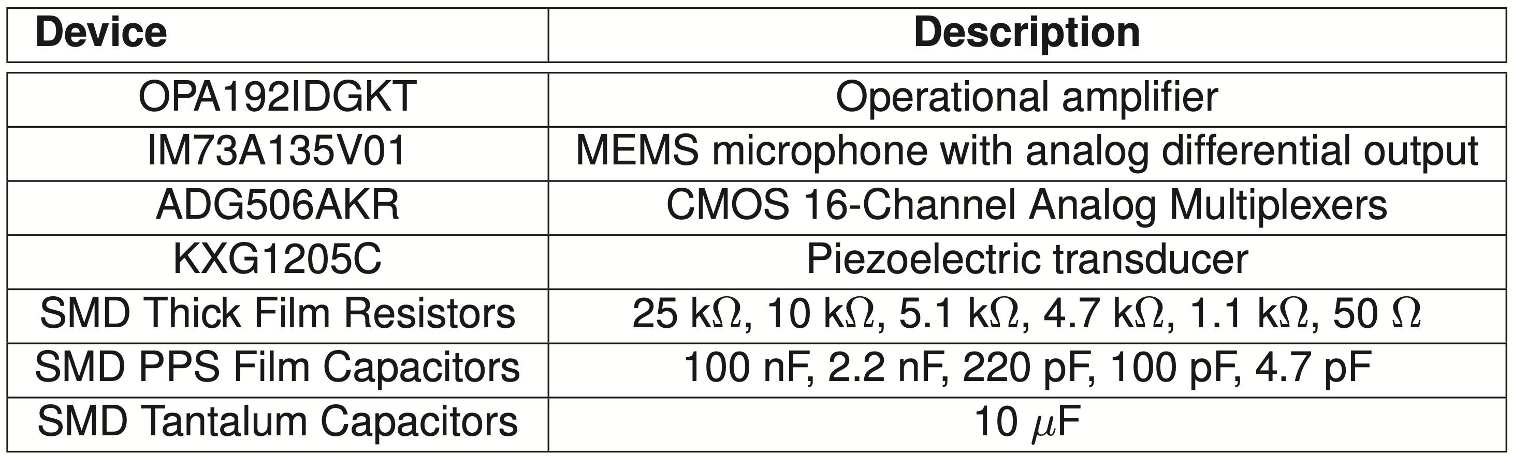
Selected components
  The components were selected with the final goal of building a complete acquisition chain.
    Components have been chosen by taking inspiration from the existing literature.
    The test of digital components (FPGA, MCUs) has been postponed to the next test campaign.

Slide 12
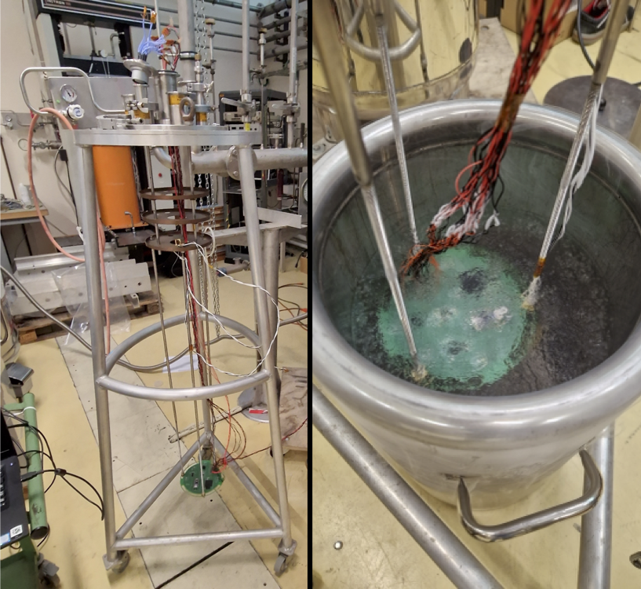
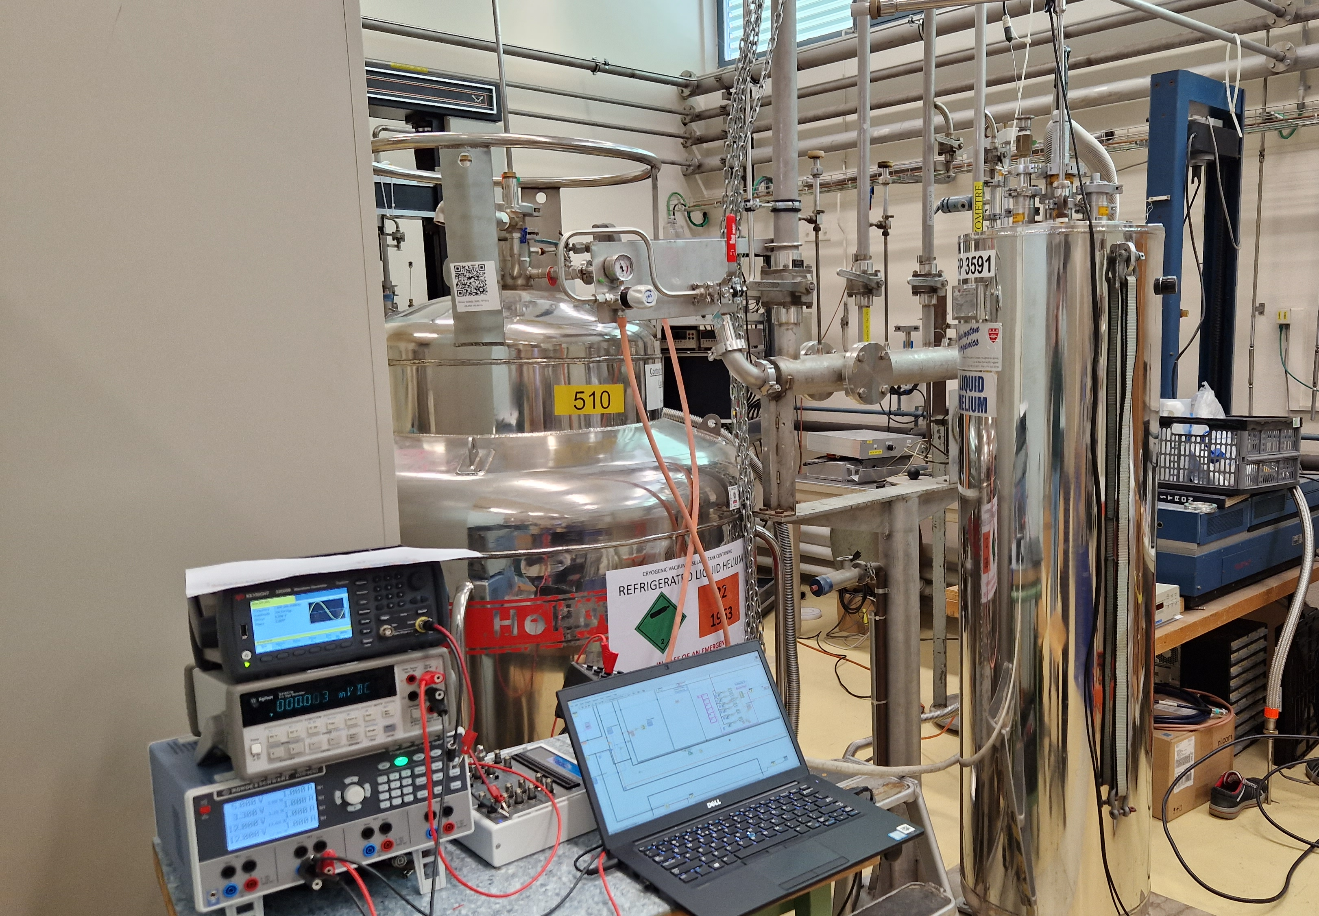
Test plan and setup
  All the selected components have been tested at :
    300 K (room temperature)
    77 K (liquid nitrogen)
    4.5 K (liquid helium)
    1.9 K (superfluid liquid helium)
  Each test has been repeated two times:
    Check for performance stability.
  After each test, the PCB has always been brought back to room temperature (thermal cycle).
Assembled test head (left), liquid nitrogen tests (right).
setup for the test in liquid Helium at 1.9 K.

Slide 13
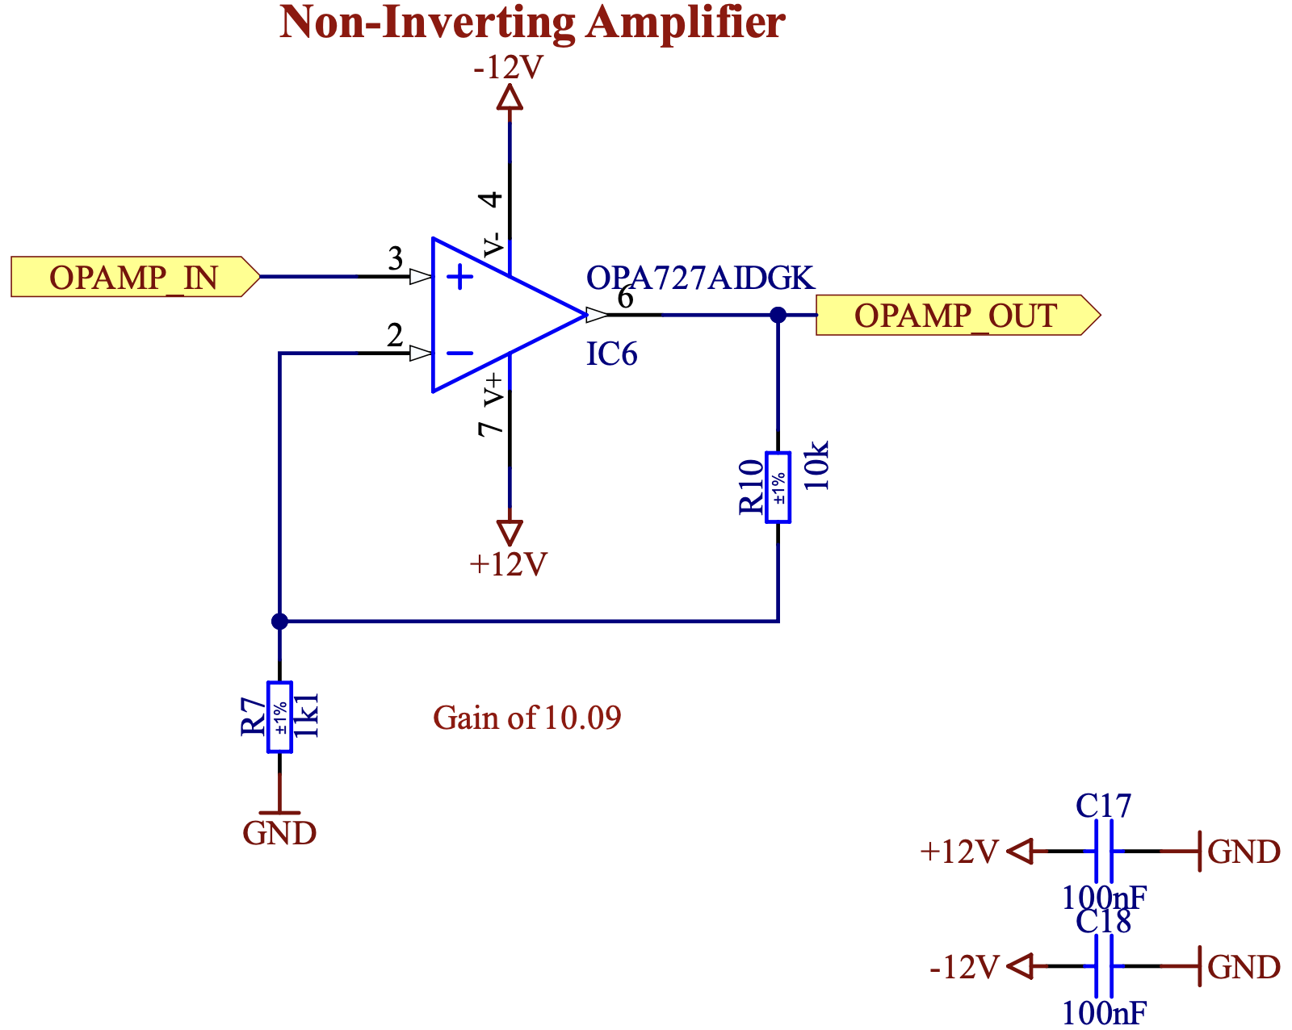
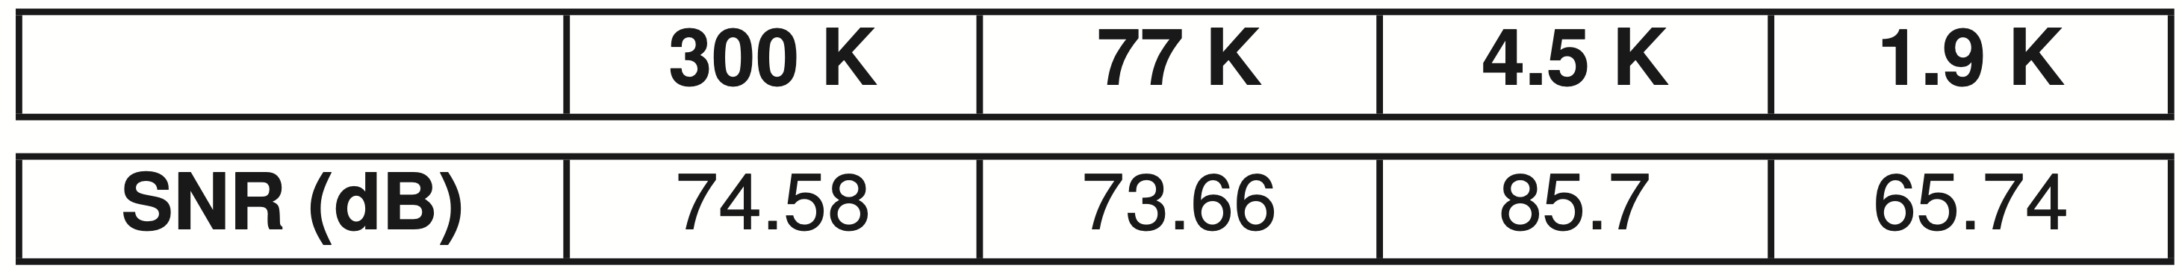
Operational Amplifier
  Configured in non-inverting mode.
  DC gain of 10.
  Test (SNR evaluation):
    1.1 V AC input at 100 Hz.
    output acquired at 50 kHz.
    Four parameters Sinfit.

Slide 14
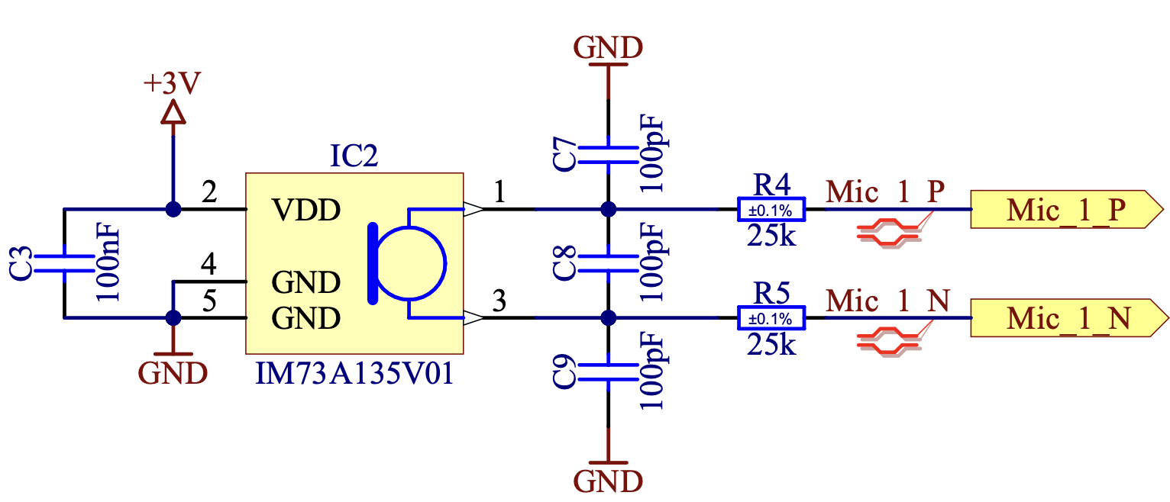
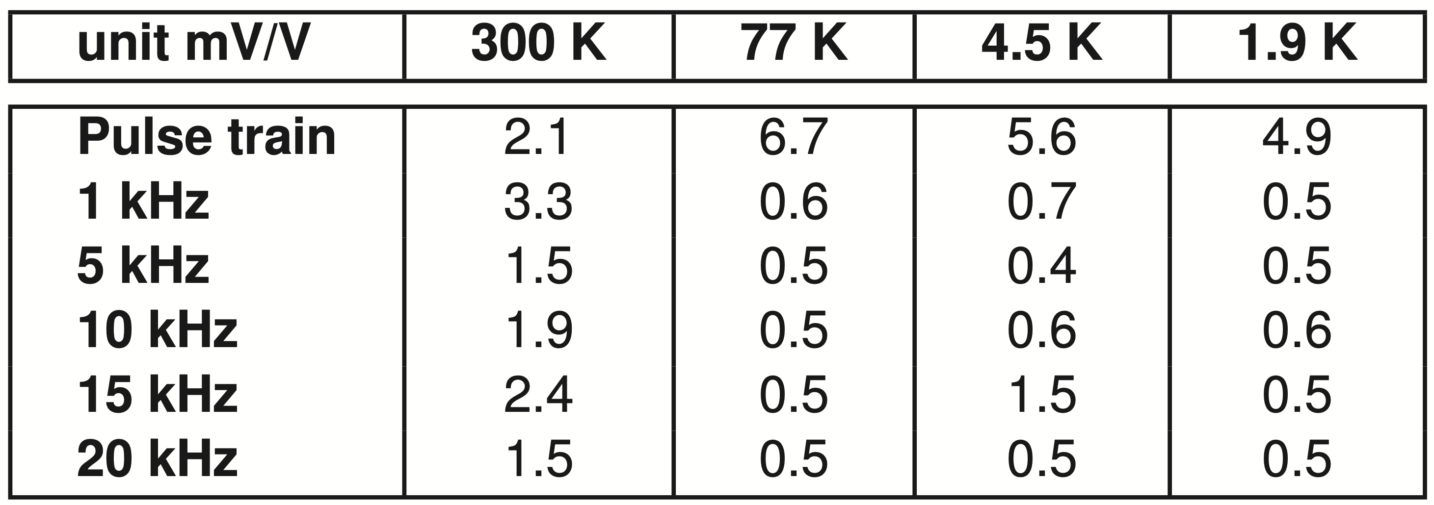
MEMS microphones
  Acoustic vibrations are provided by a piezoelectric transducer.
  Full bandwidth of the sensor tested.

Slide 15
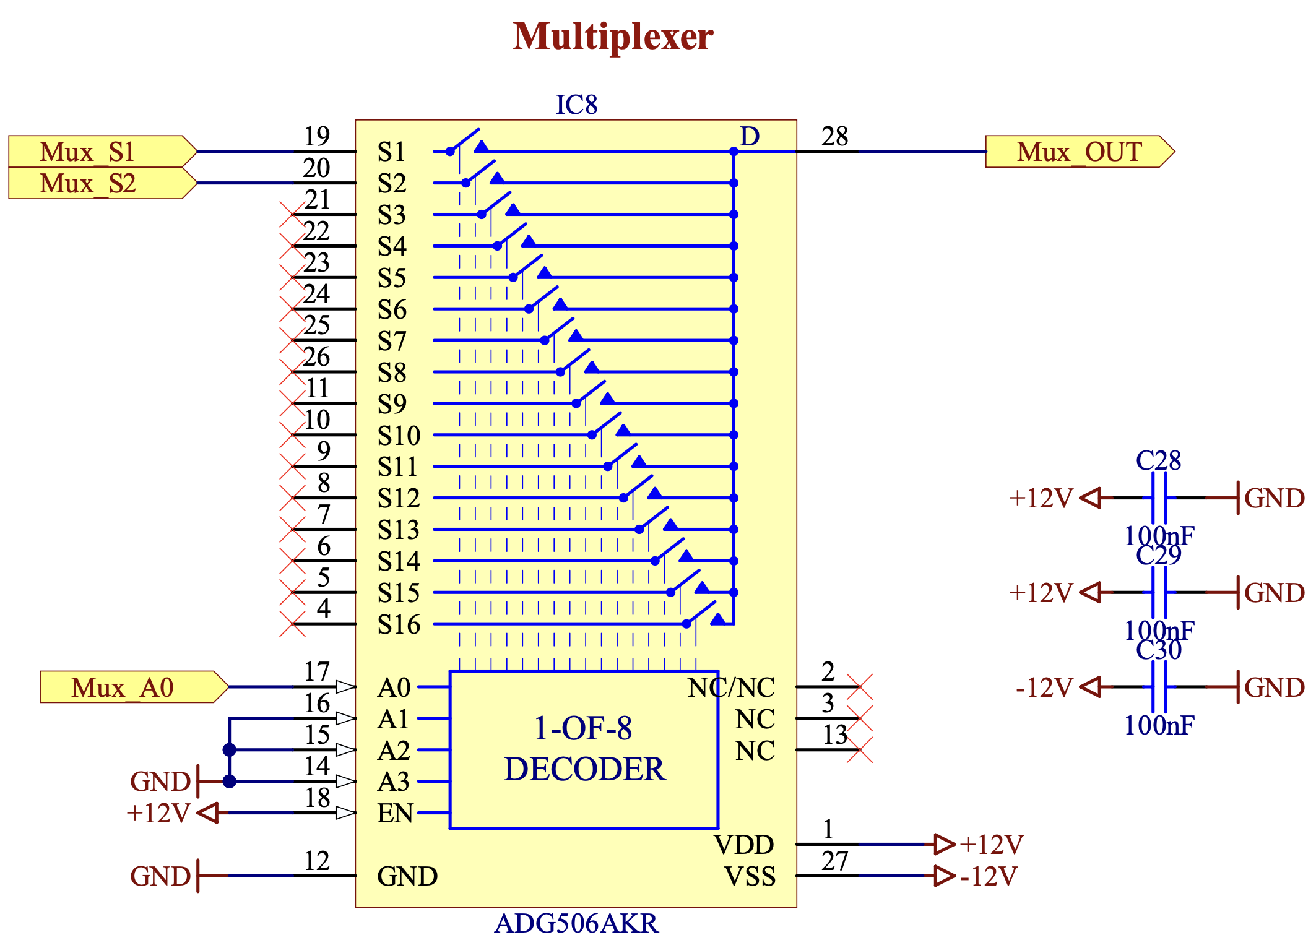
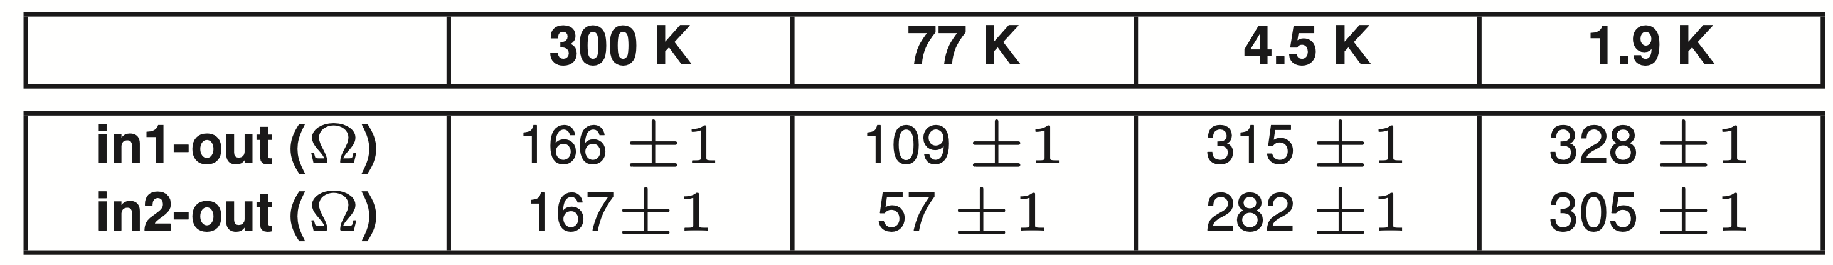
Multiplexer
  In-out resistance was evaluated for two of the inputs of the multiplexer.
    Liquid nitrogen performance comparable with room temperature.
    Increase in liquid helium by a factor of almost 2, with a negligible difference between 4.5 K and 1.9 K.
  Component suitable for multiplexing signals at cryogenic temperatures.

Slide 16
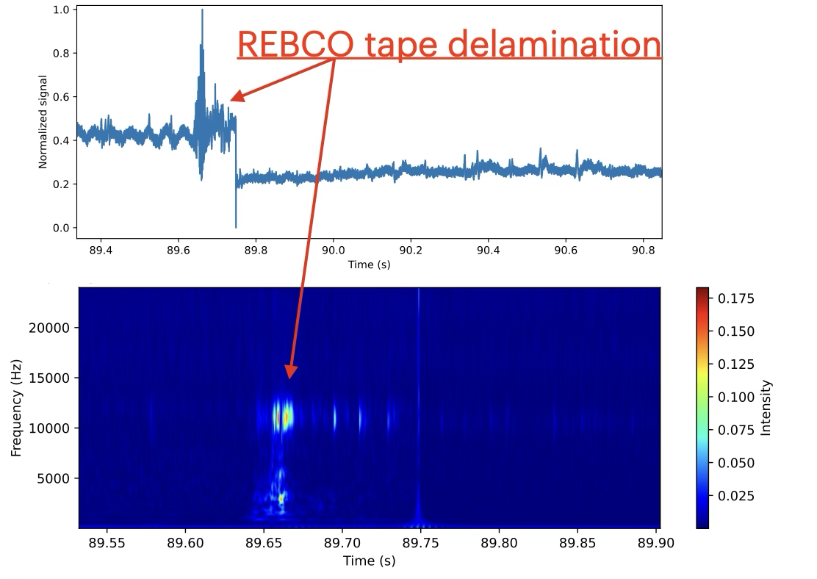
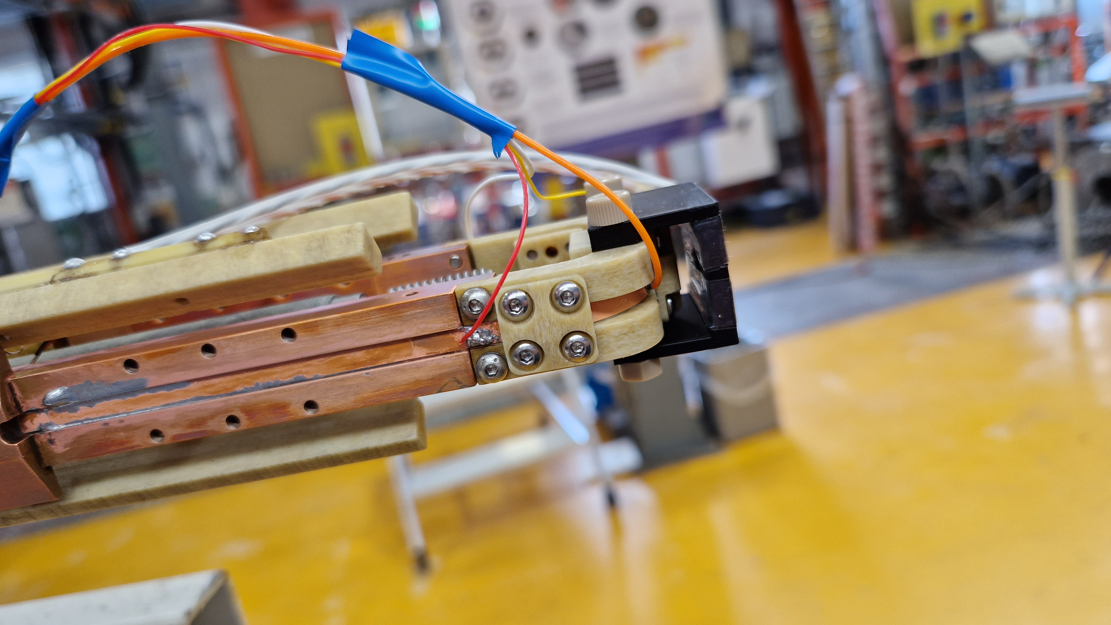
First application of MEMS microphones in the detection/ study of REBCO tests
  Study of combined physical phenomena during critical current tests (4.5 K).
  Mechanical events associated with superconductor degradation/damages.
  Case study with only one sensor tested up to 15 T.

Slide 17
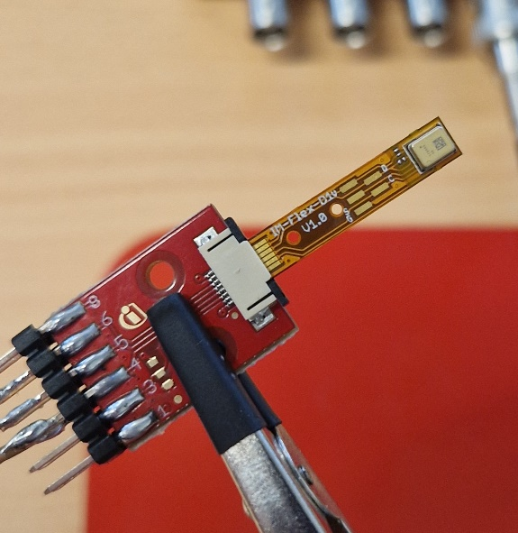
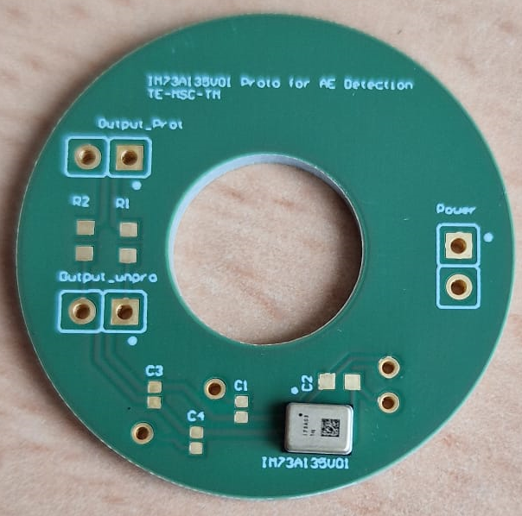
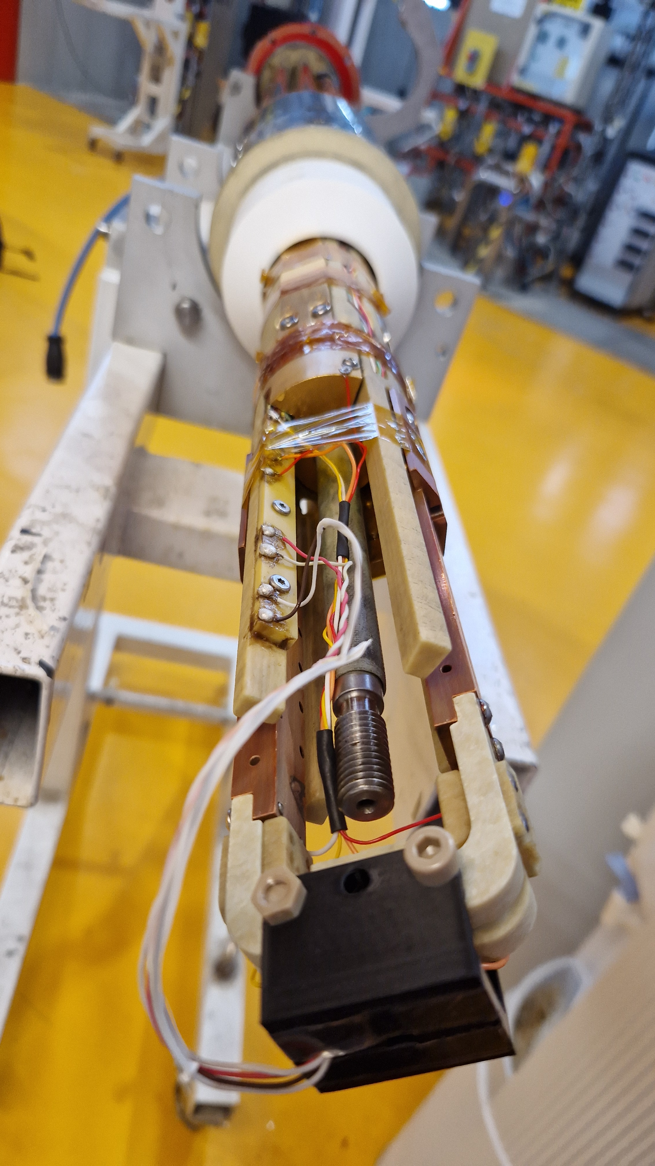
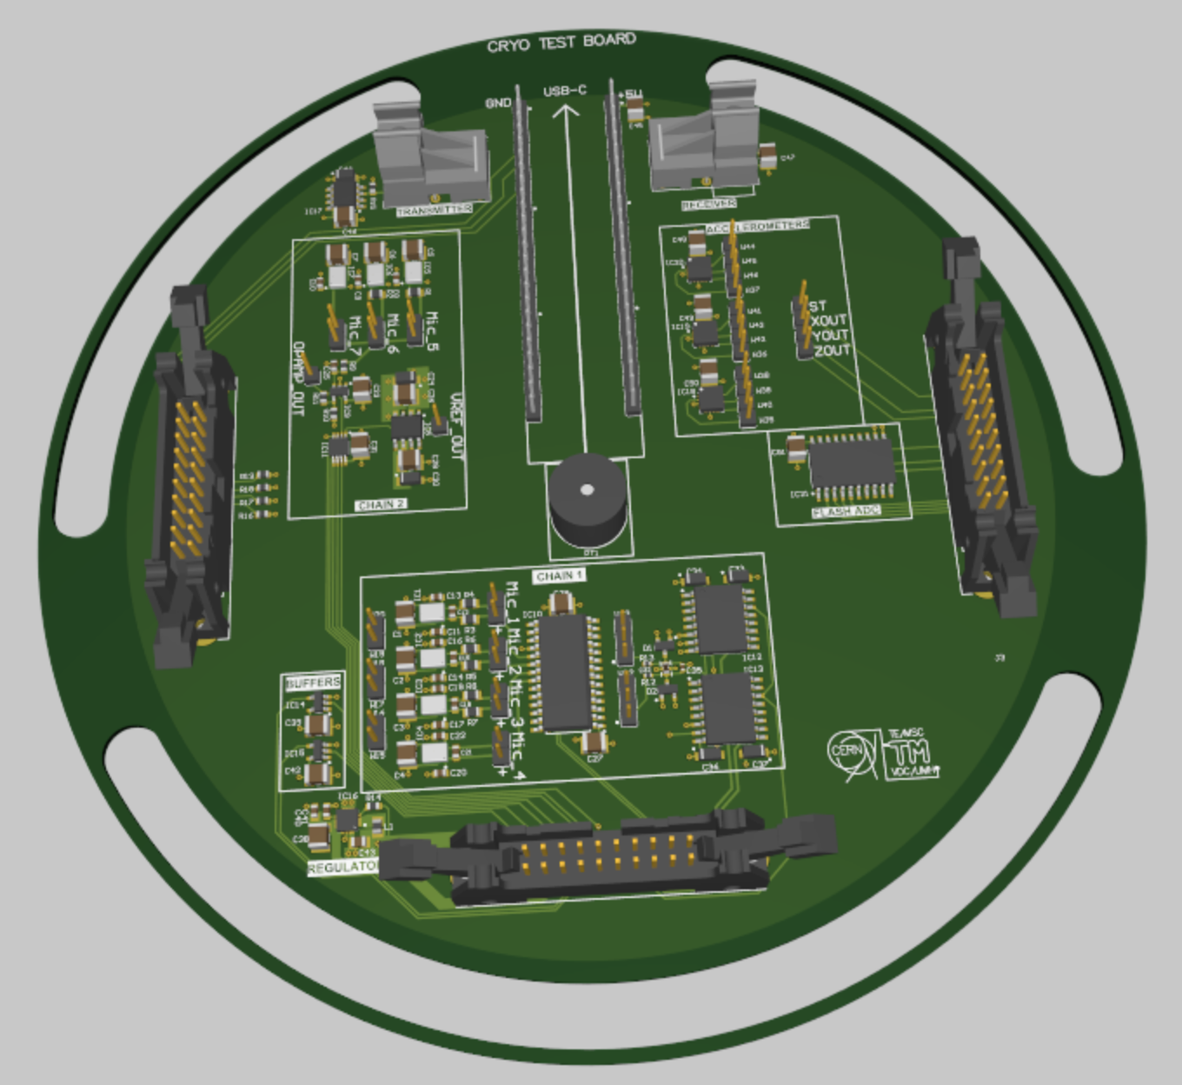
Future perspectives
  A second test campaign is foreseen
    ADC, microcontrollers, FPGA and optic fibers transducers.
  A PCB for integration of MEMS sensors on magnet structure has been developed and characterized and ready to be used in the upcoming tests.
  A rich and up to date library of components tested for cryogenic temperatures to facilitate the implementation of cryogenic electronic in the future.
Commercial MEMS microphones (left) and PCB board for integration in the magnet structure (right).
Test insert for critical current test on REBCO tapes.
PCB for 2nd campaign of tests of sensor and electronic components at cryogenic temperature.

Slide 18
Conclusions
Quench detection and localization are crucial for optimizing the design and manufacturing of superconducting magnets.
Using cryogenic electronics for signal conditioning and acquisition can improve the signal-to-noise ratio (SNR) and reduce the number of signal to be extracted.
Individual tests are necessary to verify the functionality and characterize electronic components beyond the manufacturer’s specifications.
We successfully tested the signal conditioning chain's essential components and established a stable setup and procedure.
The tested MEMS sensors have already been deployed with success for cryogenic (4.5 K) applications under magnetic field (15 T).
Future tests are planned to develop a complete cryogenic acquisition chain.

Slide 19
Thanks for the attention!

