Slide 1
Status of Drift Chamber Hardware
Malte Hildebrandt, PSI
MEG Review Meeting, PSI, 21st February 2012

Slide 2
Outline
• optical survey 2011 → theodolite and laser tracker
• dc operation in 2011 → HV performance
• observations → dc04 mystery
→ HV instability „sudden death“
→ dark / remaining currents
→ overall degradation of gas gain
→ limitation due to HV_{max} or Q_{max} ?

Slide 3
Outline
• optical survey 2011 → theodolite and laser tracker
• dc operation in 2011 → HV performance
• observations → dc04 mystery
→ HV instability „sudden death“
→ dark / remaining currents
→ overall degradation of gas gain
→ limitation due to HV_{max} or Q_{max} ?

Slide 4
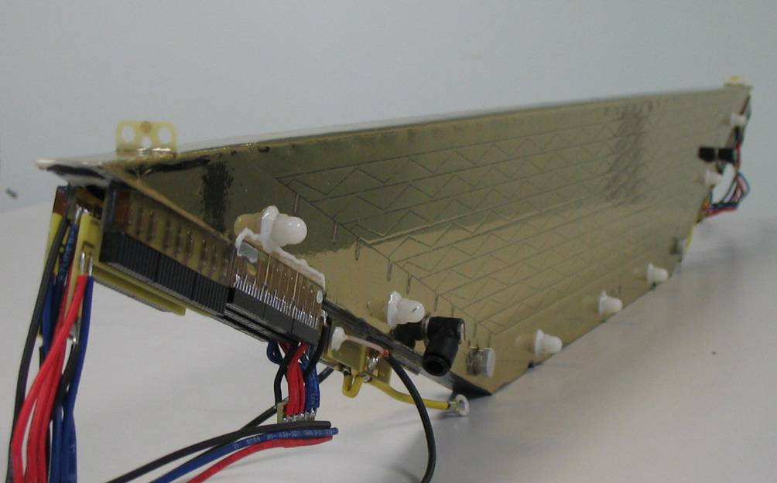
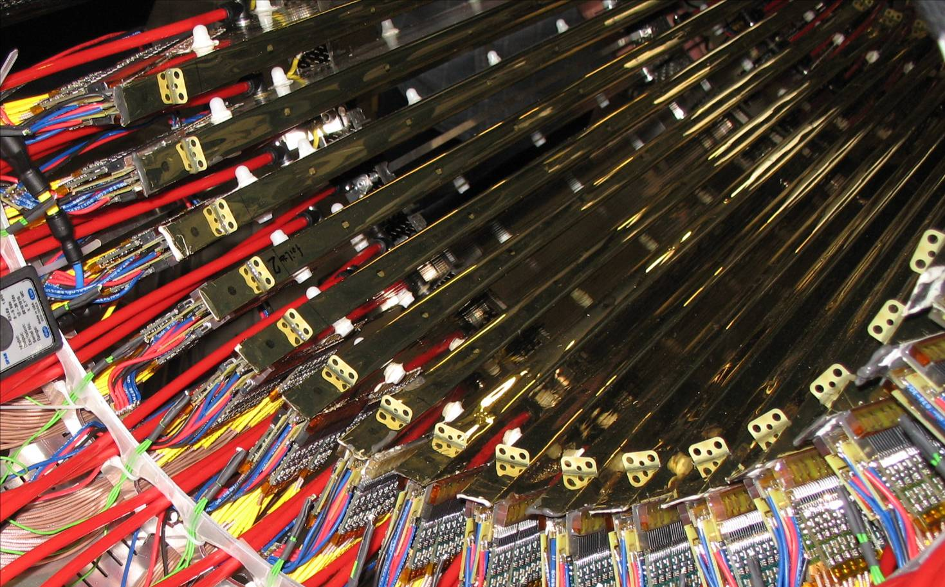
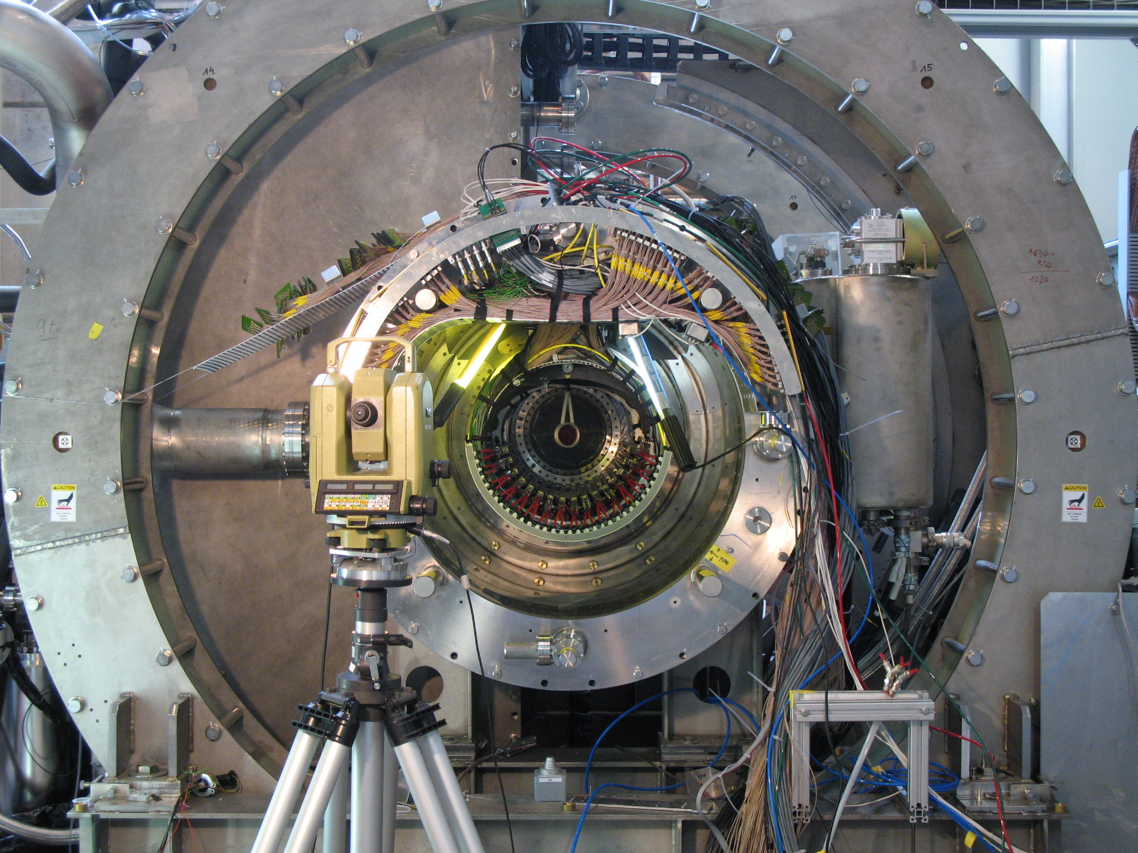
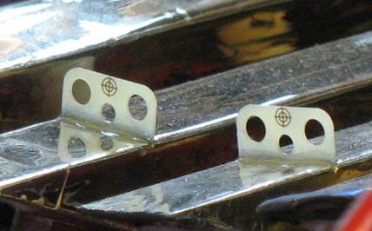
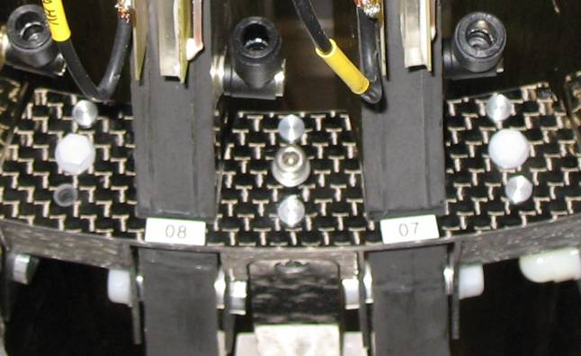
Optical Survey 2008-10
• 2008, 2009, 2010:
methode: theodolite, forward intersection methode
markers: cross-hairs (dc module), pins (support structure)
sequence: survey before insertion of N₂ bag
observation: length of dc modules is not „reproduced“
→ concern: large systematic uncertainties in z-direction
due to small intersection angle (?) !
2008-10
2008-10
2008-10

Slide 5
Observation
2009
• „optical“ length:
Δ: (ds-us) of target markers
• „mechanical“ length:
measurement with 3-dim
touch sensitive sensor
in mechanical workshop
• deformation up to 1.5 mm?
→ mechanical wire tension:
Δl = 1mm (l = 80cm)
25 μm Ni/Cr: ±8g (50g)
50 μm Cu/Be: ±30g (120g)
• phi-dependence ?
depending on different
locations of theodolite?
→ limitation of forward
intersection method in
case of small angles?
module „strechted“
module „compressed“
( )
2010
module „strechted“
module „compressed“

Slide 6
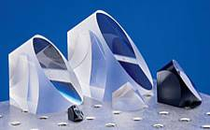
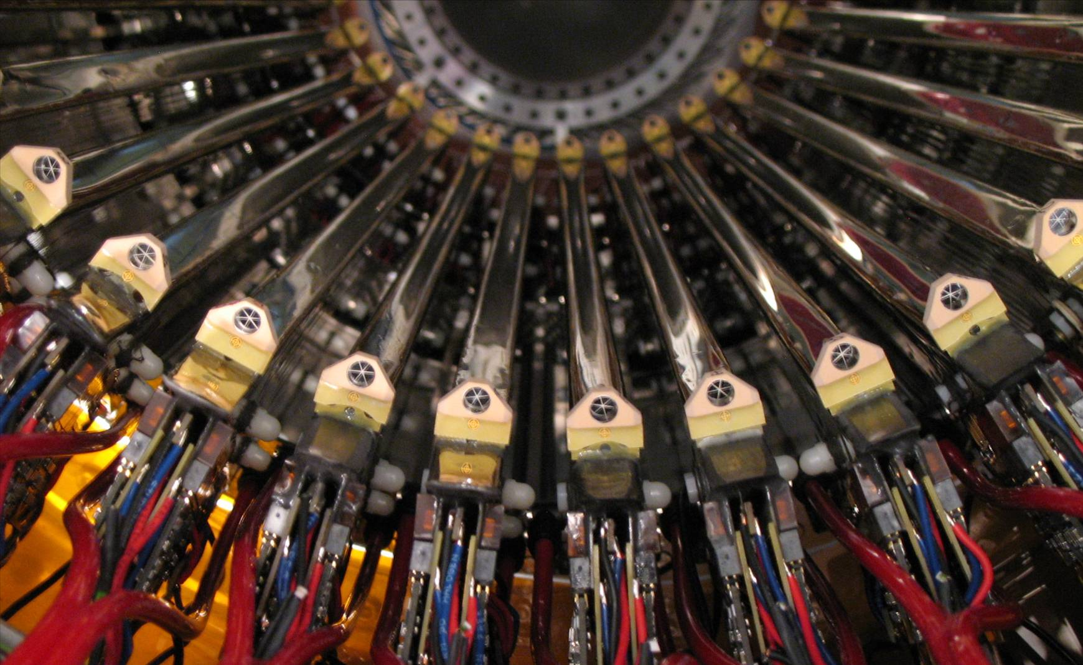
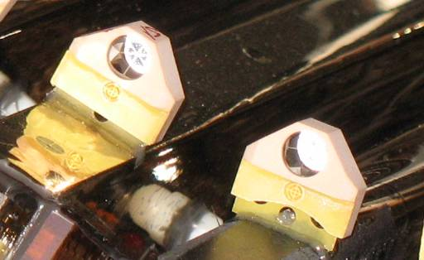
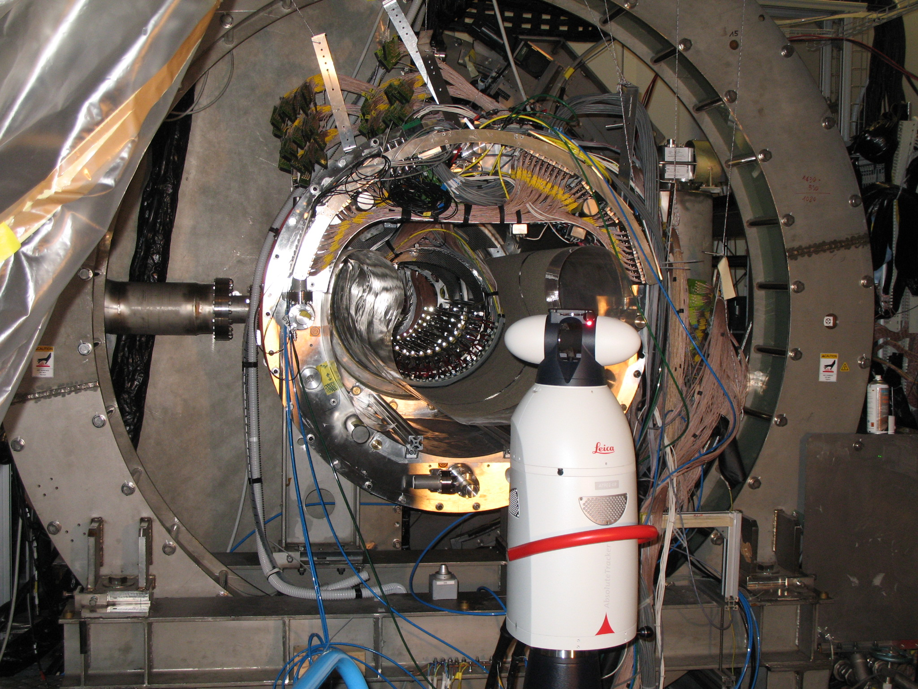
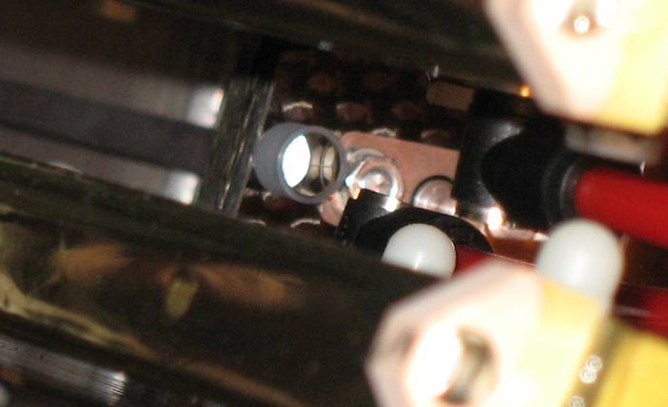
Optical Survey 2011
• 2011:
methode: theodolite, forward intersection methode
“absolute interferometer methode” (IFM + ADM)
(laser interferometer + absolute distance meter)
markers: cross-hairs (dc module), pins (ds support structure)
corner cube reflectors (dc module, support structure)
preparation: modification of ds cable duct of dc systems
sequence: survey (theodolite & laser) after insertion of N₂ bag
best boundary conditions ever for reliable survey
and trustable coordinates of drift chamber positions !
new + additional
new + additional
new
new
2011
2011
2011
2011

Slide 7
Observation
2011
theodolite
• „optical“ length:
Δ: (ds-us) of target markers
• „mechanical“ length:
measurement with 3-dim
touch sensitive sensor
in mechanical workshop
• deformation up to 1.5 mm ?
• mechanical accuracy:
alignment of cube in housing
mounting of housing on G10 plate
variation of thickness mirror coating
→ ±(0.15-0.25) mm
module „strechted“
module „compressed“
2011
laser tracker
module „strechted“
module „compressed“

Slide 8
Optical Survey 2011
theodolite measurement
laser tracker measurement
→ dx ≈ dy ≈ ±(0.2-0.3) mm
dz_{target} ≈ ±0.5 mm
dz_{cross} ≈ ±1.5 mm (ds), ±2.5 mm (us)
• pure laser tracker measurement:
→ dx ≈ dy ≈ dz ≈ ±0.015 mm
• including: alignment of cube in housing
mounting of housing on G10 plate
variations of thickness mirror coating
→ dx ≈ dy ≈ dz ≈ ±(0.15-0.25) mm
• internal alignment of dc modules
(cosmics, millepede) → shifts (RMS) ~0.3 mm
comparison of both measurements:
• coordinates x and y consistent
• z_{laser-tracker} fit into overall picture
• huge systematic uncertainties for z_{theodolite}

Slide 9
Outline
• optical survey 2011 → theodolite and laser tracker
• dc operation in 2011 → HV performance
• observations → dc04 mystery
→ HV instability „sudden death“
→ dark / remaining currents
→ overall degradation of gas gain
→ limitation due to HV_{max} or Q_{max} ?

Slide 10
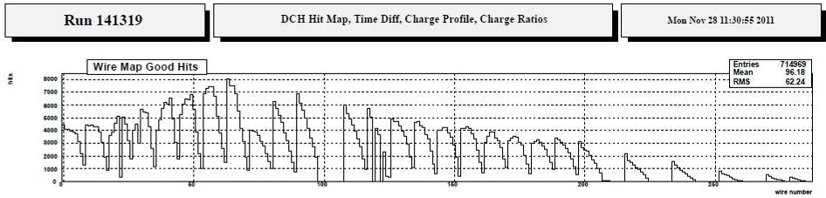
HV Performance 2011
end of run 2011
e⁺ runs, Mott scattering
dc04B
dc05A
dc09
dc11A
dc14A
dc04A
dc12A
status end of run 2011:
• dc04A, B: low gas gain, (slightly) ongoing degradation, dark / remaining currents
• dc05A: HV instabilities
• dc09A, B: reduced HV due to huge fluctuating dark / remaining currents
• dc11A: HV instabilities (continuous degradation, started already in run 2010)
• dc12A: HV instabilities („sudden death“)
• dc13A: HV instabilities („sudden death“)
• dc14A: HV instabilities (continuous degradation)
• all other planes on nominal HV, nearly no HV trips
dc13A
→ 3 topics:
• low gas gain performance
• HV instability “sudden death”
• dark / remaining currents

Slide 11
Outline
• optical survey 2011 → theodolite and laser tracker
• dc operation in 2011 → HV performance
• observations → dc04 mystery
→ HV instability „sudden death“
→ dark / remaining currents
→ overall degradation of gas gain
→ limitation due to HV_{max} or Q_{max} ?

Slide 12
dc04 Mystery
• „low gas gain performance“ mystery
• affected dc planes / dc modules: • dc04B in 2009
• dc04 A+B in 2010
• dc04 A+B in 2011
• surprising, as the affected dc module (including gas tubes) was replaced in
each year by a newly constructed module
• observation: • cosmic test in laboratory: nominal HV, normal puls height
• MEG run: nominal HV, but: • 2009 from beginning: low gas gain (I ≈ 0.2·I_{normal})
• 2010 from beginning: low gas gain (I ≈ 0.3·I_{normal})
• 2011 at beginning: normal gas gain
during run: continuous degradation
• optical inspection in lab: • outside: traces of oil / grace on cathode hood foil
(different locations in each case)
• inside: oily smell, slightly discoloured aluminum surface
• huge effort to identify possible common source
(e.g. „hot trail“: gear box of crane above detector platform)
→ but unfortunately: search up to now not successful…

Slide 13
Outline
• optical survey 2011 → theodolite and laser tracker
• dc operation in 2011 → HV performance
• observations → dc04 mystery
→ HV instability „sudden death“
→ dark / remaining currents
→ overall degradation of gas gain
→ limitation due to HV_{max} or Q_{max} ?

Slide 14
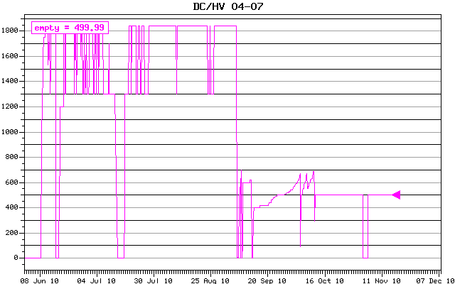
HV Instability „Sudden Death“
• „sudden death“: sudden decrease of breakdown voltage, not slow degradation
• at beginning of MEG run: • nominal HV, stable
• unexpectedly during MEG run: • drastically reduced breakdown
voltage after a HV trip
example from run2010:
dc06A

Slide 15
HV Instability „Sudden Death“
• „sudden death“: sudden decrease of breakdown voltage, not slow degradation
• at beginning of MEG run: • nominal HV, stable
• unexpectedly during MEG run: • drastically reduced breakdown
voltage after a HV trip
• occurance: • three times during run 2010
(1 module constructed in 2009, 2 modules constructed in 2010)
• twice during run 2011
(1 module constructed in 2009, 1 module constructed in 2011)
• special feature: • twice „sudden death“ occured with electrical short circuit
(1 module constructed in 2010, 1 module constructed in 2011)
→ short circuit between anode and innermost potential wire
→ damage due to electrical breakdown on anode pcb type A_L

Slide 16
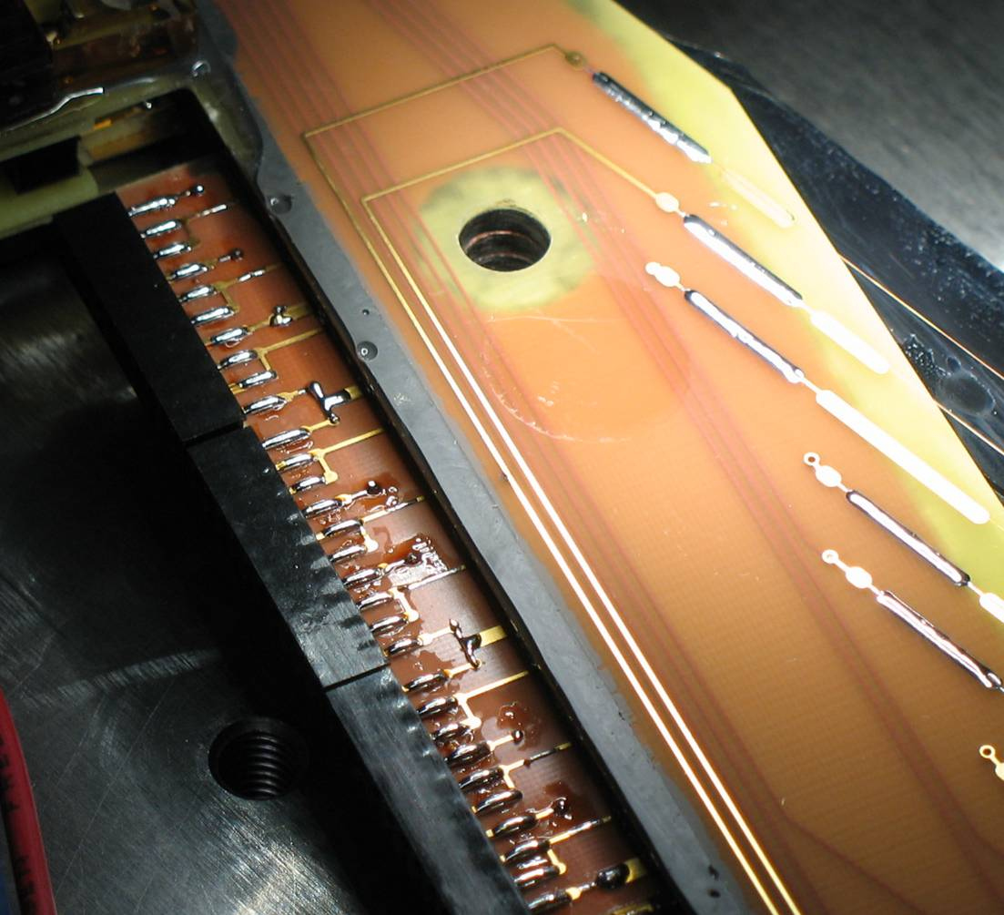
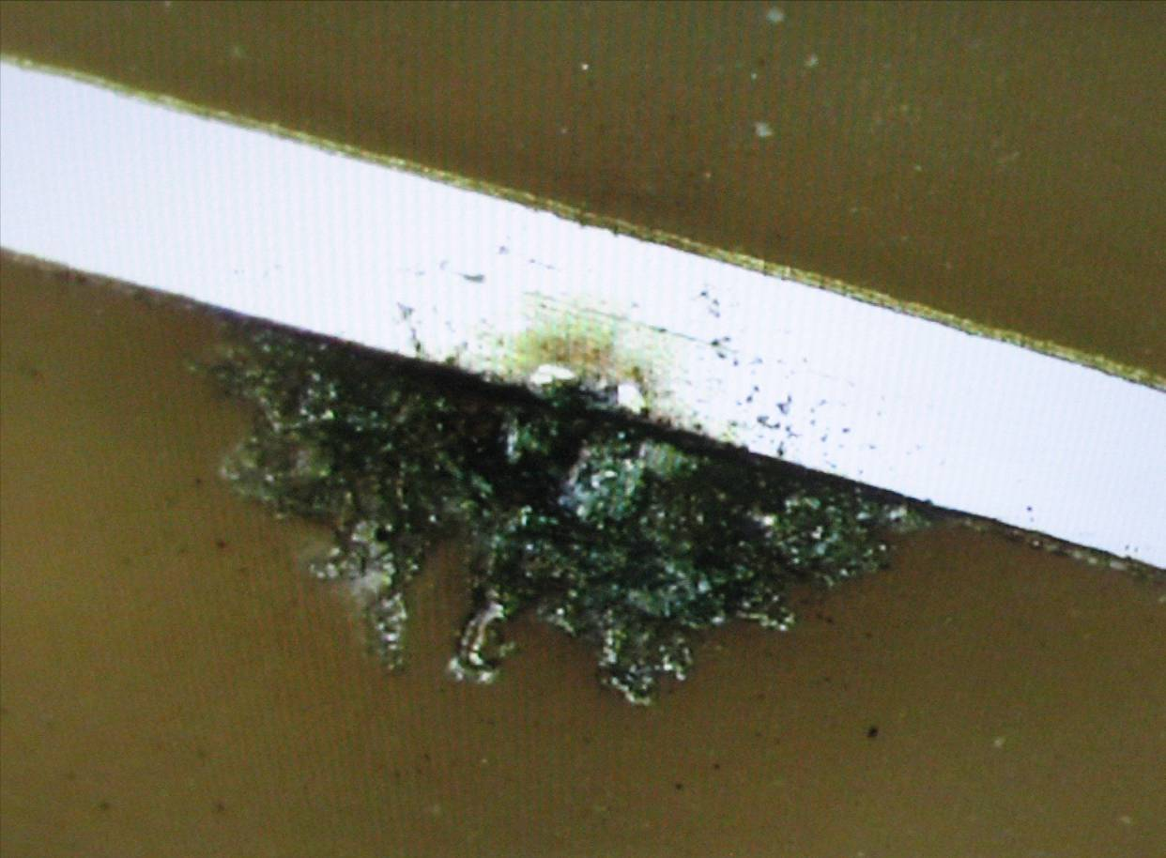
dc06A(2010)

Slide 17
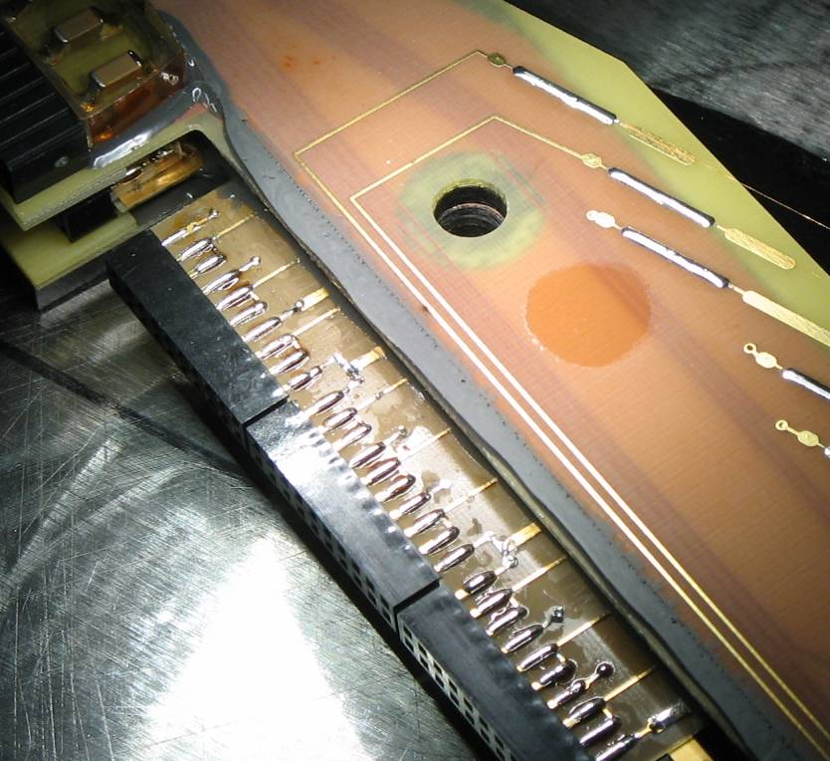
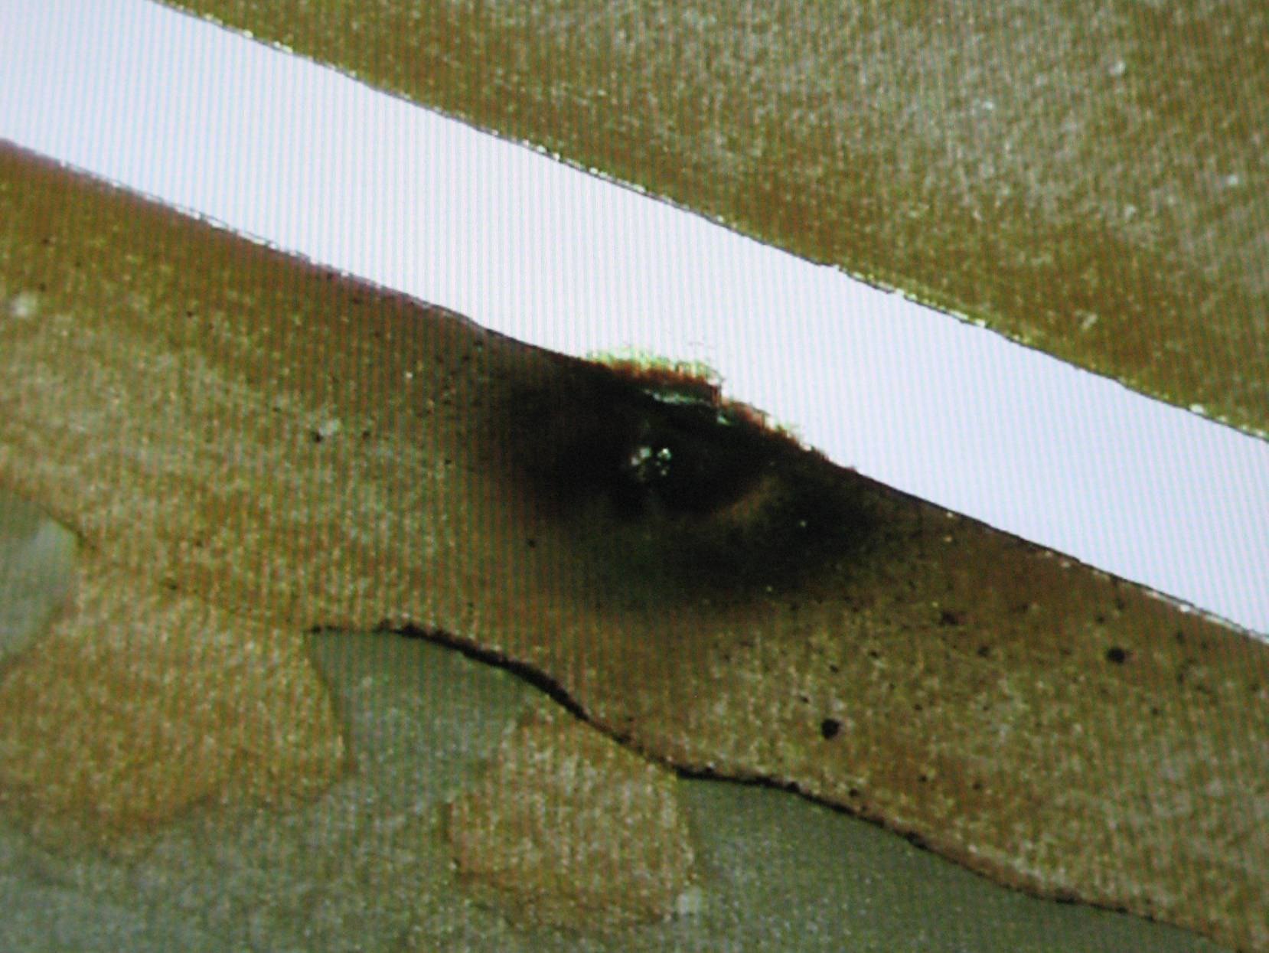
dc12A(2011)

Slide 18
HV Instability „Sudden Death“
• „sudden death“: sudden decrease of breakdown voltage, not slow degradation
• at beginning of MEG run: • nominal HV, stable
• unexpectedly during MEG run: • drastically reduced breakdown
voltage after a HV trip
• occurance: • three times during run 2010
(1 module constructed in 2009, 2 modules constructed in 2010)
• twice during run 2011
(1 module constructed in 2009, 1 module constructed in 2011)
• special feature: • twice „sudden death“ occured with electrical short circuit
(1 module constructed in 2010, 1 module constructed in 2011)
→ short circuit between anode innermost potential wire
→ damage due to electrical breakdown on anode pcb type A_L
• characteristics: • only anode plane type A was affected
→ difference in pcb design of wire plane type A and type B

Slide 19
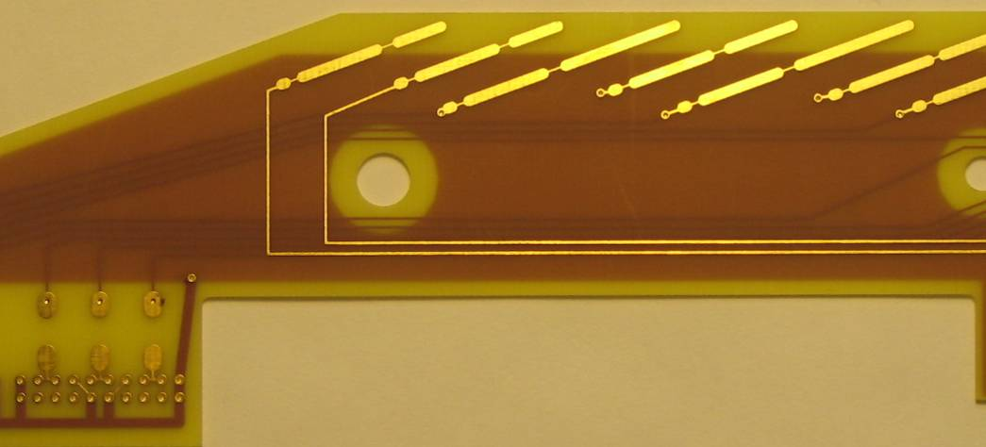
Anode_A_L
GND tracks
potential wires
top layer
+HV tracks
anode wires
layer 1
pcb A_L
inner most
potential wire
inner most
potential wire
GND
GND
2 · 63 μm preimpregnated fibres
2 · 63 μm prepreg
with 0.75 kV / mil
→ U_{d} ≈ 3.75 kV
but U_{anode} ≤ 2.0 kV
+HV
+HV
+HV
remark: no GND tracks (top layer) on pcb A_R

Slide 20
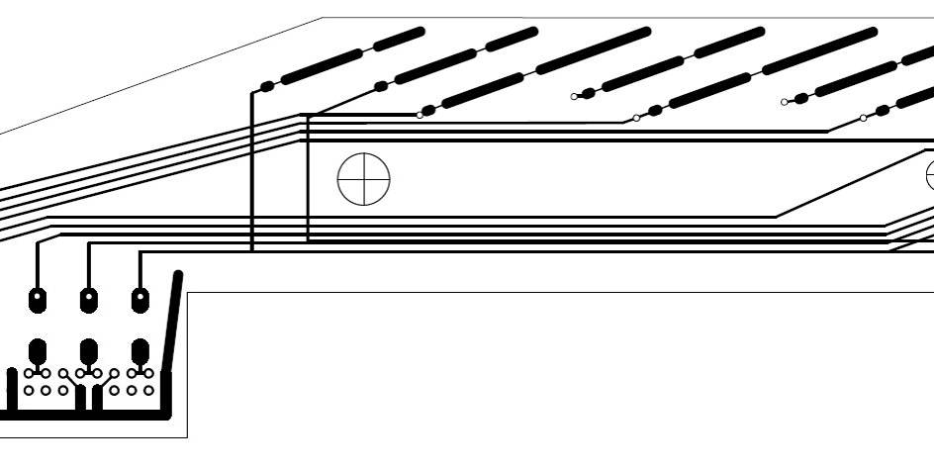
Anode_A_L
GND tracks
potential wires
top layer
+HV tracks
anode wires
layer 1
pcb A_L
inner most
potential wire
GND
GND
2 · 63 μm preimpregnated fibres
2 · 63 μm prepreg
with 0.75 kV / mil
→ U_{d} ≈ 3.75 kV
but U_{anode} ≤ 2.0 kV
+HV
+HV
+HV
remark: no GND tracks (top layer) on pcb A_R

Slide 21
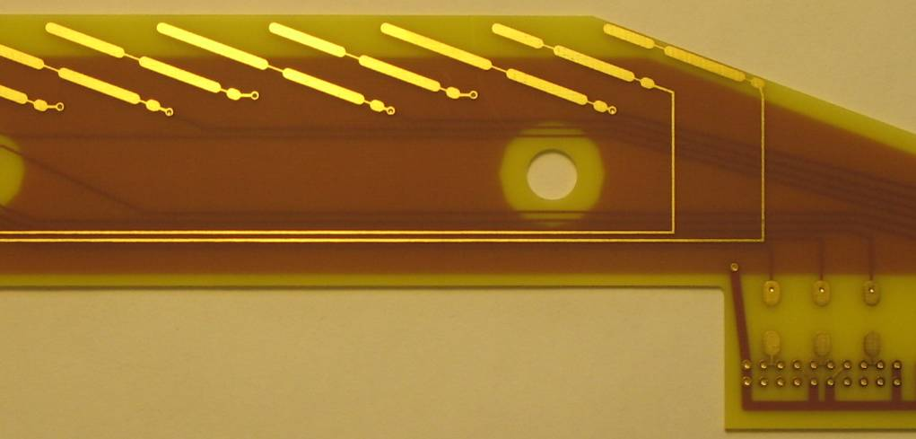
Anode_B_R
GND tracks
potential wires
top layer
+HV tracks
anode wires
layer 1
pcb B_R
inner most
potential wire
GND
GND
2 · 63 μm preimpregnated fibres
+HV
+HV
+HV
remark: no GND tracks (top layer) on pcb B_L

Slide 22
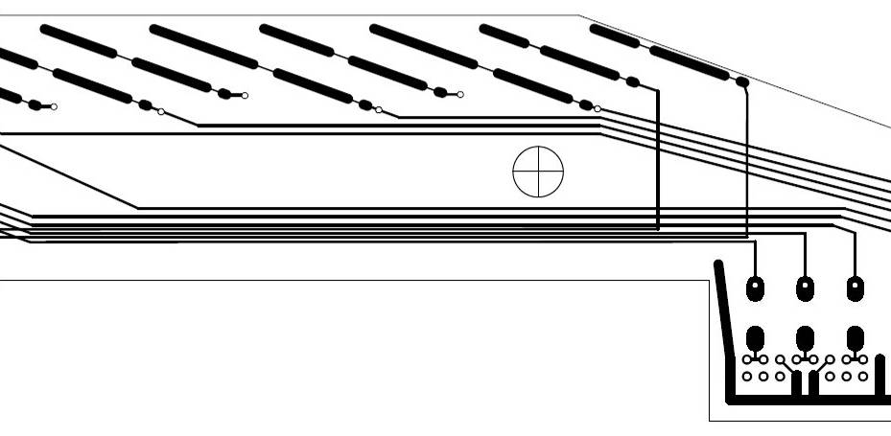
Anode_B_R
GND tracks
potential wires
top layer
+HV tracks
anode wires
layer 1
pcb B_R
inner most
potential wire
GND
GND
2 · 63 μm preimpregnated fibres
+HV
+HV
+HV
remark: no GND tracks (top layer) on pcb B_L

Slide 23
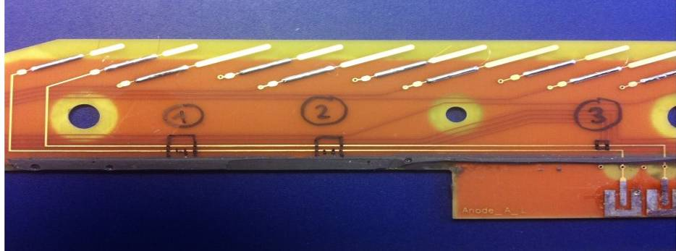
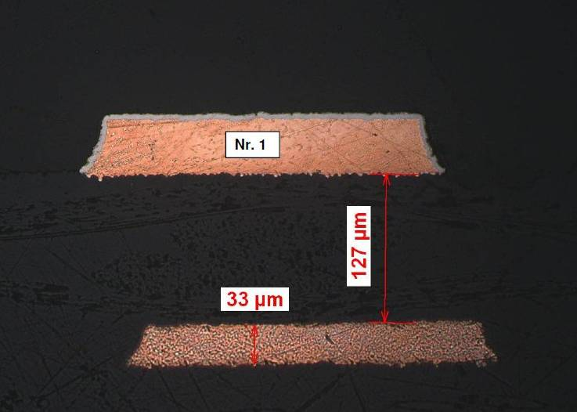
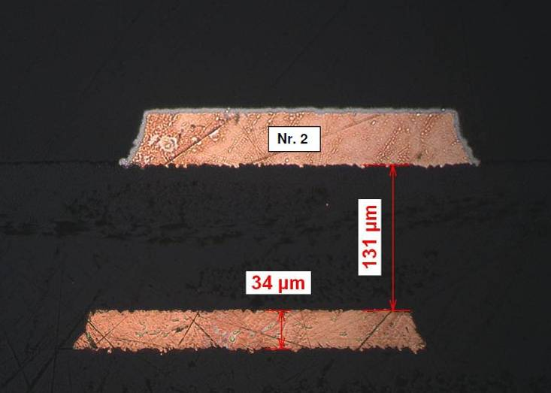
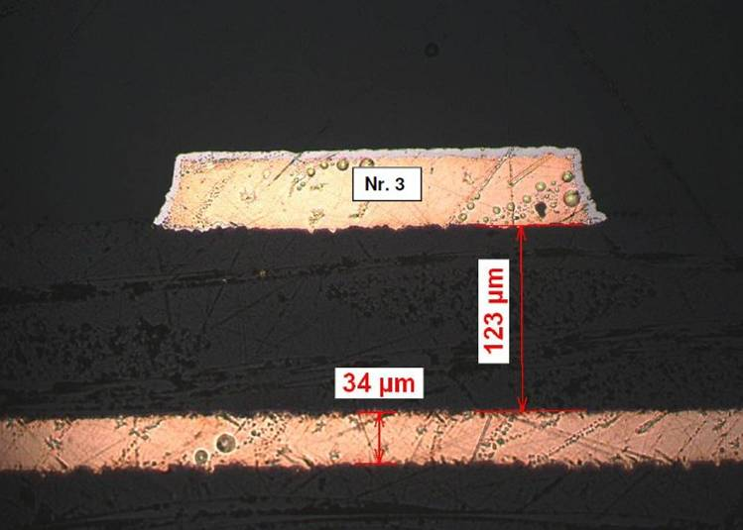
Polished Cut Image
statement of manufacturer: • design & production should be fine for more than 2 kV
• „arrangement“ of preimpregnated fibres worse in case of
parallel alignment of pcb tracks compared to crossing tracks
→ pcb type B_R not affected, even with crossing tracks
no.1: parallel alignment, discharge
no.2: parallel alignment
no.3: crossing tracks

Slide 24
HV Instability „Sudden Death“
• „sudden death“: sudden decrease of breakdown voltage, not slow degradation
• at beginning of MEG run: • nominal HV, stable
• unexpectedly during MEG run: • drastically reduced breakdown
voltage after a HV trip
• occurance: • three times during run 2010
(1 module constructed 2009, 2 modules constructed 2010)
• twice during run 2011
(1 module constructed 2009, 1 module constructed 2011)
• special feature: • twice „sudden death“ occured with electrical short circuit
(1 module constructed 2010, 1 module constructed 2011)
→ short circuit between anode innermost potential wire
→ damage due to electrical breakdown on anode pcb type A_L
• characteristics: • only anode plane type A was affected
→ difference in pcb design of wire plane type A and type B
• only 5 out of 28 wire planes type A were affected
→ different conditions during pcb production

Slide 25
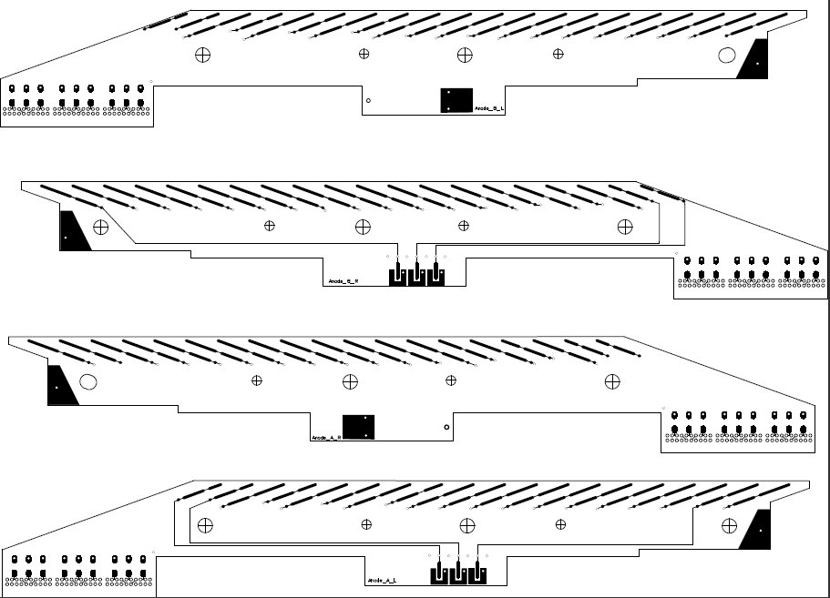
Anode PCB
• production panel contains 2 sets of 4 pcb‘s each
→ location of A_L: edge and middle of panel
• possible consequences:
→ different thicknesses of copper tracks on pcb‘s
due to inhomogenities in „vertical“ galvanic build-up
procedure of copper layer on FR4 base material
→ different insulating properties due to different
compression of preimpregnated fibres layers
• new production for 2012 (only type A_L):
→ „horizontal“ galvanic build-up procedure of
copper layer
A_L
A_R
B_L
B_R
A_L
A_R
B_L
B_R

Slide 26
HV Instability „Sudden Death“
• „sudden death“: sudden decrease of breakdown voltage, not slow degradation
• at beginning of MEG run: • nominal HV, stable
• unexpectedly during MEG run: • drastically reduced breakdown
voltage after a HV trip
• occurance: • three times during run 2010
(1 module constructed 2009, 2 modules constructed 2010)
• twice during run 2011
(1 module constructed 2009, 1 module constructed 2011)
• special feature: • twice „sudden death“ occured with electrical short circuit
(1 module constructed 2010, 1 module constructed 2011)
→ short circuit between anode innermost potential wire
→ damage due to electrical breakdown on anode pcb type A_L
• characteristics: • only anode plane type A was affected
→ difference in pcb design of wire plane type A and type B
• only 5 out of 28 wire planes type A were affected
→ different conditions during pcb production
• occurance during operation after certain running time
radiation damage ? material defect ? radiation enhances material defect ?

Slide 27
Preparations Run2012
• goal: construction of 9 new dc modules
→ 7 dc modules will be replaced in MEG for run2012
• new anode pcb type A_L: • new layout of GND tracks on top layer
→ same layout as pcb type B
• „horizontal“ galvanic copper build-up procedure
→ improved homogeinity of height of copper tracks
• status of construction of new dc modules (20.02.2012)
• 9 cathodes constructed, ongoing: soldering of connectors, etc.
• 9 cathode hoods constructed, ongoing: soldering of connectors, etc.
• 8 anode frames type B stringed with wires, ongoing: soldering of capacitors
• 4 anode frames type A stringed with wires, ongoing: soldering of capacitors
→ end of February: start assembly of dc modules
→ beginning of March: start tests inside „aquarium“

Slide 28
Outline
• optical survey 2011 → theodolite and laser tracker
• dc operation in 2011 → HV performance
• observations → dc04 mystery
→ HV instability „sudden death“
→ dark / remaining currents
→ overall degradation of gas gain
→ limitation due to HV_{max} or Q_{max} ?

Slide 29
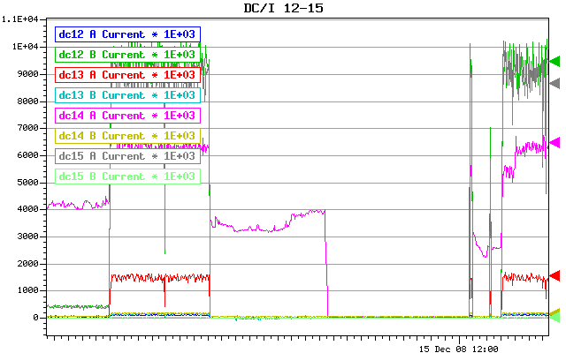
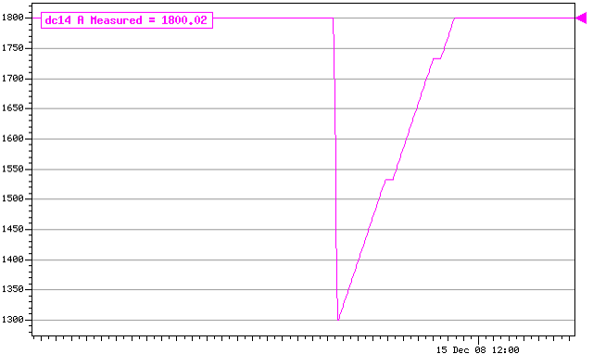
Dark / Remaining Currents
• concern for longterm operation
• observations:
• current starts during high rate irradiation
• remaining current stays, even when
irradiation has finished
• only if HV is reduced to 1300 V,
remaining current dies away
remark: nearly no gas gain below ~1300 V
→ hint:
• self-sustaining discharge (not surface current)
→ certain primary charge density necessary
to start gaseous discharge
→ once started it remains even without
source of primary charge
→ Malter effect („thin-field emission effect“) ?
2009: dc14A
reminder: • hydrocarbon in counting gas (C₂H₆)
• high gain operation
• high rate environment
→ ~1.0 C / cm / 8months

Slide 30
Malter Effect
• three conditions: • insulator on cathode
• rate of ion / charge buildup must be higher than
its removal rate from insulating layer
• ignition mechanism (e.g. in high rate environment: high charge
density reduces breakdown voltage)
• establish insulating layer (few examples):
• during construction: ▪ remaining photoresist
▪ traces of glue on electrodes
▪ finger prints
▪ …
• during operation ▪ avalanche-produced polymers (polymerization)
▪ gas pollutants
▪ insulating deposits left from sparks
▪ resistive oxides
▪ …
since 2009: improved
cleaning procedure
of cathode foils during
production at REPIC

Slide 31
Polymerization
• “leading actor”: CH₂: radical
• creation: during electron avalanche („gas gain“ process) in hydrocarbon gas
• in collisions with electrons
• in UV photon absorption processes
• due to de-excitation of atoms
• reason for creation: E_{therm.dissociation} < E_{dissociation by} < E_{ionisation} < ε_{mean, electron}
→ electrons and photons in a typical avalanche have enough energy to break the typical
covalent molecular bounds
• polymerization: CH₂: radical is a typical precurser for the production of polyethylene
(-H₂C-CH₂-)_{n}
• CH₂: radical large dipole moment • polyethylene insulator
→ sticks to electrodes
→ anodic / cathodic polymerization
→ insulating layer on cathode possible starting point for Malter effect
~(3-5) eV
~(10-15) eV
electron impact energy
• strategies for prevention of polymerization
↔ plasma chemistry / plasma polymerization
↔ experience in operation of gaseous detectors
H.Yasuda, NIM A 515 (2003) 15-30
H.Yasuda, Academic Press, 1985
Proceedings of Aging Workshops 1986 & 2001

Slide 32
Outline
• optical survey 2011 → theodolite and laser tracker
• dc operation in 2011 → HV performance
• observations → dc04 mystery
→ HV instability „sudden death“
→ dark / remaining currents
→ overall degradation of gas gain
→ limitation due to HV_{max} or Q_{max} ?

Slide 33
I_{anode}(t)
• reminder: • pressure regulation of dc system: p_{dc} vs p_{CO} and p_{CO} vs p_{atmospheric}
→ dc system is an „open“ detector system
• gaseous electronics scales with E / N, where N = particle number density = n / V
• Diethorn formula: gain variations due to density variations
, where λ = charge per unit length
→ in case of dc geometry: @ 1800 V
• no huge variations of p_{atmospheric} or T (inside COBRA) on longterm scale
• output voltages of old and new HV supplies are correct (even with 10 μA or 20 μA load)
• I_{proton} = 2.2 mA for 2009, 2010 and 2011
• sample: dc planes operated continuosly during 2009 - 2011 and each year at constant HV
→ observation: I_{anode}(t) in 2010 and 2011 shows small, but continuous degradation
nevertheless: overall dc resolutions similar to previous year due to improved s / n ratio
realised with HV power supplies (see analysis talk by Wataru Ootani)
→ hypothesis: less gas gain due to growing coating on anode wires
= kT / p

Slide 34
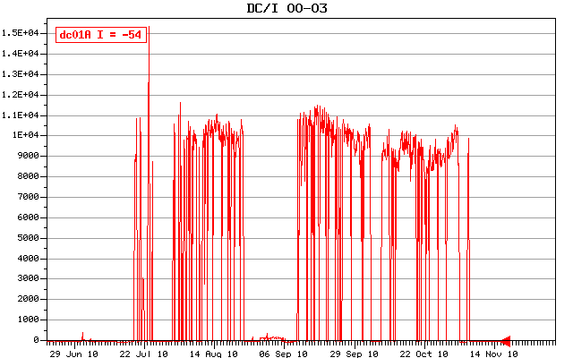
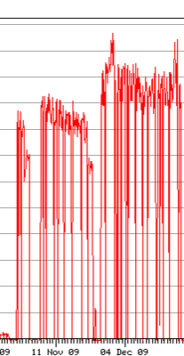
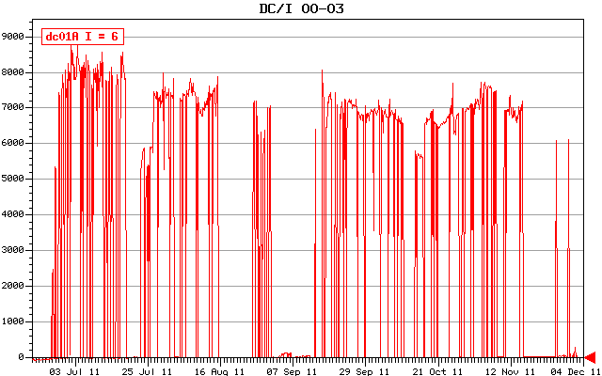
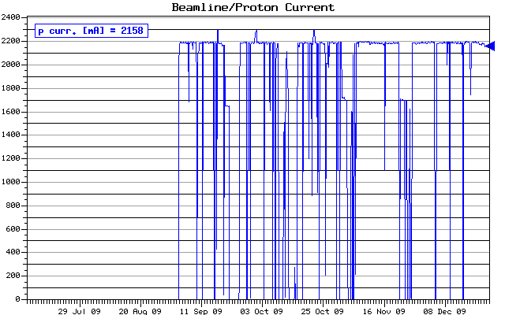
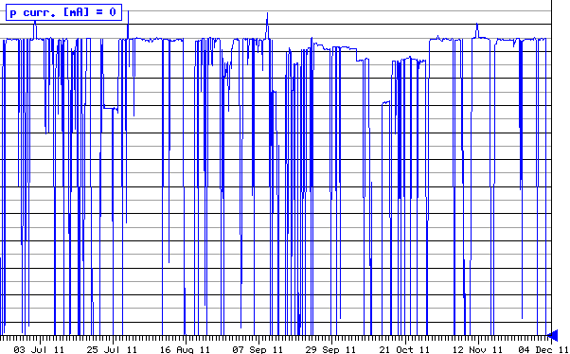
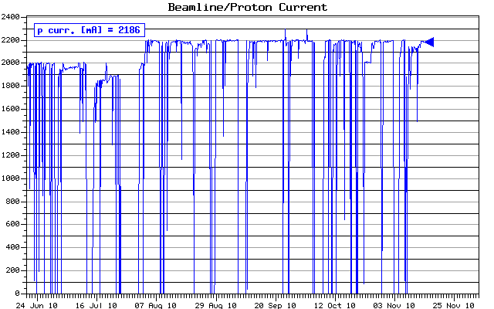
dc01A in 2009, 2010 and 2011
dc01A: same module in
2009, 2010 and 2011
2009
2010
2011
ΔV = 20 V
1840 V
1840 V
1820 V
I_{proton}

Slide 35
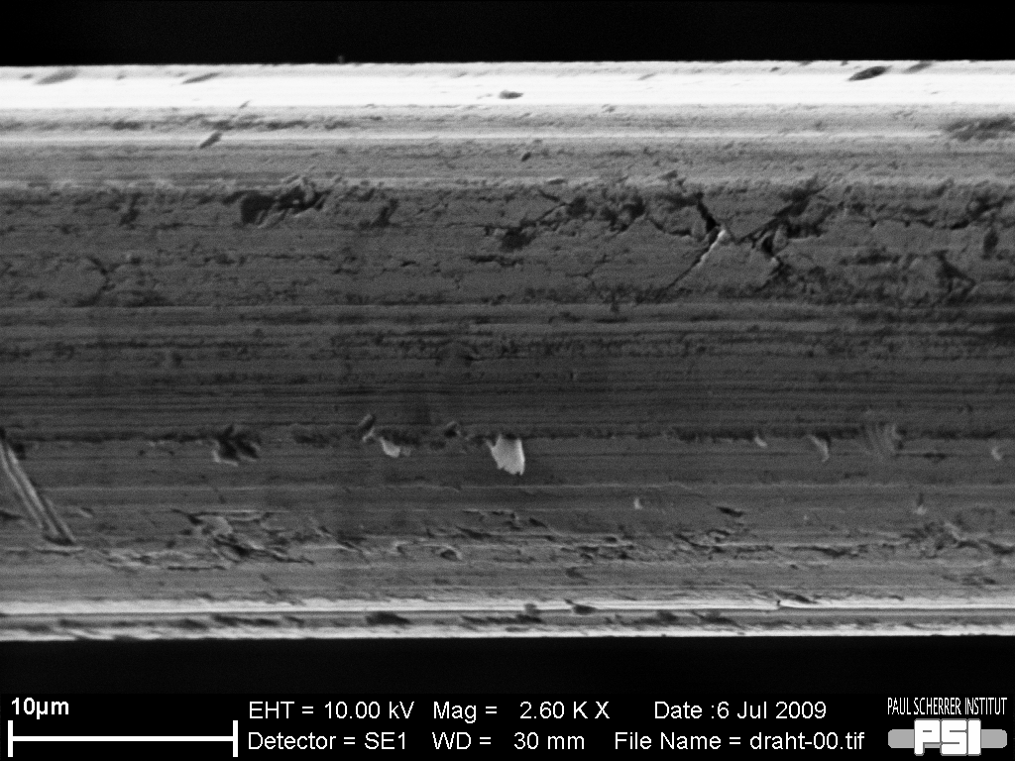
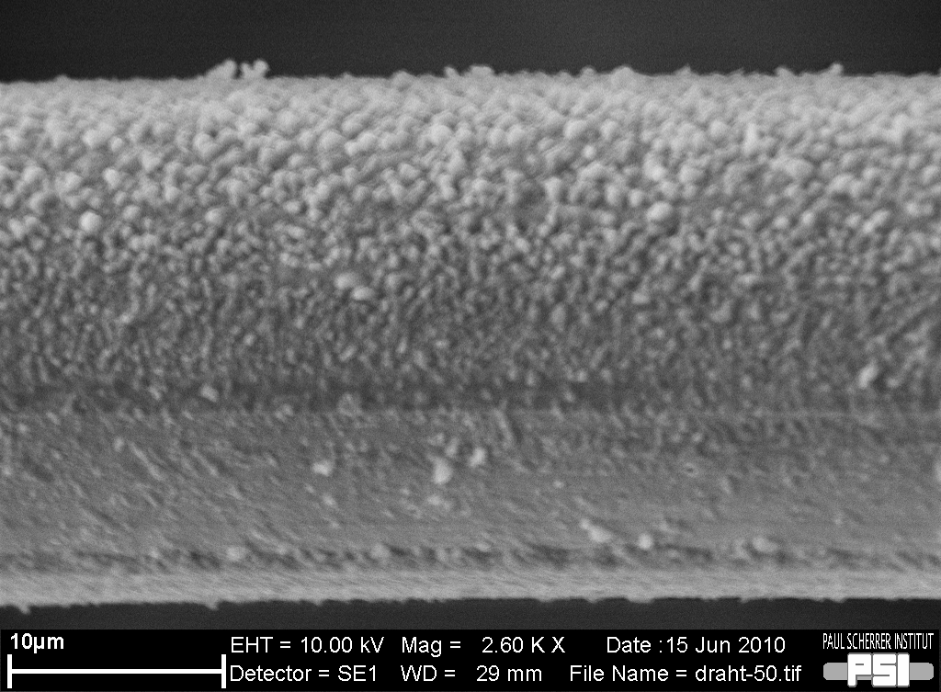
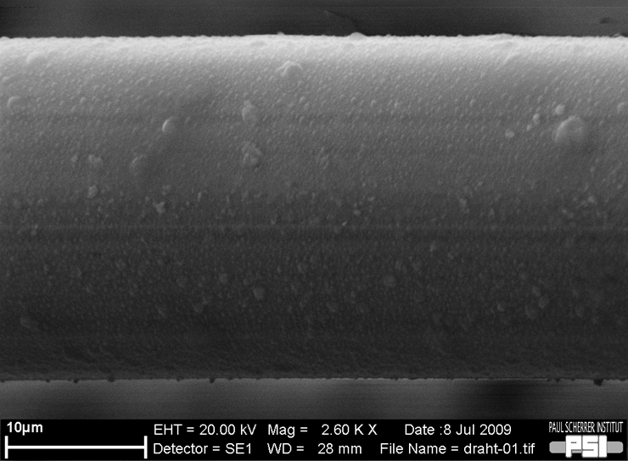
Anode Wires
Ni / Cr (80 / 20) 25 μm
Ni / Cr (80 / 20) 25 μm
dc modules operated in 2009 + 2010 + 2011:
• still mounted: dc00, dc01, dc02, dc03, dc10, dc15
• dismounted, but ok in lab : dc13
new
~3 months
~6 months
2009 + 2010 + 2011 =
~11 months
?
scanning electron microscope (SEM)
S.Ritter (NES / LNM)

Slide 36
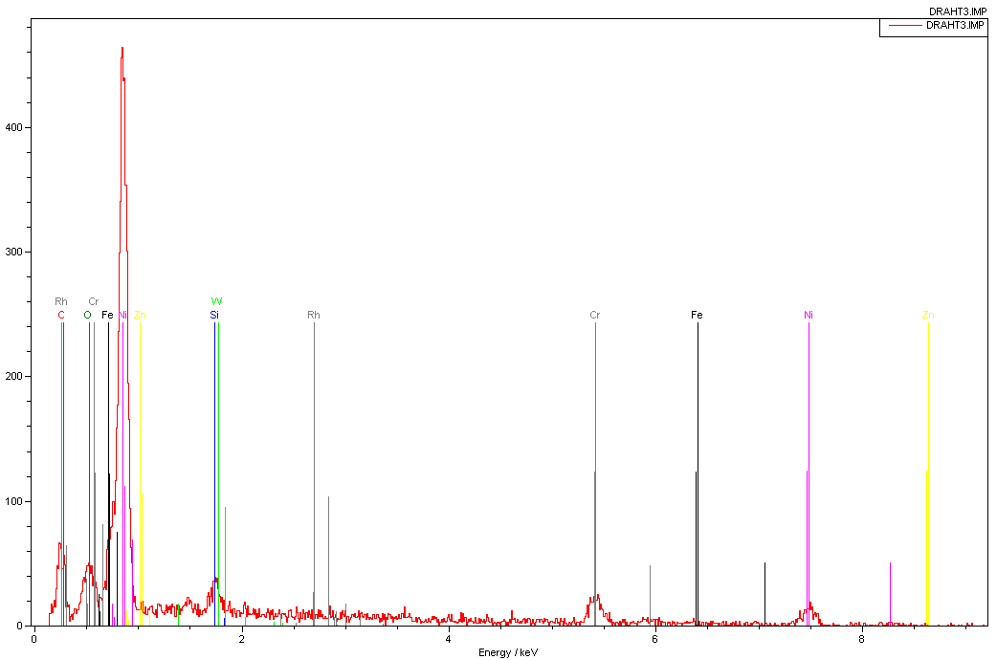
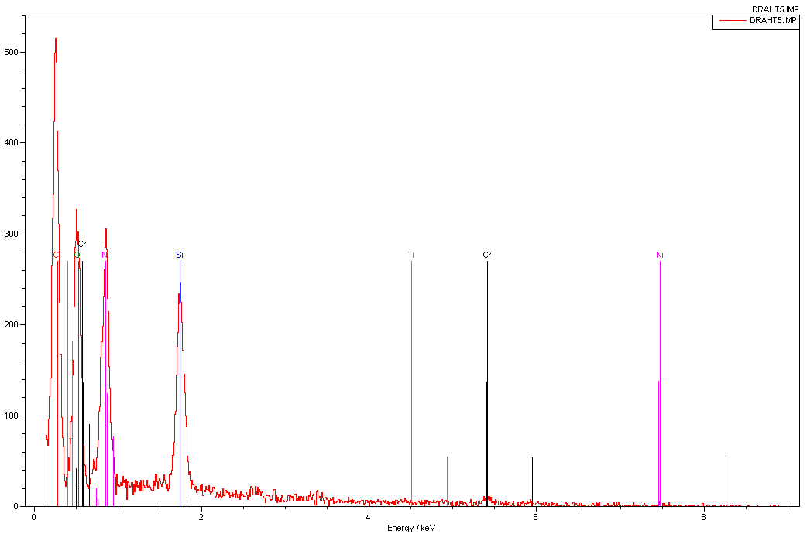
Anode Wires
new
Ni / Cr (80 / 20) 25 μm
data sheet:
Ni balance
Cr 18 - 20 %
Si 1.5 %
Al 1000 ppm
Fe 2000 ppm
Mn 2000 ppm
Ni
Cr
(C)
O
Si
Cr
Ni
~6 months
C
Cr
O
Cr
Ni
Ni
Si
scanning electron microscope (SEM) + energy-dispersed x-ray spectroscopy (EDX)
S.Ritter (NES / LNM)

Slide 37
Outline
• optical survey 2011 → theodolite and laser tracker
• dc operation in 2011 → HV performance
• observations → dc04 mystery
→ HV instability „sudden death“
→ dark / remaining currents
→ overall degradation of gas gain
→ limitation due to HV_{max} or Q_{max} ?

Slide 38
Gas Gain
→ questions: • What are the limitations?
• Can we gain by choosing “high gas gain conditions”?
higher gas gain regime smaller gas gain regime
• thin anode wire, e.g. 20 μm • thick anode wire, e.g. 25 μm
• He/C₂H₆ 70/30 • He/C₂H₆ 50/50
gas gain
[arbitrary unit]
avalanche size
~total charge
(Q=n₀A)
~signal size
1600 1700 1800 1900 HV [V]

Slide 39
Gas Gain vs HV_{max}
→ answer no.1: if limitations are caused by a certain HV_{max} due to electrical properties
of „materials“, like insulation of cable or pcb, sealing / potting of capacitors,
then “high gas gain conditions” will help
higher gas gain regime smaller gas gain regime
• thin anode wire, e.g. 20 μm • thick anode wire, e.g. 25 μm
• He/C₂H₆ 70/30 • He/C₂H₆ 50/50
gas gain
[arbitrary unit]
avalanche size
~total charge
(Q=n₀A)
~signal size
1600 1700 1800 1900 HV [V]
HV_{max}

Slide 40
Gas Gain vs Q_{max}
→ answer no.2: if limitations are caused by a certain Q_{max} → Raether limit
then “high gas gain conditions” will not help
higher gas gain regime smaller gas gain regime
• thin anode wire, e.g. 20 μm • thick anode wire, e.g. 25 μm
• He/C₂H₆ 70/30 • He/C₂H₆ 50/50
gas gain
[arbitrary unit]
avalanche size
~total charge
(Q=n₀A)
~signal size
Q_{max}
1600 1700 1800 1900 HV [V]

Slide 41
Raether Limit
• H.Raether, Electrical avalanches and breakdown in gases, 1964
• breakdown occurs if Q = n₀· A > Q_{max} = n₀· A_{max} = 10⁷ - 10⁸ e⁻
where: n₀ = primary ionisation and
A_{max} = max. gas gain / amplification
• rediscovered / confirmed in 1990s within research work on
Micro-Pattern Gaseous Detectors (↔ large gain, small distances)
MSGC, GEM, MicroMeGaS, PPAC, Micro Dot, Micro Groove, Micro Gap, CAT, etc.
→ Q_{max} hardly depends on geometry („general“ law)
→ Q_{max} reduces with increasing rate of irradiation
• low rate: avalanches are separated in time, even their spatial projection overlap
• high rate: avalanches overlap in space and time

Slide 42
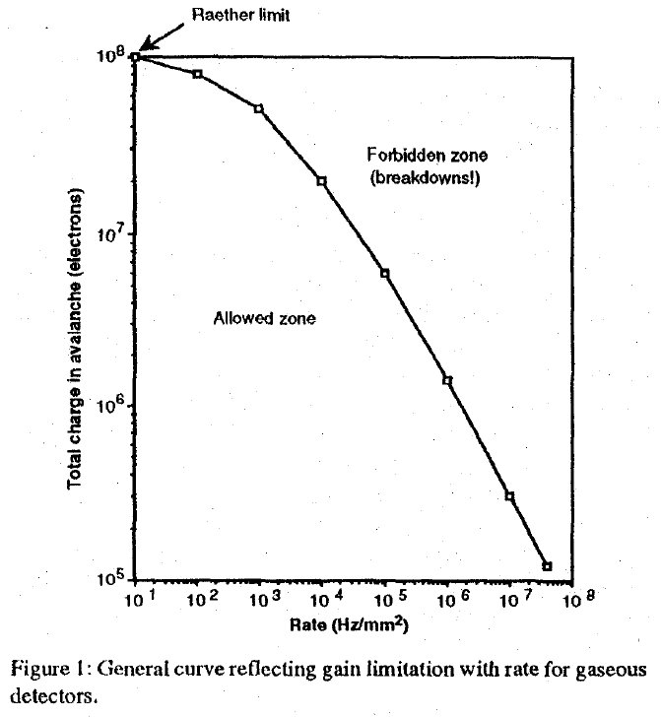
Raether Limit
• summary of ~40 years of
discharges studies in gaseous detectors
• horizontal axis: rate [Hz / mm²]
• vertical axis: Q_{total} in avalanche [# of e⁻]
remark: Q_{total} = n₀ · A
• “allowed” region of operation
• “forbidden” region of operation
occurrence of discharges:
Q_{total} > Q_{max,Raether}
→ intensive studies how to “cross” the
boarder line
→ up to now: no success to overcome the
limitations in operation caused by
(rate-dependent) Raether limit
Fonte, Peskov and Ramsey,
IEEE Trans. Nucl. Sci., Vol 46, No3, 1999

Slide 43
DC HV Scans
• HV scans: 4 dc planes at end of run2011
▪ gas mixtures: He / C₂H₆ (50 / 50)
He / C₂H₆ / CO₂ (50 / 45 / 5)
▪ μ rates: 3·10⁷ Hz (normal)
~3.5·10⁷ Hz (intermediate)
1·10⁸ Hz (high)
▪ HV: 1600 V up to 2050 V
• observation: ▪ HV trip (→ marked with x)
of different dc planes
occured as a function of Q
and not(!) of HV
→ Q_{max} reached
–
2000 V
–
x
1900 V
1800 V
1700 V
1600 V
He/C₂H₆
(50/50)
1·10⁸ Hz μ
3·10⁷ Hz μ
x = HV trip
– = hardware HV limit
= current point of operation
Fonte, Peskov and Ramsey,
IEEE Trans. Nucl. Sci., Vol 46, No3, 1999

Slide 44
DC HV Scans
• HV scans: 4 dc planes at end of run2011
▪ gas mixtures: He / C₂H₆ (50 / 50)
He / C₂H₆ / CO₂ (50 / 45 / 5)
▪ μ rates: 3·10⁷ Hz (normal)
~3.5·10⁷ Hz (intermediate)
1·10⁸ Hz (high)
▪ HV: 1600 V up to 2050 V
• observation: ▪ saturation of I(HV) curve
→space charge effects
• ongoing work to confirm this observation
with „standard formulas“, as there are
, where and
or
He/C₂H₆ (50/50)
3·10⁷ Hz μ
dc05B
He/C₂H₆/CO₂ (50/45/5)
1·10⁸ Hz μ
dc05B

Slide 45
DC Operation
• conclusions: ▪ dc‘s are operated with high gain, close to space charge limitations
▪ trip behaviour confirms Raether limit, but still safety margin wrt current
point of operation
• small increase of HV might be possible, but any possible increase of HV needs to
be balanced with increased risk of
▪ enhanced space charge effects
▪ enhanced growing of coating on anode wires
→ accelerated decrease of pulse height ?
▪ enhanced polymerisation & higher charging up rate on insulating coatings
→ increased dark / remaining currents (Malter effect) ?
▪ larger energy released by discharge due to Q = C·U
▪ exceeding the (time dependent ?) insulating capability of materials (e.g. pcb)
• keep in mind: HV values >1800 V were applied for less than 2 hours during each HV scan
→ no answer about possible longterm effects

Slide 46
Outline
• optical survey 2011 → theodolite and laser tracker
• dc operation in 2011 → HV performance
• observations → dc04 mystery
→ HV instability „sudden death“
→ dark / remaining currents
→ overall degradation of gas gain
→ limitation due to HV_{max} or Q_{max} ?
• for the sake of completeness: status new dc signal cables

Slide 47
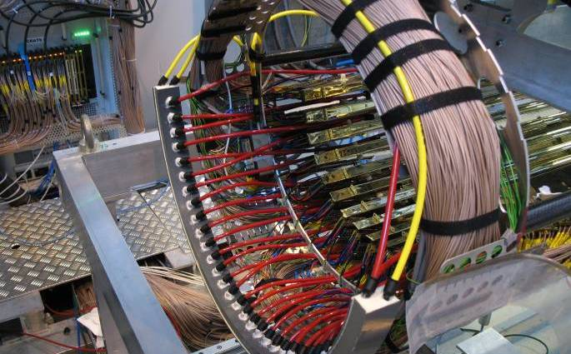
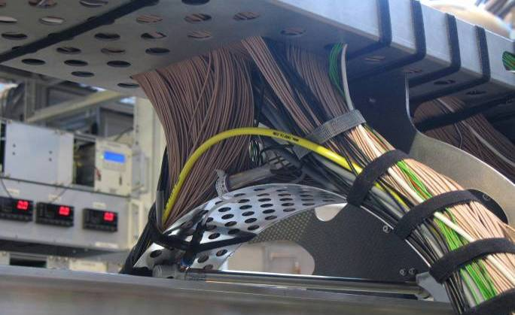
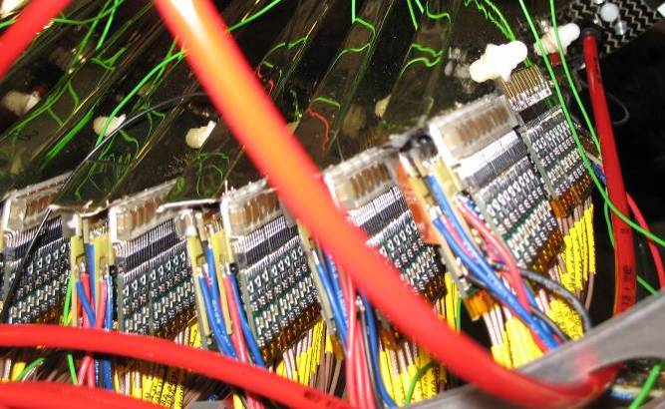
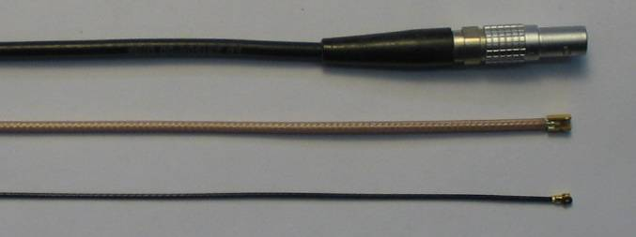
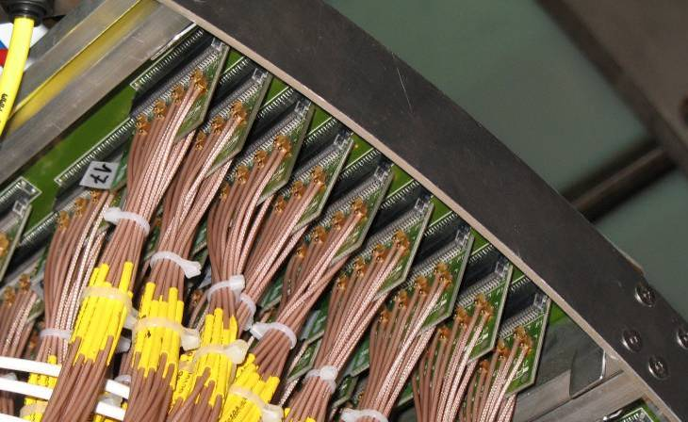
New DC Signal Cables
prospect: • increase TC-DC matching efficiency by reducing
material budget
→ thinner dc signal cables → smaller / thinner cable duct
→ thinner preamplifier pcb‘s
tasks: • choice of new signal cable, socket and connector
• design of new support structure, new cable duct
• design of new preamplifier pcb‘s and of new pcb‘s at
inside patch panel
status: • signal attenuation measured for several cables using
function generator and dc signals
• discussion with technician about „mechanical handling“
→ reliable candidate: Bando (1637 B-FLON), I-PEX
ongoing MC studies: • estimate impact of signal attenuation
• estimate / confirm the improvement in
TC-DC matching efficiency: ~41% → (44 - 50)%
for comparison:
current cable:
new candidate:
RG174, 2.55 mm Ø, connector 00
Precimation / Radial, 1.80 mm Ø
Bando / I-PEX, 0.83 mm Ø

Slide 48
Summary
• Corner cube reflectors and a laser tracker system were successfully used in
addition to the „conventional“ theodolite measurement for the optical survey of
the drift chamber modules.
• Several dc modules suffered from certain problems during run2011.
(low gas gain, dark currents, HV instabilities)
• The reason for the HV instability „sudden death“ (ocurrance with additional
electrical short circuit) was identified as an electrical breakdown on the anode pcb.
A new layout of pcb type A_L will eliminate this potential weak point.
• 7 drift chamber modules will be replaced for run2012, all equipped with new pcb.
• HV scans and gas mixture tests provided very important informations about
possible limitations of the dc system as „gaseous detector system“,
in particular concerning space charge effects and discharge behaviour.

