Slide 1
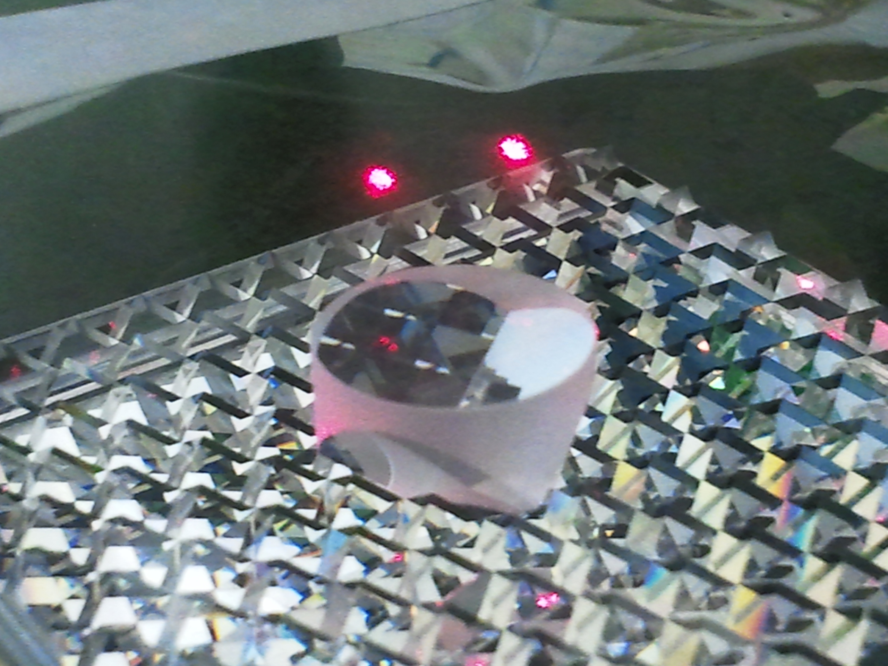
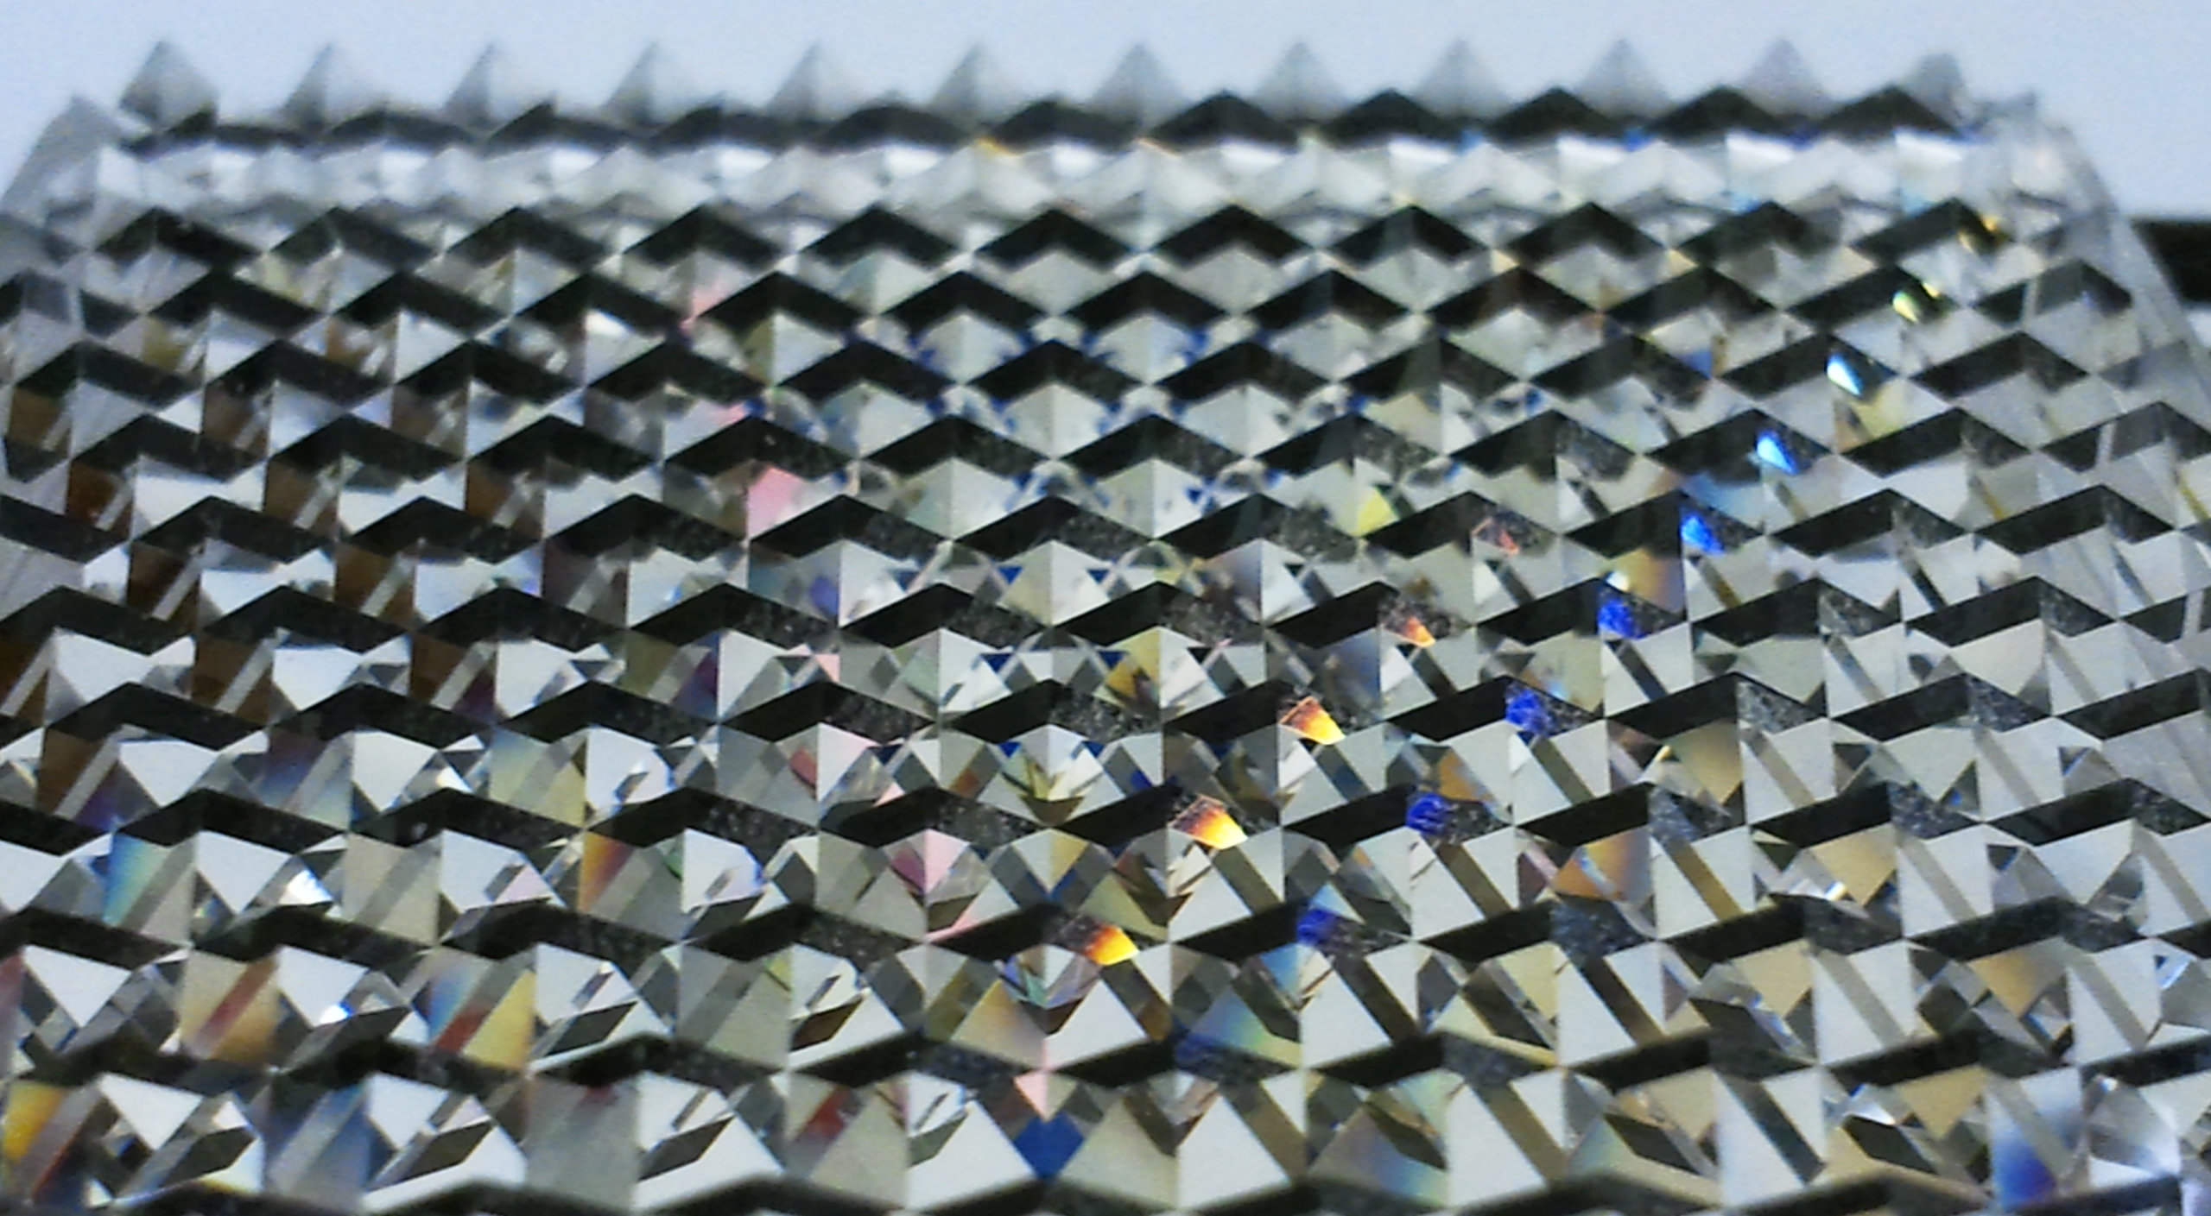
MEG 2011 Run

Slide 2
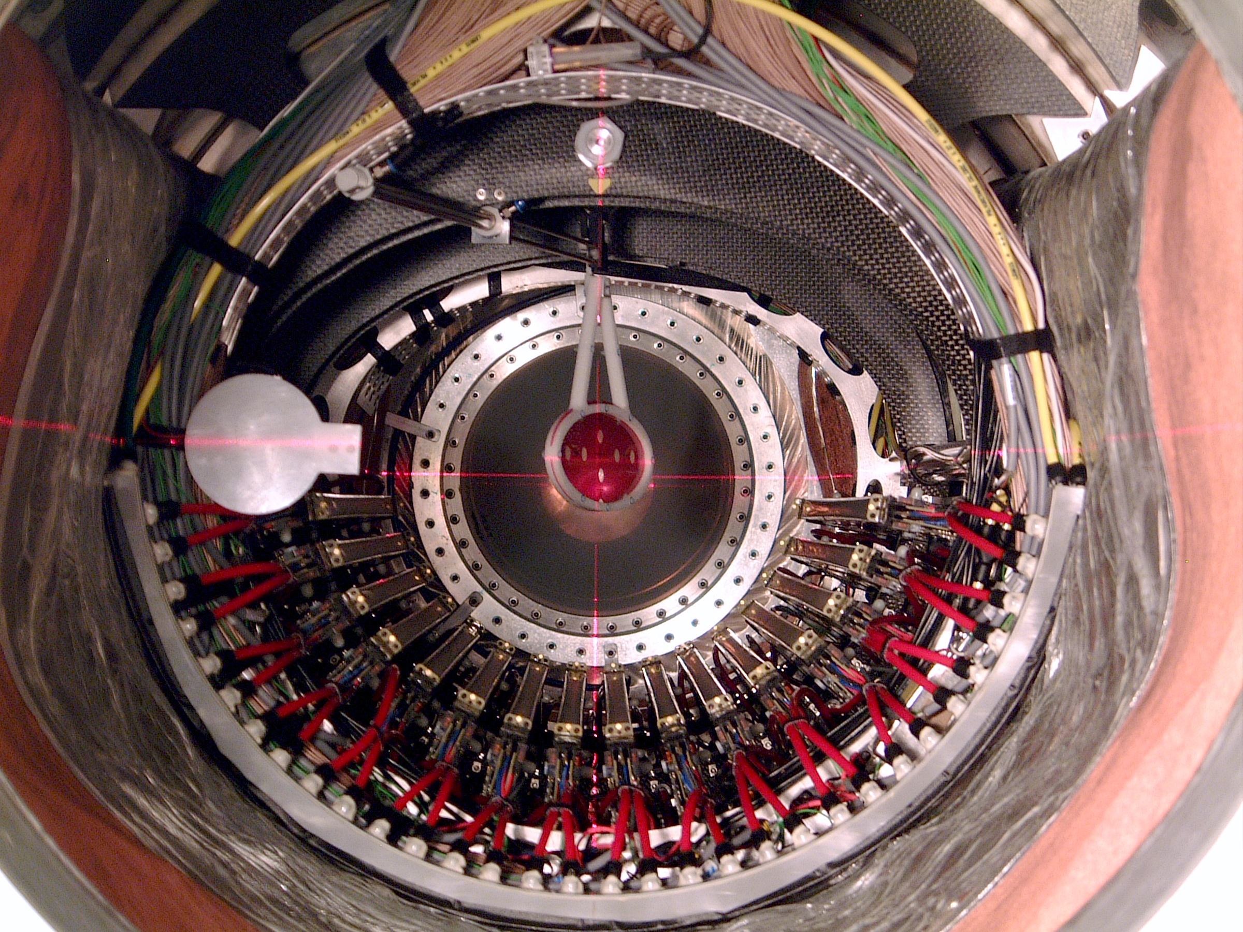
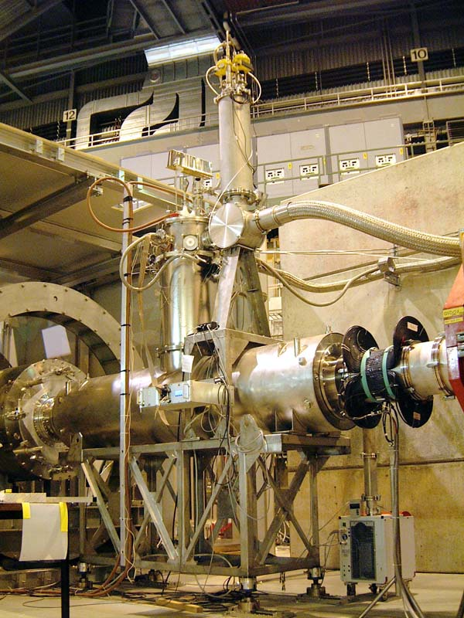
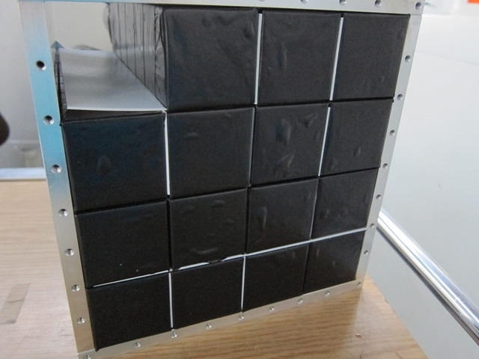
MEG 2011 Overview
VERY Successful Physics Run : Doubled 2009+2010 Statistics!!!
DCs
Beam
BGO
New DC HV-system successfully
introduced to reduce noise –
though effect on resolutions was
counter-balanced by gain-
degradation suspected to be due
to aging effects ⇨ talk Malte
New DC alignment system laser-
tracker + prismatic corner-cube
reflectors ⇨ talk Malte
Gas + beam intensity studies undertaken
Shows may be also possible to
work at ‘’Intermediate intensity’’
⇨ talk Malte
BGO array replaces NaI array
in CEX
- finer granularity,
- 30% improved σE/E at 55 MeV,
- improved position resolution,
- 30% increase in LT to 97%
- factor 2.1 > in efficiency
REDUCES π⁰ calibration time by 2
⇨ talk Toshiyuki
BTS major repair &
safety modifications
(end 2010 + Spring 2011)
– proved to be successful
Ran contiuously for 212 D
Beam-rate Optimization
low, Normal, High &
Intermediate intensities
for 2011 detector intensity
tests

Slide 3

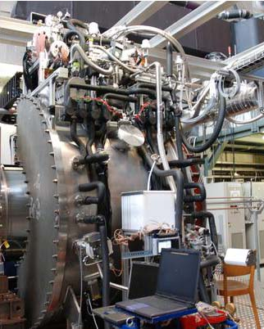
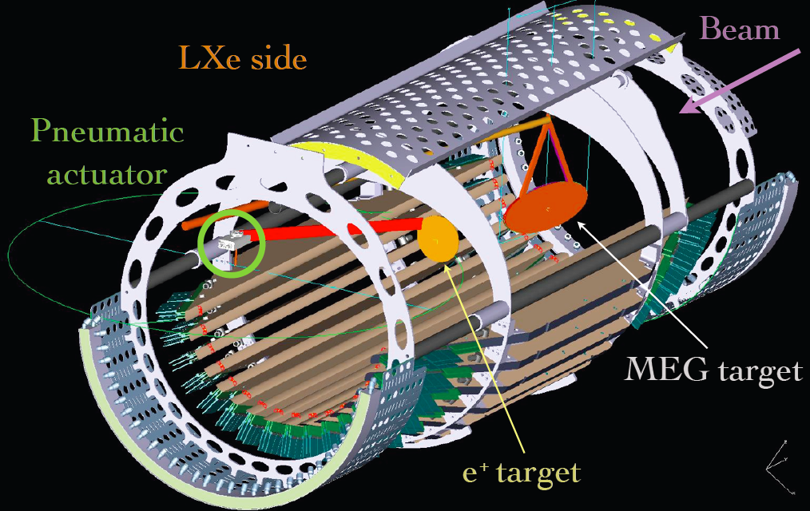
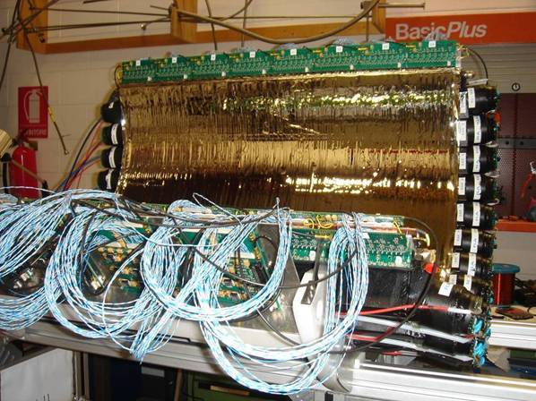
MEG 2011 Overview Cont.
Calibrations
TCs
Calorimeter
Mott scattering e⁺ Beam
- study of cloud muon
contamination 50 & 53 MeV/c
- RF introduced 1st time
- Mott & MEG target data taken
RF-selection gives good
monochromatic line
σ_{E} ~ 450 keV (8‰ σ_{E} /E)
Neutron generator with
9 MeV Ni gamma-line used as
standard calibration tool
Dedicated Cosmic Alignment
data runs taken throughout run
period
Stable operation of calorimeter
- slow 4% LY-loss (well
monitored & compensated)
- PMT gain-loss at 2010 level
0.1%/D
- improved energy resolution
- beam intensity studies show
pile-up rejection works well
even at R_{μ} ~ 1⋅10⁸ Hz
Shows could work at
increased beam rate 2012!
TC bar performance
- stable operation
- performance comparable 2010
⇨ talk Matteo
TC Fibre performance
- US-side 10% noisy channels
excluded (influence on DC)
- performance not sufficient for
online trigger inclusion
- used for ‘’offline’’ analysis
⇨ talk Matteo

Slide 4
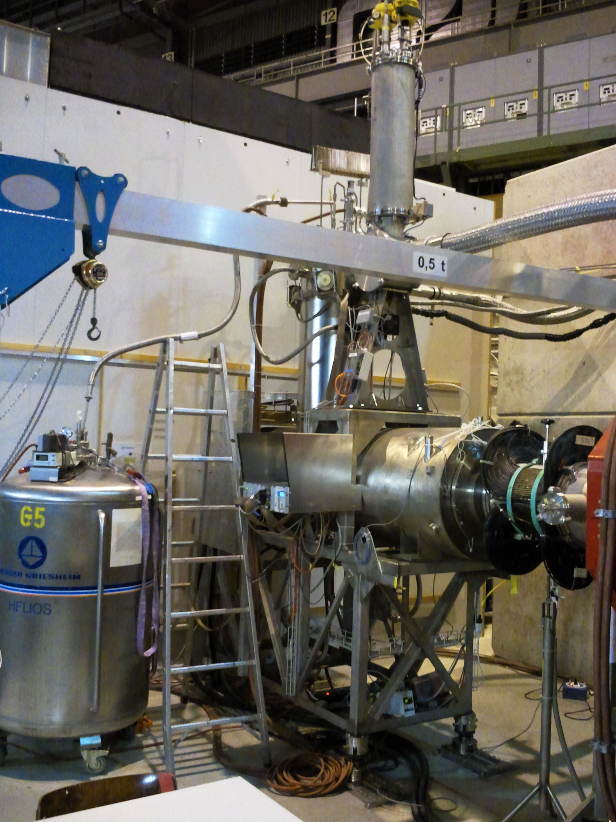
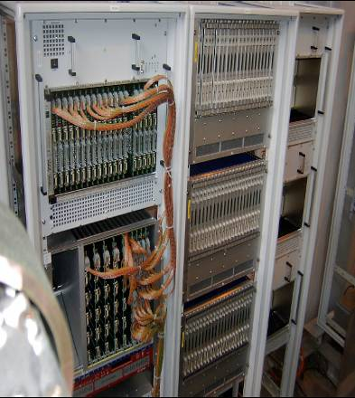
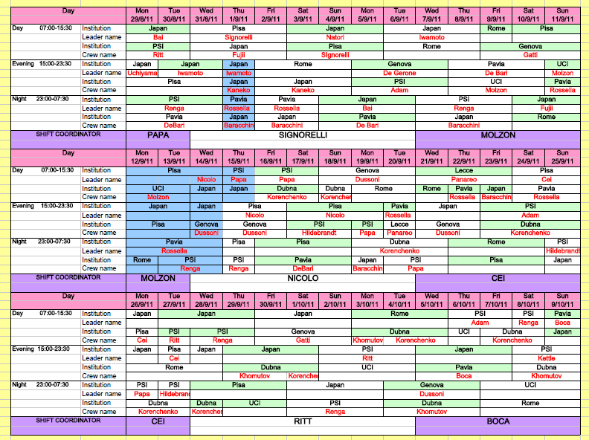
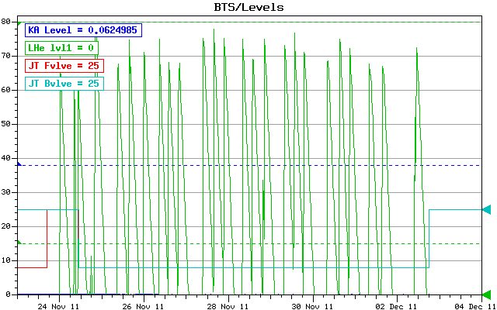
MEG 2011 Overview Cont.
Power
Outage
Trigger+DAQ
Organization
Trigger/DAQ Performance
- Multi-buffering used as standard
- LT increases to > 99%
- MEG trigger rate 511 Hz
- direction-match LUT relaxed
without loss of efficiency
- UCN spill compensation for
LXe PMT-gain change
(<1% effect)
in trigger BUT! available
UCN-signal needs optimizing
Power Outage
- kills Cryo-plant 4 down
till next year
- setup for BTS dewar operation
once another source LHe ready
- 10D beam loss to MEG
- successful dewar operations
all tests could be finished
Remote Shift Scheme introduced
- during Physics Run Part-II
- full set of ‘’remote tools’’ to run
experiment over Internet
- added monitoring & surveillance tools
- added electronic control room aids
Cryostat filling

Slide 5
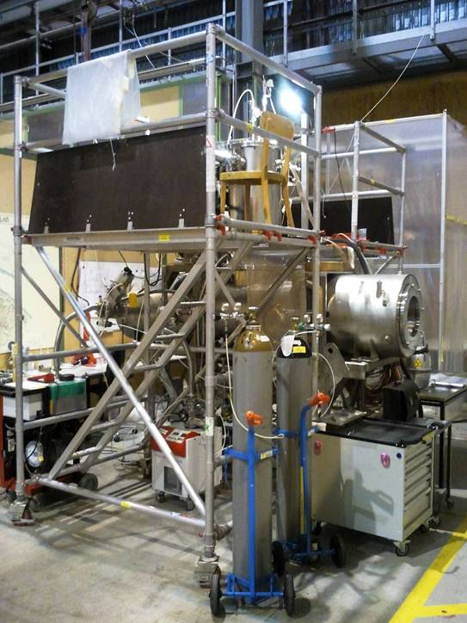
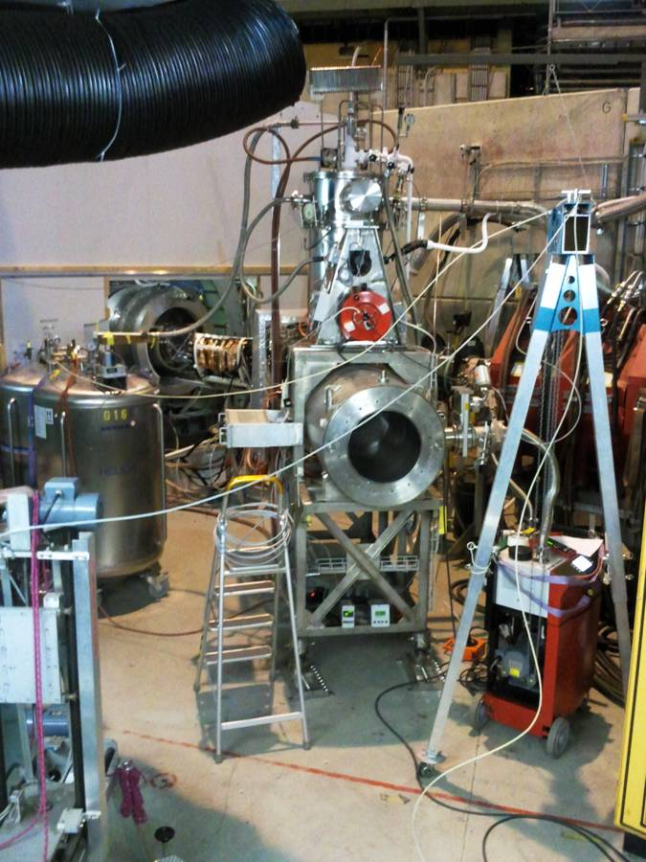
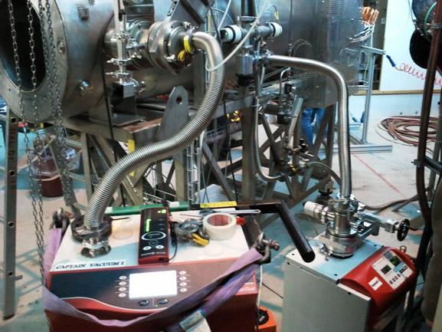
2011- the Start
January
BTS Re-mounting
outside 𝛑E5 after
Repair/modifications
Back to “Square One”
TOTAL Spectrometer
DISMANTLED + part of
Beam Line
Before Run 2011
March:
DCs de-cabled
EC + IS removed
US/DS TC out
End May:
DC-installation (5W delay
replacement DC construction
proved technically more difficult)
+ 1W minor delays
Beg. February
Cool-down Test
In 𝛑E5

Slide 6
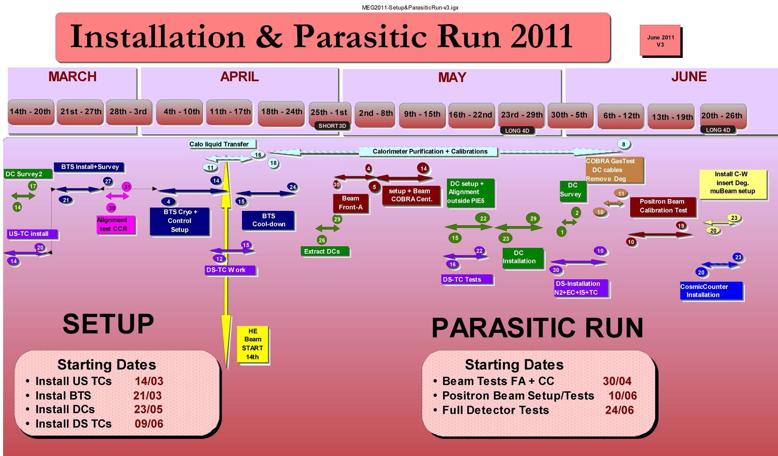
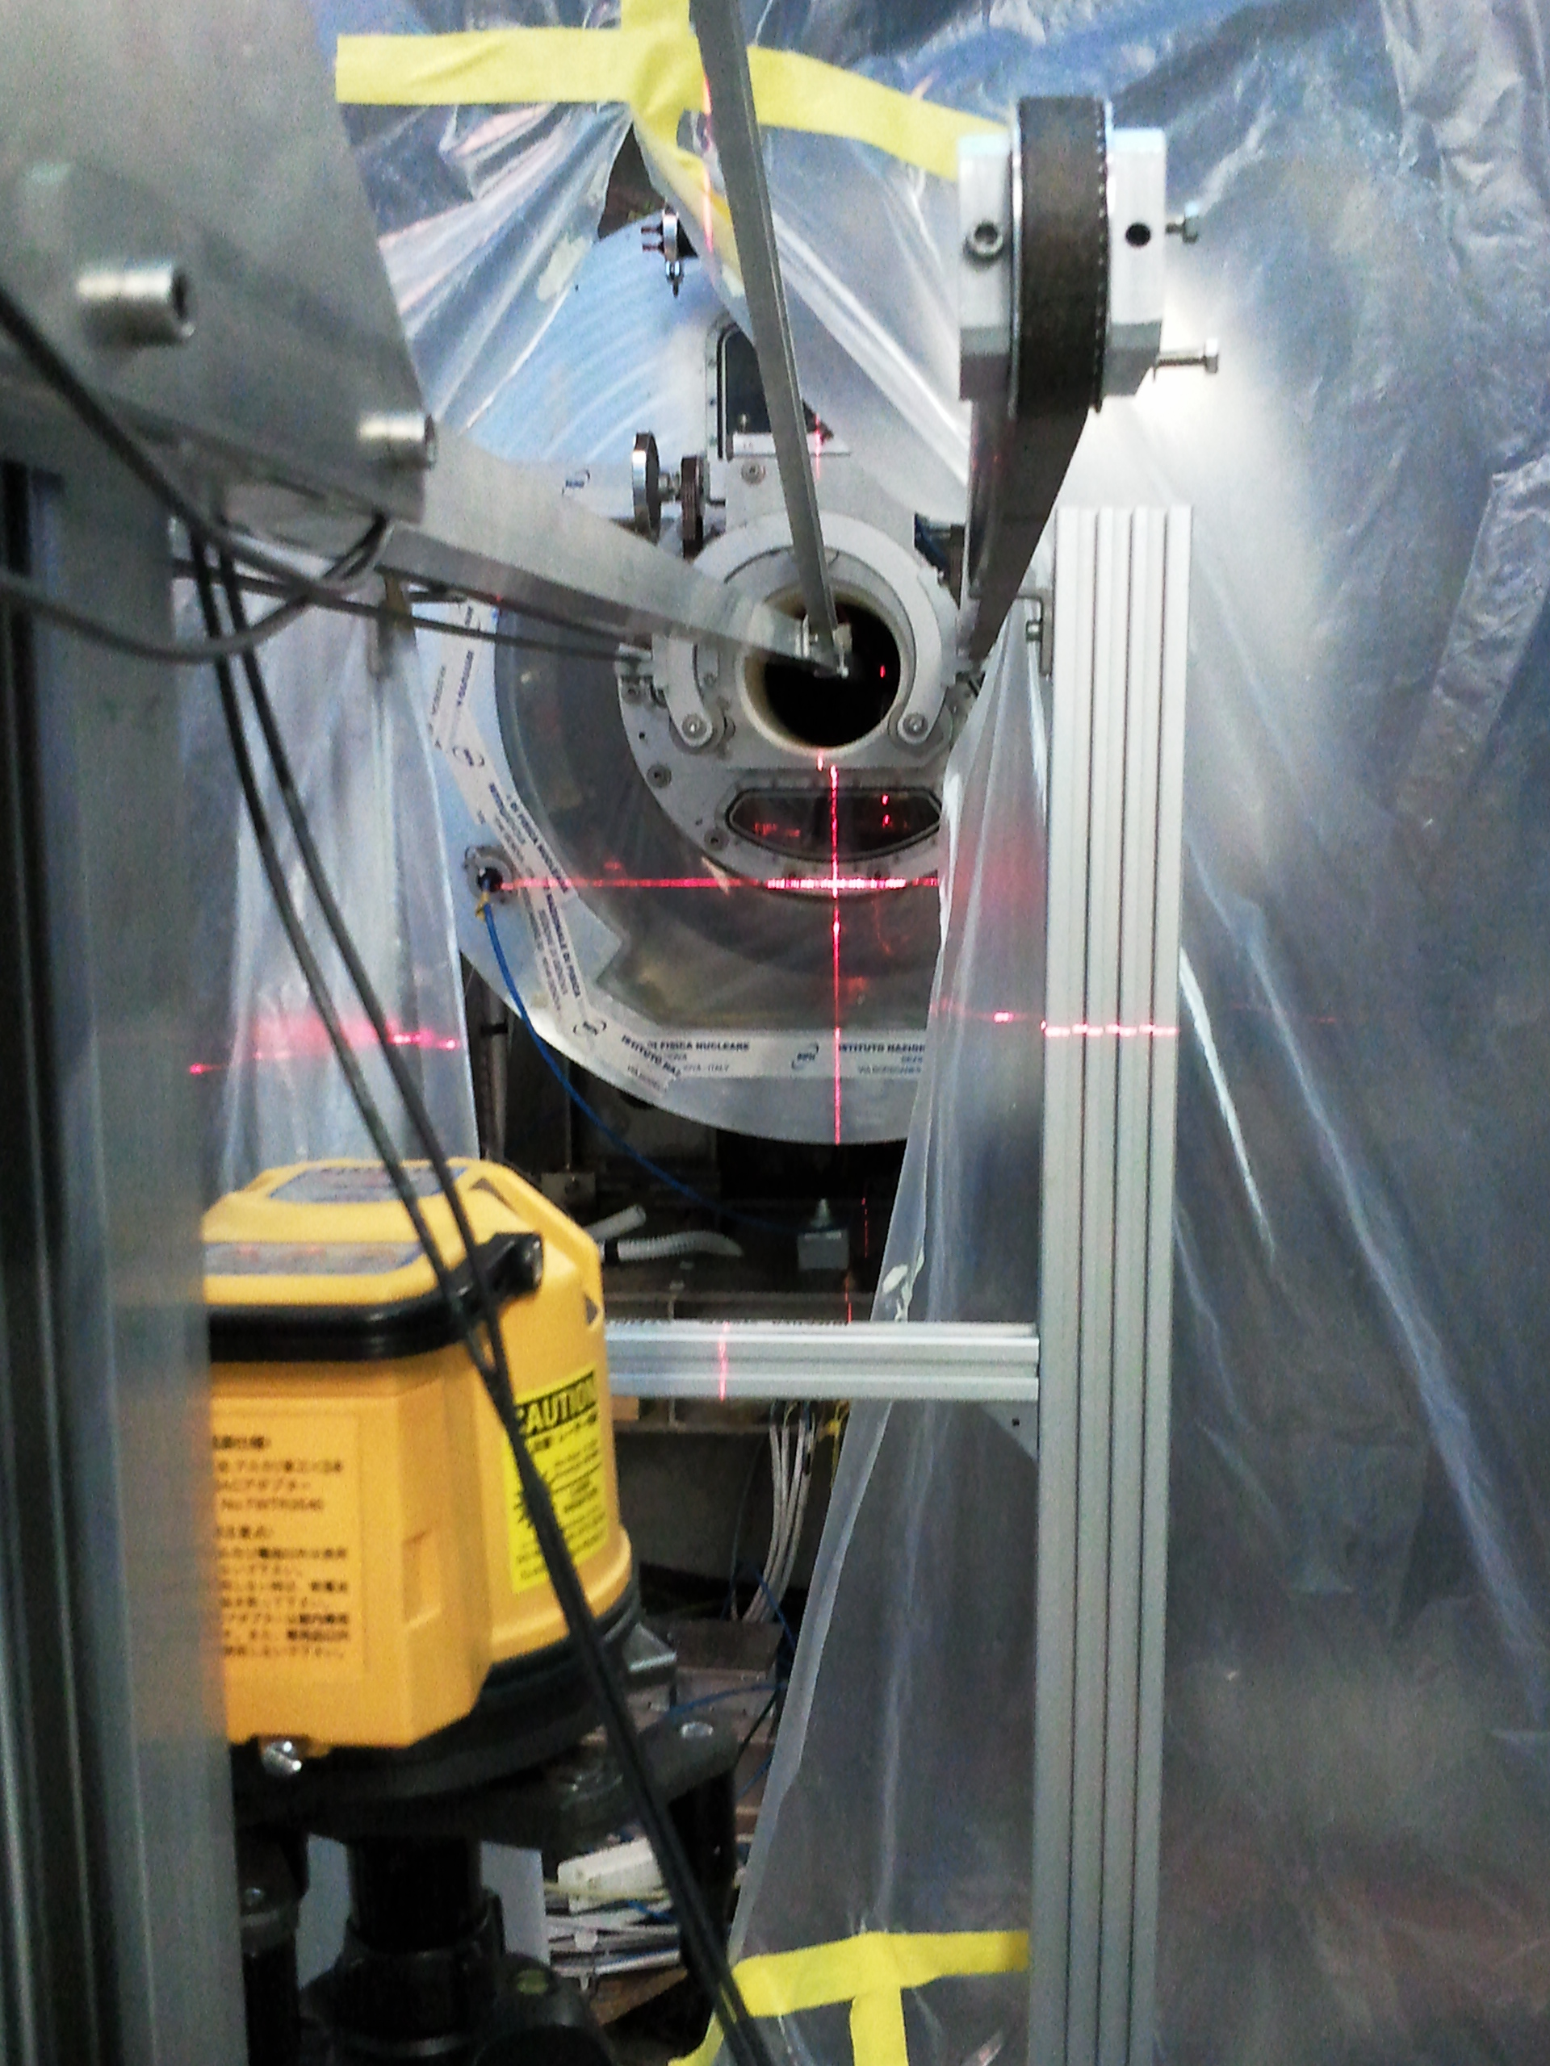
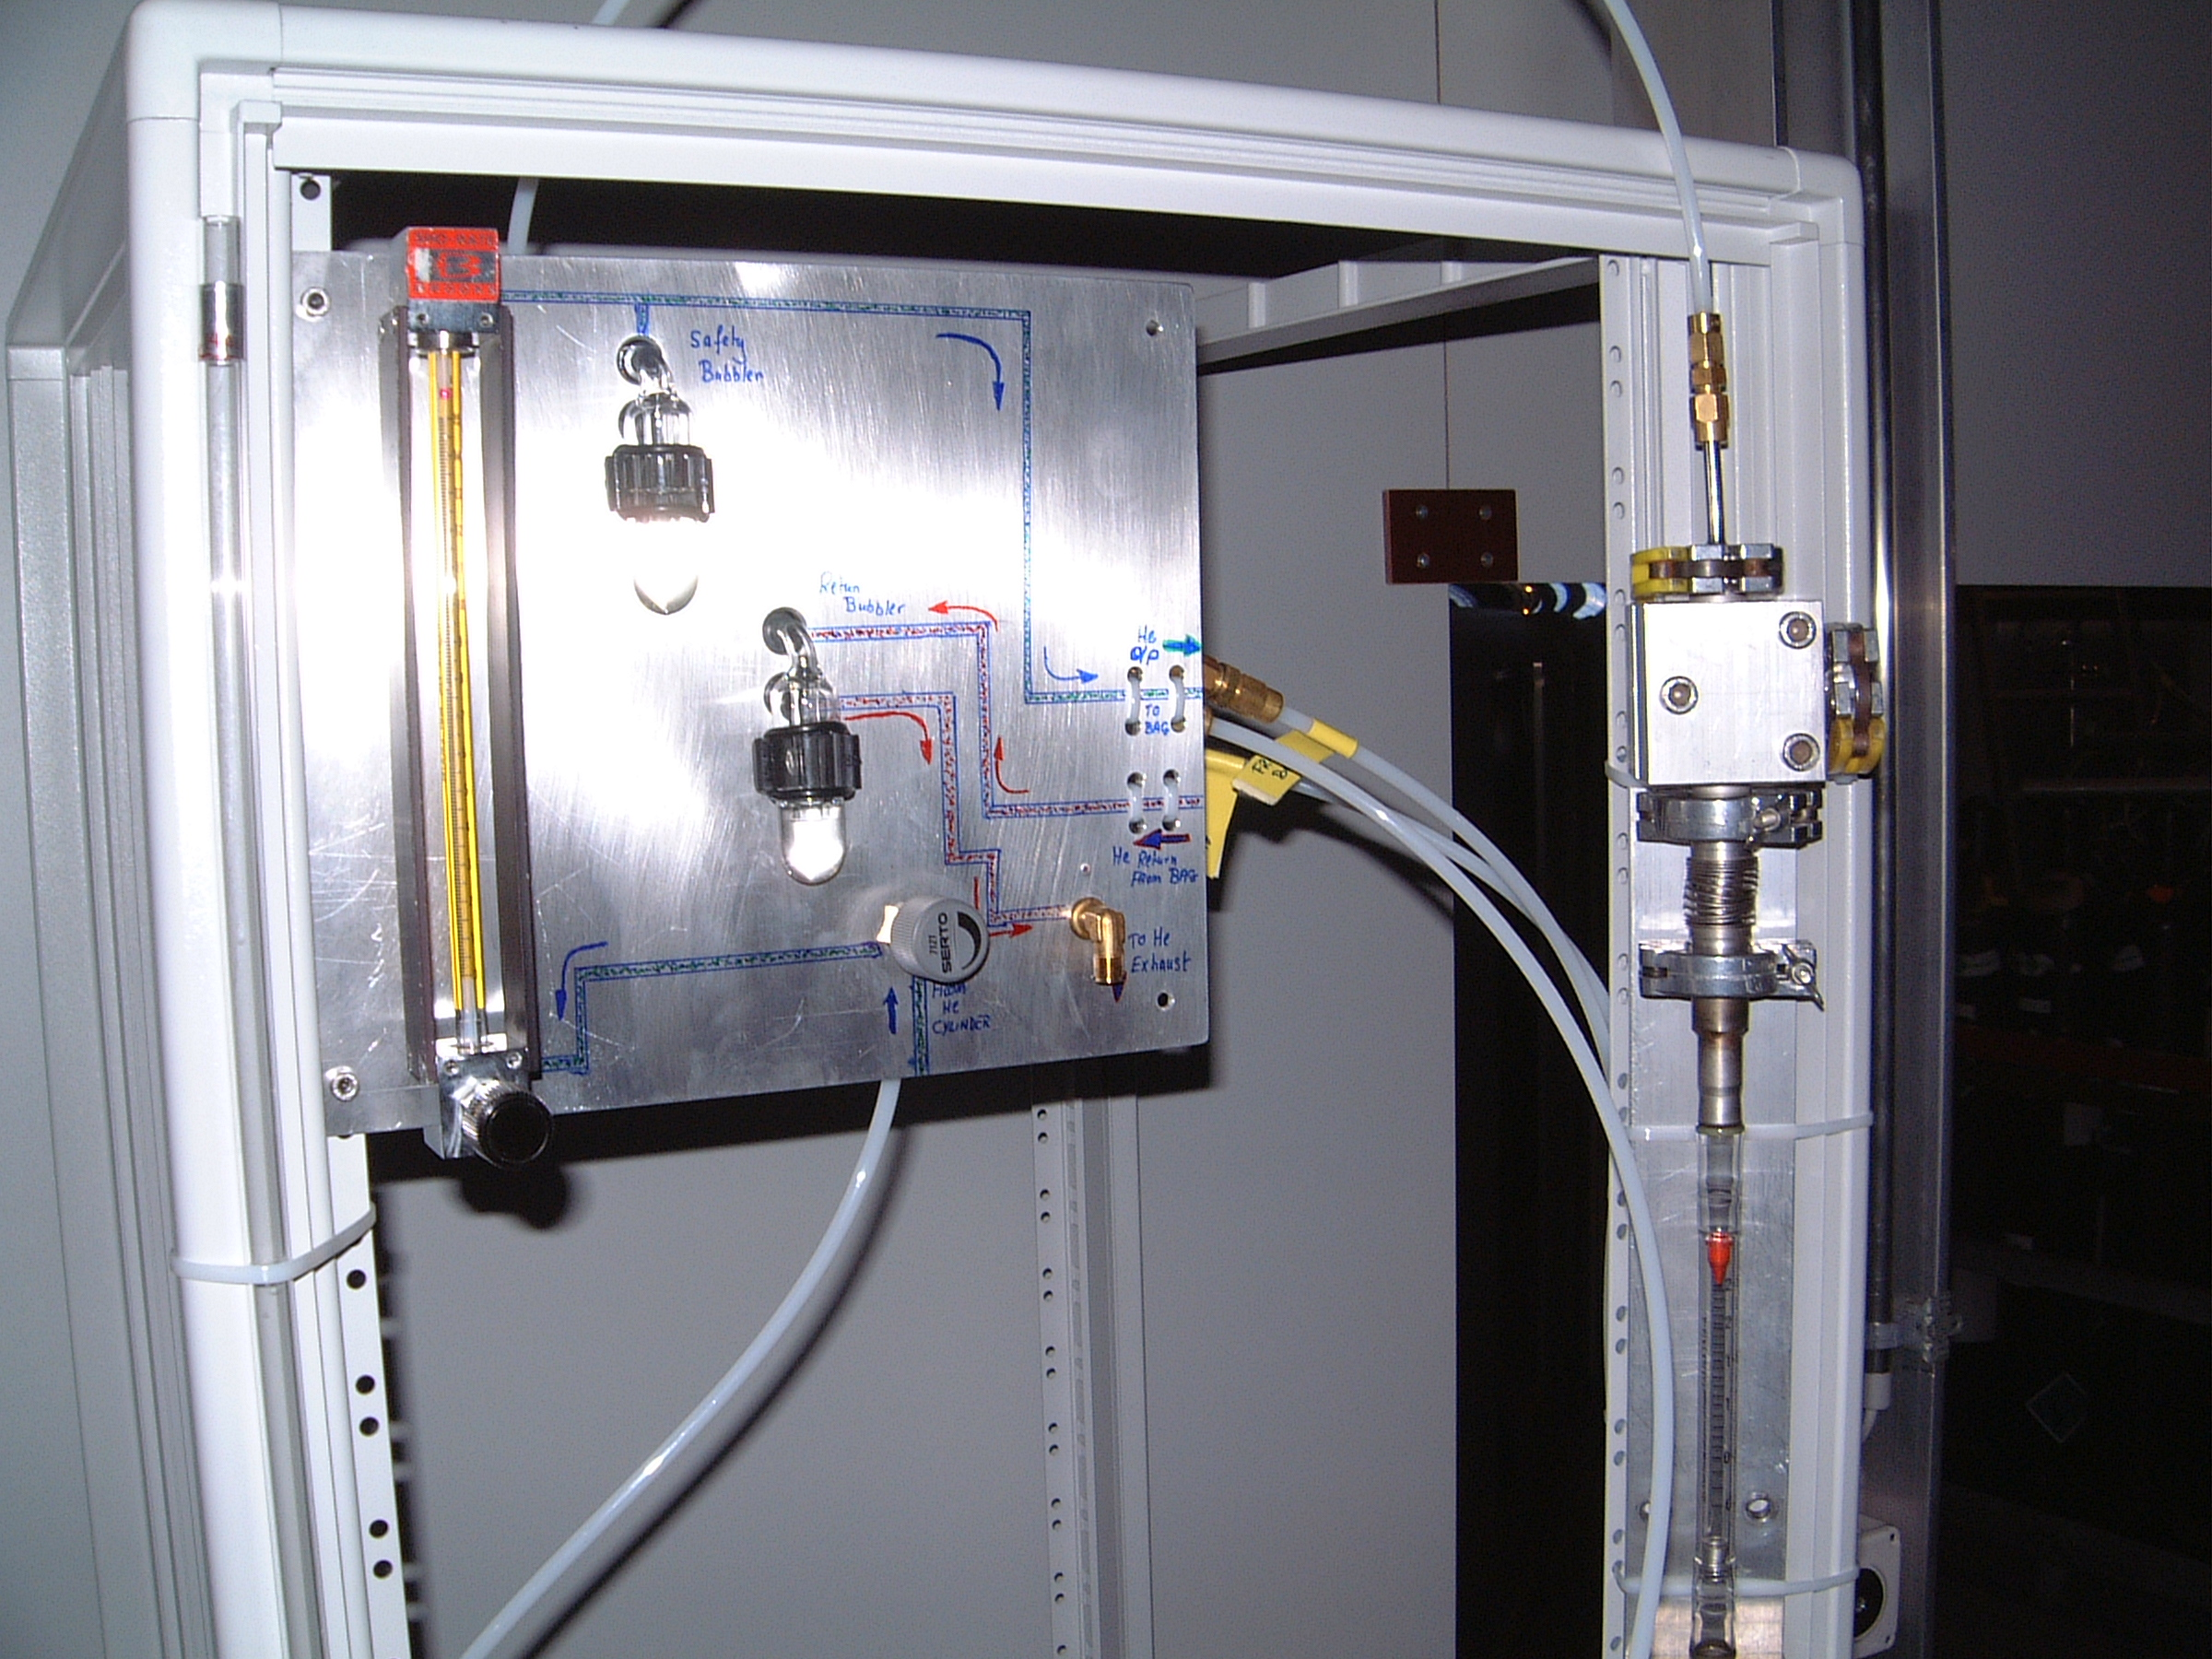
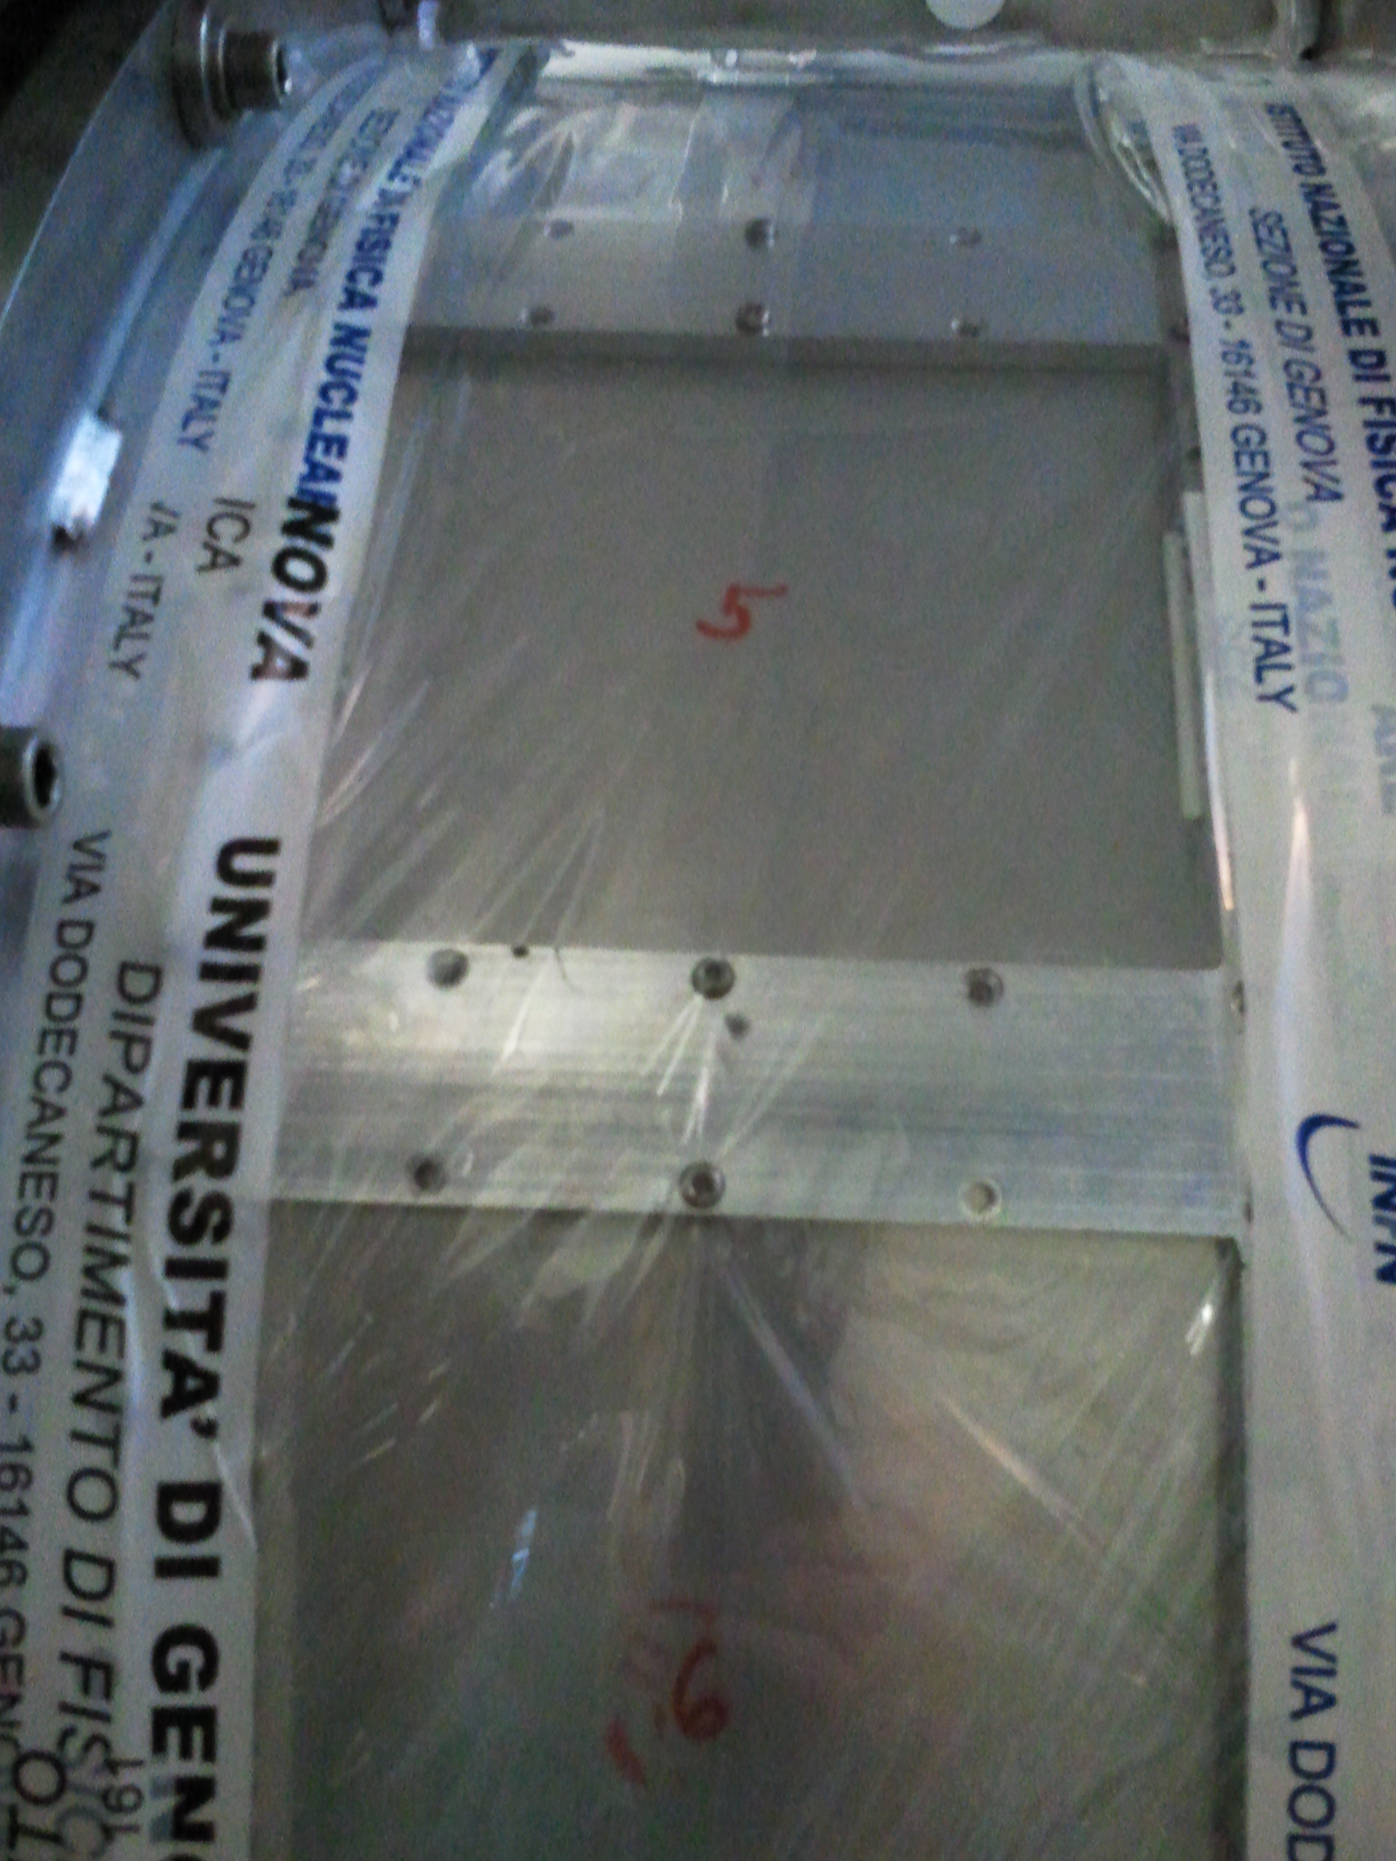
Schedule 2011
Split beam optimization & calibration time + positron beam test to minimize
influence from DC construction & installation as well as survey preparations

Slide 7
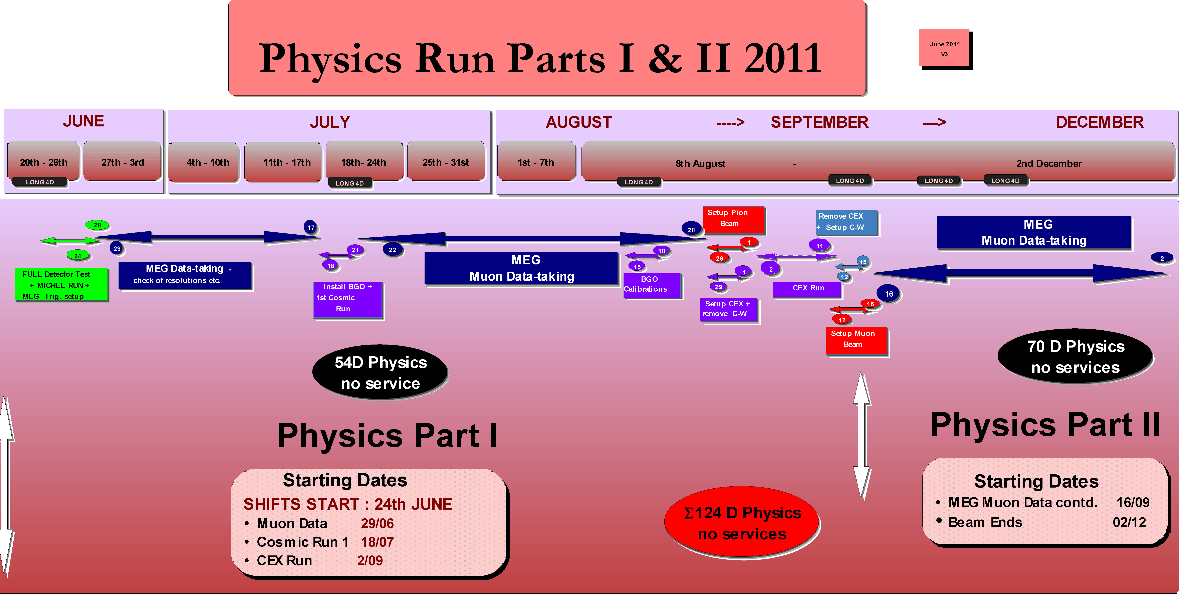
Physics Run
shifts started on schedule 24th June
due to the extensive detector testing + trigger setup “week” (24th-28th June)
MEG data-taking was also started on schedule & very efficiently
CEX calibration run flexible, in September
power-outage mid. Nov. Kills cryo-plant 4 (loss 10 D) MEG recovery using BTS Dewar-operation

Slide 8
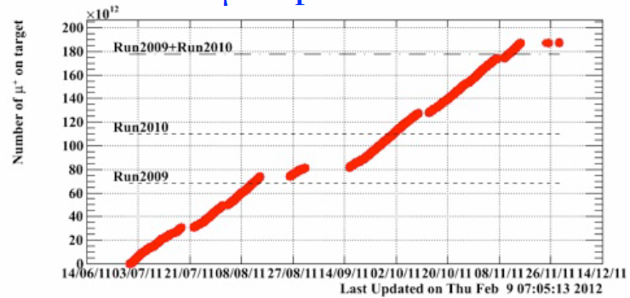
2011 in Numbers
2011
µ-stops on Target
Dewar
Statistical – MEG’s most
Significant Physics Run
Cryo-
Plant
Down
CEX
10 Day Beam-loss
due to unexpected
power-outage & loss
of cryo-plant 4
Acc
SD
  2011 Double the Statistics of 2009 + 2010
  (based on Normalization)
  2011 1.9⋅10¹⁴ µ-stops compared with
  2009+2010 1.75⋅10¹⁴ µ-stops
  113 Physics Days/81.3 DAQ Days
  62.4 M Triggers (MEG) – 30998 Runs @ 2k events
  Total of 1213 shifts & remote shifts

Slide 9
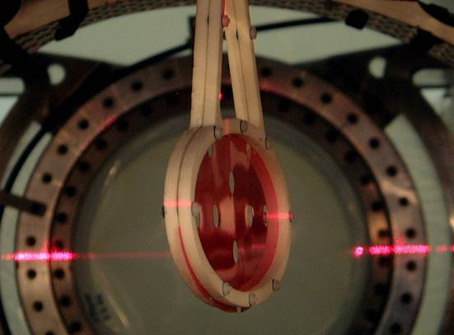
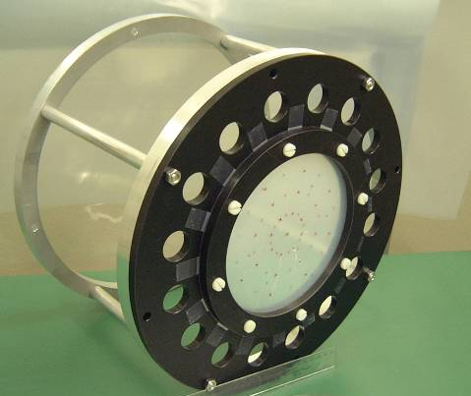
2011 Run Conditions
Muon Target Parameters:
- target
inclination
angle
Inclination Angle β =(20.0±0.3)º
Thickness 205 µm CH₂/Polyester Sandwich
Density 0.895 g/cm³
Degrader
Degrader:
Thickness 300 µm Mylar
Density 1.395 g/cm³
He/Air 95%/5%
Beam Intensity: -
Mode | Beam Rate measured COBRA Centre at 2.2 mA 300μm Degrader, He/Air 95%/5%
‘’Low’’ (slits 75) | 1.2•10⁷ μ⁺s⁻¹
“Normal” (slits 105) | 3.6•10⁷ μ⁺s⁻¹
“Intermediate” (slits 115) | 4.2•10⁷ μ⁺s⁻¹
‘’High’’ (slits 250/280) | 9.2•10⁷ μ⁺s⁻¹
⇨
Stopping Rate for physics Run (300μm degrader) at 2.2 mA ~ 3·10⁷μ⁺s⁻¹
Notes:
9

Slide 10
2011 Preliminary Data Quality c.f. 2010
DCs
TCs
Calorimeter
- 9% high ‘’core’’ contribution
10% better φ-resolution
slightly improved θ-resolution
5% improved z-vertex res.
9% improved y-vertex resolution
5% improved t_{eγ}-resolution
noise suppression FFT-technique
gives resolution improvement
BUT
lower chamber gain – (aging?)
counteracts improvement
- Michel-edge asymmetry under study
σ_{E}/E (w> 2cm) ~ 11% better
better uniformity than 2010
energy-scale linear at 0.2‰
level (50% statistics)
- most resolutions consistent
with 2010 level
some problems with NIM
timing signals – solved
with ‘’offline’’ template fit

Slide 11
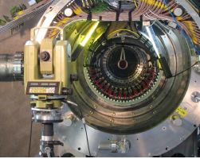
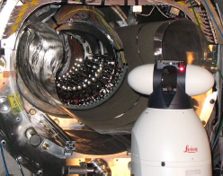
New Spectrometer Alignment System
REASON: Improve previous theodolite-based DC-survey measurements - Why?
Previously theodolite method dependent on TC N₂-Bag being extracted ∴ survey NOT
performed under final detector conditions
Large uncertainty on z-measurements due to theodolite "forward intersection method"
Can One Improve...YES using Laser-tracker which combines
⇨ laser interferometry distance measurement
+ absolute distance meter
Need implementation solution for light reflector on DCs
⇨ "Corner-cube" Reflectors

Slide 12
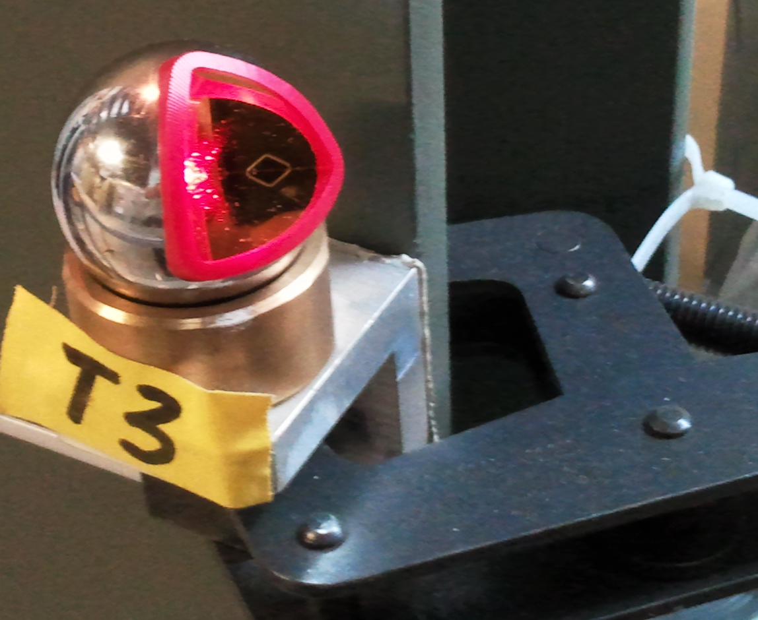
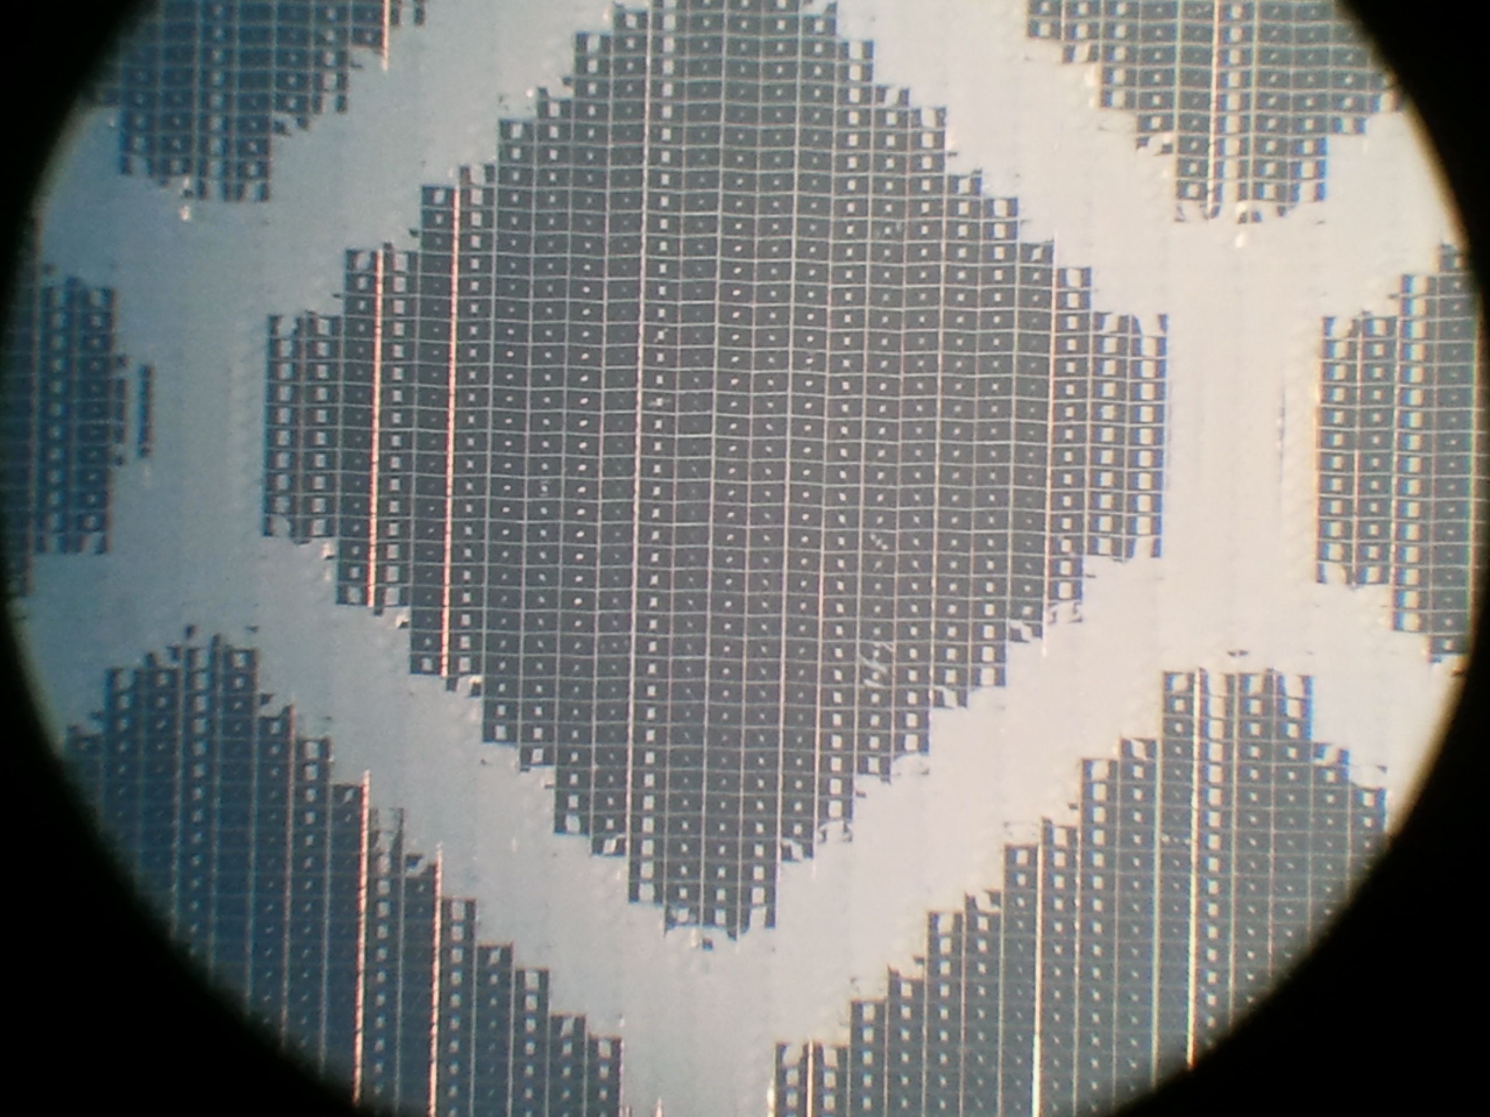
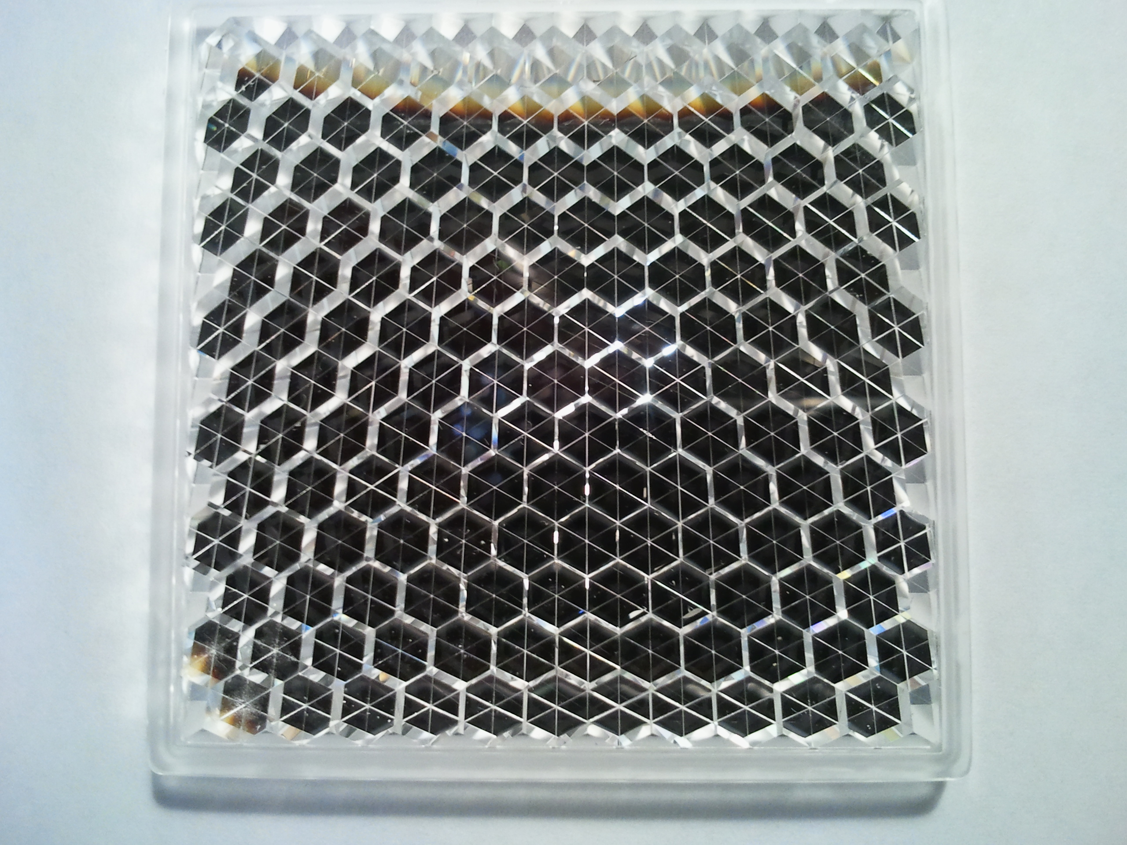
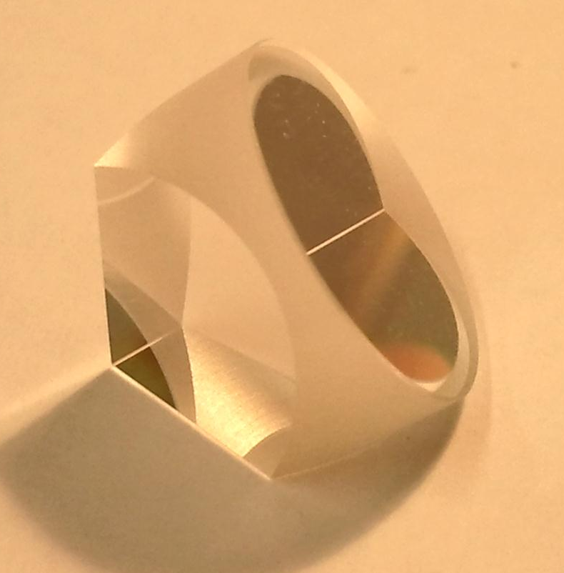
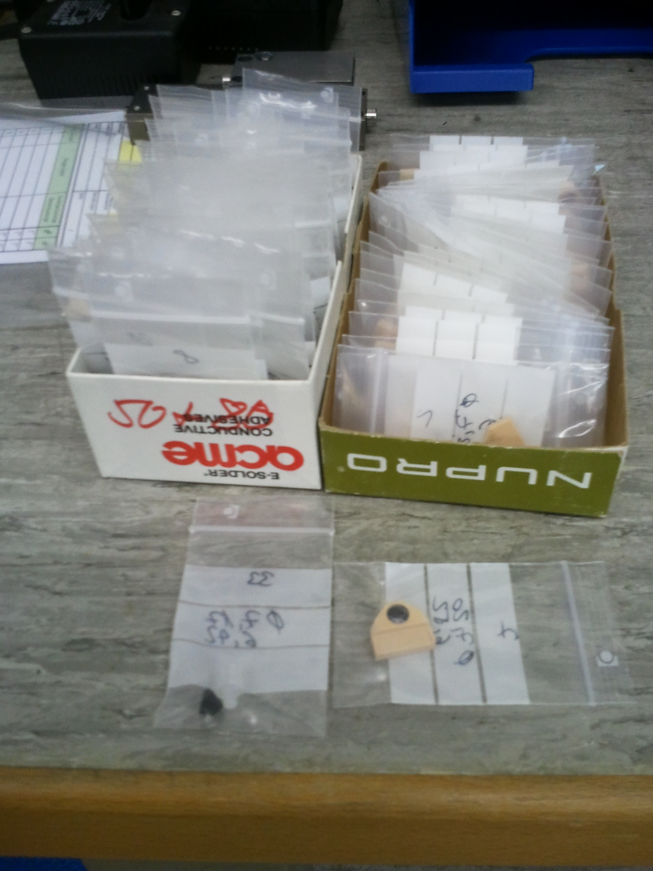
Alignment Cont.
Ideal: mirror corner-cube retro-reflectors
– PROBLEM dimension too large for mounting on system
Studied several possibilities – corner-cube ‘tapes’, ‘foils’, ‘plastic arrays’, prismatic retro-reflectors
only ‘prismatic’ type proved useable
at 630 nm
Principle of corner-cubes:
- reflected beam parallel to incident beam
irrespective of prism orientation
- optical path-length OPL= ∫ n(l)⋅ dl is constant
inside the corner-cube if n=constant
- OPL ∝ apex length
- high qulity BK7 borosilicate crown glass n=1.51519 (630 nm)
Corner-cubes individually catalogued:
- 70 corner-cubes (need 66 for DC-system) individually assessed

Slide 13
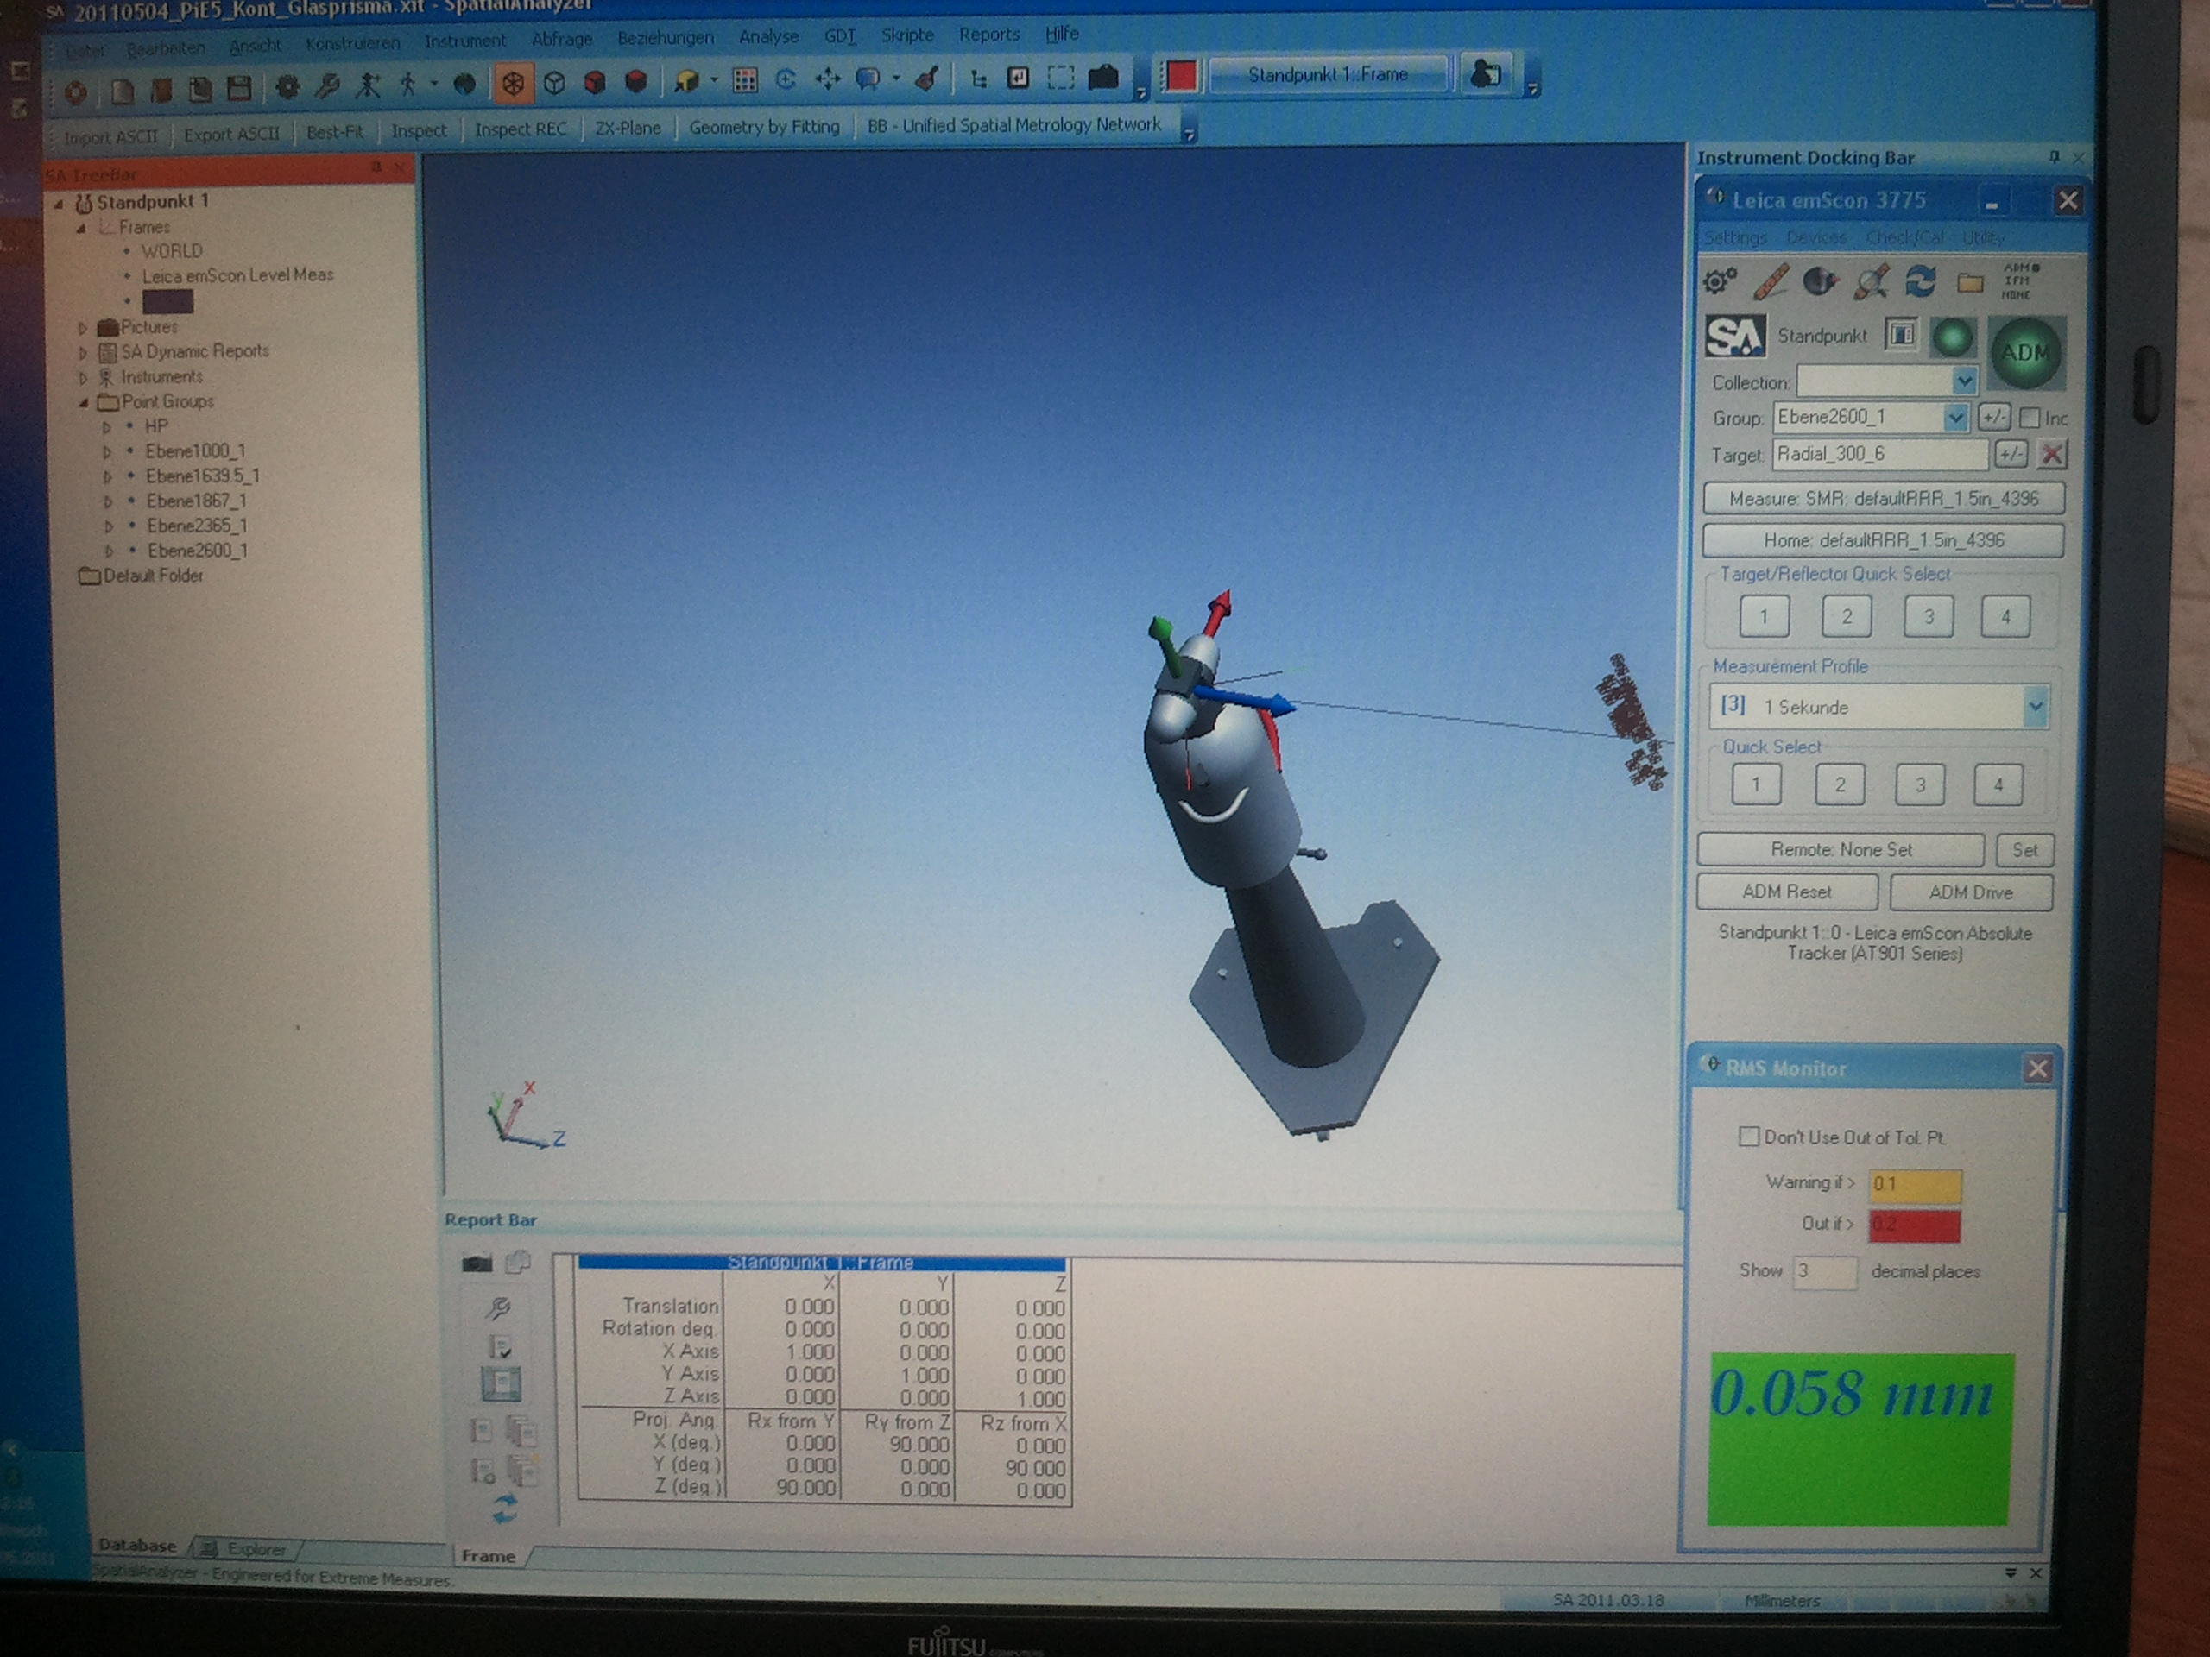
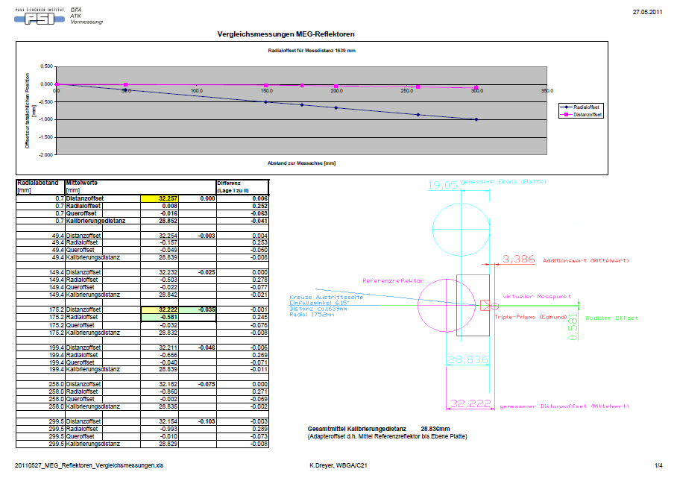
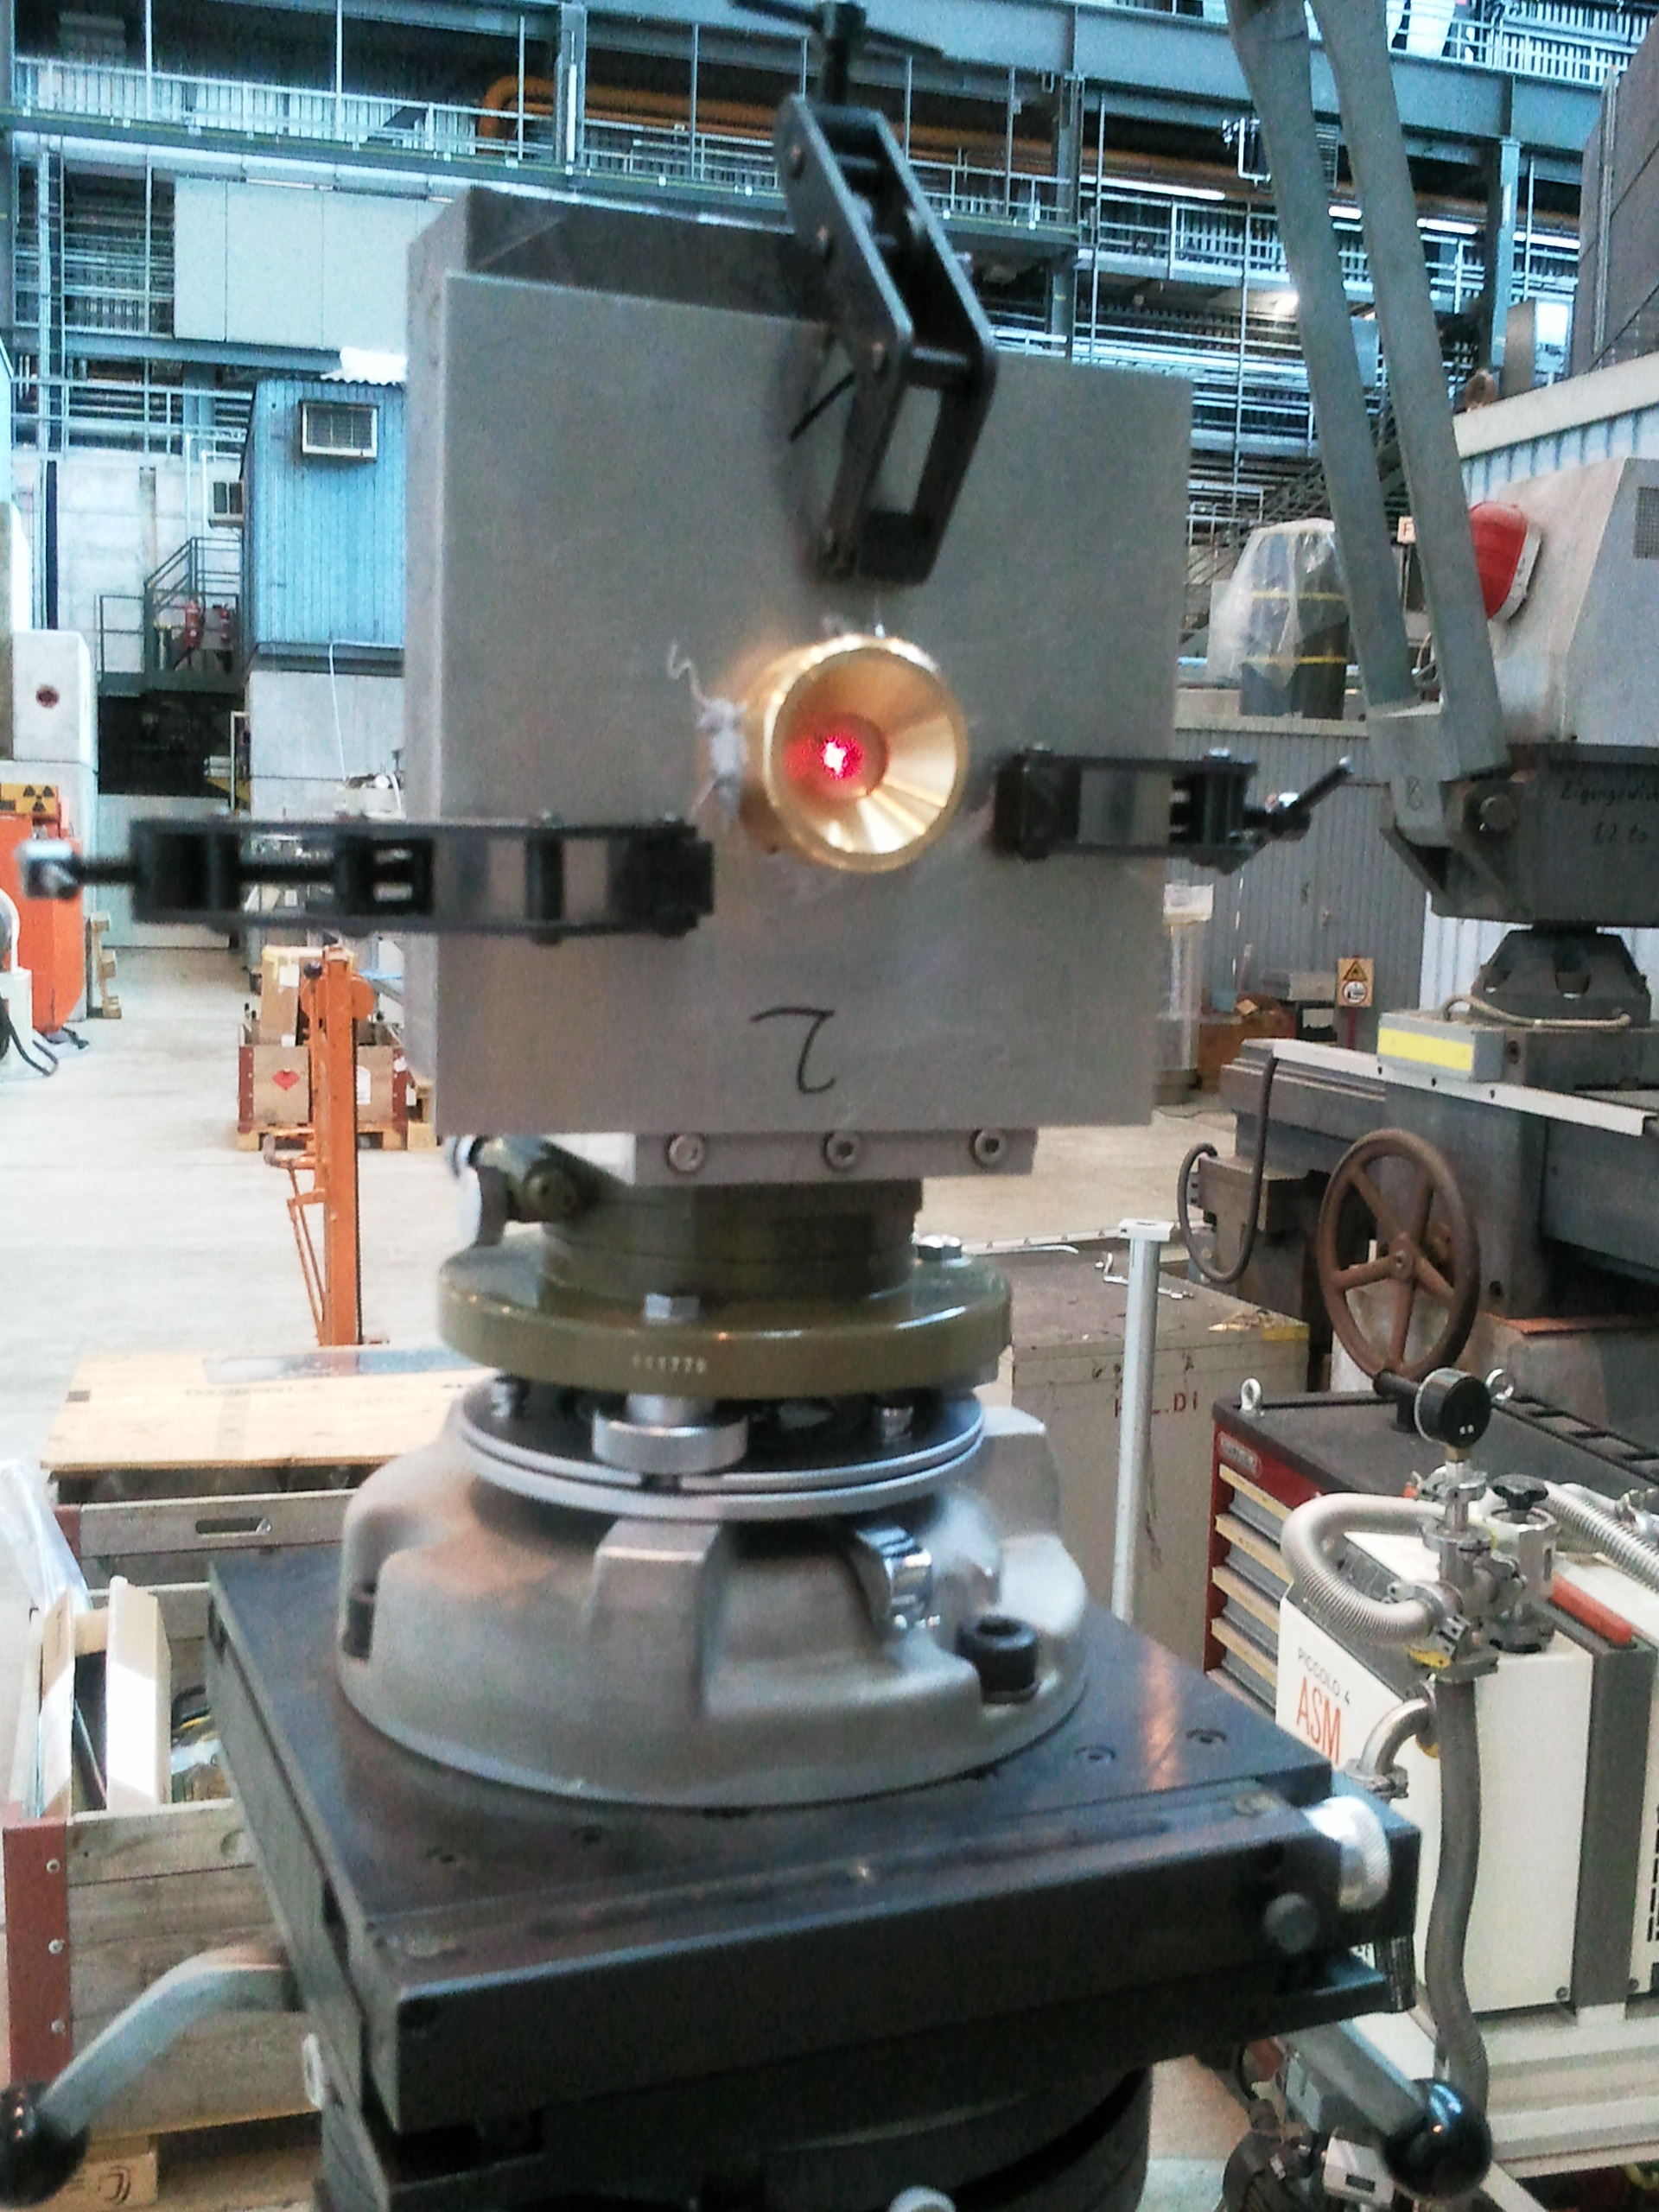
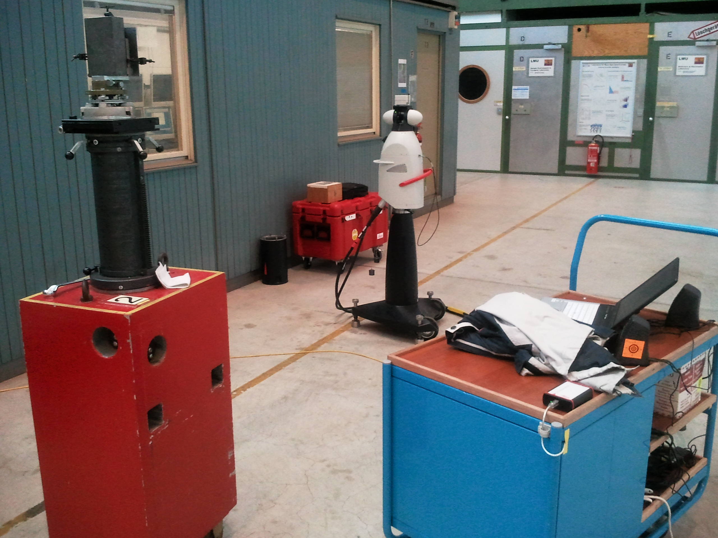
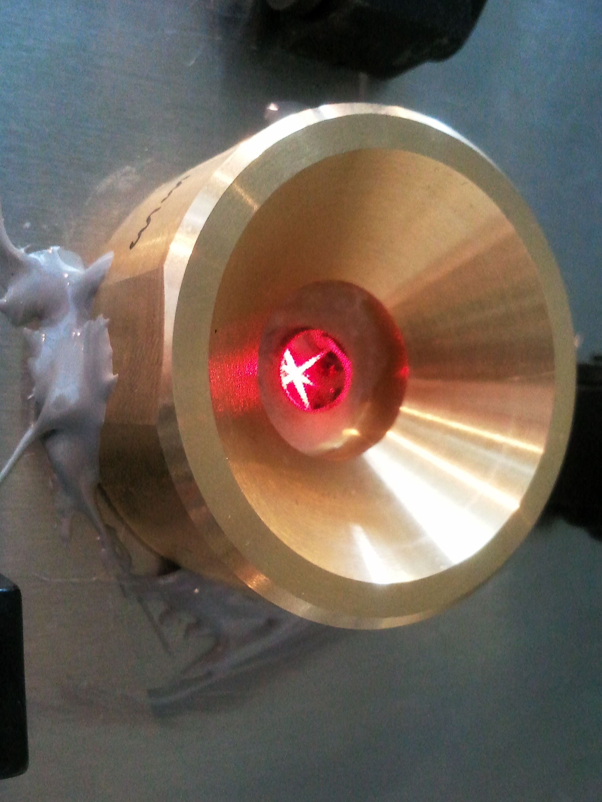
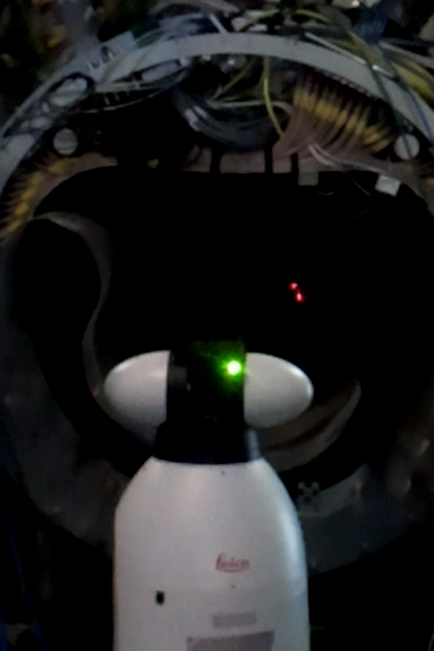
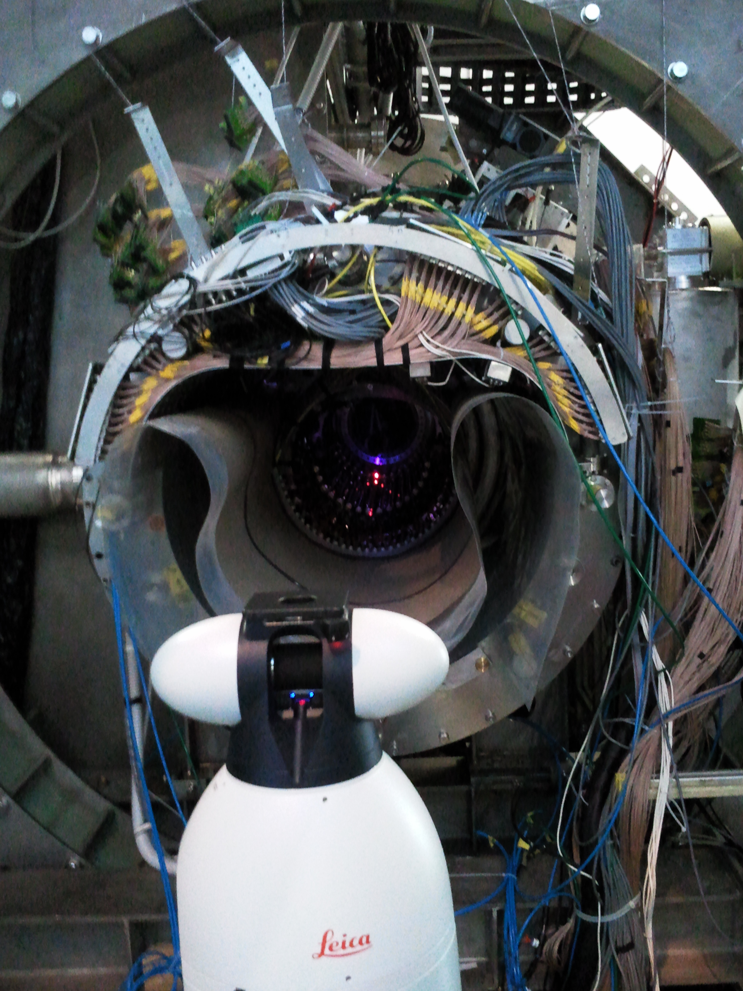
Alignment Cont.
However prismatic corner-cubes need extra calibration
due to ‘refraction effects’ which vary with incident angle at the surface of the prism
Angular calibration Measurements
Implementation on DC-system ⇨ talk Malte
Area Implementation
Solution found so that both theodolite &
laser-tracker measurements could be done
X-check
X & Y both methods consistent
Z laser tracker estimated ~10 x more precise

Slide 14
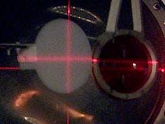
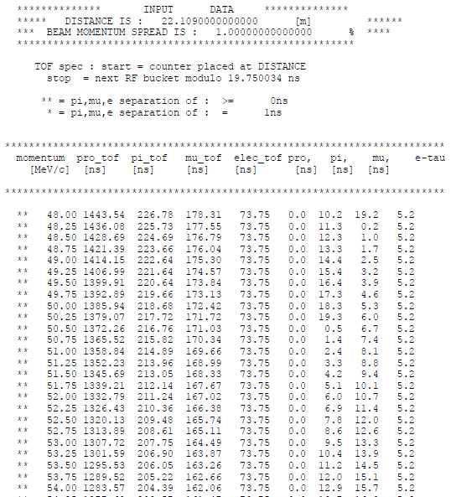
e⁺ Mott Scattered Beam
Coherent Mott-scattered
monochromatic Positron Beam
as a calibration-tool for our
spectrometer
After an initial feasibility test in 2010
2011 – first "full test" with introduction of accelerator RF for
Cloud Muon background suppression
Data at 50 MeV/c & "Signal momentum" 53 MeV/c
Mott target (1mm thick) & MEG target (0.205mm thick) used
RF-signal from accelerator used + slits 65 & 70
Michel Trigger #16 + prescaled #18, 22 (DC+ TC alone)
at our momenta ~53 MeV/c have
beam e⁺, cloud µ⁺, beam π⁺, Michel e⁺
Separator doesn’t really help much at these momenta
TOF separation wrt RF COBRA Centre only possible at 53 MeV/c
No separation at 50 MeV/c
TOF separation COBRA Centre
vs beam Momentum
P(MeV/c)
Δt(π)
Δt(µ)
Δt(e)

Slide 15
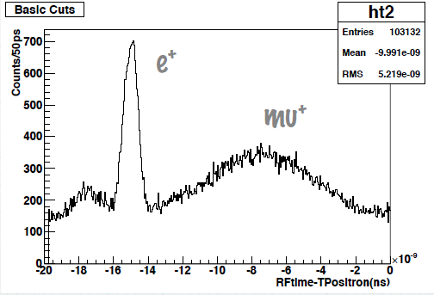
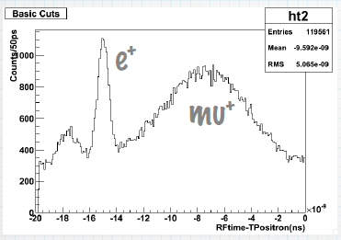
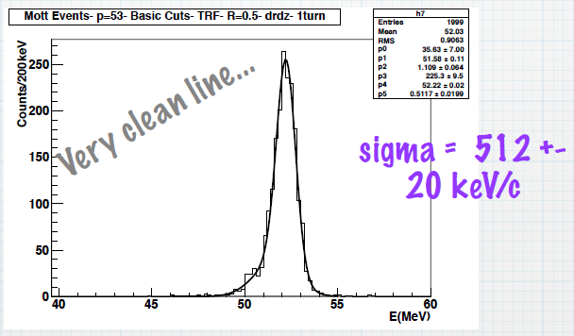
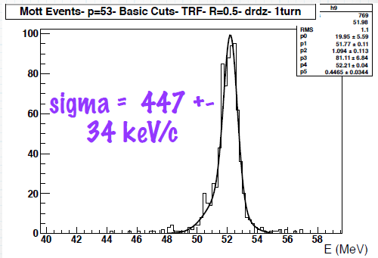

Monochromatic e⁺-Beam Cont.
53 MeV/c Mott Target 1mm
53 MeV/c MEG Target 205 µm
$$+ ?$$
TOF-Spectrum
Preliminary
Monochromatic
Prob. Energy-loss tail - investigating

Slide 16
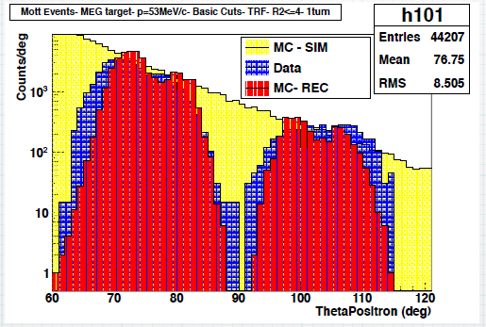
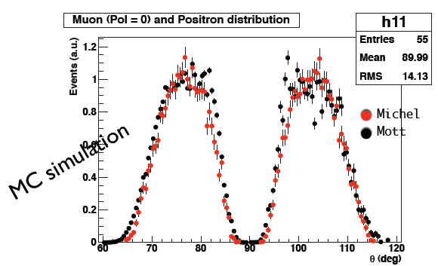
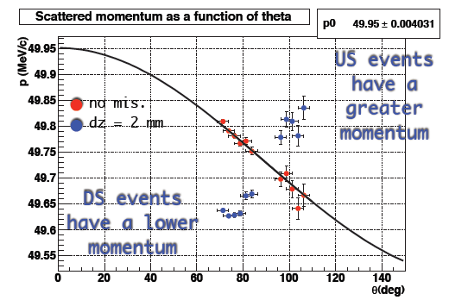
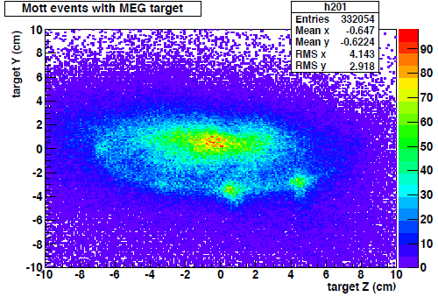
e⁺- Beam Possibilities
Polarization Study of Michel e⁺ compared to Mott e⁺ X-section-form known
θ-Distribution of Mott-events compared to
MC theoretical X-section
& detector "accepted" X-section
Preliminary
For
Polarization=0
Detector Alignment Study
Scattered e⁺ well known F(θ)
∴from binned θ-Distribution of Mott-events vs. P
can see misalignment effects – most sensitive for z!
MC Data
Vertex resolution Possibility
Shows sensitive to plastic screws on MEG-target
Could add small mettalic pins to dedicated MOTT Tg
With varying distances apart in x & y so measuring the
vertex resolution at the target for "signal" momentum

Slide 17
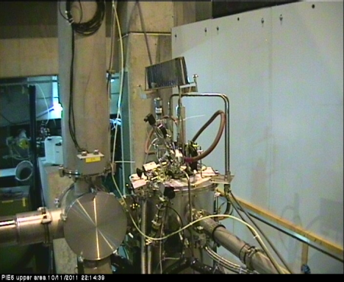
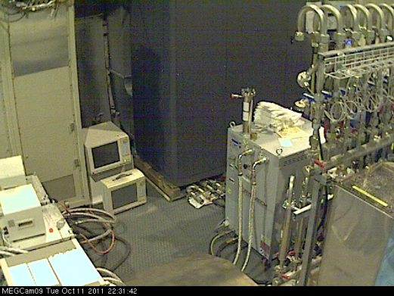
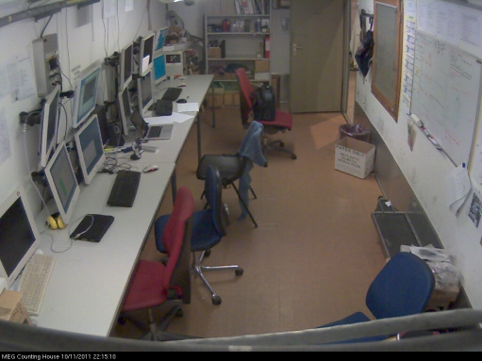








Remote Shifts
Shift-crew communications via video SKYPE link
Web-based tools for remote full control of Expt.
Remote web-based ‘’analysis tools’’ available
Full accounting + Rules integrated into MEG
shift Scheme
moveable
Webcam
Area Surveillance
Electronic Control Room
‘’White Board’’ on Web
moveable

Slide 18




Spin-off Physics
1.)
LFV-transition mediated by a very-light,
long-lived pseudo-scalar boson φ
⇨ talk Physics Results Wataru
Phys. Rev. D 72, 117701 (2005)
2.)
M. Hirsch and A. Vicente, PRD 79,(2009) 055023
2-body muon-decay decay into massless Majoran
⇨ talk Physics Results Wataru
3.)
Radiative Muon Decay
RMD measurement using polarized muons
normalization for MEG + internal check
non-SM Michel parameter measurement possible
⇨ talk Yusuke

Slide 19
Next
This gave a brief overview of the relevant
aspects of our 2011 Run
Detailed information will follow
in the remaining talks....

