Slide 1
IDEAS and R&D for a positron timing & tracker with scintillating thin sheets
F.Gatti , INFN Genova

Slide 2
Is it possible to built a tracker and timing detector for replacing the DCHs?
Beam axis
Target
R₁,Z₁,t₁
R₂,Z₂,t₂
R₃,Z₃,t₃
R₄,Z₄,t₄
Requirements:
  Position (Ri,Zi) resolution as good as in the proposal
  Reconstructed timing resolution (T) 100 ps FWHM
  Fast enough to allow muon decay rate 10 times higher than the present one

Slide 3
Pros & Cons
  Aims
Should work as a “Photon Diffusive Chamber”
Timing →100 ps FWHM
Position reconstuction → 300 um (R, Z)
  Possible Advantages
Correlated timing and tracking parameters in the same detector
“Pixellated” detector and high signal speed allow higher rate
“Cancellation” of the residual 60-70 ps indetermination of the present reconstructed timing ad the vertex.
Detector could be placed closer to the target → decrease timing uncertainties.
Higher efficiency: non need of the “far” TC.
  Drawbacks
Effective total thickness: present Rad. Length not easy to be achieved
Effective Attenuation Length: SMALL (to be measured)
Photon detector even if very small, SiPM, should be mounted on the detector.

Slide 4
Conceptual design: preliminary requirements
Use of thin, 100-200 um scintillating sheet with high light yield and fast decay time
Stay in the limit of radiation length of present DCH
Readout with SiPM mounted in a proper way onto the sheet in order to reach the required performance as result of trade off among, in order to maximize L/s :
  Light Yield
  Bulk Attenuation Length
  Surface finishing (diffusive or reflective?)
  Hit rate density (expected hit/s*cm2)
Possible structures of the scintillating sheet to be investigated
  Independent R,Z stripes with SiPM readout at each end
  Independent triangle with SiPM at each corner
  Continuous structure with SiPM array over the sheet
Expected Light
Intensity Profile
L
Scintillating sheet
SiPM
s
SiPM
SiPM

Slide 5
Possible Pixel Shape under Study
Usual geometry of pixels based on stripes in stereo configuartion with SiPM at each end is of course the main options.
But triangular shaped pixels seem provide some benefit.
SiPM
Positron hit
Scintillating Sheet
Optical decoupler

Slide 6
Which Material ?
Properties | Anthracene (C14H10) | Stilbene (C14H12) | p-terphenyl (C18H14)
Molecular weight | 178 | 180 | 230
Density, g/cm3 | 1.25 | 1.22 | 1.23
H/C ratio | 0.714 | 0.857 | 0.778
Luminescence max., | 445 | 390 | 420
Refractive index | 1.62 | 1.64 | 1.65
Decay time | 30 | 3.5 | 3.7
Light output, Photon/MeV | 20,000 | 14,000 | 27,000

Slide 7
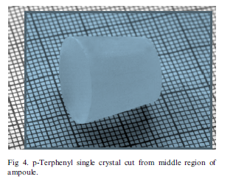
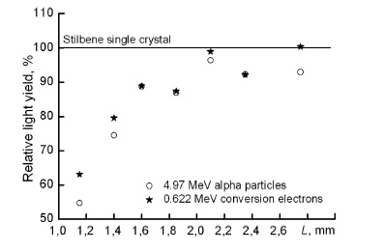
Towards Single PTP Crystral
P-Terphenyl studies (powder available, single crystals ordered) are already planned.
Doped Single Crystal are the most performing scintillating material till now found off the shelf.
Poly-crystal from hot pressed powder have poorer performance
Preliminary MC studies with literature data

Slide 8
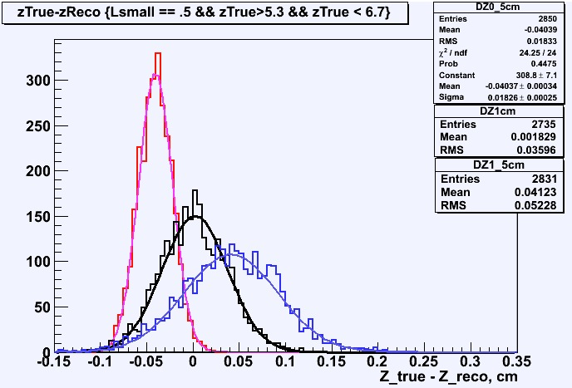
Position Resolution Considerations
The method is charge ratio:
  Toy simulations of a material with “poor” light transmission properties, shaped as a stripe with SiPM at each end.
  Photon loss length slight less and larger of 1 cm
  Z_{reco} – Z_{true} shows that a resolution of 300 μm is achievable
  Improvements in a three-vertex readout scheme are under study

Slide 9
Provisional Conclusions
We have selected P-Terphenyl doped single crystal as first material to be studied:
  Light yield > 25000 phs/MeV
  Decay Time=3 ns about
In the last few years, the interest in this scintillator has been renewed thanks to the large single crystal growth capability and the use of doping.
PTP is pretty stable chemical materials (not hygroscopic, low solubility in solvent, Rad Hard at our level,..)
Production should require chemical processes for crystal growth done in specialized lab.
Delicate sheet cutting, surface finishing and high reflectance film growth with vacuum deposition technique under controlled condition, could be done in house.
Mounting of SiPM and PTP Crystal in the final structure not yet defined
These are the preliminary numbers to be confirmed in laboratory :
Yield for thin sheet: 500 photons on 100um thickness → to be fixed.
Attenuation length (?)→ 1-10 cm(?) to be studied
Decay Time= 3ns
TTS SiPM <100ps
QE SiPM= 0.18 (to be confirmed in 320-390 nm due to presence of epoxy layer)
Timing resolution: setting the threshold to 2 p.e. , at least 10 photons per detector are needed
Correlated sequences of position and time from the planes → whole reconstructed timing resolution should be better than the one of single hit.
Position: calculated using charge ratio .

Slide 10
Summary
Presently, due to the uncertainty of scintillating material properties, the proposed detector should be considered a back-up solution of the new DCHs.
If the test of thin sheet of P-Terphenyl scintillating single crystal will confirm the predicted performance:
  A tracking/Timing photon diffusing camera could be a possible detector for positron.
  Correlation among Position-Timing of hits along the trajectory → better tracking accuracy
  “Pixellated” array and nanosecond response → faster decay rate allowed
  Shortening of the path from target to the timing detector → better reconstructed vertex time resolution
We are envisaging other possible applications for active target and/or “shroud” detector as for timing application in new DCHs.

