Slide 1
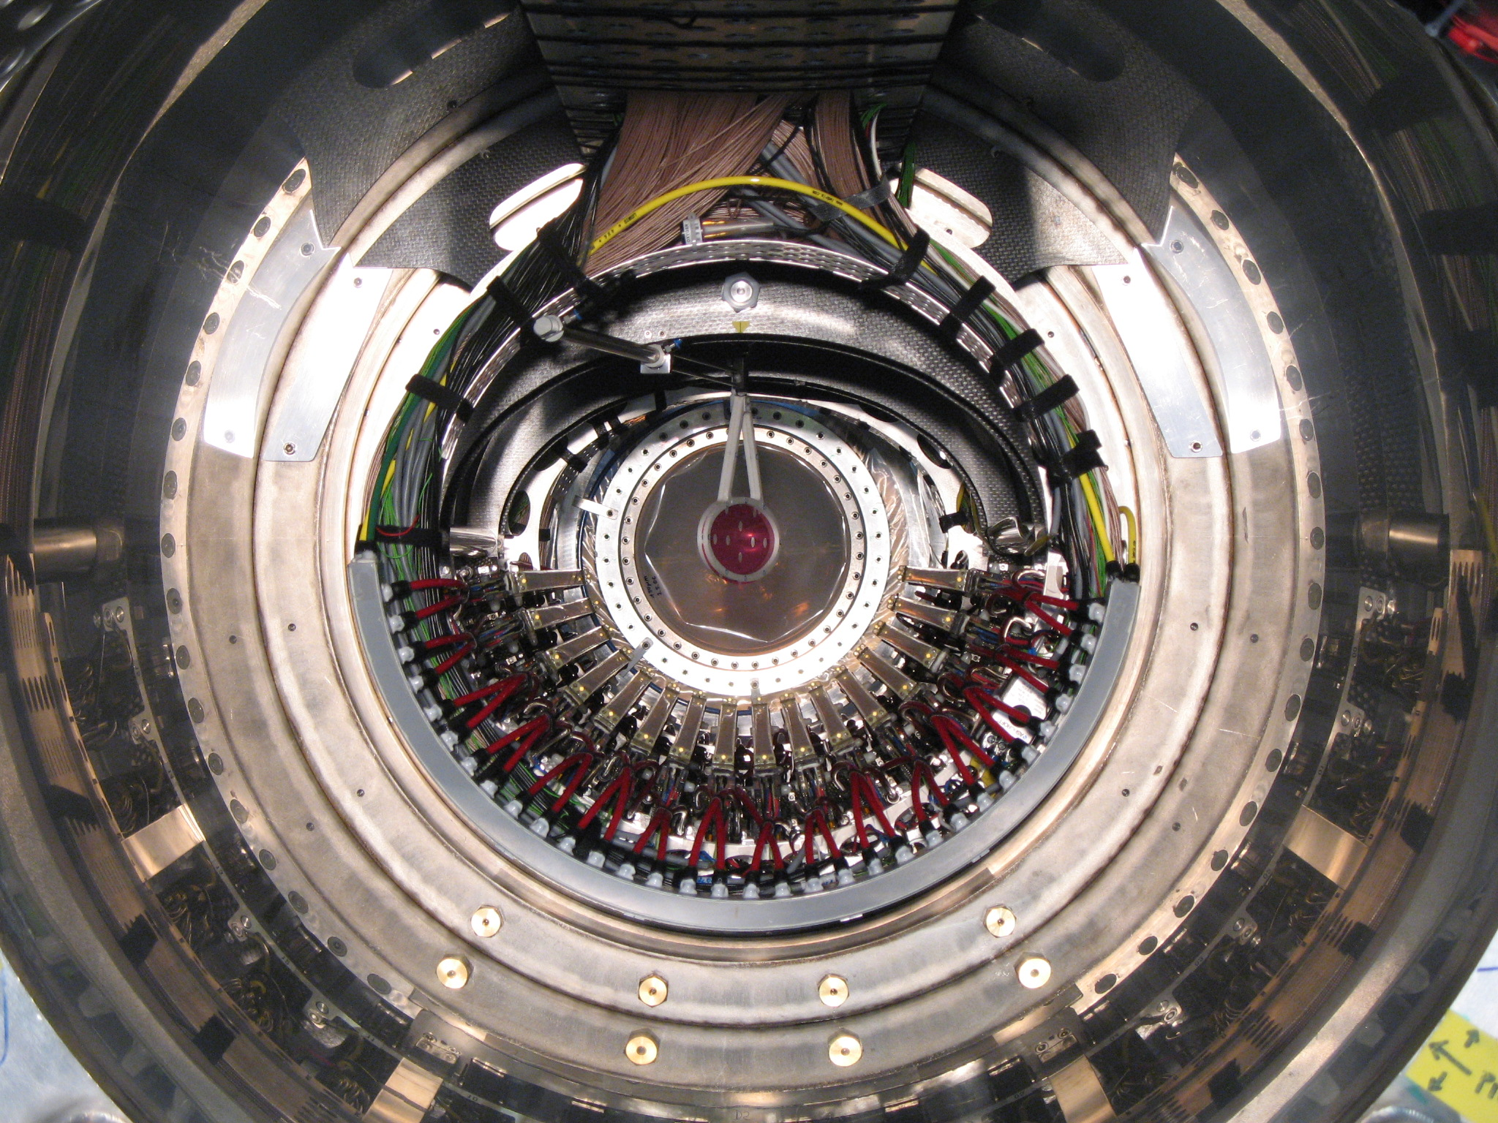
MEG Summary
A. Baldini Feb. 21°
2012 - PSI

Slide 2
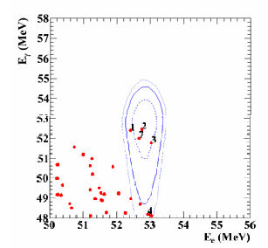
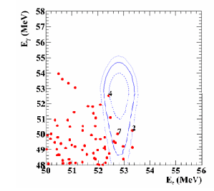
2009
2010: twice the satistics of 2009
The other 2 variables are not shown here

Slide 3
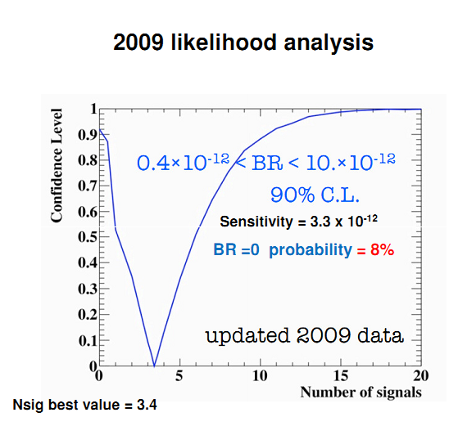
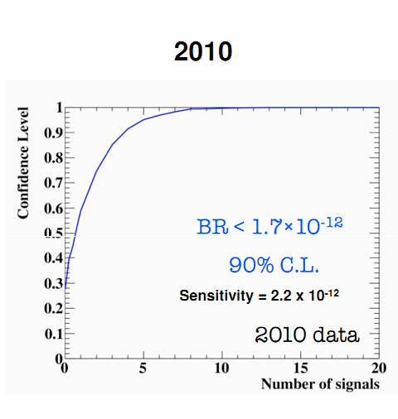
Consistent analysis for the 2 data taking periods

Slide 4
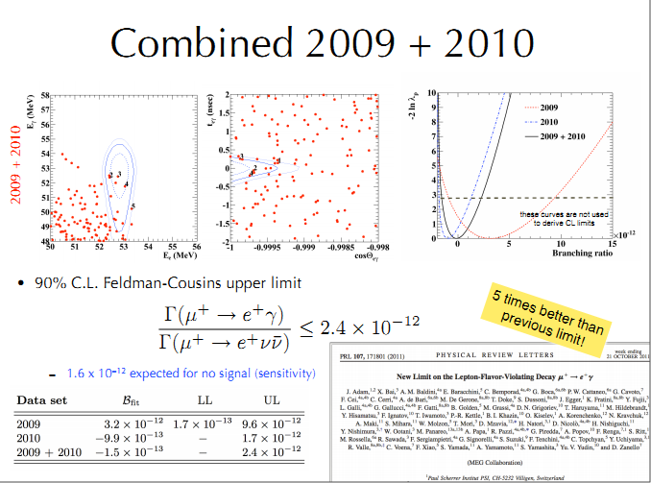

Slide 5
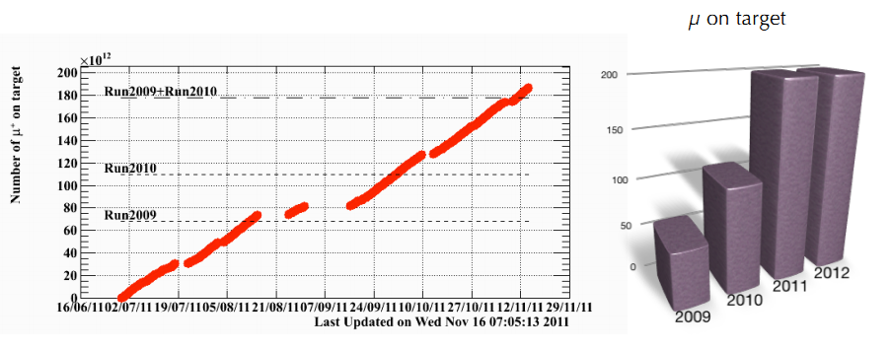
2011 quasi full year of data taking
Problems with the cryo-plant at the end of november
P.R. Kettle’s talk

Slide 6

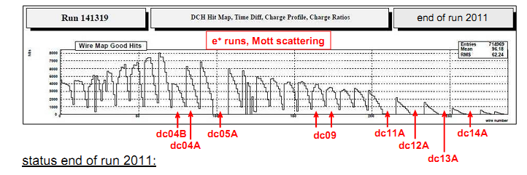
M. Hildebrandt’s talk
2011 run DC
New optical survey method (corner cube reflectors on the chambers + support system)
Cross check with CR alignement (millipede software which worked quite well for 2010 alignement)
Global DC-B-field misalignement?
Preliminary evaluation of resolutions: comparable with 2010

Slide 7
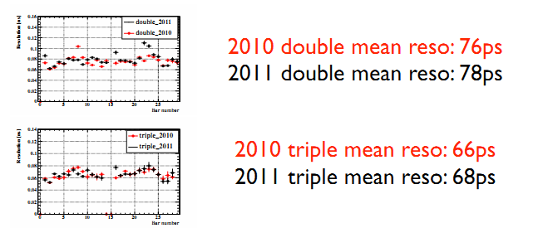
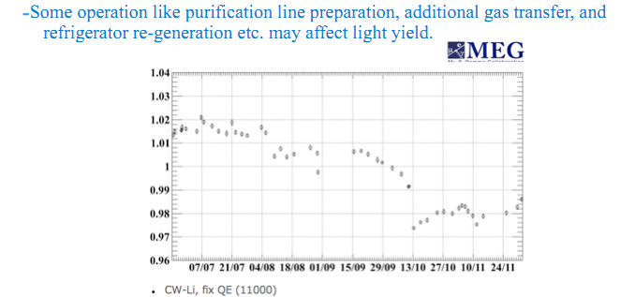

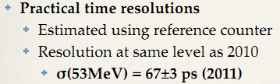
TC
M. De Gerone’s talk
LXe
T. Iwamoto’s talk

Slide 8
Calibrations already at a good level ! Ootani’s talk
2011 + 2012 data analysis together ?
Measurement of RMD branching ratio and decay parameters (talk by Uchiyama); paper together with muon polarization measurement
Paper with technical details of the apparatus
Exotic physics searches
✤ Search for muon decay mediated by very light pseudo scalar
particle
✤ Search for muon decay with massless Majoron (μ→eJ)

Slide 9
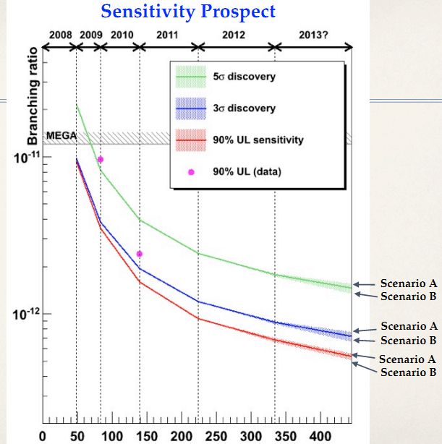

Slide 10
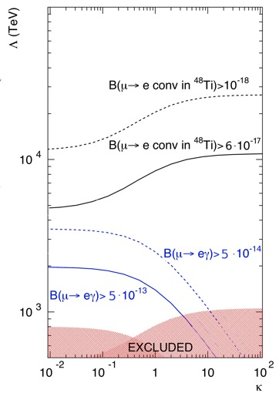
μ→eγ vs μ→e
Scientific validity of an upgrade:
Effective lagrangian
We believe an upgrade of ∼2 years of R&D + construction and 2-3 years of running is scientifically appealing
R&D started!

Slide 11
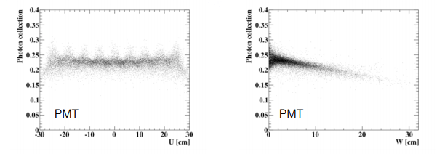
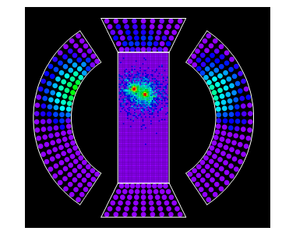
LXe upgrade(1)
R. Sawada’s talk
R&D for the use of either square 1” PMTs or SiPM (PPD, MPPC ...)
Energy and position resolutions improve especially for shallow events. γ efficiency would also improve with SiPM

Slide 12
LXe upgrade(2)
Coating the walls with non-reflective paint ?
(discrepancy data – MC)
Use of ionization charge ?

Slide 13
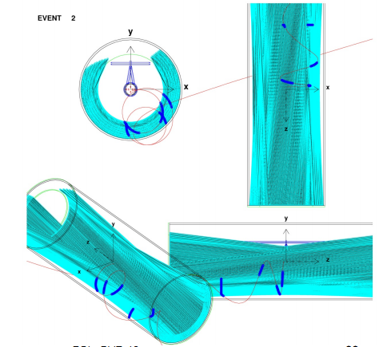
New Drift Chamber ?
M. Gassi’s talk
Possible new (unique volume) drift chamber with very fast read-out
Drift chamber for RAre decay search with Gigahertz read-Out
Joint INFN-PSI European Research Council Advanced grant request (submitted Feb. 16 2012)

Slide 14
More unconventional ideas (1)
New (tracker + TC) made of thin(100-200 μm) scintillator foils read by SiPM
F. Gatti’s talk
R₁,Z₁,t₁
R₂,Z₂,t₂
R₃,Z₃,t₃
R₄,Z₄,t₄

Slide 15
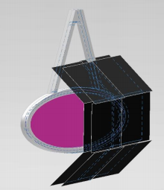
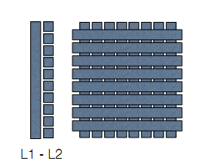
More unconventional ideas (2)
Silicon vertex tracker (50 μm) near the target
Y. Uchiyama’s talk
Active target (250 μm) scintillating fibers read by SiPM
A. Papa’s talk

Slide 16
Summary²
MEG Run 2011 was very satisfactory
2012 might be the last year of MEG phase 1
R&D for an upgraded MEG detector has started
R&D + construction budget approved in Japan
(next three years)
Scientific approval in Italy
A proposal will be produced to be presented to
BVR and to the other financing committes

