Slide 1
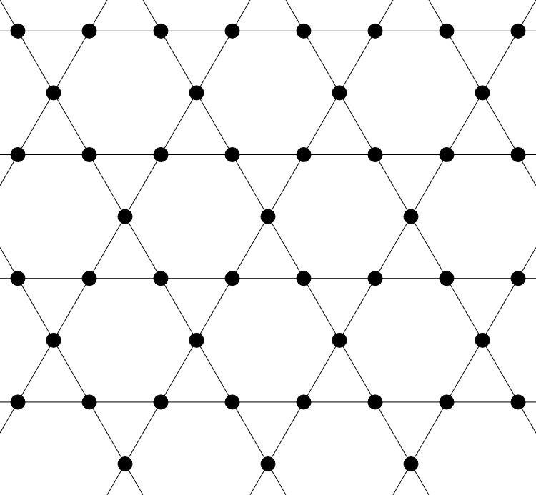

Kagome frustrated antiferromagnetism
Lara Suárez García
31st July 2024
Laboratory for Neutron and Muon Instrumentation

Slide 2
Kagome frustrated antiferromagnetism
Ferromagnetism
Antiferromagnetism
Strong magnetic interactions + no order ?

Slide 3
Kagome frustrated antiferromagnetism
?
Classical
Quantum
+
+ …
Can we play with real materials?

Slide 4
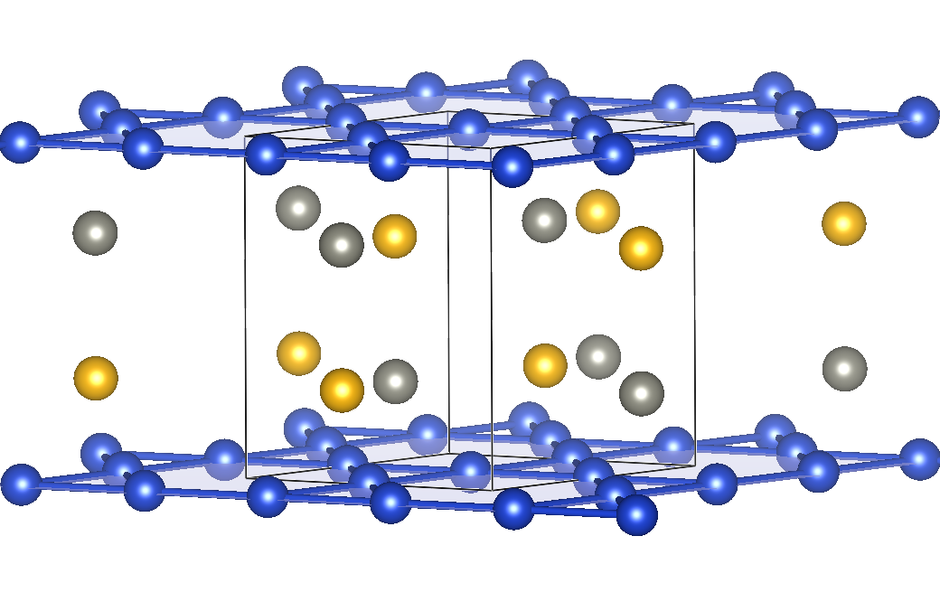
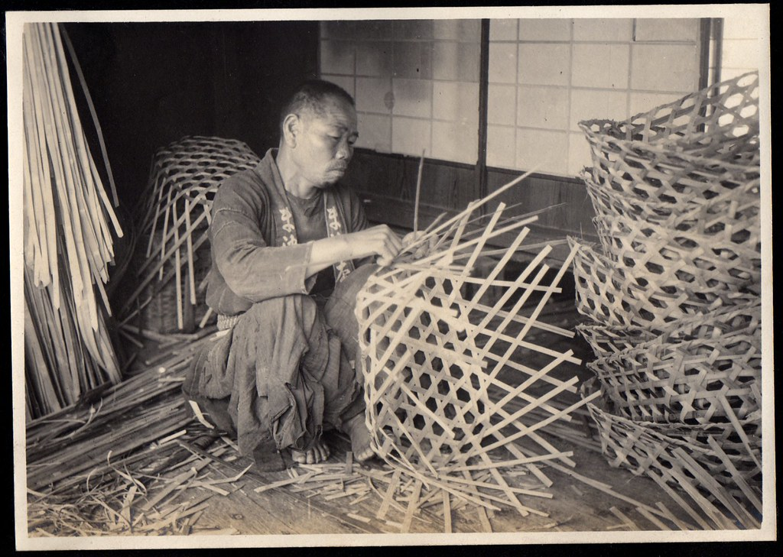
Kagome frustrated antiferromagnetism
Averievite:
Kagome layers
2-dimensionality
Notes:
Cu5−x Znx V2O10(CsCl)

Slide 5
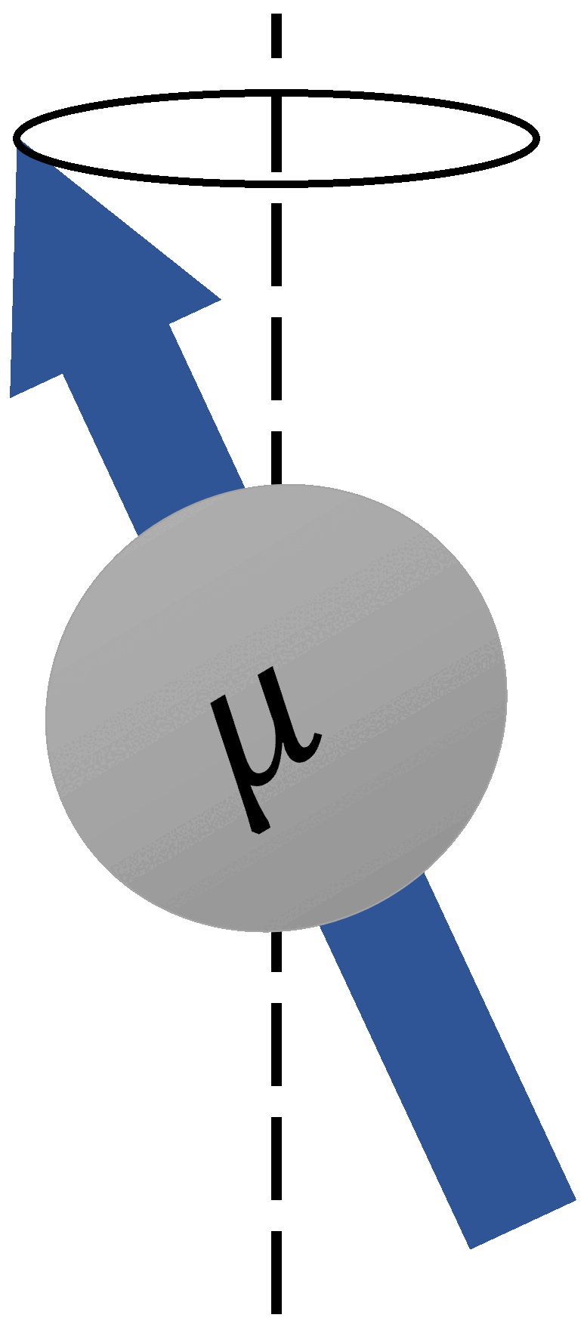
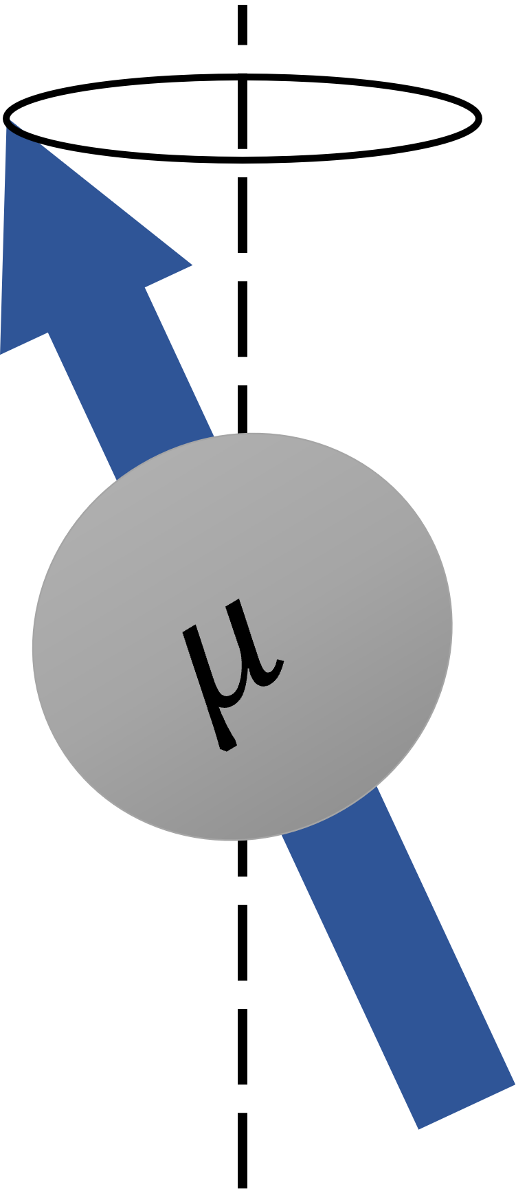
Kagome frustrated antiferromagnetism
Muon
B

Slide 6

Kagome frustrated antiferromagnetism
Muon
spin rotation (μSR)
Sample
Timer
Detectors

Slide 7

Kagome frustrated antiferromagnetism
Muon
spin rotation (μSR)
B
$$e^{+}$$
Sample
Timer
Detectors

Slide 8
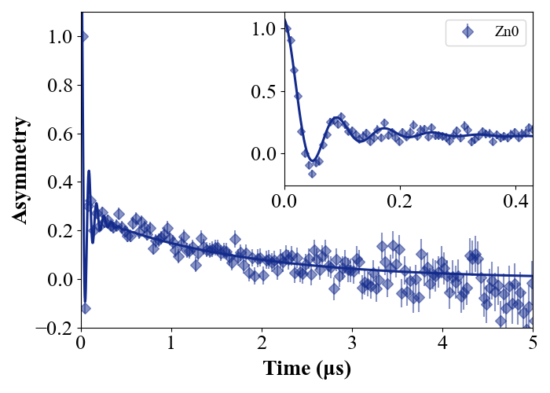
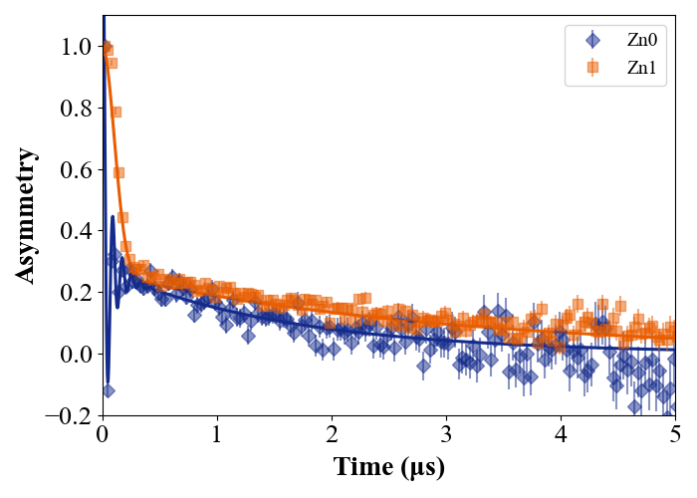
Kagome frustrated antiferromagnetism
2-dimensionality
Coupled:
  oscillations -> long range order
Partially substituted:
  fast decay -> no order, static clusters

Slide 9
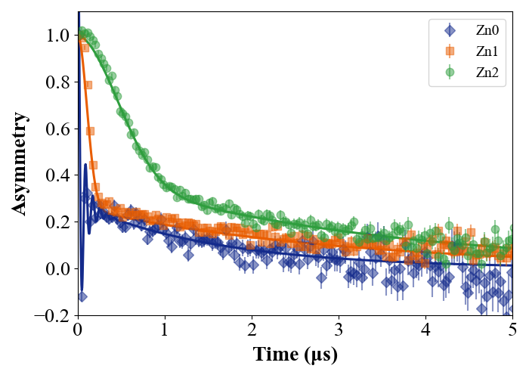
Kagome frustrated antiferromagnetism
2-dimensionality
Coupled:
  oscillations -> long range order
Partially substituted:
  fast decay -> no order, static clusters
2D:
  slow decay -> mainly dynamic
Quantum spin liquid?

Slide 10
Kagome frustrated antiferromagnetism
Thank you for your attention

Slide 11
Kagome frustrated antiferromagnetism
Backup slides
Coherent precession:
Depolarization:
B
B
B
B
B1
B2
B3
B4

Slide 12
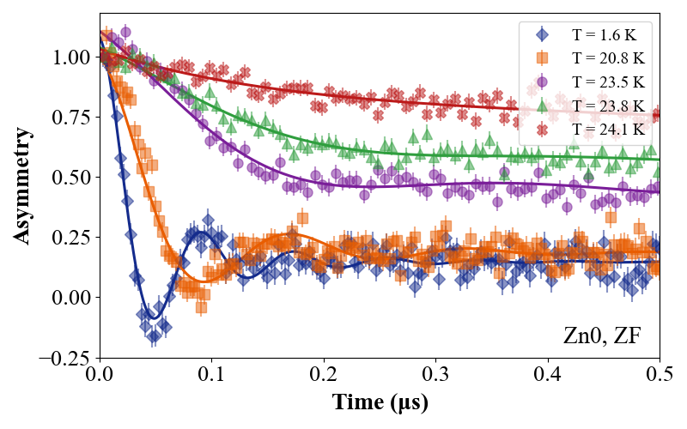
Kagome frustrated antiferromagnetism
Backup slides

Slide 13
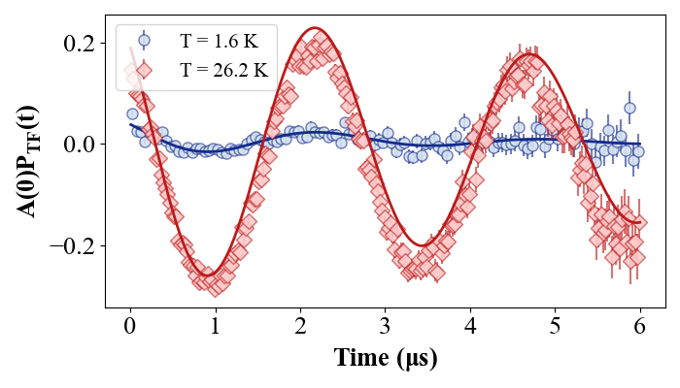
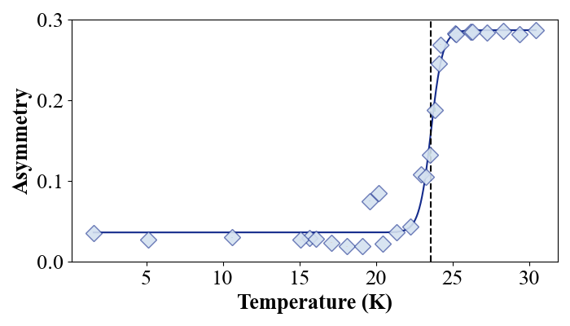
Kagome frustrated antiferromagnetism
Backup slides

Slide 14
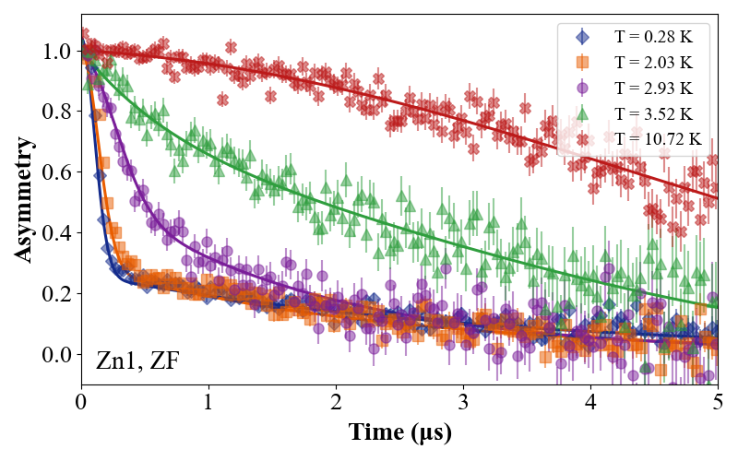
Kagome frustrated antiferromagnetism
Backup slides

Slide 15
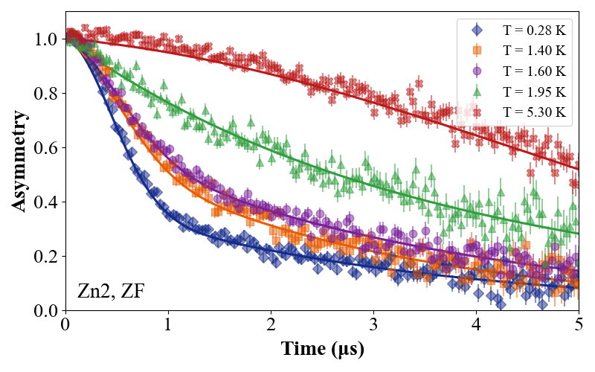
Kagome frustrated antiferromagnetism
Backup slides

