Slide 1
Neutron Instrumentation
Design, Criteria and Implementation
Nicolai Lindaa Amin
PSI, 31/7 - 2024

Slide 2
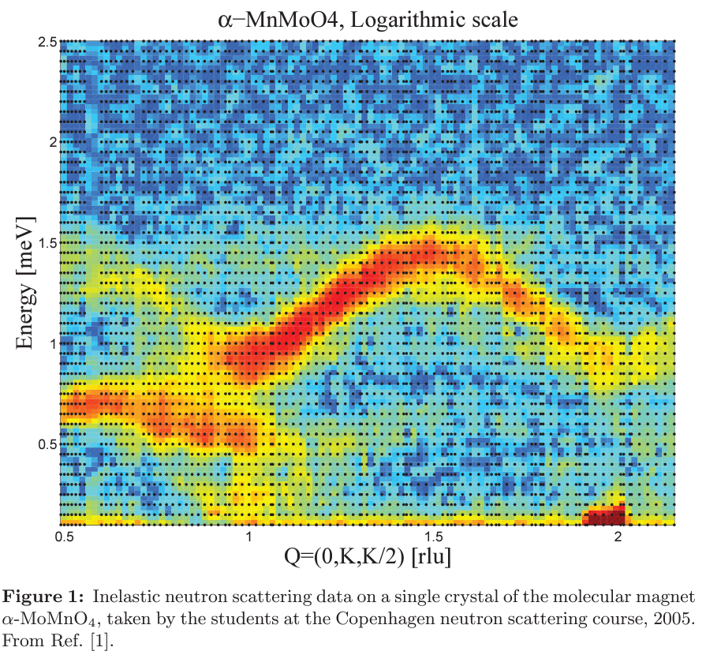
Neutrons in Condsensed Matter Physics
Neutrons vs. X-Rays
5 preferential components
  Energy and Wavelength
    1-6 Å & 1-25 meV
  Isotopes and light elements
  Quantative experiments
    Weak interections
  Penetration depth
    Sample & environments
  Magnetism
    Magnetic moment

Slide 3
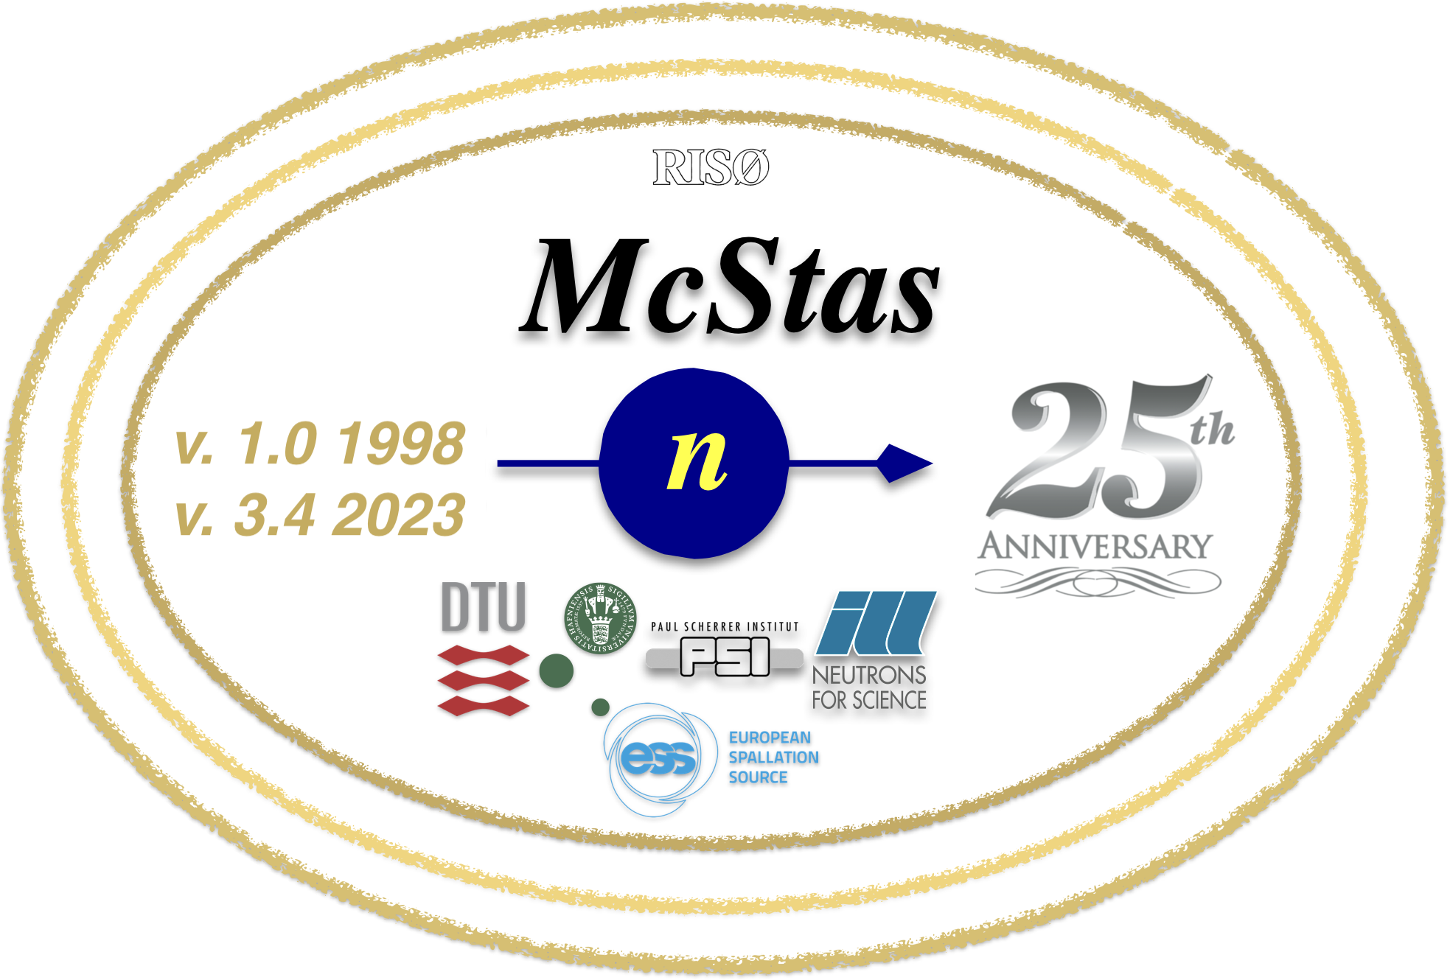
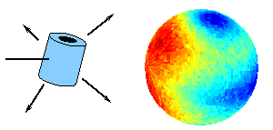
McStas

Slide 4
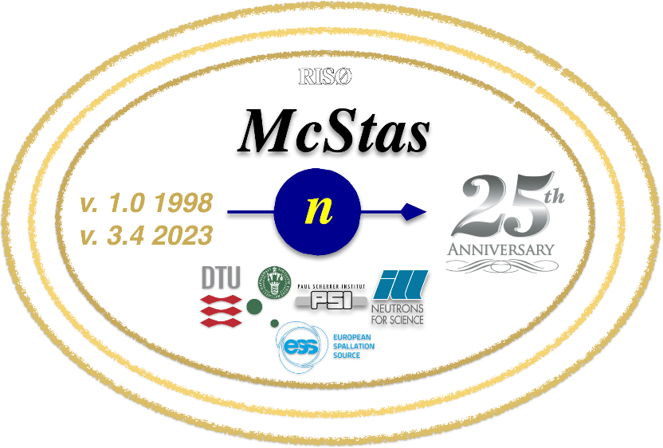
McStas – Monte Carlo Simulations of Neutron
Monte Carlo simulations
  LLN
Ray tracing algorithms
Models of Complex behavior

Slide 5
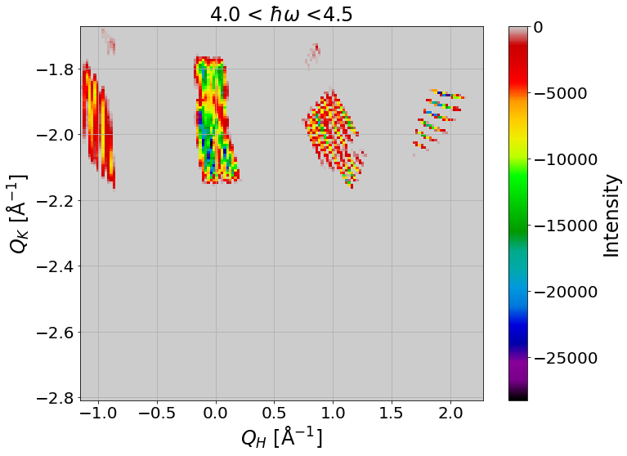
McStas – Monte Carlo Simulations of Neutron
Monte Carlo simulations
  LLN
Ray tracing algorithms
Models of Complex behavior
  Based on components and how they
  are coded

Slide 6
McStas – Monte Carlo Simulations of Neutron
Monte Carlo simulations
  LLN
Ray tracing algorithms
Models of Complex behavior
  Based on components and how they
  are coded
  Not always coded correctly

Slide 7
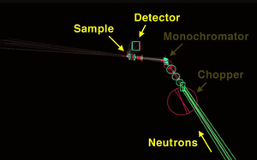
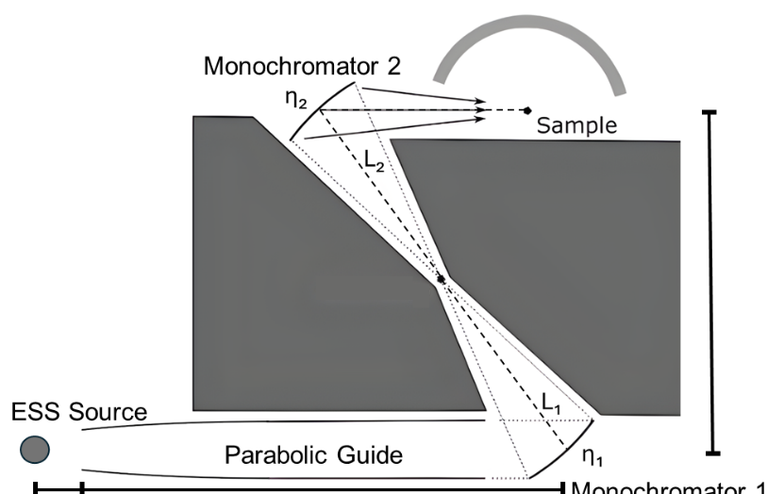
Instrument Design in McStas
Primary Use:
Instrument design and benchmarking

Slide 8
Instrument Design in McStas
Primary Use:
Instrument design and benchmarking
Why use numerical design over analytical calculations?
Source
Sample
Mosaicity
Dimensions and divergence

Slide 9
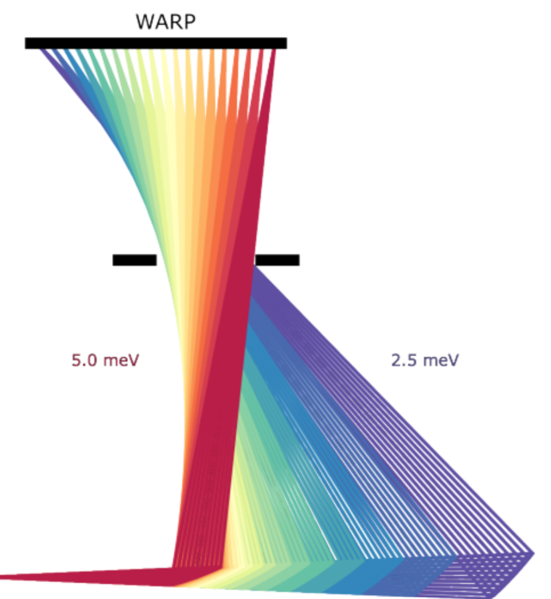
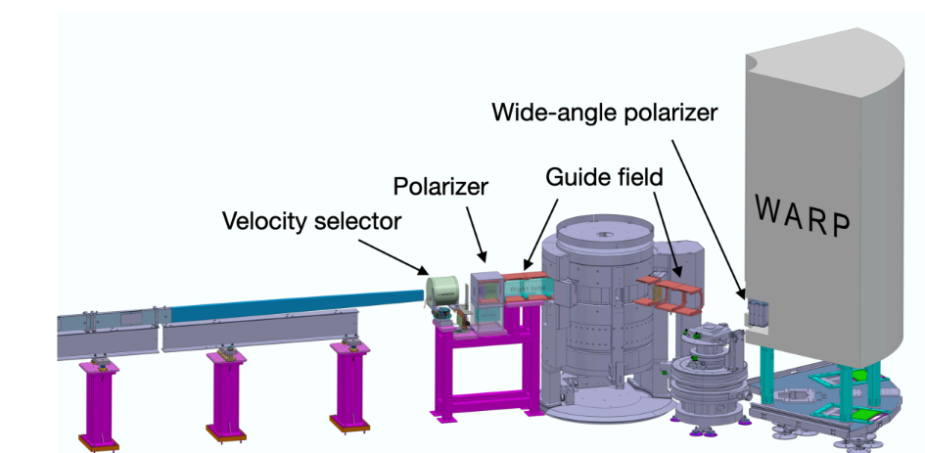
WARP – Wide-Angle high-Resolution Prismatic spectrometer with polarization option

Slide 10
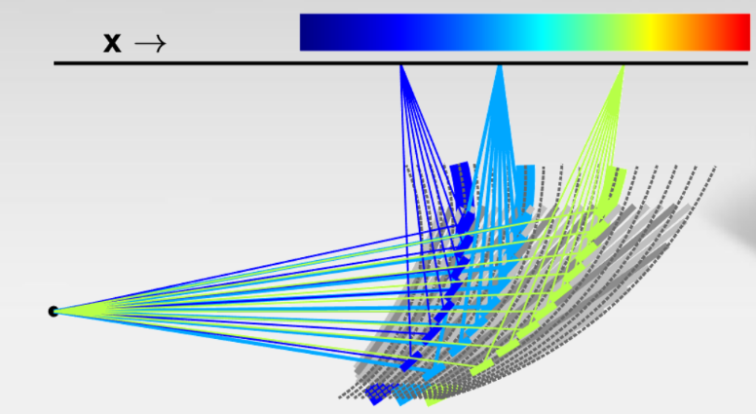
WARP – Wide-Angle high-Resolution Prismatic spectrometer with polarization option

Slide 11
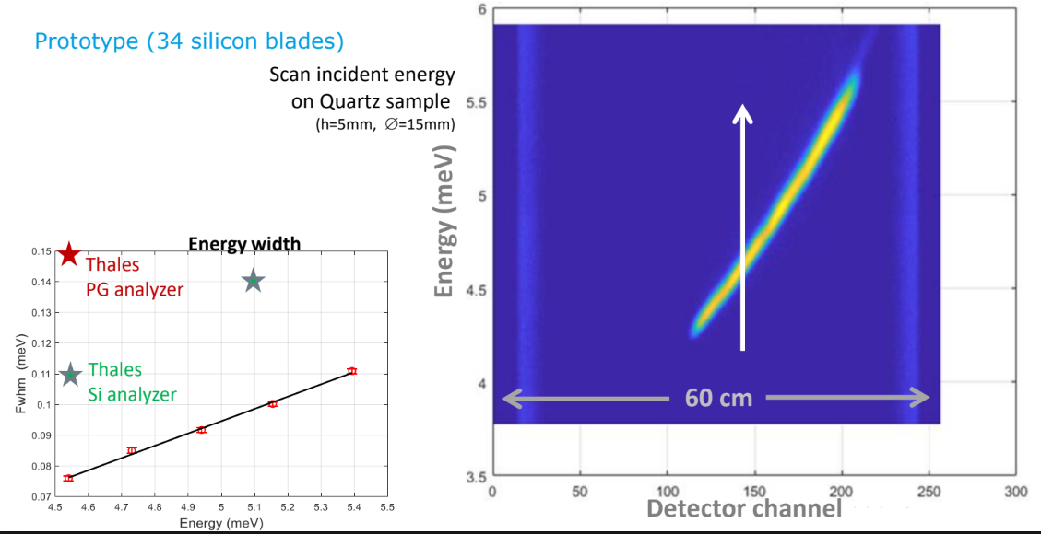
Current ILL Measurements

Slide 12
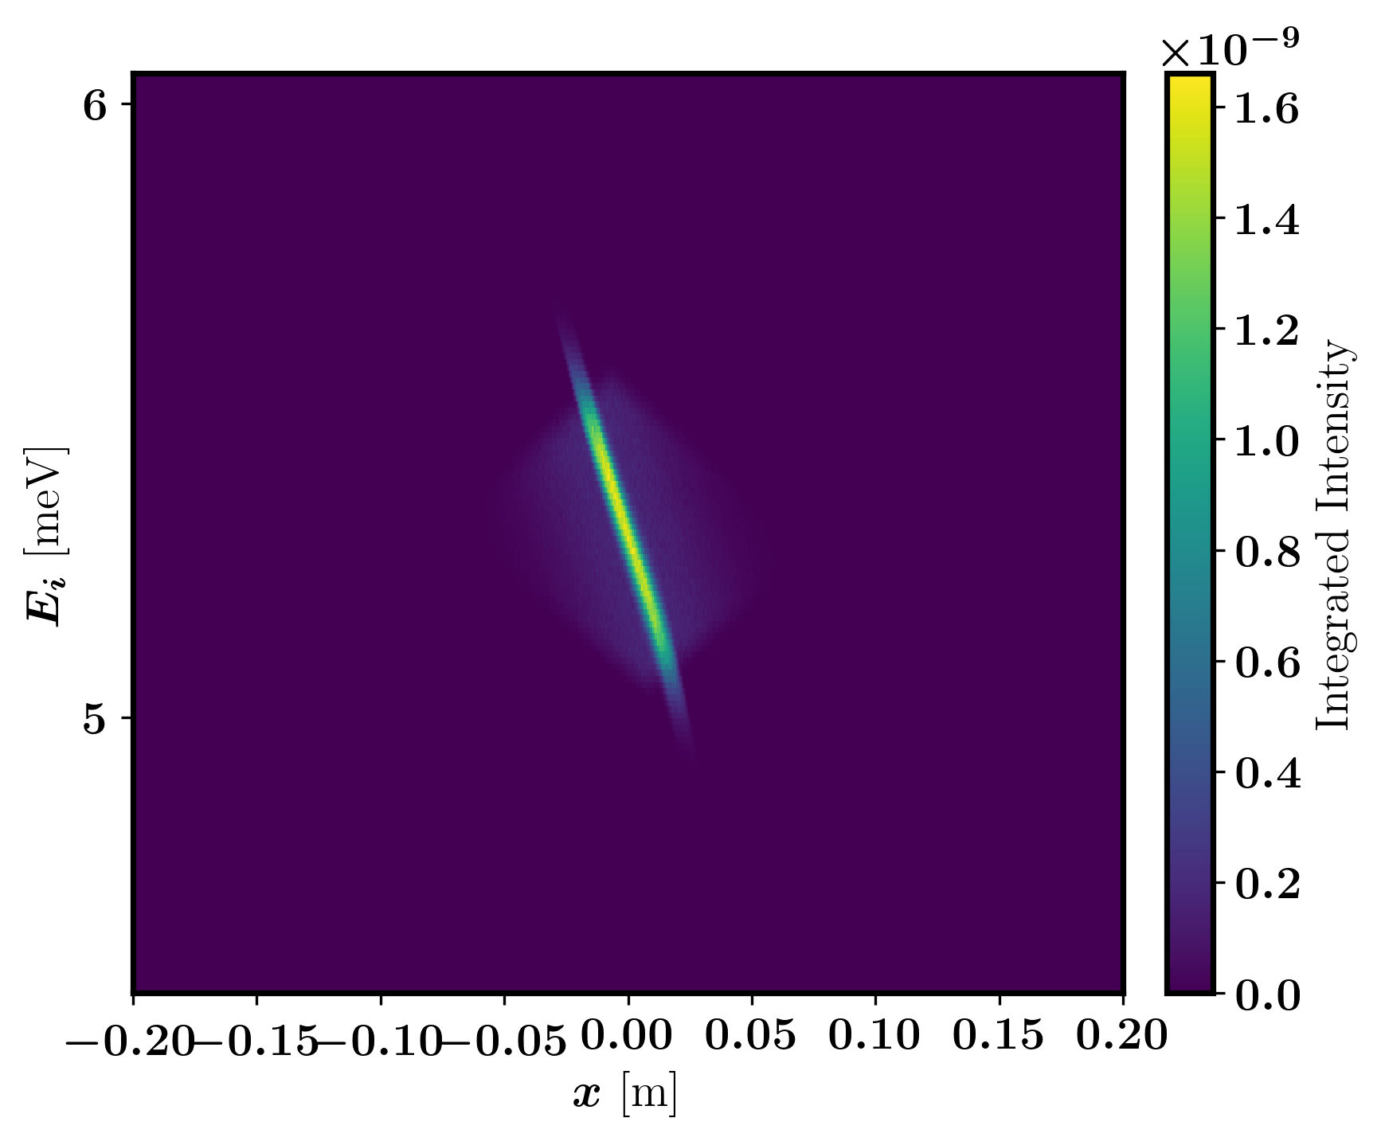
Current McStas component design
Curved Monochromator with mosaicity
Current design
Flaws
Full array causes problems

Slide 13
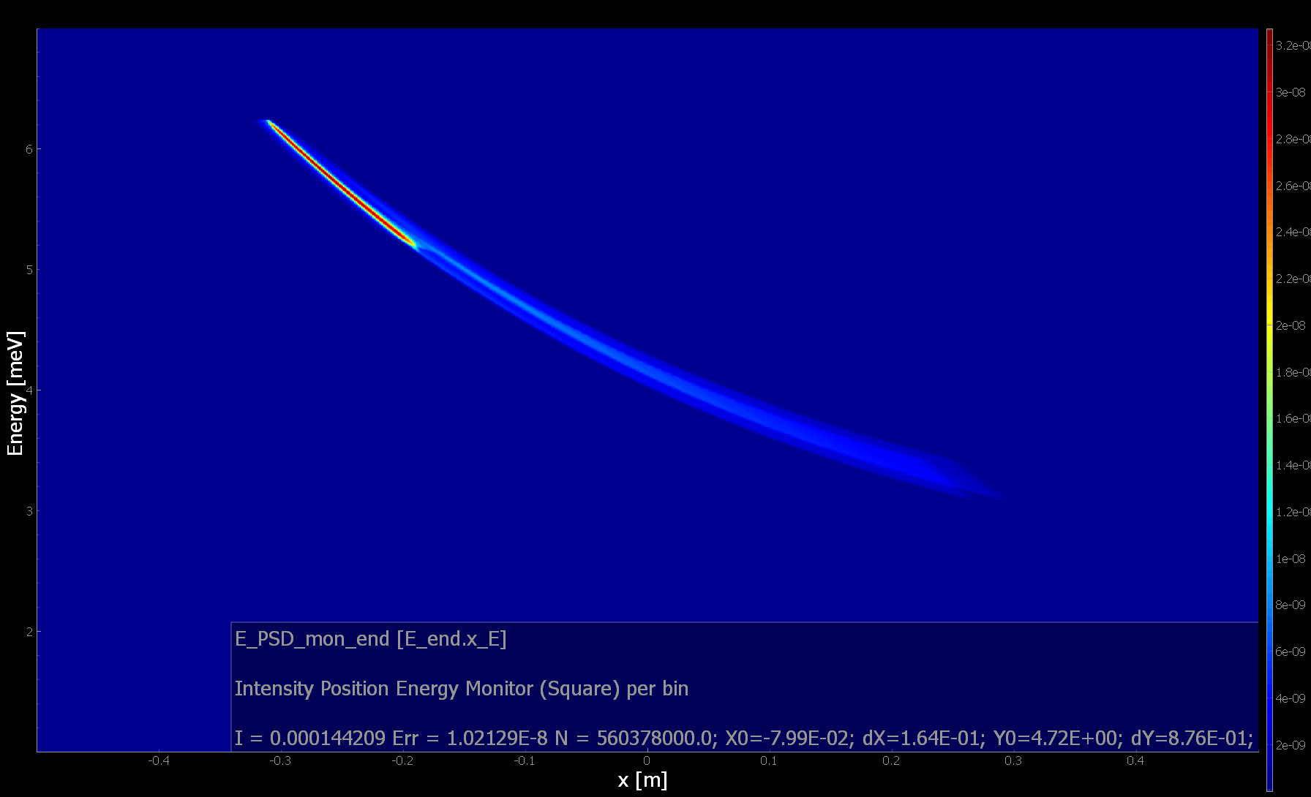
Current McStas component design
Curved Monochromator with mosaicity
Current design
Flaws
Full array causes problems

Slide 14
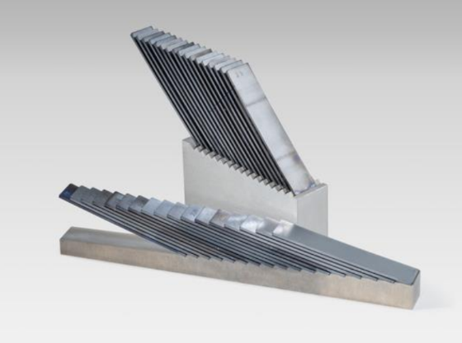
Thank you, Questions?

