Slide 1
Energy Saving Magnets
Roman Farrugia, Masters Student
PSI – Magnet Section, 31st July 2024.

Slide 2
Resistive Transport Solenoid
Length 30 cm.
100kCHF magnet costs (Gabard and Serguei).
4000 hours per year.
14kW per MuH3 coil, 2(3?) coils, and 16kW per MuH2 coil, 7 coils, assuming the coil is at 60 degrees Celsius.
13-15kCHF electricity costs per year.

Slide 3
Superconducting Transport Solenoid (1)
Startup costs (based on P3, Jaap Kosse):
240kCHF = Startup cost
Type | Cost / CHF | Notes
Cryostat | 119500.00
Vac and Cryo | 50500.00
Power Supply | 52500.00
Instrumentation | 31066.00
Installation | 30000.00 | From PSI itself
Total | 283566.00
Contingency 15% | 326100.90
Without Power Supply and installation | 210566.00
Contingency 15% | 242150.90

Slide 4
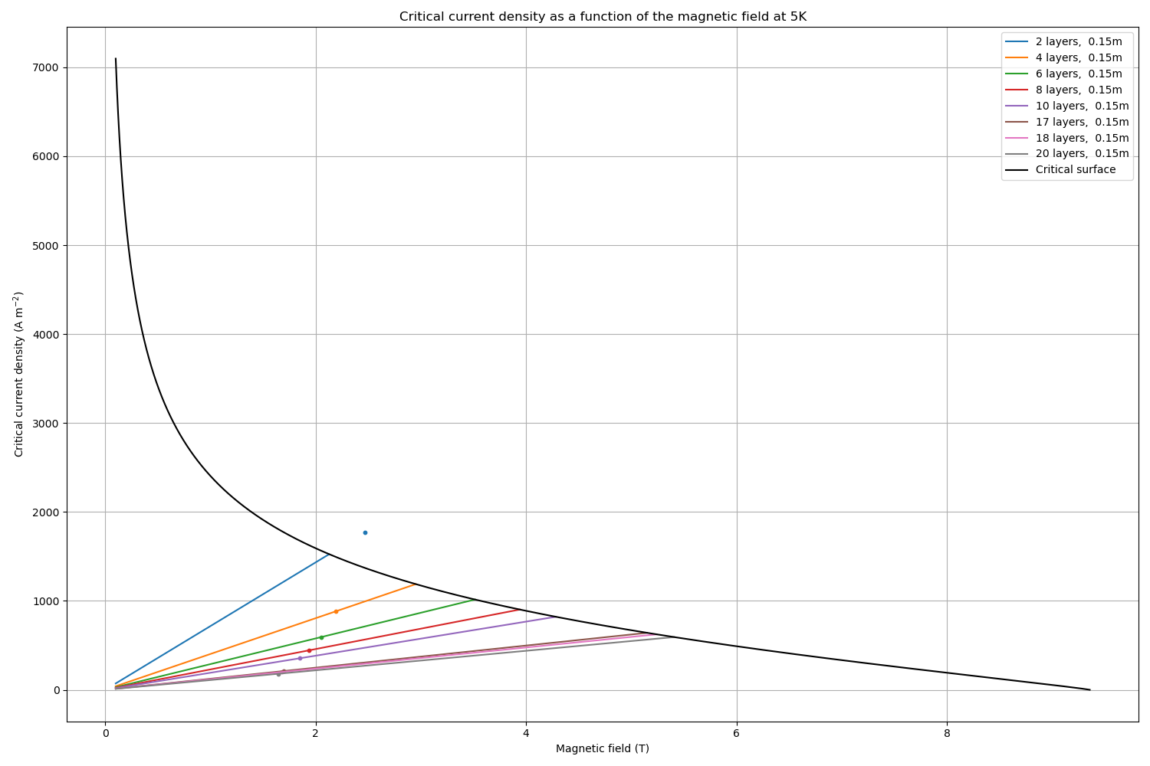
Superconducting Transport Solenoid (2)
Length 15 cm.
Inner diameter 0.65 m.
138 turns per layer, up to 20 layers considered.
Maximum field about 2T.
Field profile to be checked by the beam dynamic colleagues .

Slide 5
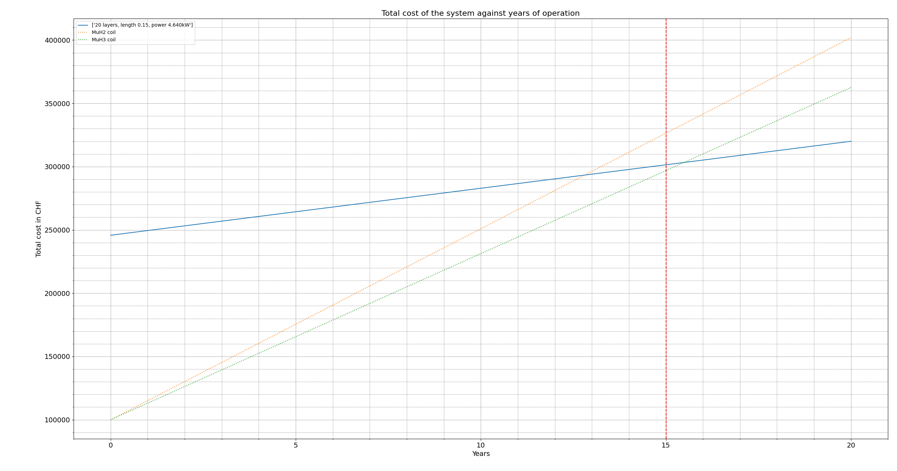
Economical Study: return of investment for 1 magnet
Assumptions:
  0.20 CHF / kWh electricity cost (PSI data).
  4000 hours annually.
  35-45GWh saved annually.
  CO2: 100g / kWh
  (Electricity Maps | Live 24/7 CO₂ emissions of electricity consumption)
  100A, 5V power supply.
Break even in 13 years,
~ 4.6kW power consumption.
  3.6 kW cryocooler
  0.5 kW power supply
  0.5 kW vacuum system
90 tonnes of CO2 saved.
240 kCHF
Capital cost for the SC magnet
100 kCHF
Capital cost for 1 resistive transport solenoid

Slide 6
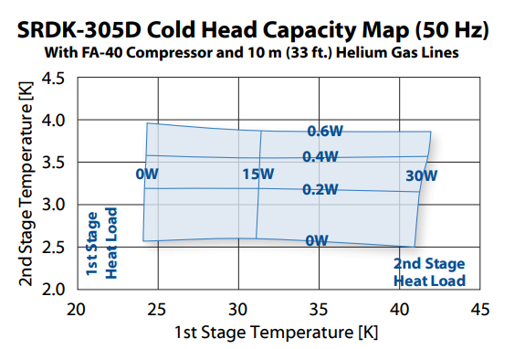
Heat budget
Candidate cryocooler RDK-305D, 3.6kW
New generation compressors (with inverter) from Sumitomo?
Heat budget | P [W]
1st stage
100 A Current leads | 9.6
Structural Support | 1.2
Thermal Radiation | 1.6
Sensor wires | 0.3
neutron dose | ?
Tot. | 12.7
2nd stage 2nd solenoid | P [W] |  | 2nd stage 3rd solenoid | P [W]
HTS leads | 0.04 |  | HTS leads | 0.04
Structural support | 0.12 |  | Structural support | 0.12
Thermal radiation | 0.13 |  | Thermal radiation | 0.13
Sensor wires | 0.15 |  | Sensor wires | 0.15
neutron dose (Vadim) | 0.17 |  | neutron dose | 0.007
Tot. | 0.61 |  | Tot. | 0.45

Slide 7
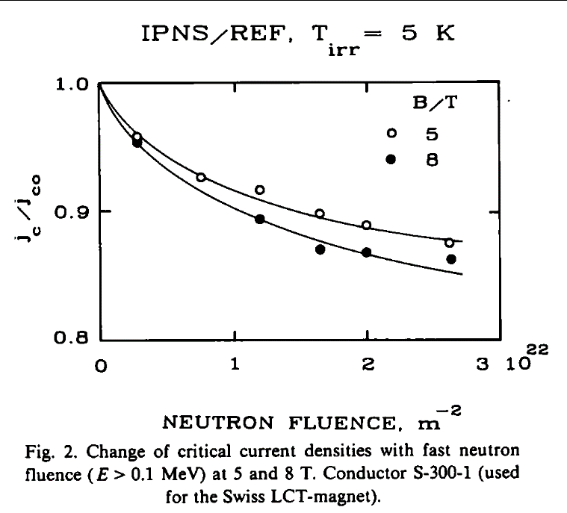
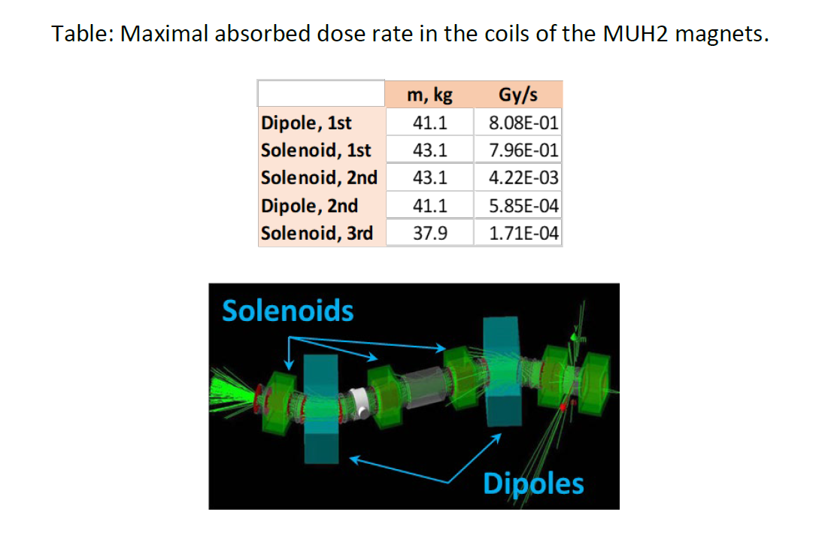
Radiation Damage and integrated dose
Nb-Ti
Simulation of fusion reactor conditions for superconducting magnet materials - ScienceDirect
Vadim Talanov

Slide 8
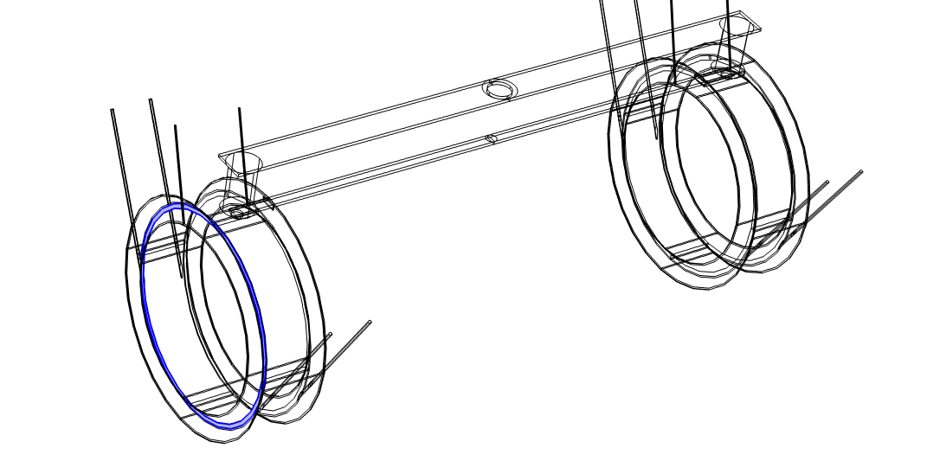
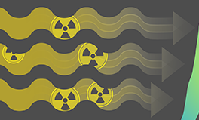
Radiation Damage and integrated dose
3rd Solenoid
Vadim Talanov
2nd Solenoid

Slide 9
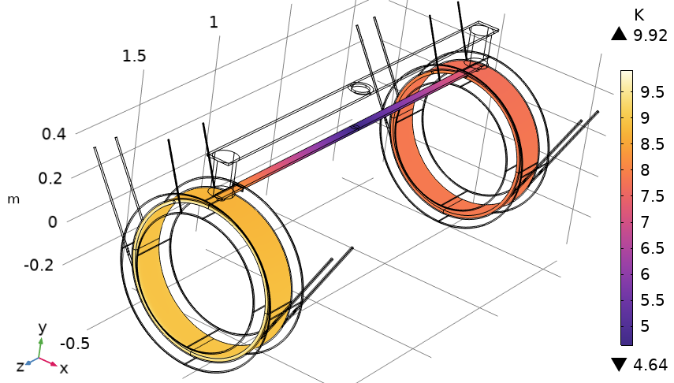
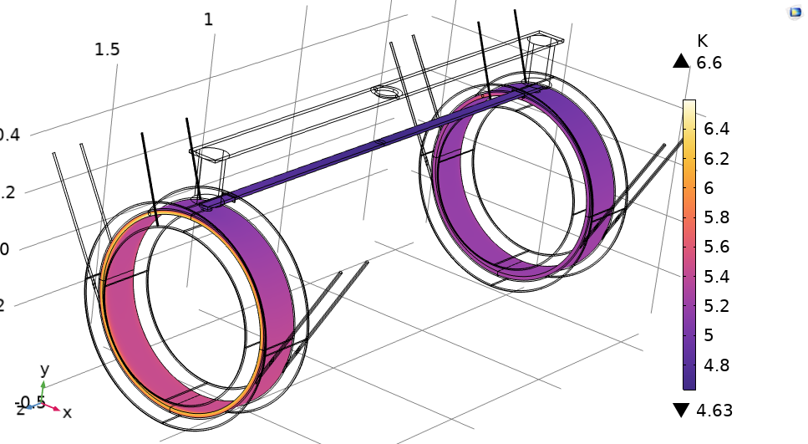
Radiation Damage and integrated dose
Cu connection bar
connection bar
k(T)=20 x kcu(T)
3rd Solenoid
2nd Solenoid

Slide 10
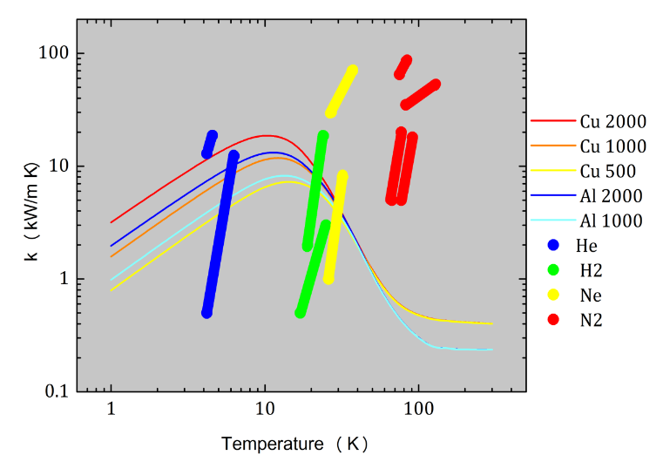
PHP – Pulsating heat pipe
Use PHP to thermally bridge two magnets.
Inter-solenoid distance varies, for MuH2 have 1.23 m, 1.23 m, 1.9 m, 2 m, 1.33 m.
Bertrand Baudouy

Slide 11
Conclusions / Questions / Comments
A crucial point for the project is the knowledge of the radiation environment in which we want to work.
  We need detailed calculation of the neutron fluence in the different magnet components.
We started by Nb-Ti mainly for its low cost (and what about its high radiation resistance??).
We are open to exploring other superconductors: MgB2, ReBCO.
We look for efficient ways to cooling systems for both single magnets and series of magnets.
  Thermal link --> Pulsating heat pipe, heat pipe, thermosiphon…
  Cryocooler+inverter

Slide 12
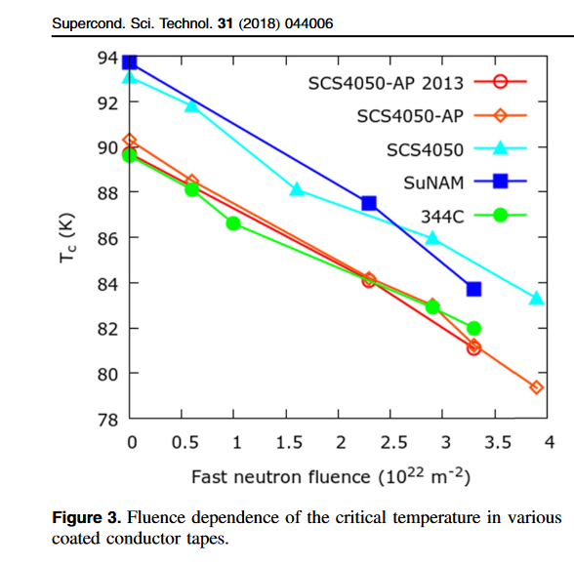
Radiation Damage - REBCO
Neutron fluence affect on the critical surface of REBCO.
The effect of fast neutron irradiation on the superconducting properties of REBCO coated conductors with and without artificial pinning centers - IOPscience

