Slide 1
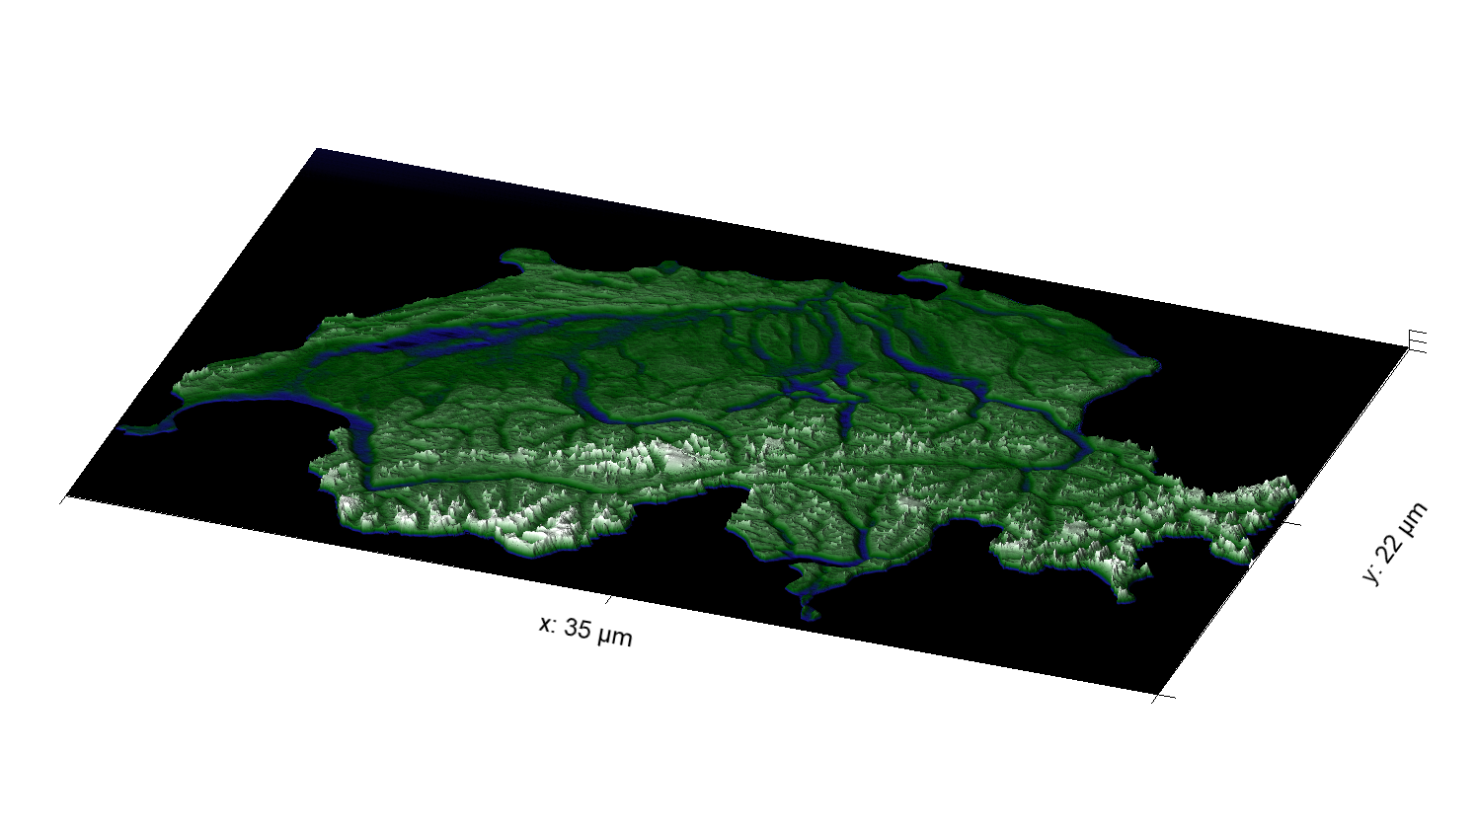
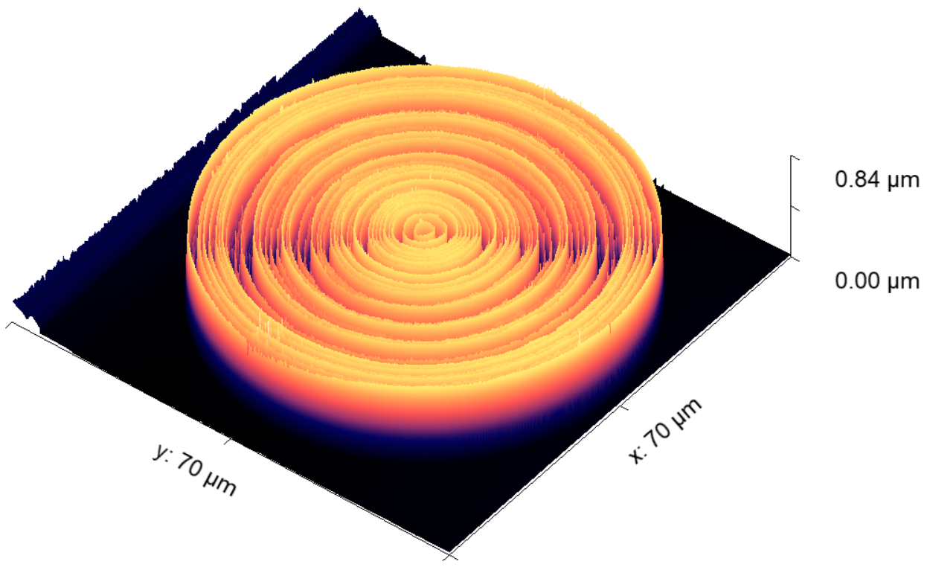
Fabricating 3D photonic devices with grayscale e-beam lithography
Laboratory for Nano and Quantum Technologies (LNQ)
Paul Scherrer Institute (PSI)
Summer Internship
Jun-Jul 2024
Bjarke Almer Frederiksen
2nd semester, MSc Engineering Physics,
Technical University of Denmark (DTU)

Slide 2
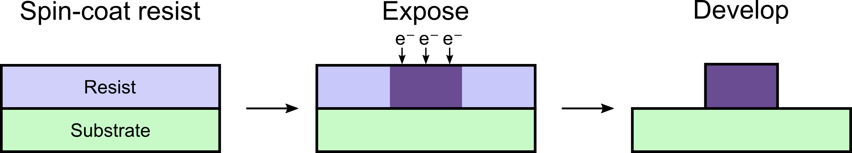
E-beam lithography

Slide 3
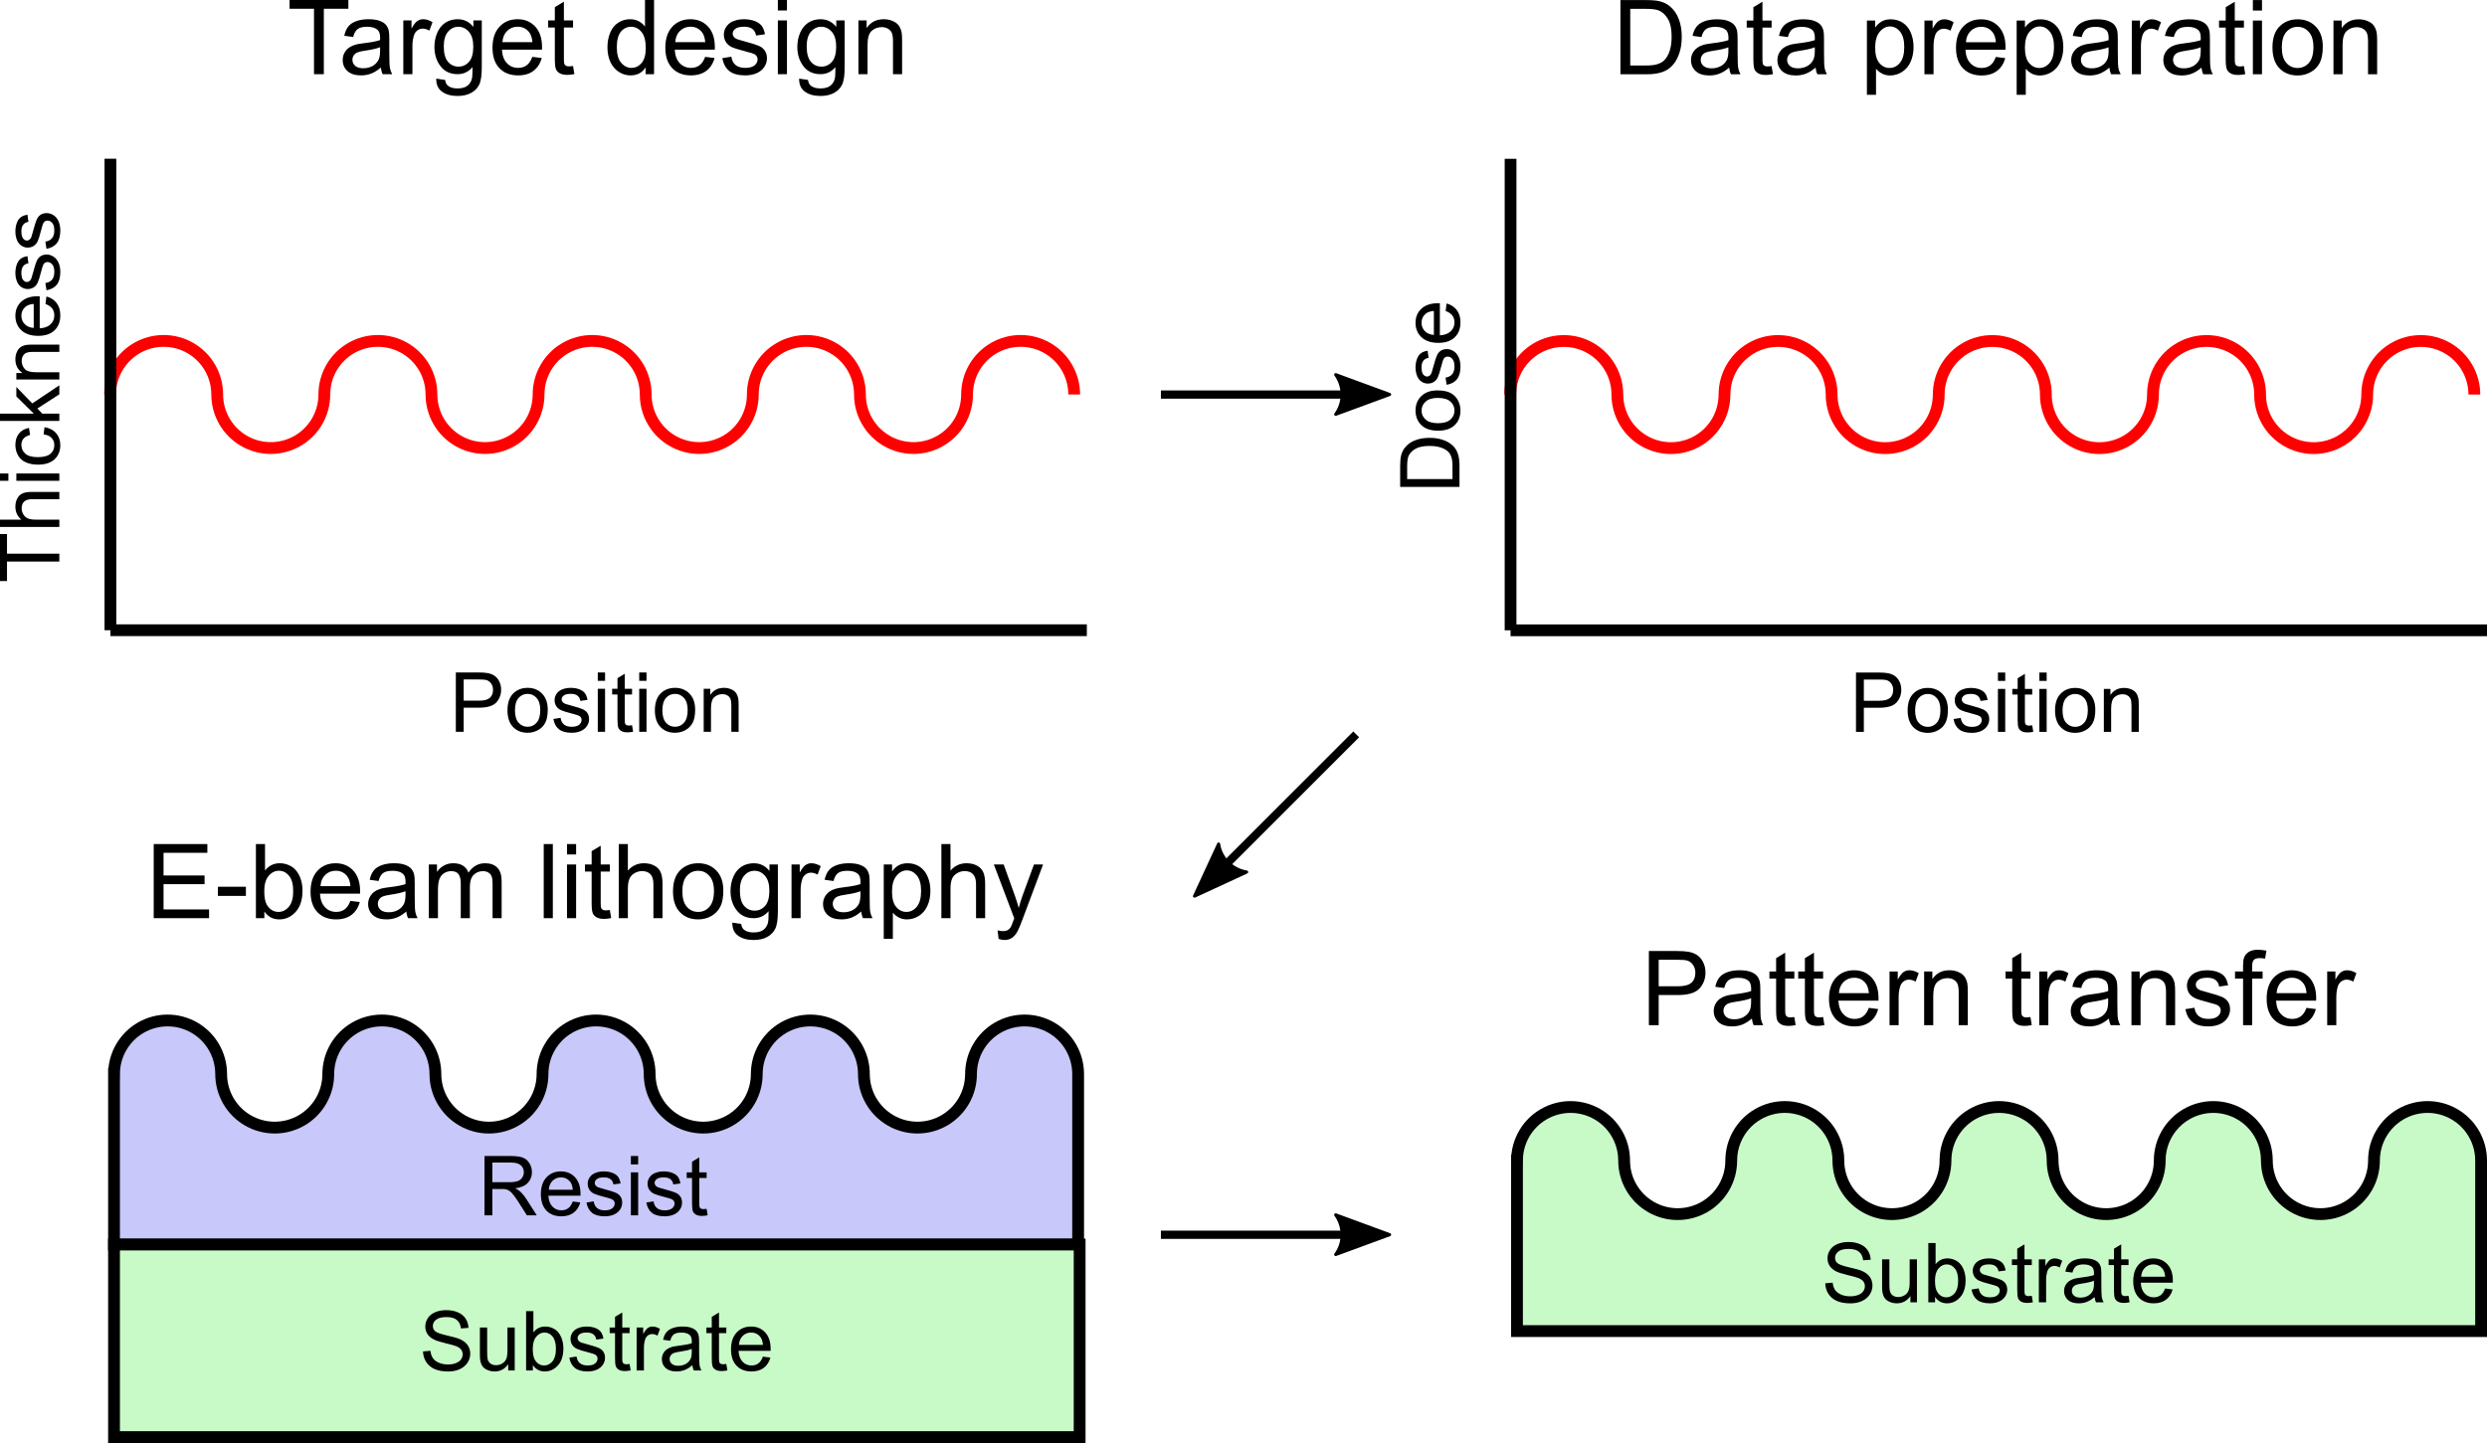
Grayscale electron-beam lithography

Slide 4
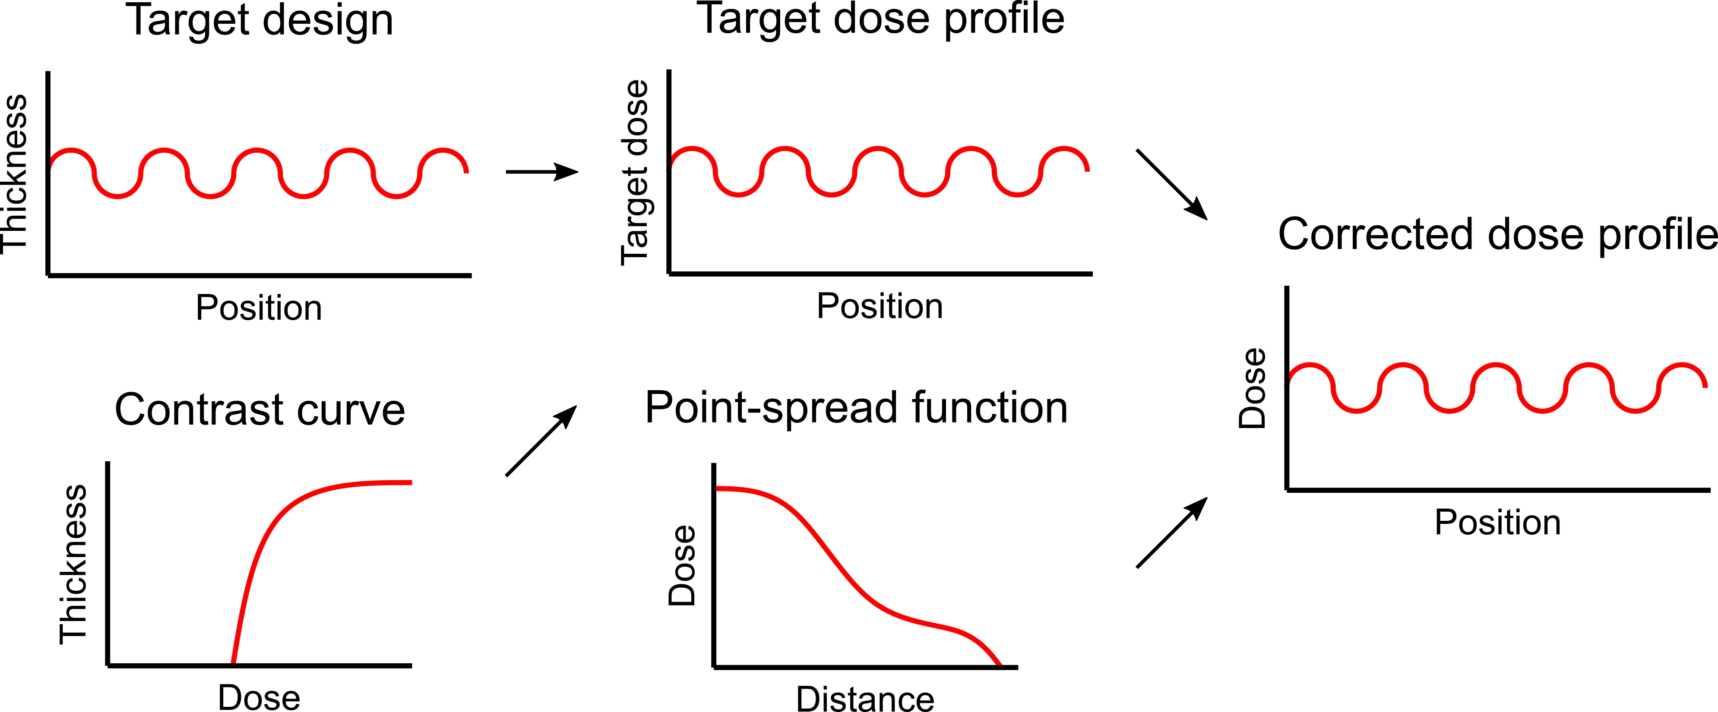
Data preparation procedure

Slide 5
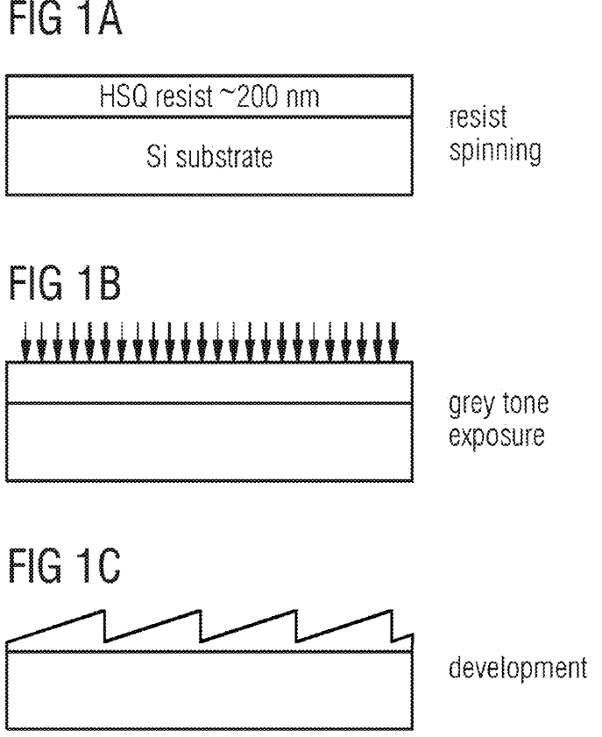
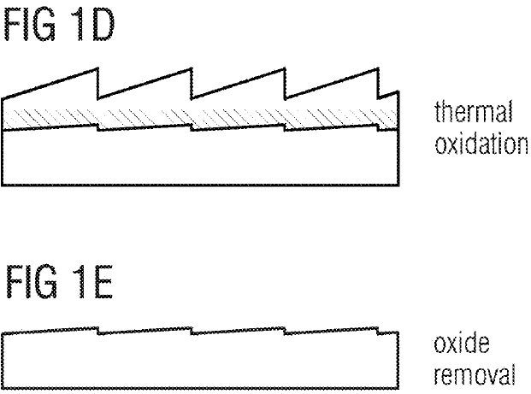
Pattern transfer to silicon through oxidation
C. David and V. Guzenko, "Fabrication of Blazed Diffractive Optics by Through-Mask Oxidation," U.S. Patent 20 220 299 685 A1, Sep. 22, 2022.

Slide 6
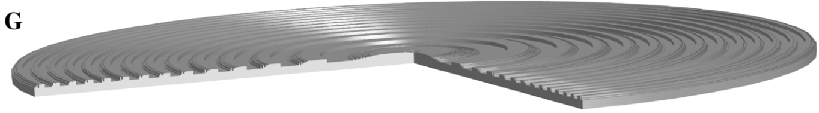
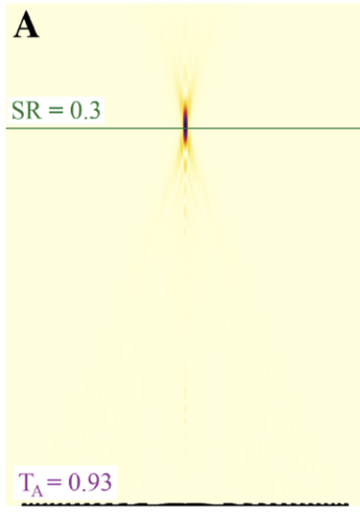
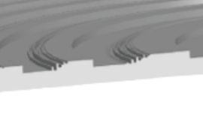
Topology-optimized photonic metalenses
Rasmus E. Christiansen, Zin Lin, Charles Roques-Carmes, Yannick Salamin, Steven E. Kooi, John D. Joannopoulos, Marin Soljačić, and Steven G. Johnson, "Fullwave Maxwell inverse design of axisymmetric, tunable, and multi-scale multi-wavelength metalenses," Opt. Express 28, 33854-33868 (2020)

Slide 7
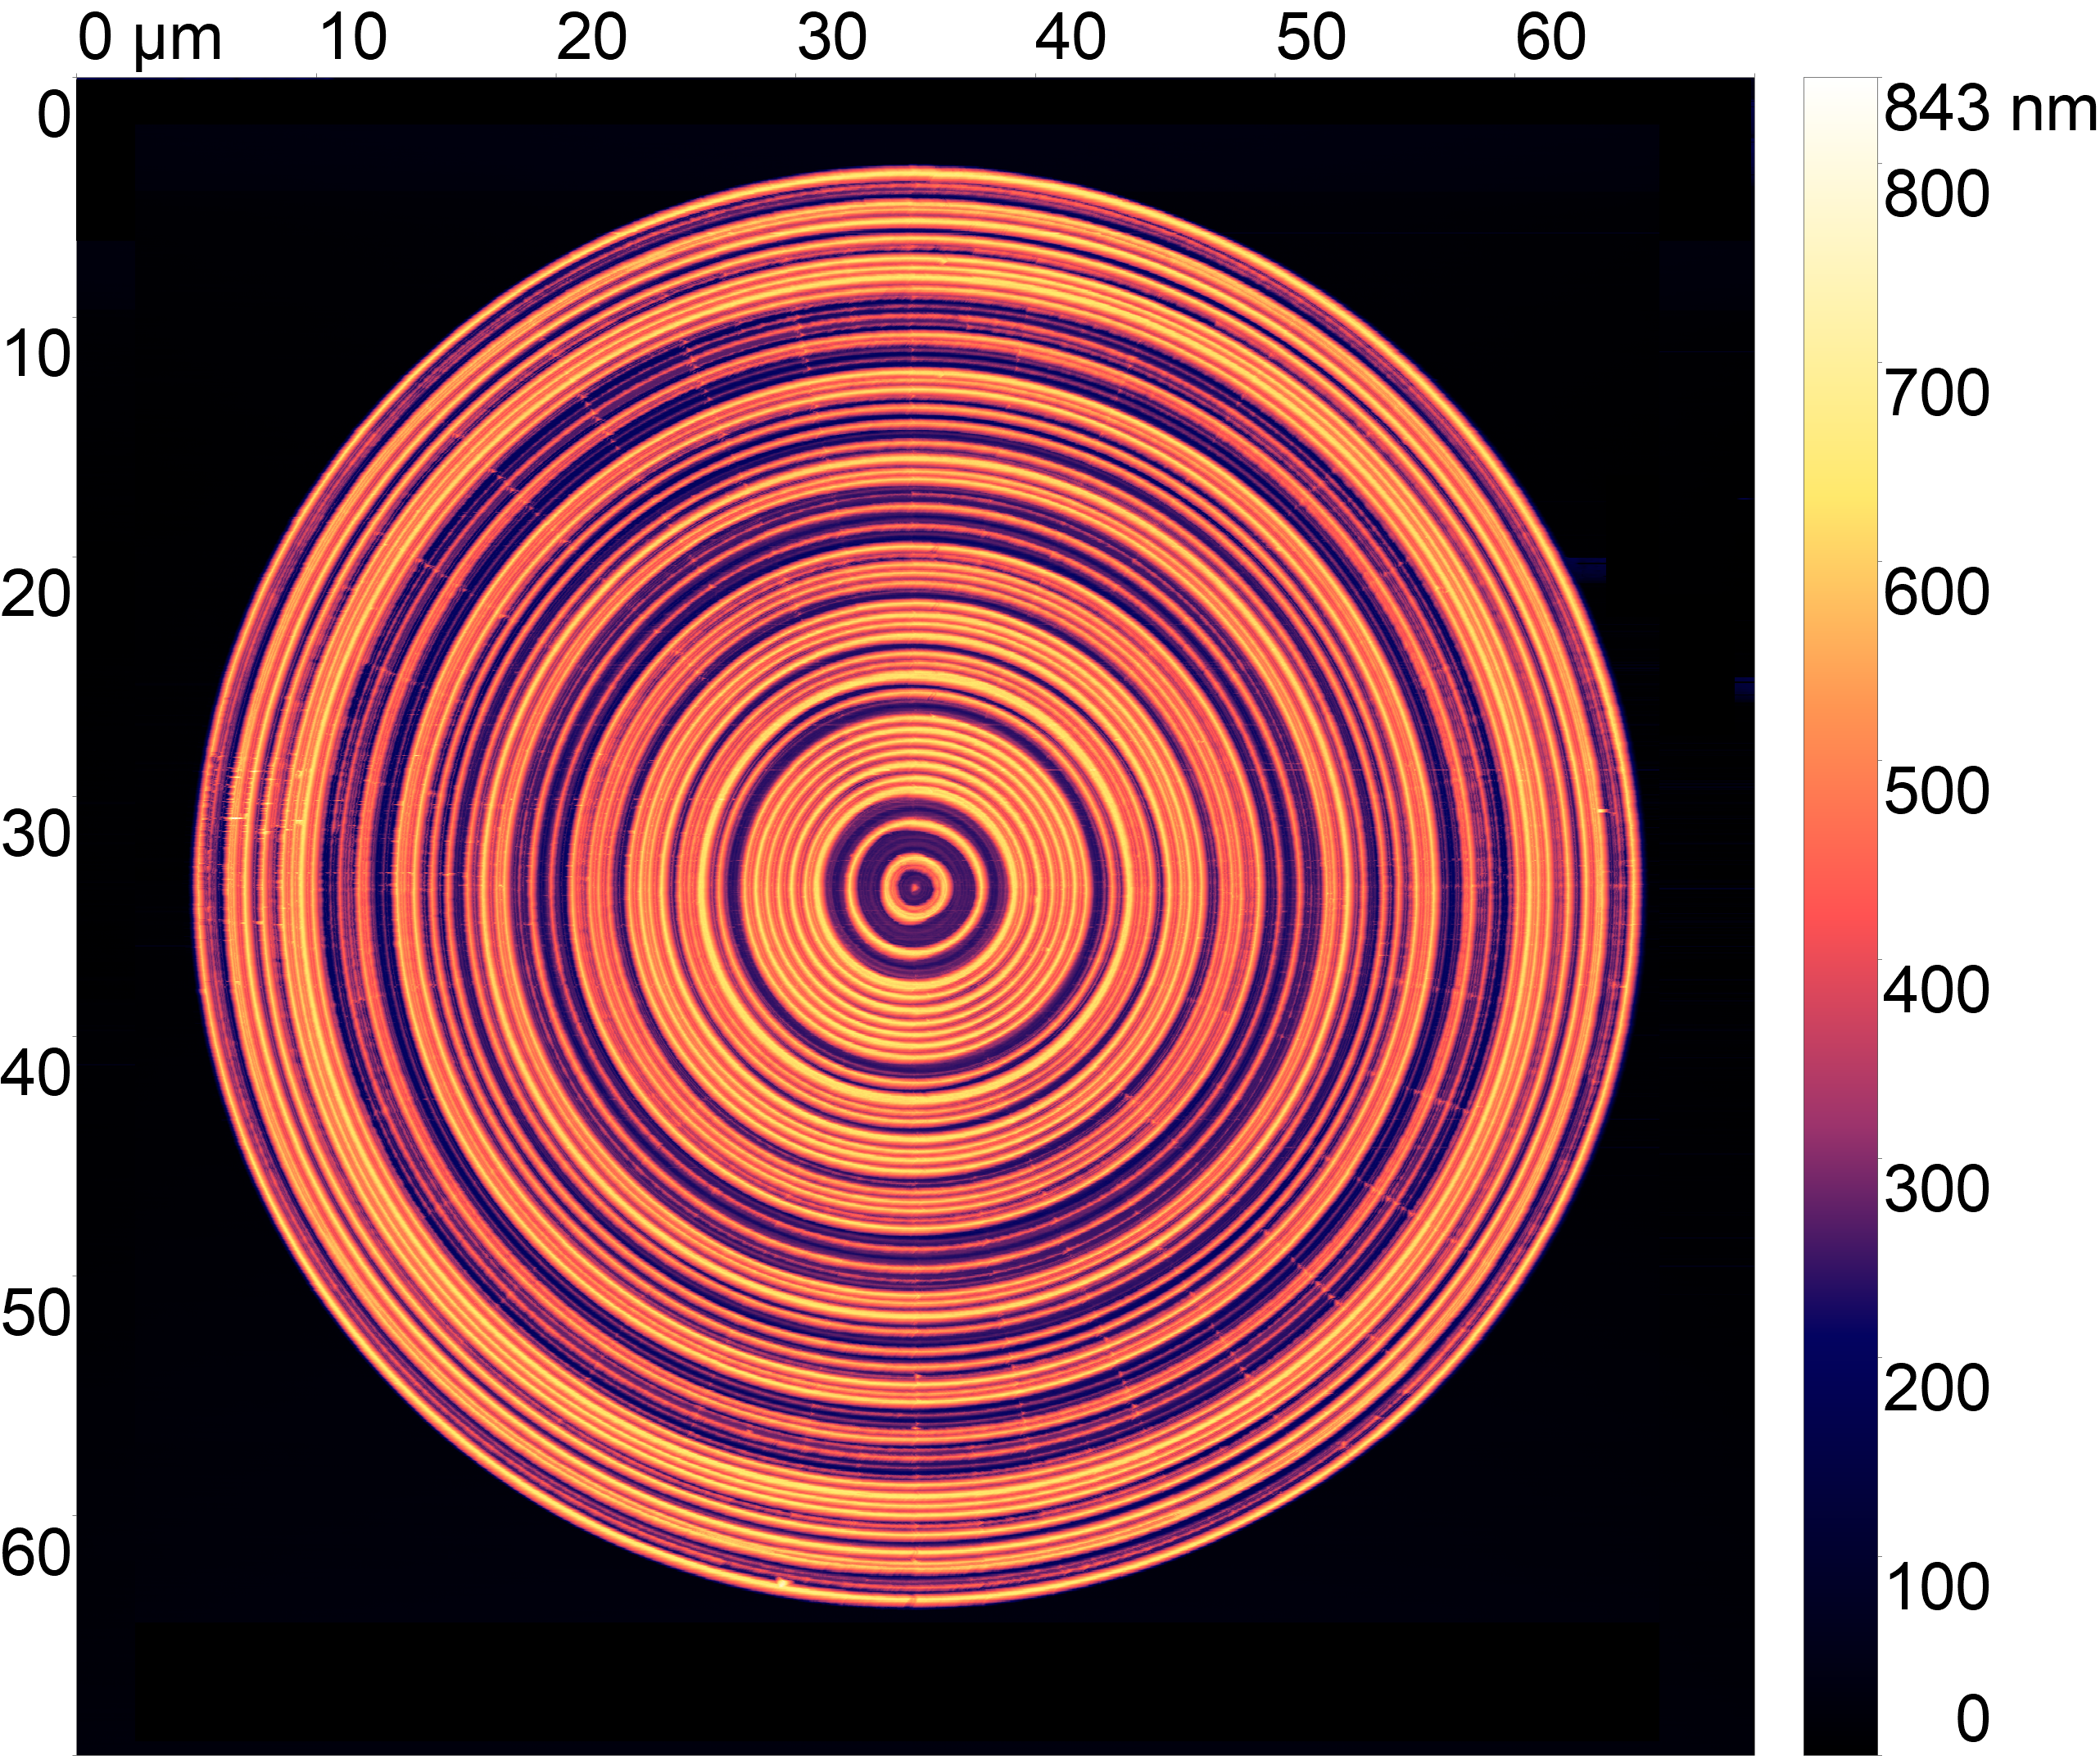
Metalens in SiO₂
Notes:
Figures:
Data\AFM\Figures\O1_SiOx_300sDev_H+300_numLambda2_right.png
Data\AFM\Figures\O1_SiOx_300sDev_H+300_numLambda2_right_mean_profile.pdf
Data analysis:
Data\AFM\O1\Metalenses\H+300_numLambda2_right.002.gwy (to extract AFM profiles)
Data\AFM\metalens_AFM_data_analysis.py (to compare AFM and target profile)
Data:
Data\AFM\O1\Metalenses\H+300_numLambda2_right.002
Data prep for pattern:
Dataprep\Metalenses\metalens_data_prep.py
Job:
FB240712_300s_SiOx.job

Slide 8
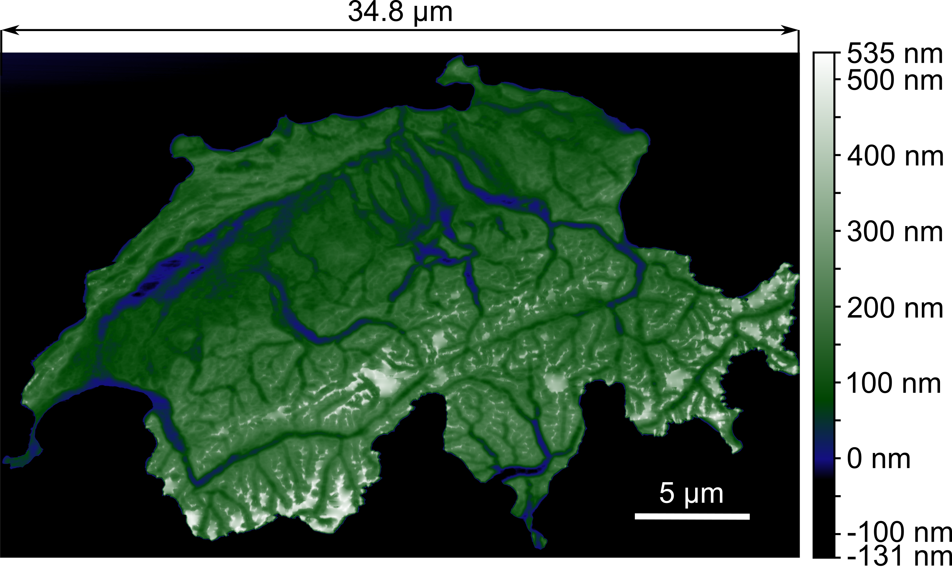
1:10¹⁰ height map of Switzerland in SiO₂
Notes:
Figure:
Data\AFM\Figures\O1 SwissMap\SwissMapAFM.svg
Data analysis:
Data\AFM\O1\Switzerland\right_top_right.002.gwy (setting correct scale and colormap)
Data:
Data\AFM\O1\Switzerland\right_top_right.002
Data prep for pattern:
Dataprep\SwissMap\SwissMap.py
Job:
FB240712_300s_SiOx.job

Slide 9
1:10¹⁰ height map of Switzerland in SiO₂
Notes:
Figure:
Data\AFM\Figures\O1 SwissMap\SwissMapAFM.svg
Data analysis:
Data\AFM\O1\Switzerland\right_top_right.002.gwy (setting correct scale and colormap)
Data:
Data\AFM\O1\Switzerland\right_top_right.002
Data prep for pattern:
Dataprep\SwissMap\SwissMap.py
Job:
FB240712_300s_SiOx.job

Slide 10
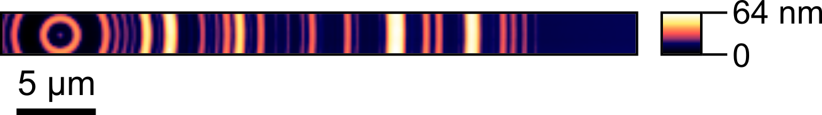
Metalens in silicon
Notes:
Data:
Data\AFM\E2\Metalenses\dR100_dH1_numLambda2.001
Job:
FB240715_dose_test_checkerboards_metalenses_FOX16_300s.job

Slide 11
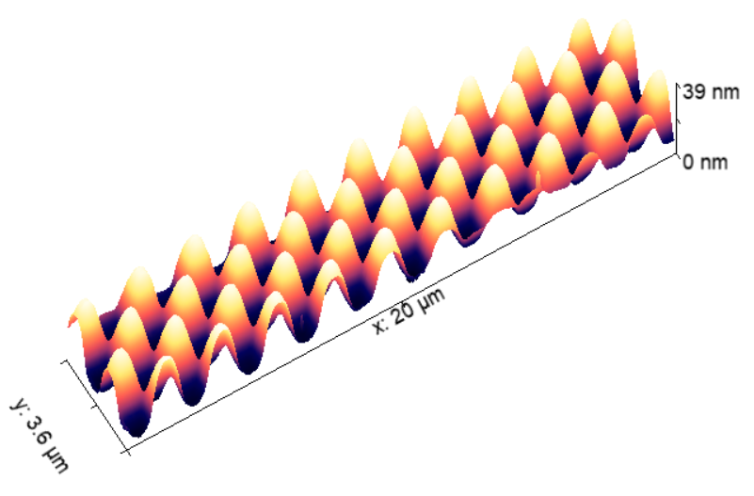
Checkerboards in silicon
Notes:
Data:
Data\AFM\E2\Checkerboards\500nm_2942uC_edge.001
Data prep for pattern:
Dataprep\Checkerboards\generate_checkerboards.sh
Job:
FB240715_dose_test_checkerboards_metalenses_FOX16_300s.job

