Slide 1
PSB and PPRE at SLS 2.0
Timing modes operations for users
Paul Tragus
Paul Scherrer Institut, 07/08/2024

Slide 2
Synchrotron Radiation

Slide 3
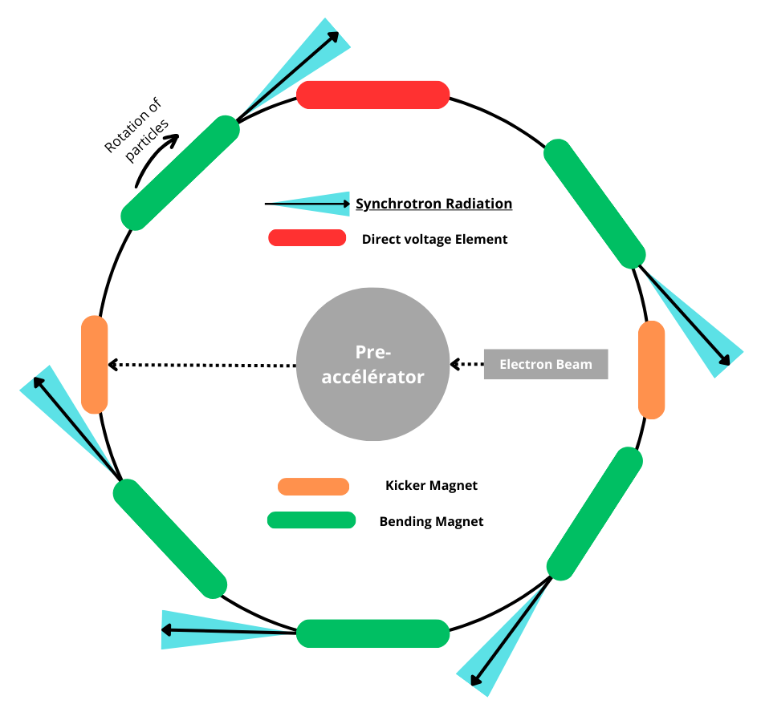
Synchrotron Radiation
EM waves radiation
A charged particle undergoing acceleration radiates energy in the form of electromagnetic waves.
Acceleration is pointed inwards to the ring at every bending magnet (source point). Radiation is tangent to the particle’s trajectory.
Synchrotron Radiation is of interest for beamline users.

Slide 4
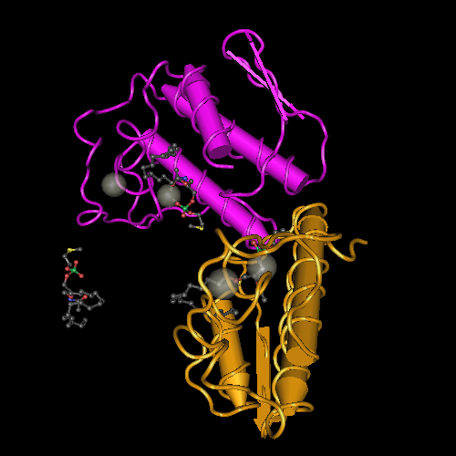
Synchrotron Radiation Usage
Biomedical research (e.g. Dr Jörg Stanfuss lecture)
Probe atomic and electronic structure of matter

Slide 5
Pseudo-Single-Bunch at SLS 2.0

Slide 6
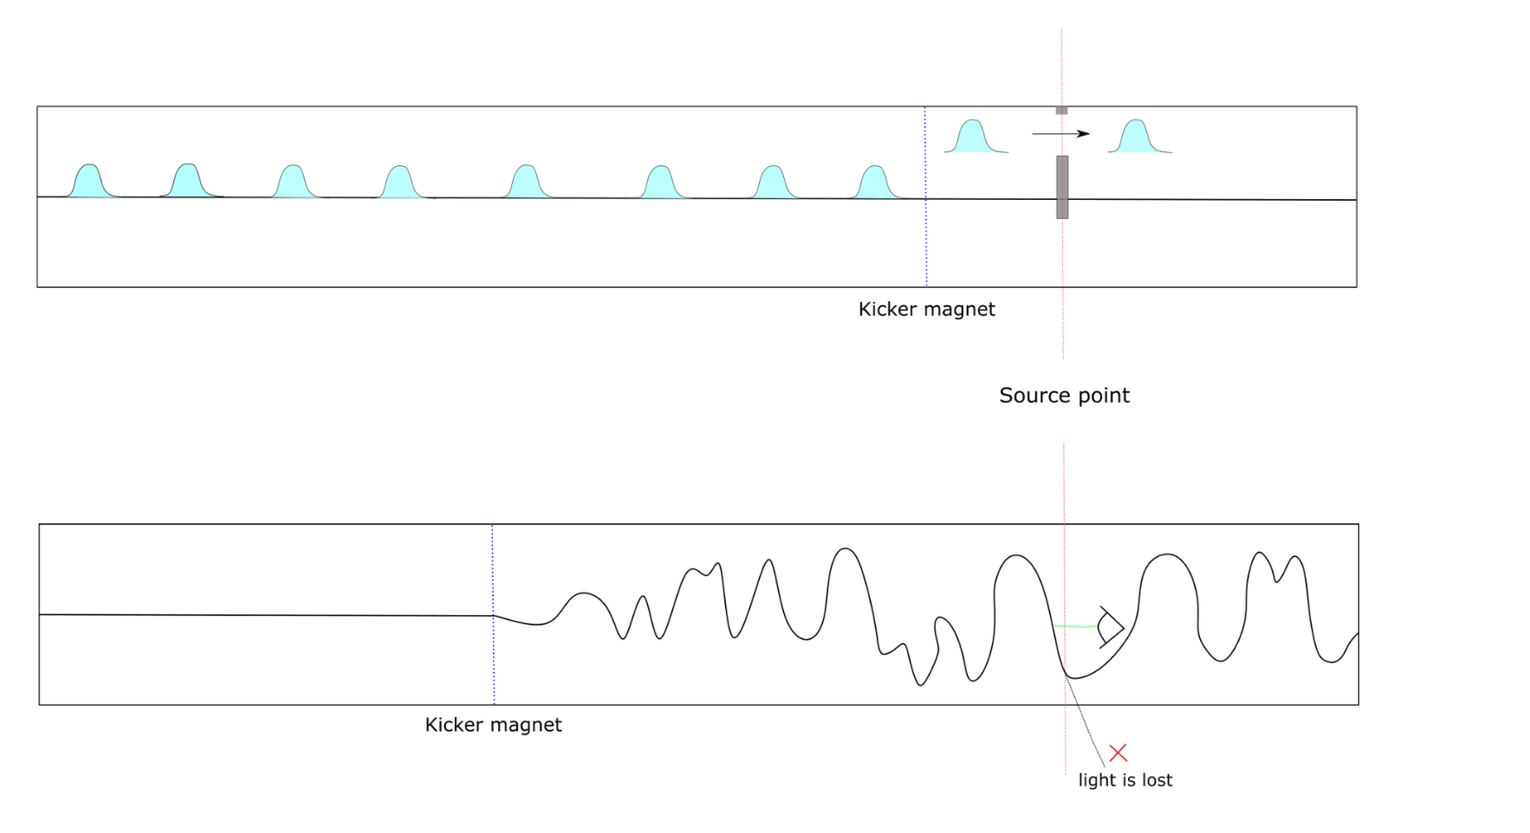
Pseudo-Single-Bunch
Kick a bunch of particles
We kick a bunch of particles out of its initial orbit. It moves the kicked beam radiation away from the unkicked beam one.
Problem : the radiation is not visible by the beam line users

Slide 7
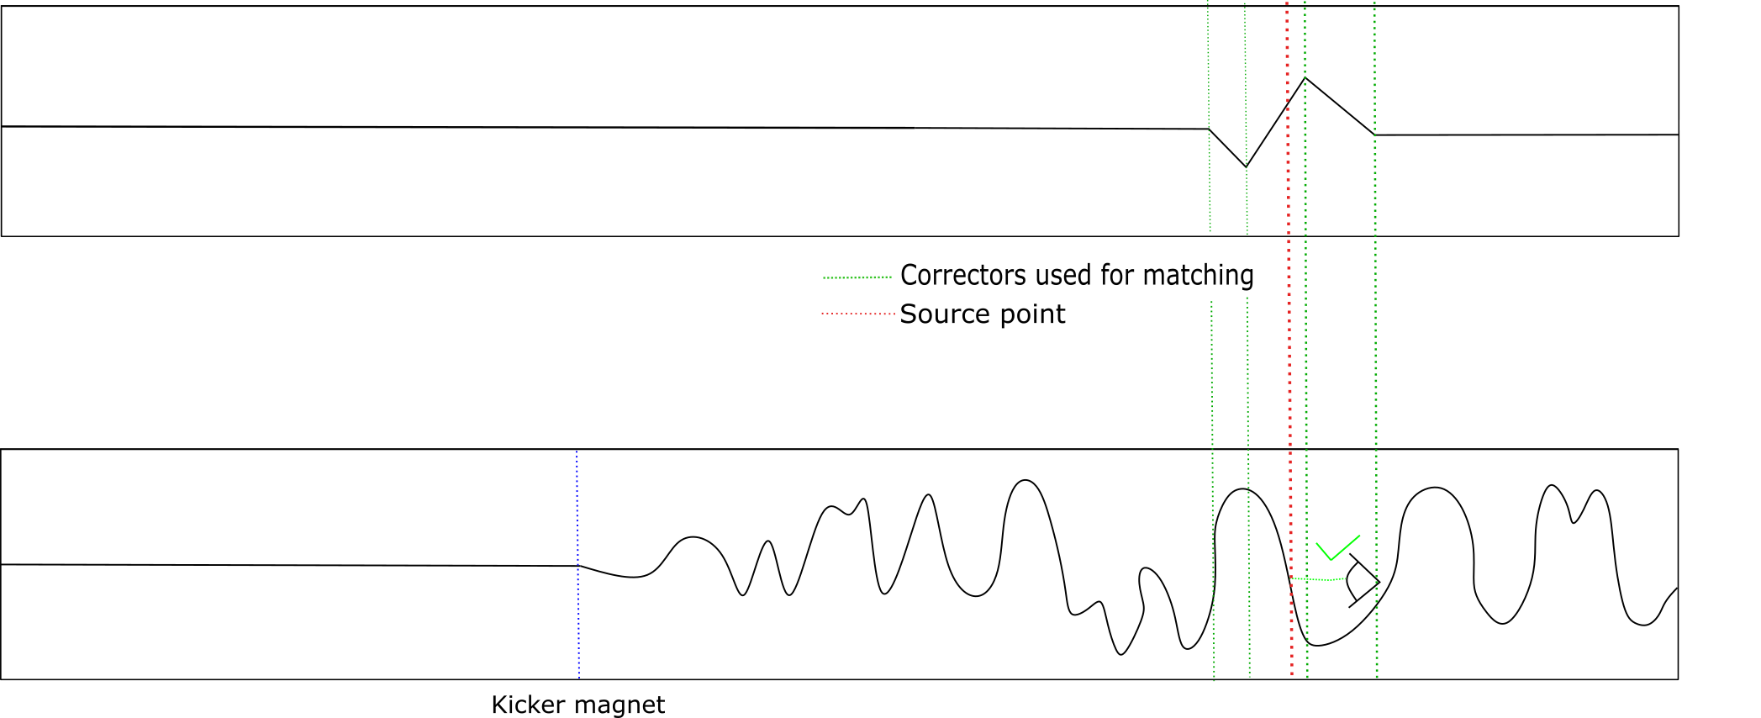
Pseudo-Single-Bunch
Local Bump : A solution
A constant local bump created by 4 corrector magnets put the kicked bunch on-axis.

Slide 8
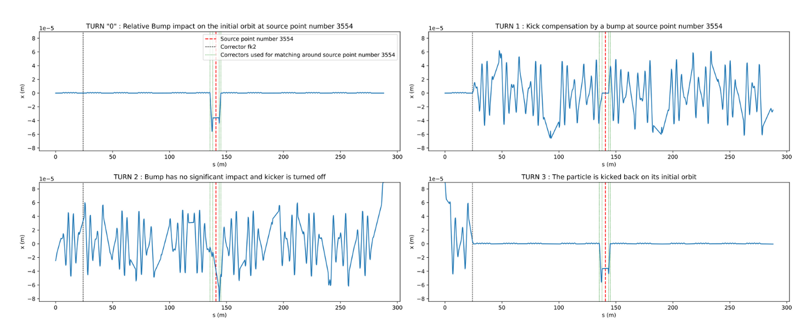
Pseudo-Single-Bunch
Turn 0 : Bump impact on orbit alone.
Turn 2 : Kicker is turned off. The particle continues its path
Turn 1 : Particle gets kicked + bump ensures to be on-axis
Turn 3 : Particle gets counter kicked. Bump has no impact

Slide 9
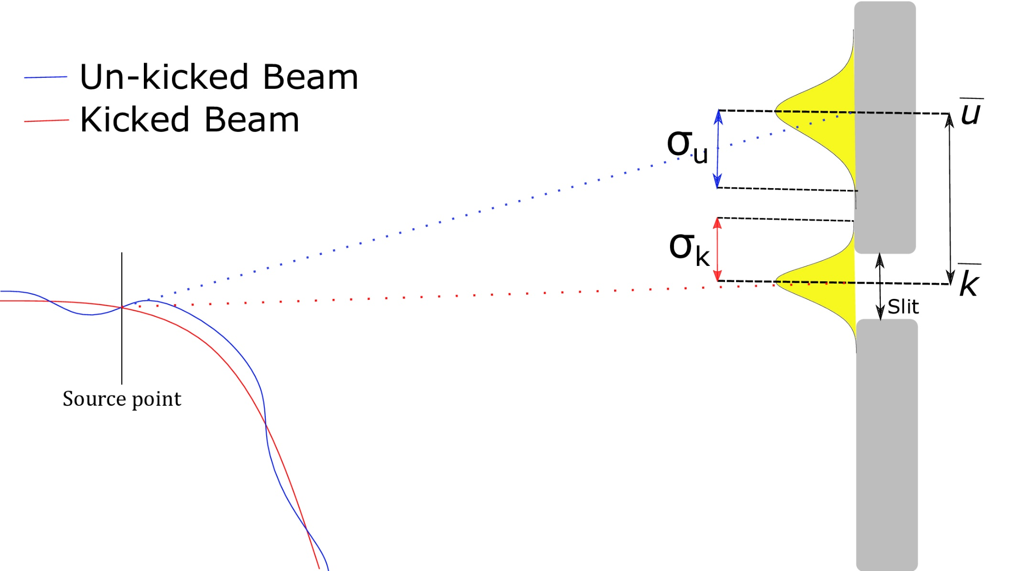
Pseudo-Single-Bunch

Slide 10
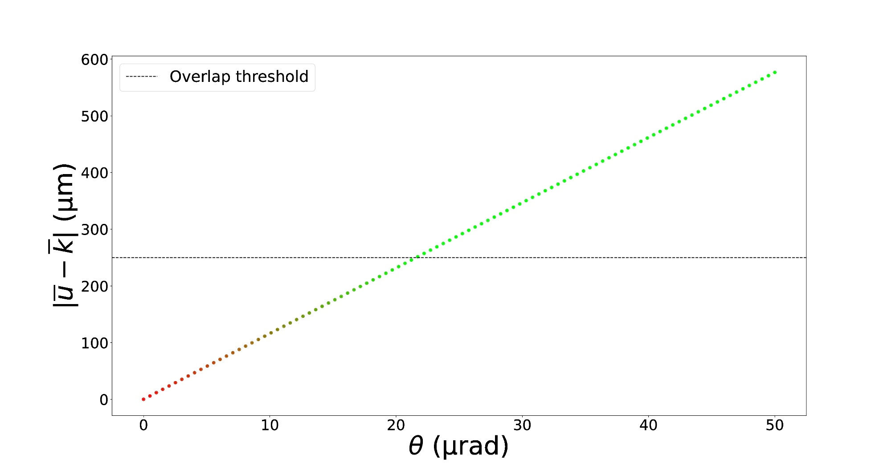
Outcome of the research for PSB

Slide 11
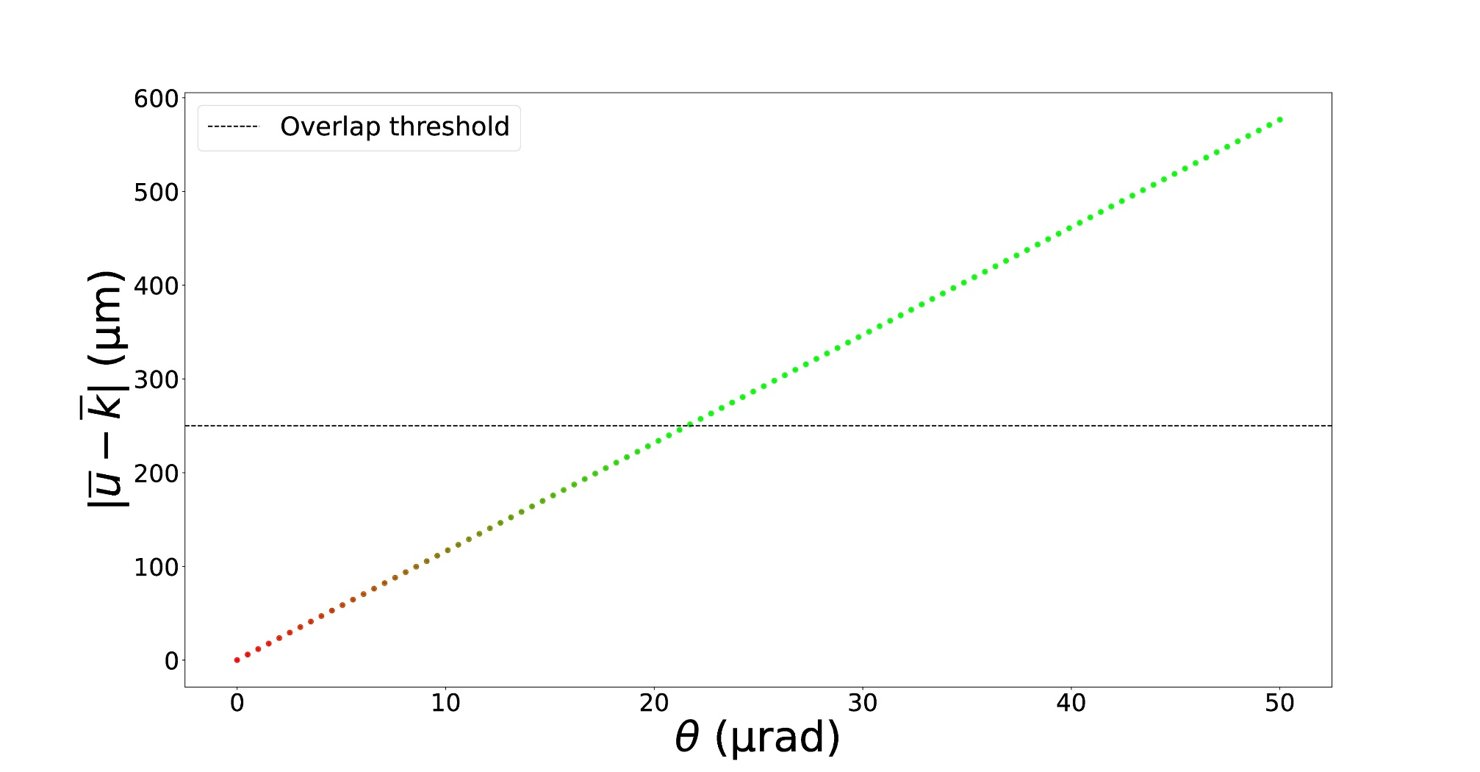
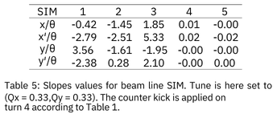
Outcome of the research for PSB

Slide 12
Pulse-Picking by Resonant Excitation at SLS 2.0

Slide 13
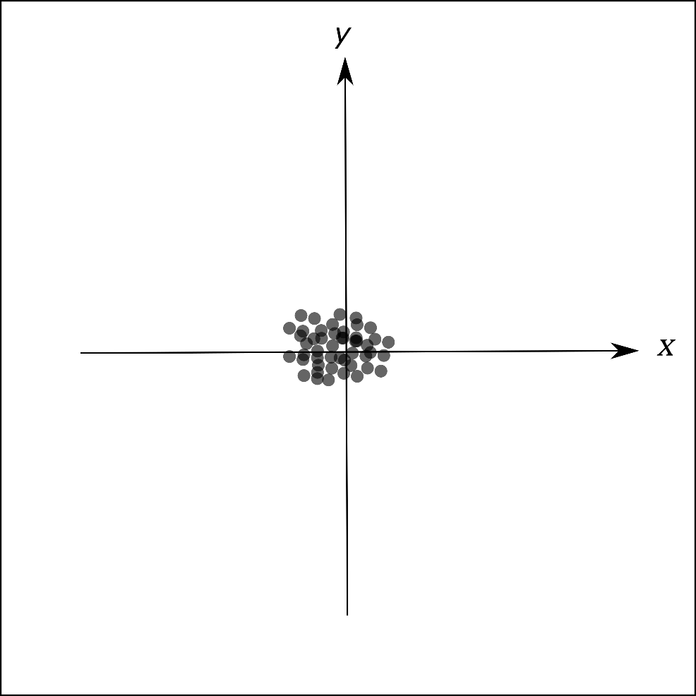
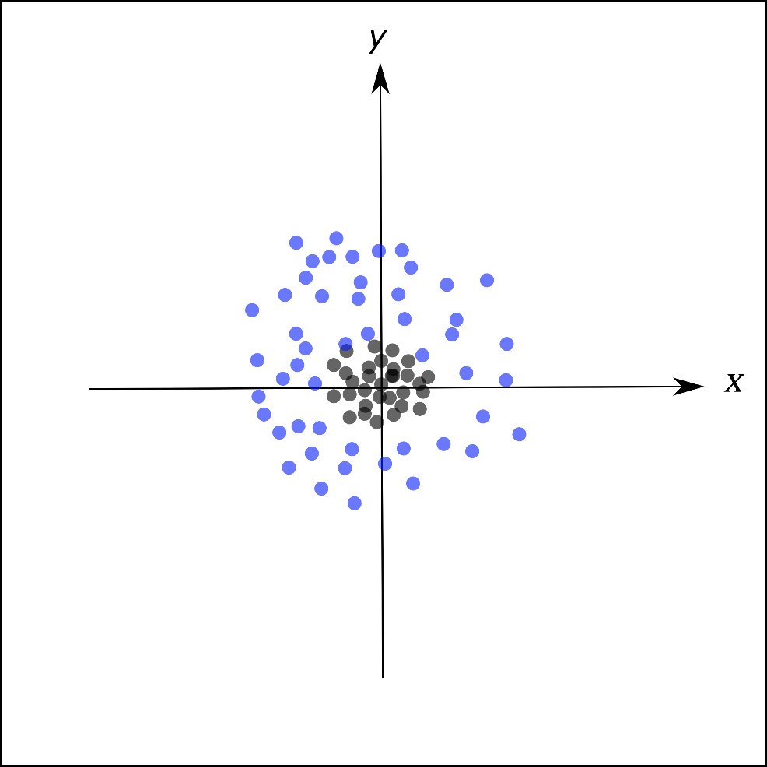
Pulse-Picking by Resonant Excitation
Turn 1
Turn 35000
PPRE Operation
Beam size
growth
Excited Electrons
Unexcited Electrons

Slide 14
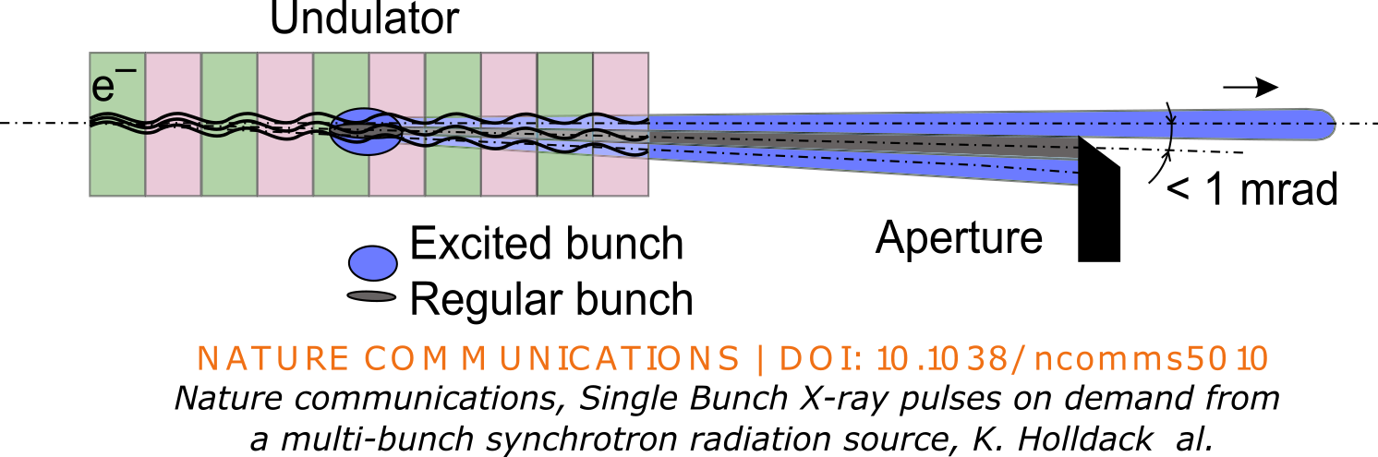
Pulse-Picking by Resonant Excitation
Local bump, as in PSB, to be on-axis
An aperture is used to split the bunch

Slide 15
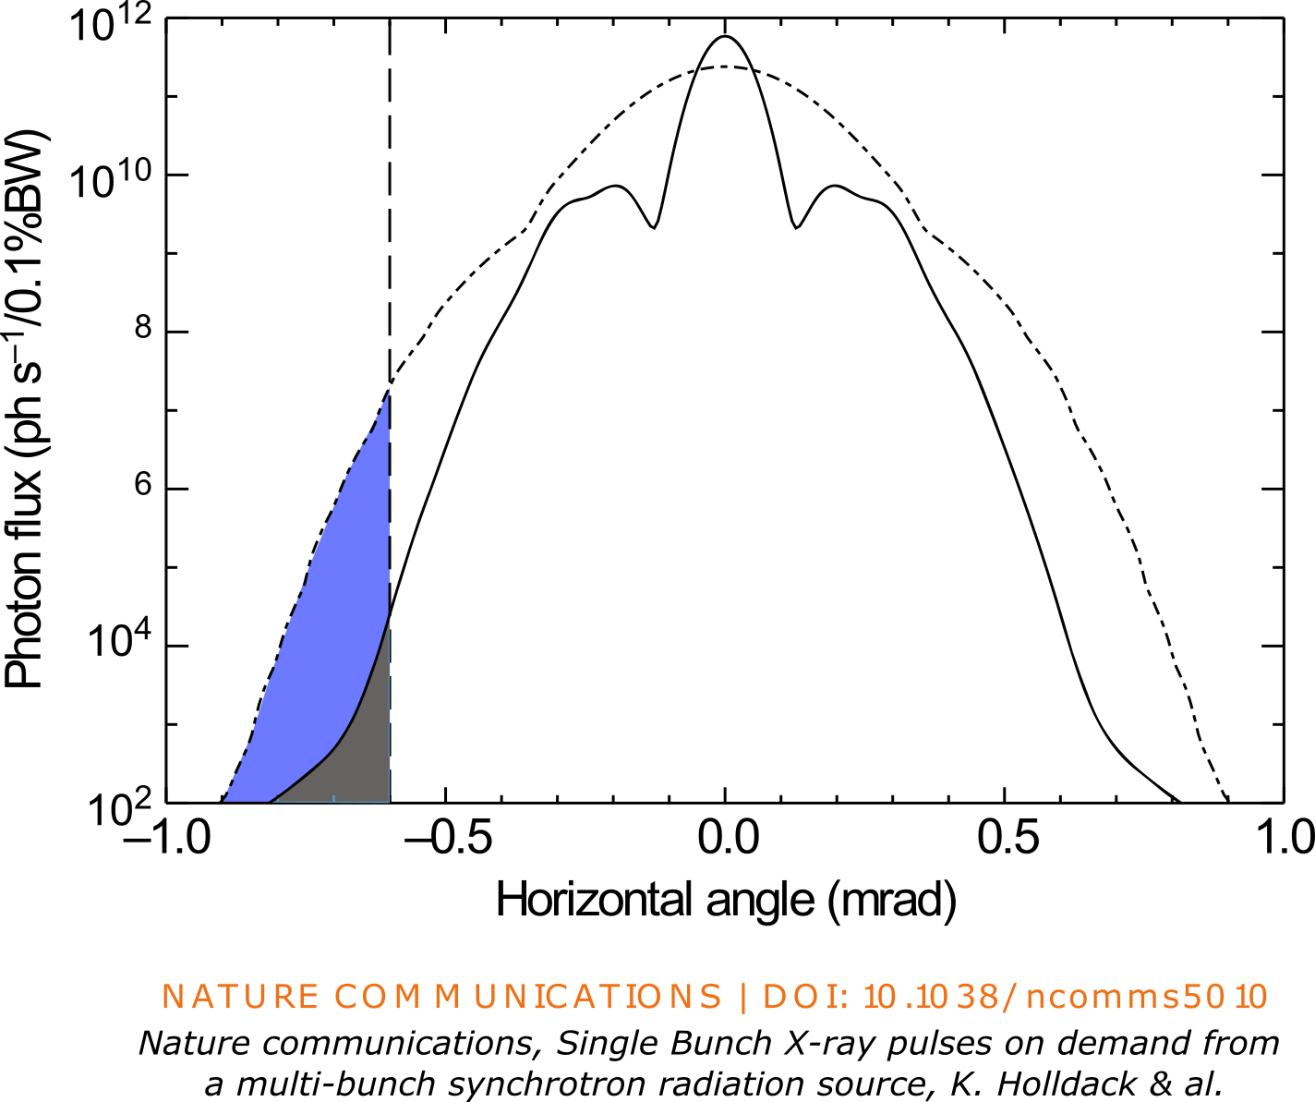
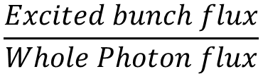
Outcome of the research for PPRE
Purity measurement
$$\frac{Excited bunch flux}{Whole Photon flux}$$

Slide 16
Thank you for your attention

