Slide 1
Summer talk
Polonium evaporation
from LBE at low temperature
Jocelyn Soppo
LRC, 07/08/2024

Slide 2
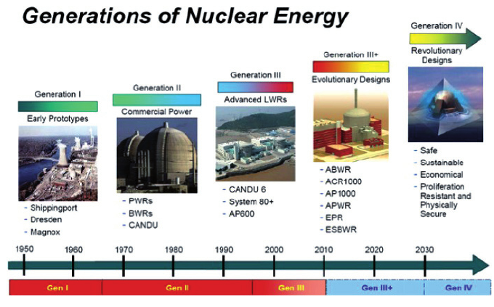
Background
Switzerland: Generation II PWR (Pressured Water Reactor’s)
Generation III+ in Europe: EPR (European Pressured Reactor)
Generation IV:
  GFR
  MSR
  SFR
  SCWR
  VHTR
  LFR
Notes:
GFR: Gas cooled fast reactor
MSR: Molten Salt Reactors
SFR: Sodium cooled fast reactors
SCWR: SuperCritical Water Cooled Reactor
VHTR: Very high temperature gas reactor
LFR: Lead Cooled fast reactors

Slide 3
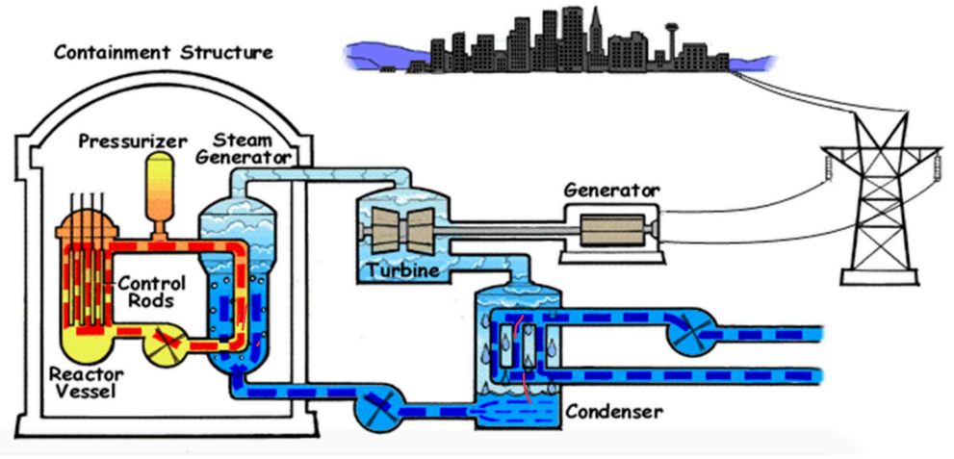
PWR operation
Fission reaction releases energy
Pressured water act as coolant
Thermal transfer between the primary and secondary water circuit
Water in the secondary circuit evaporates and spins the turbine
Induction phenomenon creates electricity
SO WHY THE GEN IV?
Notes:
Chain fission reaction

Slide 4
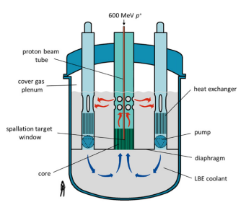
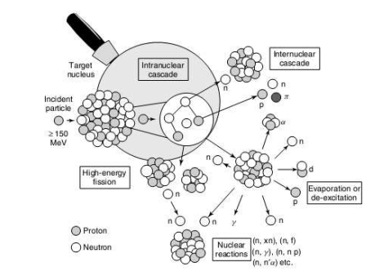
MYRRHA project
Multi-purpose Hybrid Research Reactor for High-tech Application (MYRRHA) standing out as first of a kind demonstrator for transmutation
1. Neutron produced feed the fission reaction
2. Transmutation
Notes:
Non critical reactor
Lead Bismuth
Initial collision ➔ individual or small groups of nucleons are ejected leaving it excited
Exit excited state by releasing low energy particles

Slide 5
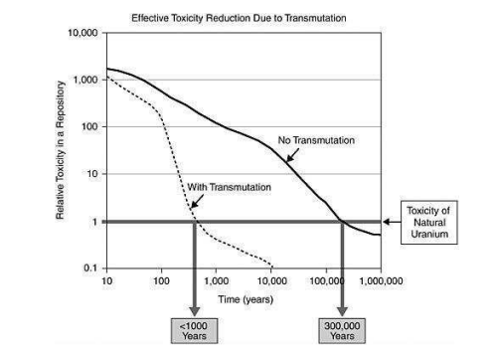
Transmutation
Much shorter half life radionuclides
Notes:
Transform long lived nucleous in

Slide 6
Main benefits of MYRRHA
1. Safety issues in case of nuclear accident
By stopping the proton beam, we stop the fission reaction
Extremely hard to evaporate lead and bismuth
2. Long lived radionuclides handling
Transmutation makes it possible to have a better visibility on active waste behavior
3. Nuclear fuel used
Possibility to use fast neutrons ➔ ²³⁸U instead of ²³⁵U (only 0.7% of the total Uranium on
Earth is ²³⁵U isotope
WHY AM I EVEN EMPLOYED HERE THEN ?

Slide 7



THE main disadvantage of MYRRHA
Po
Po
Po
Po
Po
Po
Po
Neutron capture of Bi
Po
POLONIUM IS A VOLATILE COMPONENT
➔ In case of nuclear accident:

Slide 8

Aim of the internship
Determine the influence of impurities in Lead-Bismuth Eutectic (LBE) samples
Pure LBE at high temperature
Pure LBE at low temperature
MEGAPIE LBE at high temperature
MEGAPIE LBE at low temperature
?
MEGAPIE: MEGAwatt Pilot Experiment ; high intensity proton beam used to irradiate the LBE

Slide 9
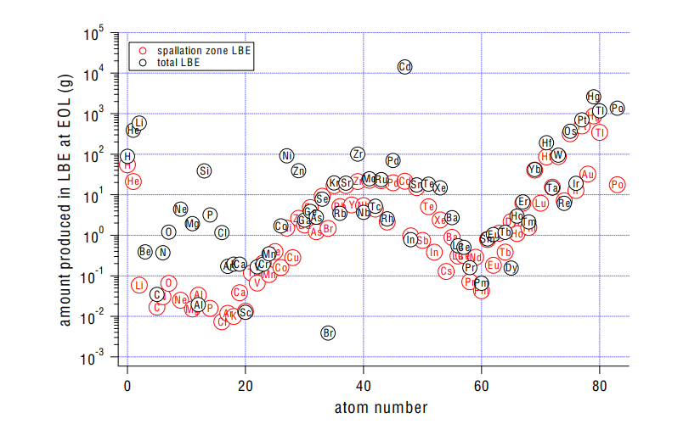
Aim of this internship

Slide 10
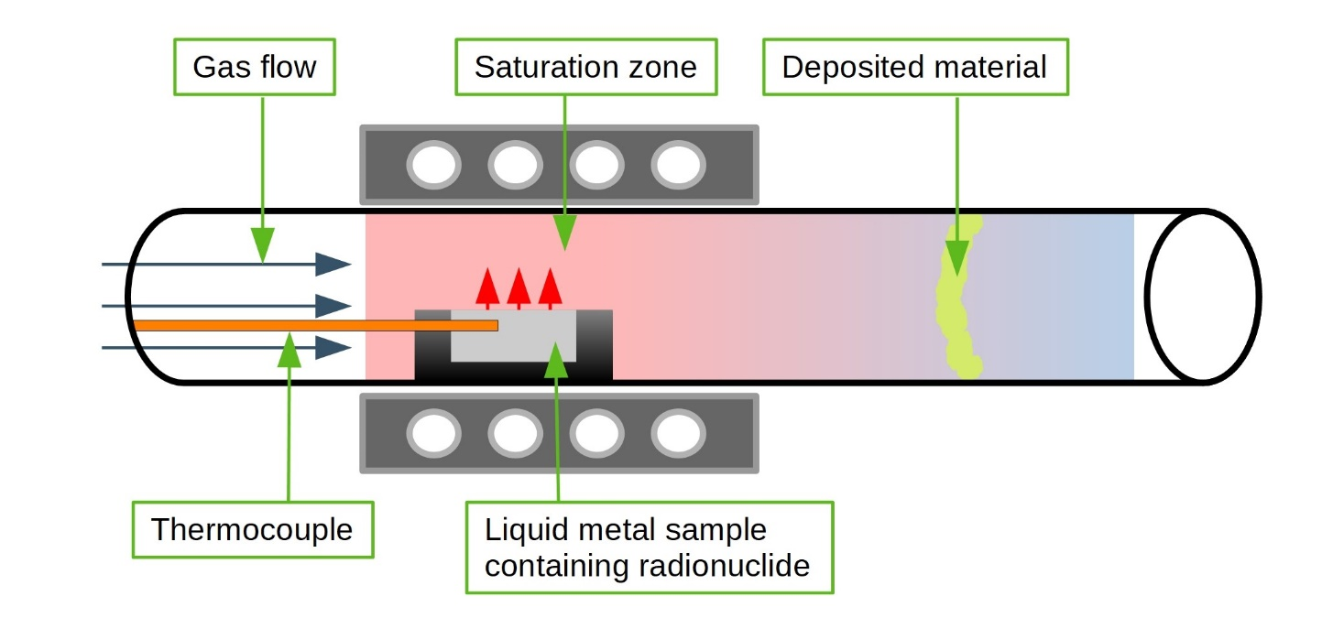
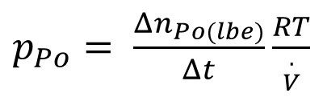
Method
Between each transpiration
Initial LBE activity
Remaining LBE activity
Evaporated activity and its distribution in washing fraction
Po vapor pressure ➔ Henry constant
Transpiration time : 15mins, 30 mins, 1h, 5h and 20h
Temperature tested : 600 °C, 500 °C, 400 °C, 300 °C
$p_{Po}= \frac{Δn_{Po(lbe)}}{Δt}\frac{RT}{{. \atop V}}$

Slide 11
Thank you for your attention
Question ?

