Slide 1
Bimodal Imaging Computed Tomography (CT) of the Steel Reinforced Concrete and the Archaeological Nail sample to study Corrosion.
Applied Materials Group, LNS
Paul Scherrer Institut
(02 May 2024 – 30 Aug 2024)
Mentors: Dr. Mahdieh Shakoorioskooie,
Dr. Markus Strobl
Presented By: Ejan Khalifa
Villigen, 07 August 2024

Slide 2
1
Motivation
2
Introduction
AGENDA
3
Why This Approach?
4
Experimental Work
5
Data Processing
6
Results
7
Forward Plans & Learnings
8
Summary/Conclusion
9
References

Slide 3

Fig. Ref.: Corrosion Corint | Home (corrosion-corint.ch)

Slide 4


INTRODUCTION
Swiss National Science Foundation (SNSF) Sinergia
WP-1: Paul Scherrer Institut, Villigen
Multimodal in-situ computed tomography
WP-2: EPFL, Lausanne
Corrosion mechanisms in homogeneous porous media.
WP-3: ETH, Zurich
Corrosion mechanisms in heterogeneous porous media.
WP-4: HE-Arc, Neuchatel
Corrosion mechanisms in archaeological artefacts in and out of soil.

Slide 5
WHY THIS APPROACH?
Why Corrosion Study?
Structural Integrity, Operational Safety, Environmental Protection and Cost Avoidance.
Why Computed Tomography?
Detailed Imaging, Non-Destructive Testing (NDT), Safety and Efficiency.
Why Bimodal Imaging?
Complementary Information, Enhanced Imaging Capability and Research Advancements.

Slide 6
EXPERIMENTAL WORK (BIMODAL IMAGING)
Steel reinforced concrete sample
Archaeological nail sample
Nail sample installed on ICON beamline
ICON beamline was used for the neutron tomography of the nail sample and x-ray tomography of both the samples.
Tomographic reconstructions were carried out using the MuhRec software.
NEUTRA beamline was used for the neutron tomography of the steel reinforced concrete sample.
Sample was maintained in the required field of view of detector.

Slide 7
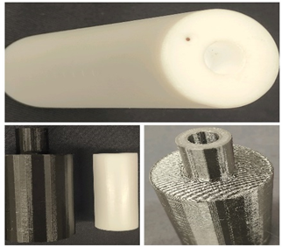
CALIBRATION FOR X-RAY CBCT
Aim
To ensure the accuracy, reliability and consistency of measurements and results as well as to compute the parameters used for the reconstruction later. (SOD, SDD, Magnification, COR)
Description
These samples consists of a vertical stack of copper beads, where the older sample has the beads touching each other while the newer sample has the stack with 1 mm separation.
Different distances between the calibration sample and the detector were used. (100, 200 & 300 mm for new sample and -30, 50 & 200 mm for old).
Process
360 projections were taken along 360 degrees of rotation, and 5 projections each for DC and OB images.
Teflon Polymer Cylinder Samples.

Slide 8
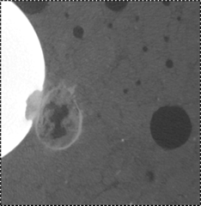
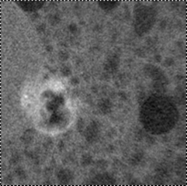
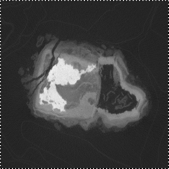
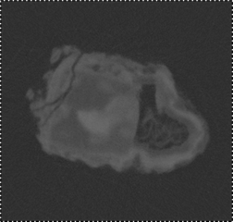
DATA PROCESSING
Reconstruction
Creating a 3D image from the 2D projection data.
MuhRec software
Registration
Aligning two or more images to match spatially.
SimpleElastix Library (Python Interface)
Segmentation
Identifying different regions in the images depending on different classes of material in the sample.
Types: K-means, Fuzzy c-means, GMM, Spectral, Mean shift clustering, etc.
XCT Slice
NCT Slice
Reconstructed Steel Reinforced Concrete Tomography Image
XCT Slice
NCT Slice
Reconstructed Archaeological Nail Tomography Image

Slide 9
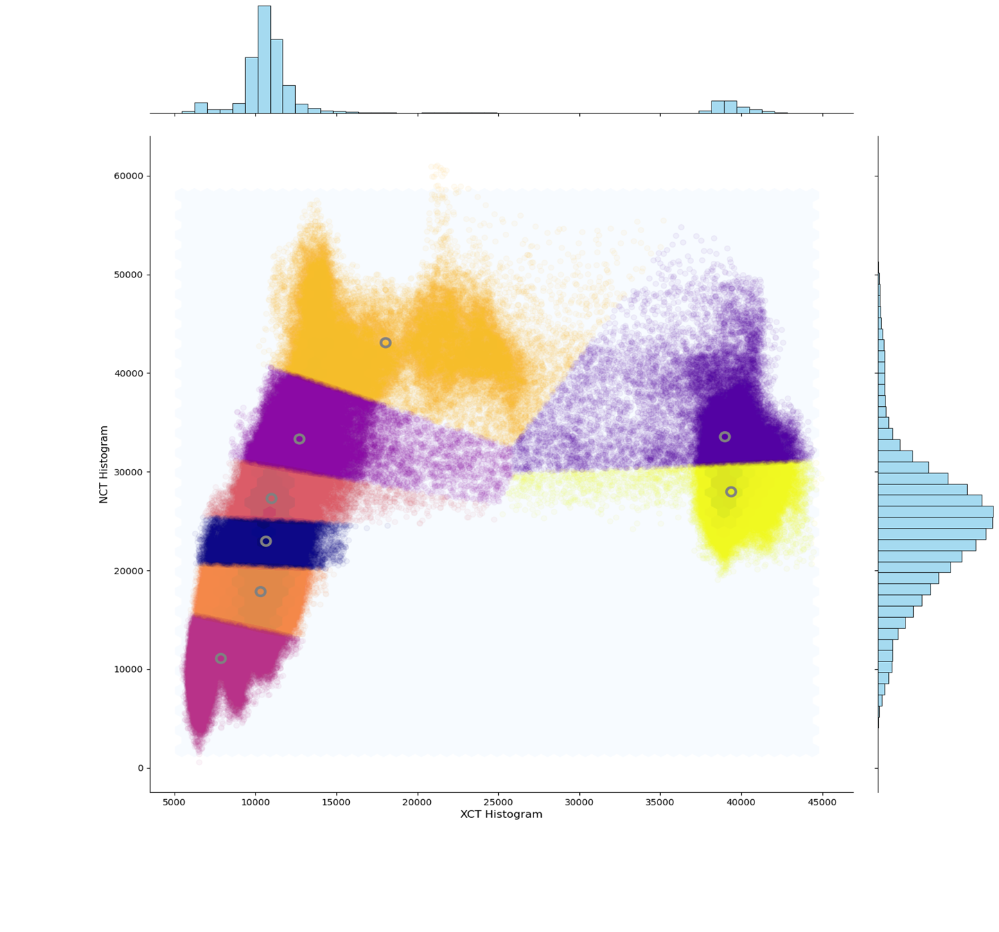
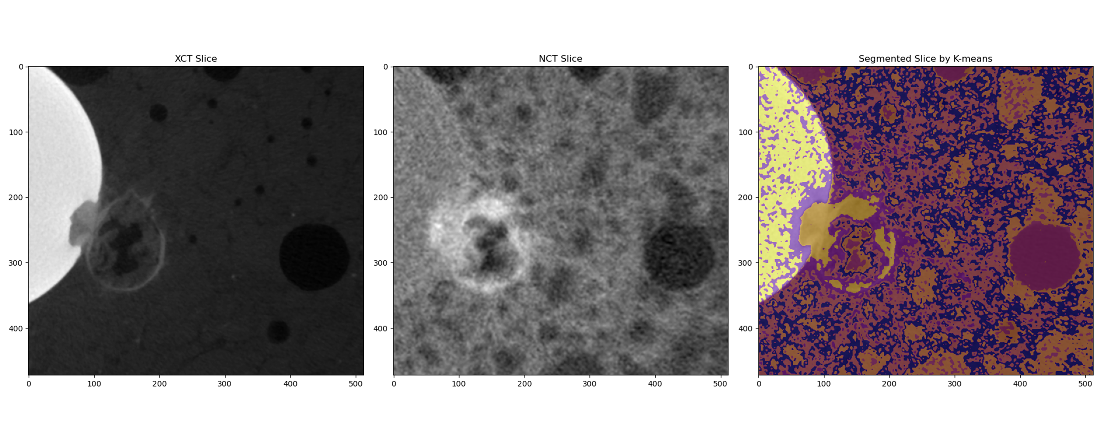
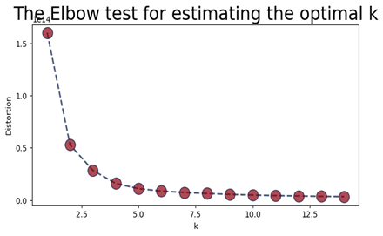
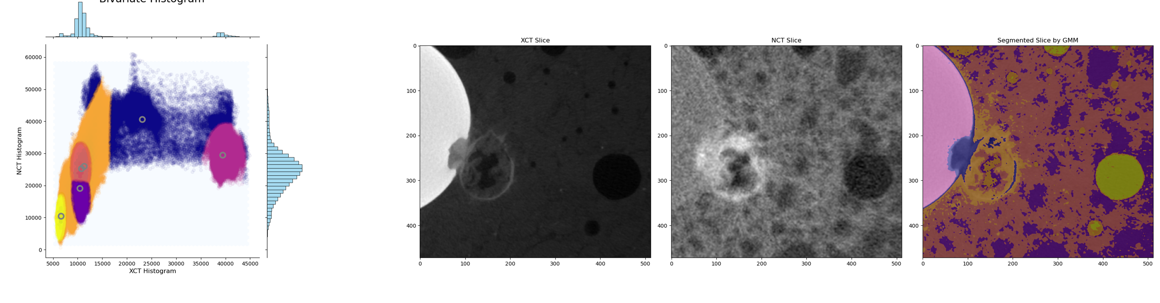
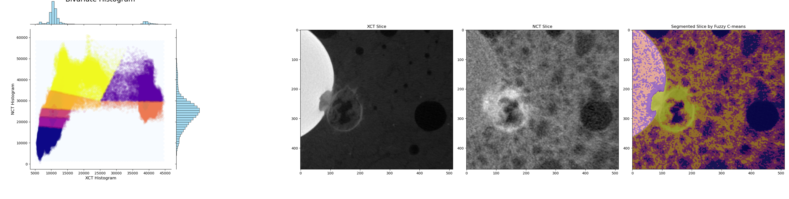
RESULTS – SEGMENTATION OF STEEL REINFORCED CONCRETE SAMPLE
A
A = K-means
B = GMM
C = Fuzzy c-means
B
GMM is considered best here as it is not very sensitive to the noise and segments especially the aggregates very well.
C

Slide 10
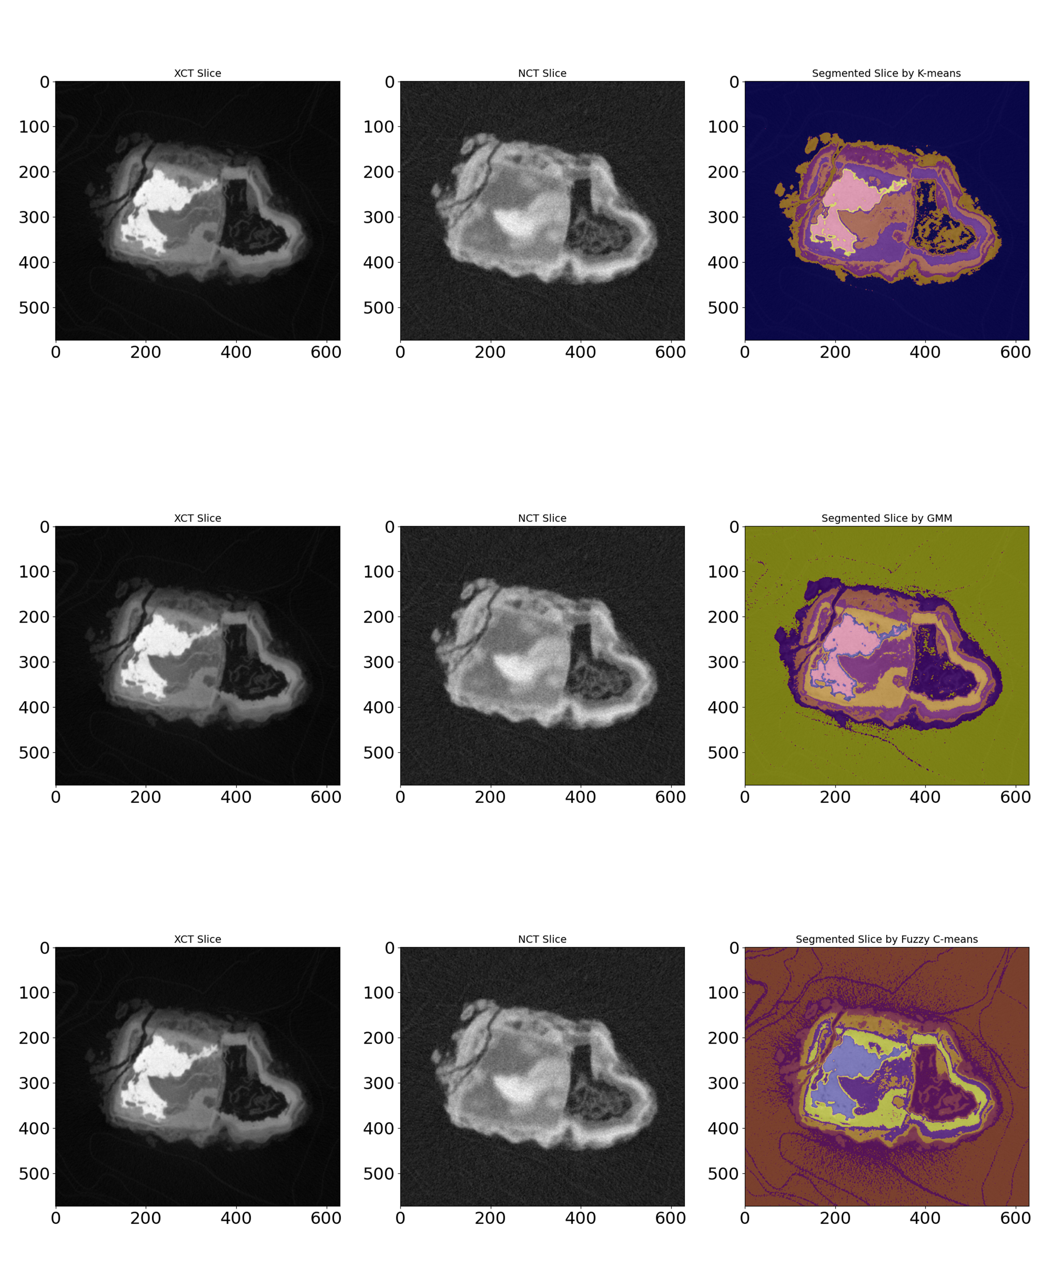
RESULTS – SEGMENTATION OF ARCHAEOLOGICAL NAIL SAMPLE
A = K-means
B = GMM
C = Fuzzy c-means
A
B
K-means produces hard boundaries which might be inaccurate.
C

Slide 11
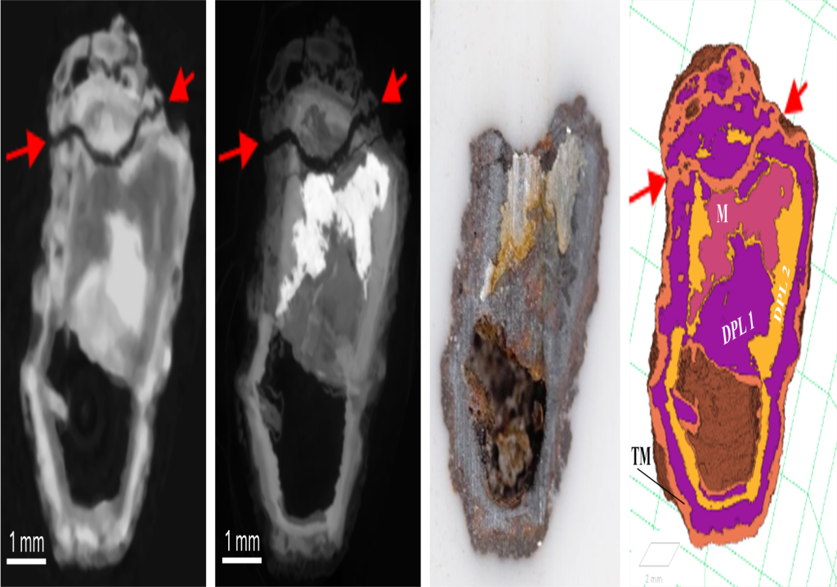
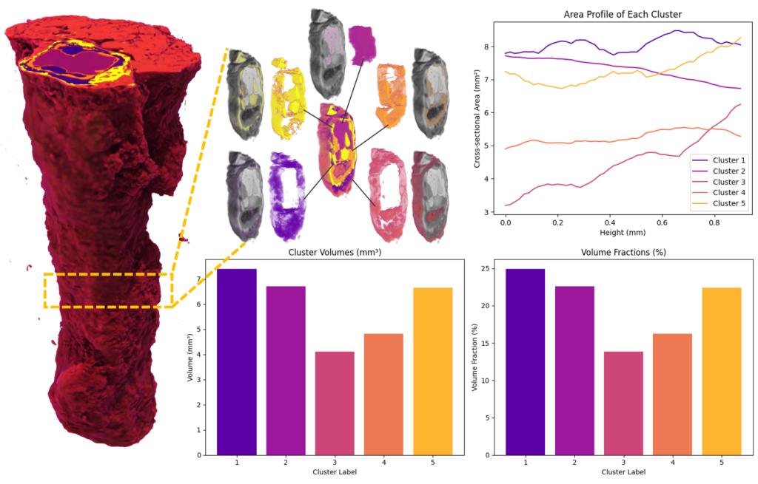
FORWARD PLANS
Comparison of Segmented Image with Optical Microscopy Image
Fig. Ref.: Cocen, O., Shakoorioskooie, M., et al. (2024), "Future from the Past: Long-term Corrosion of Iron Analyzed using Bimodal Neutron and X-ray CT", Presented at the 12th World Conference on Neutron Radiography (WCNR-12), Idaho Falls, Idaho, USA, June 2-7, 2024. Submitted to Springer Nature – Springer Proceedings in Physics.
Statistical Analysis
Fig. Courtesy: Dr. Mahdieh Shakoorioskooie, Applied Materials Group, LNS, PSI.

Slide 12
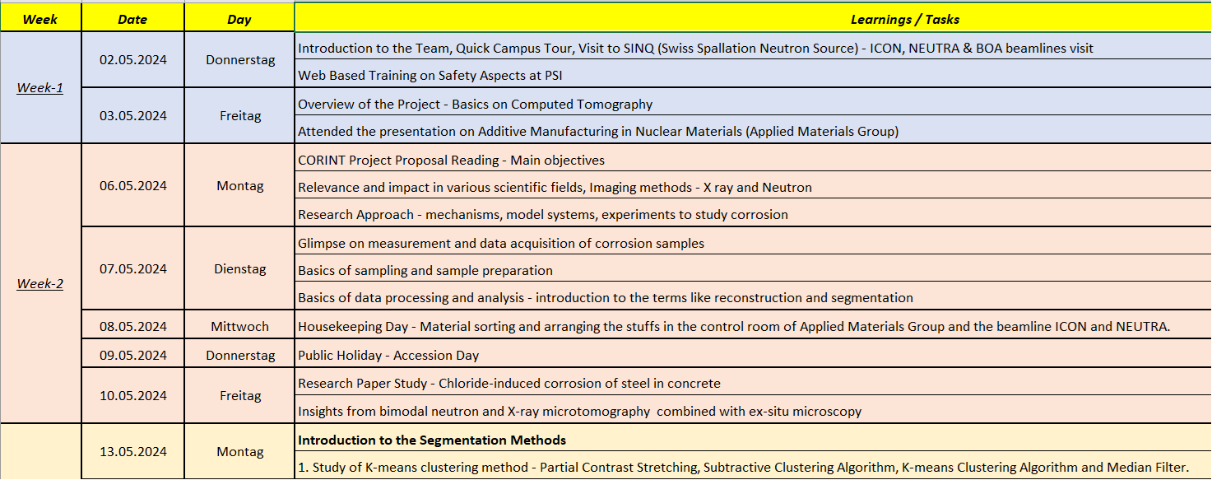
LEARNINGS
Python
X-ray v/s Neutron Imaging
ImageJ
Image Segmen-tation
Time Management
Adaptability
Collaboration

Slide 13
SUMMARY / CONCLUSION
Bimodal imaging using X-ray and neutron CT provides complementary high-resolution insights into internal structures. This presentation highlighted the experimental use of these techniques and the role of image segmentation in enhancing image interpretability.
The segmentation results presented are preliminary. Denoising techniques will be applied to the tomograms to enhance the images prior to segmentation. These further analyses will help refine our segmentation outcomes and provide more robust and accurate results.
Statistical analysis to be done to determine the volume fraction of the respective corrosion products and compare the segmented image with the optical microscopy image for the nail sample to evaluate the

Slide 14
REFERENCES
M. Angst, T. Bruckel, D. Richter, R. Zorn, Scattering methods for condensed matter research (2012).
Carminati, C., Boillat, P., Schmid, F., Vontobel, P., Hovind, J., Morgano, M., Raventos, M., Siegwart, M., Mannes, D., Gruenzweig, C. and Trtik, P., 2019.
Implementation and assessment of the black body bias correction in quantitative neutron imaging. PLoS One, 14(1), p.e0210300.
A. Kaestner, B. Münch, P. Trtik, L. Butler, Spatiotemporal computed tomography of dynamic processes, Optical Engineering 50(12) (2011) 123201-123201-9.
Kak, A. C., & Slaney, M. (1988). Principles of computerized tomographic imaging. The Institute of Electrical and Electronics Engineers. Inc., New York.
Feldkamp, Lee A., Lloyd C. Davis, and James W. Kress. "Practical cone-beam algorithm." Josa a 1, no. 6 (1984): 612-619.
K. Marstal, F. Berendsen, M. Staring, S. Klein, SimpleElastix: A User-Friendly, Multi-lingual Library for Medical Image Registration, 2016 IEEE Conference on Computer Vision and Pattern Recognition Workshops (CVPRW), pp. 574-582. (2016). DOI: 10.1109/CVPRW.2016.78
B. Lowekamp, D. Chen, L. Ibanez, D. Blezek, The Design of SimpleITK, Frontiers in Neuroinformatics, 7 (2013). DOI: 10.3389/fninf.2013.00045
N. Dhanachandra, K. Manglem, Y. Chanu, Image segmentation using k-means clustering algorithm and subtractive clustering algorithm, Procedia computer science 54 (2015) 764-771.
H. Ribeiro, A. Gonzaga, Hand image segmentation in video sequence by GMM: a comparative analysis, Computer graphics and image processing (SIBGRAPI’06).
K. Chuang, H. Tyeng, S. Chen, J. Wu, T. Chen, Fuzzy c-means clustering with spatial information for image segmentation, Computer medical imaging and graphics 30(2006) 9-15.

Slide 15
THANK YOU FOR
YOUR ATTENTION!!
ANY QUESTIONS??

