Slide 1





Precision Penning-Trap Mass Measurements for Fundamental Physics Studies
Basics of Penning-trap mass spectrometry
Nuclear masses for neutrino physics
Atomic masses for fundamental studies
Klaus Blaum
Max-Planck-Institute for Nuclear Physics, Heidelberg
PSI, Sep 11th, 2025

Slide 2
The mass of an atom
Einstein E = mc²
m_{Atom} = N•m_{neutron} + Z•m_{proton} + Z•m_{electron} - (B_{atom} + B_{nucleus})/c²
δm/m < 10⁻¹⁰
δm/m = 10⁻⁶ – 10⁻⁸
electronic structure
nuclear structure

Slide 3
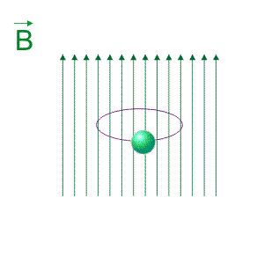
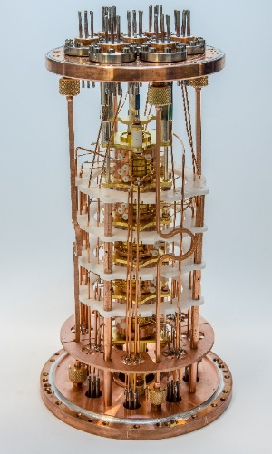
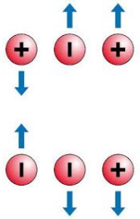
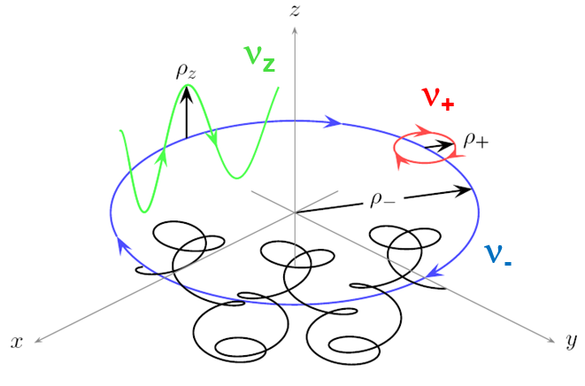
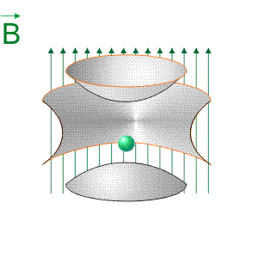
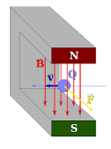
Storage of ions in a Penning trap
20 cm
Ion q/m_{ion}
20 cm
U
Charge q
Mass m_{ion}
The free cyclotron frequency is inverse
proportional to the mass of the ion!
Non-destructive FT-ICR detection technique
L.S. Brown, G. Gabrielse, Rev. Mod. Phys. 58, 233 (1986).

Slide 4
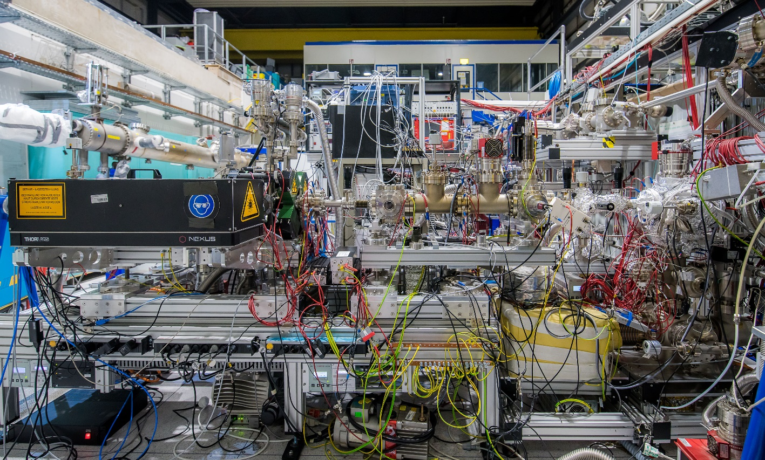
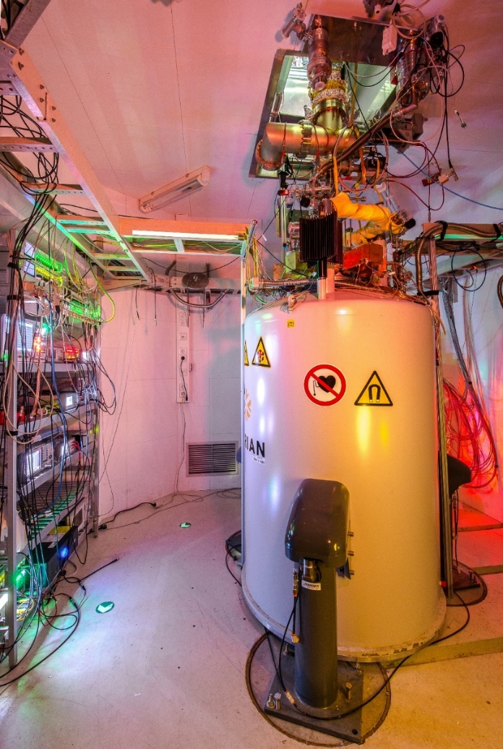

PENTATRAP – A Penning-trap setup at MPIK
A balance for highly charged ions.
4m
Penning Traps
Laser Ion Source
EBIT
Transfer Beamline
Electronics
T_{1/2} > days
Superconducting Magnet

Slide 5
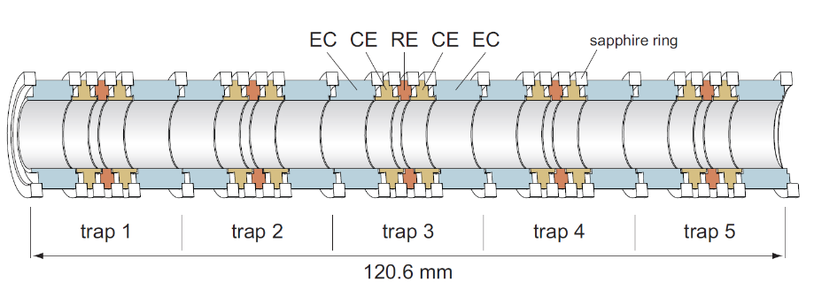
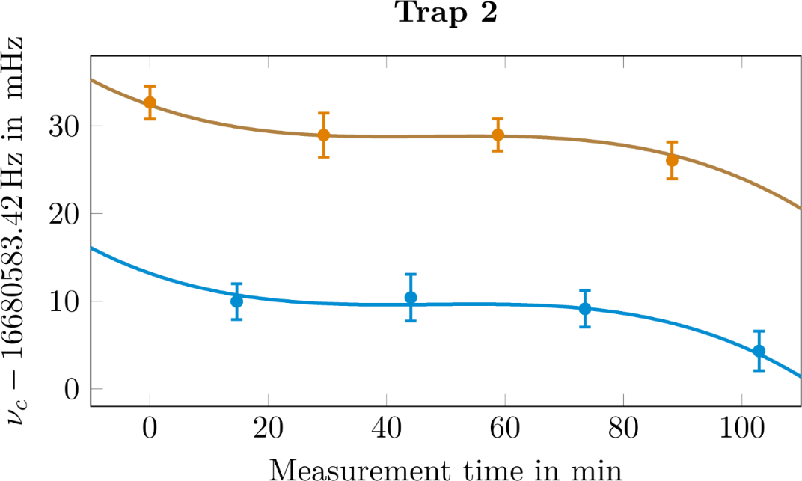
Measurement principle at PENTATRAP
Mass Ratio determination – Polynomial Method
$$ω_{c}=\frac{q}{m}⋅B$$
Magnetic field not known!
Second ion:
$$R=\frac{ω_{1}}{ω_{2}}=\frac{q_{1}⋅m_{2}}{q_{2}⋅m_{1}}\frac{{ B}_{1}\left(t\right)}{{ B}_{2}(t)}$$
meas. trap
$$f_{1}\left(t\right)=R⋅\left(a+b⋅t+c{⋅t}^{2}+d⋅t^{3}\right)$$
$$f_{2}\left(t\right)=\left(a+b⋅t+c{⋅t}^{2}+d⋅t^{3}\right)$$
A. Rischka et al., Phys. Rev. Lett. 124 (2020) 113001

Slide 6
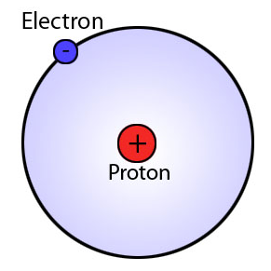
Results I
The masses of the building bocks of matter
LIONTRAP: MPIK, Uni Mainz, GSI

Slide 7
The building blocks of matter
The atomic mass of the proton and electron
and neutron ☺
Hydrogen
Deuterium
Neutron
0
Electron: previous best value improved by a factor of 13
Proton: previous best value
improved by a factor of 3
deuteron: previous best value
improved by a factor of ~3
m_{e} = 0.000 548 579 909 067 (17) u
m_{p} = 1.007 276 466 583 (33) u
m_{d} = 2.013 553 212 535 (17) u
Nature 506 (2014) 467
Phys. Rev. Lett. 119 (2017) 033001
Nature 585 (2020) 43
m(³He): O. Bezrodnova et al., PRA (2025) m (⁴He): S. Sasidharan et al., PRL (2023)

Slide 8
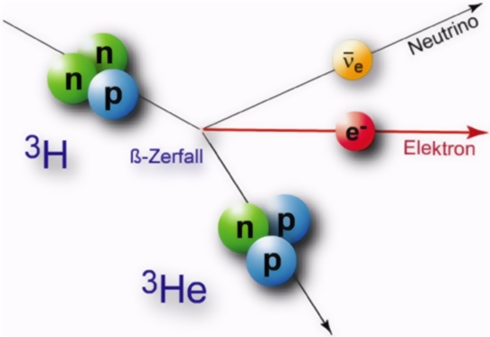

Results II
Nuclear masses for neutrino physics
Q-values: ³T → ³He ¹⁶³Ho → ¹⁶³Dy ¹⁸⁷Re → ¹⁸⁷Os
+
β ⁻ -decay of ¹⁸⁷Re
R =$\frac{ν_{c}(187Os29 )}{ν_{c}(187Re29 )}$
+

Slide 9
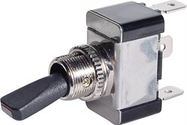
Q-value of ¹⁸⁷Re-¹⁸⁷Os for neutrino physics
pos 1
Re
Os
Re
Change position every 30 min
Measurement of ν₊, ν_{z}, ν₋
Phase detection method
Storage time of days
1
2
3
4
5
pos 2
Re
Os
Re
1
2
3
4
5
P. Filianin et al., Phys. Rev. Lett. 127 (2021) 072502
relative nuclear mass precision achieved: 610⁻¹²
BUT
For Re²⁹⁺ (Z = 75) vs. Os²⁹⁺ (Z = 76) we measure two ratios with a 50/50 probability:
R₁ = 1.000000013886(15)
R₂ = 1.000000015024(12)

Slide 10
Weighing of different electron config.
Ground-state configuration of Re²⁹⁺ and Os³⁰⁺: [₃₆Kr] 4d¹⁰
Metastable state [₃₆Kr] 4d⁹ 4f¹ with E_{exc} ≈ 200 eV in Re²⁹⁺
Similar state in Os³⁰⁺ expected!
Re²⁹⁺
Os³⁰⁺
metastable state
metastable state
Β _{PENTATRAP} = 202.2(17) eV
Β _{PENTATRAP} = 207(3) eV
Β _{Harman} = 202.2(5) eV
Β _{Haverkort} = 209(2) eV
Β _{Indelicato} = 202.1 (27) eV
Β _{Indelicato} = 207(3) eV
Β _{Haverkort} = 202.8(4) eV
ground state
ground state
R. Schüssler et al., Nature 581 (2020) 42
Possible application: search for suitable clock transitions

Slide 11
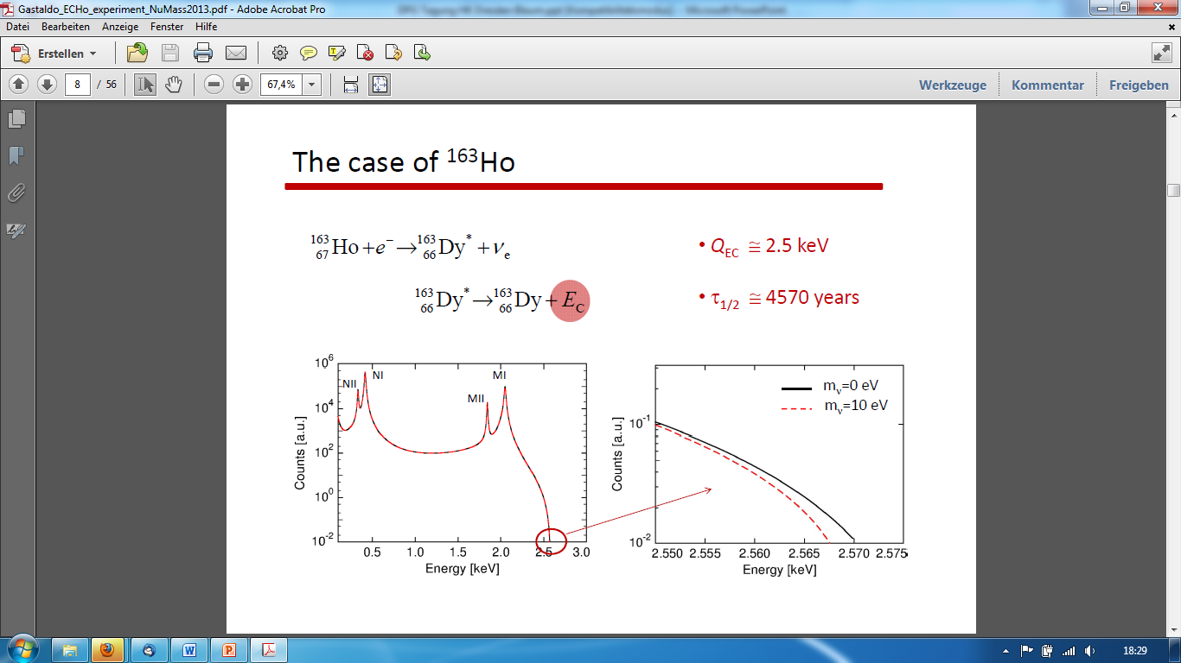
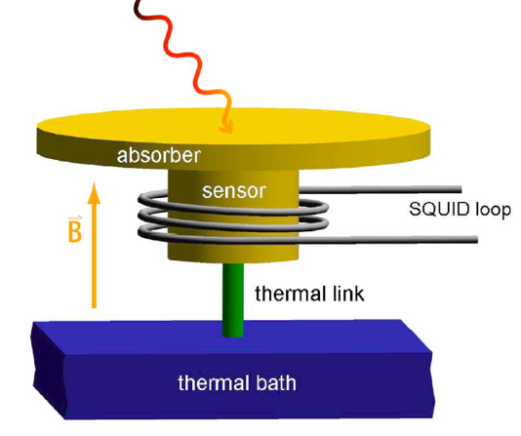

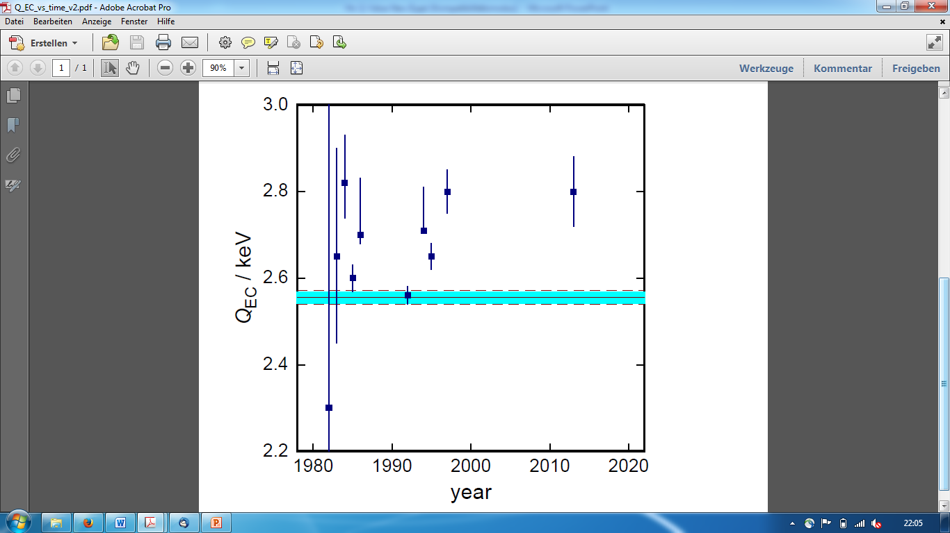

The ECHo (¹⁶³Ho) project
Metallic Magnetic Calorimetry
Q-value of EC in ¹⁶³Ho
ECHo-Collaboration: Loredana Gastaldo
Christian Enss
δQ=0.6 eV
∙
Ch. Schweiger et al., Nature Phys. 20, 921 (2024)
Q-value with
δQ<3 eV
Status in 2014
S. Eliseev et al., PRL 115 (2015) 062501
P. Ranitzsch et al., PRL 119 (2017) 122501
Notes:
N-rich

Slide 12
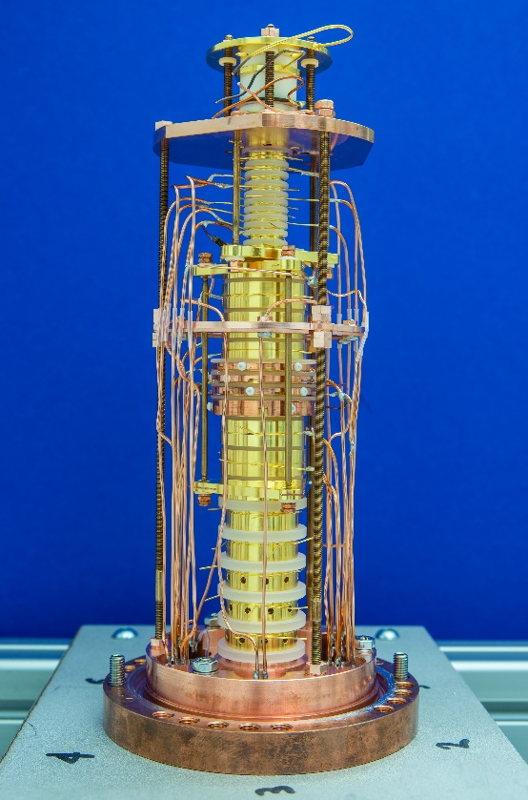
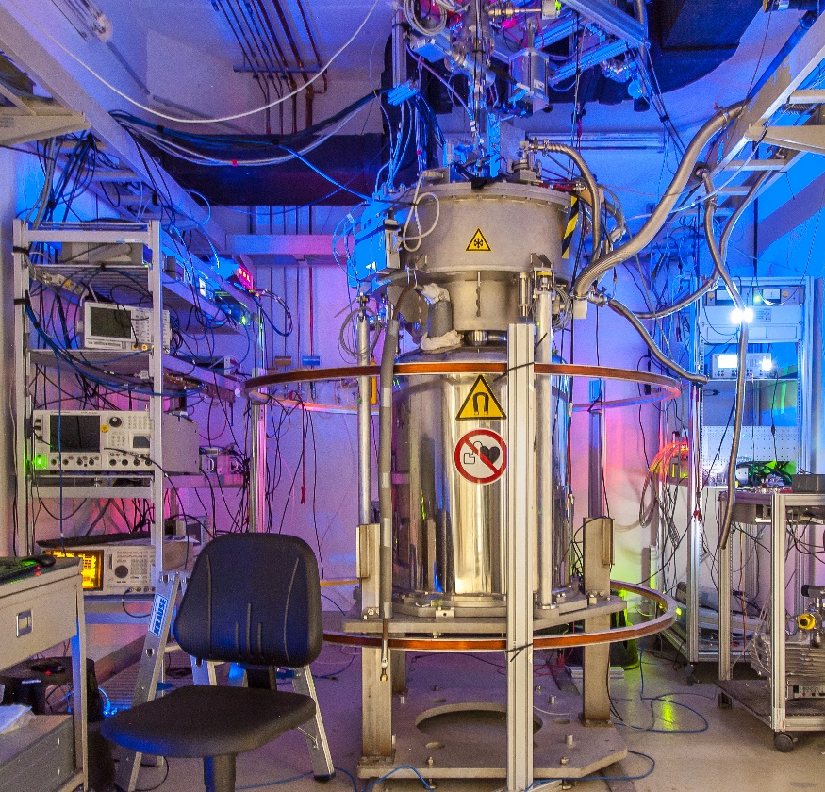
Results III
Tests of fundamental symmetries and physics beyond the SM
ALPHATRAP, BASE, μTex: HHU, MPIK, RIKEN

Slide 13
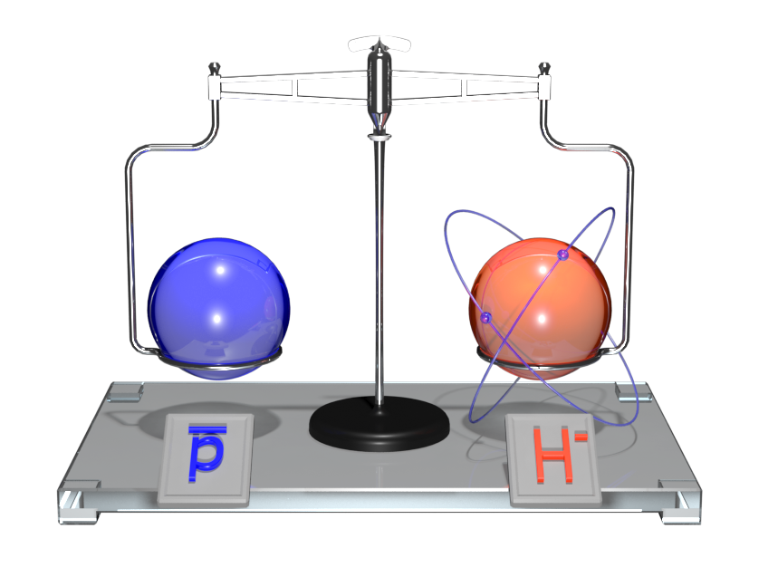
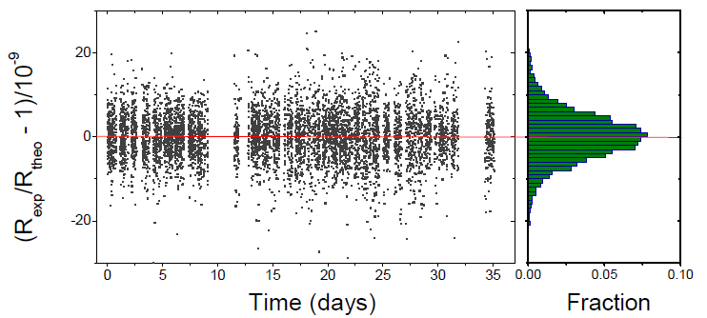
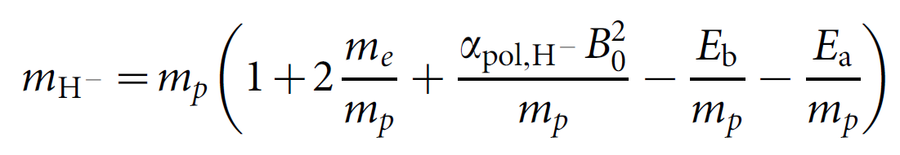
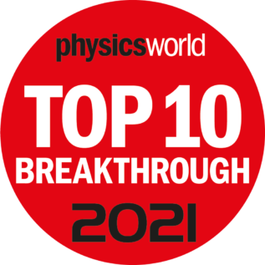
Comparison of the proton and antiproton
ν_{c,1}
ν_{c,2}
Compare charge-to-mass ratios R
of p and p:
(q/m)_{p} / (q/m)_{p} = -1.000 000 000 003 (16)
ν_{c,1}
R =
ν_{c,2}
M.J. Borchert et al., Nature 601 (2022) 53
It is not that easy!
Remarkable:
Temperature: T = -270°C
Pressure: p < 4∙10⁻¹⁹ mbar
Storage time: years
Experiment: BASE @ AD/CERN
Most stringent test of CPT symmetry in the baryon sector!
Next steps: sympathetic laser cooling and transport of p-bar
M.Bohman et al., Nature 596 (2021) 514
Ch. Will et al., PRL 133 (2024) 023002 M. Leonhardt et al., Nature 641 (2025) 841

Slide 14
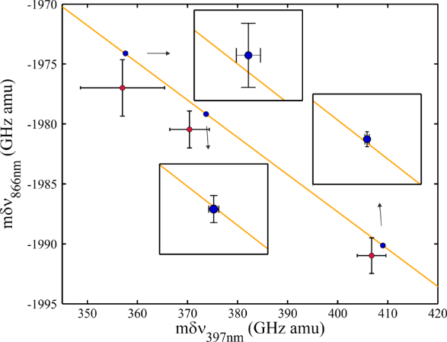
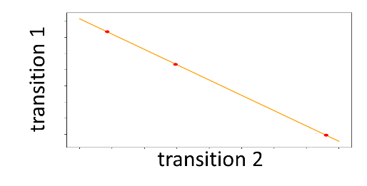
Probe for new force carriers
Isotope shift spectroscopy: 5th force?
$δν_{i}^{A,A^{′}}=F_{i}δ{〈r_{}^{2}〉}_{A,A′}+k_{i}\frac{A−A′}{AA′}$
use 2 transitions $i,j$ ➔ eliminate $δ{〈r_{}^{2}〉}_{A,A′}$
new force mediated through scalar field with boson mass $m_{φ}→X_{i}$
coupling to neutrons: $y_{n}$
coupling to electrons: $y_{e}$
nonlinearity in King’s plot:
$$δν_{i}^{A,A^{′}}=F_{i}δ{〈r_{}^{2}〉}_{A,A′}+k_{i}\frac{A−A′}{AA′}+$$ +$α_{NP}X_{i}(A−A^{′})$
High-precision atomic and nuclear spectroscopy measurements needed!
Berengut et al., PRL 120, 091801 (2018); Ozeri et al. (2020)

Slide 15
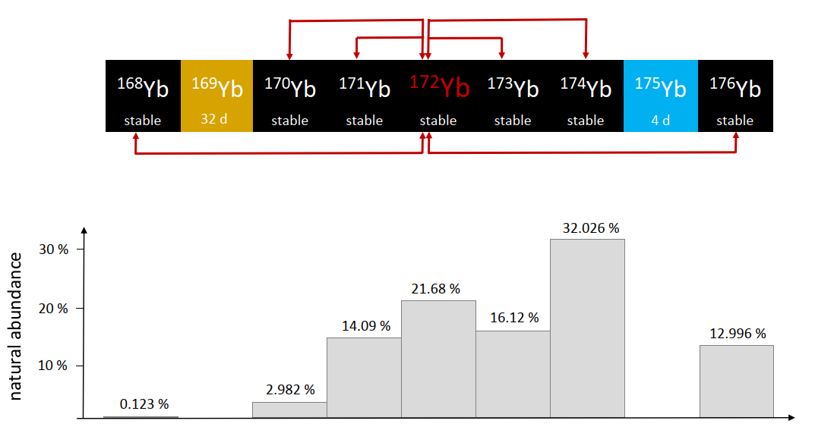
Yb mass-ratio measurements
Motivation: 5th force search using King-plot analysis in Ca, Sr, Yb
Mass-ratio uncertainties of 10⁻¹¹ and below required!
All even-even mass ratios measured. ☺
Relative mass uncertainty: ~4·10⁻¹², improvement factor: typically >50

Slide 16
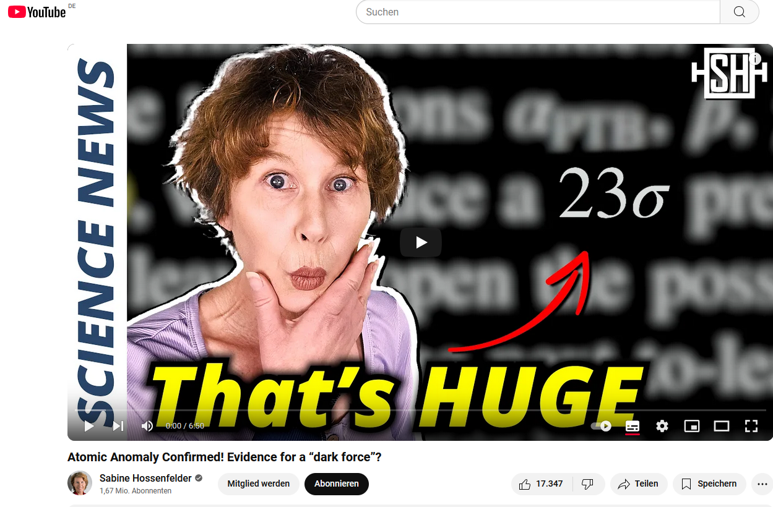
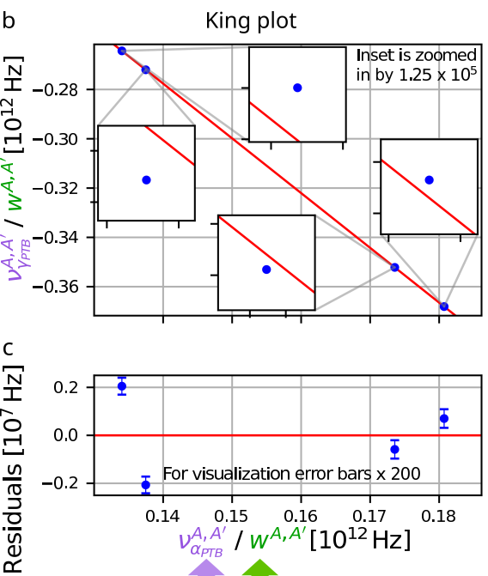
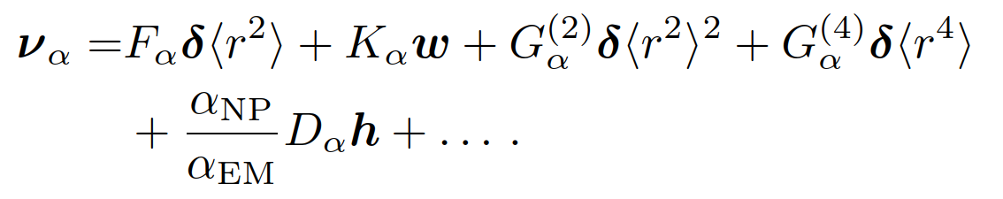
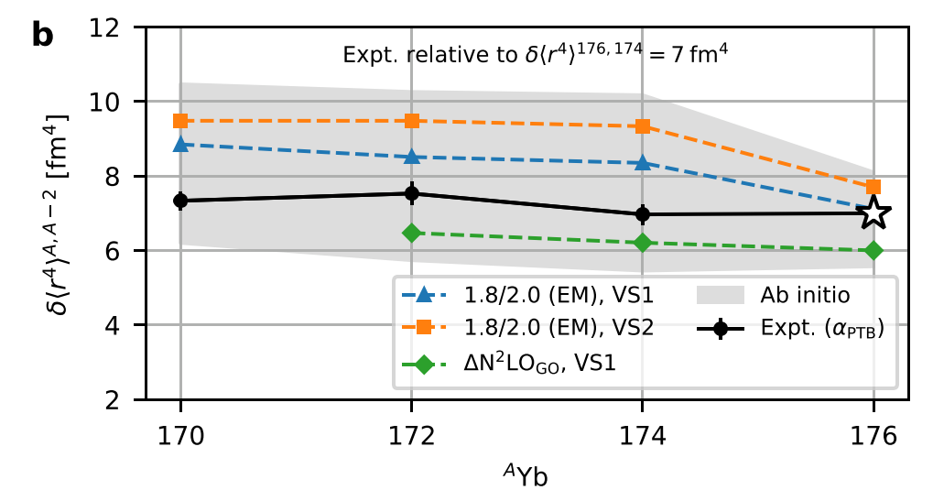
Results from the Yb isotopic chain
→ a 200σ (!!!) non-linearity observed
→ an additional nuclear structure term prop. to δ<r⁴> is considered
→ nuclear structure theory needed
M. Door et al., PRL, 134 (2025) 063002
New bounds on a fifth force in the keV/c² to MeV/c² range coupling to electrons and neutrons.
More than 325.000 views at www.youtube.com/watch?v=XCQN7g-2fag
Notes:
Recent developments have made heavy nuclei accessible to ab initio nuclear structure calculations. To predict δhr4i, we use the valence space in-medium similarity renormalization group
(VS-IMSRG) together with the quasiparticle vacua shell model (QVSM) to solve the many-body Schrödinger equation.

Slide 17
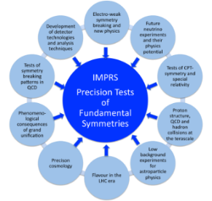


Summary
Precision Penning-trap mass spectrometry on exotic systems has reached an amazing precision and has opened up many new fields of research!
Max Planck Society
IMPRS-PTFS
IMPRS-QD
ERC AdG 832848 - FunI
DFG

Slide 18

Thanks …
to all my Division members and
you for the invitation and your attention!

Slide 19
Spare slides

Slide 20
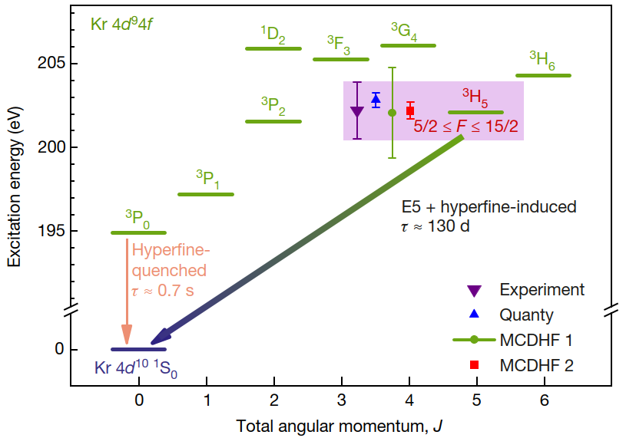
Excited electronic states in ¹⁸⁷Re²⁹⁺
R. Schüssler et al., Nature 581 (2020) 42

Slide 21
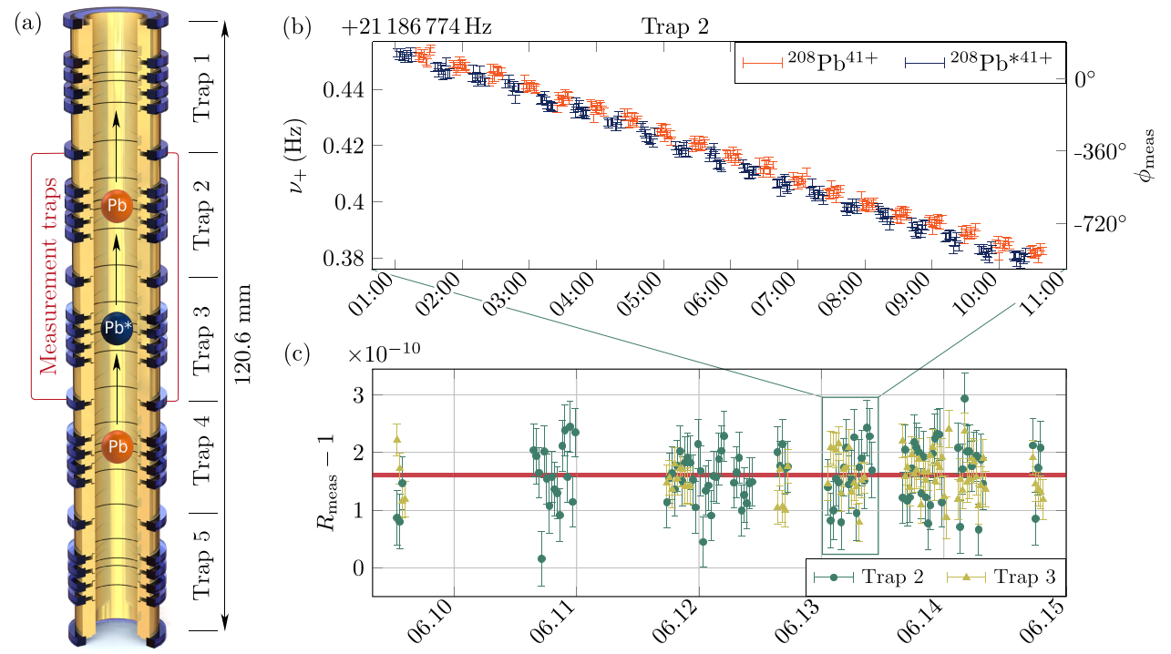
Search for low-lying isomeric states
Δm = 31.2(8) eV/c²
K. Kromer et al., PRL 131 (2023) 223002

Slide 22
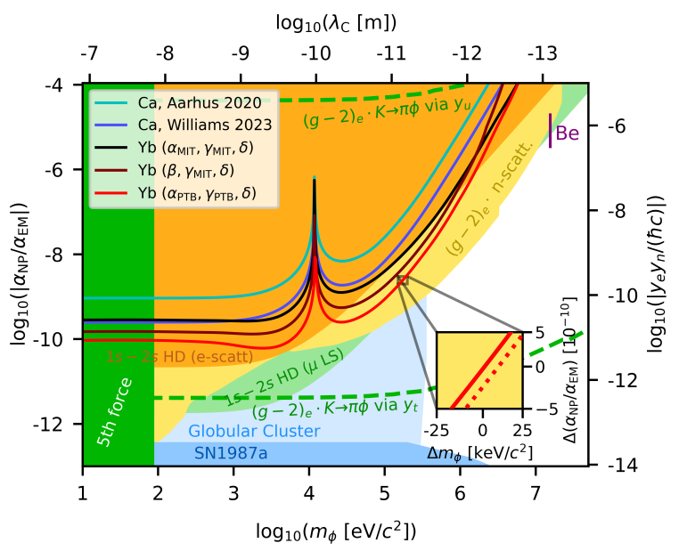
Yb spectroscopy limits
M. Door et al., PRL, 134 (2025) 063002

