Slide 1
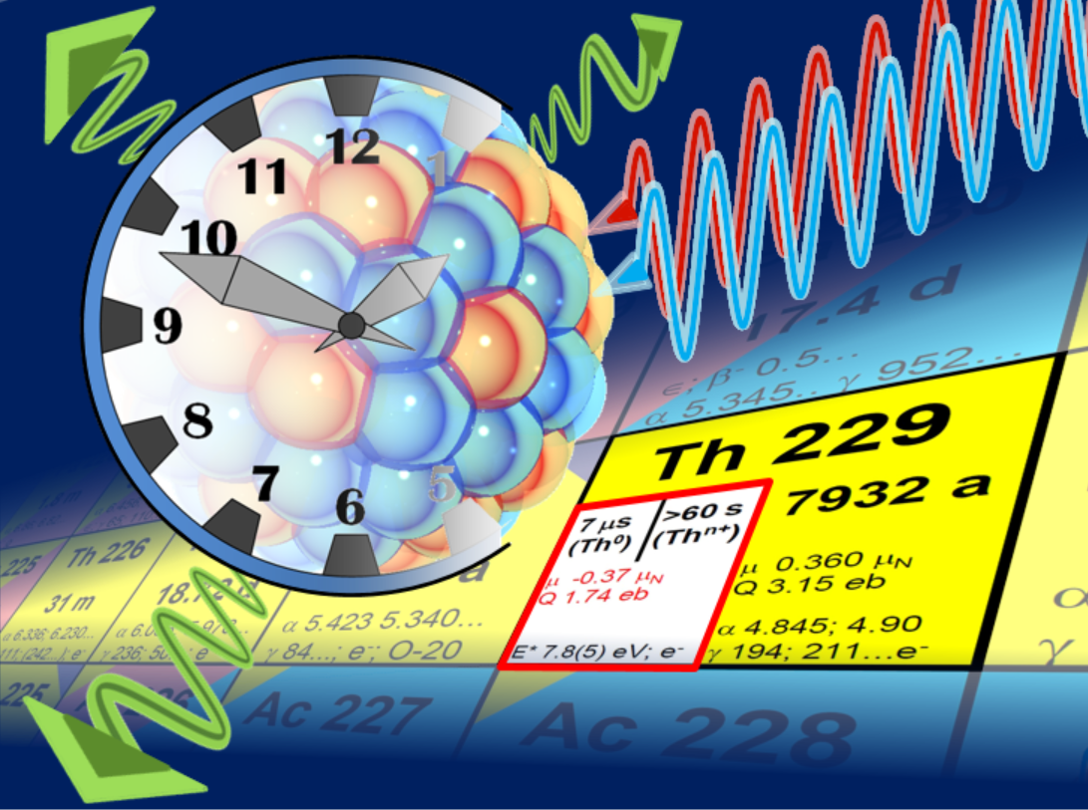

On the Horizon: The 229mTh Nuclear Clock
Peter G. Thirolf, LMU München
image: C. Düllmann
image: S. Dali
1
Notes:
25+5 minutes (invited talks): 17 (+x) slides
The idea of a nuclear frequency standard, the ‚nuclear clock‘, based on an elusive nuclear excitation in the actinide isotope 229-Thorium has been around for some decades now and I will show you where we stand today.

Slide 2
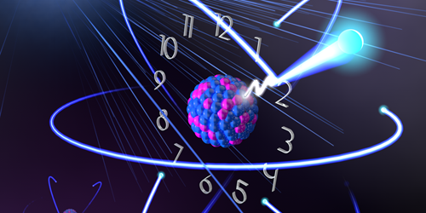
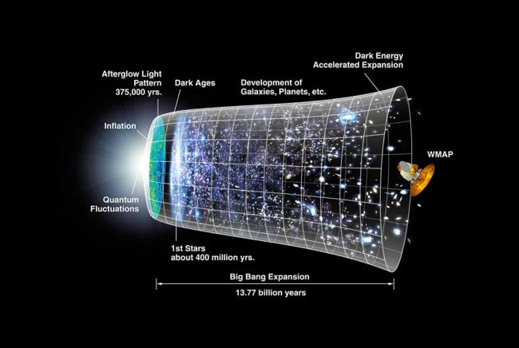
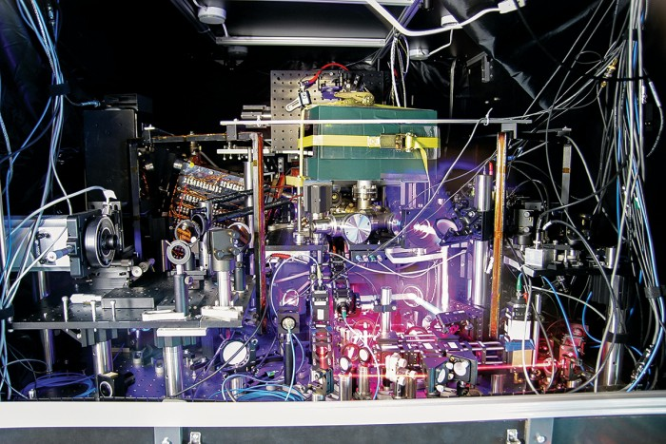
The ‚Big Picture’
Ultra-Precise Clocks:
Timekeeping and Quantum Sensors for Fundamental Physics
Tantalizing fundamental and still unsolved questions:
- how ‚constant‘ are fundamental constants?
- what is the nature of the invisible ‚Dark Matter‘ in the Universe?
(Maybe) surprising: appropriate equipment comprises
- table-top lasers
- ions traps or crystals
- radioactive nuclei
NASA / WMAP Science Team
2
Jun Ye group/JILA, Boulder
Notes:
When we talk about ultra-precise clocks, you will see that precise timekeeping is of course a key incentive, but above that such clocks also represent quantum sensors that allow to study key questions of fundamental physics.
Amongst these still unsolved topics we face topics like the paradox questions if fundamental constants are really constant or what is the nature of the invisible Dark matter in the Universe
While it appears natural that approaching such questions involves large telescopes or accelerators, it may be surprising that appropriate research equipment comprises as well table-top lasers, ion traps or crystals or radioactive nuclei.

Slide 3
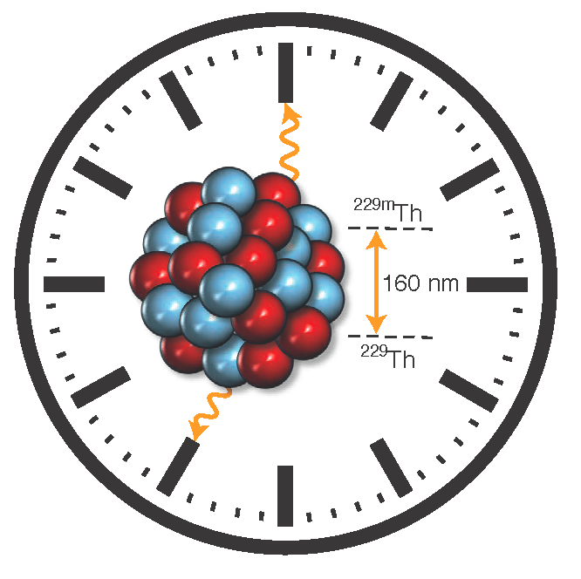
Outline
Atomic Clock & Thorium Nuclear Clock
Applications of a Nuclear Clock
The Thorium Isomer 229mTh:
- insights gained by nuclear spectroscopy
- recent achievements by laser spectroscopy
Ongoing Activities and Perspectives
3
Notes:
So in this talk I will cover the topic of the thorium nuclear clock also under the local perspective of GSI. And here I can span a bridge looking back12 years back in time from a memorable EMMI event to the present days, where another remarkable project, named HiThor plays an important role as you learn towards the end of the talk.
Inbetween I will first introduce precision clocks in general and the nuclear clock in particular, touching also upon potential applications of a nuclear clock.
I will describe the unique properties of the thorium isomer and how these were characterized first by nuclear spectroscopy techniques and recently also via laser spectroscopy.
Finally I will present the remaining perspectives on the way to a first nuclear clock prototype.

Slide 4
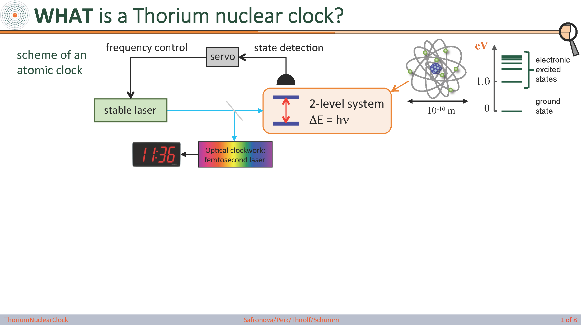
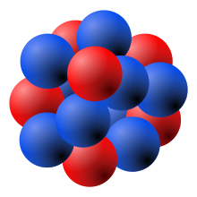
Thorium Nuclear Clock
scheme of an
atomic clock
electronic
excited
states
ground
state
scheme of a
nuclear clock
MeV
nuclear
excited
states
Nuclear clock proposal: E. Peik and Chr. Tamm, Europhys. Lett. 61, 181-186 (2003)
10 -19 performance estimate of 229Th ion clock: C. J. Campbell, et al., PRL 108, 120802 (2012)
ground
state
10-14 m
Is there a suitable nuclear candidate ?
→ low energy (eV)
→ long-lived (isomer)
→ 229mTh: ‘Thorium Isomer’
4
Notes:
A nuclear clock is very much similar to an atomic clock: every clock needs a periodic oscillator and a clockwork to count the oscillations. In case of atomic clocks the oscillator is a 2-level system in the atomic shell, which is driven by a suitable laser in a stabilized resonance loop. And then an optical clockwork like a frequency comb is used to count the oscillations. The concept of a nuclear clock is very much the same, just that here a nuclear transition is used instead of an electronic transition. Typical atomic transition energies are in the eV region and thus accessible to lasers, while normally nuclear excitation energies are many orders of magnitude higher, in the keV to MeV range.
So the question is whether there is a suitable candidate for a low-lying nuclear transition with ultra-narrow linewidth, which means we need a long-lived, low-lying nuclear isomer. And exactly here come the thorium-isomer in 229Th into the game, as the presently best candidate for a nuclear frequency standard.

Slide 5
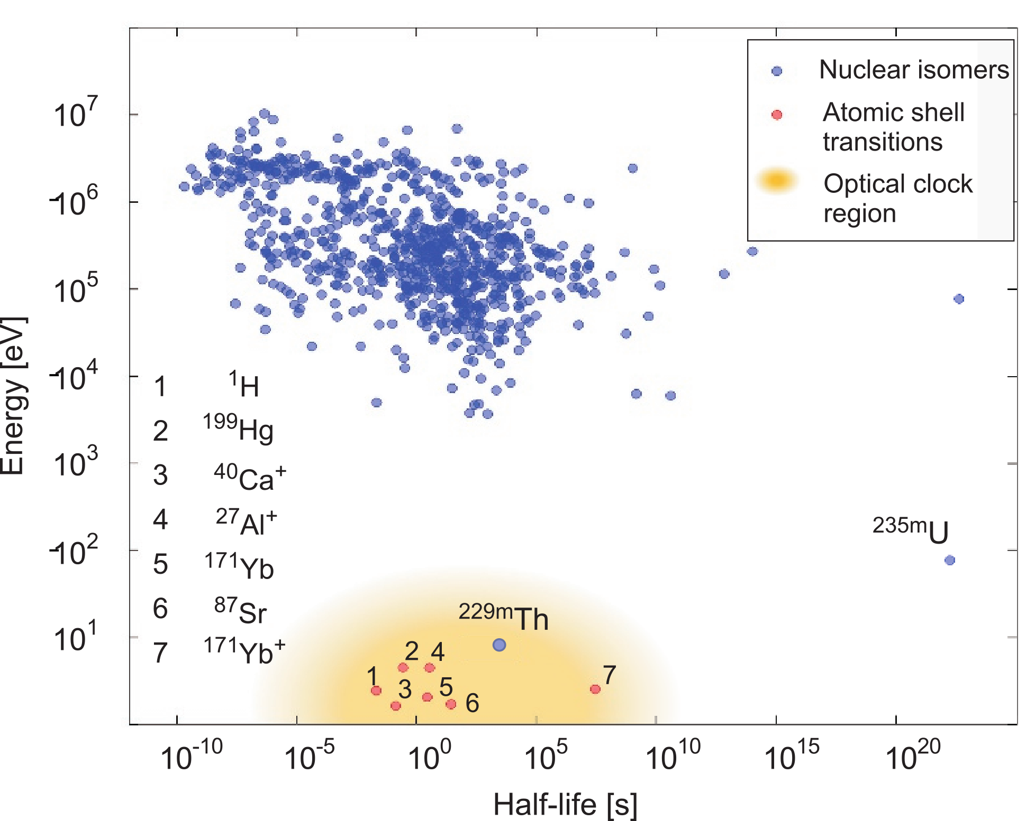
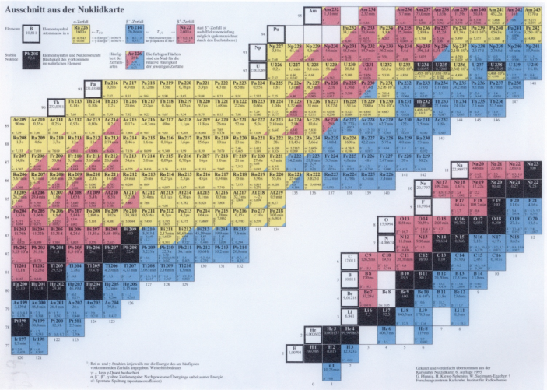
Unique properties of the ^{229m}Th Isomer
7880a
α: 4.845 MeV
3/2+
229Th isomer
E* ≈ 8.35574(3) eV
λ = 148.3821(4) nm
τ ≈ 2000 s
5/2+
229Th ground state
lowest E* of all ~186000 presently known nuclear excited states
ΔE/E ~ 10-20 ~ 0.1 mHz natural linewidth
5
Notes:
gs: 5/2^+, [633]
Isomer: 3/2^+ [631]

Slide 6
Applications of Nuclear Clocks: Timekeeping and Beyond
229mTh nuclear clock:
ΔE/E ~ 10-20 (~ 0.1 mHz nat. linewidth): extremely stable nuclear frequency standard
performance estimate of 229Th ion clock: ~ 10-19 rel. uncertainty
C.J. Campbell, et al., PRL 108, 120802 (2012)
- small nuclear moments: less sensitivity to perturbations by external fields
Beyond Timekeeping:
Quantum Sensor due to different operation principle compared to atomic clocks:
- Coulomb + weak + strong interaction contribute to clock frequency
- sensitivity to new physics searches: enhanced by 103-104 compared to present clocks
unique opportunity for new physics discoveries
M.S. Safronova et al., Rev. Mod. Phys 90, 025008 (2018)
E. Peik, PT et al., Quant. Sci. Tech. 6, 034002 (2021)
6
PT et al., Annalen d. Physik 531, 1800391 (2019)

Slide 7



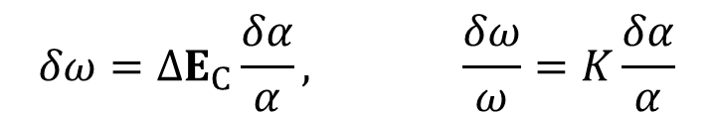
Applications of Nuclear Clocks
Temporal variation of fundamental constants
theoretical expectation: temporal (spatial) variations of fundamental “constants”
J.P. Uzan, Living Rev. Relativ. 14, 2 (2011)
α/α = (1.8 ± 2.5) . 10-19 yr-1
M. Filzinger et al., PRL 130, 253001 (2023)
- enhanced sensitivity by ~ 104 expected for 229mTh
V.V. Flambaum, PRL 97, 092502 (2006)
sensitivity of 229mTh transition frequency ω to temporal variation of α:
$$δω=ΔE_{C}\frac{δα}{α}, \frac{δω}{ω}=K\frac{δα}{α}$$
enhancement factor:
$$K=\frac{ΔE_{C}}{ω}$$
ΔE_{C}: Coulomb energy difference between 229Th, 229mTh
- measurements involve monitoring the ratio of nuclear/atomic clock over time
7
PT et al., Annalen d. Physik 531, 1800391 (2019)
Notes:
Before we come to the thorium isomer itself we have to answer the question what the benefit would be to have another highly precise clock, now based on a nuclear instead of an atomic transition.
The nuclear clock goes beyond timekeeping: it can be regarded as a quantum sensor for fundamental physics studies due to ist different operational principle compared to atomic clocks. In a nuclear clock the strong interaction, besides Coulomb and weak interaction contributes to the clock frequency and therefore a nuclear clock is sensitive to phenomena in the hadronic sector which an atomic clock would not be sensitive for. Moreover, nuclear moments are orders of magnitude smaller than atomic moments, and therefore a nuclear clock would be much less vulnerable to perturbing external fields.
A nuclear clock will provide an enhanced sensitivity of 4-5 orders of magnitude for searches of new physics compared to present clocks.
So it will provide a unique opportunity for new physics discoveries beyond the capabilities of other technologies.
For example one can imagine to ask the question if a fundamental constant, like the fine-structure constant, would indeed be constant over time, as there is the theoretical expectation of variations of fundamental constants over time and space. The presently best experimental limits are consistent with zero and indicate that such a variation would be minute and thus difficult to identify. However, the thorium isomer provides several orders of magnitude enhanced sensitivity and therefore seems ideally suited to address this topic. Measurements would involve monitoring the frequency ratio of the nuclear and atomic clocks over time, having different sensitivities to temporal variations of the fine structure constant.

Slide 8
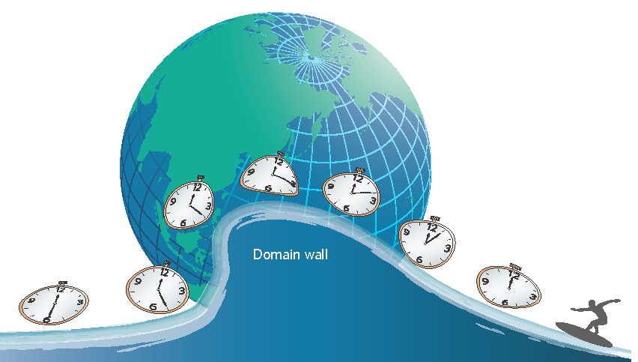
Applications of Nuclear Clocks
Search for Dark Matter
- ultralight scalar fields: searches for oscillatory variation of fundamental constants
Arvanitaki et al., PRD 91, 015015 (2015),
Van Tilburg et al., PRL 115, 011802 (2015), Hees et al., PRL 117, 061301 (2016)
- topological dark matter: monopoles, 1D strings, 2D ‘domain walls’
transient: use networks of ultra-precise synchronized clocks
- more stringent limits: non-transient variations of fundamental constants
(back action of ambient matter on scalar field)
Derevianko & Pospelov, Nat. Phys. 10, 933 (2014)
Y. Stadnik, PRD 102 (2020)
8
Notes:
A further application of a nuclear clock is the possibility to test the coupling of fundamental constants to a changing gravitational potential (like experienced by the earth on its eccentric orbit around the sun).
This tests the local position invariance hypothesis and thus ultimately Einstein’s Equivalence Principle (of gravitational and inertial mass).
Nuclear clocks could also play an important role in the search for Dark Matter, in particular for ultralight scalar dark matter candidates. Either oscillatory variations of fundamental constants or transient signals from topological, that means clumpy dark matter could be targeted. And in fact a nuclear clock ranges amongst the most sensitive sensors for these ultralight scalar fields, where experiments would use networks of synchronized clocks that would feel for example the penetration of a DM domain wall.
On the more practical side satellite based navigational systems would benefit from improved clock precision, as the presently reached position uncertainty could be shifted from the meter scale into centimeters or even millimeters., which a plethora of possible applications.
Also ultra-precise clocks are a 3D gravity sensor. Clocks at higher altitude run faster. At the presently achievable clock precision of 10^-18 already height differences of 1 cm could be sensed with an atomic clock. Improving this sensitivity by another order of magnitude would allow for various applications where the gravitational potential is locally changing, like in active volcanos where dense magma material would fill up a magna chamber or in tectonic plate movements, which could be sensed by synchronized ultra-precise clocks long before any seismic activity could be detected.
Transient signals for topological dark matter
The lower the gravitational potential (the closer the clock is to the source of gravitation), the slower time passes, speeding up as the gravitational potential increases (the clock moving away from the source of gravitation)
Equivalence principle: identity of gravitational/inertial mass (LLI)
Not only temporal but also spatial variation of fund. constants
Dependence of fund. constants on gravit. potential (eccentric earth orbit around sun): Such experiments test principle of local position invariance and, therefore, Einstein equivalence principle.
Earlier atomic clock searches focused on the “slow-drift” model of fundamental constant variation and testing the coupling of fundamental constants to a changing gravitational potential. Recently, searches for oscillatory and transient variation of fundamental constants were proposed and implemented (see review [12]). Such new experiments directly relate to the major unexplained phenomena of our universe, the nature of the dark matter. The mass of the dark matter particles is unknown and atomic clocks are sensitive to ultralight scalar bosonic dark matter (DM) [29]. Such light scalar fields arise in many theories beyond the Standard Model. In our Galaxy, such dark matter exhibits coherence behaving like a wave with an amplitude , where ρ DM = 0.3 GeV/cm3 is the local DM density [29]. The coupling of such DM to the Standard Model leads to oscillations of fundamental constants and, therefore, clock transition frequencies. Such an oscillation signal would be detectable with atomic and nuclear clocks for a large range of DM masses and interaction strengths [29, 30, 31].
Enhancement factor: K = delta V_C/omega (difference in Coulomb energy between gs/isomer and transition energy (excitation energy of isomer)
10^-18: = 1 cm height sensitivity

Slide 9
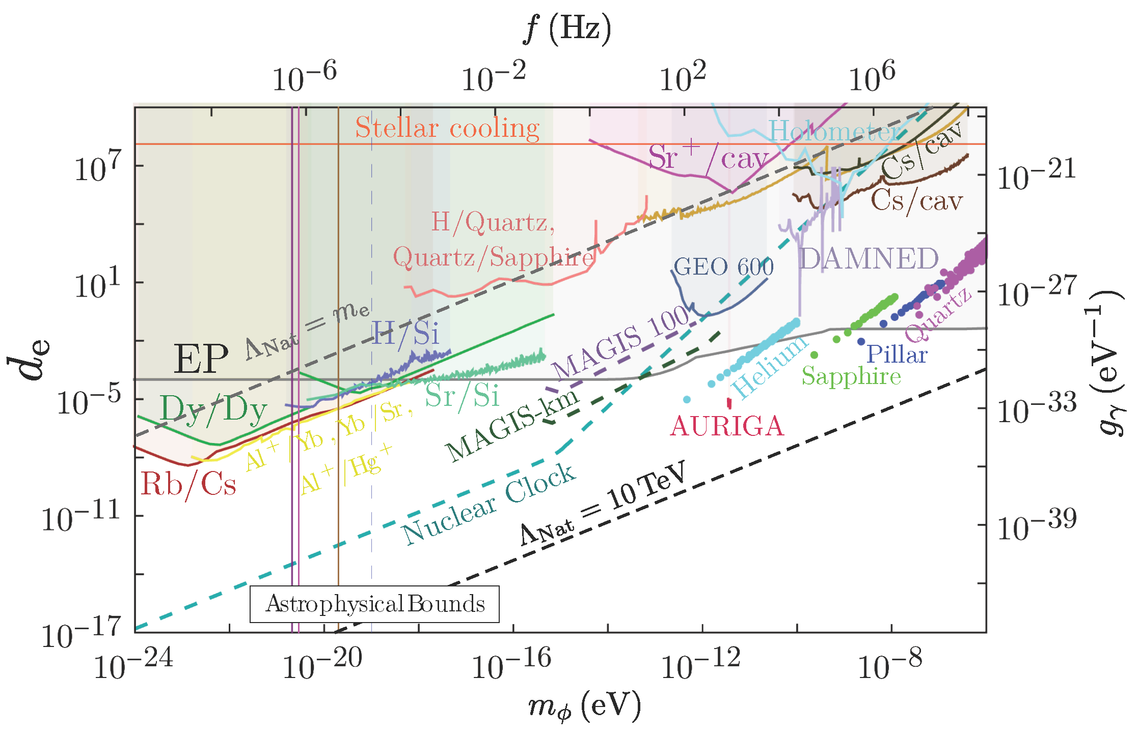
Ultra-light DM: combined exclusion plot
d_{e}: strength of the scalar DM coupling to the electromagnetic field tensor
relative to the strength of gravity
Snowmass 2021 White Paper:
New Horizons:
Scalar and Vector Ultralight
Dark Matter,
arXiv:2203.14915v1 [hep-ex]
9
Notes:
Clarify: what means Lambda_nat limit at 10 TeV?
Summary plot for d_{e} , the scalar DM coupling to the electromagnetic field tensor, defined in Eq. (2), assuming only d_e ≠ 0.
Experiments which search for EP violation, represented by the gray shaded region, provide stringent constraints over the mass
scale shown in the figure [30, 42, 451, 452, 454, 673].
Existing bounds from precision spectroscopy measurements in Dy/Dy (dark green) [329], Rb/Cs atomic, clocks (dark red) [330] and a
combination of Al + /Yb, Sr/Yb and Al + /Hg + clocks (light yellow) [331] are also shown.
Bounds from the comparison of a H-maser and Sr clock with a Si cavity (labelled H/Si and Sr/Si, respectively) are denoted by the lavender
and aqua-green regions, respectively [311], the comparison of a Sr + clock with a Si cavity is shown by the magenta region [60], comparisons
of a bulk acoustic wave quartz oscillator with a H-maser and a cryogenic sapphire oscillator are shown by the peach-orange line [438], and
comparisons of a Cs clock with a cavity are shown by the very dark green [58] and brown [439] regions.
The dark yellow line represents bounds from molecular I 2 experiments [44], whereas the cherry-red shaded
region represents bounds from the AURIGA experiment [472]. Optical interferometry bounds from GEO600
(dark blue) [444], DAMNED (lilac) [446] and Fermilab Holometer (light turquoise) [445] experiments are also shown.
We show the projected sensitivities of the MAGIS experiments by dashed purple and dashed dark green lines [412].
We show the projected sensitivity of a nuclear clock as a dashed dark turquoise line.
We also show projections from various proposed mechanical resonators by cyan (superfluid 4 He), light green
(sapphire), blue (pillar) and mauve (quartz bulk acoustic wave) circles [473]. Note that, for masses m φ .
10 −21 eV, the scalar field cannot account for 100% of the observed DM. The sensitivities of the considered
experiments scale as the square root of the local DM density, meaning that e.g. for a fractional abundance
of 1%, the actual sensitivities weaken by a factor of about 10. We have shown the stellar cooling bounds by
the horizontal orange line [274]. The vertical solid (dashed) lines show various current (projected) lower
bounds on the DM mass coming from astrophysical considerations [19, 21, 22, 24, 145, 230, 239]. Natural
values of d e for the cut-offs Λ Nat = 10 TeV and Λ Nat = m e lie below the black and gray dashed lines,
respectively.

Slide 10
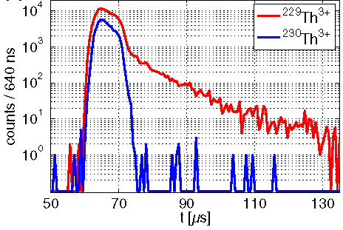
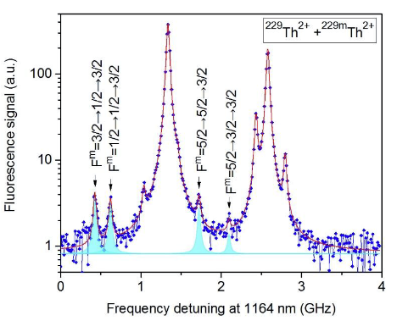
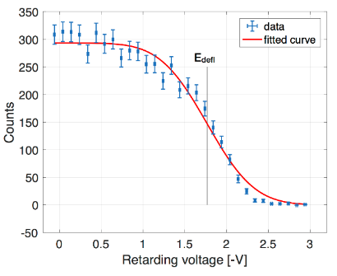
Characterization of ^{229m}Th
Internal Conversion decay:
First direct identification via Internal Conversion decay branch
→ electron detection (following α decay from 233U)
Nature 533, 2016
Isomer’s Halflife:
neutral isomer:
t_{1/2} = 7±1 μs
PRL 118, 2017
conversion coefficient: α_{IC} ~ 109 (in agreement with theory)
Hyperfine Structure:
collinear laser spectroscopy (2018: 229mTh2+, LMU + PTB)
(2024: 229mTh3+, RIKEN/Japan)
→ nuclear moments, charge radii, ionic halflife (1400600₃₀₀ s)
Nature 556, 2018
Nature 629, 2024
Isomeric excitation energy until 2022:
E*(iso) = 8.28 ± 0.17 eV (= 149.7 ± 3.1 nm)
Nature 573, 2019
E*(iso) = 8.10 ± 0.17 eV (= 153.1 ± 3.7 nm)
PRL 125, 2020
→ combined value 8.19 ± 0.12 eV (= 151.4 ± 2.2 nm)
10
Notes:
While the first 40 years did not see any direct detection and characterization of the thorium isomer, the situation drastically changed in 2016, when the first direct identification of the isomeric decay was achieved, not as before always attempted in the radiative decay channel but via internal conversion electrons following the alpha decay from 233U.
Also here GSI and local teams played an important role: we used the same buffer-gas cell technique as also in use for the SHIPTRAP project to produce the thorium ion beam and could benefit from Emma Haettner‘s design of a mass filter and various customized electronics components provided by the GSI and Giessen team around Timo Dickel.
Mass filter design, RF electronics components
With the same technique as in this breakthrough experiment we could determine the half-life of the neutral isomer, confirming that internal conversion would dominate the radiative decay by 9 orders of magnitude once it is energetically allowed. What followed were collinear laser spectroscopy experiments to unveil the hyperfine structure of the isomer, this gave us the nuclear moments and charge radii. Recently this experiments which we did in the 2+ ionic charge state was repeated by our Japanese colleagues, using 3+ ions.
We also performed a first direct measurement of the excitation energy, which shifted the energy beyond 8 eV and thus confirmed that a laser with a wavelength of less than 150 nm would be needed, which indicated the type of laser that would be needed for an optical control of the nuclear excitation.
Note strong theory support (atomic theory) for energy determination

Slide 11
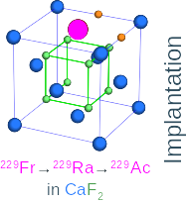
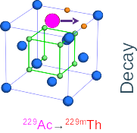
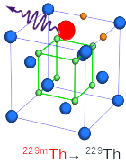
‘Game Changer’: Radiative Decay via VUV Photon
Photon spectroscopy of radioactive decay chains in solids:
- Isomer population in radioactive decay
- Implantation in (VUV transparent) large-bandgap crystals to ensure suitable chemical environment
- Vacuum-ultraviolet spectroscopy of ~150 nm photons from radiative decay
So far: experimental efforts using the alpha-decay of 233U
  → observation of radiative decay unsuccessful for almost 50 years
  new approach: using short-lived 229Ac produced using ISOL technique (Isotope Production On-Line)
11
Notes:
However, for decades the radiative decay of the thorium isomer could not be observed, which would be a prerequisite for a solid-state based nuclear clock.
As long as no suitable VUV laser is available, the only chance to populate the isomer is via radioactive decays. In a solid state approach the mother isotope would be implanted into a large-bandgap, VUV transparent crystal (like CaF2 or MgF2) and then one would search for the emission of VUV photons at around 150 nm.
So far this was exclusively done by using the alpha decay of 233U, that decays into 229Th and here with a 2% decay branch into the isomer.
And for decades this search was unsuccessful, most likely because one did not succeed to efficiently suppress the by far dominant internal conversion decay. Only recently a new approach was applied, where not alpha but beta decay was used to populate the thorium isomer. This approach uses short-lived (halflife 1 hour) 229Ac that needs to be produced online using the isotope production on-line technique, ISOL. For practical reasons short-lived precursors of 229Ac, namely Francium, was implanted into a CaF2 crystal, then 2 successive decays populate 229Ac which then beta-decays in 229mTh. And from here one is searching now for the emission of the VUV decay photons.

Slide 12
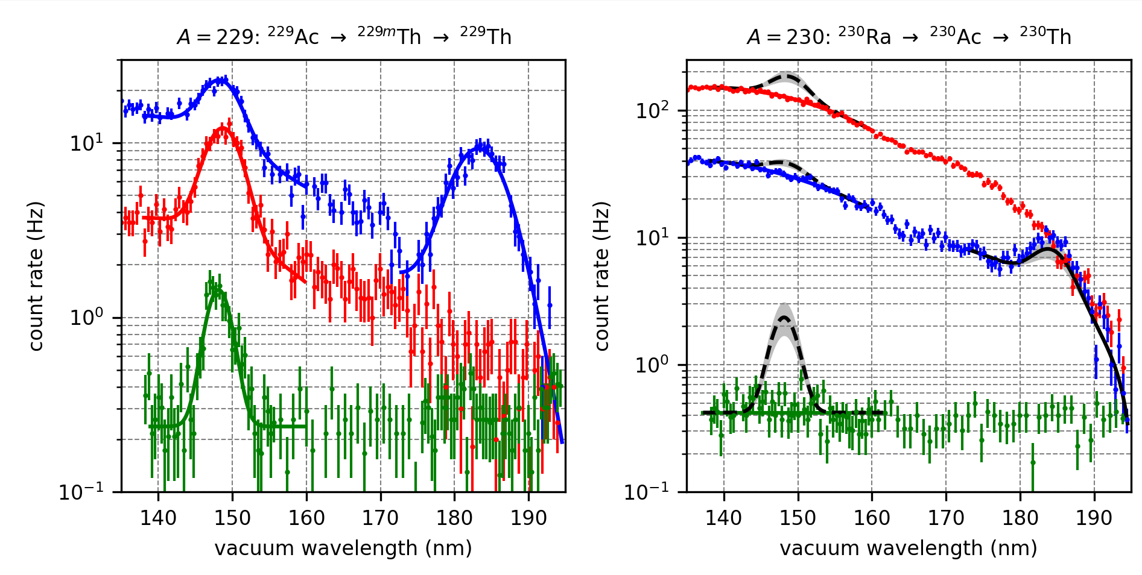
VUV Spectroscopy Results
→first observation of photonic de-excitation of thorium isomer
MgF₂ (5 mm)
CaF₂ (5 mm)
CaF₂ (50 nm)
A=229
A=230
Excitation energy:
E*(229mTh) = 8.338(24) eV
λ = 148.71(42) nm
7-fold precision improvement
Halflife:
t_{1/2} = 670(102) s (in MgF₂ )
scaled for vacuum:
~n3 : t_{1/2}~2500(380) s
S. Kraemer et al., Nature 617, 706 (2023)
12
Notes:
And here you see the results of this experiment, which worked amazingly well. Here wavelength scans are shown for 3 different crystals, two 5mm thick CaF2 and MgF2 and one quite special CaF2 crystal with a thickness of only 50 nm. In all of them a peak was observed at around 148 nm, which was the expected wavelength of the isomer transition. In addition in the CaF2 crystal a peak showed up from a crystal defect acting as color centre. A control measurement was done by implanting 230Th, were no isomer exists. The dashed lines indicate an expectation of how large a signal one would have expected under identical conditions as for mass 229 if a signal
would also appear at mass 230. No peak was seen in this run, so the peak on the left side could unambiguously be attributed to the radiative decay of the thorium isomer, which was now for the first time observed. The transition energy could be improved by about a factor of 7 and also a value for the half-life in the MgF2 crystal was determined, which can be scaled to vacuum conditions with a halflife of about 2500 seconds, which is within the range that was theoretically expected.
Left/middle: Spectra recorded with a 3 mm entrance slit after implantation of A = 229 (left panel) and A = 230 (right panel) beams in a MgF2 – 5 mm (red), a CaF2 – 5 mm (blue) and a CaF2 - 50nm (green) crystal. Wavelength data points were recorded for 11s per grating setting for the 5mm thick crystals while for the 50nm crystal 23s and 35s per grating setting were used for the A = 229 and A = 230 data, respectively. The drop in intensity in the A = 229 spectrum with the CaF2 - 5mm at 172nm coincides with an outage of the grating control causing a delay in the scanning procedure and resulting in a change of background activity. The solid red, blue and green lines show a fit to the data for the A = 229 data (see Method section). Based on the implanted activity and assuming the observed line at 183nm in the A = 229 spectra are due to crystal defects, the black solid line represents the expected signal in the A = 230 spectra. The grey uncertainty band includes the uncertainty on the radioactive ion beam production rates
Right: VUV spectrum taken with the CaF2 5mm crystal and recorded with an entrance slit width of 0.5mm, along with a ﬁt (solid line) of the data. Details on the ﬁtting procedure are given in the Methods section. The dashed line shows the peak signal whereas the dotted line includes the constant dark count rate (0.3 s−1) and the Cherenkov background contributions. A resolution of 2.25(21)nm FWHM was obtained. The resulting wavelength value corresponds to the 11th data value in Fig. 4.
The continuous background stems from Cherenkov photon emission induced by the β-decay chain of the implanted radioactive isotopes [22, 23] and the constant detector dark count rate of typically less than 1Hz. The VUV photon peak can be caused by the radiation-induced excitation of electronic modes associated with crystal defects [31]. The latter should be observed for both A = 229 and A = 230 spectra. Assuming that the two VUV photon peaks in the A = 229 spectra stem from crystal defects, the expected signal for the A = 230 case can be calculated considering the peak intensities in the A = 229 spectra and the diﬀerent instantaneous radiation from the radioactive decays (see black lines in Fig. 1). The agreement of the observed intensity for the 183 nm peak in the A = 229 and A = 230 spectra associates this structure with a CaF2 crystal defect. The observation of the 148.7nm peak in the A = 229 spectra and its absence in A = 230 spectra suggests that these photons are due to the radiative decay of 229mTh.

Slide 13
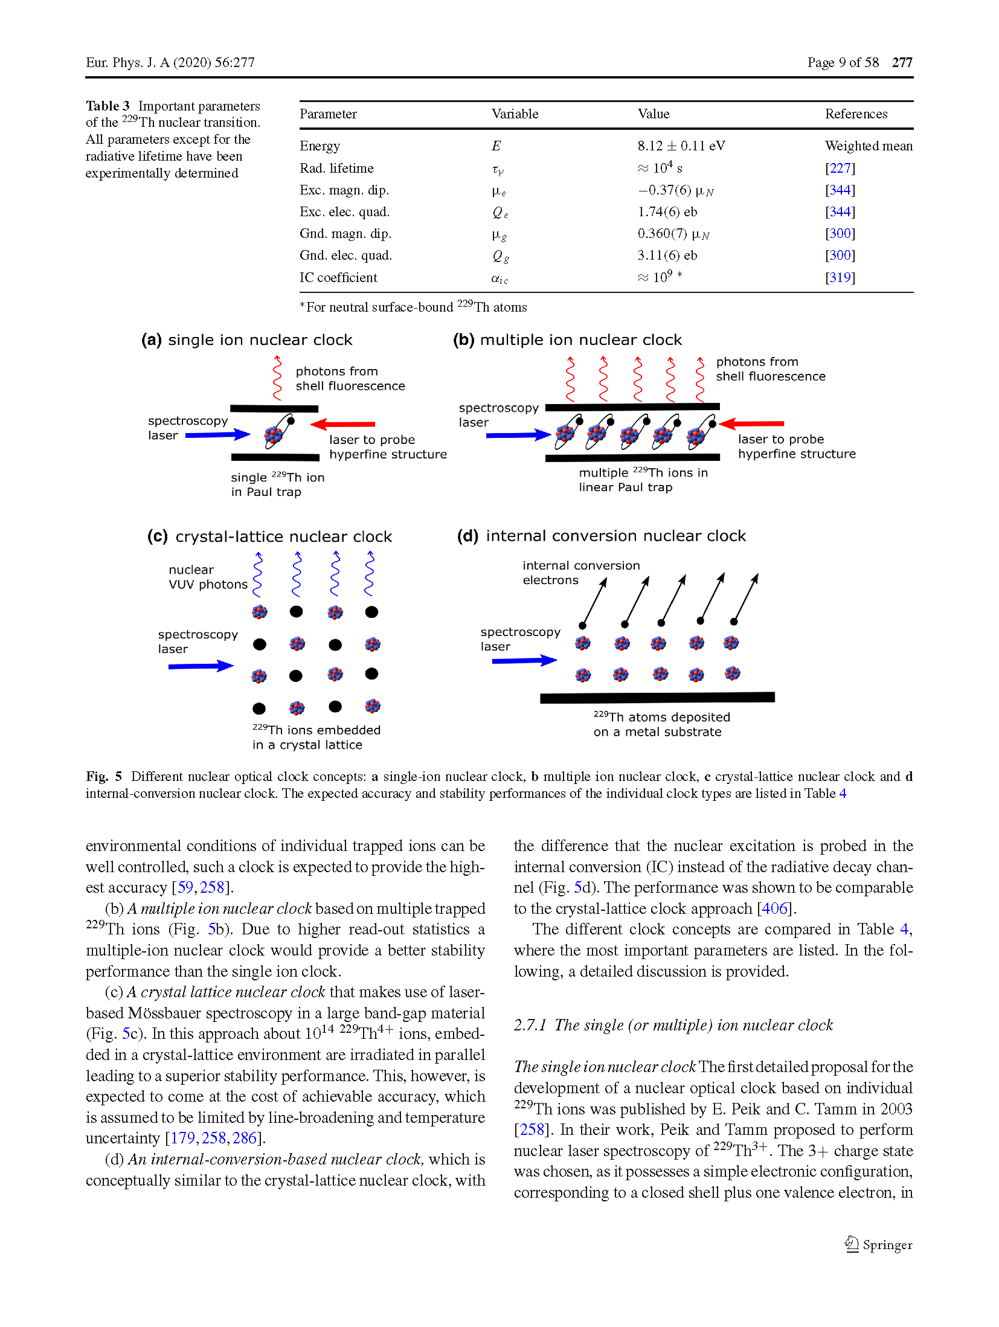
Concepts for
Direct Laser Spectroscopy of 229mTh
Crystal lattice approach
Solid surface approach
Ion trap approach
- implant 229Th nuclei in
large-bandgap crystal
- IC forbidden if band gap > E*_{iso}
- excite isomer with VUV laser light
- observe photons from isom. decay
- deposit layer of 229Th on surface
- IC allowed: band gap < E*_{iso}
- excite isomer via VUV laser light
- observe electrons from isom. decay
- store ion(s) in Paul trap
- IC is forbidden (large IP)
- excite isomer via VUV laser light
- observe hyperfine shift of electron
shell induced by nuclear spin change
PTB (Ekkehard Peik),
TU Vienna (Thorsten Schumm)
UCLA (Eric Hudson), JILA (Jun Ye)
JILA (Jun Ye)
UCLA (Eric Hudson)
PTB (Ekkehard Peik), LMU (Peter Thirolf)
U Mainz (F. Schmidt-Kaler)
13
L. v.d. Wense, B. Seiferle, EPJ-A 56, 277 (2020)
Notes:
Aiming for direct laser spectroscopy of the thorium isomer, as needed in the operation of a nuclear clock, different concepts are pursued:
In the crystal lattice approach 229Th is embedded into a crystal matrix with a large bandgap, which is larger than the isomeric excitation energy. In this case internal conversion is energetically forbidden and the isomer will be excited with a suitable VUV laser and photons from the isomeric decay are observed. This approach is followed by the groups of PTB, in Vienna and Los Angeles.
A combination of solid-state and internal conversion approach is achieved when one deposits a layer of 229Th onto a metal substrate. Then internal conversion decay is allowed, and when the VUV laser light excites the isomer, conversion electrons are detected. In the US this approach has been followed for some time. The second main approach is to store a few ions in a Paul trap, such that internal conversion is forbidden and again the excitation is performed by VUV laser light. Then photons are observed from the hyperfine components of the electron shell induced by the nuclear spin change during the excitation. This concept is followed by PTB, in our group in Munich and also in Mainz.

Slide 14
Laser-Excitation of the 229mTh Nuclear Resonance
high power, broad bandwidth
frequency comb
- initial search
- shorter scan times
- compromise on frequency resolution
- precision frequency determination
- longer scan times
laser
nuclear resonance
nuclear resonance
bandwidth ∆f
f_{rep}
1-10 GHz
1 kHz
frequency
groups:
UCLA (Eric Hudson)
PTB (Ekkehard Peik)
JILA Boulder (Jun Ye)
TU Wien (Thorsten Schumm)
LMU (Peter Thirolf)
14
Notes:
Now that the radiative decay has been observed, the door is open for exciting the thorium isomer with a suitable laser and detect its fluorescence deexcitation. The first thing to do is to search for the nuclear resonance with a VUV laser. There are 2 basic options on how such a laser scan can be done. In the first approach a high-power and broad bandwidth laser of a few GHz linewidth would be scanned across the search range and at some position hit the nuclear resonance. This mode is ideally suited for an initial search with manageable scan times, however with a compromise on the frequency resolution. This approach is followed in the groups at PTB in Braunschweig and Los Angeles in the US. The alternative uses a narrow-bandwidth VUV frequency comb laser with a mode bandwidth of around kHz. Searching with all about 100000 modes of the frequency comb will enable a precision frequency determination, however at the expense of longer scan times. This approach is followed by groups in Boulder, in Vienna and in Munich.
Now, how do these 2 approaches fit into the overall picture of our most recent knowledge of the nuclear clock transition in 229Th?

Slide 15
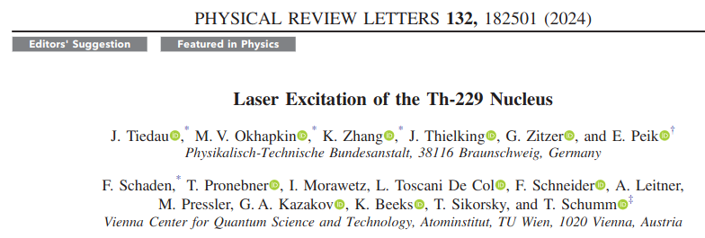

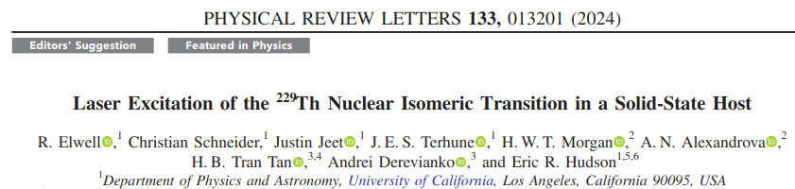
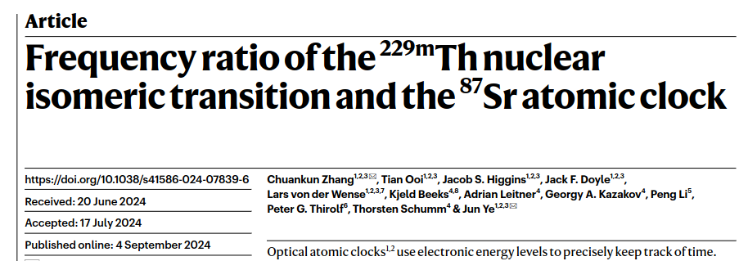
‘hot of the press’:
2024: 229mTh laser excitation breakthroughs
→ solid-state approach: 229Th doped VUV-transparent (CaF₂) crystals (TU Wien, ~1018/cm3)
PTB, UCLA: 4-wave mixing laser, linewidth ~ 10 GHz
VUV frequency comb, ~ 300 kHz
15
Notes:
Only a few weeks ago indeed this major breakthrough of the first laser excitation of the thorium isomer was achieved by the teams of PTB and TU Vienna, using the PTB 4-wave-mixing laser with a linewidth of about 10 GHz that irradiated highly thorium doped CaF2 crystals provided by the team from Vienna.
This sketch from their publication shows the full setup, where cw Ti-Sapphire lasers were used to generate VUV laser light around 148 nm by the nonlinear 4-wave mixing effect in a Xe cell, irradiate the CaF2 crystal and detect the resulting fluorescence on a PMT. To the right you see here this fluorescence as it was seen on the CCD camera
.
Omega_VUV = 2x Omega_1 – Omega_2

Slide 16
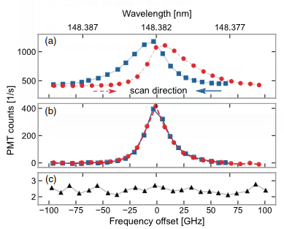
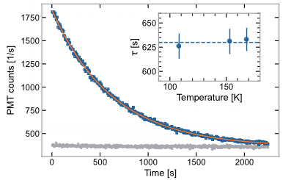
First laser excitation of the Thorium Isomer
Nuclear 229mTh resonance via laser:
229mTh halflife (in CaF₂):
229Th
230Th
Thorium Isomer:
CaF₂:
E* = 8.35574(3) eV
λ = 148.3821(5) nm
ν = 2020.409(7) THz
T_{1/2} = 1740(50) s
LiSrAlF₄:
E* = 8.355733(11) eV
λ = 148.38219(21) nm
ν = 2020.4073(31) THz
T_{1/2} = 1289(79) s
J. Tiedau et al.,
PRL 132 (2024)
R. Elwell et al.,
PRL 133 (2024)
16
Notes:
The nuclear resonance was clearly seen in a series of laser scans
and the isomeric halflife could as well be determined. The box here shows the most recent values for excitation energy
, corresponding laser wavelength and frequency and also the halflife scaled for vacuum. The box shows not only results for the CaF2 crystal used by the PTB team, but also very similar values for a different type of crystal, LiSAF, since shortly after the PTB team also the laser ecitation with a similar laser system was achieved by the team of Eric Hudson at UCLA in Los Angeles. In these experiments the precision of the isomer excitation energy was further improved by a factor of 800, so in the last 5 years the precision of the nuclear clock transition was improved by overall a factor of almost 17000!
The measurement time between frequency steps is shorter than the isomer decay time (see Fig. 3), which leads to an asymmetry in the resonance curves.
Omega_VUV = 2x Omega_1 – Omega_2

Slide 17
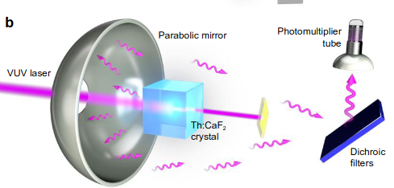
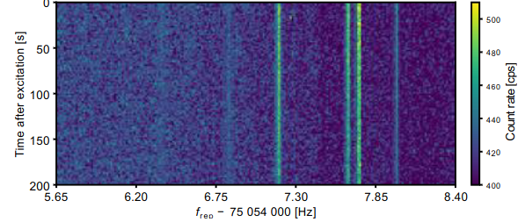
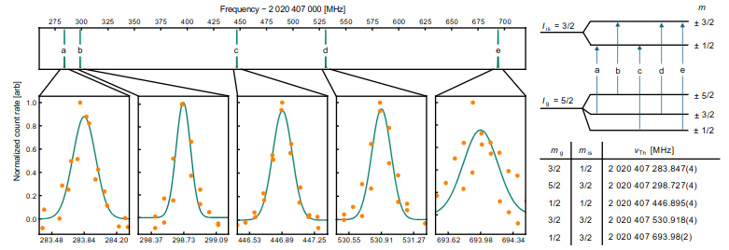
Excitation of the Thorium Isomer 229mTh via
VUV Frequency Comb
C. Zhang et al., Nature 633, 63(2024)
nuclear electric
quadrupole splitting:
sensitivity enhancement
for α:
K = 5900 (2300)
.
K. Beeks et al,
arXiv:2407.17300
17
Notes:
Fig. 1 | VUV comb spectroscopy of the 229Th nuclear clock transition. (a) An infrared frequency comb with a 75 MHz repetition frequency is stabilized by the JILA 87Sr optical lattice clock2. The
infrared frequency comb is upconverted to VUV through a coherent, high-order harmonic generation (HHG) process inside a femtosecond enhancement cavity (not shown). A single VUV
comb line in the 7th harmonic comb (~148.3 nm center wavelength) directly excites the 229Th nuclear clock transition, providing a direct frequency connection between the nuclear and atomic
clocks. A representative crystal structure53 of 229Th:CaF2 is shown with the doped 229Th colored orange. (b) Illustration of the detection setup. After 400 s illumination, the excitation comb is shut off. Fluorescent photons from the decay of 229mTh embedded in the CaF2 crystal are collected using a VUV-reflective parabolic mirror. A series of dichroic filters (only one shown) steer photons at the nuclear transition wavelength to a detector while suppressing background photons. A photomultiplier tube (PMT) is used to count individual VUV fluorescent photons for 200 s while the comb is off. (c) Photo of the Th:CaF2 crystal under VUV irradiation. The Th:CaF2 crystal scintillates, showing a visible white/blue trace of the laser path. A fluorescent screen (yellow)
blocks the VUV comb transmission through the Th:CaF2 crystal to protect the PMT from laser damage. The yellow fluorescence signal is also used for laser alignment and power monitoring

Slide 18
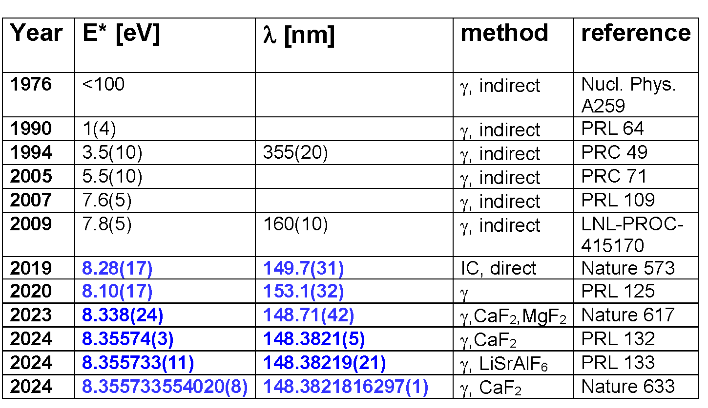
Excitation Energy of the Thorium Isomer 229mTh
2019-2024: improvement by ~ 1011
18
Notes:
When we look specifically to the development of our knowledge of the thorium isomer’s excitation energy, then you see here the development over almost 5 decades.
And I can hardly recall any other physical observable that has improved by 11 orders of magnitude within a period of 5 years.

Slide 19
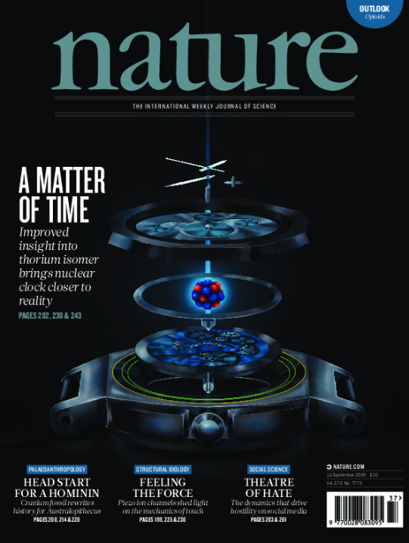
Summary: From the Atomic to the Nuclear Clock
Enormous exp. progress in recent years on 229mTh:
→ identification & characterization of the thorium isomer:
from nuclear spectroscopy to laser spectroscopy:
2019: E* = 7.8(5) eV
2024: E* = 8.355733554020(8) eV
Next major milestones:
→ optimize nuclear resonance excitation with narrowband laser towards
metrological precision
→ realize nuclear clock prototype with ion-trap approach
→ measure ionic lifetime in vacuum
→ development of intense, narrow-band cw VUV laser
→ consolidate sensitivity enhancement for α
◊ exciting program at GSI for highly-charged 229mTh studies (nuclear hyperfine mixing)
.
All building blocks for a nuclear clock have been demonstrated:
one/several nuclear clock prototypes will appear in the coming years
19
Notes:
This brings me now to my summary of the journey I presented towards the transition from the atomic to the nuclear clock:
I showed the enormous progress that was achieved in recent years on our knowledge about the identification and characterization of the elusive thorium isomer, showing a recent transition from nuclear spectroscopy to laser spectroscopy. I showed in particular the about 17000 fold improvement of the precision of the isomer excitation energy.
The next major milestones will be the identification of the nuclear resonance with narrowband laser precision and for this purpose we have started the development of an intense VUV frequency comb and other groups have started to work on a cw VUV laser.
Other major advances will comprise the determination of the sensitivity enhancement of time variations of the finestructure constant and I have shown you the exciting and ambitious program just starting here at GSI on highly-charged thorium isomers.
So ultimately ambitious goals lie ahead with drastic improvement of the sensitivity to new physics or the search for dark matter candidates not accessible by other means.
I am convinced that all major building blocks for a nuclear clock have been demonstrated and that first nuclear clock prototypes will appear in the coming years.

Slide 20

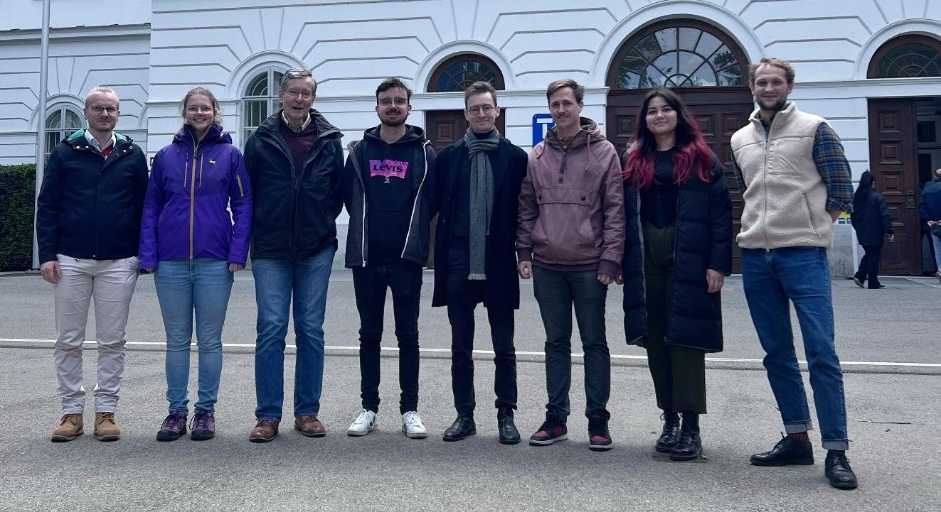


Thanks to ….
LMU: K. Scharl, D. Moritz, S. Ding, S. Kraemer, I. Hussain, T. Teschler, L. Löbell, F. Zacherl, L. v.d. Wense,
B. Seiferle, G. Holthoff, J. Rebhan, T. Teuner, M. Wiesinger, S. Wissenberg
GSI/JLU Giessen: E. Haettner, T. Dickel
PTB Braunschweig: J. Thielking, P. Glowacki, D.M. Meier, M. Okhapkin, J. Tiedau, G. Zitzer, E. Peik
Helmholtz-Institut Mainz & Johannes Gutenberg-Universität Mainz, GSI Darmstadt:
C. Mokry, J. Runke, K. Eberhardt, N.G. Trautmann, C.E. Düllmann
TU Wien: T. Schumm, S. Stellmer, T. Sikorsky, K. Beeks, C. Lemell, F. Libisch
MPQ/ILT Aachen: J. Weitenberg
MPI-HD: P. Bilous, N. Minkov, J. Crespo
U Würzburg: A. Pàlffy
NIST: S. Nam, G. O’Neil
UCLA: E. Hudson, C. Schneider, J. Jeet,
R. Elwell, J. Terhune
U Delaware: M. Safronova
Thank You !
20
Notes:
Finally I want to thank all members of my team in Munich and all collaborators contributing over the years for their great commitment.

Slide 21
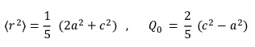
Sensitivity to Variation of Fine-Structure Constant
a
c
model: nucleus = uniform, hard-edged, prolate ellipsoid
small isomeric transition energy results from cancellation of change in Coulomb energy of 229Th, 229mTh:
ΔE_{C} = E_{C}m – E_{C}
ΔE_{C} = ( - 485 MeV) (Δ<r2> / <r2>) + (11.3 MeV) [(Q₀m / Q₀g) -1 ]
Berengut et al., PRL 102, 210801 (2009) (with updated Q₀):
Safronova et al., PRL 121, 213001 (2018)
ΔE_{C} = - 0.049(19) MeV
K. Beeks et al., arXiv:2407.17300
K = −18400 (2300) + 24300 (400) = 5900 (2300)
based on Zhang et al., Nature 633, 63 (2024)
BUT: influence of nuclear octupole deformation to be quantified !
19

Slide 22

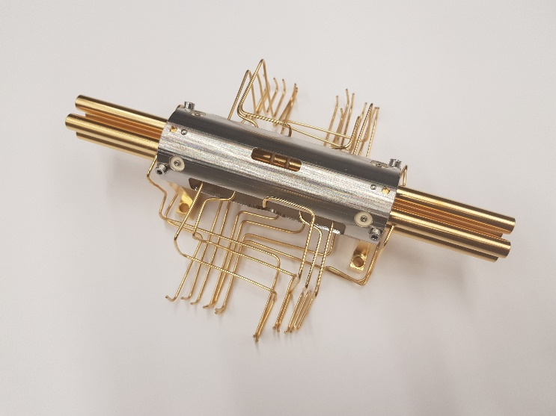
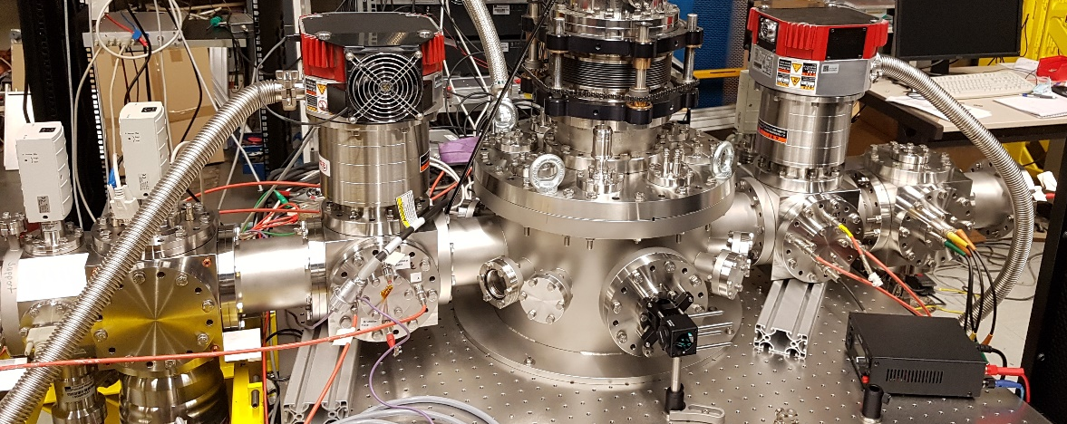
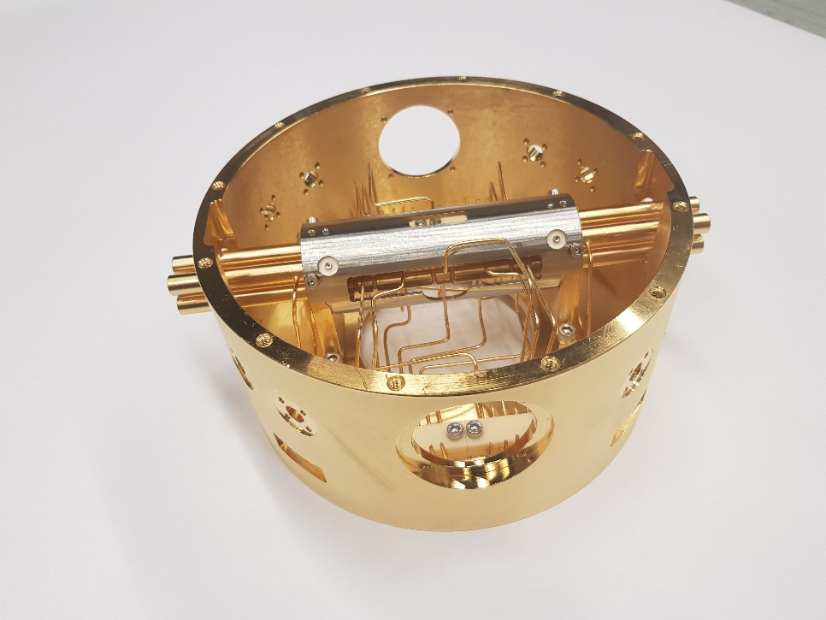
Ionic Lifetime Measurement
needs longer storage time (= better vacuum)
- setup of a cryogenic Paul trap
- platform for laser manipulation towards nuclear clock prototype
- ionic lifetime measurement: via HFS spectroscopy of 229mTh3+
19

Slide 23
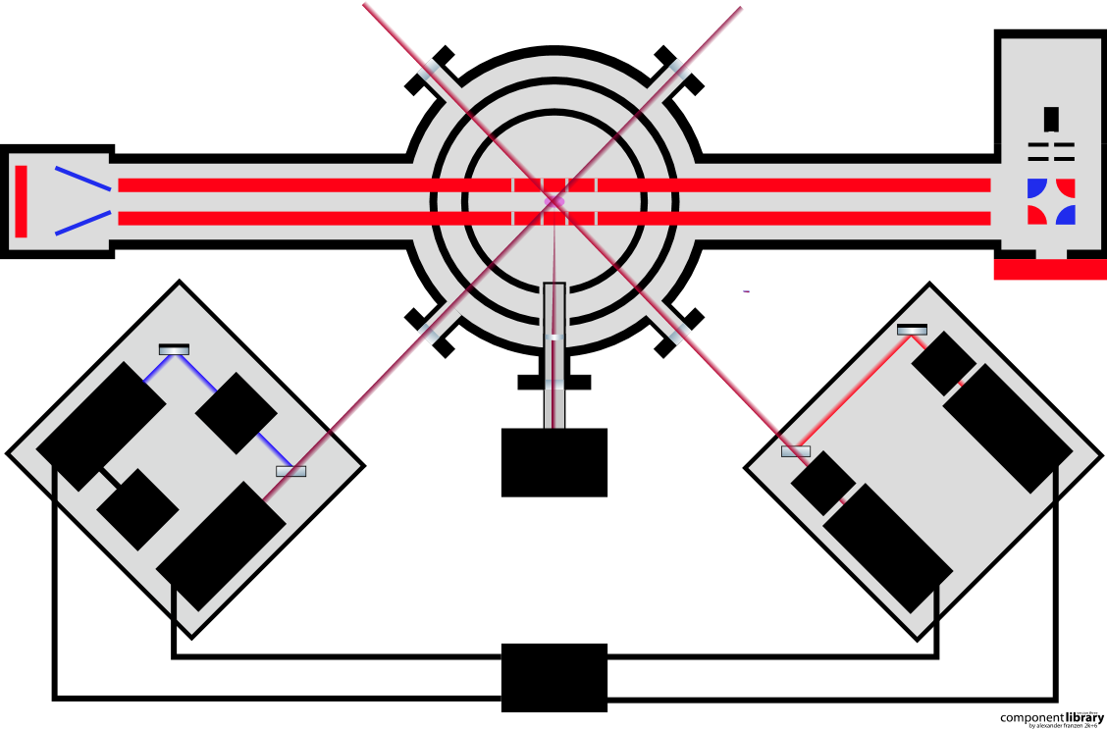
Cryo Trap & Laser Setup
Cryogenic Paul Trap
88Sr-
source
laser ablation
source
40 K
RFQ and QMS
RFQ and QMS
4 K
Buffer gas
stopping cell
233U-
source
90°
bender
MCP
EOM
88Sr+-
Cooling
Lasers
422 nm
AOM
690 nm
229Th-
Spectroscopy Lasers
EM-CCD
EOM
Rb
Fluorescence
Detection
1090 nm
984 nm
Stabilization
Stabilization
Reference
WLM
Stabilization
- sympathetic laser cooling of 229(m)Th3+ with 88Sr+ set up and ready
- HFS fluorescence spectroscopy ongoing
20

Slide 24
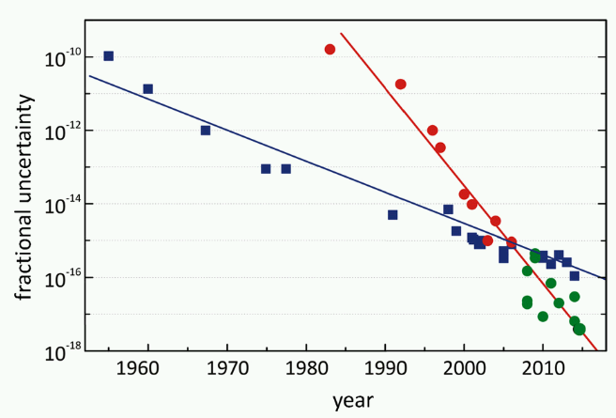
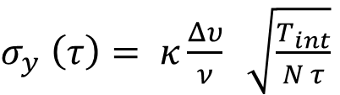
Clock Accuracy
Limitations:
Essen and Parry atomic clock
Redefinition of the second
Cesium fountain clock
first laser ccoled clocks
first frequency combs
external pertubations:
- Stark & Zeeman shifts
- second order Doppler
- black-body radiation
fundamental limit:
quantum projection noise
$σ_{y} \left(τ\right)= κ\frac{Δυ}{ν} \sqrt{\frac{T_{int}}{N τ}}$
optical clocks
hyperfine splitting clocks
Best atomic clocks:
Ytterbium E3 single-ion clock : 3.2 .10-18
N. Huntemann et al., PRL 116 (2016)
Strontium optical lattice clock: 2.1 .10-18
T.L. Nicholson et al., Nature Comm. (2015)
Ytterbium optical lattice clock: 1.4 .10-18
W.F. McGrew et al., Nature 5634 (2018)
Aluminum single-ion clock: 9.4 .10-19
S.M. Brewer et al., PRL 123 (2019)
lattice clocks
(1)
(1) mod. from Riehle, C.R. Physiques 16, 506 (2016)
4
achieved accuracy: 1 s in 30 billion years
Notes:
When we talk about ultra-precise timekeeping we can follow the historical development of fractional clock uncertainties from the invention of the atomic clock by Essen and Parry in the late 1950’s up to today. And here you see the continuous precision improvement of clocks built on hyperfine states in the atomic shell, which led to the still nowadays valid definition of the second in 1967 based on Cesium. Even steeper progress could be achieved with optical clocks using about 5 orders of magnitude higher frequencies than in microwave clocks. Laser cooling and frequency combs played a key role in this success story. Limitations are given by external perturbations like Stark and Zeeman shifts, Doppler effect and black –body radiation.
The achievable uncertainty is related to the linewidth of the clock transition and the square root of the interrogation time, the number of sample atoms and the averaging time.
Here you see a list of presently best optical atomic clocks from various ions, now already reaching the 10^-19 relative precision regime. This means that the best clocks lose only 1 second in about 30 billion years, more than twice the age of the universe.
…, in agreement with the predictions of quantum mechanics. These fluctuations, which we call quantum projection noise, are the fundamental source of noise for population measurements with a fixed number of atoms. These fluctuations are of practical importance, since they contribute to the errors of atomic frequency standards.
Allan deviation: Die Allan-Varianz, auch Zweiwert-Varianz, stellt ein Maß für die Frequenzstabilität von Uhren und Oszillatoren dar: eine geringe Allan-Varianz ist ein Merkmal einer Uhr mit hoher Stabilität über den gemessenen Zeitraum. Die Allan-Varianz hängt von der zeitlichen Auflösung der Messdatenerfassung ab.
Allan variance is defined as one half of the time average of the squares of the differences between successive readings of the frequency deviation sampled over the sampling period.
Equation: tau: observation (=averaging) time; Gamma_d: clock cycle time (?) ; N: number of interrogated absorbers (atoms/nuclei)
κ is a number of order unity that depends on the type of interrogation, ν is the frequency of the optical clock, ∆ν is the line width at the interrogation time T_{int}, N is the number of absorbers interrogated, and τ is the averaging time.

Slide 25
1976-2016: Chasing a Phantom ?
(λ = 355 ± 20 nm)
(λ = 160 ± 10 nm)
2007:
7.6 ± 0.5 eV
2009:
7.8 ± 0.5 eV
?
1976:
< 100 eV
1990:
-1 ± 4 eV
1994:
3.5 ± 1 eV
2005:
5.5 ± 1 eV
Indirect Evidence
229mTh properties:
3/2+
isomer
lowest E* of all ~186000
presently known nuclear
excited states
7880a
E* ≈ 8.35574(3) eV
λ = 148.3821(4) nm
τ ≈ 2000 s
α: 4.845 MeV
ΔE/E ~ 10-20
~ 0.1 mHz nat. linewidth
5/2+
ground state
→ best candidate for a nuclear frequency standard
6
Notes:
The existence of the isomer dates back almost 50 years when a low lying ground-state doublet was conjectured from gamma-spectroscopic data. Over the years many attempts were made to identify and characterize it and you see that in the first 20-30 years the energy was assumed to lie in the visible to UV range range, before in 2007 with a modern detector the energy was shifted upwards and the wavelength went into the vacuum ultraviolet regime. All these findings were from indirect evidence and some people even doubted the existence of the isomer at all.
In fact the first excited state of 229Th is the lowest nuclear excitation amongst all presently about 186000 known excited states with an extremely narrow relative linewidth of about 10^-20. here on the right you see already our most recent knowledge of this M1 transition and you see the enormous progress that has been reached in recent years. This is what I want to present in the next minutes.
8.35574 eV: Tiedau PRL

Slide 26

^{229m}Th research: worldwide activities
PTB, Braunschweig
E. Peik
229-Th in Paul trap
Laser spectrosocopy
Electronic bridge
U Mich., Ann Arbor
A. Kuzmich,
C. Campbell
Laser cooling
Electronic bridge
JYFL, Jyväskylä
I. Moore
population from 229-Ac
GSI Darmstadt
C. Brandau, T. Stoehlker
Highly charged 229Th
in storage ring
JILA, NIST, Boulder
J. Ye, S. Nam
laser spectroscopy
SNSPD
VNIIM St. Petersburg
F. Karpeshin
Theory
U Würzburg
A. Palffy
Theory
MEPhI, Moscow
E.V. Tkalya, P. Borisyuk
Laser plasma excitation,
Theory
LLNL, Livermore
J. Burke
Microcalorimetric
γ spectroscopy
INRNE Sofia
N. Minkov
Theory
Quantum, Mainz
F. Schmidt-Kaler
L. v.d. Wense
229-Th symp. cooling
cw laser develop.
RIKEN, Tokyo
M. Wada, H. Katori
229mTh ions in Paul trap
HIRFL, Lanzhou
X. Ma
NEET in storage ring
U Delaware, Newark
M. Safronova
Theory
UCLA, Los Angeles
E.R. Hudson
D. Leibrandt
Crystal lattice
Laser spectroscopy
Synchrotron
SNSPD
TU Wien
T. Schumm
Doped crystals,
synchrotron,
VUV irradiation
SPring-8, Sayo
K. Yoshimura
29 keV excitation
via synchrotron
LMU, Munich
P.G. Thirolf
Direct IC spectroscopy
cryo-Paultrap
VUV frequency comb dev.
LANL, Los Alamos
X. Zhao
Crystal lattice
Spectroscopy after
implantation
CERN, Geneva
P. Van Duppen
population via 229-Ac
implantation in solids
U Heidelberg
C. Enss, A. Fleischmann
Magnetic microcalorimetric
γ spectroscopy
CQD Brisbane
M. Piotrowski
229-Th in Paul trap
UNSW Sydney
V.V. Flambaum
Theory
9
Notes:
These intriguing perspectives triggered experimental and theoretical activities around the thorium isomer in many groups worldwide and it is likely that this overview here misses activities that may have started recently.

Slide 27
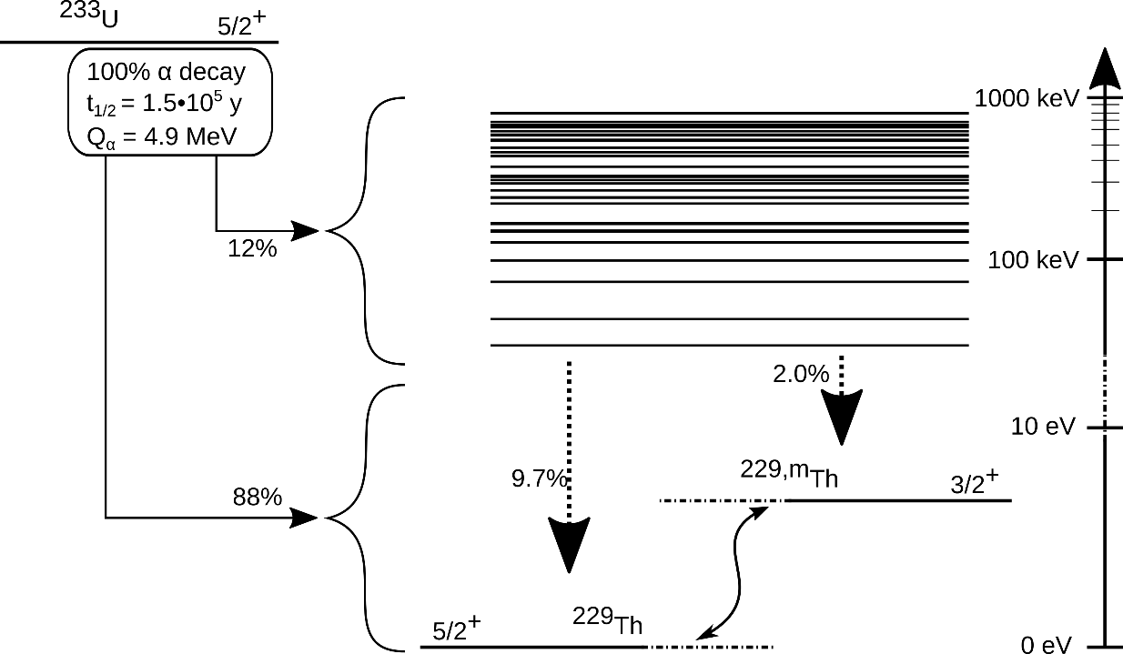
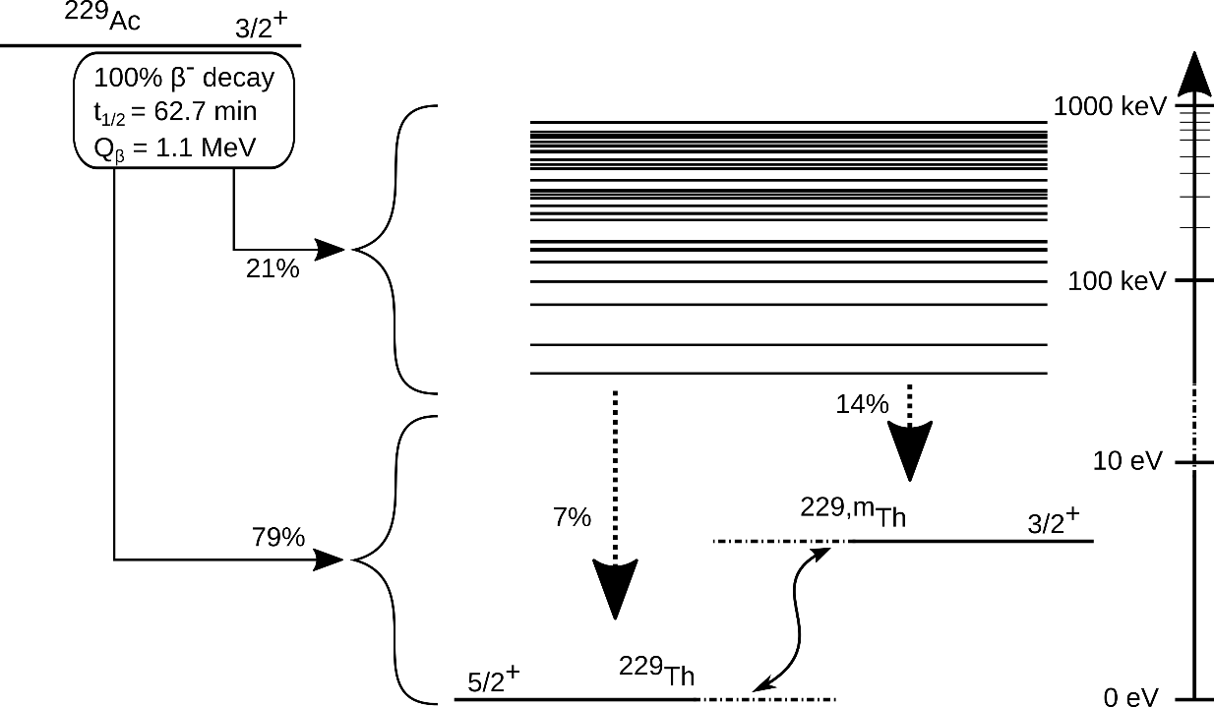
Exploit 229Ac β decay: Experiment at ISOLDE/CERN
233U (α-)decay:
Efficient population of 229mTh:
 | ²³³U | ²²⁹Ac
BR | 2% | 14%
Decay | α | β⁻
Recoil | 84keV | <6eV
Production | stockpile | ISOL
Technique | doping | implantation
ISOLDE beam composition: 229Fr, 229Ra
229Fr → 229Ra → 229Ac → 229mTh/229Th
229Ac (β-)decay:
ISOLDE beam implantation:
VUV transparent, large-bandgap crystals:
MgF₂ (5mm), CaF₂ (0.5 mm, 1.5 mm, 5 mm, 50 nm)
Decay diagnostcis:
VUV grating spectrometer, PMT + camera
13
Notes:
This experiment was performed at the ISOLDE facility at CERN, which is the nuclear physics facility attached to the Proton Synchrotron Booster. As introduced Francium beams were implanted into various MgF2 and CaF2 crystals, finally ending up in the thorium isomer. And the decay diagnostics was performed with a VUV grating spectrometer.
The advantage of using the 229Ac beta decay is twofold: first of all the branching ratio into the thorium isomer is about 7-10 times higher than for the alpha decay in 233U. This is what you can learn from the two nuclear level schemes of the uranium and actinium radioactive decays. And most importantly, the alpha decay is a rather violent process, where the recoil energy is about 84 keV. This is enough to drive implanted thorium atoms in the crystal lattice away from the lattice sites and thus free electrons may emerge which then trigger Internal Conversion. For the beta decay the recoil energy is very low with less than 6 eV, therefore the implanted nuclei will stay on their lattice positions.

Slide 28
From the Nuclear to the Optical Domain
from eV to (k)Hz:
nuclear methods → optical methods
10¹⁵
10¹²
109
10⁶
10³
10⁰
uncertainty from IC electron
and (first) 𝛾 spectroscopy: 0.12 eV
10⁰
10^{‒3}
10^{‒6}
10^{‒9}
10^{‒12}
10^{‒15}
uncertainty achieved by
𝛾 spectroscopy: ~0.024 eV
(~ 6 THz)
first (broad-band) optical excitation:
4-wave mixing laser setup:
- PTB (J. Tiedau et al, PRL 132, (2024)
- UCLA (R. Elwell et al, PRL 133, 013201 (2024)
uncertainty achieved with broadband (GHz) VUV laser system: ~ 0.00003 eV (~ 7 GHz)
uncertainty / resolution of ²²⁹Th nuclear clock transition frequency [Hz]
fractional uncertainty / resolution of ²²⁹Th nuclear clock transition frequency
first (narrow-band) optical excitation:
uncertainty with single mode of fs-VUV frequency comb: ~100 kHz
VUV frequency comb:
- JILA / Vienna
(Ch. Zhang et al, Nature 633, 63 (2024)
Th nuclear clock as high-accuracy
optical clock: ~Hz
→ still to bridge for metrological application:
> 5 orders of magnitude
expected progress
16
Notes:
Here you see where we stand at present on the way towards a metrological competitive nuclear clock.
On a scale of the uncertainty in Hz or the fractional uncertainty it shows
the region accessible with nuclear spectroscopic methods, either conversion electrons or gamma spectroscopy, and the big step forward enabled by switching from nuclear to optical methods.
Here the first broadband laser excitations with GHz uncertainties and finally the first narrowband frequency comb excitation improving further by 5 orders of magnitude.
Still the clock regime requires at least another 5 orders of magnitude improvement.
Leave out?
1 Hz = 4.1356655 x 10^-15 eV

Slide 29
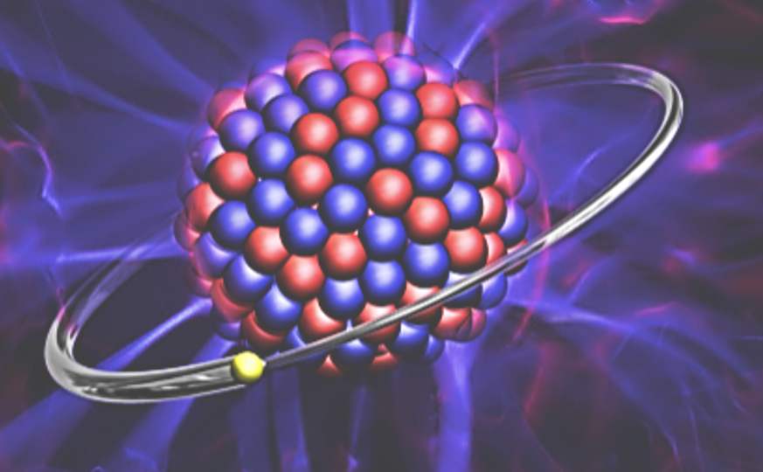
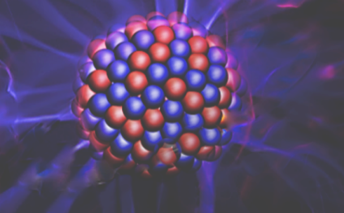



Highly Charged 229Th89+ at GSI
ESR-experiment: laser excitation of 229Th89+ using Nuclear Hyperfine Mixing
PI: C. Brandau, part of new ERC Grant HiThor (T. Stöhlker)
Bare ²²⁹Th⁹⁰⁺ nucleus
One-electron ²²⁹Th⁸⁹⁺
isomeric
state
Nuclear Hyperfine Mixing
One unpaired electron required
ground
state
Laser excitation of ^{229(m)}Th⁸⁹⁺
~10⁵-10⁶ more probable
and
~10⁵-10⁶ more decays
Line width $\frac{ ∆E}{E} ≈$ ${10}^{−19}$
$\frac{ ∆E}{E} ≈$ ${10}^{−14}$
Mixing of ground and isomeric state due to the huge magnetic field (≈30 MT)
V.M. Shabaev, et al., PRL 128, 043001 (2022)
Courtesy: T. Stöhlker
24
Notes:
GSI stood at the beginning of our tour towards the nuclear clock, and now towards the end of this journey we again arrive at GSI and the new HiThor project which is a new ERC advanced grant awarded recently to Thomas Stoehlker. Part of this project is an experiment at the ESR just is just about to start taking data this week, aiming at the laser excitation of highly charged, hydrogen-like Thorium 229 in the 89+ charge state with only 1 electron left. The PI is Carsten Brandau, who already organized the EMMI workshop 12 years before. Now the goal is to observe the effect of nuclear hyperfine mixing, which is the mixing of ground and isomeric state due to the huge magnetic hyperfine field of about 30 MegaTesla at the nucleus.
Here we see the transition between ground and isomeric state in the bare nucleus with an extremely narrow linewidth of about 10^-19, as calculated theoretically, in comparison to the one-electron system Thorium 89+. Here the hyperfine structure is shown, with a splitting and energy shift of the F-components. Mixing of the F=2 hyperfine components of ground- and excited state finally leads to the structure shown here, together with the expected transitions.
What is most important to be noticed is the reduction of the lifetimes of the transition by 5-6 orders of magnitude from about 2000 seconds in the bare nucleus to ms-lifetimes in the 1 electron system.
This reduction of the lifetime is equivalent to a corresponding broadening of the linewidth by about 5-6 orders of magnitude which makes laser excitation more probable by the same amount and thus leads to more detectable decays.

Slide 30
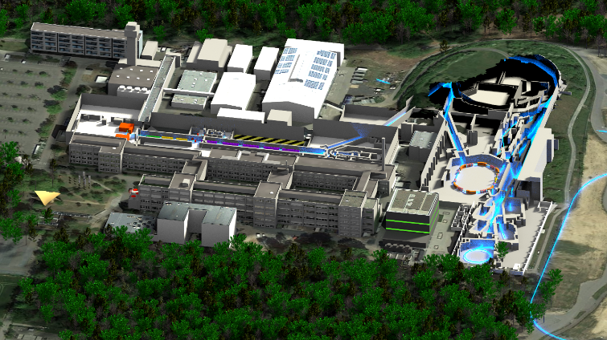
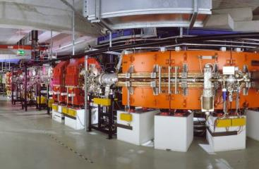
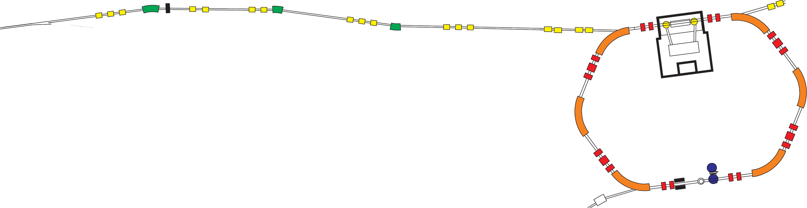
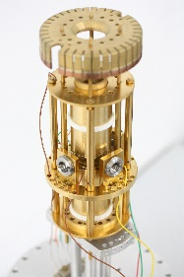
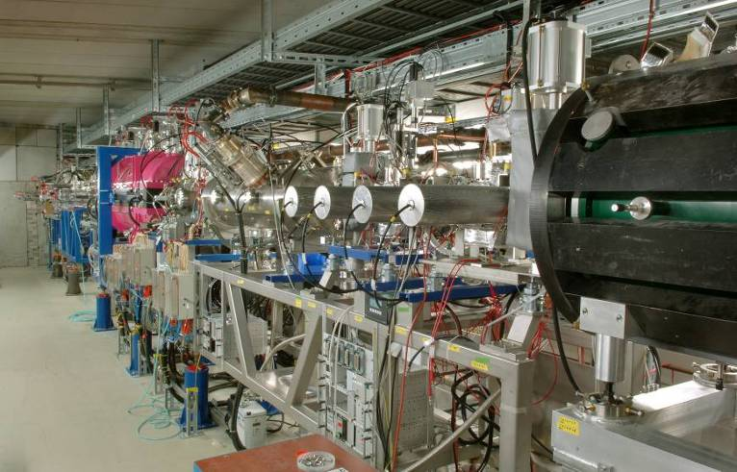
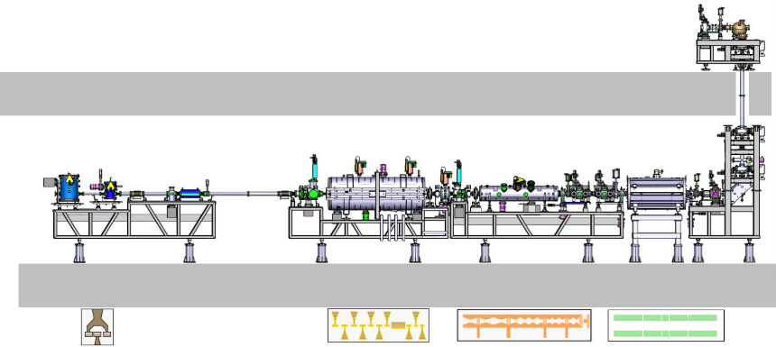
HiThor: worldwide unique at GSI – ²²⁹Th⁸⁹⁺
Ion storage ring and traps at GSI
GSI
²²⁹Th⁸⁹⁺
ESR
Uranium beam
from synchrotron
²²⁹Th production
target
HITRAP
β = 0
ESR
β ≈ 0.7
HITRAP
30
Courtesy: T. Stöhlker
Notes:
This is an experimental scenario which is worldwide unique to be realized only at GSI, where a uranium beam from the synchrotron is used to produce 229Th in the high charge state 89+ which is then fed into the ESR at relativistic velocity. The HiThor project also foresees to perform precision spectrometry in the of decelerated and trapped highly-charged thorium isomers in the HITRAP facility.
Production target: (232Th beam best, also 238U): 400 MeV/u; target: thick Be stripper 1850mg/cm^2 (as installed in the stripper section).
2E9/spill primary

Slide 31
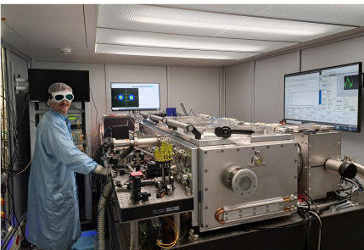
VUV laser source for 229mThorium @ LMU
VUV frequency comb: use 7th harmonic of amplified IR frequency comb:
reference cavity
ECDL
frequency comb
λ = 1040 nm
ν_{rep} = 40 MHz
ν
nonlinear pulse compression
Yb:YAG amplifier (Innoslab)
400 W, 𝜏 = 800 fs, λ₀ = 1030 nm
𝛥𝜆 = 65 nm, 𝜏 = 50 fs
enhancement resonator
spectroscopy chamber
PZT
Paul trap
229Th3+
laser under development at Fraunhofer ILT (Aachen)
together with LMU.
expected linewidth < 1 kHz ; operational: early 2026
8.4 eV
10 kW
HHG
(Xe jet)
>10 nW/mode
20
J. Weitenberg, ILT Fraunhofer/ RWTH Aachen & MPQ Garching
Notes:
To give you an impression on the complexity of such a VUV frequency comb laser, I show you here the principle layout of the laser together with our Munich team: it starts from a commercial system presently under development at the Institute for Laser Technology of the Fraunhofer Association in Aachen ultra-low noise and cavity-stabilized IR frequency comb. From there the output at 1040 nm is amplified in a fibre amplifier before pulse compression down to about 50fs is performed in a multi-pass cell. These pulses are then sent to an enhancement cavity where the 10 kW circulating power will hit a Xenon gas jet that generates high harmonics. The 7th harmonic of 1040 nm will then finally represent our VUV laser beam that is extracted and guided into a cryogenic Paul trap with laser-cooled stored thorium3+ ions.
We expect this laser system to be operational by the end of the year.
Laser specs:
IR comb: 80 MHz, 12 mW at 1030 nm, 35 mW @ 1043-1056 nm
Central wavelength: 1050 nm
phase noise < 100 mrad rms
power > 10 mW
Fibre amplifier: 200 W @ 40 MHz,
400 W @ 80 MHz
pulse picker at fixed pulse energy: 5 microjoule, ~ 13 MW total power
output 200 W: limited by isolator behind amplifier
pulse duration ~ 250 fs
nonlinear pulse compression:
‘intermediate amplifier’: 50 W @ 40Hz = 1.25 microjoule: not enough for HHG, enough for pulse compression test

Slide 32


LMU Setup: Sympathetically laser-cooled 229mTh3+ in Cryogenic Paul Trap
Fluorescence detection from co-trapped, cooled 88Sr+/229Th3+ ion crystals
21
Notes:
When we look specifically to the development of our knowledge of the thorium isomer’s excitation energy, then you see here the development over almost 5 decades.
And I can hardly recall any other physical observable that has improved by 11 orders of magnitude within a period of 5 years.

