Slide 1





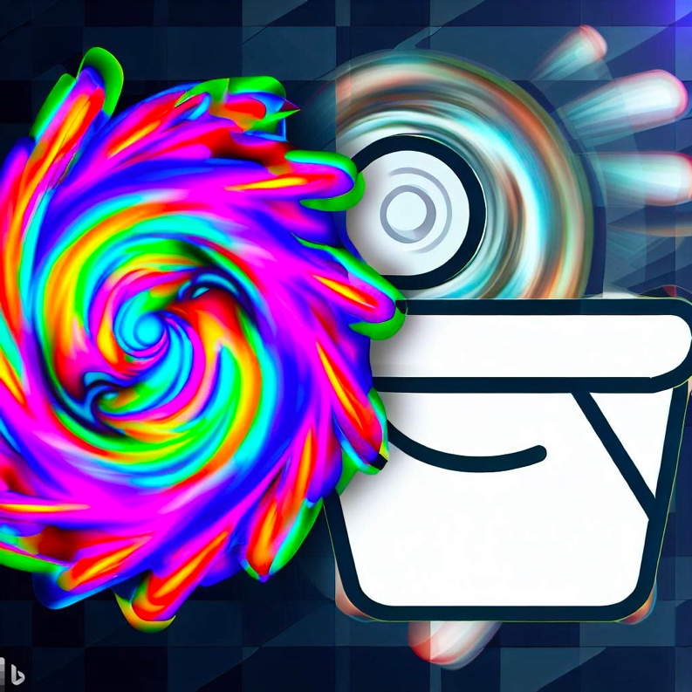
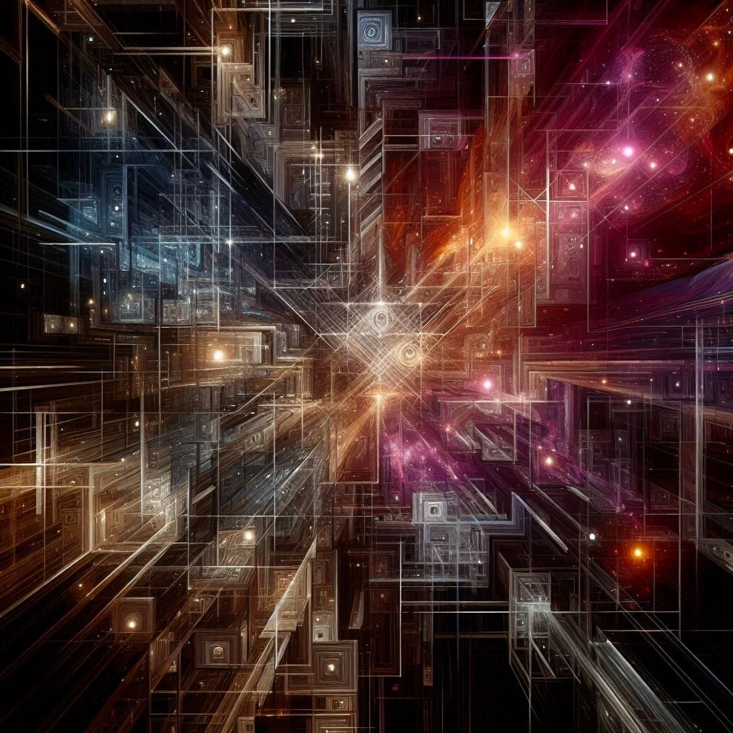

+
CML
Matter-Antimatter Asymmetry
Helmholtz Institute, Johannes Gutenberg U.
Mainz, Germany
1

Slide 2
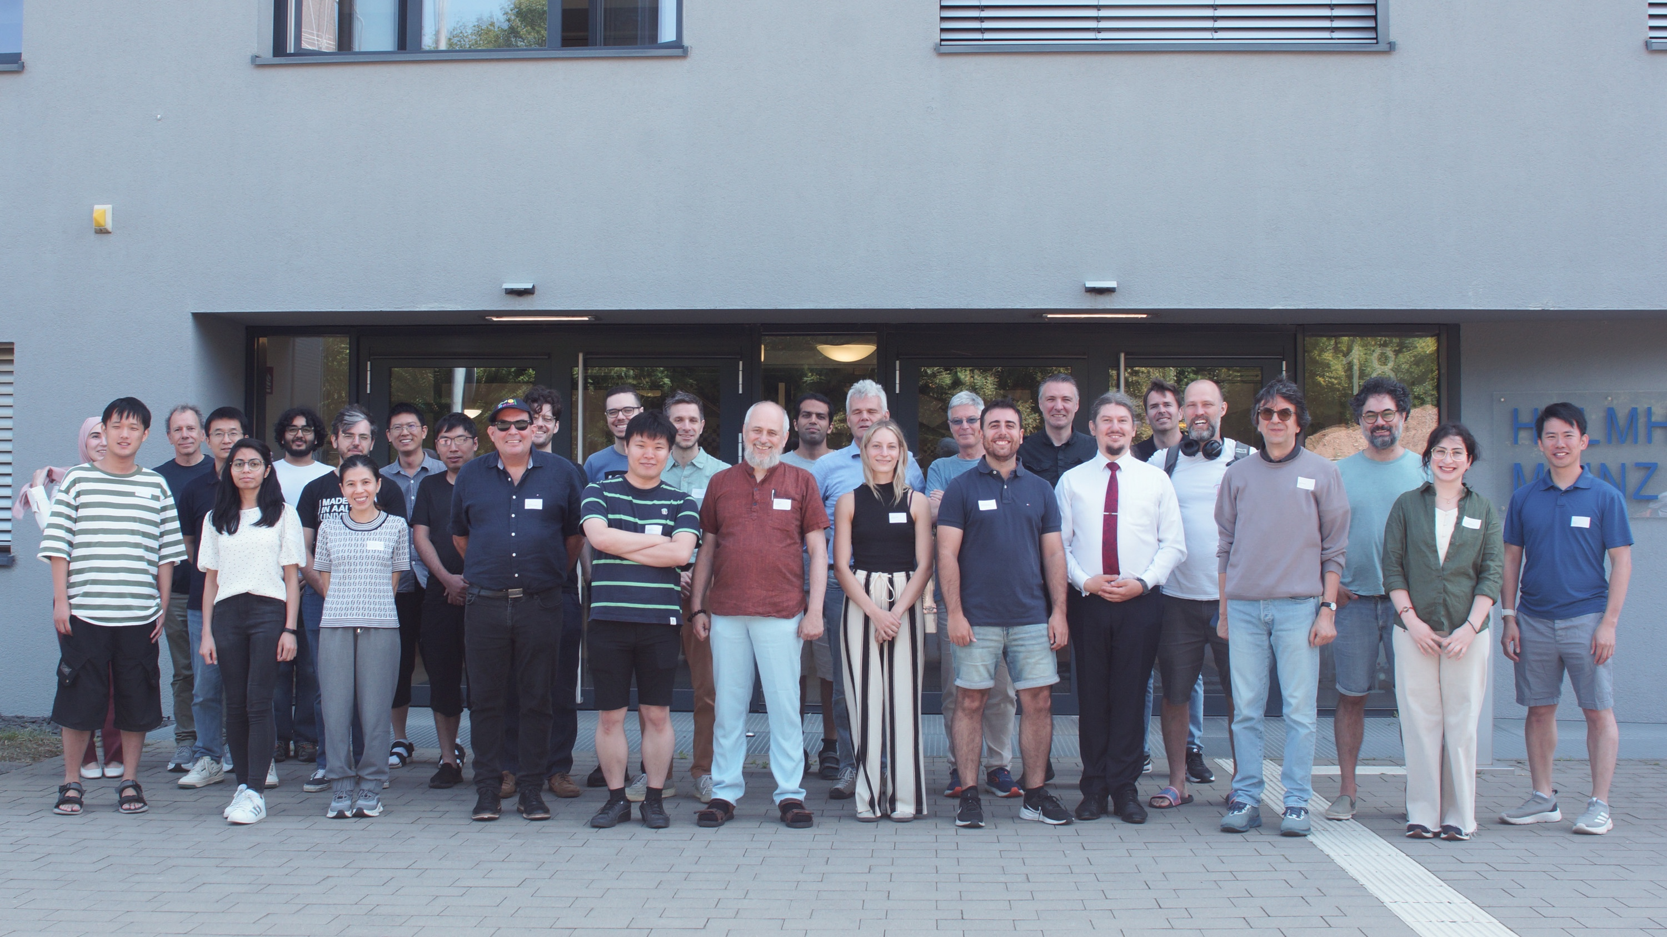
Spectroscopy 2.0 Biomedical applications Brain Heart Magnetic particles ZULF NMR Hyperpolarization Fundamental physics Chemical analysis Biomedical applications Theory Exotic spin-dependent interactions Atomic and molecular PNC Gamma factory and p(pbar)EDM AI in physics External collaborations GravNet Gamma Factory srEDM Q4Phys, … TACTICA AMOC
CML
Parity violation Exotic spin-dependent interactions Dysprosium Chiral molecules Dark matter searches: CASPEr GNOME (and other networks) Precision atomic spectroscopy Search for high-frequency gravitational waves Reanalysis of DM search experiments Network of cryocavities (with Bonn and Frascati) International networking New approaches Quantum sensors Novel atomic magnetometers Diamond based magnetometers Levitated magnets (Einstein Elevator->space) Remote sensing (Laser Guide Star technology)
2

Slide 3
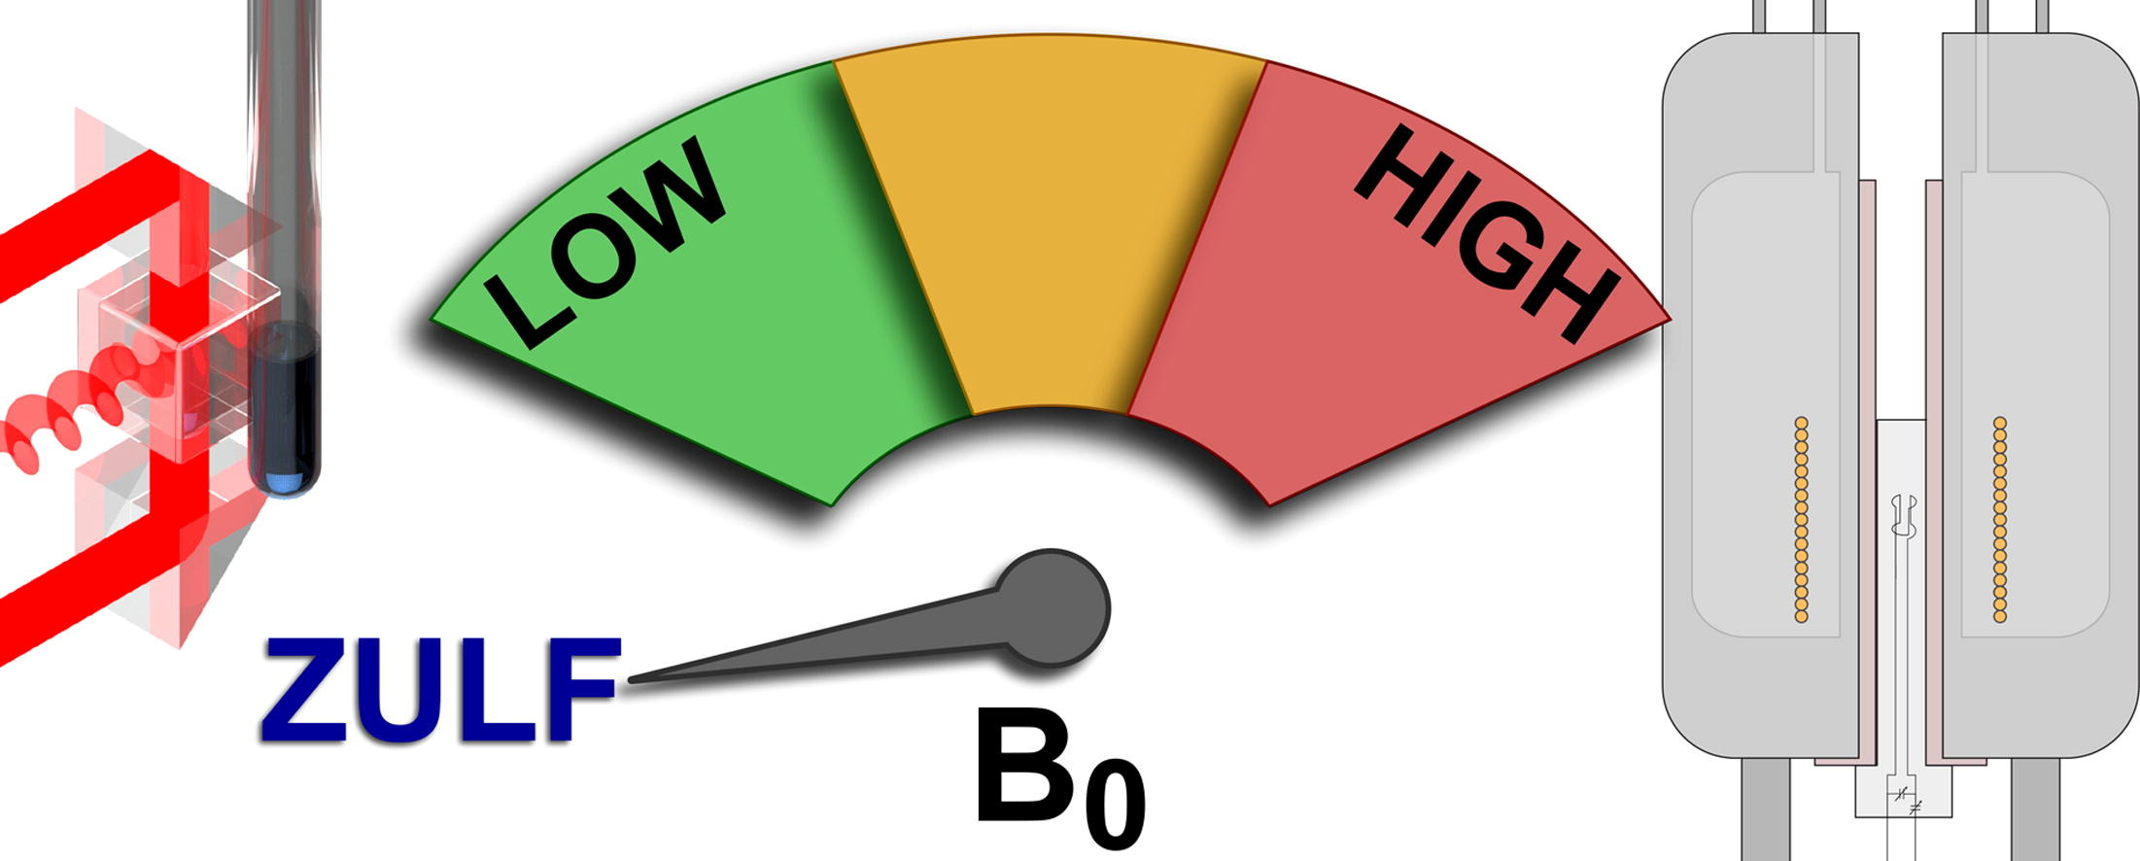
Fundamental physics with NMR: from high field to lower than low
Dmitry Budker
Helmholtz Institute, JGU Mainz, Germany
University of California, Berkeley, USA
PSI2025
Notes:
Watch for MMMMMM and EEEEEEEE

Slide 4
Parity Violation in high-field NMR spectroscopy of chiral molecules
Notes:
First, a brief reminder of the atomic parity violation story…

Slide 5
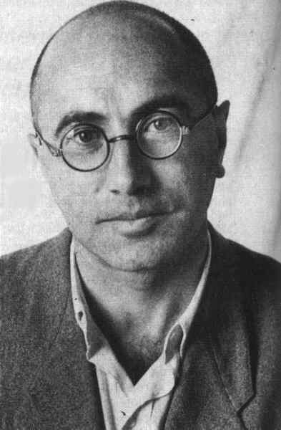
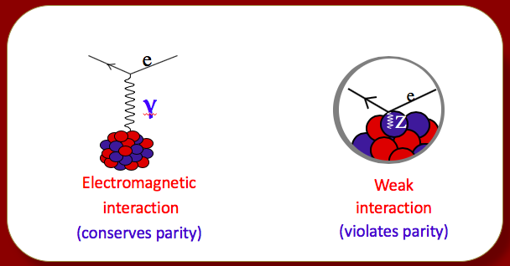

Weak-Neutral-Current (NC) Parity Violation
NC discovered in 1973 in $υ−e$ scattering @ CERN
But already in 1959: prediction of atomic parity violation
Manifestation: optical rotation by unpolarized atoms in the absence of fields (like chiral molecules)
Ya. B. Zel’dovich
P-odd, T-even correlation
Notes:
Gargamelle bubble chamber
Zel’dovich considered hydrogen and found that the effect was too tiny to realistically see. The story was forgotten for over a decade until the discovery of the NC

Slide 6
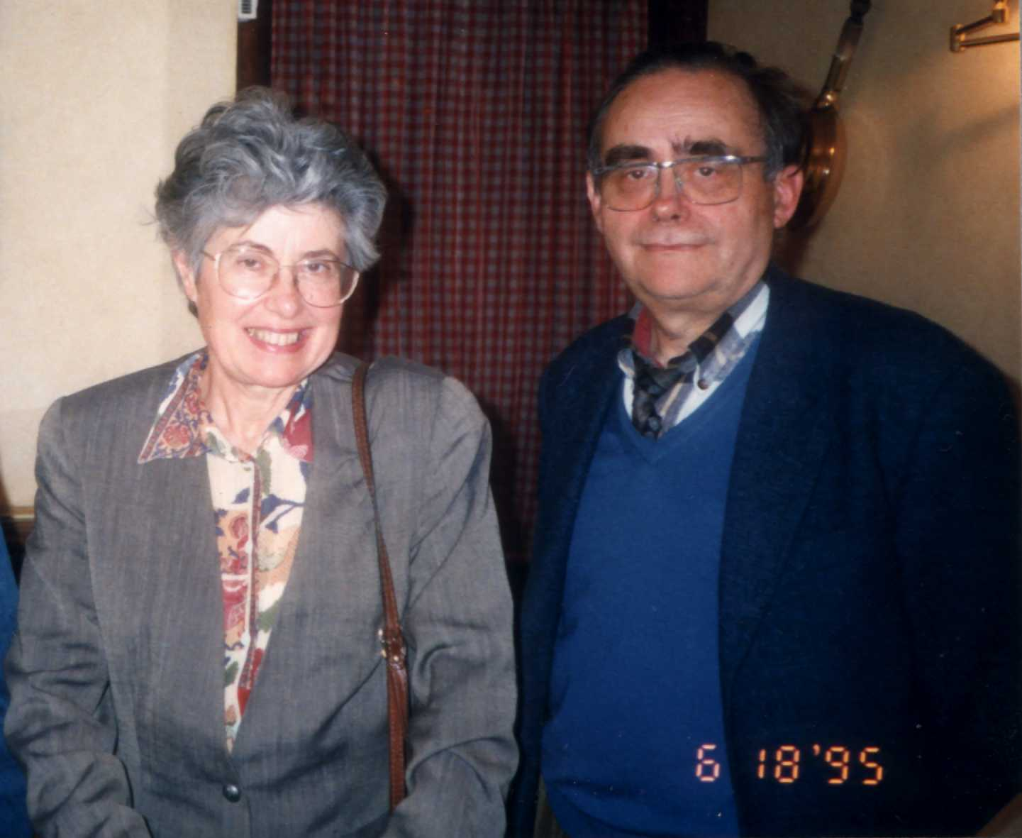

The second birth of Atomic Parity Violation
Photo: D. Budker
Marie-Anne and Claude Bouchiat
>Z³/$∆E$ enhancement of the PV effects
An ultimately better way to measure: Stark-PV interference
Notes:
And the rest is history

Slide 7
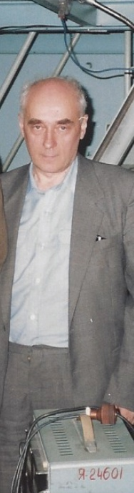
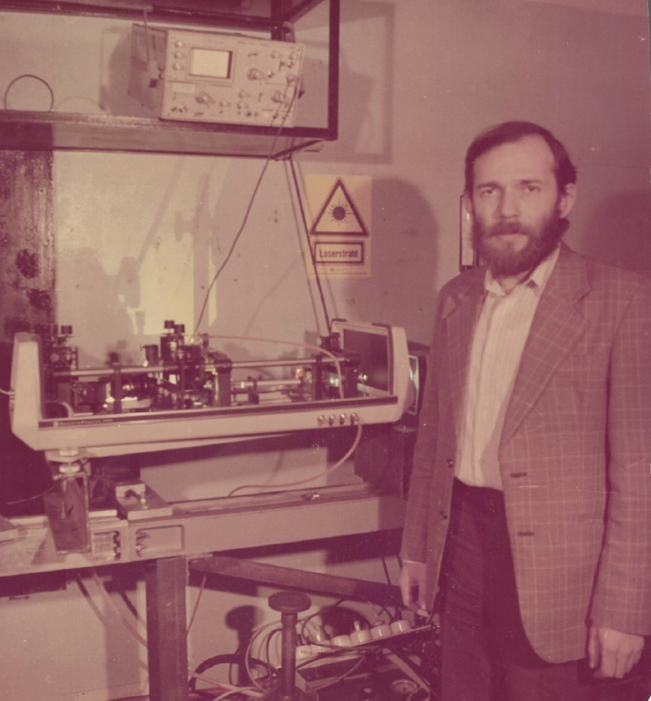
Seven decades of Atomic PV
1959 Ya. B. Zel’dovich:
PNC (Neutr. Current) ⇒ Opt. Rotation in atoms
1974 M.-A. & C. Bouchiat
Z³ enhancement ⇒ PV observable in heavy atoms
1978-9 Novosibirsk, Berkeley
discovery of PV in OR(Bi) and Stark-interf.(Tl)
…1995 Boulder, Oxford, Seattle, Paris
PV measured to 1-2% in Cs, Tl, Bi, Pb
1997 Boulder
0.35% measurement, discovery of anapole moment
2009 Berkeley: Large APV in Yb (personal landmark)
2018 Mainz: APV in a chain of Yb isotopes
Lev M. Barkov & Max Zolotorev
26 years
Notes:
Today, parity violation experiments continue but with a different motivation

Slide 8
Reference
arXiv:1804.05747 (2018)

Slide 9
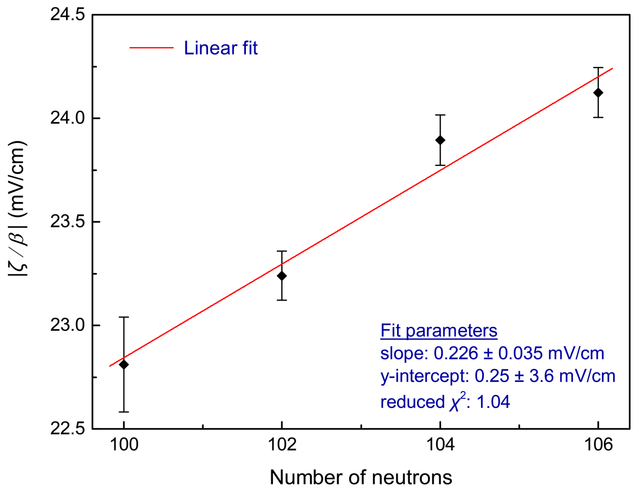

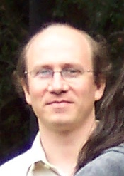
Summary (PV in Yb)
Measured PV on a chain of isotopes
0.5% accuracy per isotope
D. Antypas A. Fabricant J. Stalnaker K. Tsigutkin

Slide 10
AMO parity violation experiments today
Neutron distributions
Parity violation in nuclei
Search for light “new” bosons
Search for dark matter
Molecules!

Slide 11
Notes:
Nondegenerate atomic stated do not have energy shifts that are first-order in the weak interaction but chiral molecules do!

Slide 12
PV in racemic mixtures: impossible?
PV in chiral mol.➜ energy shift
PV in NMR ➜ Nucl.Spin.Dep PNC
B=20 T ➜ ~ 1 mHz line shifts
No way in a mixture…

Slide 13
Diastereomeric NMR shift
Dr. James Eills
Notes:
Proton decoupled natural abundance 13C spectra of racemic 1-phenylethanol dissolved in CDCl3 and racemic (top) vs. enantiopure
(bottom) 1-phenylethylamine. The insets present the signal for the 13C spins denoted by the asterisks on the molecules. Both spectra
were acquired at 298K by averaging 32 transients. The bottom spectrum shows a diastereomeric splitting, where the distinct peaks
correspond to the starred carbon nuclei in both L-1-phenylethanol and D-1-phenylethanol. These starred nuclei are usually equivalent
due to fast rotation of the phenyl group. Note the omission of the hydrogen atom indicates a racemic mixture of molecules.

Slide 14
Diastereomeric NMR shift
“Built-in co-magnetometer” !!!
Notes:
We lock the magnetic field to a 2H (deuterium) signal

Slide 15
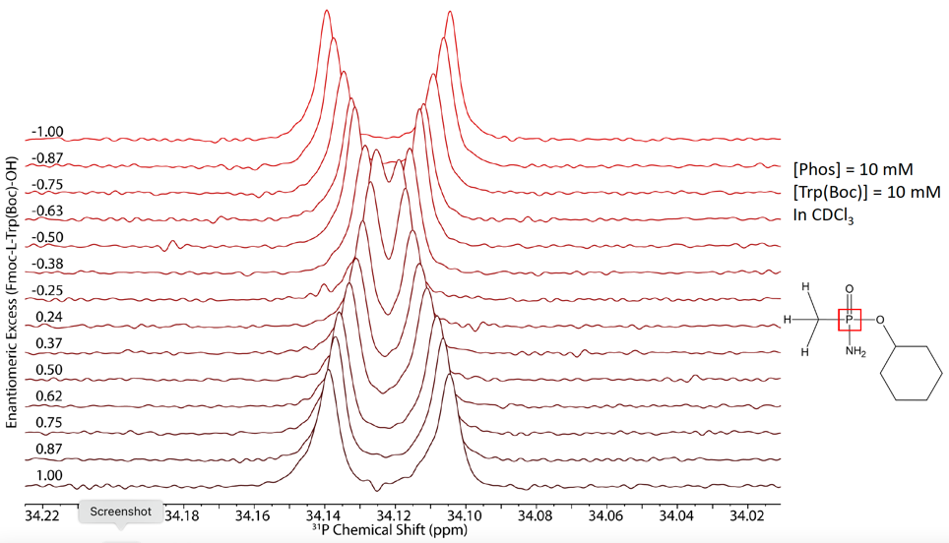
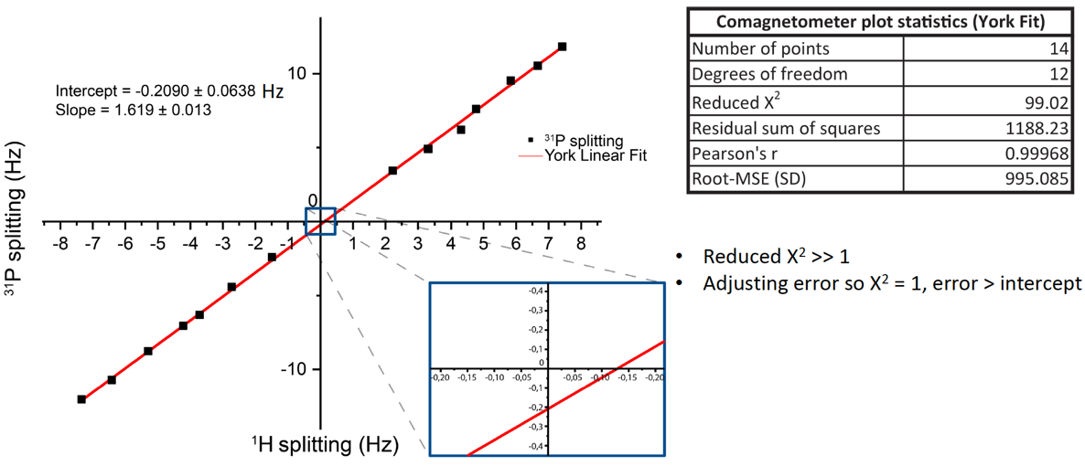


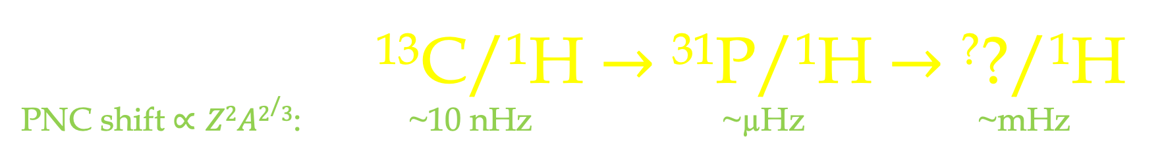
An optimistic roadmap from here
¹³C/¹H $→$ ³¹P/¹H $→$ ??/¹H
PNC shift $∝Z2A2/3$: ~10 nHz ~µHz ~mHz
arxiv: 2412.20997; PCCP 2025
Collaboration @ ELCH:
Rudolf Pietschnig
Denis Kargin
Robert Berger
Konstantin Gaul (now @Mainz)
Collaboration @ MPIP:
Manfred Wagner
Tanja Weil
Another effort: ¹⁰³Rh (ACAC)
M. Sabba (M. Levitt’s group, SOTON)
Danila Barskiy Erik Van Dyke

Slide 16


Slide 17
Graser
Laser
Maser
Raser
?
S/o magnetom.
Spin maser
Floquet maser
J-oscillator
Notes:
First, a brief reminder of the atomic parity violation story…

Slide 18
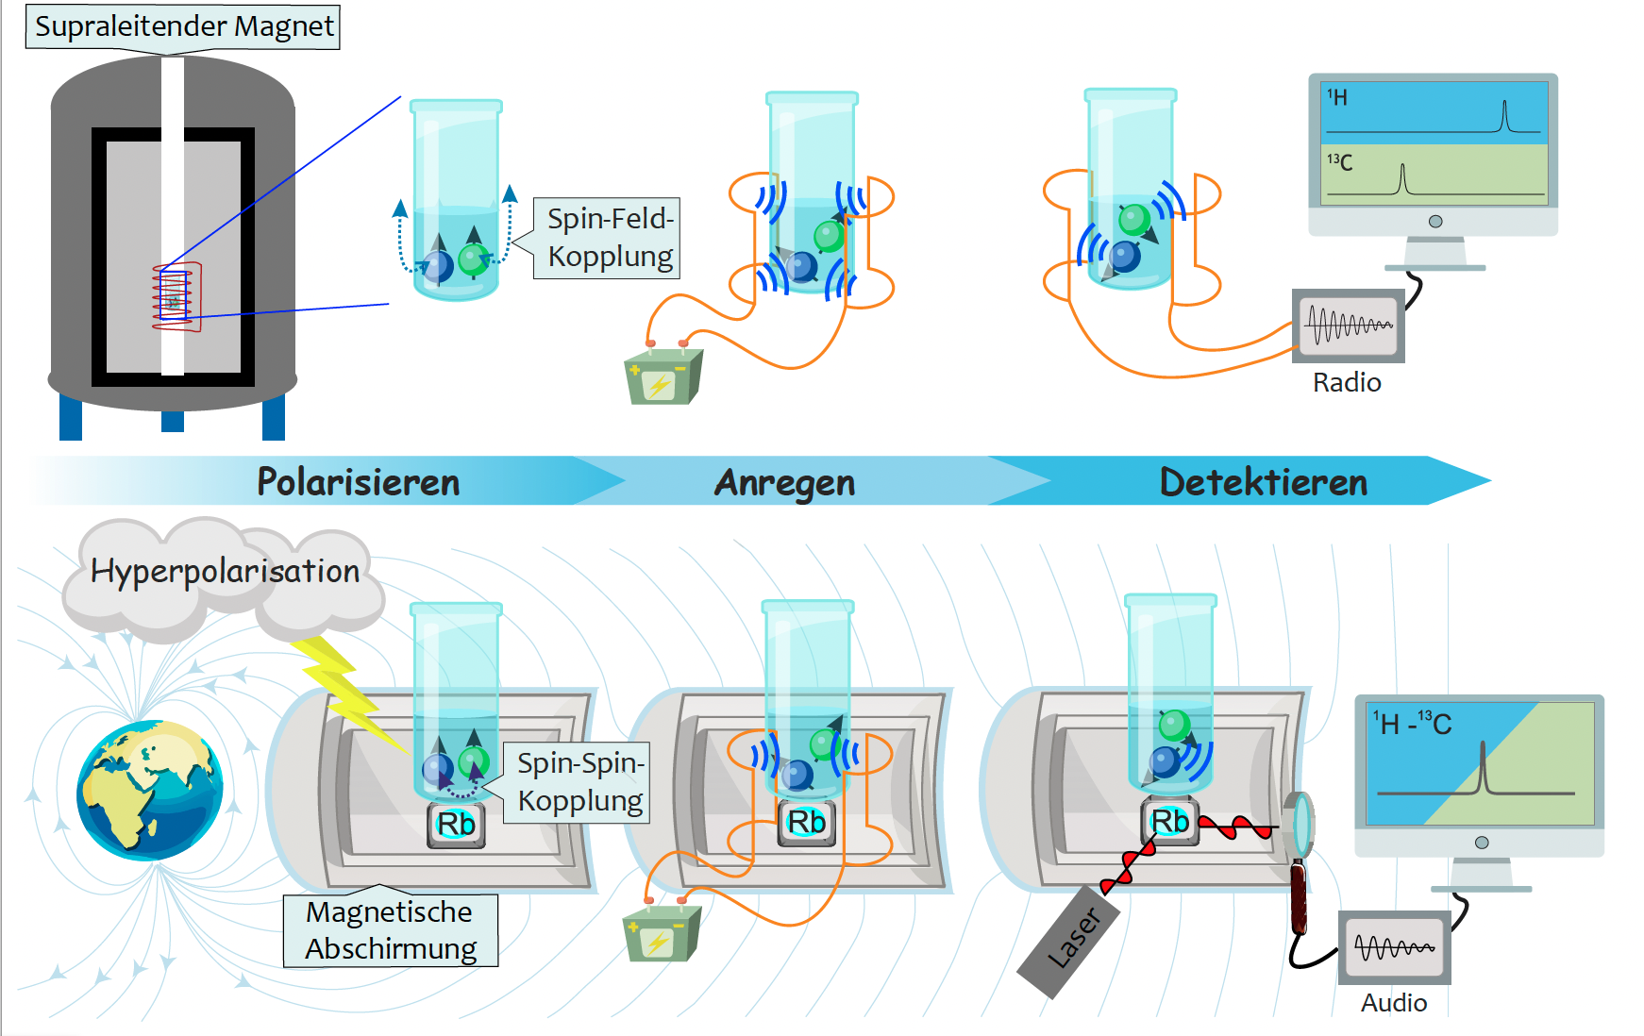
What is ZULF NMR ?
Polarization Encoding Detection
Physik Im Unserer Zeit, June (2023); adapted from https://blog.zulf.eu/
Notes:
Three stages!

Slide 19
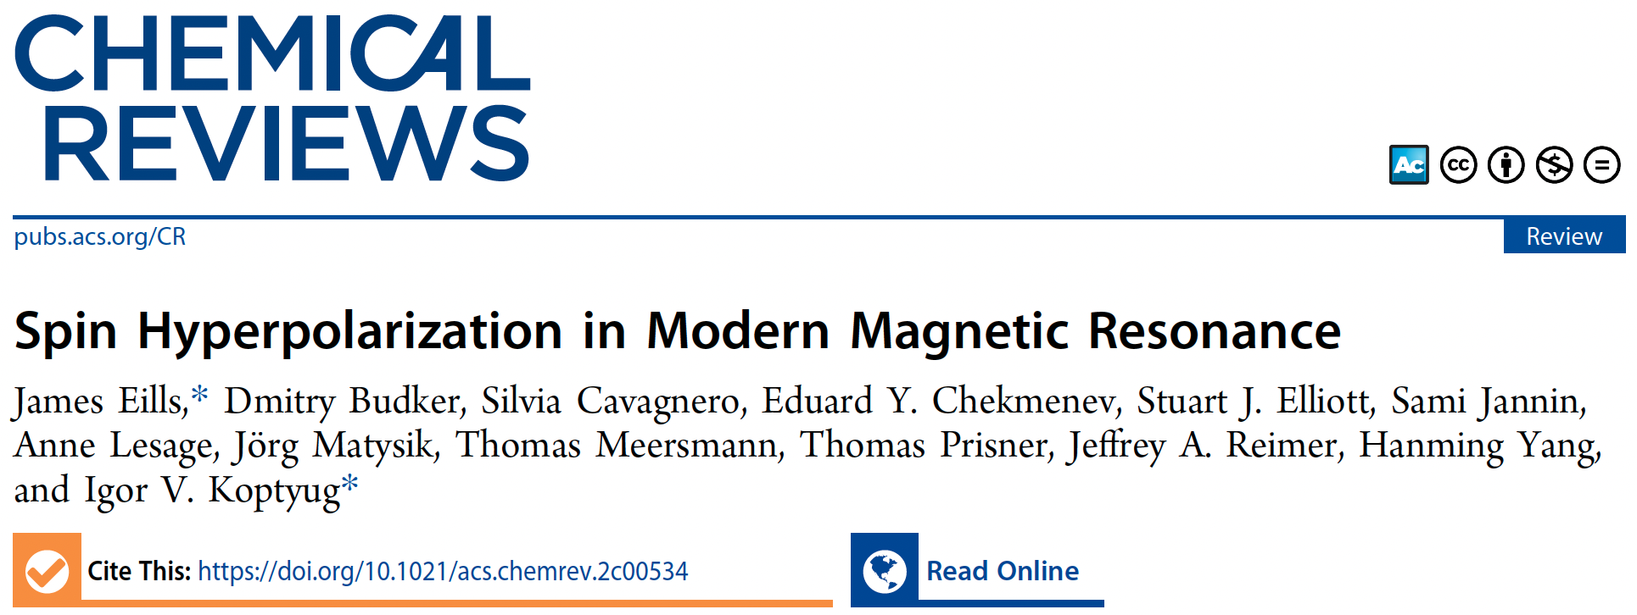

Slide 20
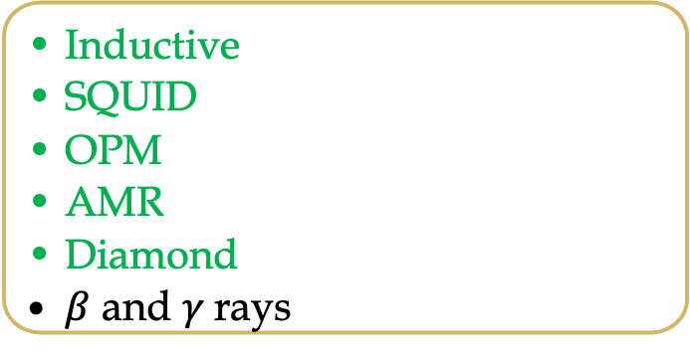
Directions and Applications demonstrated & in progress
Brute Halbach force
Parahydrogen
PHIP (x)
SABRE (relay)
SEOP
DNP
CI DNP
Stochastic
Polarization transfer
Relaxometry
Partially aligned/oriented molecules
2D NMR
Single-molecule ZULF (extreme) NMR
RD ZULF NMR
Hyper
polarization
Techniques, extensions
Detection
Applications
Biomolecules
Quadrupolar nuclei
Catalysis
Chemical dynamics
Fundamental Physics
Quantum control
Chirality
Inductive
SQUID
OPM
AMR
Diamond
$β$ and $γ$rays

Slide 21
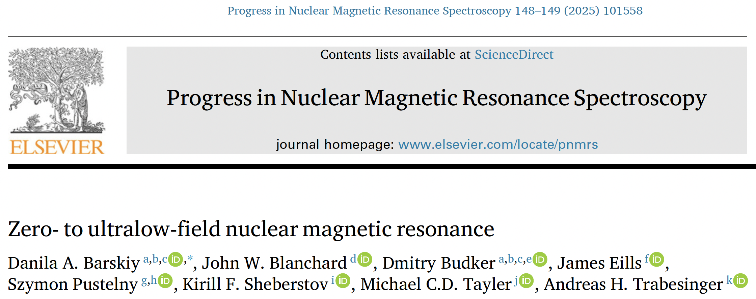

Slide 22
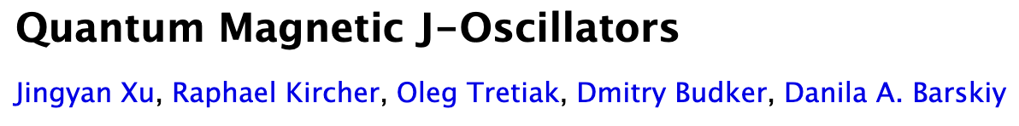
arXiv:2504.06498
Like RASER or Xe (e.g. Floquet) masers, but…
…oscillation at J-coupling frequencies of µHz to 10s of Hz
No need for population inversion
(only polarization)
Works with many different molecules (nitriles,
heterocycles, and organic acids) and mixtures
May help resolve blended ZULF NMR lines
On-demand spectral editing

Slide 23
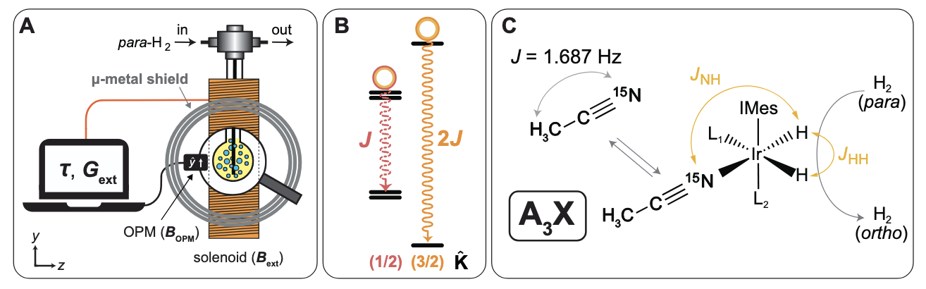
arXiv:2504.06498
Spin Amplification By Reversible Exchange
Measure ZULF NMR signal and apply feedback
Two parameters: delay (τ) and gain (G_{ext})

Slide 24
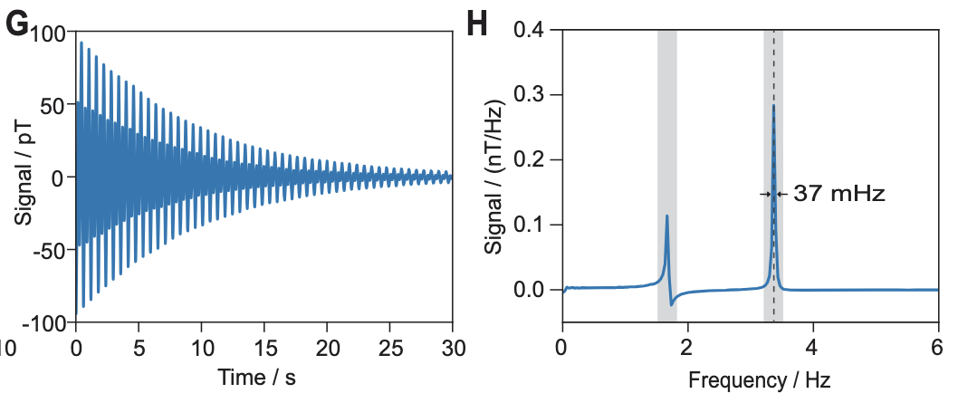
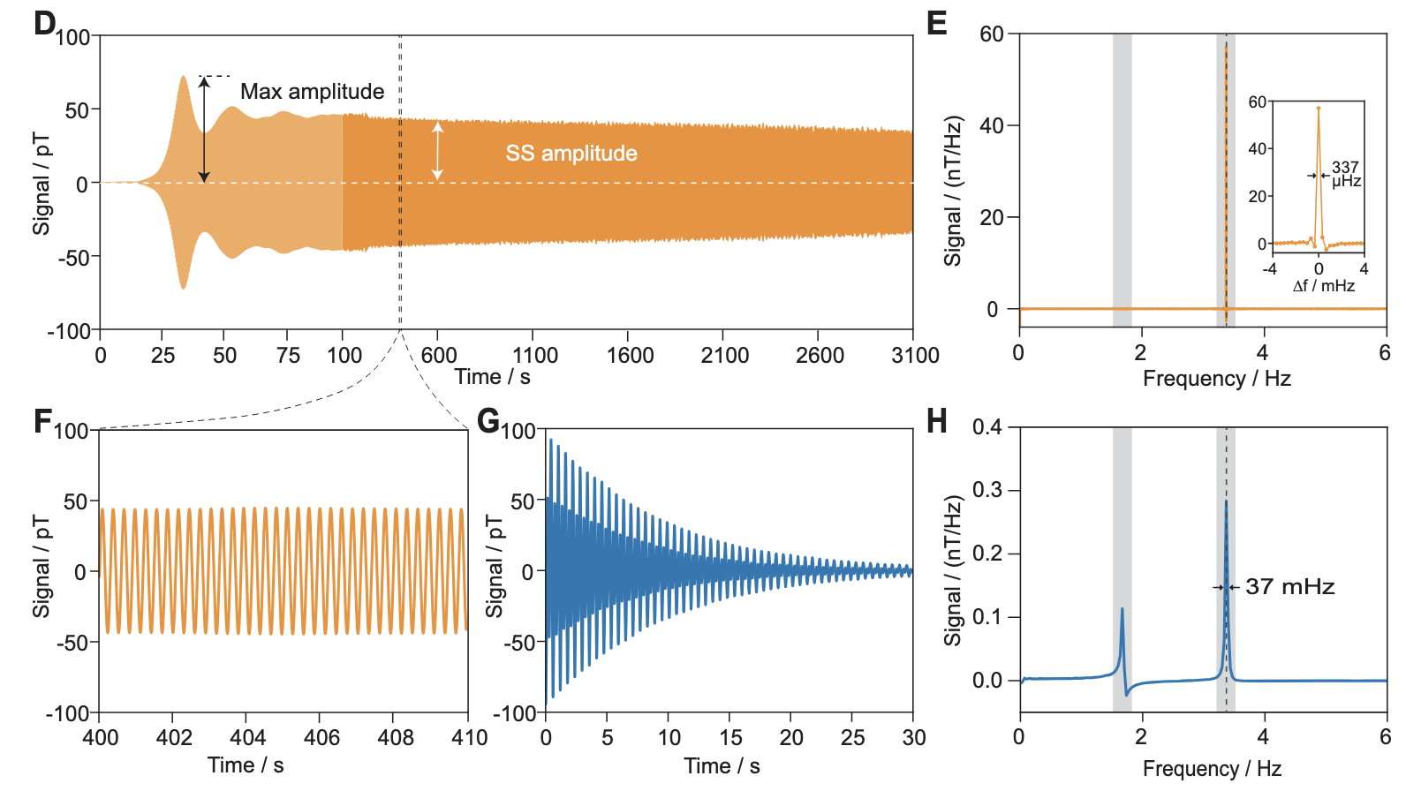
arXiv:2504.06498
Self-oscillation with feedback
Free decay @ ZULF

Slide 25
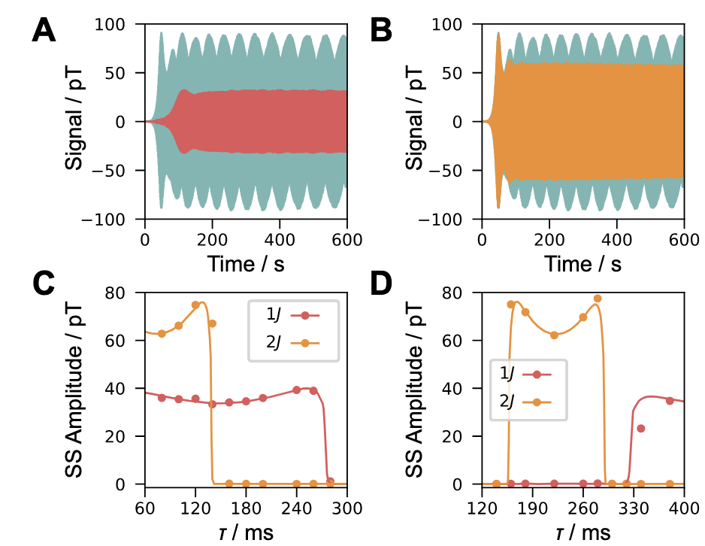
arXiv:2504.06498
Depending on feedback parameters,
only J or 2J or both oscillate
Solid lines --- analytical model

Slide 26
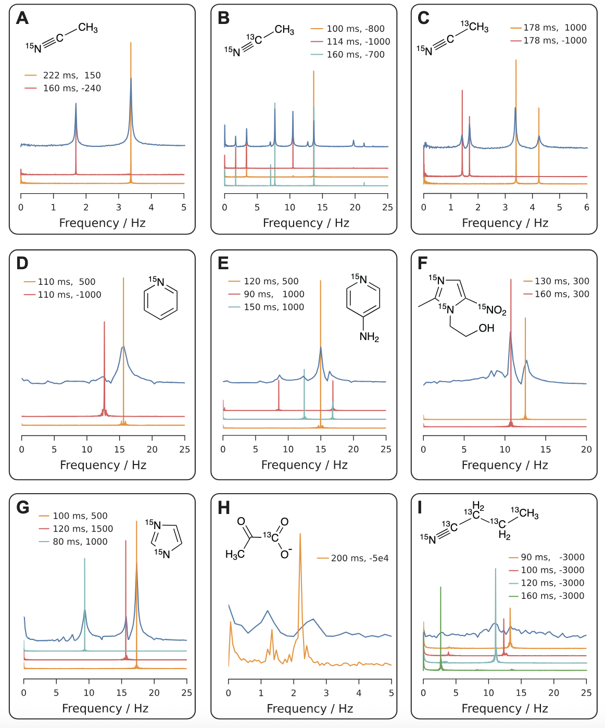
arXiv:2504.06498
Many hyperpolarized molecules!
Narrower lines
Spectral simplification…
… but complications: resonance pulling, multiple oscillation points, nonlinear interactions

Slide 27
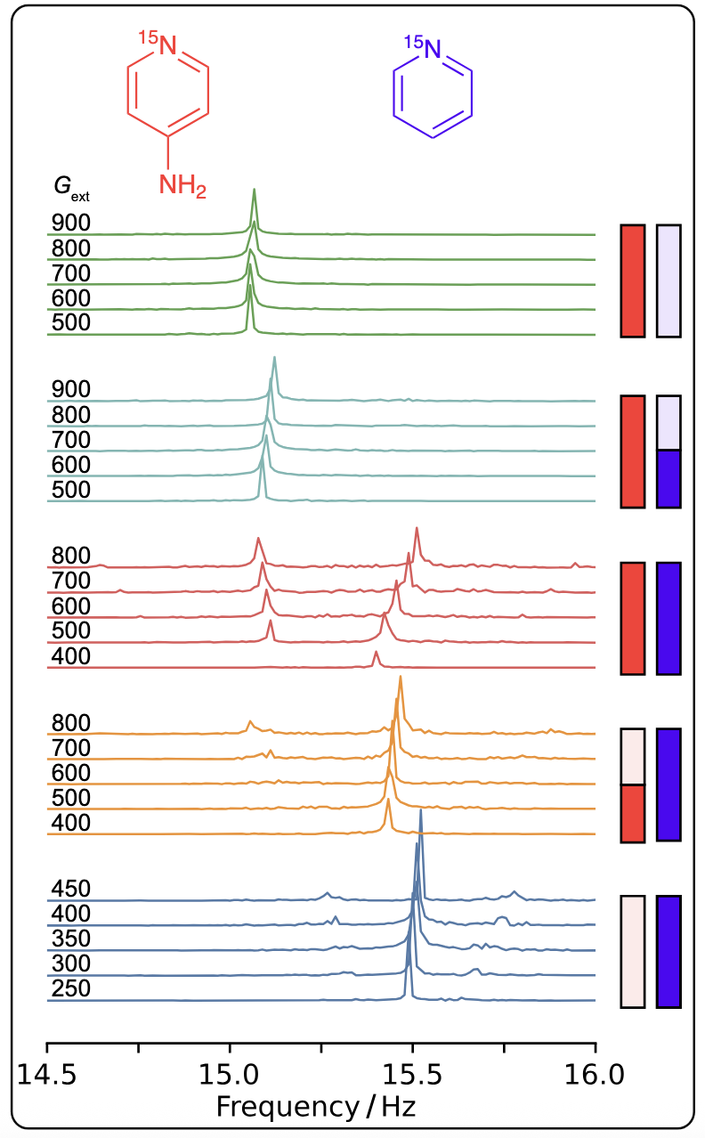
arXiv:2504.06498
Separation of chemical and MR effects
Equal mixture of fampiridine & piridine…
… but different isotopic enrichment
Resonance repulsion
Detailed theory under development
Notes:
¹⁵N: 0.380%

Slide 28

Hyperpolarization for ZULF NMR (Dr. Raphael Kircher & Jingyan Xu)
Experiment | Molecule | Enrichment | Polarization | Polarization method | Note
NV ZULF | [¹⁵N]Acetonitrile | 19M 25 % [¹⁵N] | 0.05 % | SABRE @ zero-field | decreased eﬃciency due to diamond gradient
ZULF Spin-order | [¹⁵N]Acetonitrile | 19M 0.4 % [¹⁵N] | 0.1 % | SABRE @ zero-field
ZULF Spin-order | [¹⁵N]Acetonitrile | 19M 0.4 % [¹⁵N] | 0.3 % | SABRE @ uT
TDK ZULF | [1-¹³C]Fumarate | 40mM 10% [¹³C] | 12 % | PHIP
Spin amplifier | [¹⁵N]Acetonitrile | 19M 100% [¹⁵N] | Under investigation | SABRE @ zero-field
Spin amplifier | Pyridine | 19M 100% [¹H] | Under investigation | SABRE @ mT
J-osicllator | [¹⁵N]Acetonitrile | 19M 5 % [¹⁵N] | 0.1 % | SABRE @ zero-field
J-osicllator | [¹⁵N]Pyridine | 50 mM 100% [¹⁵N] | Under evaluation | SABRE @ zero-field
J-oscillator | [¹⁵N]Fampridine | 50mM 100% [¹⁵N] | Under evaluation | SABRE @ zero-field
J-oscillator | [1-¹³C]Pyruvate | 60mM 100% [¹³C] | Under evaluation | SABRE @ zero-field
ZULF-cells | [1-¹³C]Fumarate | 40mM 20-40% [¹³C] | 15 % | PHIP

Slide 29
arXiv:2504.06498
Hyperpolarization enabled
Novel* platform for
Chemistry
Nonlinear dynamics
Fundamental physics
…

Slide 30
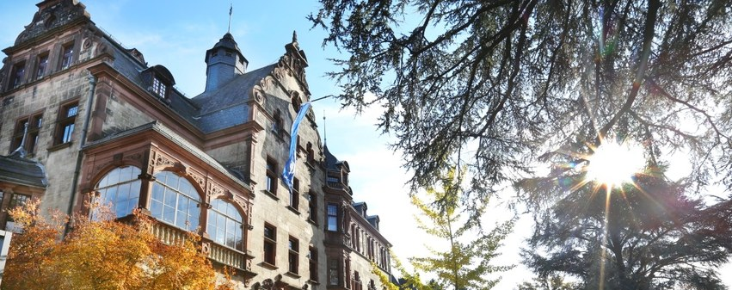
WEH seminar: “Parity Violation in Molecules”
March 30 – April 1, 2026
Physikzentrum, Bad Honnef, Germany

Slide 31

“Dark Intersections” school
August 2-7, 2026 (registration open)
Physikzentrum, Bad Honnef, Germany
Ferromagnetic He-3
Rydberg atoms
Single-photon microwave detectors
High Frequency Gravitational Waves
…
"Dark Intersections"
Made with Designer. Powered by DALL·E 3.

Slide 32

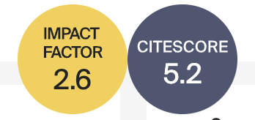
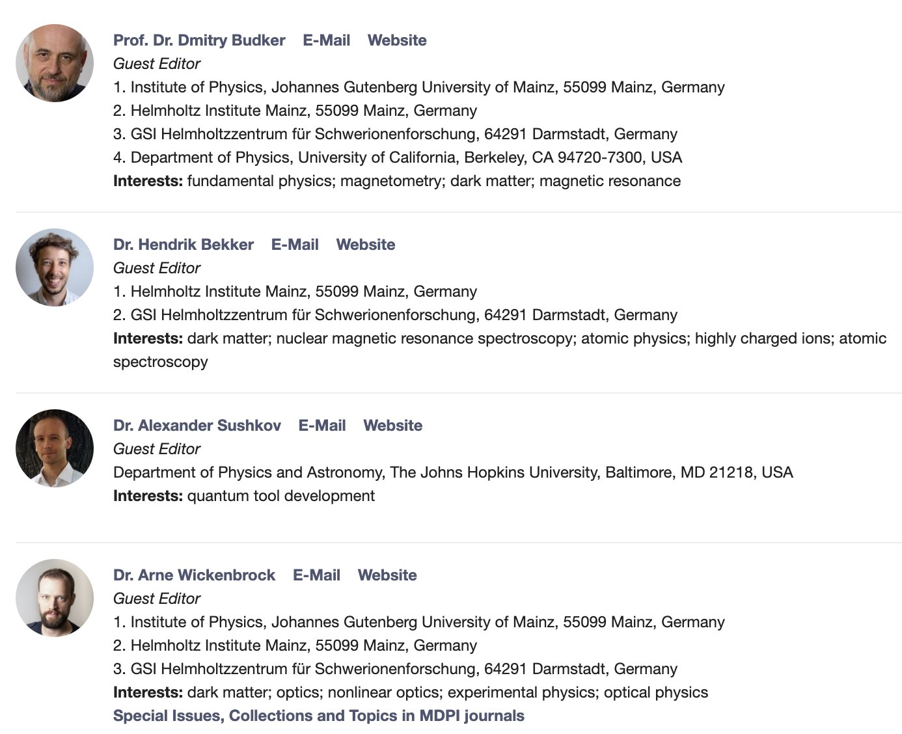
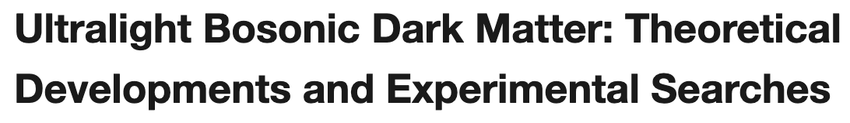


Derek F. Jackson-Kimball Jason E. Stalnaker

Slide 33
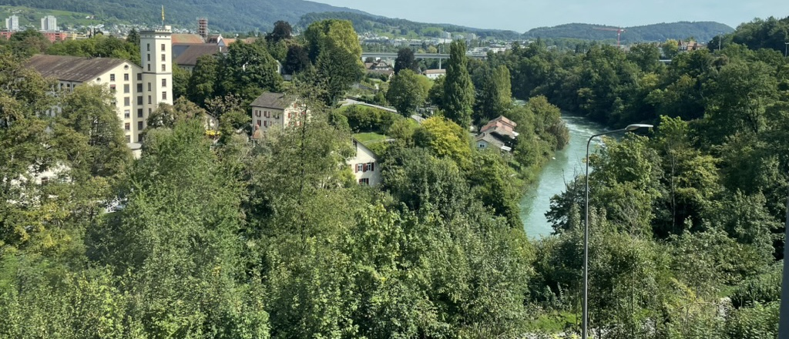
Merci vilmals!
Notes:
In West Schweizedeutch

