Slide 1
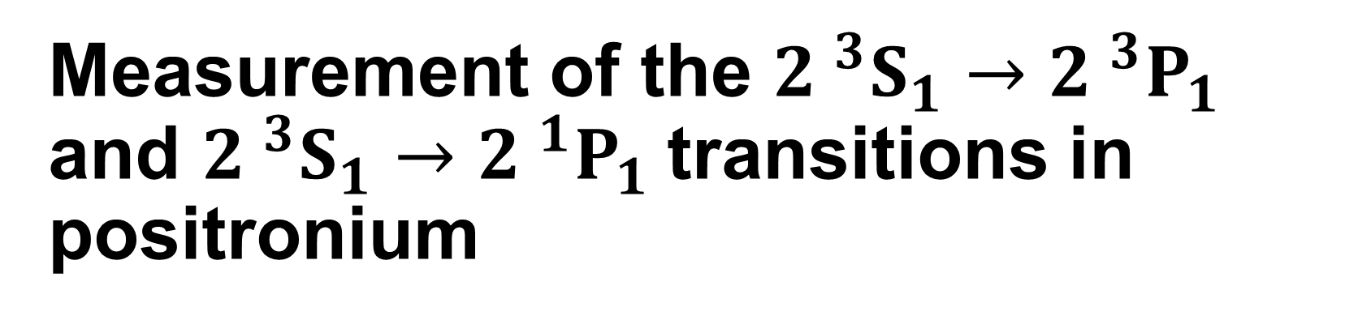
Measurement of the ${2 }^{3}S_{1}→{2 }^{3}P_{1}$ and ${2 }^{3}S_{1}→{2 }^{1}P_{1}$transitions in positronium
Rebecca J. Daly
Department of Physics and Astronomy, University College London,
Gower Street, London, WC1E 6BT, United Kingdom
rebecca.daly.18@ucl.ac.uk

Slide 2
K. P. Habdas, D. M. Newson, S. D. Hogan, R. E. Sheldon* and D. B. Cassidy
Department of Physics and Astronomy, University College London, Gower Street, London, WC1E 6BT, United Kingdom
J. Pérez-Ríos
Department of Physics and Astronomy, Stony Brook University, Stony Brook, New York, 11794, US
*present address: Stefan Meyer Institute for Subatomic Physics of the Austrian Academy of Sciences

Slide 3
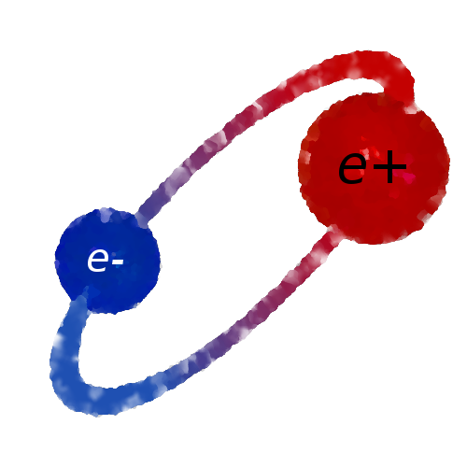
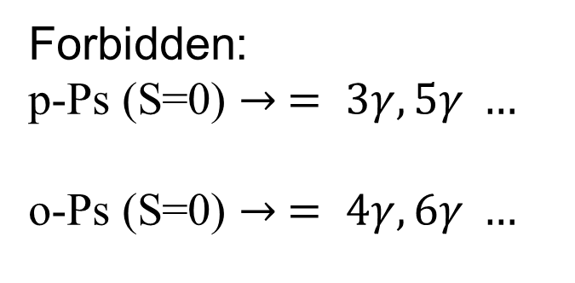
Positronium (Ps)
As a leptonic particle-antiparticle pair, Ps is an eigenstate of the charge conjugation operator C, the parity operator P, their combination CP, and various combinations including the time reversal operator T.
Since Ps is an eigenstate of these discrete symmetries, experiments involving Ps can be used to test them:
Studies of C-forbidden decay pathways.
Studies of forbidden momenta or polarization correlations of decay photons.
Searches for transitions forbidden by a given symmetry.
Forbidden:
p-Ps (S=0) $→ = 3γ, 5γ …$
o-Ps (S=0) $→ = 4γ, 6γ …$

Slide 4
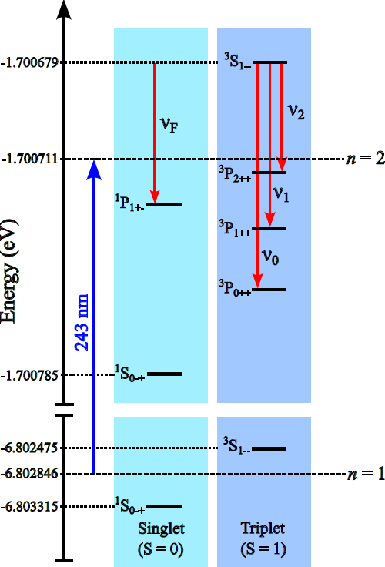
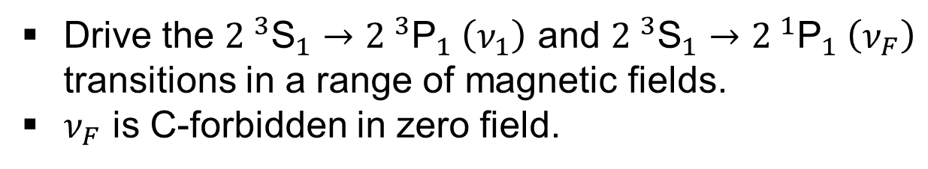

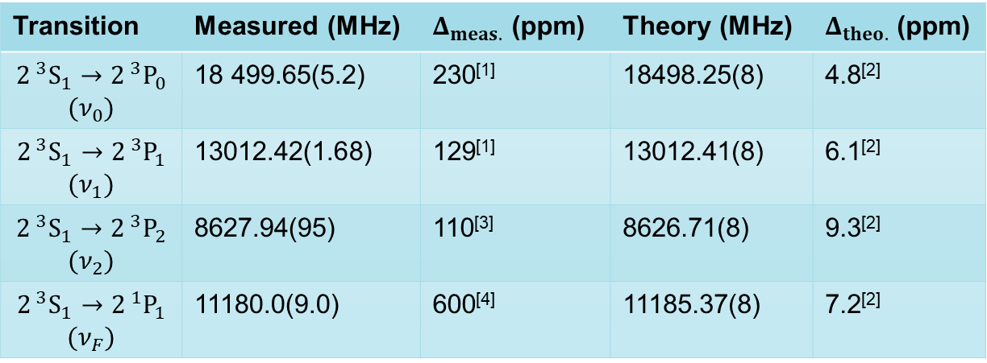
State of Ps n = 2 tests
Drive the ${2 }^{3}{\text{S}}_{1}→{2 }^{3}{\text{P}}_{1} \left(ν_{1}\right)$ and ${2 }^{3}{\text{S}}_{1}→{2 }^{1}{\text{P}}_{1} \left(ν_{F}\right)$ transitions in a range of magnetic fields.
$ν_{F}$ is C-forbidden in zero field.
$ν_{F}$ = 11185.37 MHz
Transition | Measured (MHz) | $Δ_{meas.}$ (ppm) | Theory (MHz) | $Δ_{theo.}$ (ppm)
$$2^{ 3}S_{1}→2^{ 3}P_{0}$$ $$(ν_{0})$$ | 18 499.65(5.2) | 230^{[1]} | 18498.25(8) | 4.8^{[2]}
$$2^{ 3}S_{1}→2^{ 3}P_{1}$$ $$(ν_{1})$$ | 13012.42(1.68) | 129^{[1]} | 13012.41(8) | 6.1^{[2]}
$$2^{ 3}S_{1}→2^{ 3}P_{2}$$ $$(ν_{2})$$ | 8627.94(95) | 110^{[3]} | 8626.71(8) | 9.3^{[2]}
$$2^{ 3}S_{1}→2^{ 1}P_{1}$$ $$(ν_{F})$$ | 11180.0(9.0) | 600^{[4]} | 11185.37(8) | 7.2^{[2]}
¹D. Hagena, et al., Phys. Rev. Lett., 71:2887–2890 (1993).
²A. Czarnecki et al., Phys. Rev. A 59, 4316 (1999).
³R. E. Sheldon et al., Phys. Rev. Lett. 131, 043001 (2023).
⁴R. Ley et al., Hyperfine Interactions, 89(1):327–341 (1994).

Slide 5
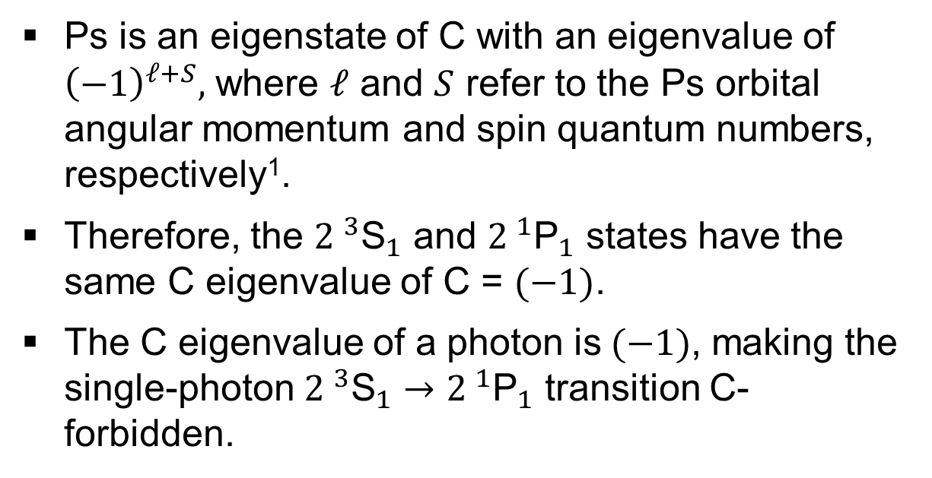
Charge (C) symmetry
Ps is an eigenstate of C with an eigenvalue of ${\left(−1\right)}^{ℓ+S},$ where $ℓ$ and $S$ refer to the Ps orbital angular momentum and spin quantum numbers, respectively¹.
Therefore, the ${2 }^{3}{\text{S}}_{1}$ and ${2 }^{1}{\text{P}}_{1}$ states have the same C eigenvalue of C = $(−1)$.
The C eigenvalue of a photon is$(−1)$, making the single-photon ${2 }^{3}{\text{S}}_{1}→{2 }^{1}{\text{P}}_{1}$ transition C-forbidden.
$ν_{F}$ = 11185.37 MHz
¹Bernreuther, W., Nachtmann, O. Z. Phys. C - Particles and Fields 11, 235–245 (1981).

Slide 6
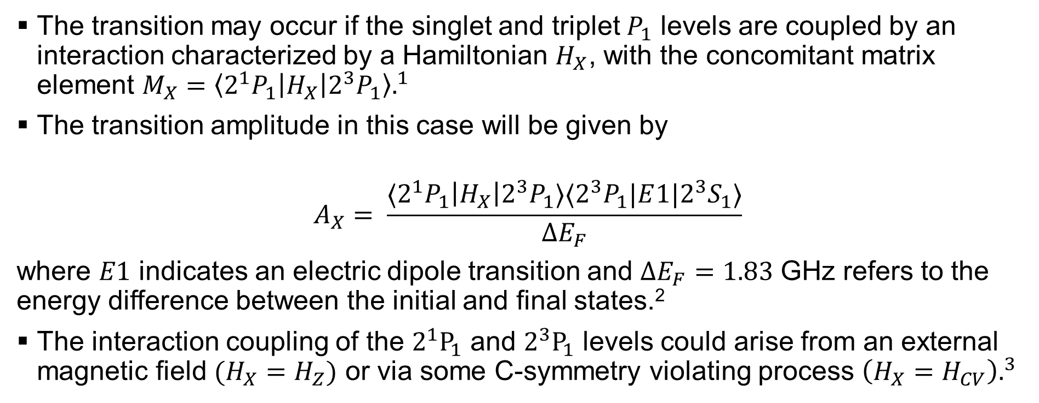
Charge (C) symmetry
The transition may occur if the singlet and triplet $P_{1}$ levels are coupled by an interaction characterized by a Hamiltonian $H_{X}$, with the concomitant matrix element $M_{X}={\left\langle 2^{1}P_{1}\left|H_{X}\right|2^{3}P_{1}\right\rangle .}^{1}$
The transition amplitude in this case will be given by
$$A_{X}= \frac{⟨2^{1}P_{1}\left|H_{X}\right|2^{3}P_{1}⟩⟨2^{3}P_{1}|E{1|2}^{3}S_{1}⟩}{ΔE_{F}}$$
where $E1$ indicates an electric dipole transition and $ΔE_{F}=1.83$ GHz refers to the energy difference between the initial and final states.²
The interaction coupling of the ${2^{1}P}_{1}$ and $2^{3}P_{1}$ levels could arise from an external magnetic field $(H_{X}=H_{Z})$ or via some C-symmetry violating process $\left(H_{X}=H_{CV}\right).^{3}$
¹R. S. Conti et al, Phys. Rev. A 33, 3495–3498 (1986).
²A. Czarnecki et al, Phys. Rev. A 59, 4316 (1999).
³A. M. Alonso et al, Phys. Rev. A 93, 012506(2016)

Slide 7
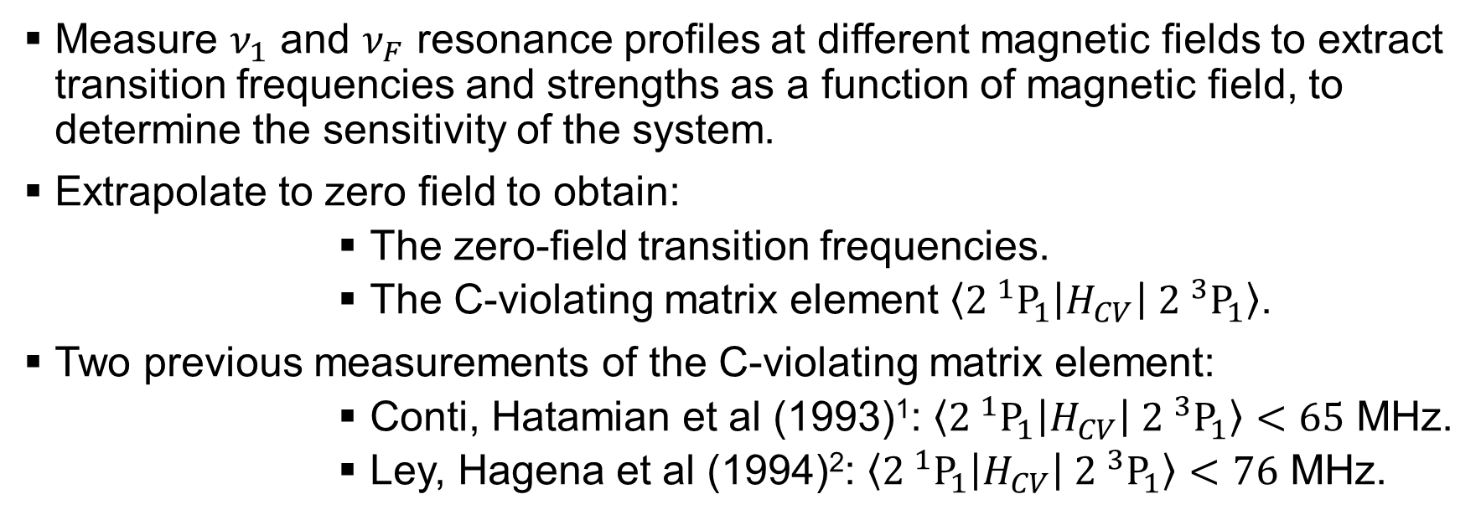
Symmetry tests
Measure $ν_{1}$ and $ν_{F}$ resonance profiles at different magnetic fields to extract transition frequencies and strengths as a function of magnetic field, to determine the sensitivity of the system.
Extrapolate to zero field to obtain:
          The zero-field transition frequencies.
          The C-violating matrix element $\left\langle {2 }^{1}P_{1}\right|H_{CV}\left| {2 }^{3}P_{1}\right\rangle$.
Two previous measurements of the C-violating matrix element:
          Conti, Hatamian et al (1993)¹: $\left\langle {2 }^{1}P_{1}\right|H_{CV}\left| {2 }^{3}P_{1}\right\rangle <65$ MHz.
          Ley, Hagena et al (1994)²: $\left\langle {2 }^{1}P_{1}\right|H_{CV}\left| {2 }^{3}P_{1}\right\rangle <76$ MHz.
¹D. Hagena, et al., Phys. Rev. Lett., 71:2887–2890 (1993).
²R. Ley et al., Hyperfine Interactions, 89(1):327–341 (1994).

Slide 8
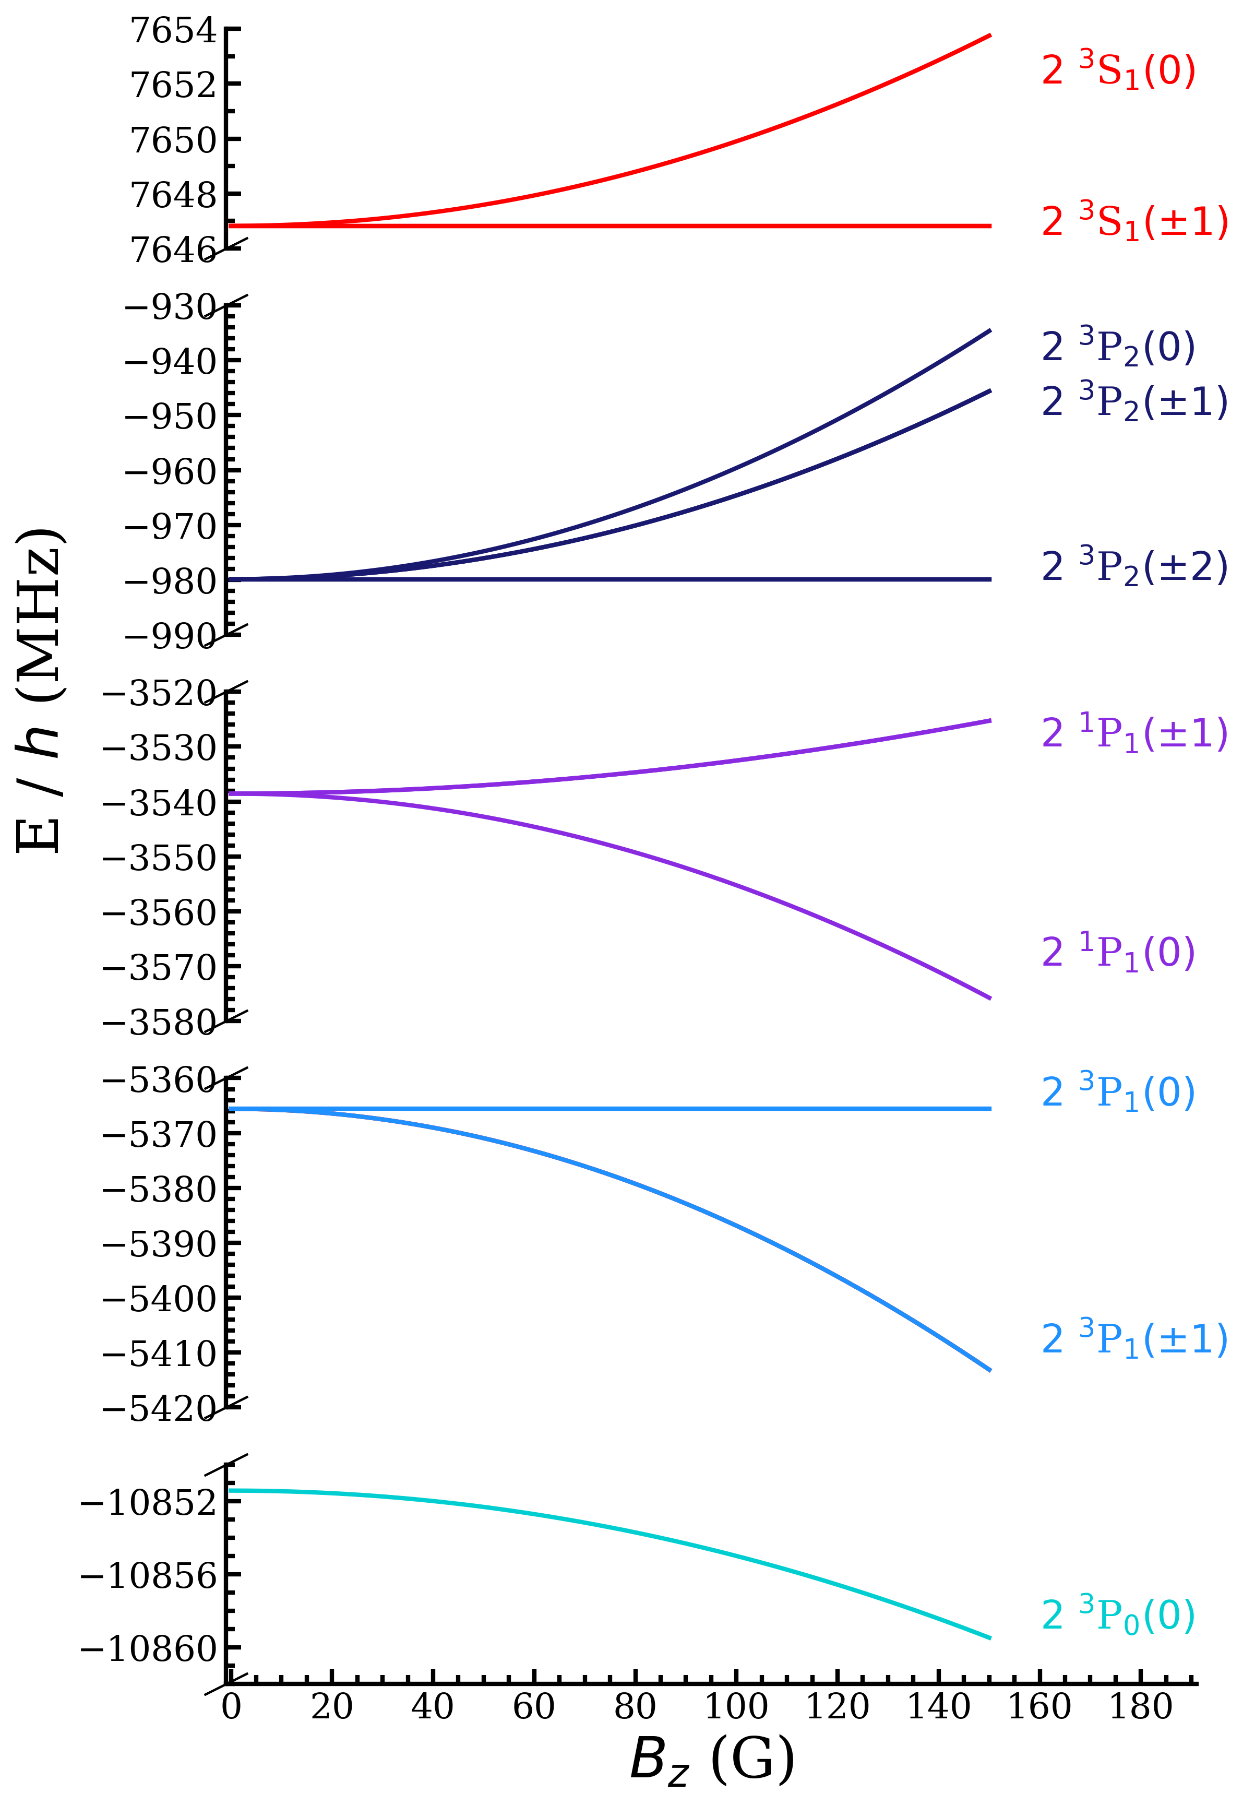


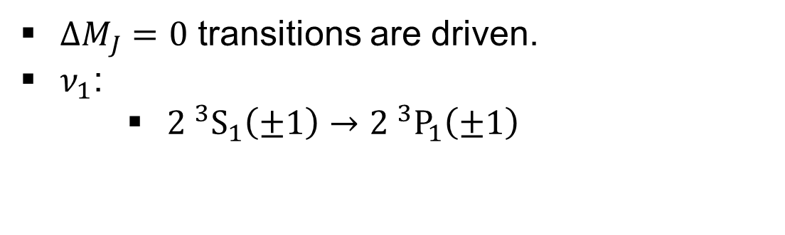



Microwave transitions
$ΔM_{J}=0$ transitions are driven.
$ν_{1}$:
    ${2 }^{3}S_{1}\left(±1\right)→{2 }^{3}P_{1}\left(±1\right)$
$$ν_{1}$$
-1
0
+1
$$M_{J}=$$
$${ 2 }^{3}S_{1}$$
$$M_{J}=$$
$$2^{ 3}P_{1}$$

Slide 9

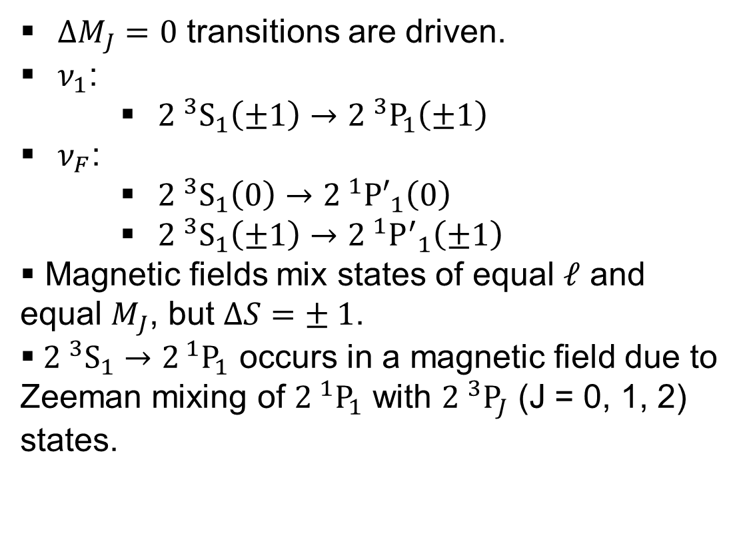




Microwave transitions
$ΔM_{J}=0$ transitions are driven.
$ν_{1}$:
    ${2 }^{3}S_{1}\left(±1\right)→{2 }^{3}P_{1}\left(±1\right)$
$ν_{F}$:
    ${2 }^{3}S_{1}\left(0\right)→{2 }^{1}{P′}_{1}\left(0\right)$
    ${2 }^{3}S_{1}\left(±1\right)→{2 }^{1}{P^{′}}_{1}\left(±1\right)$
Magnetic fields mix states of equal $ℓ$ and equal $M_{J}$, but $ΔS=± 1$.
${ 2 }^{3}S_{1}→2^{ 1}P_{1}$ occurs in a magnetic field due to Zeeman mixing of ${2 }^{1}P_{1}$ with ${2 }^{3}P_{J}$ (J = 0, 1, 2) states.
$$ν_{F}$$
-1
0
+1
$$M_{J}=$$
$${ 2 }^{3}S_{1}$$
$$M_{J}=$$
$$2^{ 1}{P′}_{1}$$

Slide 10
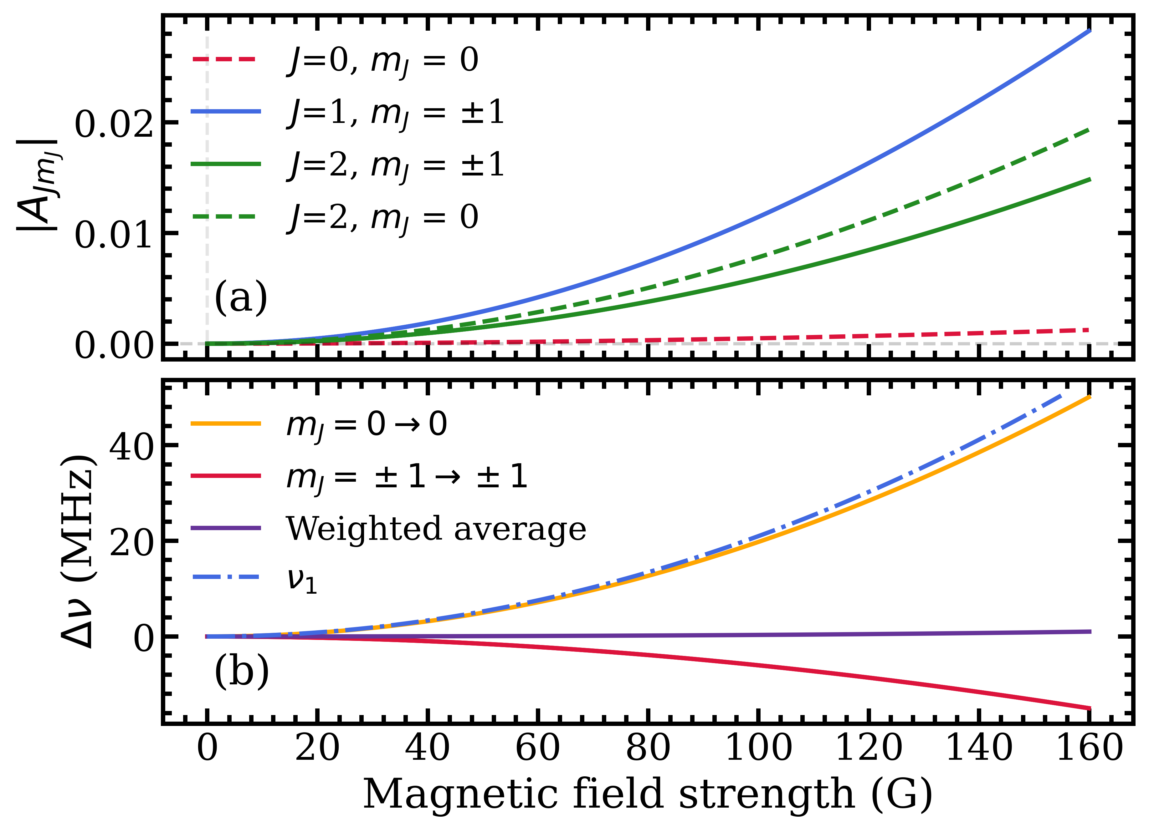
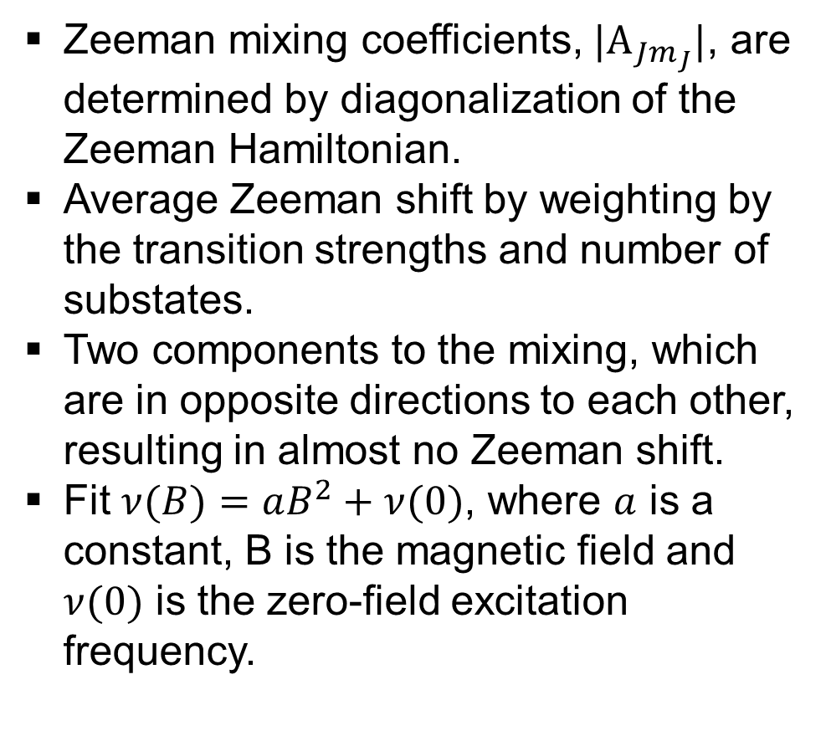
Microwave transitions
Zeeman mixing coefficients, ${|A}_{Jm_{J}}|$, are determined by diagonalization of the Zeeman Hamiltonian.
Average Zeeman shift by weighting by the transition strengths and number of substates.
Two components to the mixing, which are in opposite directions to each other, resulting in almost no Zeeman shift.
Fit $ν(B)=aB^{2}+ν(0)$, where $a$ is a constant, B is the magnetic field and $ν(0)$ is the zero-field excitation frequency.
(a)
(b)

Slide 11
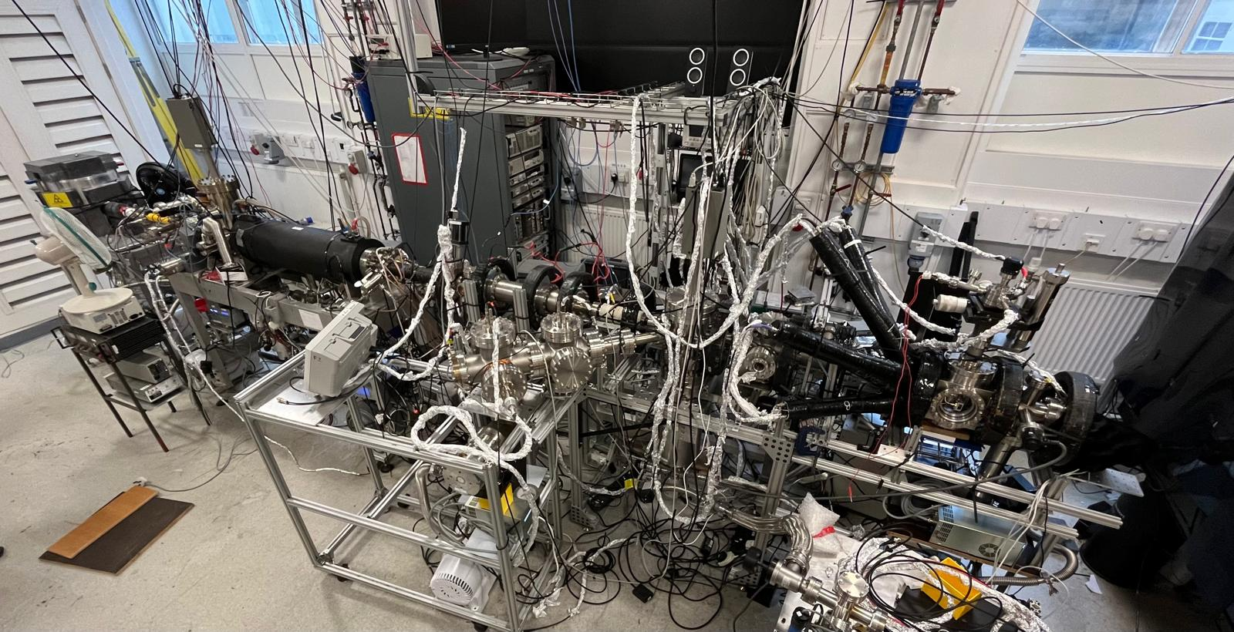
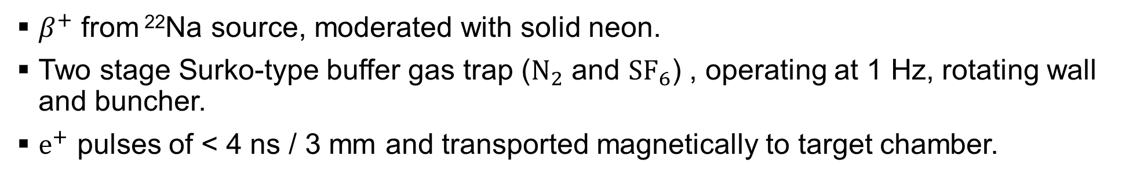
Beamline
z
See B. S. Cooper et al, Rev. Sci. Instrum. 86, 103101 (2015) for details on beamline
$β^{+}$ from ²²Na source, moderated with solid neon.
Two stage Surko-type buffer gas trap ($N_{2}$ and ${SF}_{6}$) , operating at 1 Hz, rotating wall and buncher.
$e^{+}$ pulses of < 4 ns / 3 mm and transported magnetically to target chamber.

Slide 12
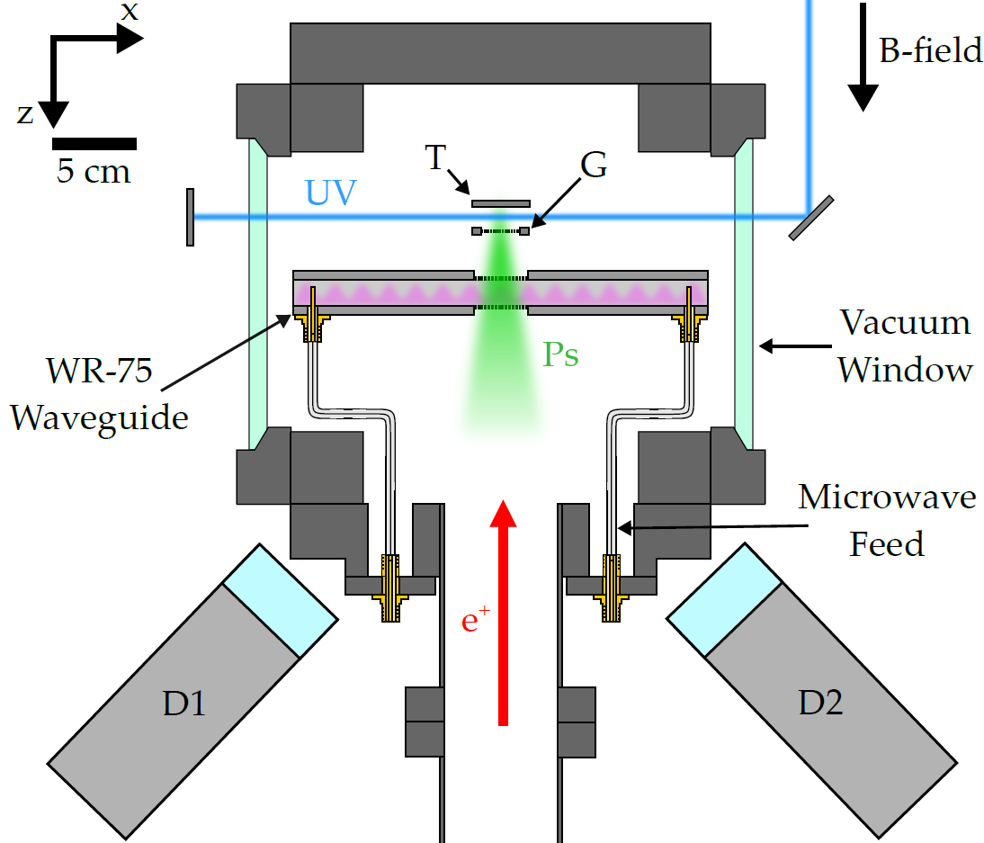
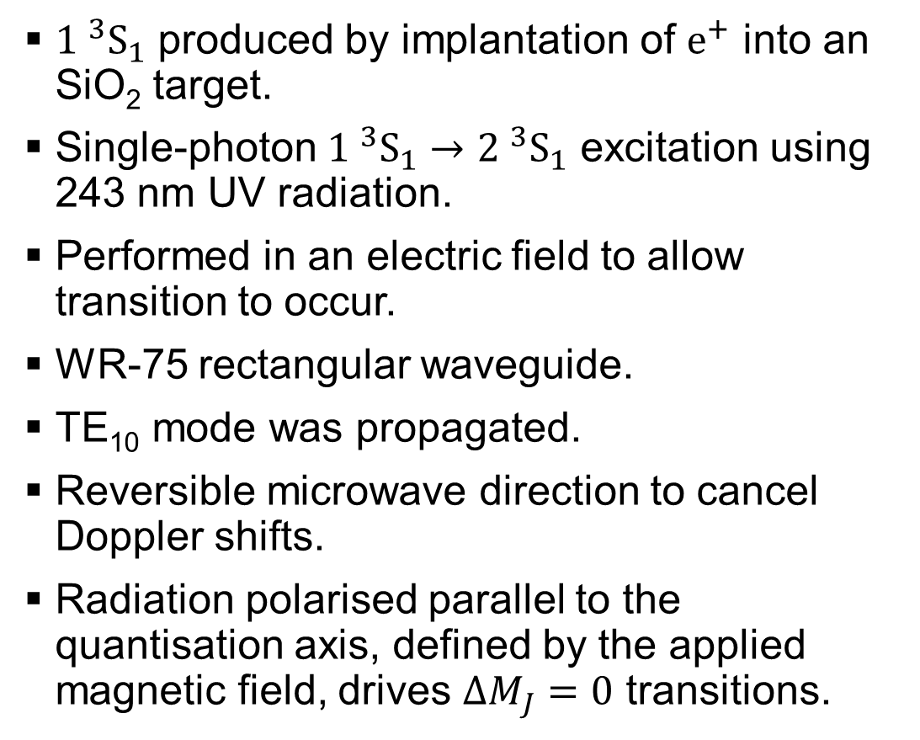
Ps production and excitation
${1 }^{3}S_{1}$ produced by implantation of $e^{+}$ into an SiO₂ target.
Single-photon ${1 }^{3}S_{1}→{2 }^{3}{\text{S}}_{1}$ excitation using 243 nm UV radiation.
Performed in an electric field to allow transition to occur.
WR-75 rectangular waveguide.
TE₁₀ mode was propagated.
Reversible microwave direction to cancel Doppler shifts.
Radiation polarised parallel to the quantisation axis, defined by the applied magnetic field, drives $ΔM_{J}=0$ transitions.

Slide 13
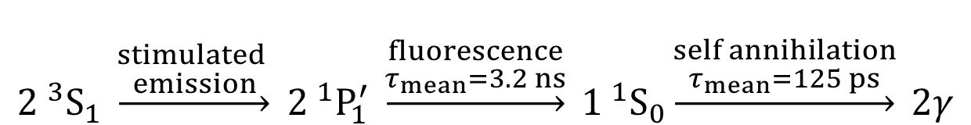
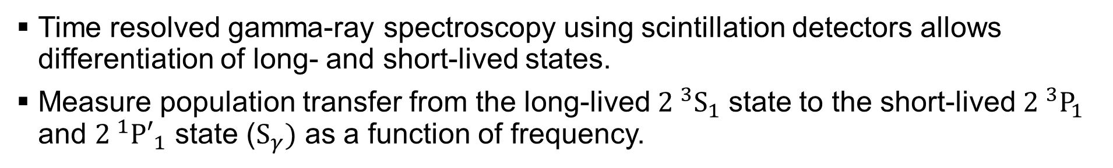
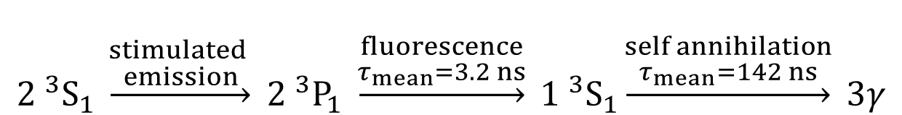
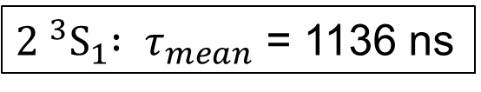
Line shape measurements
Time resolved gamma-ray spectroscopy using scintillation detectors allows differentiation of long- and short-lived states.
Measure population transfer from the long-lived ${2 }^{3}S_{1}$ state to the short-lived ${2 }^{3}P_{1}$ and ${2 }^{1}{P′}_{1}$ state ($S_{γ})$ as a function of frequency.
$${2 }^{3}S_{1} \underset{→}{\begin{aligned}stimulated \\ emission\end{aligned}} {2 }^{3}P_{1} \underset{→}{\begin{aligned}fluorescence \\ τ_{mean}=3.2 ns\end{aligned}} {1 }^{3}S_{1}\underset{→}{\begin{aligned}self annihilation \\ τ_{mean}=142 ns\end{aligned}} 3γ$$
$${2 }^{3}S_{1} \underset{→}{\begin{aligned}stimulated \\ emission\end{aligned}} {2 }^{1}P_{1}^{′} \underset{→}{\begin{aligned}fluorescence \\ τ_{mean}=3.2 ns\end{aligned}} {1 }^{1}S_{0}\underset{→}{\begin{aligned}self annihilation \\ τ_{mean}=125 ps\end{aligned}} 2γ$$
${2 }^{3}S_{1}{ : τ}_{mean}$ = 1136 ns

Slide 14
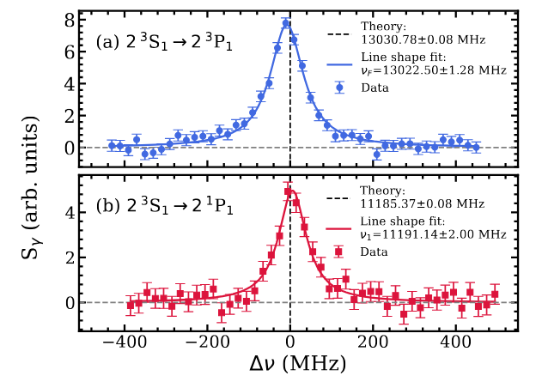
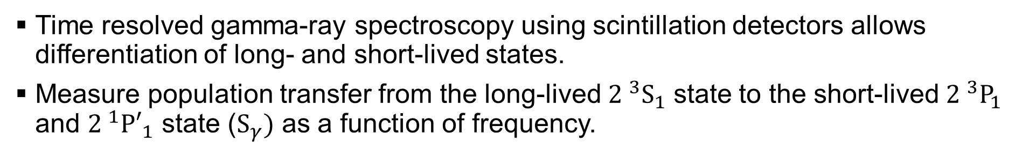
Line shape measurements
Time resolved gamma-ray spectroscopy using scintillation detectors allows differentiation of long- and short-lived states.
Measure population transfer from the long-lived ${2 }^{3}S_{1}$ state to the short-lived ${2 }^{3}P_{1}$ and ${2 }^{1}{P′}_{1}$ state ($S_{γ})$ as a function of frequency.

Slide 15
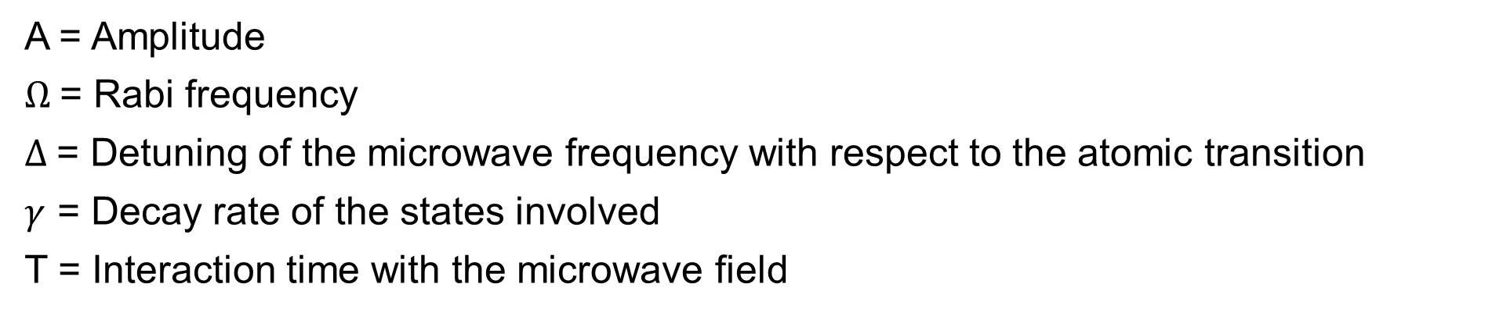
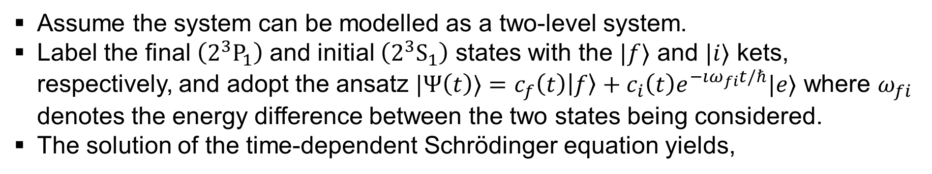
Line shape model
Assume the system can be modelled as a two-level system.
Label the final$\left(2^{3}P_{1}\right)$ and initial $\left(2^{3}S_{1}\right)$ states with the $|f⟩$ and $|i⟩$ kets, respectively, and adopt the ansatz $|Ψ\left(t\right)⟩=c_{f}\left(t\right)\left|f\right\rangle +c_{i}\left(t\right)e^{−ıω_{fi}t/ℏ}|e⟩$ where $ω_{fi}$ denotes the energy difference between the two states being considered.
The solution of the time-dependent Schrӧdinger equation yields,
A = Amplitude
$Ω$= Rabi frequency
$Δ$= Detuning of the microwave frequency with respect to the atomic transition
$γ$ = Decay rate of the states involved
T = Interaction time with the microwave field

Slide 16
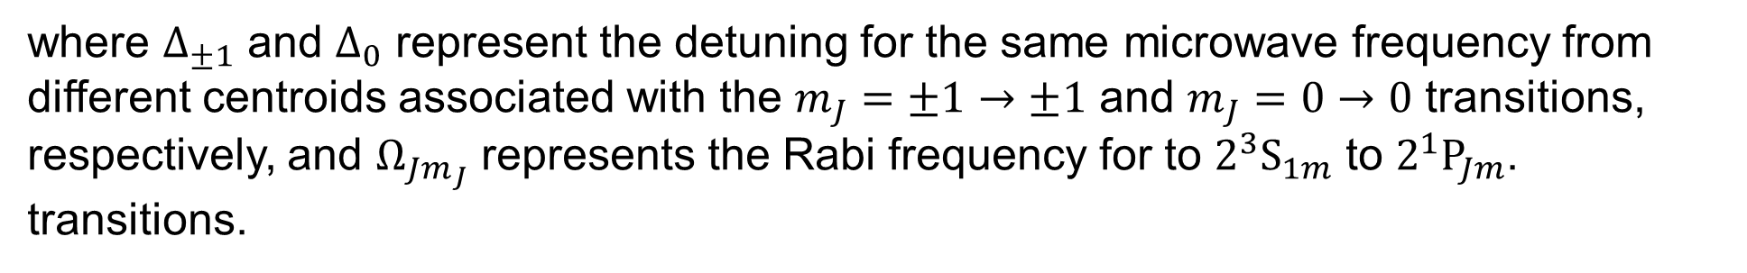

Line shape model
Assume the system can be modelled as a two-level system.
Label the final$\left(2^{3}P_{1}\right)$ and initial $\left(2^{3}S_{1}\right)$ states with the $|f⟩$ and $|i⟩$ kets, respectively, and adopt the ansatz $|Ψ\left(t\right)⟩=c_{f}\left(t\right)\left|f\right\rangle +c_{i}\left(t\right)e^{−ıω_{fi}t/ℏ}|e⟩$ where $ω_{fi}$ denotes the energy difference between the two states being considered.
The solution of the time-dependent Schrӧdinger equation yields,
Full $ν_{F}$ line shape model:
where $Δ_{±1}$ and $Δ_{0}$ represent the detuning for the same microwave frequency from different centroids associated with the $m_{J}=±1→±1$ and $m_{J}=0→0$ transitions, respectively, and $Ω_{Jm_{J}}$ represents the Rabi frequency for to $2^{3}S_{1m}$ to $2^{1}P_{Jm}$. transitions.

Slide 17
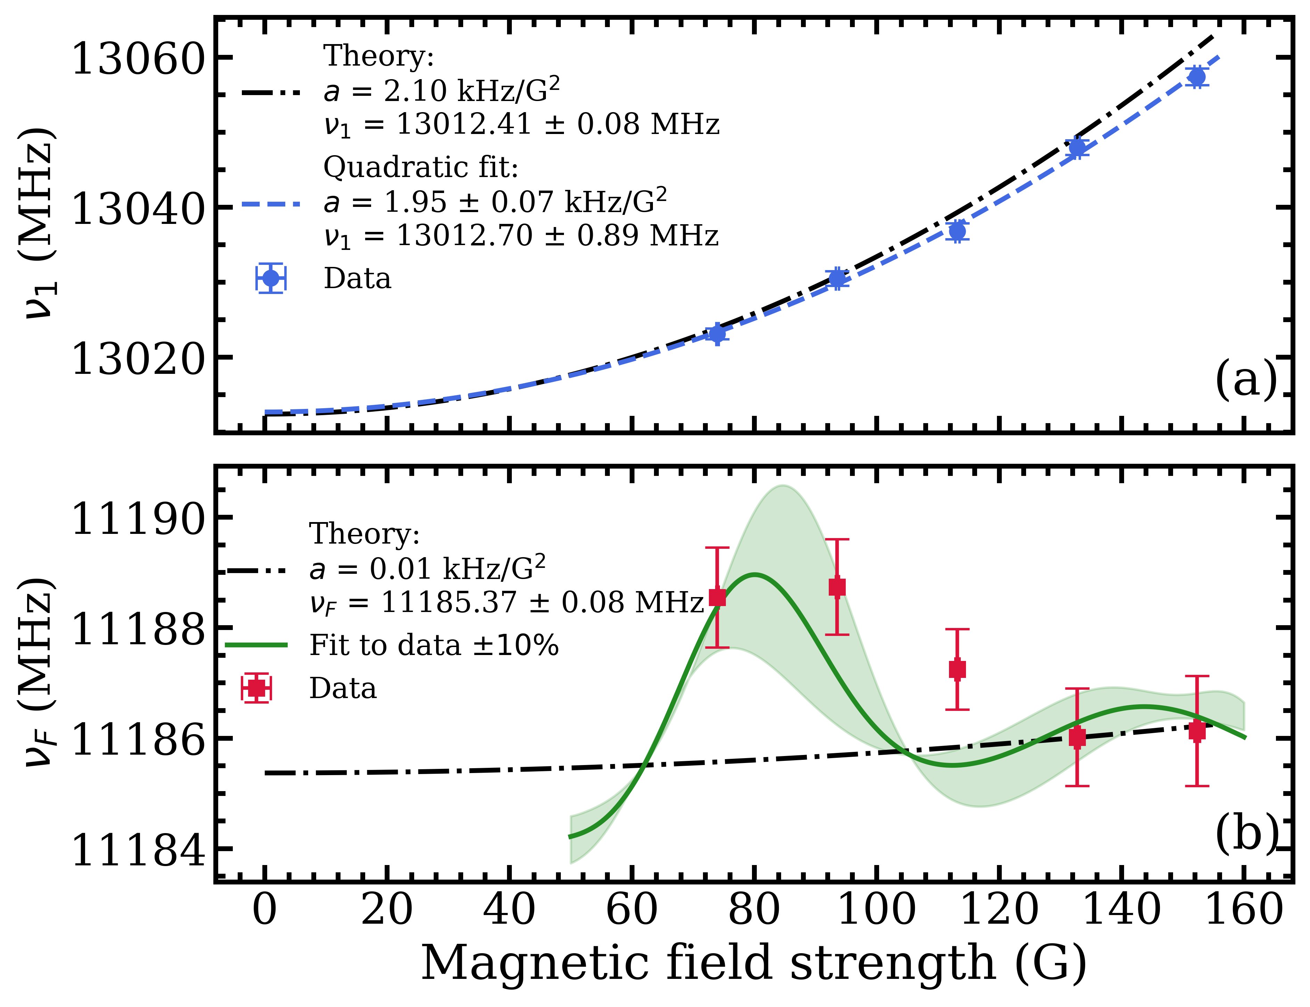
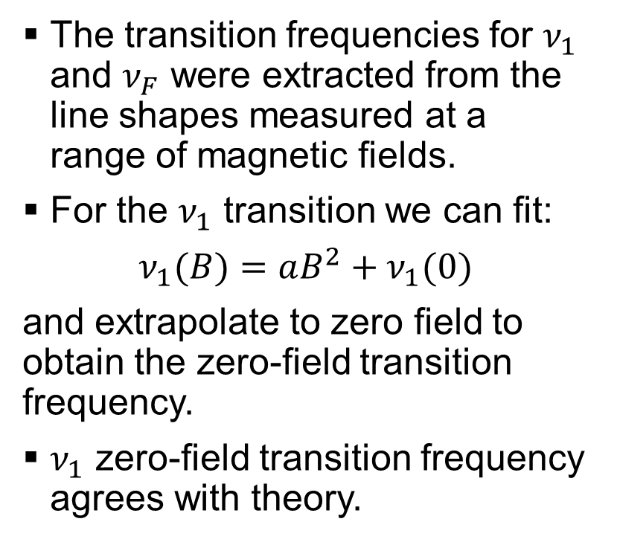
Transition frequencies
The transition frequencies for $ν_{1}$ and $ν_{F}$ were extracted from the line shapes measured at a range of magnetic fields.
For the $ν_{1}$ transition we can fit:
$ν_{1}(B)=aB^{2}+ν_{1}(0)$
and extrapolate to zero field to obtain the zero-field transition frequency.
$ν_{1}$ zero-field transition frequency agrees with theory.

Slide 18
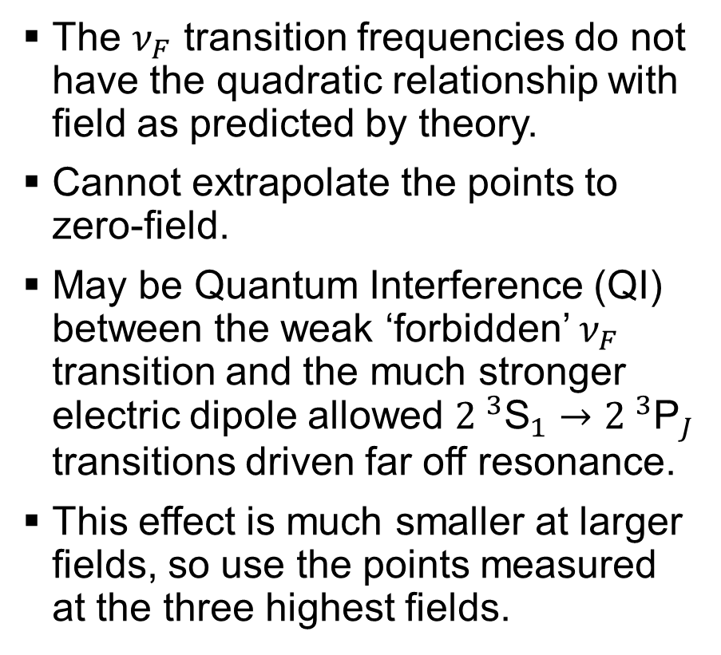
Transition frequencies
The $ν_{F}$ transition frequencies do not have the quadratic relationship with field as predicted by theory.
Cannot extrapolate the points to zero-field.
May be Quantum Interference (QI) between the weak ‘forbidden’ $ν_{F}$ transition and the much stronger electric dipole allowed ${2 }^{3}{\text{S}}_{1}→{2 }^{3}{\text{P}}_{J}$ transitions driven far off resonance.
This effect is much smaller at larger fields, so use the points measured at the three highest fields.

Slide 19
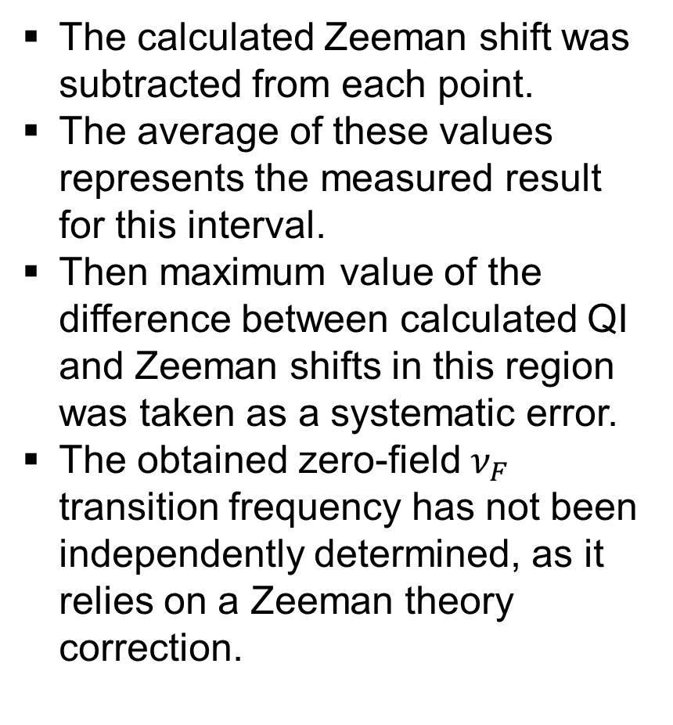
Transition frequencies
The calculated Zeeman shift was subtracted from each point.
The average of these values represents the measured result for this interval.
Then maximum value of the difference between calculated QI and Zeeman shifts in this region was taken as a systematic error.
The obtained zero-field $ν_{F}$ transition frequency has not been independently determined, as it relies on a Zeeman theory correction.

Slide 20
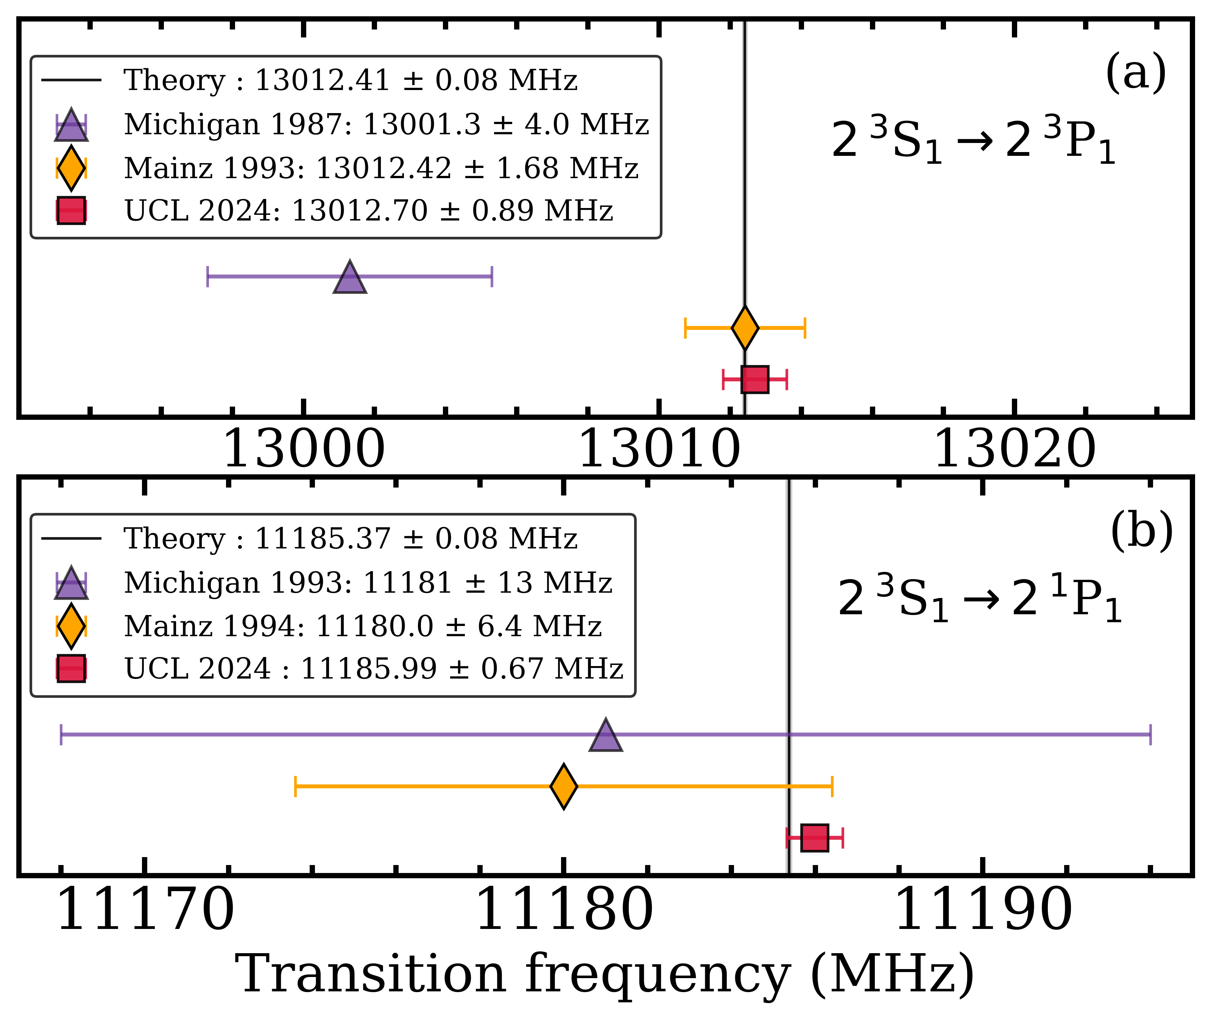
Transition frequencies
The calculated Zeeman shift was subtracted from each point.
The average of these values represents the measured result for this interval.
Then maximum value of the difference between calculated QI and Zeeman shifts in this region was taken as a systematic error.
The obtained zero-field $ν_{F}$ transition frequency has not been independently determined, as it relies on a Zeeman theory correction.
Agree with theory.
Most precise measurements to date.

Slide 21
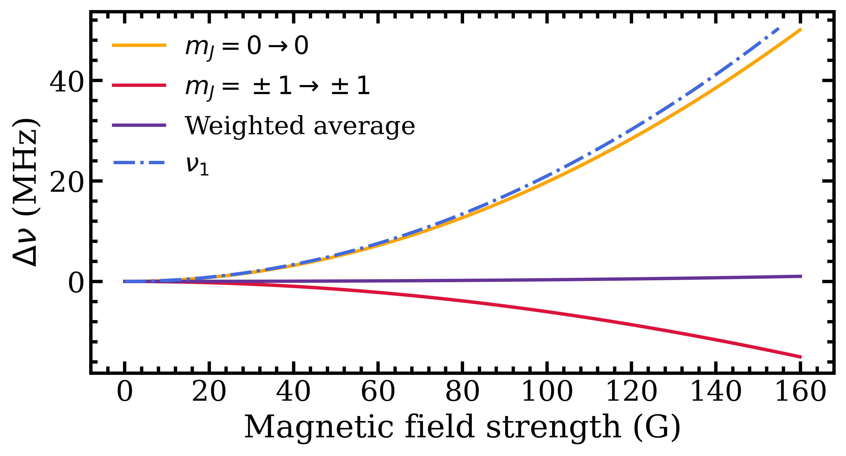
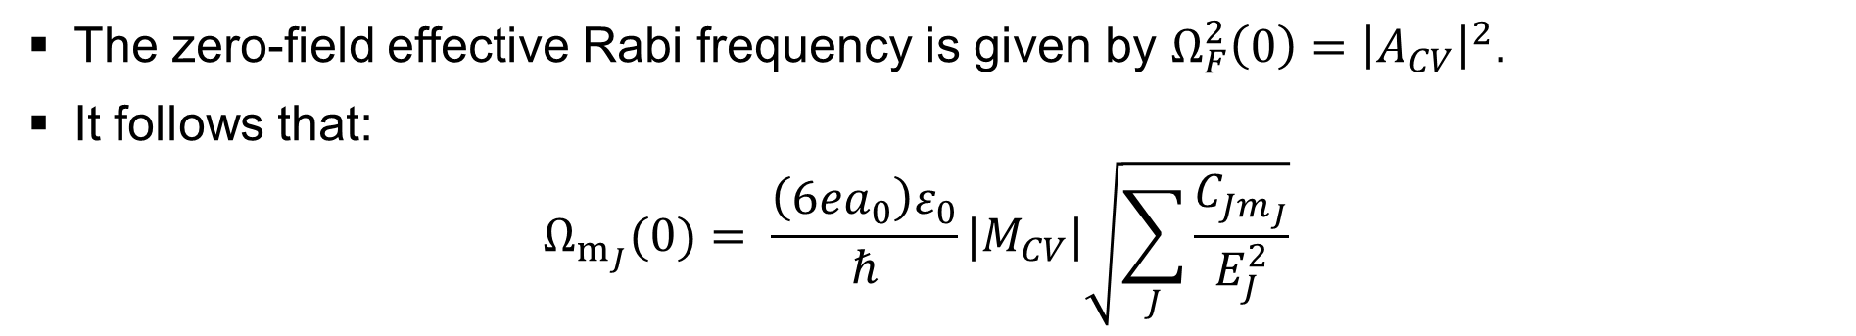
Rabi frequencies
The zero-field effective Rabi frequency is given by $Ω_{F}^{2}\left(0\right)={\left|A_{CV}\right|}^{2}$.
It follows that:
$$Ω_{m_{J}}(0)= \frac{\left(6ea_{0}\right)ε_{0}}{ℏ}|M_{CV}|\sqrt{\sum_{J}{\frac{C_{Jm_{J}}}{E_{J}^{2}}}}$$
Here, we do not include the transition frequencies as fit parameters and instead fix the transition frequencies according to the calculated Zeeman shifts.

Slide 22
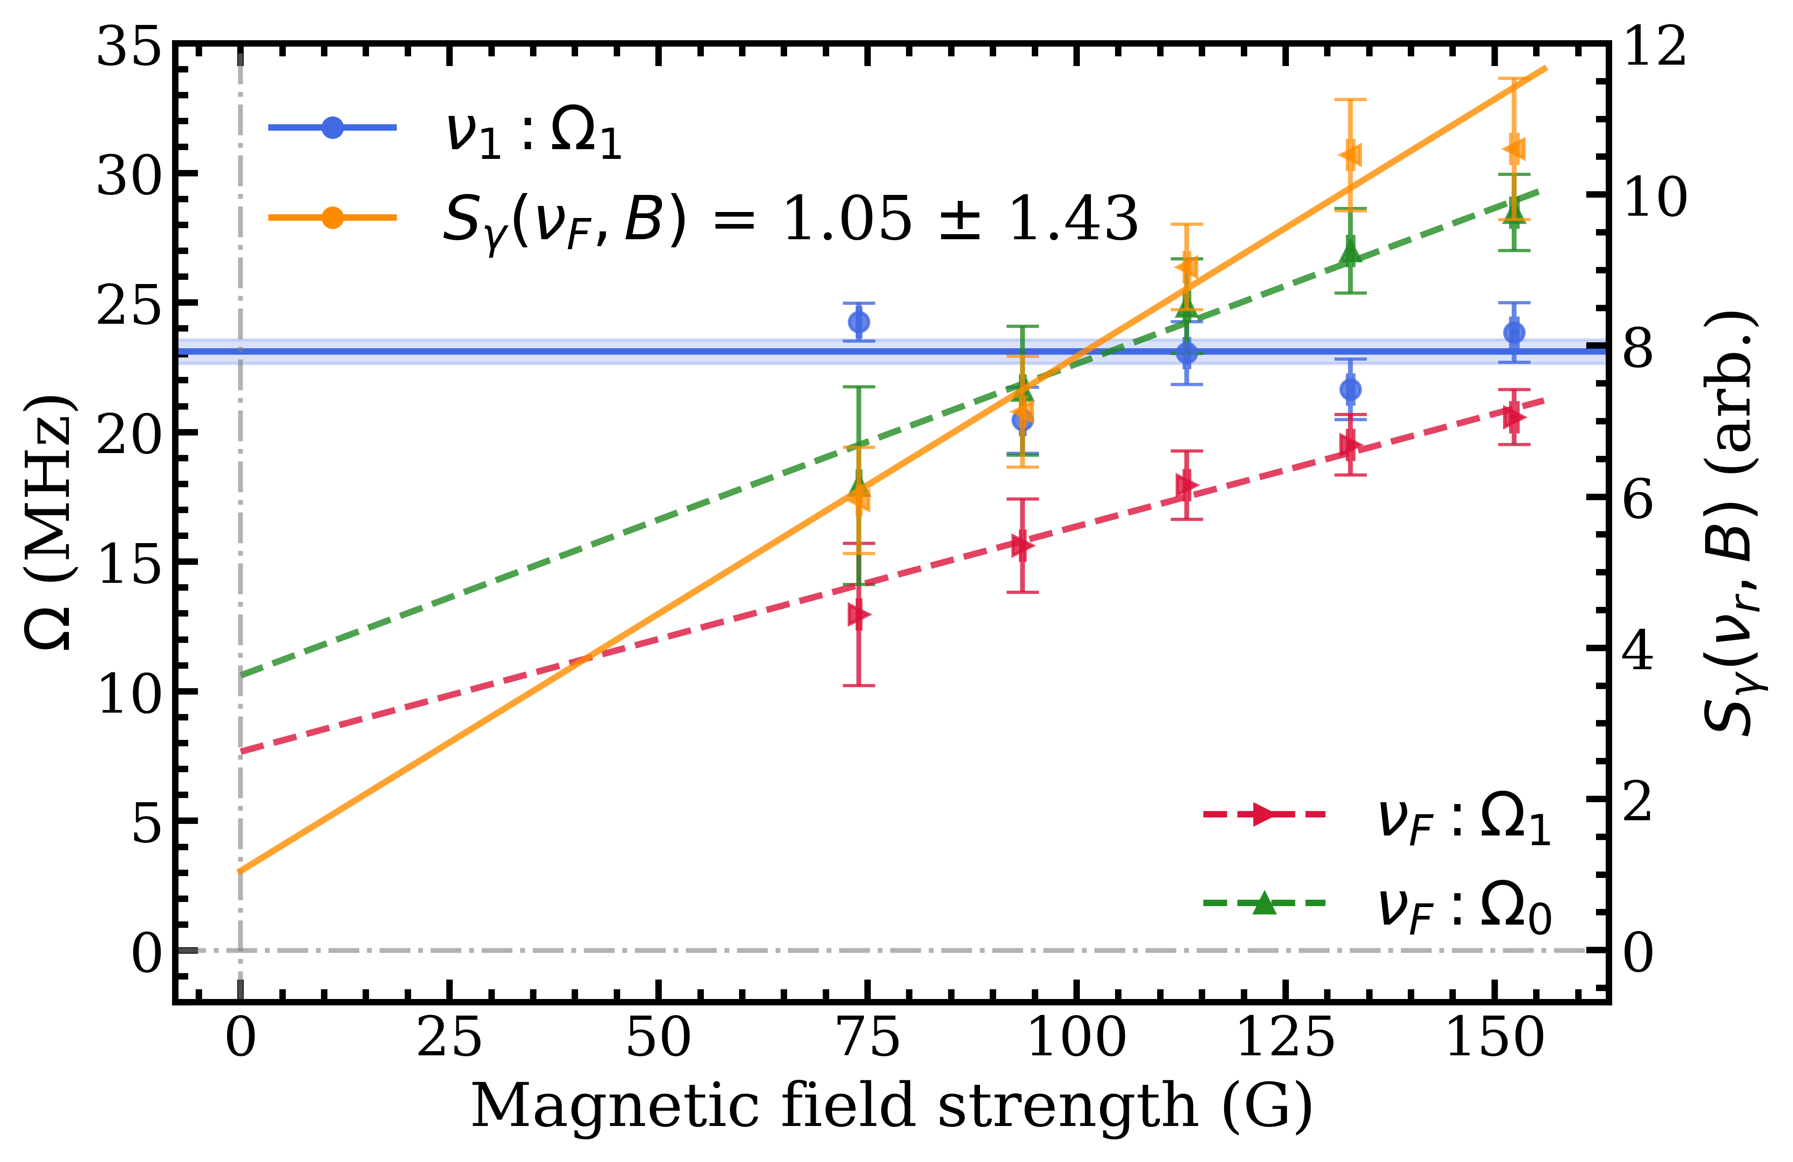
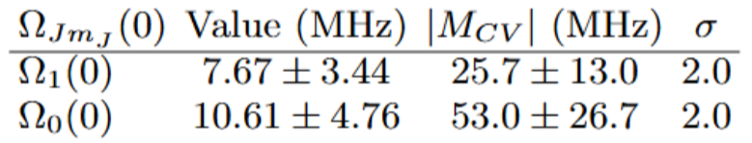
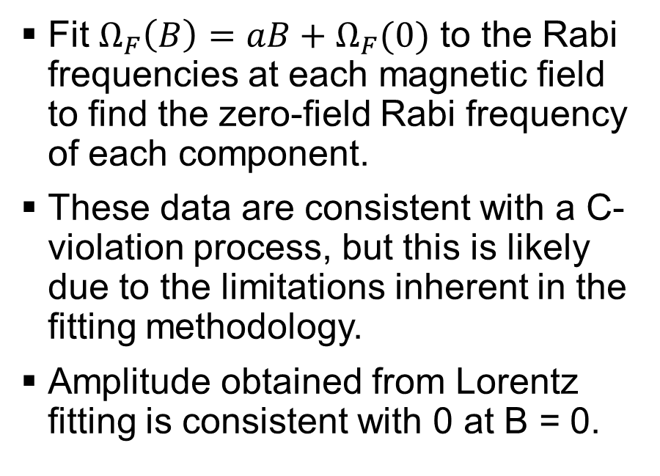
Rabi frequencies
Fit $Ω_{F}\left(B\right)=aB+Ω_{F}(0)$ to the Rabi frequencies at each magnetic field to find the zero-field Rabi frequency of each component.
These data are consistent with a C-violation process, but this is likely due to the limitations inherent in the fitting methodology.
Amplitude obtained from Lorentz fitting is consistent with 0 at B = 0.
We will need to explicitly extract the underlying Rabi frequencies…

Slide 23
Increase range of magnetic field: lower field (0-50 G)
Directly check for any observable signal at zero-field.
But at low fields the transition strength, and hence the measured signal, is reduced.
To counter this, improved signal could be obtained by using a large-area detector array.

Slide 24
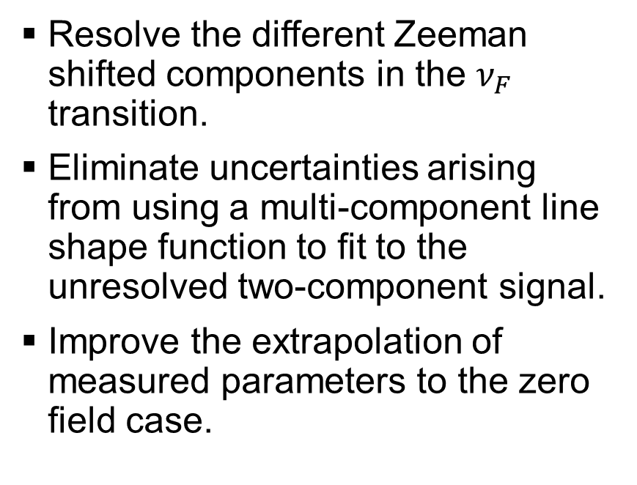

Increase range of magnetic field: higher field ($≥$ 300 G)
Resolve the different Zeeman shifted components in the $ν_{F}$ transition.
Eliminate uncertainties arising from using a multi-component line shape function to fit to the unresolved two-component signal.
Improve the extrapolation of measured parameters to the zero field case.

Slide 25
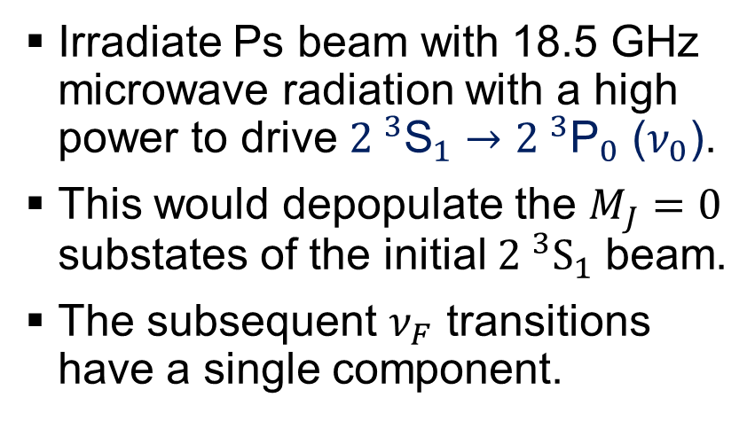
Selecting a specific polarisation state
Irradiate Ps beam with 18.5 GHz microwave radiation with a high power to drive ${2 }^{3}{\text{S}}_{1}→{2 }^{3}{\text{P}}_{0}$ ($ν_{0}$).
This would depopulate the $M_{J}=0$ substates of the initial ${2 }^{3}S_{1}$ beam.
The subsequent $ν_{F}$ transitions have a single component.
18.5 GHz

Slide 26


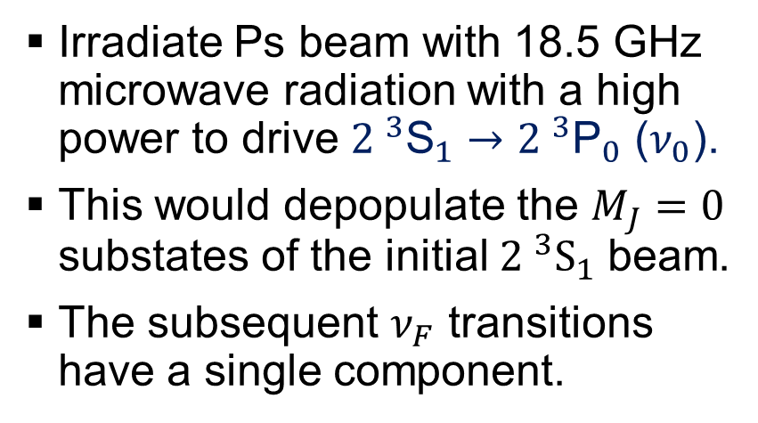




Selecting a specific polarisation state
$$ν_{F}$$
Irradiate Ps beam with 18.5 GHz microwave radiation with a high power to drive ${2 }^{3}{\text{S}}_{1}→{2 }^{3}{\text{P}}_{0}$ ($ν_{0}$).
This would depopulate the $M_{J}=0$ substates of the initial ${2 }^{3}S_{1}$ beam.
The subsequent $ν_{F}$ transitions have a single component.
$$ν_{0}$$
-1
0
+1
$$M_{J}=$$
$${ 2 }^{3}S_{1}$$
$$M_{J}=$$
$$2^{ 1}{P′}_{1}$$

Slide 27
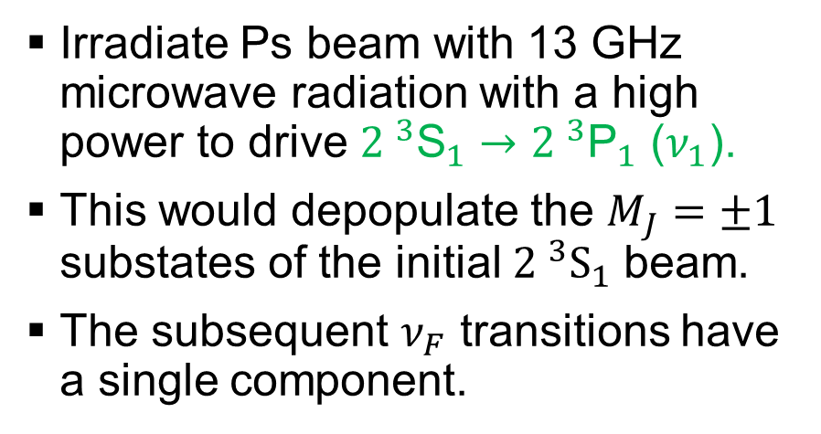
Selecting a specific polarisation state
Irradiate Ps beam with 13 GHz microwave radiation with a high power to drive ${2 }^{3}{\text{S}}_{1}→{2 }^{3}{\text{P}}_{1}$ ($ν_{1}$).
This would depopulate the $M_{J}=±1$ substates of the initial ${2 }^{3}S_{1}$ beam.
The subsequent $ν_{F}$ transitions have a single component.
13 GHz

Slide 28


Selecting a specific polarisation state
$$ν_{F}$$
Irradiate Ps beam with 13 GHz microwave radiation with a high power to drive ${2 }^{3}{\text{S}}_{1}→{2 }^{3}{\text{P}}_{1}$ ($ν_{1}$).
This would depopulate the $M_{J}=±1$ substates of the initial ${2 }^{3}S_{1}$ beam.
The subsequent $ν_{F}$ transitions have a single component.
$$ν_{1}$$
-1
0
+1
$$M_{J}=$$
$${ 2 }^{3}S_{1}$$
$$M_{J}=$$
$$2^{ 1}{P′}_{1}$$

Slide 29
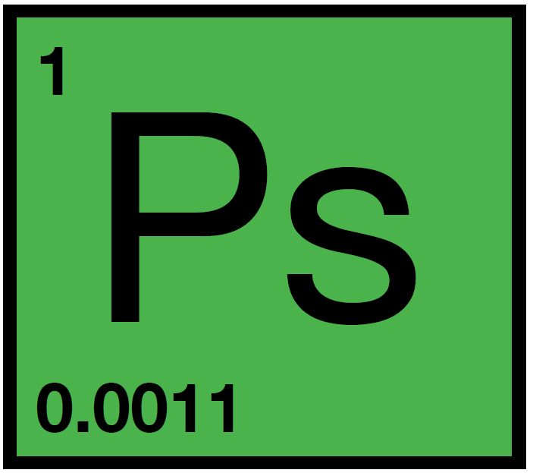

UCL Ps Spectroscopy
David Cassidy
Stephen Hogan
Krzysztof Habdas
Josh Wang
Andreas Lanz
Rebecca Daly
Donovan Newson

Slide 30
Extra slides

Slide 31
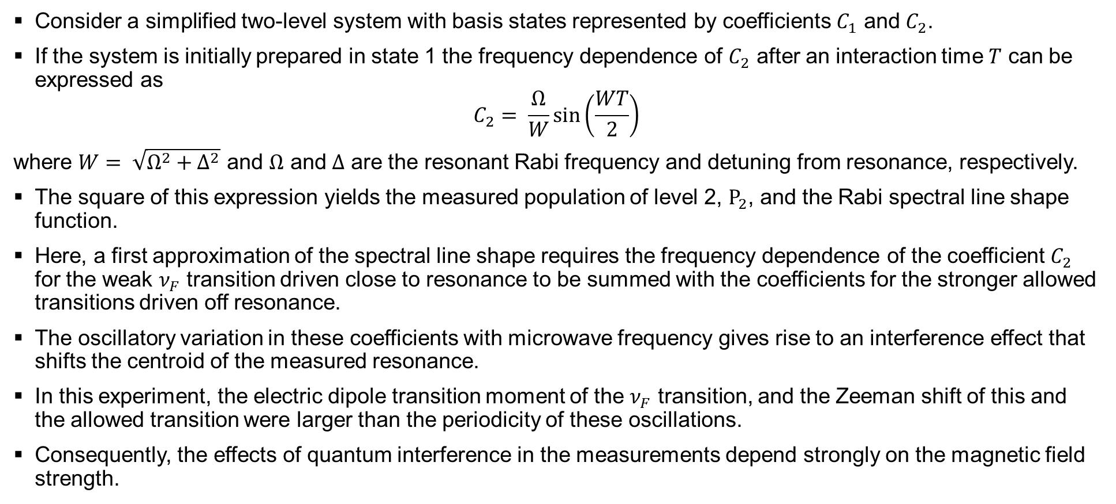
Quantum Interference (QI) effect
Consider a simplified two-level system with basis states represented by coefficients $C_{1}$ and $C_{2}$.
If the system is initially prepared in state 1 the frequency dependence of $C_{2}$ after an interaction time $T$ can be expressed as
$$C_{2}= \frac{Ω}{W}\sin\left(\frac{WT}{2}\right)$$
where $W= \sqrt{Ω^{2}+Δ^{2}}$ and $Ω$ and $Δ$ are the resonant Rabi frequency and detuning from resonance, respectively.
The square of this expression yields the measured population of level 2, $P_{2}$, and the Rabi spectral line shape function.
Here, a first approximation of the spectral line shape requires the frequency dependence of the coefficient $C_{2}$ for the weak $ν_{F}$ transition driven close to resonance to be summed with the coefficients for the stronger allowed transitions driven off resonance.
The oscillatory variation in these coefficients with microwave frequency gives rise to an interference effect that shifts the centroid of the measured resonance.
In this experiment, the electric dipole transition moment of the $ν_{F}$ transition, and the Zeeman shift of this and the allowed transition were larger than the periodicity of these oscillations.
Consequently, the effects of quantum interference in the measurements depend strongly on the magnetic field strength.

Slide 32
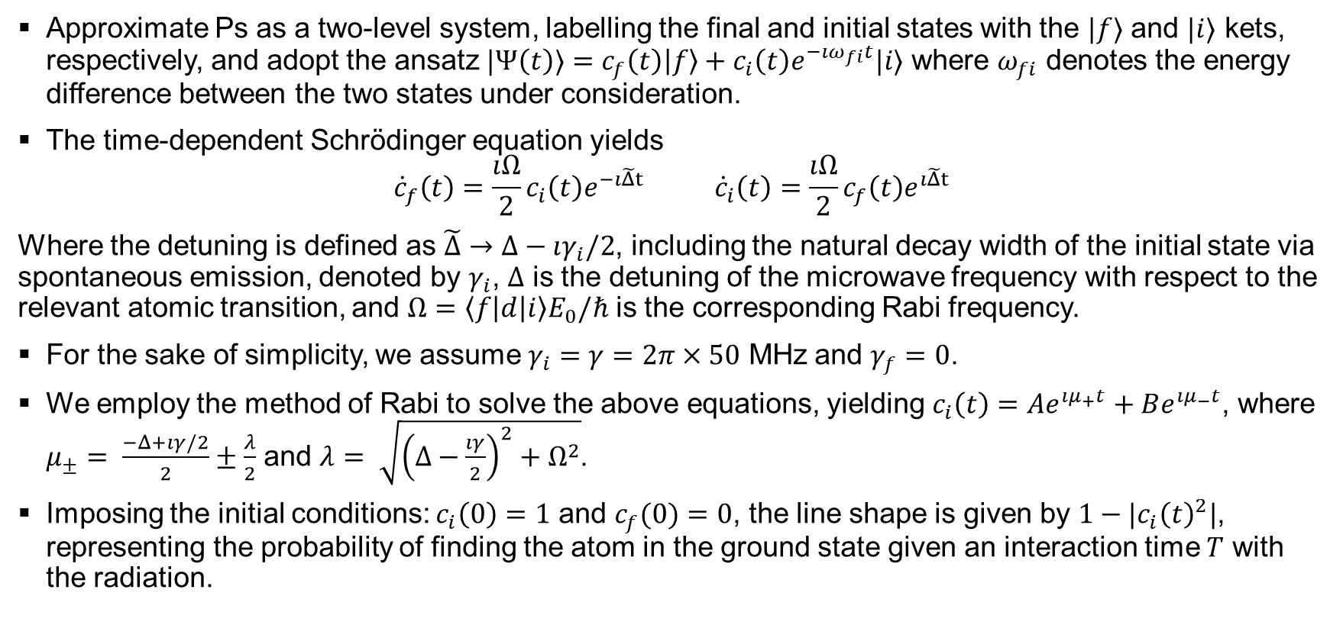
Line shape model background
Approximate Ps as a two-level system, labelling the final and initial states with the $|f⟩$ and $|i⟩$ kets, respectively, and adopt the ansatz $|Ψ\left(t\right)⟩=c_{f}\left(t\right)\left|f\right\rangle +c_{i}\left(t\right)e^{−ıω_{fi}t}|i⟩$ where $ω_{fi}$ denotes the energy difference between the two states under consideration.
The time-dependent Schrӧdinger equation yields
$${\dot{c}}_{f}\left(t\right)=\frac{ıΩ}{2}c_{i}\left(t\right)e^{−ı\tilde{Δ}t} {\dot{c}}_{i}\left(t\right)=\frac{ıΩ}{2}c_{f}\left(t\right)e^{ı\tilde{Δ}t}$$
Where the detuning is defined as $\tilde{Δ}→Δ−ıγ_{i}/2$, including the natural decay width of the initial state via spontaneous emission, denoted by $γ_{i}$, $Δ$ is the detuning of the microwave frequency with respect to the relevant atomic transition, and $Ω=\left\langle f\left|d\right|i\right\rangle E_{0}/ℏ$ is the corresponding Rabi frequency.
For the sake of simplicity, we assume $γ_{i}=γ=2π×50$ MHz and $γ_{f}=0$.
We employ the method of Rabi to solve the above equations, yielding $c_{i}\left(t\right)=Ae^{ıμ_{+}t}+Be^{ıμ_{−}t}$, where $μ_{±}= \frac{−Δ+ıγ/2}{2}±\frac{λ}{2}$ and $λ= \sqrt{{\left(Δ−\frac{ıγ}{2}\right)}^{2}+Ω^{2}}$.
Imposing the initial conditions: $c_{i}\left(0\right)=1$ and $c_{f}(0)=0$, the line shape is given by $1−|c_{i}{\left(t\right)}^{2}|$, representing the probability of finding the atom in the ground state given an interaction time $T$ with the radiation.

