Slide 1
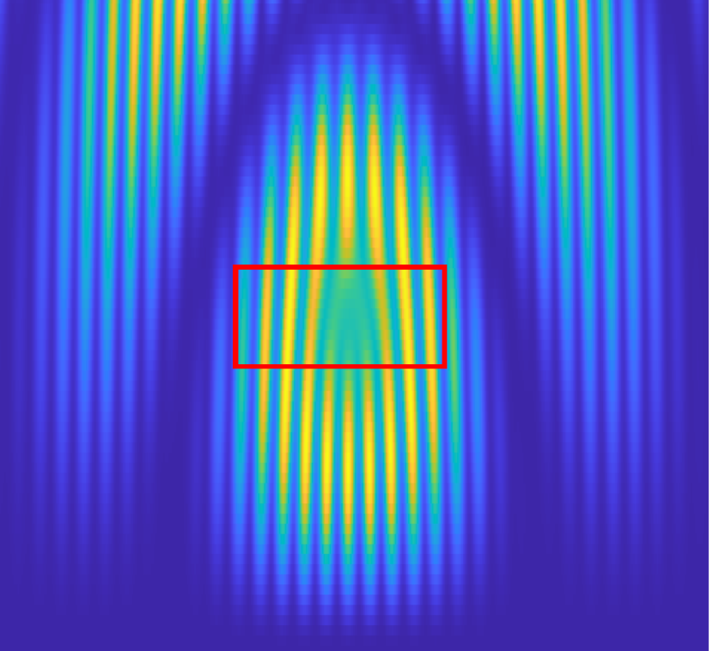


Beyond systematics: How to determine an electron EDM using BaF molecules
Jelmer Levenga
on behalf of the NL-eEDM collaboration
PSI2025
Sep 2025

Slide 2
Motivation
EDMs are a possible source of CP violation beyond the standard model

Slide 3
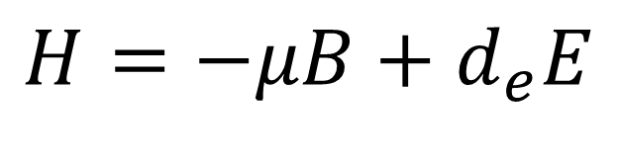

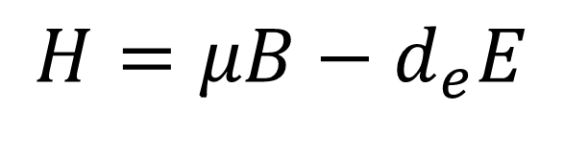
The permanent electron electric dipole moment (eEDM)
Dipole moments -> linear energy shifts with electric/magnetic fields
$$H=μB+d_{e}E$$
T
P
$$H=−μB+d_{e}E$$
$$H=μB−d_{e}E$$
Within molecules enhancement $d_{e}→ D^{P,T}$ > ${ 10}^{6}$ depending on molecule
The NL-eEDM collaboration. In: The European Physical Journal D, Vol. 72, No. 11, 197, 20.11.2018.

Slide 4
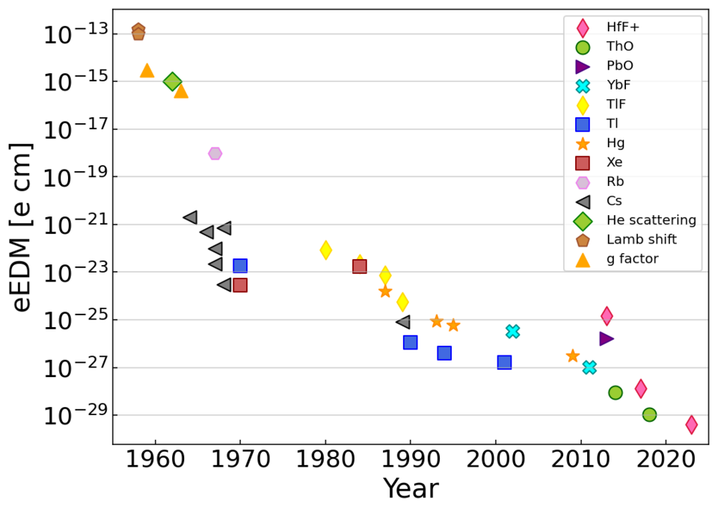

The current eEDM playing field
Some of our other friends:
Imperial college YbF beam
ACME, ThO beam
JILA, current limit
with trapped HfF+
$<4.1×{10}^{−30}$e cm
JILA
ACME
ICL
ICL
JILA
JILA
ICL
ACME
JILA
ACME

Slide 5
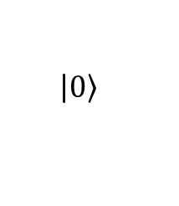

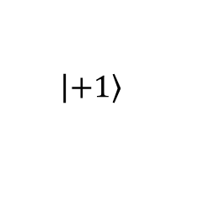

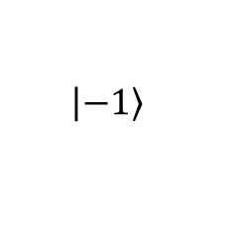
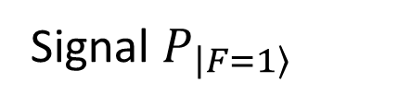
Spin precession
Supersonic source
Pumping
Spin precession
Detection
$$F=1$$
$$\left|\left.−1\right\rangle \right.$$
$$\left|\left.+1\right\rangle \right.$$
$$F=0$$
$$\left|\left.0\right\rangle \right.$$
Precession
Signal $P_{\left|\left.F=1\right\rangle \right.}$

Slide 6
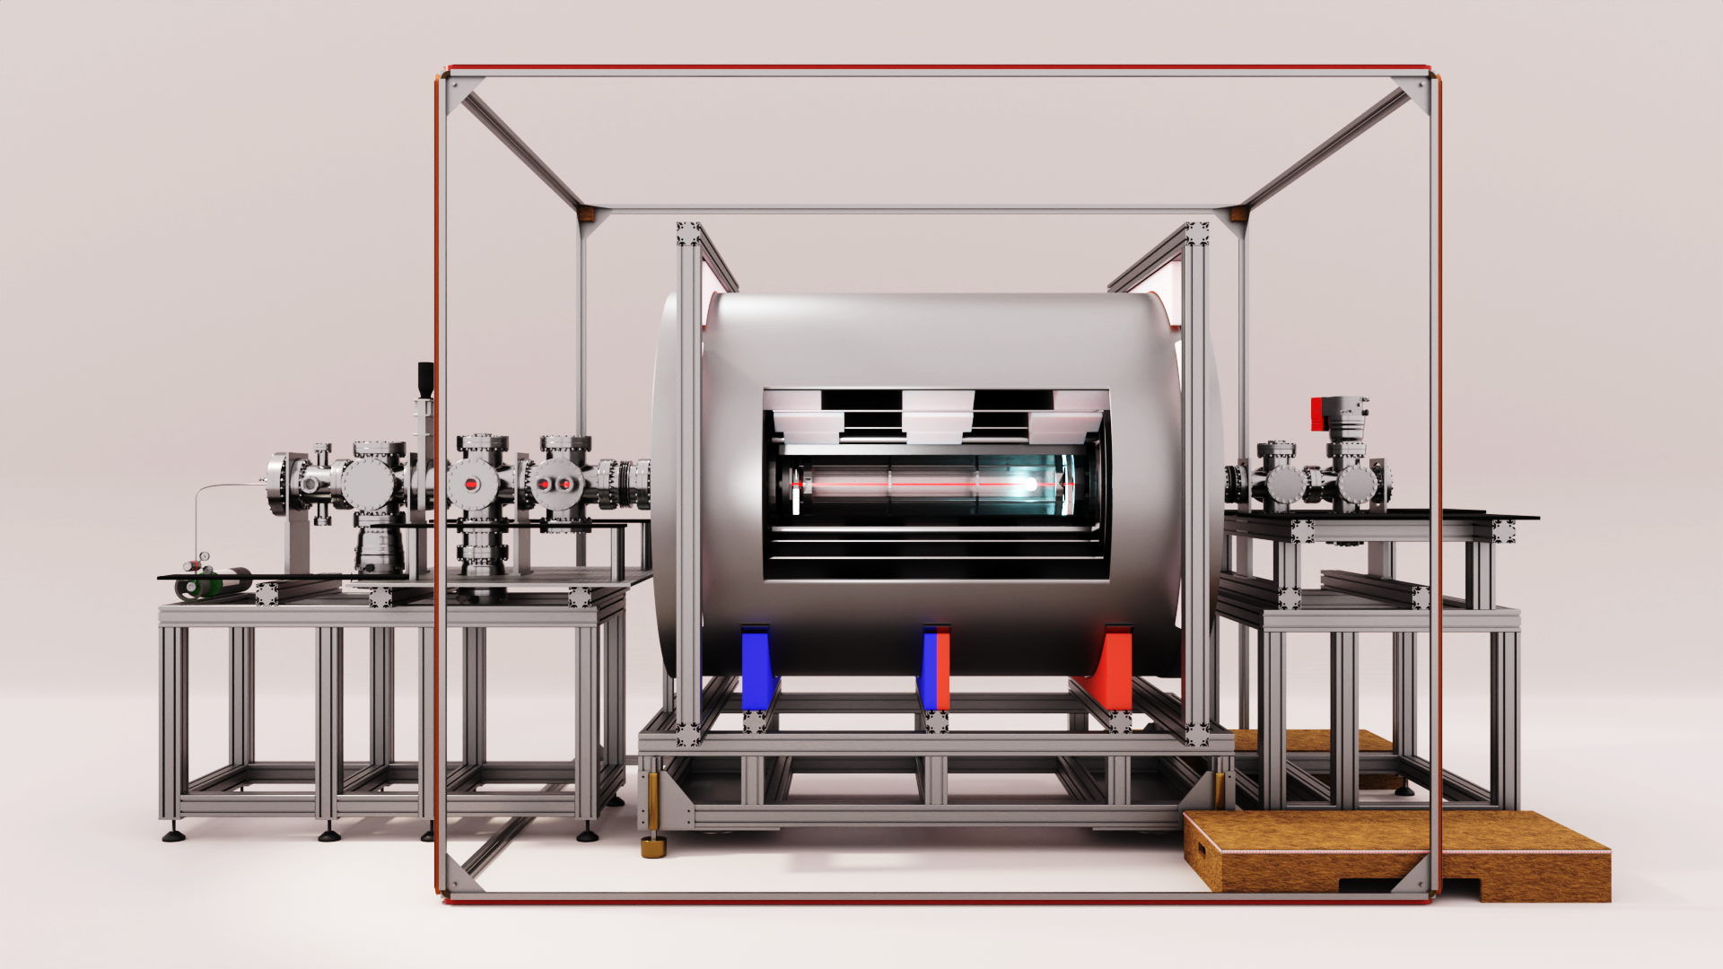

$B \sim nT$
$$E∼kV/cm$$
Counter-propagating laser beams
Supersonic beam source
Magnetic shield 5 mu-metal layers

Slide 7
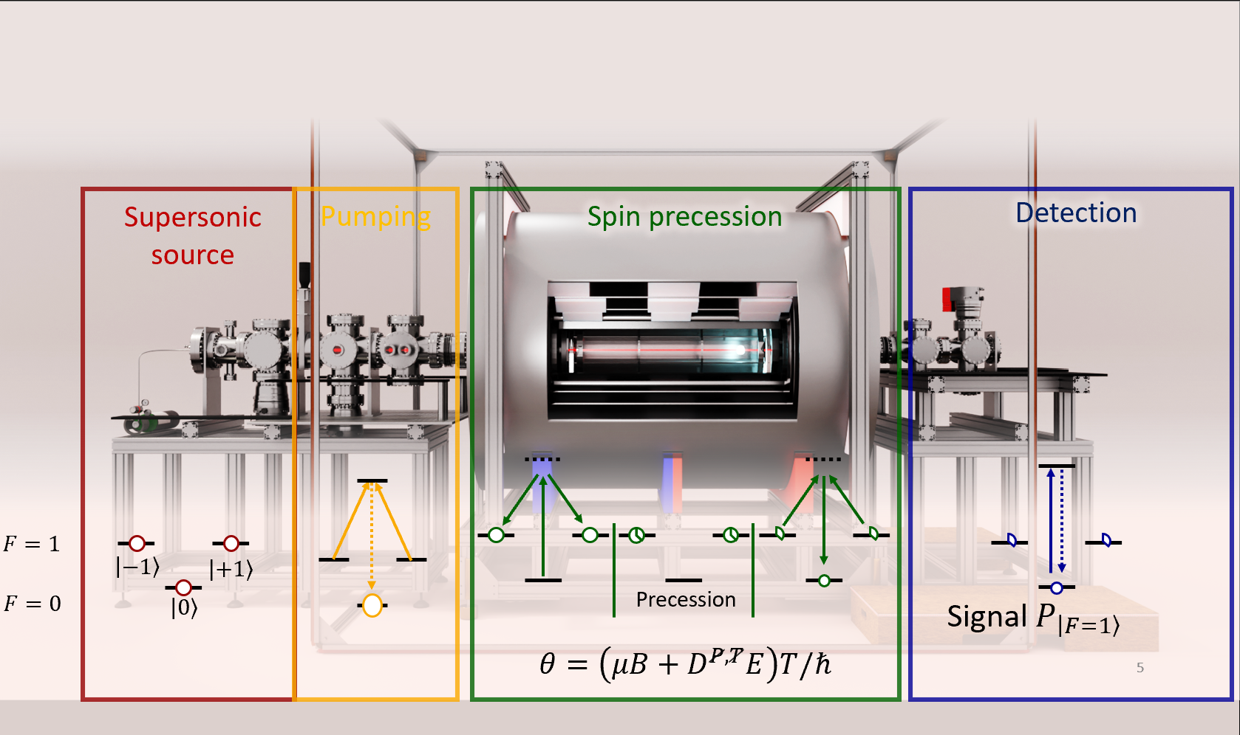

Modelling the signal
$P_{F=1}$(properties of: molecules, laserlight, EM-fields)

Slide 8
Separating the EDM from systematic effects

Slide 9
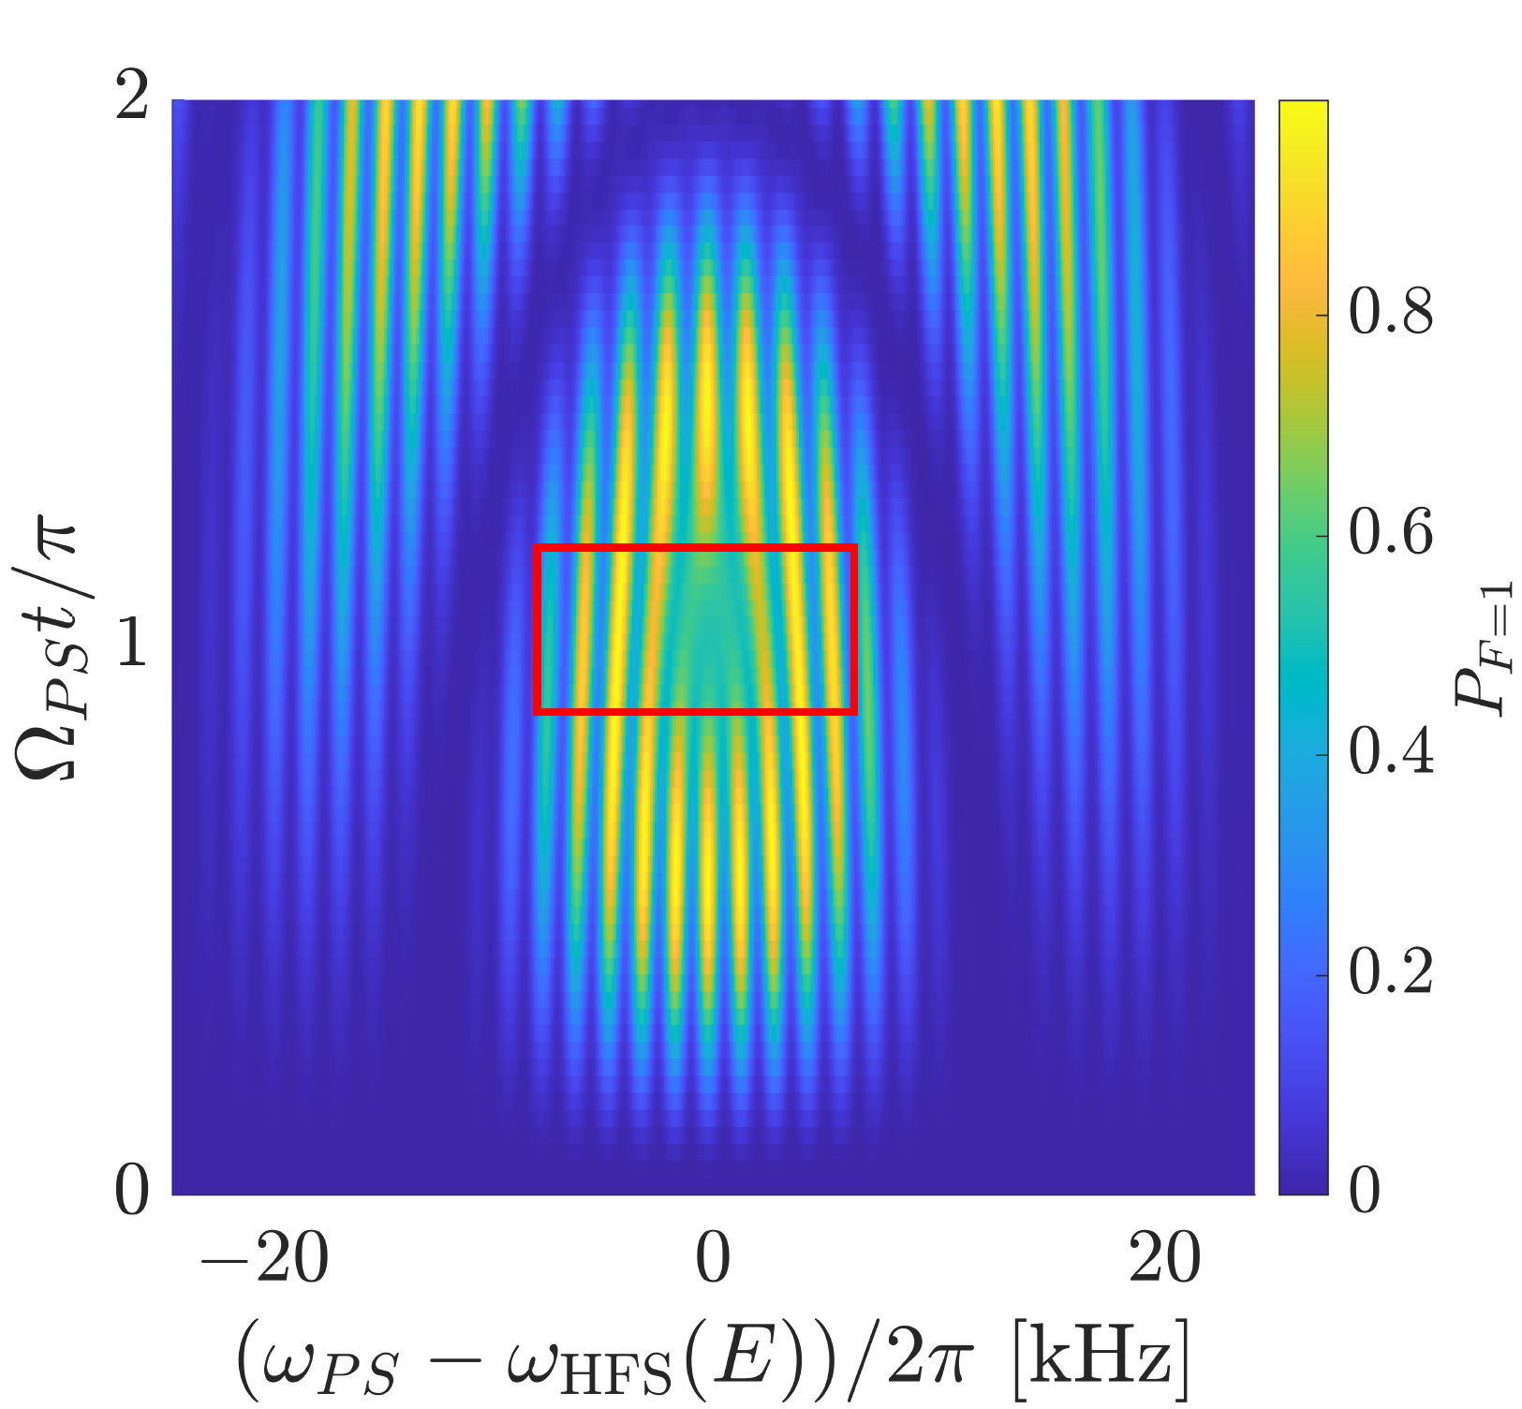
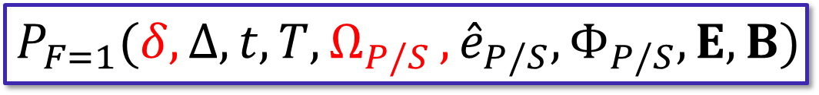

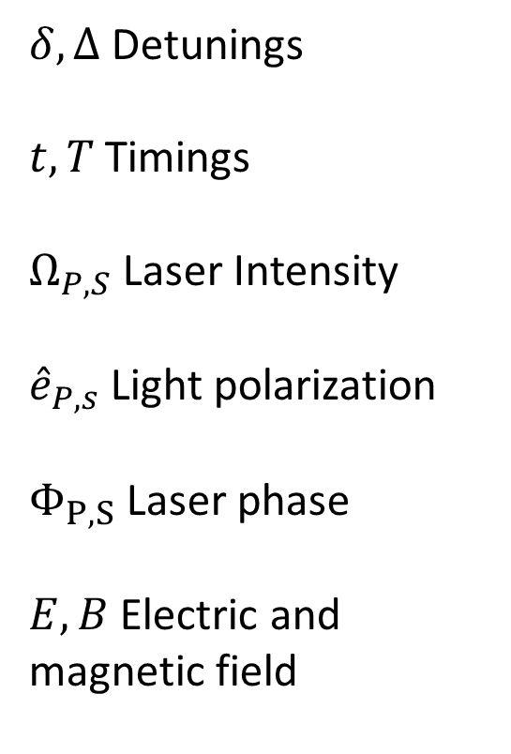
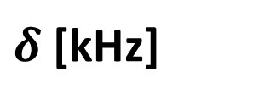
Describing the signal function
$$P_{F=1}(δ, Δ{,t,T, Ω}_{P/S},{\hat{e}}_{P/S},Φ_{P/S},E,B)$$
$δ, Δ$Detunings
$t,T$ Timings
$Ω_{P,S}$ Laser Intensity
${\hat{e}}_{P,s}$ Light polarization
$Φ_{P,S}$Laser phase
$E,B$Electric and magnetic field
$$Ω_{Ps}t/π$$
$δ$[kHz]
Boeschoten, A., et al. Phys Rev A L010801. July 2024

Slide 10
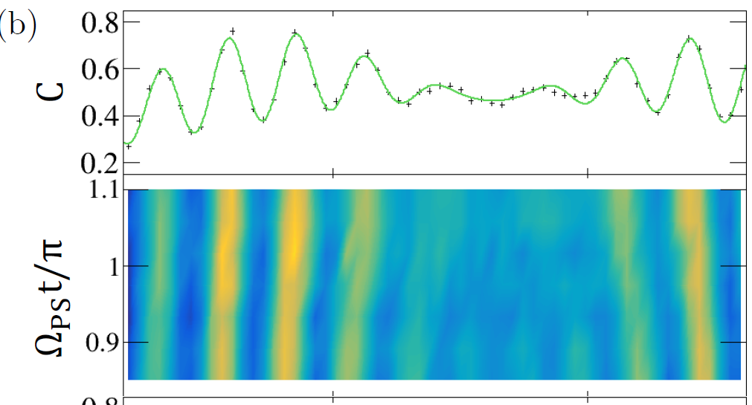
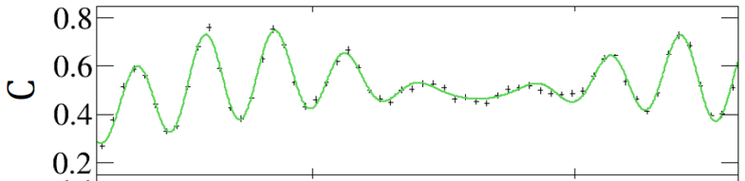
Comparing theory and experiment
Calculated prediction lines up very well
with measurement
Shown that parameters -> model works
Then use model->parameters
Boeschoten, Alexander. PhD Thesis, University of Groningen, 2023.

Slide 11
Controlling and measuring systematics
The best sensors for experimental parameters are the molecules

Slide 12
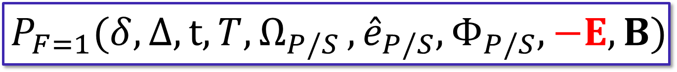
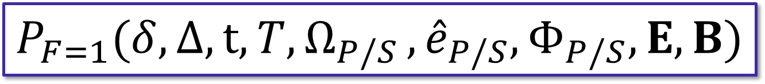
Using symmetries to suppress systematics
Exploit the parity operation of the EDM experiment
$$P_{F=1}(δ, Δ{,t,T, Ω}_{P/S},{\hat{e}}_{P/S},Φ_{P/S},E,B)$$
P
$$P_{F=1}(δ, Δ{,t,T, Ω}_{P/S},{\hat{e}}_{P/S},Φ_{P/S},−E,B)$$
Can we do even better?

Slide 13
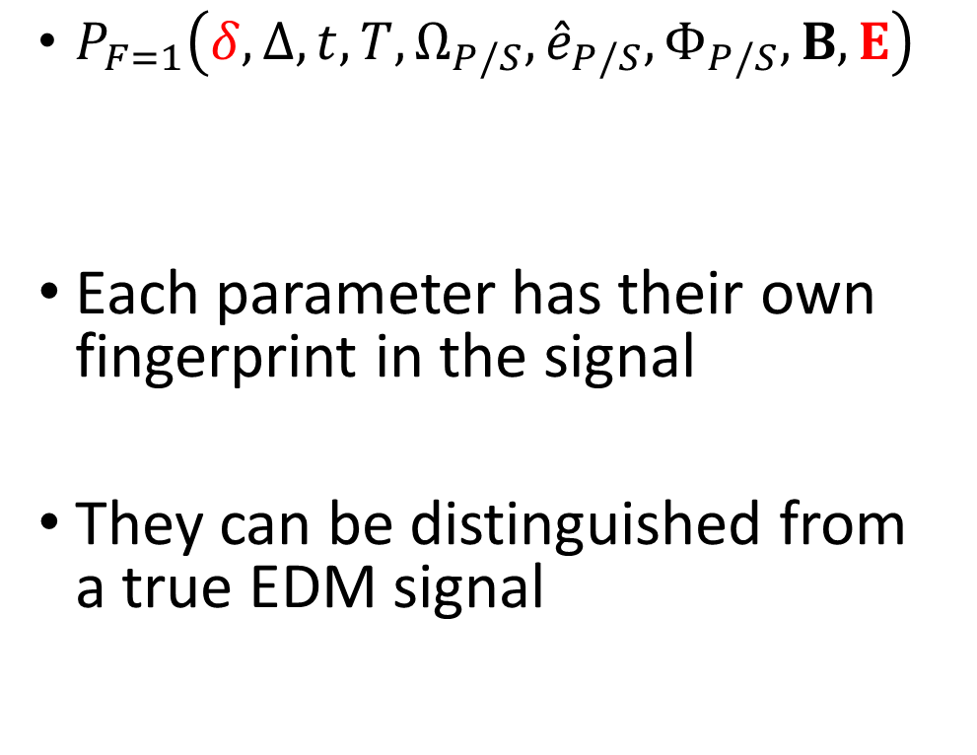
Example: information on E from detuning scan
$P_{F=1}\left(δ, Δ,t,T,Ω_{P/S},{\hat{e}}_{P/S},Φ_{P/S}, B,E\right)$
Each parameter has their own fingerprint in the signal
They can be distinguished from a true EDM signal
Changing E
$$δ/2π [kHz]$$
EDM signal
$$δ/2π [kHz]$$

Slide 14
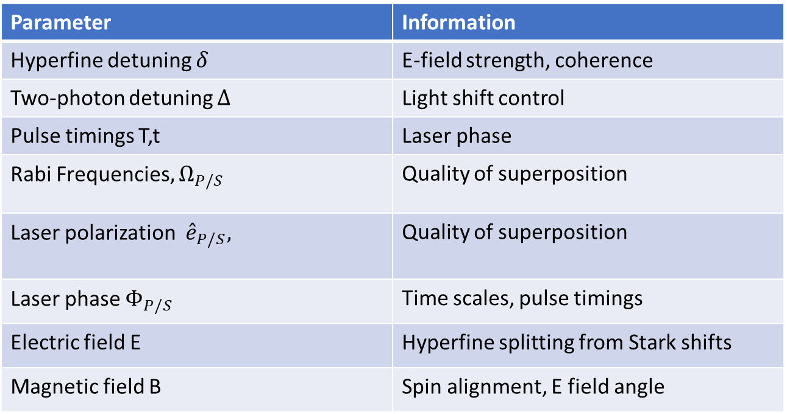
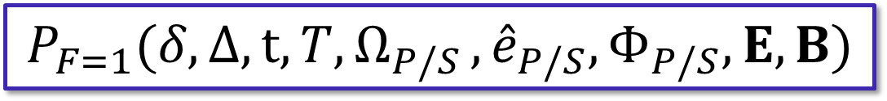
All parameters are linked to physical processes
$$P_{F=1}(δ, Δ{,t,T, Ω}_{P/S},{\hat{e}}_{P/S},Φ_{P/S},E,B)$$
Parameter | Information
Hyperfine detuning $δ$ | E-field strength, coherence
Two-photon detuning $Δ$ | Light shift control
Pulse timings T,t | Laser phase
Rabi Frequencies${, Ω}_{P/S}$ | Quality of superposition
Laser polarization ${\hat{e}}_{P/S},$ | Quality of superposition
Laser phase $Φ_{P/S}$ | Time scales, pulse timings
Electric field E | Hyperfine splitting from Stark shifts
Magnetic field B | Spin alignment, E field angle

Slide 15
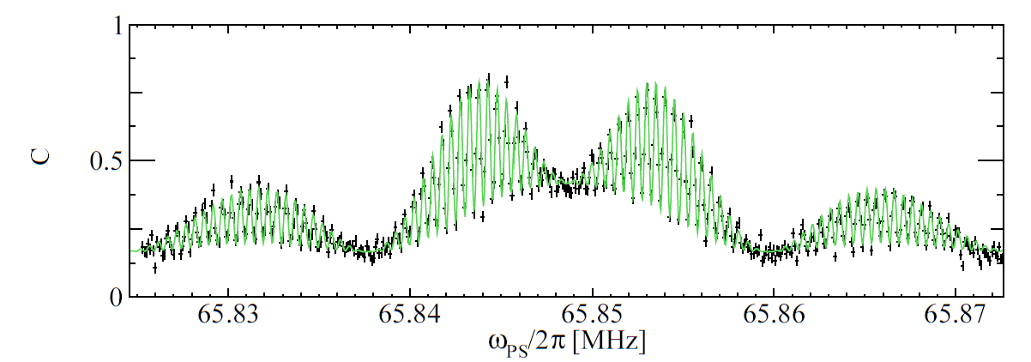
Signal contains immense amounts of information
Most sensitive to EDM
Most sensitive to systematics
e.g. Peak spacing -> timings
Peak location -> E-field
Peak height -> B-field
Marshall, V. R. PhD thesis, University of Groningen, 2024

Slide 16
Outlook
Improvements after moving building
Improve detection efficiency
Add cold molecule source and lasercooling

Slide 17
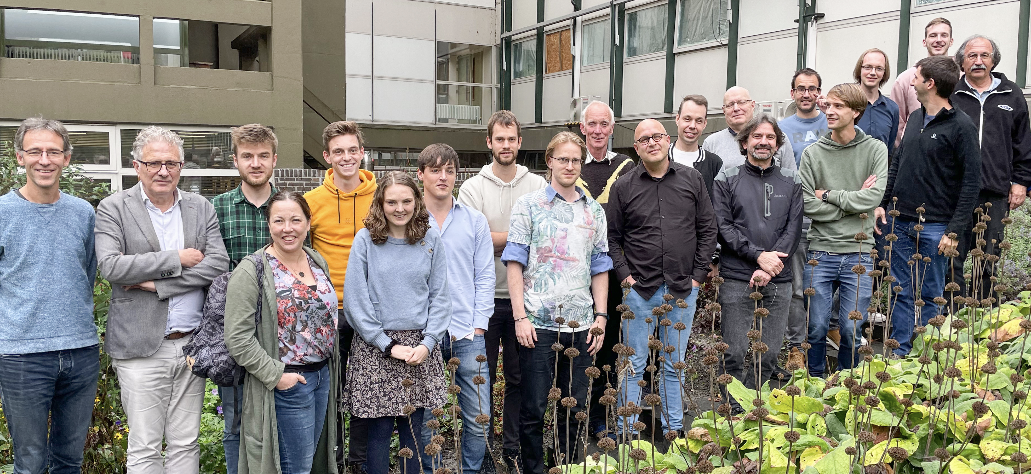
The NL-eEDM team
Current PhD students:
Nitesh Balasubramanian
Ties Fikkers
Joost van Hofslot
Jelmer Levenga
Heleen Mulder
Bastiaan Nijman
Bart Schellenberg
Lucas van Slooten
Izabella Thompson
Former members:
Alexander Boeschoten
Virginia Marshall
Thomas Meijknecht
Maarten Mooij
Anno Touwen
Pi Haase
Parul Aggarwal
Kevin Esajas
Yanning Yin
Malika Denis
Roman Bause
Senior staff:
Hendrick Bethlem
Anastasia Borschevsky
Steven Hoekstra
Steve Jones
Klaus Jungmann
Rob Timmermans
Wim Ubachs
Jordy de Vries
Lorenz Willmann
Technical support:
Leo Huisman
Oliver Böll
Picture of the team with unfortunately not every current member present

Slide 18
Conclusion
The best sensors for experimental parameters are the molecules
Signal contains immense amounts of information which can be used to reduce systematic error
Thank you for your attention!

