Slide 1
The future science program at the Fundamental Neutron Physics Beamline
September 9, 2025 | Physics of fundamental Symmetries and Interactions - PSI2025
Wolfgang Schreyer
Oak Ridge National Laboratory

Slide 2
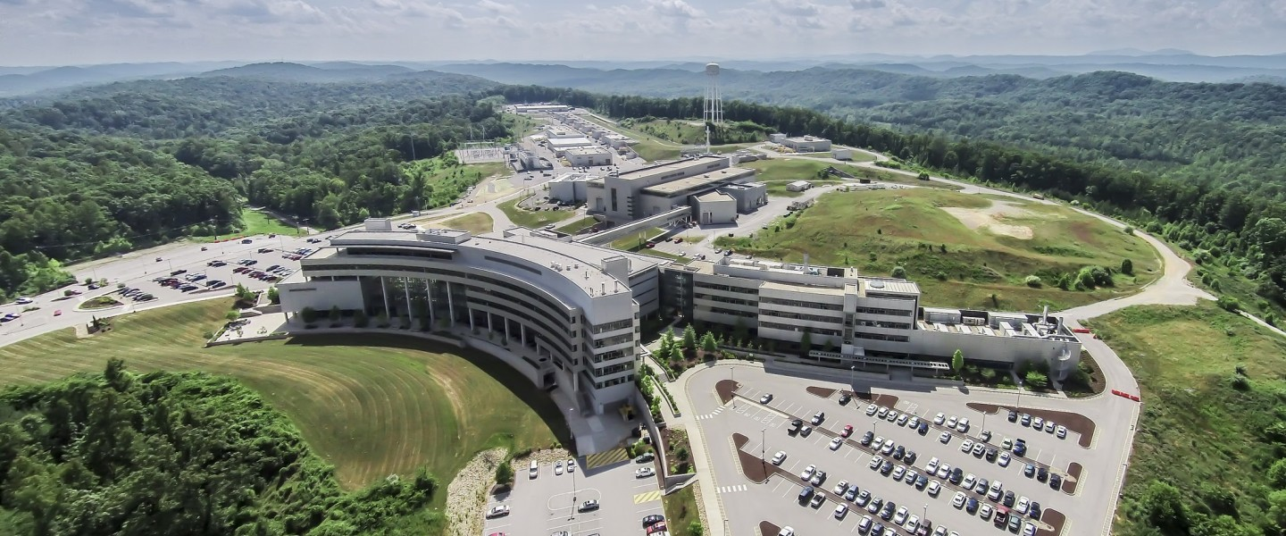
The Spallation Neutron Source
Oak Ridge National Laboratory, Tennessee
Linear proton accelerator
Target station &
Instrument Hall
Accumulator ring
Future second
target station
1.3 GeV, 1.8 MW proton beam
1us-long pulses at 60Hz
20t mercury target

Slide 3
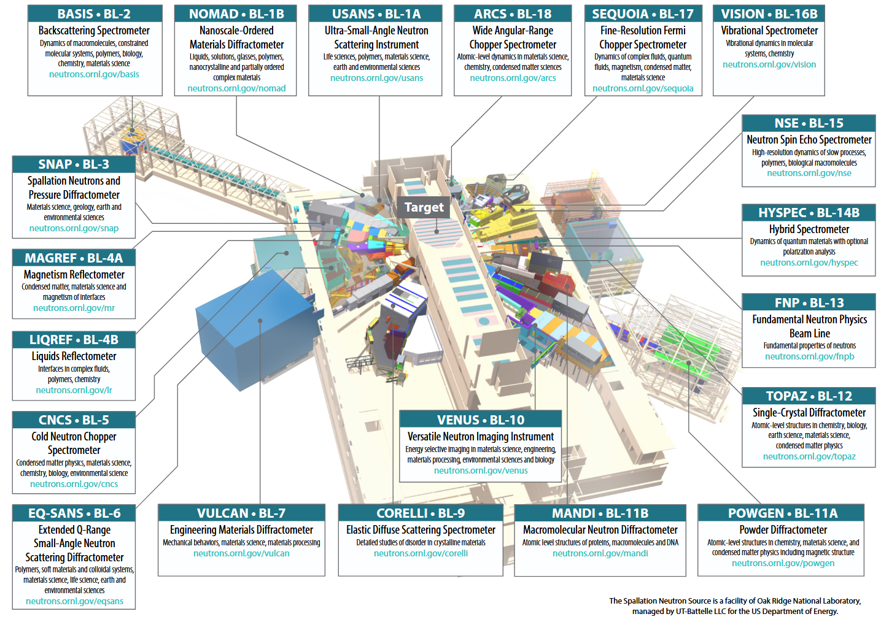

Slide 4
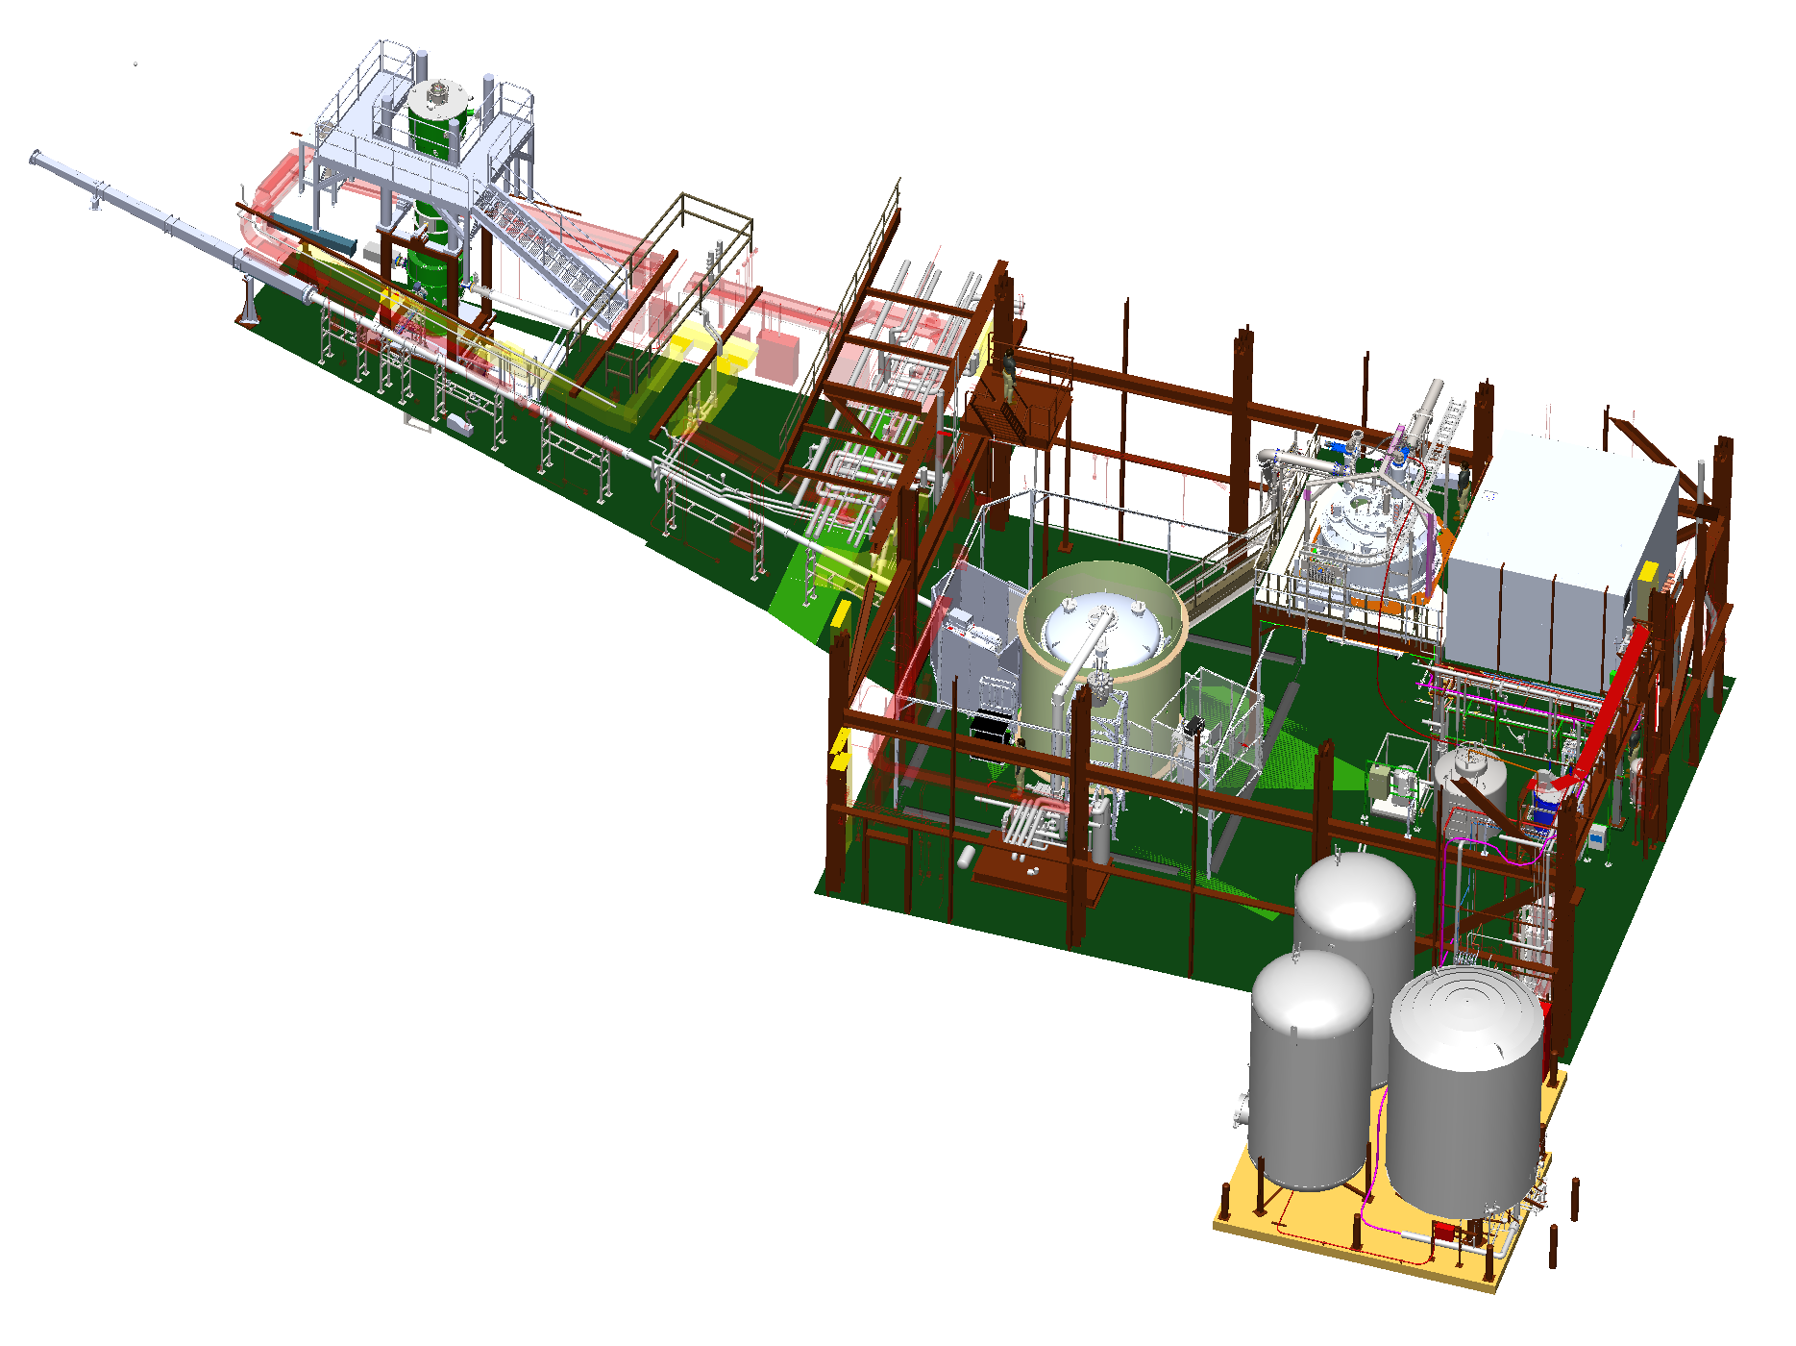
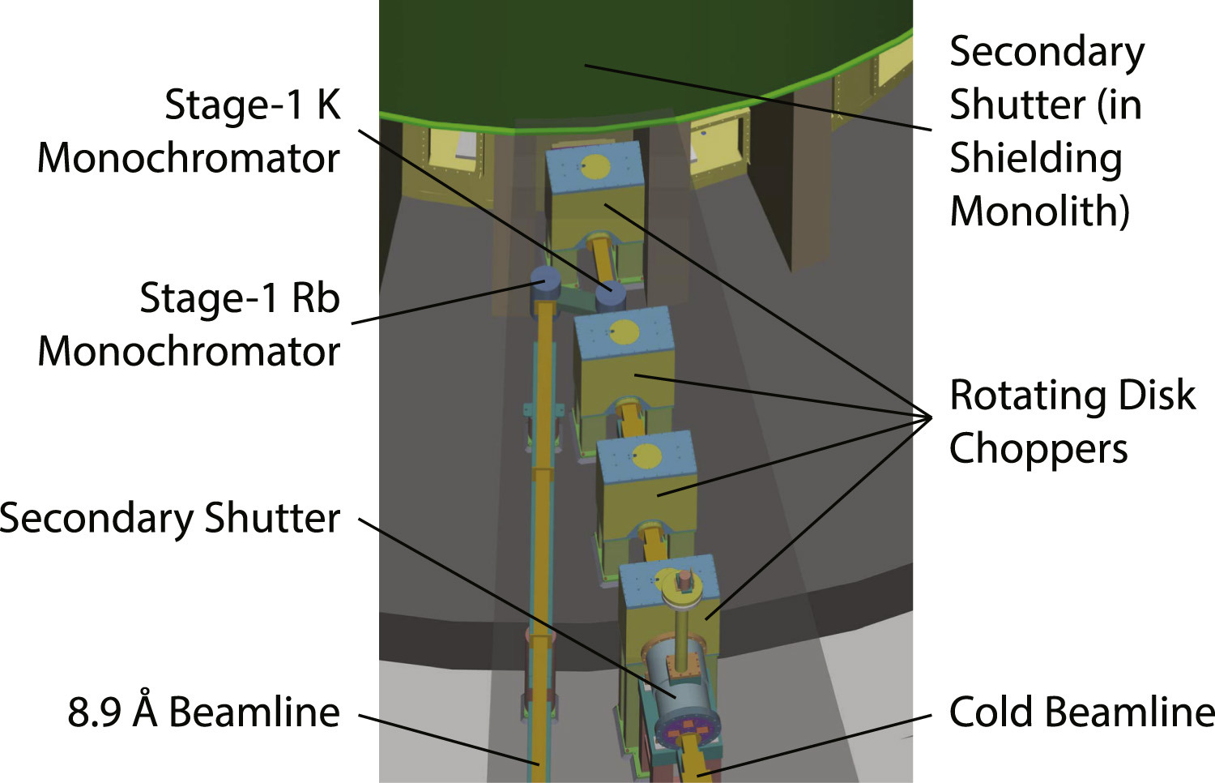
The Fundamental Neutron Physics Beamline (FNPB)
BL13B: Pulsed, high-flux
cold-neutron beam
Nab spectrometer
in shielding cave
BL13A: Mono-
chromatic 9.8Å beam
External
building

Slide 5
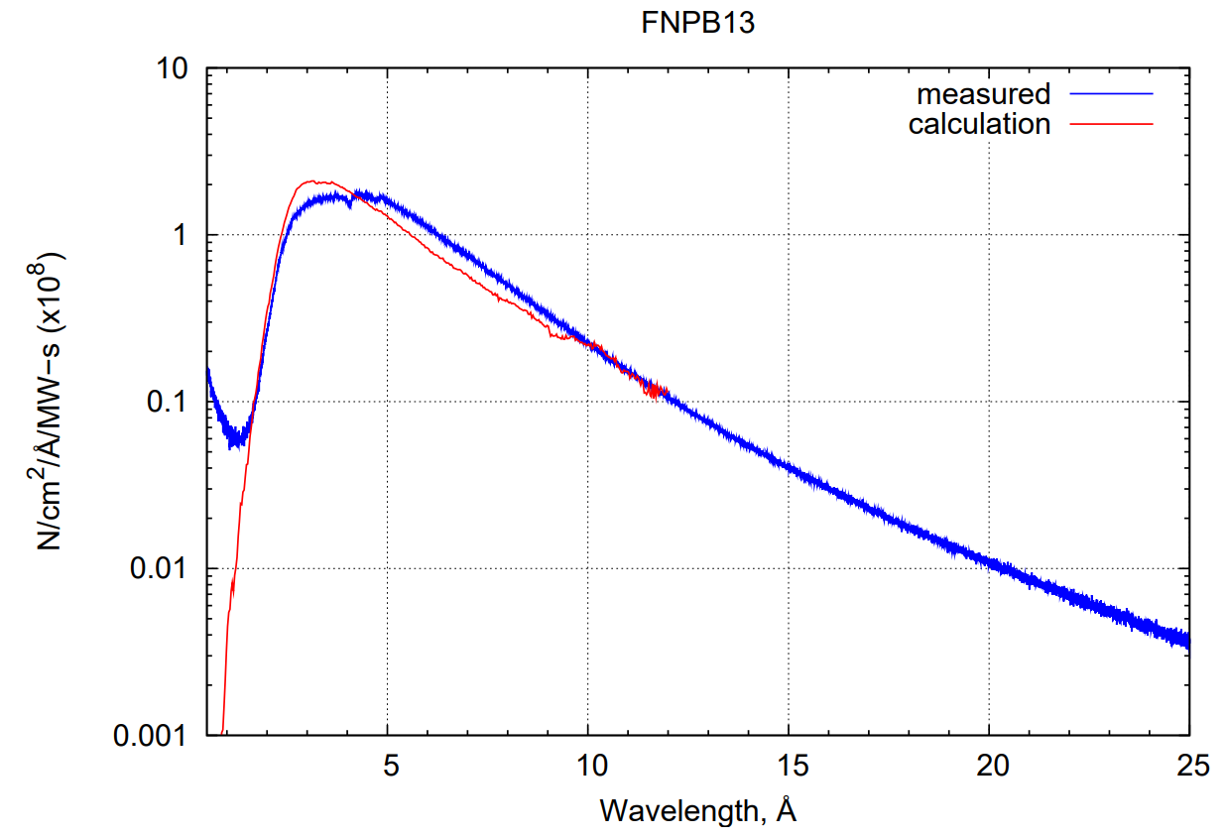
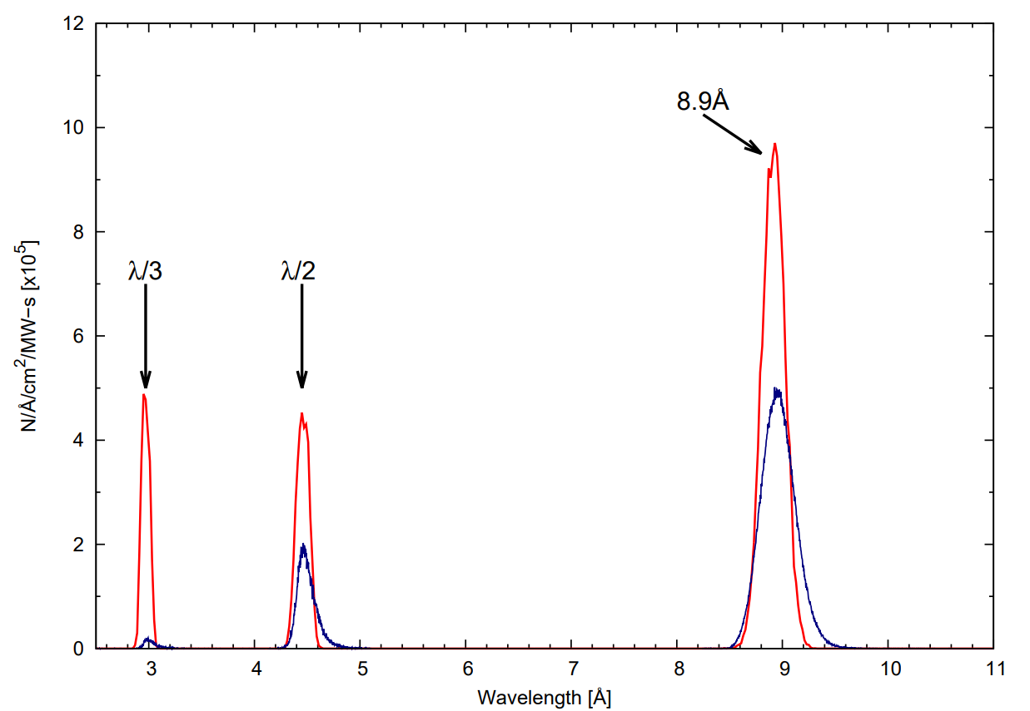
The Fundamental Neutron Physics Beamline (FNPB)
BL13B: Pulsed, high-flux
cold-neutron beam
Nab spectrometer
in shielding cave
BL13A: Mono-
chromatic 9.8Å beam
External
building
BL13B
BL13A

Slide 6
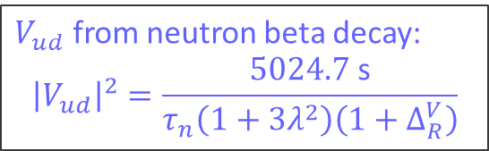
Lots of interest during new call for proposals
6 out of 12 proposals recommended by PRAC:
Neutron spin rotation
Phase Grating Moire Interferometer
Nab: Unpolarized neutron decay correlations
pNAB: Polarized neutron decay correlations
Neutron Lifetime Measurement with Pulsed Cold Neutron Beam inside Superfluid Helium
Neutron Lifetime using Ultracold Neutrons in Superfluid Helium
Apparatus
available
V_{ud}
program
$V_{ud}$ from neutron beta decay:
$${\left|V_{ud}\right|}^{2}=\frac{5024.7 \text{s}}{τ_{n}\left(1+3λ^{2}\right)\left(1+Δ_{R}^{V}\right)}$$
DOI: 10.22323/1.472.0066

Slide 7
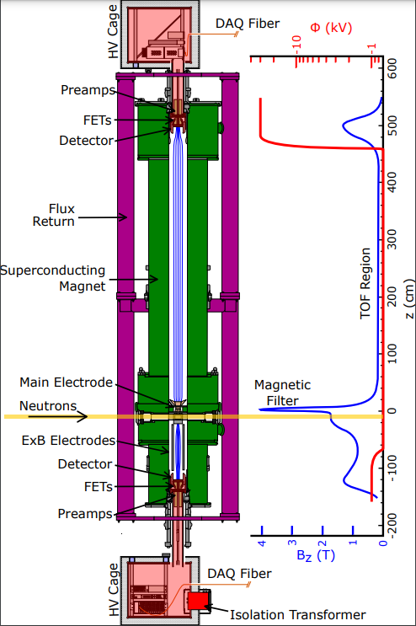
Nab: Neutron ‘a’ and ‘b’
Electron-neutrino correlation for unpolarized neutrons
Charged neutron decay products guided to upper and lower detectors by magnetic field
Protons accelerated into upper detector only by -30 kV potential: momentum from TOF
Electron energy measured in both silicon detectors

Slide 8
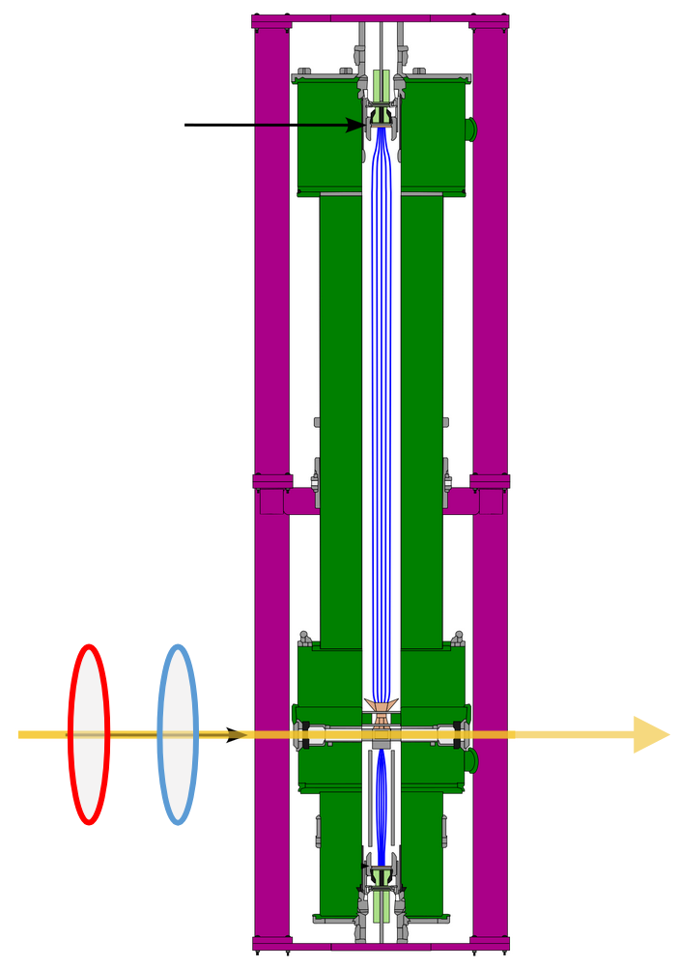
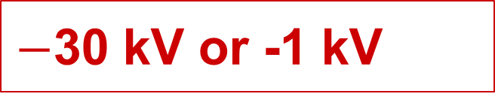
pNAB Concept
0 kV or -30 kV
Start with Nab Spectrometer:
Silicon detectors
New components:
Neutron beam polarizer
Neutron beam polarization analyzer
SF
Analyzer
Neutron Beam
Polarizer
$−$30 kV or -1 kV

Slide 9




pNAB measurement modes: proton detection can be turned on and off by setting detector accelerating voltage
‘A’: Proton detection in lower detector
‘B’: Proton detection in upper detector
$−30$ kV
TOF region
TOF region
Segmented Si detector
Segmented Si detector
Magnetic filter
4 m flight path omitted
Magnetic filter
4 m flight path omitted
Fiducial (decay) volume
Fiducial (decay) volume
$+1$ kV
neutron beam
neutron beam
1 m flight path omitted
Polarizer
1 m flight path omitted
Polarizer
$+1$ kV
Spin flipper
$−30$ kV
Spin flipper
All protons detected at lower detector, electrons in both
Protons that pass the magnetic filter are detected at upper detector, electrons in both

Slide 10
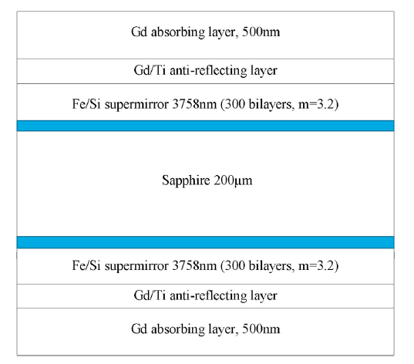
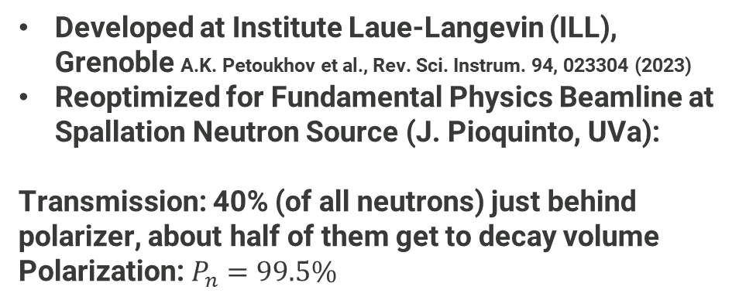


Neutron beam polarization, Solid state polarizer
Idea: Very high polarization efficiency doesn’t allow for much non-uniformity
Magnet
Solid State Polarizer
Collimation system
FNPB guide
$$φ_{2}$$
neutron path
...
...
$$−φ_{1}$$
Decay volume
Developed at Institute Laue-Langevin (ILL), Grenoble A.K. Petoukhov et al., Rev. Sci. Instrum. 94, 023304 (2023)
Reoptimized for Fundamental Physics Beamline at Spallation Neutron Source (J. Pioquinto, UVa):
Transmission: 40% (of all neutrons) just behind polarizer, about half of them get to decay volume
Polarization: $P_{n}=99.5\%$
neutrons
(³He polarization also practical!)

Slide 11
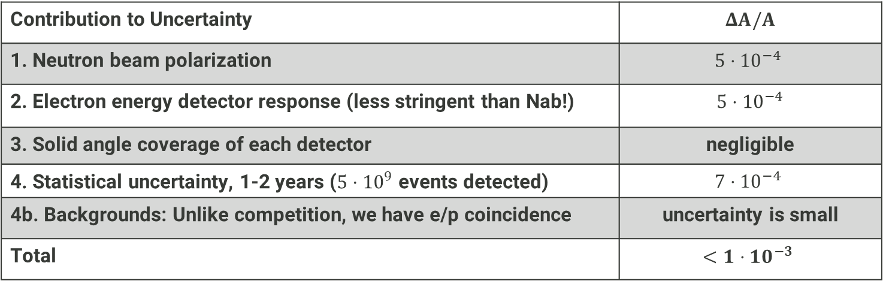
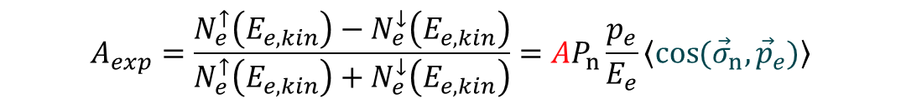
Uncertainty budget for beta asymmetry A in pNAB
4
1
2
3
$$A_{exp}=\frac{N_{e}^{↑}\left(E_{e,kin}\right)−N_{e}^{↓}\left(E_{e,kin}\right)}{N_{e}^{↑}\left(E_{e,kin}\right)+N_{e}^{↓}\left(E_{e,kin}\right)}=AP_{n}\frac{p_{e}}{E_{e}}\left\langle \cos{({\vec{σ}}_{n},{\vec{p}}_{e})}\right\rangle$$
Contribution to Uncertainty | $$ΔA/A$$
1. Neutron beam polarization | $$5⋅{10}^{−4}$$
2. Electron energy detector response (less stringent than Nab!) | $5⋅{10}^{−4}$
3. Solid angle coverage of each detector | negligible
4. Statistical uncertainty, 1-2 years ($5⋅{10}^{9}$ events detected) | $$7⋅{10}^{−4}$$
4b. Backgrounds: Unlike competition, we have e/p coincidence | uncertainty is small
Total | $$<1⋅{10}^{−3}$$

Slide 12
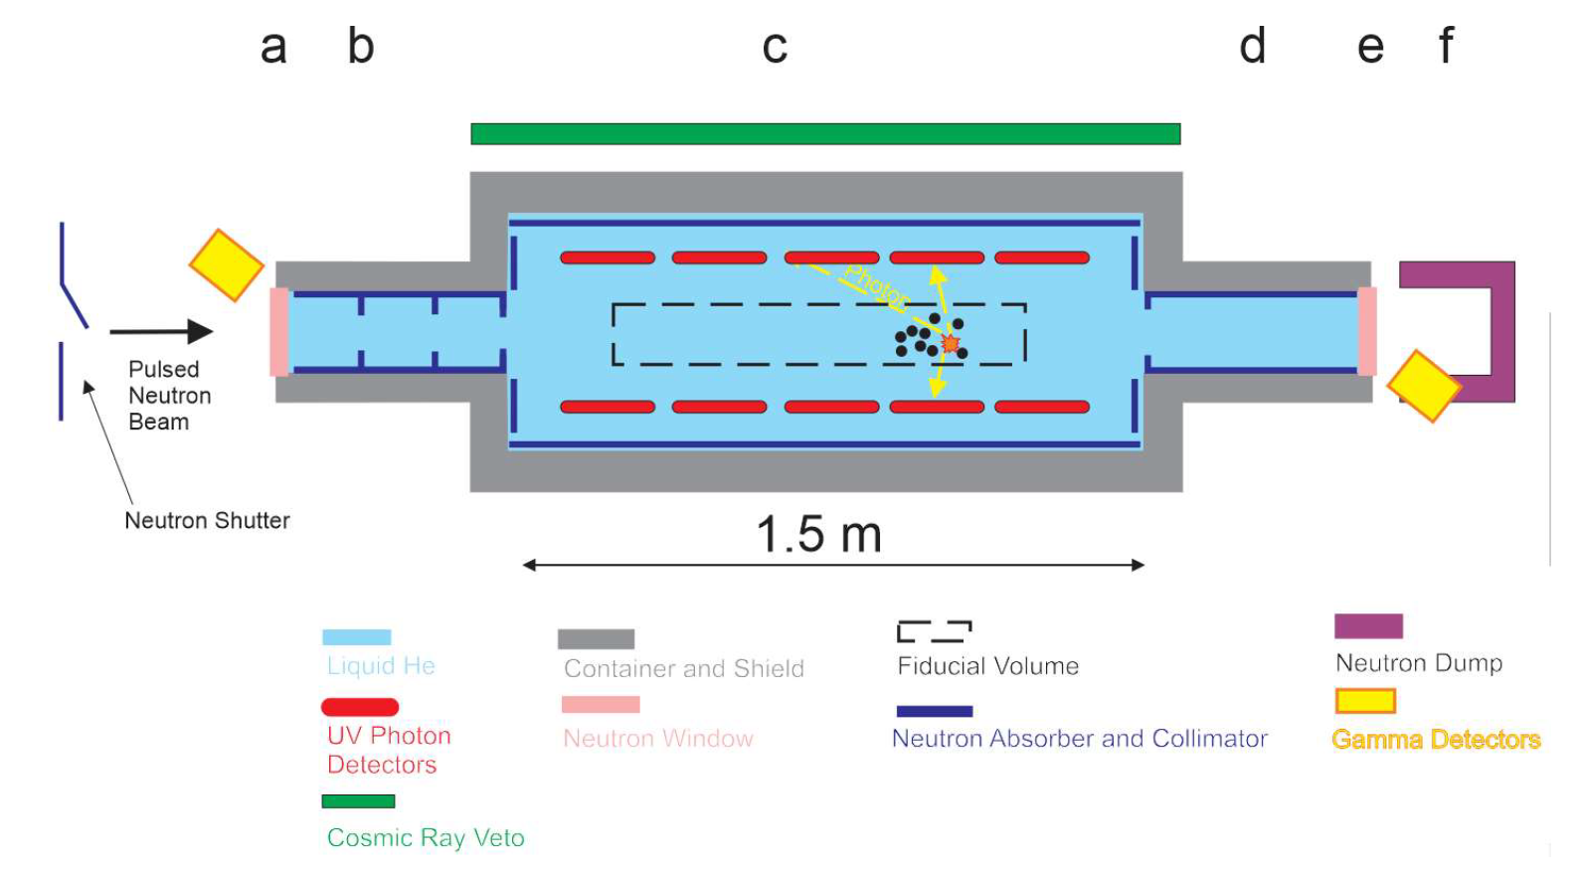
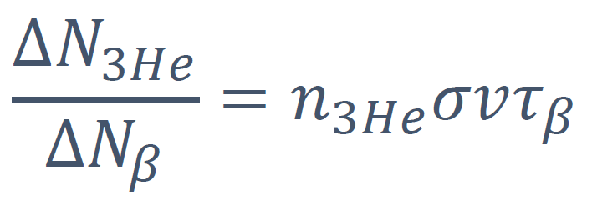
Neutron Lifetime Measurement with Pulsed Cold Neutron Beam inside Superfluid Liquid Helium
17Å Neutron pulse travelling through superfluid helium with precisely known ³He concentration
Detect He scintillation light from beta decay and capture on ³He at small concentrations
Determine ³He capture cross section from extinction at large concentrations
At the concept stage
W. Yao et al, FNPB Letter of EOI for new fundamental physics experiments

Slide 13
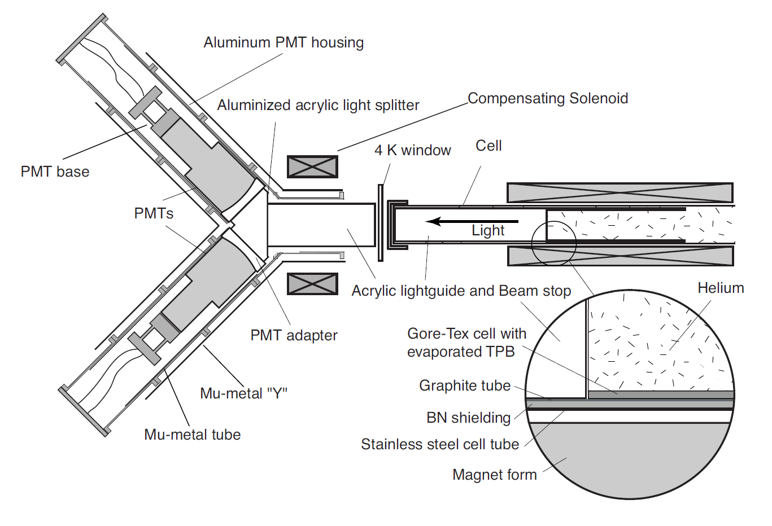
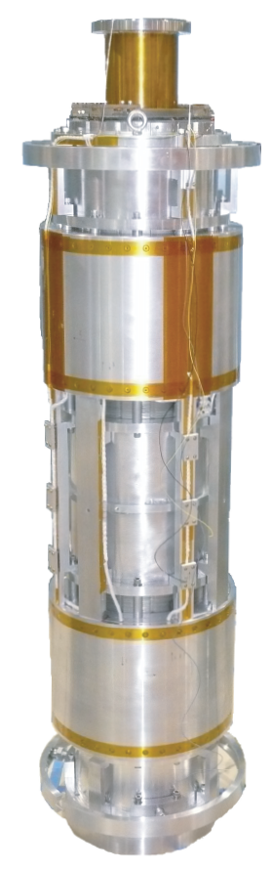
Neutron Lifetime using Ultracold Neutrons in Superfluid Helium
Cold neutron beam downscattered to ultracold using superfluid helium at 300mK in a magnetic trap
Detect He scintillation light from beta decays
Has been operated at NIST
Upgrades with new ⁴He purification and light detection systems
Expect improvements at FNPB over NIST projections (~3s precision in 40 days) thanks to reduced backgrounds
P. Huffman et al, Determination of the Neutron Lifetime Using Magnetically Trapped Ultracold Neutrons

Slide 14
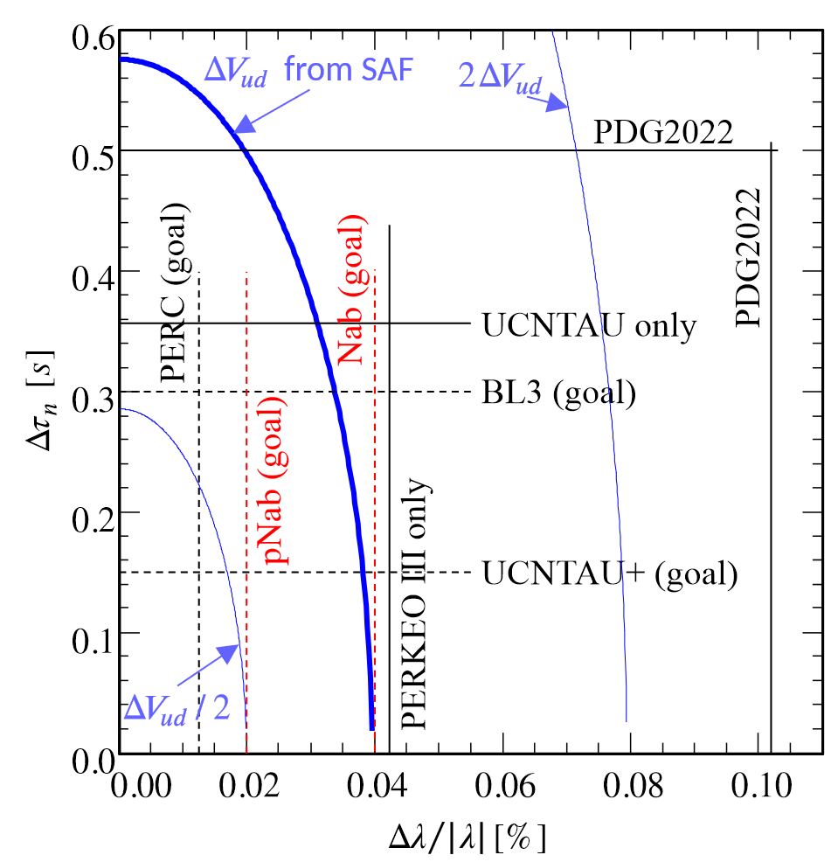
Neutrons can provide most precise V_{ud} measurement and CKM unitarity test
… if we can solve measurement discrepancies
$V_{ud}$ from neutron beta decay:
$${\left|V_{ud}\right|}^{2}=\frac{5024.7 \text{s}}{τ_{n}\left(1+3λ^{2}\right)\left(1+Δ_{R}^{V}\right)}$$

Slide 15
How to accommodate new instruments at FNPB?
Instrument | Beamline
Nab: Unpolarized neutron decay correlations | Currently occupying BL-13B, calibration system interfering with BL-13A! 70% of original beam into beam stop!
pNAB: Polarized neutron decay correlations | Reuse Nab spectrometer at BL-13B
Neutron spin rotation | BL-13B (white beam)
Phase Grating Moire Interferometer | BL-13A (8.9Å beam)
Neutron Lifetime Measurement with Pulsed Cold Neutron Beam inside Superfluid Helium | Requires pulsed 17Å beam (BL-13B with choppers?)
Neutron Lifetime using Ultracold Neutrons in Superfluid Helium | BL-13A (BL-13B for improved statistics?)

Slide 16
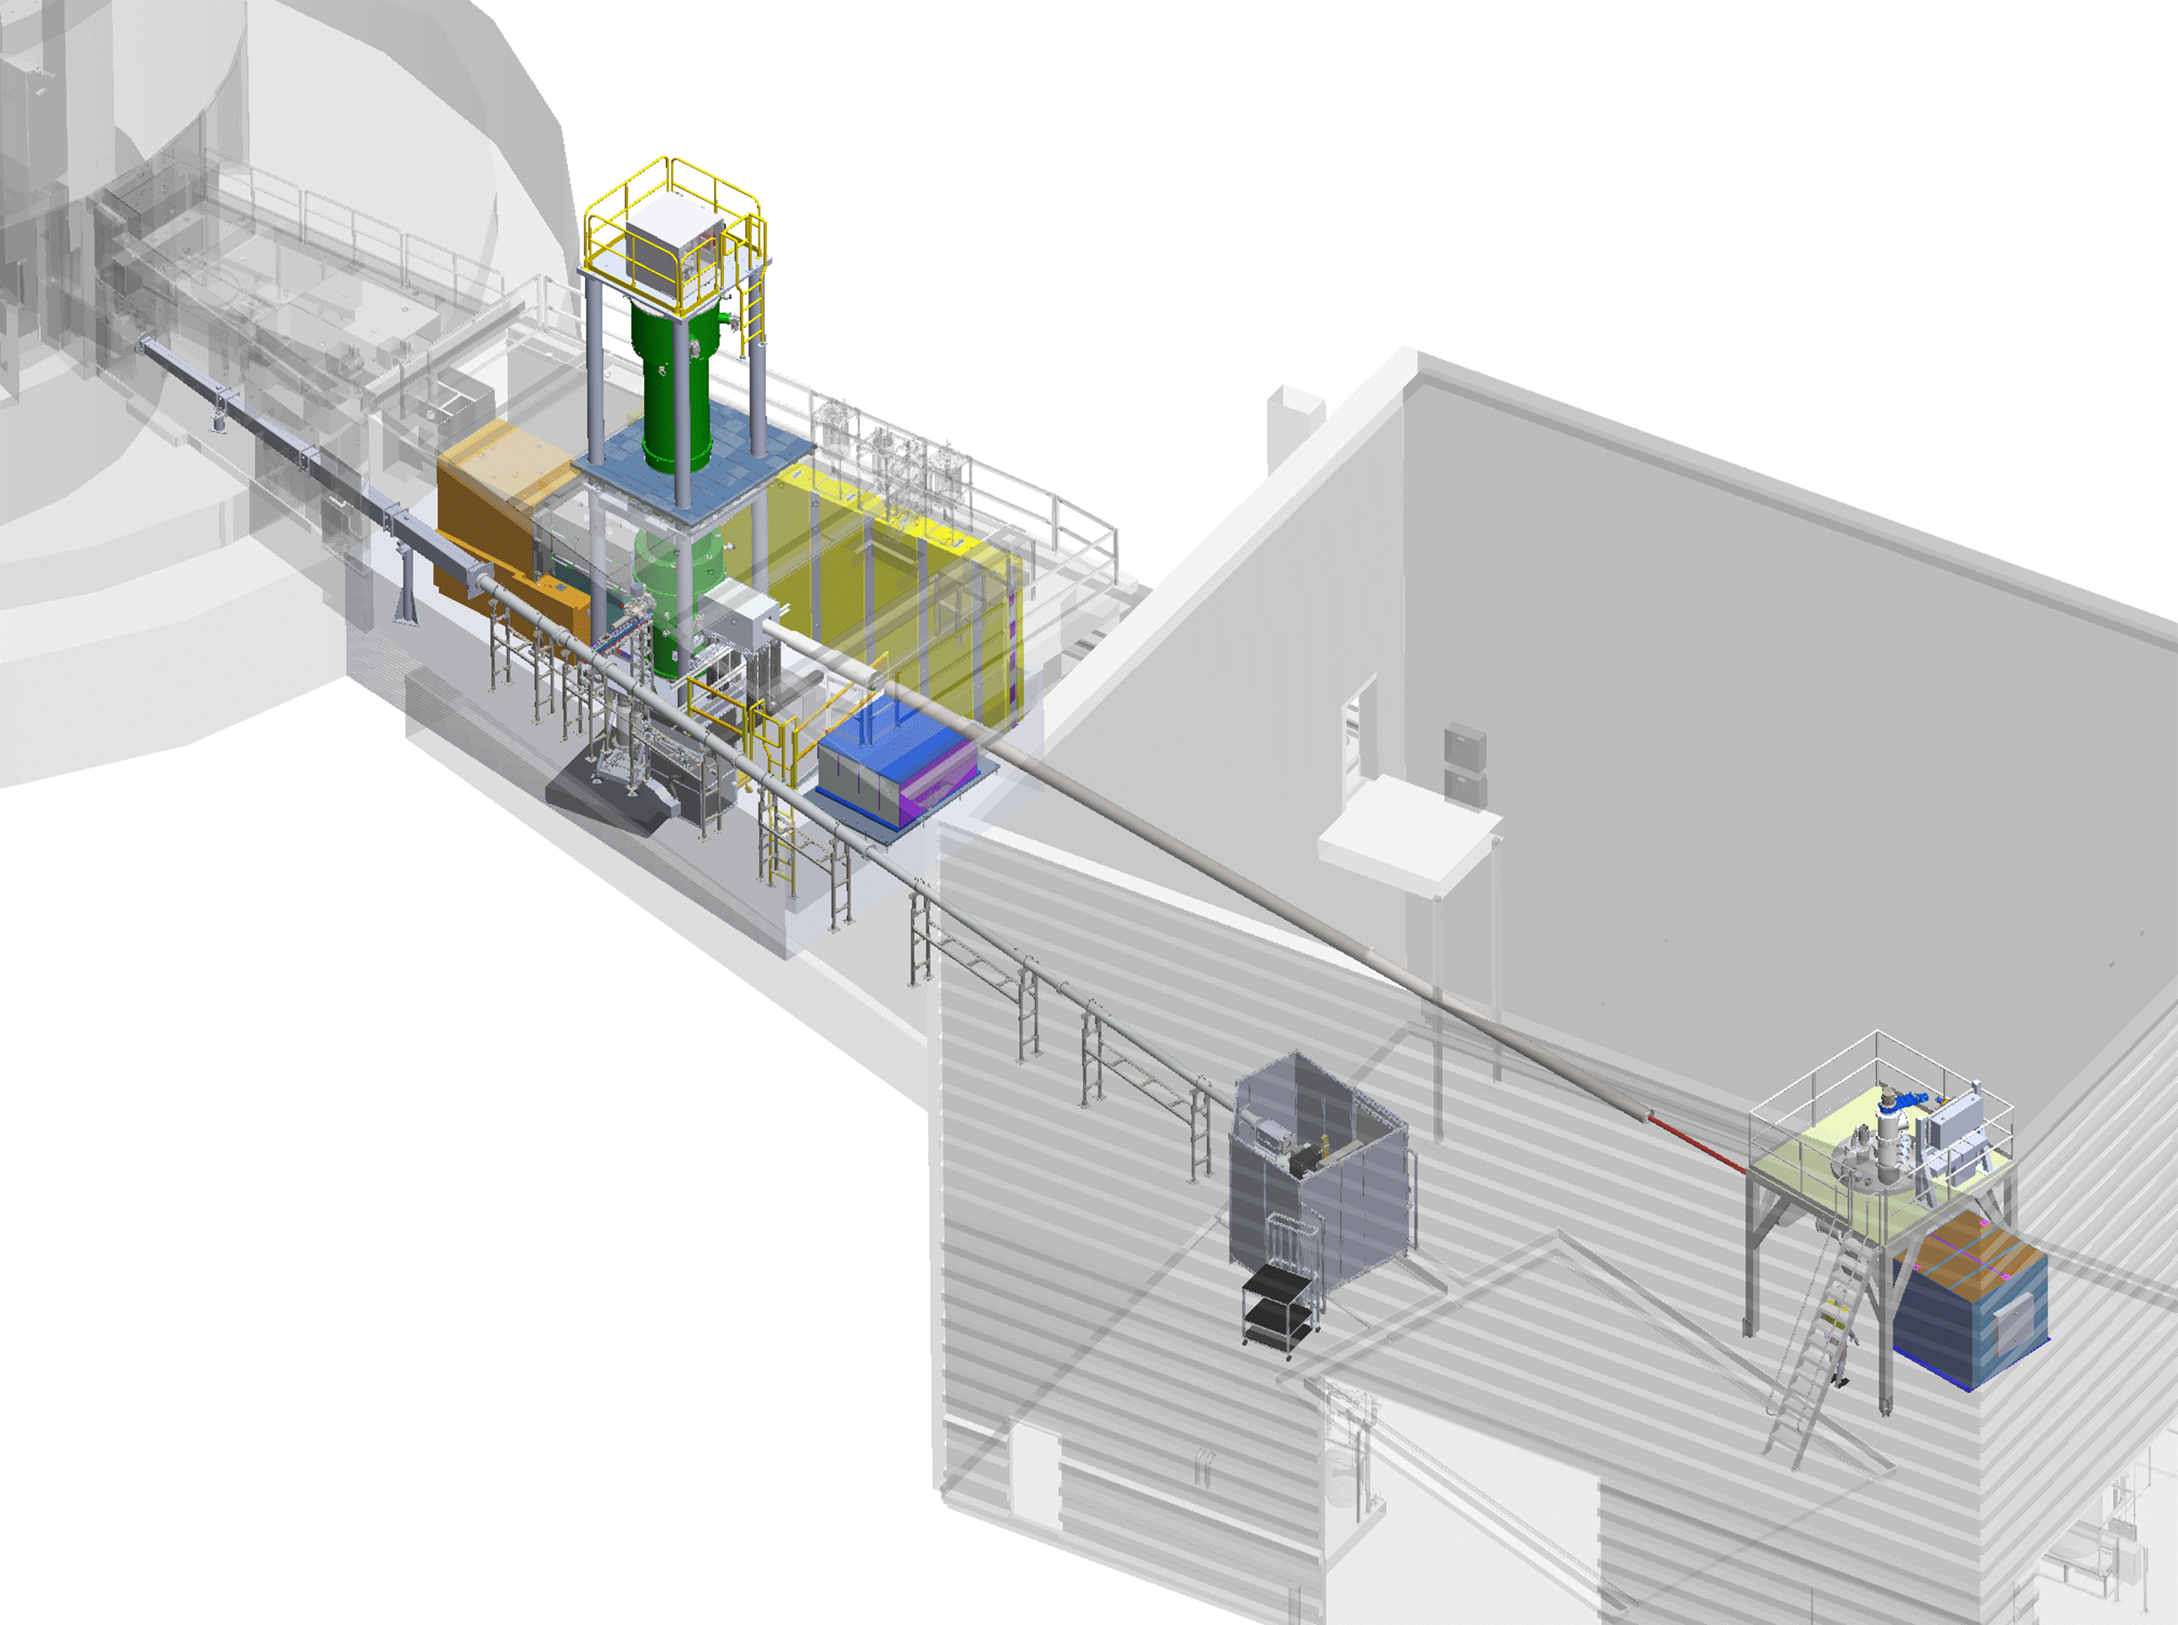
Next steps
Demonstrate Nab can achieve ~1% precision (2026)
Complete Nab data collection (earliest 2028)
Develop proposal to build BL13-B polarizer and start pNAB program
Improve Nab calibration system to allow concurrent BL-13A operation (2025/26)
Start new science program at BL-13A
Phase Grating Moire Interferometer?
Explore feasibility of BL-13B extension and third experiment station
Establish multi-user facility

