Slide 1

Measurement of the EDM of the muon
(and beta-decaying nuclei) using the frozen-spin technique in a compact storage trap
Philipp Schmidt-Wellenburg
Physics of fundamental symmetries and interactions 2025 | Villigen | 11.09.2025

Slide 2

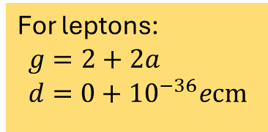





Lepton dipole moments (non-relativistic)
Non-relativistic Hamiltonian:
$$ℋ=−μ\vec{s}⋅\vec{B}−d\vec{s}⋅\vec{E}$$
$$\left|\vec{s}\right|=1$$
The magnetic $μ$ and electric $d$ dipole moment of a lepton are defined by
For leptons:
$$g=2+2a \\ d=0+{10}^{−36}ecm$$
$$μ=\frac{gq}{2m}\frac{ℏ}{2}$$
$$d=\frac{ηq}{2mc}\frac{ℏ}{2}$$
$${\vec{ω}}_{L}=\frac{gq}{2m} \vec{B}$$
$${\vec{ω}}_{E}=\frac{ηq}{2mc} \vec{E}$$

Slide 3
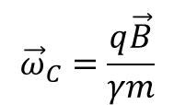
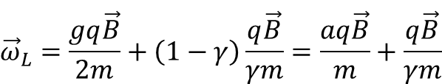

Lepton spin precession and motion in a B-field
Relativistic lepton spin precession in a perpendicular
magnetic field
$${\vec{ω}}_{L}=\frac{gq\vec{B}}{2m}+\left(1−γ\right)\frac{q\vec{B}}{γm}=\frac{aq\vec{B}}{m}+\frac{q\vec{B}}{γm}$$
Cyclotron frequency of a lepton in a perpendicular
magnetic field
$${\vec{ω}}_{C}=\frac{q\vec{B}}{γm}$$
Momentum
Spin
Measurement of the anomalous magnetic moment by observing relative precession
$${\vec{ω}}_{a}={\vec{ω}}_{C}−{\vec{ω}}_{L}=−\frac{q}{m}a\vec{B}$$

Slide 4
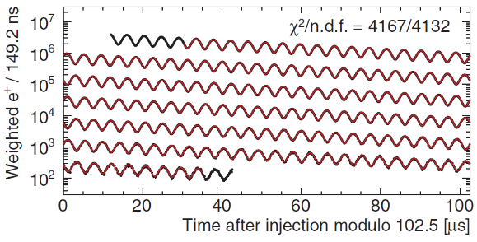
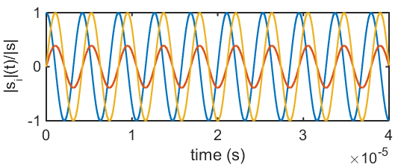

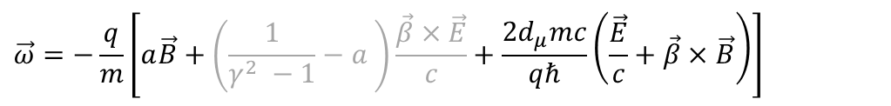


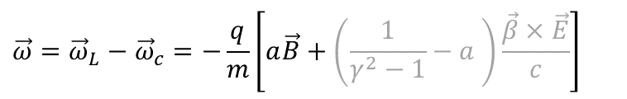








Muon dipole moments and frequencies
$$\vec{ω}=−\frac{q}{m}\left[a\vec{B}+\left(\frac{1}{γ^{2} −1}−a \right)\frac{\vec{β}×\vec{E}}{c}+\frac{2d_{μ}mc}{qℏ}\left(\frac{\vec{E}}{c}+\vec{β}×\vec{B}\right)\right]$$
$$\vec{ω}={\vec{ω}}_{L}−{\vec{ω}}_{c}=−\frac{q}{m}\left[a\vec{B}+\left(\frac{1}{γ^{2}−1}−a \right)\frac{\vec{β}×\vec{E}}{c}\right]$$
g-2 term $ω_{a}$
EDM term $ω_{e}$
B
$$\sqrt{{\vec{ω}}_{a}^{2}+{\vec{ω}}_{e}^{2}}$$
$${\vec{ω}}_{a}$$
$$ζ$$
$$R=7.114 m$$
$$ζ=\operatorname{atan}\left(\frac{2d_{μ}βcm}{a}\right)$$
$$\vec{s}$$
FNAL*:
JPARC**:
$$σ\left(d_{μ}\right)≈{10}^{−20}ecm$$
$${\vec{ω}}_{e}$$
$$σ\left(d_{μ}\right)≈{10}^{−21}ecm$$
[Abi et al., PRL126 141801(2021)]
[*D. Vasikova (MPI2025), **Abe et al., PTEP053C02 (2019)]
Notes:
Many of you probably know about the g-2 measurement of the muon at Fermilab.
The principle physics are described in the equation. The difference between the Larmor frequency of the muon, essentially the precision due to the magnetic moment, and the cyclotron frequency of the muon moving in a magnetic and electric field.
The muon moves along its reference orbit perpendicular to the main magnetic field. Due to the small anomalous magnetic moment the difference is not exactly zero and one can observe the famous wiggle plot by measuring in the number of decay positrons per time.
The electric field is required for steering the muon inside the storage ring. By selecting the correct momentum the electric term can be set to zero and the observed oscillation frequency directly relates to the anomalous magnetic moment.
Now in the presence of a electric dipole moment the plane of oscillation tilts and one could observe a tiny vertical observation of the positron intensity, and the measured frequency would be a little bit larger.
The prospected sensitivity is about 10E-21 ecm for the EDM at Fermilab and JPARC.

Slide 5
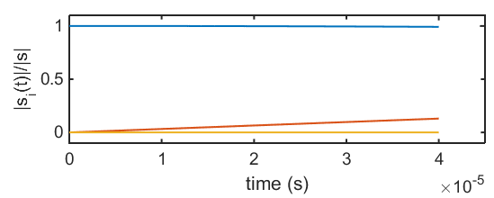






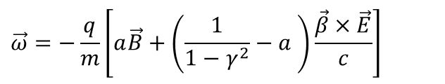

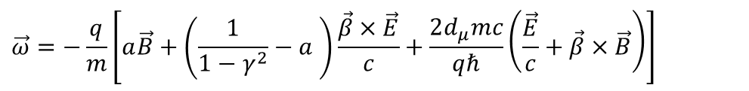


Muon dipole moments –freezing the spin at PSI
$$\vec{ω}=−\frac{q}{m}\left[a\vec{B}+\left(\frac{1}{1−γ^{2}}−a \right)\frac{\vec{β}×\vec{E}}{c}+\frac{2d_{μ}mc}{qℏ}\left(\frac{\vec{E}}{c}+\vec{β}×\vec{B}\right)\right]$$
$$\vec{ω}=−\frac{q}{m}\left[a\vec{B}+\left(\frac{1}{1−γ^{2}}−a \right)\frac{\vec{β}×\vec{E}}{c}\right]$$
g-2 term $ω_{a}$
EDM term $ω_{e}$
$$s_{z}$$
Frozen-spin potential at PSI:$σ\left(d_{μ}\right)<{6⋅10}^{−23}ecm$
B
$$s_{y}$$
$$R=31 mm$$
$${\vec{ω}}_{e}$$
E
$$s_{x}$$
set $E ≅aBcβγ^{2}$
Phase I: $σ\left(d_{μ}\right)<{4⋅10}^{−21}ecm$
[*Farley et al,, PRL93 042001 (2004) ] ,
Notes:
To further increase the sensitivity to a muon EDM we propose to use the frozen-spin technique to measure the electric dipole moment.
By applying a well tuned electric field this entire term can be canceled and the spin exactly follows the momentum, essentially it is frozen to the momentum.
The only term present is the one of the electric dipole moment which leads to a precession of the spin around the radial axis like a bicycle going in a circle.
This in turn leads to a build up of a asymmetry of positron decays along and against the direction of the magnetic field, the signal we are searching for.

Slide 6
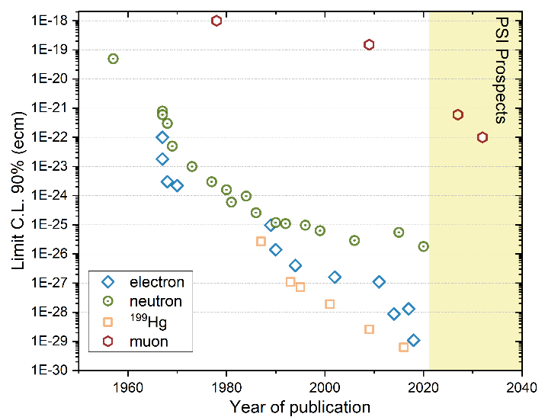
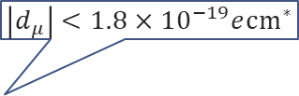
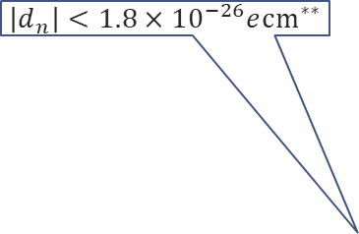

A not so brief history of EDM searches
$$\left|d_{μ}\right|<1.8×{10}^{−19}e{cm}^{∗}$$
Neutron
Electron
Muon
log(d) /ecm
log(d) /ecm
log(d) /ecm
$$\left|d_{n}\right|<1.8×{10}^{−26}e{cm}^{∗∗}$$
-18
-20
-22
-24
-26
-28
-30
-32
-34
-36
-38
-18
-20
-22
-24
-26
-28
-30
-32
-34
-36
-38
-18
-20
-22
-24
-26
-28
-30
-32
-34
-36
-38
$$\frac{m_{μ}}{m_{e}}$$
10¹⁸
10⁶
*Bennett et al.,PRD80(2009)052008
** Abel et al., PRL124(2020)081803
10⁸
Notes:
Searches for electric dipole moments started a long time ago in the 1950 when Ramsey and Purcell were first searching an EDM using a beam of neutrons.
Since then, the race to the bottom started.
Here on this graph I depicted for you the 90% limits versus the year of publication. In green the neutron, the blue diamonds are measurements on atoms and molecules extracting the EDM off the electron.
In yellow squares the impressive story of the mercury EDM. Lagging far behind is the muon, the only sizable search for an EDM of a particle in the second generation.
On the right side you see the expectation range for standard model EDM from the small imaginary phase of the CKM matrix in relation to the current limit.
The neutron still has another 6 orders of magnitude until they will hit the SM background. The electron another 9 order of magnitude, while the muon is today where Ramsey started 70 years ago and has another 18 orders of magnitude of legroom.

Slide 7
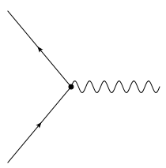


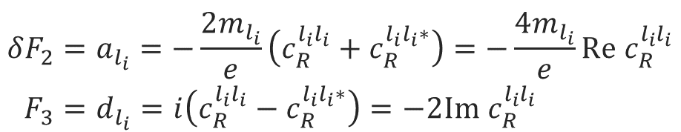

Lepton form factors and dipole moments
$$l_{f}$$
$$F^{μν}$$
$$l_{i}$$
magnetic-dipole
Anapole - moment
$$\left\langle p′ | J_{μ}^{EM} | p\right\rangle =\overline{Ψ}\left(p^{′}\right)\left[F_{1}γ_{μ}+\frac{iF_{2}}{2M}σ_{μν}q^{ν}+\frac{iF_{3}}{2M}σ_{μν}γ_{5}q^{ν}+\frac{F_{4}}{M^{2}}(q^{2}γ_{μ}−γ^{μ}q_{μ}q_{μ})\right]Ψ\left(p\right)$$
charge
electric-dipole
$${δF}_{2}=a_{l_{i}}=−\frac{2m_{l_{i}}}{e}\left(c_{R}^{l_{i}l_{i}}+c_{R}^{l_{i}l_{i}∗}\right)=−\frac{4m_{l_{i}}}{e}Re c_{R}^{l_{i}l_{i}} \\ F_{3}=d_{l_{i}}=i\left(c_{R}^{l_{i}l_{i}}−c_{R}^{l_{i}l_{i}∗}\right)=−2Im{ c}_{R}^{l_{i}l_{i}}$$
Notes:
For the purpose of a general discussion, effective field theories are particular useful, as no assumptions are needed for the exact realization of a high energy theory.
The most general form in which one can write down the interaction of a lepton current with an external electric/magnetic field is using this electro magnetic current with all possible bilinears.
In this case the first form factor is the electric charge, the second the magnetic and the third the electric dipole moment. The anapole moment I just depicted for completeness
Interestingly the anomalous magnetic moment is connected to the same Wilson coefficient in effective field theories. The real part of this Wilson coefficient is proportional to the anomalous magnetic momentum, while the imaginary part is related to the electric dipole moment.

Slide 8
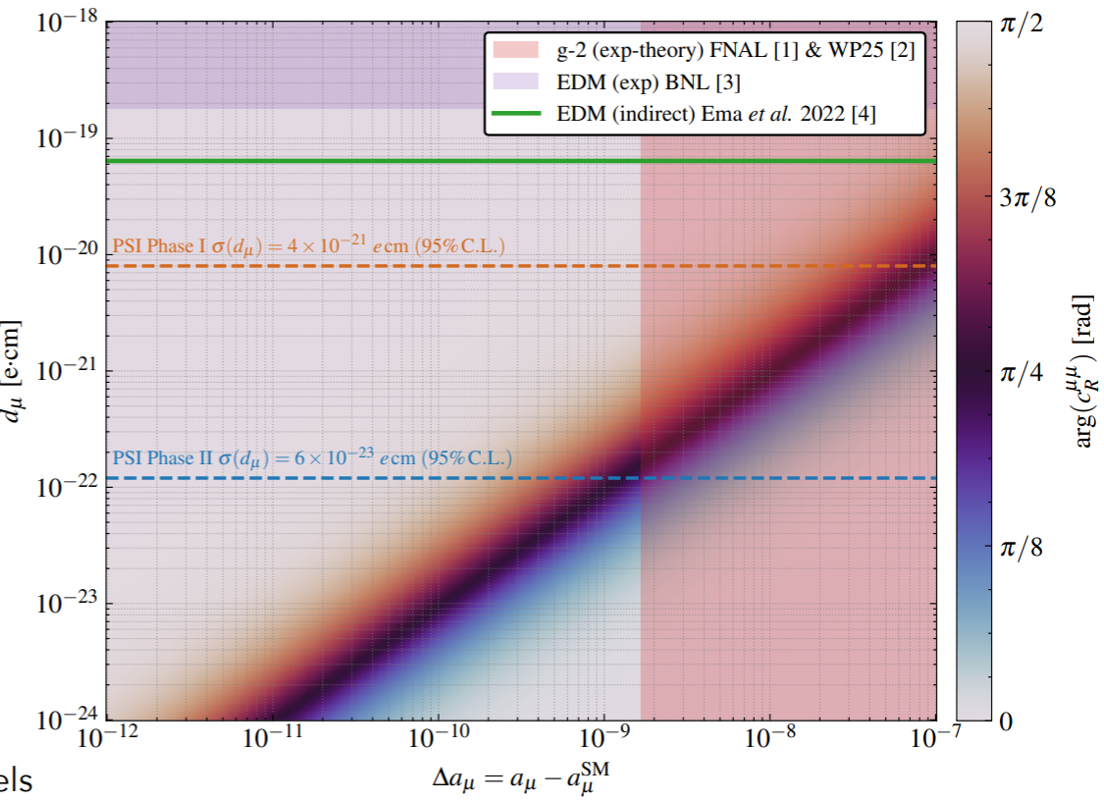
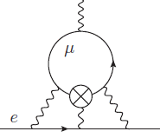
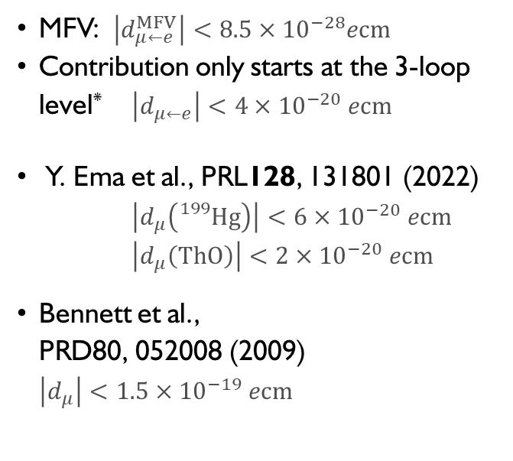
General limits on $μ$EDM
MFV: $\left|d_{μ←e}^{MFV}\right|<8.5×{10}^{−28}ecm$
Contribution only starts at the 3-loop level* $\left|d_{μ←e}\right|<4×{10}^{−20} ecm$
Y. Ema et al., PRL128, 131801 (2022)
$\left|d_{μ}\left({}_{}^{199}{Hg}\right)\right|<6×{10}^{−20} ecm$
$\left|d_{μ}\left(ThO\right)\right|<2×{10}^{−20} ecm$
Bennett et al.,
PRD80, 052008 (2009)
$\left|d_{μ}\right|<1.5×{10}^{−19} ecm$

Slide 9
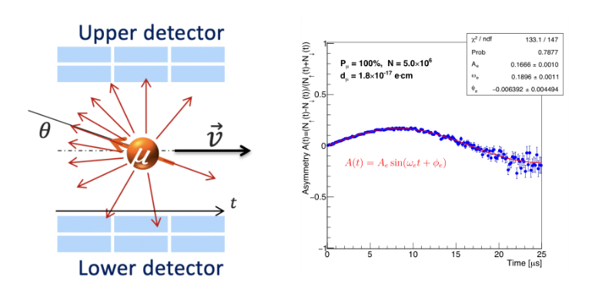


The general experimental idea
EDM ≠ 0 induces a vertical spin-precession out of the plane of the orbit.
Build-up of longitudinal asymmetry with time, observed by recording decay positrons.
If EDM = 0, spin “frozen” to the momentum
change in asymmetry should be zero
Some change in asymmetry could
still be observed due to
systematic effects
B
$$R=31 mm$$
$${\vec{ω}}_{e}$$
E

Slide 10
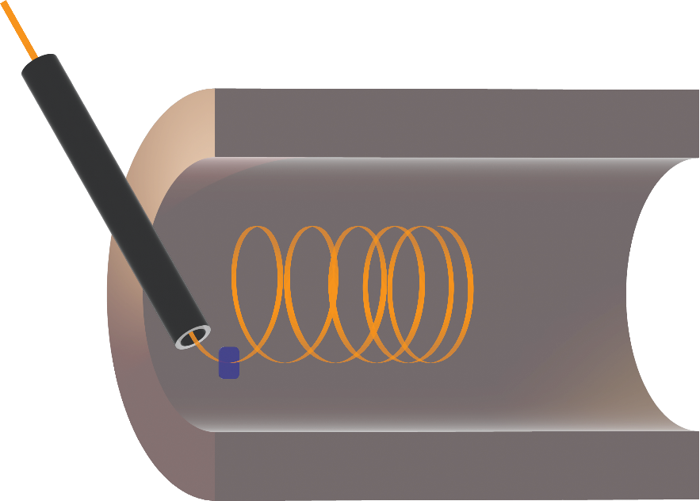





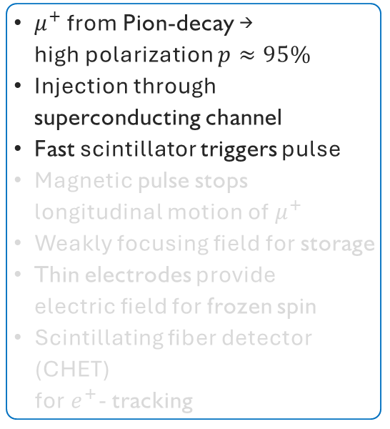



Search for a muon EDM using the frozen-spin technique with longitudinal injection
$$\vec{s}$$
$$\vec{s}$$
$$π$$
$μ^{+}$ from Pion-decay →
high polarization $p≈95\%$
Injection through superconducting channel
Fast scintillator triggers pulse
Magnetic pulse stops longitudinal motion of $μ^{+}$
Weakly focusing field for storage
Thin electrodes provide
electric field for frozen spin
Scintillating fiber detector (CHET)
for$e^{+}$- tracking
$${\overline{ν}}_{μ}$$
$μ^{+} @ 125MeV/c$ or $28MeV/c$
$$μ^{+}$$
Superconducting Injection Chanel
Entrance Detector
(t=0 & trigger signal)
$$\vec{B}$$
Notes:
fringe fields, avoid deflection and divergence
why SC? they can induce persistent eddy currents to provide field-free region

Slide 11
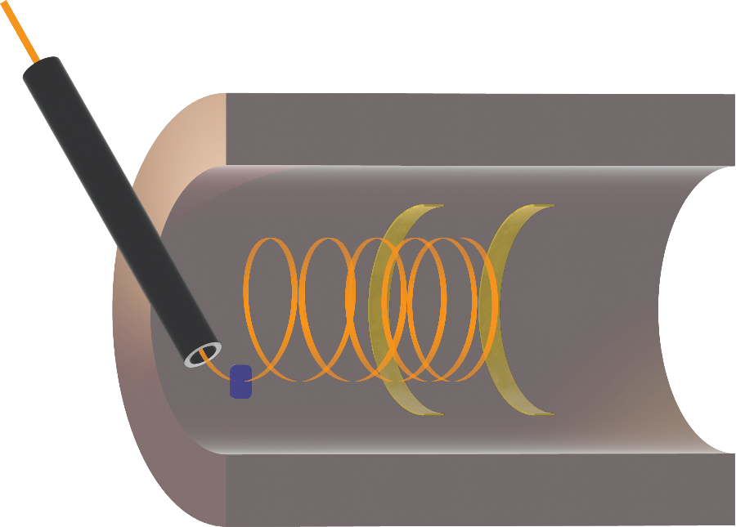
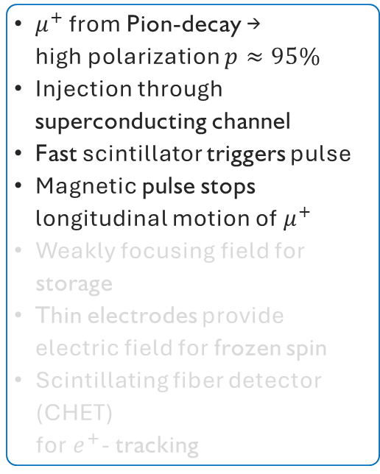
Search for a muon EDM using the frozen-spin technique with longitudinal injection
$$\vec{s}$$
$$\vec{s}$$
$$π$$
$μ^{+}$ from Pion-decay →
high polarization $p≈95\%$
Injection through superconducting channel
Fast scintillator triggers pulse
Magnetic pulse stops longitudinal motion of $μ^{+}$
Weakly focusing field for storage
Thin electrodes provide
electric field for frozen spin
Scintillating fiber detector (CHET)
for$e^{+}$- tracking
$${\overline{ν}}_{μ}$$
$μ^{+} @ 125MeV/c$ or $28MeV/c$
$$μ^{+}$$
Pulse Coils
(pulsed B field)
Superconducting Injection Chanel
Entrance Detector
(t=0 & trigger signal)
$$\vec{B}$$
Notes:
fringe fields, avoid deflection and divergence
why SC? they can induce persistent eddy currents to provide field-free region

Slide 12
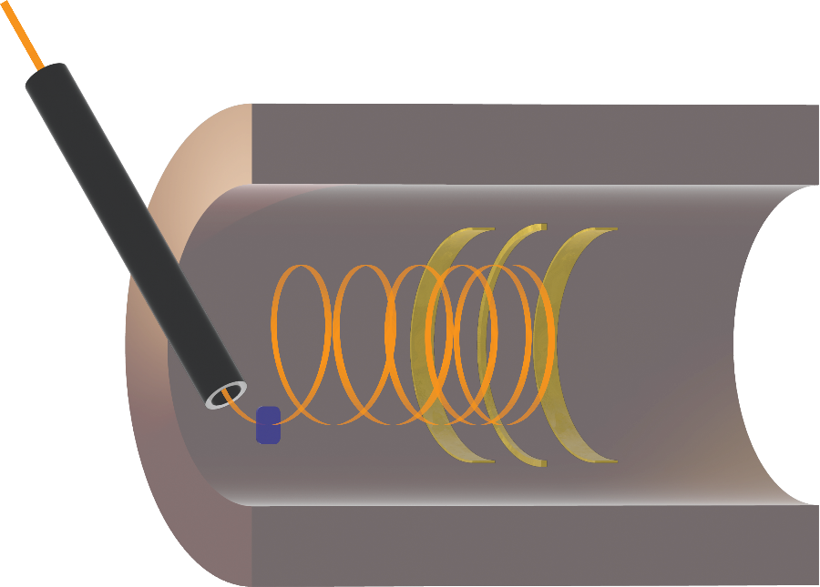
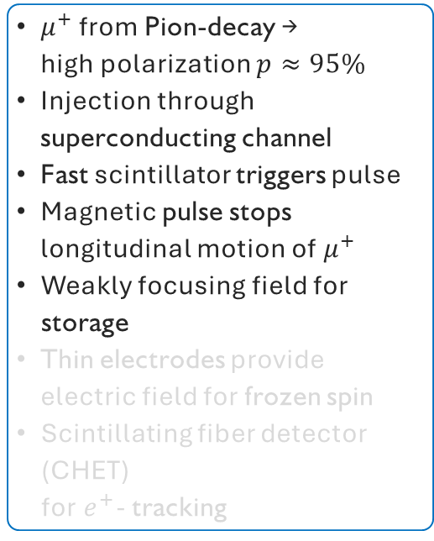

Search for a muon EDM using the frozen-spin technique with longitudinal injection
$$\vec{s}$$
$$\vec{s}$$
$$π$$
$μ^{+}$ from Pion-decay →
high polarization $p≈95\%$
Injection through superconducting channel
Fast scintillator triggers pulse
Magnetic pulse stops longitudinal motion of $μ^{+}$
Weakly focusing field for storage
Thin electrodes provide
electric field for frozen spin
Scintillating fiber detector (CHET)
for$e^{+}$- tracking
$${\overline{ν}}_{μ}$$
$μ^{+} @ 125MeV/c$ or $28MeV/c$
$$μ^{+}$$
Pulse Coils
(pulsed B field)
Superconducting Injection Chanel
$$\vec{B}$$
Entrance Detector
(t=0 & trigger signal)
Weakly-focusing Coil (static B field)
Notes:
fringe fields, avoid deflection and divergence
why SC? they can induce persistent eddy currents to provide field-free region

Slide 13
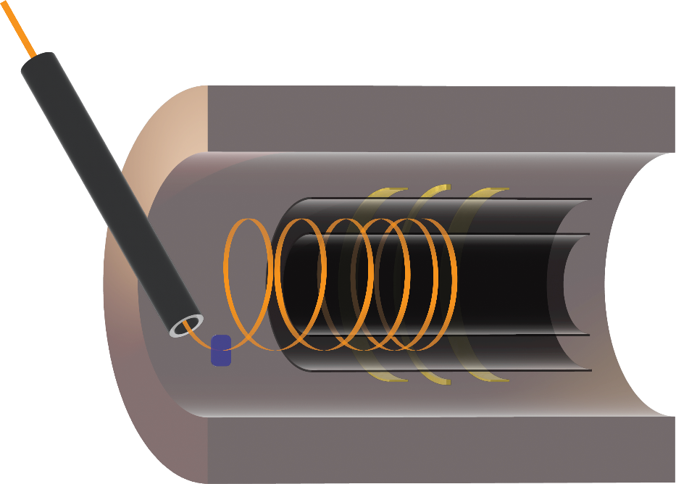
Search for a muon EDM using the frozen-spin technique with longitudinal injection
$$\vec{s}$$
$$\vec{s}$$
$$π$$
$μ^{+}$ from Pion-decay →
high polarization $p≈95\%$
Injection through superconducting channel
Fast scintillator triggers pulse
Magnetic pulse stops longitudinal motion of $μ^{+}$
Weakly focusing field for storage
Thin electrodes provide
electric field for frozen spin
Scintillating fiber detector (CHET)
for$e^{+}$- tracking
$${\overline{ν}}_{μ}$$
$μ^{+} @ 125MeV/c$ or $28MeV/c$
$$μ^{+}$$
Pulse Coils
(pulsed B field)
Electrodes
(static E field)
Superconducting Injection Chanel
$$\vec{B}$$
Entrance Detector
(t=0 & trigger signal)
Weakly-focusing Coil (static B field)
Notes:
fringe fields, avoid deflection and divergence
why SC? they can induce persistent eddy currents to provide field-free region

Slide 14
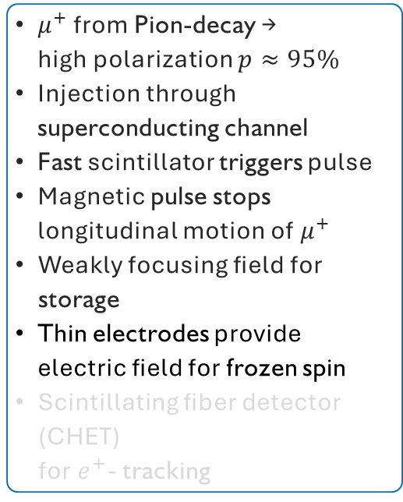

Search for a muon EDM using the frozen-spin technique with longitudinal injection
$$\vec{s}$$
$$\vec{s}$$
$$π$$
$μ^{+}$ from Pion-decay →
high polarization $p≈95\%$
Injection through superconducting channel
Fast scintillator triggers pulse
Magnetic pulse stops longitudinal motion of $μ^{+}$
Weakly focusing field for storage
Thin electrodes provide
electric field for frozen spin
Scintillating fiber detector (CHET)
for$e^{+}$- tracking
$${\overline{ν}}_{μ}$$
$μ^{+} @ 125MeV/c$ or $28MeV/c$
$$μ^{+}$$
Pulse Coils
(pulsed B field)
Electrodes
(static E field)
Superconducting Injection Chanel
$$\vec{B}$$
Entrance Detector
(t=0 & trigger signal)
$$\vec{E}$$
Weakly-focusing Coil (static B field)
Notes:
fringe fields, avoid deflection and divergence
why SC? they can induce persistent eddy currents to provide field-free region

Slide 15
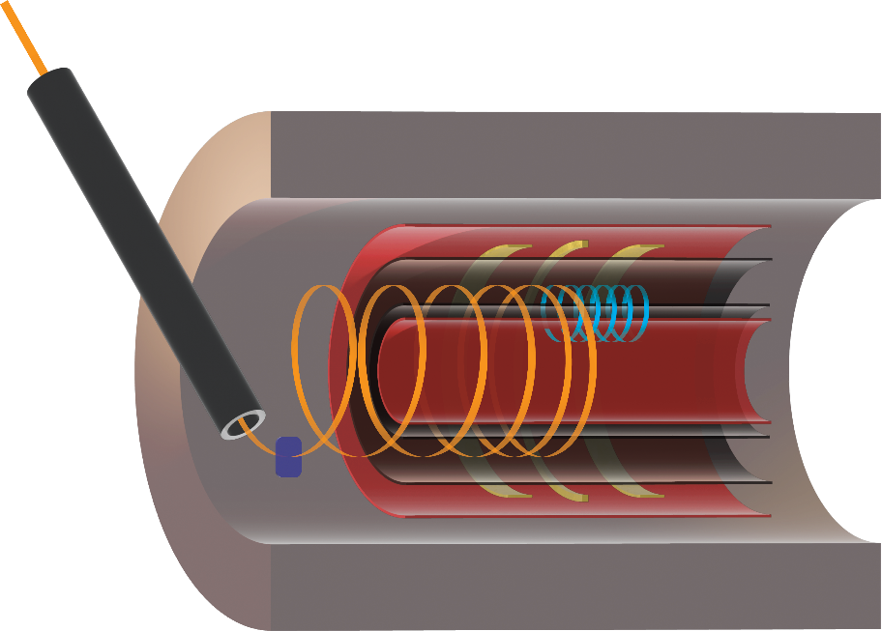
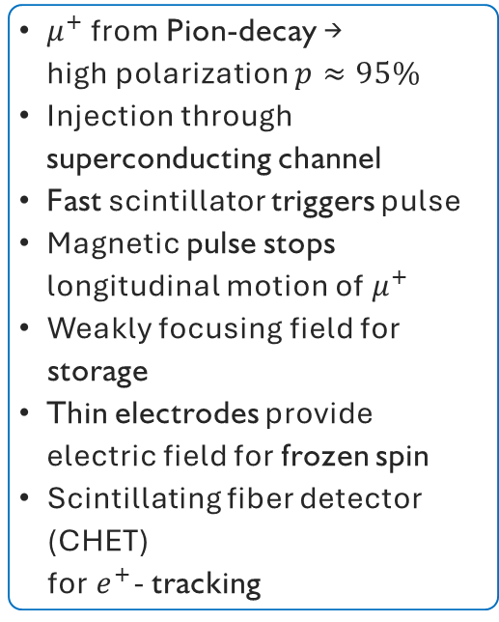
Search for a muon EDM using the frozen-spin technique with longitudinal injection
$$\vec{s}$$
$$\vec{s}$$
$$π$$
$μ^{+}$ from Pion-decay →
high polarization $p≈95\%$
Injection through superconducting channel
Fast scintillator triggers pulse
Magnetic pulse stops longitudinal motion of $μ^{+}$
Weakly focusing field for storage
Thin electrodes provide
electric field for frozen spin
Scintillating fiber detector (CHET)
for$e^{+}$- tracking
$${\overline{ν}}_{μ}$$
$μ^{+} @ 125MeV/c$ or $28MeV/c$
$$μ^{+}$$
Pulse Coils
(pulsed B field)
Electrodes
(static E field)
Superconducting Injection Chanel
$$\vec{B}$$
Entrance Detector
(t=0 & trigger signal)
$$\vec{E}$$
Weakly-focusing Coil (static B field)
Notes:
fringe fields, avoid deflection and divergence
why SC? they can induce persistent eddy currents to provide field-free region

Slide 16
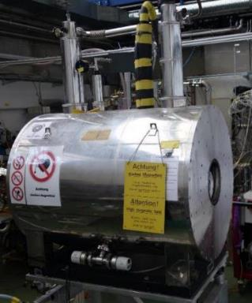
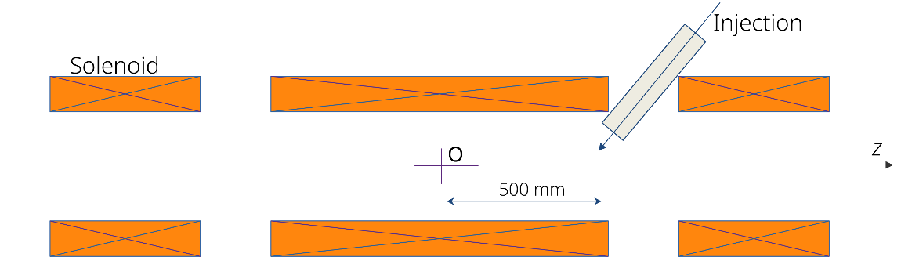
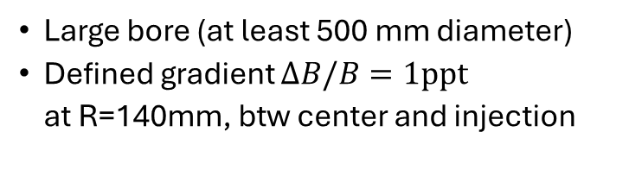
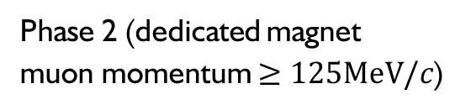
A phased approached
Phase I (small solenoid, surface muons)
Phase 2 (dedicated magnet
muon momentum $≥125MeV/c$)
500 mm
100 mm
Existing solenoid at PSI (max 5T)
Bore diameters (200mm)
Field was measured in 2022
(found suitable for injection)
Large bore (at least 500 mm diameter)
Defined gradient $ΔB/B=1ppt$
at R=140mm, btw center and injection

Slide 17
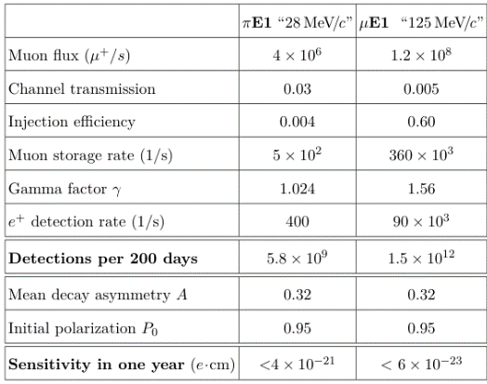
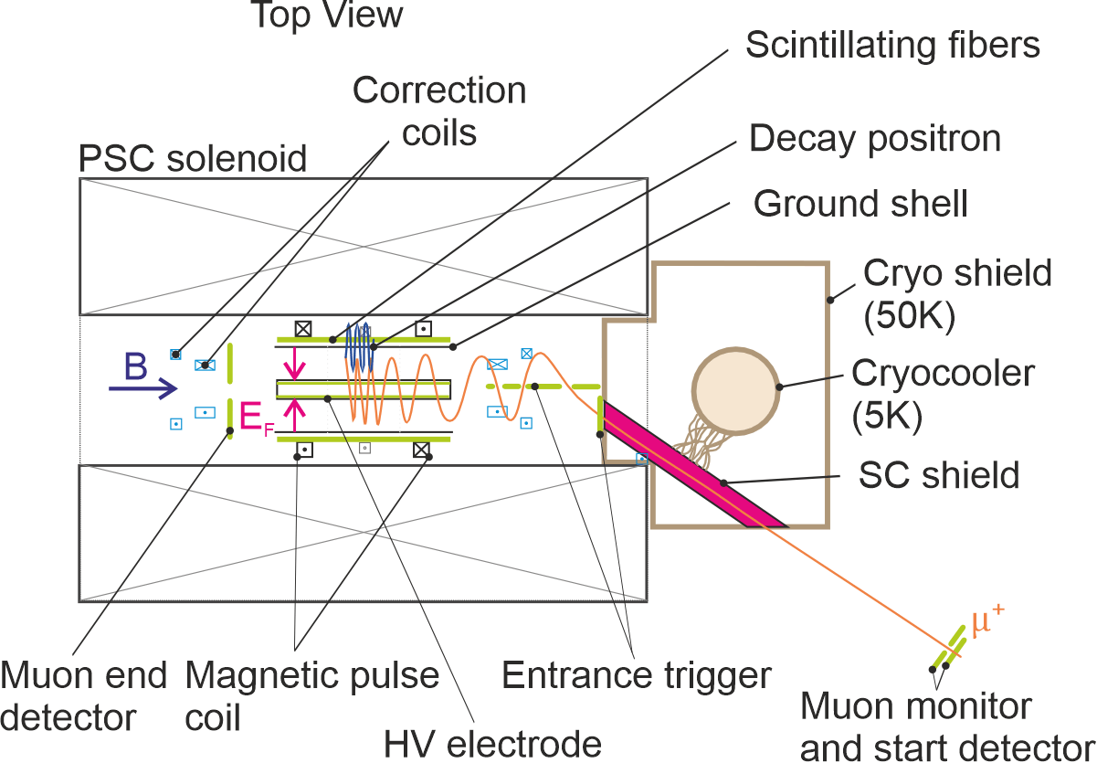

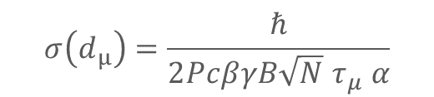
Injection and statistical sensitivity
Large phase space at exit of beam,
collimated by passage through SC -shield
Due to adiabatic magnetic collimation large part of transmitted $μ^{+}$ are reflected.
Simulations show, only about $0.4×{10}^{−3}$ muons can be stored
$$σ\left(d_{μ}\right)=\frac{ℏ}{2PcβγB{\sqrt{N} τ}_{μ} α}$$
[A. Adelmann et al., EPJC85(2025)622]
Page 17
Notes:
At PSI we will profit from the highest muon fluxes in the world.
The two possible beamlines provide very different energies and phase spaces.
For the precursor experiment we will use low energy muons and profit from a high transmission through the collimation channel
As the solenoid is not optimized only a small fraction will be stored.
Already this precursor experiment will have a sensitivity better than 3E-23 ecm.
In the long run with a dedicated magnet, using higher energetic muons we expect a sensitivity better than 10E-23ecm.

Slide 18
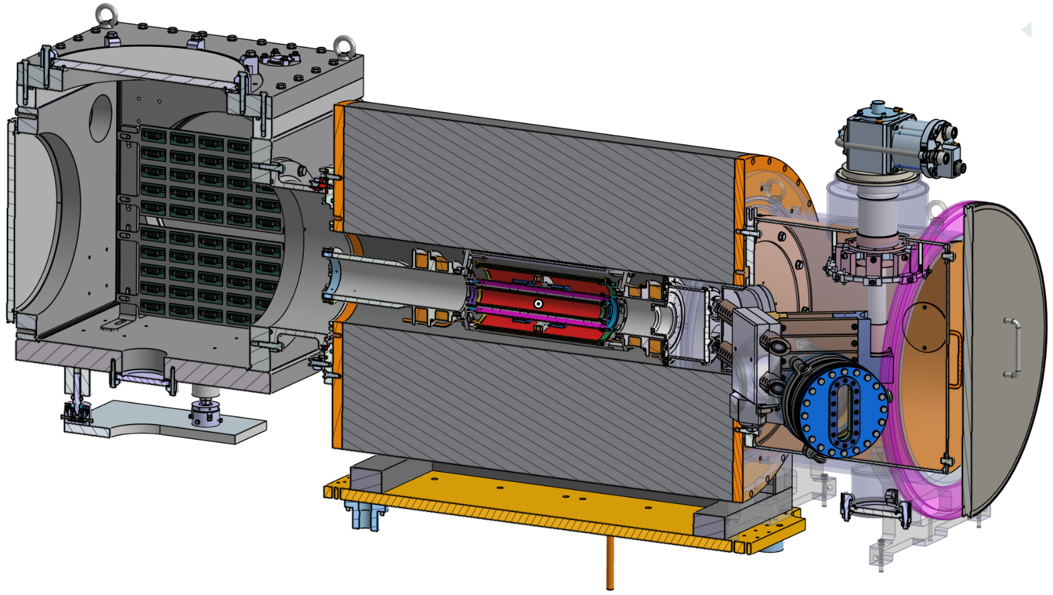
The Experiment - Technical overview
Vacuum box for services
4K cryo head
SC storage magnet
Fiber ports for
~ 2000 DAQ channels
Field correction coils
Positron tracker
Scintillating fibers
Off-axis Injection tubes
Radial electrodes

Slide 19
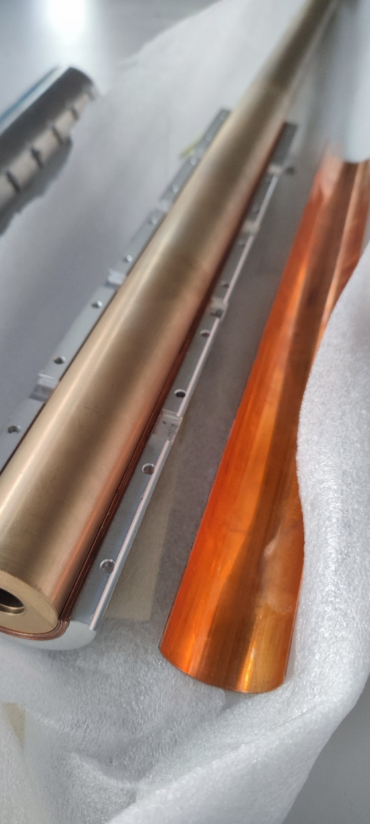
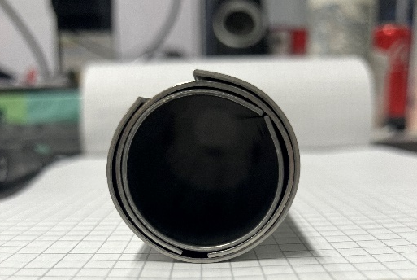
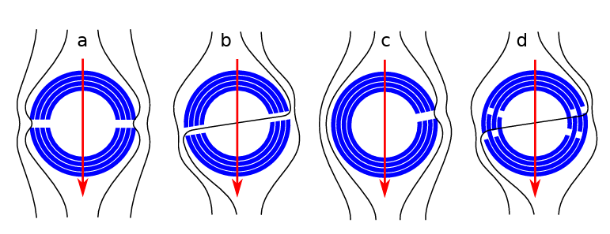
Bending the NbTi/Nb/Cu sheets
✅ Sheets @PSI
✅ Initial tests with steel sheets
✅ Tested to shield up to ~3.1T @CERN
  NbTi/Nb/Cu multilayer shield for the superconducting shield (SuShi) septum
  D. Barna et al.
https://arxiv.org/abs/1809.04330
✅ /❌ Holder design
❌ Formed sheets

Slide 20
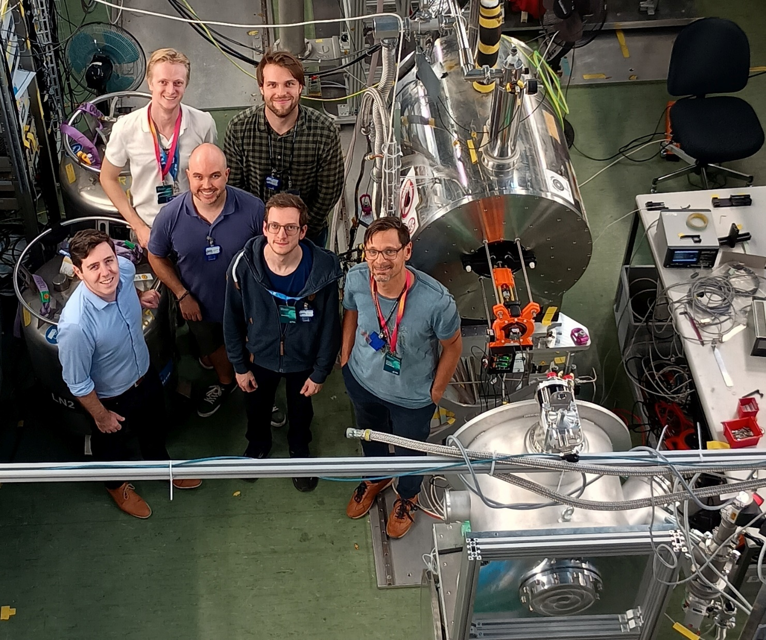

Slide 21
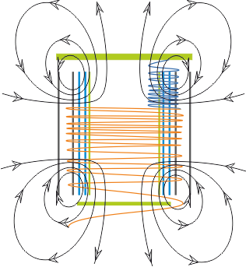
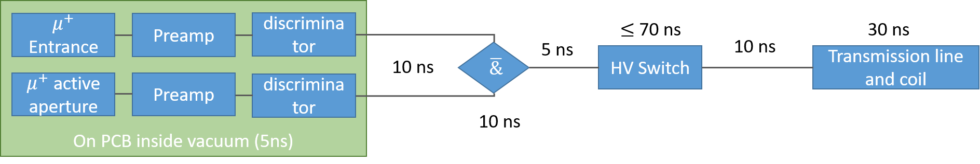
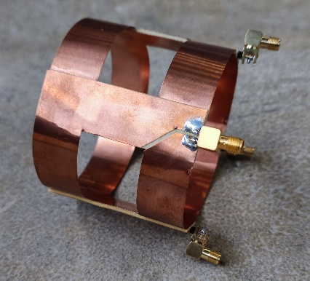
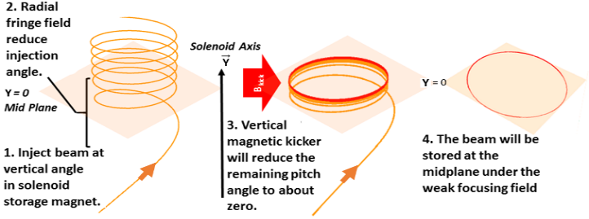
Radial magnetic field pulse to kick muons
Pulse generator
courtesy A.M. Rehman
Page 21

Slide 22
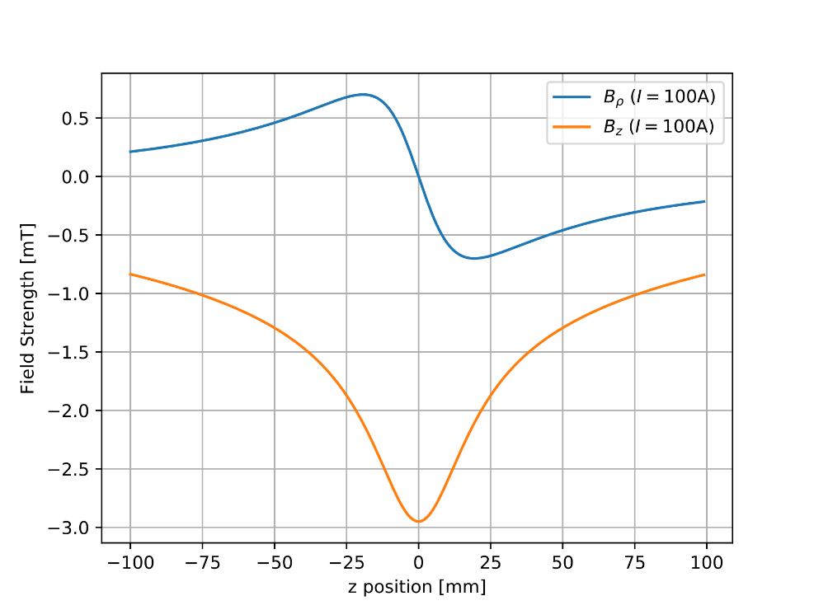
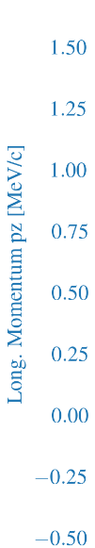
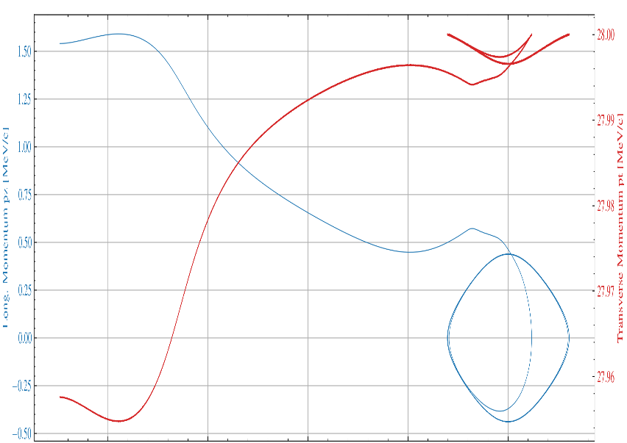


Longitudinal confinement
A static weakly-focusing field produced by a single circular coil will ensure confinement.
A longitudinal betatron oscillation of about 10MHz will persist during the measurement due to the remaining longitudinal momentum.
0.5MeV/c
0.14MeV/c
Kicker Coil
11

Slide 23
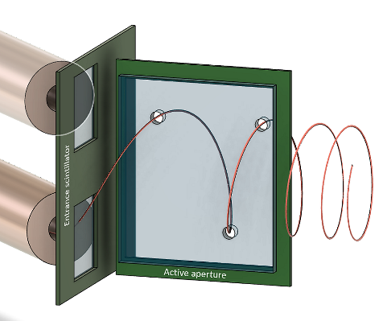



Muon entrance trigger
Entrance
Magnetic pulse needs to be triggered by incident muon
Only about 0.4% of muons passing through the collimation channel are within the acceptance phase space
Scattering in scintillators increase beam divergence
Combine thin ($≤100μm)$entrance scintillator with
Active aperture as veto
Veto
Entrance
Veto

Slide 24


Trigger detector
Detector requirements $≤10 ns$ propagation delay ✅
Maximise acceptance rate and rejection rate
Optimise design for best compromise
Storable muons
Non-storable muons

Slide 25



C1 demonstrator prototype: final details
US
DS
Total weight of the demonstrator prototype is 51.3 g
  27.5 g given by the 420 fibers (PS)

Slide 26




Extension to $β−$ decaying nuclei

Slide 27




Extension to $β−$ decaying nuclei
$σ\left(d_{Li}\right)≤2.4×{10}^{−25}ecm$ $(1 week)$

Slide 28



Conclusion and outlook
Searches of EDMs are sensitive to BSM and complementary to HEP
The muon EDM search is the only search using a bare particle
The frozen-spin technique in a compact trap has a unique sensitivity for cp EDMs
The PSI muEDM search demonstrates all essential techniques in a step-by-step approach
In the first phase we will demonstrate a sensitivity to a muEDM of better than $4×{10}^{−21}ecm$
Phase II welcomes collaborators and aims for
a sensitivity of $6×{10}^{−23}ecm$

Slide 29




















The collaboration open for participation
PSI proposal R-21-02.1

Slide 30
Backup

Slide 31





Geometric phases, and non-uniformities
Magnetic field
Electric field
$$ω_{a}$$
$$ω_{c}$$
Cavoto G., Chakraborty R., Doinaki A., et al., EJPC 84(2024)262

Slide 32


Detection efficiency asymmetry
The EDM will be deduced from the accumulation of asymmetry between the upstream and downstream detectors that increases with time
Static differences in the detection efficiency of one detector compared to the other is not a problem
Change of the detection efficiency with time is a problem as it will introduce time dependent asymmetry
Positron detectors
y
$$n_{L}=κ_{L}N$$
py
-py
$$n_{R}=κ_{R}N$$

Slide 33



Constraints on the total detection efficiency
Assumption: Change of detection efficiency triggered by pulse,
exponential decay
Detection efficiency of up and downstream detectors:
Change in measured asymmetry with time:

Slide 34

Systematic study - overview

Slide 35

Finding New Physics with Flavor
At colliders one produces many (up to 10¹⁴) heavy quarks or leptons and measures their decays into light flavors
Experiment
SM
b→sµµ
PIONEER
New Physics
Mu3e
MEG
LHC
Flavor observables are sensitive to higher energy scales than collider searches
Courtesy Andreas Crivellin

Slide 36

Leptoquark models with large muEDM
Bigaran PRD105(2022)015002
Dermisek PRD108(2023)055019
No signifcant tuning necessary
8

