Slide 1

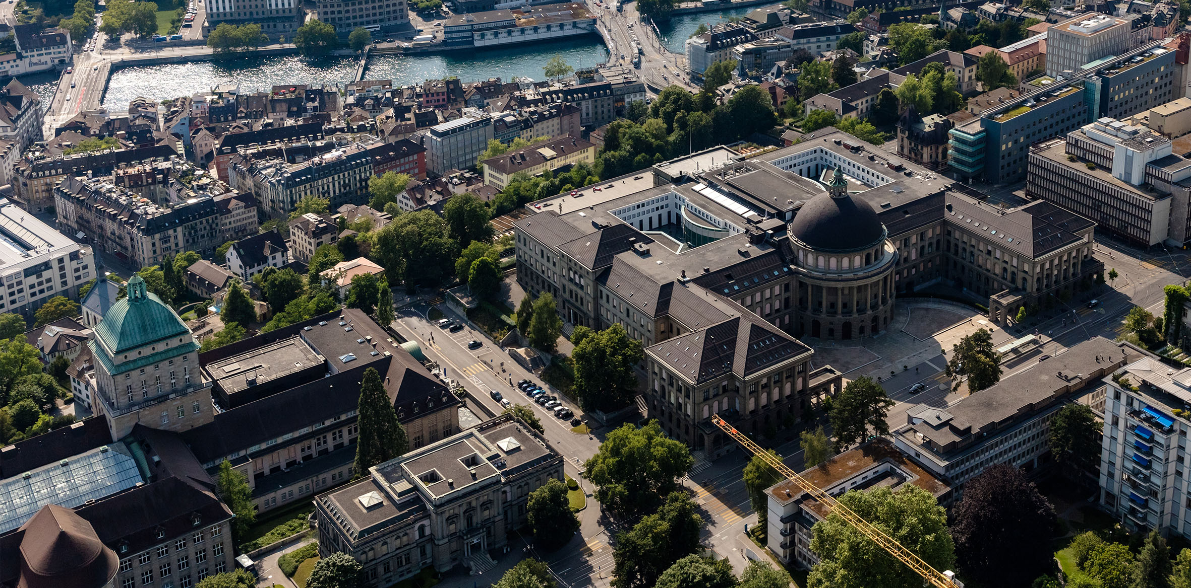
New results of Positronium 1S-2S transition and Muonium Fine structure
Edward Thorpe-Woods,
on behalf of the Mu-MASS collaboration and Crivelli group. PSI 2025
Ted Thorpe-Woods
on behalf of the Exotic Matter group at ETH Zurich

Slide 2
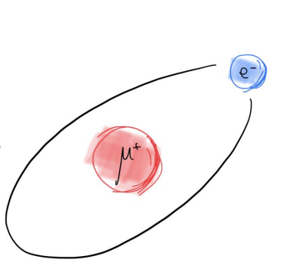
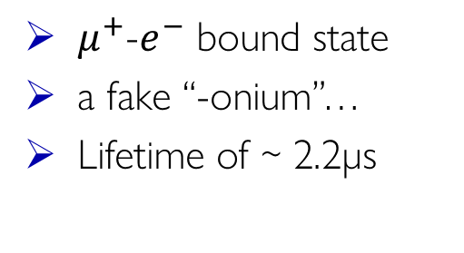
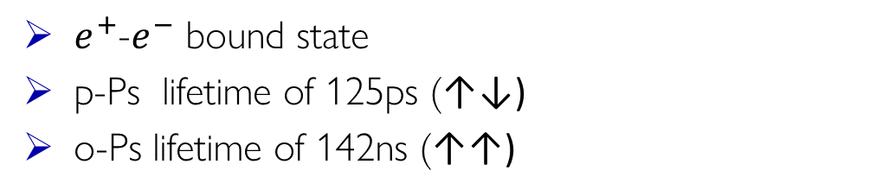
Edward Thorpe-Woods; PSI 2025
Leptonic atoms
Muonium (M)
Positronium (Ps)
$μ^{+}$-$e^{−}$ bound state
a fake “-onium”…
Lifetime of ~ 2.2µs
$e^{+}$-$e^{−}$ bound state
p-Ps lifetime of 125ps (↑↓)
o-Ps lifetime of 142ns (↑↑)
Precise theoretical calculations can be done with bound state QED
  Devoid of finite nuclear size effects.
  Enhancement of recoil effects
Fundamental constants (muon mass).
Fundamental symmetries & new physics searches

Slide 3

Mu-MASS
Edward Thorpe-Woods; PSI 2025

Slide 4
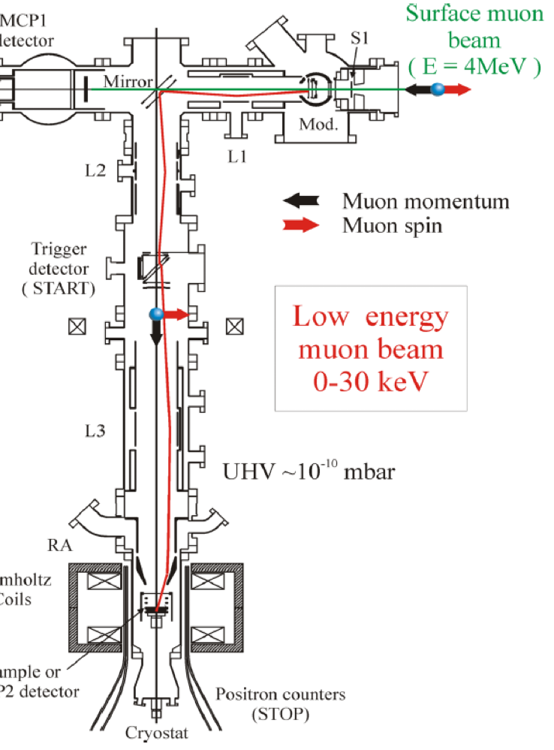
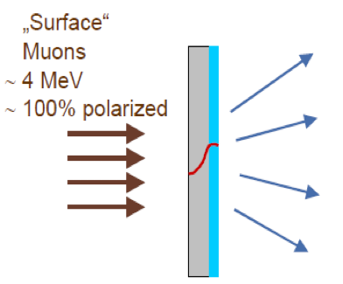

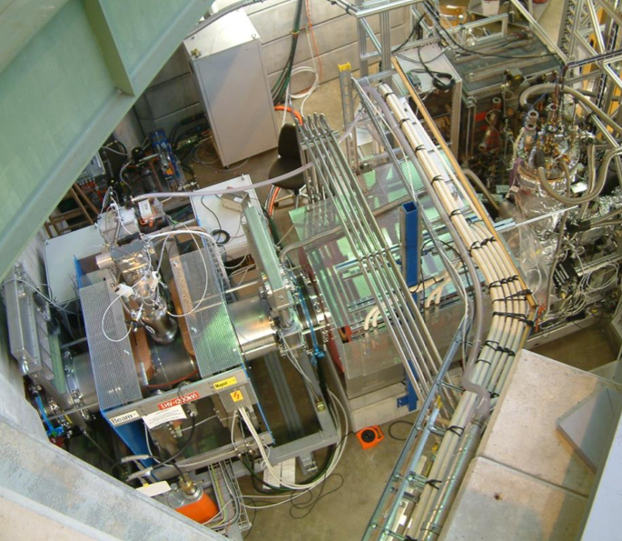
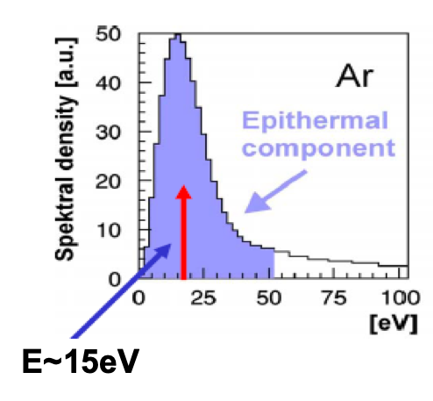
Edward Thorpe-Woods; PSI 2025
The PSI low energy muon beam (LEM)
Solid Ne/Ar
500 nm film
https://www.psi.ch/en/low-energy-muons
Up to 5x10³ μ⁺/s
Helmholtz coil
TARGET

Slide 5





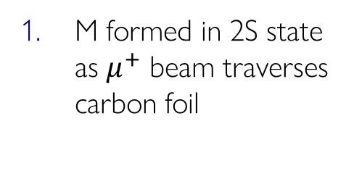


Edward Thorpe-Woods; PSI 2025
Muonium Microwave spectroscopy setup
y
z
Carbon foil
LyA MCP
Microwave
Lya
$$e^{−}$$
$$M\left(1S,2S\right)$$
$$M$$
$$μ^{+}$$
$$M (2S →1S)$$
StopMCP
$$μ^{+}$$
$$μ^{+}$$
Quenching electrodes
Tag MCP
LyA MCP
M formed in 2S state as $μ^{+}$ beam traverses carbon foil

Slide 6
Edward Thorpe-Woods; PSI 2025
Muonium Microwave spectroscopy setup
y
z
Carbon foil
LyA MCP
Microwave
Lya
$$e^{−}$$
$$M\left(1S,2S\right)$$
$$M$$
$$μ^{+}$$
$$M (2S →1S)$$
StopMCP
$$μ^{+}$$
$$μ^{+}$$
Quenching electrodes
Tag MCP
LyA MCP
M formed in 2S state as $μ^{+}$ beam traverses carbon foil
Resonant microwaves excite 2S→2P, followed by 2P→1S decay
Resonant RF
2S
2P
Undetected
LyA Photon
1S

Slide 7
Edward Thorpe-Woods; PSI 2025
Muonium Microwave spectroscopy setup
y
z
Carbon foil
LyA MCP
Microwave
Lya
# Dectected LyA
$$e^{−}$$
$$M\left(1S,2S\right)$$
$$M$$
$$μ^{+}$$
$$M (2S →1S)$$
StopMCP
$$μ^{+}$$
$$μ^{+}$$
Quenching electrodes
f
Tag MCP
LyA MCP
Remaining 2S states quenched in detection region, 121nm photon detected
M formed in 2S state as $μ^{+}$ beam traverses carbon foil
Resonant microwaves excite 2S→2P, followed by 2P→1S decay
Stark Mixing
2S
2P
DETECTED
LyA Photon
1S

Slide 8
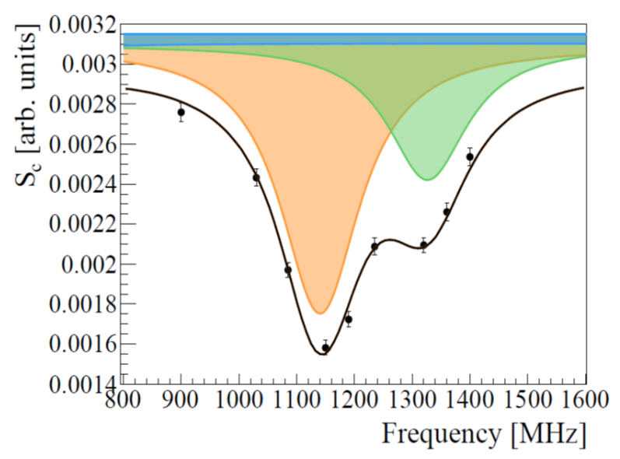
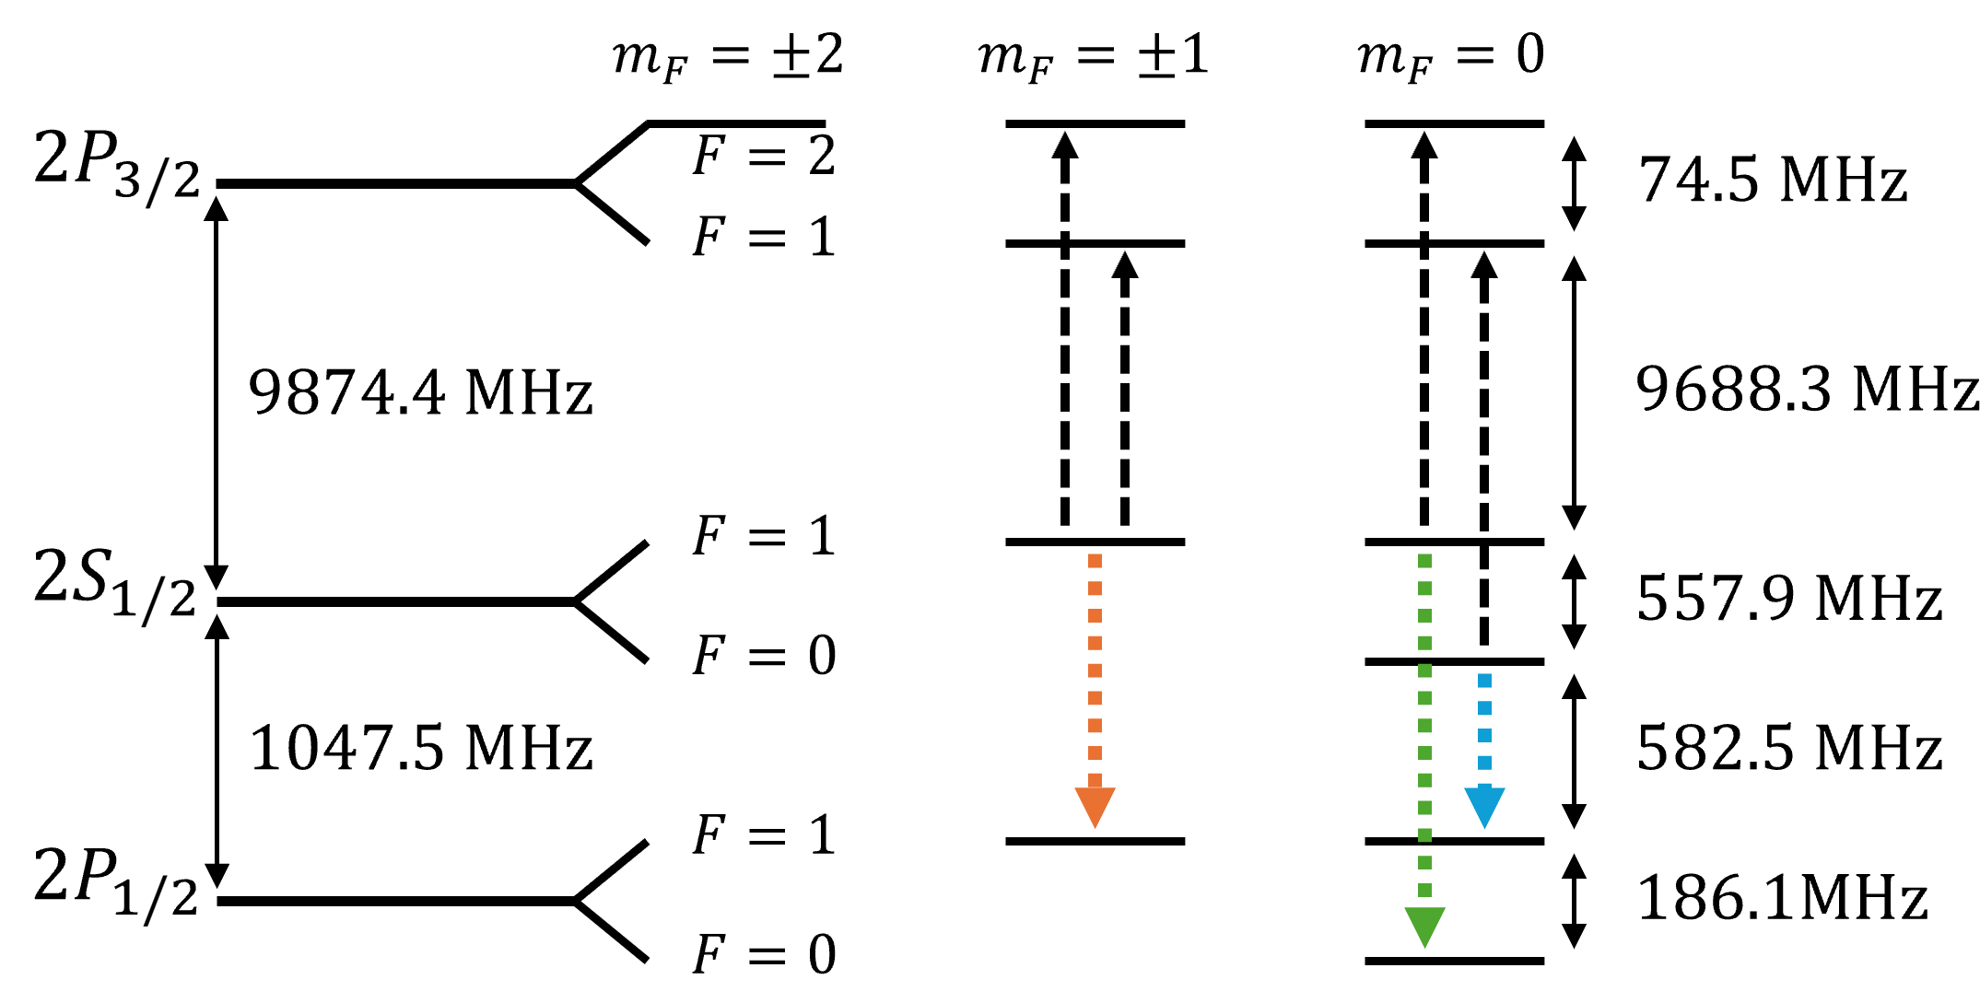
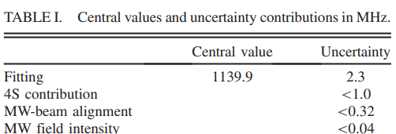
Edward Thorpe-Woods; PSI 2025
Lamb Shift Measurement
B. Ohayon, G. Janka, et al., PRL 128, 011802 (2022)

Slide 9
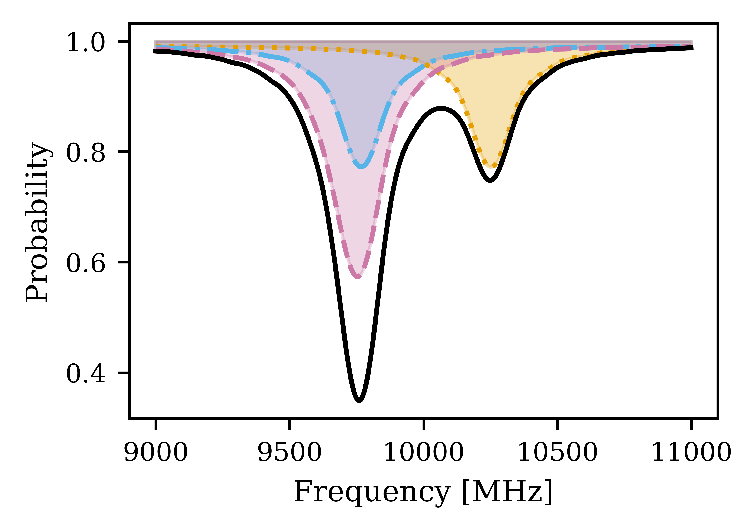
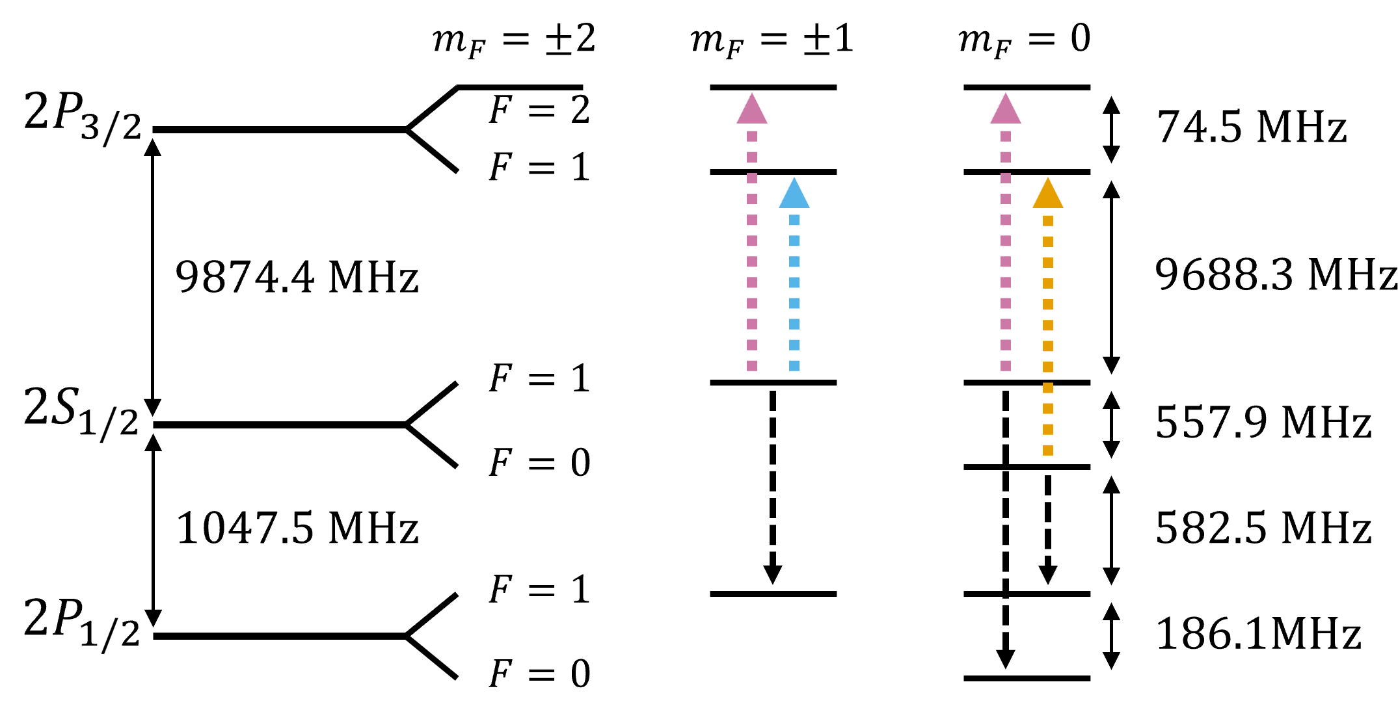
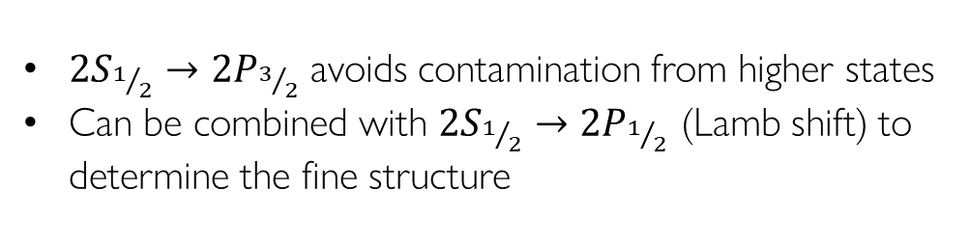
Edward Thorpe-Woods; PSI 2025
Fine Structure Measurement
${2S}_{1/2}→{2P}_{3/2}$ avoids contamination from higher states
Can be combined with ${2S}_{1/2}→{2P}_{1/2}$ (Lamb shift) to determine the fine structure

Slide 10
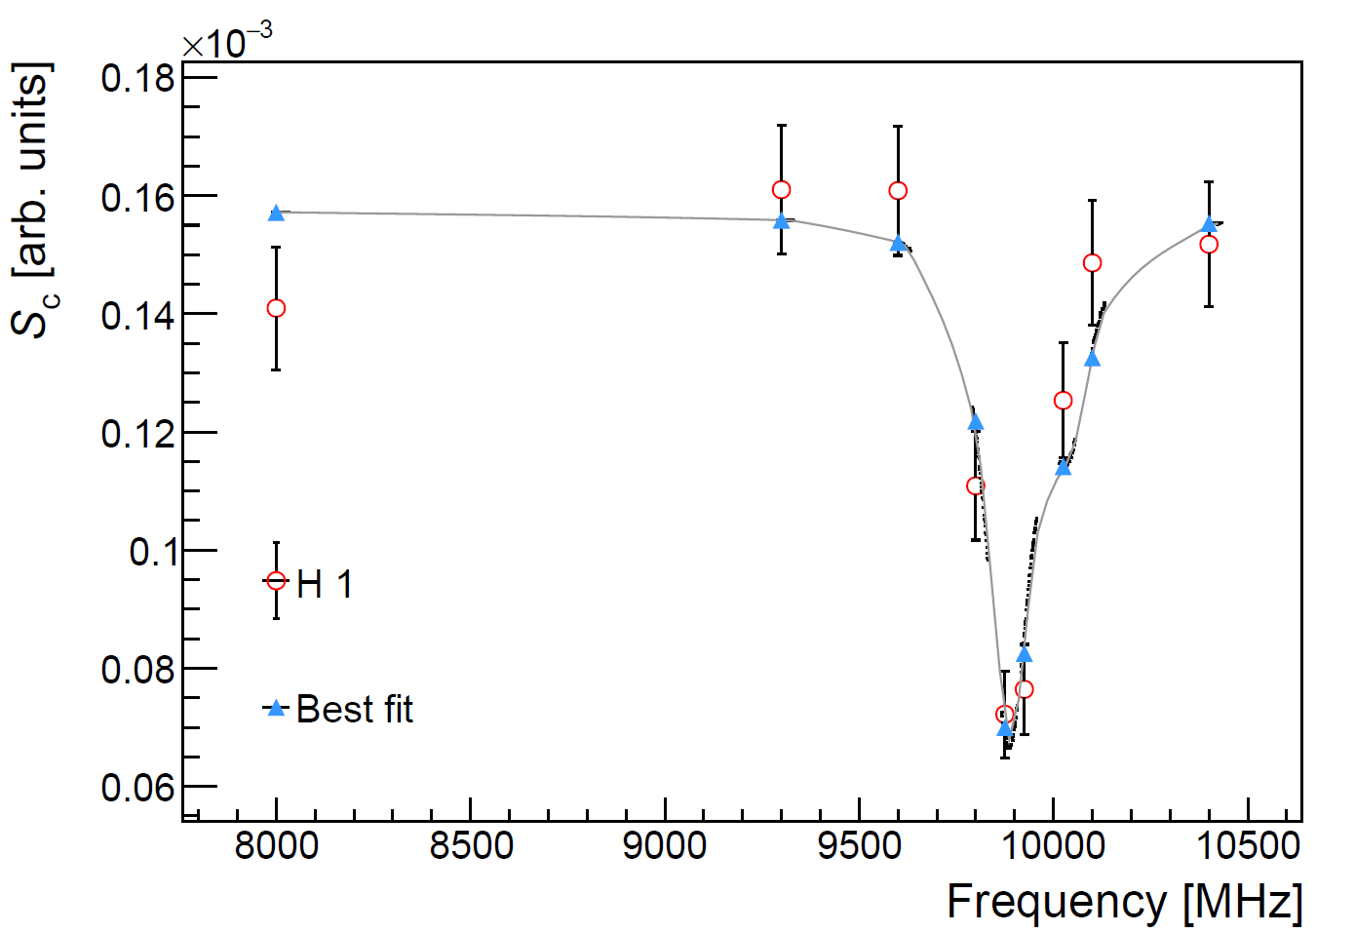
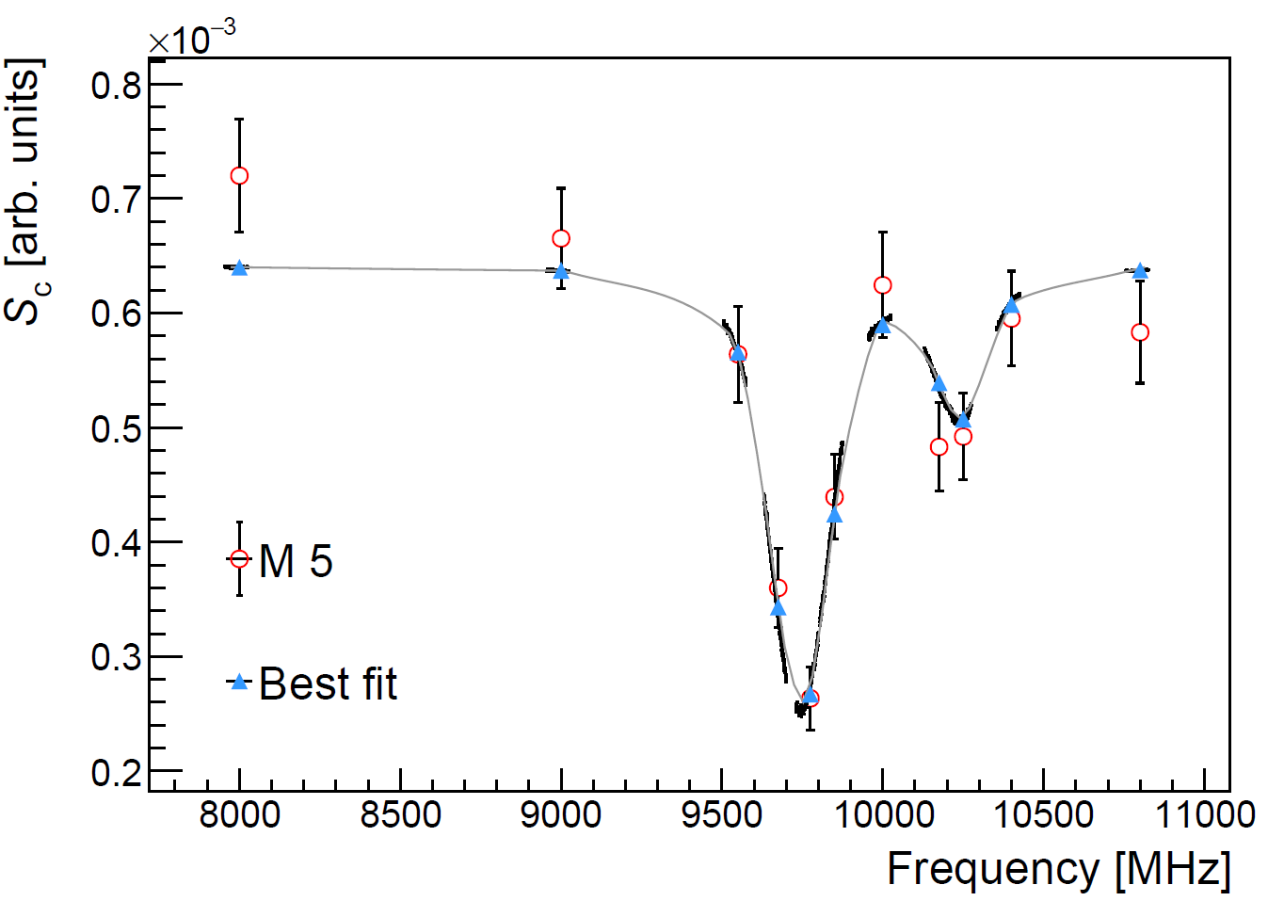
Edward Thorpe-Woods; PSI 2025
Spectra
First test with Hydrogen
Optimize experimental setup
Fit with Monte Carlo simulations to benchmark analysis
  Apply analysis to Muonium once it is approved with Hydrogen

Slide 11
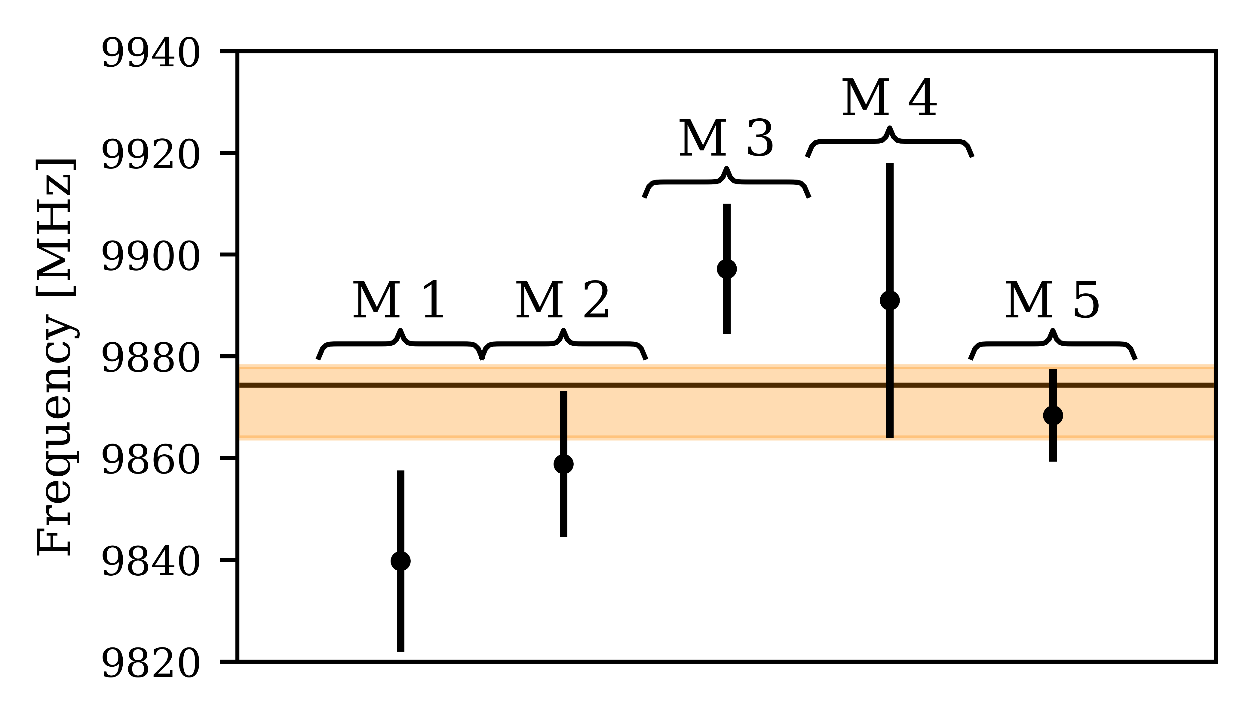
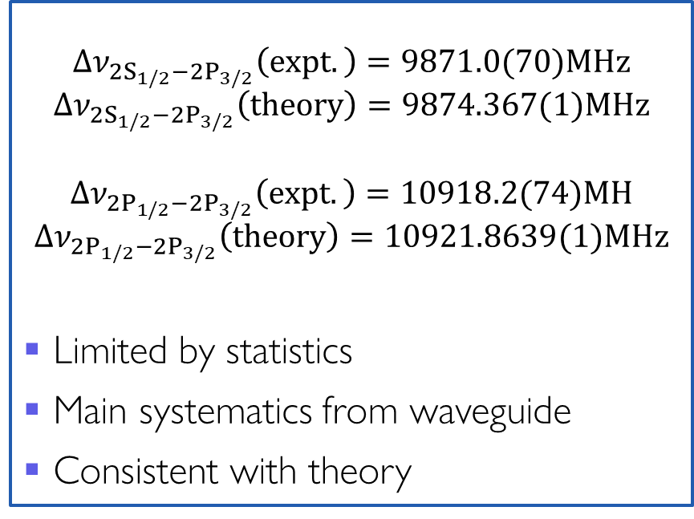
Edward Thorpe-Woods; PSI 2025
Results
$${∆ν}_{{2S}_{1/2}−{2P}_{3/2}}\left(expt.\right)=9871.0(70)MHz$$
$${∆ν}_{{2S}_{1/2}−{2P}_{3/2}}\left(theory\right)=9874.367(1)MHz$$
$${∆ν}_{{2P}_{1/2}−{2P}_{3/2}}\left(expt.\right)=10918.2(74)MH$$
$${∆ν}_{{2P}_{1/2}−{2P}_{3/2}}\left(theory\right)=10921.8639(1)MHz$$
Limited by statistics
Main systematics from waveguide
Consistent with theory
P Bulmer et al. arXiv:2509.04674

Slide 12
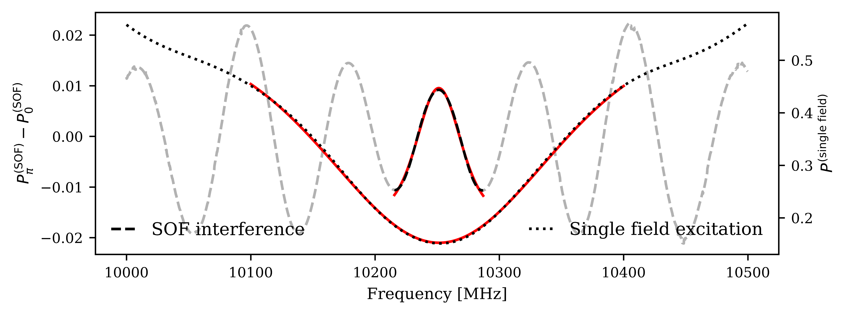
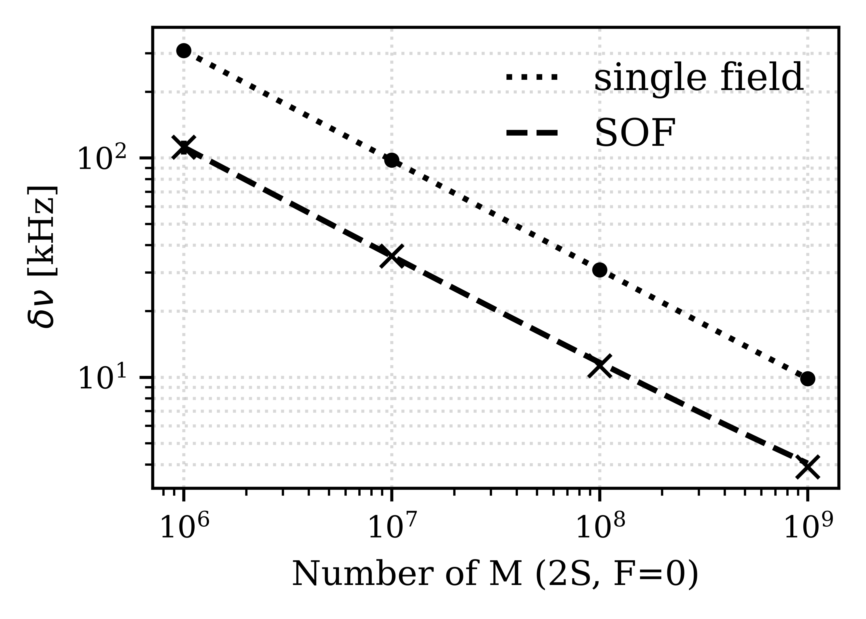
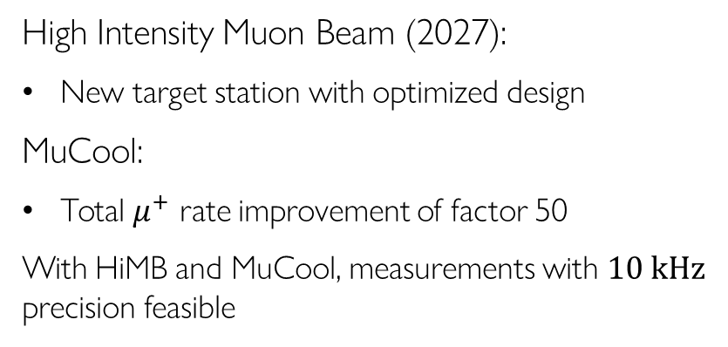



Edward Thorpe-Woods; PSI 2025
Future: Ramsey Methods
Blumer, P., Geissmann, S., Vargas, A.J. et al. Eur. Phys. J. D 79, 24 (2025)
$$E_{0}\cos{(ωt+φ_{1})}$$
$$E_{0}\cos{(ωt+φ_{2})}$$
$$τ$$
T
$$τ$$
Time
High Intensity Muon Beam (2027):
New target station with optimized design
MuCool:
Total $μ^{+}$ rate improvement of factor 50
With HiMB and MuCool, measurements with $10 kHz$ precision feasible

Slide 13
Positronium 1S-2S

Slide 14
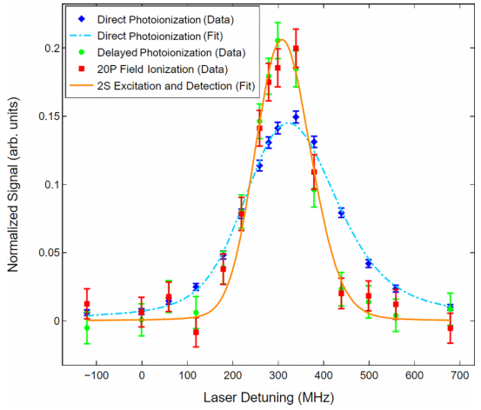
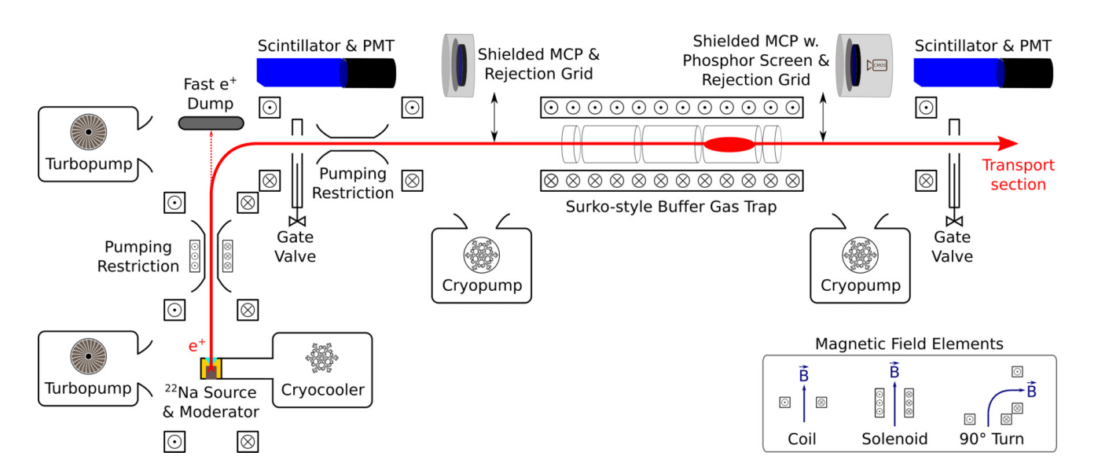
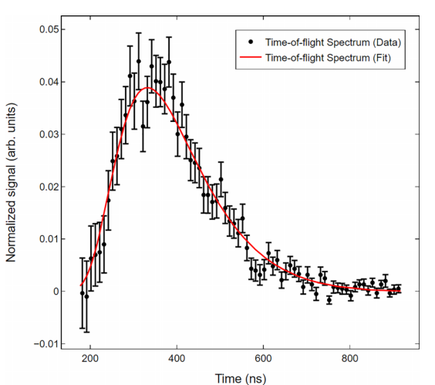
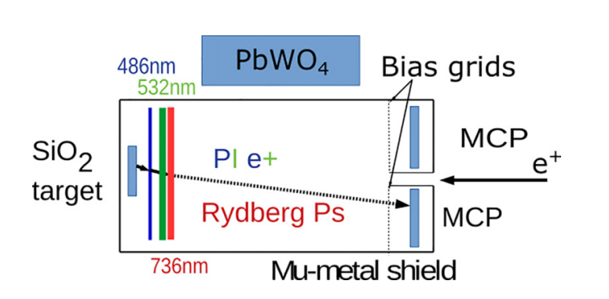
Edward Thorpe-Woods; PSI 2025
Ps pulsed 1S-2S experiment
M W. Heiss et al. Phys. Rev. A 111 (2025)

Slide 15
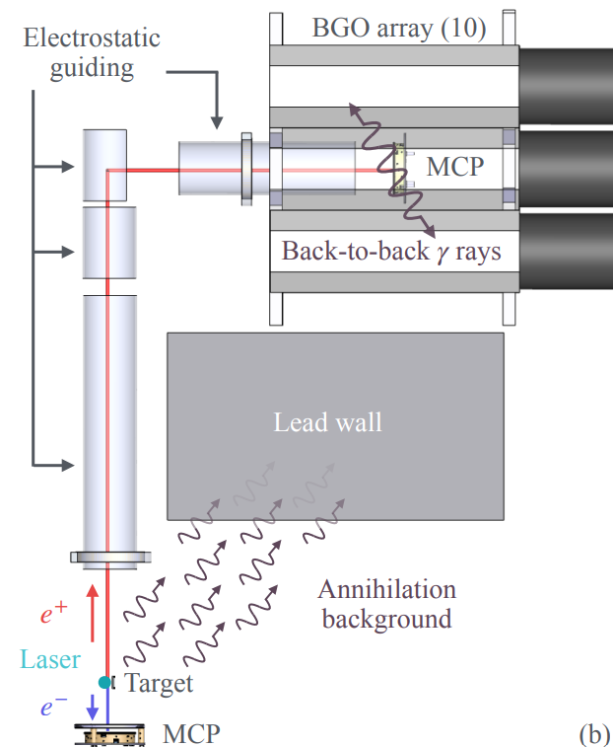

Edward Thorpe-Woods; PSI 2025
Ps 1S-2S experimental setup
CW experiment on the pulsed $e^{+}$ beam at ETH Zurich:
continuum
2S
1S
a)
Porus silica
target
486nm
~500W
Ps internal state
Zoom on laser & target
Cross section of experiment
b)
c)

Slide 16
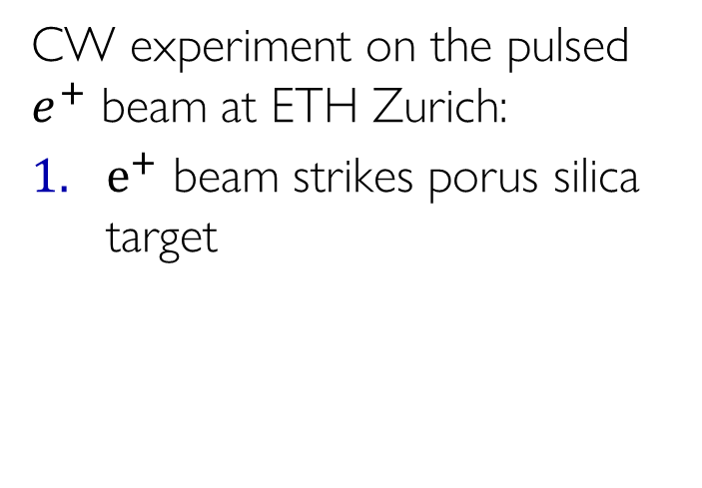

Edward Thorpe-Woods; PSI 2025
Ps 1S-2S experimental setup
CW experiment on the pulsed $e^{+}$ beam at ETH Zurich:
$e^{+}$ beam strikes porus silica target
continuum
2S
1S
a)
Porus silica
target
$e^{+}$
486nm
~500W
Ps internal state
Zoom on laser & target
Cross section of experiment
b)
c)

Slide 17

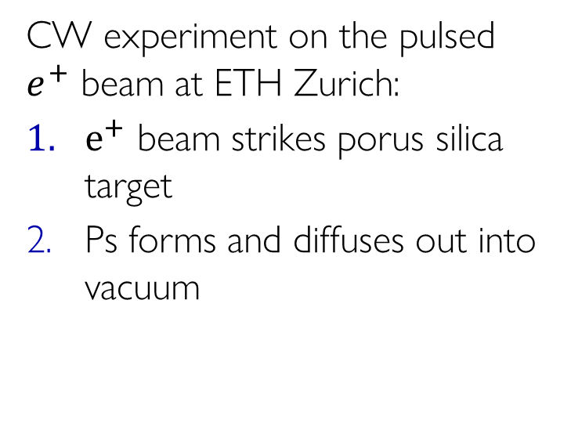
Edward Thorpe-Woods; PSI 2025
Ps 1S-2S experimental setup
CW experiment on the pulsed $e^{+}$ beam at ETH Zurich:
$e^{+}$ beam strikes porus silica target
Ps forms and diffuses out into vacuum
continuum
2S
1S
a)
Porus silica
target
$$Ps$$
486nm
~500W
Ps internal state
Zoom on laser & target
Cross section of experiment
b)
c)

Slide 18
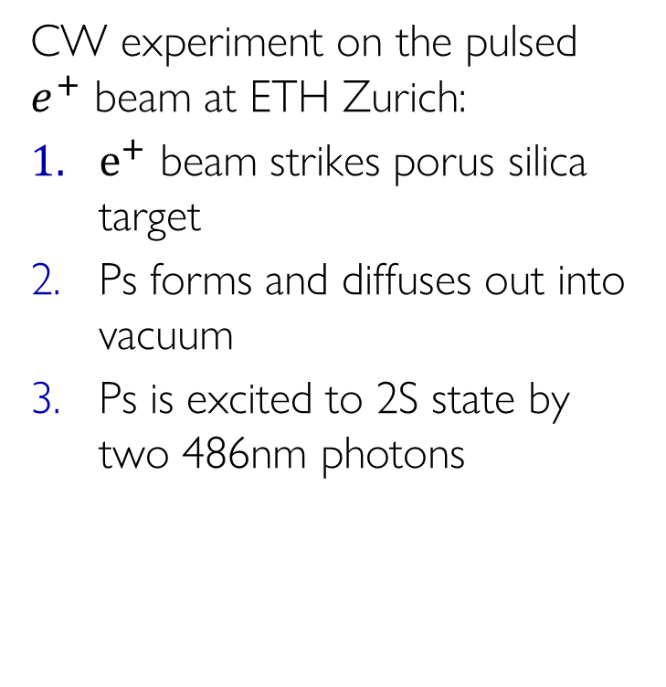
Edward Thorpe-Woods; PSI 2025
Ps 1S-2S experimental setup
CW experiment on the pulsed $e^{+}$ beam at ETH Zurich:
$e^{+}$ beam strikes porus silica target
Ps forms and diffuses out into vacuum
Ps is excited to 2S state by two 486nm photons
continuum
2S
1S
a)
Porus silica
target
$$Ps$$
486nm
~500W
Ps internal state
Zoom on laser & target
Cross section of experiment
b)
c)

Slide 19


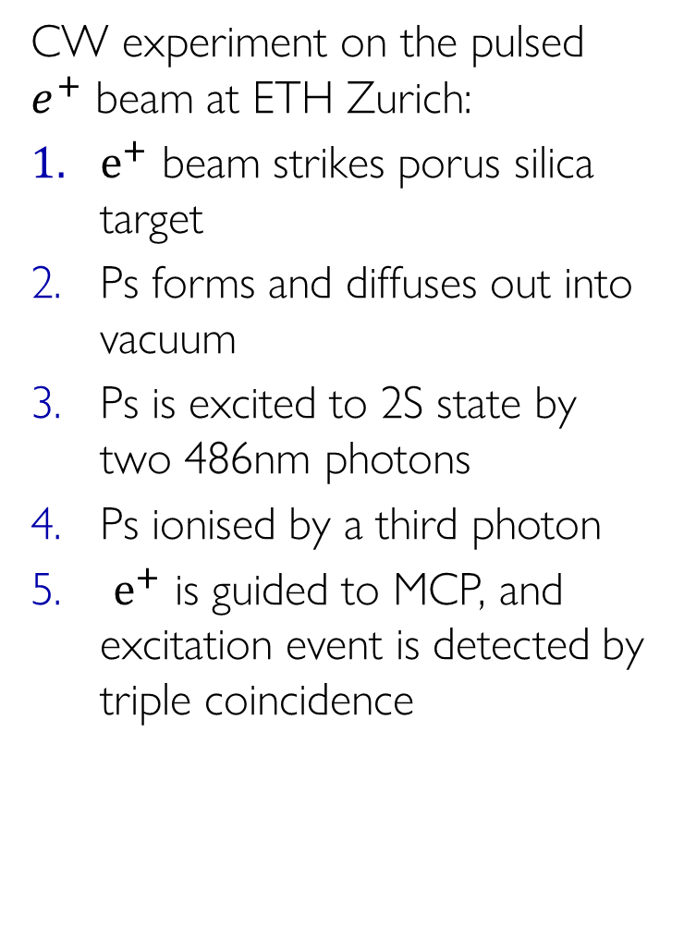
Edward Thorpe-Woods; PSI 2025
Ps 1S-2S experimental setup
CW experiment on the pulsed $e^{+}$ beam at ETH Zurich:
$e^{+}$ beam strikes porus silica target
Ps forms and diffuses out into vacuum
Ps is excited to 2S state by two 486nm photons
Ps ionised by a third photon
$e^{+}$ is guided to MCP, and excitation event is detected by triple coincidence
continuum
2S
1S
a)
Porus silica
target
$e^{+}$
$e^{−}$
486nm
~500W
Ps internal state
Zoom on laser & target
Cross section of experiment
b)
c)

Slide 20
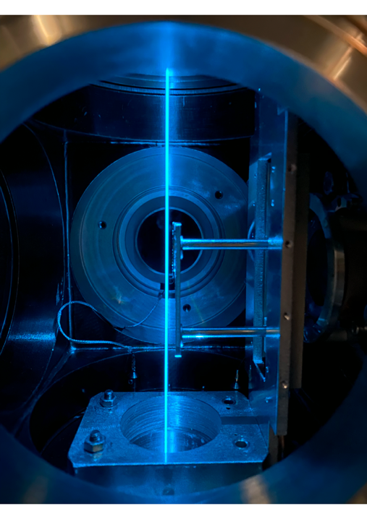
Edward Thorpe-Woods; PSI 2025
Ps 1S-2S experimental setup
CW experiment on the pulsed $e^{+}$ beam at ETH Zurich:
$e^{+}$ beam strikes porus silica target
Ps forms and diffuses out into vacuum
Ps is excited to 2S state by two 486nm photons
Ps ionised by a third photon
$e^{+}$ is guided to MCP, and excitation event is detected by triple coincidence
continuum
2S
1S
a)
guiding
target
b)
c)

Slide 21
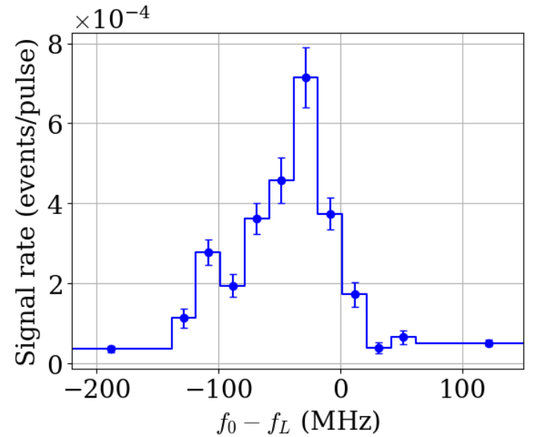
Edward Thorpe-Woods; PSI 2025
Results
Around 3 weeks of data-taking
95MHz FWHM
Unfortunately, no access to frequency comb
  Wavemeter used instead
  Regularly calibrated with rubidium reference
  Comb will be available for future measurements
21

Slide 22
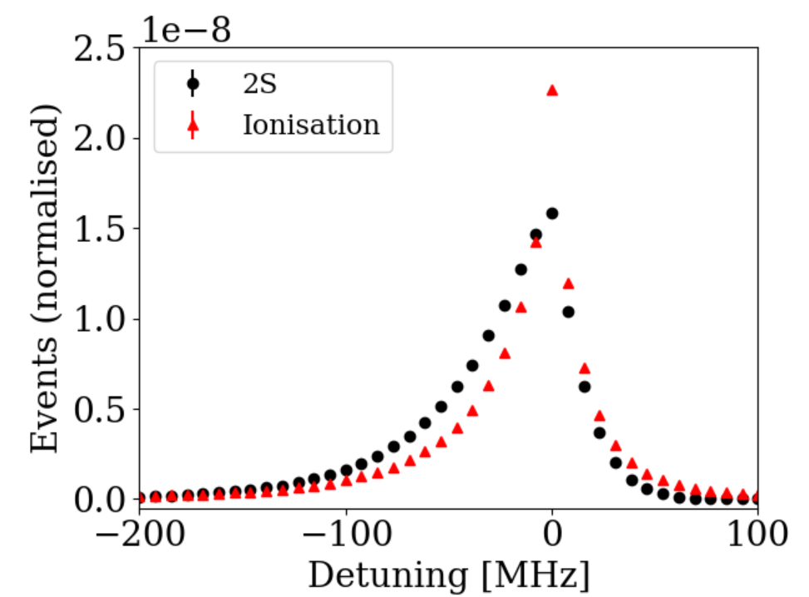
Edward Thorpe-Woods; PSI 2025
Semi-analytic lineshape
Simulated Data
To analyse the spectrum we can use Monte-Carlo Simulations
  “Black box”
We have developed a semi-analytic function which reproduces the simulated spectrum

Slide 23
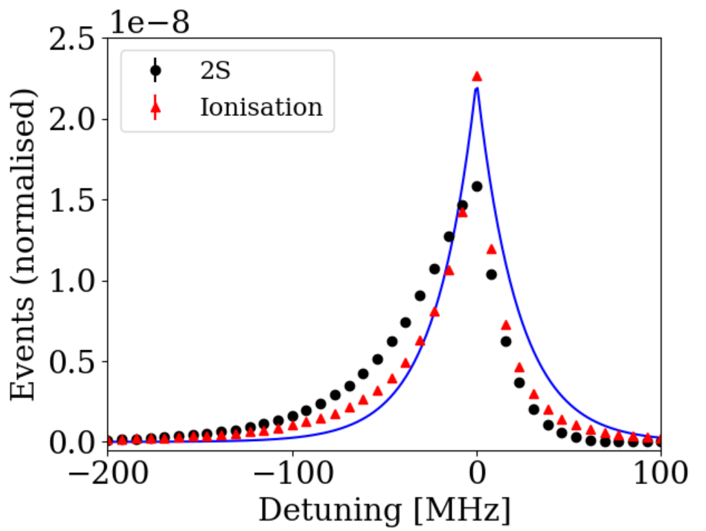




Edward Thorpe-Woods; PSI 2025
Semi-analytic lineshape
Simulated Data
To analyse the spectrum we can use Monte-Carlo Simulations
  “Black box”
We have developed a semi-analytic function which reproduces the simulated spectrum
$${P_{2S}∝\int{ }}_{0}^{∞} dv_{⊥}exp\left(−{\left[\frac{2πw\left(f_{L}−f_{0}\right)}{v_{⊥}}\right]}^{2}−\frac{v_{⊥}^{2}}{u^{2}}\right)$$
From [1]
$f_{0} :$resonance frequency ;
$f_{L} :$laser frequency ;
$v_{⊥}^{ }:$perpendicular velocity
[1] F. Biraben, M. Bassini, B. Cagnac. Journal de Physique, 1979, 40 (5)
$w_{ }^{ }:$laser waist ; $D_{ }^{ }:$laser displacement ; $τ_{ }^{ }:$Ps lifetime; $u_{ }^{ }:$thermal velocity

Slide 24
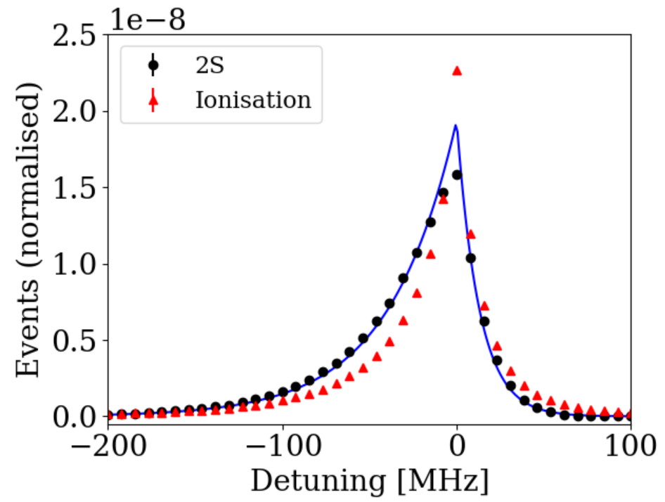
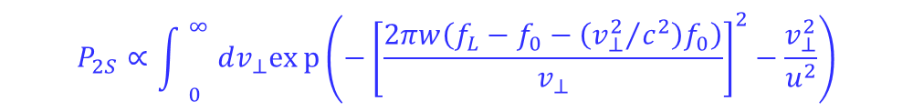
Edward Thorpe-Woods; PSI 2025
Semi-analytic lineshape
Simulated Data
To analyse the spectrum we can use Monte-Carlo Simulations
  “Black box”
We have developed a semi-analytic function which reproduces the simulated spectrum
2nd order Dop
$${P_{2S}∝\int{ }}_{0}^{∞} dv_{⊥}exp\left(−{\left[\frac{2πw\left(f_{L}−f_{0}−\left({v_{⊥}^{2}}/{c^{2}}\right)f_{0}\right)}{v_{⊥}}\right]}^{2}−\frac{v_{⊥}^{2}}{u^{2}}\right)$$
$f_{0} :$resonance frequency ;
$f_{L} :$laser frequency ;
$v_{⊥}^{ }:$perpendicular velocity
F. Biraben, M. Bassini, B. Cagnac. Journal de Physique, 1979, 40 (5)
$w_{ }^{ }:$laser waist ; $D_{ }^{ }:$laser displacement ; $τ_{ }^{ }:$Ps lifetime; $u_{ }^{ }:$thermal velocity

Slide 25
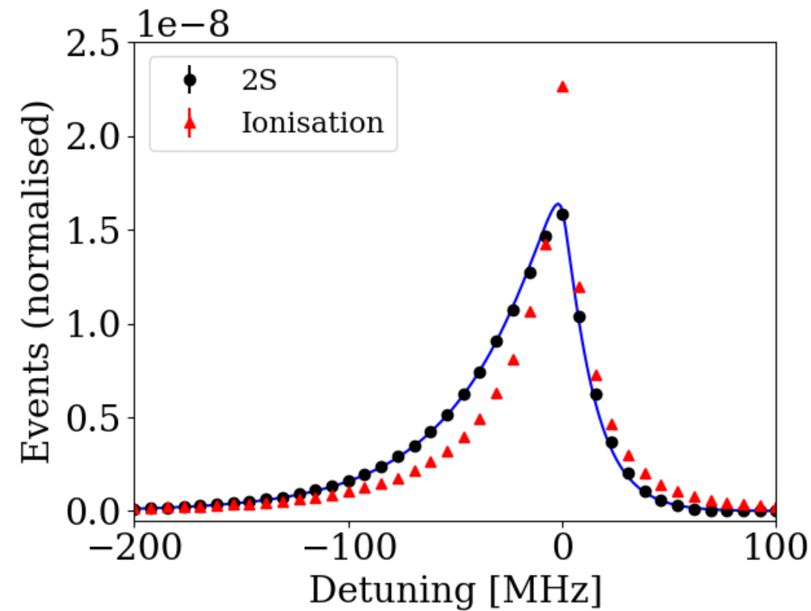
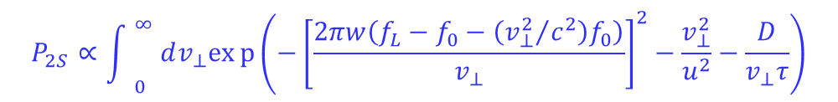
Edward Thorpe-Woods; PSI 2025
Semi-analytic lineshape
Simulated Data
To analyse the spectrum we can use Monte-Carlo Simulations
  “Black box”
We have developed a semi-analytic function which reproduces the simulated spectrum
2nd order Dop
$${P_{2S}∝\int{ }}_{0}^{∞} dv_{⊥}exp\left(−{\left[\frac{2πw\left(f_{L}−f_{0}−\left({v_{⊥}^{2}}/{c^{2}}\right)f_{0}\right)}{v_{⊥}}\right]}^{2}−\frac{v_{⊥}^{2}}{u^{2}}−\frac{D}{v_{⊥}τ}\right)$$
Finite lifetime
$f_{0} :$resonance frequency ;
$f_{L} :$laser frequency ;
$v_{⊥}^{ }:$perpendicular velocity
[1] F. Biraben, M. Bassini, B. Cagnac. Journal de Physique, 1979, 40 (5)
$w_{ }^{ }:$laser waist ; $D_{ }^{ }:$laser displacement ; $τ_{ }^{ }:$Ps lifetime; $u_{ }^{ }:$thermal velocity

Slide 26
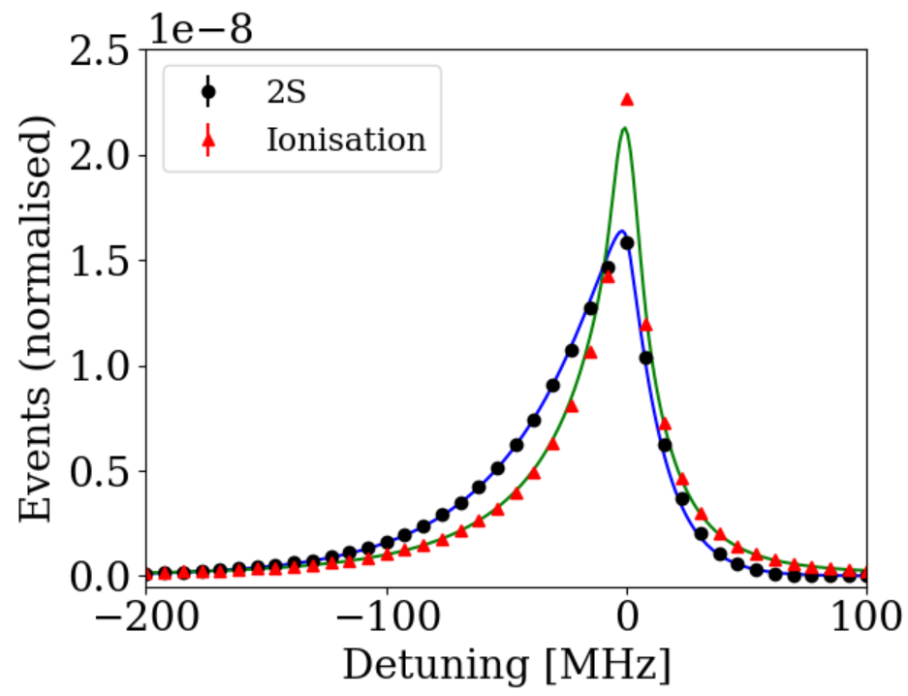
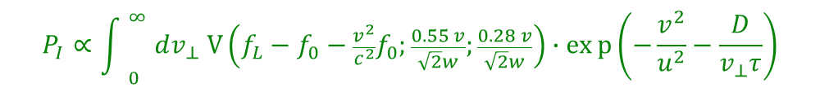
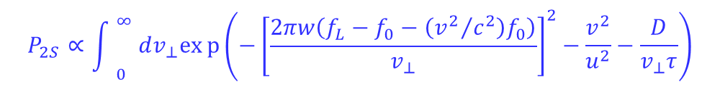
Edward Thorpe-Woods; PSI 2025
Semi-analytic lineshape
Simulated Data
To analyse the spectrum we can use Monte-Carlo Simulations
  “Black box”
We have developed a semi-analytic function which reproduces the simulated spectrum
2nd order Dop
$${P_{2S}∝\int{ }}_{0}^{∞} dv_{⊥}exp\left(−{\left[\frac{2πw\left(f_{L}−f_{0}−\left({v_{ }^{2}}/{c^{2}}\right)f_{0}\right)}{v_{⊥}}\right]}^{2}−\frac{v_{ }^{2}}{u^{2}}−\frac{D}{v_{⊥}τ}\right)$$
Voight function due to photoionisation
Finite lifetime
$${P_{I}∝\int{ }}_{0}^{∞} dv_{⊥} V\left(f_{L}−f_{0}−\frac{v_{ }^{2}}{c^{2}}f_{0};\frac{0.55 v}{\sqrt{2}w};\frac{0.28 v}{\sqrt{2}w}\right)∙exp\left(−\frac{v_{ }^{2}}{u^{2}}−\frac{D}{v_{⊥}τ}\right)$$
$f_{0} :$resonance frequency ;
$f_{L} :$laser frequency ;
$v_{⊥}^{ }:$perpendicular velocity
[1] F. Biraben, M. Bassini, B. Cagnac. Journal de Physique, 1979, 40 (5)
$w_{ }^{ }:$laser waist ; $D_{ }^{ }:$laser displacement ; $τ_{ }^{ }:$Ps lifetime; $u_{ }^{ }:$thermal velocity

Slide 27
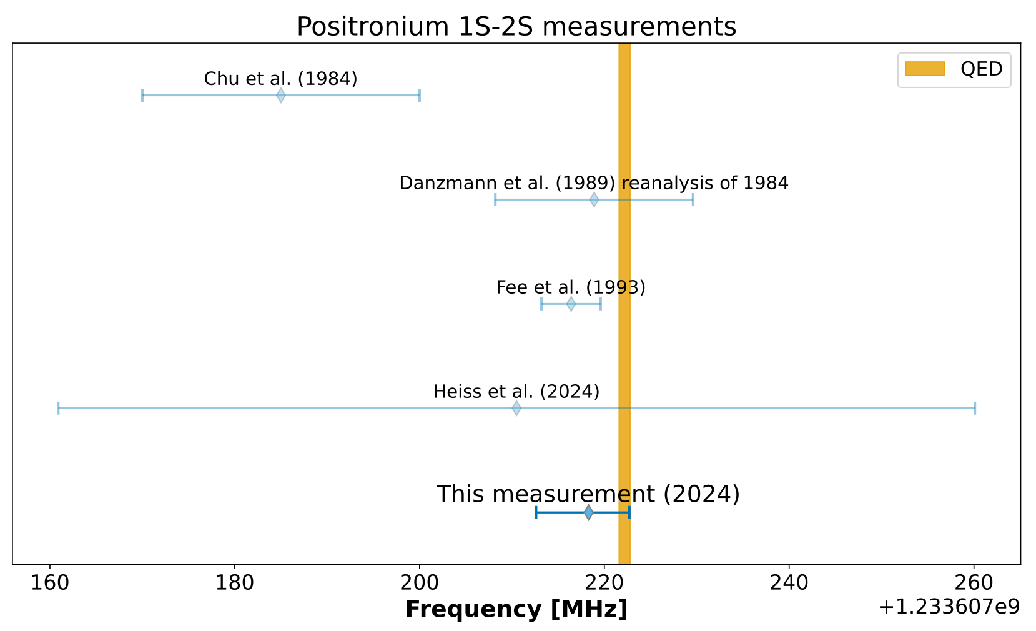
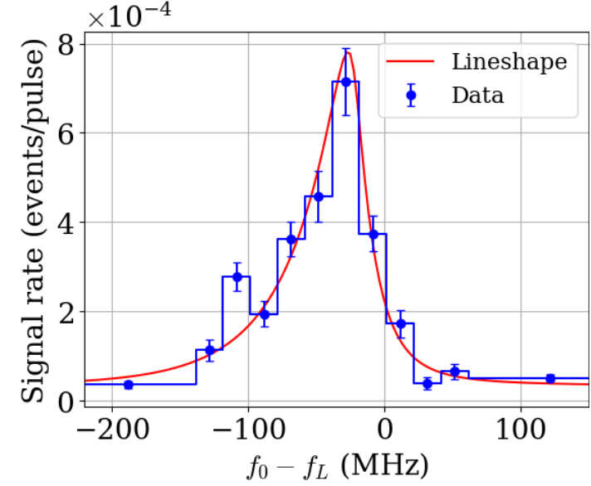
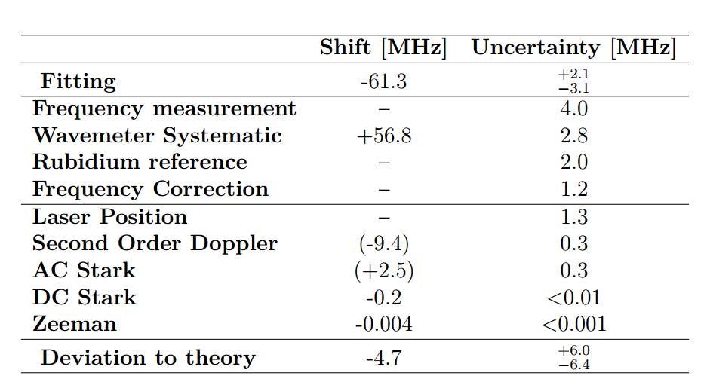
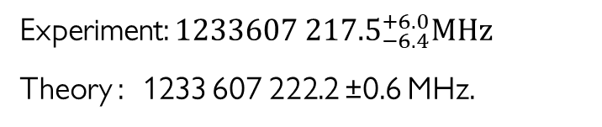
Edward Thorpe-Woods; PSI 2025
Results
Preliminary
(2025)
Preliminary
Experiment: ${1233607 217.5}_{−6.4}^{+6.0}MHz$
Theory : 1233 607 222.2 ±0.6 MHz.
Preliminary
L. de Sousa Borges, et al., in preparation
G. S. Adkins et al., Phys. Rep. 975, 1 (2022).

Slide 28
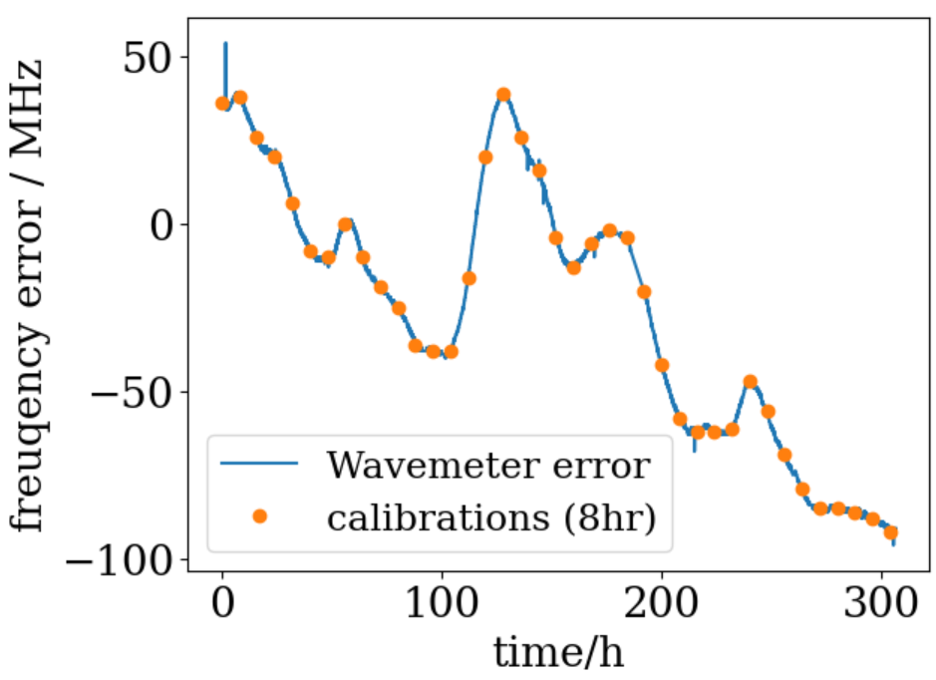
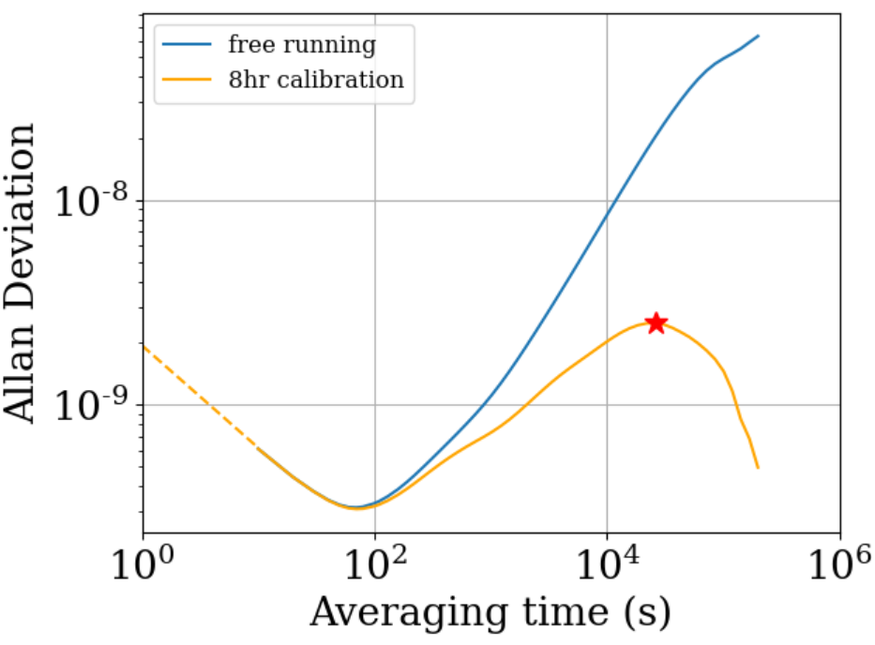
Edward Thorpe-Woods; PSI 2025
Near future: Improving this result
Laser frequency stability limited by wavemeter
Systematic shift due to different calibration frequency
  → With comb stability should be ~5-50 kHz

Slide 29
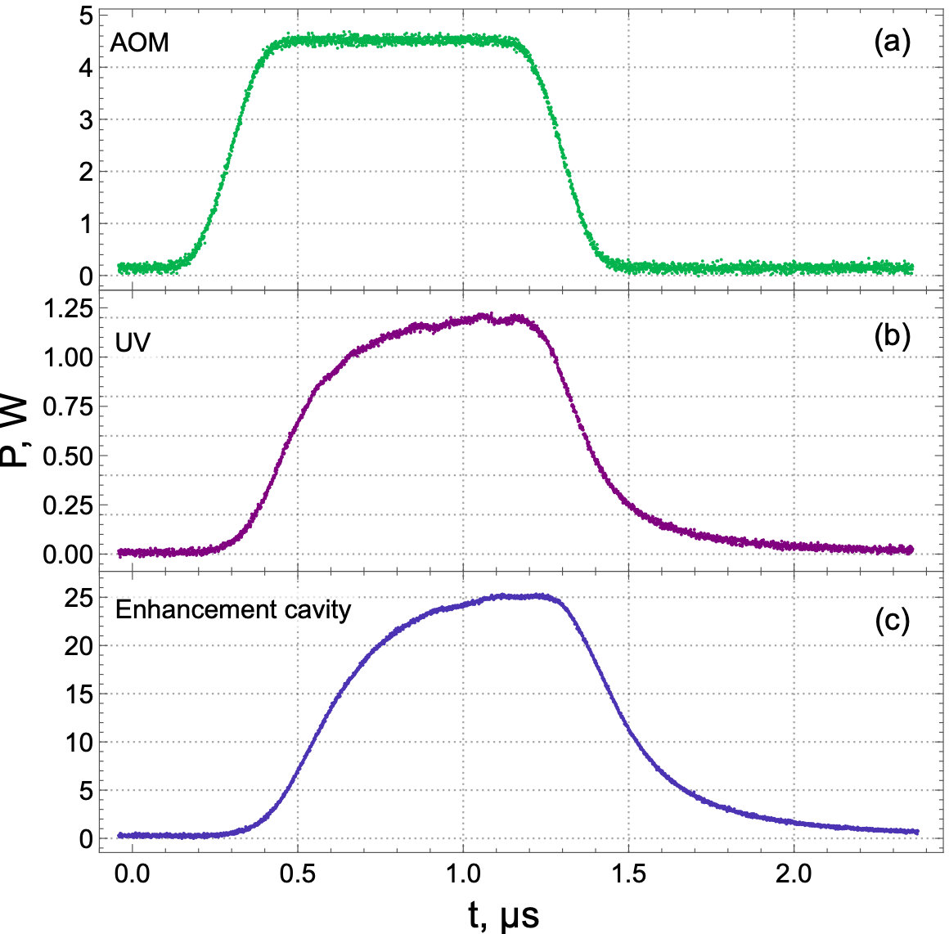

Edward Thorpe-Woods; PSI 2025
Near future: Improving this result
Power had to be run at 500W with 50mW input for stability
Laser easily capable of above 500mW
Power pulsed to kW → higher statistics, ~$P^{3}$
Use Pulsed CW techniques developed with muonium
N. Zhadnov. Opt. Express 31, 28470-28479 (2023).

Slide 30


Edward Thorpe-Woods; PSI 2025
Future : Ramsey-Doppler Spectroscopy
Ramsey Spectroscopy has been applied to 1S-2S of Hydrogen
Combine Ramsey spectroscopy with a detection system which can correct the 2nd Order Doppler
Laser frequency is fixed, and Doppler effect used to scan the detuning
FWHM reduced to 2.2MHz!
~ sub 100kHz precision expected from method
Huber, A et al. Phys. Rev. A 58, (1998)
Javary, E., Thorpe-Woods, E., Cortinovis, I. et al. Eur. Phys. J. D (2025).

Slide 31
Edward Thorpe-Woods; PSI 2025
Summary
Spectroscopy of leptonic atoms provides a precision test of QED
We have recently submitted a manuscript for fine structure of muonium
Currently finalising the results of a CW 1S-2S measurement of Ps
  Estimated to be similar precision as state-of-the-art
Ramsey methods offer a future direction for significantly improving both muonium and positronium measurements with minimal changes to the current setup

Slide 32







Edward Thorpe-Woods; PSI 2025
Thank you for listening!
PART OF THIS WORK IS SUPPORTED BY an ERC consolidator grant
(818053 -Mu-MASS) and by the Swiss National Foundation under the grants 197346
219485 and NIST Precision Measurement Grant.

Slide 33
Extra Slides

Slide 34



Lineshape full expression
$$\begin{aligned}\begin{matrix}\begin{aligned}L_{2S}=\int_{−∞}^{∞}{ }𝒩\left(μ,σ^{2}\right) dy\int_{0}^{2π}{ }dφ\int_{0}^{\frac{π}{2}}{ }\sin{2θ}\int_{0}^{∞}{ }\frac{4v^{2}π^{2}β_{gc}^{2}I_{0}^{2}w^{2}}{\sqrt{π}u^{3}v_{⊥}^{2}}(1 − λ_{2S}) \\ ×\exp\left\{−{\left(\frac{2π\left(δf+Δf_{ΛC}−v^{2}/2c^{2}f_{L}\right)w}{v_{⊥}}\right)}^{2}−\frac{D}{v_{⊥}τ}−\frac{v^{2}}{u^{2}}−\frac{4ρ^{2}}{w^{2}}\right\}dv\end{aligned} & \\ & \end{matrix} \\ \\ \\ \begin{aligned} \\ \begin{matrix}\begin{aligned}L_{\text{ion} }=\int_{−∞}^{∞}{ }𝒩\left(μ,σ^{2}\right)dy\int_{0}^{2π}{ }dφ\int_{0}^{\frac{π}{2}}{ }\sin{2θ}\int_{0}^{∞}{ }\frac{1.4132π^{3}β_{i}β_{gc}^{2}I_{0}^{3}v^{2}w^{2}}{\sqrt{π}u^{3}v_{⊥}^{2}} (1 − λ_{ion}) \\ ×exp\left\{−\frac{6ρ^{2}}{w^{2}}−\frac{D}{τv_{⊥}}−\frac{v^{2}}{u^{2}}\right\}V\left(δf+Δf_{ΛC}−\frac{v^{2}}{2c^{2}}f_{L};1.1132η;0.4535η\right)dv\end{aligned} & \\ & \end{matrix}\end{aligned}\end{aligned}$$
$$λ_{2S}= πβ_{i}I_{0}\exp\left(−\frac{2ρ^{2}}{w^{2}}\right)\frac{w\sqrt{2π}}{3v_{⊥}}$$
$f_{L} :$laser frequency ;
$$η=\frac{v_{⊥}}{2\sqrt{2}πw}$$
$f_{0} :$resonance frequency ;
$v_{⊥}^{ }:$perpendicular velocity
$w_{ }^{ }:$laser waist ; $D_{ }^{ }:$laser displacement ; $τ_{ }^{ }:$Ps lifetime; $u_{ }^{ }:$thermal velocity
y$:$formation location; $μ_{ }^{ }:$beam location ; $σ_{ }^{ }:$beam size; ${θ,φ}_{ }^{ }:$emission angles
$$λ_{ion}= πβ_{i}I_{0}\exp\left(−\frac{2ρ^{2}}{w^{2}}\right)\frac{w}{2\sqrt{2} v_{⊥}}$$

Slide 35


Lineshape comparison to simulation

Slide 36

Bin variation
Preliminary

Slide 37

2022
2024
2026
2027-28

Slide 38



Muonium 1S-2S
I. Cortinovis, PC, et al., EPJD 77 (2023)
N Zhadnov et al, Optics Express 31, 17(2023)
continuum
2S
244nm (100mW)
1S

Slide 39

Muonium 1S-2S
I. Cortinovis, PC, et al., EPJD 77 (2023)
N Zhadnov et al, Optics Express 31, 17(2023)
1) Incoming Muon trigger from LEM
continuum
$$μ^{+}$$
2S
244nm (100mW)
1S

Slide 40
Muonium 1S-2S
I. Cortinovis, PC, et al., EPJD 77 (2023)
N Zhadnov et al, Optics Express 31, 17(2023)
2) Muonium diffuses out into vacuum
M
continuum
2S
244nm (100mW)
1S

Slide 41
Muonium 1S-2S
I. Cortinovis, PC, et al., EPJD 77 (2023)
N Zhadnov et al, Optics Express 31, 17(2023)
3) 244nm power ramped to ~25W
M
continuum
2S
244nm (25W)
1S

Slide 42


Muonium 1S-2S
I. Cortinovis, PC, et al., EPJD 77 (2023)
N Zhadnov et al, Optics Express 31, 17(2023)
4) Pulsed 355nm laser to photoionise M
$$μ^{+}$$
continuum
2S
$$e^{−}$$
355nm
(Pulsed)
244nm (25W)
1S

Slide 43


Muonium 1S-2S
I. Cortinovis, PC, et al., EPJD 77 (2023)
N Zhadnov et al, Optics Express 31, 17(2023)
5) Lasers extinguished & $μ^{+}$guided to detection region
$$μ^{+}$$
continuum
2S
$$e^{−}$$
244nm (100mW)
1S

Slide 44
Muonium 1S-2S
I. Cortinovis, PC, et al., EPJD 77 (2023)
N Zhadnov et al, Optics Express 31, 17(2023)
5) Lasers extinguished & $μ^{+}$guided to detection region
$$μ^{+}$$
Stable for long operation (80h)
Background < 1 event per day
<1MHz uncertainty projected
$$e^{−}$$
244nm (100mW)

Slide 45
Muonium 1S-2S
I. Cortinovis, PC, et al., EPJD 77 (2023)
More power! (~2W)
Mechanical stability
Active beam stablisation
N Zhadnov et al, Optics Express 31, 17(2023)
5) Lasers extinguished & $μ^{+}$guided to detection region
Faster pulsing (Pockles cell)
$$μ^{+}$$
Stable for long operation (80h)
Background < 1 event per day
<1MHz uncertainty projected
$$e^{−}$$
We return this winter!
244nm (100mW)

Slide 46

Edward Thorpe-Woods; FFK 2025
Muonium spectroscopy current status of Theory and Experiments
Karshenboim et al. PRA 103, 022805 (2021)
Eides, Phys. Lett. B 795, 113 (2019)
HFS (LAMPF 1999)
Liu et al. PRL82, 711 (1999)
Adkins et al. PRL130, 023004 (2023)
I. Cortinovis et al., EPJD 77, 66 (2023)
1S-2S (RAL 1999)
Meyer et al. PRL84, 1136 (2000)
LS (PSI 2022)
B. Ohayon et al, PRL 128, 011802 (2022)
V.A. Yerokhin, et al. Ann. der Phys. 531, 1800324 (2019)
M. Heides et al. PRA 105 (2022) 1, 012803
G. Janka et al. EPJ Web Conf. 262, 01001 (2022)
FS (PSI 2024)
P. Blumer et al, paper in preparation
  UNCERTAINTY (LEFT EDGE)
  MEASURED QUANTITY (RIGHT EDGE)
  EXP.
  THEORY
  UNCERTAINTY DUE TO UNCALCULATED b-QED TERMS (LEFT EDGE)
  UNCERTAINTY FROM KNOWLEDGE mμ/me (RIGHT EDGE)
46

Slide 47




Edward Thorpe-Woods; FFK 2025
Muonium Spectroscopy – expected
S. Kanda et a. PLB 815 (2021) 136154
HFS
I. Cortinovis, PC, et al., EPJD 77, 66 (2023)
1S-2S
LS
G. Janka, PC, et al. EPJ Web Conf. 262, 01001 (2022)
FS
  PROJECTED UNCERTAINTY (LEFT EDGE)
  MEASURED QUANTITY (RIGHT EDGE)
  EXP.
  THEORY
  UNCERTAINTY DUE TO UNCALCULATED b-QED TERMS (LEFT EDGE)
  UNCERTAINTY FROM KNOWLEDGE mμ/me (RIGHT EDGE)
47

