Slide 1

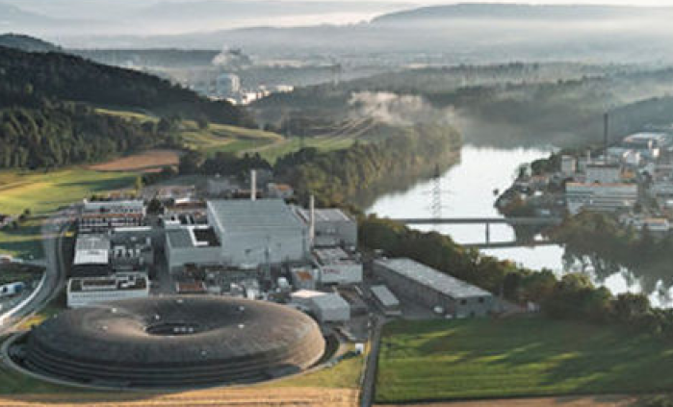



eEDM and nEDM Discovery Prospects in General 2HDM in the Next Two Decades
Sept 9 @ PSI 2025

Slide 2
e EDM - n EDM in two decades?
0. Intro: EWBG Still ? Need large CPV beyond KM !
0. Intro: Glashow-Weinberg NFC is ad hoc
I. t → ch: mysterious alignment
II. λ_{t} Im ρ_{tt} robust for EWBG: O (1) quartics / eEDM cancell.
Fuyuto, WSH, Senaha, PLB’18
1st order EWPh.Tr.
III. Cancellation Mechanism for n EDM
IV. LHC Search: cg → bH⁺ → btb(bar)
V. Conclusion: Comment on Flavor

Slide 3
PSI-PR-91-34
0. Intro: tensions; t → ch
PLB’92
h(125) ✔ New Physics ✘
Where is SUSY/WIMP ?
Beyond CKM CPV (Large)
EW BaryoGenesis (EWBG)
- more testable -
tension
LHC
- N o N ew P hysics -
EWBG ought to be pursued
while LHC is still running!
NNP
tension
competition
J I L A 22
e EDM: ACME14 → ACME18
- L.E. Precision Frontier -
0.41
|d_{e}| < 1.1 x 10^{‒29} e cm
Cutting edge of CPV & B.A.U.

Slide 4
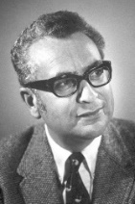
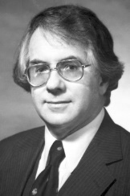

0. Intro: Glashow-Weinberg NFC is ad hoc
Natural
Gell-Mann (1969 sole Laureate)
“Everything not forbidden is compulsory.”
the “Totalitarian Principle ofTruth” (wiki)
∃ Weak Higgs Doublet
υ ≈ 246 GeV
Φ =
φ⁺
φ⁰
⟨φ⁰⟩ ≠ 0
G⁺
υ + h⁰ + G⁰
Observed.
S.S.B.
Higgs Mechanism
h(125) ✔
ad hoc
No Reason to forbid
a Second Higgs,
so ∃ Second Higgs Doublet
(1979 Laureates)
Φ' =
Glashow-Weinberg’77 sought to
forbid Second Set of Yukawa’s,
φ' ⁺
φ' ⁰
⟨φ' ⁰⟩ = 0
H⁺
H + i A
usually implemented by a Z₂,
general
2HDM w/o Z₂ → g2HDM
refuted by my PLB’92 & EPL’18 (next pages).
Identical Doublets
- Still Minority View -

Slide 5
I. t → ch example: mysterious alignment
K.-F. Chen, WSH, C. Kao, M. Kohda, PLB’13
c
g2HDM
param.
t
ρ_{tc}c_{γ}
c_{γ} small: h-H don’t seem to mix much !?
h(125)
H⁺
H + i A
h(125) is so close to SM Higgs! [Higgs properties] Why ?
t → ch still Not Seen to date!

Slide 6
II. λ_{t} Im ρ_{tt} robust EWBG: O (1) quartics /eEDM cancell.
1st order EWPh. Tr.
S. Kanemura, Y. Okada, E. Senaha, PLB’05
λ_{t} known to be real, ρ_{tt} provides imaginary part !
K. Fuyuto, W.S. Hou, E. Senaha, PLB’18 [1705.05034]
ρ_{tc}, ρ_{tt} satisfy
B_{d, s} mixing, b → sγ
scan over
for illustration (t_{β} = 1)
no obvious diff.
⇒ ρ_{tt} driven !
ρ_{tc} as backup
the charm of EWBG
small ρ_{tt}

Slide 7

Baryogenesis & e EDM Cancel
complex
exquisite cancellation
by flavor hierarchies
complex
Fuyuto, WSH, Senaha, PLB’18
ρ_{tt}
Fuyuto, WSH, Senaha, PRD-RC’20
ρ_{tt}
t
ACME’14
ACME’18
x
ρ_{ee}
JILA’22
eN scattering
CPV
EWBG
λ_{t} Im ρ_{tt} robust driver
Phase
lock!
λ_{e}
ρ_{ee}
O(λ_{t}) ≈ 1
ρ_{tt}
simplified
“Ansatz”
“Know” SM Hierarchy !
[ρ_{tc} as backup
N.B. r depend on loop functions

Slide 8

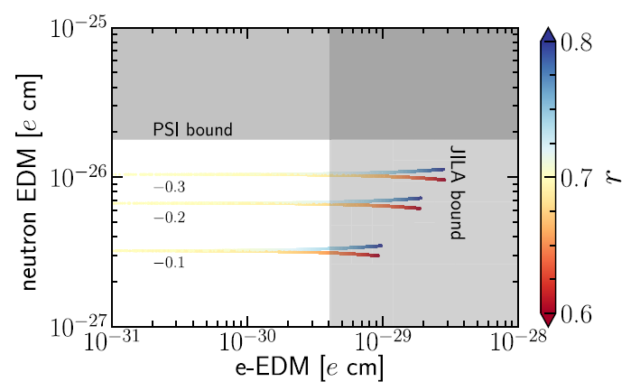
V. Cancellation Mechanism for n EDM
Rather than Pospelov and Ritz, we take the more
recent Hisano, Kobayashi, Kuramoto, Kuwahara
formula (C_{W} is Weinberg operator ), JHEP’15:
n2EDM should improve to 10⁻²⁷ e cm
r ~ 0.71 illustrates spread
in exotic Higgs mass.

Slide 9
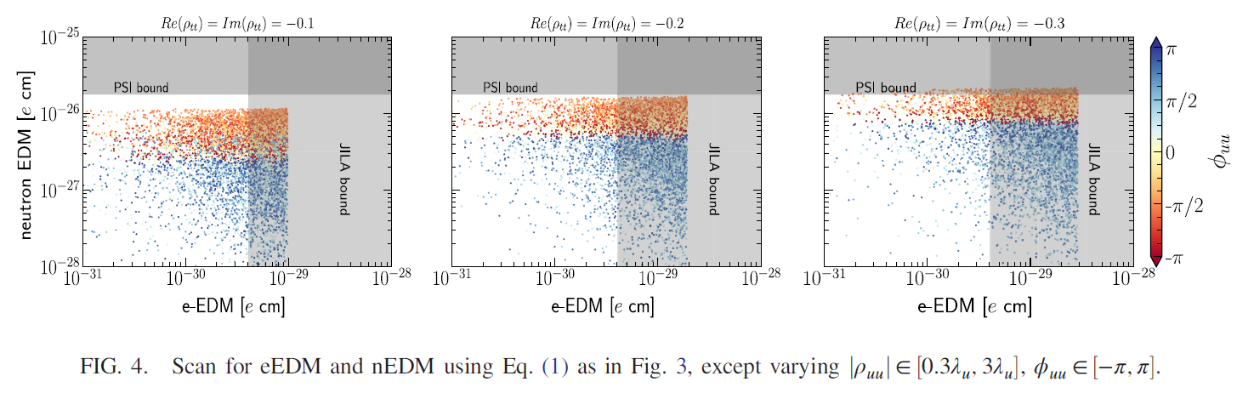
Further Cancellation Mechanism for n EDM
All we know is |ρ_{uu}| ~ λ_{u}, therefore let us explore order of magnitude,
as well as put in a phase. I.e.
This leads to Fig. 4 below:
Justified towards the end.
e EDM may well emerge at 10⁻³⁰ e cm, as JILA is still
not inconsistent, let’s hope
we will have a facility to probe n EDM at 10⁻²⁸ e cm.

Slide 10
Why g2HDM hiding so well ?
extra Yukawas reflect SM Yukawa pattern
seen in eEDM
IV./V. H/A/H⁺ Search & Flavor Frontier
LHC

Slide 11
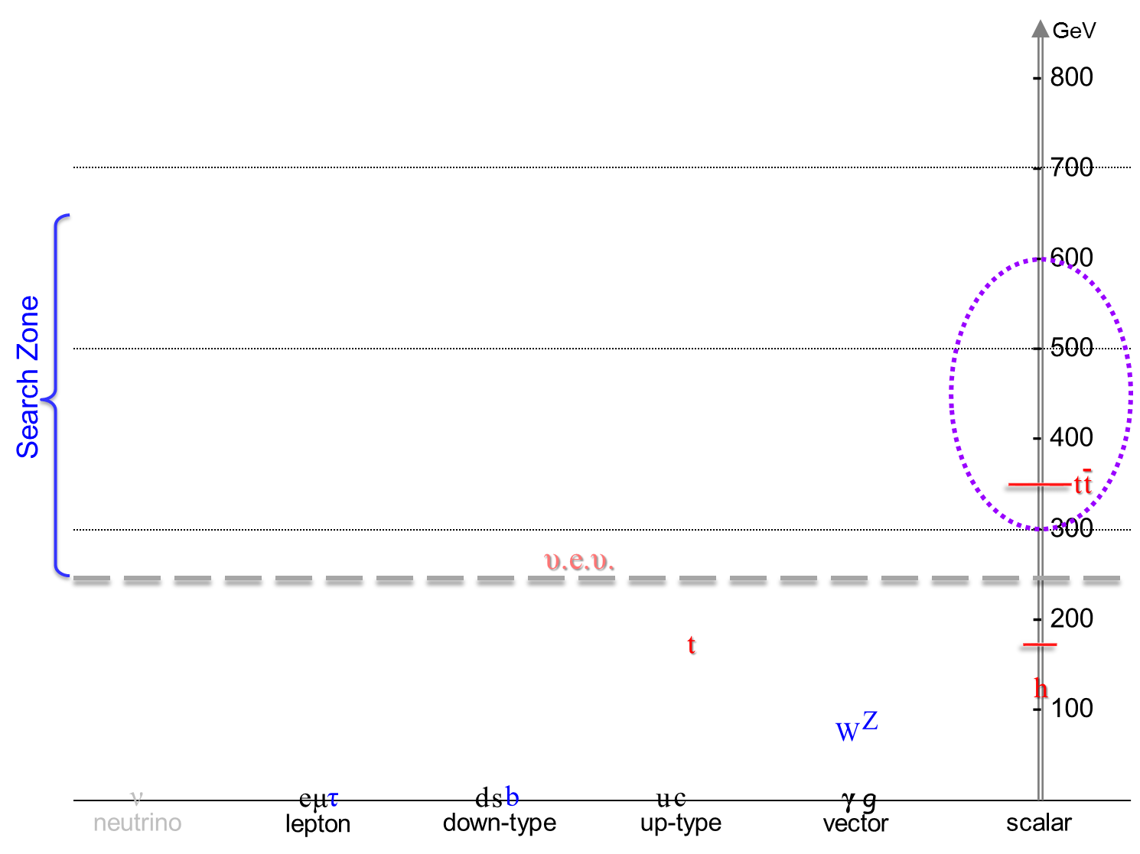

IV./V. Leading Search Modes at the LHC
g 2HDM
sub-TeV Spectrum
H/A/H⁺ Search
Not c_{γ} suppressed
Search at ATLAS/CMS published.
ρ_{tc}
JHEP’23/PLB’24
ρ_{tc}
Kohda, Modak, WSH, PLB’18
cg → tH/A → ttc(bar) Same-Sign Top + jet
→ ttt(bar) Triple-Top (High Lumi LHC);
higher mass, more exquisite, tiny SM
ρ_{tt}
H, A, H⁺
Search since 2/2020 @ NTUCMS
cg → bH⁺ → btb(bar) Top w/ two p_{T} b-jets (H⁺)
√
Ghosh, WSH, Modak, 1912.10613 (PRL’20)
KHM, PLB’18
CKM enhanced vs. 2HDM-II
ρ_{tc}V_{tb}
CMS PAS → Lepton-Photon’25

Slide 12
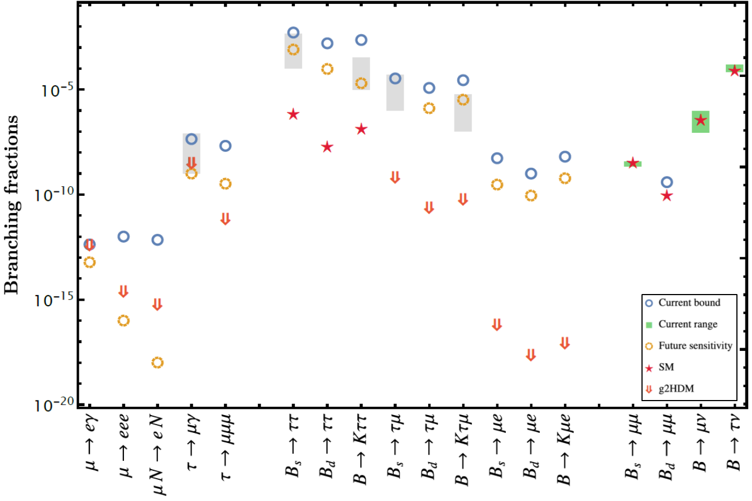
V. Conclusion: Comment on Flavor
in B decay
~ eEDM diagrams
5 Grey boxes: Astounding BSM via
“LQ ” from B-Anom.
μ & τFV (Flav.Viol.)
R_{K}, R_{K*} nullified (shame on LHCb)
g2HDM-SM interference
ρ_{μe}
LHCb
LHCb
What hides H, A, H⁺ effects so well from our view ?
PRD’20
“Know” SM Hierarchy !
eEDM
cancel.
Much more promising if
muon g-2 is harbinger
general 2HDM
WSH&Kumar, PRD’20
Belle II
EPJC’21
Belle II
LHCb
Belle/II
CMS

Slide 13
VI. Conclusion
lpha
the Α and the Ω
Still my goal & hope.
I could have told you up front:
H ⁰, A ⁰, H ± ~ 500 GeV
CAN
Verify at LHC.
can generate B.A.U.
⬅
Fantastic !!
accommodates e EDM
and F P C P Probes !
Many Flavor Probes; however
b → sγ: a traditional powerful probe of H⁺ in 2HDM II, but for g2HDM
Probe ρ_{tt}-EWBG & ρ_{bb}-EWBG thru chiral enhancement
Currently b → sγ inclusive rate is best measured.
Belle II can measure ΔA_{CP} in future, crosscheck w/ eEDM – EWBG !
inclusive B⁺ vs. B⁰
emerge?

Slide 14
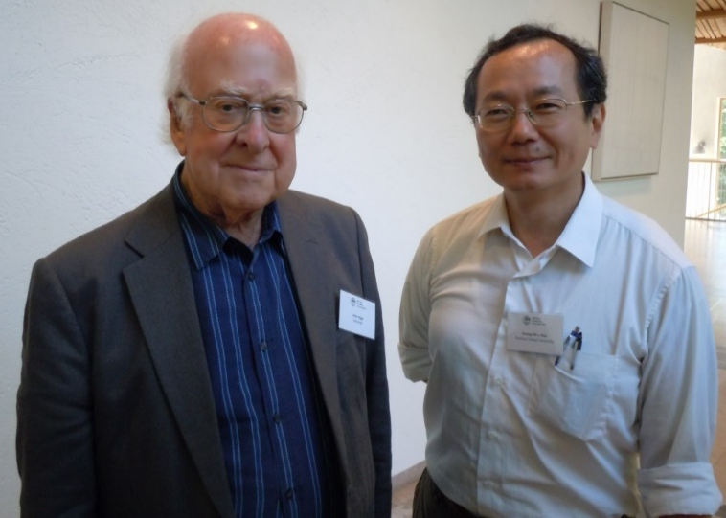
Thank you !
Join the Mission
Chin.J.Phys.’22
2109.02557
Caution: Good reasoning does not mean Nature has to oblige …
a Higgs; and a 2nd Higgs ...

